Slide 1
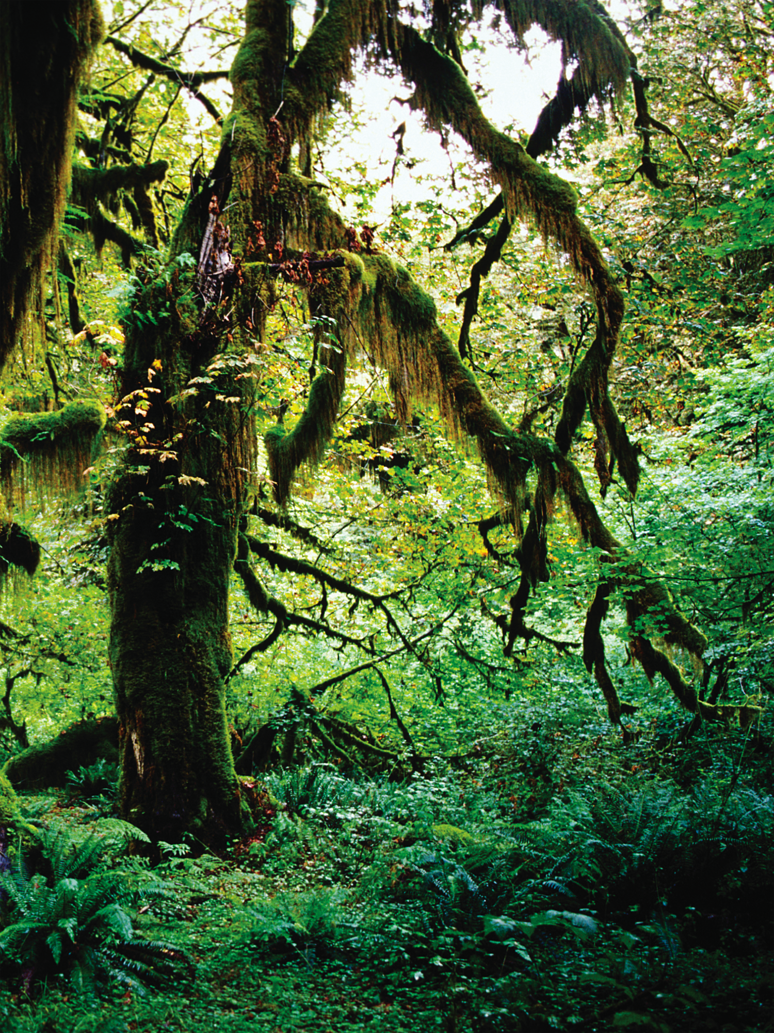
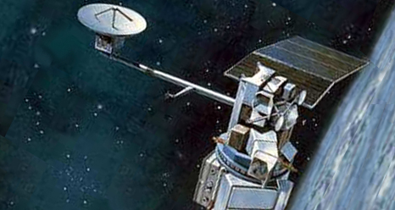
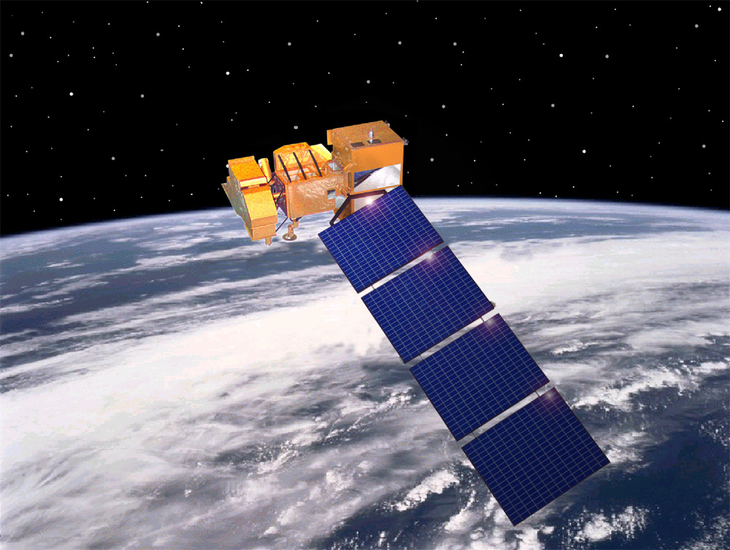
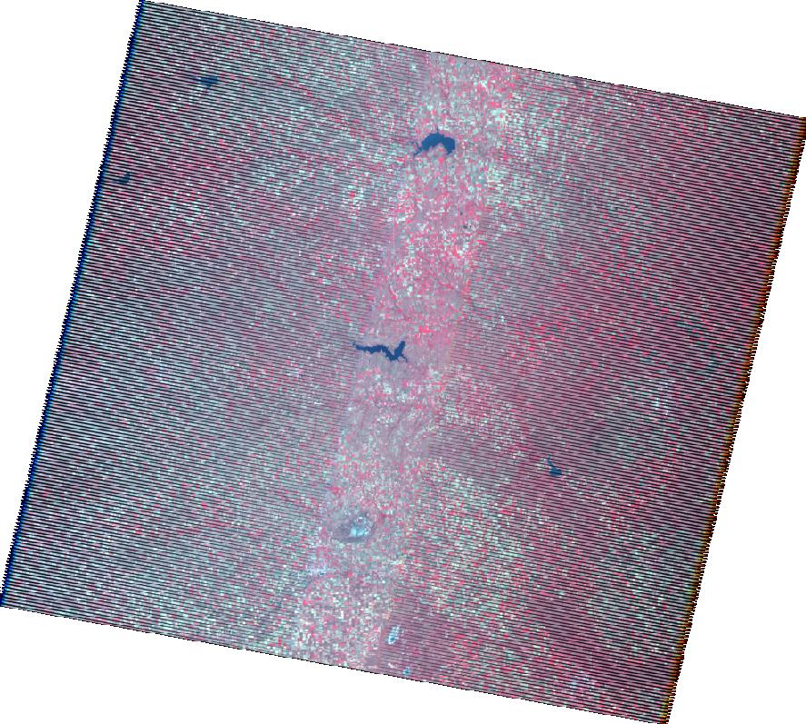
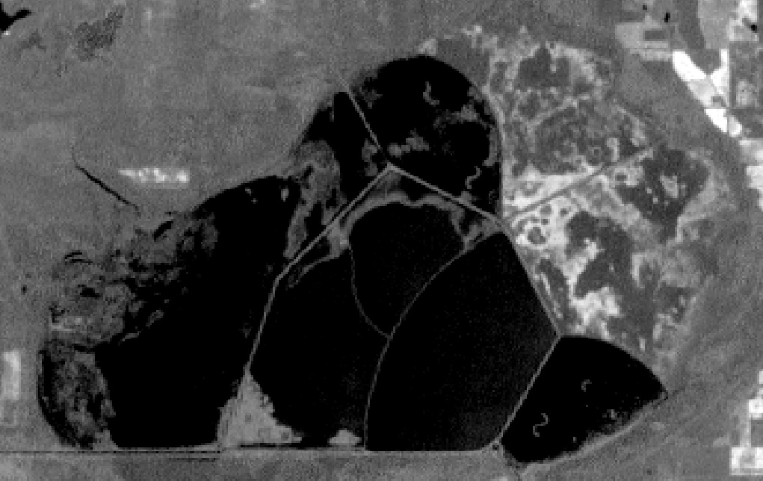
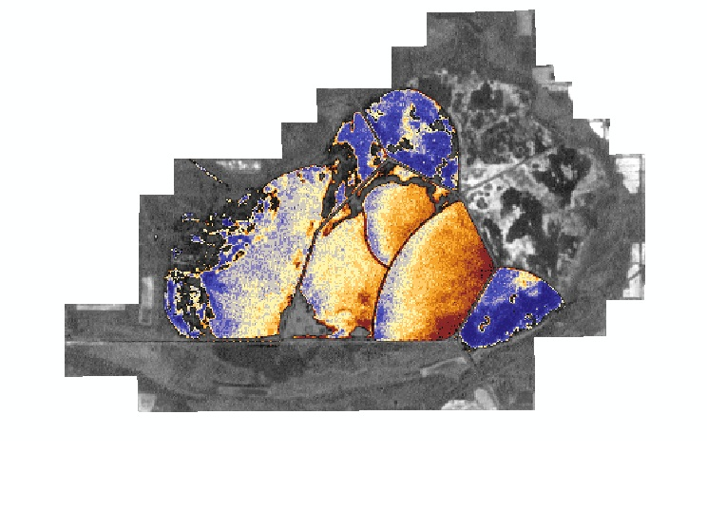

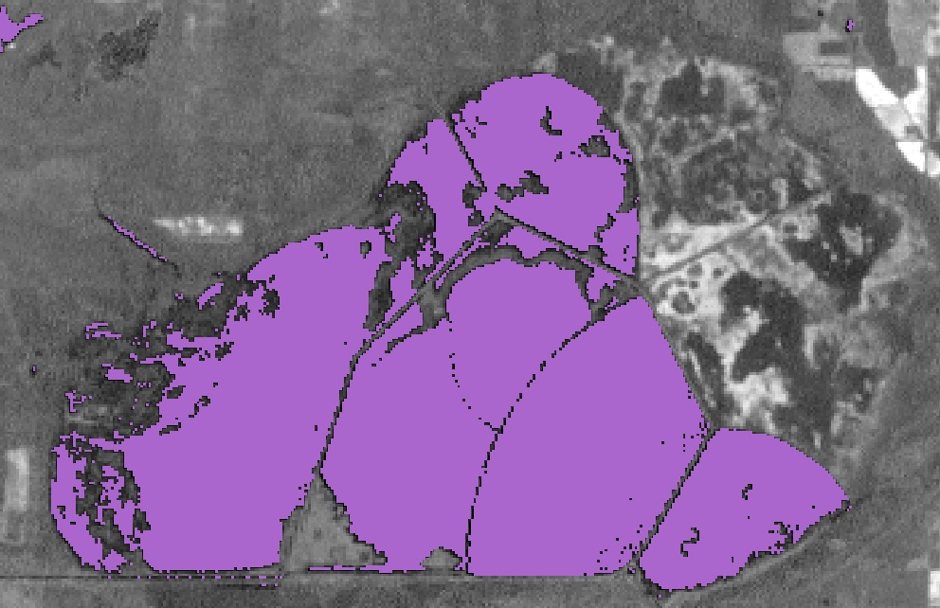
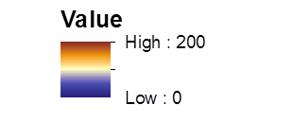

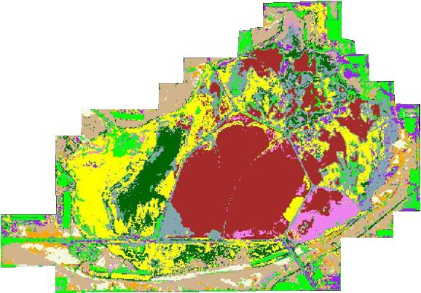
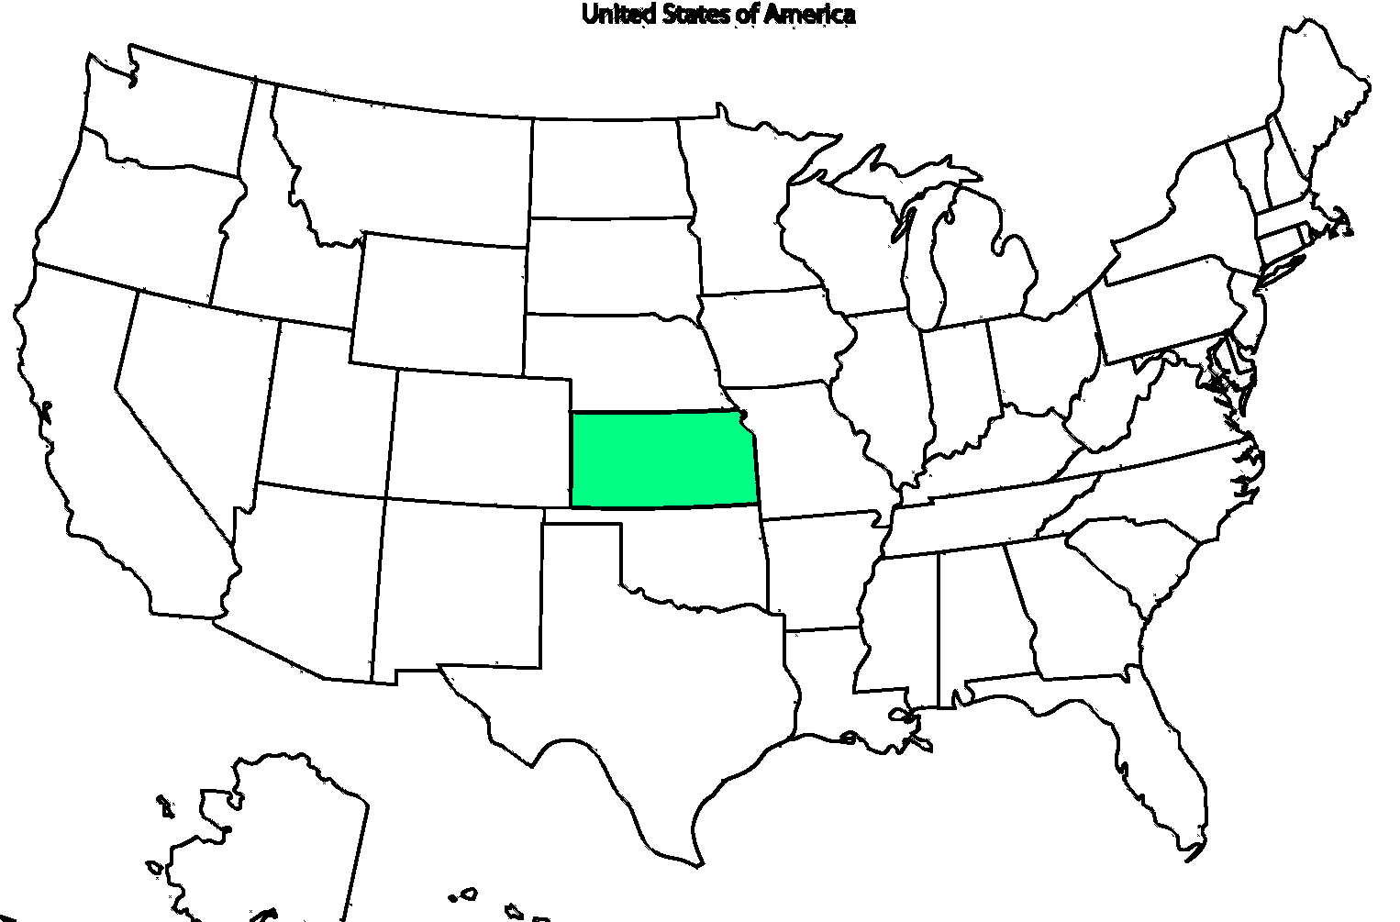
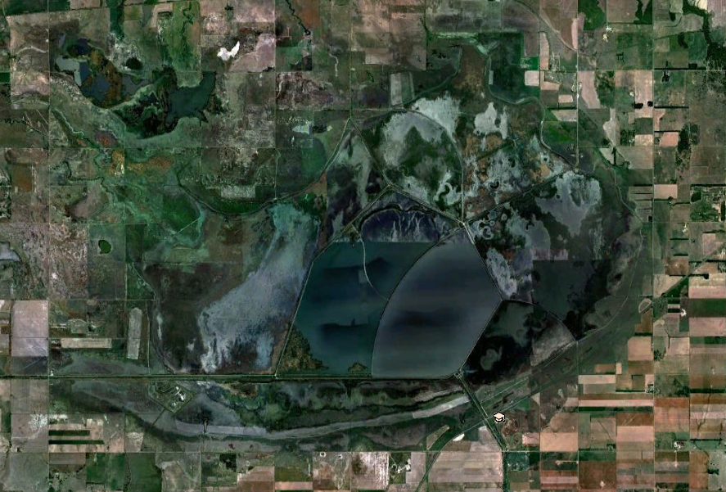

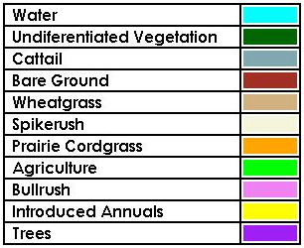


Kansas Ecological Forecasting
Utilizing NASA EOS to Assess Turbidity and its Effects on Kansas Wetland Areas
Amanda Bordeaux (Christopher Newport University), Katie Nohe (Plymouth State University), Allison Bowman (Old Dominion University), Lauren Steel (Christopher Newport University), Peter Marinescu (Stony Brook University), Tiffani Orne (Liberty University)
NASA Langley Research Center
Abstract
Objectives
Documented as a wetland of international importance by the Ramsar Convention, the Cheyenne Bottoms Wildlife Area (CHBW) is comprised of 8,036 ha of diverse and unique marshland in central Kansas. As a critical stopover for over 45% of migrating bird populations in the western hemisphere, the CHBW places a strong emphasis on creating a diverse marsh habitat for these migrating shorebirds and waterfowl in their management practices. This project provided the CHBW with tools to aid in the management of their marsh systems, allowing for proactive management techniques rather than the reactive techniques in place currently. Using Landsat 5 TM and 7 ETM+ the CHBW was provided with an evaluation of water turbidity in the pools during the years 2005-2012. Landsat 7 ETM+ was also used to provide a time series of land cover classification maps to the CHBW.
Provide CHBW with two decision support tools: a land cover classification time series and an estimate of turbidity
Estimate turbidity to provide an evaluation over time of sediment location within CHBW pools
Complete a land cover classification time series to aid in determining areas at high risk of ecological change
Earth Observations
Methodology
A.
Turbidity
Analysis
B.
Land
Cover
Classification
Turbidity Index
Landsat 5 TM
Landsat 7 ETM+
Landsat 5 and 7 Scenes:
2005-2012
NDVI calculated to find open water areas
Turbidity algorithm
over open water
Study Area
Cheyenne Bottoms Wildlife Area, Kansas
Landsat 7 Scene:
Fall 2005-2012
Land Cover Classification
Turbidity by Pool
Results
Turbidity Analysis
A yearly time series was created to show the turbidity per season over the years 2005 -2012
Land Cover Classification
A supervised land cover classification was completed for the year 2012 with eleven classes
Conclusions
Project Partners
Team Members
Turbidity product assesses trends in suspended sediment, enabling CHBW to prevent damage to infrastructure and hinder the development of invasive species that are caused by high sediment conditions
Land cover classification demonstrates that invasive species dominate fewer areas than in previous years, especially in areas focused on by the management
Karl Grover Site Manager
Cheyenne Bottoms Wildlife Area
Acknowledgements
Michael Houts, GIS/Remote Sensing Specialist
Kansas Applied Remote Sensing (KARS)
Dr. Kenton Ross, Science Advisor
NASA Langley Research Center (LaRC)
Peter Marinescu, Katie Nohe, Lauren Steel,
Tiffani Orne, Amanda Bordeaux, Allison Bowman
Notes:
To be fixed before final copy:
Methodology: TSS-new landsat image to represent the end product from that specific date.
Methodology: Land Cover Classification (currently unsupervised, needs to be changed to completed supervised classification for final)
Conclusion: Form conclusions from TSS numbers
Team Picture

