Slide 1
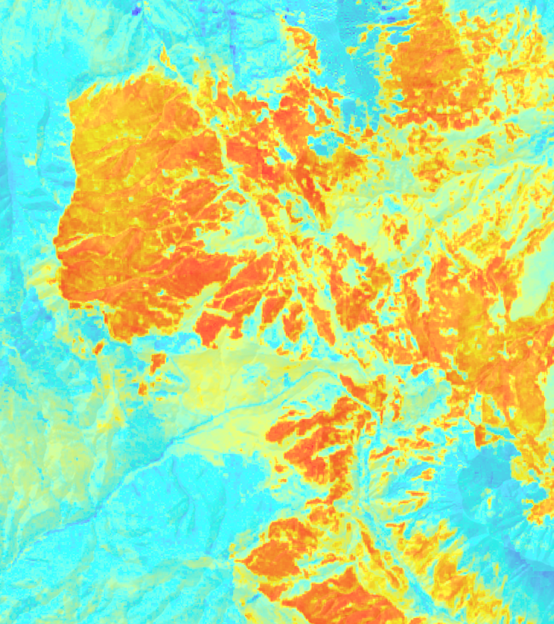


2018 Fall | Colorado – Fort Collins
COLORADO & NEW MEXICO DISASTERS
Using NASA Earth Observations to Quantify Tree Mortality and Burn Severity to Inform Management on Ranches and Open Lands
Sophia Leiker
Kristin Davis
Kristen Dennis
Leorah McGinnis
Christa Torrens
Notes:
Speaker Notes:
Good Afternoon, My name is _____ and I am presenting a project of using NASA Earth Observations to quantify tree mortality and burn severity to inform management on ranches and open lands on behalf of the Colorado and New Mexico Disasters.
Your project Website Image should be placed behind the hexagon grid. An example image has been placed in this position for your reference. Delete the example image, insert your image, right click your image and select the “Send to Back” option. Position and adjust the size of your image so that it lines up with the provided margin rulers.

Slide 2
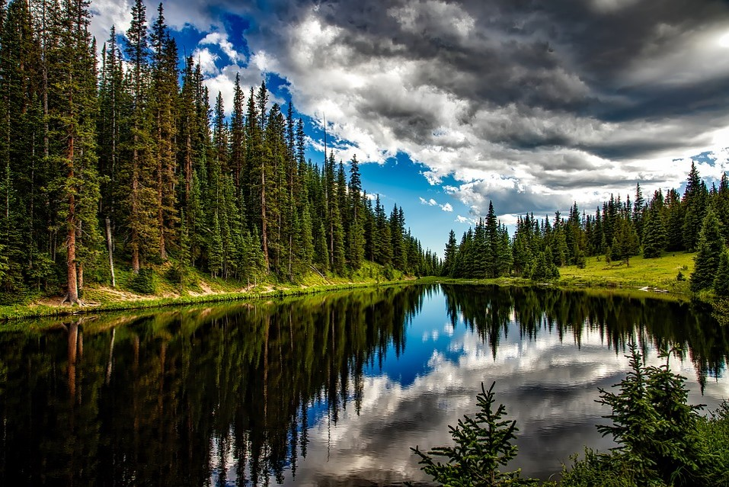
Image Credit: Pixabay
Notes:
Speaker Notes:
Colorado’s forests are an important state asset, both for the resources they provide and for their beauty and tourism value.
Drastic changes in environmental conditions, including drought, can lead to extreme outbreaks of native herbivorous insects, which may threaten these iconic landscapes.
https://pixabay.com/en/lake-irene-colorado-water-1679708/
CC0 - No attribution required.

Slide 3
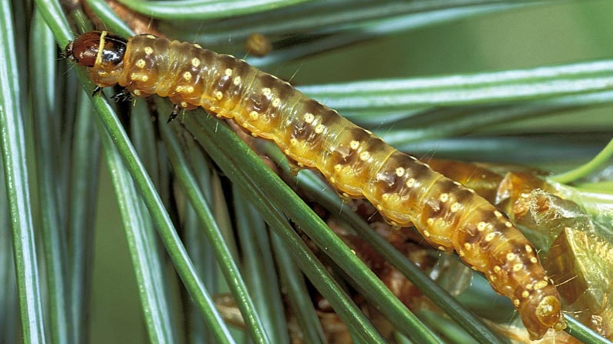
Western Spruce Budworm
Choristoneura freemani
Defoliator species
Consumes current years growth
Douglas-Fir, Spruce, Fir
Impacts
Kills crowns of coniferous trees
Inhibited regeneration
Contributes to tree mortality
Weakened trees → prone to insect/disease attacks
Image Credit: Dion Manastyrski
Notes:
Speaker Notes:
(first click)The western spruce budworm (Choristoneura freemani) influences have gained the attention of forest managers, particularly in the region of the Spring Creek Fire as its populations have reached outbreak proportions in recent years (West 2017, Colorado State Forest Service).
The budworm is a widespread native caterpillar that eats the needles and leaves from a host tree and spreads to other trees during a moth life stage.
(second click)Budworm attacks gradually affect host trees (primarily firs and spruces, and less commonly pines) over the span of three to five years.
(third click)Trees weakened from budworm defoliation are more prone to other insect and disease attacks, resulting in tree mortality (Meigs et al. 2016).
Image Credit: Dion Manastyski, https://tidcf.nrcan.gc.ca/en/insects/factsheet/1000040
https://tidcf.nrcan.gc.ca/en/insects/factsheet/1000040

Slide 4
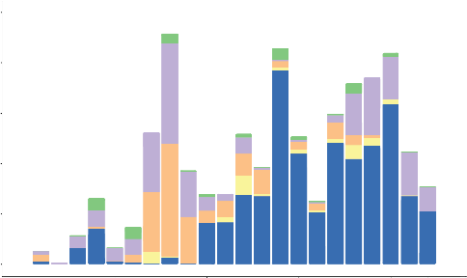
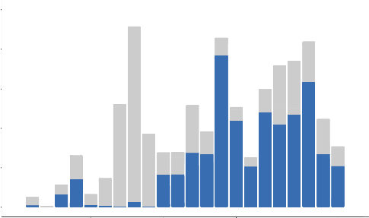
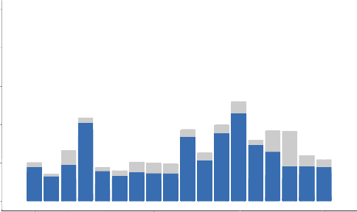
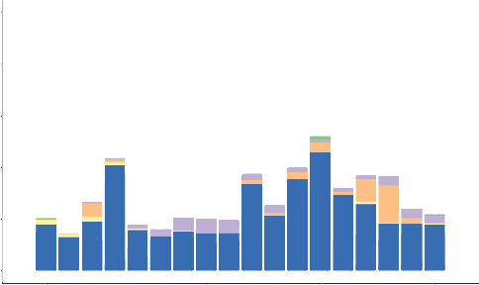
Budworm Outbreak Dates
Causes of Tree Damage in Colorado Study Area
Causes of Tree Damage in New Mexico Study Area
250,000
250,000
200,000
200,000
150,000
Acres
150,000
Acres
100,000
100,000
50,000
50,000
0
0
2000
2005
2010
2015
2000
2005
2010
2015
Year
Year
Abiotic/unknown
Bark beetle
Insect/disease
Other defoliator
Western spruce budworm
Other
Notes:
Speaker Notes:
Here we have the bar plots for the aerial detection survey data which indicate varying causes of tree damage. This data represents our study area for the years 1996 through 2017.
By graying out other causes, we see that spruce budworm in blue, is the predominant cause of damage during our study period.
We identified 1998 as the most representative year prior to major budworm outbreak seen here.

Slide 5
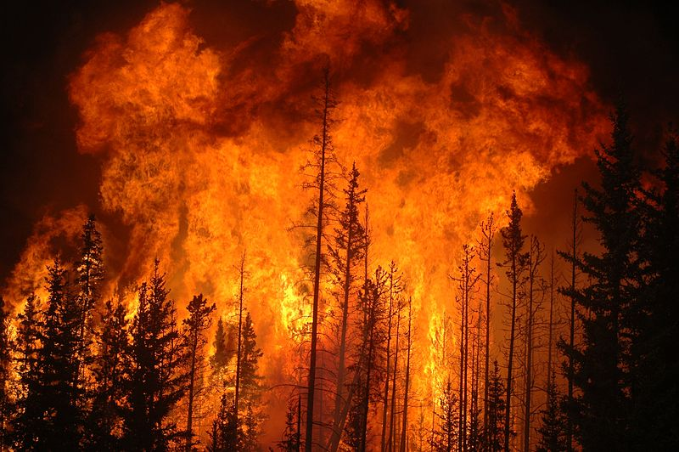
Spring Creek Fire
Started in June 2018
3rd largest fire in Colorado’s recorded history
Burned 108,000 acres
Destroyed 140 homes
100% contained on September 10th
Image Credit: Cameron Strandberg
Notes:
Speaker Notes
In June 2018 the Spring Creek Fire(click), the third largest wildfire in Colorado history (click), burned108,045 acres (click).
This devastating fire destroyed 140 homes (click) and was declared 100% contained on September 10, 2018 (click) (Kackley 2018)
Image credit: https://commons.wikimedia.org/wiki/File:Fire-Forest.jpg
https://pixabay.com/en/forest-fire-hose-water-wildfire-3694495/
http://www.canoncitydailyrecord.com/news/colorado/ci_31997423/colorado-fire-update-spring-creek-fire-set-become
http://www.lavozcolorado.com/detail.php?id=9797
https://youtu.be/u755lTHxTcE

Slide 6
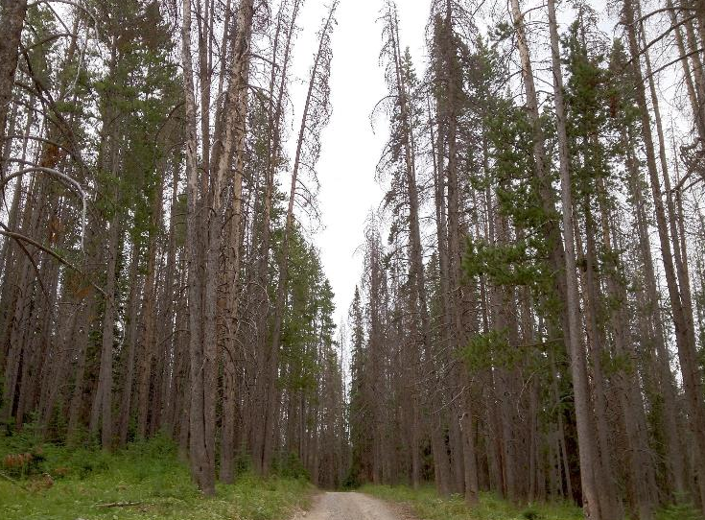
Community Concerns
Insect-related Tree Mortality
Wildfire
Monitoring Techniques
Image Credit: Justin Hirsch
Notes:
Speaker Notes:
Land Managers do not know whether insect-related tree mortality will impact the severity of subsequent wildfires.
The Spring Creek Fire motivated questions about the relationship between standing dead trees (i.e. tree mortality) and wildfire frequency/severity.
Using field monitoring alone, forest managers cannot thoroughly asses tree mortality. These monitoring techniques are either nonexistent or limited, making it difficult to address these questions at landscape scales
Nasa Earth observations and remote sensing data can help provide a more comprehensive picture of forest health
Image Credit: “Pine trees killed by pine bark beetles in northern Colorado”, Image copyright Justin Hirsch, used with permission
nasa
https://www.nasa.gov/mission_pages/landsat/news/40th-landscapes-routtCO.html

Slide 7



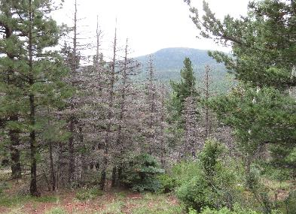
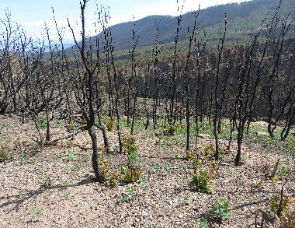
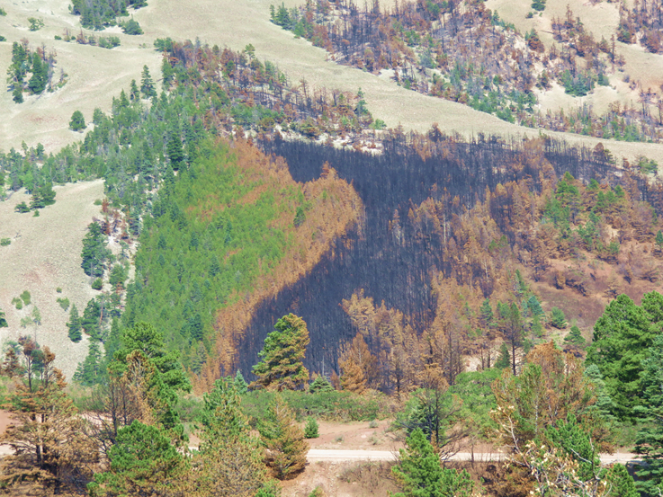
Objectives
Map tree mortality prior to the Spring Creek Fire
Map burn severity for the Spring Creek Fire
Model relationship between pre-fire tree mortality and burn severity
Image Credits: Dr. Bill Romme
Notes:
Speaker Notes:
This project comprised of three objectives:
First, we wanted to map tree mortality prior to the spring creek fire [using methods established in Woodward et al, 2018.]
Next, we wanted to map burn severity following the fire. We were looking to identify areas of low, medium, and high burn severity.
Finally, we wanted to model the relationship between pre-fire tree mortality and burn severity.
There have been studies in the past relating tree mortality and burn severity but many have come to different conclusions. Our study hopes to add to this body of knowledge.
Image Credit: Bill Romme, provided to us by our Science Advisor.

Slide 8
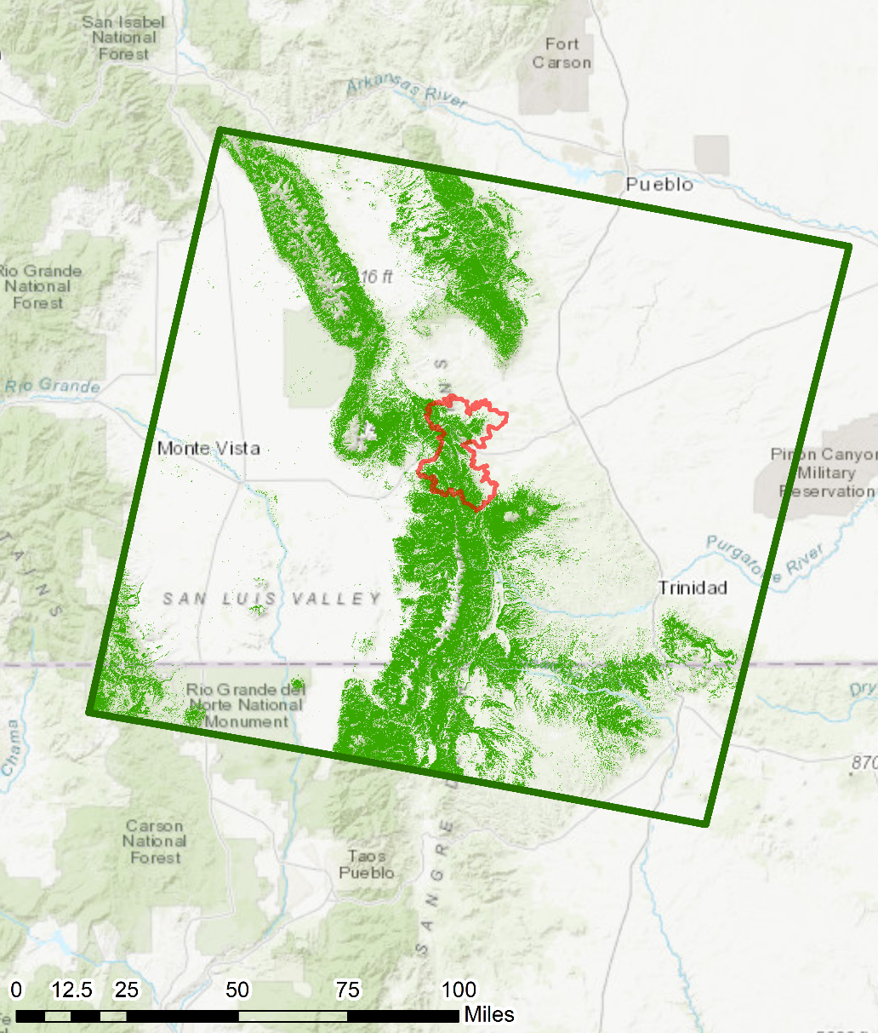
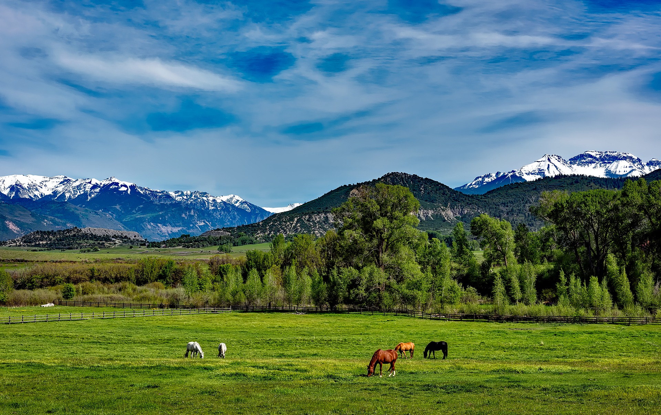


Partners & Study Area
Aaron Swallow
Ranch Environmental Manager
Colorado State Forest Service
Amanda West, Manager of Science Information
CO
NM
Spring Creek Fire Area
Study Area (~7 million acres)
Spruce-Fir Forests
Image Credit: Pixabay
Notes:
Speaker Notes:
We partnered with private Ranches and the Colorado State Forest Service to conduct this project.
The study area was a scene from Landsat 8 Operational Land Imager (OLI) of southern Colorado and northern New Mexico (path 33, row 34).
This scene (green outline) encompasses the ranches of interest and the Spring Creek Fire footprint (red outline). We chose to narrow our study area to the Spruce Fir-forest (green) because this is where host trees for budworm impacts are present
Our study encompassed around 7 million acres
Image Credit:
https://pixabay.com/en/colorado-mountains-horses-grazing-1680631/
https://pixabay.com/en/forest-trees-firefighters-78239/
Map Credit:
Created by Leorah McGinnis in ESRI ArcMap

Slide 9
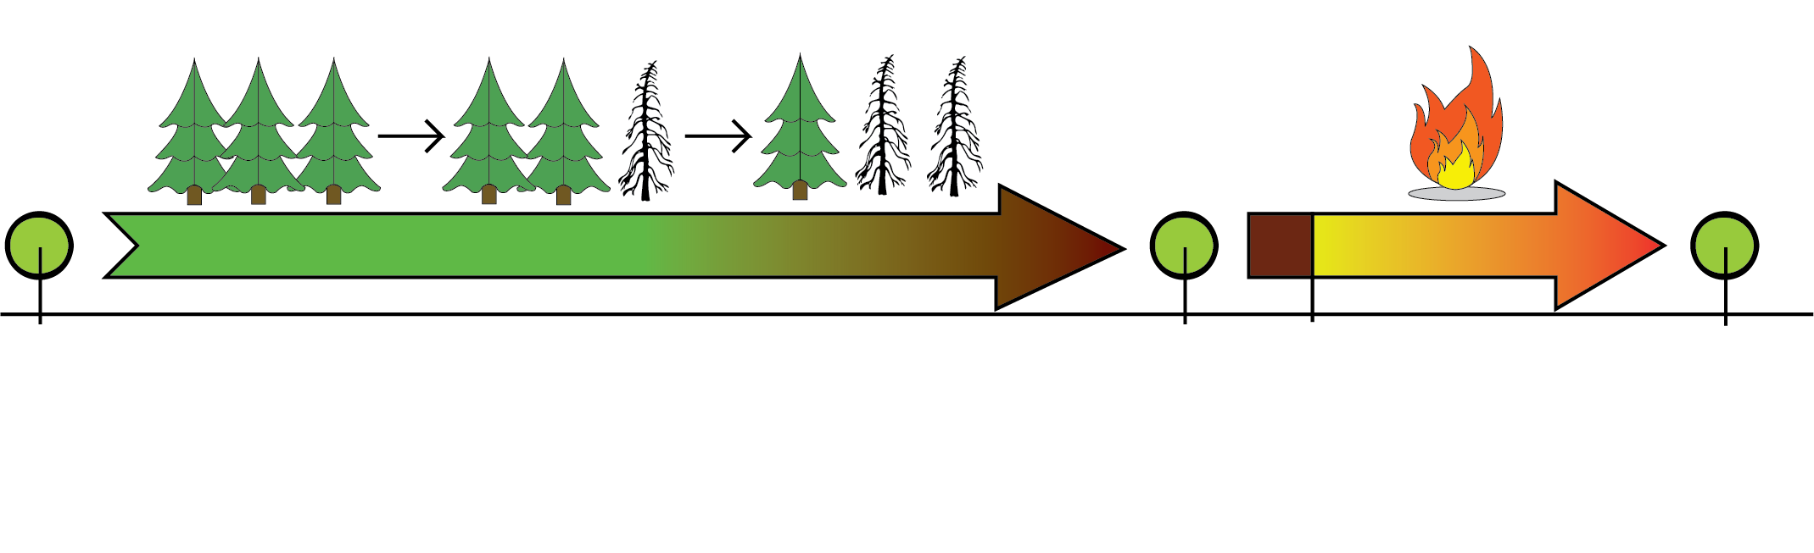
Study Timeline
Pre-Outbreak
Pre-Fire
Post-Fire
Spruce Budworm Outbreak
Spring Creek Fire
July 1998
August 2017
June 2018
September 2018
July 1998
August 2017
June 2018
September 2018
Notes:
Speaker Notes:
When looking at our project as a whole, we identified three key timestamps that would allow us to explore the connections between tree mortality and burn severity.
Our first time stamp, “pre-outbreak”, was chosen because predictors calculated from this time would represent conditions prior to budworm outbreak related mortality
Our second time stamp, “pre-fire”, represents tree mortality conditions before the Spring Creek fire.
Our third and final time stamp, “post-fire”, was chosen because calculated indices would allow us to classify burn severity after the fire
To identify these times we looked at Aerial Detection Surveys provides by the US Forest Service.
Our post-fire date was chosen as Sept 2018, the time the fire was 100% contained.
Our pre-fire date was chosen as August 2017, one year prior to fire containment. This was done to prevent seasonal differences in remotely sensed imagery
Image Credit: Created by Sophia Leiker via Adobe Illustrator

Slide 10

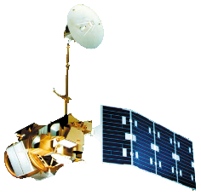


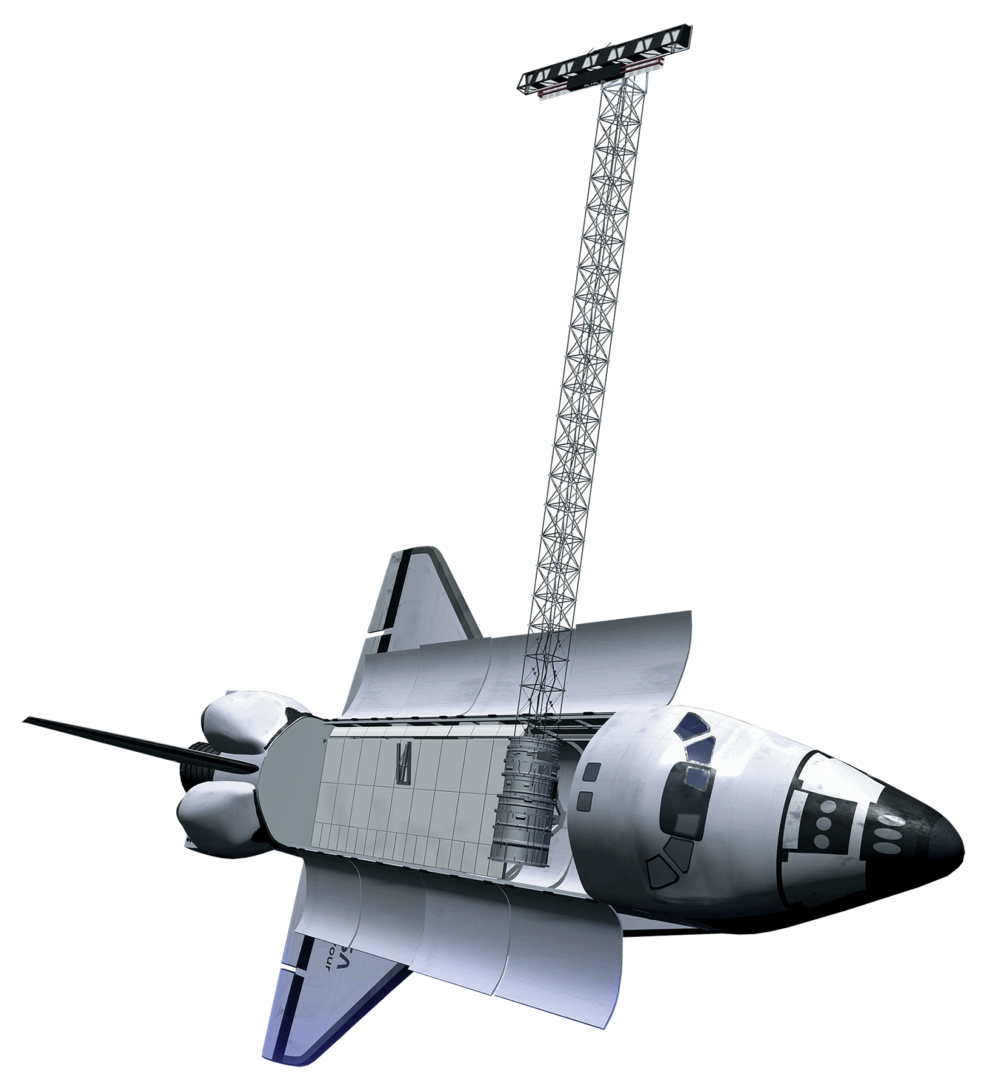
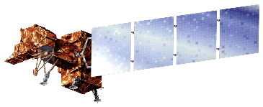
NASA Satellites and Sensors
Landsat 8 OLI
Landsat 5 TM
Landsat 7 ETM +
SRTM
Background Image Credit: Pixabay
Notes:
Speaker Notes:
To create our tree-mortality maps we used 30m resolution Landsat 5 Thematic Mapper (TM), Landsat 7 Enhanced Thematic Mapper Plus (ETM+), Landsat 8 Operational Land Imager (OLI), and Shuttle Radar Topography Mission (SRTM).
Background image credit: https://pixabay.com/en/milky-way-starry-sky-night-sky-star-2695569/
CC0 – No attribution required.
Satellite image credits: NASA, used with permission

Slide 11
Methods
Sampling
Processing
Modeling
GEE, ArcMap
GEE
R
Creating sampling locations
Processing imagery to calculate spectral indices for predictors
Employing VSURF (Variable Selection) to identify predictor variables
Plotting ADS data to identify budworm outbreak dates
Quantifying burn severity using RBR (Relativized Burn Ratio)
Digital Ocular Sampling for tree mortality (NAIP)
Modeling tree mortality using the randomForest package
Notes:
Speaker Notes:
Our methodology can be broken into three parts.
The first part is sampling using both Google Earth Engine and ArcMap.
In this part, we created random sampling locations in the spruce-fir forest for our sampling script. We then digitally ocular sampled for tree mortality using NAIP 1m resolution imagery. Finally, we plotted ADS data to identify budworm outbreak dates.
The second part is processing which was done in Google Earth Engine.
In this part, we processed satellite imagery for our area and dates of interest. We used the processed imagery to calculate multiple indices to use as predictors in our modeling efforts. We also quantified burn severity using the Relativized Burn Ration (RBR) using processed imagery.
The third part is Modeling in R.
In this part, we employed VSURF to identify important tree-mortality predictor variables. Then, we modeled tree-mortality percentages using the random Forest package.
Methods - **for objective 1 – and remove the RBR block

Slide 12
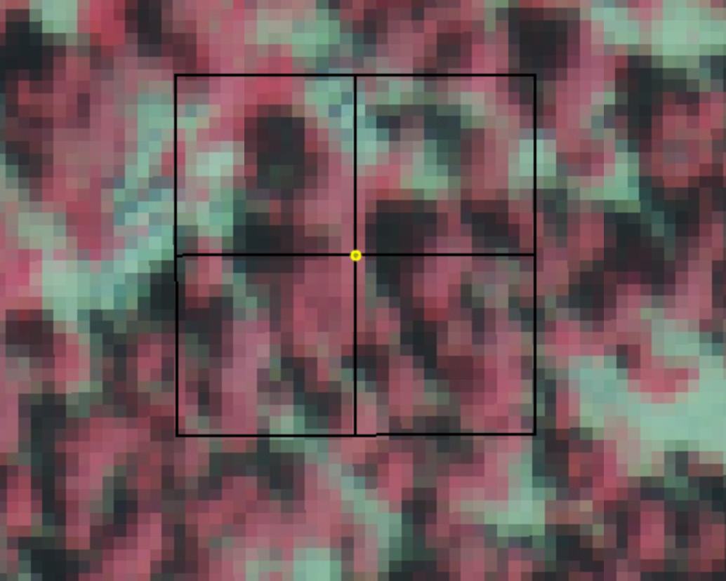
Digital Ocular Sampling
600 sampling points
Random within select forest types
Sampled % cover in each pixel using 2015, 2017 NAIP
Categories: dead woody vegetation, live vegetation, other, and shadow
2 Sampler approach
30m
30m
Notes:
Speaker Notes:
We sampled 600 randomly stratified points within the appropriate vegetation classes.
250 of the points were created within the aerial detection survey polygons with top 15% tree mortality.
We then overlaid 30m x 30m landsat pixel aligned boxes and sampled percent of pixel cover using 1m National Agriculture Imagery Progam imagery from 2015 and 2017.
We classified the land cover into four categories: dead woody vegetation, live vegetation, other, and shadow.

Slide 13
Processing Imagery
Landtrends:
1) Harmonize Imagery
2) Mask Clouds
3) Median Reduce
4) Select years of interest
Gather & Calculate Predictors
Export predictor values from training dataset sampling points
Year | Months | Predictors
1998 | Jul & Aug | NDMI, NDVI, Tasseled Cap wetness, brightness, greenness, evapotranspiration
2017 | Jul & Aug | Blue, Green, Red, NIR, SWIR1, SWIR2, NDMI, NDVI, Tasseled Cap (wetness, brightness, greenness), evapotranspiration, slope, aspect, elevation
Differenced | Jul & Aug | NDMI, NDVI, Tasseled Cap (wetness, brightness, greenness), evapotranspiration
Notes:
Remove “add indices” block – add differencing?
Talk about indices here – why we chose what we did
list indices in “Calculate spectral indices”

Slide 14
Random Forests & VSURF
Random forests: powerful machine learning algorithm
VSURF: Variable Selection Using Random Forests
Key Predictors: NIR, Differenced NDMI, NDVI (1998), Tasseled cap wetness (2017) and brightness (1998), elevation
Notes:
Speaker Notes:
Random forests is a powerful machine learning algorithm that uses an ensemble of decision trees to train models.
We used the Random Forest method in two different ways: for variable selection, as part of the R package VSURF [Variable Selection Using Random Forest] and to train models to our data using the R package randomForest.
To ID top predictors, we used VSURF and correlation (checks) in an iterative process. When we found correlated variables (corr values >0.76), we removed the variables with the lowest predictive power.
The variables listed here were our final key predictor variables. We used these in both our 1- and 2-step tree mortality models.

Slide 15
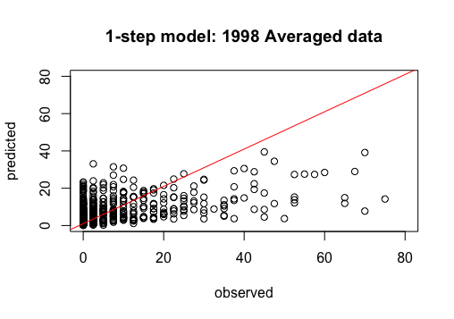
One-Step Results
Evaluation metrics:
  R² = 0.246
  RMSE = 11.21
  RMSE as % mean = 1.556
  percent bias = +5.8
Best model: 1-step RF 1998 averaged data
Zero-inflated
  Zero = absence of mortality
  Model impacts?
One-Step model: 1998 Averaged Data
80
60
Predicted
40
20
0
0
20
40
60
80
Observed
Notes:
Speaker Notes:
Once we had our top predictors, we used the randomForest R package to run 1-step models for all four of our datasets.
We used the evaluation metrics shown to select the best-performing model for our tree mortality map; metrics shown are from the best model, the 1998 Averaged dataset.
We wondered if the high number of zeros (indicating no mortality) in our training data points were negatively affecting our model
performance. To test this hypothesis, we also used a 2-step model:

Slide 16
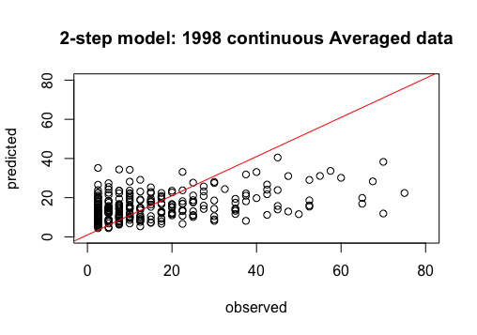
Two-Step Results
Binary and continuous models
  Savage et al., Remote Sensing of the Environment, 2015
Both steps used random forests
Evaluation metrics:
  R² = 0.174
  RMSE = 13.78
  RMSE as % of mean = 0.929
  percent bias = +2.2
  Binary model OOB error: 50.75%
Best model: 2-step RF.RF 1998 averaged data
Improved performance?
  Worse metrics
  Fewer false “presence” identifications
Two-Step model: 1998 Averaged Data (continuous only)
80
60
Predicted
40
20
0
0
20
40
60
80
Observed
Notes:
*We chose the Savage et al. two-step model, because it was designed to work with “zero-inflated” data (data like ours, with lots of absence points.
This method uses the same dataset to create 2 different models: 1st a binary (presence/absence) model from all of the data; 2nd a continuous model (of % mortality) from the non-zero data.
These two models are mapped separately and overlaid using raster multiplication. In this process, pixels marked as “Absence” (zeros) in the binary model become zeros in the combined model.
*We used Random Forest for both modeling steps: it worked best in our tests and was preferred in the literature (Long & Lawrence 2016).
*Again, the metrics shown are from our best model, the 2-step RF.RF 1998 averaged data
*The 2-step model had slightly worse R2, RMSE and other values. The percent bias was improved, and it did improve performance in the actual map, resulting in fewer false ‘presence’ identifications.

Slide 17
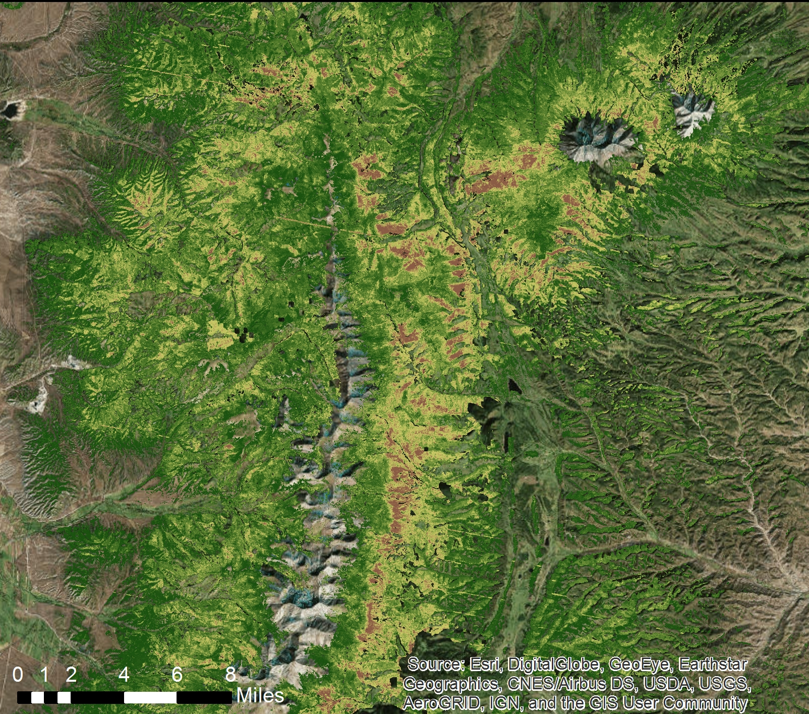
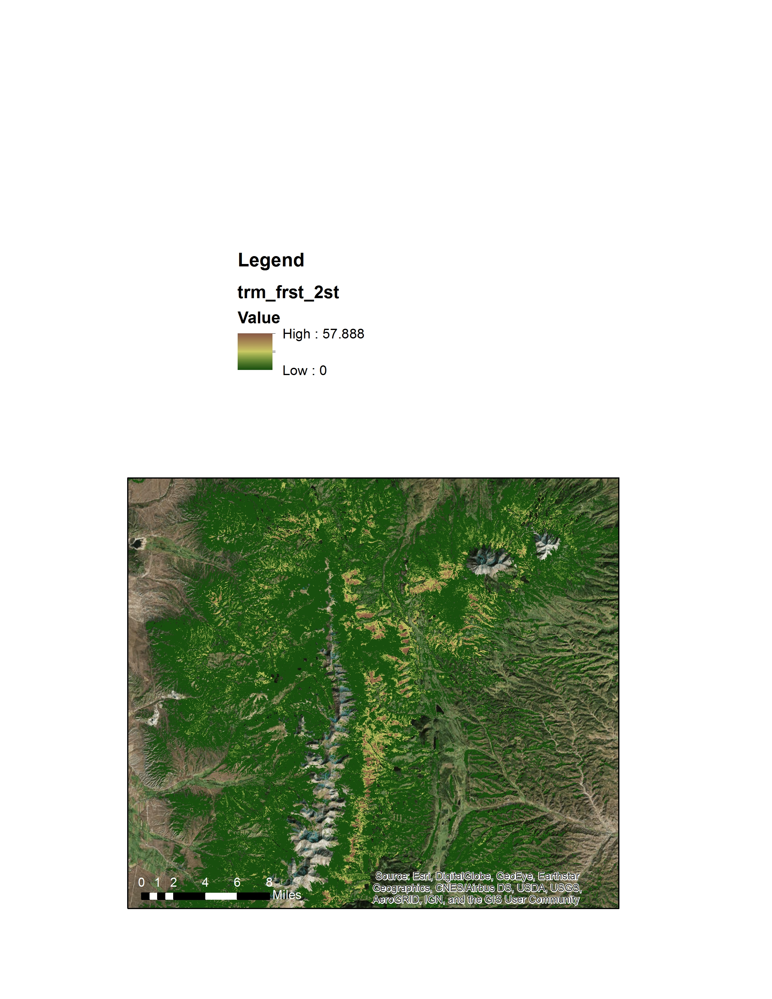
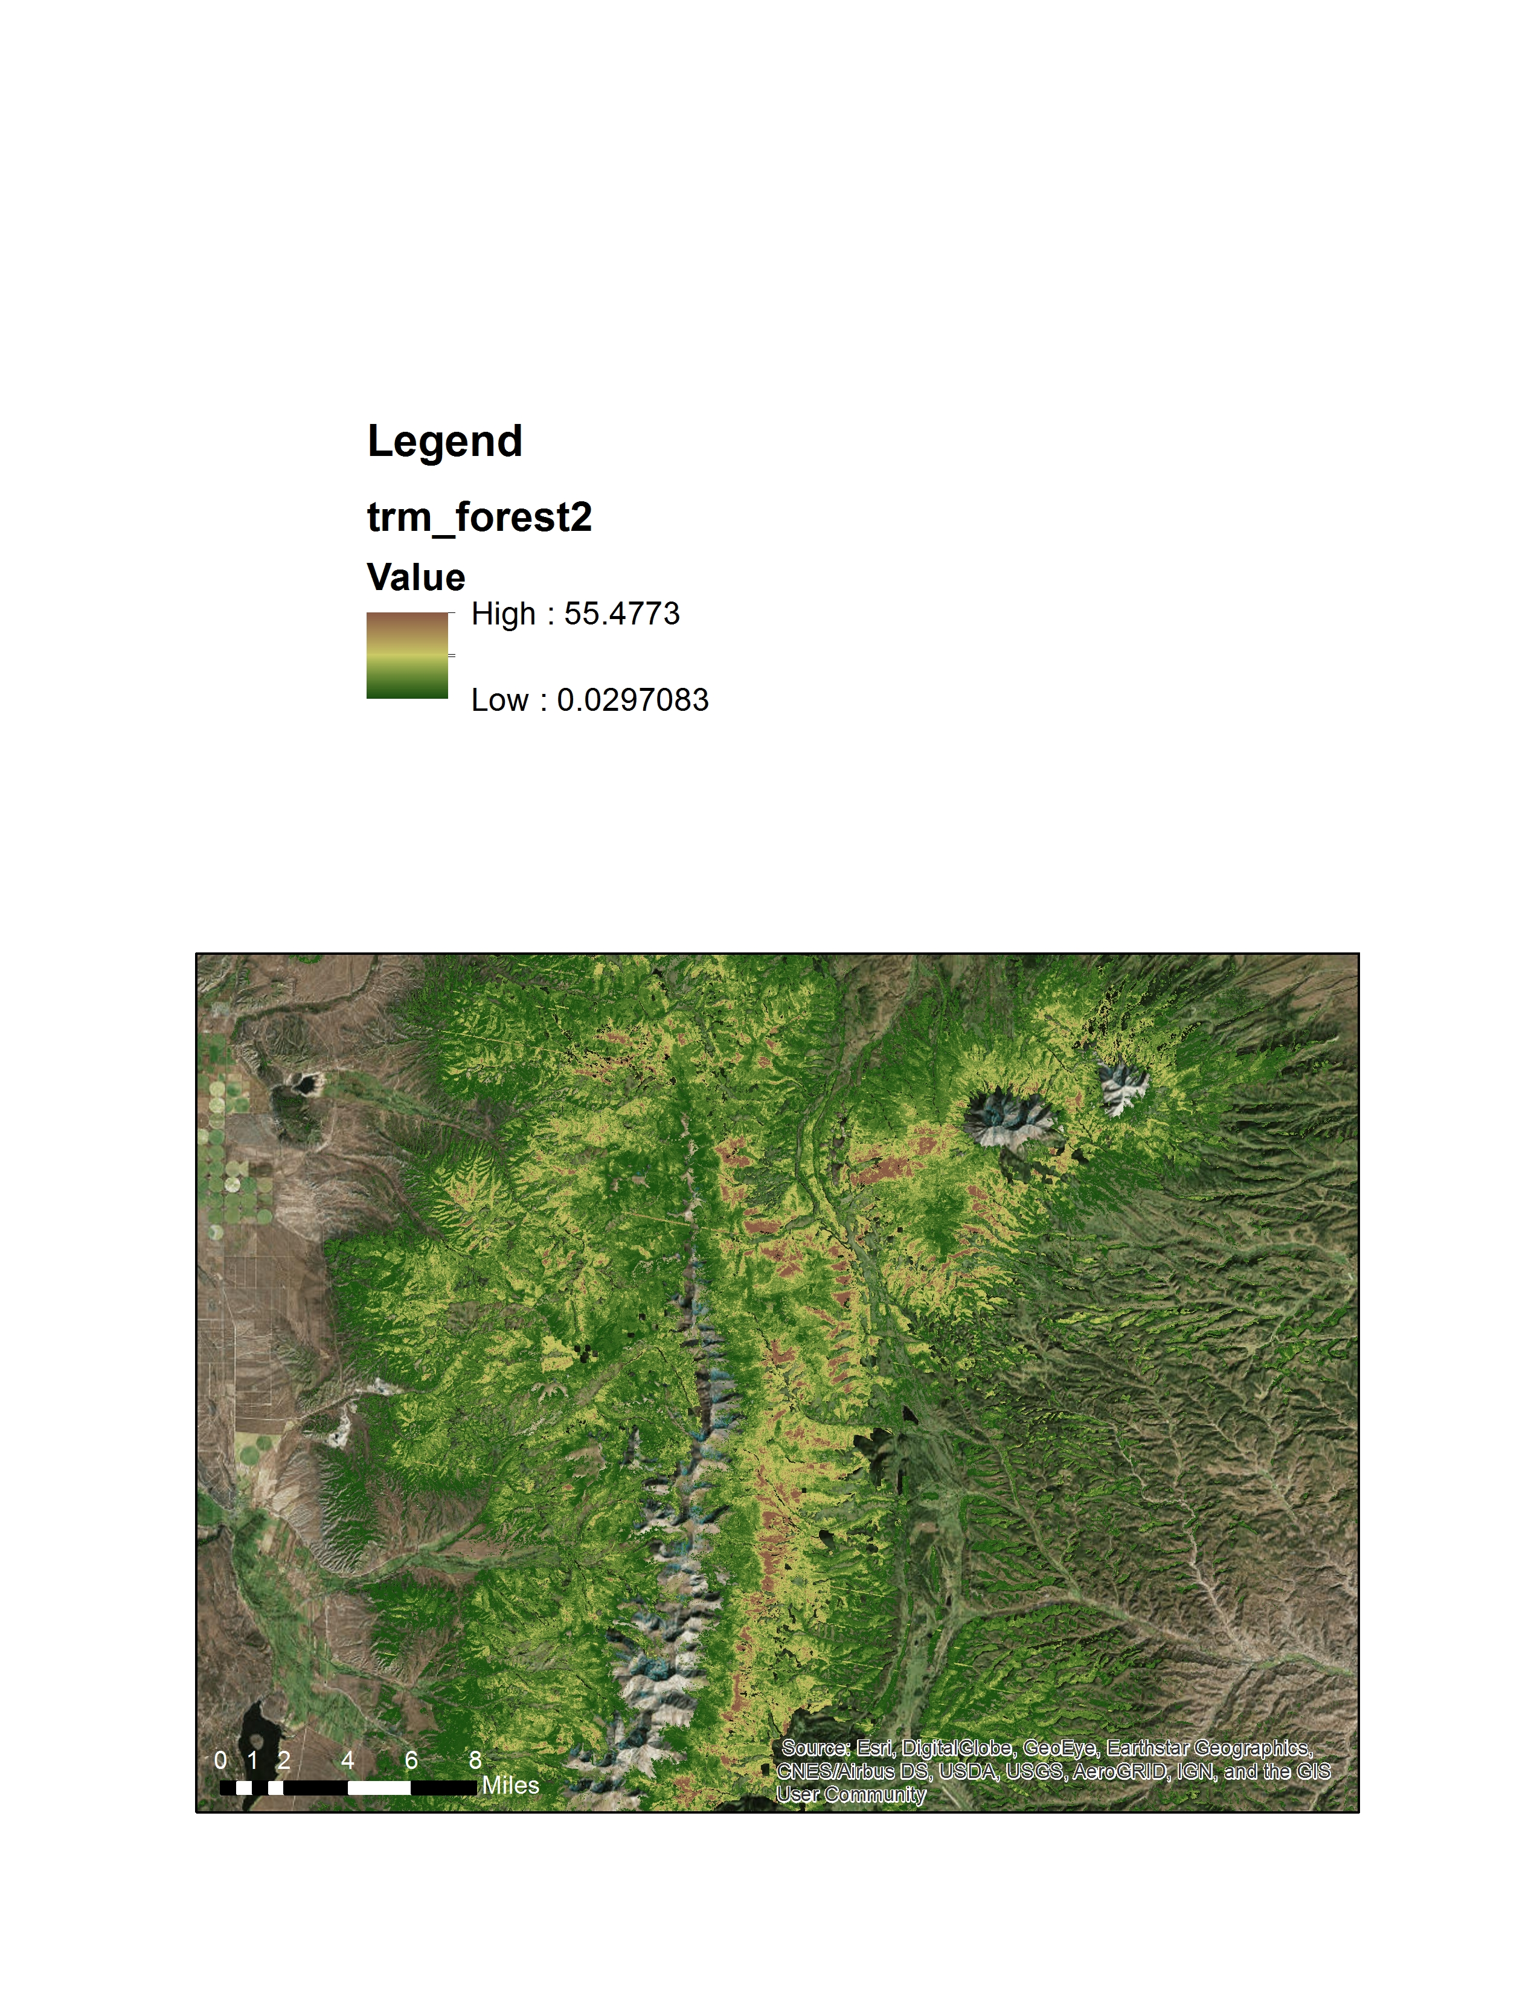
One-Step Tree Mortality Map
Two-Step Tree Mortality Map
High: 56%
High: 58%
More “false positive” pixels
More “false negative” pixels
Low: 0%
Low: 0%
Notes:
We used our best one- and two- step models to predict and map tree mortality across our study area.
The color scale ranges from dark green (no mortality) to dark brown (high mortality).
As you can see, the two-step model has many more dark green (or zero mortality) pixels; this model is more conservative at lower ranges and has fewer “false positive” pixel misidentifications.
The two-step model also misses occurrences of low-mortality pixels, assigning them a false negative value (i.e. zero when there is mortality); the one-step model appears to have more nuanced classifications for low-mortality pixels (5-15%), with fewer “false negative” identifications.

Slide 18
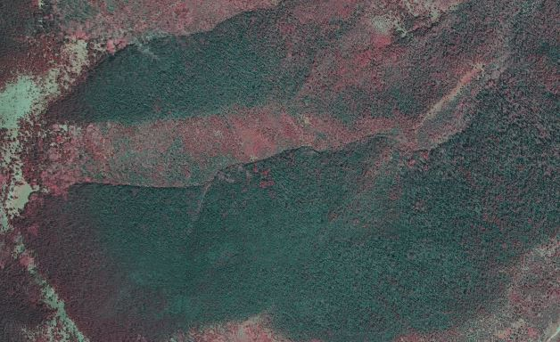
Map Comparison NAIP Imagery
Notes:
1 The next slides will compare model performance on the same close-up section of our map area. This first image is from the NAIP imagery – the bands we used to train our model. Pink represents live woody vegetation, and grey represents dead.
IMPORTANT TO BE ABLE TO CLICK BACK AND FORTH 1-2X SO THE AUDIENCE CAN SEE THE DIFFERENCES.

Slide 19
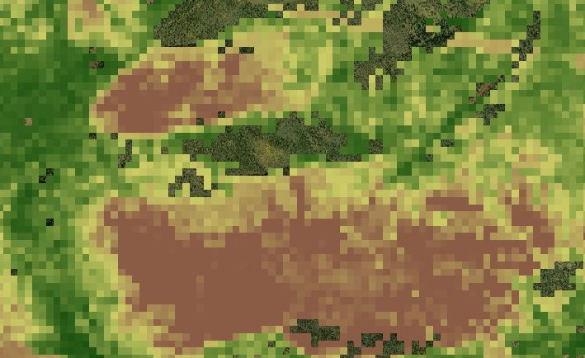
Map Comparison One-Step
High: 56%
Low: 0%
Notes:
Newer index – objective 2
Notice that both of the models accurately find mortality in these fully-grey sections, although degree varies by model.
(There are some pixels w/o mortality model values. These were excluded from the models because they are not categorized as spruce-fir forest classes, thus are outside of our spruce-fir study area. )
In areas that appeared mixed grey and pink, the 2-step model underpredicts mortality, categorizing them as dark green, or 0%, while the 1-step model (more accurately) identifies some mortality.
The 1-step model false positives are harder to find in this view – but appears to be a small area L of the top dead lobe.
Take-home: in spite of the poor performance metrics, these models seem to do a reasonably good job predicting tree mortality in our study area.

Slide 20
Map Comparison NAIP Imagery
Notes:
1 The next slides will compare model performance on the same close-up section of our map area. This first image is from the NAIP imagery – the bands we used to train our model. Pink represents live woody vegetation, and grey represents dead.
IMPORTANT TO BE ABLE TO CLICK BACK AND FORTH 1-2X SO THE AUDIENCE CAN SEE THE DIFFERENCES.

Slide 21
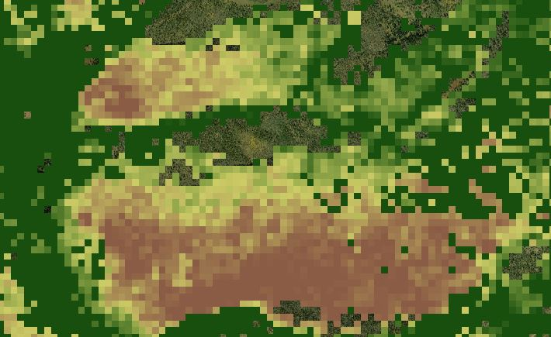
Map Comparison Two-Step
High: 58%
Low: 0%
Notes:
Notice that both of the models accurately find mortality in these fully-grey sections, although degree varies by model.
(There are some pixels w/o mortality model values. These were excluded from the models because they are not categorized as spruce-fir forest classes, thus are outside of our spruce-fir study area. )
In areas that appeared mixed grey and pink, the 2-step model underpredicts mortality, categorizing them as dark green, or 0%, while the 1-step model (more accurately) identifies some mortality.
The 1-step model false positives are harder to find in this view – but appears to be a small area L of the top dead lobe.
Take-home: in spite of the poor performance metrics, these models seem to do a reasonably good job predicting tree mortality in our study area. They do perform differently, esp noticable in the lower % mortality range.

Slide 22
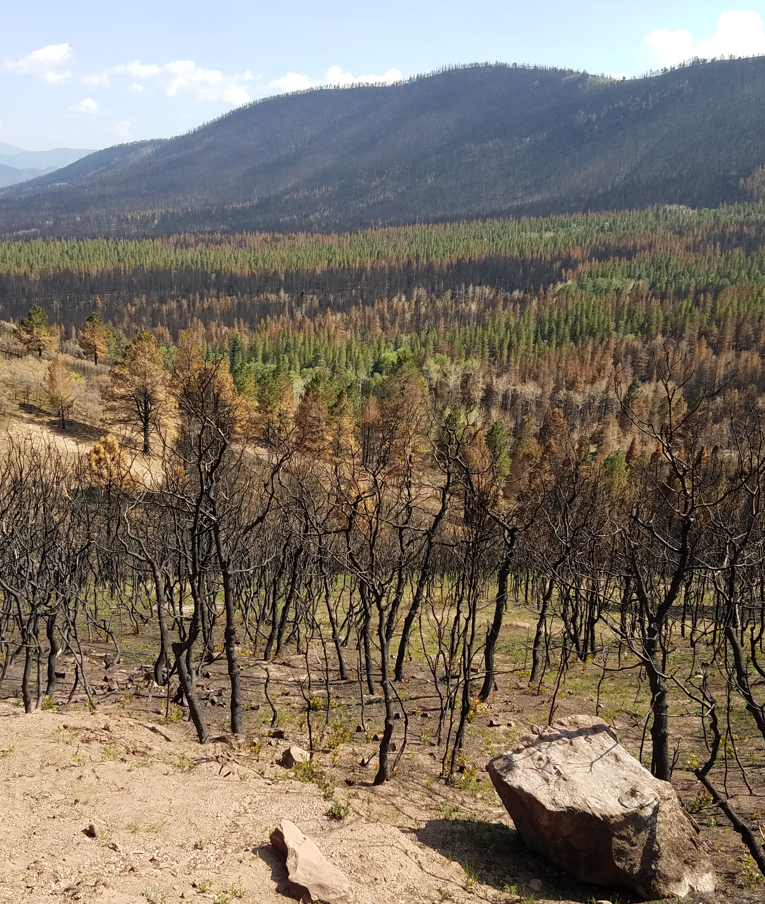
Burn Severity
Commonly Used Indices:
delta Normalized Burn Ratio (dNBR)
Relativized dNBR (RdNBR)
Newer Index:
Relativized Burn Ratio (RBR)
Image Credit: Dr. Bill Romme
Notes:
Speaker Notes:
Quantifying burn severity for wildfires using remotely sensed data is relatively common practice, and is often done using two main indices – the delta normalized burn ratio (dNBR) and the relativized delta normalized burn ratio (RdNBR).
These indices essentially use the near infrared and short-wave infrared bands to calculate the difference in biomass pre and post-fire.
There are proponents and critics of both indices - one criticism of dNBR is that it doesn’t well capture changes in biomass in areas with low vegetation, and one criticism of RdNBR is that the equation that calculates the index has strange behavior at low values of change.
To address the latter concern, researchers recently proposed the relativized burn ratio, or RBR, which calculates burn severity in a way that is similar to the RdNBR but removes the strange behavior of the equation at low values of change.
Researchers also found the RBR aligned better with field-collected burn severity data and had higher classification accuracy than dNBR and RdNBR, so we used RBR to quantify burn severity for the Spring Creek Fire.

Slide 23
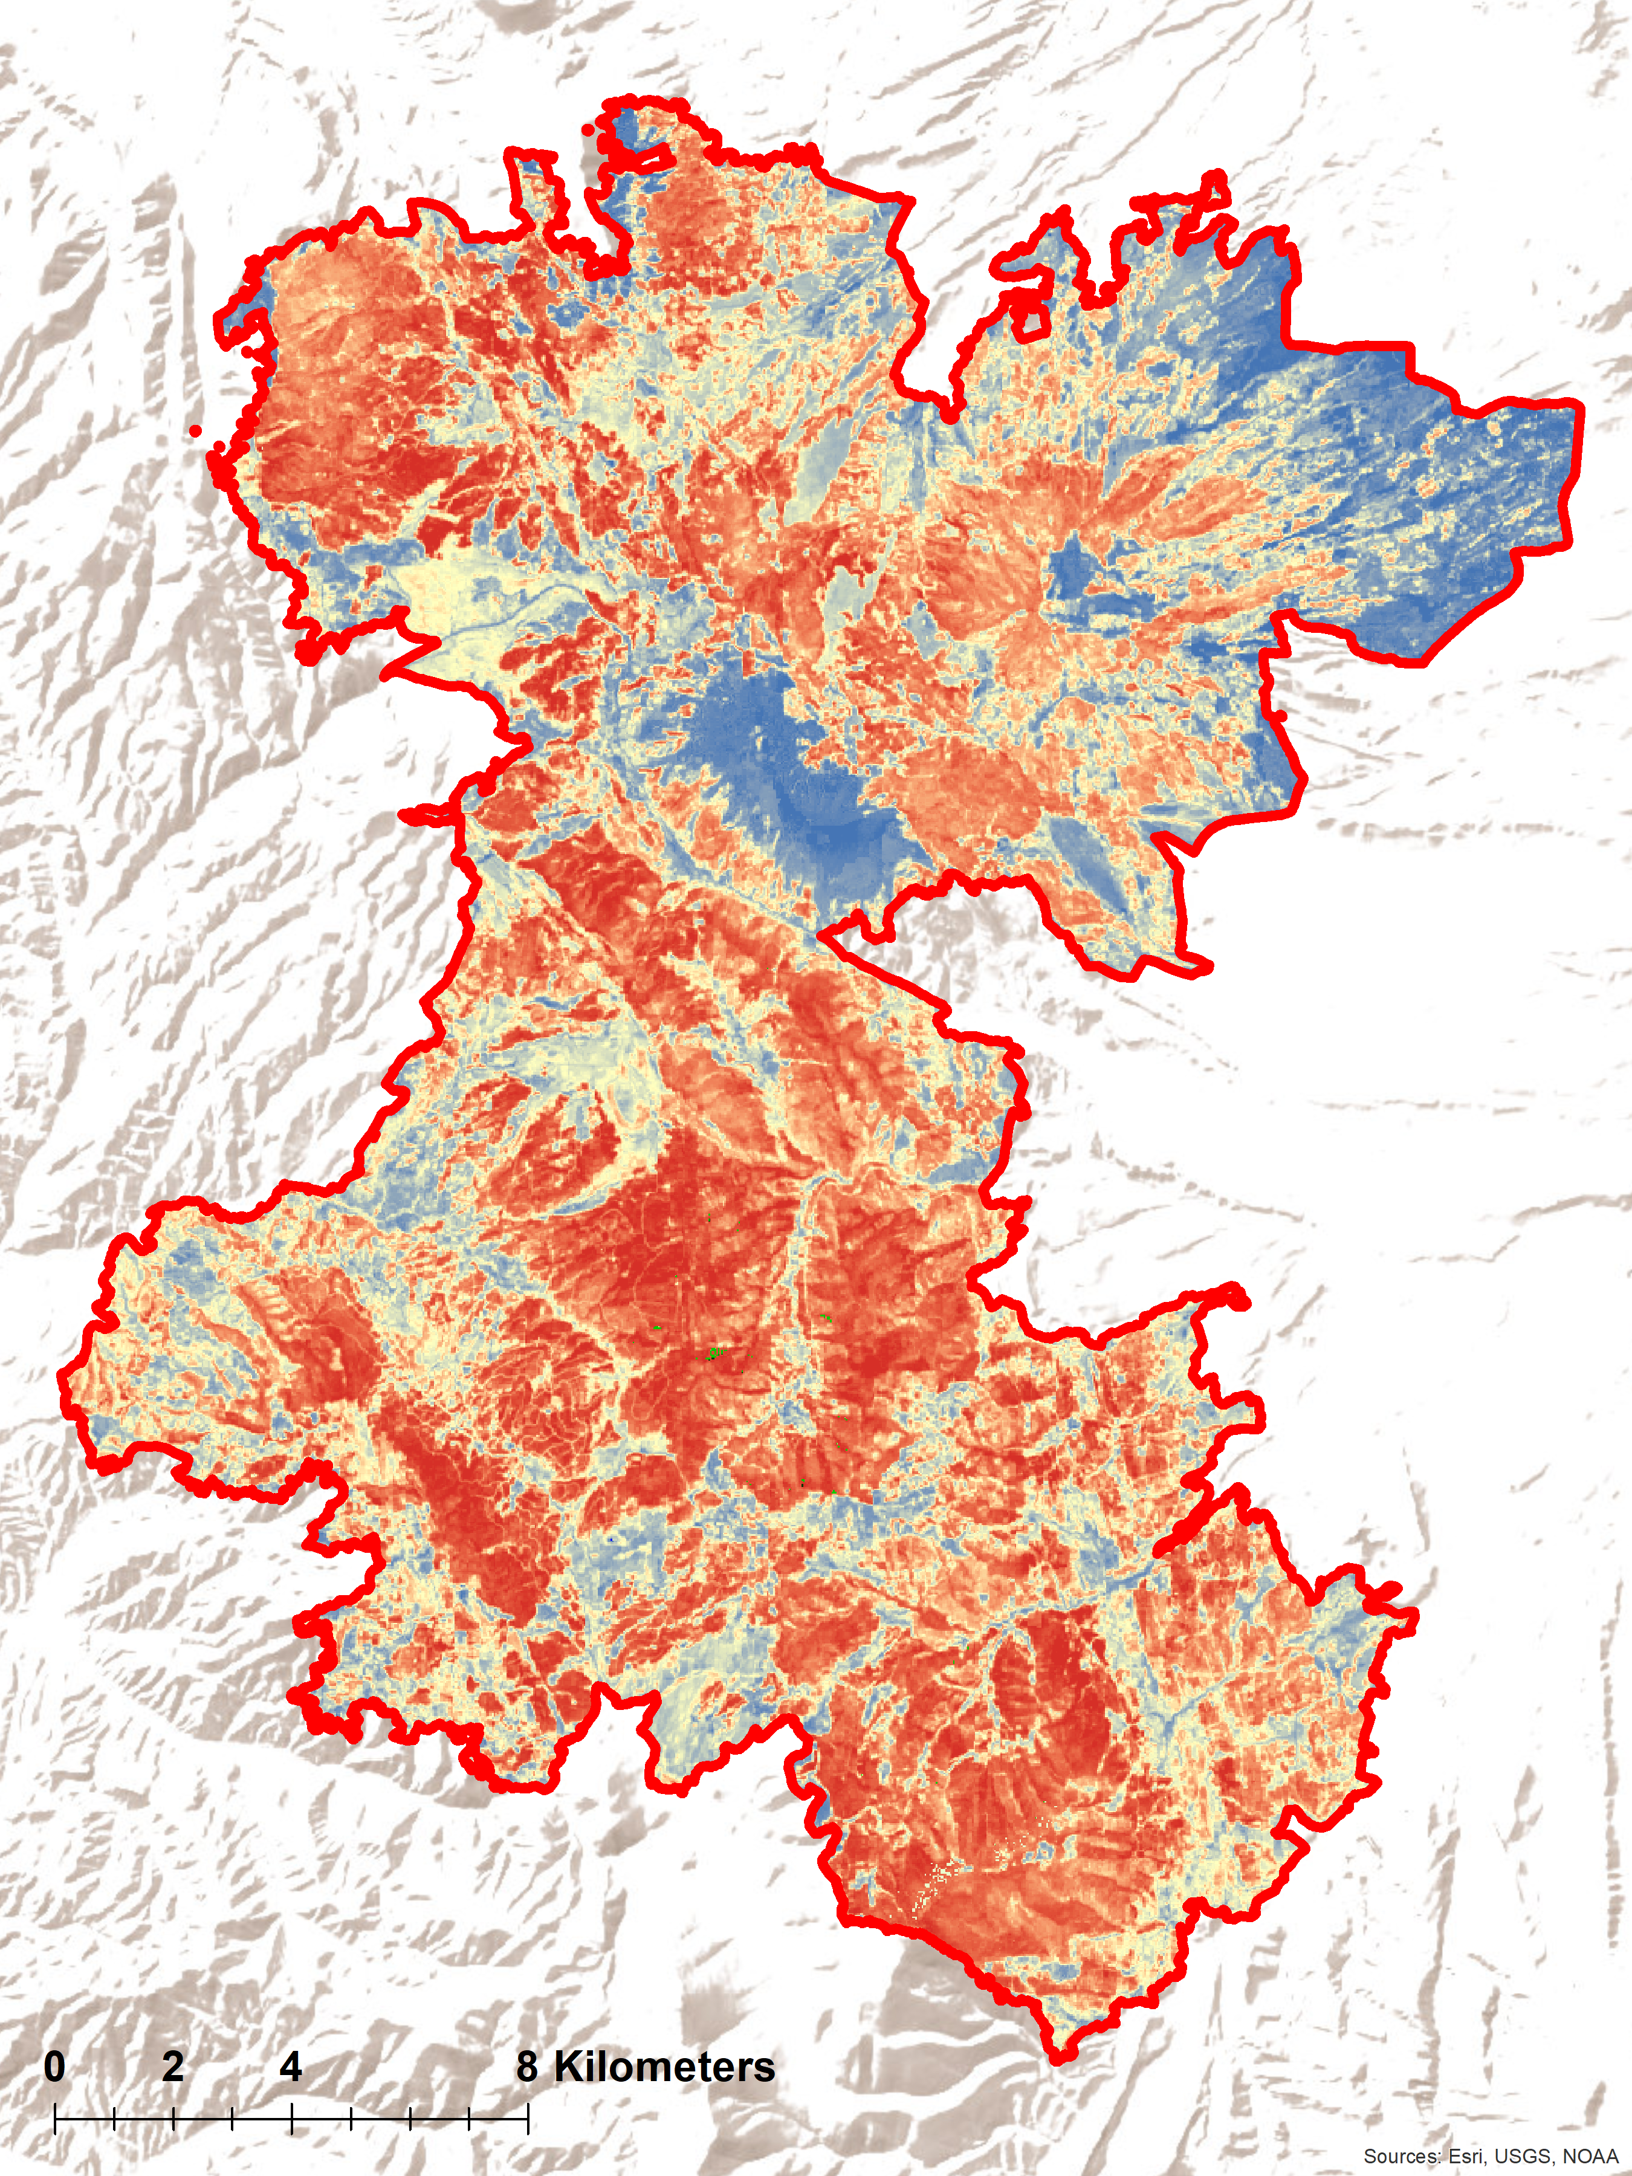
Relativized Burn Ratio
High
Low
Notes:
Speaker Notes:
This map shows burn severity for the fire, calculated using the RBR.
We can see from this map that the Spring Creek Fire was a pretty severe fire, where large areas within the fire perimeter were quantified as high severity.
Map Credit: Created by Kristin Davis in ESRI ArcMap

Slide 24
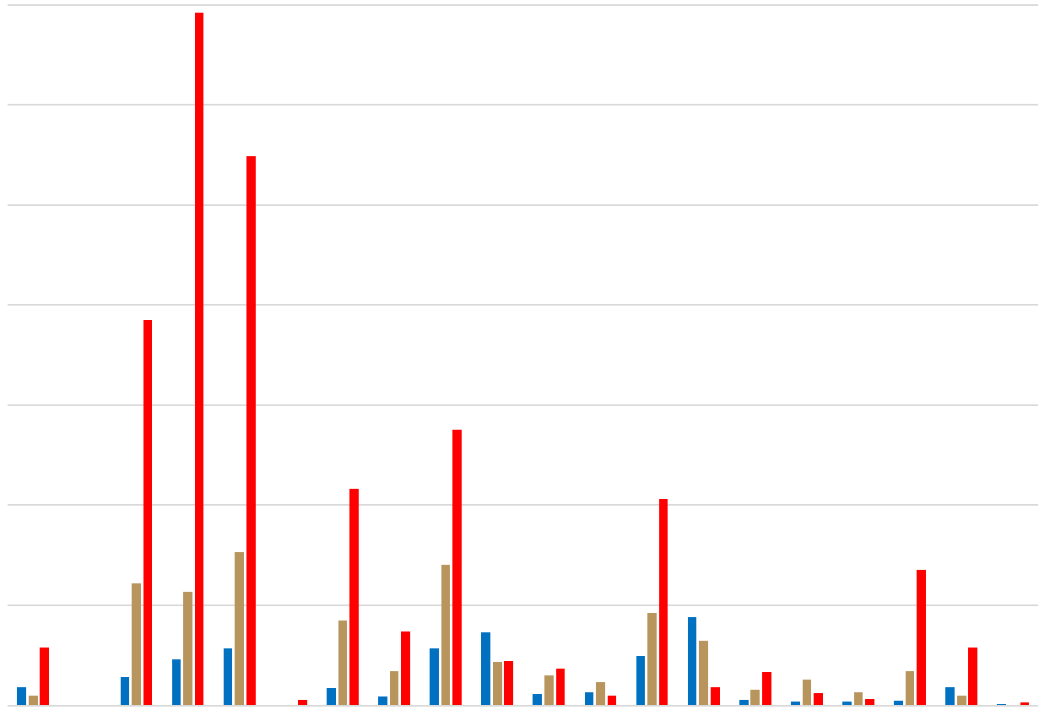
Burn Severity by Vegetation Class
Mesic Montane
High
Moderate
Low
7000
Aspen Mixed
6000
Dry-Mesic Montane
Area (ha)
5000
Gambel Oak –Mixed Montane Shrubland
4000
Ponderosa Pine
Southern Rocky Mountain Pinyon – Juniper
Gambel Oak Shrubland Alliance
Colorado Plateau Pinyon – Juniper
3000
Aspen Forest
Subalpine Dry-Mesic Spruce-Fir
Montane-subalpine Grassland
Lower Montane Shrubland
Dry-Mesic Spruce-Fir
Limber-Bristlecone Pine
Mesic-Wet Spruce-Fir
Perennial Grassland
2000
Abies concolor
Montane Riparian
Big Sagebrush
Shortgrass
1000
0
Notes:
Speaker Notes:
If we visualize burn severity across vegetation classes within the Spring Creek Fire, we see that almost all forest classes burned at high severity, including our focal forest types which could be impacted by western spruce budworm, indicated here by the stars.
** are these classes normalized for the entire area?
(no, not standardized by the area for these classes)

Slide 25
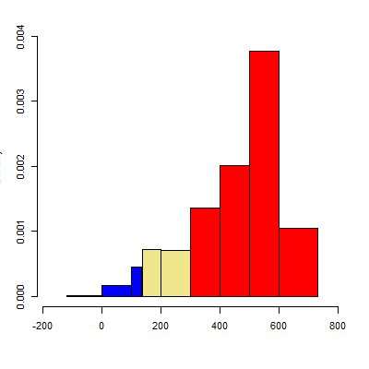
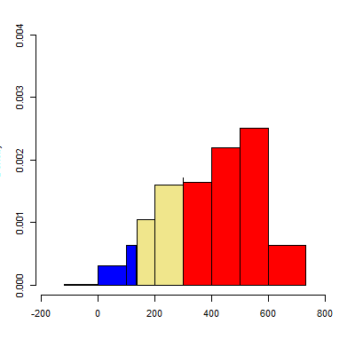
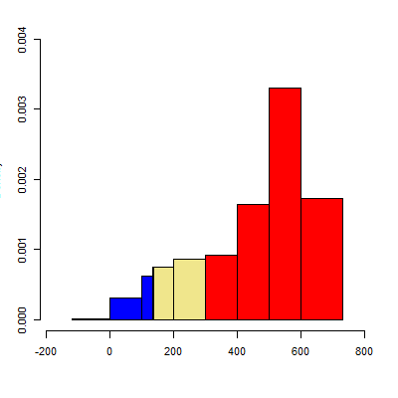
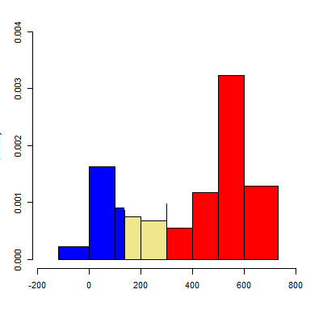
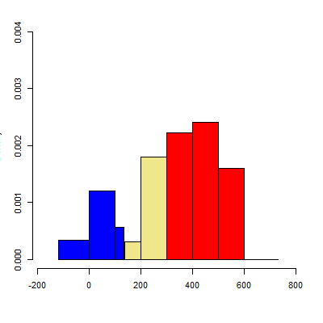
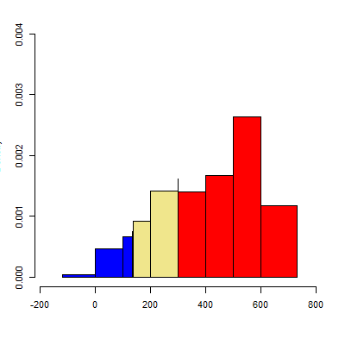
Burn Severity by Focal Forest Class
0.004
Abies concolor
Dry-Mesic Montane Mixed Conifer
Mesic Montane Mixed Conifer
0.003
Density
0.002
0.001
0.000
0.004
Dry-Mesic Spruce-Fir
Mesic-Wet Spruce Fir
Aspen-Mixed Conifer
0.003
Density
0.002
0.001
0.000
200
0
200
400
600
800
200
0
200
400
600
800
200
0
200
400
600
800
RBR
Notes:
Speaker Notes:
If we focus on our six focal forest classes and standardize the classes for total area so that they’re on comparable scales, we see two main trends. First, all forest classes potentially impacted by western budworm generally had the same distribution of burn severity from the Spring Creek Fire. S

Slide 26
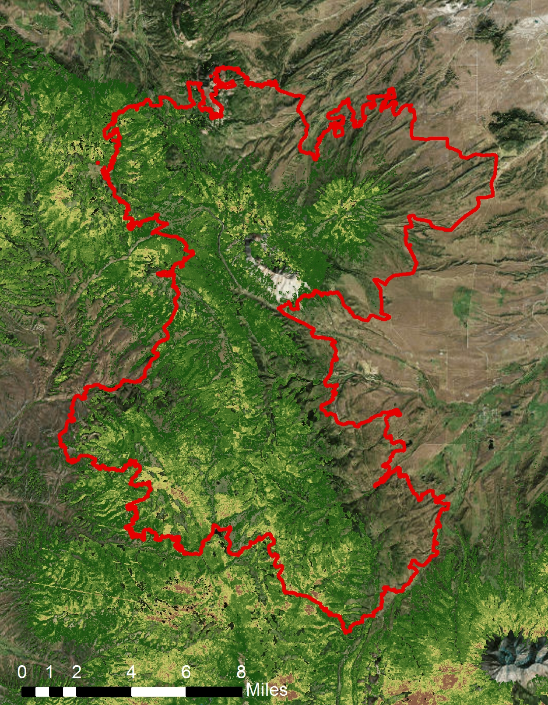
Burn Severity Random Forest Model
?
High 56%
High
Low: 0%
Low
Notes:
Speaker Notes:
To address our third objective, we used a random forests model to examine whether tree mortality preceding the Spring Creek Fire influenced burn severity of the fire.
We used the results from our tree mortality model as one of our predictors, and also considered slope, aspect, elevation, and forest type as predictors in this model.
We found that tree mortality was of low importance to predicting burn severity for the fire, and also the variance explained by this model was only ~10%.
Given these results, we cannot say whether tree mortality influenced burn severity of the Spring Creek Fire using this model.
However, our modeling approach to address this question could certainly be built upon in future projects.

Slide 27
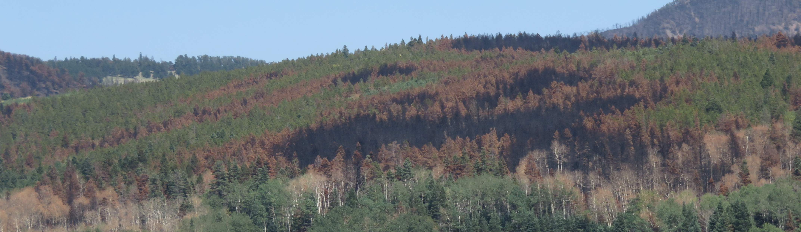
Conclusions
One-step vs two-step approaches both identified tree mortality within study area → analysis differed at the lower values
Tree mortality was of low importance for predicting burn severity when compared to other environmental predictors
Image Credit: Dr. Bill Romme
Notes:
When reflecting on overarching conclusions for our study we first determined that the one step…..
This may be due to the severity of the fire
Fire is a very complex process and it is diffult to attributy severity due to one factor. As severity is influenced by many factors that we were unable to explore for this project.

Slide 28
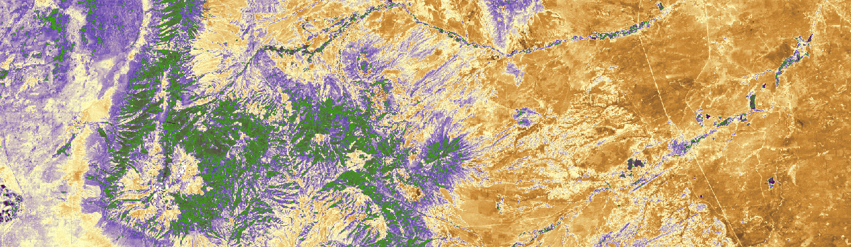
Limitations & Challenges
Unable to isolate budworm from other causes of tree mortality
  Treetop defoliation difficult to identify remotely
Limited time to determine relevant predictors for burn severity
No access to field data to verify our results
Image Credit: Dr. Bill Romme

Slide 29
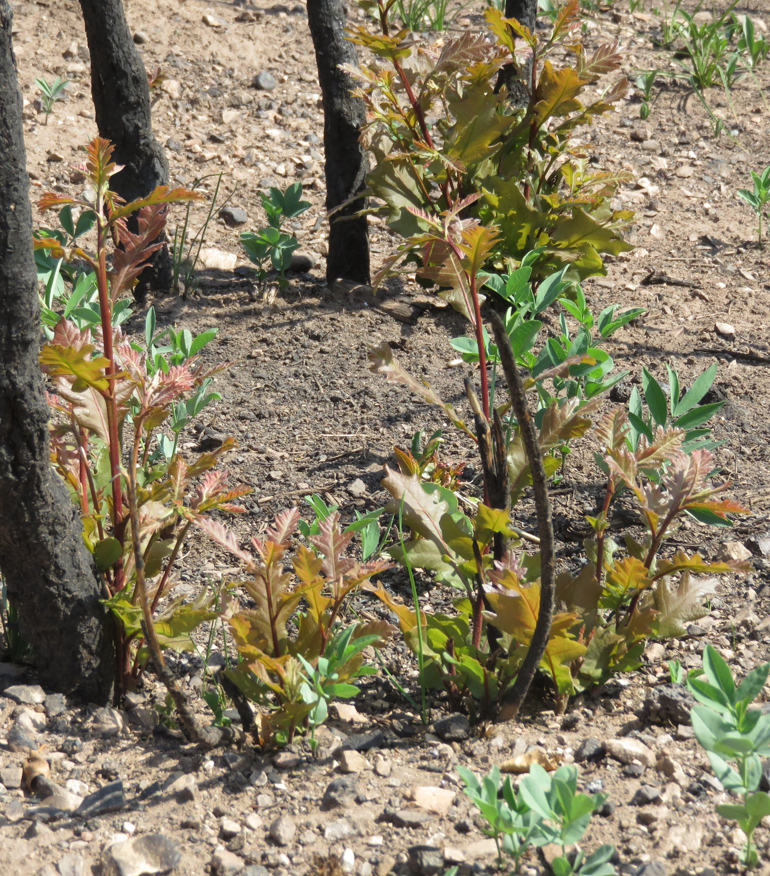
Future Work
Exploring single sampler vs. double sampler approaches
Using Sentinel-2 MSI to quantify burn severity
  More detailed resolution
Other modeling approaches for fire dynamics
  Using additional variables
Image Credit: Dr. Bill Romme
Notes:
More detailed resolution → 10m data our partners expressed interest in\
Our project has created a really good foundation to help inform land management decisions

Slide 30
Acknowledgements
Dr. Paul Evangelista (Colorado State University, Natural Resource Ecology Laboratory)
Tony Vorster (Colorado State University, Natural Resource Ecology Laboratory)
Brian Woodward (Colorado State University, Natural Resource Ecology Laboratory)
Nicholas Young (Colorado State University, Natural Resource Ecology Laboratory)
Dr. Catherine Jarnevich (United States Geologic Survey – Fort Collins Science Center)
Aaron Swallow (Ranch Environmental Manager)
Dr. Amanda West (Colorado State Forest Service, Manager of Science Information)

Slide 31
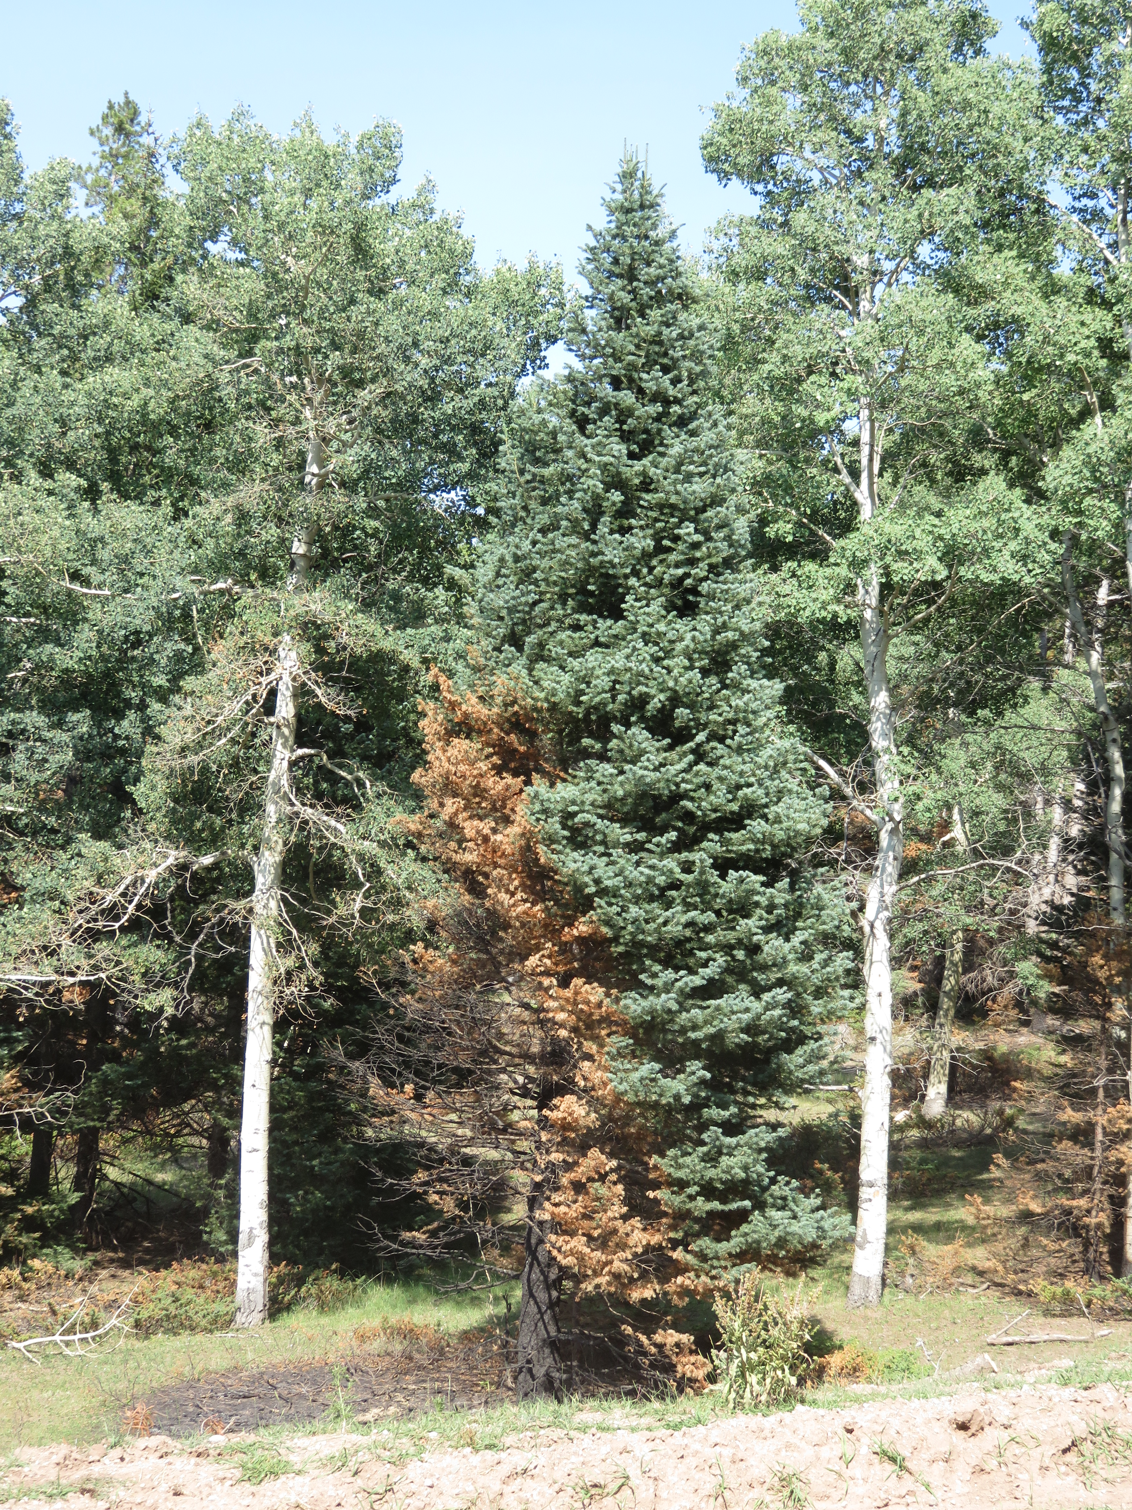
Questions?
Icon Credit:
Freepik via Flaticon
Icomoon via Flaticon
FlatIicon
Image Credit: Dr. Bill Romme

Slide 32
Bonus Slides

Slide 33
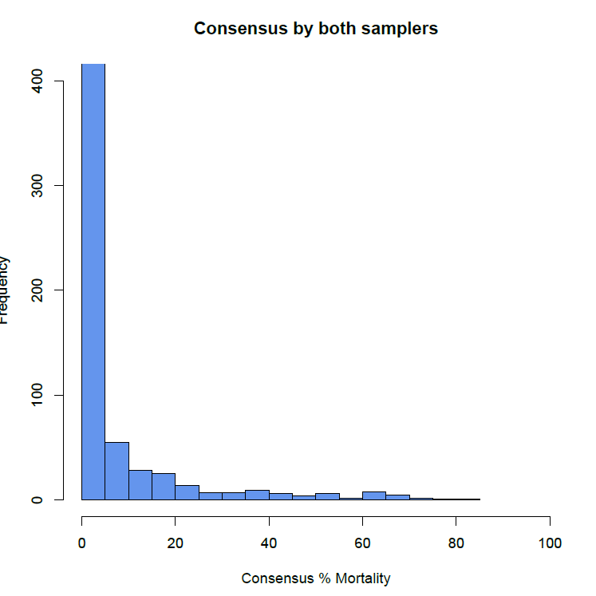
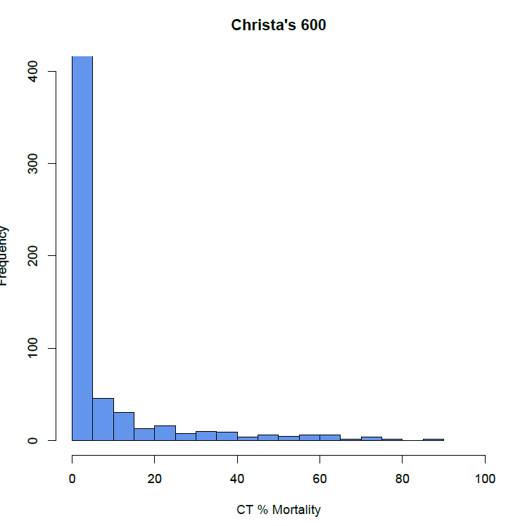

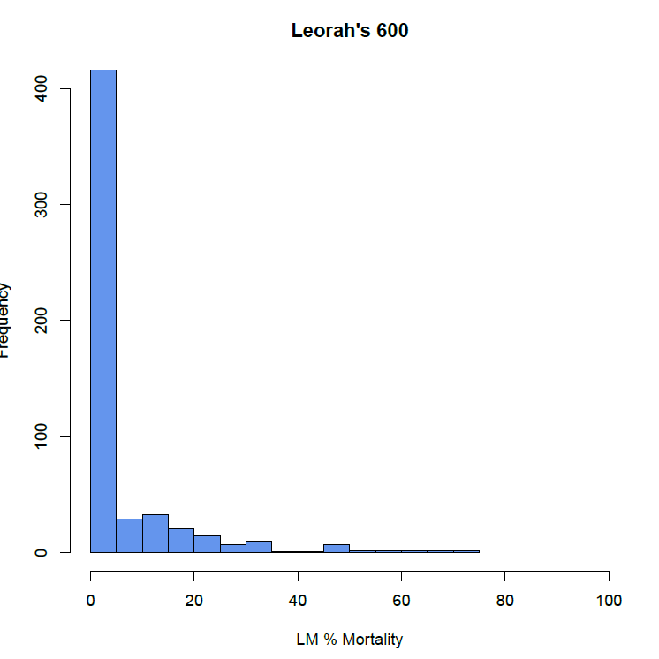
Training Data Results
Consensus Dataset
Sampler 2 Dataset
Average Dataset
Sampler 1 Dataset
Sampler 1
  41% sampling points had tree mortality, range: 5-90%
Sampler 2:
  33% points with tree mortality range: 5-70%
Average:
  49% points with tree mortality, range: 2.5-75%
Consensus:
  49% points with mortality, range: 2.5-85%
400
400
400
400
300
300
300
300
200
200
200
200
Frequency
Frequency
Frequency
100
100
100
100
0
0
0
0
0
20
40
20
40
60
80
100
60
100
0
20
80
100
0
20
40
80
0
40
60
80
60
100
Percent Mortality
Percent Mortality
Percent Mortality
Percent Mortality
Notes:
Speaker Notes:
We ended up with four separate Training Datasets from our two Samplers.
Sampler 1

