Slide 1
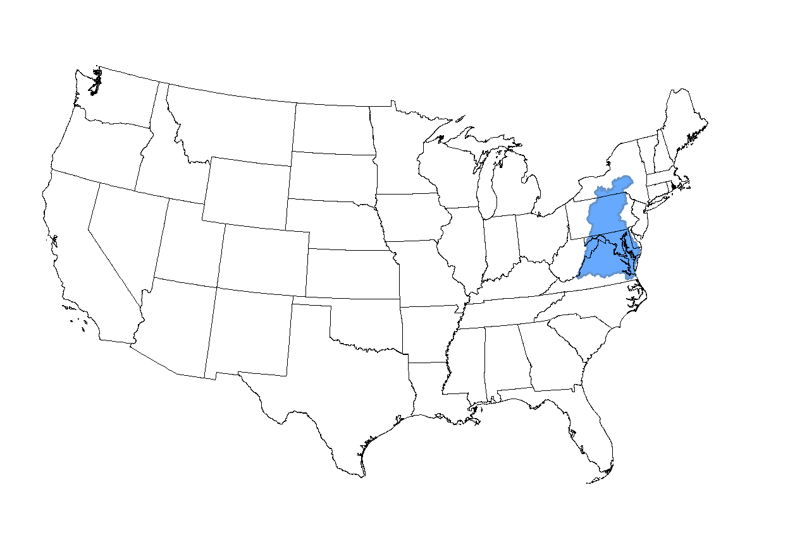
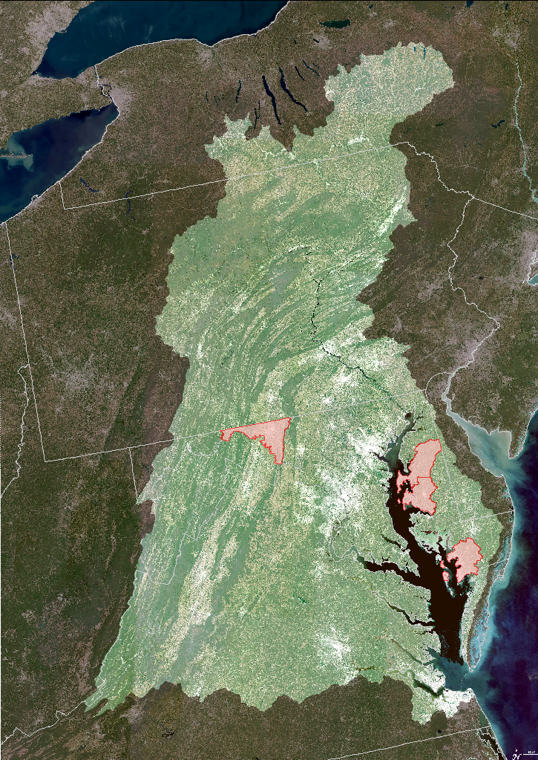
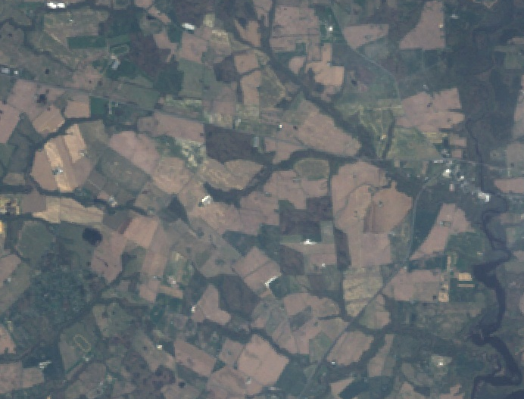
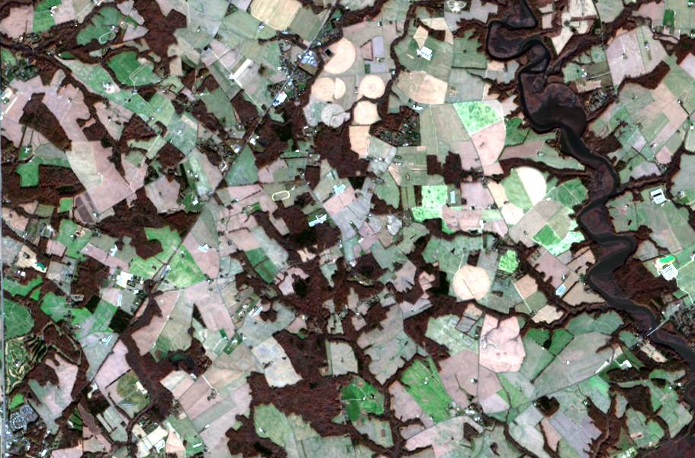
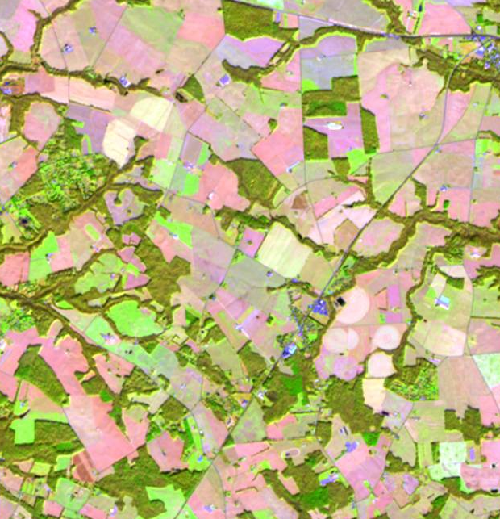
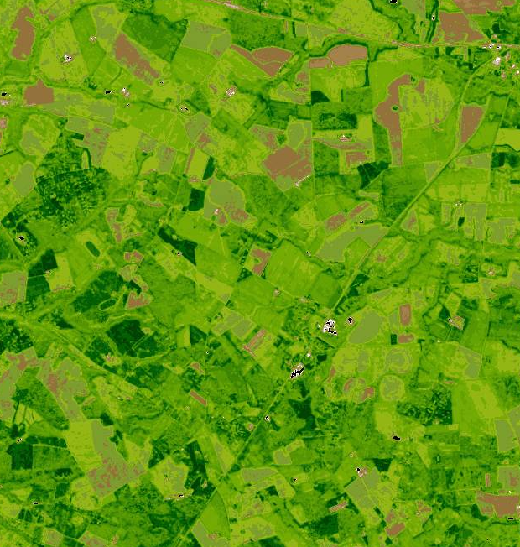
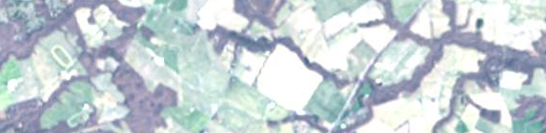
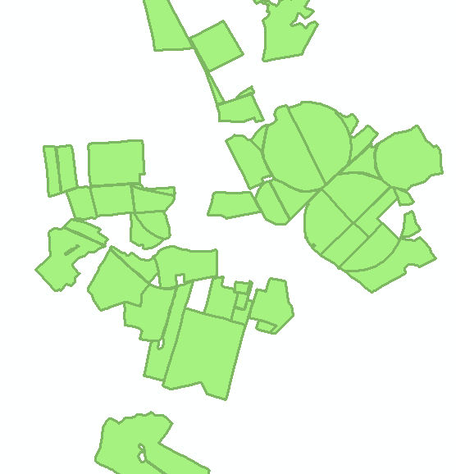
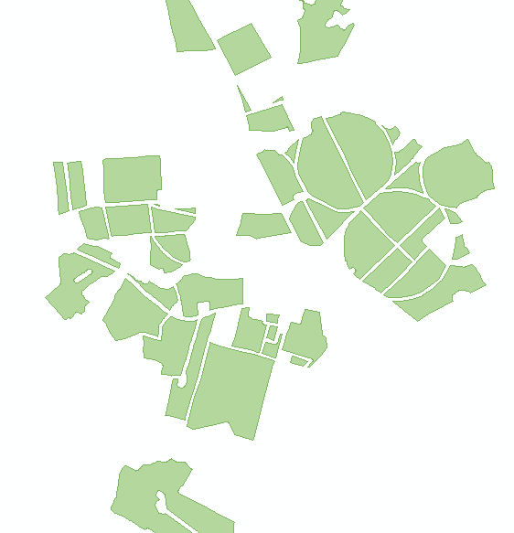
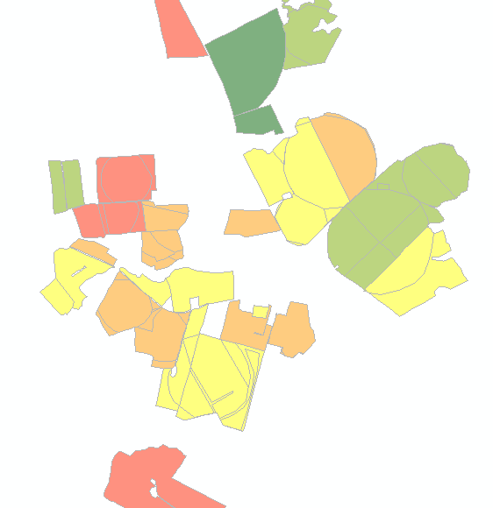
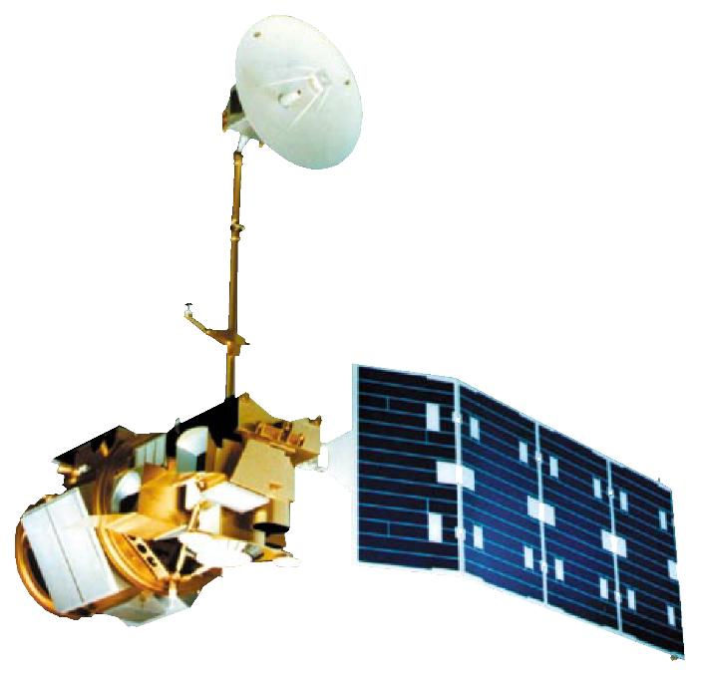
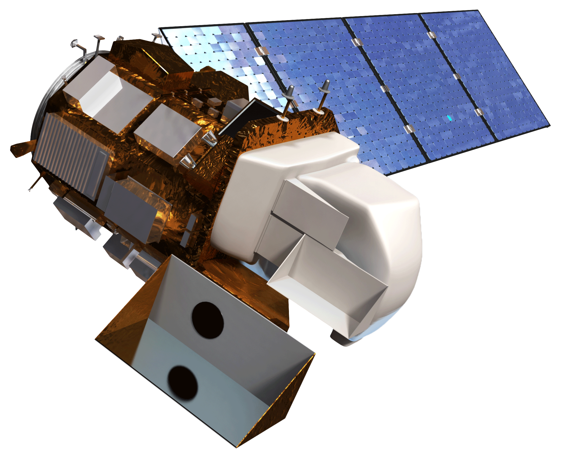
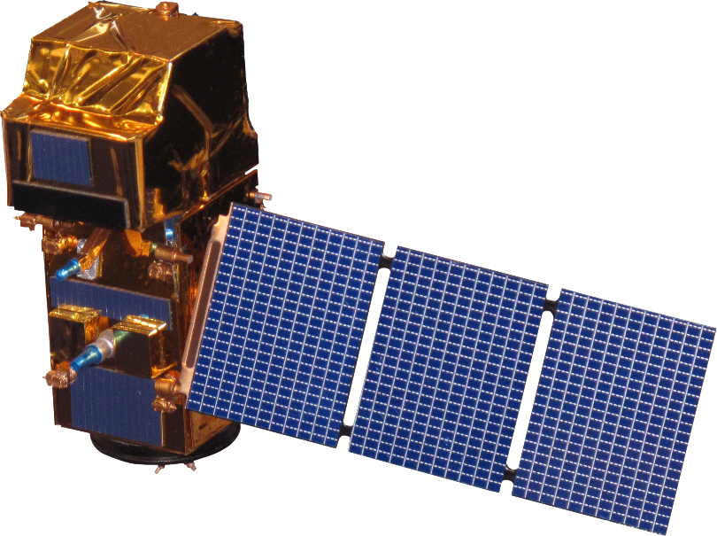
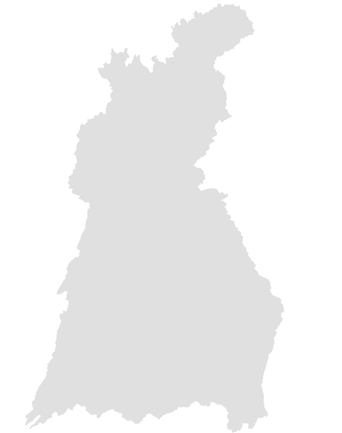
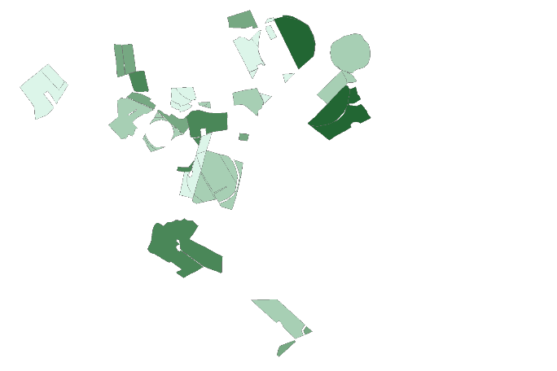
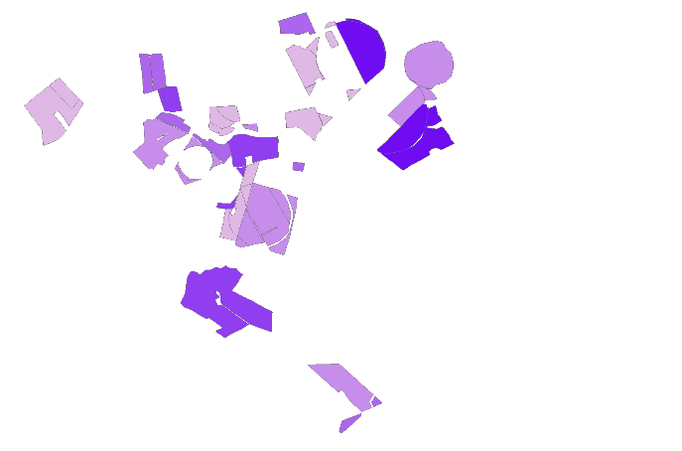

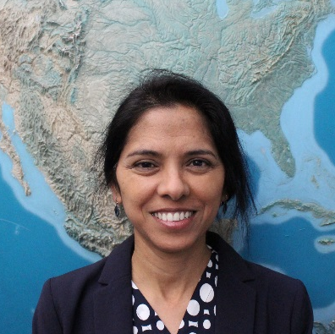
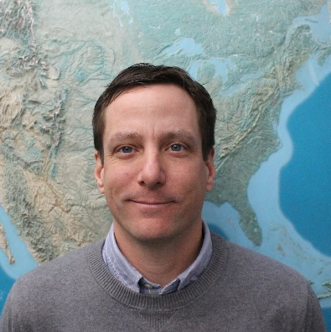

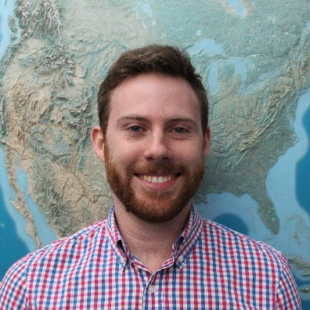
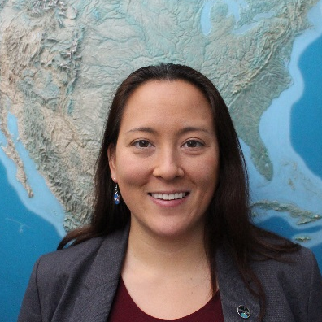



Using NASA Earth Observations to Map Winter Cover Crop Conservation Performance in the Chesapeake Bay Watershed
Abstract
Objectives
Winter cover crops are an essential component of adaptive management practices to reduce soil erosion, nutrient loss, and nutrient leaching leading to water quality degradation. The Maryland Department of Agriculture (MDA) and Chesapeake Bay partners (US Geological Survey and USDA Agricultural Research Service) oversee a cost-sharing program that offers subsidies to farmers enrolled in the winter cover crop program. The effectiveness of mitigating soil and nutrient loss varies by crop species, planting date, planting method, prior crop species, manure inputs, and growing degree days. In addition to field related factors, landscape factors may also influence winter crop performance. While methods to quantify crop performance are available, they are not automated for timely analysis. This study used Landsat 5 and 8 and Sentinel-2 imagery to quantify crop performance using vegetation indices to estimate biomass, and nitrogen uptake in three counties on the Eastern Shore of Maryland in the Chesapeake Bay, in addition to one_ western county, all located in Maryland. The methods developed in this project _ automate acquisition of annual satellite imagery and calculation of winter cover _ crop metrics. The crop performance data produced facilitates analysis for the _ MDA to monitor winter cover crop efficiencies at varying scales, for example by_ identifying underperforming versus satisfactory cover crop fields, as well as those with high biomass.
Measure winter cover crop performance within four Maryland counties
Evaluate estimated nitrogen uptake by quantifying biomass, nitrogen content, and percent nitrogen
Provide vegetation metrics to the Maryland Department of Agriculture to improve crop adaptive management practices
Study Area
NY
PA
NJ
Methodology
MD
Imagery
Landsat 5
Landsat 8
Sentinel - 2
Google Earth Engine
Surface Reflectance
Applied Masking
Exctract NDVI
Calibration
Biomass
% Ground Cover
% Nitrogen
% Residue Cover
Chesapeake Bay
Watershed Boundary
WV
DE
Study Area Counties
VA
U.S. State Boundaries
0
75
150
300
Credit: Taylor & Estrada, 2015
Kilometers
Earth Observations
Ancillary Data
MDA Cover Crop Enrollment
Agronomic Data
Field Boundaries
GIS Processing
Group Crop Field Files By Path / Row
15 Meter Buffer Into Field
Convert To Fusion Tables
Performance Measures
Output Tables
Field Performance Maps
Chesapeake Bay Agriculture
Landsat 5
Sentinel-2
Landsat 8
Results
Conclusions
NDVI can be used to predict crop biomass (R² = 0.33, p<0.05)
NDVI was not a significant predictor of nitrogen percent (R² = 0.002, p<0.51)
It was possible to automate the image search in Google Earth Engine to find the image with maximum NDVI within a time period
It was possible to extract NDVI values by individual field boundaries
NDVI and Growing Degree Days (GDD) both have a significant influence on crop biomass
The data processing and crop performance scripts will enable the MDA to evaluate the performance of the winter cover crop program
±
R² = 0.33
±
R² = 0.002
Nitrogen Content
(kg/ha)
Acknowledgements
Biomass (kg/ha)
0 - 9.42
Dr. W. Dean Hively, USGS
Jason Keppler, MDA
Dr. Greg McCarty, USDA-ARS
Rich Batiuk, EPA
Mary LeeAnn King, USDA-ARS
Alisha Mulkey, MDA
Dr. John Bolten, NASA GSFC
0 - 285
9.43 - 14.73
286 - 487
14.74 - 21.16
488 - 705
21.17 - 32.00
0
1
2
3
Km
706 - 1090
0
1
2
3
Km
1091 - 2541
32.01 - 74.45
Spring crop biomass estimation by NDVI (Spring 2015 Wheat)
Spring nitrogen percent estimation by NDVI (Spring 2015 Wheat)
Project Partners
Team Members
Maryland Department of Agriculture (MDA), Office of Resource Conservation
USDA-ARS Hydrology and Remote Sensing Laboratory
USGS Eastern Geographic Science Center
US EPA, Chesapeake Bay Program
Sunita Yadav-Pauletti
Team Lead
John Fitz
Sean McCartney
Perry Oddo
Alison Thieme
NASA Goddard Space Flight Center – Spring 2017

