Slide 1

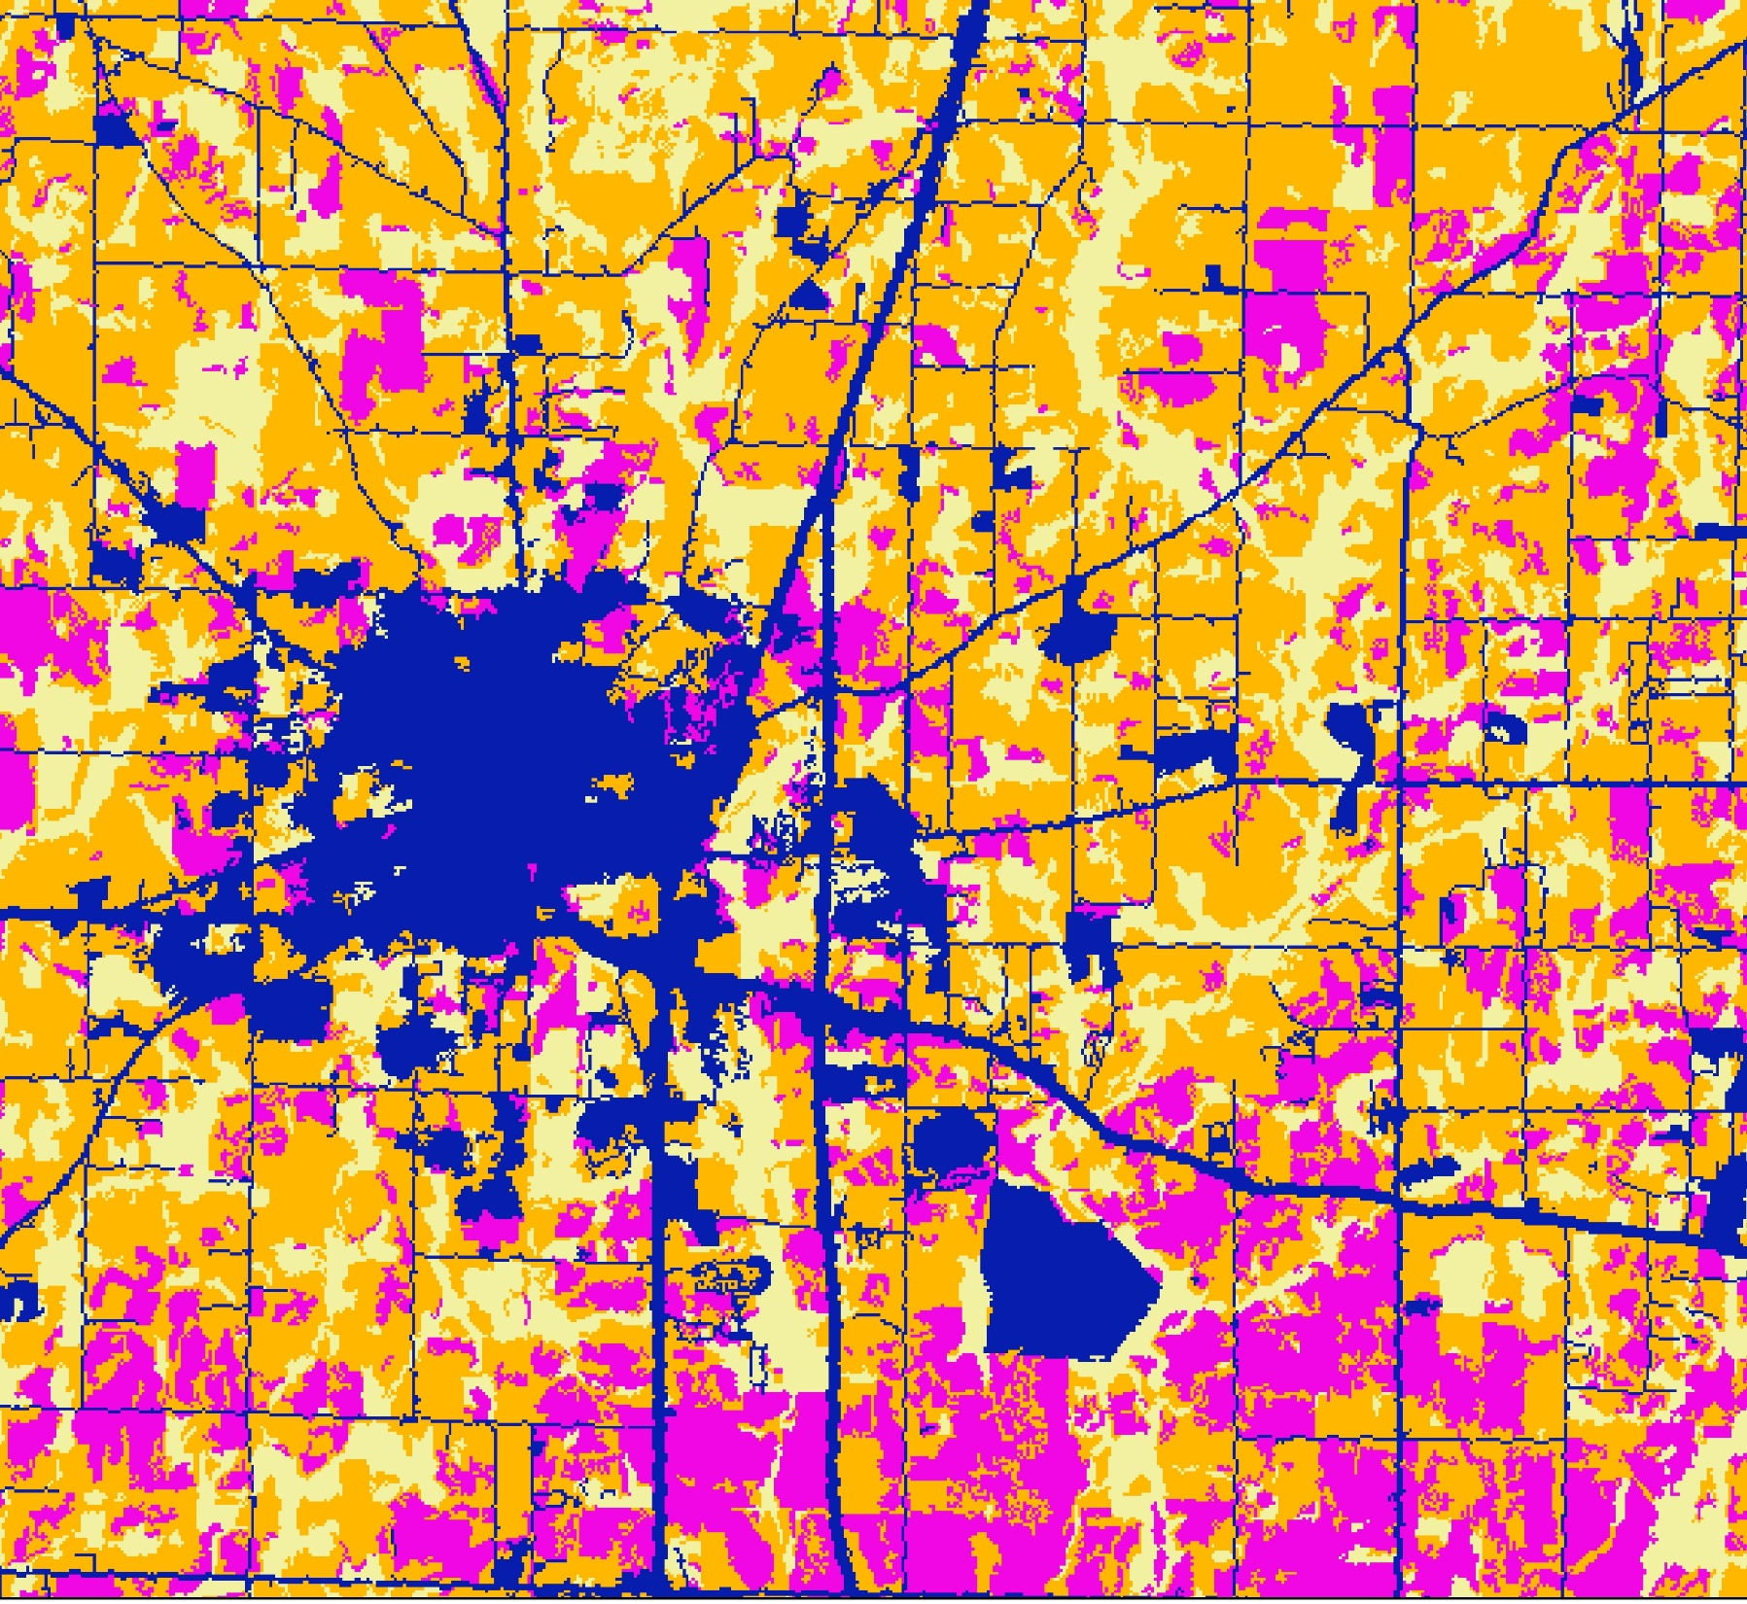

North Alabama Ecological Forecasting
Spatial Modeling of the Fragmentation of Local Species Habitat from Increasing Urbanization in North Alabama
Nicholas McVey
Helen Baldwin-Zook
Emily Kinkle
Alabama – Marshall
Fall 2017
Notes:
Image: Classified Landsat 5 Image of Huntsville AL

Slide 2
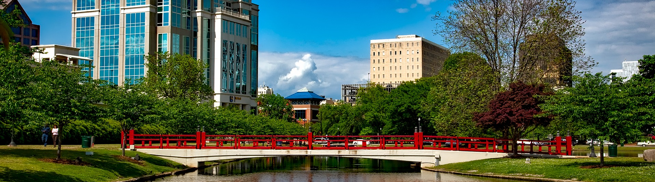
Community Concerns
Image Credit: 12019
Urbanization in Madison County, increased from 13% in 1984 to 30% in 2000
Expected commercial development in Limestone County
Population growth 1980 to 2010: Limestone County – 36,000+ and Madison County 137,000+
30 endangered/threatened species
Notes:
Image Source: https://pixabay.com/en/huntsville-alabama-city-cities-1616869/
Alabama is the fourth most biodiverse state in the United States, there are 30 endangered/threatened species that live within Madison and Limestone counties alone. Due to urbanization, local habitats are at risk. Urbanization in Madison has been found to have increased from 13% in 1984 to 30% in 2000. Commercial development is expected to increase in Limestone County, although no known studies have been completed. One indicator of urbanization is population growth. Limestone county’s population has increased by more than 36,000 people from 1980 to 2010, while Madison county has increased by 137,000 people.

Slide 3
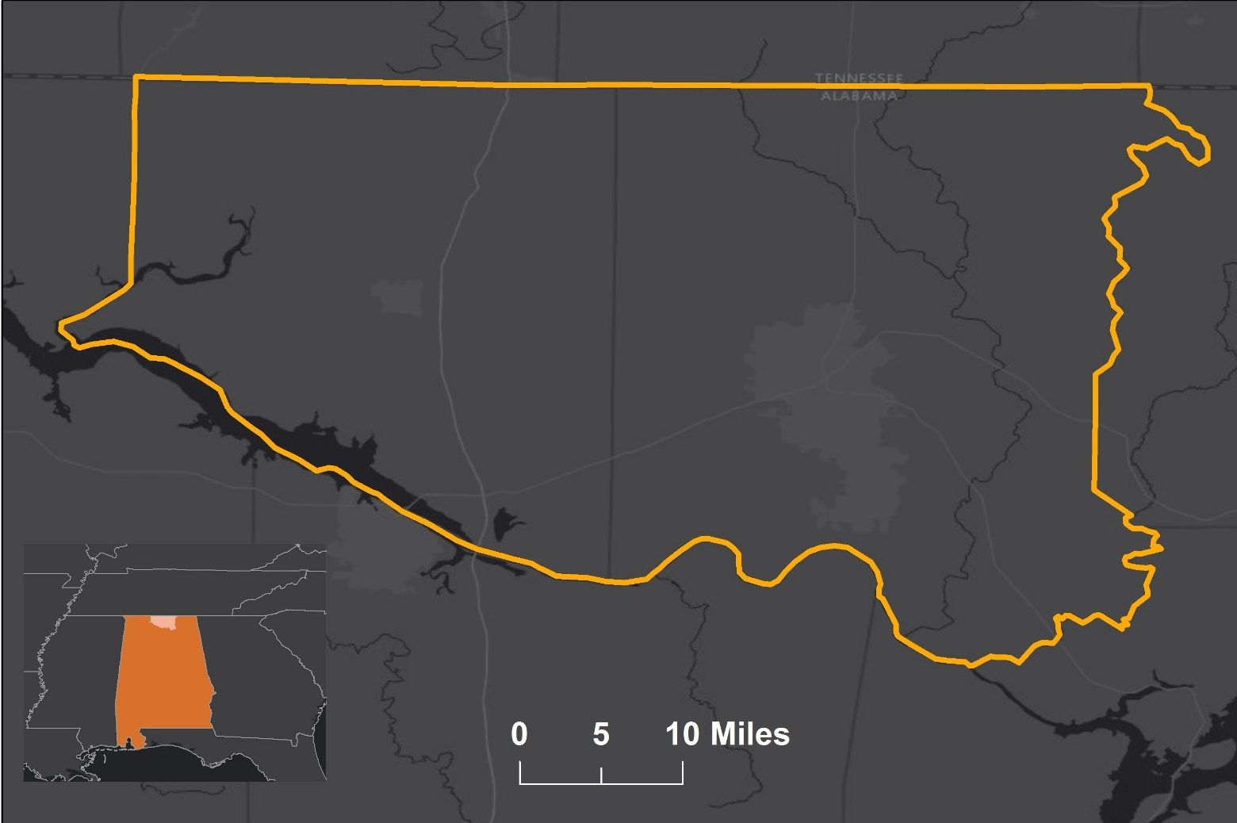
Objectives and Benefits
Analyze urban growth in Madison and Limestone counties over the past 30 years and project potential growth
Illustrate impacts on focus species
Provide the Land Trust of North Alabama with an automated resource that will allow them to expand into Limestone County
I
Notes:
This project will analyze urban growth in Madison and Limestone counties over the past 30 years and then project potential growth through 2045
We will highlight focus species that will be put at risk due to urbanization so that these areas can be considered for conservation efforts
Some of our current focus species include the TN Cave Salamander, The American Black Duck, Price’s Potato Bean, Green Salamander
The Land Trust of North Alabama has primarily obtained land in Madison county, but with increasing populations and urbanization, they are looking to expand into Limestone county
Currently, their decision making relies heavily on field studies and outsourced or volunteered research. They are in need of a better system for long-term strategic conservation planning but currently do not have the funds to pay someone to develop an automated resource for them to use. We’re aiming to provide them with a tool that can assist them in planning, and presenting their case for procurement of land to landowners and local government officials
Once this land is obtained, they can put their resources into conservation of habitats
Service Layer Credits: Esri, HERE, DeLorme, MapmyIndia, © OpenStreetMap contributors, and the GIS user community
Esri, HERE, MapmyIndia, © OpenStreetMap contributors, and the GIS user community

Slide 4
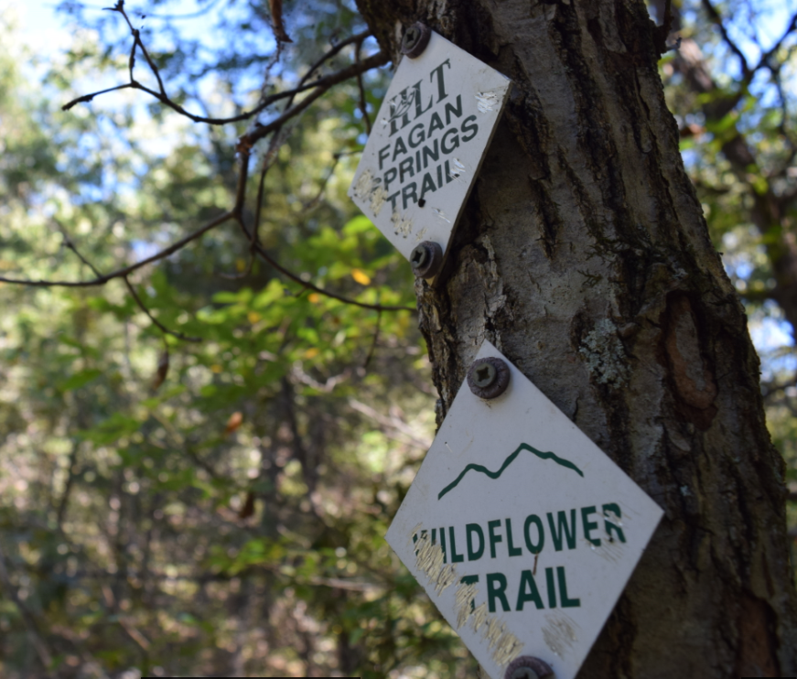
Project Partner
Land Trust of North Alabama
1980s: Founded in response to proposed development on Monte Sano
Mission: Preserve land and its legacies to enhance quality of life in North Alabama
2003: Study of development in Madison County conducted
Currently 6,200+ acres and 60+ miles of trails
Image Credit: Emily Kinkle
Notes:
The North Alabama Ecological Forecasting team partnered with the Land Trust of North Alabama. The Land Trust was founded in the 1980s in response to a proposed development site on Monte Sano. It’s mission is to enhance quality of life in Alabama through preserving land and environmental education. They currently have over 6,200 acres of land and more than 60 miles of trails. In 2003, the Land Trust completed a study of development in Madison County. This project builds and expands that study to Limestone County and using different methodology.
Image credit: Emily Kinkle (team member)

Slide 5
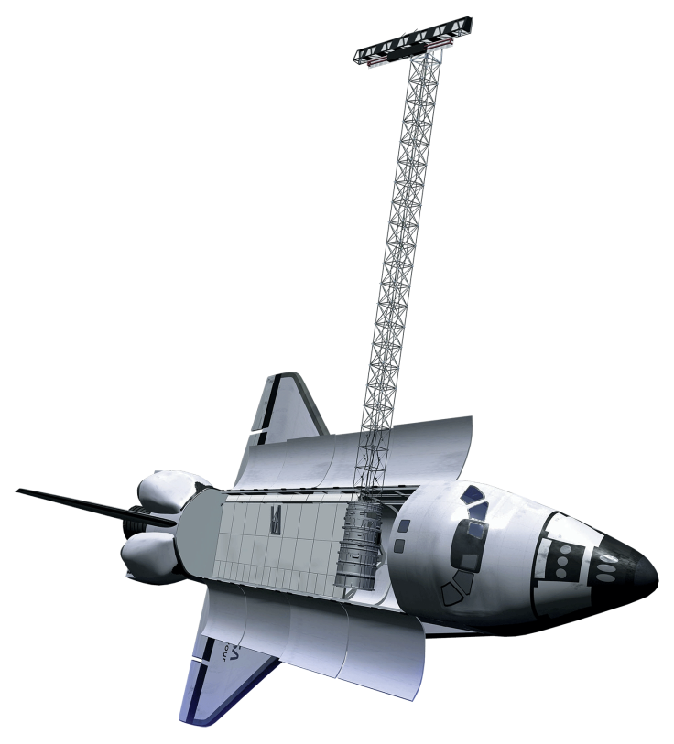


NASA Satellites Used
Shuttle Radar Topography Mission (SRTM)
Launch Date: February 11, 2000
Spatial Resolution: 30 m
Landsat 5 Thematic Mapper (TM)
Landsat 8 Operational Land Imager (OLI)
Launch Date: March 1,1984
Spatial Resolution: 30 m
Launch Date: February 11, 2013
Spatial Resolution: 30 m
Image Credit: NASA
Notes:
Landsat 5 Thematic Mapper – Dataset provides the temporal and spatial resolution required to model the progression of development in the study area with imagery beginning in 1985
Shuttle Radar Topography Mission – Orbital study of the global topography of the earth. Program mapped over 80% if the world’s topography. Dataset was used to derive topographic indices for modeling hydrological features
Landsat 8 Operation Land Imager – Dataset provides the temporal and spatial resolution required to model the progression of development in the study area with imagery beginning in 2013

Slide 6
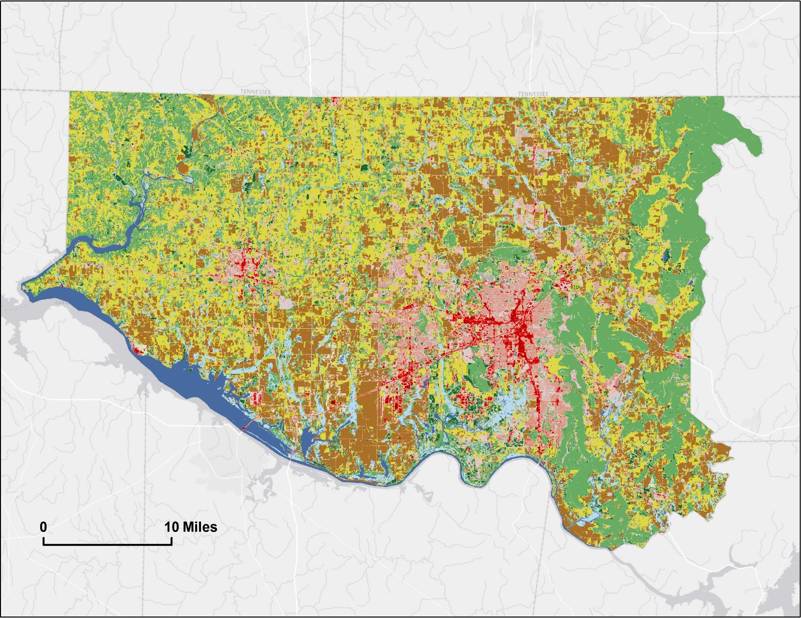

Ancillary Datasets
Open Water
Barren Land
Shrub/Scrub
Cornell Lab of Ornithology eBird Species Location Dataset
Land Trust of North Alabama Property Shapefile
USGS National Land Cover Database (NLCD) 2006, 2011
Numerous scientists’ contribution of species location data
Developed, Open Space
Deciduous Forest
Grassland / Herbaceous
Developed, Low Intensity
Evergreen Forest
Pasture / Hay
Developed, Medium Intensity
Mixed Forest
Cultivated Crops
Developed, High Intensity
Dwarf Scrub
Woody Wetlands
Emergent Herbaceous Wetlands
Notes:
eBird Dataset was used for bird point data
Land Trust of North Alabama provided a shapefile with all of the land they currently own
USGS NLCD was used to compare with our land classification
NASA SEDAC was used for population census data
https://www.mrlc.gov/nlcd11_data.php

Slide 7
Methodology: Land Use
Least cloud cover Landsat image for each year
Maximum Likelihood Classifications: 5 land cover types
Urban Growth Rate Estimate
Land Use classifications with NLCD
Data Acquisition
Analysis
Comparison
Output
Notes:
Used a code in GEE to download the least cloud cover Landsat 8 OLI image for each year within the study period (all bands). These were preprocessed (TOA). Clipped to study area. Classified land classes (grassland, urban, forest, wetland, cropland, barren, etc.) in ArcMap 10.4 using Maximum Likelihood Classification tool. Different bands were used for the 6 land classes (water masked out with NLCD water mask). 100 training polygons were created for each class. Training polygons based on world imagery basemap (year: 2017). We tested four band combinations: NDVI, EBBI, EVI and (). Then created a map showing land fragmentation over time, then created an ArcMap tool that allows the Land Trust to incorporate new data into the map as it becomes available.

Slide 8
Methodology: Projected Urbanization
Define Fuzzy Logic Model Parameters and Memberships
Suitability for Urban Development
Species Habitat Location and Buffer Sensitivity Information
End Product: Habitat Fragmentation Map & Tool
Data Acquisition
Output
Data Input
End Product
Notes:
First we downloaded layers related to our topic, for example, population data from Landscan, school location, etc (refer to ancillary data slide). Then we created distance to feature rasters using the Euclidean distance tool, finally we defined memberships and the logic to combine them, creating a map forecasting urbanization to 2045. This map is called the Suitability for urban development map, as it depicts the areas most likely to be developed should urbanization occur. Intersecting this land suitability map with species location data and buffers for habitat sensitivity, allows us to measure the impact that potential urbanization increases would have on the local population of species.
This analysis is known as our Species Fragmentation Map.

Slide 9
Fuzzy Logic Modeling
Used for urbanization risk assessment
Two different memberships used
  Linear
  MSLarge
Land classification: reclassified from least to most suitable
Inputs | Fuzzy Memberships
Land Classification | MSLarge
Distance to Colleges | Linear
Distance to Fire Stations | Linear
Distance to Public Schools | Linear
Distance to Hospitals | Linear
Notes:
To analyze urban development in the area and project what areas are at the highest risk of being urbanized, we used fuzzy logic modeling. We used land classification with an MSLarge membership and distance to colleges, firestations, public schools, and hospitals with linear memberships. We took into consideration the area surrounding Madison and Limestone counties as well for our distance buffers. Before assigning the land classification membership, we reclassified the values to rank land classification from least to most suitable for development. The fuzzy memberships used were linear and MSLarge. A linear membership is just that, it assumes that the suitability or desirability for an outcome is directly depending on the linear distance that object is away from some other parameter. This was assumed for most of the distance to place inputs. The land Classification use and MSLarge member ship. Areas closer to developed land face a greater probability of being developed, while areas that are already developed can’t become developed again, and therefore is assigned a probability of 0. This aimed to create a map of the study area that depicted where the location of least to most suitable areas for development were located.

Slide 10
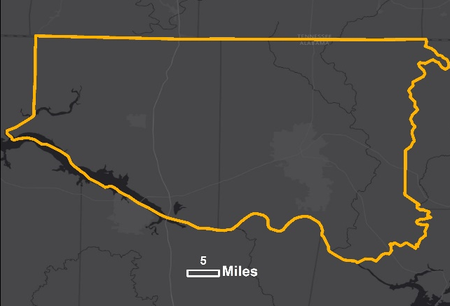


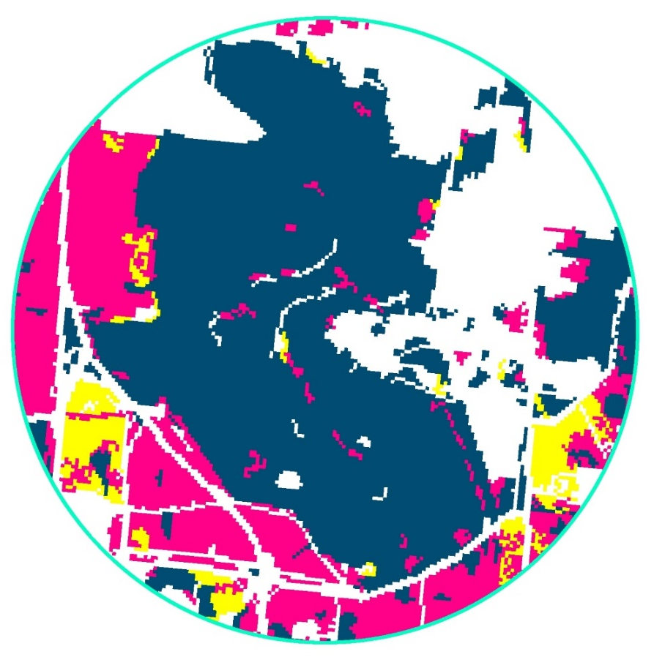
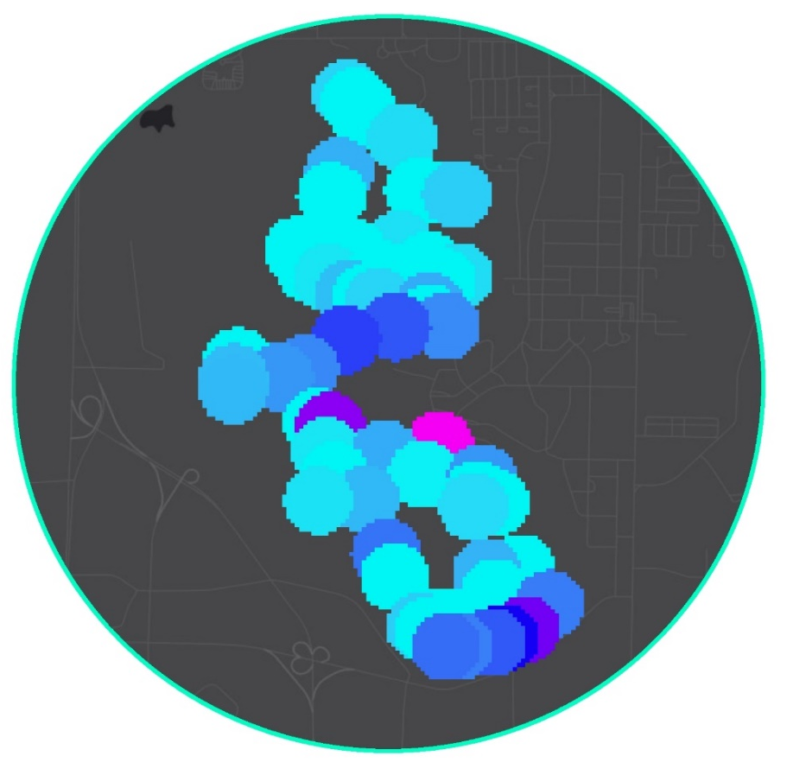
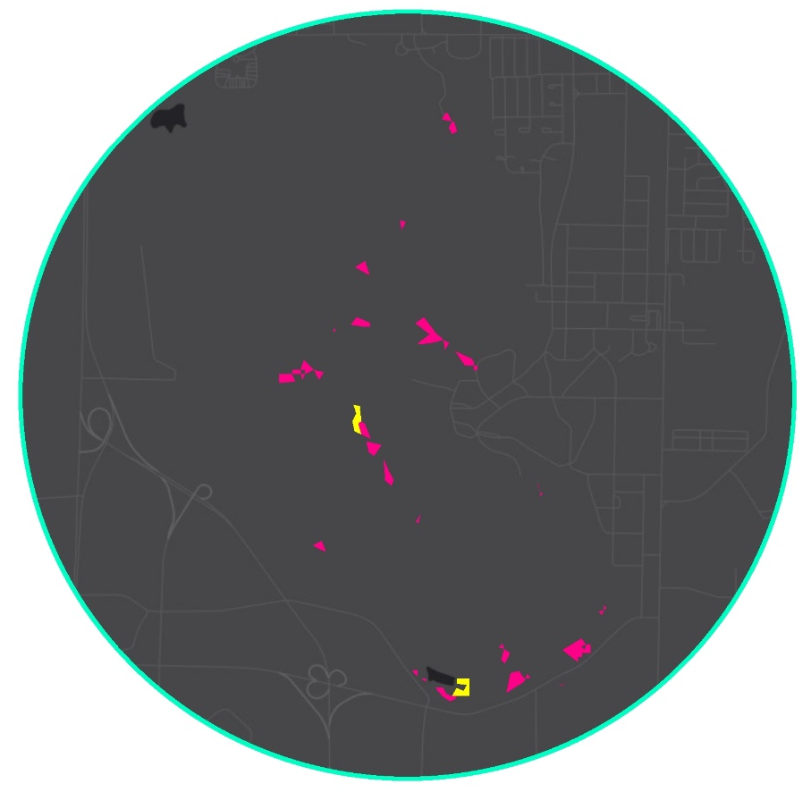


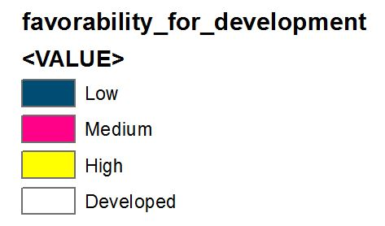
Species Analysis
Focus Species:
  Green Salamander
  Price’s Potato Bean
  American Black Duck
  Morefield’s Leatherflower
  Northern Slimy Salamander
  Cave Salamander
Tool shows where these species’ habitats overlap with the risk of urbanization
Will aid the Land Trust of North Alabama identify areas that are crucial for conservation
Suitability for Development
Threat to Habitat
Mean Habitat Risk
High
Low
High
Medium
High
Medium
Low
Developed
Notes:
The species that we used for our analysis were Green Salamander, Price’s Potato Bean, American Black Duck, Mooresfield Leatherflower, Northern Slimy Salamander and the Spotted-tail Salamander. The tool that we created shows where these species’ habitats overlap with risks of urbanization and can show exactly how much area is being impacted. This will help the Land Trust of North Alabama identify areas that are crucial for conservation so that they can acquire land and put forth the necessary resources to protect these species. This tool also allows the Land Trust to put in their own species data.
We determined a buffer of 250 m for each of the species, which closely approximate a safe buffer for all of the species. Some this is bigger than what is necessary, some slightly smaller. This buffer was then intersected with the land suitability for development. Taking an average of all the buffers that intersect the land use suitability map gives us an idea of the general threat each species faces from increased urbanization. Assume that high suitability would cause the highest threat to the species.
Service Layer Credits: Esri, HERE, DeLorme, MapmyIndia, © OpenStreetMap contributors, and the GIS user community
Esri, HERE, MapmyIndia, © OpenStreetMap contributors, and the GIS user community

Slide 11
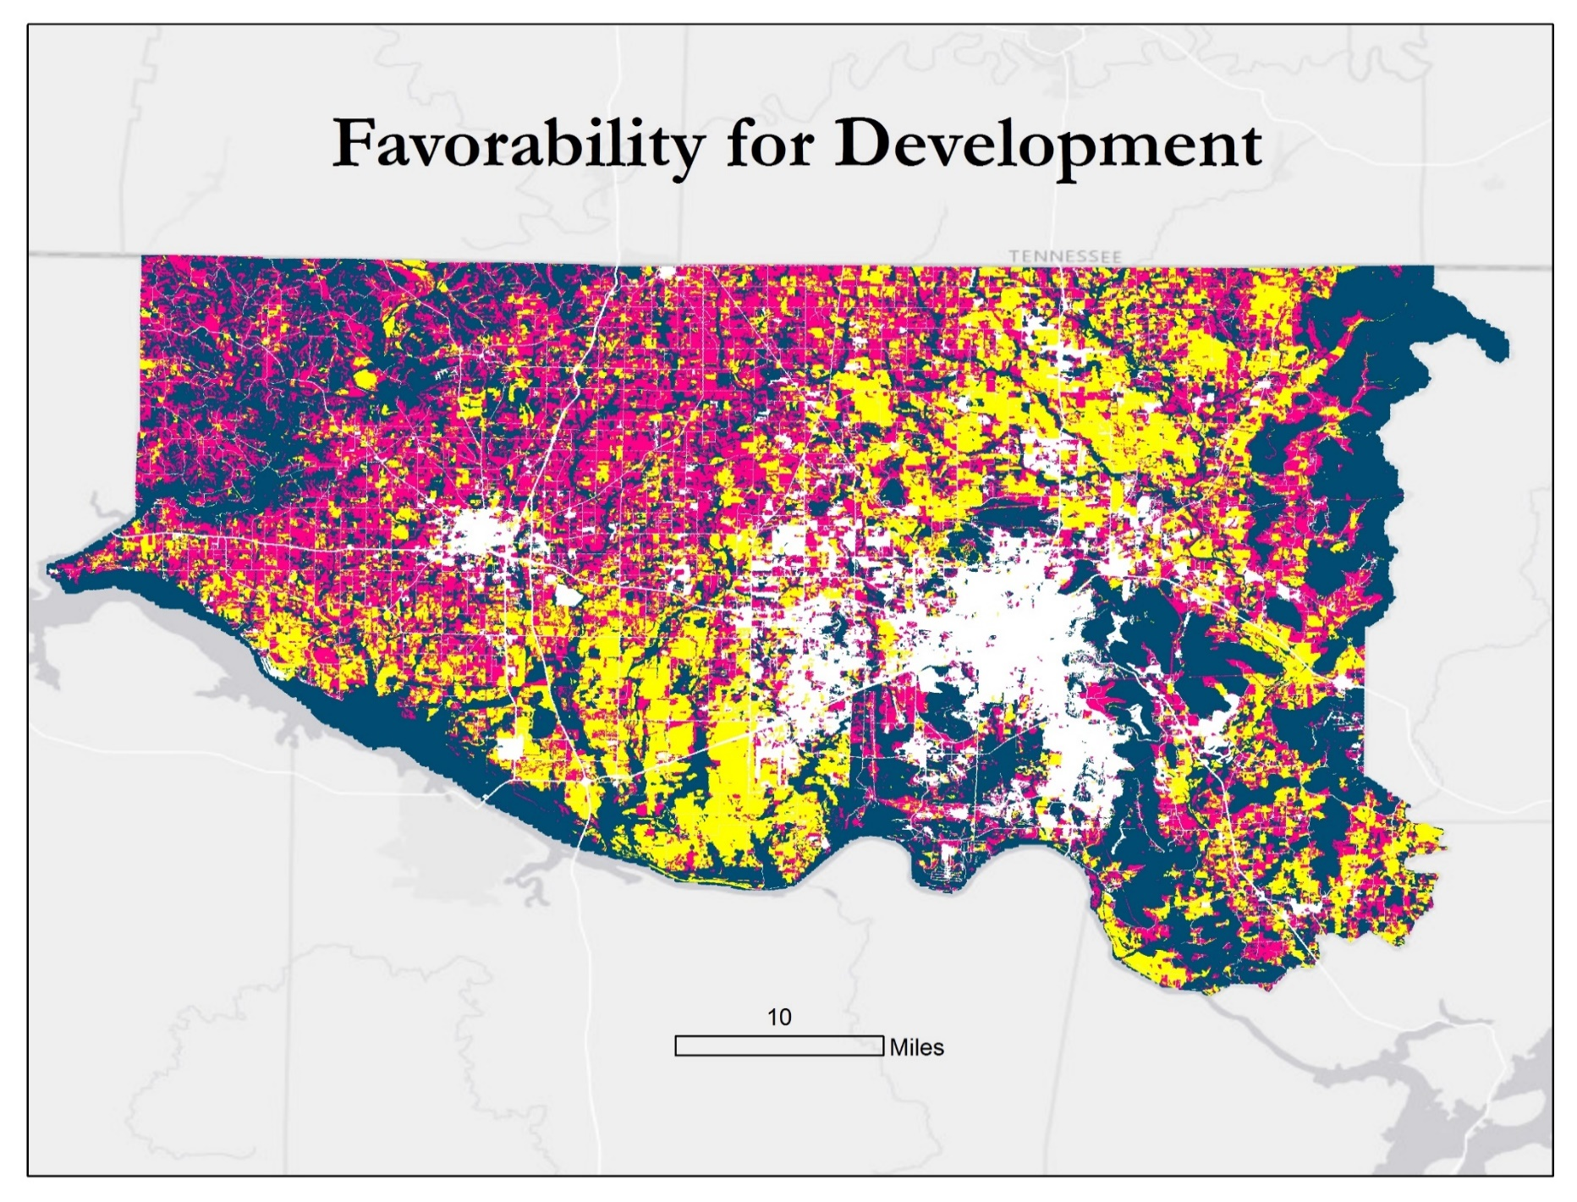
Results
Low
Medium
I
High
Already Developed
Notes:
After assigning memberships, we used the fuzzy overlay tool to create the map shown here. This map shows what areas in the counties are at highest risk for being urbanized. The white area is land that has already been urbanized, the navy blue is low risk area (mostly water and high elevations), pink is medium risk, and the yellow is high risk areas. You’ll notice that the strongest favorable areas are the areas between Decatur and Huntsville and the areas just north of Huntsville. Discussing with the Land Trust we learned some interesting facts associated with pending development in the next few years. The area between Decatur and Huntsville is already zoned and slated for development, and most of that entire area is expected to be developed within the next 10 – 15 years. And the Area north of the city of Huntsville is also slated for development by the company AeroJet.

Slide 12
Results
Assuming a 1% growth rate of the area, all of our high suitability land in Madison and Limestone counties will be urbanized by 2100
By 2045, 25% of the high suitability lands will be urbanized accounting for 20% of the total area of Madison and Limestone Counties
American Black Duck: ~1,700 km² of habitat in high risk areas
Notes:
We calculated growth rate from NLCD and got 1%. We assumed this growth rate for our entire study. At this rate, all of Madison and Limestone counties will be urbanized by 2035. The areas that are considered high risk will be completely urbanized by 2023. The green salamander habitat overlaps with 62,000 m^2 of high risk for development area.

Slide 13
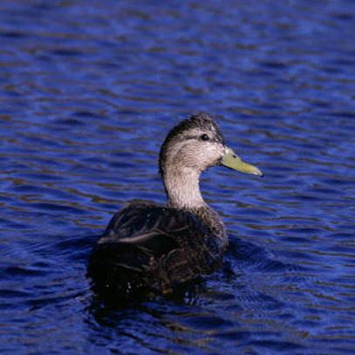
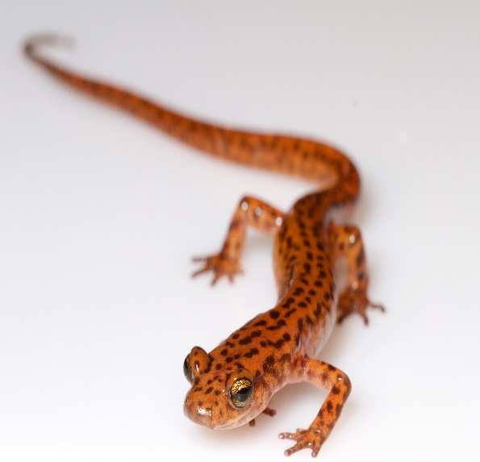
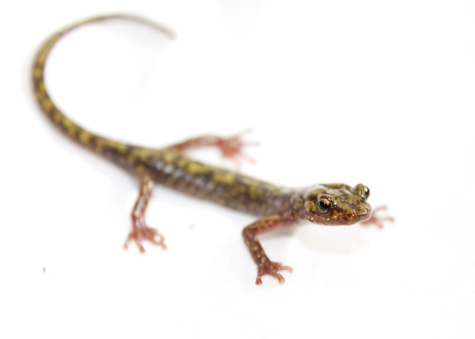
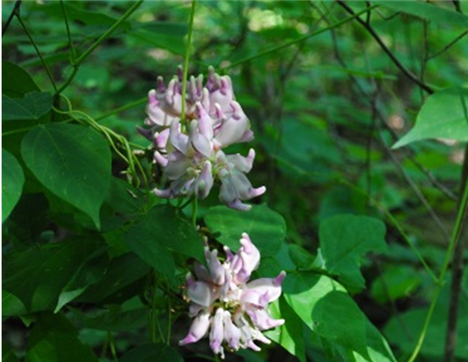
Conclusions
All species studied are expected to be negatively impacted from increased urban development
Conservation efforts are necessary in high risk areas to ensure the protection of these species.
The Land Trust of Alabama can use the tool to study potential impact on any species with point location data
Image Credits: Tom Gotzy, Brian Gratwicke, National Park Service, and U.S. Fish and Wildlife Service
Notes:
The area should start building up instead of out to remain sustainable. Urbanization will affect species’ habitats and measures should be put into place soon to protect high risk areas that are homes to many different species.
Image Credits: https://www.flickr.com/photos/tomg1961/28071285566/in/photolist-JLyFdb-7zi4rx-SjuKzV-dNxyp7-cUKhDw-82sFVj-TjAEob-qTyQYg-9XqtyY-oU4jHW-2GroH-6TG3fk-RauL2M-7q4rqx-6V5qpx-5f5PS7-q6j5vf-BMk1Es-f12fYY-VNN8wB-gBVaVt-8C8QuQ-6kHthr-bDUFmr-nANJSv-TjAEAW-7zmKzW-9XnyD2-6Vb2dR-jgrJL-7zmQbL-6kHvSk-fz2nS5-2U4wwd-nD517B-8C5HX2-eXjewK-a53woF-a53urc-eDwAJJ-qdSPvZ-6QfyPW-qixkoP-owoUaz-e4xDKH-zUJxJK-8boNBC-7kipzy-7kamGj-5Cj3Sm
http://digitalmedia.fws.gov/cdm/ref/collection/natdiglib/id/6091
https://www.nps.gov/articles/long-term-wildland-urban-interface-and-fuels-reduction-project-restores-rare-and-threatened-species-on-national-park-service-land.htm
https://www.flickr.com/photos/19731486@N07/4629815630

Slide 14
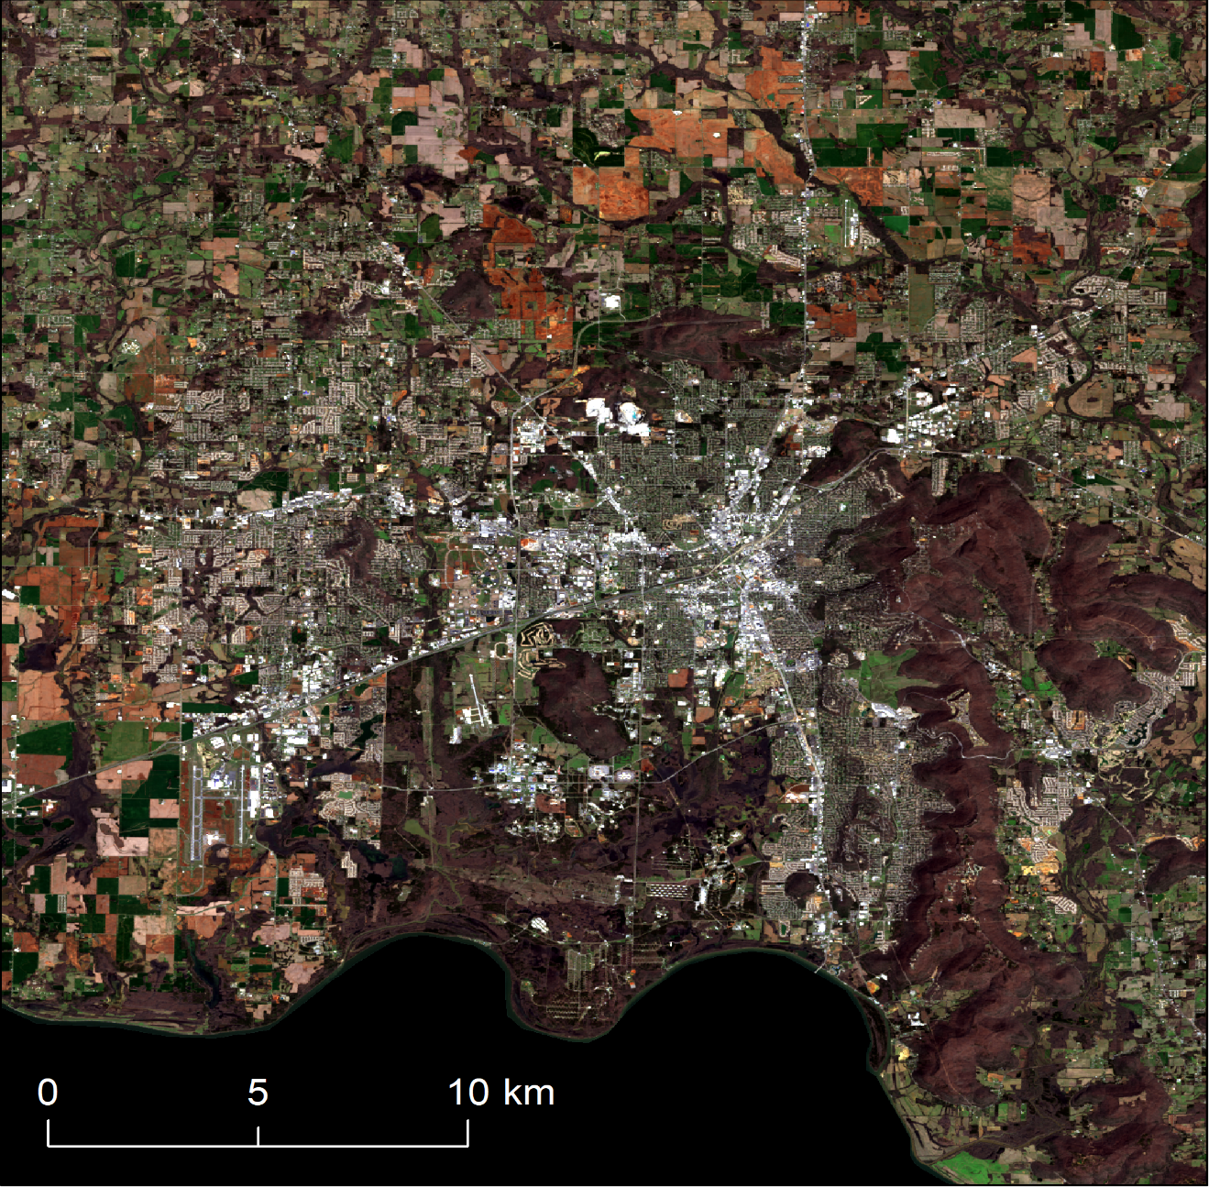
Limitations and Uncertainties
Supervised Classification
Least cloudy image
  Slight variation in dates imagery was taken
Fuzzy Logic Modeling
Species data
  Observation
Growth Rate
  Increase/Decrease
  Vertical Development
I
Notes:
So we used a supervised approach to this project, as far as possible errors, the human factor in generating signature files and training samples for the classifier is certainly there. We tried to counter it by using the National Land Cover Database’s Land Cover Maps as guidelines while drawing our own samples for the project.
For the classification itself, we used the least cloudy image taken for each year in the study period. Most of these images occurring during the early spring/later winter range which was great, but the occasional image occurred over the summer or late fall, and the variations in vegetation during these time frames could have led to the erroneous classification of certain land use types.
Fuzzy Logic Modeling itself has the modeler, placing an importance factor of each variable in the model to determine what the overall impact will be on the system. Again the human component in this approach allows for the possibility of errors. Extensive research on influencing factors for land development was conducted so that the urban growth model could be as accurate as possible.
Lastly our Fragmentation maps, depicting the impact of the urban growth on species in North Alabama is fairly limited to a few species. Ideally we would like to input the point data for a significant number of species to better represent the impact of urban development in North Alabama.

Slide 15

Future Work
Include a hydrological model
Create a more robust land use classification to better map urban areas
Analyze more species in land fragmentation map
Repeat process with Sentinel-2 data
Image Credit: 3DMan_EU
Notes:
Image Credit: https://pixabay.com/en/refugees-economic-migrants-1020268/
The most important feature that we would like to add to this modelling project, is the inclusion of a hydrological model. Most of the endangered/threatened species are aquatic, like snails and clams. The inclusion of the hyrdological model would allows us to better determine the impact development on these species, especially focusing on runoff and water pollution.
Having more accurate land use classification would allow us to better estimate the growth rate of urban development in the study area. This would allow us to assess the potential impacts on species habitats. Additionally having more species point data inserted into the tool would give us a better overall picture of the areas facing the highest risk from urban development.
Using sentinel – 2 data, would provide higher resolution and means to better distinguish land use types. We are assuming that this could give us more accurate analysis of urban growth/sprawl as well as a more accurate measure of the impact on species across north Alabama.
https://pixabay.com/en/refugees-economic-migrants-1020268/

Slide 16
Acknowledgements
Marie Bostick (Executive Director, Land Trust of North Alabama)
Andy Prewett (Land Manager, Land Trust of North Alabama)
Hallie Porter (Development Director, Land Trust of North Alabama)
Dr. Jeffrey Luvall (Science Advisor, NASA Marshall Space Flight Center)
Dr. Robert Griffin (Science Advisor, University of Alabama in Huntsville)
Leigh Sinclair (Mentor, University of Alabama in Huntsville, Information Technology and Systems Center)
Maggi Klug (NASA DEVELOP Center Lead, Alabama – Marshall)
Mercedes Bartkovich (NASA DEVELOP Fellow, Alabama – Marshall)
Dashiell Cruz (NASA DEVELOP, Alabama – Marshall)
Christine Easterwood (U.S. Army Garrison, Redstone Arsenal)
Rebecca John (Auburn University)
Michael Barbour (Alabama Natural Heritage Program, Auburn University)
Andrew Cantrell (Alabama A&M University)

Slide 17
Scientific Names
  Green Salamander
    Aneides aeneus
  Price’s Potato Bean
    Apios priceana
  American Black Duck
    Anas rubripes
  Morefield’s Leatherflower
    Clematis morefieldii
  Northern Slimy Salamander
    Plethodon glutinosus
  Spotted-tail Salamander
    Eurycea lucifuga

