Slide 1
Develop AWS EC2 Jenkins Guide
How to manage your Develop EC2 instance asset for the summer session.

Slide 2
Jenkins is your friend.
Develop is providing an AWS EC2 instance to assist in your learning.
These assets are available for up to 8 hours a day.
There is a hard cut-off of 6PM each night and these instances are only available M-F.
You will be utilizing a Develop job in our Jenkins server to start/stop/check status/reboot your EC2 instance for the duration of this summer session.
Your fellowship project leads can request adjustments to your EC2 instance hours/days of operation. This is a case-by-case basis.

Slide 3
Jenkins How-To
Jenkins Server URL: https://ec2-54-175-190-227.compute-1.amazonaws.com:8443/login?from=%2F
You should have been provided with a Develop login/password. You will use this login/password for accessing Develop Jenkins, EC2 instances, AWS WorkDocs and Develop AWS SFX share.
On the following screens, I will walk you through login, selecting Develop Jenkins job and starting/status/stopping of your EC2 instance.
Onward to the login splash page be entering the URL above.

Slide 4
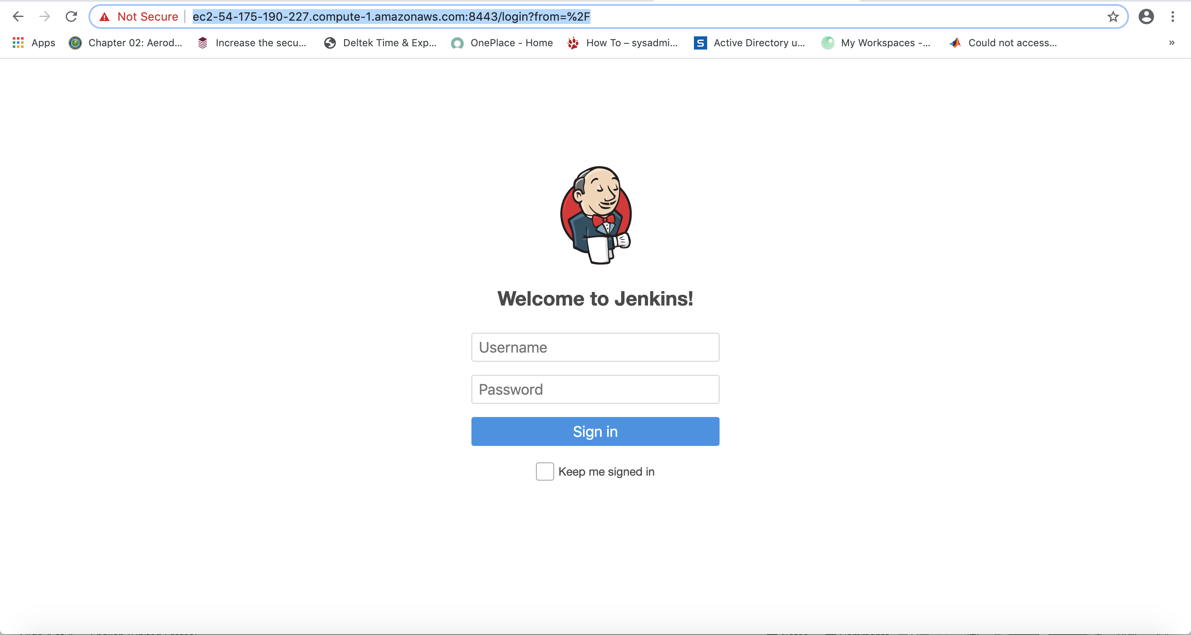
Jenkins Login Splash Page

Slide 5
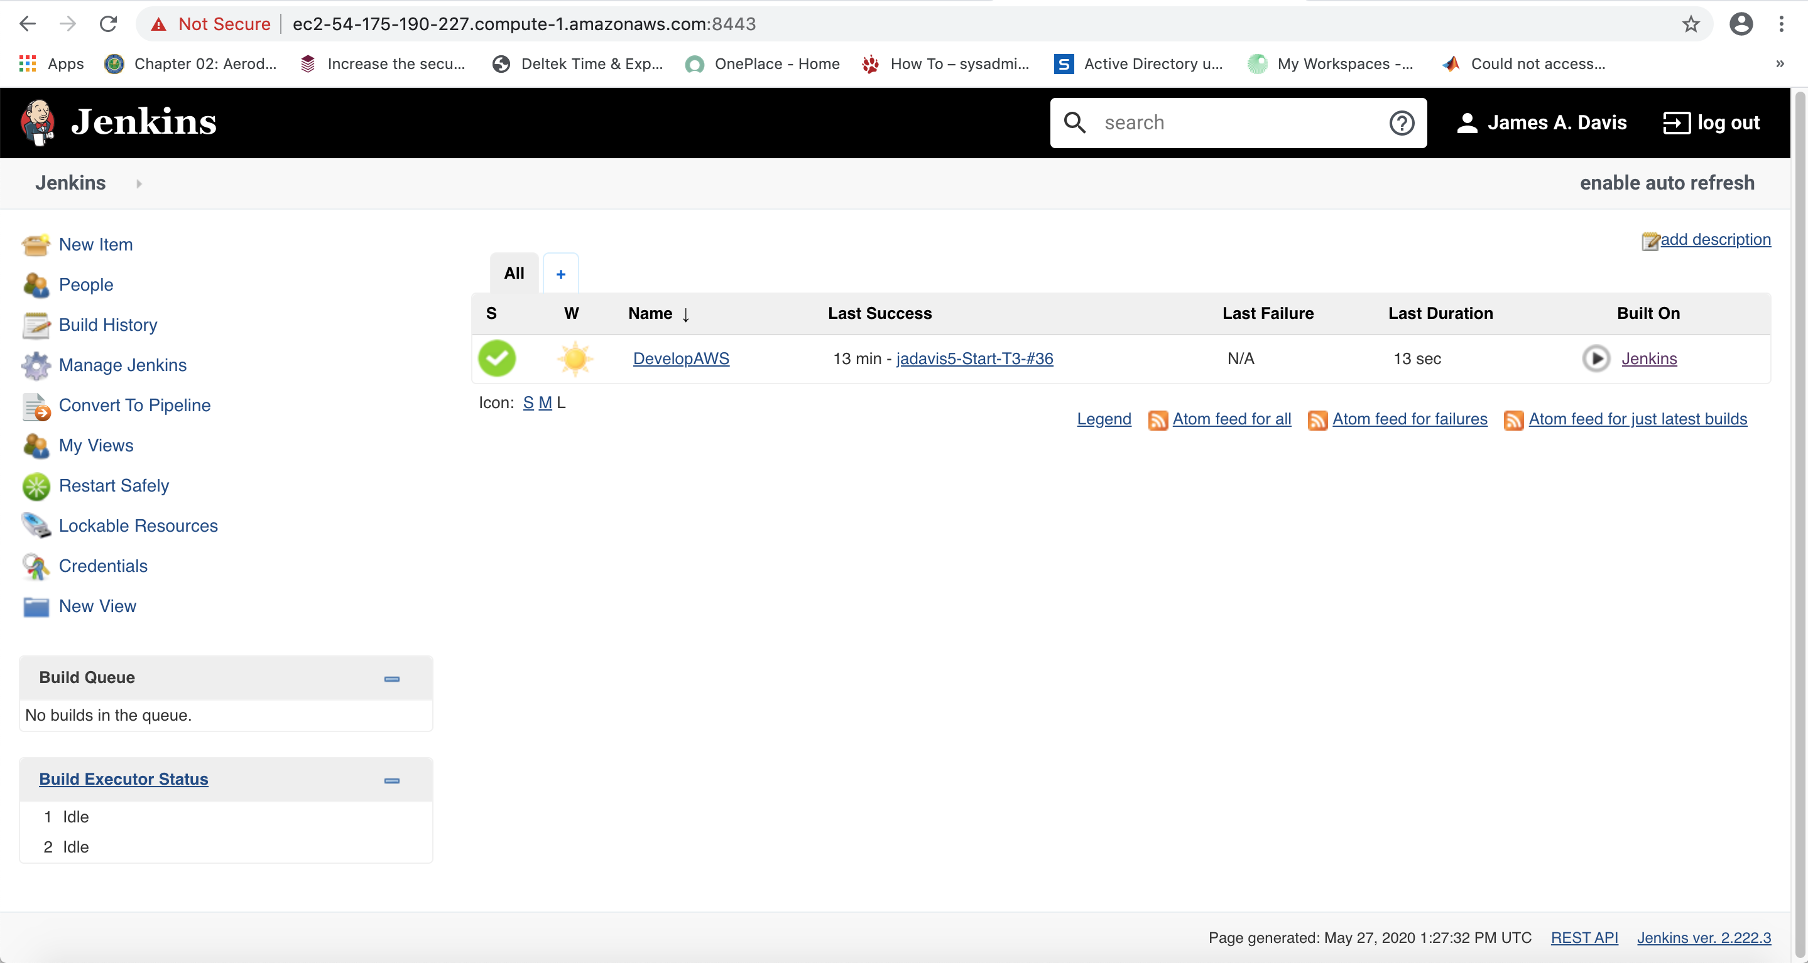
Jenkins Desktop

Slide 6
Launch the DevelopAWS Job
Click on the DevelopAWS (circled in red in the previous picture).
This will take you to the DevelopAWS job splash page.
From this page you can see status of previous jobs, edit build parameters for your own job.
Click on Build with Parameters selection in the left hand panel.

Slide 7
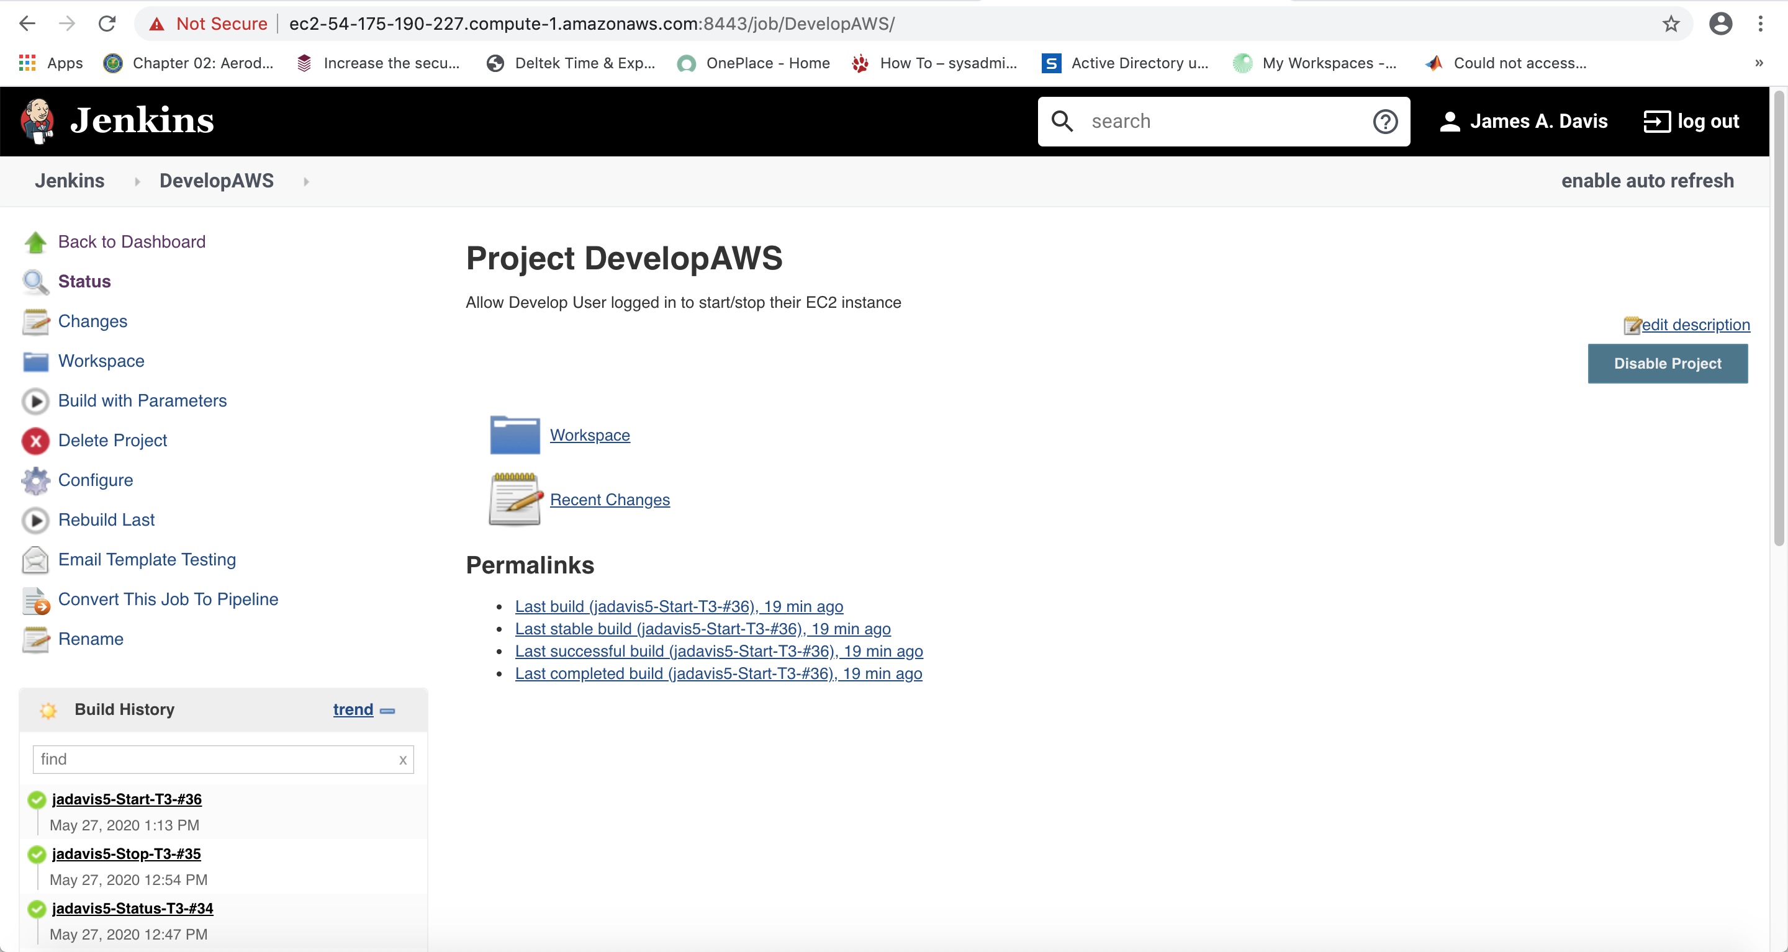
Build with Parameters

Slide 8
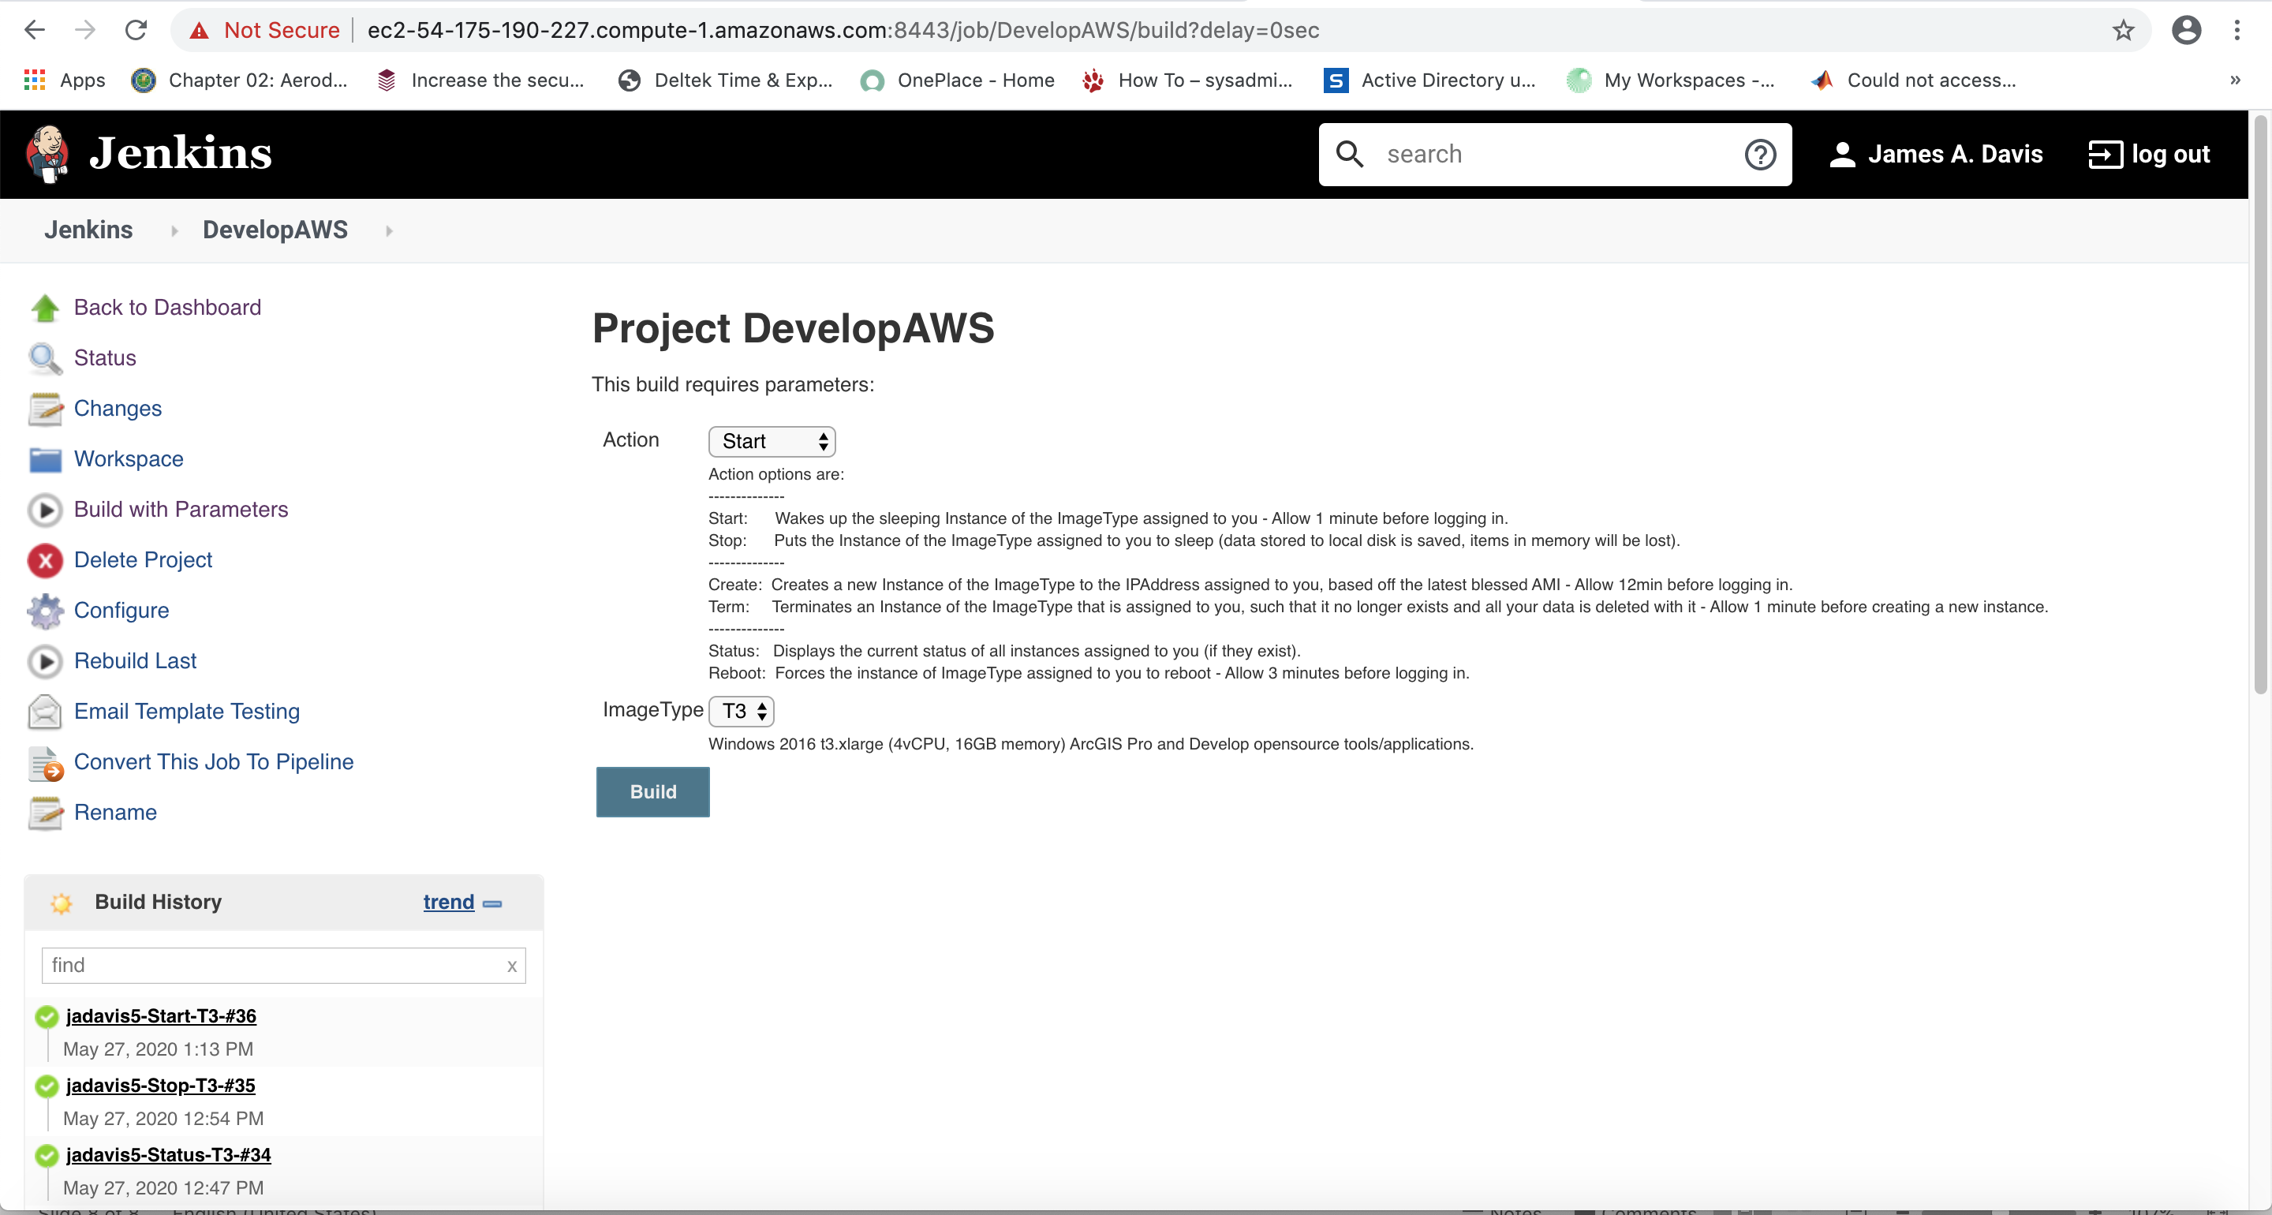
Build with Parameters

Slide 9
Build with Parameters
By default the DevelopAWS build parameters are set to Start.
Your EC2 instances have already been created and are in a Stopped state.
To start your EC2 instance, all you have to do is click on the Build button (hightlighted in red in previous image).
Click Build.

Slide 10
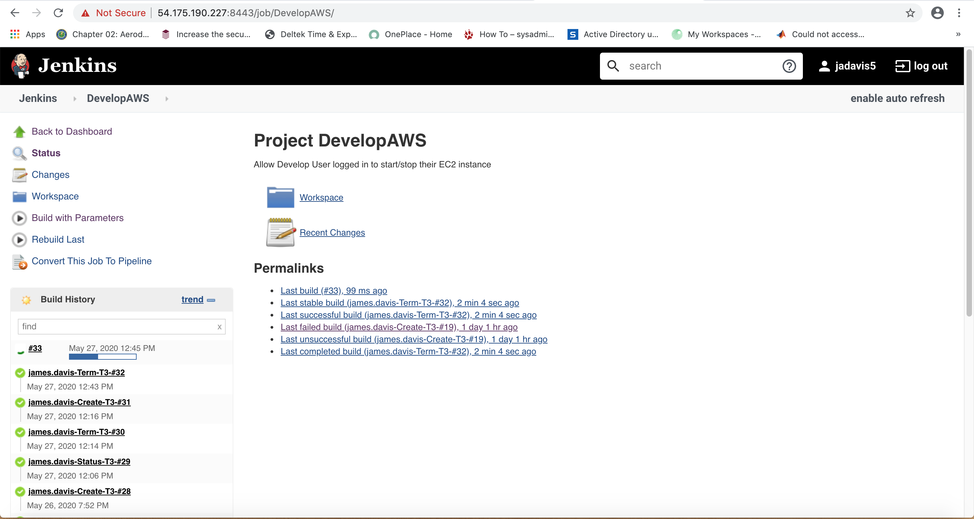
Accessing the console to check status

Slide 11
Entering the console to view logs
In the previous image, you will see your job on the left hand pane.
Your job will always be the first in the list.
You have two options to access the console log.
1. when you job is running, you can click on the progress bar in the left hand pane and it will take you to the console log.
2. If you waited to long or clicked on the title above the progress bar, it will take you to your job’s splash page. From this page you are given a console output link in the left hand pane as depicted in the next image.

Slide 12
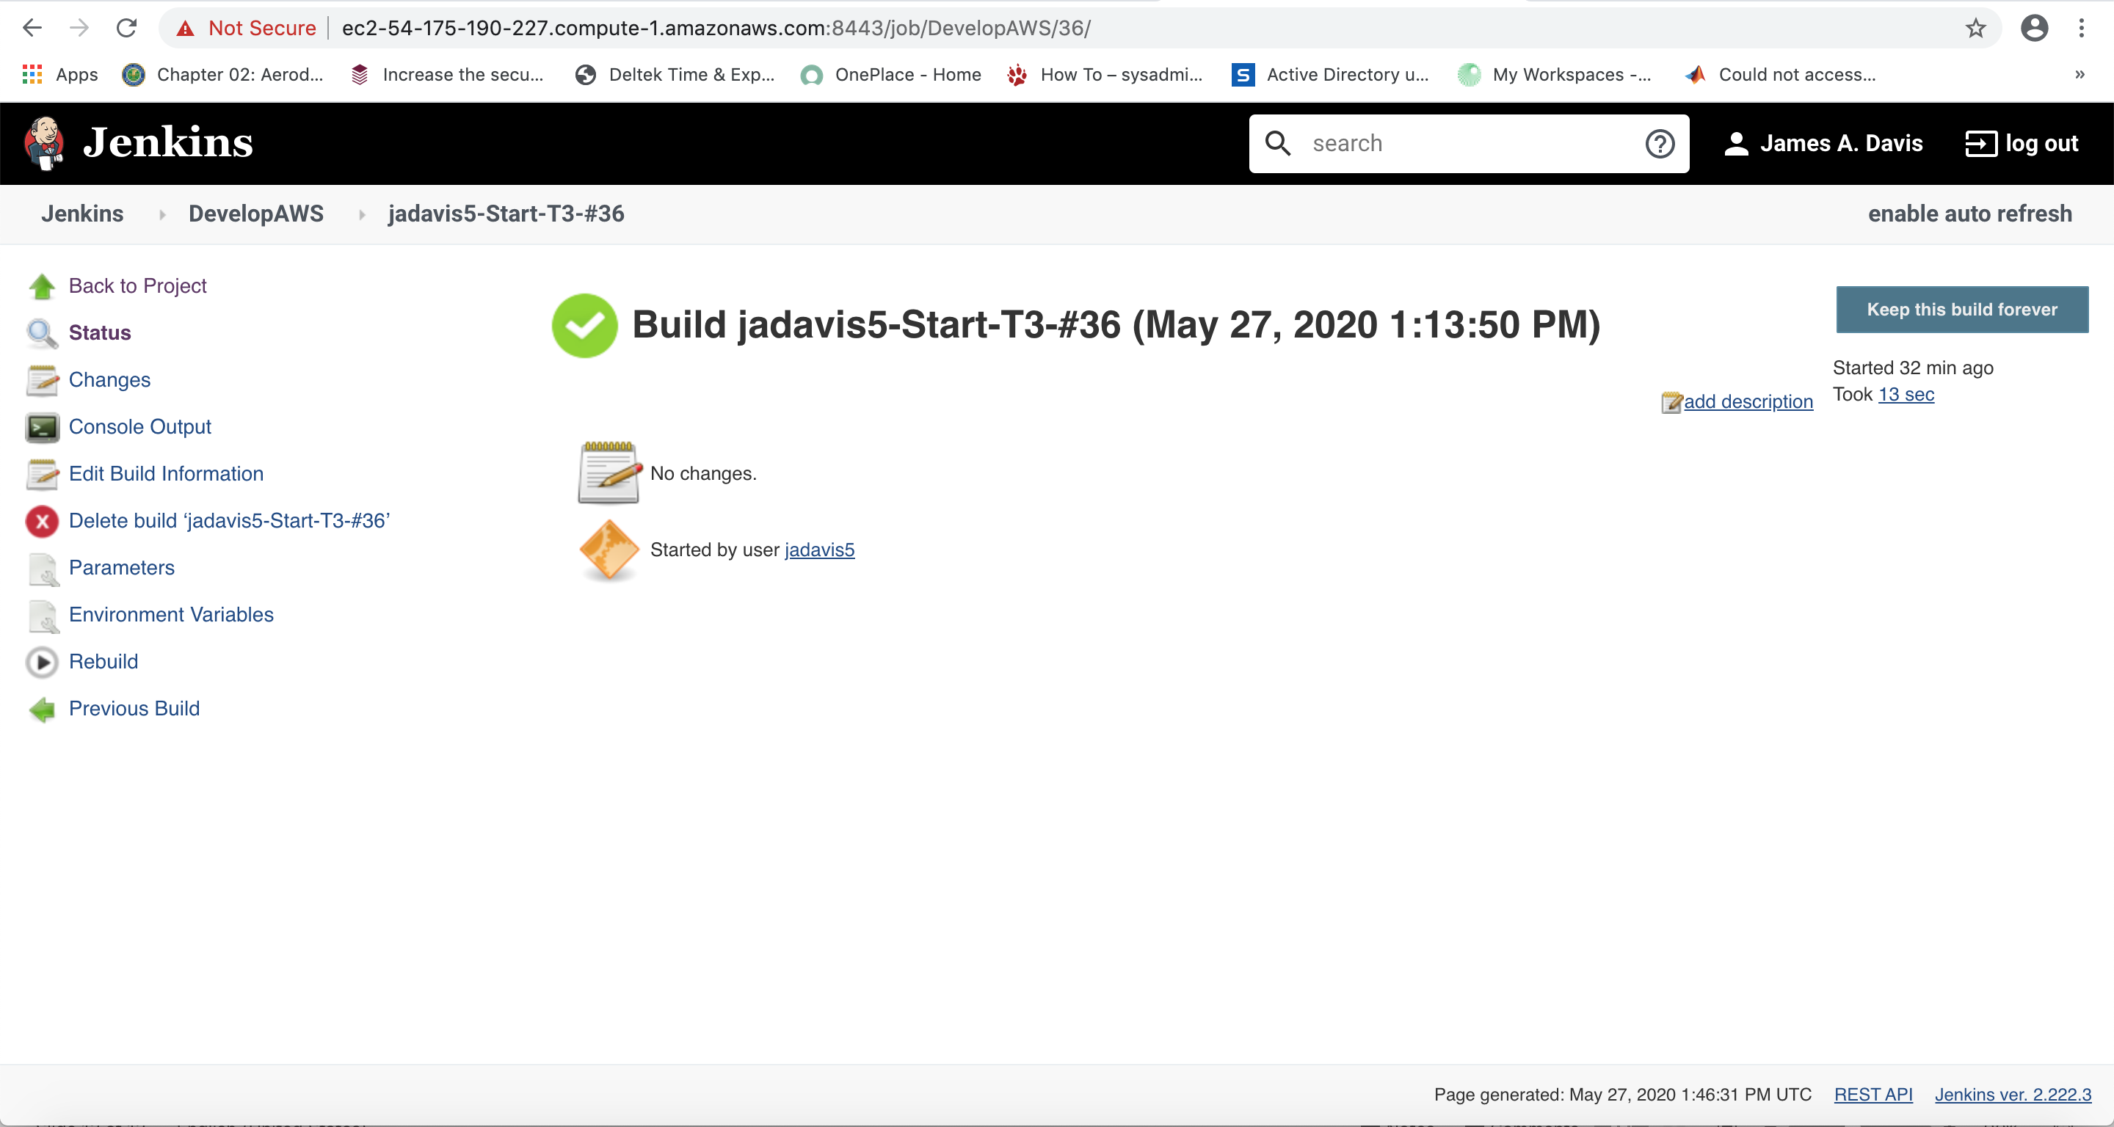
Jenkins Job Splash Page

Slide 13
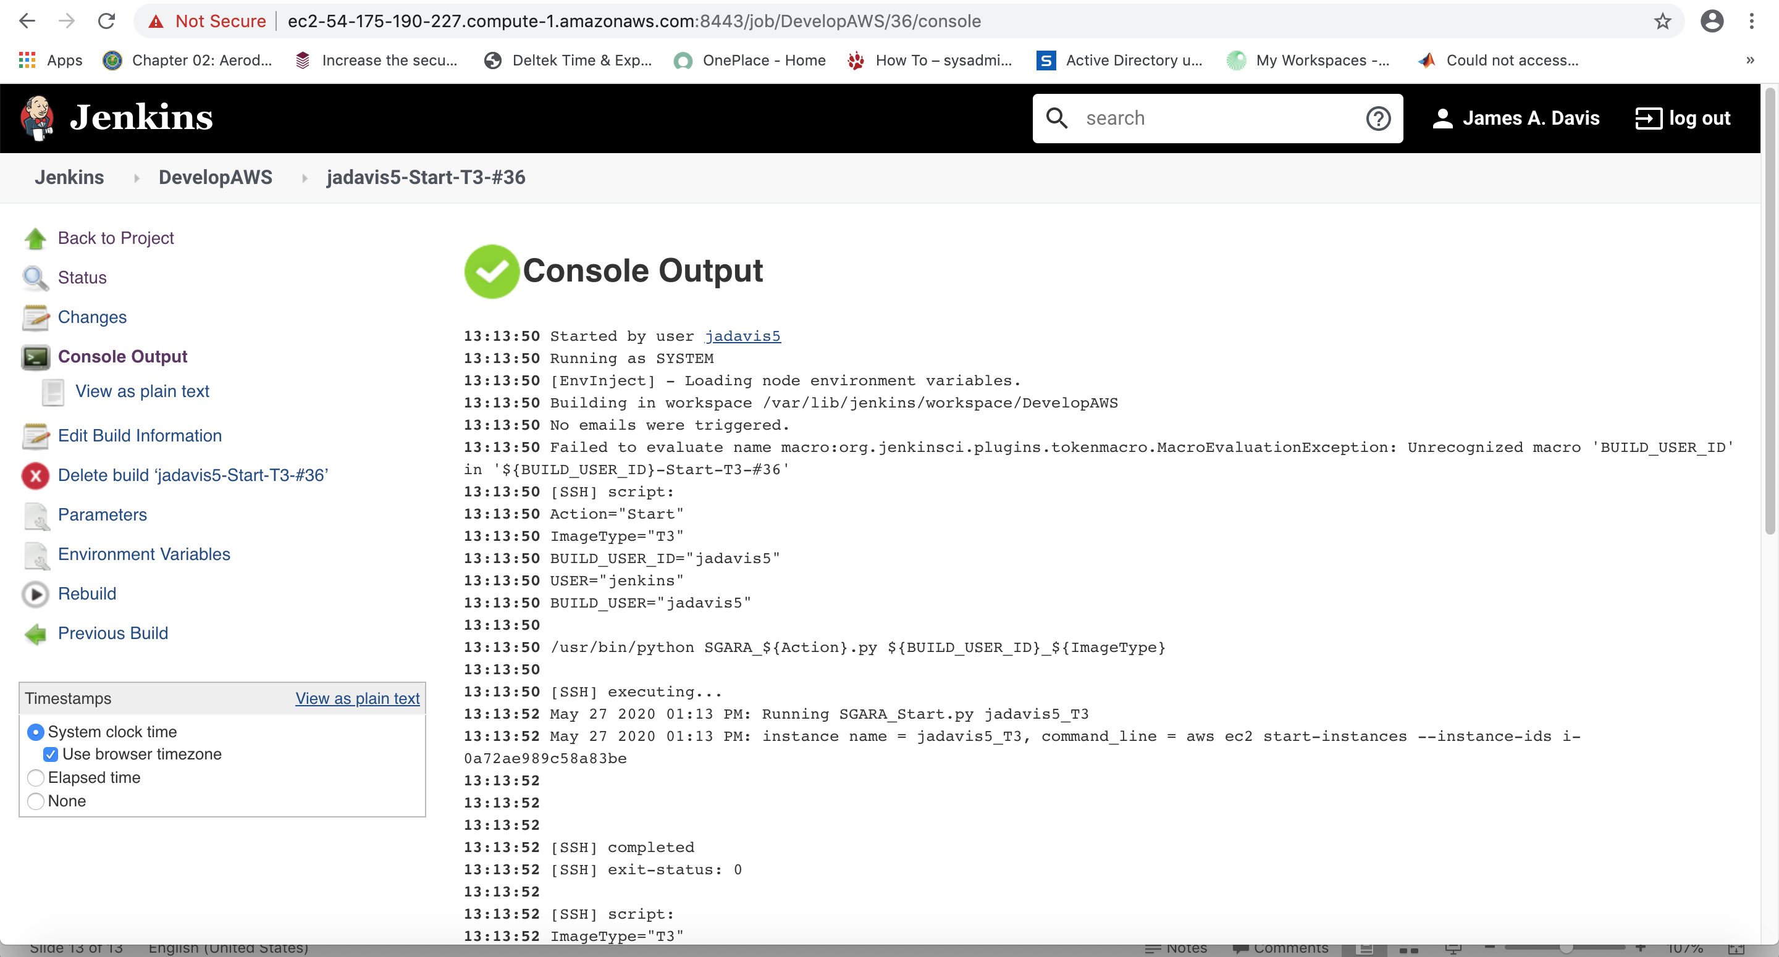
Console Output

Slide 14
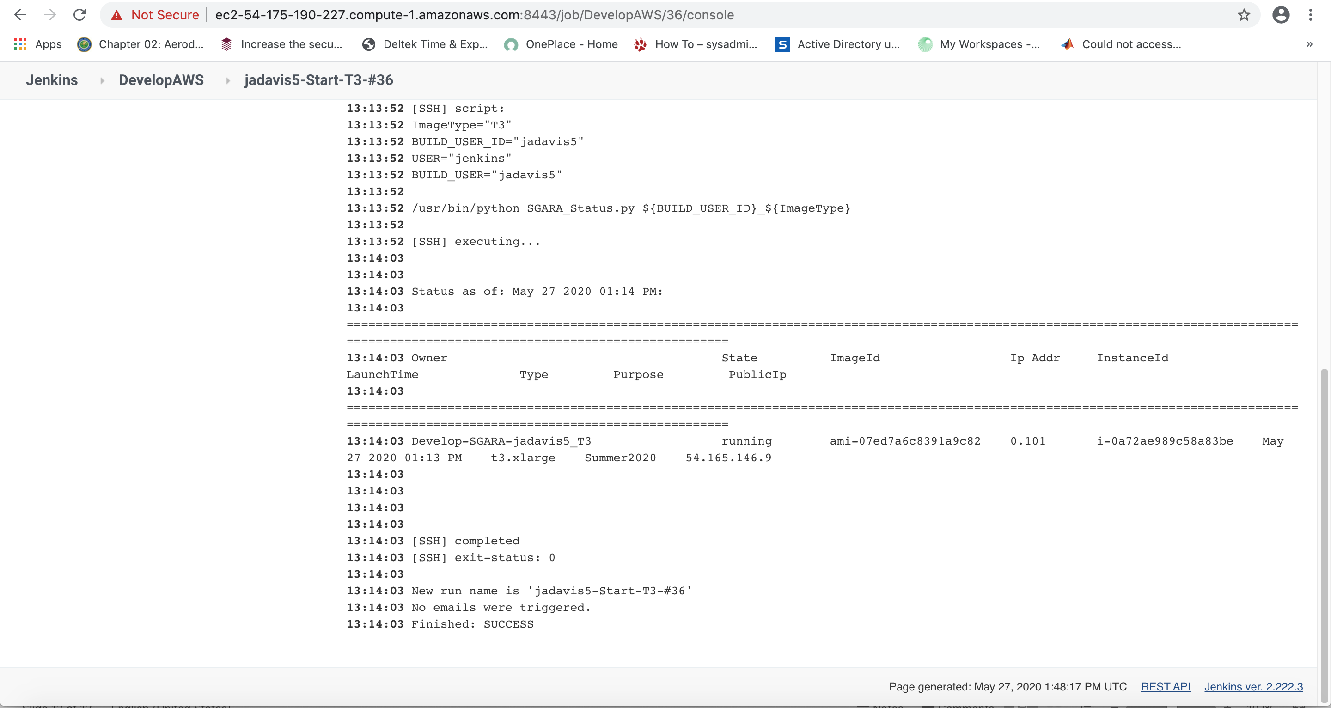
Console Output

Slide 15
Things to note in the Console Output Log
1. Whether your job was successful or failed.
2. If it failed any error messages that appear in the console output log.
3. For a successful job, the bottom part of the console output log includes the important information you need to connect to your instance it just started.
Look for the entry like this:
Develop-SGARA-jadavis5_T3 running ami-07ed7a6c8391a9c82 0.101 i-0a72ae989c58a83be May 27 2020 01:13 PM t3.xlarge Summer2020 54.165.146.9
The IP address on the end of the entry is the public IP address of your EC2 instance. You will need this IP address in order to Remote Desktop into your EC2 instance.

Slide 16
Return to Jenkin Home
In the upper left corner of the left pane of any Jenkins page, you will see Jenkins spelled out.
Click this link to return the the Jenkins Home Page.
Always reset to the home page when you have completed a job.
All of the instructions will assume you are starting out on the Jenkins starting splash page.
Click Jenkins now before we go through the steps to stop your EC2 instance.

Slide 17
What Stop your EC2 instance?
Although, AWS automation will stop your instance at 6PM at night, why should you stop your instance before that.
EC2 instances are charged by the hour. To keep our operational cost down, we ask that you shut down your EC2 instance when you are not using it for an hour or more.
You have two options to stop your instances:
1. From your remote desktop session into your EC2 instance, you can simply select Shutdown from the Window start menu.
2. Use Jenkins DevelopAWS job to stop your EC2 instance.
Always save any work prior to stopping your EC2 instance.

Slide 18
Use Jenkins, click on the DevelopAWS job.

Slide 19
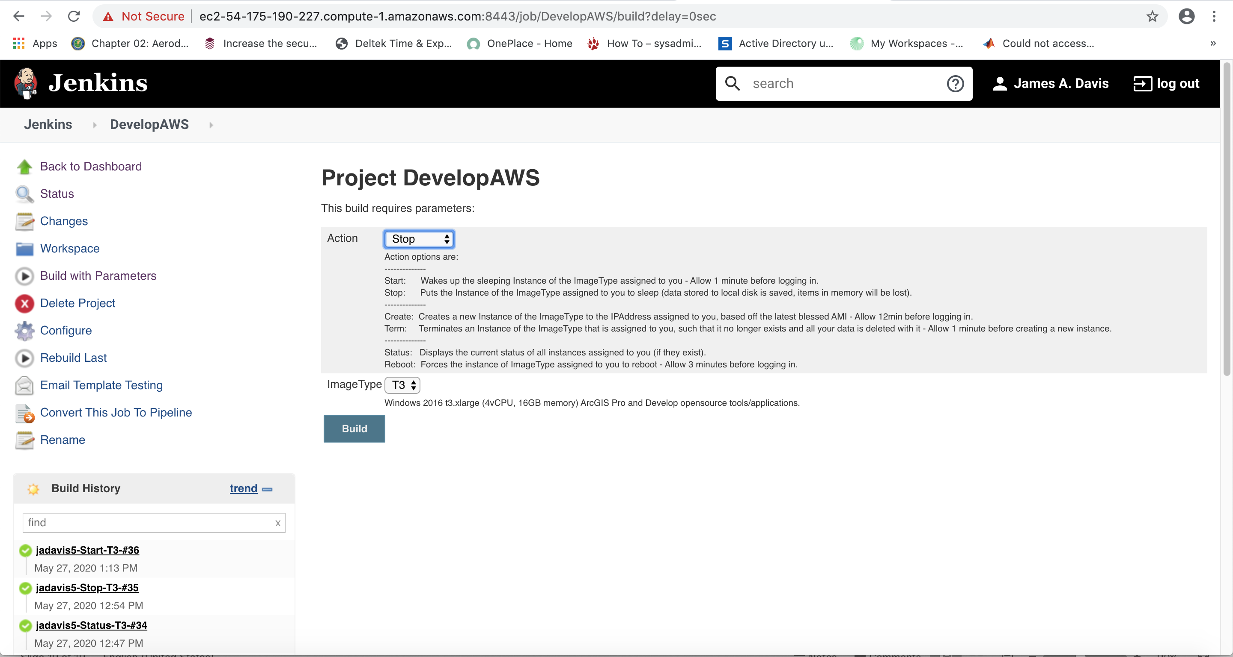
Click on Build with Parameters, Select Stop from Action Drop Down Menu, then click Build.

Slide 20
Entering the console to view logs
In the previous image, you will see your job on the left hand pane.
Your job will always be the first in the list.
You have two options to access the console log.
1. when you job is running, you can click on the progress bar in the left hand pane and it will take you to the console log.
2. If you waited to long or clicked on the title above the progress bar, it will take you to your job’s splash page. From this page you are given a console output link in the left hand pane as depicted in the next image.

Slide 21
Jenkins Job Splash Page

Slide 22
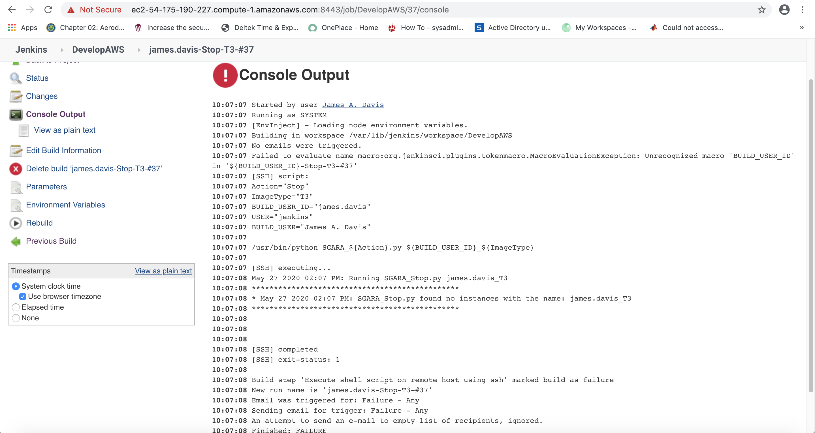
Console Output Log example of running a stop job when your instance is not running.

Slide 23
Checking status of your instance
You can repeat the steps for starting/stopping and select Status from the Action drob down menu to get console log output with the state of your EC2 instance.
Is it running?
Is it stopped?
What is it’s public IPv4 Address?

