Slide 1
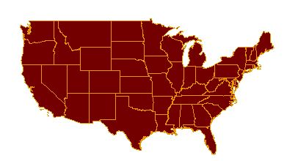
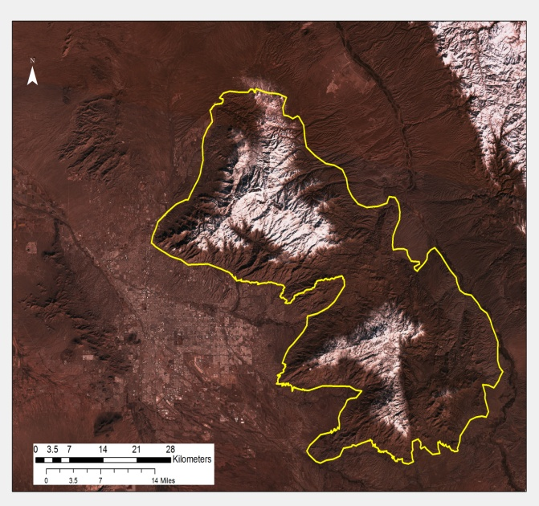
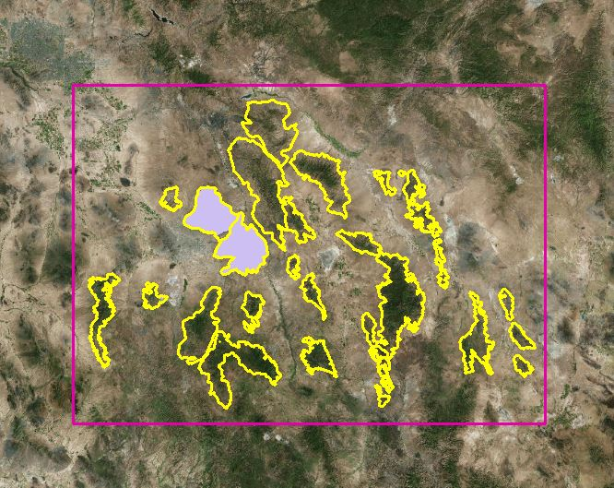
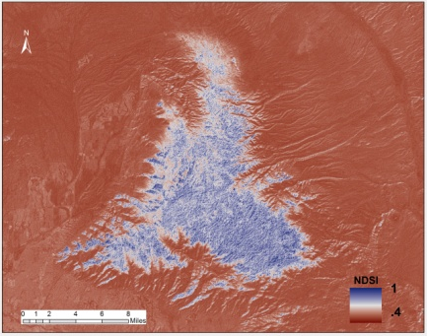
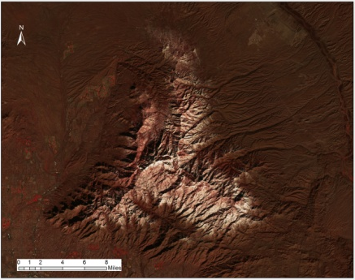
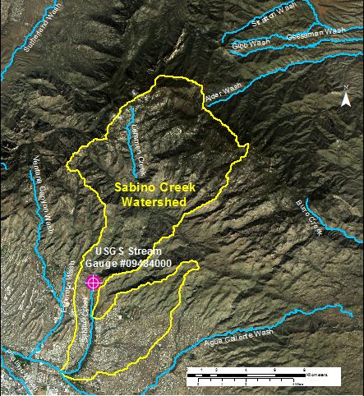
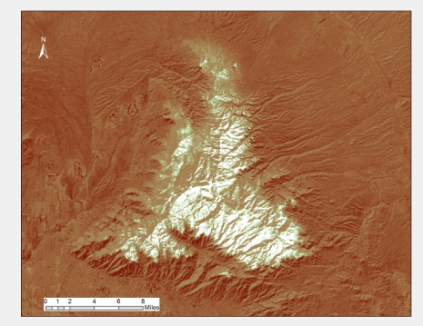
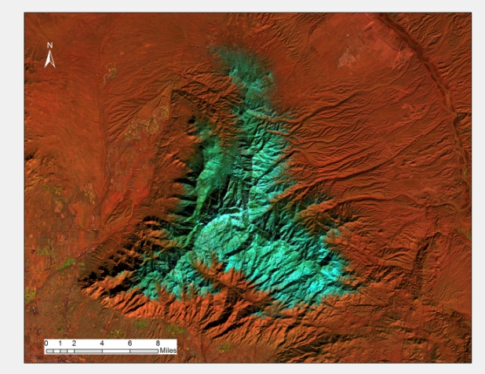
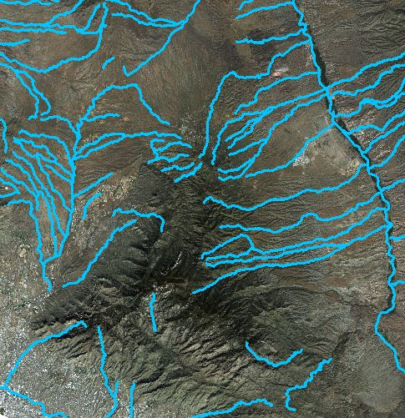
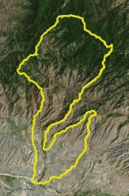
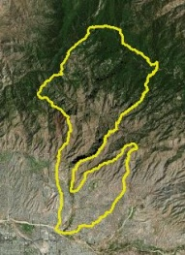
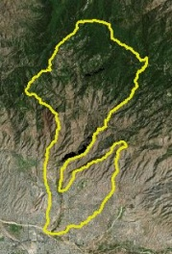
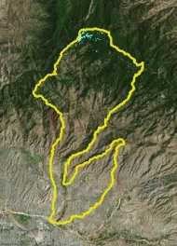
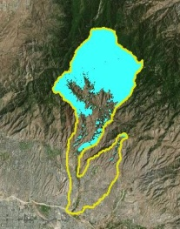
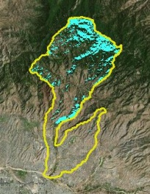
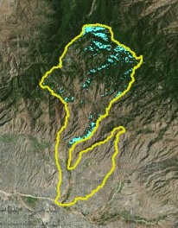
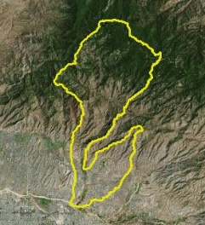
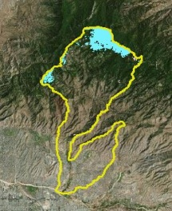
Using NASA Earth Observations to Assist the National Park Service in Assessing Snow Cover Distribution and Persistence Changes in the Sky Islands
Abstract
Study Area
Southeastern Arizona is home to unique mountain ranges known as the Sky Islands. Sky islands are biodiversity hotspots and host various ecosystems, ranging from arid deserts to temperate forests. These mountain ecosystems rely on slow melting snowpack to sustain themselves during dry periods. However, climate change and its contribution to decreasing snow cover is of growing concern. Currently, the National Park Service (NPS) monitors water presence, but a synoptic record of snow presence does not exist due to the remote and rugged topography of the region. As a result, it is difficult to study how climate change has affected water resources in the Sky Islands and what effect this has on wildlife and vegetation. This project used NASA Earth observations such as Landsat data to aid the NPS in understanding the role of snow cover in the Arizona Sky Islands. Historical snow cover maps were created to address the current gap in information regarding snow presence. With a more complete understanding of the impact of snow cover, the NPS will be able to analyze past snow cover changes to improve future land management decisions.
Santa Catalina Mountain
Objectives
Figure1: Sky Islands of Southeastern Arizona
Figure 2: Area of Interest (True Color Composite)
Create an overall assessment of snow cover distribution in Rincon and Santa Catalina mountain ranges, using NASA Earth observations (Landsat) data
Assess and identify watersheds experiencing higher loss of snowpack with remote sensing products and supplement with stream gauge and pool data provided by the NPS
Earth Observations & Study Period
Landsat 5 TM (1985-2011)
Landsat 7 ETM+ (2011-2013)
Landsat 8 OLI
(2013-present)
Sentinel -2A
(2015 - present)
1985
2017
Methodology and Results
Data Acquisition
Data Processing
Data Analysis
a
b
Landsat 5 (TM )
Landsat 7 (ETM+)
Landsat 8 (OLI)
NDSI and S3 Index
Snow cover Distribution
c
d
NDSI and S3 Index
Southeastern Arizona Water Resources II
SENTINEL-2
Snow cover Distribution
Figure 3: (a) Landsat 8 OLI NDSI imagery, (b) True color composites, (c) S3 index, (d) False color composites
Figure 4: Landsat 8 true color image of the Sabino Creek watershed and the location of the USGS stream gauge
USGS Stream Gauge Data
Historical and Current Stream Discharge and Stream Flow
NDSI = Normalized Difference Snow Index
Conclusions
Figure 5: Monthly average stream discharge (Ft³/sec) and snow cover distribution(%)for Sabino Creek watershed
Snow cover distributions (%) were compared with stream discharge data in Sabino Creek watershed for 2015-2016 snow season in order to assess the effect of snow on water resources.
Percent snow cover distribution shows fluctuations throughout the season with peak accumulation (50%) occurring in January 11, 2016 and the greatest average monthly stream flow occurred in January 2016 when 21.23 Ft³/sec were recorded.
Monthly average stream discharge increased from December to January, indicating possible influence of snow melt on stream flow.
Landsat snow cover distribution maps provided useful information on snowpack phenology; however, some issues with satellite data (e.g., clouds and shadow) were encountered.
Figure 6: Min/Max stream discharge (Ft³/sec) for Sabino creek watershed
10/23/2015
11/08/2015
12/10/2015
12/26/2015
01/11/2016
Project Partners
01/27/2016
02/12/2015
02/28/2015
03/15/2016
03/31/2016
Snow Cover Distribution (%)
National Park Service (NPS), Intermountain Region and Saguaro National Park
Figure 7. Landsat 8 time series snow cover distribution (%) for Sabino Creek Watershed for 2015-2016 snow season
Team Members
Acknowledgements
Bernard Eichold, M.D., Dr. PH (Mobile County Health Department)
Joseph Spruce (NASA Langley Research Center)
Kenton Ross, PhD (NASA Langley Research Center)
Colleen Filippone (NPS) and Don Swann (NPS)
Previous contributors: Farnaz Bayat and Katie Harville.
Charles Barrow
Saranee Dutta
Elaina Gonsoroski
Tyler Lynn (POC)
Mobile County Health Department– Spring 2017

