Slide 1
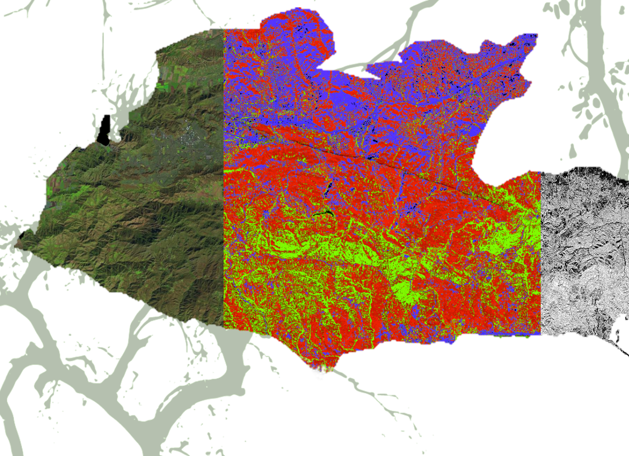
Natalie Queally (Project Lead)
SANTA MONICA MOUNTAINS CLIMATE
Emil Chang
Nick Rousseau
Using NASA Earth Observations to Determine the Extent of Drought-Related Dieback in Oak Woodlands within the Santa Monica Mountains
NASA Jet Propulsion Laboratory, Pasadena, CA
2017 Spring

Slide 2
Community Concerns
Oak woodlands and other biologically important plant communities in the Santa Monica Mountains (SMM) have experienced dieback during the recent drought
Adverse effects of oak loss include:
Loss of ecosystem services
Decreased real estate value, recreation use, and aesthetic appeal
Negative effect on associated species
Image Source: Emil Chang
Notes:
The Santa Monica Mountains represent the largest, most pristine, and ecologically complex example of a Mediterranean ecosystem in coastal southern California. The mountains support several important plant communities including chaparral, coastal sage scrub, and oak woodland, and hundreds of native vertebrates. Although years of low rainfall and extended drought are common, the recent drought in particular has caused noticeable dieback in the oak woodlands. These woodlands hold high use and nonuse values, and a typical mature oak within one of these woodlands can be valued up to $100,000 due to its contributions to real estate value, recreation use, aesthetic appeal, and ecosystem services.
Image Source: Emil Chang

Slide 3
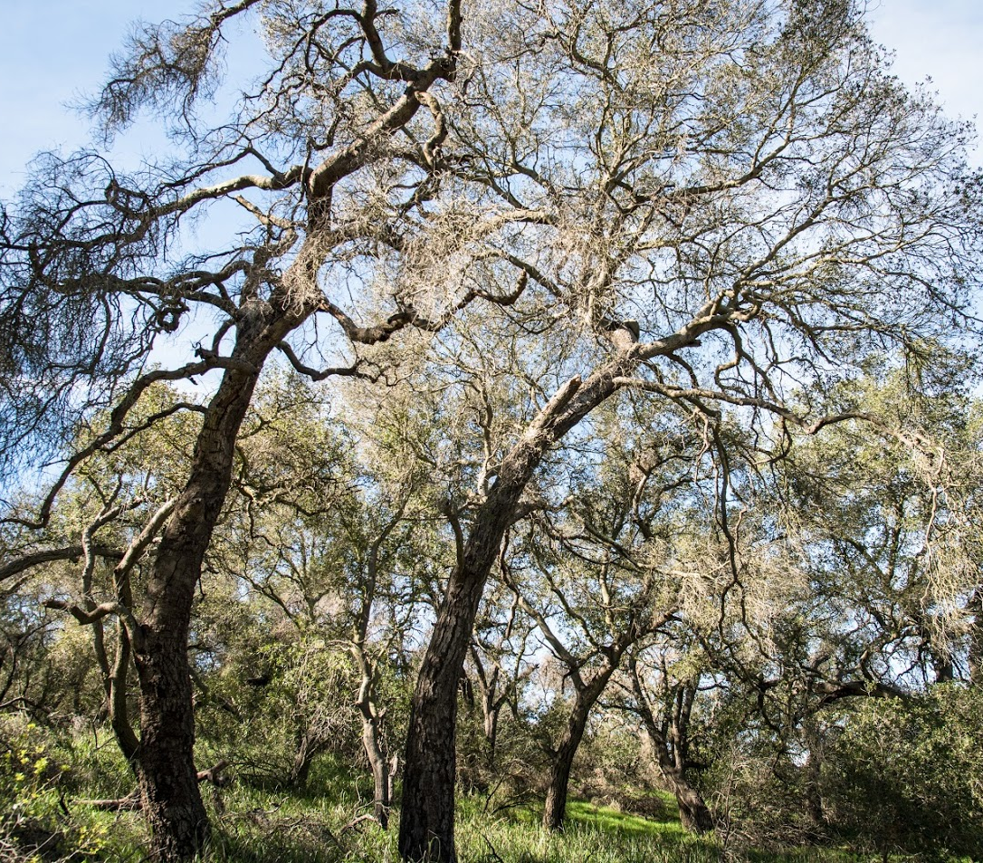
Objectives
Map annual changes in fractional cover of green vegetation, nonphotosynthetic vegetation, and substrate
Identify high-risk areas for vegetation dieback within study area
Provide better understanding to project partners of spatial dynamics of oak woodland dieback
Image Source: Emil Chang
Image Credit: Monet
Notes:
Objectives:
Map annual changes in GV:NPV:S using spectral unmixing on AVIRIS and RVI on UAVSAR.
Identify high-risk areas for vegetation dieback within study area by calculating annual change in fraction of alive vegetation cover.
Provide better understand of spatial dynamics of dieback by identifying spatial relationships between high-risk areas and climatic variables.
Image source: Emil Chang

Slide 4
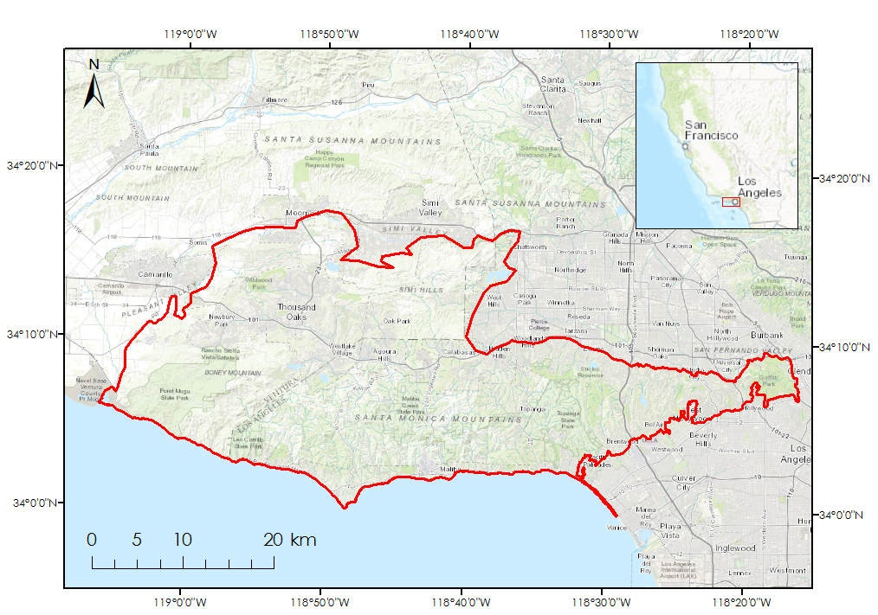
Study Area & Time Period
Ecological Monitoring Zone in SMM used by Resource Conservation District of SMM and NPS
Time period: 2010 - 2016
Study Area
Notes:
The study area encompasses the Santa Monica Mountains and the neighboring Simi Hills. The Santa Monica Mountains National Recreation Area is marked in blue and the broader ecological monitoring area including Simi Hills is marked in red. This area contains considerable oak woodland cover.
The study period begins in 2010, before the severe drought began, and ends in 2016, right before the recent winter storms of early 2017. Annual precipitation shown in inches in the plot. Data taken from a 4km quadrant from PRISM at coordinates listed.

Slide 5
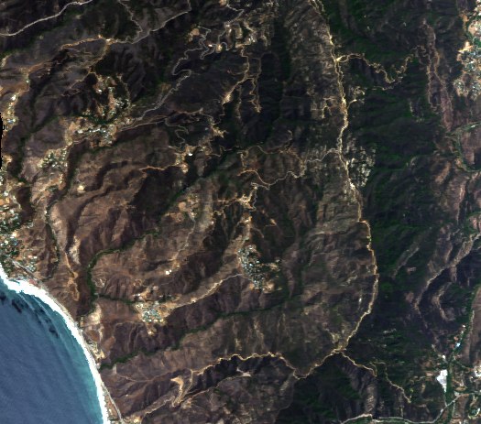
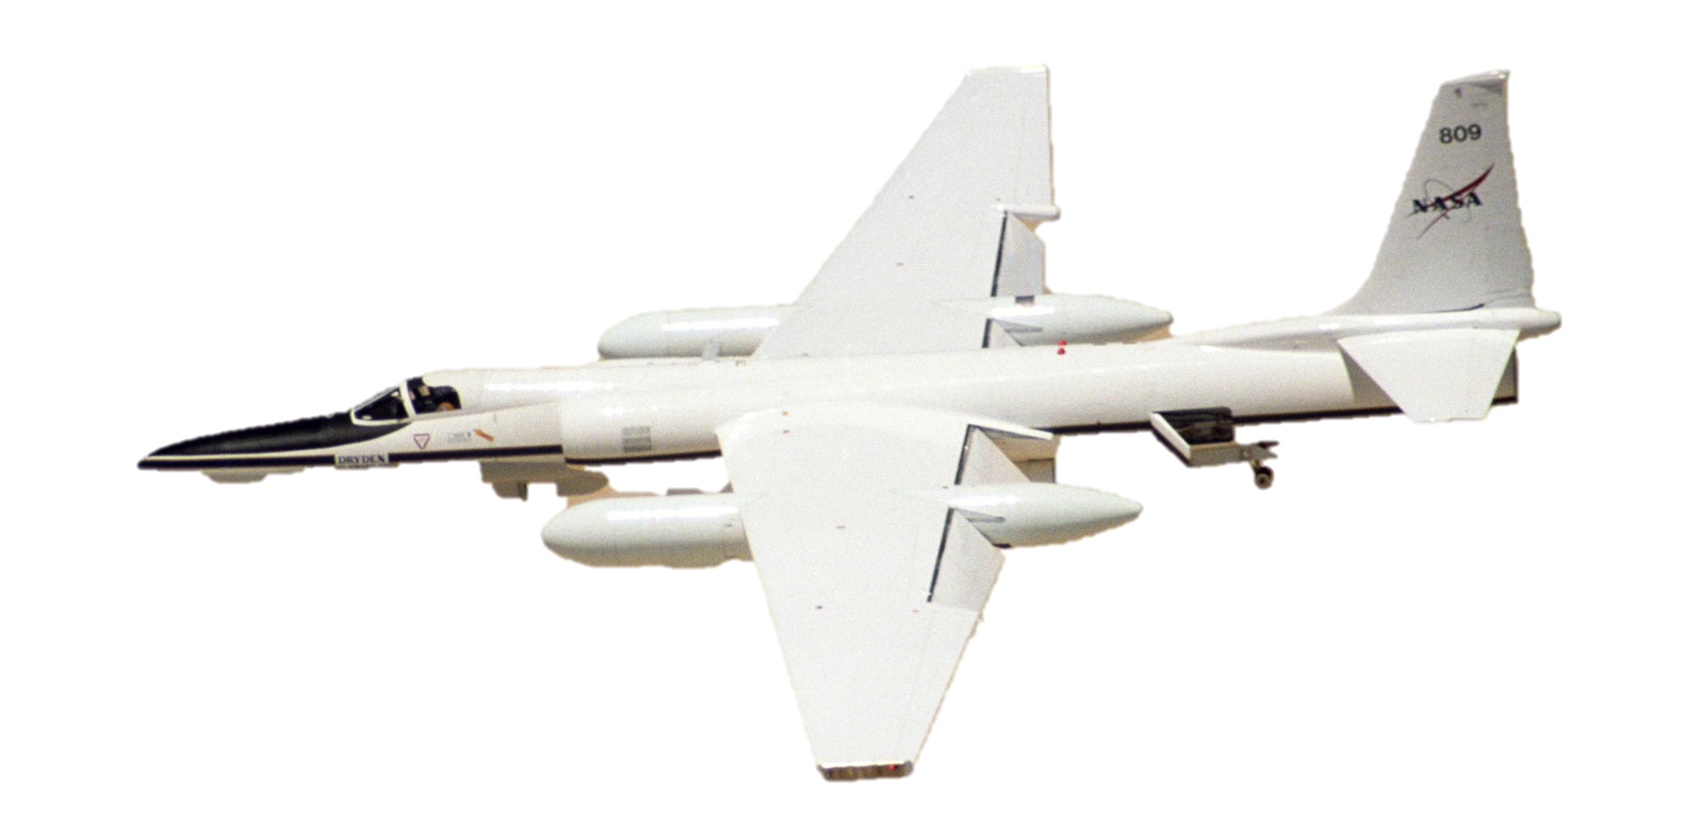
NASA Earth Observations
UAVSAR – flown on Gulfstream III
AVIRIS – flown on ER-2
Image Credit: NASA
Image Credit: Monet
Notes:
UAVSAR = Uninhabited Aerial Vehicle Synthetic Aperture Radar
An airborne radar used to study earth science
AVIRIS = Airborne Visible / Infrared Imaging Spectrometer
An optical sensor that has 224 spectral channels, largely used to study the global environment and climate change
Gulfstream Image Source: https://www.nasa.gov/topics/earth/features/haiti20100205.html
ER-2 Image Source: https://www.nasa.gov/sites/default/files/images/256052main_EC01-0232-6_full.jpg

Slide 6
Methodology - UAVSAR
Clip to study area
Calculate RVI w/Band
Math
Apply low pass filter (3x3)
Correct for Incidence Angle
Download
UAVSAR
Calculate annual RVI differences
Repeat for both swaths
Compare with FAL change
Compare with climate trends
Stack layers
Notes:
The first step was downloading the UAVSAR from an online data portal. Two swaths were needed to cover the study area. Available years were 2010 – 2015. We clipped to study area and masked out any abnormal values (outside 0-1 since data was given in linear units). We then calculated RVI with band math formula, applied a low pass filter to account for noise, corrected for incidence angle, and then calculated the differences. Then we stacked all the differences with the FAL differences to check for correlation as well as compared the differences with climate trends.

Slide 7
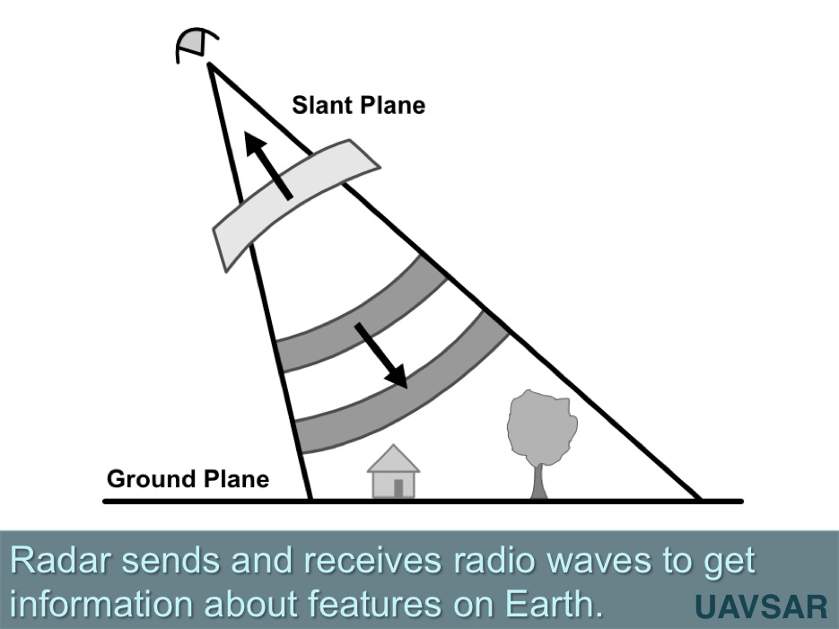
UAVSAR
Unmanned Aerial Vehicle Synthetic Aperture Radar (UAVSAR) is an airborne sensor that sends out radio waves in the L band (24mm). Radar will tell you about physical properties of the surface. Unlike the AVIRIS, it only has one band. However, radar is polarized.
L Band: 24cm
1.8m resolution
Orthometrically and radiometrically corrected
Image source: UAVSAR.jpl.nasa.gov
Notes:
UAVSAR flies on a Gulfstream jet with autopilot that allows the plane to repeat flight paths within 10m accuracy. A lot of scientists use UAVSAR to produce change images for this reason (interferogram). It transmits and receives radio waves that are 24cm long. This means that anything under 24cm, it cannot detect but everything larger, the SAR will detect. The data downloaded was orthometrically and radiometrically corrected and received in linear units. Radar is usually measured in power (db). UAVSAR is polarmetric, which means it sends out waves that “wiggle” horizontally and vertically.

Slide 8
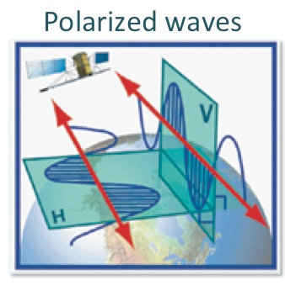
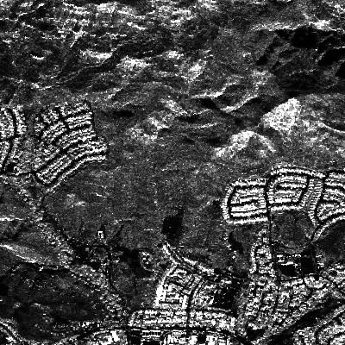
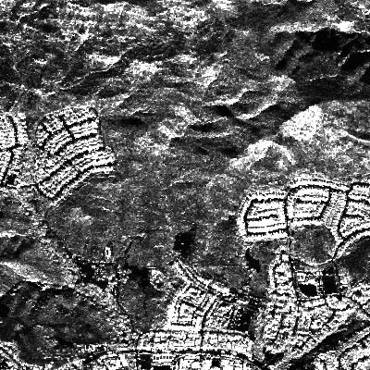
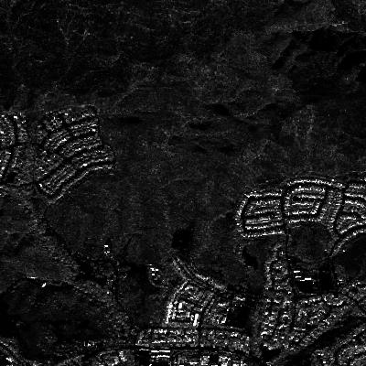
Polarization
When radio waves are sent out, they wiggle horizontally or vertically (polarization).
radar
radar
radar
Sent: vertical
Returned: vertical
(VV)
Sent: horizontal
Returned: horizontal
(HH)
Sent: vertical
Returned: horizontal
(HV)
Image Credit: UAVSAR.jpl.nasa.gov
Notes:
As mentioned before, UAVSAR is polarized and radio waves can wiggle horizontally or vertically. The sensor sends horizontal or vertical pulses and then senses what the pulse returns as. For example, the sensor can send a horizontal pulse. Then it waits for the same wave to return and will sense whether or not it returned with the same polarization or a different one. Depending on the surface they bounce off of, the polarization of the waves can remain the same or change.
All example images displayed with the same area and same histogram parameters. Notice that when looking at the same thing, the intensity of the backscatter differs between different polarizations.

Slide 9
Radar Vegetation Index
How does this help us?
$$\frac{8σ_{HV}}{σ_{VV}+2σ_{HV}+σ_{HH}}$$
COMPLEX SURFACE
Radar Vegetation Index (RVI)
Calculated in linear units
Highlights cross polarization over total power
Minimizes environmental factors such as topography and soil moisture
Notes:
Due to the complicated surface of most vegetation, vegetation is known to have cross-polarization (HV). For example, the radar wave reaches a tree canopy, bounces around randomly, and returns with a random polarization. (in comparison to bare earth or urban infrastructure).
The more complex the surface, the higher the return for RVI.

Slide 10
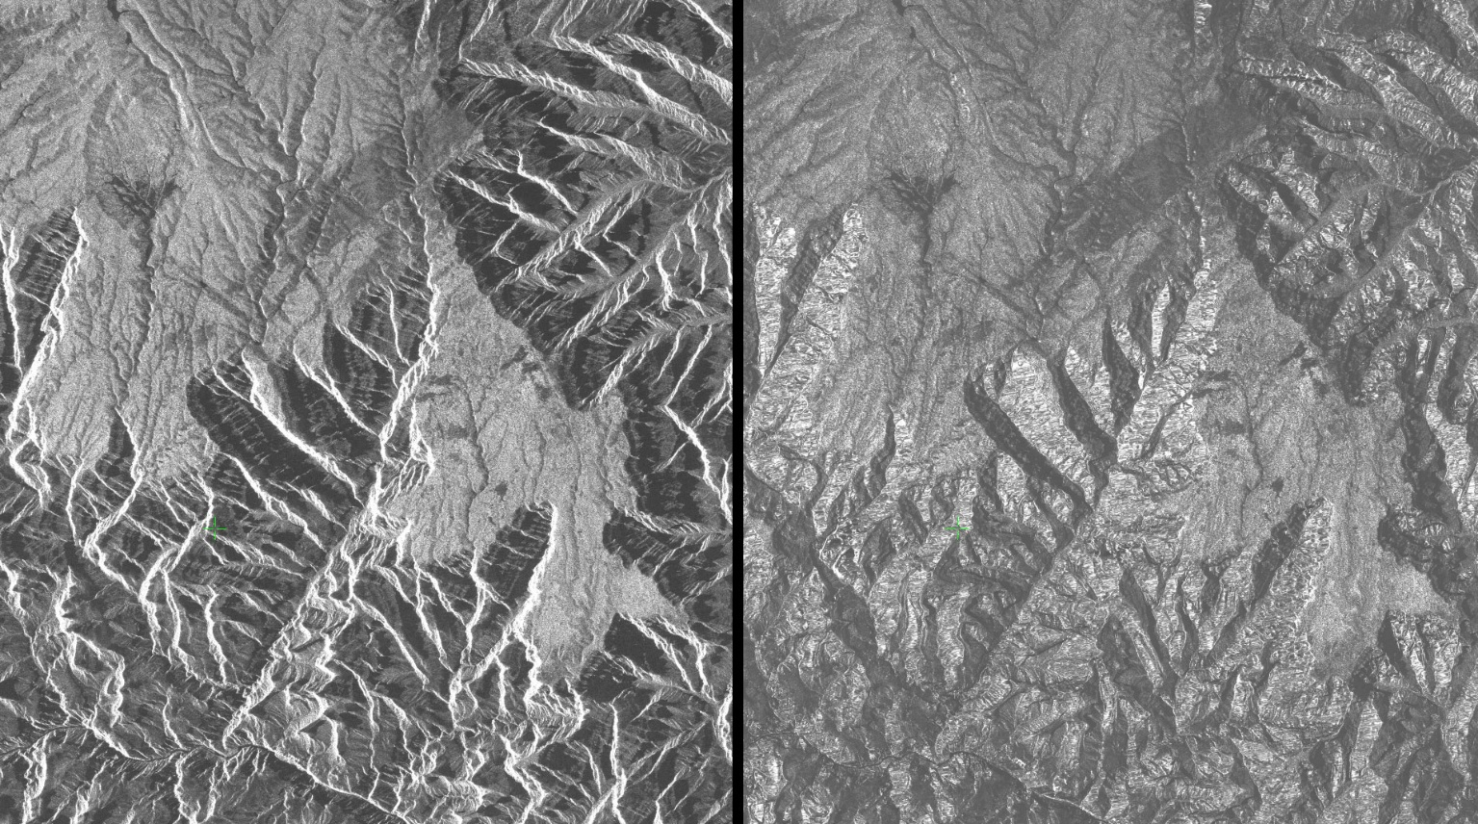
Incidence Angle
Radar senses at an angle, so the angle at which something is detected can affect the properties perceived by the radar
Incidence Angle from radar lights up one side of the canyon
Incidence angle effects removed
Since our study area is in the mountains, this is important to consider.
Image Credit: SAR data of the Grand Canyon from the Alaska Satellite Facility
Notes:
Unlike other sensors, which send signal nadir to the ground, radar sends its signal at an angle. This can affect what the radar “sees”. Different parts of the image can therefore taken at a different angle depending on how far away from the sensor it is. Data collected at an extreme angle <20, >70 is hard to trust. This can make things like topography seem different than it actually is and can “shadow” parts of topography that are facing away from the sensor.

Slide 11
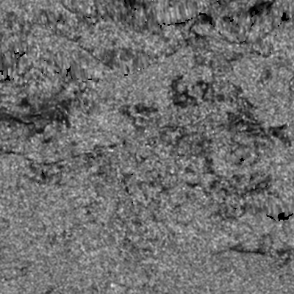
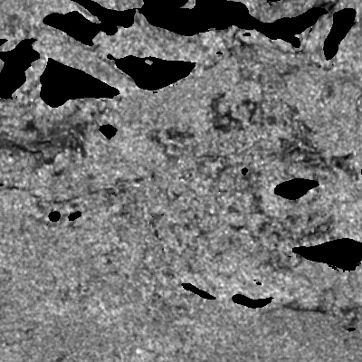
Uncorrected
Incidence angle in degrees vs average RVI at that incidence angle
Plots show about the same trend line slope for all three years. We use .0045 as the average correction value
Corrected
Notes:
Bruce Chapman’s idl code. After loading in the RVI and incidence angle file (in degrees), we give the code a sample area to get the incidence angle dependence. We tried this first on 2015. This is where we get the trend. Since the reliance on incidence angle is about the same, we will input the best fit line for subsequent files. We decided to normalize everything to the dependence at 45 so the correction will be trend(angle)/trend(45). We also take out values at incidence angles under 20 and over 70. We output a new raster with incidence angle corrections and use this for our differencing.
On the right we have a comparison between an uncorrected portion of an RVI image and a corrected portion. Notice in the corrected portion there are clearer trends where it’s brighter and the extreme incidence angle distortion parts are taken out and marked as no data (black)

Slide 12
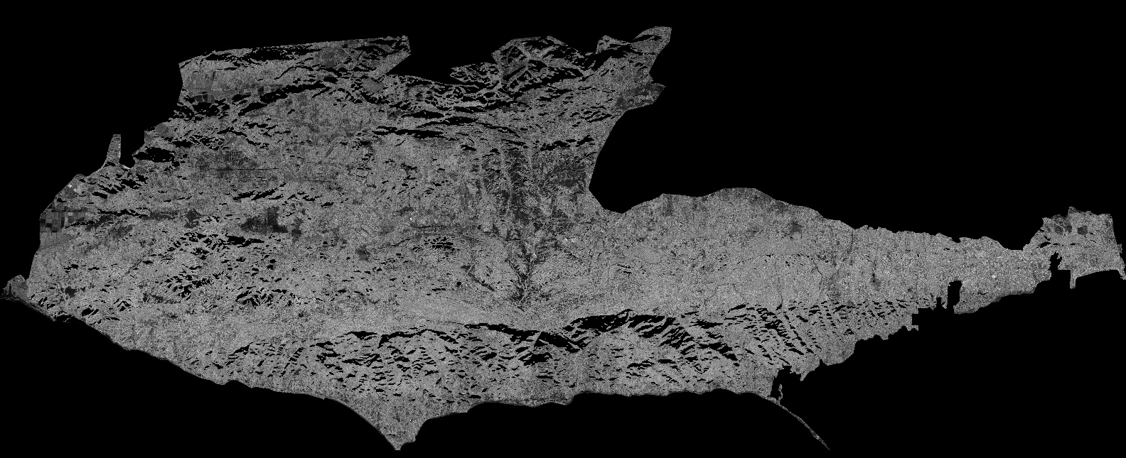
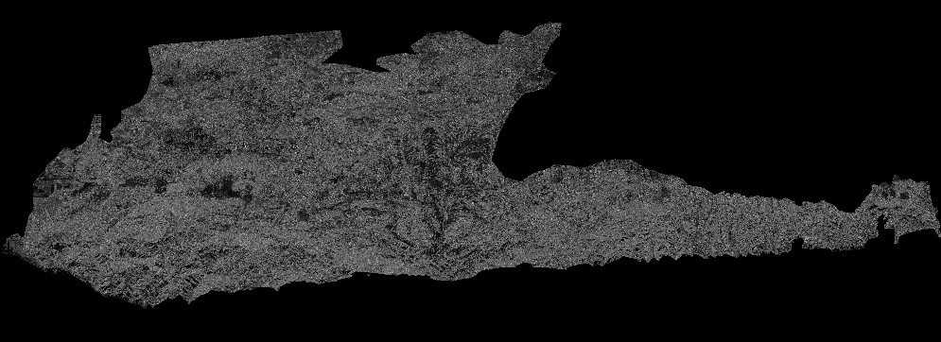
Final RVI
HH
HV
NORTHERN SWATH
Incidence Angle file
VV
Mask+ RVI formula + clip +low pass filter
Repeat for both swaths
Incidence angle correction
Notes:
Here is a simplified visual of the workflow. First, download the three polarizations and incidence angle file. We first mask out any abnormal values. Since we receive the UAVSAR in linear units, we get rid of anything outside 0-1. Then we do the RVI processing, clip, and low pass. The slope incidence angle file from UAVSAR data portal (available for 2012-2015) is used for incidence angle correction. Then corrected and processed rasters are put into Arc for differencing.
Notice in the corrected image in the Southern half of the mountains, some of the mountain sides are taken out. This is because they were at an extreme angle. (Unfortunate, but better to have a reliable dataset). A simplified version of the workflow is shown here.

Slide 13
Methodology - AVIRIS
Clip to study area
Build spectral library
Download
AVIRIS
Select End-members
Run
MESMA
Calculate annual FAL change
Compare with RVI change
Compare with climate trends
Shade normalize
Calculate FAL
Notes:
The first step was to download AVIRIS from the study portal. Four swaths were needed to cover the study area. Once the swaths were spatially subset, we used VIPER tools to classify the image based on a user-defined spectral library.

Slide 14
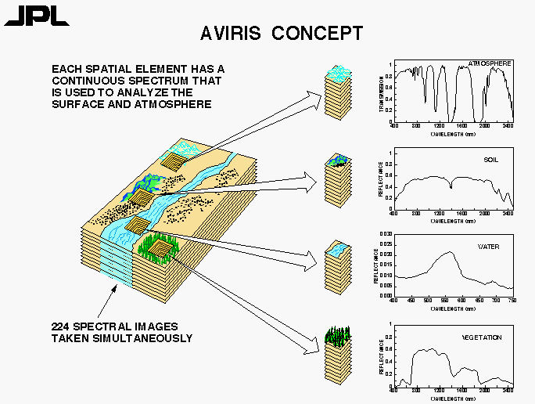
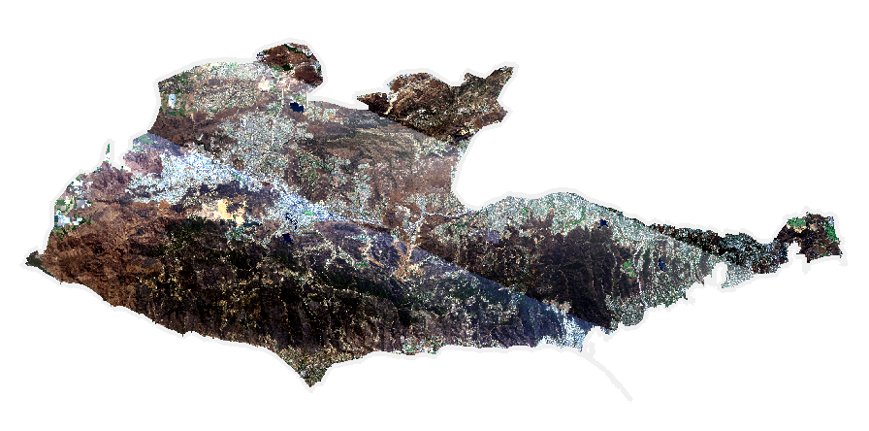
AVIRIS
Airborne Visible/Infrared Imaging Spectrometer (AVIRIS) is a unique optical sensor that measures spectral radiance across 224 bands, from 400 – 2500 nanometers.
Image source: UAVSAR.jpl.nasa.gov
Image Credit: NASA JPL
Notes:
AVIRIS is a hyperspectral sensor used for imaging spectroscopy. Whereas the sensor on Landsat 8 measures spectral radiance in 11 bands, AVIRIS measures across 224 bands. This makes AVIRIS very sensitive to differences in spectral reflectance, and gives AVIRIS a far superior ability in classifying images based on spectral reflectance
Image source: https://aviris.jpl.nasa.gov/aviris/concept.html

Slide 15
MESMA – Endmembers
Multiple Endmember Spectral Mixture Analysis (MESMA) uses spectrally “pure” pixels to classify an image
We used MESMA to calculate fractional cover of three classes: Green Vegetation (GV), Nonphotosynthetic Vegetation (NPV), and Substrate (S)
For each class we chose 3 – 5 endmembers
GV
Chaparral
Willow
Coastal
Sage
Scrub
Sycamore
Oak
Woodland
NPV
S
Dead
Tree
Dead
Chaparral
Dry
Grass 1
Dry
Grass 2
Sand
Dirt Road
Soil
Notes:
We used Multiple Endmember Spectral Mixture Analysis to classify the AVIRIS images. Using MESMA, we can classify the image based on user-defined spectral classes. We wanted to classify the image based on three classes: green vegetation, nonphotosynthetic vegetation, and substrate. To classify the image this way, I built my own spectral library by choosing endmembers from within an AIVRIS image itself. I aimed for 3 – 5 endmembers within each class to account for variability in spectral reflectance in different land cover types.

Slide 16
MESMA – Choosing endmembers
2016 NAIP Orthoimagery
Multiple Endmember Spectral Mixture Analysis (MESMA) uses spectrally “pure” pixels to classify an image
Finding endmembers combined using partner data and imagery with high spatial resolution
AVIRIS grid
2015 fire perimeter
Endmember
Notes:
Choosing the endmembers was a visual process. I would overlay datasets from the partners and look within them on the NAIP imagery to find areas that seemed a pure representation of a given class. I used the NAIP imagery because its spatial resolution is very high – 1 m, and therefore it’s easier to see more detailed land cover than in the 15m pixels of AVIRIS. In this example I was looking for nonphotosynthetic vegetation and looked in an area that had been recently scarred by fire. I traced a small portion of the AVIRIS grid so I could see how the NAIP and AVIRIS lined up. Then I would place a point in the pixel that seemed the purest representation of the class I was searching for.

Slide 17
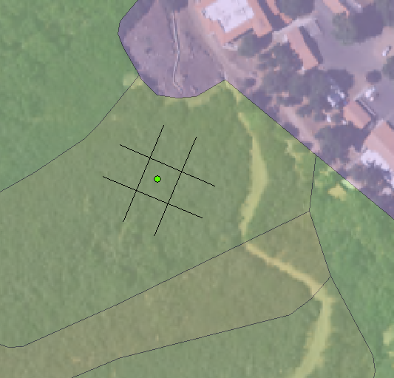
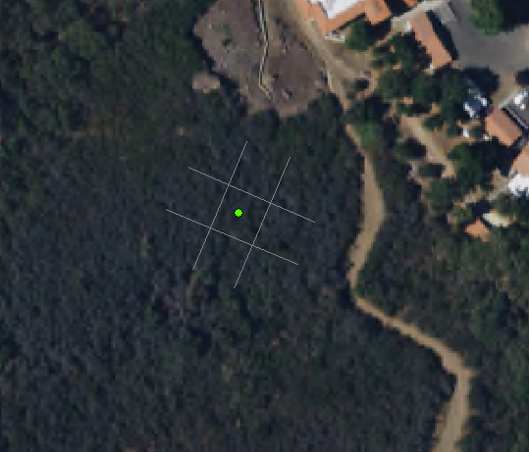
MESMA – Choosing endmembers
Multiple Endmember Spectral Mixture Analysis (MESMA) uses spectrally “pure” pixels to classify an image
Quercus agrifolia
Urban/disturbed
Ceanothus megacarpus
Ceanothus spinosus
AVIRIS grid
Endmember
Notes:
This is another example of choosing an endmember. I used the very detailed NPS vegetation map to look for Green Vegetation (GV) in dominant vegetation types, like chaparral seen here.

Slide 18
MESMA – Spectral library
Reflectance
GV
NPV
Substrate
Wavelength (nm)
Notes:
After I chose the endmembers, I built the spectral library using VIPER tools, which is a special add-on to ENVI that I obtained from Dr. Dar Roberts at UCSB. The tool pulled the spectral signature of each endmember using a 2016 AVIRIS image, since I had used the 2016 NAIP Orthoimagery to confirm where certain classes were. I was able to view the spectral libaray and throw out the spectra that didn’t look like pure representations of their class. This is my final library. You can see, especially in the 1500 – 1700 and 2000 – 2500 nm ranges how distinct these classes are.

Slide 19
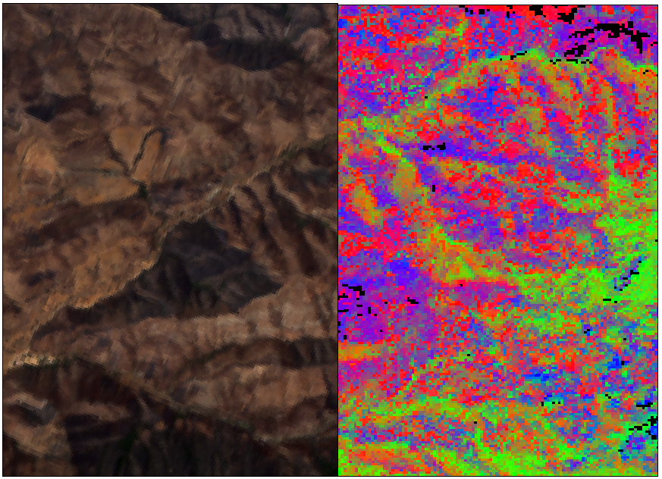
MESMA
AVIRIS Reflectance Image
MESMA Output
MESMA outputs fractional cover of the chosen classes: Green Vegetation, NonPhotosynthetic Vegetation, and Substrate
10% GV
60% GV
10% NPV
30% NPV
80% S
10% S
RGB display
NPV
GV
S
Notes:
This is what a MESMA output would look like, displayed in RGB. Every pixels was assigned a fractional value for each class, and every pixel that is classified adds up to 1. Some pixels are not classified if VIPER tools cannot model the pixel’s fractional coverage with less than 0.1 RMSE (a user-defined threshold).

Slide 20
Fraction of Alive Cover (FAL)
FAL = GV
Change in FAL shows how the fraction of alive vegetation has changed over the study period
GV + NPV
2014 FAL
2013 FAL
2013-2014 change in FAL
.40
.15
.60
.10
-.20
+.05
.60
.40
.80
.50
-.20
-.10
Notes:
For each pixel simple band math was calculated to find the Fraction of Alive Cover (FAL) for each pixel. Once we calculated FAL for each year, we could find the difference. So for example, if you subtracted the 2013 image from the 2014 image, you could see where the FAL decreased or increased, implying loss or gain of vegetation.

Slide 21
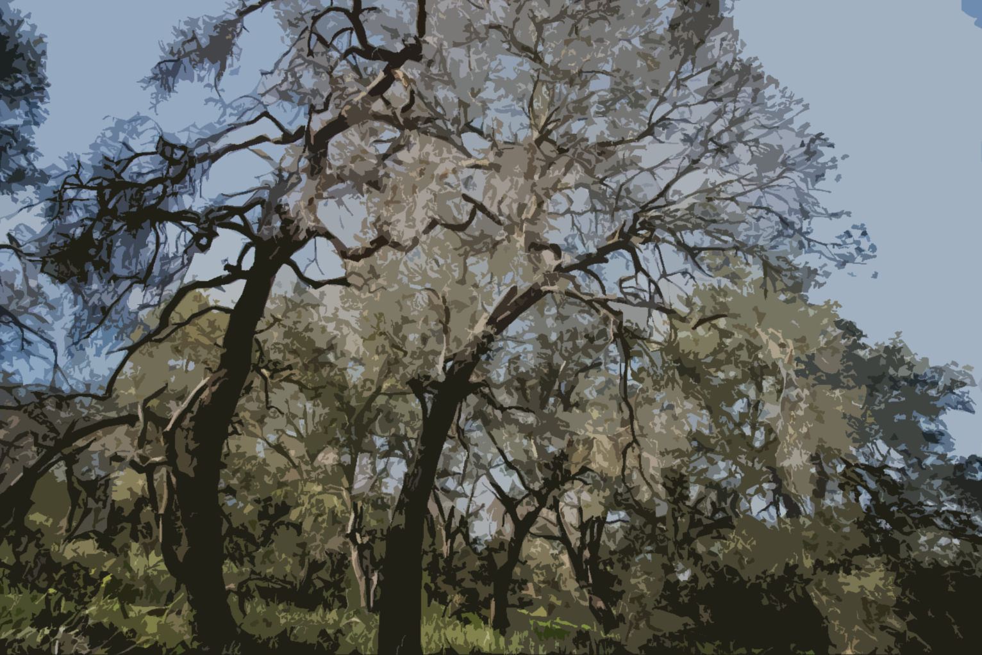
RESULTS
Notes:
Image Source: Emil Chang

Slide 22
Results - UAVSAR
2014 - 2013
2011-2010
RVI Change Legend
Negative change (Min- -.1)
No change (-.1- .1)
Positive change (.1 – Max)
0km
5km
10km
20km
Notes:
The change images show areas where RVI decreased (red), decreased (green), or didn’t change (gray). Red would signal a decrease in surface roughness while green would signal an increase in surface roughness.

Slide 23
Results - UAVSAR
2012-2011
RVI Change Legend
Negative change (Min- -.1)
No change (-.1- .1)
Positive change (.1 – Max)
0km
5km
10km
20km

Slide 24
Results - UAVSAR
2013-2012
RVI Change Legend
Negative change (Min- -.1)
No change (-.1- .1)
Positive change (.1 – Max)
0km
5km
10km
20km

Slide 25
Results - UAVSAR
2014-2013
RVI Change Legend
Negative change (Min- -.1)
No change (-.1- .1)
Positive change (.1 – Max)
0km
5km
10km
20km

Slide 26
Results - UAVSAR
2015-2014
RVI Change Legend
Negative change (Min- -.1)
No change (-.1- .1)
Positive change (.1 – Max)
0km
5km
10km
20km

Slide 27
Results - UAVSAR
2014-2010
RVI Change Legend
Negative change (Min- -.1)
No change (-.1- .1)
Positive change (.1 – Max)
RVI Change Legend
Negative change (Min- -.1)
No change (-.1- .1)
Positive change (.1 – Max)
0km
5km
10km
20km
Notes:
The difference for the entire time period shows where the most change occurred over the years. The large red area on the left marks a large fire from 2013. Some other read areas correspond with annual grasses, and may be the result of seasonal changes.

Slide 28
Results - AVIRIS
2014 - 2013
2014-2013
– change (-1 - -0.1)
No change (-0.1- 0.1)
+ change (0.1 – 1)
0
5
10
20 km
Notes:
The change images show areas where FAL decreased (red), increased (green), or stayed the same (gray). Green areas imply vegetation gain and red areas imply vegetation loss.

Slide 29
Results - AVIRIS
2015 - 2014
2015-2014
– change (-1 - -0.1)
No change (-0.1- 0.1)
+ change (0.1 – 1)
0
5
10
20 km

Slide 30
Results - AVIRIS
2016 - 2015
2016-2015
– change (-1 - -0.1)
No change (-0.1- 0.1)
+ change (0.1 – 1)
0
5
10
20 km

Slide 31
Results - AVIRIS
2016-2013
– change (-1 - -0.1)
No change (-0.1- 0.1)
+ change (0.1 – 1)
0
0
5
5
10
10
20 km
20 km
Notes:
This shows the change across all years. The map is overwhelmingly red, implying a decrease in fractional cover of green vegetation across much of the study area.

Slide 32
Relating to Meteorological Data
Total annual precipitation in inches
Median RVI or Mean FAL difference marked on succeeding year (2013-2012 marked on 2013)
Notes:
Precipitation data taken at 4km PRISM quadrant 24.0791, -118.7323 at 1516ft elevation.
These plots show how the average RVI and FAL change values relate to annual precipitation totals. It is hard to draw conclusions for FAL difference since there are so few data points. It’s possible that the increase in green vegetation seen from 2014-2015 could respond to the increase in precipitation from 2013-2014.
For RVI change, it appears that its trend follows the precipitation trend from 2011-2013. The rapid increase in surface roughness from 2014-2015 (also seen in FAL) could also be in response to the increased precipitation from 2013-2014.
Median values were used for RVI because the histogram of RVI difference values for one year was skewed rather than normally distributed.
All FAL change histograms were normally distributed, so mean values were used.

Slide 33
Mean temperature in Fahrenheit
Median RVI or Mean FAL difference marked on succeeding year (2013-2012 marked on 2013)
Notes:
Taken at 4km PRISM quadrant 24.0791, -118.7323 at 1516ft elevation

Slide 34
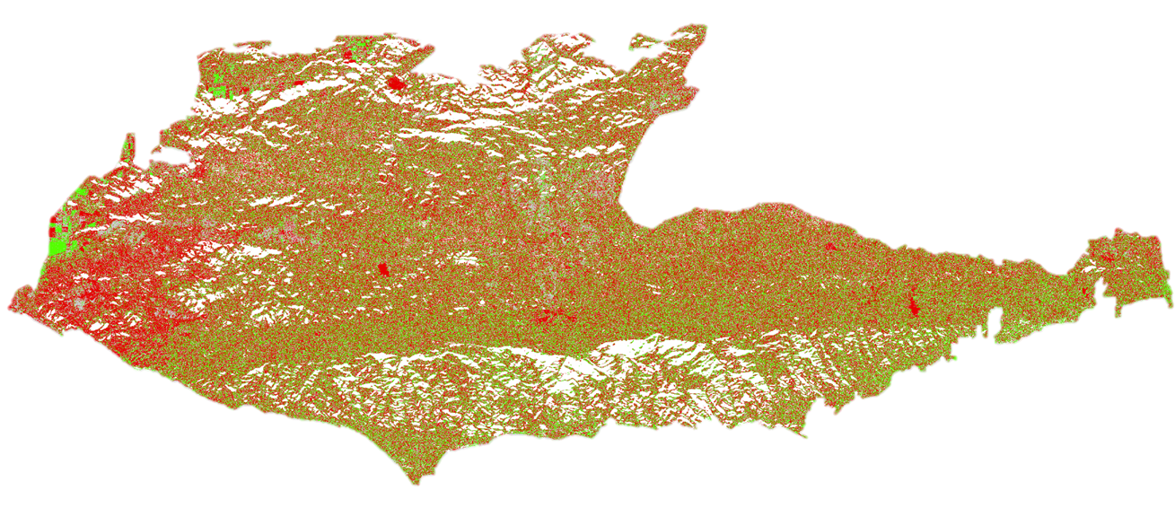
Conclusions
RVI and FAL for the short overlapping time period are not directly related
The 2014 – 2013 difference showed the greatest negative change, implying the period of greatest stress on vegetation
It appears that the plants have been making a comeback since the 2014-2013 vegetation stress period
RVI 2014-2013
FAL 2014-2013
Notes:
We were unsuccessful in relating the FAL and RVI change. This may be because of their inherent differences; FAL is a direct measure of plant health while RVI measures it by proxy of surface complexity. Therefore their differences may not necessarily line up. However, the biggest problem is that the only overlapping change years were 2014 – 2013 and 2015 – 2014. Having more data overlap would help us draw conclusions here.
For both methods, it was clear that the 2014-2013 change year saw the most negative change. We expect that 2013 caused the greatest stress on the plants and their reaction took some time to present itself. This is the year that we observed the lowest amount of precipitation.
Finally, both methods see a rise in mean change value after the 2014-2013 period. This would imply a regain of structural complexity via RVI and return to green vegetation via FAL.

Slide 35
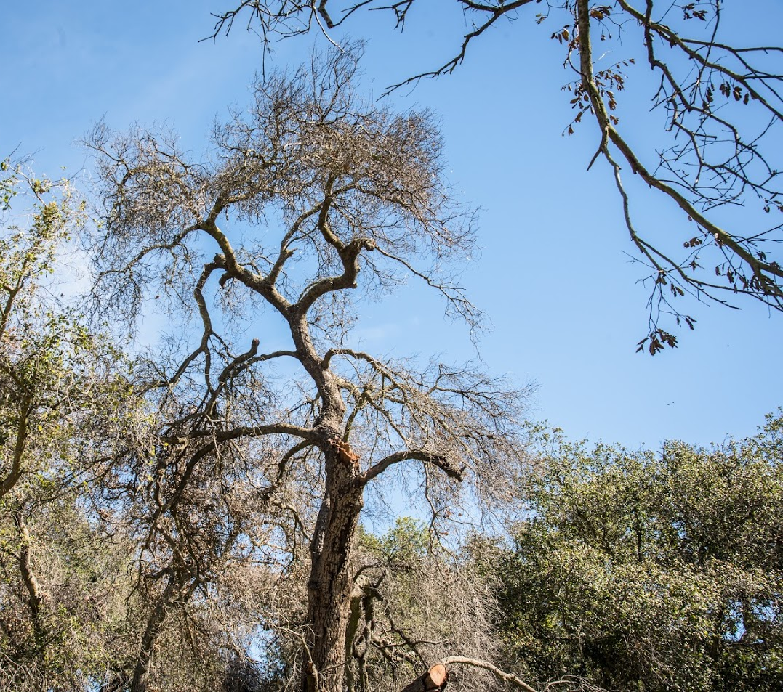
Errors & Uncertainties
Availability of data sets
For both UAVSAR and AVIRIS, we were not able to obtain data from every year at the same time. For UAVSAR, there may be seasonal changes between months. For AVIRIS, we couldn’t cover the desired time period
Reliability of RVI and incidence angle correction
Reliability of calculating FAL – soon this will be a Level 3 NASA product
Image Credit: Emil Chang
Image Credit: Monet
Notes:
In a perfect world, this analysis would be done on images from the same time every year. Ideally, we would also have data from each sensor for the entire desired range (2010-2016). However, we had to work with the best that we could get, which resulted in comparing images from different seasons and lacking information for certain years.
There are also questions of reliability with some of the processes we completed.
Also, calculating FAL was a trial and error process. Our classifications may be subject to imperfect inputs in the MESMA process (imperfections in the spectral ibrary, for example). However, future users will not have to worry about these problems because soon NASA will have a Level 3 data product for AVIRIS showing GV-NPV-S.
Image Source: Emil Chang

Slide 36
Errors & Uncertainties
Northern Swath (SanAnd 26526)
Collection Date | Approx precip (in) in week | Monthly Total (in) | Ave temp for the day (Topanga weather station) | High temp for the day (Topanga) | Yearly Total (in)
4/15/2010 | .11-.15 | 2.07 |  |  | 31.92
7/8/2011 | 0 | .06 | 73 | 64 | 16.05
11/15/2012* | 0 | 2.43 | 59 | 65 | 12.78
5/28/2013** | 0 | .43 | 69 | 83 | 4.84
10/23/2014 | 0 | 0 | 76.5 | 75 | 10
2015 not available | N/A | N/A | N/A | N/A | N/A
Notes:
Some yearly differences are due to seasonal changes. However, this was the availability of data and the dates that would be the most consistent. Phenology differences between the years might account for some of the RVI change.
** Used flightlines 08523 and 08525. Previous swaths for 2013 cross scatter was not removed and resulted in faulty values. New swaths were downloaded at similar times.
* Due to availability of incidence angle file, we used flightlines 08523 and 08525 in 2012. This is a very similar flight line to 26524 and 26536. Same products were downloaded.

Slide 37
Errors & Uncertainties
Southern Swath (SanAnd 26524)
Collection Date | Approx precip (in) in week | Monthly Total (in) | Ave temp for the day ( Topanga weather station) | High temp for the day (Topanga) | Yearly Total (in)
4/15/2010 | .11-.15 | 2.07 | -- | -- | 31.92
7/8/2011 | 0 | .06 | 56.9 | 64 | 16.05
11/14/2012* | 0-.12 | 2.43 | 59.5 | 65 | 12.78
5/31/2013** | 0 | .43 | 69 | 88 | 4.84
10/23/2014 | 0 | .05 | 76.5 | 92 | 10
6/29/2015 | 0 | .08 | 83 | 97 | 7.71
Notes:
** Used flightlines 08523 and 08525. Previous swaths for 2013 cross scatter was not removed and resulted in faulty values. New swaths were downloaded at similar times.
* Due to availability of incidence angle file, we used flightlines 08523 and 08525 in 2012. This is a very similar flight line to 26524 and 26536. Same products were downloaded.
These were the best dates we could find with the least seasonal change. However, since the dates range from April to November, there will definitely be phenology differences. Note all of the Northern and Southern swaths are either taken on the same day or one or two days apart. No major weather changes between flights. Also, only the Southern flightline (26524) has a 2015 flight.

Slide 38
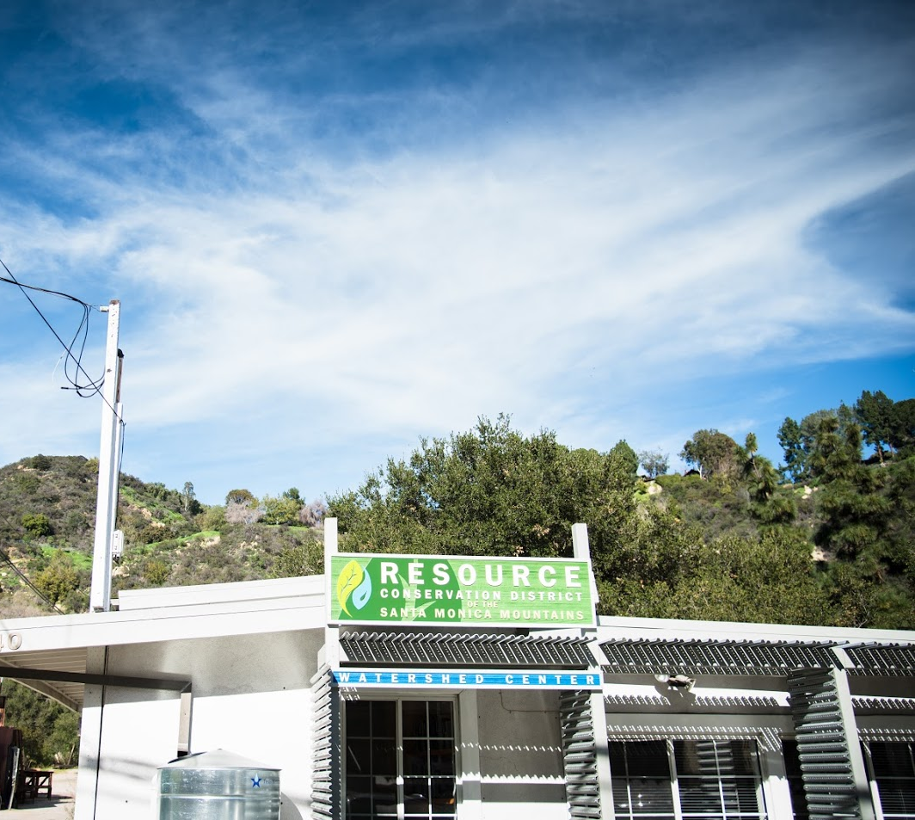
Future Work
Evaluating Recovery
Recent storms may have helped vegetation recover from drought. Where is vegetation responding to the rain and where is it still dead?
AVIRIS Level-3 Fractional Cover
The study could be repeated using the standard Level-3 product (released soon) to reduce the uncertainties associated with manually running MESMA
Invasive Pests
Due to insufficient data, this project was unable to include data on invasive pests, which may play a large role in vegetation dieback
Image Source: Emil Chang
Notes:
It would be interesting to explore the effects of the recent rain. The rate of recovery may be different for different species or some species may not respond to the sudden rain at all.
The study may be more reliable once the L3 data (NPV-GV-S fractional cover) is available for AVIRIS images, as it will take out the uncertainties associated with building your own spectral library and running MESMA with user-defined settings.
Finally, we were unable to investigate the effects of invasive pests due to lack of data. However, it should be explored in future studies
Image Source: Emil Chang

Slide 39
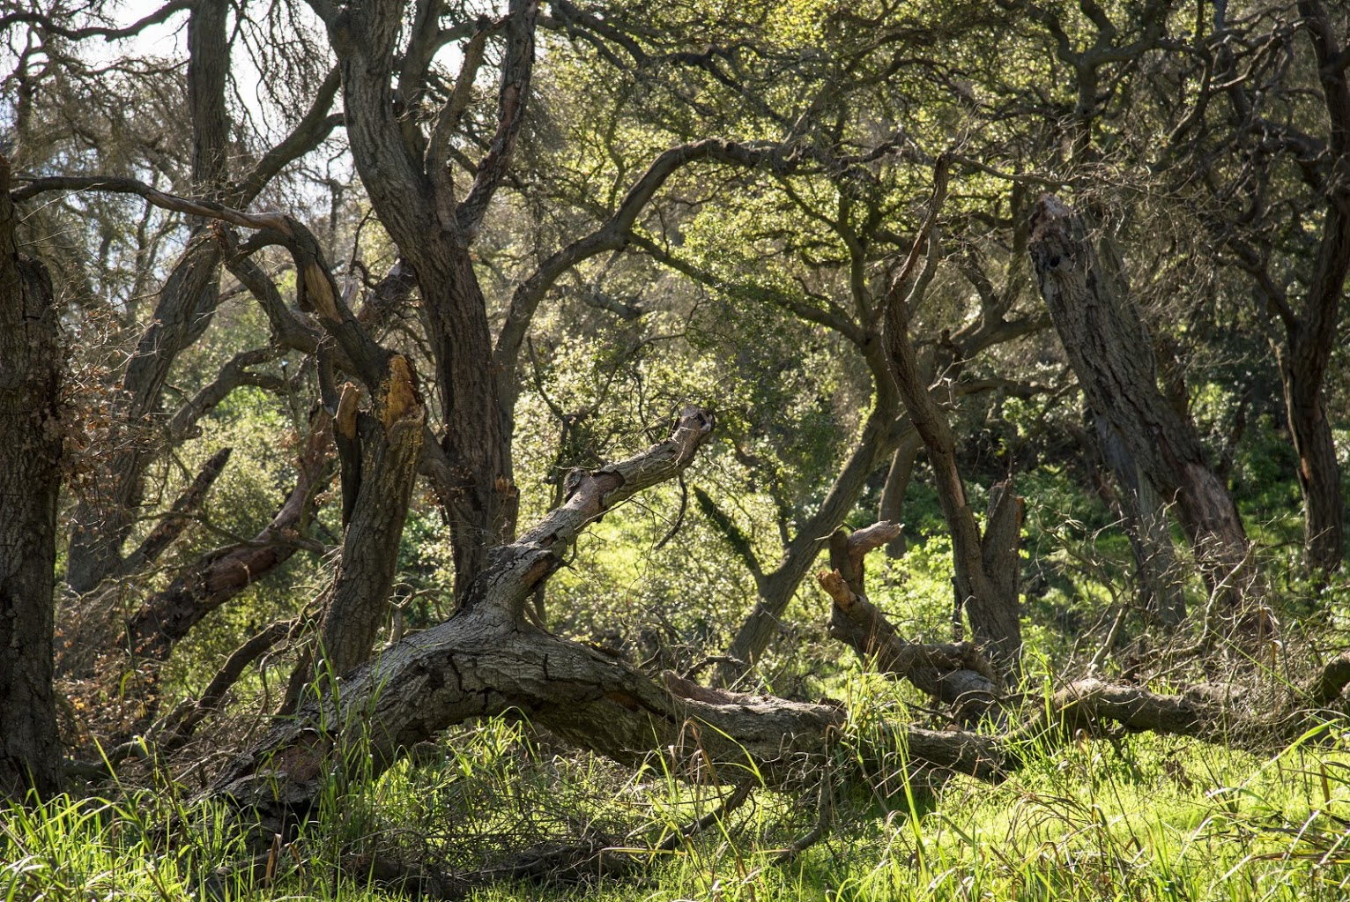
Dr. Natasha Stavros, JPL
Dr. Erika Podest, JPL
Benjamin Holt, JPL
Dr. Bruce Chapman, JPL
Christine Rains, JPL
Image Source: Emil Chang
Notes:
Image Source: Emil Chang

