Slide 1
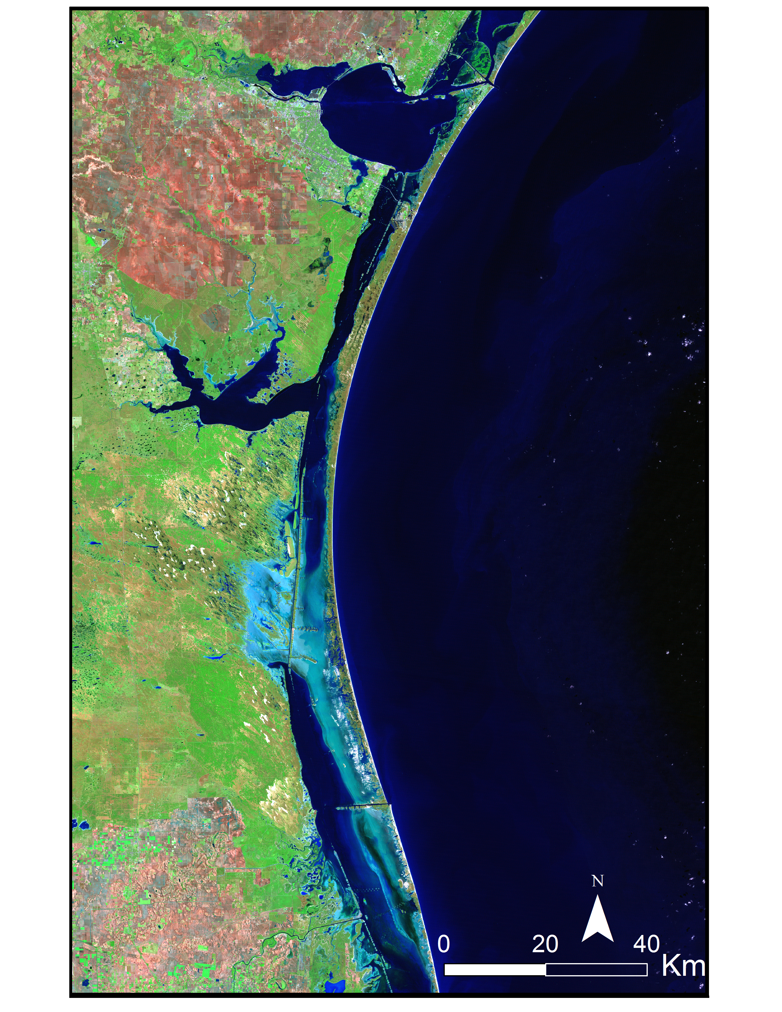
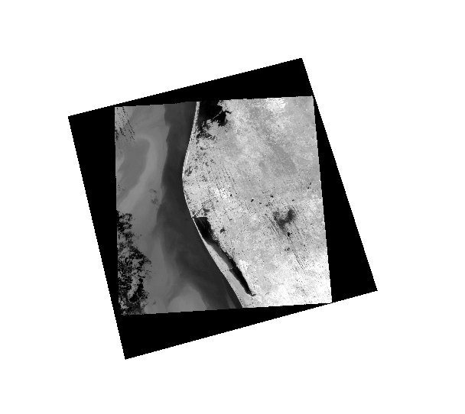
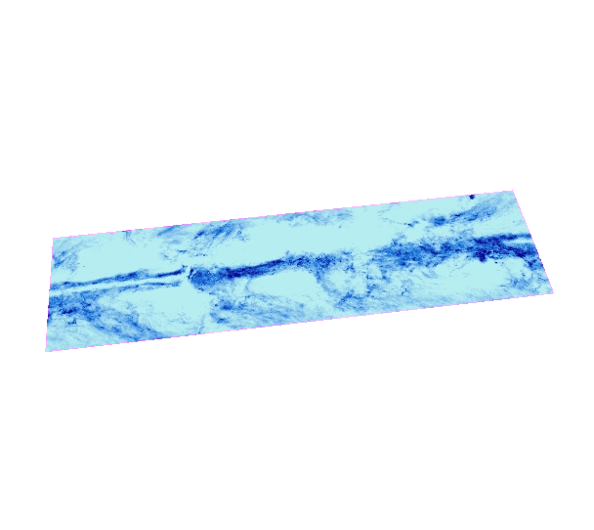
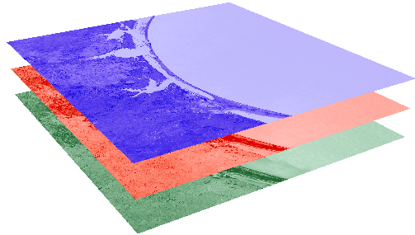
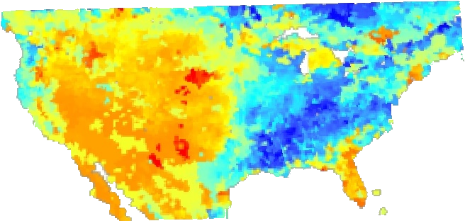
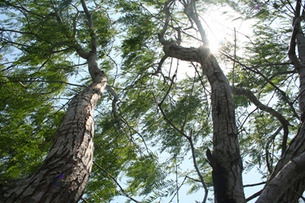
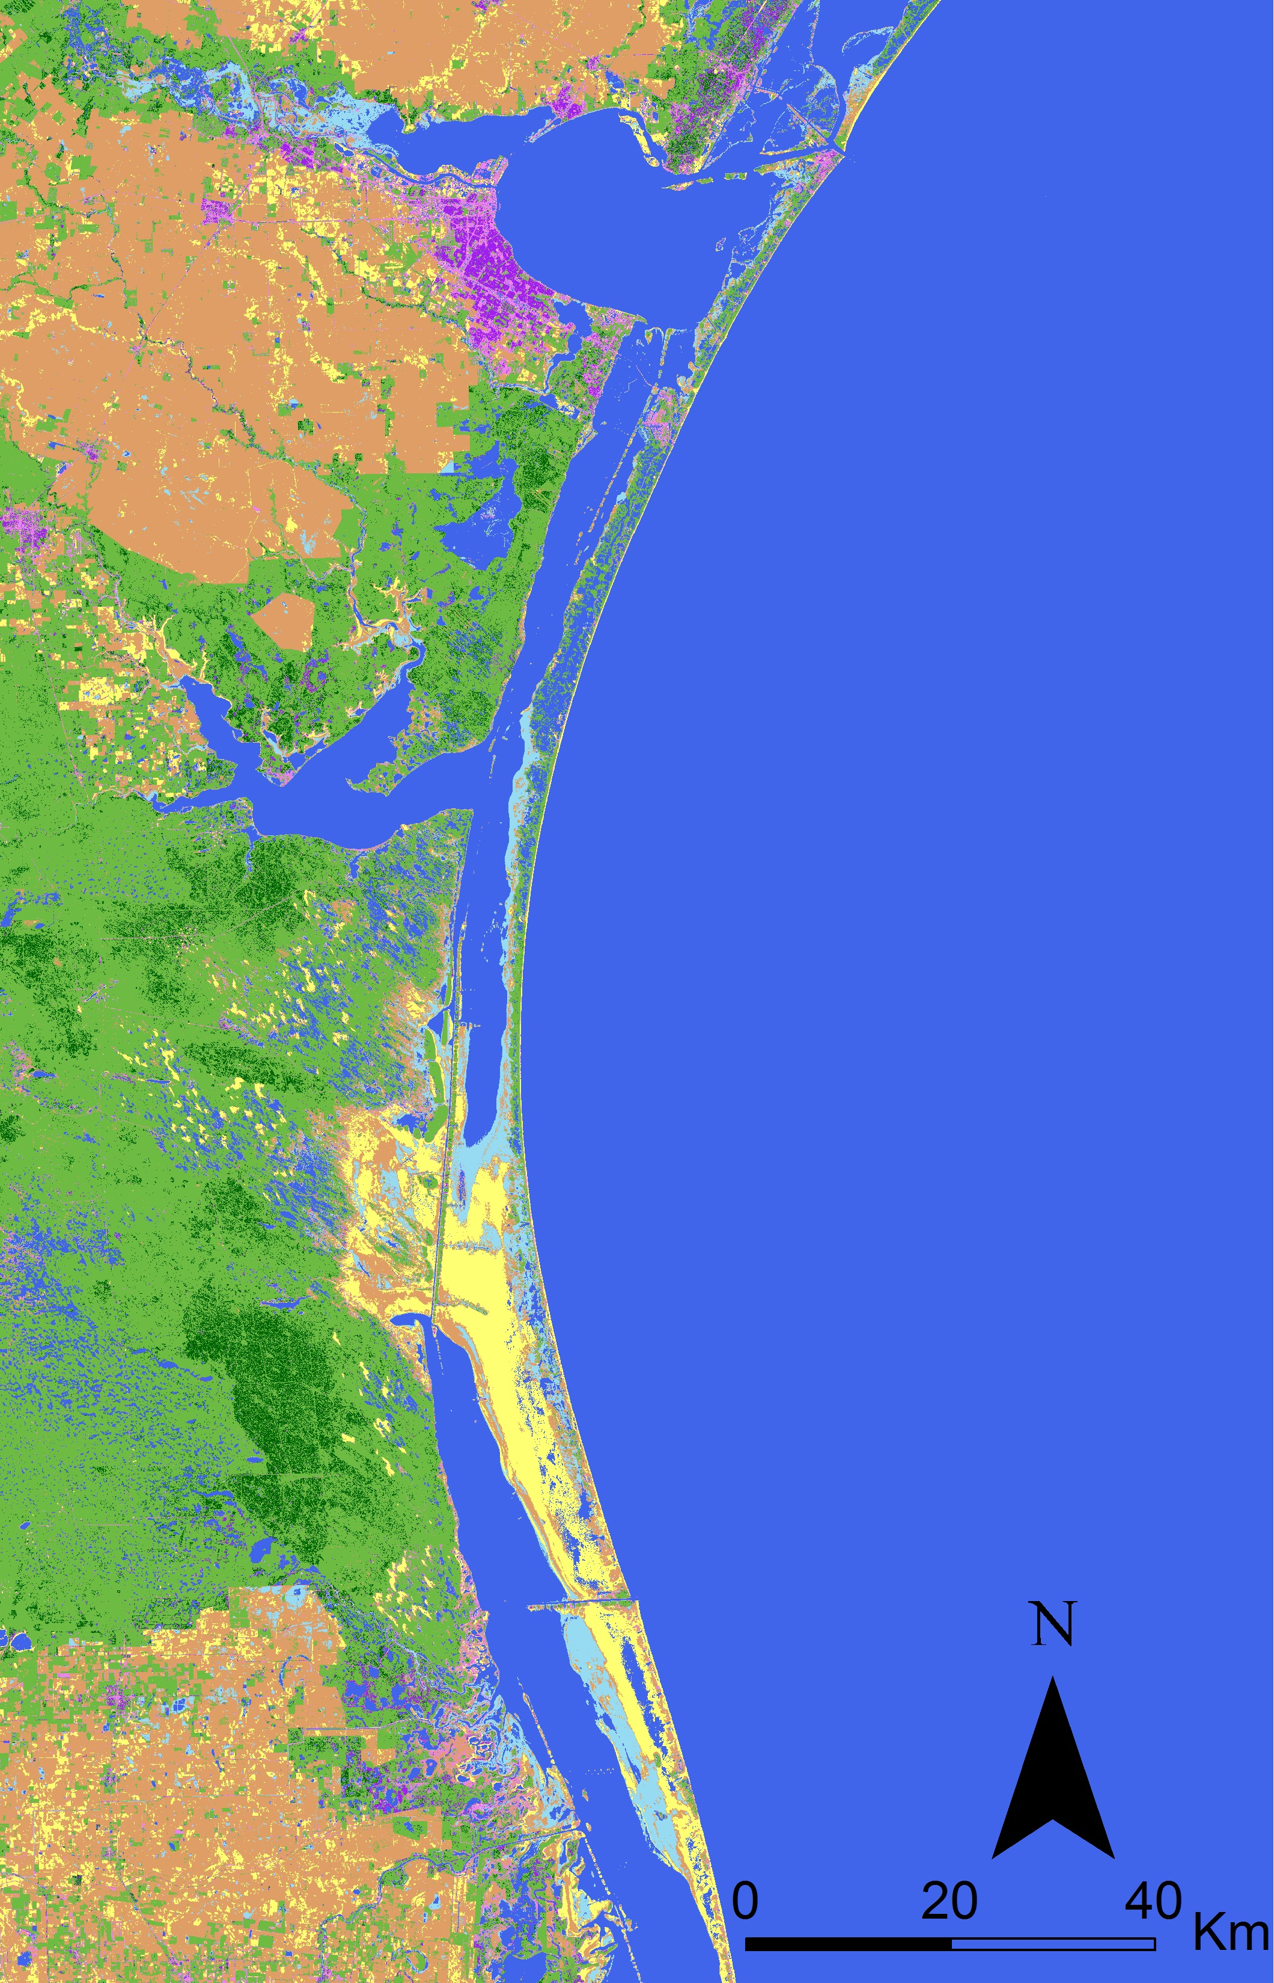
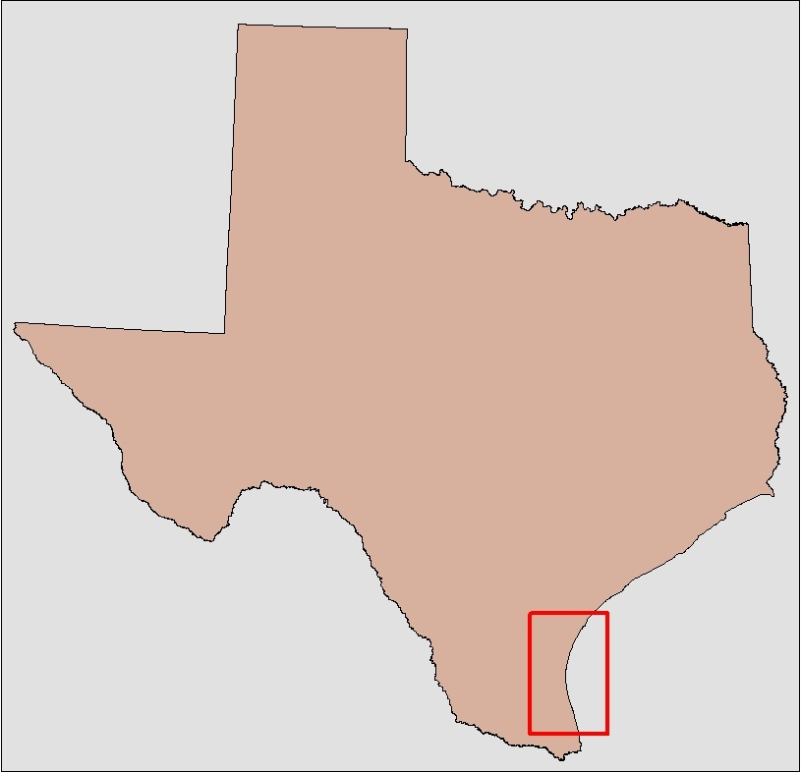
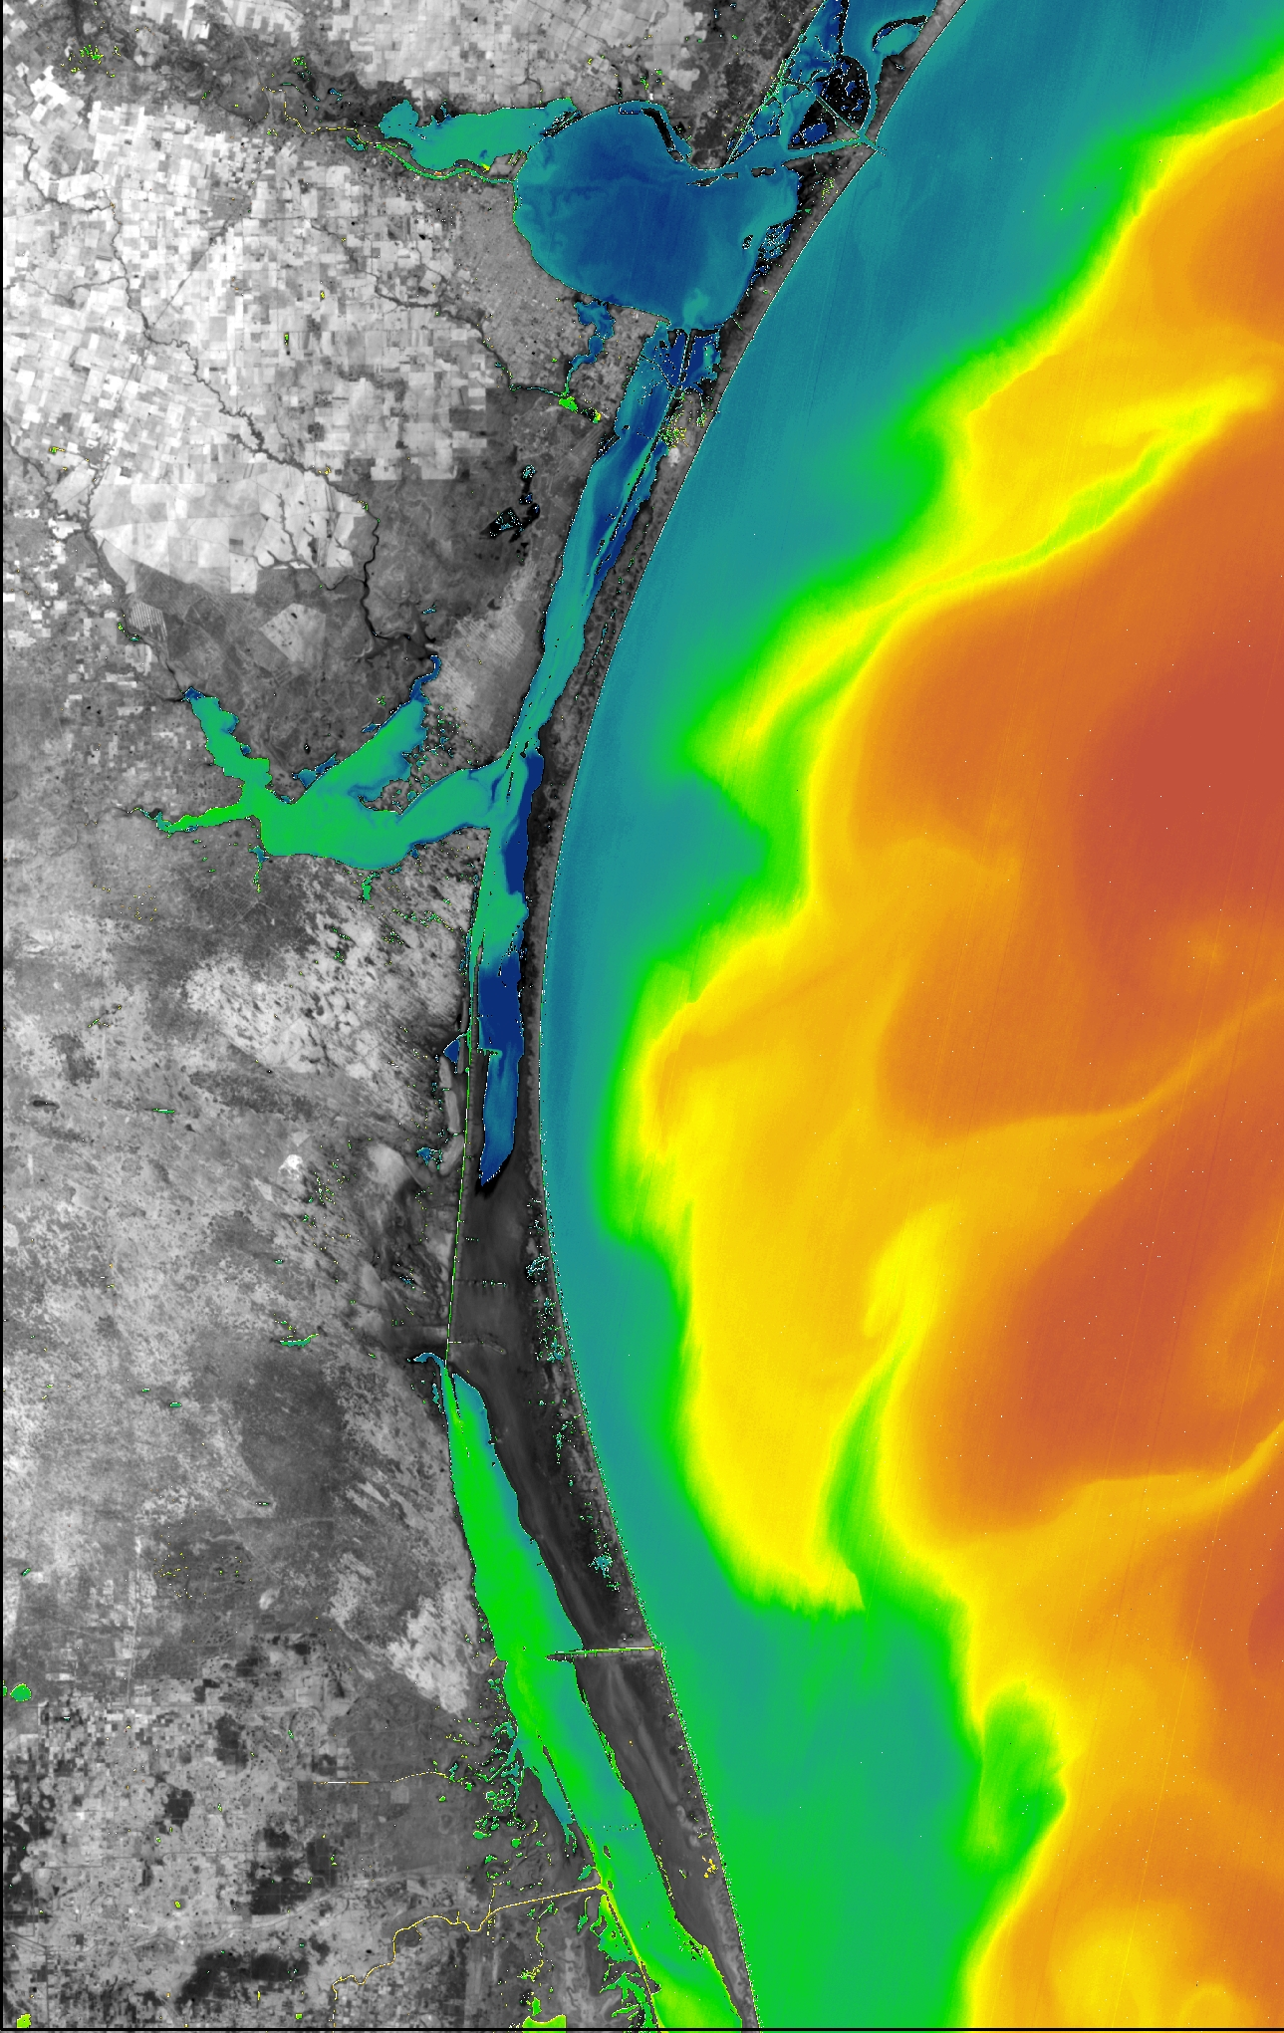
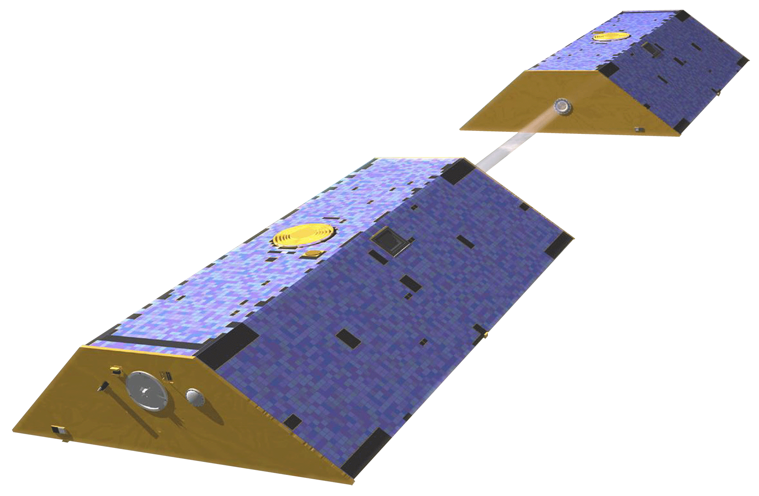
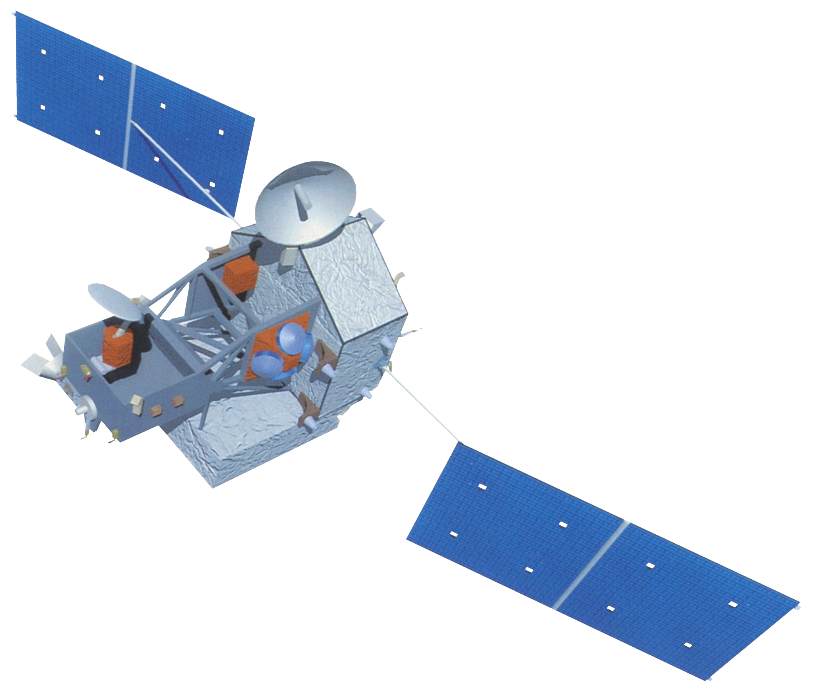
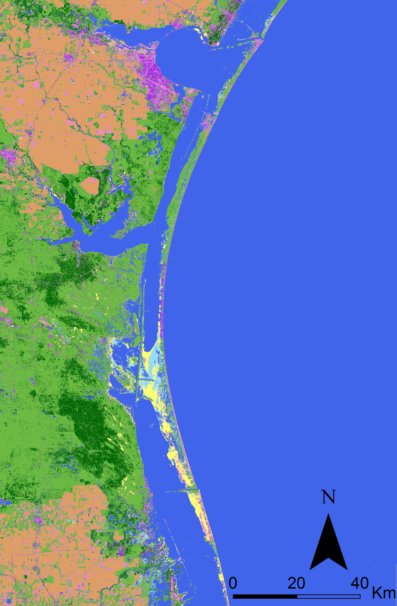
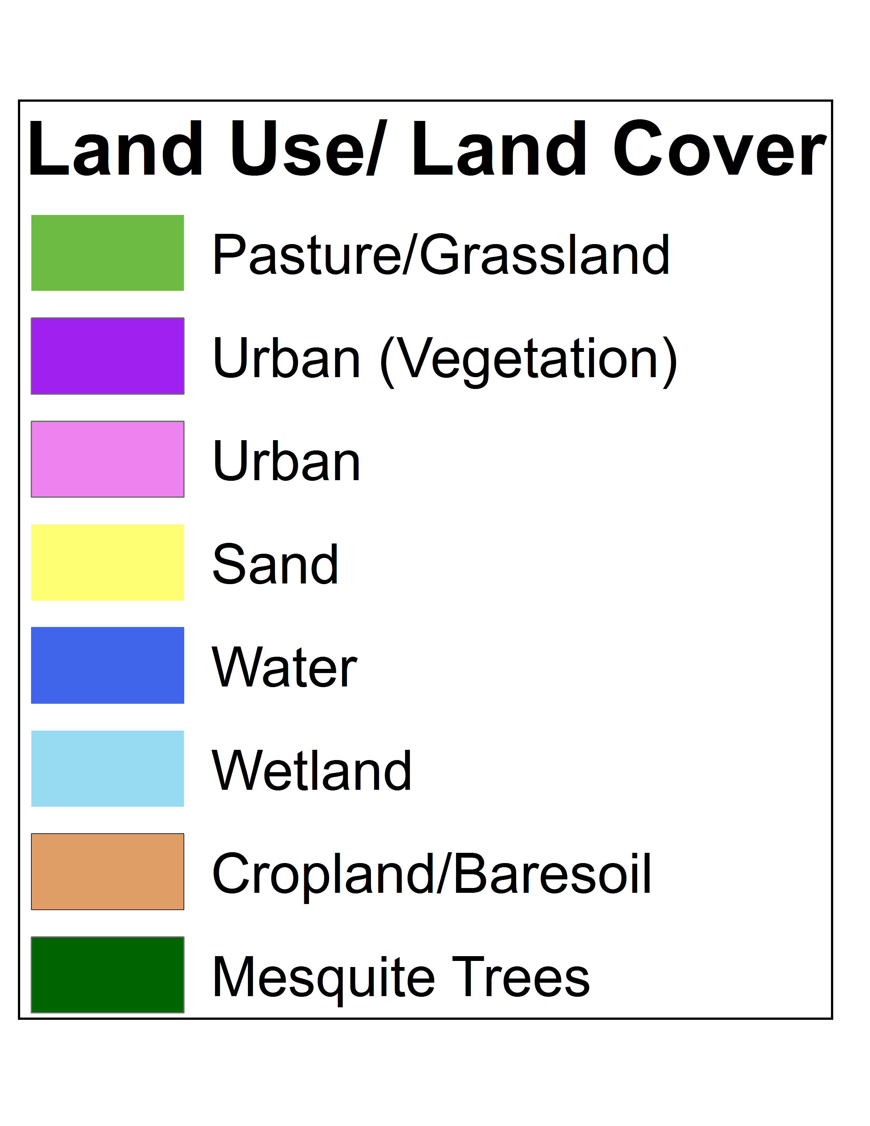
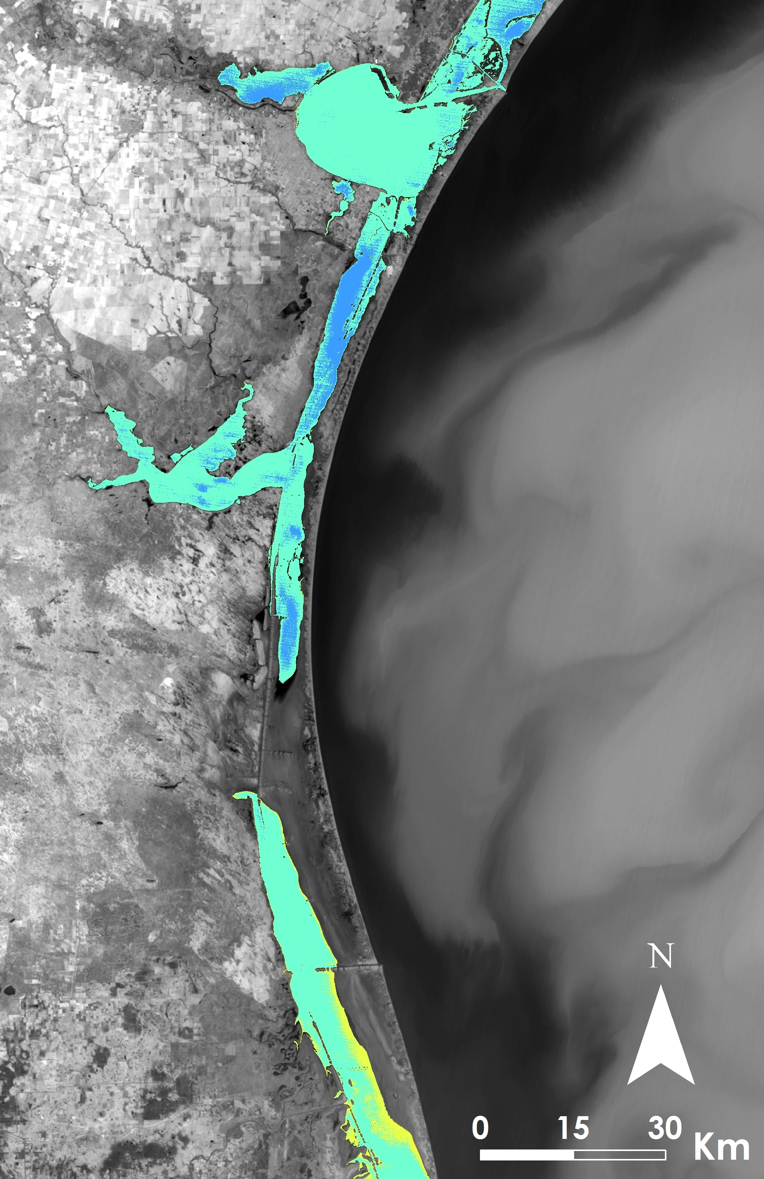
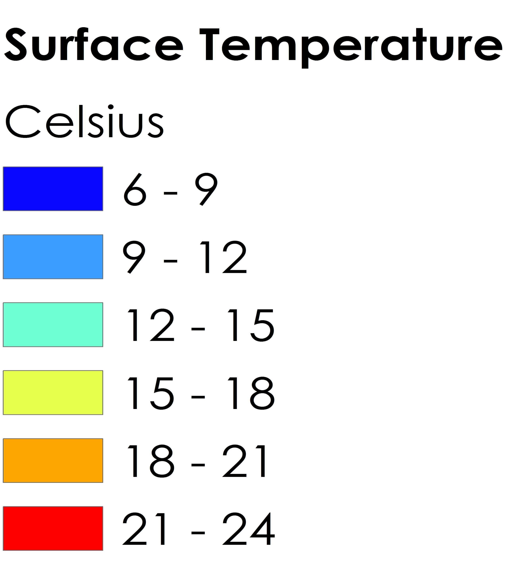
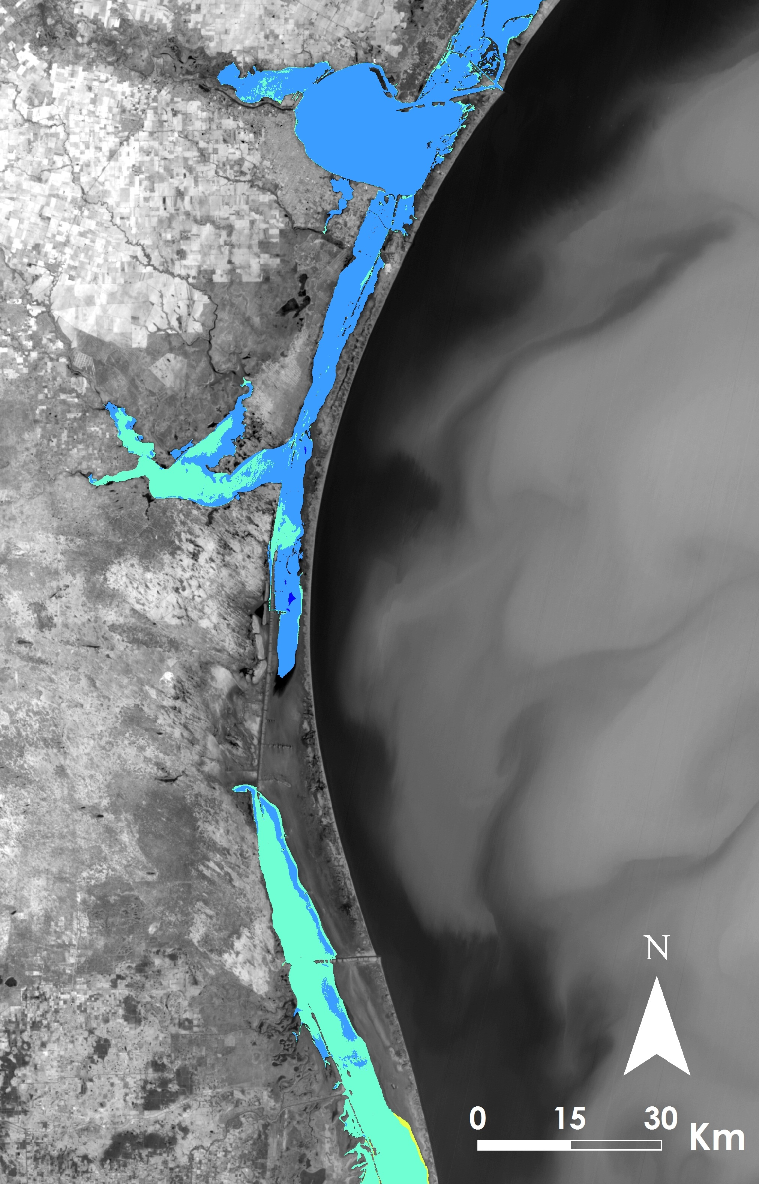
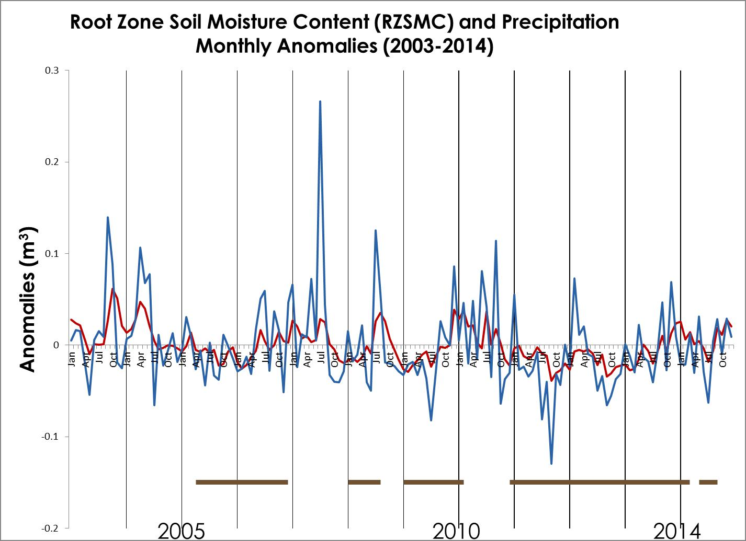
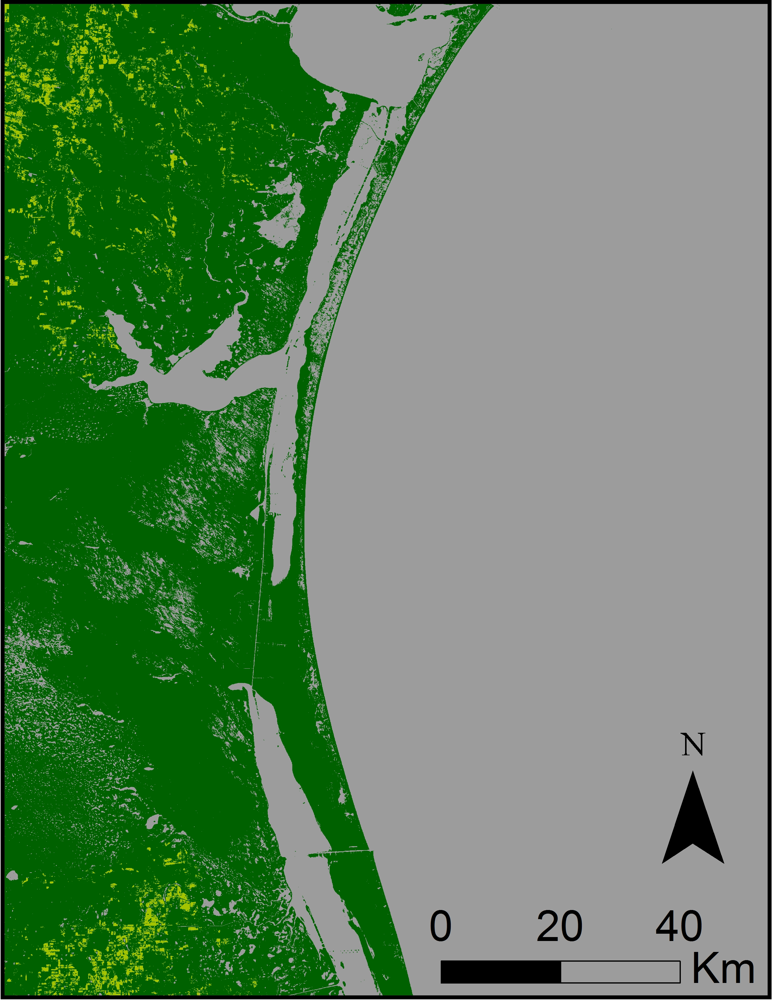
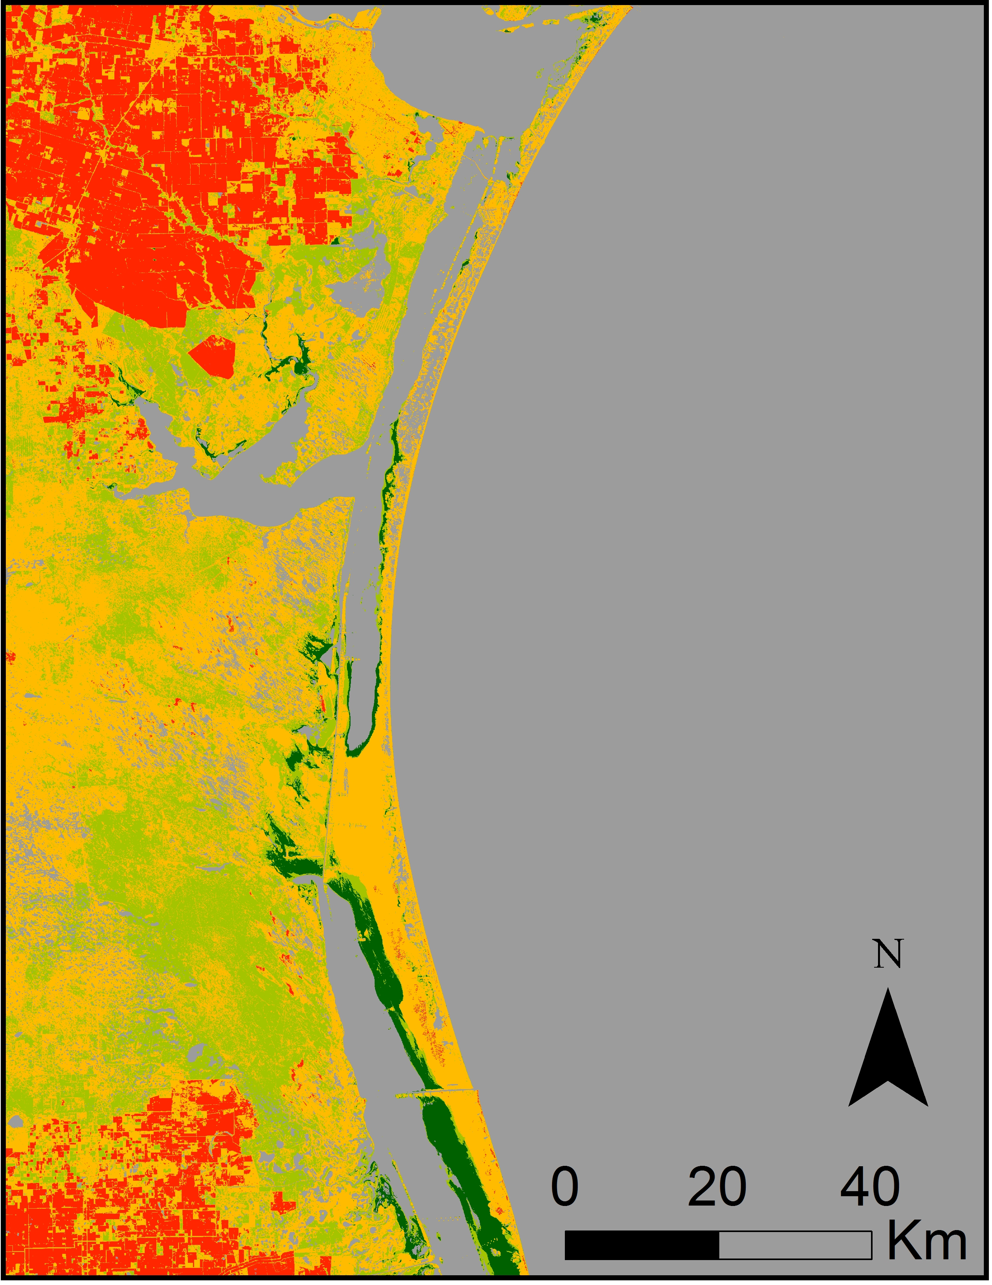
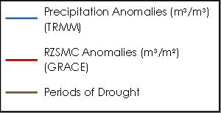
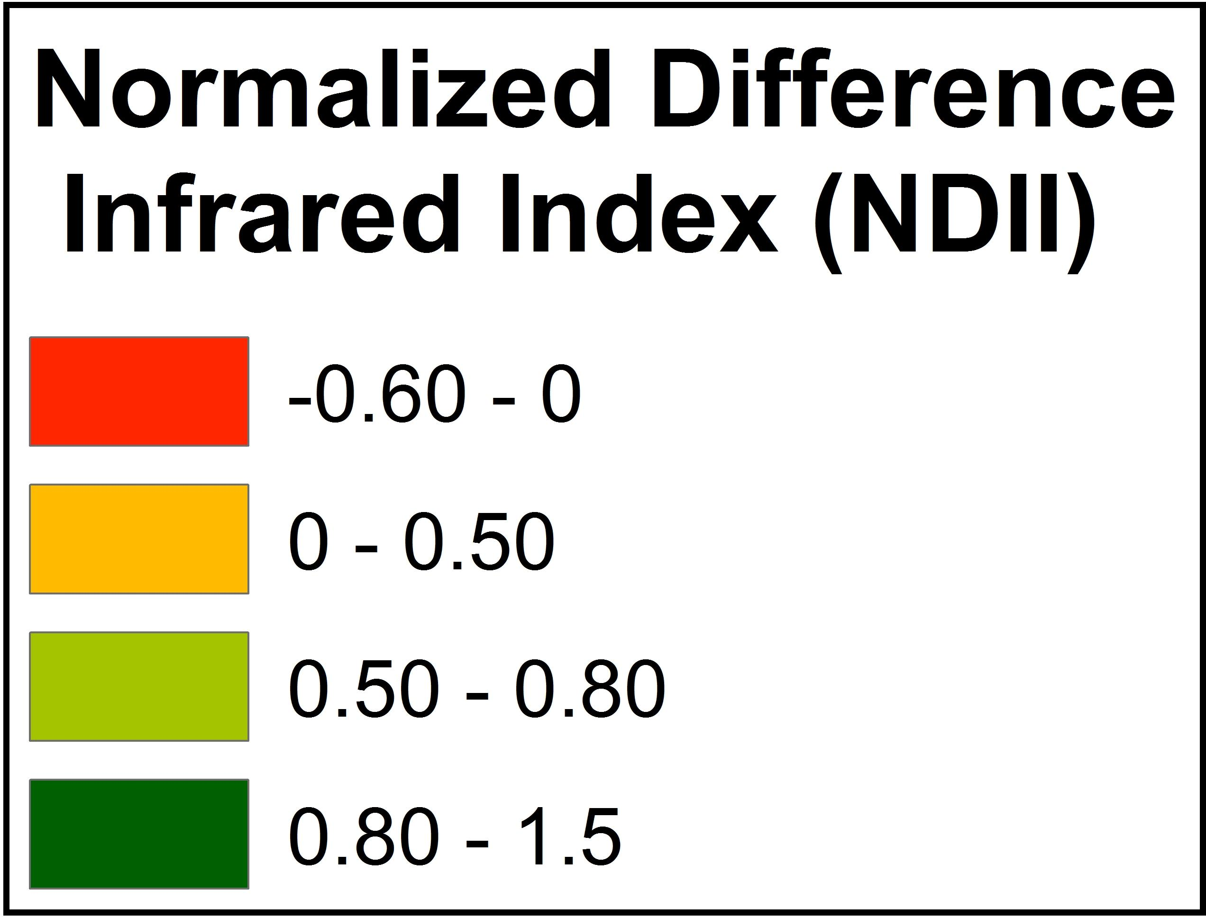
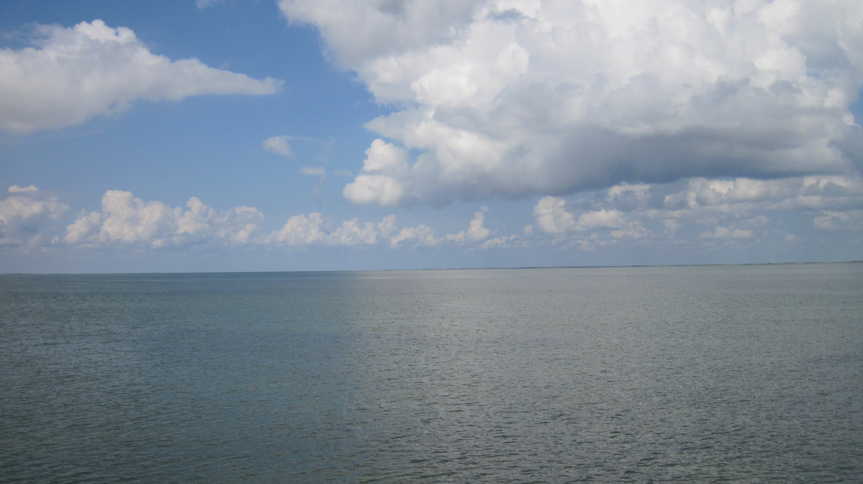
Coastal Texas Water Resources
Utilizing NASA Earth Observations to Assess Estuary Health and Enhance Management of Water Resources in Coastal Texas Through Land Cover and Precipitation Mapping
Elaina Gonsoroski (Project co-Lead), Tyler Lynn (Project co-Lead), Georgina Crepps, Rodrigo Pereira da Silva, Ryan Schick
DEVELOP National Program at the Mobile County Health Department
Abstract
Objectives
This project partnered with the National Park Service (NPS) to help analyze the correlation between mesquite trees and the salinity of the Laguna Madre of the Padre Island National Seashore. The lagoon is currently a hypersaline estuary; however, there is historical evidence that this was not always the case. It is hypothesized that the increased frequency of honey mesquite trees (Prosopis grandulosa var. glandulosa) in the area has effectively increased the Laguna Madre’s increased salinity by decreasing the groundwater inflow to the lagoon. These mesquite trees have long taproots capable of extracting significant amounts of groundwater. This project utilized Earth observation data to create time series of land cover maps that included mesquite trees as a cover type. Landsat 5, 7, and 8 data were used to compute needed land cover maps to analyze the change in the occurrence of mesquite trees over time. Thermal maps of the lagoon were generated using Landsat 5, 7, and 8 data to understand changes in groundwater inflow. In addition, TRMM precipitation data and GRACE derived changes in root zone soil moisture content data were compared over the study period. By assessing the relationships between mesquite tree distributions and the salinity of the Laguna Madre, the NPS can improve future land management practices.
Use NASA data to compile LULC, precipitation, thermal, and groundwater maps of the study area
Compare trends in salinity of the Laguna Madre to trends in the mesquite tree distribution in the surrounding area
Develop a systematic method for studying the relationship between the mesquite trees, groundwater, and lagoon to aid in land management decisions by the NPS
Methodology
Study Area
Land Use/ Land Cover (LULC)
Normalized Difference Infrared Index (NDII)
Thermal Mapping
Water Analysis
Laguna Madre
Padre Island National Seashore
Study Period:
2000 - 2015
Laguna Madre
TOA Reflectance
Landsat 5, 7, & 8
TOA Radiance → Kelvin → Celsius
TRMM
GRACE - derived Root Zone Soil Moisture Content
$$NDII=\frac{NIR−SWIR}{NIR+SWIR}$$
Landsat 5 - TM Bands 7, 4, 2
Mesquite Trees
Credit: National Park Service
LULC Map
Earth Observations
GRACE
Landsat 7
Accuracy Assessment
NDII Map
Thermal Map
Calculate Monthly Anomalies
Results
Landsat 5
TRMM
Landsat 8
Conclusions
Accuracy Assessment of Mesquite Trees
2002 | 92%
2006 | 94%
2010 | 88%
2014 | 88%
The occurrence of mesquite trees increased over the study period (2002-2014).
Mesquite trees identified by the land cover analysis were typically also the locations of moister vegetation on the NDII maps.
The Pearson’s correlation coefficient between the TRMM precipitation data and the GRACE derived root zone soil moisture content was moderately strong.
No anomalies were identified from the thermal mapping to indicate groundwater inflow to the lagoon, but analysis will continue.
Future analyses will examine changes in groundwater recharge by estimating evapotranspiration rates using mesquite tree coverage in the LULCs and precipitation.
2002
2014
2003
2014
Team Members
Project Partner
Acknowledgements
National Park Service
Dr. Bernard Eichold, M.D., Dr. PH
Mobile County Health Department
Joe Spruce
CSC, NASA Stennis Space Center
James “Doc” Smoot
CSC, NASA Stennis Space Center
Dr. Kenton Ross
NASA Langley Research Center
Joe Meiman
National Park Service
(L to R) Back Row: Rodrigo Pereira da Silva, Ryan Schick, Elaina Gonsoroski; Front Row: Tyler Lynn, Georgina Crepps
Laguna Madre. Credit: Joe Meiman, National Park Service
Mobile County Health Department
Notes:
Photo Credit: Joe Meiman, National Park Service

