Slide 1
SOUTHERN BHUTAN
Ecological Forecasting II
Utilizing NASA Earth Observations to Model Land Cover Change and Elephant Wildlife Corridors in Southern Bhutan
Thinley Yidzin Wangden, Kezang Choki Tshering, Kelzang Jigme, Karma Dema, & Thinley Jurmi
Maryland – Goddard
Notes:
Hello, we are the Southern Bhutan Ecological Forecasting II Team
Introduction of each presenter
The focus of our project was to utilize NASA Earth Observations to model land cover change and elephant wildlife corridors in Southern Bhutan

Slide 2
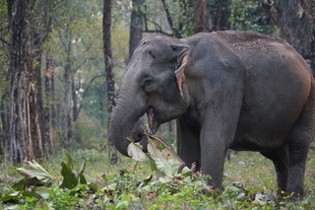
COMMUNITY CONCERNS
Ecosystem: Asian elephants (Elephas maximus) are a keystone wildlife species
Elephant populations: Listed as Endangered by the IUCN
Elephant habitat: Habitat loss and fragmentation due to urbanization
Human-Elephant Conflicts (HEC): Habitat shrinkage increases HECs
Biological corridors: Effective as a wildlife conservation strategy
Image Credit: Bhutan Foundation
Notes:
Bhutan has a forest cover of more than 70% of the country's entire area. Asian elephants are a flagship species essential for the functioning of Bhutan’s forest ecosystems and are directly connected to a rich biodiversity. They are environmental engineers that build pathways for other animals and are also seed dispersers of various plants.
However, Asian elephants has been listed as Endangered on the International Union for Conservation of Nature (IUCN) Red List and their populations continue to shrink due to habitat loss, poaching and retaliatory killings.
Their habitats in southern Bhutan has been shrinking due to increased human activities and rapid urbanization. Elephants are very sensitive to habitat loss and fragmentation.
Habitat loss associated with the scarcity of food for the elephants drives more human-elephant contacts and could lead to increased Human-Elephant Conflicts, costing the livelihood of farmers, and even their lives, in Southern Bhutan. This problem could promote retaliatory killings if left unresolved.
Building biological corridors is a very useful conservation device that attempts to counter the threats of habitat fragmentation by ensuring the long-term persistence of species population. Although Bhutan has dedicated 10% of its total area for corridors, their allocation has been done without much empirical guidance. Realignment of some of these corridors with data-driven studies using remote-sensing data and Earth Observation data could bring substantial improvements in the conservation of endangered species and resolving the human-animal conflict in Bhutan.
------------------------------Image Information Below ------------------------------
•Image Credit: Bhutan Foundation
•Image Source: Image provided by project partner organization

Slide 3
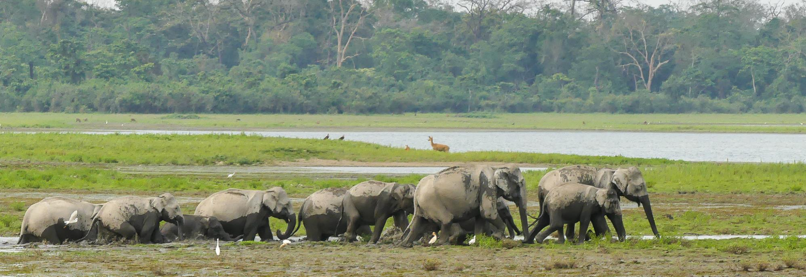
Image Credit: Mike Prince
OBJECTIVES
Develop potential biological corridor map for Asian elephants in southern Bhutan
Produce land cover classification maps for 2010 and 2015
Notes:
Our project has two objectives:
1. To develop a map of potential biological corridors linking protected areas in Southern Bhutan based on the habitat suitability model developed by the previous term. These maps will allow our end user to make informed decisions and inform other policy makers on matters such as urban planning and conservation plans.
2. To generate Land Cover Classification maps for the years 2010 and 2015. These maps were created to build on the LULCs for 1999 and 2019 generated in the previous term for a more comprehensive understanding of the pattern of landscape use.
------------------------------Image Information Below ------------------------------
• Image Credit: Asian Elephants by Mike Prince [CC by 2.0 (https://creativecommons.org/licenses/by/2.0/)]
Image cropped from the original
• Image Source: Creative commons https://www.flickr.com/photos/mikeprince/43815436594/in/photolist-29KPyMY-cnkJeJ-cnkNDJ-9PQ3Zx-Lw617-cnkU2C-bLtbbK-8qk1qo-bgz43c-e2pzou-8A5jB-2AKSN-b2s2tc-b2s3EP-cnkFG5-cnkSmJ-9PQ4ax-9PQ43P-b2rXyV-CwUVxP-cnkENQ-g8QAUA-g8Q9Qd-g8Q1Si-g8Qr68-4VP1Rp-g8QESM-g8QdW9-g8PT4m-g8PKdS-g8Qw4U-g8PpeK-g8QJxm-pHYaib-qCFFt9-p37gKt-pJcp8D-qEY7Dz-qopMqE-LDcfpT-g8QPNR-qEU1cS-qoxHCa-qop7TC-qCFBRQ-g8QK8b-qowjuF-pJcadp-qCFGww-bcH51K

Slide 4
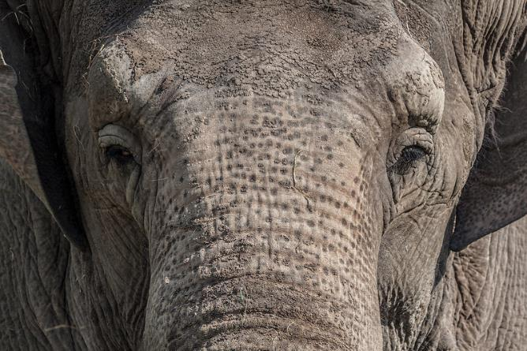
PROJECT PARTNERS
Bhutan Tiger Center
End User:
Collaborators:
Bhutan Foundation
Bhutan Ecological Society
Image Credit: Joel V
Notes:
Our team partnered with the Bhutan Tiger Center, the Bhutan Foundation and Bhutan Ecological Society for this project. These organizations are non-profit organization that are involved in various environment conservation and climate change projects. Our end user, the Bhutan Tiger Center, in particular, is the organization that is responsible for managing the collection of elephant data and informing the public regarding this subject in Bhutan.
These organizations currently do not use NASA Earth Observations in their projects so incorporating NASA Earth Observations and remote sensing data will bring substantial improvements in the conservation of endangered species.
------------------------------Image Information Below ------------------------------
• Image credit: Asian Elephants by Joel V [CC BY–N.C 2.0 (https://creativecommons.org/licenses/by-nc/2.0/)]
• Image Source: Creative commons https://www.flickr.com/photos/razaonetwo/8910506107/

Slide 5
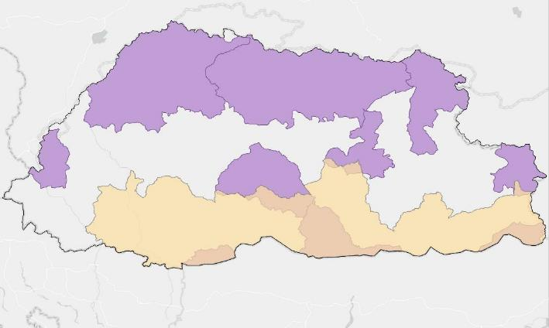
STUDY AREA & PERIOD
N
Bhutan
India
Protected parks
0 25 50 75 100 Kilometers
Study area
Study Area: Southern Bhutan
Study Period: 2010-Present
Notes:
Asian elephants are found in the Southern Bhutan foothills. The town of Gelephu, especially is a hotspot for human-elephant conflict, given its location on previous feeding grounds. It is also conveniently located in between two protected parks: Royal Manas National Park and Phipsoo Wildlife Sanctuary where elephants have been spotted. We will be mainly looking to connect the three protected areas where elephant occurrences have been documented: Royal Manas National Park, Phipsoo Wildlife Sanctuary and Jomotshangkha Wildlife Sanctuary.
For the study period, we are focusing on the past, looking for historical trends and patterns in landscape use and change over the past few decades.
As the previous term had developed LULC maps for 1999 and 2019, we focused on assessing rates of LULC from 2010 onwards.
-----------------
Basemap credits: Esri, DeLorme, HERE, MapmyIndia

Slide 6
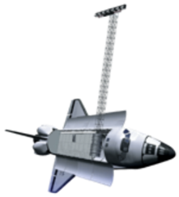
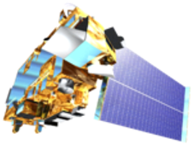
EARTH OBSERVATIONS:
SATELLITES/SENSORS USED
Landsat 5
Thematic Mapper (TM)
Landsat 8
Operational Land Imager (OLI)
Shuttle Radar Topography Mission (SRTM)
Moderate Resolution Imaging Spectroradiometer (MODIS)
Image Credit: NASA
Notes:
We utilized NASA Earth Observations from:
Landsat 5 to obtain annual image composite of the year 2010
Landsat 8 to obtain the annual image composite for the year 2015 and 2020
SRTM and MODIS were used in the previous term to obtain data for the habitat suitability model which will be used in our project to derive the resistance map.
------------------------------Image Information Below ------------------------------
Image source: NASA
http://www.devpedia.developexchange.com/dp/index.php?title=List_of_Satellite_Pictures

Slide 7
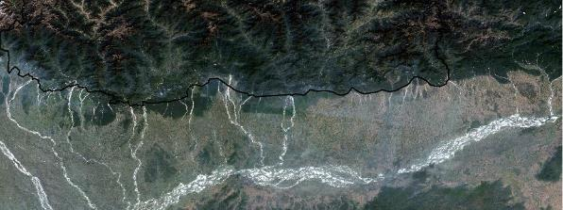
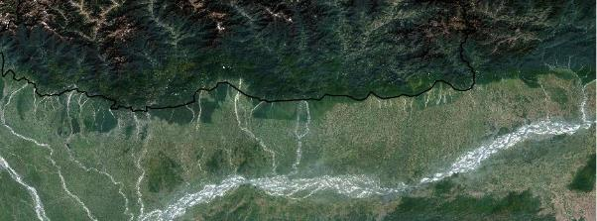
METHODOLOGY:
Data inputs to LULC classifications
2010 Land Cover Land Use
Landsat 5 TM from GEE
2015 Land Cover Land Use
Landsat 8 OLI from GEE
0 50 100 150 200 Kilometers
0 50 100 150 200 Kilometers
N
N
Notes:
The team used the codes scripted by the previous term on Google Earth Engine to obtain annual cloud-free Landsat scenes for 2010 and 2015 based on median composite method. Landsat 5 TM and Landsat 8 OLI were used to obtain Landsat images for 2010 and 2015 respectively.
Note: * The 2010 image looks more hazy than the 2015 image. This may be the factor in the 2010 LULC map accuracy being lower which we will show in later slides.

Slide 8
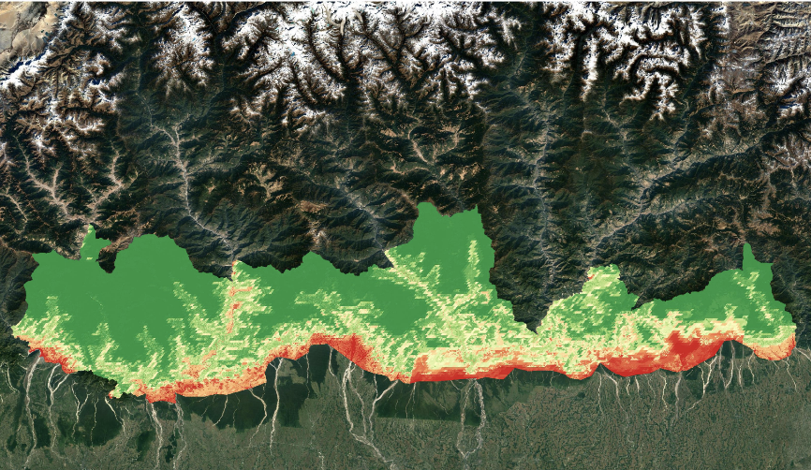
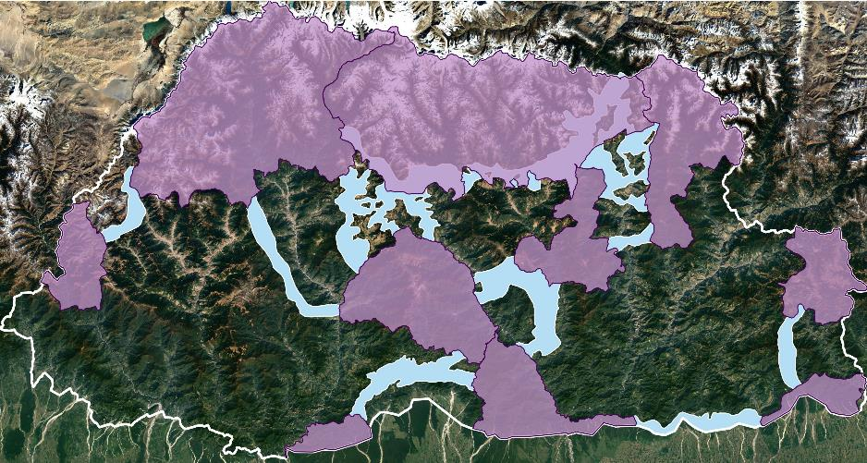
METHODOLOGY:
Data Inputs to Corridor Models
Elephant Habitat Suitability Map from the previous term
Map of Protected Areas and Corridors in Bhutan provided by the Bhutan Foundation
0 30 60 Kilometers
0 30 60 Kilometers
Parks
N
N
Corridors
Low
High
Notes:
The team used the Boosted Regression Tree (BRT) elephant habitat suitability model generated in the last term to build the resistance raster for elephant habitats.
In addition to NASA data, the Bhutan Foundation also provided the team with maps of existing protected areas and corridors that was as used as input for mapping linkages.
-----------------
Basemap credits: Google Satellite

Slide 9
METHODOLOGY: Data Processing & Analysis
Potential Corridor Map
LULC Maps
Bhutan Foundation GIS Data
Habitat Suitability Model from Term I
Landsat Mosaics from GEE
ArcGIS Pro
ArcGIS Pro
Multispectral Composites
(2010, 2015 & 2020)
Protected Areas Map
Resistance
Raster
LULC Maps – 20 clusters (2010 & 2015)
Linkage Mapper (ArcMap)
LULC Maps – 5 classes (2010 & 2015)
Map of Potential Elephant Corridors
Accuracy Assessment
Notes:
For mapping the potential corridors for elephants, we used the Bhutan Foundation GIS data on existing protected areas and corridors in Bhutan. The data were imported into ArcGIS Pro and processed to create a protected area map.
The BRT Habitat Suitability Model from the previous term was also imported into ArcGIS Pro where we normalized it and inverted it by using the Raster Calculator tool and the Con tool to create the resistance raster.
Then, the protected area map and the resistance raster were used as inputs for Linkage Mapper in ArcMap to identify possible linkages befitting the elephant habitats and create a map of biological corridors using the least cost path.
For the LULC maps, we acquired the Landsat 5 and Landsat 8 scenes Google Earth Engine. The extent of the scenes were the same as those of the LULC maps created during the previous term. We imported the Landsat scenes to ArcGIS Pro and mosaicked them to create true color composites for the years 2010, 2015 and 2020.
In order to create LULC maps for 2010 and 2015, we performed unsupervised classification in Arc GIS Pro, yielding 20 different classes. We identified and grouped similar classes through training data and machine learning algorithm to reclassify the map into 5 classes. We then performed accuracy assessment tests on the LULC maps using 500 points. In order to assess the accuracy of our classified result, we used the Create Accuracy Assessment Points geoprocessing tool to read and write out the dataset. Stratified random sampling strategy was performed to create randomly sampled points, which were then used for the post-classification accuracy assessment.
We will be focusing on the results of the LULC classification first. (Move on to next slide)

Slide 10
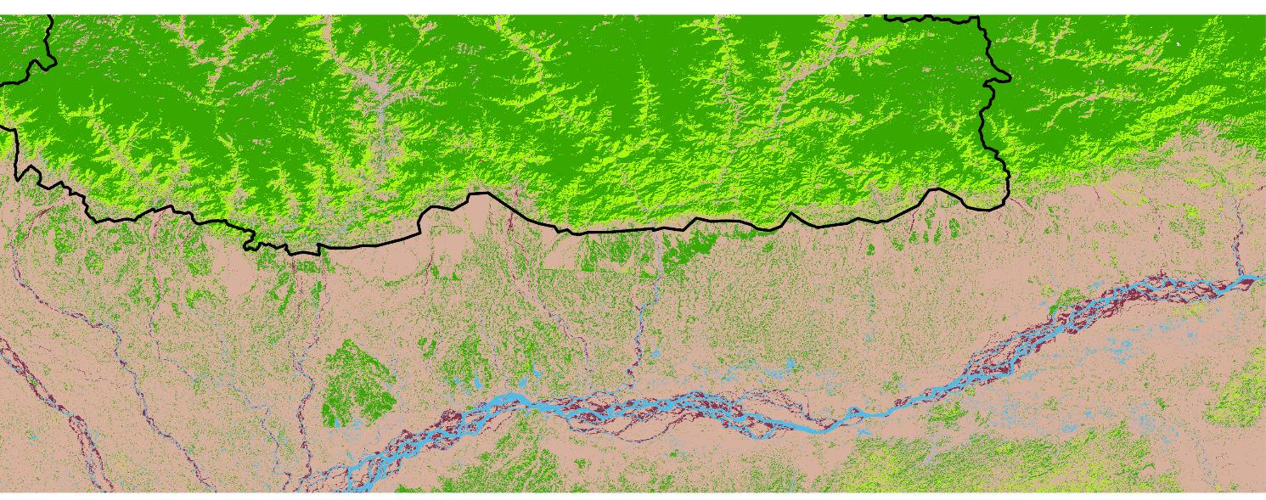
RESULTS: 2010 LULC Map
0 50 100 150 Kilometers
N
Mature Forest
Immature Forest
Water Bodies
Barren Lands
Cultivated Lands
Notes:
The first of the LULC maps we created is the LULC map for 2010 made with Landsat 5 TM scenes. The five classes used are Mature Forest, Immature Forest, Cultivated Land, Barren Land and Water Bodies. These classes are the same classes used for the LULCs made in the previous term of the project, with the exception of snow. These were determined as the most useful classes in relation to the elephant habitat suitability. We recognized that keeping the same classes would be helpful in comparing the land cover change over the years and can be compared with the other two maps from the previous term of the project. It will make it easier for the next term of the project to work on land change analysis. Mature Forest was the dominant class for southern Bhutan as seen in the map. It seems like the 2010 LULC map underclassifies some forests just south of Bhutan border in adjacent India - it might be due to atmospheric contamination on the Landsat mosaic for 2010. Which might have also affected our accuracy rate. From our accuracy assessment, this map had an accuracy rate of 87%.

Slide 11
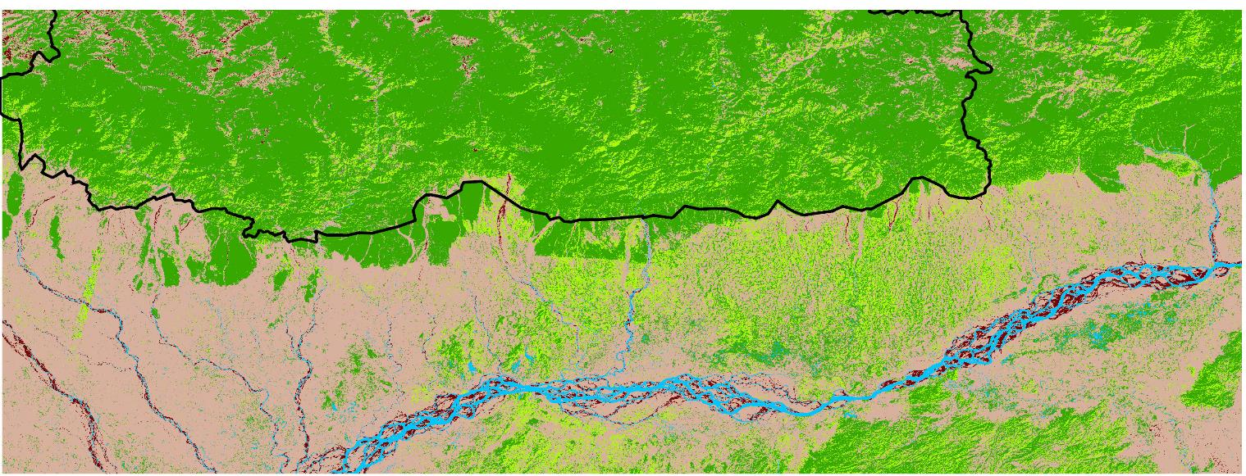
RESULTS: 2015 LULC Map
0 50 100 150 Kilometers
N
Mature Forest
Immature Forest
Water Bodies
Barren Lands
Cultivated Lands
Notes:
This is the LULC map for 2015. This also displays the same 5 classes as the 2010 LULC map. Mature forests was still the dominant class in this map. There doesn't seem to be much of a change in landscape from 2010 except for a slight increase in cultivated and barren lands.
Due to the huge difference in terrains between Bhutan and India, there were conflicting classifications between the two. So, for our purposes, our classification and accuracy assessments were primarily focused on the Bhutan part of the map. The accuracy rate for this turned out to be 96% .
The previous term created two LULC maps for 1999 and 2019, and with these two maps, it completes the series of the LULC maps that will be used for assessing rates of land use and land cover as well as forecasting future land changes. Land change maps can be created to statistically visualize the change in land cover over the years. This will provide useful information for the third term in forecasting future land cover.

Slide 12
METHODOLOGY: Data Processing & Analysis
Potential Corridor Map
LULC Maps
Bhutan Foundation GIS Data
Habitat Suitability Model from Term I
Landsat Mosaics from GEE
ArcGIS Pro
ArcGIS Pro
Multispectral Composites
(2010, 2015 & 2020)
Protected Areas Map
Resistance
Raster
LULC Maps – 20 clusters (2010 & 2015)
Linkage Mapper (ArcMap)
LULC Maps – 5 classes (2010 & 2015)
Map of Potential Elephant Corridors
Accuracy Assessment
Notes:
Our other product is the potential corridor map (Move on to next slide)

Slide 13
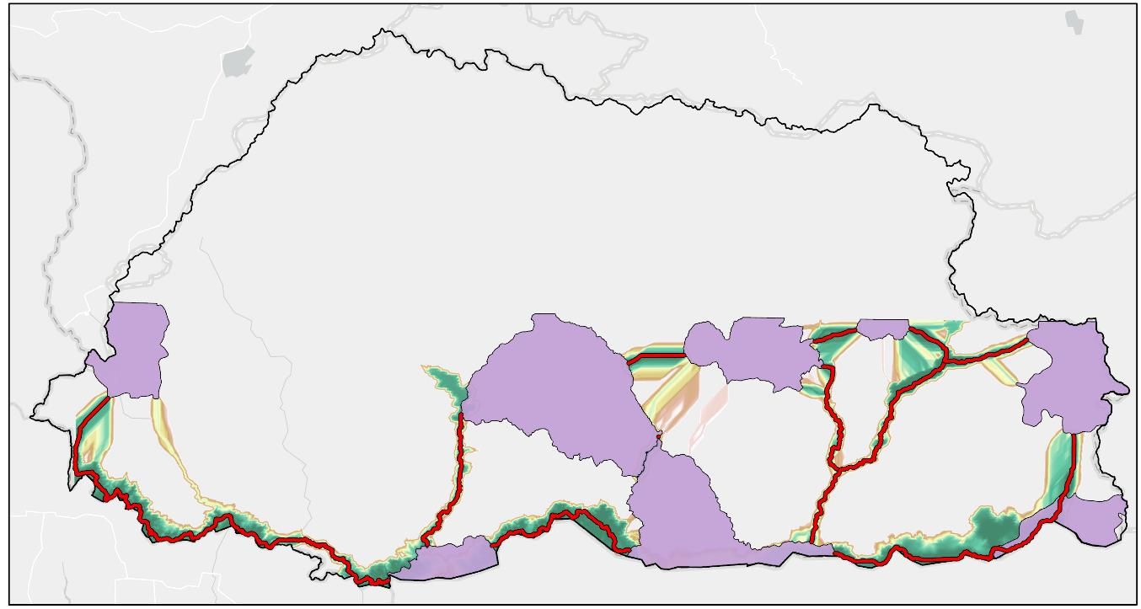
RESULTS: Potential Corridor Map
N
Least cost path
Protected parks
Corridor suitability
High suitability
Low suitability
0 50 100 150 Kilometers
Notes:
Our second product is the potential corridor map for elephants in the southern Bhutan foothills mapped via the least cost path on Linkage mapper. They were created based on the habitat suitability model for Asian elephants that identifies suitable habitat based on the elevation, precipitation, distance from water, Normalized Difference Vegetation Index (NDVI) Phenology, etc. The least costs paths identified have the least resistance accumulated in connecting the protected areas in relation to all these aspects of the terrain. This means that these paths are the most suitable in terms of resistance to elephants and are the most ideal.
A range of suitability for corridors is also shown as cost in distances away from the least cost paths. The dark green areas closest to the least cost paths are more suitable than those further away. This map reflects the most suitable corridors and the suitability of the areas around the least cost paths.
A point to note would be that we did not set limiting parameters that would exclude possible corridors like the maximum number of linkages between corridors, maximum cost weighted or Euclidean distances for corridors. We did this to be able to see all possible linkages and then identify which ones might be of interest. This means that not all these linkages are realistically ideal.
An example would be this linkage. It runs through the entire border and is very long. Furthermore, these protected areas may not need connecting as they are very far and with very different terrains and conditions. (click next)
Another point to note is that our study area only included southern Bhutan and generated potential linkages within Bhutan. However, elephants practice transboundary migration in the real world, so expanding our study area to include areas in North India could have given us different results.

Slide 14
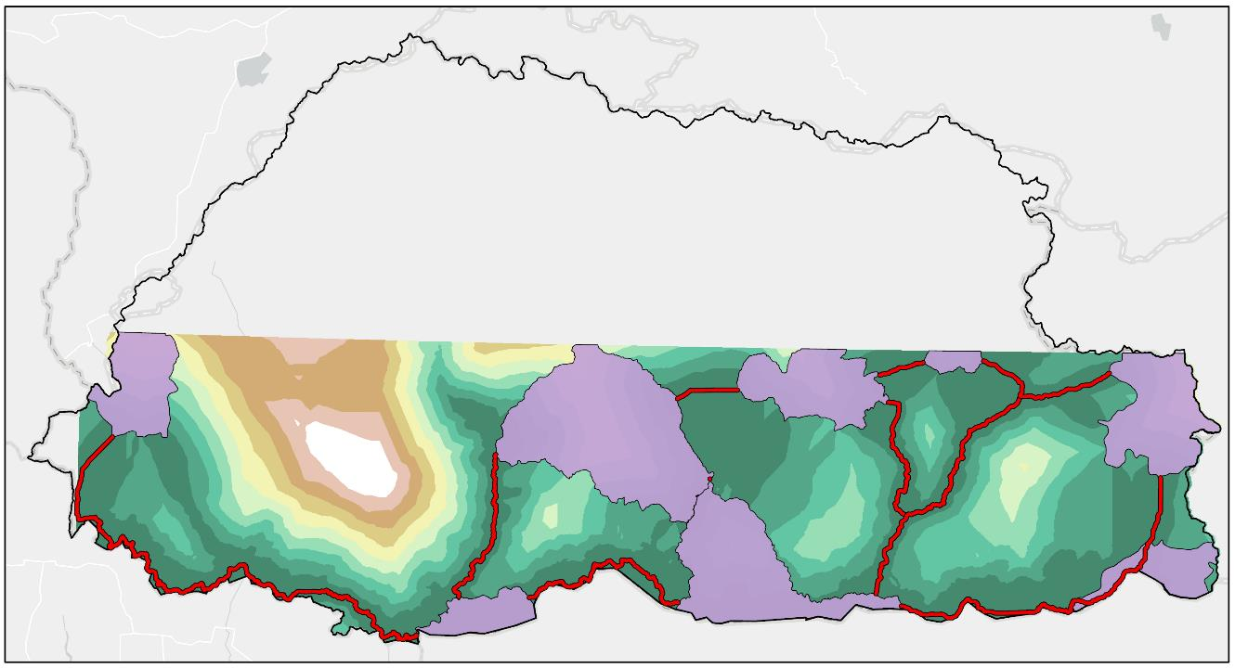
RESULTS: Potential Corridor Map
Least cost path
N
Protected parks
Corridor suitability
High suitability
Low suitability
0 50 100 150 Kilometers
Notes:
Our second product is the potential corridor map for elephants in the southern Bhutan foothills mapped via the least cost path on Linkage mapper. They were created based on the habitat suitability model for Asian elephants that identifies suitable habitat based on the elevation, precipitation, distance from water, Normalized Difference Vegetation Index (NDVI) Phenology, etc. The least costs paths identified have the least resistance accumulated in connecting the protected areas in relation to all these aspects of the terrain. This means that these paths are the most suitable in terms of resistance to elephants and are the most ideal.
A range of suitability for corridors is also shown as cost in distances away from the least cost paths. The dark green areas closest to the least cost paths are more suitable than those further away. This map reflects the most suitable corridors and the suitability of the areas around the least cost paths.
A point to note would be that we did not set limiting parameters that would exclude possible corridors like the maximum number of linkages between corridors, maximum cost weighted or Euclidean distances for corridors. We did this to be able to see all possible linkages and then identify which ones might be of interest. This means that not all these linkages are realistically ideal.
An example would be this linkage. It runs through the entire border and is very long. Furthermore, these protected areas may not need connecting as they are very far and with very different terrains and conditions. (click next)
Another point to note is that our study area only included southern Bhutan and generated potential linkages within Bhutan. However, elephants practice transboundary migration in the real world, so expanding our study area to include areas in North India could have given us different results.

Slide 15
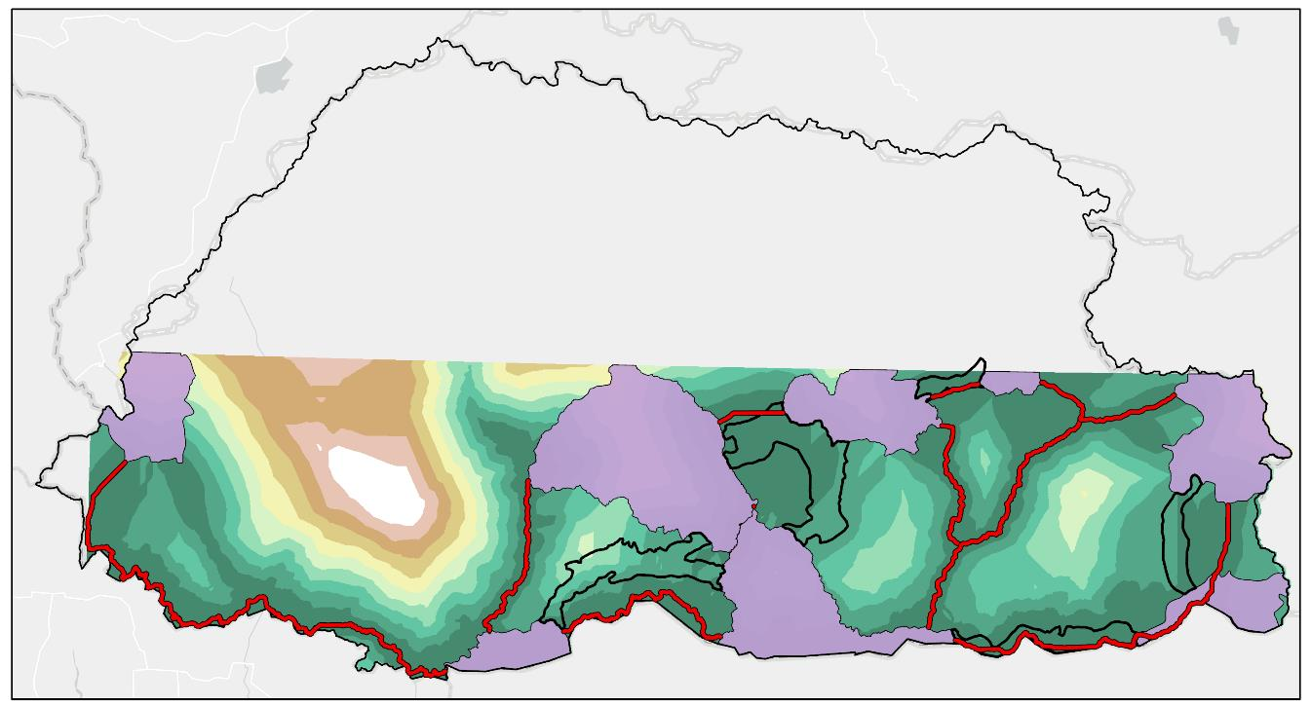
RESULTS: Suitability of Existing Corridors
Least cost path
N
Protected parks
Existing Corridors
Corridor suitability
High suitability
Low suitability
0 50 100 150 Kilometers
Notes:
We compared the existing corridors to the potential corridors and cost weighted distances that we created. In doing so, we found that there were a few existing corridors that slightly overlap with the new corridors we mapped. (next) This tells us that these corridors are very close and occupy some areas of the least cost path.
Out of the corridors in the south, one seems to align well and covers the least cost path. (next) Furthermore, the entire corridor area seems to fall within a high suitability range. (next)
The other existing corridors in the south do not align with the potential corridors that our team mapped but they do fall within a range of relatively higher suitability.

Slide 16
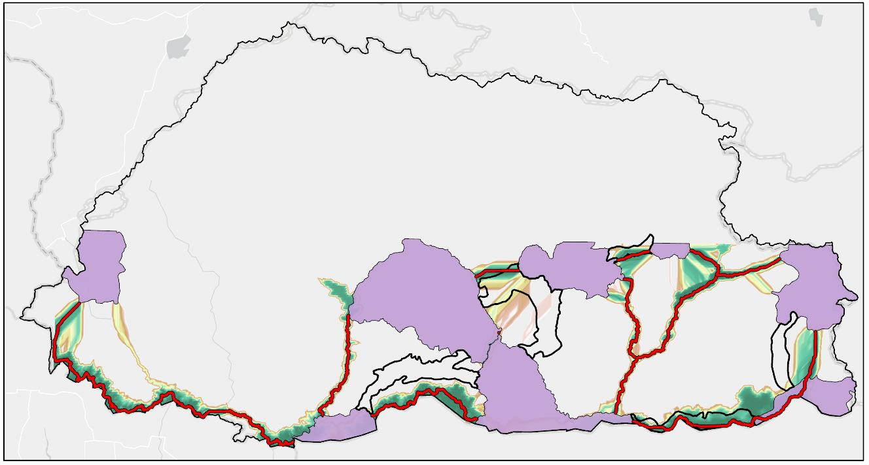
RESULTS: Suitability of Existing Corridors
Least cost path
N
Protected parks
Existing Corridors
Corridor suitability
High suitability
Low suitability
0 50 100 150 Kilometers
Notes:
We compared the existing corridors to the potential corridors and cost weighted distances that we created. In doing so, we found that there were a few existing corridors that slightly overlap with the new corridors we mapped. (next) This tells us that these corridors are very close and occupy some areas of the least cost path.
Out of the corridors in the south, one seems to align well and covers the least cost path. (next) Furthermore, the entire corridor area seems to fall within a high suitability range. This tells us that the NDVI, elevation, precipitation, and the other variables in the habitat suitability model are more suitable for elephant movement between these corridors. (next)
The other existing corridors in the south do not align with the potential corridors that our team mapped but they do fall within a range of relatively higher suitability.

Slide 17
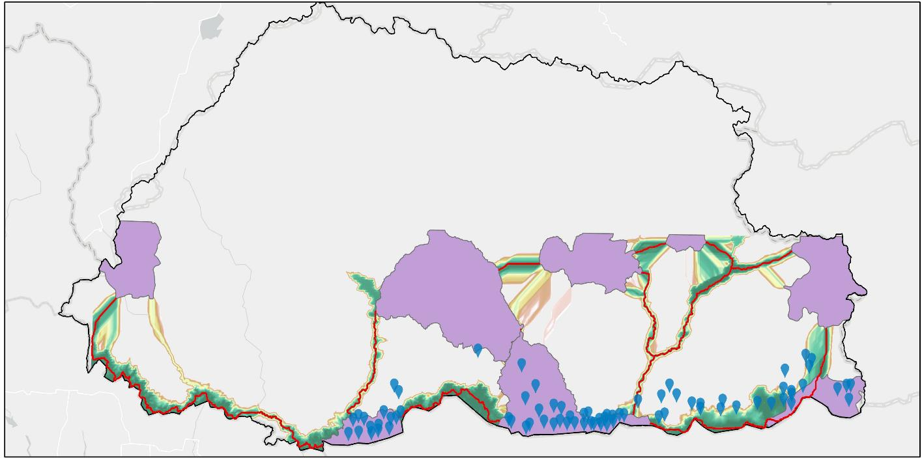
RESULTS: Potential Corridor Map
Least cost path
N
Protected parks
Elephant Occurrences
Corridor suitability
High suitability
Low suitability
0 50 100 150 Kilometers
Notes:
We also compared the elephant occurrences data we had to our corridor map to see if there were any overlaps and check whether our corridors are feasible in real life. This is not a proper validation of our corridor map as the elephant occurrence data we were provided was not complete.
We found that in the northern areas, there are not as much elephant occurrences which could potentially be due to the elevation differences. This means that of the potential corridors we have mapped, the ones in the north would not pertain to Asian elephant movement. Research to identify more suitable potential corridors up north could be conducted with a more relevant indicator species.
(next)
From the elephant occurrences, we can infer that these corridors to the south are of greater significance to the Asian elephants.

Slide 18
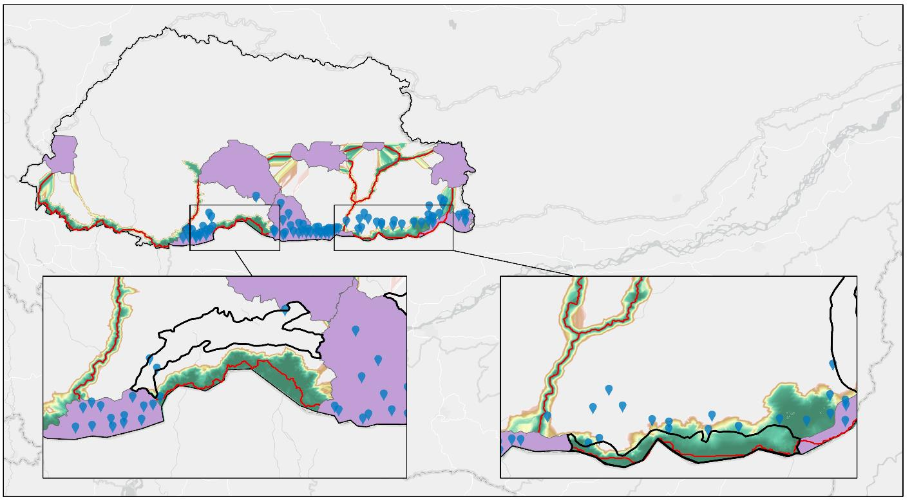
RESULTS: Potential Corridor Map
N
Least cost path
Protected parks
Elephant Occurrences
Corridor suitability
High suitability
Low suitability
0 50 100 150 Kilometers
Notes:
This provides a better view of the elephant occurrence in the south in relation to existing corridors and the linkages we mapped. Bear in mind that these occurrences data is not complete so that may explain some of the absences. This can guide focus for further research in filtering and examining the actual feasibility of the least cost path corridors that will be useful for the elephants. Further studies can look at urban settlements around the area and pair with a forecasted land use land cover map to determine the eligibility of the potential corridors.

Slide 19
CONCLUSIONS
Produced model of potential linkages between protected areas
Provide information for aiding wildlife conservation and land use planning in Bhutan
Linkage Mapper enabled mapping and evaluation of potential wildlife corridors
Landsat data were useful for deriving LULC maps needed for future work
Image Credit: Bhutan Foundation
Notes:
We identified multiple potential linkages connecting protected areas in southern Bhutan and from our analysis, we recognized that there are some existing corridors that closely with the least cost paths while others are located in areas with relatively higher suitability for elephants. Our results can guide the future use of landscape in southern Bhutan by displaying areas that are suitable elephant habitats and thus must be protected from anthropological activities. It is important to involve all stakeholders to prioritize potential linkages and reallocate some corridors to reduce HEC and support elephant conservation. There is a need to incorporate areas in North India in this research to promote transboundary cooperation and initiative for better conservation strategies of Asian elephants. Linkage Mapper is a very useful tool for research in identifying potential biological corridors for not only elephants but other endangered species to combat habitat loss and provide support in the conservation scene.
------------------------------Image Information Below ------------------------------
•Image Credit: Bhutan Foundation
•Image Source: Image provided by project partner organization

Slide 20
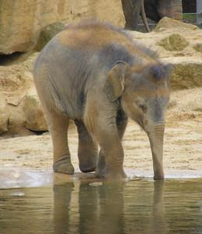
ERRORS & UNCERTAINTIES
Landsat TM and OLI data have different spectral band characteristics
The LULC classifications were based on limited reference data and Landsat data that included some haze in the visible bands
Our corridor mapping depended heavily on the previous term's habitat suitability model
Study Period
Variables
A full quantitative validation of our corridor maps was not performed due to lack of available reference data
Image Credit: Marie Hale
Notes:
The Landsat data from Landsat 8 OLI has additional band designations compared to Landsat 5 TM resulting in different accuracy rates for the two maps.
Limited training data and subjectivity in the classification process of the LULC maps due to different interpretations of the data caused some errors.
With the different terrains, similar areas in Bhutan and India were classified differently so we focused mostly on Bhutan. The Landsat results were good overall across the entire study area - also the unsupervised classification method is less subjective than that employed using the supervised classification method.
Our corridor mapping is highly dependent on the previous term's habitat suitability model and data. So, it encompasses all the errors and uncertainties from the previous term. The elephant data collected ranged from 2014 to 2019. This disparity in the study period could have caused some errors in our results. The distance to road and the distance to water variables for the past years were considered as static since these variables, specifically for the year 1999, could not be determined. Another variable that was not included in the habitat suitability model is barriers to elephant movement such as fences due to lack of data.
Validation of our potential corridors could not be done because we did not have appropriate ground data of elephant occurrences and absence data. The partners could do further research on this by collecting more in-situ data.
------------------------------Image Information Below ------------------------------
• Image credit: Asian Elephants by Marie Hale [CC BY 2.0 (https://creativecommons.org/licenses/by/2.0/)]
Image cropped from the original
• Image Source: Creative commons https://www.flickr.com/photos/15016964@N02/5895401696/in/photolist-9YXtwQ-6TA491-29j3LNt-dvudk4-M5Bfrt-8mWCp6-r42syo-CMuris-7fqr19-aBYBZ6-7fmz52-r3XhX6-cABjrf-qGeZ7n-cABjbA-bsdjt9-qLFxxT-g7Jf4-r3XdTz-rrg7bg-dgSe3y-GzCQh-8EDkj-M6h5k8-EqV6Lg-7fqqk7-iv5WM-8ECcS-GzCdy-9yTaUv-mJ8CwK-cABiWW-8wrBRi-6pKZ8E-7LKKSP-N6ssVq-QhNMGF-LDchvr-29KPyMY-uuhf3-BShywA-7chdV7-CwUVxP-5DgV9s-RsRxKC-4wdgAy-8ECxT-29iAE39-2ap2r5V-29iBZ3G

Slide 21
FUTURE WORK
Forecast
Forecast Land Use and Land Cover for 2030
Predict
Predict future habitat change and examine susceptibility of elephant movement corridors in the future
Implement
Implement the Land Use Conflict Identification Strategy (LUCIS) model to address the land use conflict in southern Bhutan
Notes:
For future work, an additional term is recommended to build on the results of the past two terms and look at the feasibility of the biological corridors in the future. The two terms so far has only focused on the past in terms of LULC. Future work could assess the land cover change and forecast the LULC for the next few years in order to predict future habitat change of Asian elephants and the susceptibility of the corridors amidst the rapid urban developments. They could also implement the Land Use Conflict Identification Strategy (LUCIS) model to address the land use conflict in southern Bhutan.

Slide 22
Advisors:
Joe Spruce, SSAI Research Consultant, Diamondhead, MS
Dr. Kenton Ross, NASA Langley Research Center
Sean McCartney, SSAI, NASA Goddard Space Flight Center
Fellows:
Nicole Ramberg-Pihl, DEVELOP Fellow, NASA Goddard Space Flight Center
Darcy Gray, DEVELOP Fellow, NASA Georgia Center of Geospatial Research
Partners:
Tshewang Wangchuk, Bhutan Foundation
Dr. Tshering Tempa, Bhutan Tiger Center
Nawang Norbu, Bhutan Ecological Society
Past Contributors:
Palchen Wangchuk, NASA DEVELOP Maryland – Goddard
Tashi Choden, NASA DEVELOP Maryland – Goddard
Kuenley Pem Dem, NASA DEVELOP Maryland – Goddard
Kelzang Jigme, NASA DEVELOP Maryland – Goddard
Sonam Choden, NASA DEVELOP Maryland – Goddard
Notes:
First, we would like to thank our science advisors, Joe Spruce, Dr. Kenton Ross, and Sean McCartney, and our DEVELOP Fellows, Nicole Ramberg-Pihl and Darcy Gray for all your guidance throughout the project. We would also like to thank our partners for all the support they provided and the previous team for their contributions. Thank you everyone.

Slide 23
Backup Slides

Slide 24
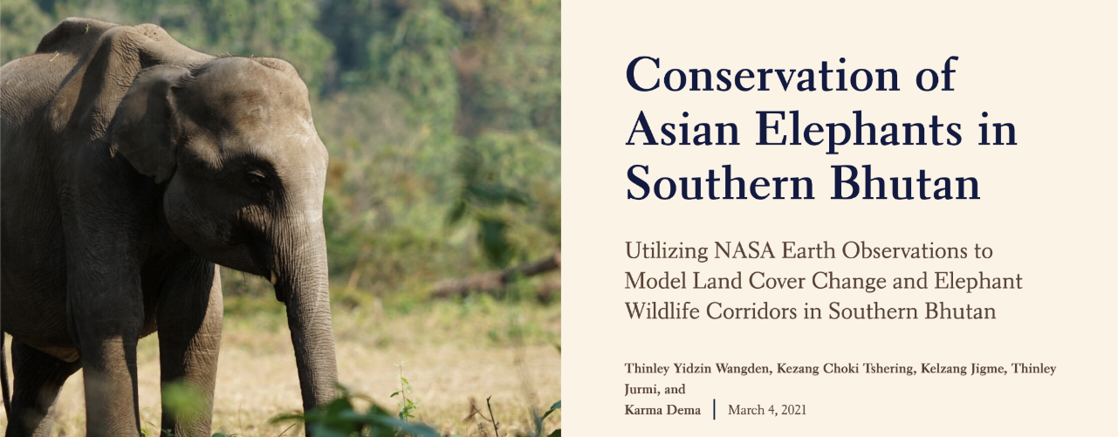
AGOL StoryMap

Slide 25
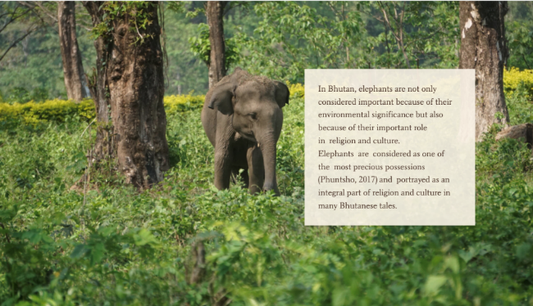
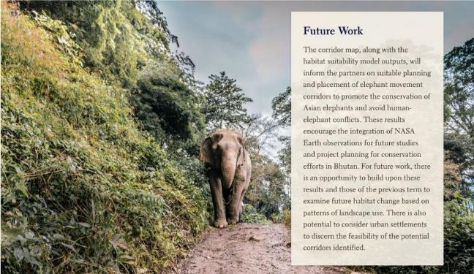
AGOL StoryMap

