Slide 1
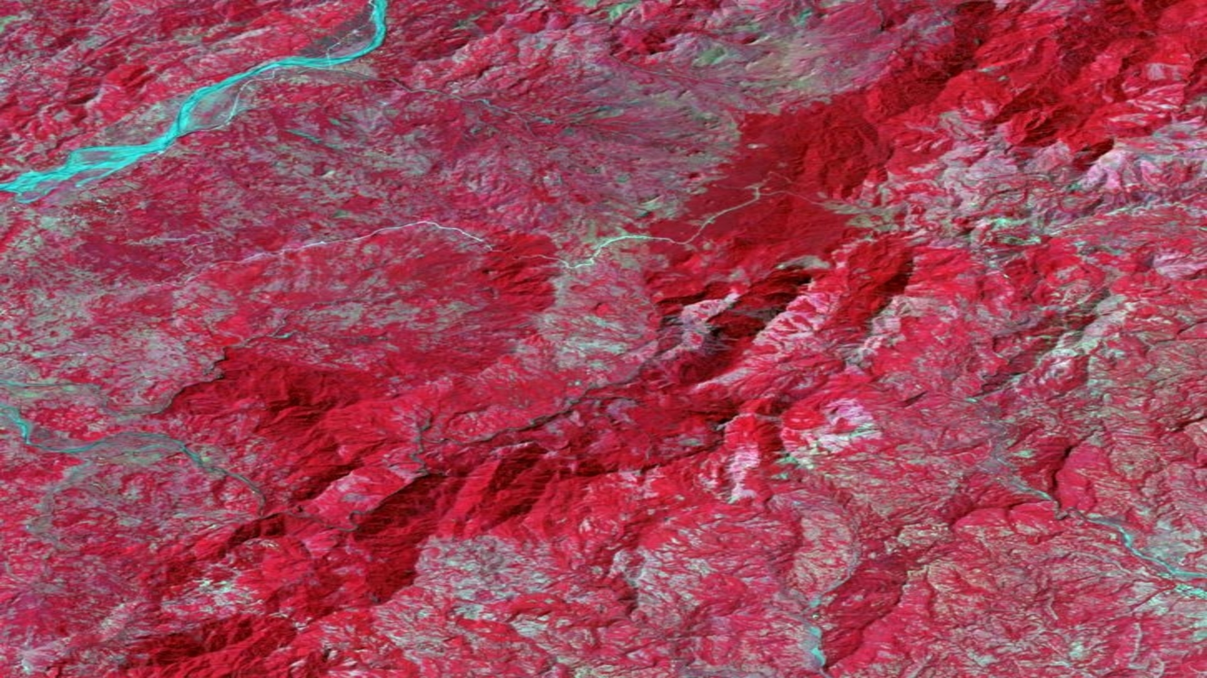
VISAYAN ISLANDS
ECOLOGICAL FORECASTING
Identifying and Evaluating Changes in Land Use and Land Cover on the Visayan Islands over time for Reintroduction of the Visayan Warty Pig (Sus cebrifons) and Visayan Spotted Deer (Rusa alfredi)
Ryan Slapikas
Naomi Belle
Eze Amadi
Lusitania Savio
Georgia – Athens | Fall 2019
Notes:
Introduction Speaker:
Hello, my name is Ryan Slapikas. I have a Masters Degree in Geographic Information Science from Florida State University with Bachelors Degrees in Geography and International Affairs.
I am Naomi Belle, I graduated with a bachelors in biology and masters in environmental science from Tuskegee University.
I am Lusitania Savio, I graduated with a bachelor in Environmental Science from Westminster College in MO.
I am Eze’ Amadi, I have a bachelors degree in environmental technology from the University of Technology in Owerri, Nigeria. I am currently obtaining my masters in agriculture and environmental sciences at Tennessee State University.

Slide 2
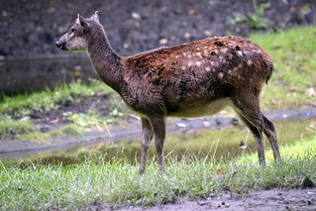
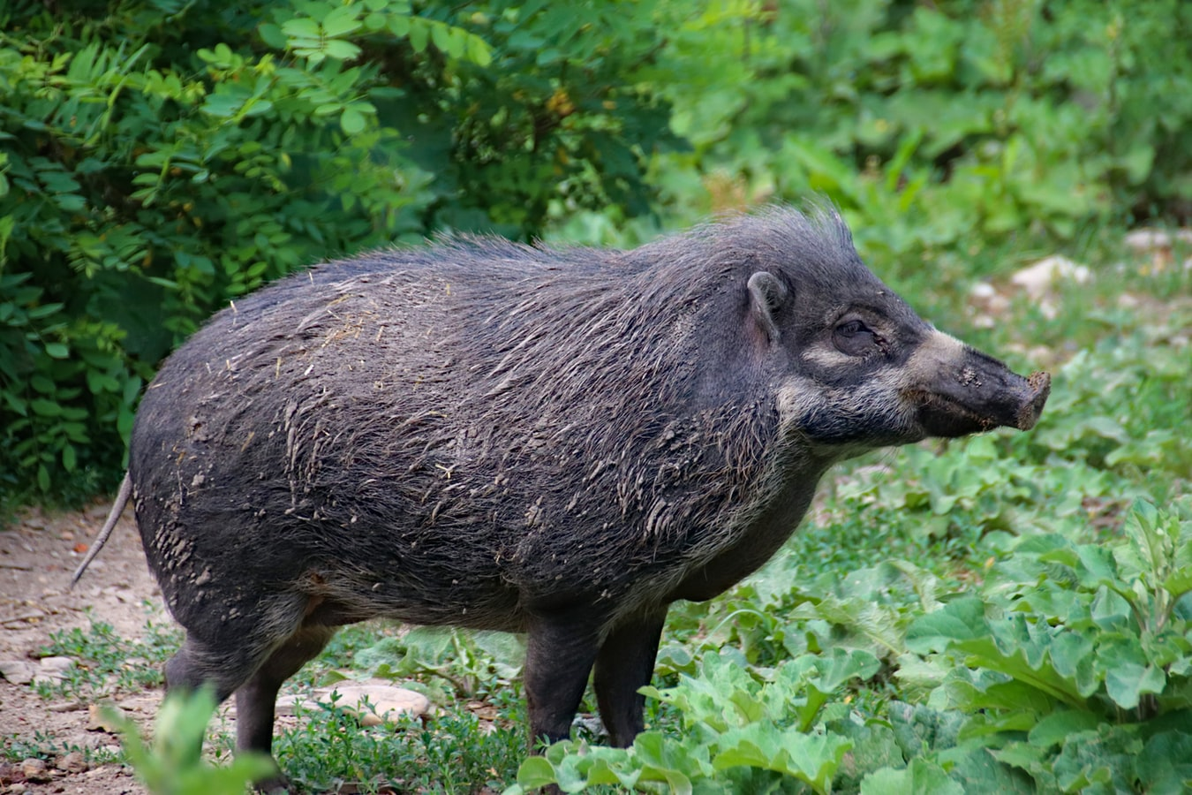
Background
 Increased rate of species endemism
 Decreased biodiversity
 Vegetation degradation
 Native vs Indigenous plant species
Image credit: Tim Strater
Image credit: Dušan Smetana
Notes:
Lucy
The Philippines is a priority for wildlife conservation due to a large number of endemic species. The Visayan warty pig (Sus cebrifons) and Visayan spotted deer (Rusa alfredi) are threatened due to extirpation from native habitat. The exploitation and destruction of natural resources and habitat have reduced the amount of unique biodiversity. There have been reforestation efforts, however, the planting of invasive plant species is decreasing native forest cover.
Image Source: Tim Strater https://www.flickr.com/photos/stuutje/14967516761/in/photolist-oNCrgP-c1PWfS, (CC BY-SA 2.0)
Image source: Dušan Smetana https://unsplash.com/photos/yWcnDXXvsZA, Unsplash license

Slide 3
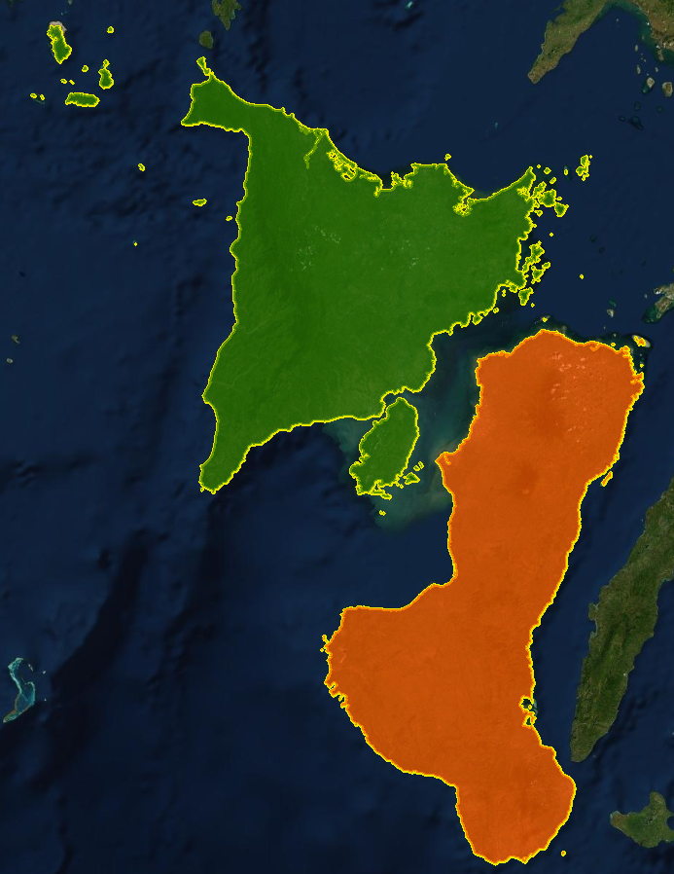
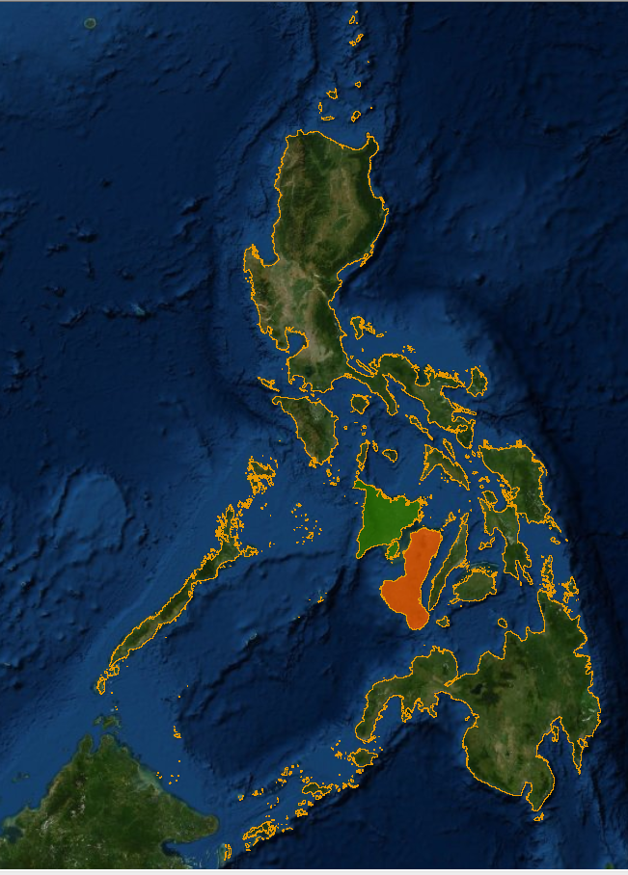
Study Area
Two Islands
Panay Island
Negros Island
Study Period
1987 to 2019
Forecasting Years
2030 and 2050
Philippines
N
Philippines
Negros Island
Panay Island
Visayan Islands
0
25
50
75
100
km
Notes:
Lucy
These two islands of the Central Visayan Islands group are primary areas of interest for the critically endangered Visayan spotted deer (Rusa alfredi) and Visayan warty pig (Sus cebifrons). The Arizona Center for Nature Conservation - Phoenix Zoo and Talarak Foundation Inc. took the initiative to set up cameras for surveillance on Panay Island. For the first 8 months, there were not any sitings of either species. The surveillance footage later revealed presence of the Warty pig species.
Base layer source: World Imagery provides one meter or better satellite and aerial imagery in many parts of the world and lower resolution satellite imagery worldwide. Esri, DigitalGlobe, GeoEye, Earthstar Geographics, CNES/Airbus DS, USDA, USGS, AeroGRID, IGN, and the GIS User Community.
http://goto.arcgisonline.com/maps/World_Imagery

Slide 4
Objectives
Develop code in Google Earth Engine to perform image correction for Landsat imagery, display NDVI/EVI indices, and complete land classification
Apply NDVI, EVI, NDWI, NDMI, and NDBI for vegetation analysis along with Texture analysis with Tasseled cap for land cover classification in Google Earth Engine
Analyze vegetation land cover change during the study period
Forecast land classes to show land cover change from 2019 to 2030 and 2050
Notes:
Naomi
Google Earth Engine was used to produce Normalized Difference Vegetation Index (NDVI) and Enhanced Vegetation Index (EVI) images for Panay and Negros Islands. The images were classified to distinguish between various land cover attributes including: Primary forest, Secondary Forest, Water, and Urban, and Plantation areas. Using TerrSet software and QGIS MOLLUSCE, we were able to forecast future land cover classes for the years 2030 and 2050.

Slide 5
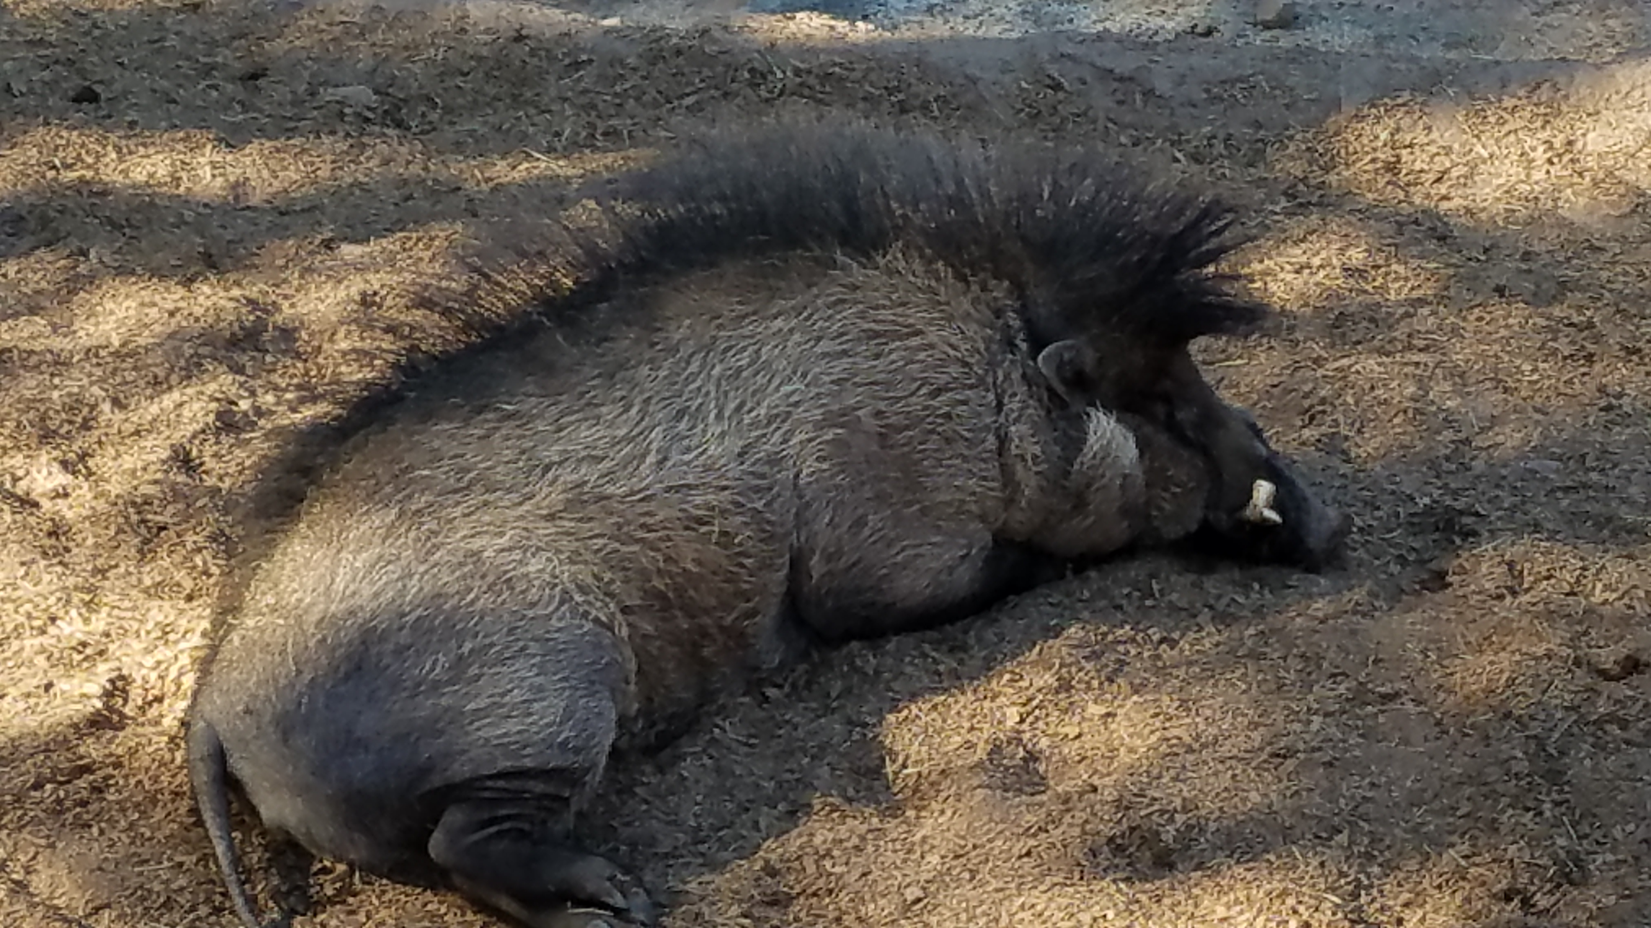
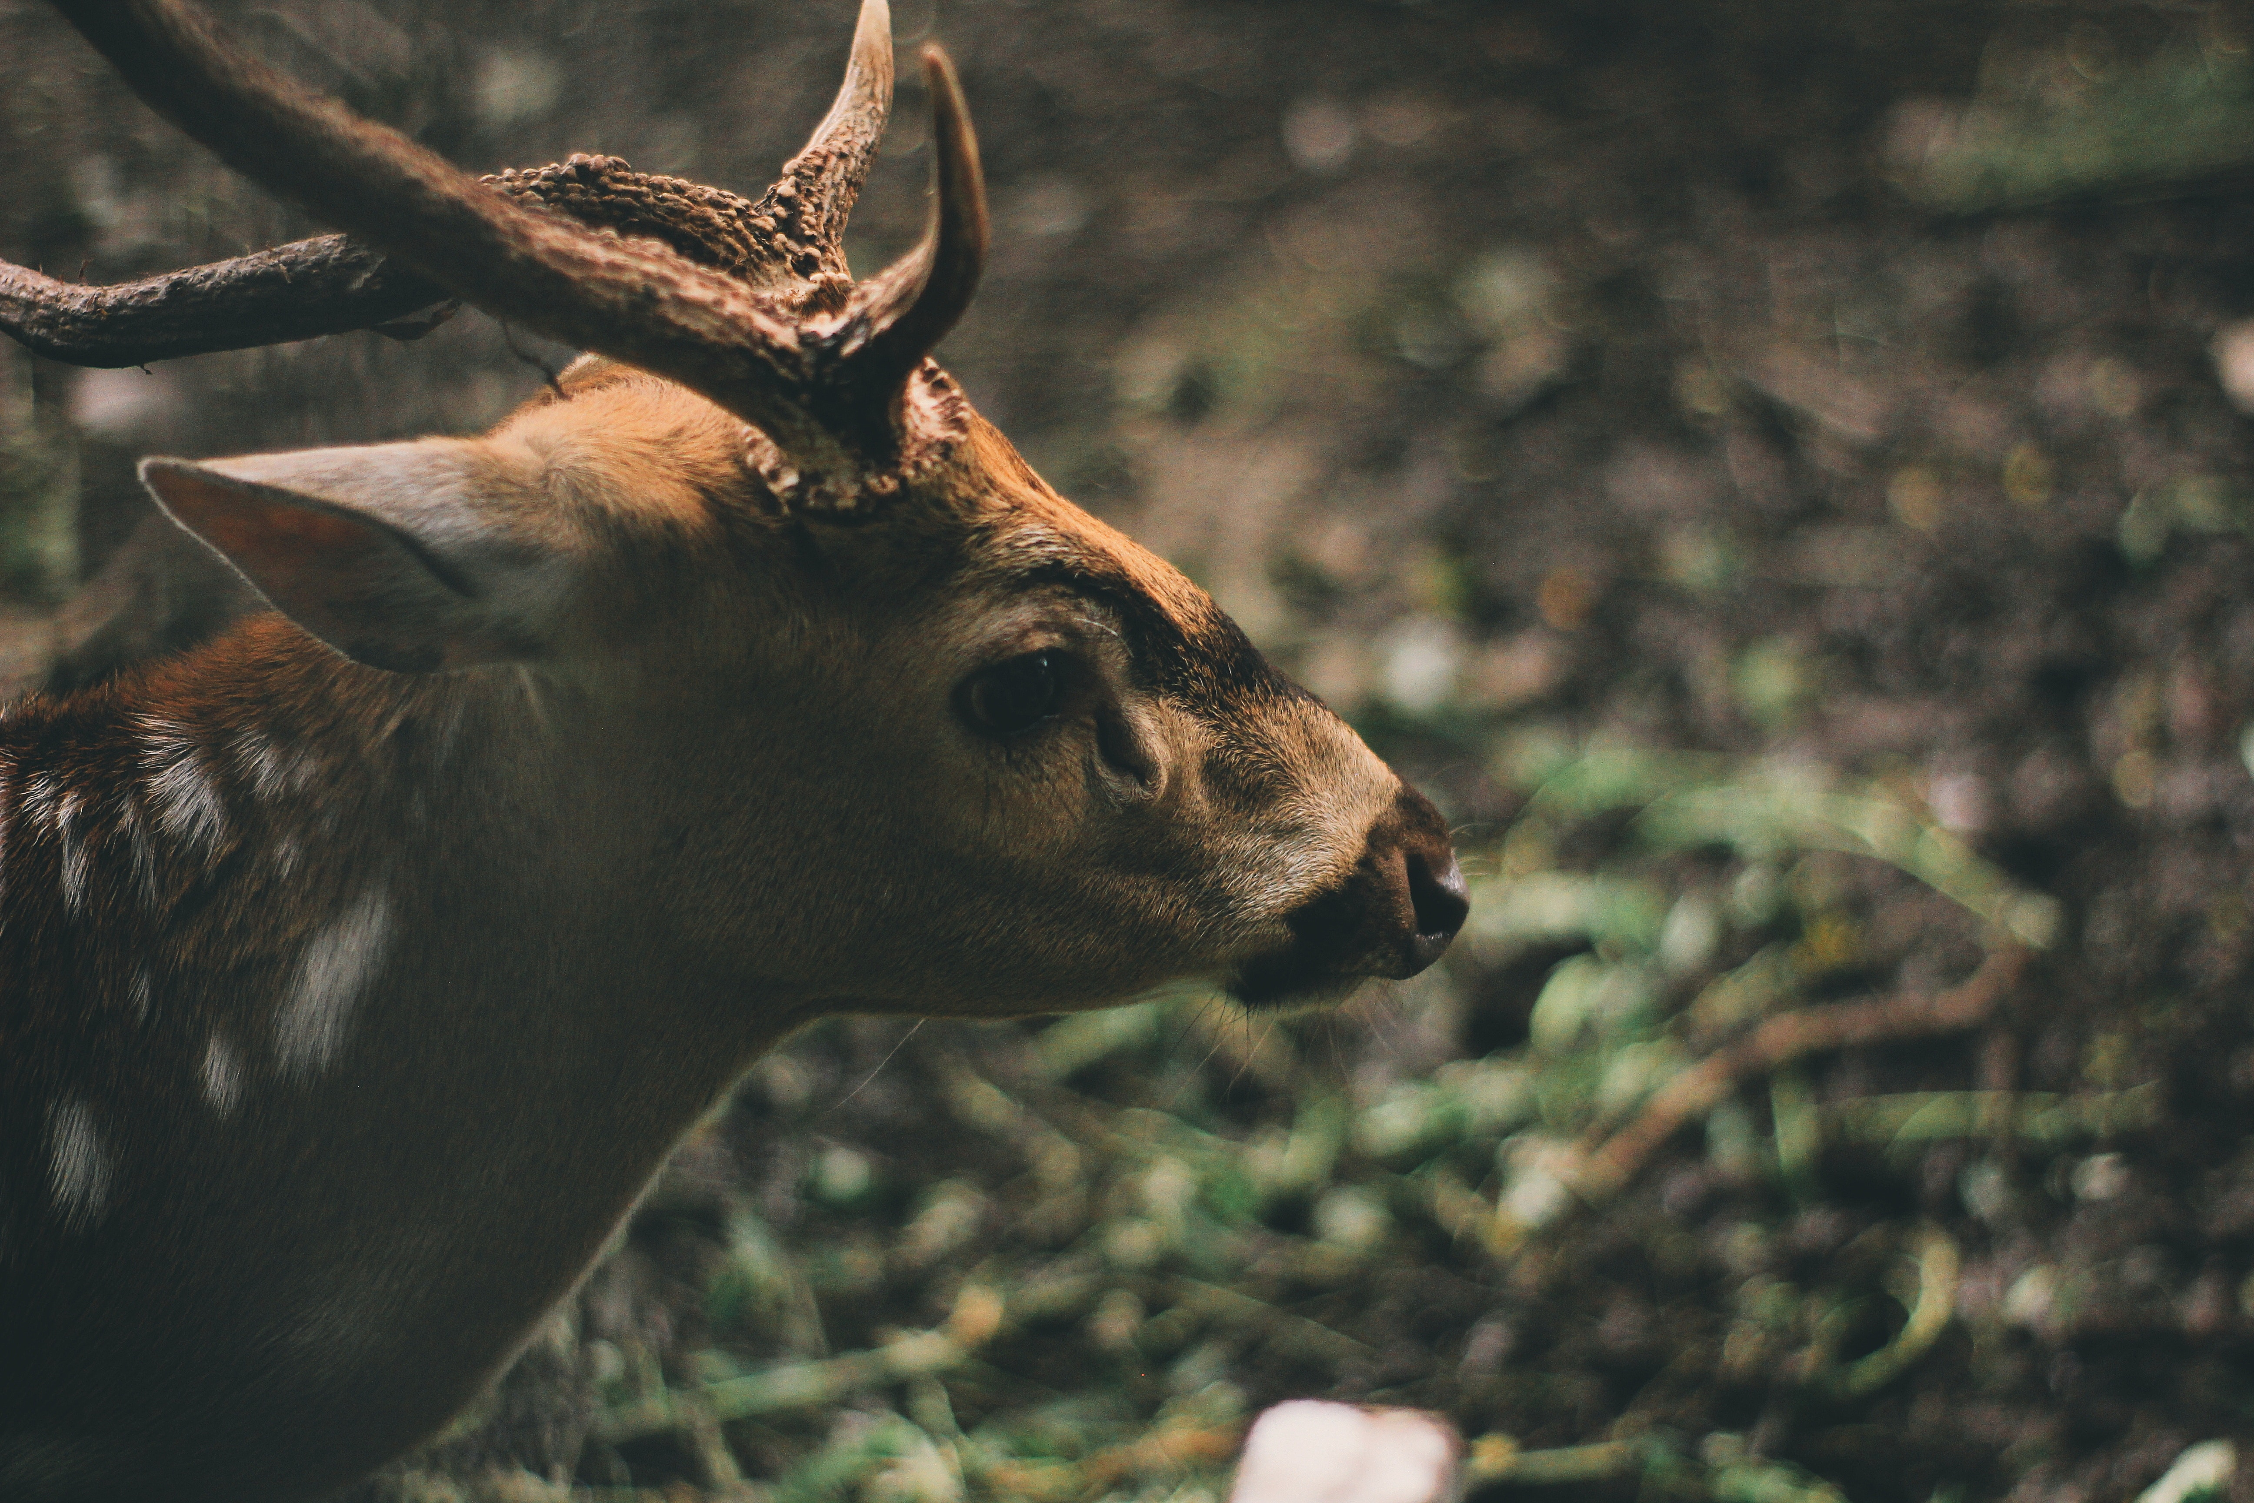
Partners
 Arizona Center for Nature Conservation - Phoenix Zoo
 Talarak Foundation Inc.
 International Union for Conservation of Nature (IUCN)-Species Survival Commission
Image credit: Arizona Center for Nature Conservation
Image credit: Melissa Valentin
Notes:
Naomi
The Talarak Foundation is currently stationed in Negros which allows them to reach out to the community through educational initiatives to raise awareness about endemic species and conservation. In addition to being an advisor and collaborator for the reintroduction program, the Arizona center for Nature Conservation provides instructions on how to collect ground data with all the beneficial organizations. Both the Talarak Foundation Inc. and Arizona Center for Nature Conservation are directly involved with the reintroduction program by participating in the planning & meeting with stakeholders such as the Department of Natural Resources, natural park officials, and village leaders
The IUCN is one of the many organizations which takes charge of funding the stationed organization (Talarak Foundation Inc.) for the breeding and reintroduction of the two endemic species.
Image Source: Arizona Center for Nature Conservation, permission to use
Image Source: Melisa Valentin https://www.pexels.com/photo/brown-deer-in-forest-704417/, Pexels Free Stock Photo

Slide 6
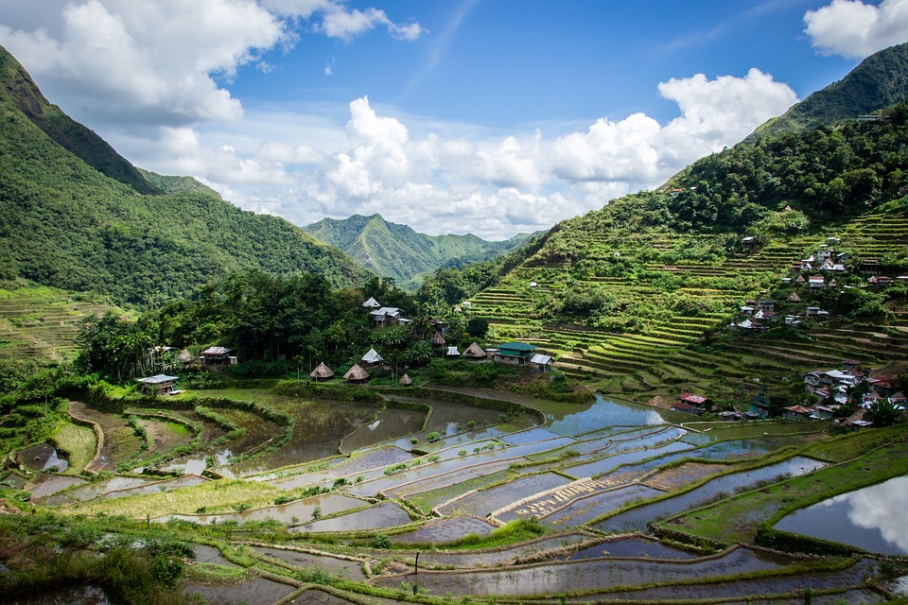
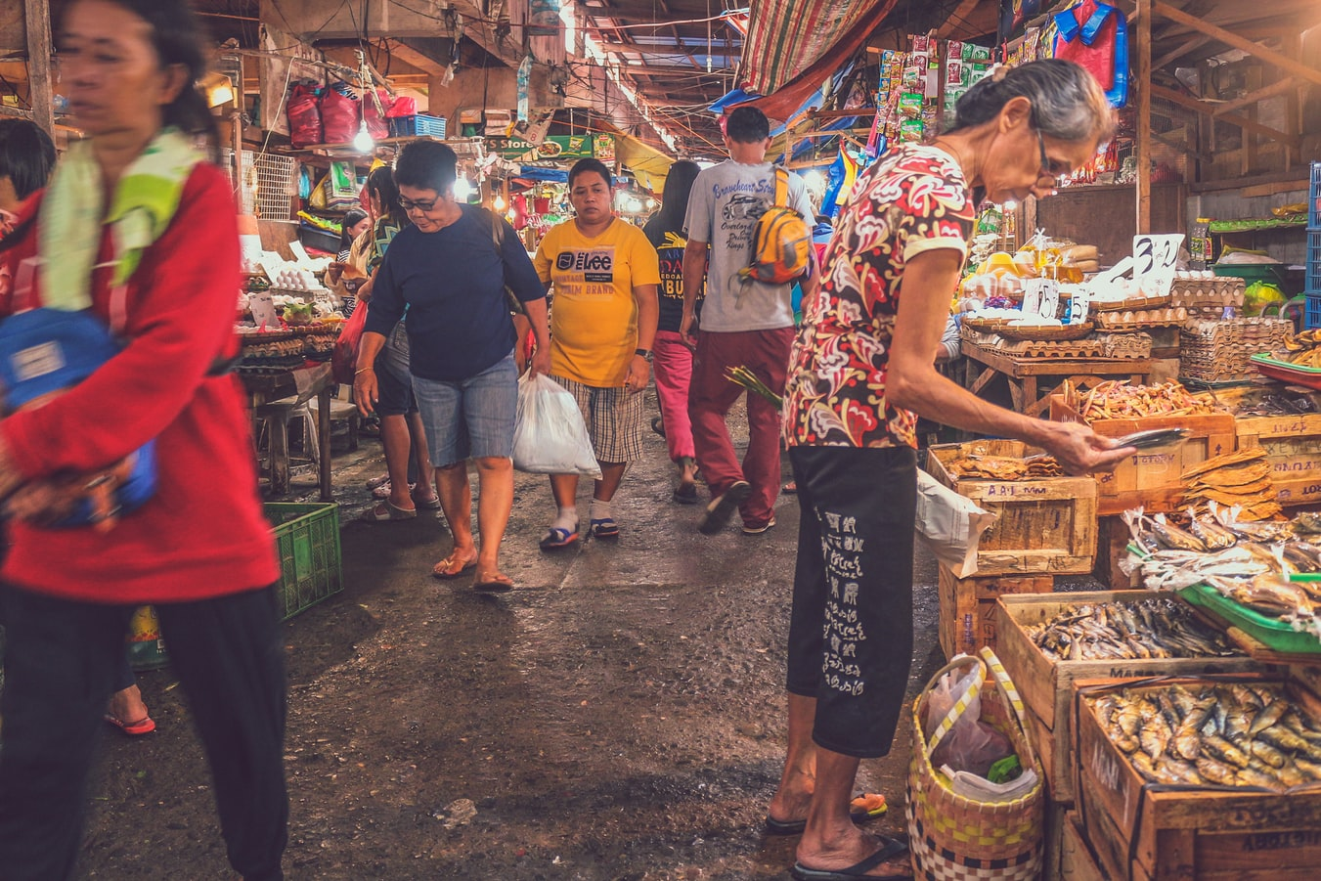
Community Concerns
 Knowledge of local environmental issues
 Species Protection
 Reforestation & conservation efforts
 Vegetation Health
 Poor land use management
 Agricultural clearing
Image credit: Français
Image credit: Frank Lloyd De La Cruz
Notes:
Eze’
Habitat destruction through illegal logging and clearing for agriculture, excessive hunting poaching, and poor land use management all contribute to the verge of species extinction. Lack of awareness about local environmental issues promotes indifferent views on species endemism from the native people of the Philippines. Programs have been implemented to improve biodiversity and sustainability, but invasive plant species continue to threaten indigenous vegetation of the Philippines.
Image Source: Français (lester56) https://pixabay.com/photos/philippines-rice-terraces-batad-3806979/, Pixabay License
Image Source: Frank De La Cruz (@franklloyd) https://unsplash.com/photos/_1DIKCetFFk, Unsplash License

Slide 7
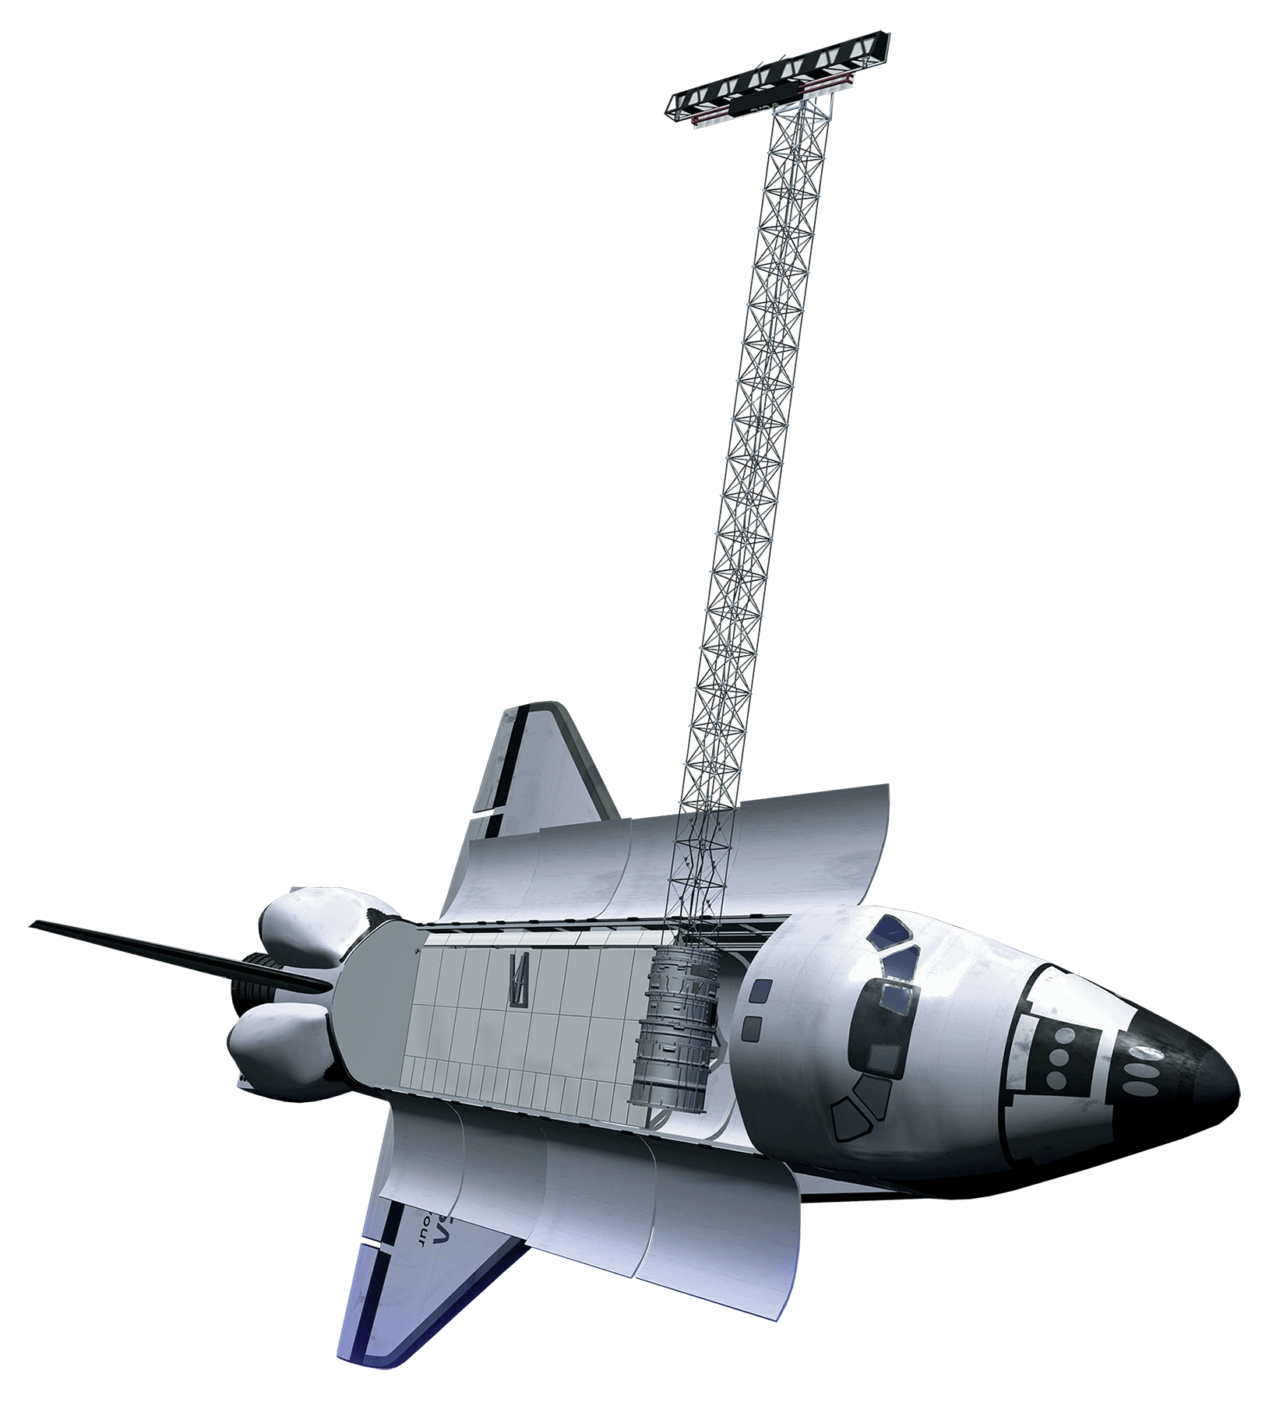
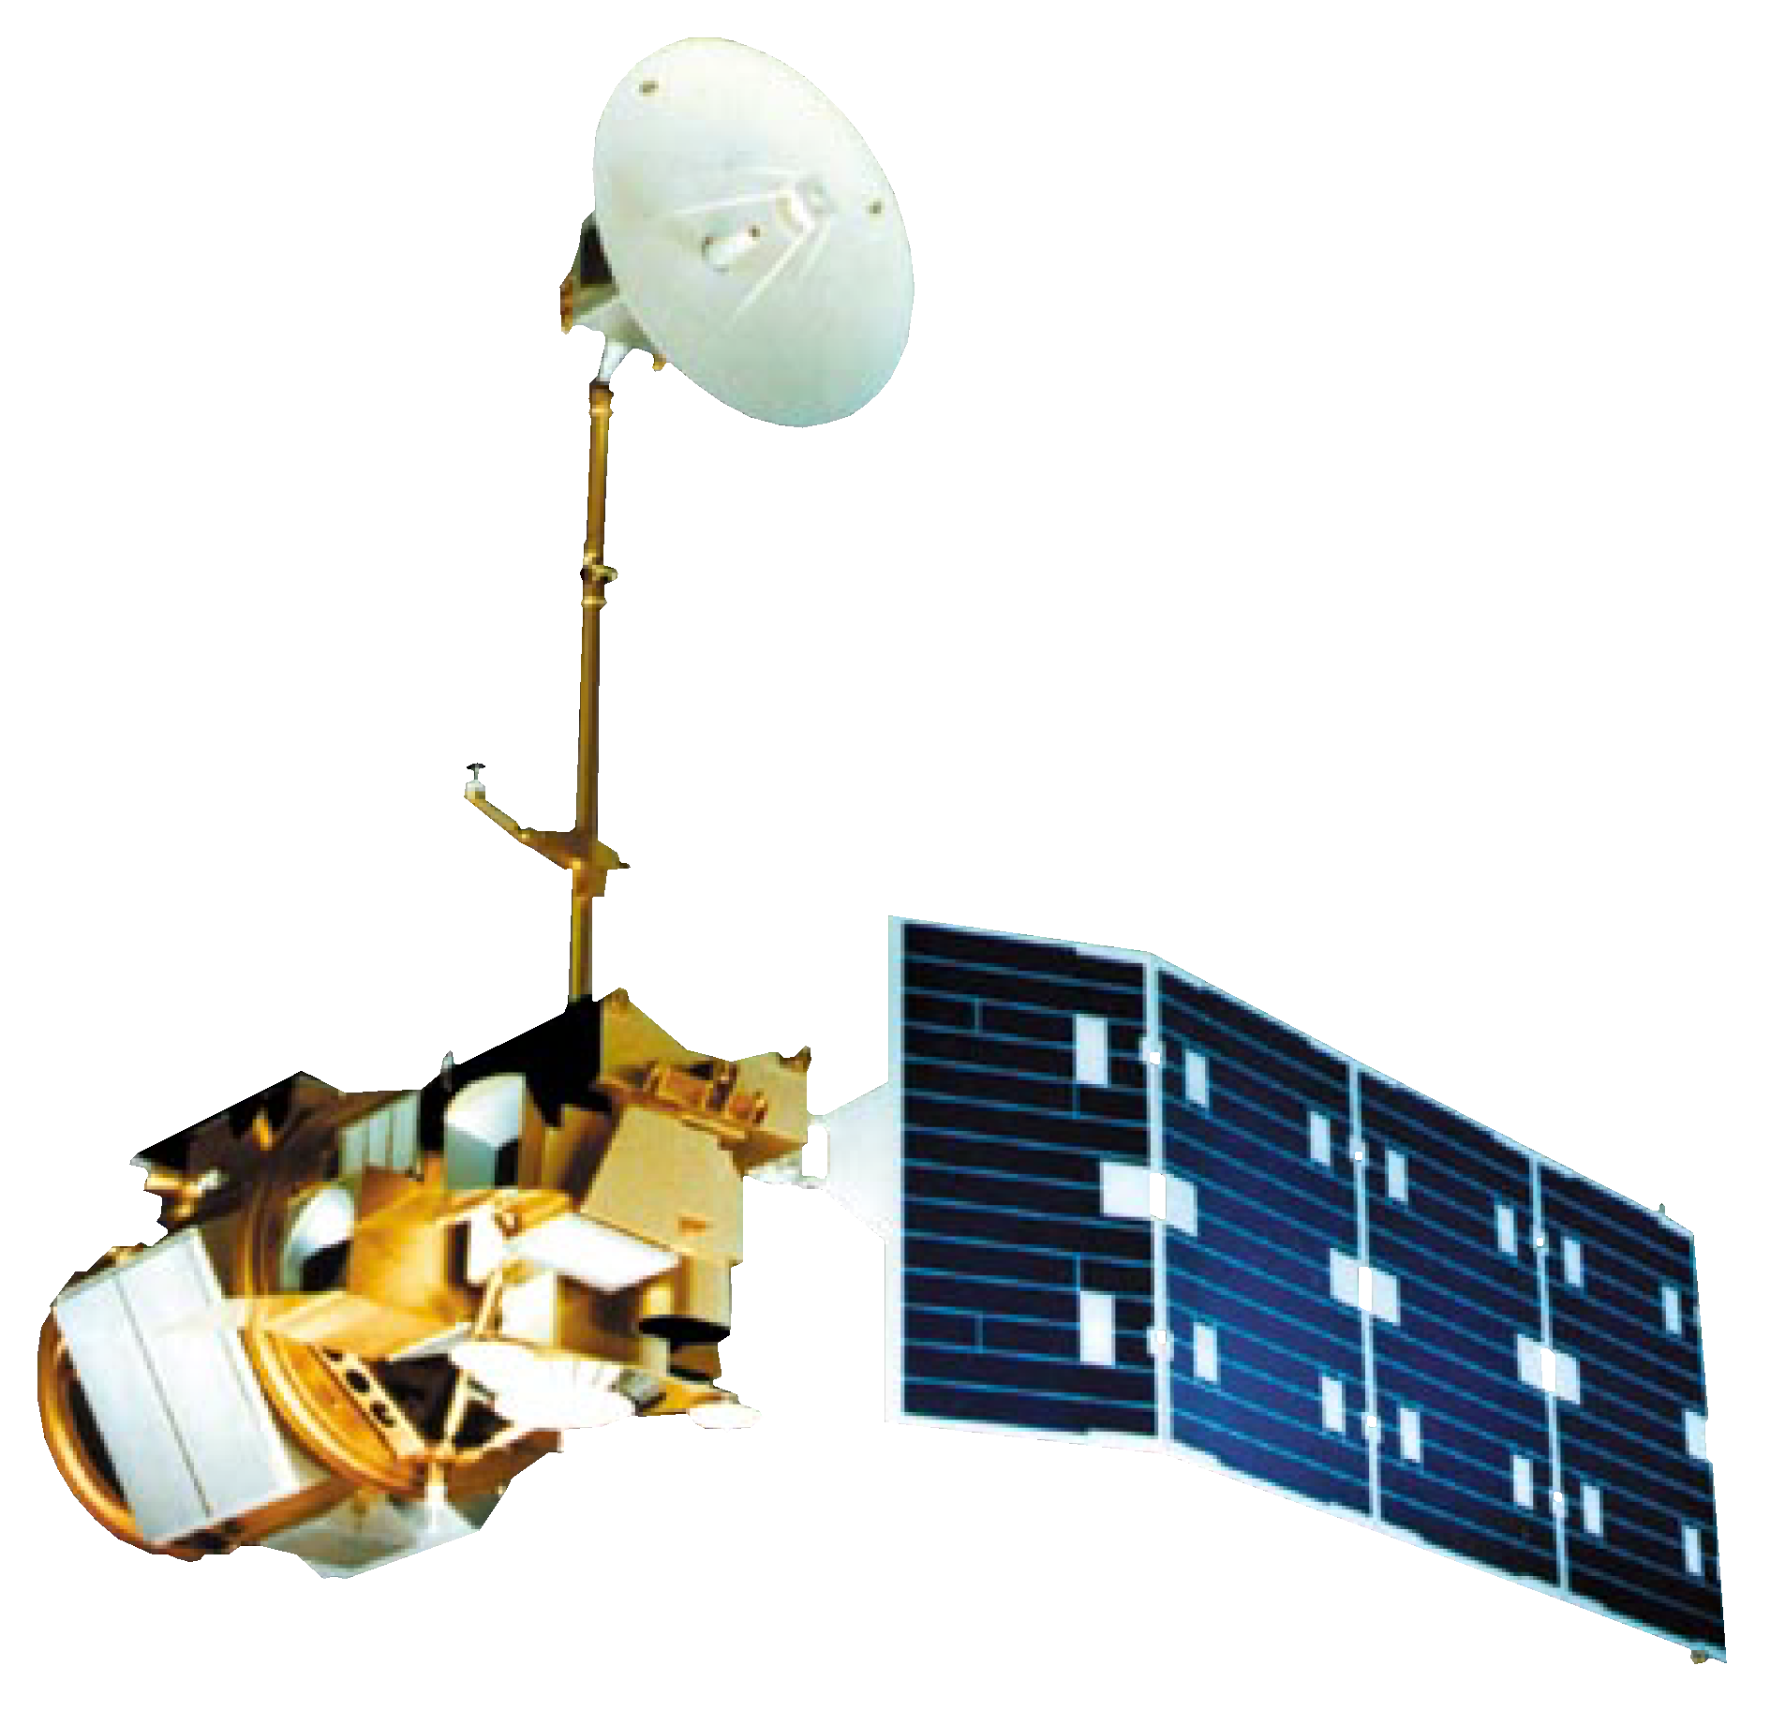


NASA Satellites/Sensors Used & Study Period
Landsat 5 Thematic Mapper (TM)
1987 to 2013
Landsat 8 Operational Land Imager (OLI)
2013 to 2019
Terra Moderate Resolution Imaging Spectroradiometer (MODIS)
Time Series Change
2000 to 2019
Shuttle Radar Topography Mission (SRTM)
Image credit: NASA
Image credit: NASA
Image credit: NASA
Image credit: NASA
Notes:
EZE’
The satellite sensors used for this project are the Landsat 5 Thematic Mapper, Landsat 8 Operational Land Imager, and Terra/Aqua Moderate Imaging Spectroradiometer for the Visayan Islands from 1987 through 2019. Landsat 5 and Landsat 8 imagery was used for NDVI and EVI analysis and land classification of Panay and Negros Islands. Shuttle Radar Topography Mission provide the digital elevation model used for random forest classification. We applied Terra MDIS to develop a time series to show to increase and decline of NDVI and EVI overtime.
Image Source: NASA http://www.devpedia.developexchange.com/dp/images/6/69/01_Landsat5.png, Public Domain
Image Source: NASA http://www.devpedia.developexchange.com/dp/images/c/c2/03_Landsat8.png, Public Domain
Image Source: NASA http://www.devpedia.developexchange.com/dp/images/9/91/05_Terra.png, Public Domain
Image Source: http://www.devpedia.developexchange.com/dp/index.php?title=List_of_Satellite_Pictures, NASA DEVELOP National Program

Slide 8




Methodology
Landsat 5
TM
Landsat 8
OLI
Terra
MODIS
Ancillary Data (GLCM, Vegetation Indices, and SRTM: DEM)
Cloud
Masking
NDVI and EVI Time Series Charts and
Maps from 2000 to 2019
1987 to 1989
1995 to 1997
2005 to 2007
2015 to 2017
2017 to 2019
Composite Images
Land use and Land Cover (LULC) Classification Using
Random Forest Machine Learning Classifier
Cloud Free Surface
Reflectance Images
1987 to 1989
1995 to 1997
2005 to 2007
2015 to 2017
2017 to 2019
LULC Classified map
2030 and 2050
Forecast Maps
QGIS MOLLUSCE and TerrSet
Land Change Modeler

Slide 9
Results

Slide 10
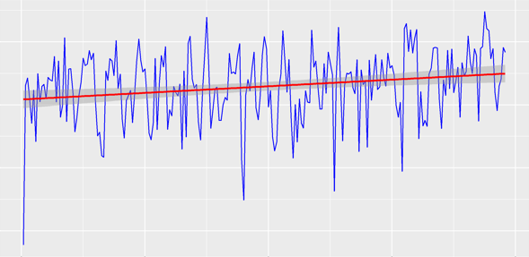
NDVI Timeseries
7000
6000
5000
4000
NDVI Value
2000 2005 2010 2015 2020
Date
Notes:
Ryan
This graph is a NDVI timeseries of the study area from 2000 to 2019. The data was collected from MODIS Terra. MODIS vegetation indices, are produced on 16-day intervals and at multiple spatial resolutions, that provide consistent spatial and temporal comparisons of vegetation canopy greenness, a composite property of leaf area, chlorophyll and canopy structure. The values are in Kelvin. Normalized difference vegetation index (NDVI) is a simple graphical indicator that can be used to analyze and assess whether the target being observed contains live green vegetationn or not. The graph shows an increase in vegetation overtime seeing that the mean is increasing. However this does not mean that the vegetation growth in the area is from indigenous plant species.

Slide 11
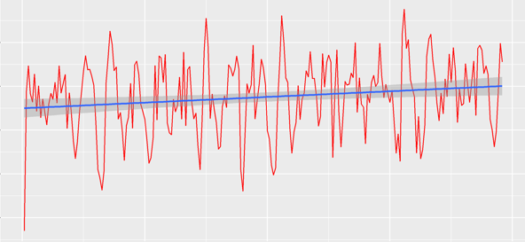
EVI Timeseries
5500
5000
4500
4000
3500
3000
EVI Value
2000 2005 2010 2015 2020
Date
Notes:
Ryan
This graph is an EVI timeseries of the study area from 2000 to 2019. Enhanced vegetation index (EVI) is an 'optimized' vegetation index designed to enhance the vegetation signal with improved sensitivity in high biomass regions, which has improved vegetation monitoring through a de-coupling of the canopy background signal and a reduction in atmosphere influences. This graph shows an increase in vegetation much like the NDVI timeseries.

Slide 12
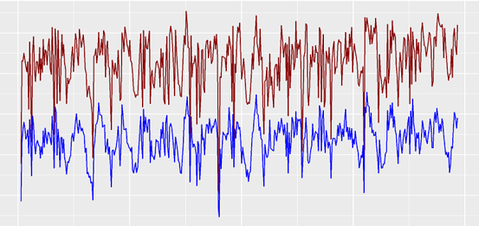
Time Series 2000 to 2019
7000
6000
5000
40003000
Values
NDVI
EVI
2000 2005 2010 2015 2020
Date
Notes:
Ryan
This graph is a Timeseries of NDVI and EVI for the study area. The reason for the graphs not being aligned is because of EVI being a vegetation Index that helps eliminate some of the saturation that NDVI displays due to haze. EVI fixes this issue by utilizing the Blue band from MODIS along with the NIR band and the Red band.

Slide 13
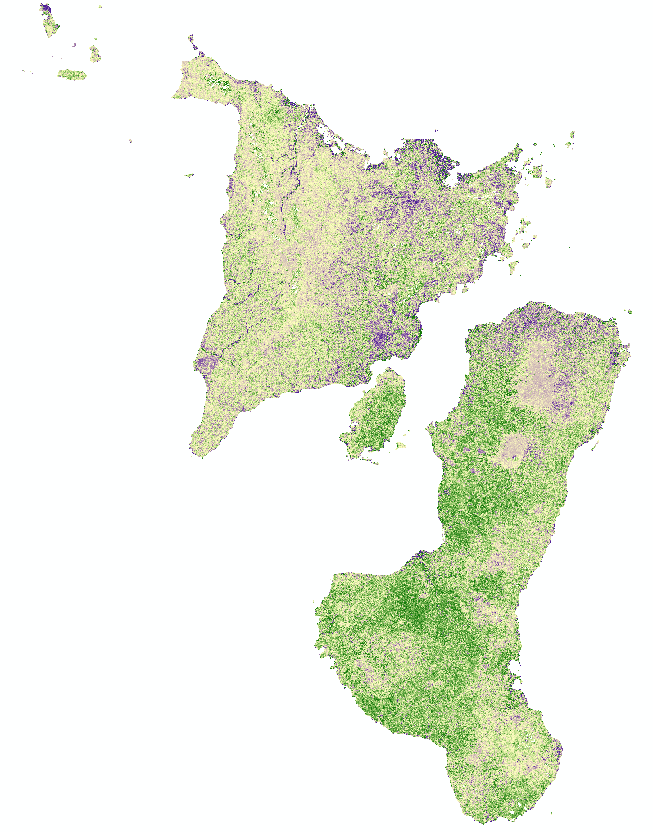
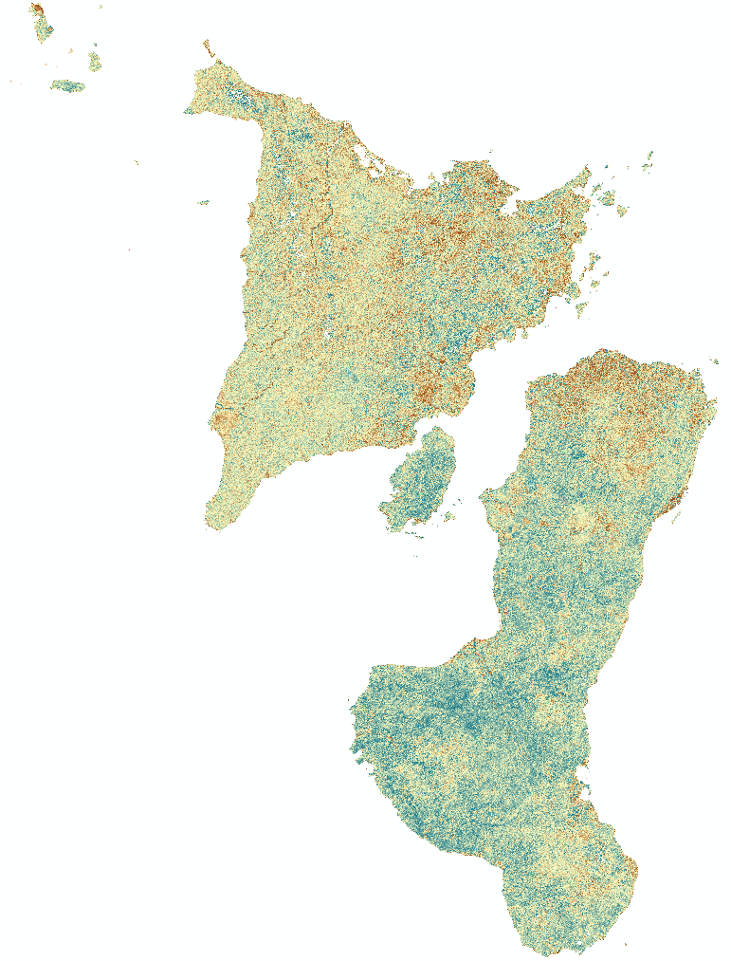

NDVI Change
EVI Change
NDVI
Increase
EVI
Increase
No Change
No Change
NDVI
Decrease
EVI
Decrease
N
0
10
20
30
40
Kilometers
Notes:
Naomi
NDVI and EVI indices revealed a decrease in forest cover between 1987 to 2019. Although, both also show vegetation increase across the two islands, it is possible that the increase is represented by planted invasive species. The decline in primary and secondary forest cover means a decline in habitat for the Visayan warty pig and spotted deer. They rely on these specific forest types for shelter and nourishment.

Slide 14
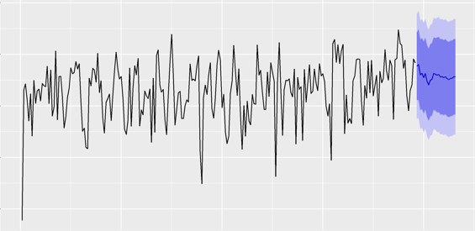
NDVI Forecasting
8000
7000
6000
5000
4000
NDVI Value
2000 2005 2010 2015 2020
Date
Notes:
Ryan
This graph shows a potential forecasting of what NDVI may be in the upcoming years for the Visayan Islands. This forecasting was conducted using the ARIMA model which used past data to help predict the potential vegetation health in the upcoming years. The graph shows the predicted mean along with a degree of certainty of what the NDVI value may be in the upcoming years.

Slide 15
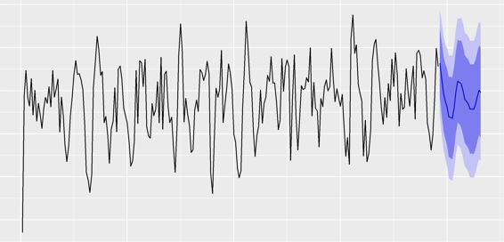
EVI Forecasting
5500
5000
4500
4000
35003000
EVI Value
2000 2005 2010 2015 2020
Date
Notes:
Ryan
This graph shows a potential forecasting of what EVI may be in the upcoming years for the Visayan Islands. This forecasting was conducted using the ARIMA model which used past data to help predict the potential vegetation health in the upcoming years.

Slide 16
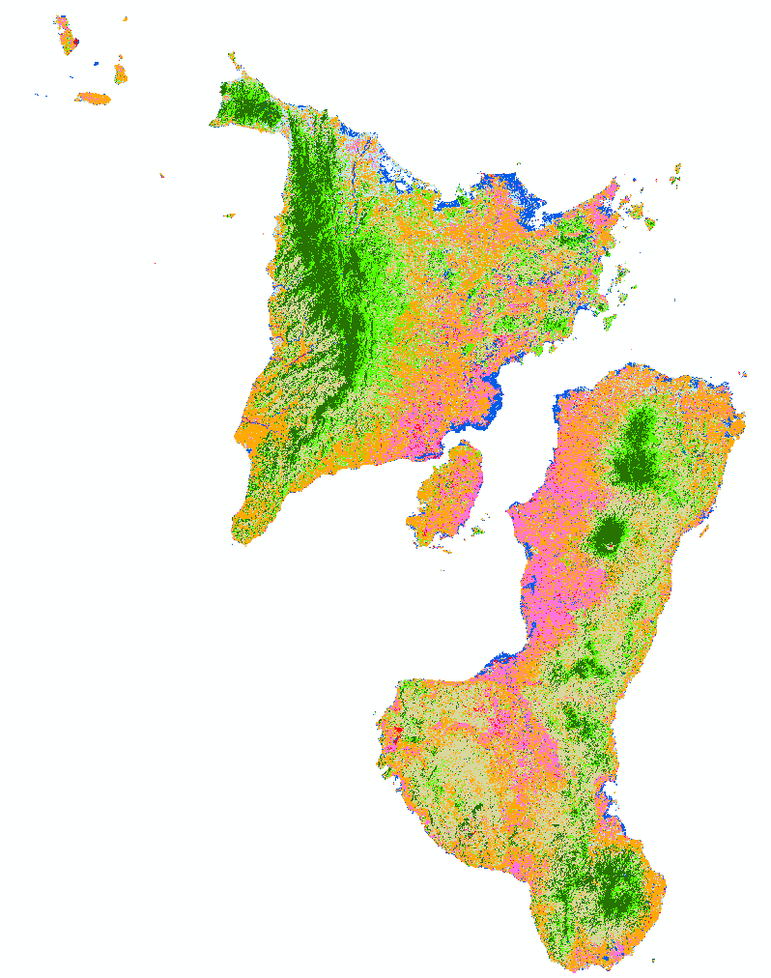
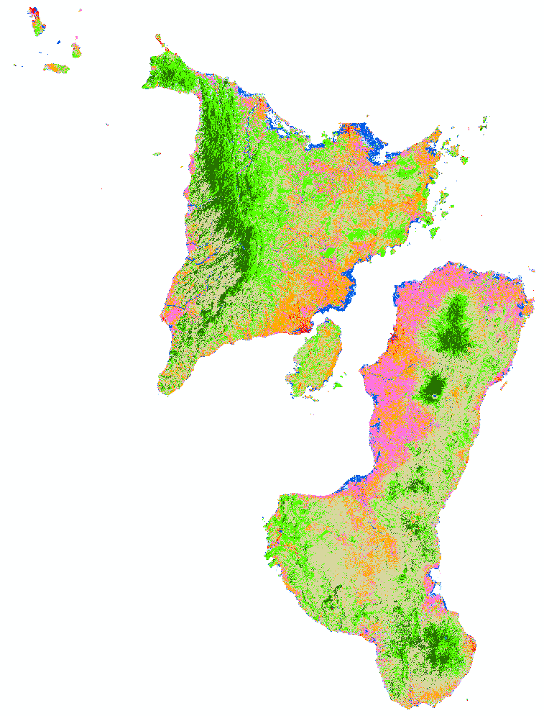
LULC for 2019
LULC for 1987
Urban
Urban
Primary Forest
Primary Forest
Secondary Forest
Secondary Forest
Sugarcane
Sugarcane
Rice
Rice
Grassland
Grassland
Mangroves
Mangroves
Fishpond/Water
Fishpond/Water
N
0
10
20
30
40
Kilometers
Notes:
Lucy
The land use land cover classification analysis shows a shift between rice and sugar cane plantations which are grown alternately on these islands. The LULC maps also display a decrease in primary and secondary forest cover, which provide favorable habitat for the two endemic species. Urban development is increasing which is a possible cause for the decline in primary and secondary forest. These endemic species require a certain patch size to survive. Because these animals rely strictly on primary and secondary forest land cover for survival, urban area increase could continue to be a threat to their survival and may threaten the success of reintroduction.

Slide 17
Percent Change by LULC Class from 1989 to 2019
Water
Mangroves
Grasslands
Rice
Sugarcane
Secondary Forest
Primary Forest
Urban/Bare
400000 3000000 200000 100000 0 100000 200000 300000 400000
Area in Hectares

Slide 18
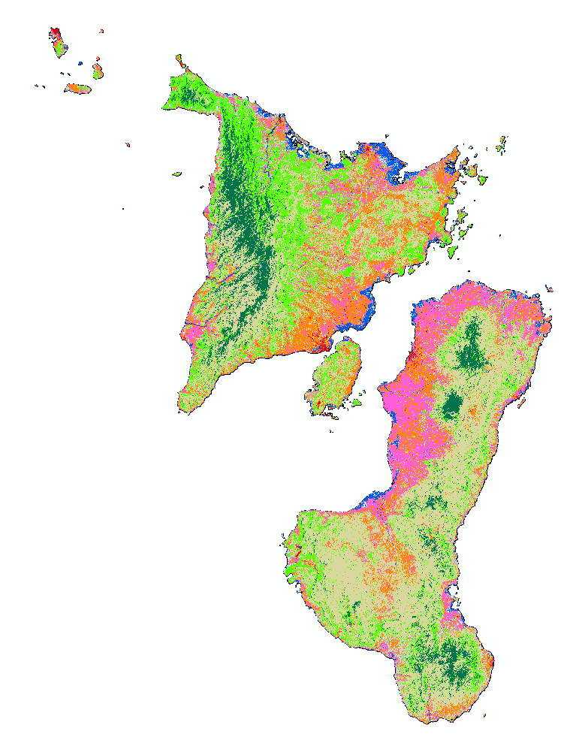
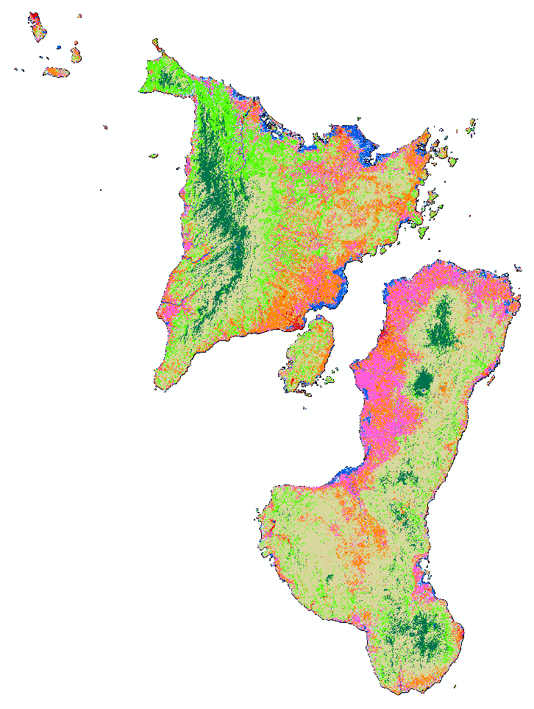
LULC Forecasting for 2030
LULC Forecasting for 2050
Urban
Urban
Primary Forest
Primary Forest
Secondary Forest
Secondary Forest
Sugarcane
Sugarcane
Rice
Rice
Grassland
Grassland
Mangroves
Mangroves
Fishpond/Water
Fishpond/Water
N
0
10
20
30
40
Kilometers
Notes:
Eze’

Slide 19
Conclusions
Primary and Secondary Forest Cover has decreased from 1987 to 2019
The loss of primary forest from 1987 to 2019 was 126,924 ha
The amount of urban area grew from 22,451.8 ha to 44,932.2 ha from 1987 to 2019

Slide 20
Errors and Uncertainties
NDVI and EVI indices did not differentiate between invasive and indigenous vegetation
Misclassification of plantation crops planted in close proximity
30m x 30m resolution did not allow for the location of invasive species
Minimal ground truth data for plantations and invasive species
Specified habitat preferences for the Visayan Spotted Deer
Notes:
Naomi
The vegetation indices did not make the distinction between invasive and native plant species. The increase seen in vegetative biomass is represented by invasive species on the island. Plantation crops are planted in the same vicinity and alternately on the same plantation which caused for the miss classification of sugar cane and rice. Google earth pro was used to identify sugar cane and rice plantations for designated years. We also utilized ground truth data from the Talarak Foundation to specify crop land cover and distinguish between the texture of crops grown on the two islands.

Slide 21
Future Work
Gathering in situ data of invasive plantations to help map out the areas where these species are encroaching onto indigenous species.
The use of a suitability analysis for the Warty pig and Spotted deer, utilizing explanatory variables to discover locations on the island to release the endangered species.

Slide 22
Acknowledgements
Advisors
Dr. Marguerite Madden (University of Georgia, Department of Geography)
Dr. Sergio Bernardes (University of Georgia, Department of Geography)
Fellow
Shelby Ingram (NASA DEVELOP, Georgia – Athens Node)
End Users
Dr. Jan Schipper, Field Conservation Research Inspector (Arizona Center for Nature Conservation- Phoenix Zoo
Dr. Johanna Rode- Margono, Wild Pig Specialist Group Chair (International Union for Conservation of Nature, Species Survival Commission)
Matt Ward, Field Ecologist and In Situ Project Manager (Talarak Foundation Inc.)
Notes:
Thank you to our advisors Dr. Madden and Dr. Sergio for direction and project support. Thanks to our fellow, Shelby, for research guidance and advice, and thank you to our partners, Dr. Jan, Dr. Johanna, and Matt Ward for providing data materials, incite, and background information necessary to complete our project.

