Slide 1

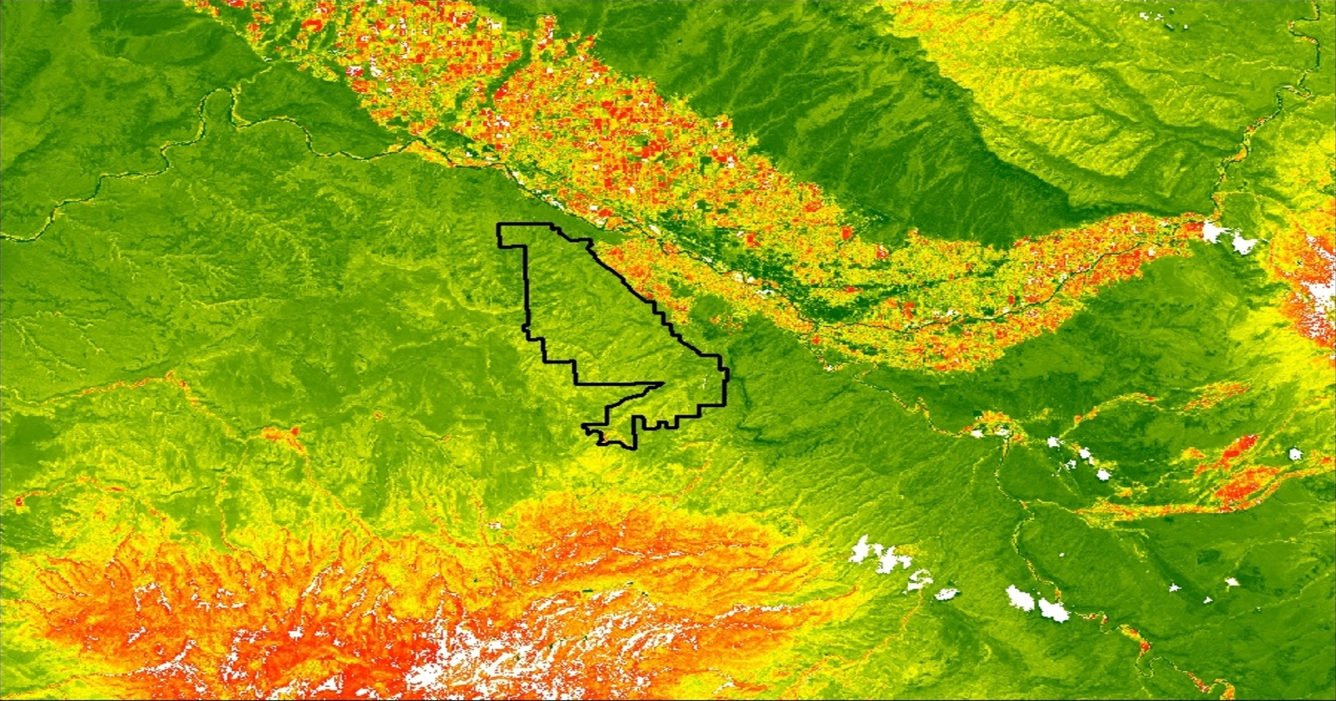


COLORADO NATIONAL MONUMENT ECOLOGICAL FORECASTING
Identifying Early Season Invasives for Monitoring and Management in the Colorado National Monument
Zachary Peloquin
Kayla Rini
James Ficklin
Owen Cox
NASA Langley Research Center
2017 Summer
NASA Langley Research Center
2017 Summer
2017 Summer
Notes:
Hello, we are the Colorado National Monument Ecological Forecasting group from the Langley Research Center. Our objective was identifying early season invasives for monitoring and management in the Colorado National Monument. We focused on the spread of cheatgrass within the national park and surrounding areas.

Slide 2
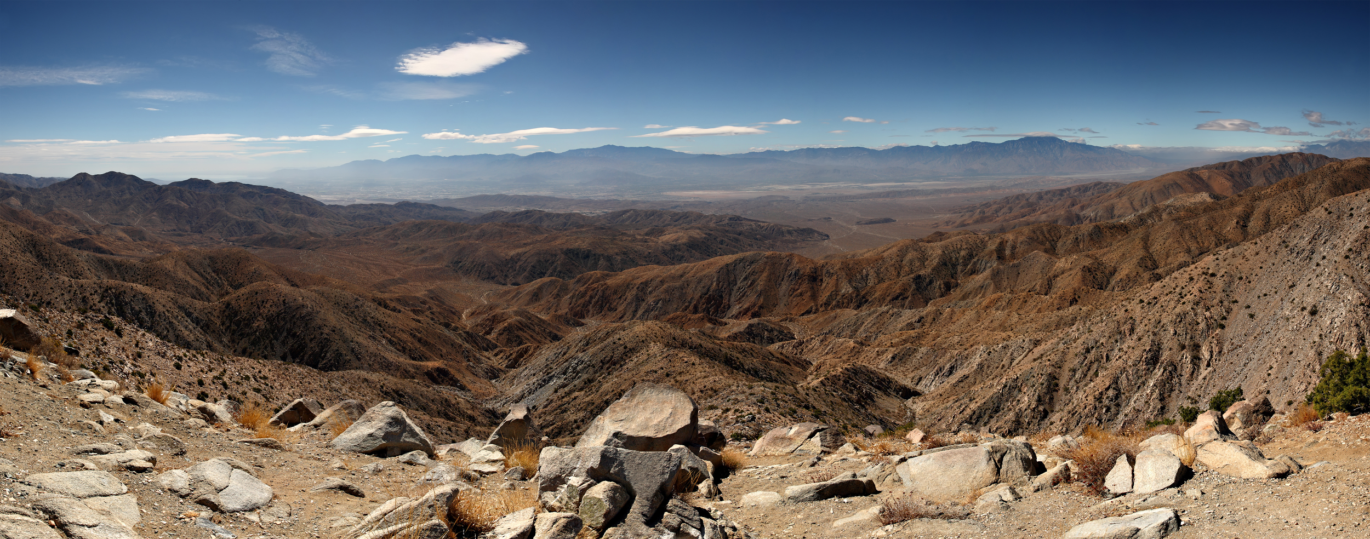
Partners
Ann Rodman and Molly Murphy, National Park Service, Colorado National Monument
Dr. Deborah Kennard, Colorado Mesa University
Image Credit: Monet
Photo credit: Travel Blue Book
Notes:
Photo credit: Scenic view, from the Travel Blue Book, http://travelbluebook.com/joshua-tree-national-park/
The partners involved in this project are the National Park Service at the Colorado National Monument, who want to reduce the impact cheatgrass has on the area, and to further prevent its spread.
In addition, Colorado Mesa University collaborated with us to gain insight on the cheatgrass issue from our results.

Slide 3
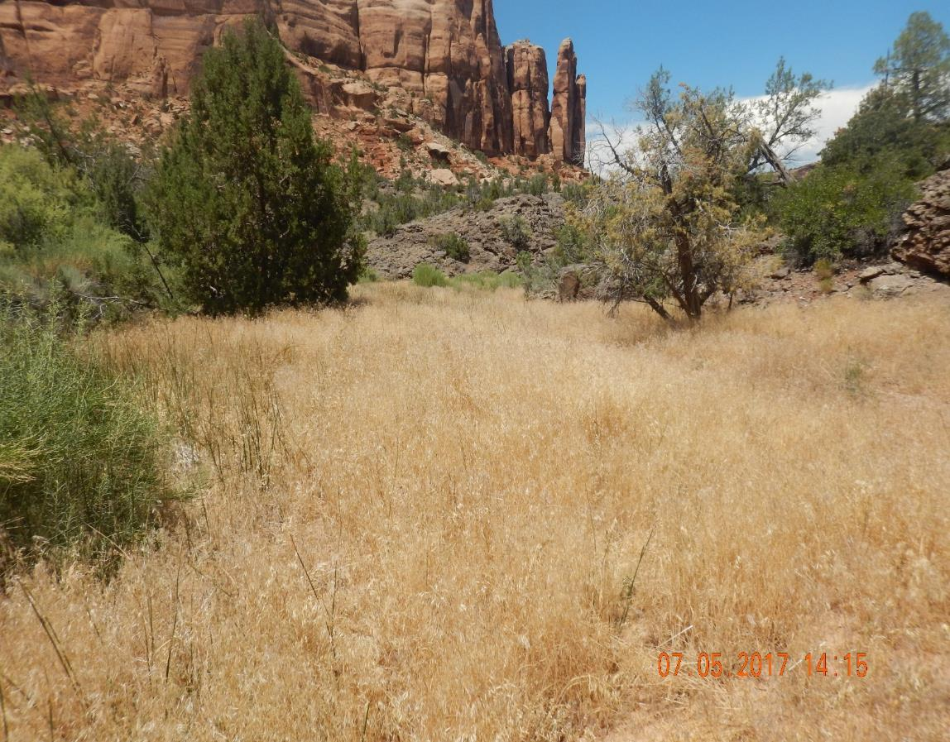
Objectives
Our objective was to create three maps using data collected from 2008 to 2017
Current distribution of Early Season Activity
Historical Trends of Early Season Activity distribution
Forecasted Early Season Activity distribution
Image credit: Colorado National Monument
Notes:
For this project, we focused on the years between 2008 and 2017. These years were chosen do to Earth Explorer having a large supply of data for those years and are fairly recent. For this project, our objectives were to create 3 maps that detailed the spread of cheatgrass around the Colorado National Monument. The first map would be created using the data from 2016 and 2017 and show the approximate “current” locations for cheatgrass. The second map would be based on the data collected from 2008 to 2017 and would show historical locations for cheatgrass. This map would focus on areas that regularly had cheatgrass. The last map would show our predictions for where cheatgrass would spread. This would be based on the first map, and also take into consideration factors such as elevation, proximity to roads, and proximity to farmland.
Photo credit: Image provided by Colorado National Monument

Slide 4
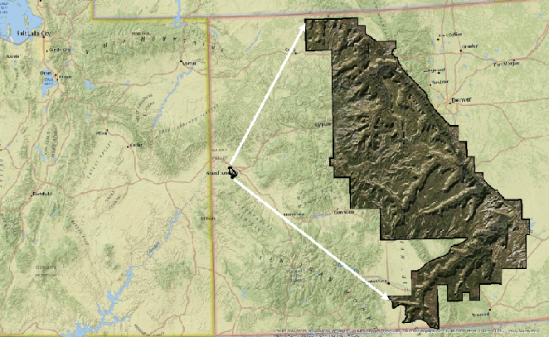
Study Area
Image Credit: Monet
Colorado National Monument
Located in western part of the state
Varied topography that allows for diverse wildlife to flourish
Main biome: Pinyon and Juniper woodland
Notes:
The area of interest lies within the boundaries of Colorado National Monument, a national park consisting of 32 square miles and located in western Colorado. The park has a varied topography that ranges in elevation. Throughout the region, a variety of wildlife is able to flourish. In particular, Colorado is known for its Pinyon-Juniper woodland, which are old-growth coniferous trees that are able to thrive in desert-like conditions. These trees are of significance because they offer food sources and habitats to many species of wildlife. They are under threat due to the infiltration of cheatgrass.

Slide 5
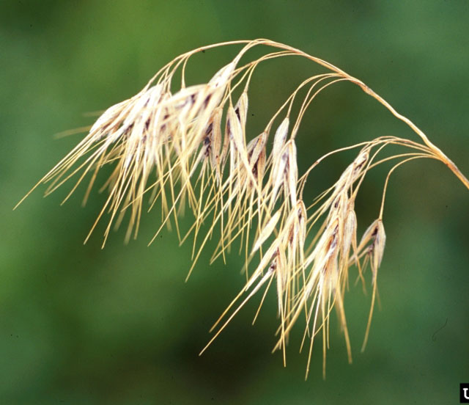
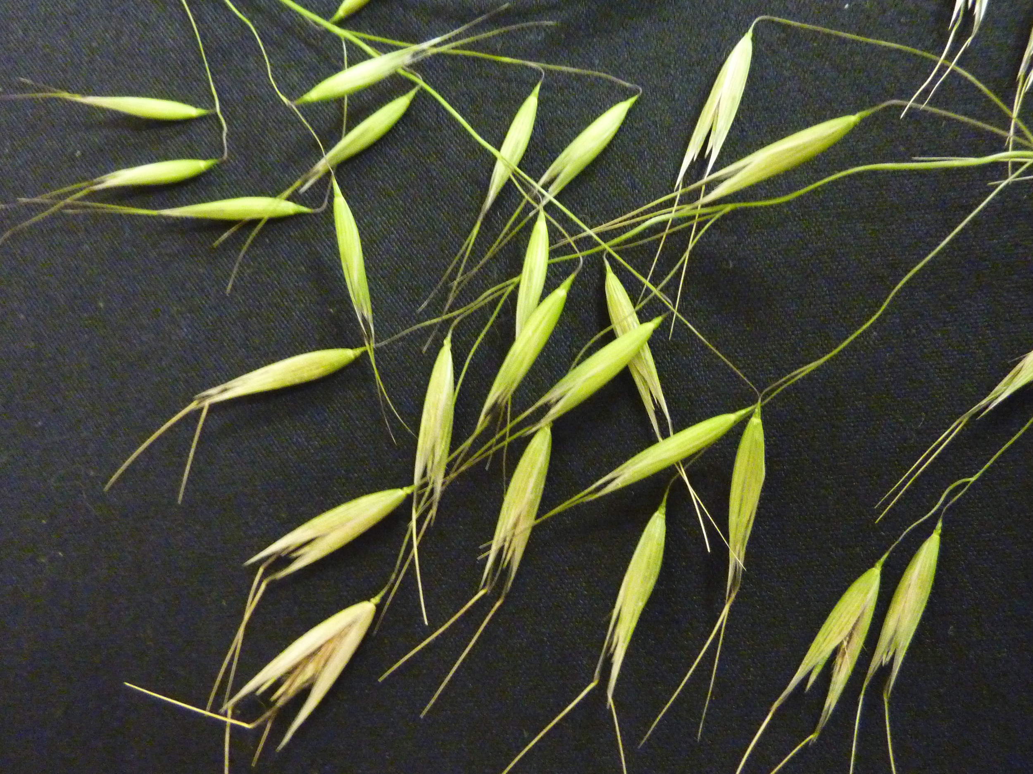
Cheatgrass (Bromus tectorum)
Native to Eurasia
It came to United States through a grain shipment
Germinates in autumn, blooms in the early spring, and dies in early summer
Spread throughout the US due its adaptability and germination period
Image Credit: Monet
Image credit: Montana Weed Association and Grass Awn Project
Notes:
Image 1: Cheatgrass stalk, from Montana Weed Association http://mtweed.org/weeds/cheatgrass
Image 2: Cheatgrass seeds from Cathy Lewis, of the Grass Awn Project, http://mtweed.org/weeds/cheatgrass/
Cheatgrass known as ‘Bromus tectorum’ is native to Europe and Asia. It first came to the United States by a grain shipment, and since then, has spread throughout the entire United States. It develops in autumn and first blooms in early spring (around May) before it dies in the early summer. Its characteristics have allowed it to expand, which we will next discuss.

Slide 6
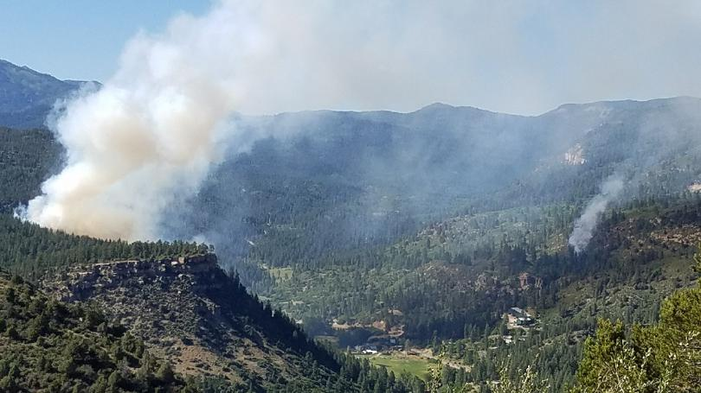
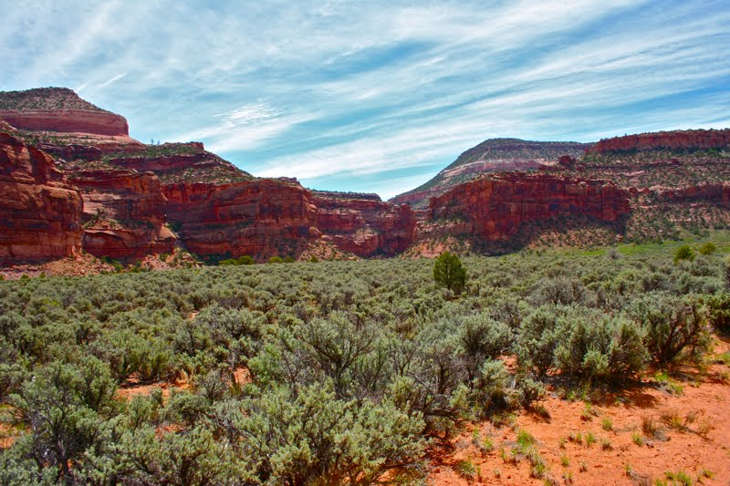
Community Concerns
Cheatgrass impacts its environment in many ways...
Image Credit: Monet
Photo credit: Colorado Lifestyle
Photo credit: Durango Fire Department
It increases the risk and frequency of wildfire in the monument
It out competes native species and disrupts area’s unique ecosystem
Notes:
Image 1: Wildlife Fire in Colorado, Durango Fire Department, from http://www.kktv.com/content/news/More-than-200-evacuated-for-Colorado-wildfire-431428533.html
Image 2: Sagebrush in Colorado, http://colorado-lifestyle.blogspot.com/2011/06/sagebrush.html
Cheatgrass is a major threat to the area because of its detrimental impact to the local environment. Cheatgrass is highly flammable and dry, which allows fires to easily start and spread. Due to their high flammability, it also increases their frequency of occurrence. Cheatgrass also outcompetes native species, such as sagebrush, by taking away these plants necessary nutrients for their own growth.

Slide 7

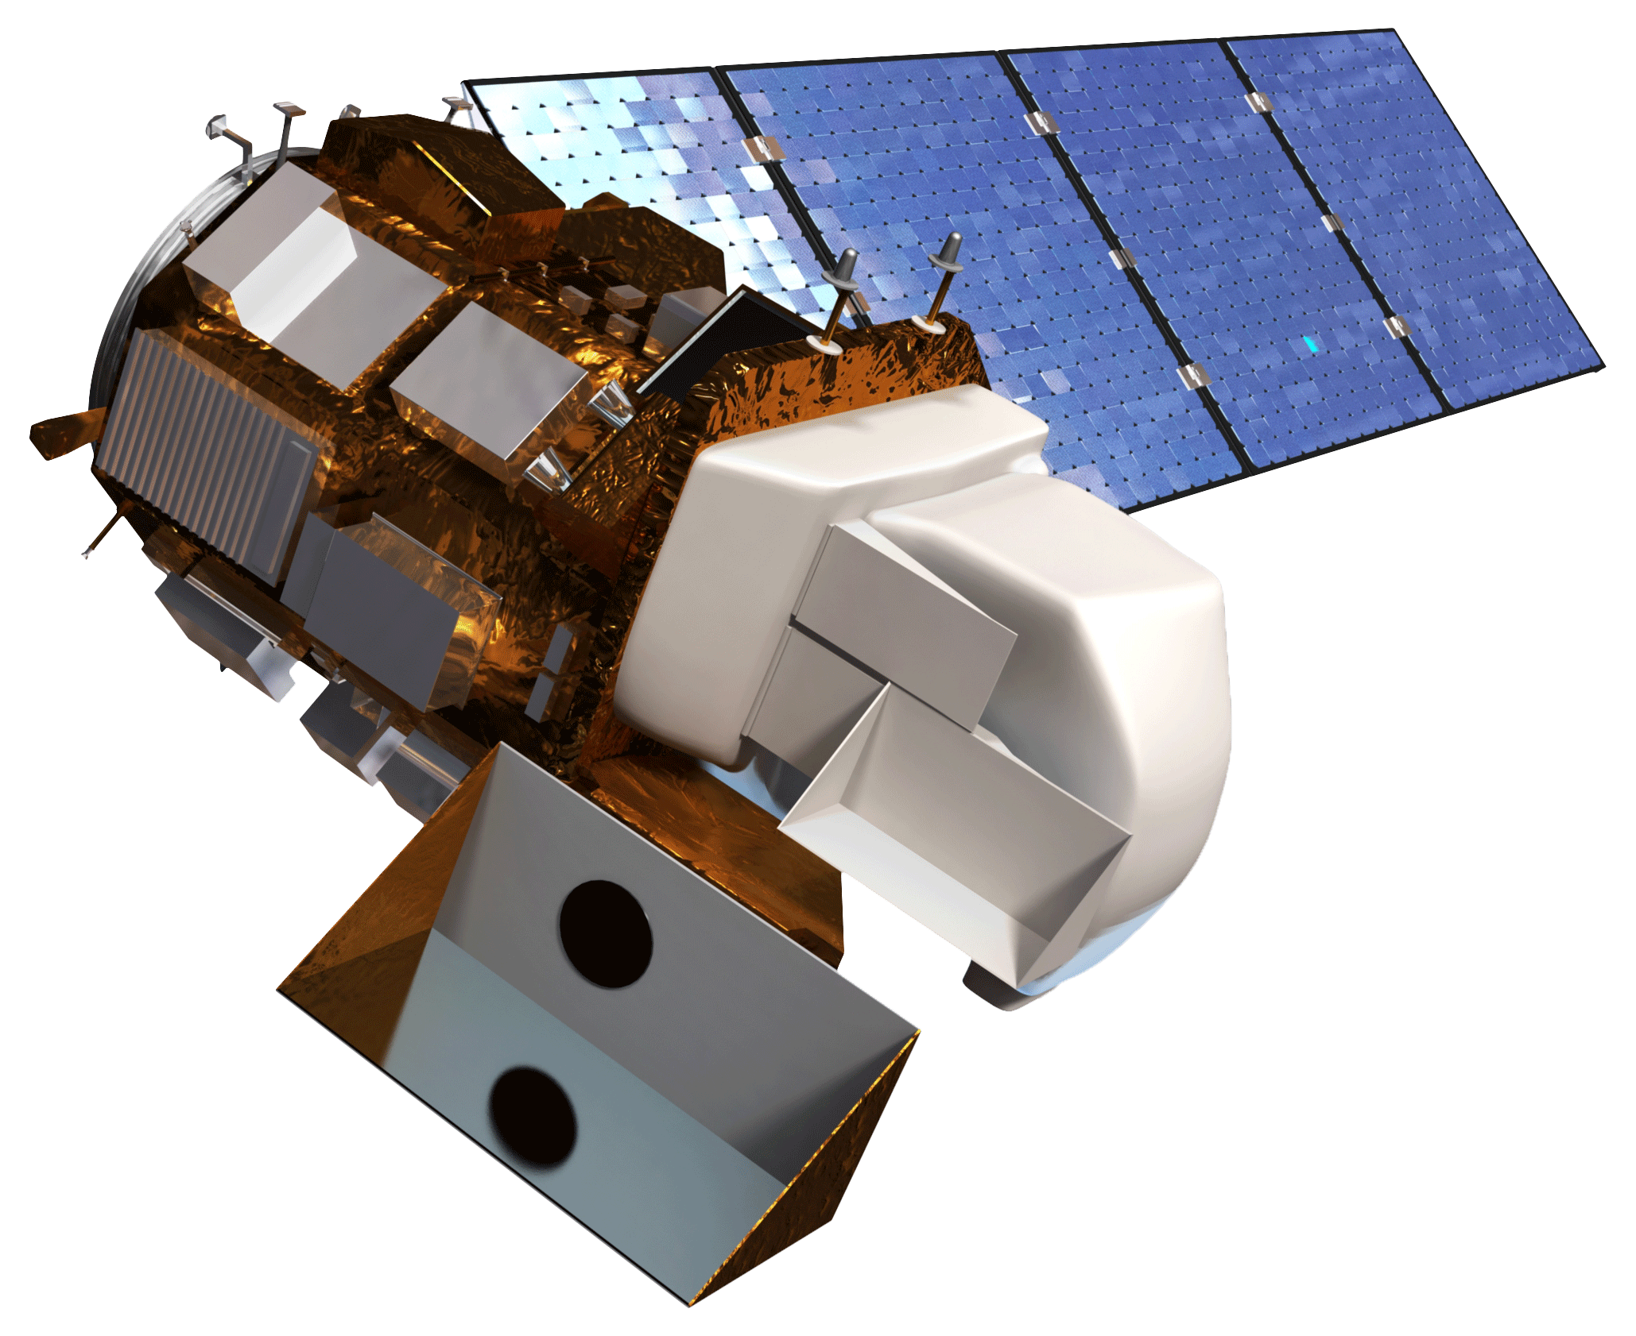
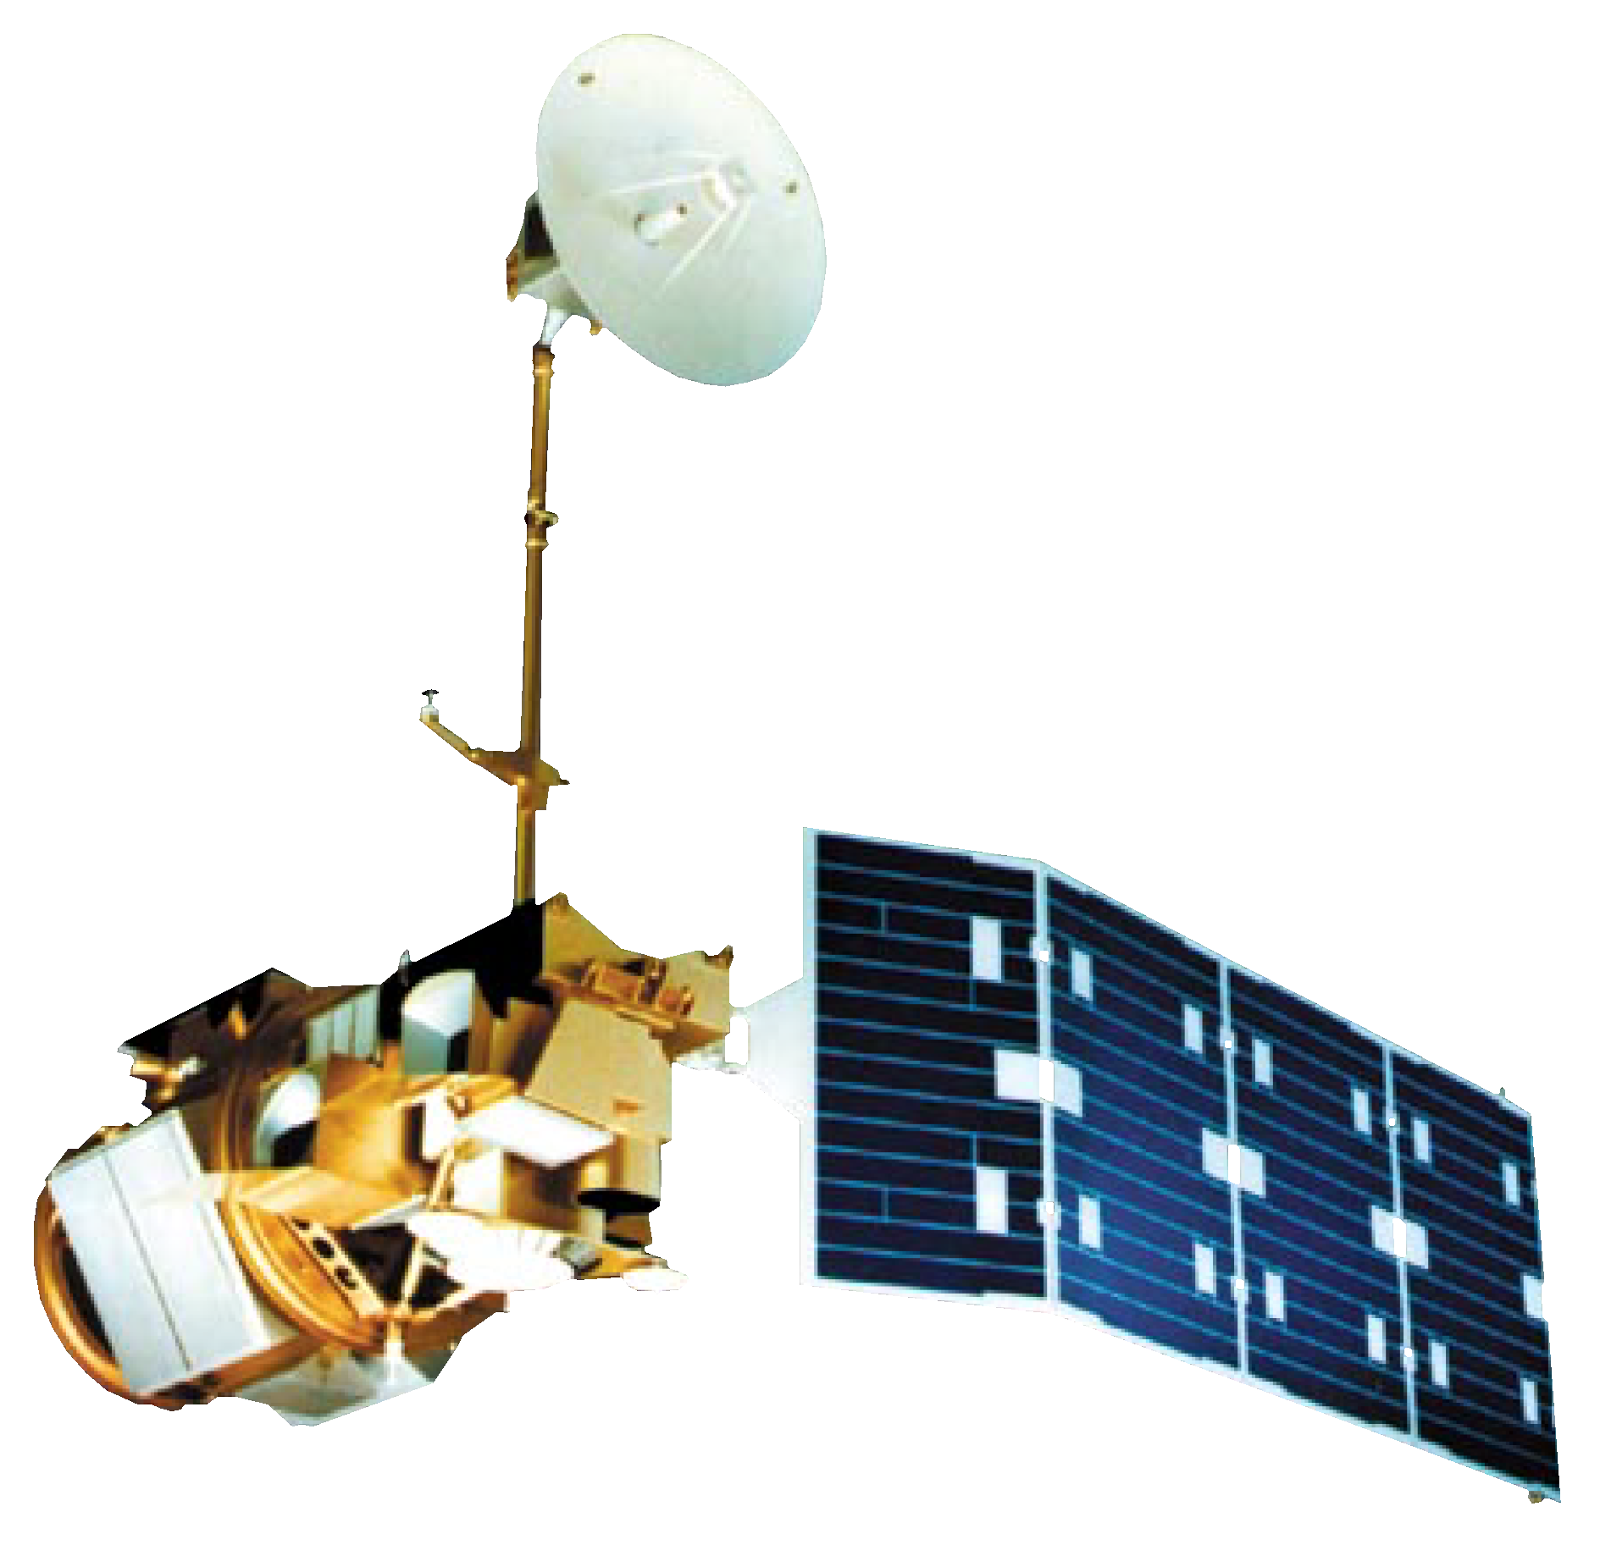
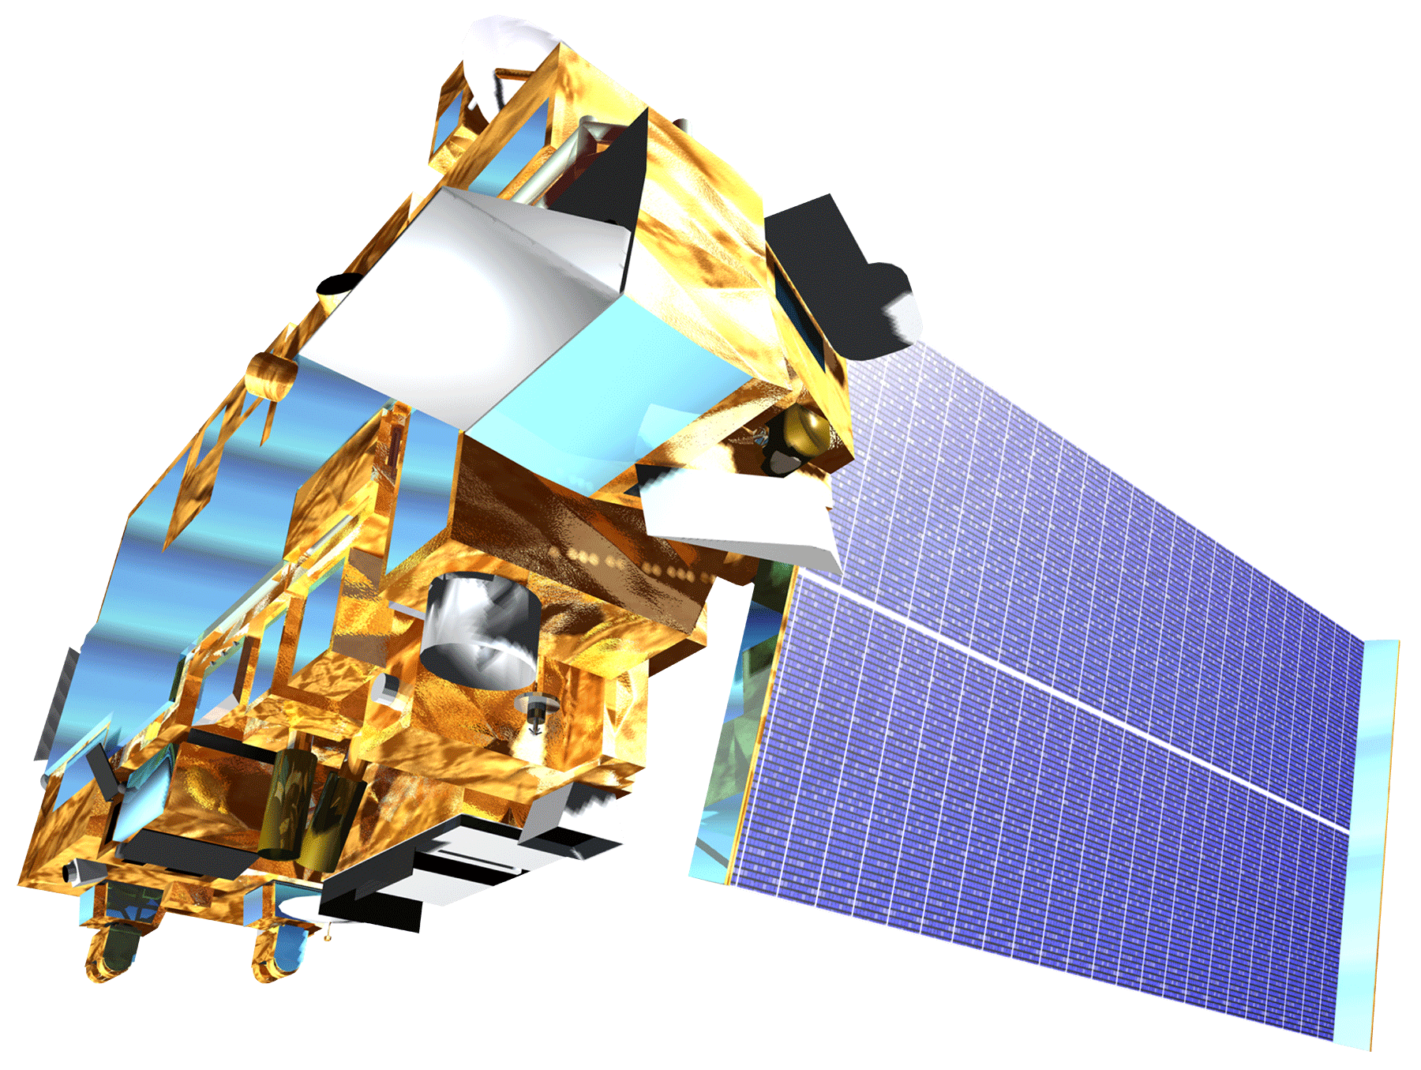
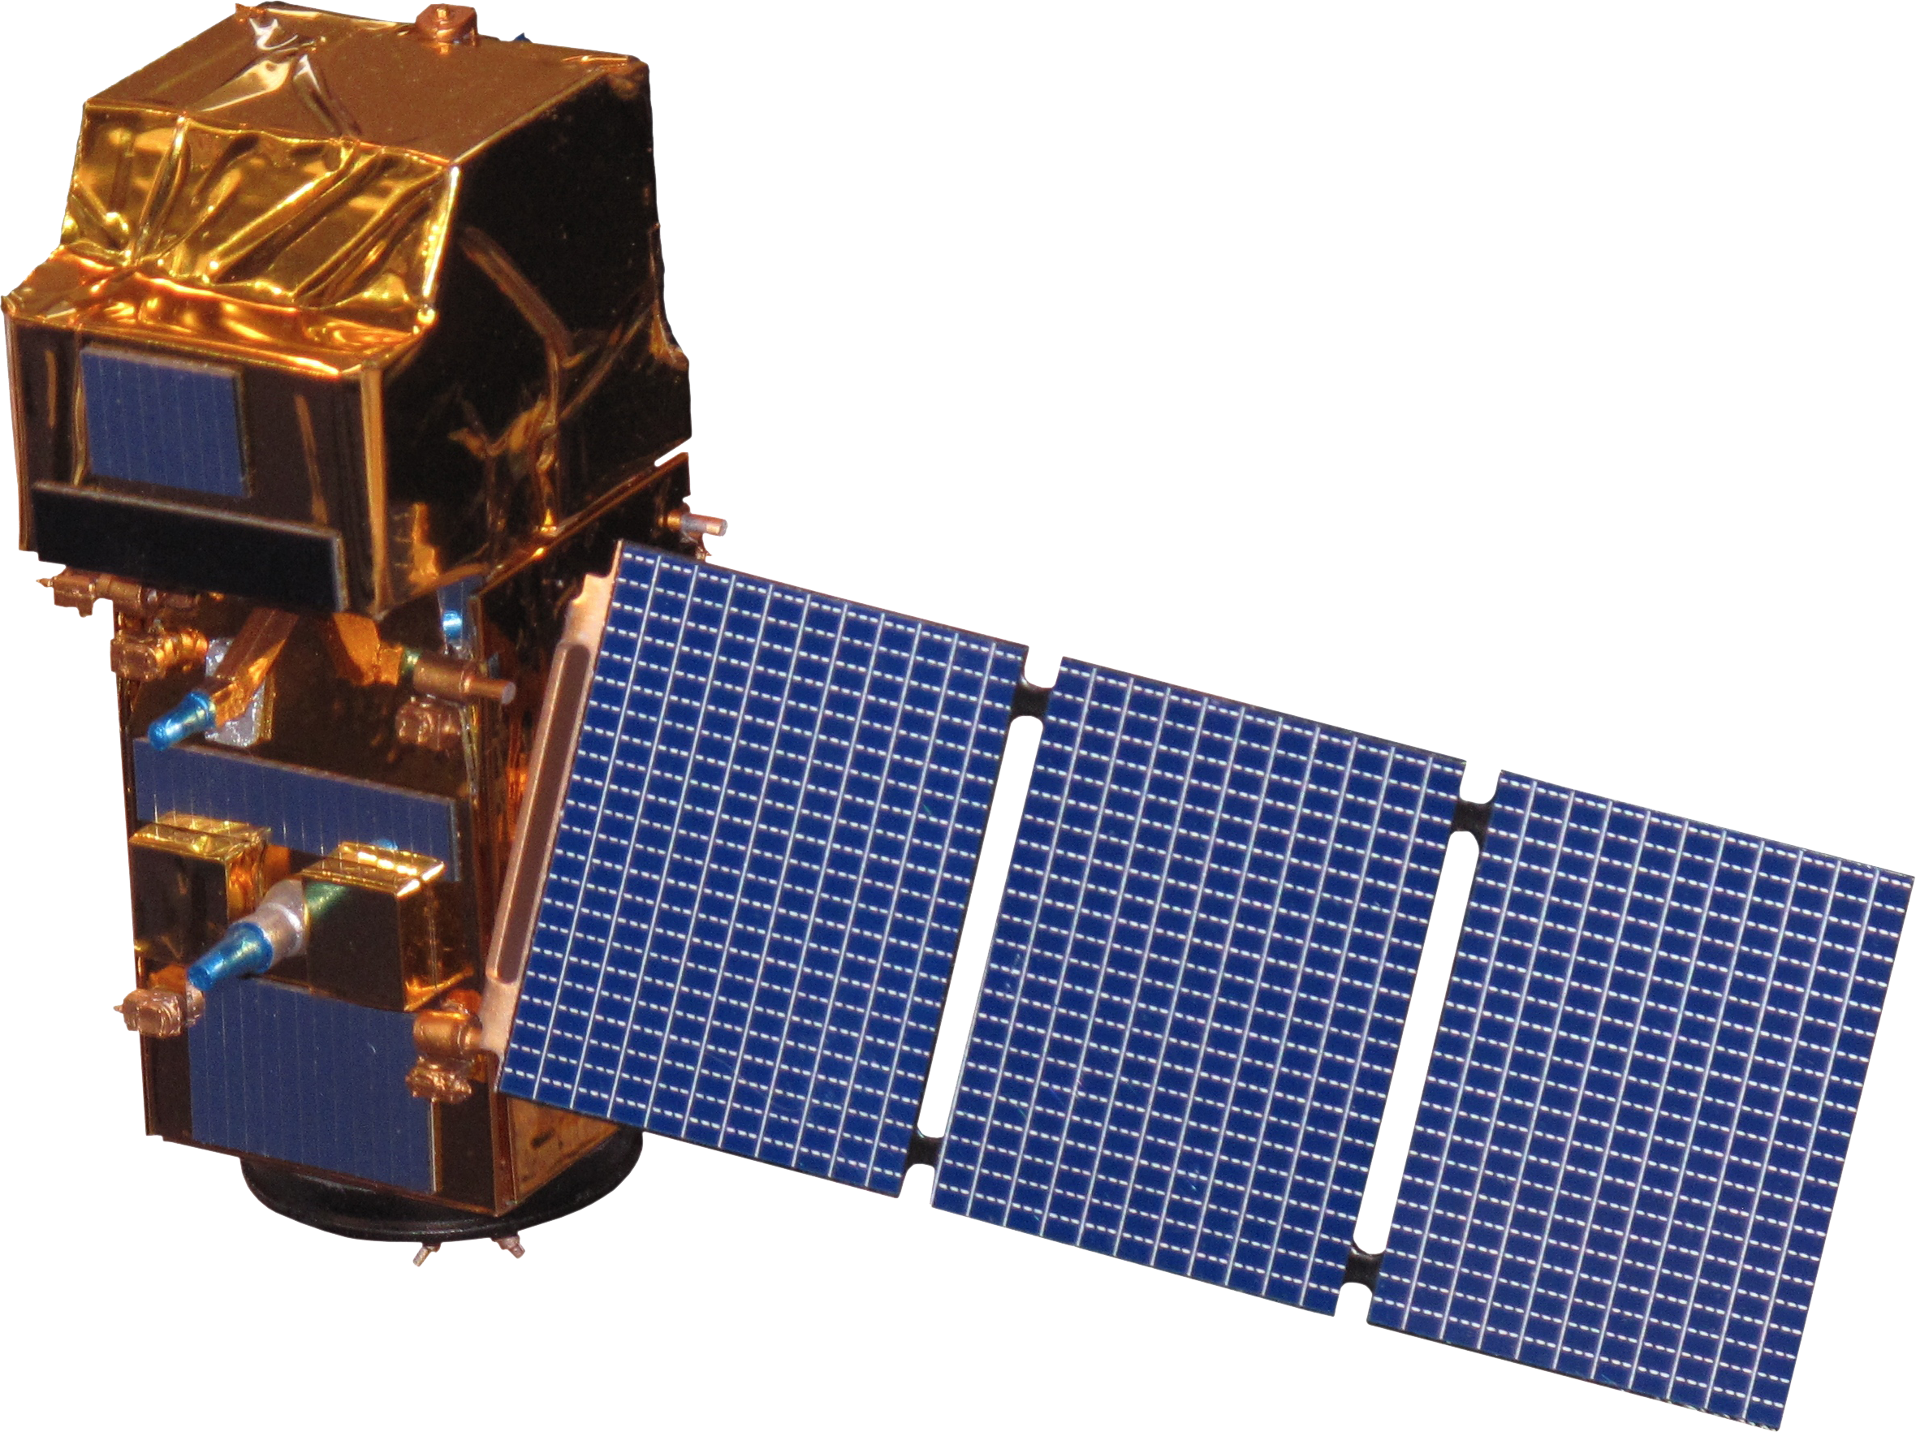
NASA Earth Observations
Landsat 8 OLI & TIRS
Landsat 5 TM
Terra MODIS
Sentinel-2 MSI
Image credit: NASA
Notes:
Satellite images from DEVELOPedia, NASA, http://www.devpedia.developexchange.com/dp/index.php?title=List_of_Satellite_Pictures
In order to predict areas that are vulnerable to further cheatgrass growth, we first had to identify areas that previously or still currently contained cheatgrass.
For this, we utilized the application of remote sensing, which allowed us to look at the Vegetation Index, a measure of the density and health of vegetation. We used 4 satellites
Landsat 5 TM- primary method for vegetation classification for 2003-2011
Sentinel-2- More in depth detailed analysis for classifying vegetation, for 2016-2017
Landsat 8 OLI-Further classifying vegetation indices for 2013-2016
MODIS Terra Normalized Vegetation Index-to analyze peak greenness of cheatgrass, to identify the times of year it is fully in bloom and healthy.
We took into account some of the limitations with remote sensing data, as factors such as the weather conditions, cloud cover, time of day, etc could influence the images taken.

Slide 8
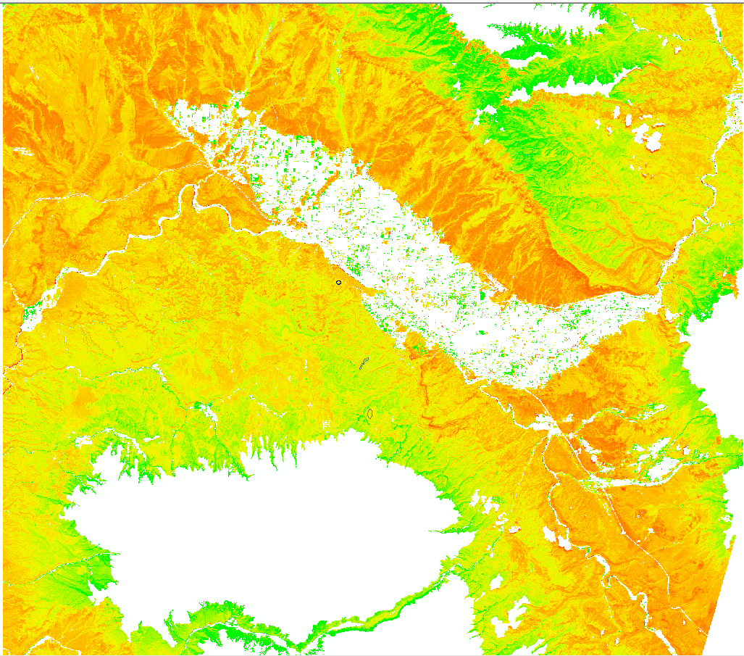
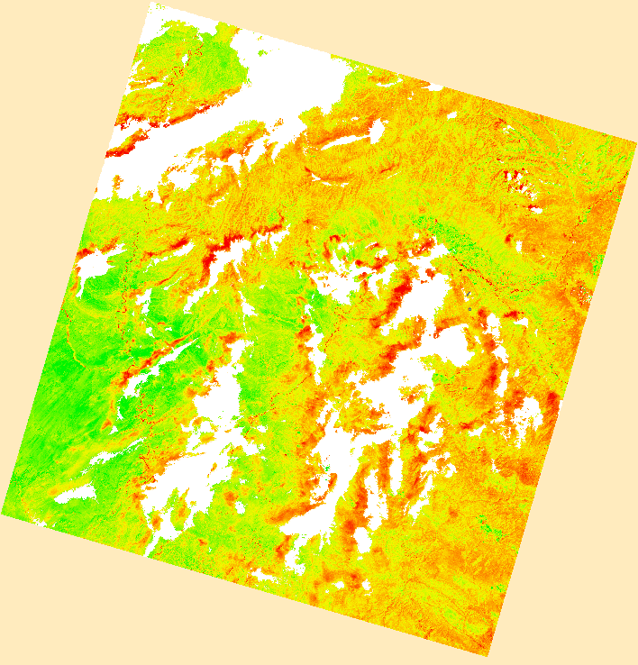

Methodology: NDVI
Used the NDVI formula:
Calculated the difference between peak greenness and die off of cheatgrass
Results in cheatgrass presence/absence map
To the left: Snapshot of NDVI, Dieoff Vegetation from 2016.
$$NDVI=\frac{NIR −Red}{NIR+Red}$$
Image Credit: Monet
NDVI_{total} = NDVI_{Peak} - NDVI_{Dieoff}
To the right: Snapshot of NDVI, Peak Vegetation from 2016
Notes:
After we acquired our satellite imagery, and processed the data, we calculated the Normalized Difference Vegetation Index (NDVI). The satellites take images in the form of several bands, and each band corresponds to a different part of the electromagnetic spectrum. In order to view the healthiness of vegetation, we calculated the Near Infrared bands (NIR) and Visible red band in order to view the healthiness of vegetation.
Calculated the difference between Peak greenness of cheatgrass and die off of cheatgrass
Turned the pixels with high change in NDVI to cheatgrass. The result of this is a cheatgrass presence/absence map
For Landsat 5, the Near Infrared band is band 4, while the visible red band is band 3. For the equation we subtracted and added band 4 and band 3.
For Landsat 8, the Near Infrared band is band 5, while the visible red band is band 4 and we also subtracted and added these bands.
The values from NDVI range from -1 to .7, with values greater than .1 indicate increasing greenness and density of vegetation, while values between .0 and .1 indicate bare soil and rocks. Values less than 0 most likely indicate rain, clouds and snow. (NOAA, Normalized Vegetation Index, http://www.ospo.noaa.gov/Products/land/mgvi/NDVI.html)

Slide 9
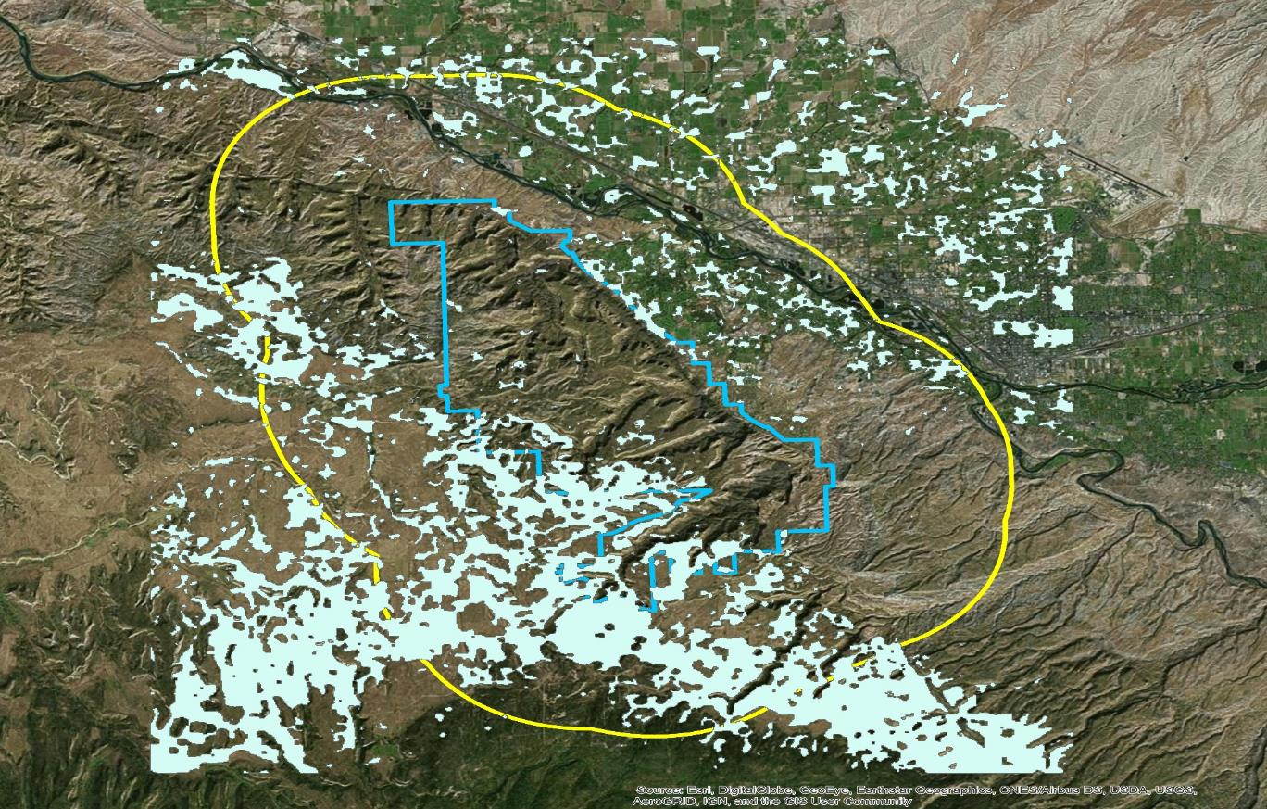
Current Early Season Activity Distribution
Current Locations
3 mile buffer
Colorado National Monument
Notes:
The first map indicates the current cheatgrass distribution as predicted using the previous methods. Several of these locations have been tested in person by ground crews to ensure that cheatgrass is actually present in the indicated areas.

Slide 10
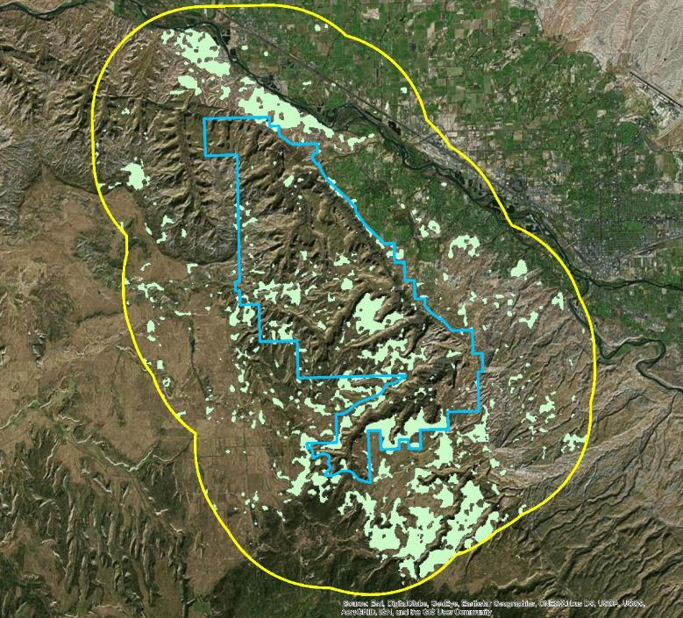
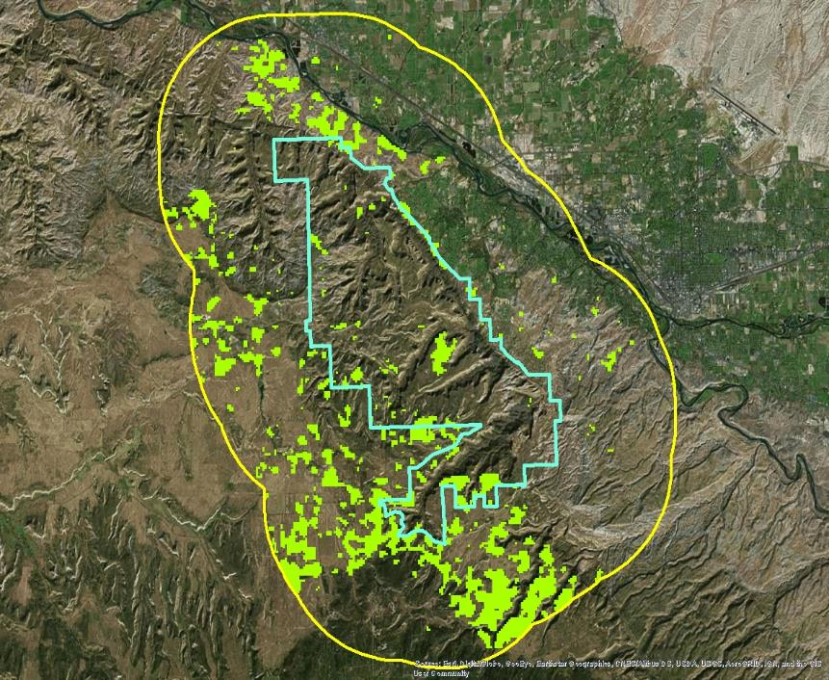
Historic Early Season Activity Distributions
.
3 Mile Buffer Around Park
Colorado National Monument
Locations From 2008 to 2013
3 Mile Buffer Around Park
Colorado National Monument
Locations From 2008 to 2017
Notes:
From these two maps, you can see cheatgrass expansion towards the southwest region of the park from the northern and southern areas.

Slide 11
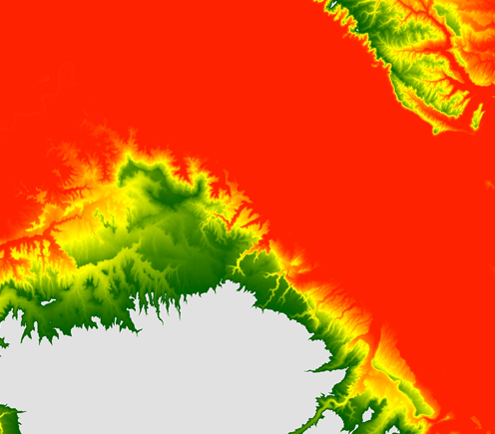
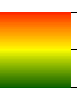
Methodology: MCE Factors
Multi-Criteria Evaluation:
Created a fuzzy image from each of the factors
Used MCE module in TerrSet to evaluate a total of seven factors
Elevation
Image Credit: Monet
Image Credit: Monet
Vulnerability Contribution Index
High: 1.0
Low: 0.0
Notes:
The team used 7 factors to assess the risk of cheatgrass invasion:
Hydrographic Features
Early Season Activity
Developed Area
Elevation
Aspect
Roads
Crops
The Elevation was assessed based on Bradley and Mustard 2006. The elevation range chosen as the peak of the contribution was 1400-1700 meters. A monotonically decreasing sigmoidal curve was applied to the fuzzy operation. This means that as a pixel location becomes farter away from the ideal location its contribution to increasing vulnerability. The grey areas represent elevations that were masked out of the analysis. The areas excluded from analysis are locations above 2200 meters.
Created fuzzy datasets for each of the factors.
The Multi-Criteria Evaluation consisted of deciding the factors and constraints that affect cheatgrass distribution in order to indicate areas of vulnerability.
We used the MCE module in Terrset software and input the created factors, which were: aspect the hill is facing; cheatgrass population; crops, developed areas; elevation; hydrographic channels, and roads.
We set the factor weights by rating the importance of each factor, which we decided through past research and observations (i.e. Bethany A. Bradley and John F. Mustard “Characterizing the Landscape Dynamics of an Invasive Plant and Risk of Invasion using Remote Sensing.”).

Slide 12
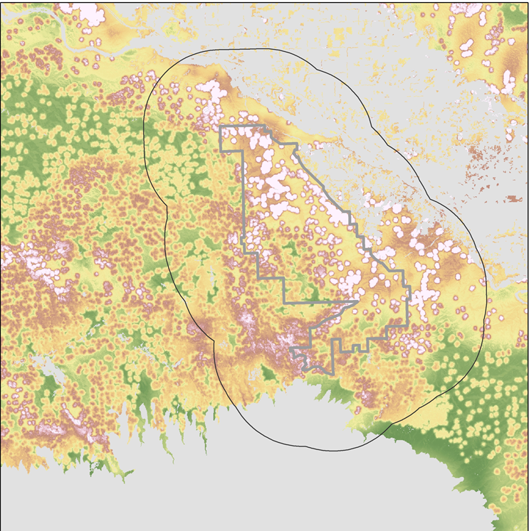
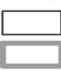


Methodology: MCE
The result: a map showing areas most vulnerable to cheatgrass invasion based upon
The highest vulnerability is located in the northeastern and southwestern portion of the park.
Vulnerability
Kilometers
3 Mile Buffer Around Park
Colorado National
Monument Boundary
High: 0.916
Low: 5.52e-9
Aspect
Roads
Crops
Notes:
The results were a map that depicts areas most vulnerable to cheatgrass invasion, based on the weighted factors. The intensity of red on the map indicates areas of varying vulnerabilities (the darker the red, the more vulnerable)

Slide 13
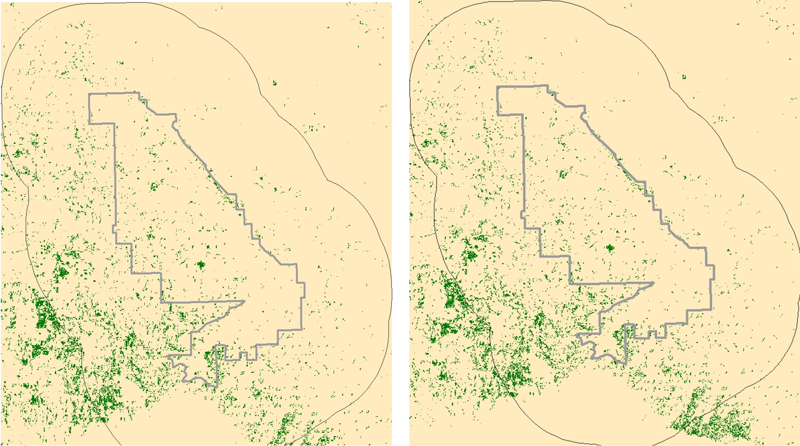
Predicted Early Season Activity
3 Mile Border Around Park
Colorado National Monument
Predicted Early Season Activity Locations
2017
2023
Notes:
The 2017 image shows the early season activity that detected through the use of NDVIs.
The 2023 image show the location of the forecasted early season activity. The 2023 image is the result of the assumed 4% compounded annually growth.
There are three scenarios being forecasted to 2023. The represent a 1%, 2.5%, and 4% growth compounded annually.
The starting point is in 2017 when all scenarios are equal.
When forecasting, we had to predict the approximate growth rate for cheatgrass. Based on Bradley and Mustard’s 2006 research, they found that the average rate of cheatgrass expansion was approximately 2.5%. That value was used as the business as usual model. The 1% and 4 % forecasting model were used as a means making a bad yearand an optimal year scenarios.

Slide 14
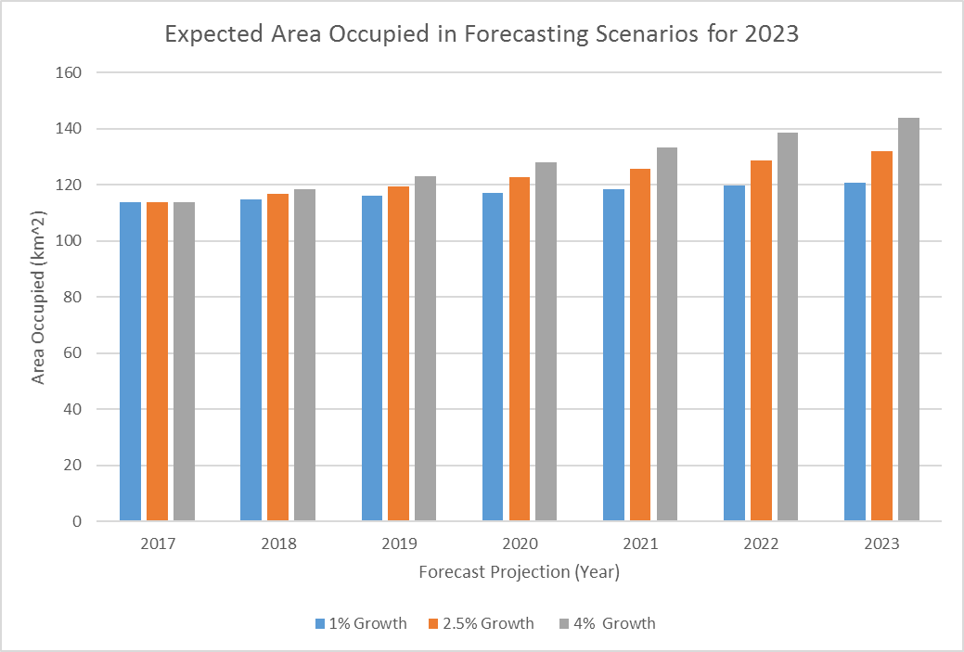
Results
Notes:
There are three scenarios being forecasted to 2023. The represent a 1%, 2.5%, and 4% growth compounded annually.
The starting point is in 2017 when all scenarios are equal.
When forecasting, we had to predict the approximate growth rate for cheatgrass. Based on Bradley and Mustard’s 2006 research, they found that the average rate of cheatgrass expansion was approximately 2.5%. That value was used as the business as usual model. The 1% and 4 % forecasting model were used as a means making a bad yearand an optimal year scenarios.
When making predictions for the future locations of cheatgrass, we used three different growth rates. The growth rates can vary based upon natural conditions and the ability of NPS to manage and remove cheatgrass populations. The upper and lower threshold forecasting were done to provide the NPS with the ability to scale their efforts to the type of year.
Discuss the total area that will be occupied in in both time periods.
Compare how the distributions compare to the most vulnerable area to invasion.

Slide 15
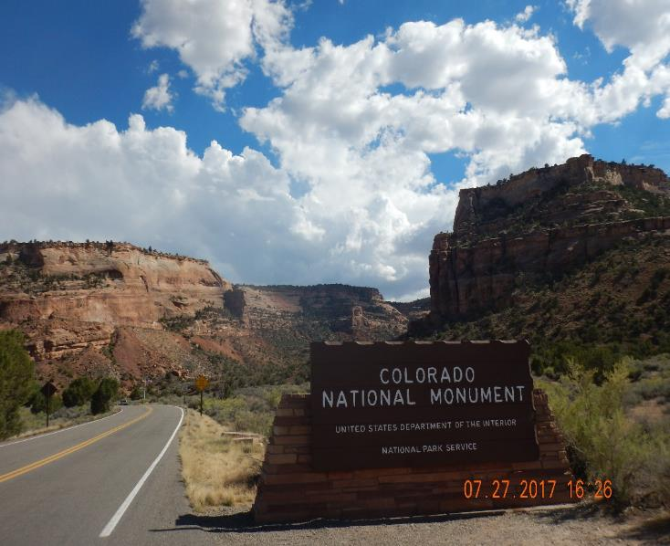
Conclusions
Not all early season activity detected by satellite imagery is cheatgrass.
Early Season Activity can skip years.
Early Season Activity appears to be concentrated in the southwest and northeast of the park.
The concentration of Early Season Activity also has a similar pattern as the areas of greatest vulnerability.
Image Credit: Colorado National Monument
Notes:
Image Credit: provided by the Colorado National Monument
After doing this project, we came to several conclusions. First, we detected large amounts of concentrated Early Season activity in the Northeast and Southwest areas of the park. After having staff members at Colorado National Monument investigate, most of these sightings were in fact cheatgrass. However, there were a few areas that didn’t have it, which indicates that not all early season activity detected by satellite imagery is cheatgrass. Ground truthing is needed to confirm that cheatgrass is present in that area.
After looking through multiple years and talking with our partners, we came to the conclusion that Early Season Activity can skip years. This indicates that just because cheatgrass is present one year, it may not be present the following one or two years. This is why any chart showing the current locations of cheatgrass needs to investigate the previous 2 or 3 years in order to make a more accurate estimation. There are multiple cases where an area went 2-4 years in between cheatgrass blooms.
Finally, the Multi Criteria Evaluation shows that the areas of greatest vulnerability to invasion are located east and southwest of the park. This means that precautions should be made in these areas to prevent further invasion and spread of cheatgrass.
When making predictions for the future locations of cheatgrass, we used three different growth rates. The growth rates can vary based upon natural conditions and the ability of NPS to manage and remove cheatgrass populations. The upper and lower threshold forecasting were done to provide the NPS with the ability to scale their efforts to the type of year.

Slide 16
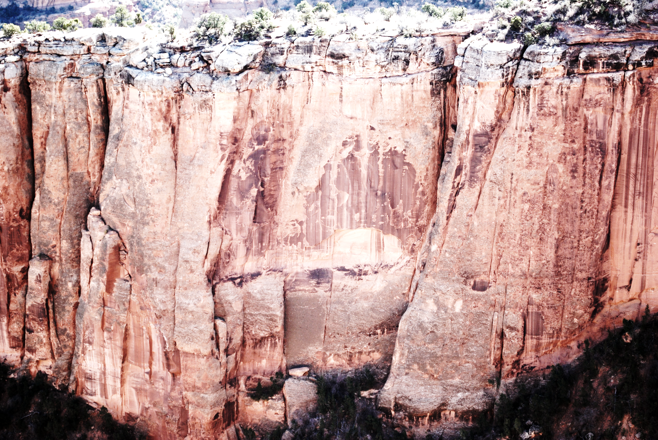
Limitations/Future Work
Satellite Imagery
Early Season Activity
For Future
More ground-truthing for all the spots detected
Continue to use both Landsat 8 and Sentinel-2 in order to provide more accurate results
Improved resolution for satellites
Survey utilizing drone technology
Several maps during peaks and dieoffs couldn’t be used due to clouds cover
Low spatial resolution of satellite imagery
Not accurate enough to detect just cheatgrass
Any plant that has a similar growing habit to cheatgrass will be difficult to distinguish

Slide 17

Acknowledgements
Ann Rodman, Chief of Cultural and Natural Resources, Colorado National Monument
Molly Murphy, Biological Science Technician, Colorado National Monument
Dr. Deborah Kennard, Associate Professor, Colorado Mesa University
Dr. Kenton Ross, DEVELOP Science Advisor, NASA Langley Research Center
Image credit: Arline Titus
Notes:
Image credit: Arline Titus, http://arlinetinusoilpaintings.com/coloradosouthwes.html
Thank you to our partners from the Colorado National Monument Park Service: Ann Rodman, and Molly Murphy, and to Dr. Deborah Kennard from Colorado Mesa University.
A special thank you to Dr. Ross, our project advisor and everyone at the DEVELOP program from the NASA Langley Research Center– we couldn’t do this project with all of your help and assistance!

