Slide 1
Alto Orinoco Health & Air Quality
Utilizing NASA Earth Observations to Locate Remote Yanomami Villages in the Alto Orinoco Municipality for Targeted Eradication of River Blindness Disease
Sara Amirazodi (Project Lead)
Notes:
Good morning, I’m Sara Amirazodi with the Alto Orinico Health & Air Quality team.
I worked with two other DEVELOP nodes at Goddard and the Wise County Clerk’s Office.
This project stemmed from communication between President Carter of The Carter Center and NASA Administrator Charles Bolden.
Our goal was to help The Carter Center eliminate Onchocerciasis in the Yanomamo territory of Venezuela by using satellite imagery to locate remote villages for treatment distribution.

Slide 2
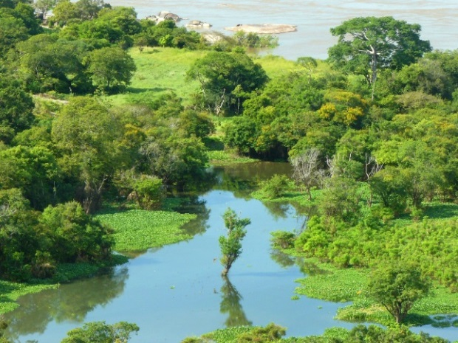
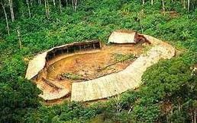
Study Area
Yanomamo territory, Alto Orinoco municipality, Venezuela
Image Credit: Flickr user Pedro Gutiérrezs
Image Credit: Wikimedia user Zeljko
Notes:
Our study area shown here is the Brazil-Venezuela border.
And 7 sub regions of the Alto Orinoco Municipality.
The sub region outlined in red is Alto Ocamo-Parima, our primary focus.
There are about 35,000 indigenous people who live in the Amazon rainforest on the Brazil-Venezuela border.
And this is the last remaining area for active transmission of Onchocerciasis in the Americas.
Top Right Image Source: https://commons.wikimedia.org/wiki/File%3AOrinoco4.jpg
Orinoco River, Amazonas State. Venezuela.
Bottom Right Image Source: https://commons.wikimedia.org/wiki/File%3AShabanoYanomami.jpg
ShabanoYanomami.

Slide 3
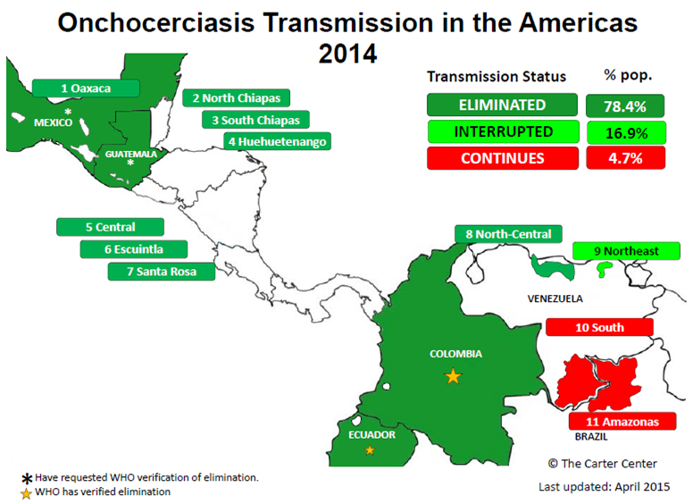
Project Objectives
Onchocerciasis Elimination Program for the Americas (OEPA)
Assist the Carter Center in 2015 elimination goal
Locate Yanomamo villages and predict migration
Create a village location map and suitability model for distribution of medical treatment
Image Credit: The Carter Center, 2015
Notes:
Currently, The Carter Center’s Onchocerciasis Elimination Program for the Americas (OEPA) has been working with a World Health Organization mandate to eliminate the disease in the Americas by the end of 2015.
In the past, village identification was done with expensive helicopter field surveys, but it was difficult to keep up with the nomadic Yanomamo people.
So the Carter Center needed timely and accurate results to pass on to the Venezuelan government and local health workers.
Image Source: http://www.cartercenter.org/resources/pdfs/health/river_blindness/OEPA-foci.pdf

Slide 4
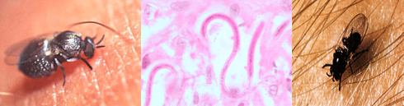
Community Concerns
About Onchocerciasis
Neglected tropical disease (NTD) caused by Onchocerca volvulus
Symptoms include debilitating itching, skin discoloration, visual impairment
Over 100,000 at risk and over 20,000 in need of treatment
Yearly dose of Mectizan
Image Credit: Centers for Disease Control and Prevention (CDC)
Notes:
Onchocerciasis is otherwise known as River Blindness.
It’s a eye and skin disease caused by a parasitic worm.
And transmitted to humans through the repeated bites of infected blackflies that breed in fast-flowing rivers and streams in tropical climates.
The adult female worm produces thousands of baby worms that migrate throughout the body and become toxic when they die.
Symptoms include severe itching and skin depigmentation, and eventually blindness if left untreated.
A yearly dose of Mectizan is required to relieve the symptoms, block the development of the worms, and stop the progression toward blindness.
Image Source: http://www.cdc.gov/parasites/onchocerciasis/

Slide 5
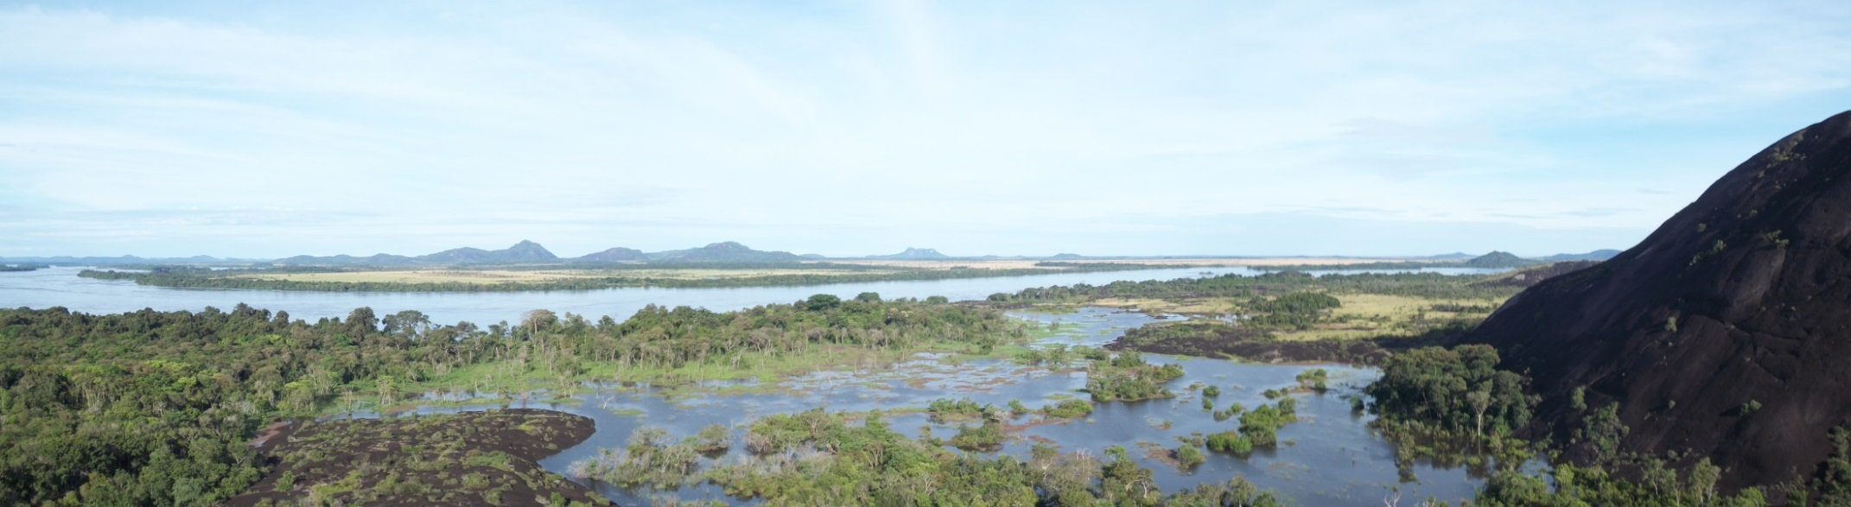
Community Concerns
About Yanomamo Tribes
Live primarily near water
In secluded rainforest settlements without outside contact
Migration every couple of years for survival
Cycle of poverty reinforced due to blindness
Image Credit: Wikimedia user Shishoxisrax
Notes:
The Yanomamo people are at great risk of contracting the disease.
Their survival depends on living in isolation and regular migration due to: food shortages, exhausted crop land, flooding, disease, and invasions.
Blindness makes working and learning necessary survival skills very difficult, and fear of the disease sometimes causes premature abandonment of villages.
This decreases production and increases poverty.
Image Credit: https://commons.wikimedia.org/wiki/File%3APanoramica_del_rio_orinoco_en_amazonas.JPG
Orinoco River, South America.

Slide 6

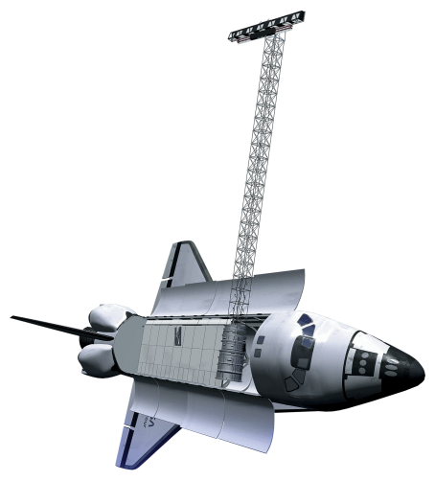
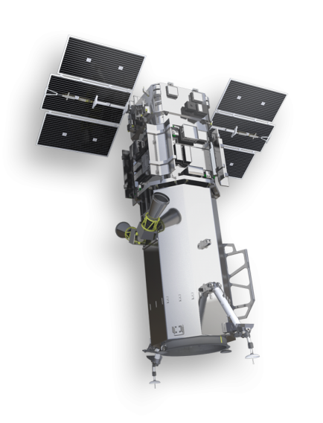
Datasets Used
NASA Earth Observations
Landsat 8 OLI/TIRS
SRTM
Landsat 8
Ancillary Datasets
SRTM
Worldview - 3
GeoEye - 1
Quickbird - 2
Worldview-3
Notes:
Our study period was from 2012 to present.
We gathered a lot of data, but mainly we used 30m Landsat 8, Digital Globe’s Worldview-3 commercial high-res imagery, and SRTM.

Slide 7
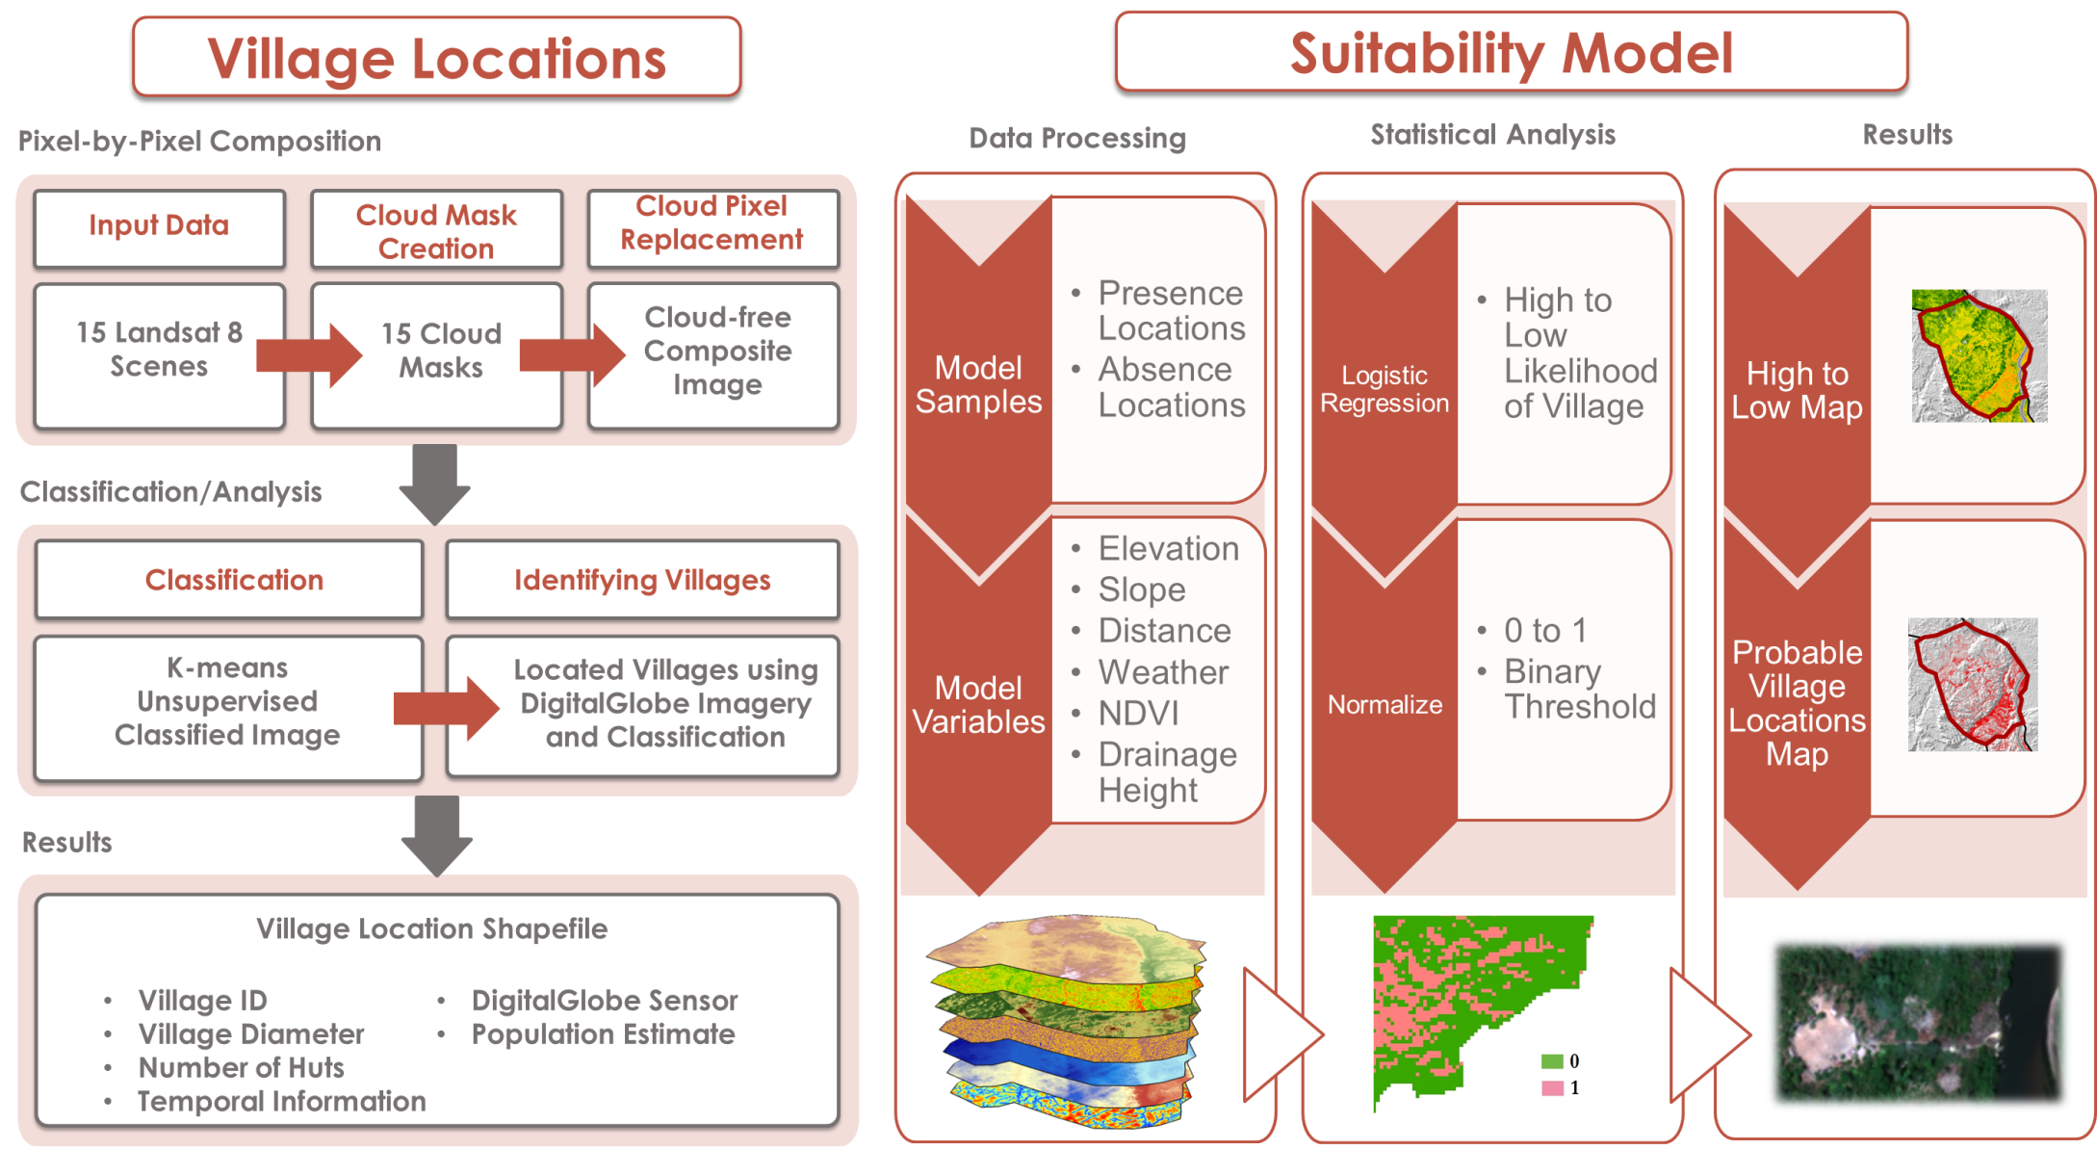

Methodology
Notes:
Basically we gathered a set of village coordinates and put together a list of suitable habitat parameters, which we used to create our suitability model.
For suitable habitats, the Yanomamo people favor lower elevations within 500 meters of water, live in circular huts, with village sizes typically about 100 square meters, surrounded by gardens of about 50, 000 square meters, and with populations from 40-80 for smaller villages and 250-400 for larger villages.

Slide 8
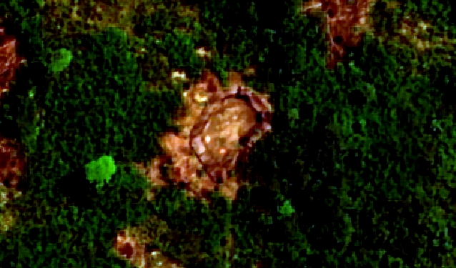
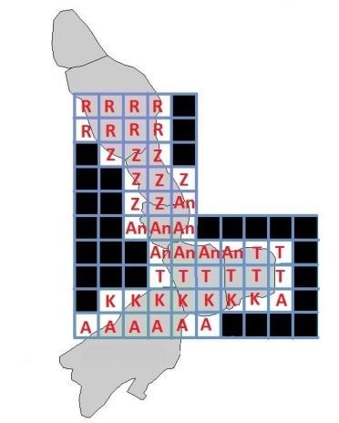
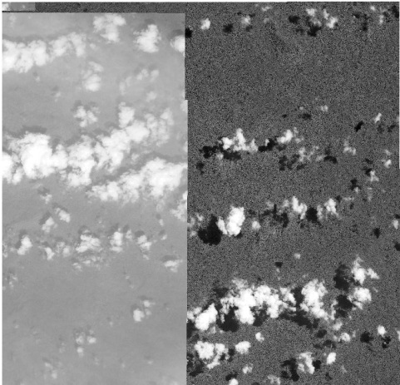
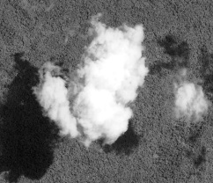
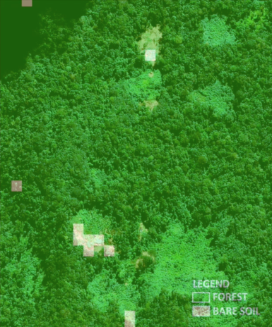
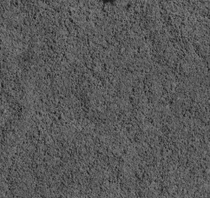
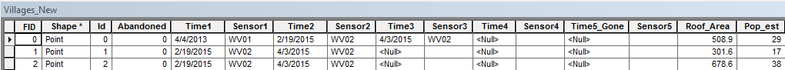
Methodology
Locating Villages
Inspect Digital Globe mosaics
Perform unsupervised land classification
Locate villages
Image source: DigitalGlobe
Notes:
To locate villages, the study area was divided into grids for visual inspection using a cloud free digital globe mosaic, and raw data from other dates replaced instances where clouds were present.
Unsupervised land classification was performed on a Landsat 8 composite to show forest and non-forest, and grids were cross-checked with high-res imagery.
When villages were identified, their characteristics were noted.

Slide 9
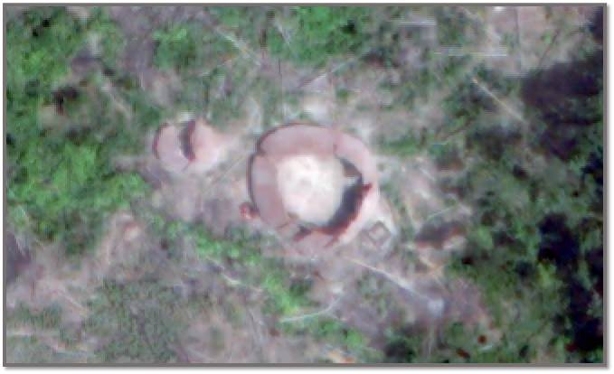
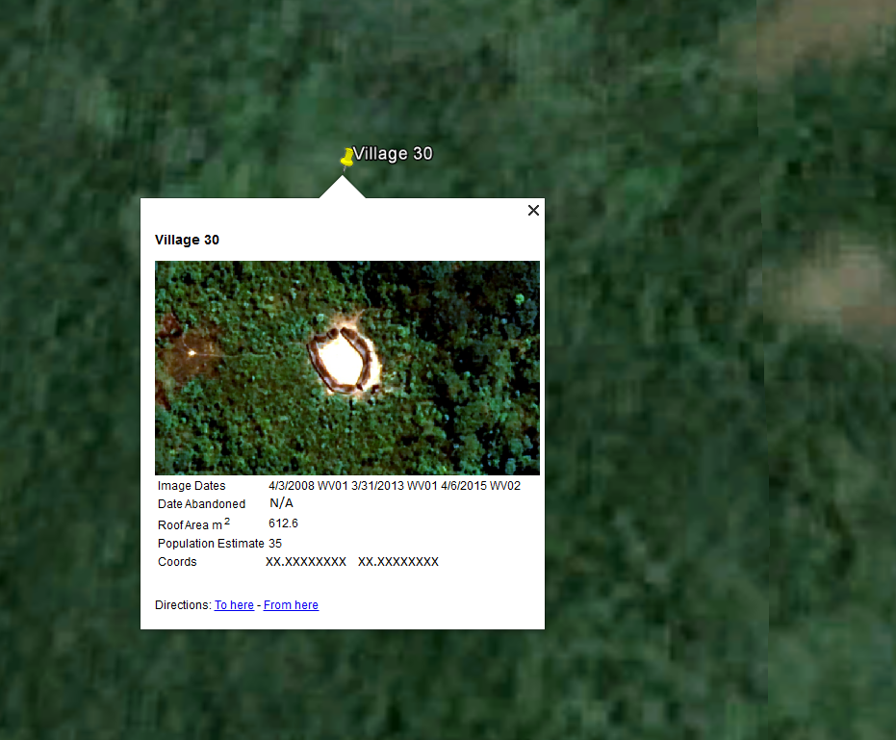
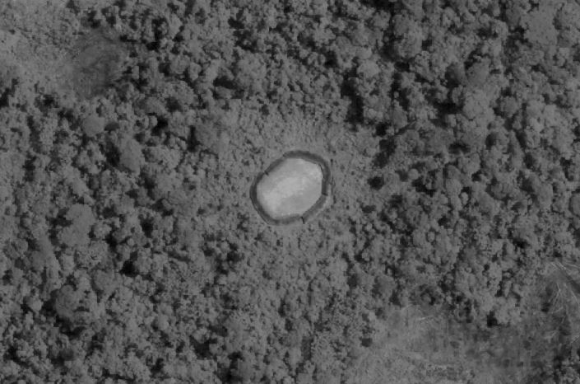
Results
Village Identification
140 villages
High-res accuracy check
KML file created for Google Earth
Image Source: DigitalGlobe
Notes:
140 villages were identified.
And a KML file was created for anyone at the Carter Center to use in Google Earth.

Slide 10
Methodology
Developing a Suitability Model
Input village locations and habitat variables
Perform logistic regression to predict absence vs. presence
Scale outputs from zero to one as relative probability
Identify threshold to create binary absence or presence
Extract probable village locations
Notes:
So then we took our village locations along with a set of suitable habitat variables created in ArcMap to develop our suitability model.
First, the village location coordinates were used as presence samples to create random absence points.
Then a logistic regression technique was performed with Python using the variables to predict presence vs. absence.
This output the probability of a village occurring at a particular location, and results were scaled to values of zero to one as a relative probability.
Then a threshold was identified to create a binary presence or absence.
Predictions were extracted and compared to absence and presence.
And statistics were run on samples to check for accuracy.

Slide 11
Results
Probability of Village
Elevation
Slope
Distance to streams
Height above nearest drainage
NDVI
Temperature
Precipitation
Notes:
Shown here is a map of village probability, with the most probable locations occurring in the southern part of our study area.
The variables used were elevation, slope, distance to streams, NDVI, height above nearest drainage, temperature, and precipitation.

Slide 12
Results
Probable Village Locations
Cross-validation accuracy: 76%
Cross-validation correlation: 0.6
Significance: less than 0.01
Notes:
And here we added probable village locations.

Slide 13
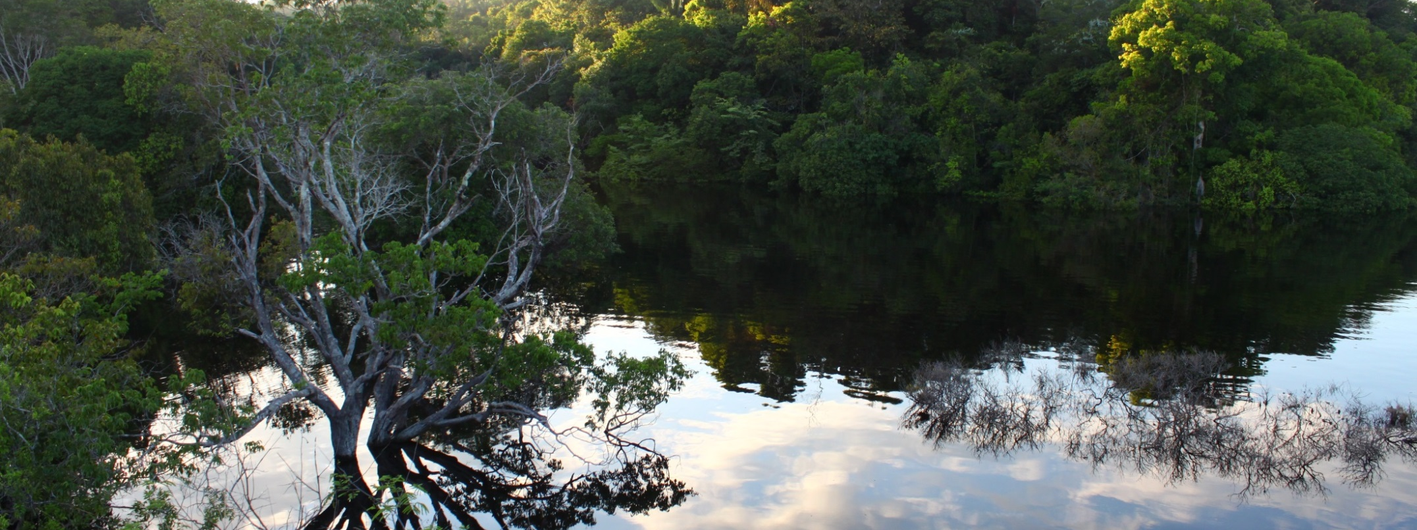
Image Credit: Wikimedia user Artur Warchavchik
Conclusions and Future Work
Villages and suitability model available for treatment missions
Communication with Venezuelan government
Possible applications elsewhere
Notes:
In the next couple of months, the Carter Center will share our results with the Venezuelan government
So that initial treatments and follow-up treatments can be delivered to local aid workers, who will also provide health education to the Yanomamo people.
This study may also prove useful for missions in other regions, such as Africa where Onchocerciasis is still a major cause of blindness.
Image Source: https://commons.wikimedia.org/wiki/File%3AAmanhecer_no_Amazonas_II.jpg
Amanhecer no Parque Nacional do Jaú, Amazonas.

Slide 14
Advisors
Dr. Jeff Luvall
NASA at NSSTC
Dr. Jim Tucker
NASA Goddard Space Flight Center
Dr. Kenton Ross
NASA DEVELOP
Dr. John D. Bolten
NASA Goddard Space Flight Center
Mentors
Dan Irwin
SERVIR
Dr. Robert Griffin
University of Alabama in Huntsville
Kel Markert
University of Alabama in Huntsville
Partners
Dr. Frank Richards
Lindsay Rakers
The Carter Center
Notes:
Lastly, I’d like to thank our science advisors and mentors - Dr. Luvall, Dr. Griffin, Kel Markert, and Dan Irwin.
Lindsay and Frank at the Carter Center.
And also the teams at Goddard and Wise for their contributions.
For without their support, this project would not have been possible.

