Slide 1
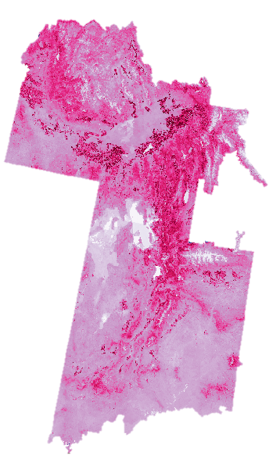
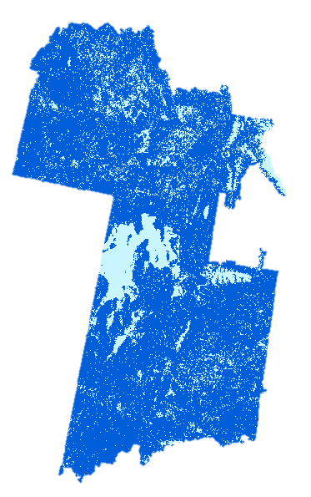
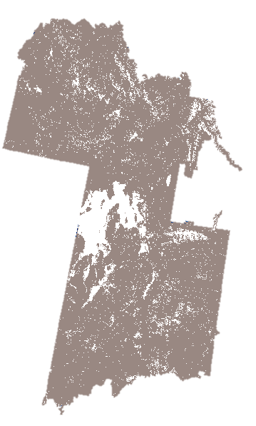
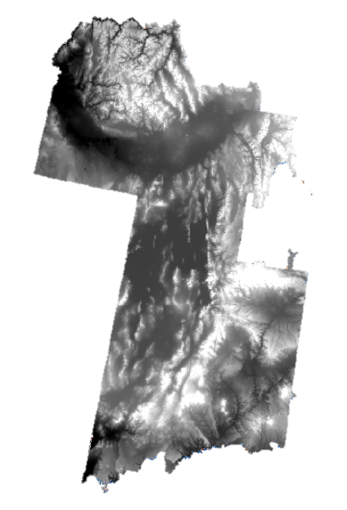
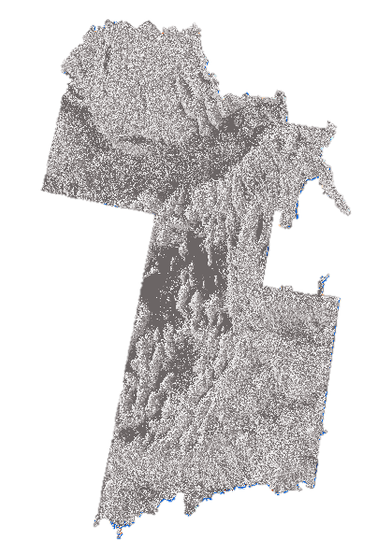
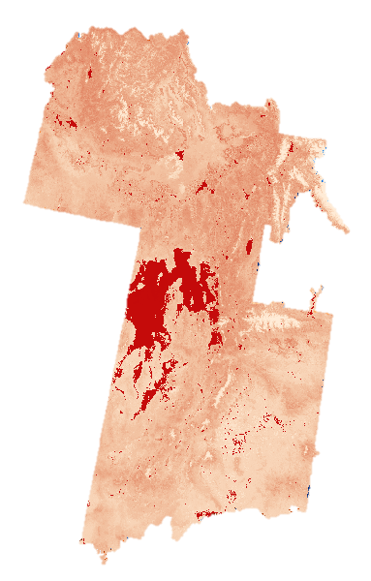
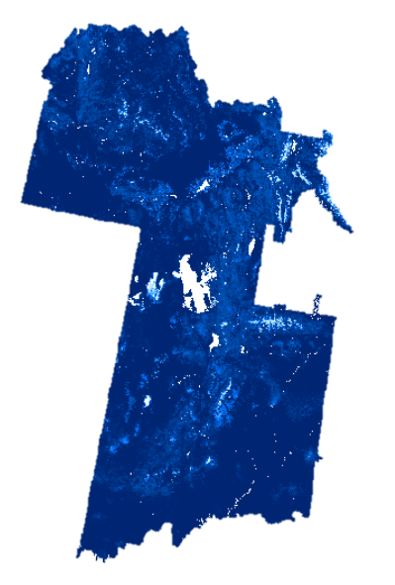
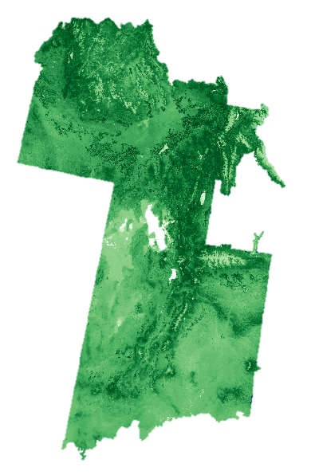
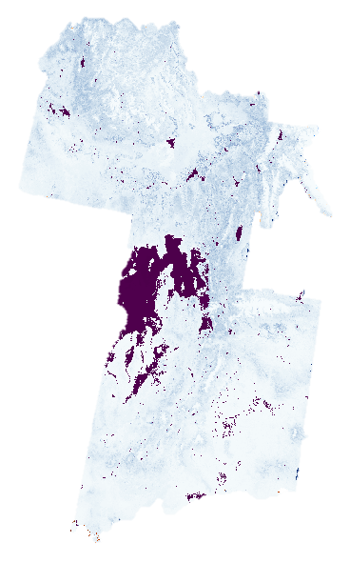
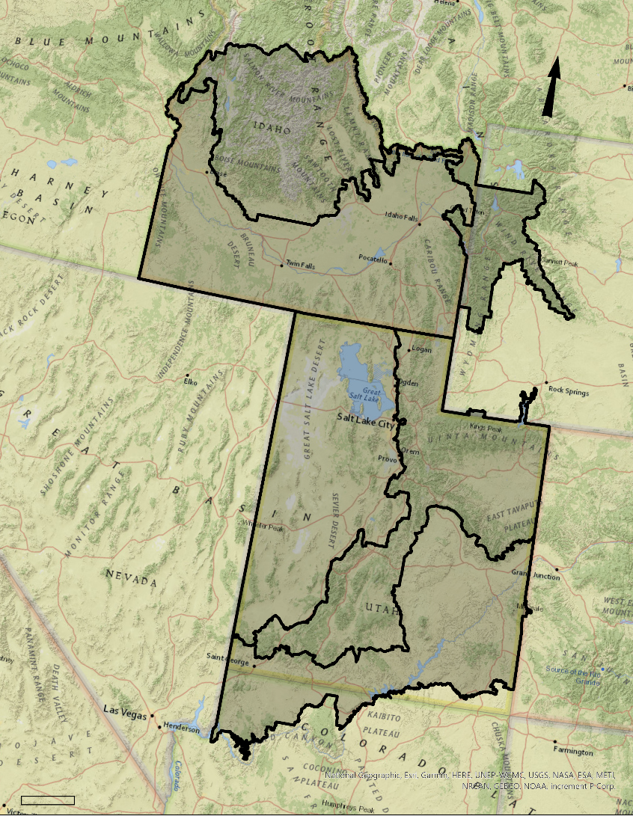
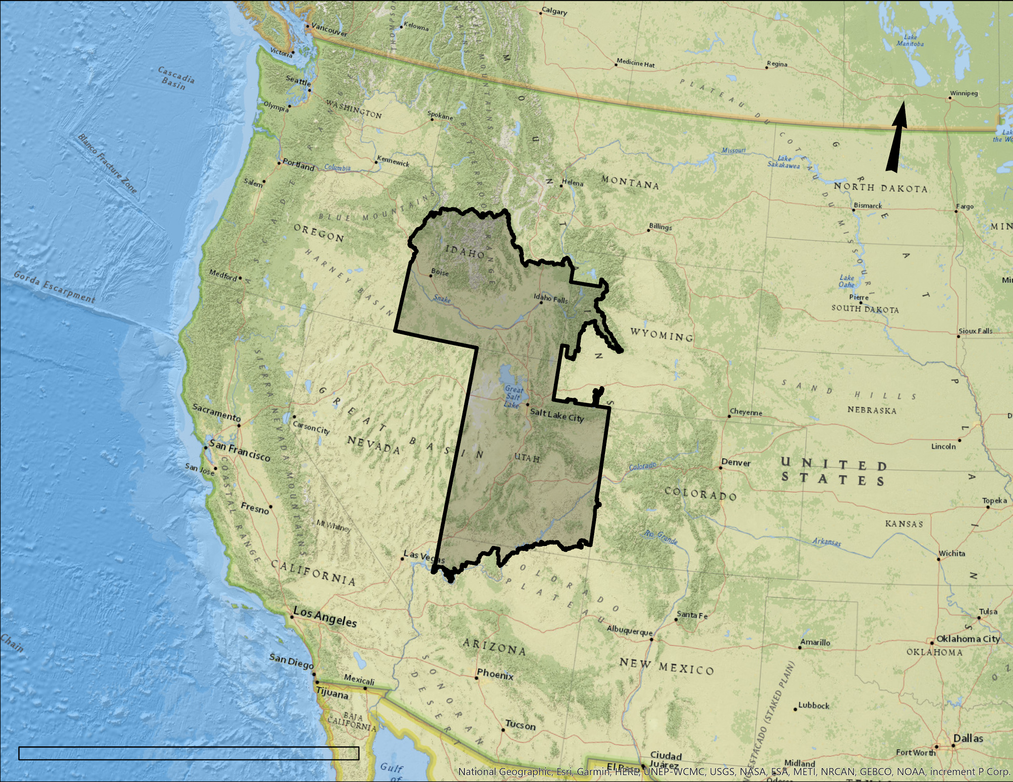
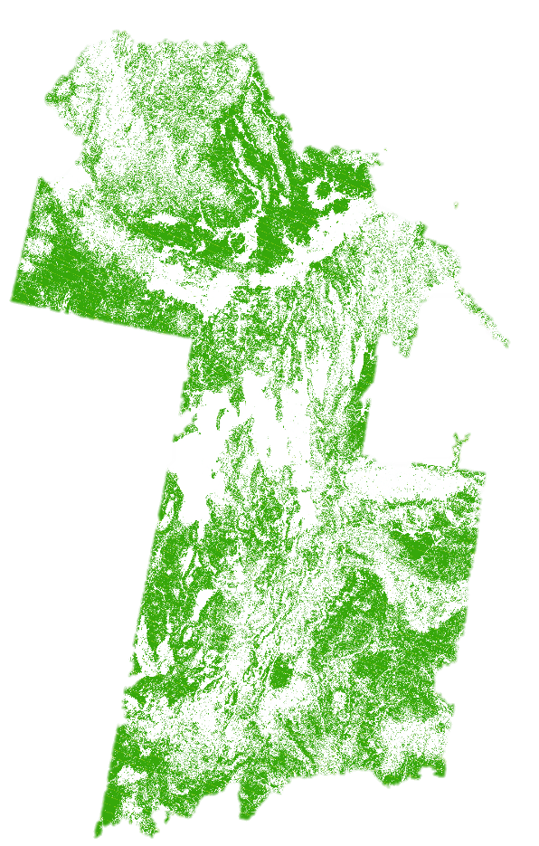
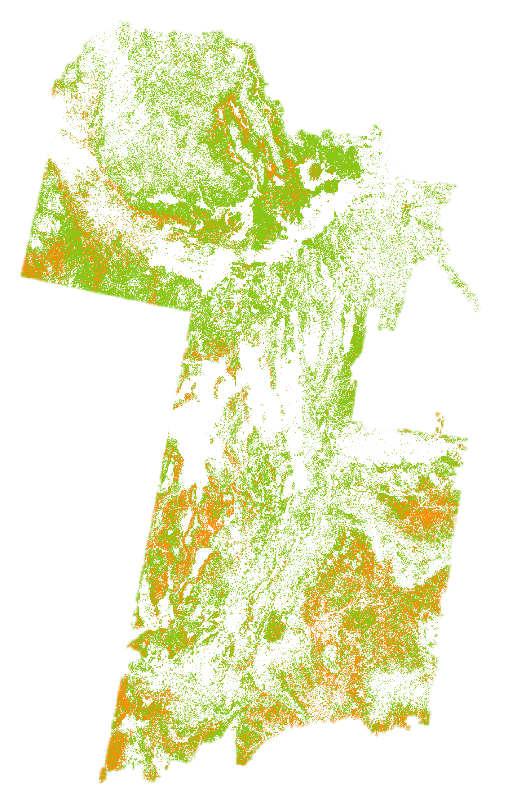
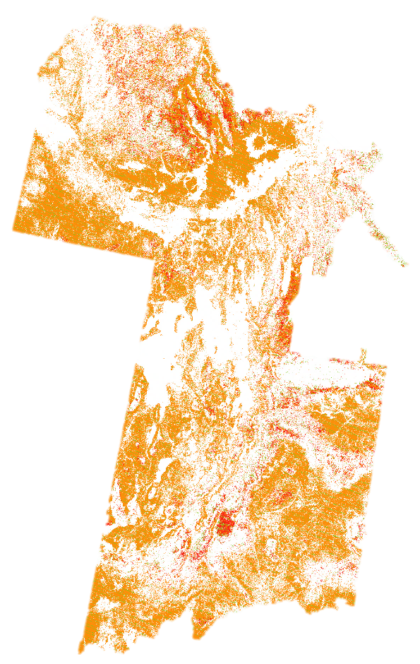
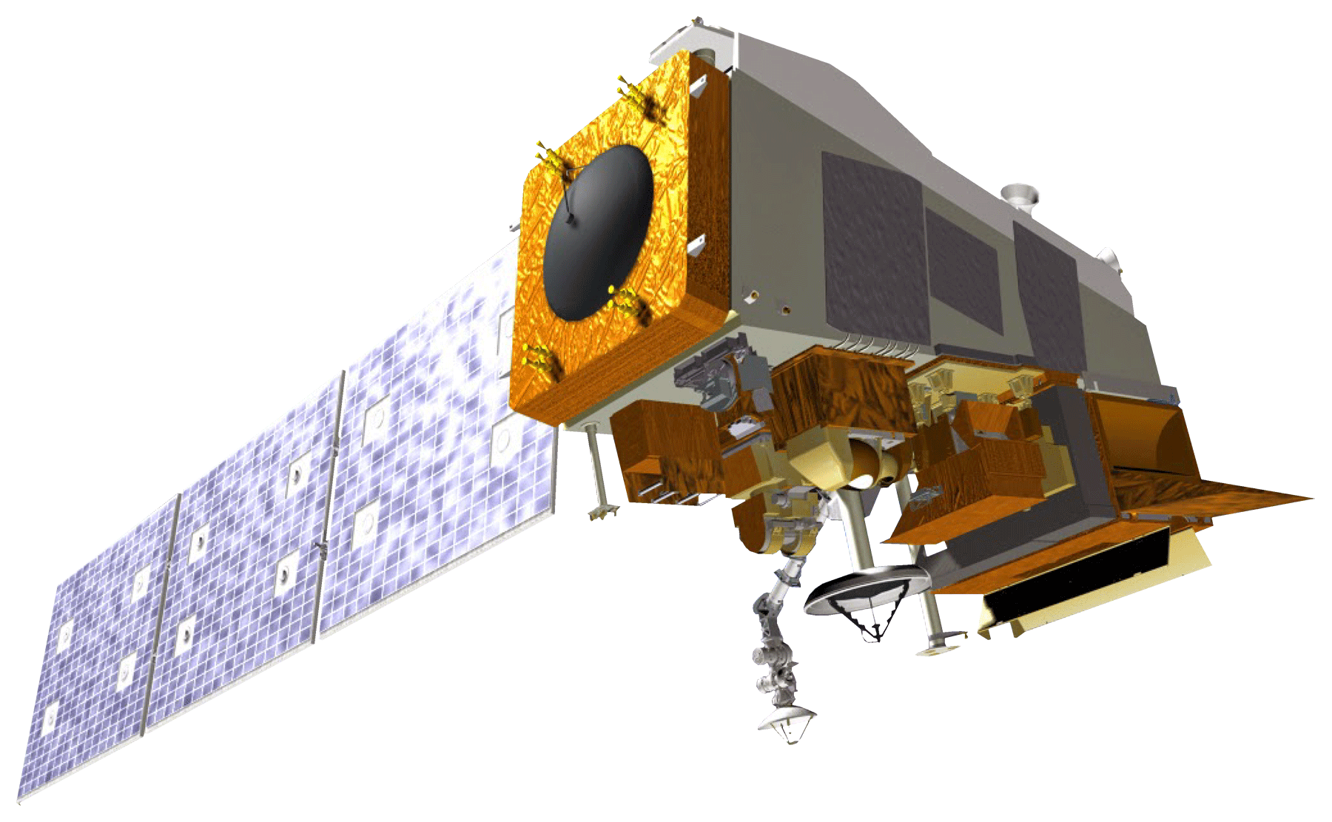
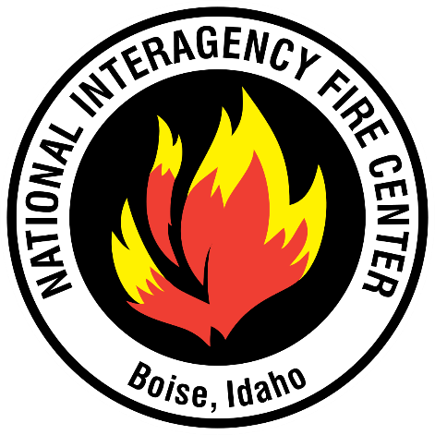
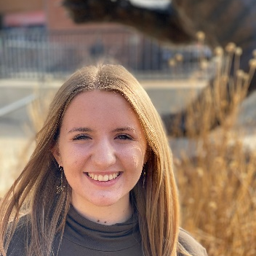
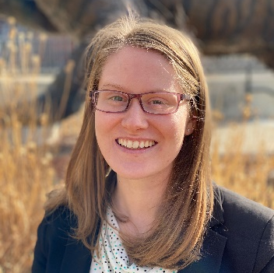
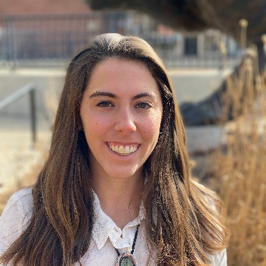
Assessing and Forecasting Live Fuel Moisture Content of Wildfire Fuels for the Eastern Great Basin to Improve Wildfire Timing and Severity Predictions
Abstract
Methodology
Great Basin Ecological Forecasting II
The eastern Great Basin (EGB) extends throughout the states of Arizona, Colorado, Idaho, Utah, and Wyoming, covering approximately 411,000 km². In recent years, wildfires in the EGB have increased in frequency and size, representing a growing concern for our partners at the Bureau of Land Management (BLM), the National Weather Service (NWS), and the Great Basin Coordination Center (GBCC). Live fuel moisture (LFM) is an important factor in predicting wildfire risk, as dry vegetation requires less energy to combust than wet vegetation. Land managers currently derive LFM levels from just 165 in situ sites in the EGB. In order to provide partners with a more accurate assessment of LFM, the team used data from the National Elevation Dataset, Aqua and Terra Moderate Resolution Imaging Spectroradiometer, and Suomi National Polar-orbiting Partnership Visible Infrared Imaging Radiometer Suite. These datasets include vegetation indices, evapotranspiration, and topographic variables, which were used to create biweekly forecasts of LFM throughout the EGB. An accuracy assessment was conducted using historical in situ data from our partners at the BLM and the GBCC. This model allowed our partners to make informed decisions regarding resource allocation in response to the predicted timing and severity of wildfires in the EGB.
Our model is comprised of 9 different input rasters: (1) Elevation, (2) Aspect, (3) Aqua Evapotranspiration (ET), (4) Terra ET, (5) VIIRS Enhanced Vegetation Index 2 (EVI 2), (6) VIIRS Fraction of Photosynthetically Active Radiation (FPAR), (7) VIIRS Leaf Area Index (LAI), (8) VIIRS Normalized Difference Vegetation Index (NDVI), and (9) Terra Normalized Difference Water Index (NDWI).
1 2 3 4 5 6 7 8 9
Study Area
N
N
Fig 1. Model Input Rasters
Time 1 & Time 2 Inputs
Linear Regression
Composite Rasters
Train Support Vector Machine
Time 3 Classified Raster
1000
Kilometers
Fig 2. Summary of the LFM forecast model built in Model Builder in ArcGIS Pro 2.5.1. Time 1 and Time 2 inputs include the above rasters (Fig. 1) and the in situ historic fuel moisture measurements. Time 3 Classified Raster is the forecasted LFM map.
Maps were generated for the 2019 fire season, which were validated against in situ LFM data from 2019. Then, maps were generated to forecast LFM into the future for the 2020 fire season.
Eastern Great Basin Fire Zones
100
Kilometers
Objectives
Results
N
Determine which data inputs are best correlated with in situ measurements of live fuel moisture (LFM)
Produce a more accurate model to better reflect LFM in the EGB
Create biweekly forecasts of LFM in the EGB to better predict fire risk for the 2020 fire season
Produce a tutorial describing the model that allows partners to replicate the process
May (Term 1)
July (Term 2)
August (Term 1)
Live Fuel Moisture Classes (%)
≤ 74
75 - 99
100 - 124
125 - 149
150 - 199
Earth Observations
100
≥ 200
Kilometers
Fig 3. Model-generated LFM forecast maps for May (Term 1), July (Term 2), and August (Term 1) 2019 that depict LFM classes throughout the eastern Great Basin. LFM classification changes significantly during the 2019 fire season.
Conclusions
Terra MODIS
Suomi-NPP VIIRS
Forecasting LFM using Earth observations is feasible for the eastern Great Basin.
The spatial resolution of the model was roughly ten times higher than that which in situ measurements provide.
Additional in situ data would be beneficial to more accurately train and validate the model.
Further refinement of the model is necessary to improve its accuracy.
Aqua MODIS
Project Partners
Team Members
Acknowledgements
We thank our node advisors, Keith Weber and Mason Bull, for their guidance and mentorship and our past contributors, Amber Hobbs and Lauren Lad. Additionally we thank our partners: Ben Dyer, Brian Holmes, Michelle Mavor, Greg Mann, Nanette Hosenfeld, Shelby Law, Kurt Buffalo, Mike Huston, and Jeremy Schulz.
Gavin Pirrie
Project Lead
Helena Bierly
Avery King
Katherine Mistick
Idaho - Pocatello

