Slide 1
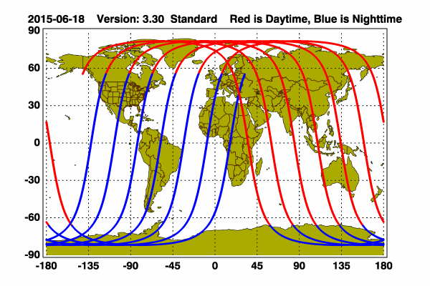
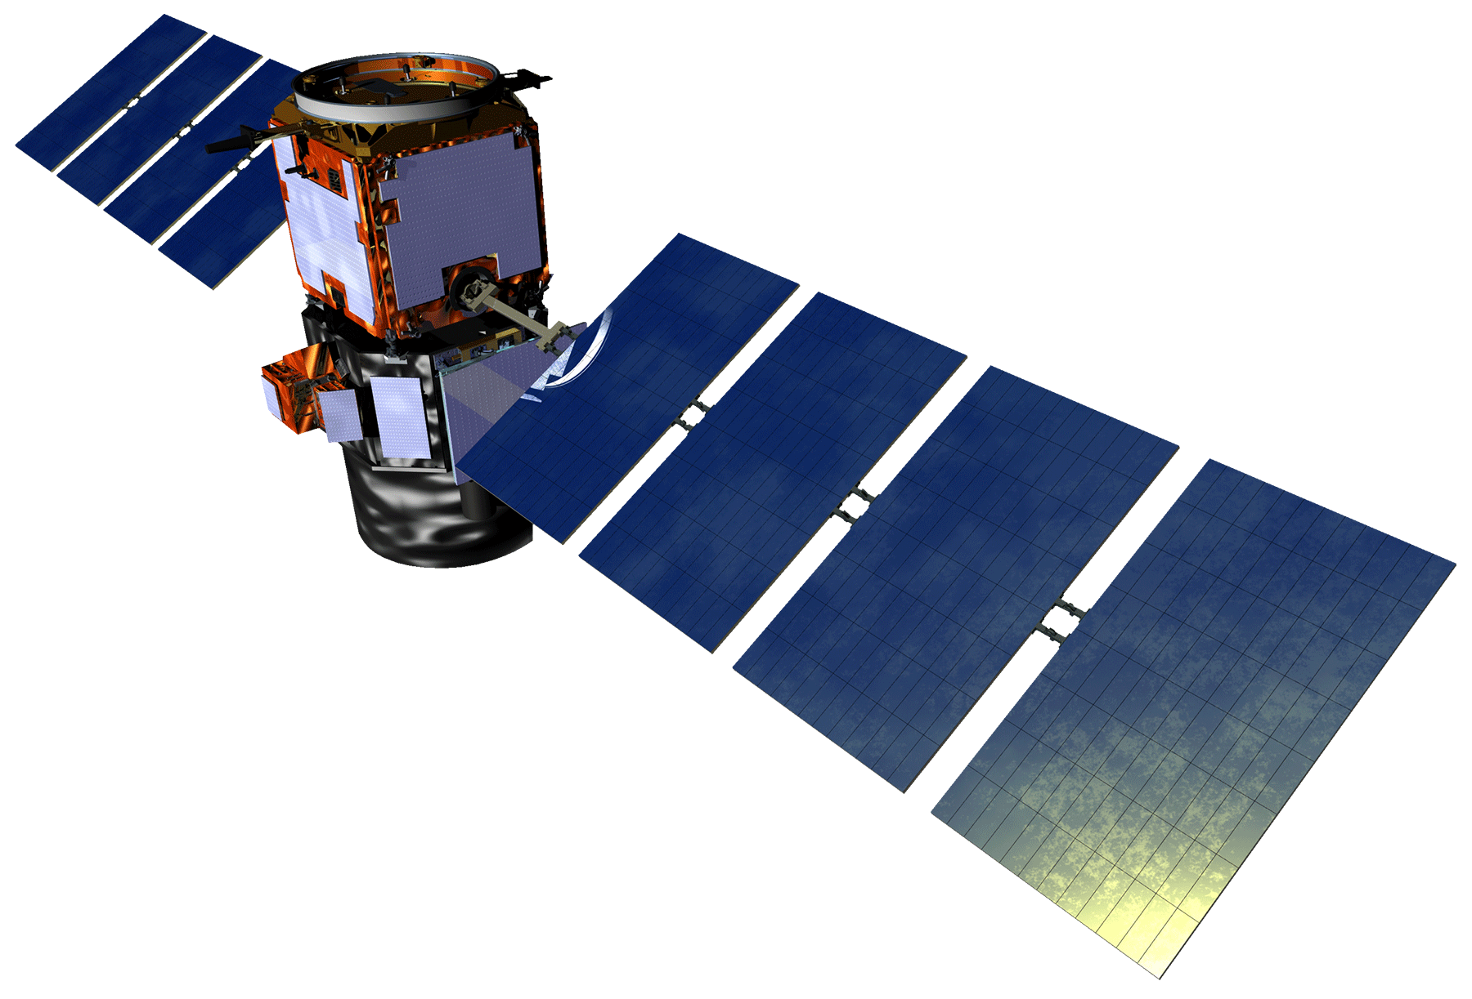
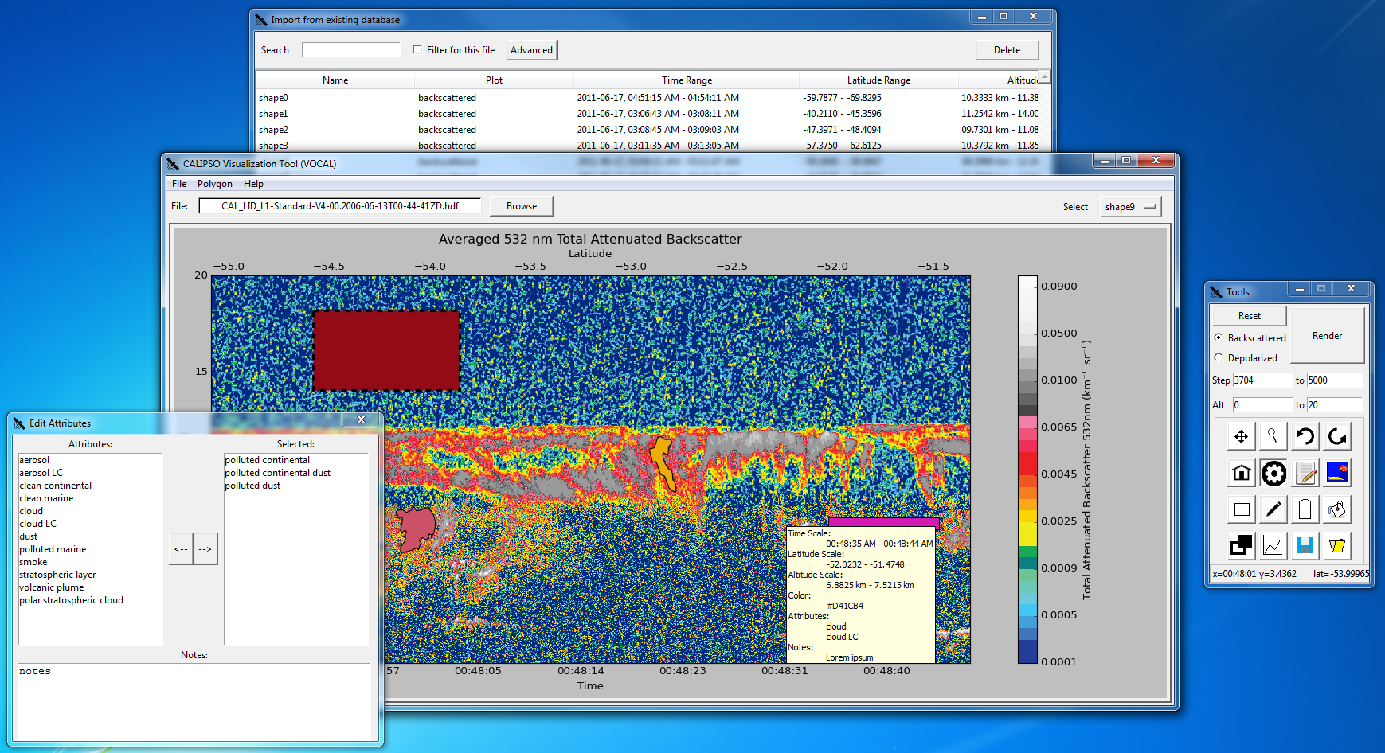
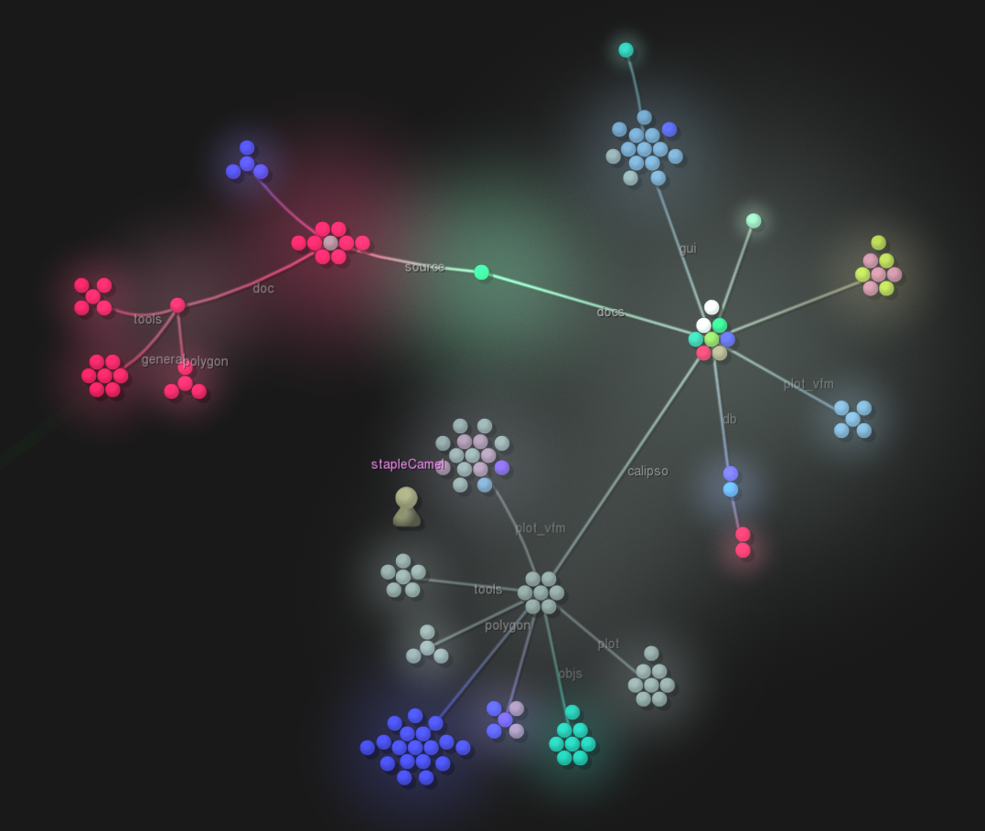
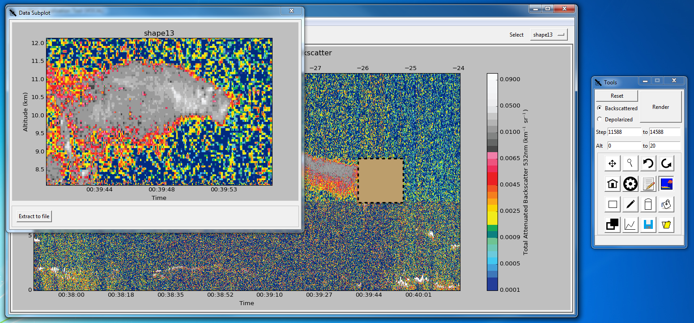
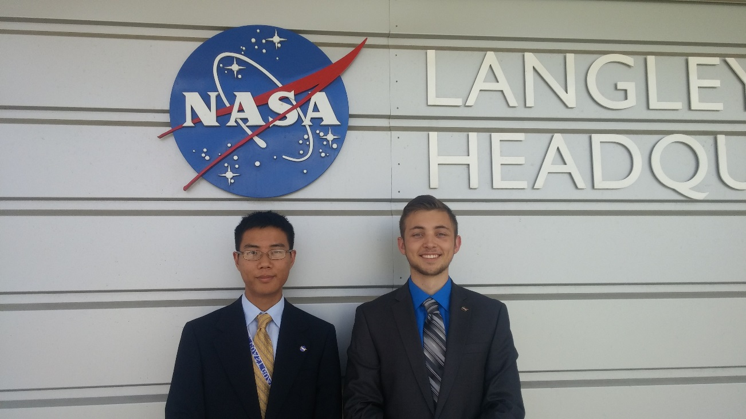
CALIPSO Cross-Cutting
Interfacing CALIPSO data through a graphical user interface
Grant Mercer (Project Lead), Nathan Qian
NASA DEVELOP National Program at NASA Langley Research Center
Abstract
Objectives
The Cloud-Aerosol Lidar and Infrared Pathfinder Satellite Observation (CALIPSO) satellite is a NASA Earth observation that analyzes aerosol particles suspended in the Earth’s atmosphere. Researchers use visualized CALIPSO data to track the global distribution, dispersion, and source of aerosols. However, the current visualization tool for displaying CALIPSO data does not support needed features for tracking aerosols such as selecting areas of data and sharing those selected sections, making tracking specific airborne objects difficult for researchers. Adding these necessary features to the current CALIPSO visualization tool is difficult, as the tool is written in Interactive Data Language (IDL), a proprietary and obscure language , and writing additional features for the tool would require a specialized development team. For the 2015 summer term, our team is focused on the development of the Visualization of CALIPSO (VOCAL) Python program. VOCAL will serve as the successor to the current visualization tool for CALIPSO data. We will be building off the previous 2015 spring team’s work to implement a number of new features and offer new functionalities to Earth scientists to more easily identify the sources of aerosols and their impact on Earth’s climate.
Create an open source CALIPSO visualization tool
Help Earth scientists track and identify aerosols
Add data analysis and sharing features
Study Area
Methodology
Calipso
Displays Interface
ShapeManager
Holds lists of Shapes
Handles shape manipulation requests
DatabaseManager
Creates and maintains the database
Shape
Draws shape
Stores shapes’ internals
Shape Reader
Reads shapes from JSON
CALIPSO Image Viewer
DatabasePolygon
Converts shape into database entry
Legend
Association
Aggregation
Composition
Earth Observations
Results
Cloud-Aerosol Lidar and Infrared Satellite Observation (CALIPSO)
Conclusions
VOCAL allows Earth scientists to better identify, analyze, and track the characteristics of aerosols.
The new tool will enable researchers to work on collaborative efforts.
With these features, VOCAL will help scientists better understand how aerosols affect global climate systems and human health.
Caption
Top Left: A sample of features.
Top: A graphical overview of VOCAL’s development.
Left: The shape data subview, showing the data bounded by the shape.
Acknowledgements
CALIPSO Health and Air Quality LaRC Spring 2015
Jordan Vaa (Team Lead)
Ashna Aggarwal
Courtney Duquette
CALIPSO Science Team
Dr. Charles Trepte
Dr. Amber Soja
NASA DEVELOP National Program
Jeffry Ely
Dr. Kenton Ross
Team Members
Project Partners
CALIPSO Crossing Cutting II
Left: Nathan Qian
Right: Grant Mercer (Team Lead)
CALIPSO Science Team
Dr. Charles Trepte
Dr. Amber Soja
NASA Langley Research Center

