Slide 1
DEVELOP National Program
COASTAL Mid-atlantic water resources
larc
Spring 2015
Final Imagery

Slide 2
Checklist for Each Image:
Image is derived from NASA sensor data
  Not from an outside source
  Not a photograph of the team/issue
Preferably, At least one image provided is derived from recent data (2014-2015)
  This is mandatory for inclusion in any highlight to NASA HQ
Some kind of processing has taken place
  Not a raw image or a photograph
The team actually created the image
  Not from some other source/world wide web/etc.
High-resolution (over 300 dpi)
Saved as a JPEG or TIFF
Also:
While there are three slides, you can have more imagery. Minimum of one, max of ten.
The “best” image should have a SVG version, saved as a separate file, that will be used on the DEVELOP website and brochures

Slide 3
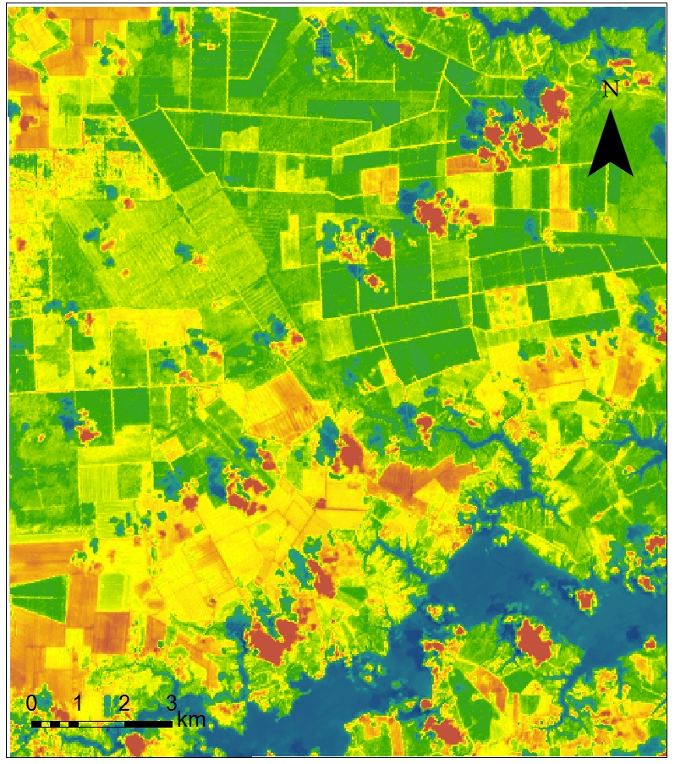
Mid Atlantic Coastal Region
Coastal Mid-Atlantic Water Resources
Caption Here -
The image displays Daily evapotranspiration rates that can be used to make decisions concerning irrigation planning and drought monitoring. This variable was derived using data from the Landsat 8 platform with the OLI/TIR sensor.

Slide 4
Mid Atlantic Coastal Region
Coastal Mid-Atlantic Water Resources
Daily ET legend

