Slide 1
DEVELOP National Program
CALIPSO Health & Air Quality
Nasa Langley research center
Spring 2015
Final Imagery

Slide 2
Checklist for Each Image:
Image is derived from NASA sensor data
  Not from an outside source
  Not a photograph of the team/issue
Preferably, At least one image provided is derived from recent data (2014-2015)
  This is mandatory for inclusion in any highlight to NASA HQ
Some kind of processing has taken place
  Not a raw image or a photograph
The team actually created the image
  Not from some other source/world wide web/etc.
High-resolution (over 300 dpi)
Saved as a JPEG or TIFF
Also:
While there are three slides, you can have more imagery. Minimum of one, max of ten.
The “best” image should have a SVG version, saved as a separate file, that will be used on the DEVELOP website and brochures

Slide 3
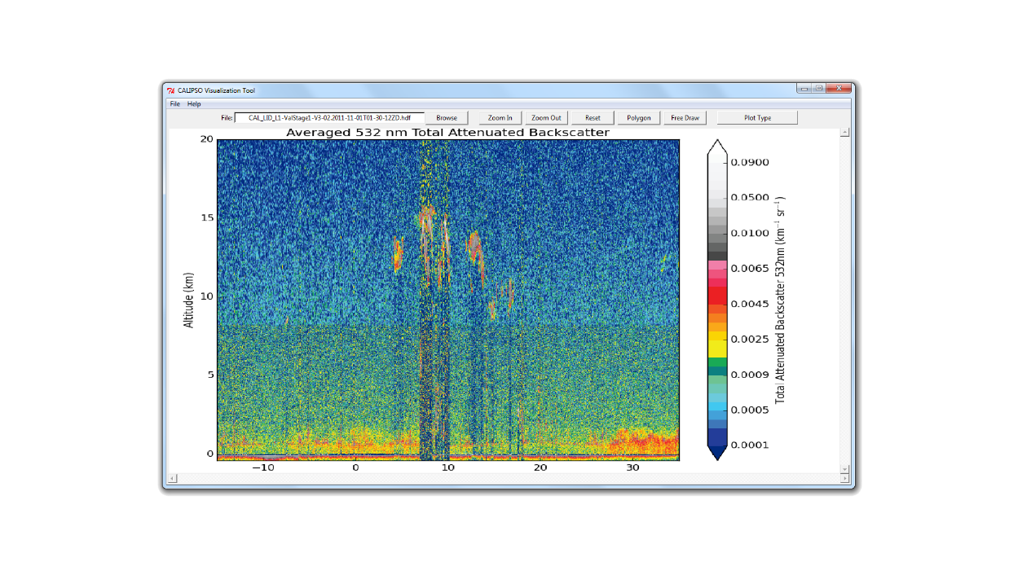
LaRC
CALIPSO Health & Air Quality
Caption Here -
Tool created by the DEVELOP team to display CALIPSO data

Slide 4
Team Location Here
Project Title Here
Caption Here -
Make sure to include what NASA satellite and sensor the image is derived from and the date the data was collected by the satellite. Also include what the image is (ex. NDVI, etc.), and how it can be used for decision making.
Submit legends as separate images so they can be re-sized for future use if needed.

Slide 5
Team Location Here
Project Title Here
Caption Here -
Make sure to include what NASA satellite and sensor the image is derived from and the date the data was collected by the satellite. Also include what the image is (ex. NDVI, etc.), and how it can be used for decision making.
Submit legends as separate images so they can be re-sized for future use if needed.

