Slide 1
Milwaukee
Urban Development II
Assessing Climate Vulnerability through the InVEST Model on Urban Cooling in Milwaukee Using NASA Earth Observations
Nash Keyes (Project Lead)
Caleigh McLaren
Nati Phan
Dalia Vazquez
Virtual Environmental Justice | Fall 2022

Slide 2
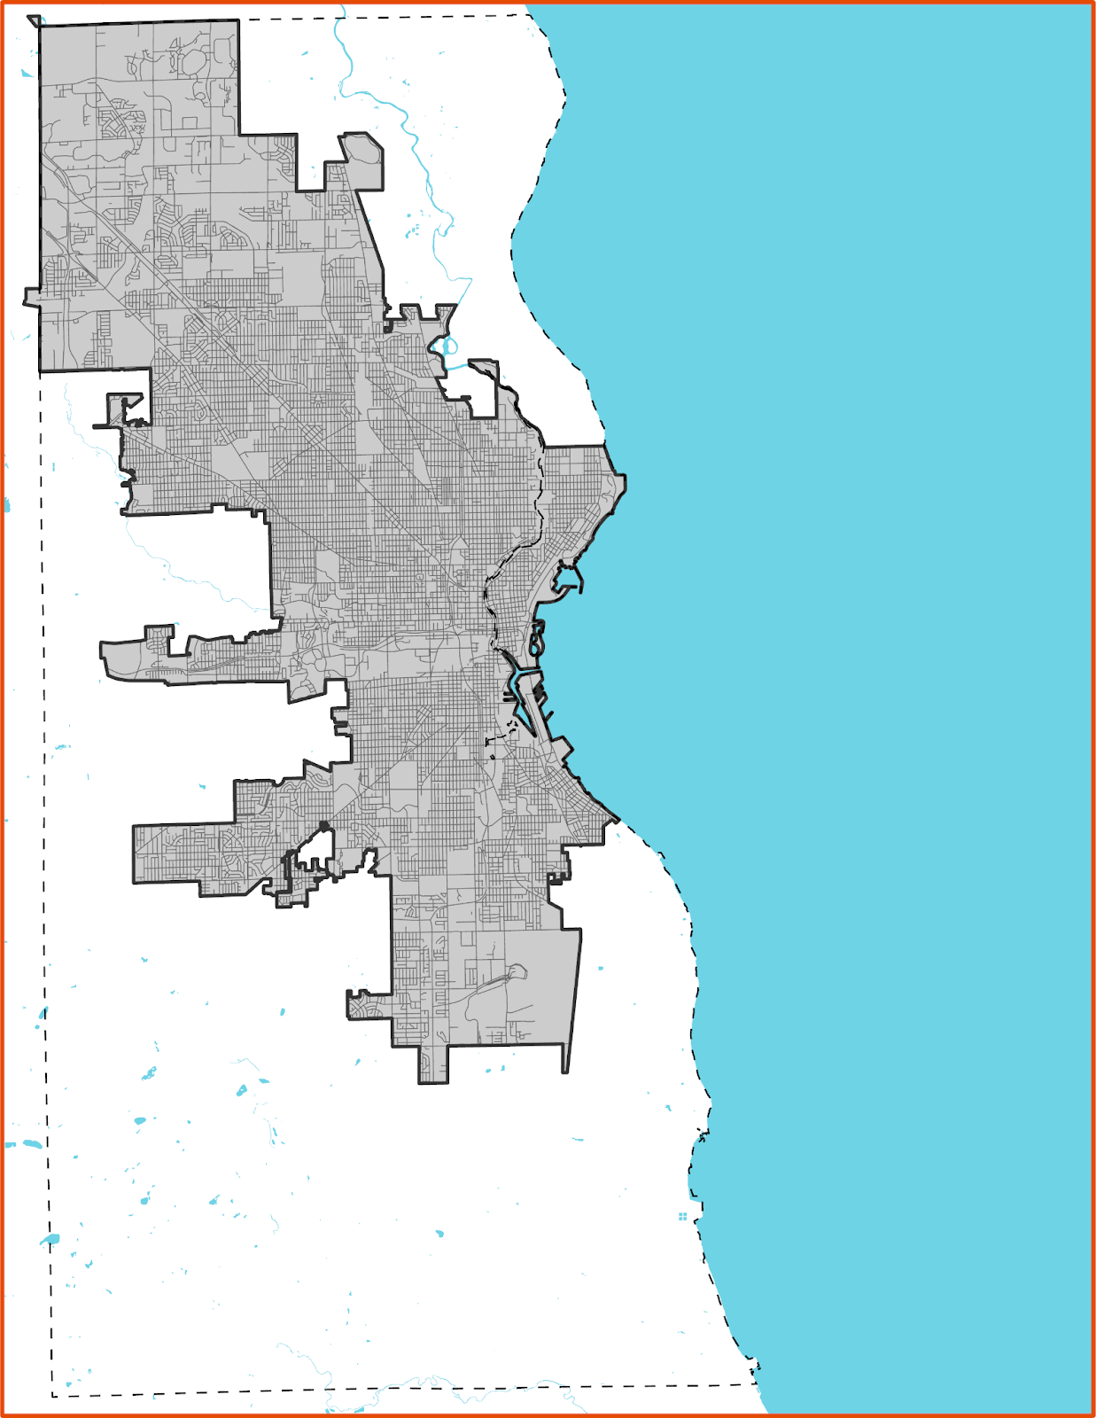
STUDY AREA
Milwaukee, Wisconsin
Study period: 2010 – 2021
Most segregated city in the U.S.
Humid continental climate
Focus area: Metcalfe Park
Milwaukee, Wisconsin
Streets
Hydrology
City Boundary
Country Boundary
Notes:
Our study focused on Milwaukee County, located in the southeastern part of Wisconsin. Our study period ranged from 2010 to 2021. Our study area map here shows the Milwaukee city border within Milwaukee county. These boundaries were separated for comparison of extreme heat in urban and rural areas. Milwaukee is home to over 500,000 residents and is considered most segregated city in the US. The racial makeup as of 2020 is 42% white, 38% Black, and 19% Hispanic or Latino (Census, 2020). The majority of the Black population resides in North and North Central Milwaukee, while the Hispanic/Latino population resides on the Central and South side of the city. An estimated 24.6% of the population in the City of Milwaukee has an income below the poverty level, the majority of them residing in Black and Hispanic/Latino neighborhoods (ACS, 2016-2020).
The city has a humid continental climate, with the hottest months being June through September. Milwaukee continues to experience the impact of climate change, such as heavy rain storms and temperature increases which are becoming more of a concern in the city. In the coming decades, the region will continue to experience more frequent extreme heat events, which is a public health concern for residents in urban areas.
------------------------------Image Information Below ------------------------------
Study area map created with city and county shapefile for Milwaukee
Demographics pie chart created using Census 2020 data for Milwaukee

Slide 3
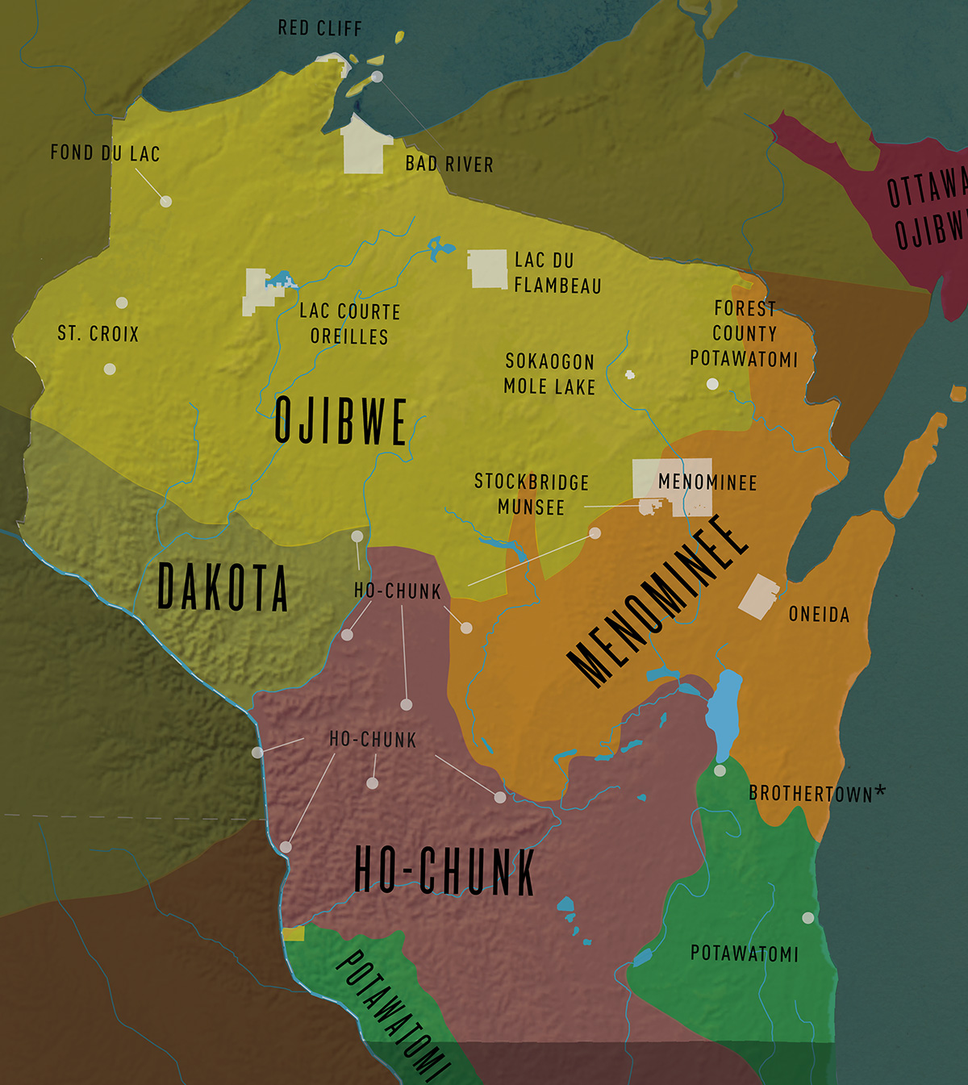
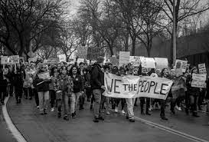
HISTORY
Located on Menominee, Ojibwe, Ho-Chunk, Potawatomi, and other Indigenous nations' lands; continued Indigenous presence in Wisconsin & Milwaukee today
City founded in 1830s after white settlers violently dispossessed Indigenous peoples
Black, Latinx, and Asian-American communities grew in the city in the 1900s
Rich history of labor, housing, and Civil Rights activism, and lots of current Environmental Justice work
Image Credit: PBS Wisconsin Education
wisconsinfirstnations.org/map
Image Credit: Wikimedia Commons
Notes:
Located on the lands of many Indigenous nations, including Menominee, Ojibwe, Potawatomi, and Ho-Chunk. Before white colonization, current-day Milwaukee was a site where nations traded and came together. The City of Milwaukee was founded in 1830s after white settlers violently dispossessed & expelled Indigenous peoples via the Treaty of Chicago at the end of the Black Hawk War. 12 Indigenous nations have land bases in Wisconsin currently, including the Oneida, Menominee, Stockbridge-Munsee, and Brothertown in the Milwaukee area; and per the census, thousands of Indigenous people live within the city of Milwaukee.
Milwaukee was a destination for Black people moving north in the early 1900s during the Great Migration. City government and institutions segregated the city from the beginning, forcing Black people into the north side and disinvesting, as we will discuss later. Also, Latinx communities formed in the city in the 1920s, and Asian American communities in the 1970s. Milwaukee also has a rich history of activism around labor rights and Civil Rights, and a lot of important Environmental Justice work is happening in the city today, including the work being done by our partners!
------------------------------Image Information Below ------------------------------
Tribal Lands Map
•Image Credit: PBS Wisconsin Education (used with permission)
•Image Source: https://wisconsinfirstnations.org/map
Milwaukee Women's March
•Image Credit: Wikimedia Commons
•Image Source: https://commons.wikimedia.org/wiki/File:Milwaukee_Women%27s_March_-_09.jpg

Slide 4
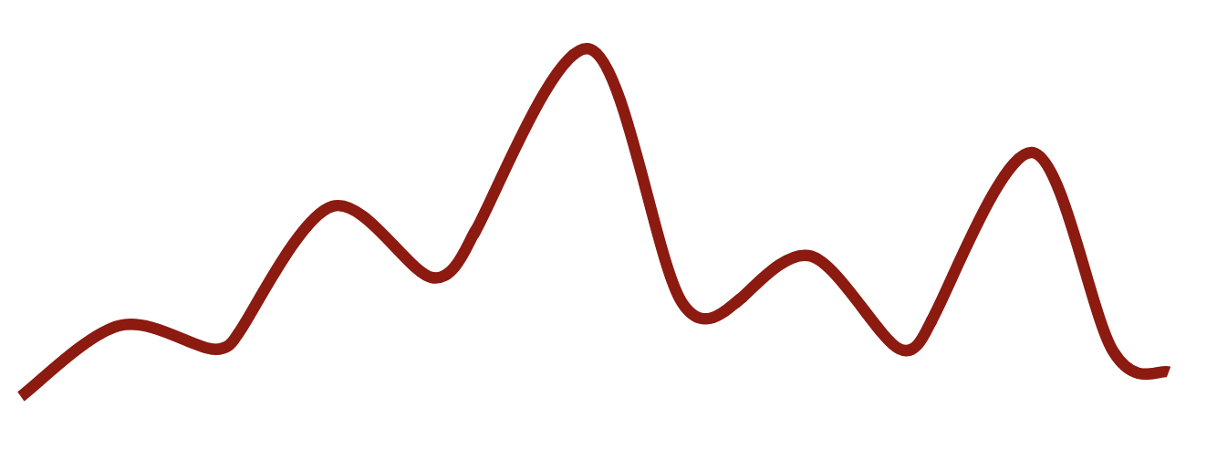
URBAN HEAT ISLANDS
Urban Heat Island (UHI) effect
Flood vs. Heat Risk Perception
Disproportionate Impact
Surface Temperature °C
Suburban Residential: Canopy
Suburban Residential: No Canopy
Rural
City
Urban Park
Notes:
The Urban Heat Island Effect is a phenomenon in which cities experience more heat than surrounding rural areas because of the ratio of impervious area to canopy cover. Impervious or built surfaces heat up and cool off slower than vegetation. Here we have a graphic illustrating how different landscapes experience temperature. Urban heat does not impact residents equally. Historically redlined communities tend to have lower canopy cover and higher impervious surfaces. This means residents in communities of color with lower income tend to experience the brunt of the urban heat island effect and its related outcomes including heat related illnesses and higher energy bills. Another dimension specific to Milwaukee is the flood vs. heat risk perception. While Milwaukee experiences both chronic flooding and urban heat issues, residents tend to focus the majority their attention on flooding as Milwaukee is perceived as a “northern, cool city”.
------------------------------Image Information Below ------------------------------
All images on this slide are sourced via Microsoft PowerPoint icons

Slide 5
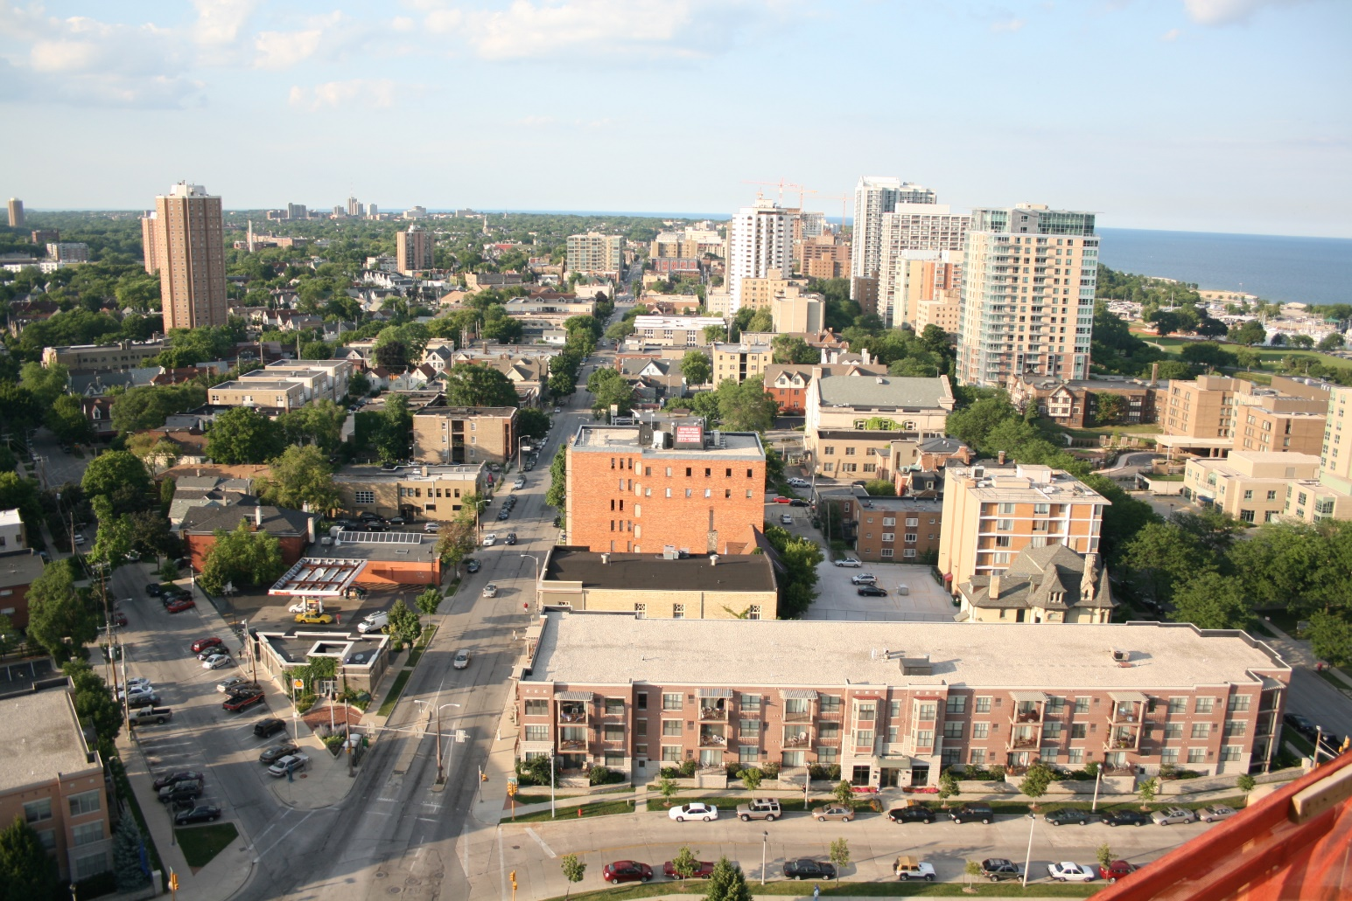
KEY CONCEPTS
East side Milwaukee overlooking north along Farwell Ave
Environmental Justice
Structural Racism
Image Credit: Jeramey Jannene, Creative Mania
Notes:
As the virtual environmental justice node, and in accordance with Groundwork’s goals and values, we strive to prioritize environmental justice as a key concept throughout our work. We have chosen to follow Charles Lee’s definition of the term environmental justice, which is “The fair treatment and meaningful involvement of all people regardless of race, color, national origin, or income with respect to the development, implementation, and enforcement of laws, regulations and policies that affect the environment and/or public health.” (Lee, 2021, p.336)
Lee, C. (2021). Evaluating Environmental Protection Agency's Definition of Environmental Justice. Environmental Justice, 14(5), 332-337.
Similarly, we also find it important to define structural racism as “the historical and contemporary ways in which society maintains discriminatory practices that mutually reinforce inequitable systems across a variety of sectors, including housing, education, employment, income, criminal justice, and healthcare" (Bikomeye et al., 2021, p. 2).” A prime example of structural racism that has led to the denial of environmental justice for BIPOC communities is redlining.
Bikomeye, J. C., Namin, S., Anyanwu, C., Rublee, C. S., Ferschinger, J., Leinbach, K., Lindquist, P., Hoppe, A., Hoffman, L., Hegarty, J., Sperber, D., & Beyer, K. M. M. (2021). Resilience and Equity in a Time of Crises: Investing in Public Urban Greenspace Is Now More Essential Than Ever in the US and Beyond. International Journal of Environmental Research and Public Health, 18(16), Article 16. https://doi.org/10.3390/ijerph18168420
------------------------------Image Information Below ------------------------------
Heat Wave
•Image Credit: Creative Mania, the Noun Project
•Image Source: https://thenounproject.com/search/?q=heat+wave&i=1028786 (Creative Commons)
East side milwaukee overlooking north along Farwell Ave
•Image Credit: Jeramey Jannene from Milwaukee, WI, United States of America
•Image Source: https://commons.wikimedia.org/wiki/File:East_side_milwaukee_overlooking_north_along_farwell.jpg
All other images on this slide are sourced via Microsoft PowerPoint icons

Slide 6
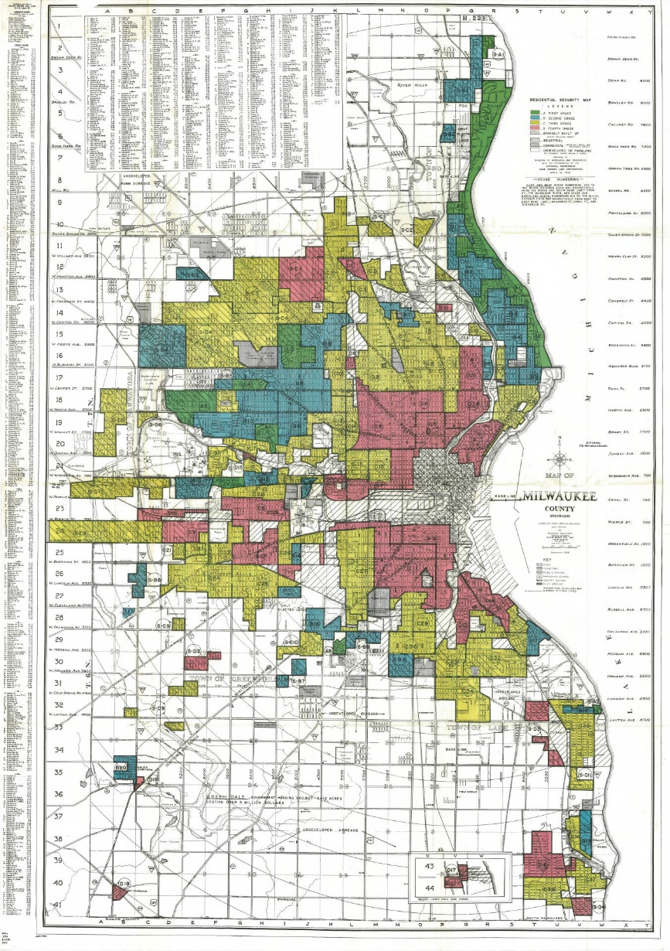
REDLINING
1938 Redlining Map of Milwaukee
1930s: Home Owners’ Loan Corporation (HOLC) loan risk categories
Graded neighborhoods across 200 U.S. cities
Grades really were based on race
Milwaukee: central and north side redlining
A
B
C
D
GREEN
“Best”
BLUE “Desirable”
YELLOW “Declining”
RED “Hazardous”
Image Credit: National Archives
Notes:
In the 1930s, the HOLC created residential security maps of over 200 cities in the US that rated neighborhoods on their value for investments. Each neighborhood was assigned a grade and color to indicate their mortgage security risk. A (green) meaning best, B (blue) meaning desirable, C (yellow) meaning declining, and D (red) meaning hazardous. These grades were found to be mostly based upon racial makeups of the areas at the time, particularly, Black and Brown communities were given the lowest grades.
In Milwaukee, the current racial geography of Milwaukee neighborhoods remains reflective of the divides formalized in the 1930s. Black and Asian people predominantly live on the city’s north side, while Latinx communities are centered in south central Milwaukee, and white people dominate the rest. Redlining isn’t just a thing that happened in the past – it continues to shape our environment today, as we will discuss in tandem with our heat mitigation and vulnerability analysis.
------------------------------Image Information Below ------------------------------
1938 Redlining Map of Milwaukee
•Image Credit: National Archives
•Image Source: https://collections.lib.uwm.edu/digital/collection/agdm/id/3028/ (public domain)
All other images on this slide are sourced via Microsoft PowerPoint icons

Slide 7
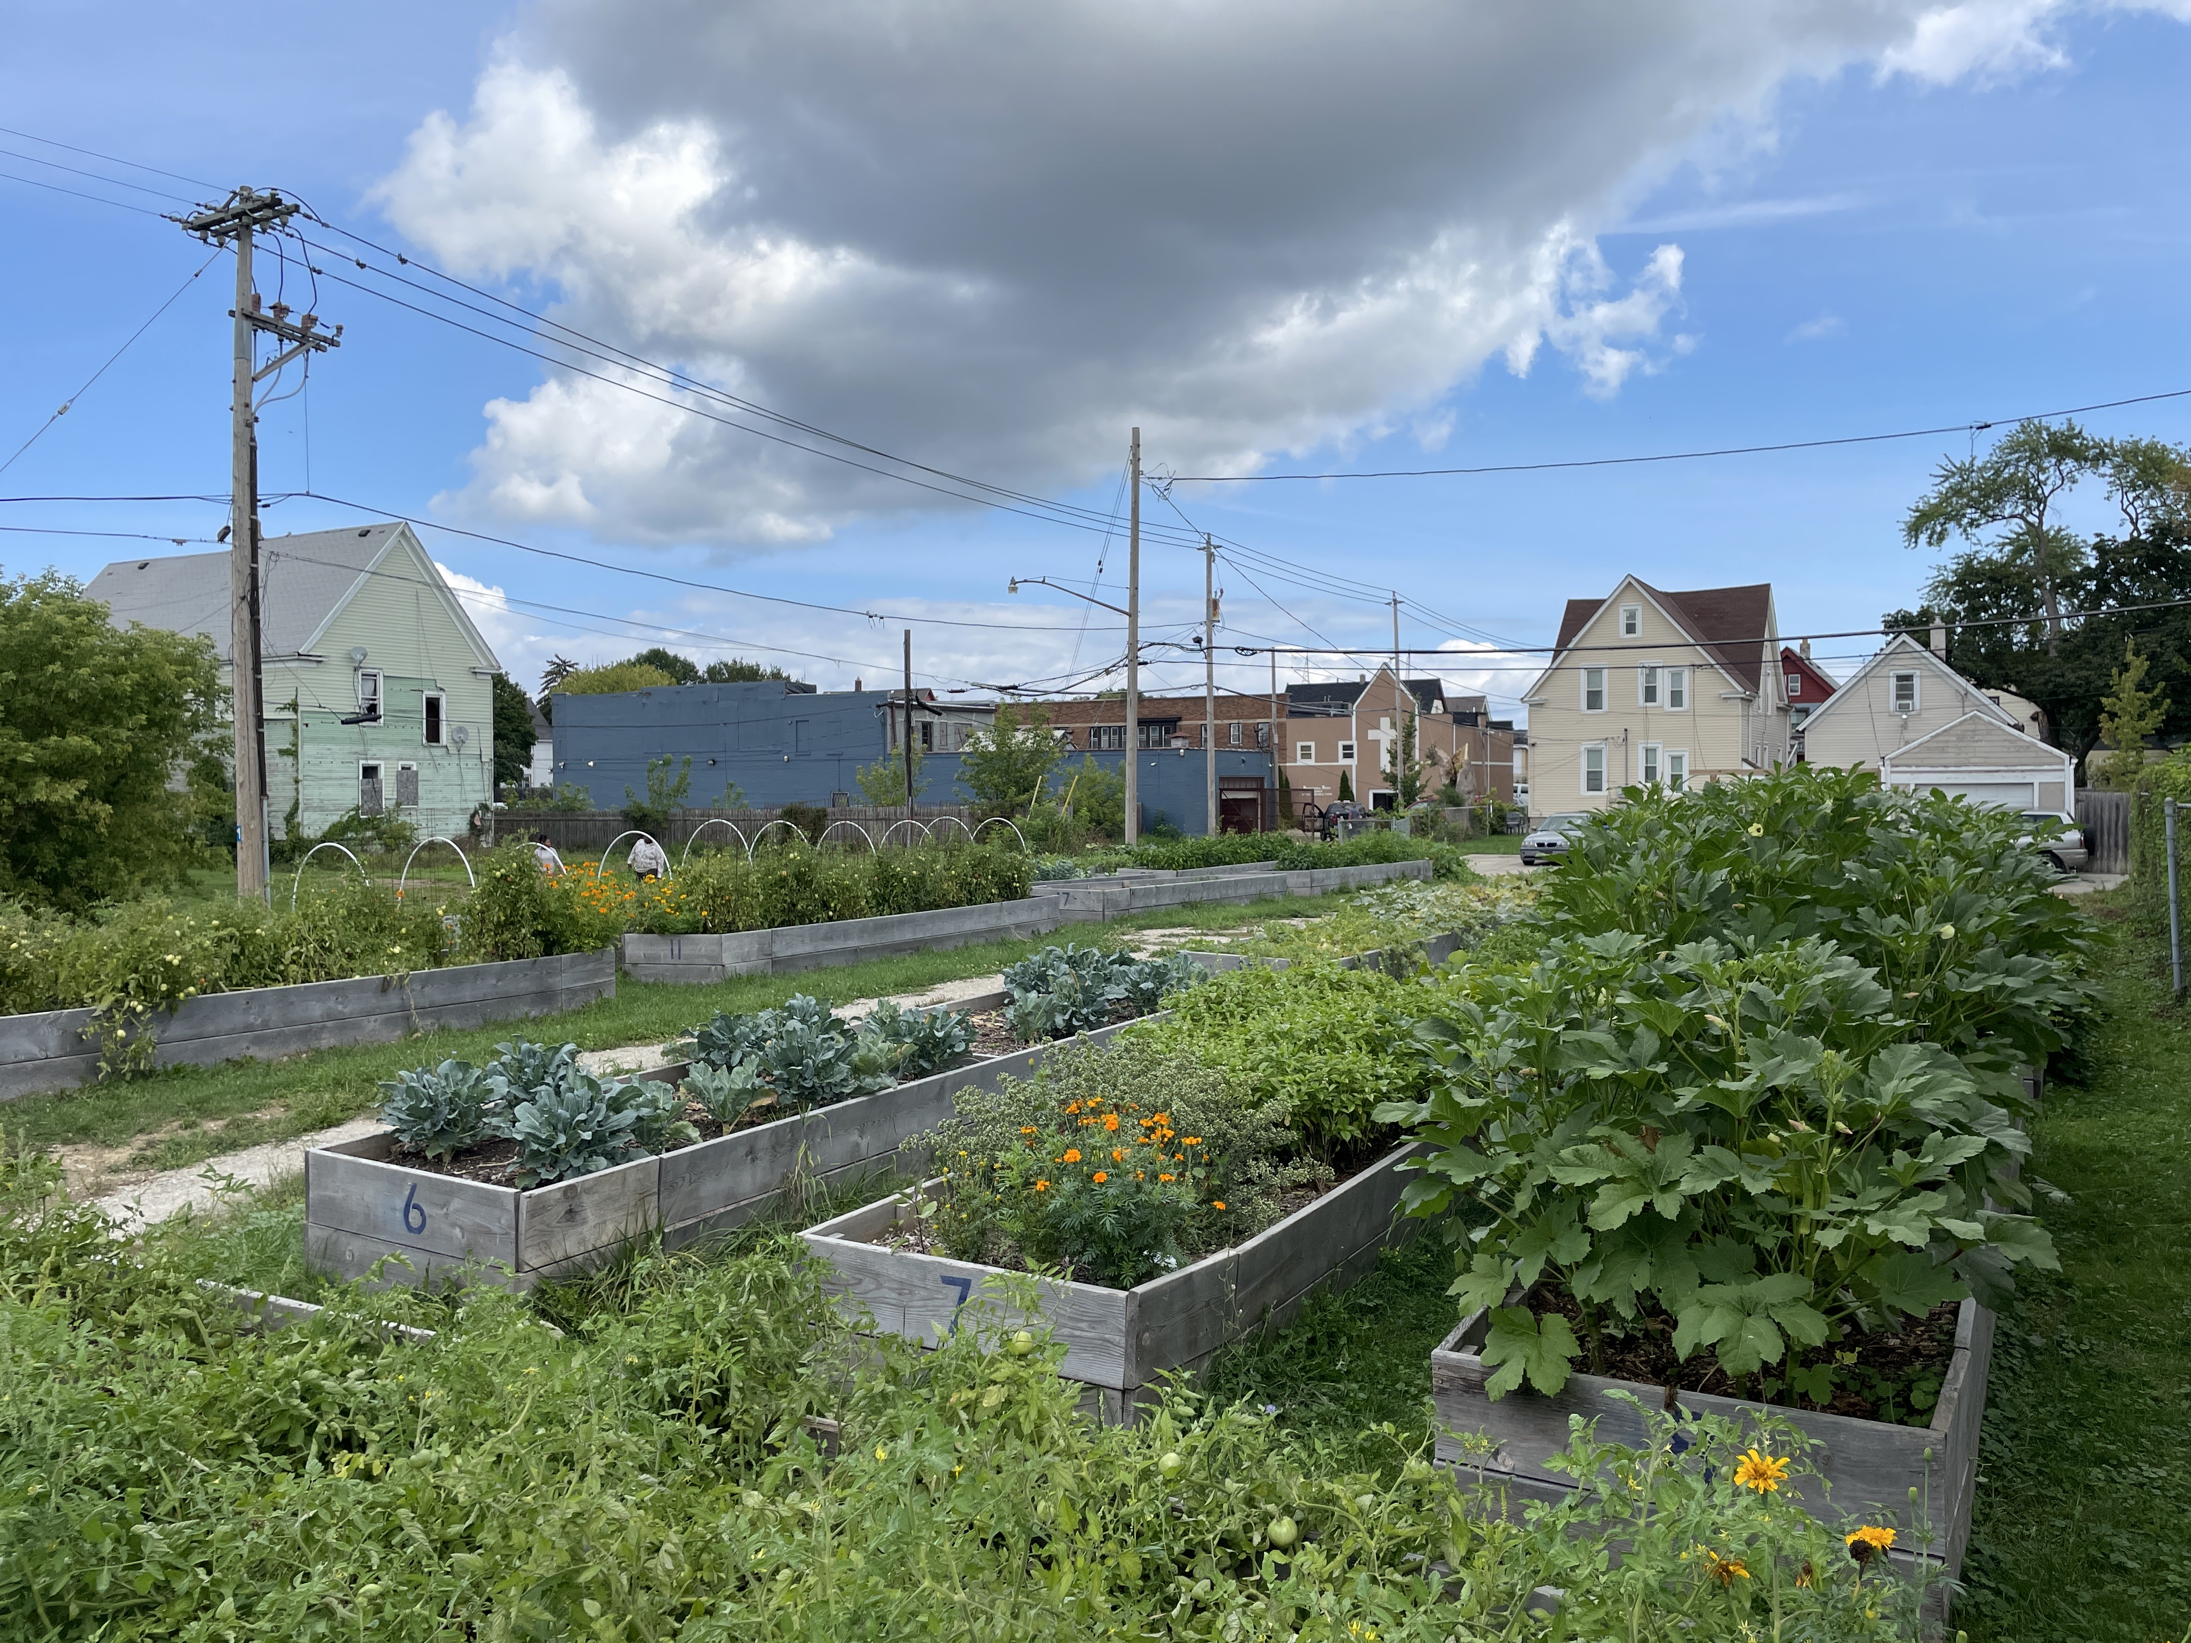
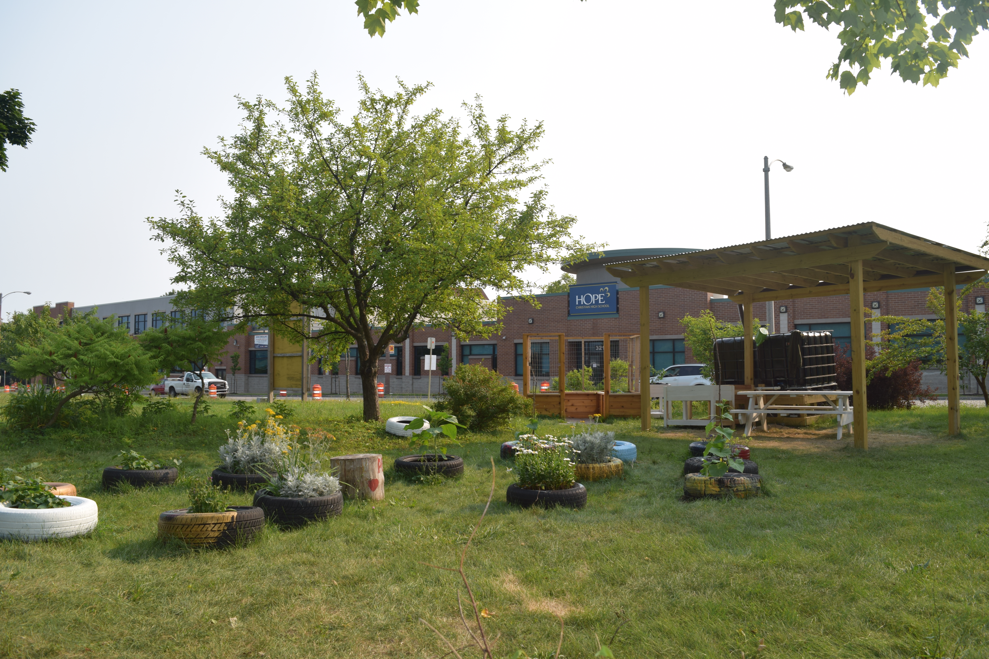
OUR PARTNERS
Groundwork USA:
National network of local trusts across the country that partners with communities, local governments, and businesses on Environmental Justice efforts.
Groundwork Milwaukee:
Participating in the Climate Safe Neighborhoods program to study connections between redlining and climate change impacts on marginalized communities in the city.
Groundwork Milwaukee urban gardens
Image Credit: Groundwork Milwaukee
Notes:
Groundwork USA is a national network of local trusts across the country that partners with communities, local governments, and businesses on Environmental Justice efforts. As a part of the Groundwork USA network, Groundwork Milwaukee focuses on transforming brownfields into community spaces, facilitating programs to educate, train, and empower the community, and protecting urban waters. Groundwork Milwaukee is among one of the many Groundwork USA trusts participating in the Climate Safe Neighborhoods program to study connections between redlining and climate change impacts on marginalized communities in the city. One of Groundwork Milwaukee’s goals is to increase climate resiliency and provide concrete evidence for green infrastructure interventions in the city. Photos here show some of Groundwork’s urban gardens in Milwaukee, which promote community green space and environmental stewardship.
------------------------------Image Information Below ------------------------------
Photos by Groundwork Milwaukee courtesy of Groundwork Milwaukee, used with permission

Slide 8
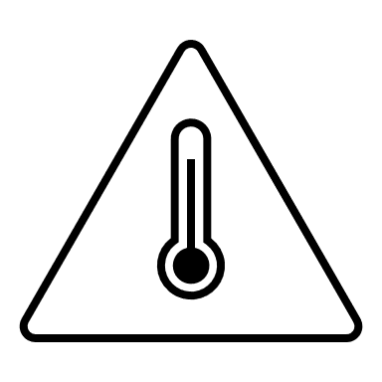
COMMUNITY CONCERNS
Extreme Heat
Urban Development
Climate Resilience
Mitigation Scenarios
Notes:
Our partners have four primary concerns: extreme heat, climate resilience, urban development, & understanding outcomes of future mitigation scenarios.
------------------------------Image Information Below ------------------------------
All images on this slide are sourced via Microsoft PowerPoint icons

Slide 9
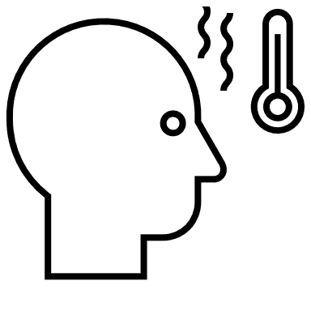
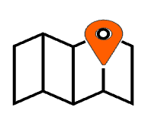
PROJECT OBJECTIVES
Urban Heat Mitigation Map Package
InVEST Flood and Cooling Tutorial/Project Methodology
Heat Vulnerability Analysis
Milwaukee Climate Resiliency Flyer
Notes:
Our project objectives are to map the heat mitigation capacity of Milwaukee using the InVEST urban cooling model and provide our partners with a better understanding of community resilience to heat, quantify the spatial distribution of urban heat vulnerability using earth observations in combination with sociodemographic data, create tutorials on InVEST model methodologies to build partner capacity to effectively use end products and pursue their own analyses moving forward, and produce an informational flyer to educate the community on the effects of climate change and current mitigation strategies
------------------------------Image Information Below ------------------------------
All images on this slide are sourced via Microsoft PowerPoint icons

Slide 10
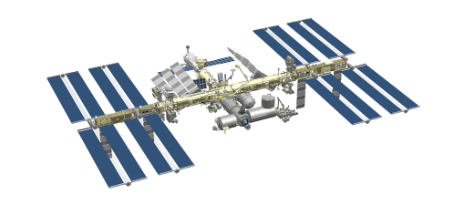
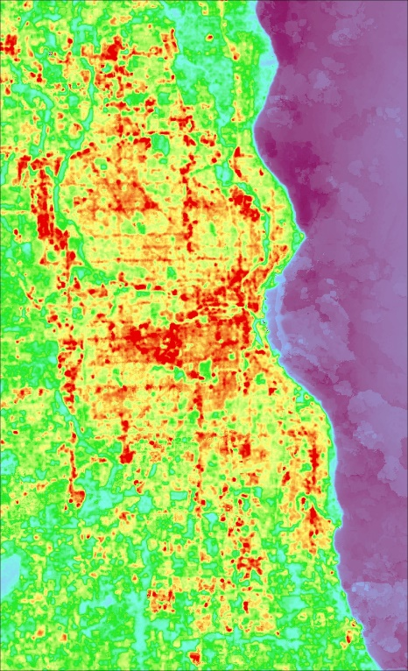
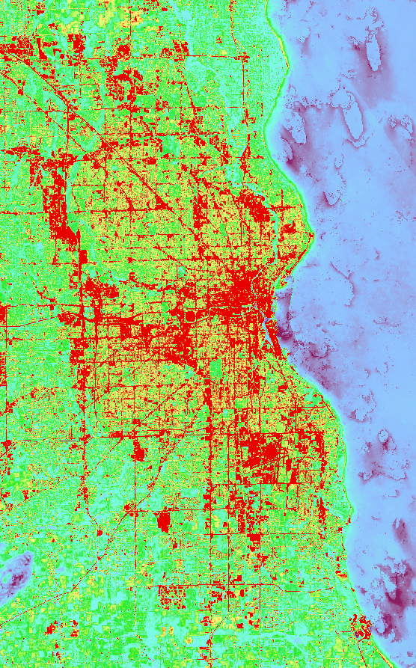
NASA EARTH OBSERVATIONS
Landsat 8
Thermal Infrared Sensor (TIRS)
Operational Land Imager (OLI)
ISS
The ECOsystem Spaceborne Thermal Radiometer Experiment on Space Station (ECOSTRESS)
Higher Values
Lower Values
N
Daytime LST
Surface Reflectance
Evapotranspiration
Nighttime LST
0
4
8
Miles
Image Credit: NASA
Notes:
Now, we will move to discussing the data and technical side of our study. For our modeling and analysis, we used numerous Earth observation datasets from NASA satellites.
We used data from Landsat 8’s TIRS and OLI sensors to obtain daytime land surface temperature and surface reflectance, and data from ISS’s ECOSTRESS sensor to obtain evapotranspiration and nighttime land surface temperature.
Here, these datasets are shown with a rainbow color scheme where warmer colors show higher values and cooler colors show lower values.
------------------------------Image Information Below ------------------------------
Landsat 8, ISS, AppEEARS ECOSTRESS
Image Credit: NASA
Image Source: https://www.devpedia.developexchange.com/dp/index.php?title=List_of_Satellite_Pictures

Slide 11
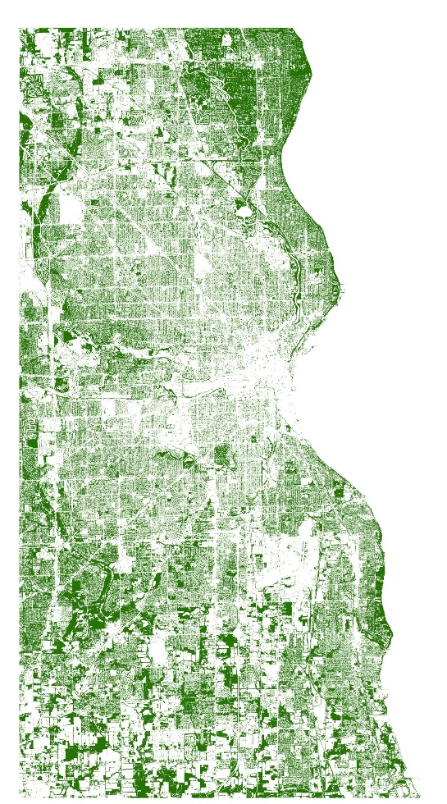
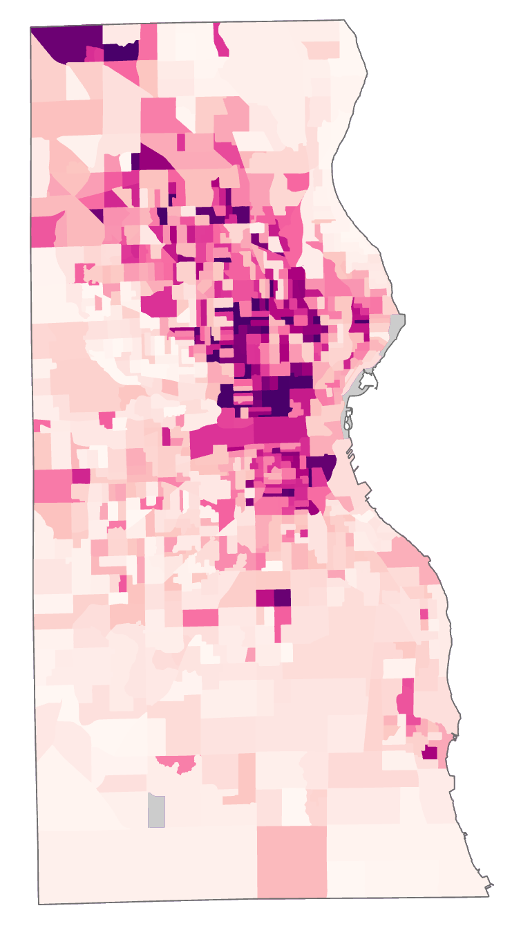
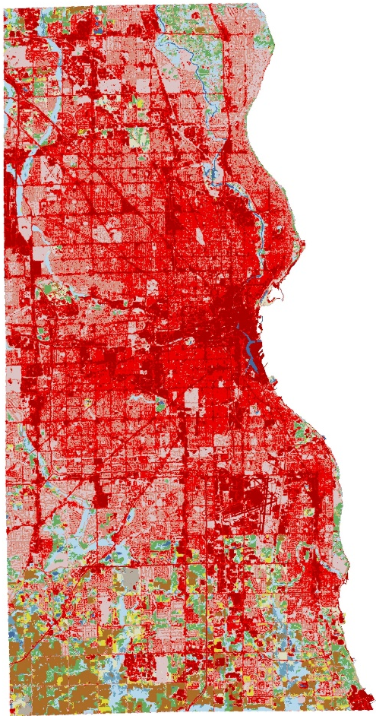
ANCILLARY DATASETS
Study Area
(Milwaukee Land Information Office)
Land Cover
(National Land Cover Database)
Tree Canopy
(Wisconsin Department of Natural Resources)
Sociodemographic
Datasets
(American Community Survey)
N
0
4
8
Miles
Notes:
Data from other sources was also key to our heat analysis.
We obtained datasets like city & county boundaries and census block groups from the Milwaukee County land information office.
We used the land cover layer from the National Land Cover Database, or NLCD. Land cover types are distinguished by color, and the most important feature for us is the distinction between developed urban areas in red shades and natural areas in greens, blues, and browns.
We used the Wisconsin community tree canopy dataset to obtain shade percentages, shown here with darker green indicating a higher percentage of shade.
We also compared our results to the CAPA Heat Survey done by citizens of Milwaukee in partnership with NOAA, shown here with darker orange indicating higher air temperatures.
In addition, we drew on many sociodemographic datasets from the American Community Survey and from our partners as we incorporated social factors into our analysis.
------------------------------Image Information Below ------------------------------
Land cover image created using Dewitz, J., and U.S. Geological Survey, (2021). National Land Cover Database (NLCD) 2019 Products (ver. 2.0, June 2021). U.S. Geological Survey data release, https://doi.org/10.5066/P9KZCM54
Tree canopy image created using Wisconsin Department of Natural Resources Wisconsin Community Canopy Cover https://dnr.wisconsin.gov/topic/urbanforests/ufia/landcover
CAPA image created using https://www.heat.gov/pages/mapping-campaigns

Slide 12
InVEST MODEL
INPUTS
OUTPUTS
Study Area (Milwaukee County)
Cooling
Capacity Index
Temperature values
Land Cover (NLCD)
Heat Mitigation
Index
Reference temp.
UHI magnitude
Evapotranspiration (ECOSTRESS)
Air Temperature
Estimate
Daytime Land Temperature (TIRS)
Biophysical table
Surface Reflectance (OLI)
Green space
Albedo
Shade
Tree Canopy (WI DNR)
Notes:
In order to run the InVEST model, our required inputs were a shapefile for Milwaukee County, a Land Cover raster layer (NLCD), an Evapotranspiration Layer (ECOSTRESS), and Daytime Land Surface Temperature (TIRS). We also used Daytime Surface Land Temperature (TIRS) to compute the reference temperature and UHI magnitude inputs. We also created a biophysical table containing attributes for each land cover class including green space, albedo, and shade, and we computed these attributes using Landsat 8 OLI and tree canopy (WI DNR) data. The model takes these inputs and calculates from them a cooling capacity index, heat mitigation index, and an air surface temperature estimate.
------------------------------Image Information Below ------------------------------
All images on this slide are sourced via Microsoft PowerPoint icons

Slide 13
MITIGATION SCENARIOS
City Wide Tree Canopy Increase
Neighborhood Mitigation
County Wide Tree Canopy Increase
Notes:
Using the InVEST Model and the input we introduced earlier, we ran four different scenarios where we increased canopy as potential mitigation effort.
We ran a model where we increased tree canopy cover at a city county / city level, at a neighborhood scale, and in vacant lots and parks.
------------------------------Image Information Below ------------------------------
All images on this slide are sourced via Microsoft PowerPoint icons

Slide 14
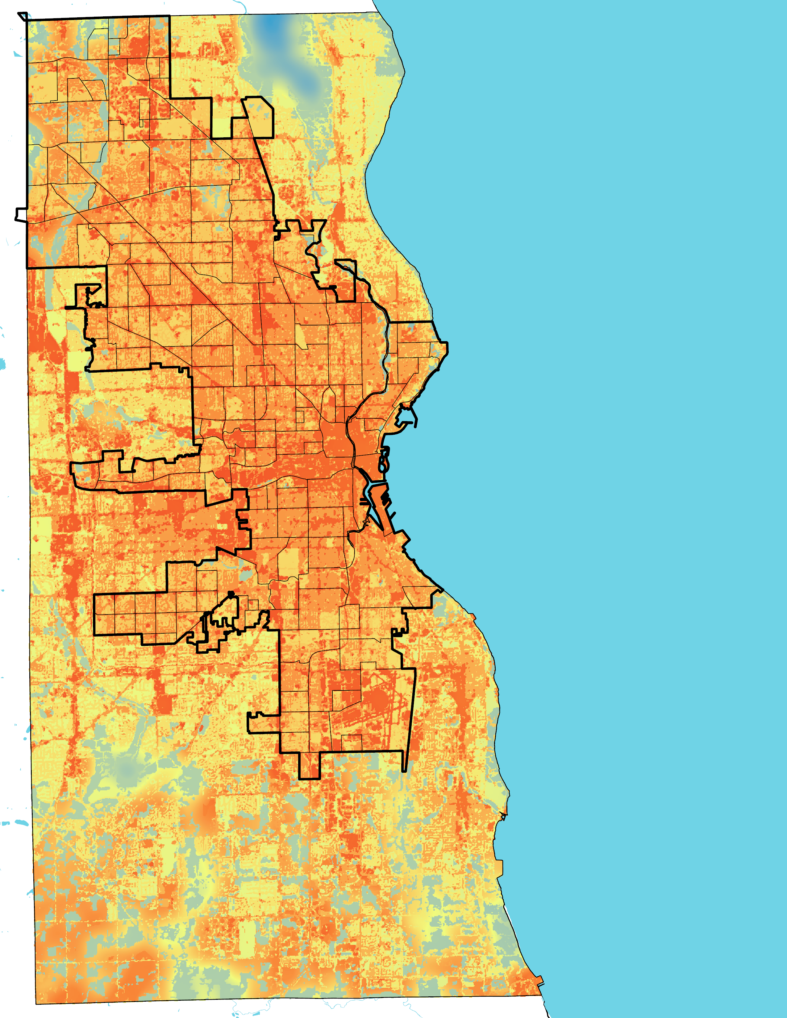
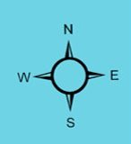
InVEST RESULTS: Current Heat Mitigation
Current Heat Mitigation: 26% Canopy Cover
Metcalfe Park
City Boundary
Neighborhoods
Metcalfe Park has the 16th lowest heat mitigation in the city, out of 190 neighborhoods
Heat Mitigation Index
1
0
Notes:
This map is our first output from InVEST, and it shows the current heat mitigation of Milwaukee with 26% canopy cover. The heat mitigation index ranges from 0 to 1, with zero showing the least amount of heat mitigation, and 1 showing high levels of heat mitigation.
We then identified the 5 neighborhoods with the best and worst heat mitigation scores. Among the best were Hilltop Parish, Mill Valley, Ridgeview, Little Menomonee Parkway and North Granville. Among the worst were Menomonee River Valley, Miller Valley, Killbourne Town, Haymarket, and Schlitz Park
Maps were created by the team using the InVEST urban cooling model.

Slide 15
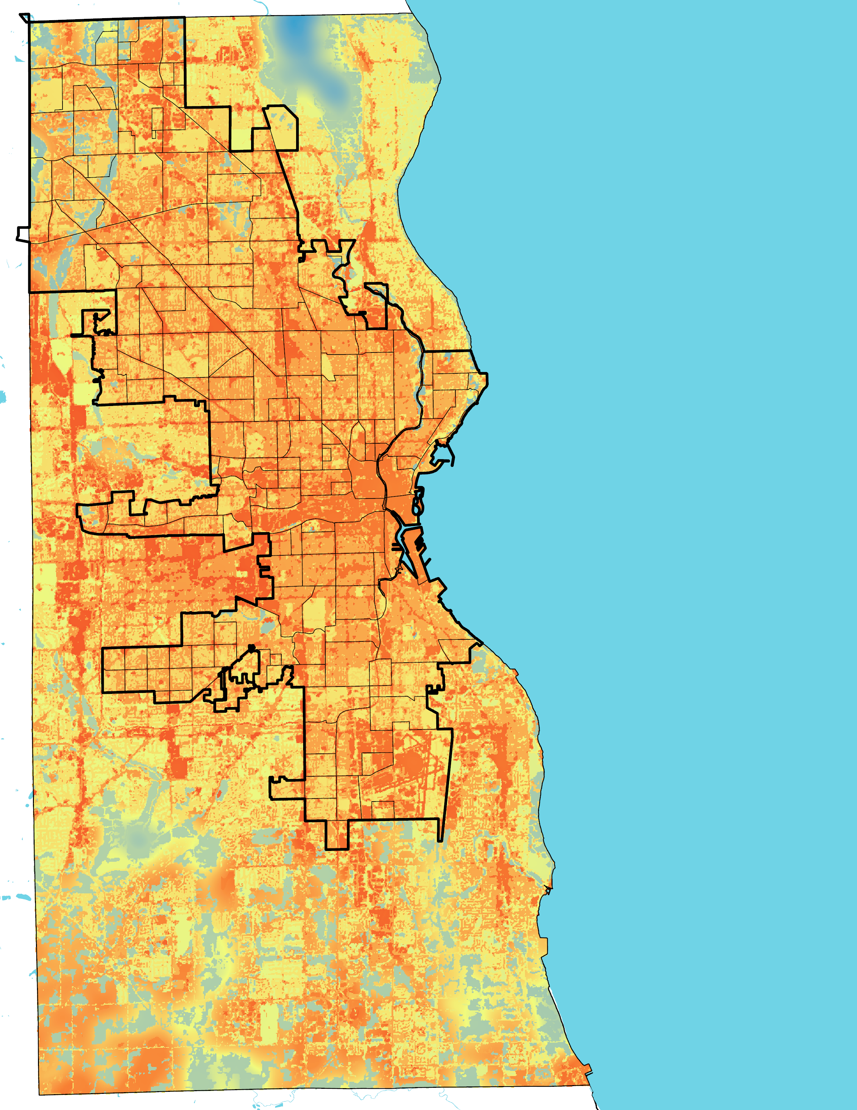
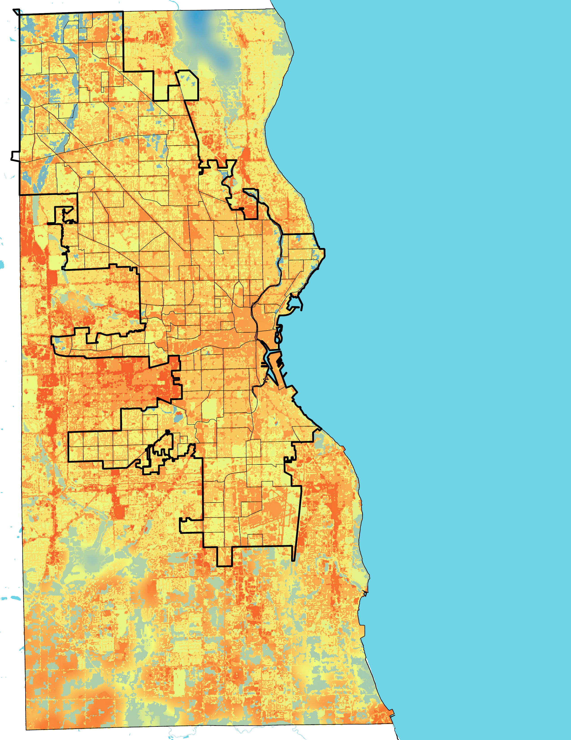
InVEST RESULTS: City-wide Mitigation
Current Heat Mitigation: 26% Canopy Cover
Modeled Heat Mitigation: 30% Canopy Cover
Modeled Heat Mitigation: 40% Canopy Cover
City Boundary
Neighborhoods
Heat Mitigation Index
1
0
Mean = 0.30
Mean = 0.31
Mean = 0.33
Notes:
Our first mitigation scenario involves increasing canopy cover only within the city bounds. This first map is showing Current Heat Mitigation with 26% canopy cover within the city and a mean heat mitigation value of 0.2974 (rounded to 0.30). As you can see, the city is significantly hotter than the surrounding county. The mean is displaying the mitigation value, basically showing how well this is area is at mitigating heat from a scale of 0 to 1.
The second map is showing projected heat mitigation when we modeled 30% canopy cover and a mean heat mitigation value of 0.3065 (rounded to 0.31). There is slight cooling throughout the city, especially in the hotspot along the city’s eastern edge.
The third map is showing projected heat mitigation when we modeled 40% canopy cover and a mean heat mitigation value of 0.3297 (rounded to 0.33), which is the national recommended canopy cover threshold for cities. In this scenario, we are seeing a gradual increase cooling throughout the city, specifically again in that hotspot along the eastern edge.
Maps were created by the team using the InVEST urban cooling model.

Slide 16
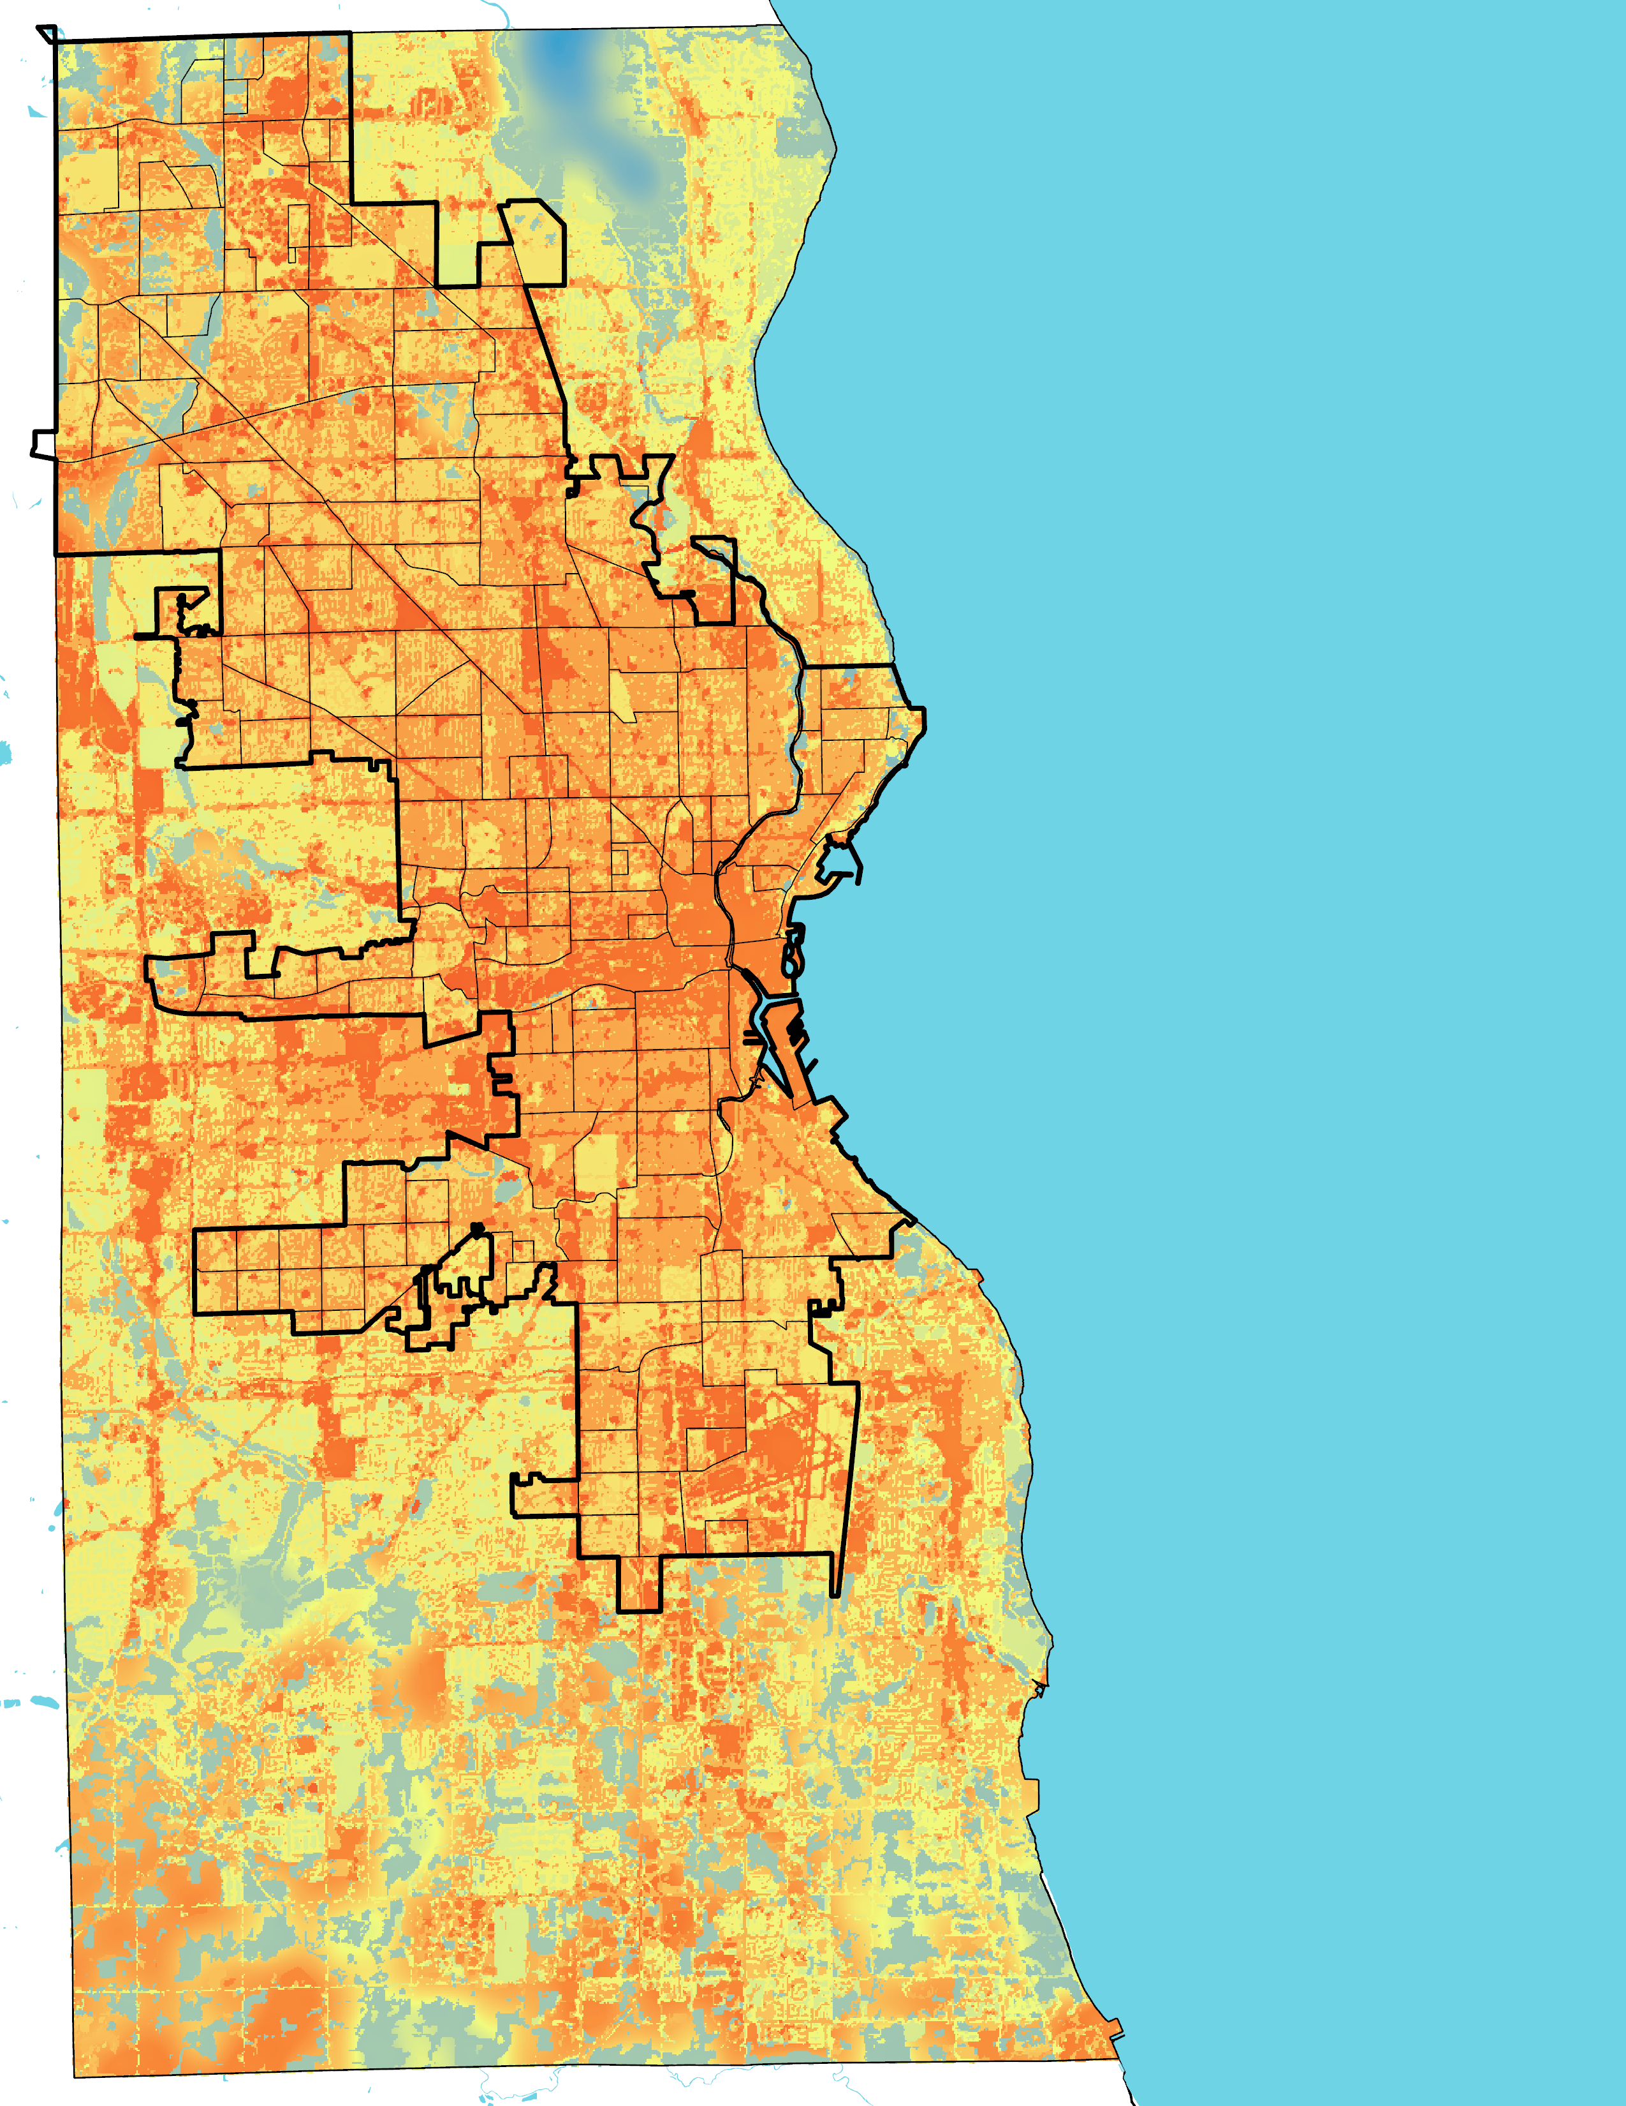
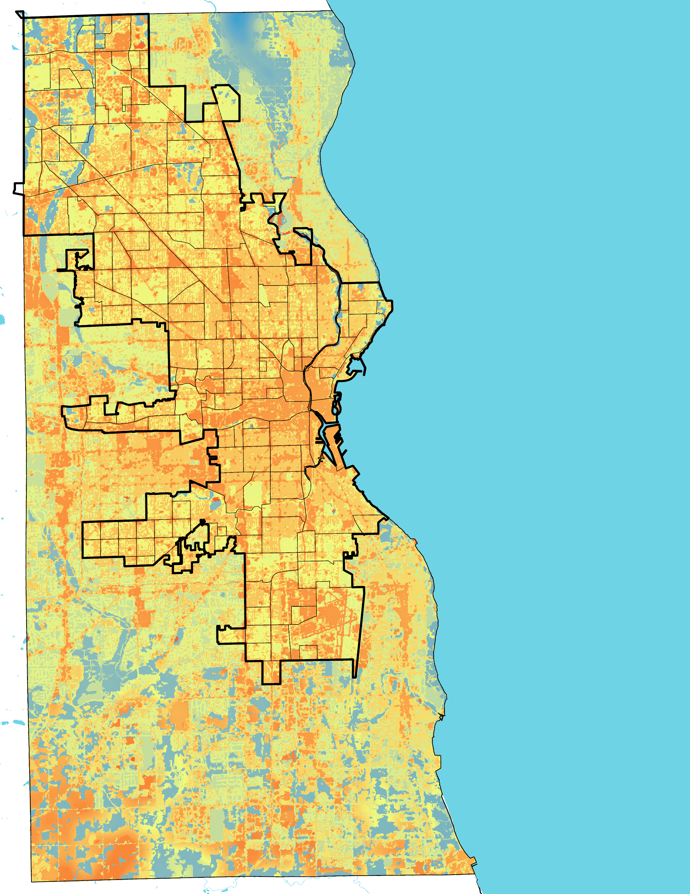
InVEST RESULTS: County-wide Mitigation
Current Heat Mitigation: 26% Canopy Cover
Modeled Heat Mitigation: 30% Canopy Cover
Modeled Heat Mitigation: 40% Canopy Cover
City Boundary
Neighborhoods
Heat Mitigation Index
1
0
Mean = 0.30
Mean = 0.32
Mean = 0.37
Notes:
Next, we modeled increasing canopy cover across the entire study area.
The first map is again showing the current heat mitigation at 26% canopy cover within the city. Since canopy cover was increased by 4% and 14% respectively for the city-wide mitigation of 30% and 40%, the county canopy cover was also increased by 4% and 14%.
The second map shows an increase in canopy cover of 4% across the entire county. There is more heat mitigation as a result, specifically within the city. Ina addition, the overall mean value increases to 0.3184.
The third map shows an increase in canopy cover of 14% across the entire county. There is significantly more heat mitigation as a result, and the overall mean value increases to 0.3724.
Maps were created by the team using the InVEST urban cooling model.

Slide 17
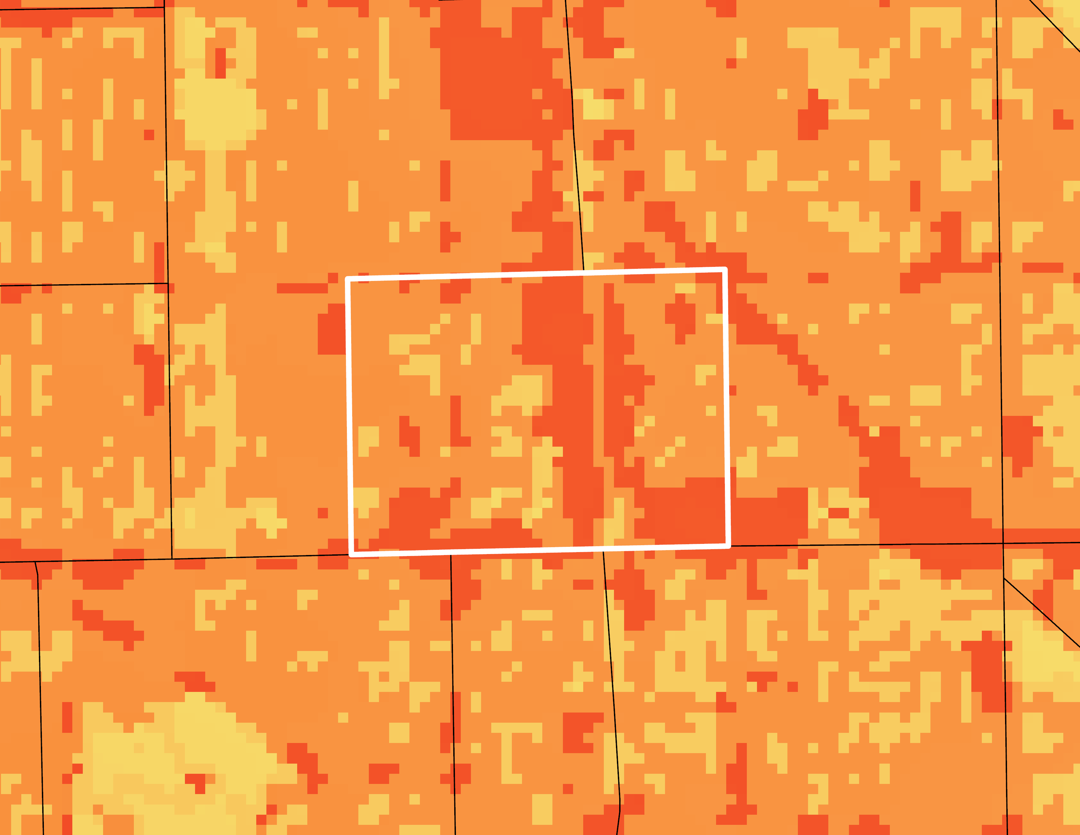
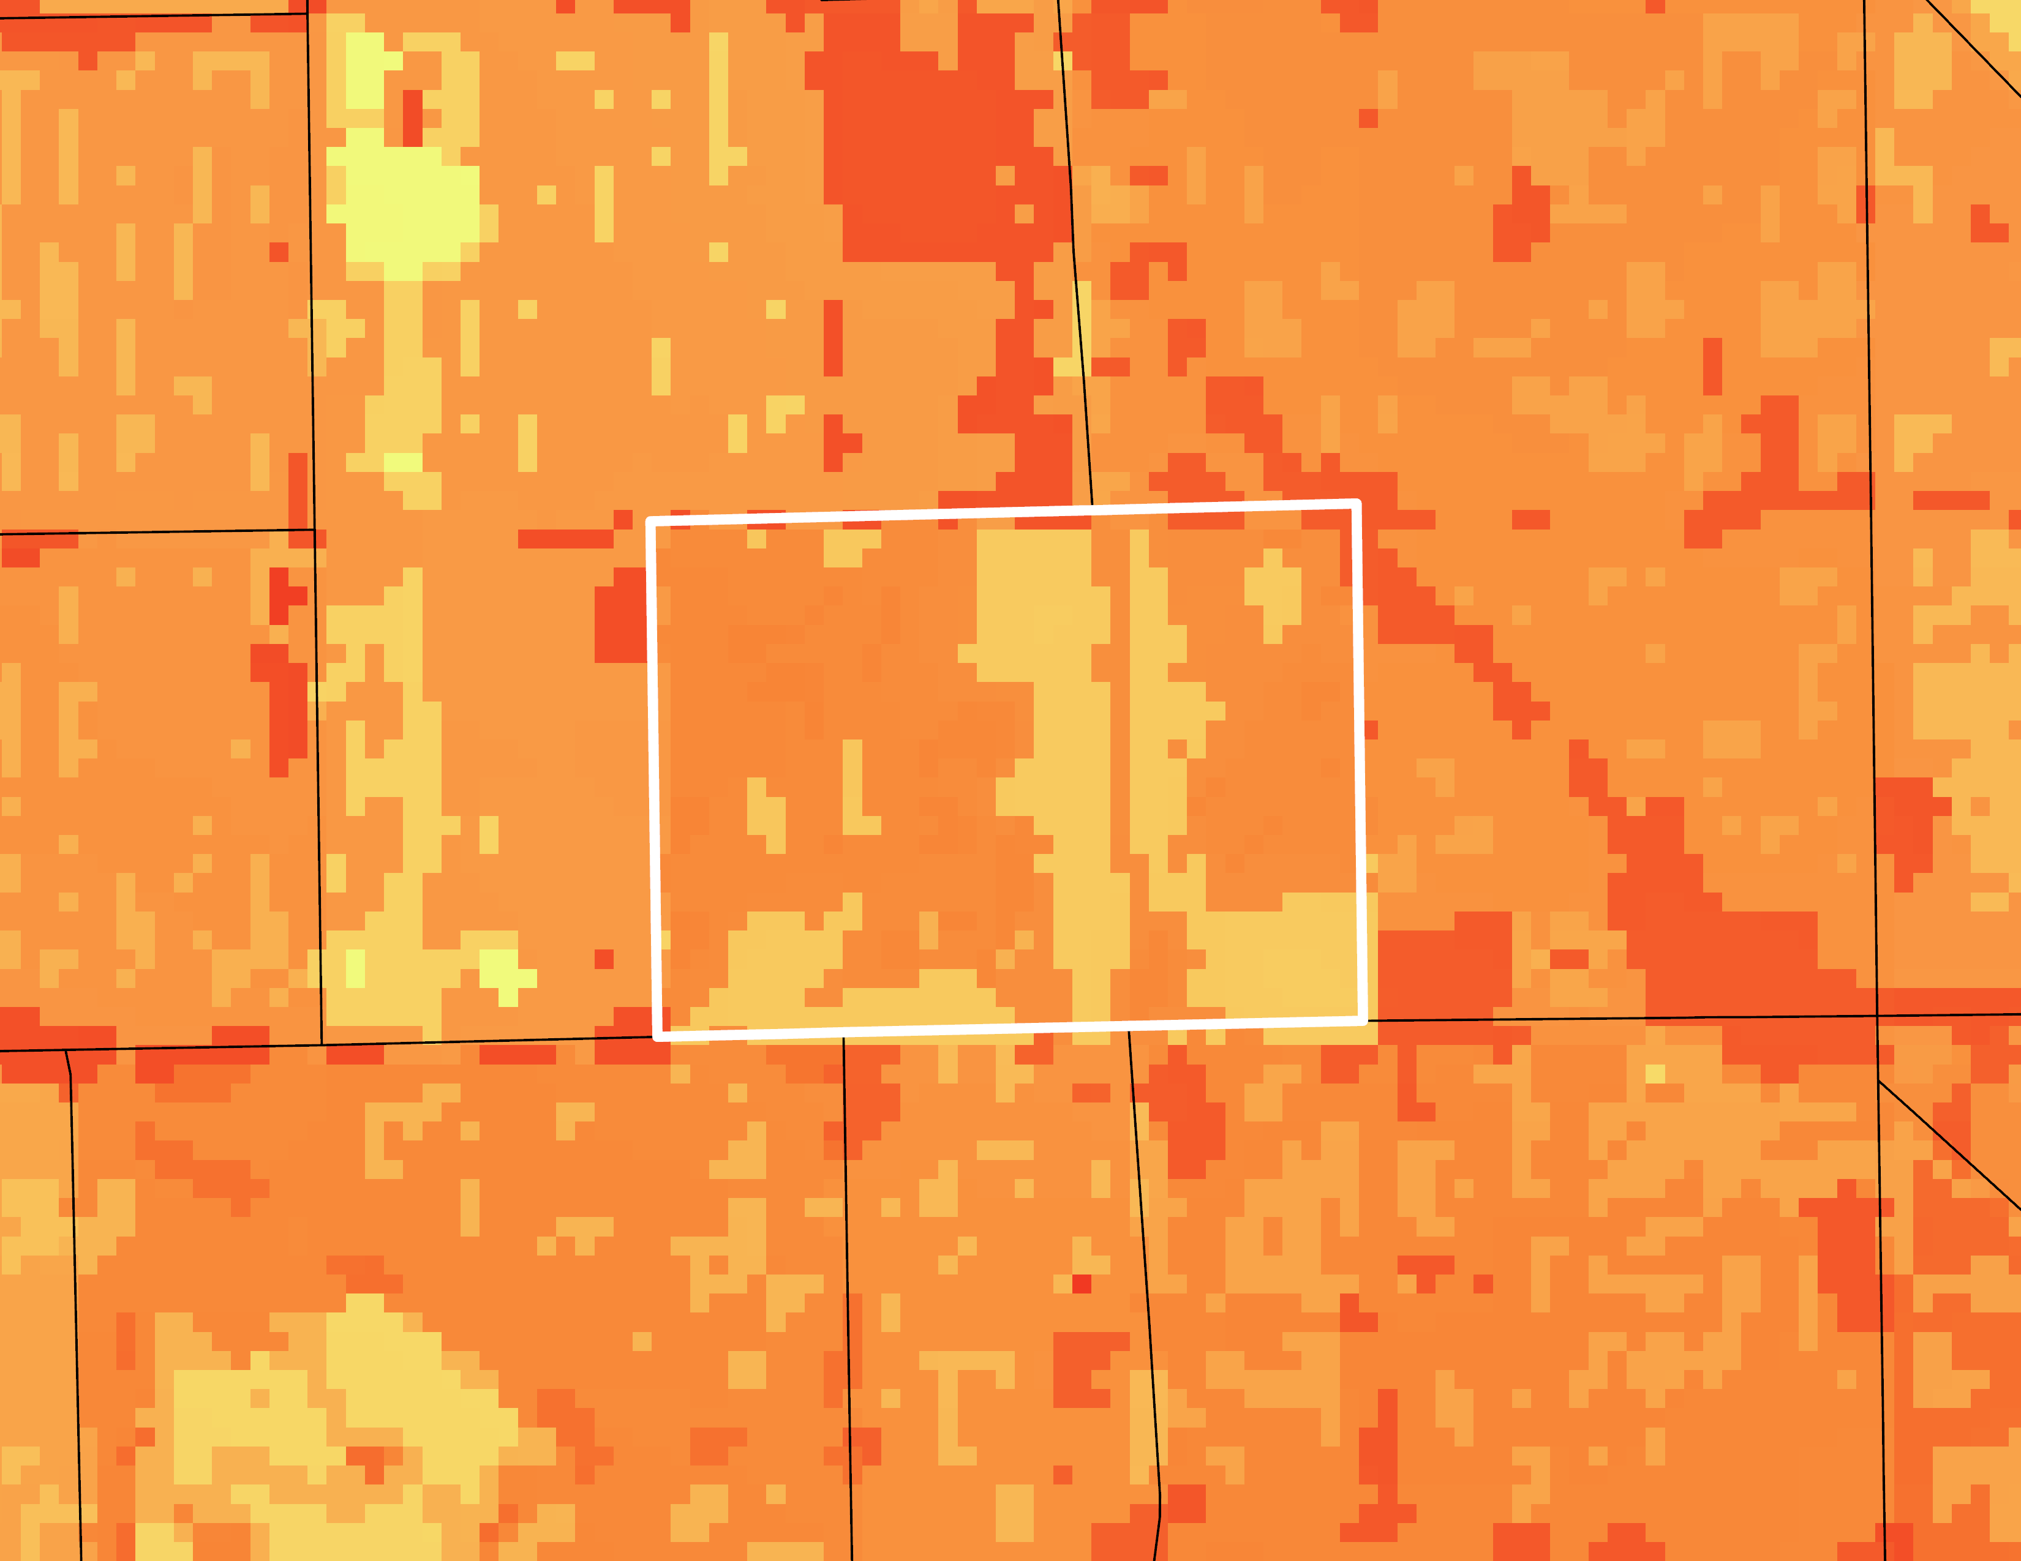
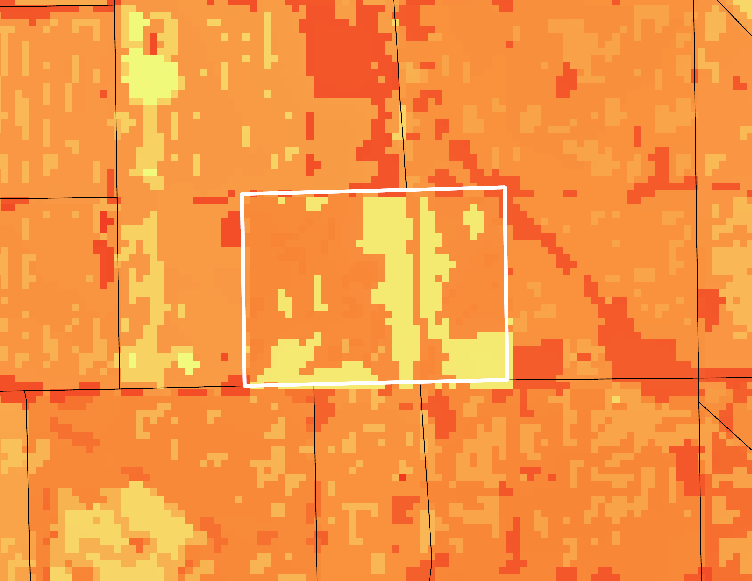
InVEST RESULTS: Metcalfe Park Mitigation
Current 26% Canopy Cover
Mean 0.1828
Mean = 0.18
Modeled 30% Canopy Cover
City Boundary
Mean = 0.22
Neighborhoods
Heat Mitigation Index
Modeled 40% Canopy Cover
1
Mean = 0.24
0
Notes:
One of Milwaukee’s goals outlined in the ReFresh Sustainability Plan for 2013–2023 was to increase canopy cover to 40%. In the 2018 progress report, this goal was flagged as unrealistic with current resources and in need of revision. We then modeled a canopy cover increase for just Metcalfe Park to see if more localized mitigation tactics would make a difference in urban heat. This first map showing the county on the left is the current heat mitigation at 26% canopy cover.
The first inset map is again showing the current heat mitigation at 26% canopy cover, for Metcalfe Park. As you can see it is one of the hotter neighborhoods in Milwaukee. (Mean value = 0.1828)
The second inset map is showing the modeled 30% canopy cover for only Metcalfe Park. This decreased heat overall in the neighborhood. (Mean value = 0.2233)
The last inset map modeled 40% canopy cover, which caused significant cooling in the neighborhood. (Mean value = 0.2424)
Maps were created by the team using the InVEST urban cooling model.

Slide 18
HEAT VULNERABILITY ANALYSIS
Data
Principal Components
Heat Vulnerability Index
Principal
Component
Analysis
Sum up
scores
Notes:
The second section of our study is an analysis of heat vulnerability across the city of Milwaukee. We developed a heat vulnerability index, which combines many different variables related to heat and its impacts to give a comparative measure of overall vulnerability to extreme urban heat. This helps identify areas most in need of heat mitigation intervention and can serve as a tool for residents advocating for change.
To create our heat vulnerability index, we combined different types of data that relate to heat exposure, heat sensitivity, and adaptivity to heat. We used principal component analysis, or PCA, to figure out which variables are most important, and then how we should combine them into one heat vulnerability index.
------------------------------Image Information Below ------------------------------
All images on this slide are sourced via Microsoft PowerPoint icons

Slide 19
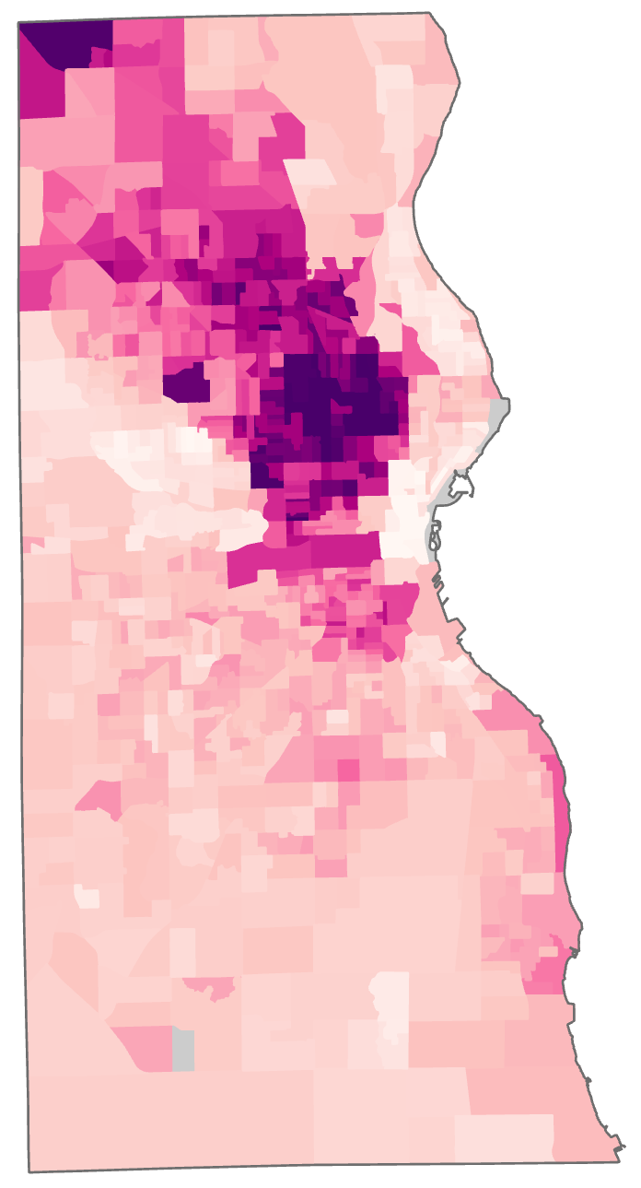
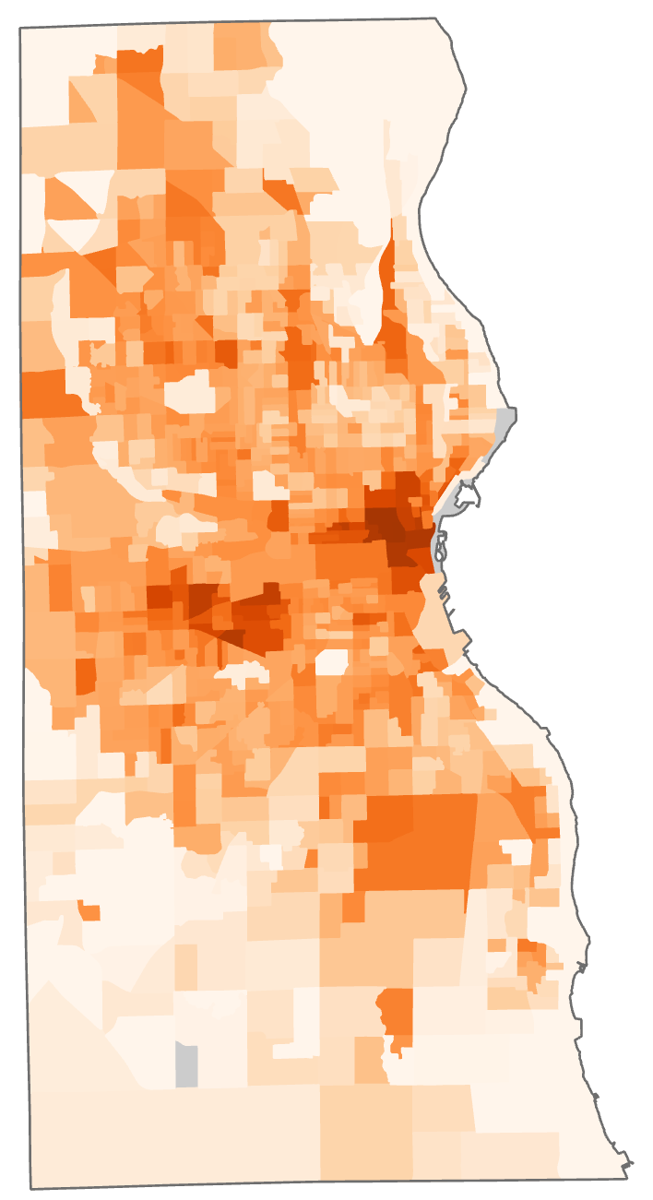
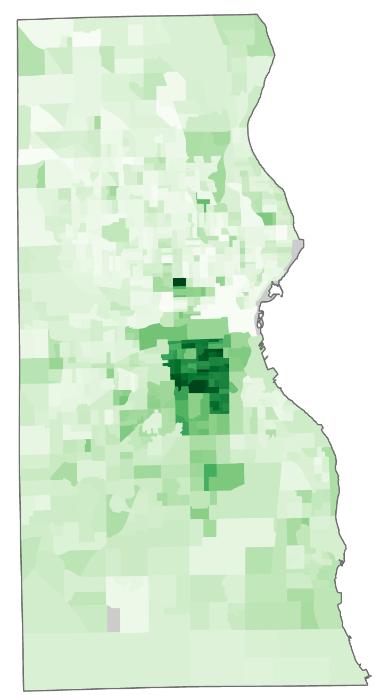
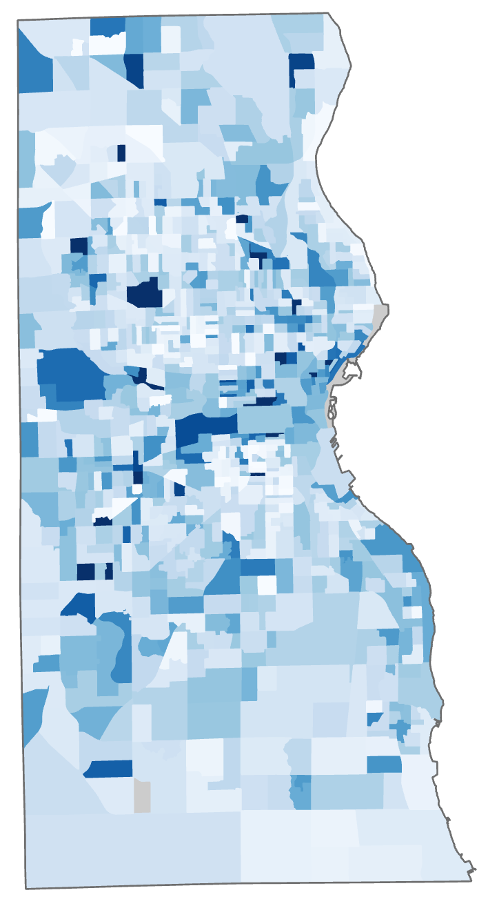
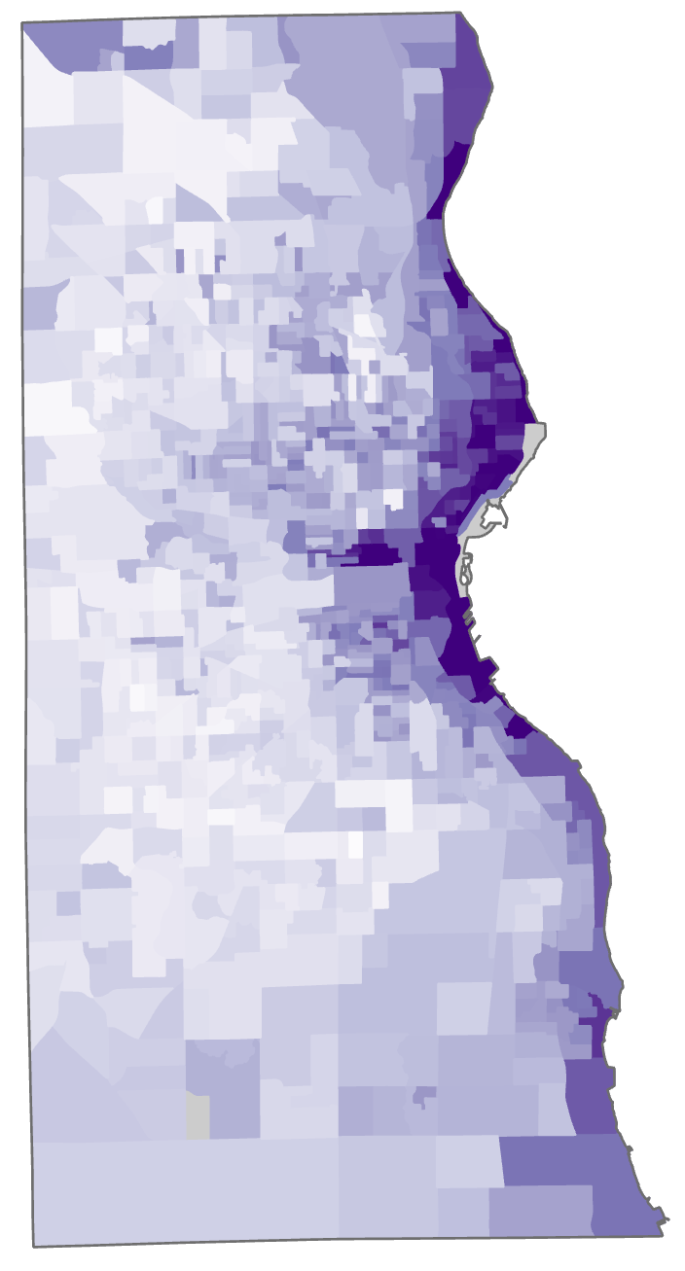
HEAT VULNERABILITY: PCA COMPONENTS
PC 1
PC 2
PC 3
PC 4
PC 5
health, race, income
temperature, shade, heat mitigation
language, citizenship, education
no computer, living alone
albedo, car use, evapo-transpiration
Higher
Vulnerability
Lower
Vulnerability
Notes:
We can map the values of each of our five components to see how their associated vulnerabilities are distributed differently across the city.
Component 1 shows high vulnerability in central and northwest Milwaukee, following known distributions of people of color, especially Black communities, and low-income people.
Component 2 has a distribution very similar to our current heat mitigation map, showing higher vulnerability in the central and northwestern parts of the county that are hotter and less good at cooling.
Component 3’s high vulnerability is concentrated on the south side of the city, which is home to significant Latinx and Eastern European immigrant communities.
Component 4’s distribution has a less clear pattern, and Component 5 shows most vulnerability on the east side of the city. These phenomena don’t have obvious explanations and would be interesting to explore further in the future.

Slide 20
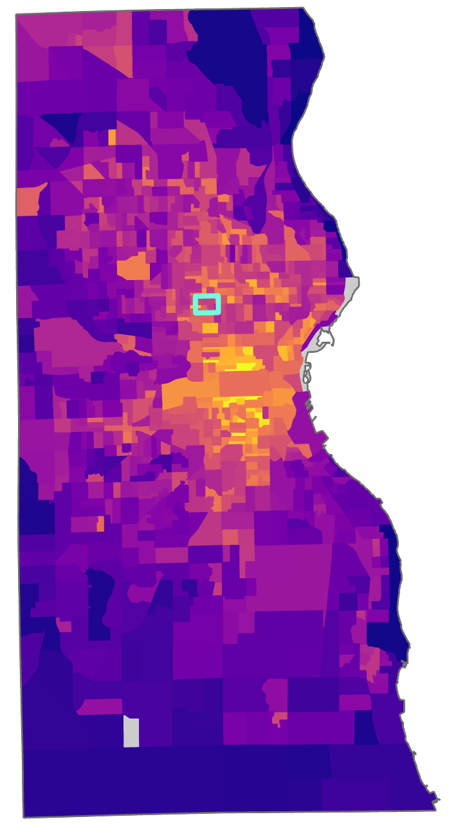
HEAT VULNERABILITY: INDEX RESULT
Surrounding county area to northeast & south less vulnerable
PC 1
+
PC 2
+
PC 3
+
PC 4
+
PC 5
Metcalfe Park is somewhat vulnerable, ranking 49th out of 190 neighborhoods
Central & Northwest city areas more vulnerable
Higher
Vulnerability
Lower
Vulnerability
Missing census data
Notes:
To create our heat vulnerability index, we added up the values from our five components to get one unified score for each census block group in Milwaukee.
This map shows the distribution of the resulting index. The index follows the tendencies of many other variables toward higher vulnerability closer to the center of Milwaukee, and lower vulnerability farther out into the county.
Also, we can locate Metcalfe Park on the vulnerability map, and observe that our index shows that it is vulnerable although not the most so in the city. Our index ranks it 49th most vulnerable out of Milwaukee’s 190 neighborhoods, placing it at around the 75th percentile.
Maps were created by the team using environmental and American Community Census data via principal component analysis

Slide 21
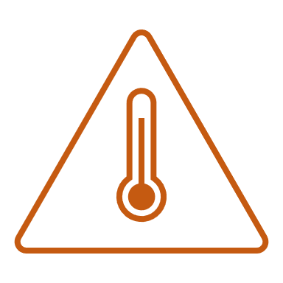
CONCLUSIONS
Current city-wide heat mitigation is low
40% canopy cover at city & county levels cools effectively
Metcalfe Park: heat mitigation 16th lowest in city
Localized tree canopy interventions can cool effectively
Metcalfe Park: vulnerability 49th highest in city
Central city area is most vulnerable to extreme urban heat
Unequal distribution of urban heat & vulnerability
Ongoing need for heat mitigation in EJ communities
Notes:
The 40% canopy cover threshold will provide the ideal heat mitigation, but neighborhood scale 40% mitigation goals rather than city-wide might be more feasible.
Metcalfe Park has the 16th lowest heat mitigation ranking of the 190 neighborhoods in Milwaukee. Our InVEST model showed targeted neighborhood interventions to be effective in cooling.
Metcalfe Park ranks as the 49th highest vulnerability in the city, and the central city area was found to be the most vulnerable to heat.
Our vulnerability maps showed that urban heat and vulnerability are unequally distributed throughout the area, along lines of race, class, health, and resource access. This demonstrates the ongoing need for heat mitigation in EJ communities.
------------------------------Image Information Below ------------------------------
All images on this slide are sourced via Microsoft PowerPoint icons

Slide 22
LIMITATIONS AND UNCERTAINTIES
Limitations in satellite imagery analysis
ACS data based on estimates
HVI attribute
limitations
Notes:
Some of the limitations of our study include the possibility of errors in our analysis of satellite imagery such as loss of data. It is also important to mention that land surface temperature is not equivalent to the ambient air temperature that people experience on the ground in Milwaukee.
We used ACS data for demographic attributes, there could be limitation to this data because it is based on estimates, certain population may not be fully represented from this survey,
and it is subject to bias.
We also attempted to incorporated as many relevant HVI attributes as possible, but our results are limited to the attributes we included.
------------------------------Image Information Below ------------------------------
All images on this slide are sourced via Microsoft PowerPoint icons

Slide 23
FUTURE WORK
Integrate urban flooding and urban heat results
Re-run InVEST model for white roof and green roof mitigation options
Analyze cooling center locations in relation to HVI
Investigate urban heat impacts on community health & Environmental Justice
Empower community through education on urban heat and mitigation strategies
Notes:
Future work on this topic should firstly include integration of the Milwaukee Urban Development Term I’s findings from the InVEST urban flood risk mitigation model and Term II’s findings from the InVEST urban cooling model to better understand climate resiliency in Milwaukee. It would be beneficial to model urban cooling with a white roof and green roof urban heat mitigation scenario. These are two other green infrastructure tactics that could contribute to urban cooling in Milwaukee. This work could be furthered by a GIS analysis of cooling center locations in relation to our HVI. This would help identify areas where more cooling centers are needed, or which cooling centers are underutilized. Impacts of our work may be furthered by an investigation into the impacts of urban heat on EJ and health in the Milwaukee community. Lastly, this work may be incorporated into education and empowerment of the community to combat the unequal impacts of climate change.
------------------------------Image Information Below ------------------------------
All images on this slide are sourced via Microsoft PowerPoint icons

Slide 24
A special thank you to our Fellow and Science Advisors for their direction and support:
Julianne Liu (Environmental Justice Fellow)
Dr. Kenton Ross (NASA Langley Research Center)
Lauren Childs-Gleason (NASA Langley Research Center)
A big thanks to our wonderful project partners at Groundwork USA & Groundwork Milwaukee:
Lawrence Hoffman, Deputy Director of GIS
John Valinch, Manager of Equity and Resilience Programs
And many thanks to Milwaukee Urban Development I for their previous contributions:
Madeleine Tango (Project Lead), Jack Acomb, Annika Harrington, Lisa Sun,
Marco Vallejos (Fellow), and Remi Work (Assistant Fellow)
Additionally, our thanks to Christina Dennis, Akshay Agarwal, and Lance Watkins for their help with our InVEST and heat vulnerability index methodologies. And gratitude to the Wichita Climate II team who supported and collaborated with us.

Slide 25
BACKUP SLIDES

Slide 26
TEAM MEMBERS
Nash Keyes
Caleigh McLaren
Nati Phan
Dalia Vazquez

Slide 27
CONTINUED PROJECT
Term I
Term II
Modeled Urban Flood Risk in Milwaukee
Analyzed drivers of urban flood risk
Quantified spatial distribution of flood vulnerability
Modeled Urban Cooling in Milwaukee
Analyzed drivers of urban heat risk
Quantified spatial distribution of heat vulnerability & cooling capacity
Notes:
In the first term of this project, the team focused on urban flood risk in Milwaukee. They analyzed the various drivers of urban flood risk and quantified spatial distribution of flood vulnerability. In the second term of this project, we are building off their work and shifting focus to urban heat vulnerability in Milwaukee to get a better understanding of climate resilience in the city. We analyzed the drivers of urban heat risk and quantified the spatial distribution of heat vulnerability and cooling capacity.
------------------------------Image Information Below ------------------------------
All images on this slide are sourced via Microsoft PowerPoint icons

Slide 28
SATELLITE DATA PREPARATION
Acquisition
Google Earth Engine (GEE)
Application for Extracting and Exploring Analysis Ready Samples (AppEEARS)
Processing
Cloud masking & mean pixel value (GEE)
Project to State Plane & clip to Milwaukee County (GIS)
Zonal statistics (GIS)
Outputs
Daytime & Nighttime LST
Shade fraction, building intensity, albedo by land use
Evapotranspiration
Notes:
Satellite data such as Daytime LST, shade fraction, building intensity, albedo and land use were retrieved using Google Earth Engine for our specific study period. Additionally, mean and cloud masking functions were used within Google Earth Engine for these data images. ArcGIS pro was used to run zonal statistics and to clip to MKE county for these images.
AppEEARS was used to retrieve Evapotranspiration data in which a cloud mask was already applied. We processed the data in ArcGIS pro to create a mean image of the evapotranspiration for the study time. Nighttime LST was retrieved from AppEars as well, and a CSV with file names and dates was filtered using Python to only retrieve the files during nighttime hours. Then, ArcGIS Pro was used to run cloud mask functions using a filtered cloud mask dataset from AppEARS. Finally, we calculated the median of the raster images.

Slide 29
InVEST MODEL, nighttime
INPUTS
OUTPUTS
Study Area (Milwaukee County)
Cooling
Capacity Index
Land Cover (NLCD)
Temperature values
Heat Mitigation
Index
Reference temp.
UHI magnitude
Nighttime Land Temperature (ECOSTRESS)
Air Temperature
Estimate
Biophysical table
Buildings (Milwaukee County)
Building intensity
Notes:
The nighttime InVEST model required similar inputs as the daytime model such as the Milwaukee shapefile and Land Cover layer (NCLD).
The difference between the daytime and nighttime model, is that the nighttime model includes an LST layer that is filtered for nighttime hours of 8pm – 5am. The nighttime LST was used to reference temperature and UHI magnitude.
The biophysical table for the nighttime model also differs in that it needs values for building intensity, or how much building floor area there is relative to total land area. We computed these values from a LIDAR building height dataset.
The combination of these inputs provided a cooling capacity index, heat mitigation index, and an air temperature estimate for the nighttime.
------------------------------Image Information Below ------------------------------
All images on this slide are sourced via Microsoft PowerPoint icons

Slide 30
Exposure
Heat mitigation
Sensitivity
Adaptivity
High temperature
Low temperature
Tree cover
Albedo
Evapotranspiration
Heat related illness
Elderly population
Computer access
Citizenship
Language
Transportation
Income
Energy burden
Education
Race*
Living arrangement
HEAT VULNERABILITY: DATA
*
race is harder to categorize like this, but very important to include!
PCA finds important combinations = PCs!
Notes:
We gathered data on many different variables related to heat from census surveys, satellite data, and our partners. Exposure variables like daytime and nighttime surface temperature, shade, albedo, and evapotranspiration relate to extreme heat and heat mitigation. Sensitivity variables like health conditions and age relate to how much heat directly affects people. Adaptive capacity variables like income, education, transportation, and energy burden relate to people’s ability to access resources and change their behaviors to cope with heat. Some variables, like race, don’t fall as neatly into one category, but the categories are still useful in helping us think about different aspects of vulnerability and organizing our analysis.
------------------------------Image Information Below ------------------------------
All images on this slide are sourced via Microsoft PowerPoint icons

Slide 31
HEAT VULNERABILITY: PCA COMPONENTS
Lots of variables
a
b
c
d
e
...
importance
PC 1
PC 2
PC 3
PC 4
PC 5
Notes:
PCA is a statistical procedure that summarizes the information in a large set of variables by identifying correlations among them and creating a smaller set of component indices based on those correlations. The components clarify the most important aspects of the data and indicate how the variables should be weighted to construct our index.

Slide 32
HEAT VULNERABILITY: PCA COMPONENTS
PC 1
PC 2
PC 3
PC 4
PC 5
health, race, income
temperature, shade, heat mitigation
language, citizenship, education
no computer, living alone
albedo, car use, evapo-transpiration
Notes:
Each component is a combination of different variables that are associated with each other. In some cases, these combinations of variables make obvious sense together because they represent underlying factors that drive variation in the data. In our case, this was in fact true for our five significant components, and we can then map the values of each of the five components to see where in Milwaukee County higher vulnerability is driven by which set of variables.
Component 1 is a combination of health, race, and income, which we know are extremely linked to each other and to discrimination and lack of access to resources in general.
Component 2 combines daytime and nighttime temperatures, shade, and heat mitigation, all of which relate to how much heat a certain area experiences and how well it can cool off.
Component 3 is a combination of language, citizenship, and education, variables that relate to people’s interactions with society and the resources that might be available to them to cool off.
Component 4 relates to computer access and living alone, which is a bit harder to interpret but seems relevant to people’s ability to access resources and ask for help in coping with heat.
Component 5 incorporates car use, albedo, and evapotranspiration, variables that relate to increased pavement and lack of vegetation.

Slide 33
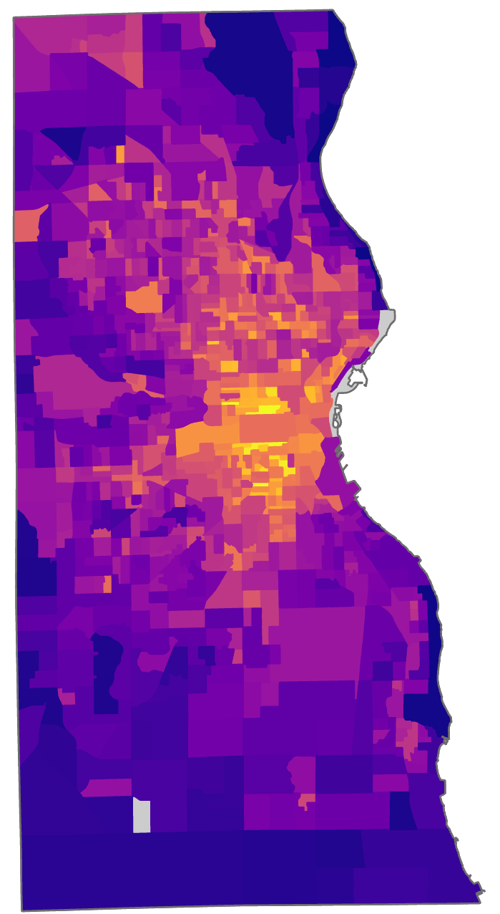
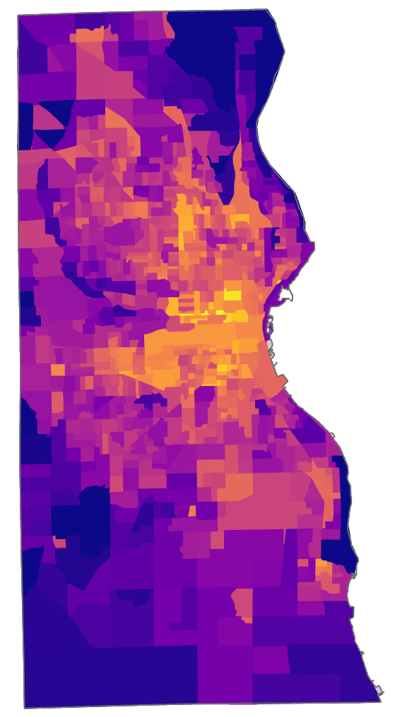
HEAT VULNERABILITY: INDEX COMPARISON
Our index:
Groundwork index:
Higher
Vulnerability
Lower
Vulnerability
Notes:
Our partner Groundwork Milwaukee had previously developed a heat index based on an unweighted sum of a few variables. Here we show a comparison of the index that we developed with theirs. It’s clear that the overall in geography of our index values are very similar, which is very interesting! Hopefully, this means that both of our indices are relatively accurate and useful. This also seems to indicate that adding more variables doesn’t necessarily change the vulnerability landscape across the city – meaning, its already clear which areas are more or less vulnerable.
Maps were created by the team using environmental and ACS data with PCA

