Slide 1
ALASKA CLIMATE
Utilizing NASA Earth Observations to Model Present Suitable Habitat of
Invasive Species in Alaskan Wetlands
Emma Zink Hatcher
Audrey Martinez
Sarah Carroll
Tim Mayer
USGS at Colorado State University
2017 Summer
Notes:
Hi, my name is ______, and I graduated from the _____ in _______. Today I am presenting the project Alaska Climate completed by the Fort Collins DEVELOP node. This project applied NASA Earth observations to model potential suitable habitat for aquatic invasive plant species in Alaska.

Slide 2
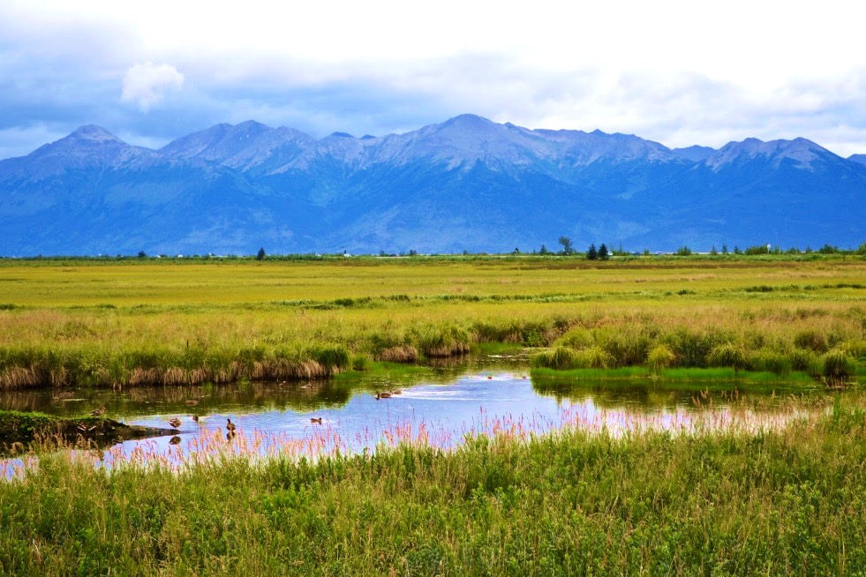
Overview
Suitable habitat distributions for invasive species are shifting due to changing climate trends
Northern latitudes and high altitudes at risk
Habitat suitability models inform invasive species management decisions to protect ecosystems and economies
Reed canarygrass and purple loosestrife follow this pattern and have been documented in Alaskan wetland habitats
Image Credit: Alaina McDavid
Notes:
Changing climate trends globally are expanding the geographic extent of suitable habitat for invasive species into higher latitudes and altitudes than historically observed. This is of major concern to natural resource managers and government agencies as they attempt to preserve the ecological and recreational value of environments such as wetlands in Alaska. Reed canarygrass and purple loosestrife are two invasive species in Alaskan wetlands that have established only in recent decades due to the emergence of more temperate climate ranges near the arctic that support populations of these species.
Image Credit: https://www.flickr.com/photos/allie444/29065068640/in/photolist-rQjXqG-KTreHT-mSahkw-8wyDPD-3gPhv5-6AYjL4-aZ5UN-gtK33W-nbAPXs-gtJaQu-6B3sx7-cF4Ta7-oc4Rye-6e6Md-6e6Hy-6e6Pa-91VVTh-6itWWi-9dZBCv-7Wj852-qP6Vv7-vcacaQ-uwTVhi-LsAxt-vtJQyF-R3Fdbp-uwJfWE-vtJQQx-vtcFCJ-uwJfSm-vcakTj-JFGs2L-JJKetK-JTrNiy-KLFeUZ-KLFmmr-KQGsdW-LgLPGC-KTucec-LXBu33-KTukRH-KTuAjF-KTxBF2-nt8wp7-Lho5i7-nbARuo-nSNsZQ-88B6LJ-3Z8ga3-iZQ1y/ Creative Commons License: https://creativecommons.org/licenses/by-sa/2.0/legalcode

Slide 3
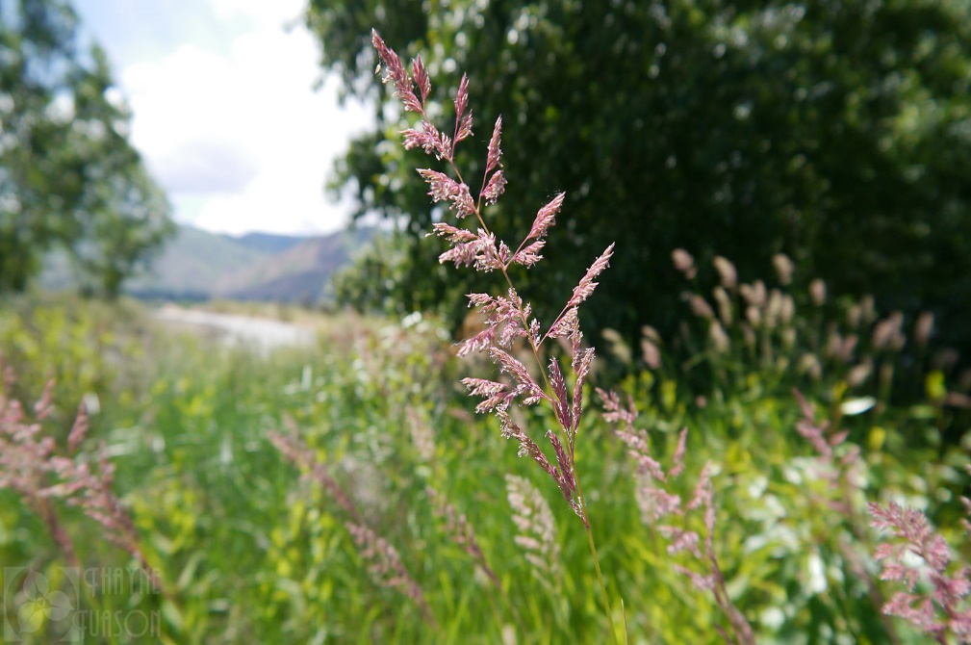
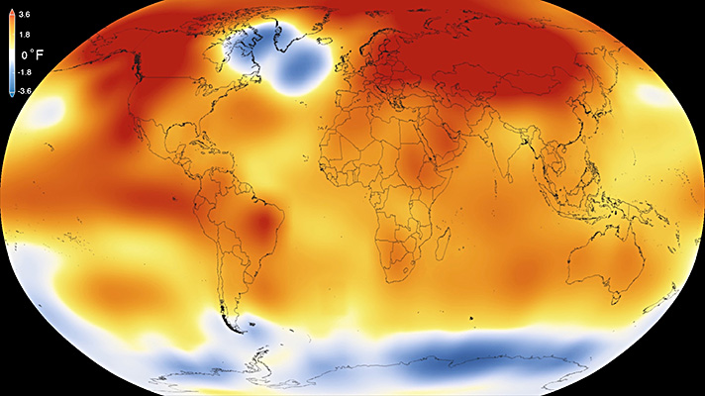
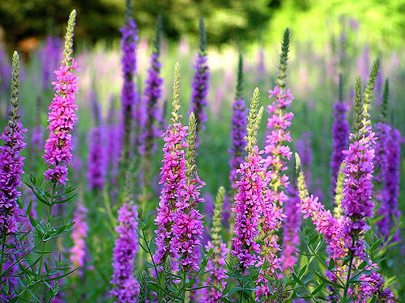
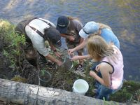
Community Concern
Changing climate trends and establishment patterns
Invasive species in Alaska
Image credit: Thanye Tuason
Image credit: NOAA 2016
Data gap: areas at high risk
Image credit: US Fish and Wildlife Service
Image credit: Liz West
Notes:
There a hundreds of invasive species in North America in lower latitudes that have become of concern for natural resource managers in Alaska.
Purple loosestrife and reed canarygrass are two species of concern that were previously limited to lower latitudes, have been documented in Alaska for the first time in the past decade.
Changing climate will influence wetland ecosystems, creating additional suitable locations for invasive species in Alaska.
Encroachment of invasive species will increase competition with native wetland flora decreasing biodiversity and pose a risk to sensitive, intact ecosystems.
Aesthetic and recreation value of wetland regions may depreciate in Alaska as a result of increased abundance of aquatic invasive.
Currently, the Aquatic Division of USFW oversees invasive wetland species and implements the “National Fish Habitat Action Plan”, which relies on field-based monitoring and surveillance programs to locate invasive species and to prioritize management actions. However, to date, no remote sensing based analyses of suitable habitat for new invasive have been conducted, and no map is currently available to guide new management policies and actions for managing purple loosestrife and reed canarygrass in Alaska.
Reed canarygrass: https://www.nps.gov/voya/learn/nature/reedcanarygrass.htm
Purple loosestrife: https://www.flickr.com/photos/calliope/953569123
https://www.flickr.com/photos/alaska_region/12824797104/in/photolist-kxhrns
install a light blocking tarp over invasive reed canarygrass near Cordova. Chugach National Forest. (Alaska)
Climate change NOAA https://www.pmel.noaa.gov/arctic-zone/detect/detection-images/2015-annual.jpeg

Slide 4
Project Objectives
Provide habitat suitability models
(HSM) in Alaska for the invasive
species purple loosestrife (Lythrum Salicaria) and reed canargyrass (Phalaris arundinacea L.) to inform target areas that fall within species potential distribution.
Provide HSM for the continental United States and Canada for both species.
Purple loosestrife
Create a tutorial to enable partners at the Alaska Region US Fish and Wildlife Service to replicate methods.
Reed canarygrass
Notes:
The primary objective of this project was to model the current potential species distribution of reed canarygrass in Alaska to provide a region-specific model that can utilized by partners at the Alaska Region, US Fish and Wildlife Service to inform management decisions and target areas of high-priority for invasive species management actions.
An additional object was to create a second set of models provided the contextual current distribution of suitable niches on a continental scale of purple loosestrife (Lythrum salicaria) and reed canarygrass (Phalaris arundinacea L.).
Finally, we also created a tutorial of these methods for US Fish and Wildlife Service to replicate these modeling efforts and continue model refinement.

Slide 5
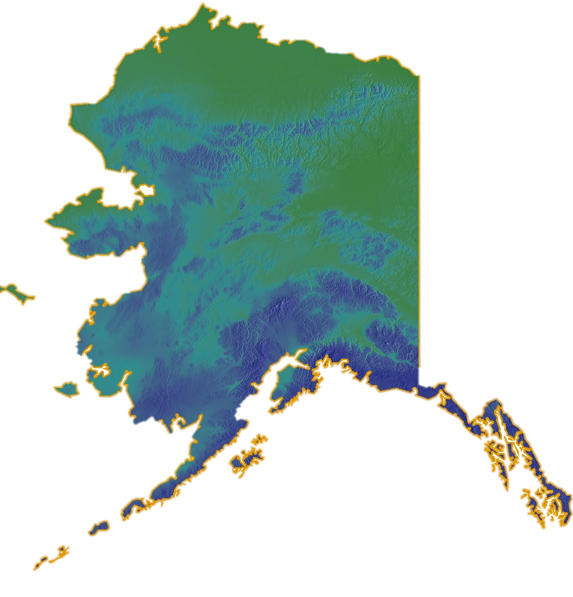
Study Area
Alaska
AK
Canada
520
1,040
miles
CONUS
high
Mean Annual
Precipitation (1981-2010)
low
Notes:
Our study area is ultimately Alaska, however, the United States and Canada were also included in the modeling scale to provide contextual suitable habitat distribution to compare to Alaska-scale models. The study period is from 1981 – 2017. A more detailed view of our study area shows the wide range in variation of climate across the state using just the indicator of precipitation. Here we have the Kenai, inside passage and the Alaska peninsula where our study species were commonly found. Several reed canarygrass presence points were found in the central interior area of Alaska, on the north side of the Alaska Range near Fairbanks.

Slide 6
Study Area
Species included:
Purple loosestrife
- first appeared in Alaska in 2005
Reed canarygrass
-first appeared in Alaska in 1987
Purple loosestrife (1155)
Reed canarygrass (3273)
Study area: Alaska
Contextual model area: United States and Canada
Study period: 1981 - Present
Notes:
. This map shows the continental distribution of presence points of reed canarygrass in blue and purple loosestrife in red. There are many instances of reed canarygrass in Alaska, as it has a 30 year history in the state. However, there are far fewer purple loosestrife points, as it has only been present and documented in the state since 2005. A visual assessment shows that both species tend to do well in costal and wetland regions with a moderate degree of seasonal variability across winter, spring, summer, and fall.
The study period was selected due to data (presence and environmental predictor variable ) availability and continuity.

Slide 7
Additional Models:
Hydrilla and Eurasian watermilfoil
Hydrilla (190)
Eurasian Watermilfoil (524)
Notes:
These images show the final cleaned and merged presence datasets with the total number of presence points.
Several public datasets
***Removed = Collective species count between 1981 - 2016: 98,958 (this is by discussing all 4 species)

Slide 8
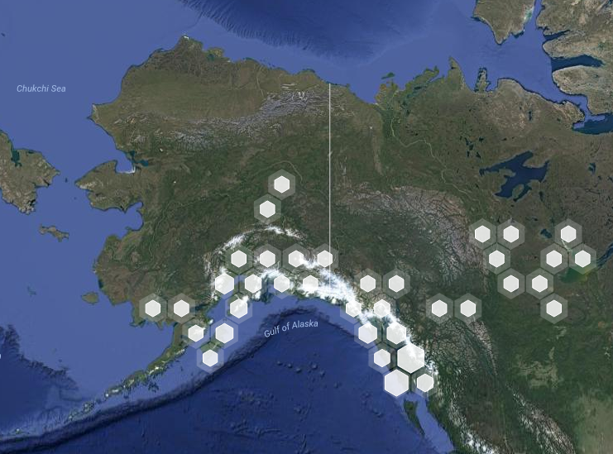
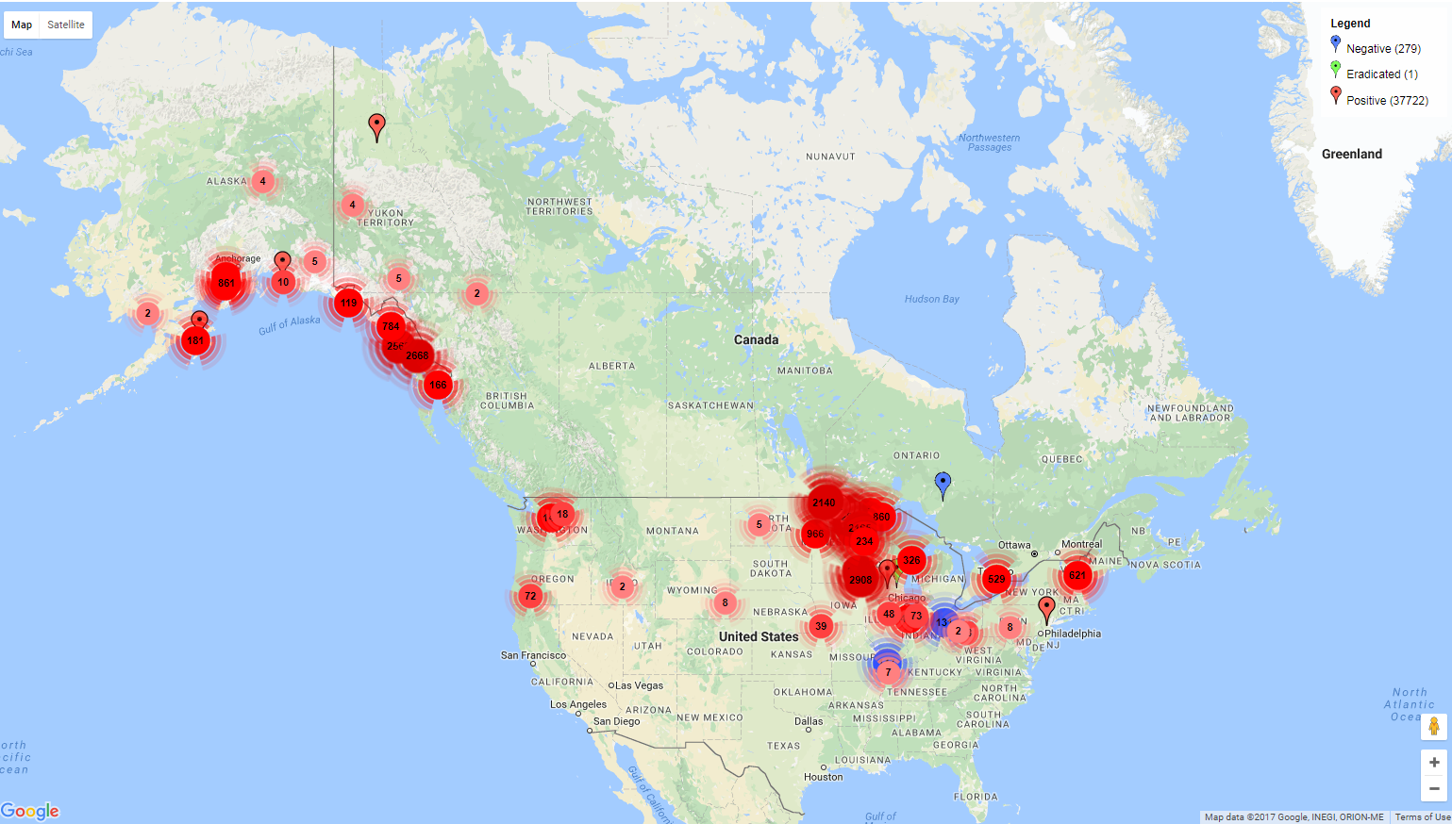
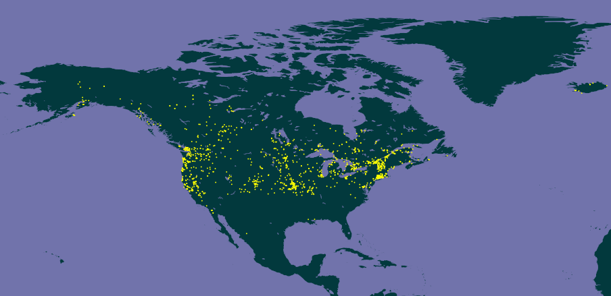
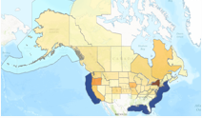
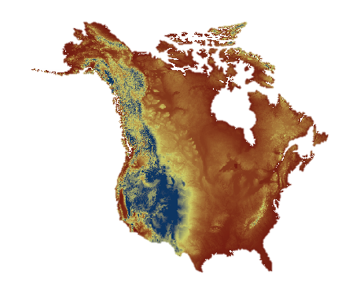
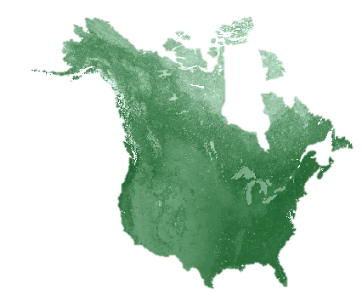
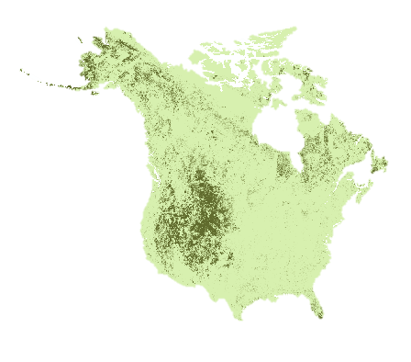
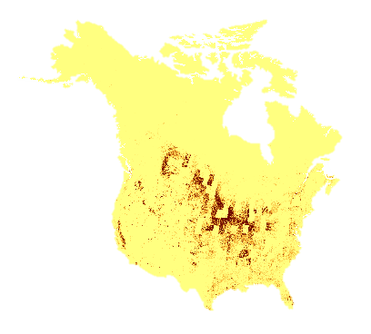
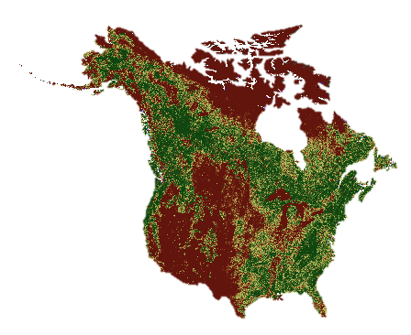
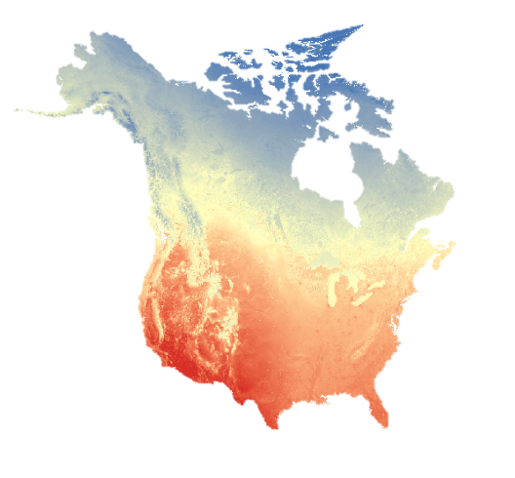
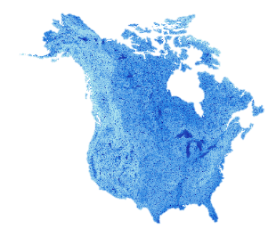
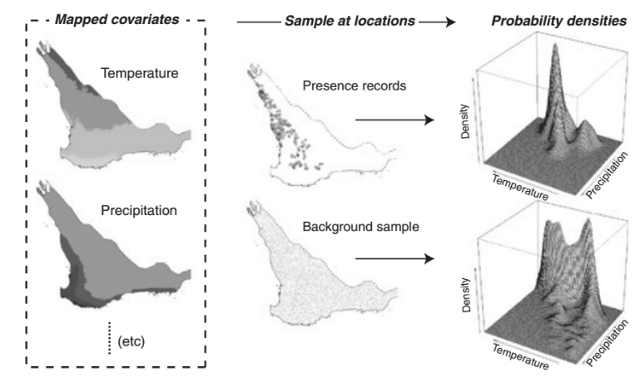
Methods
Overview
Format Species Presence Data for SAHM input
1) Download Presence Data (1981-2016) from GBIF, BISON, AKNHP, and EDD
2) Generate climate normals (1981-2010) and acquire MODIS-derived vegetation indices
Process and project to create environmental predictor variables
3) Habitat Suitability modeling approaches via SAHM
Model Evaluation:
AUC
Model Potential Distribution
Notes:
To generate habitat suitability models, presence data was downloaded from GBIF, BISON, AKNHP, and EDD for our species. Duplicated and clear errors were removed and the points dataset was filtered to leave only the points without georeferencing and coordinate issues.
We then used ClimateNA software to generate seasonal and annual climate normals for the period of 1981-2010. We also used Google Earth Engine to generate vegetation, land surface, and land cover data from Terra and Aqua MODIS. Several of these and topographic datasets for the continental scale models were generously provided by USGS.
Our models were then run and evaluated in SAHM (Software for Assisted Habitat Modeling).
SAHM flowchart image= https://nrelecopress1.files.wordpress.com/2015/02/sahm_fig3.png
RC = https://www.eddmaps.org/distribution/viewmap.cfm?sub=6170
RC= https://demo.gbif.org/species/5289756
Rc = https://bison.usgs.gov/#home
RC= http://aknhp.uaa.alaska.edu/apps/akepic/#map?lg=f37ef462-d080-11e3-a36b-00219bfe5678&p=proj3857&b=google_hybrid&z=3&ll=60.00000%2C-140.00000
Species Distribution Models: Ecological Explanation and Prediction Across Space and Time
Elith and Leathwick 2009
Source: Annual Review of Ecology, Evolution, and Systematics, Vol. 40 (2009), pp. 677-697
----
Elith et al .2011

Slide 9
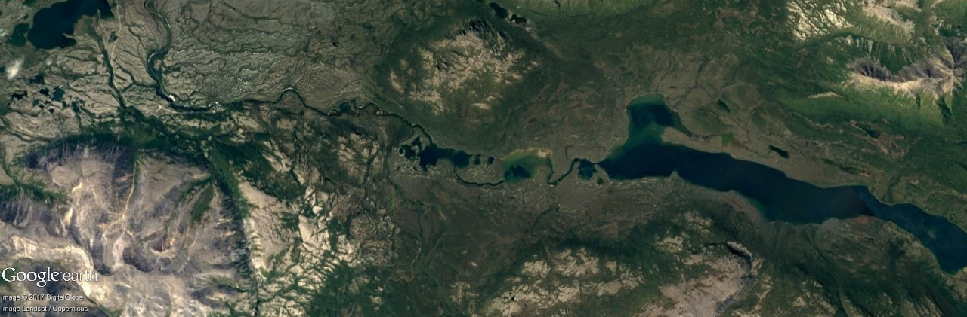
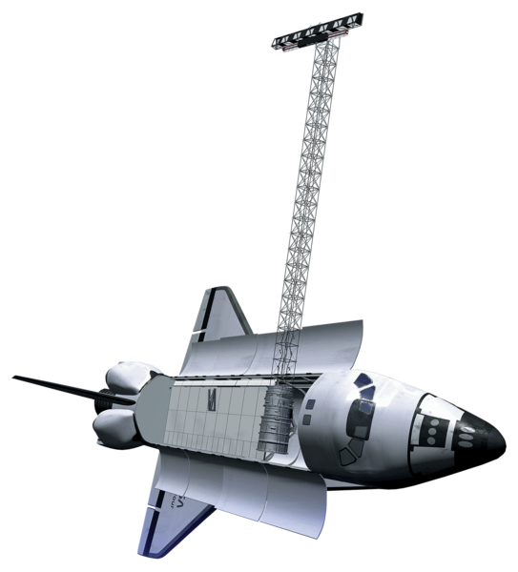
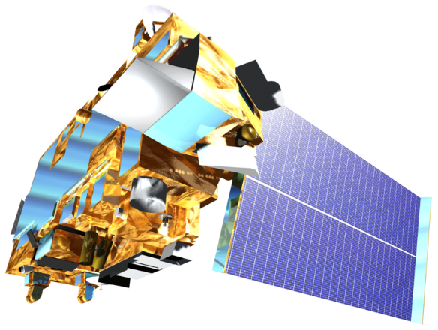
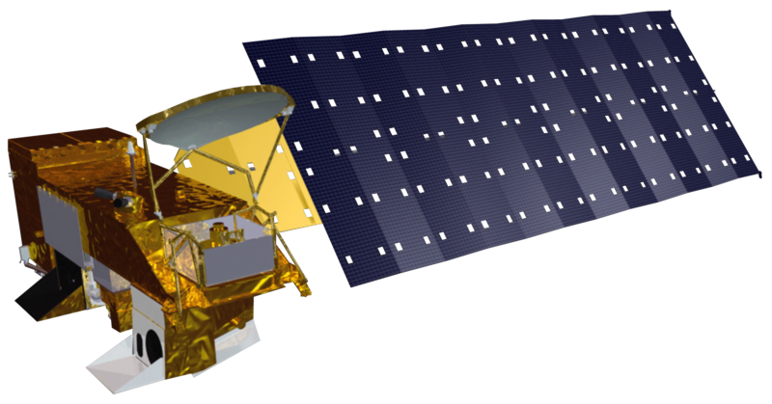
NASA Earth Observations
Aqua MODIS
&
Terra MODIS
Landsat 7
Shuttle Radar Topography Mission (SRTM)
Spectral and topographic environmental data layers
Vegetation Indices (Aqua and Terra MODIS)
Reflectance
(Terra MODIS and Landsat 7)
Land Surface Temperature
(Aqua MODIS)
Topography
(SRTM V2)
Notes:
Multiple Nasa Earth observations were used to create predictor layers.
Aqua MODIS was used for NDVI, NDWI, and land surface temperature.
Terra MODIS was used for surface reflectance.
Collectively Terra and aqua were used for Burn area index, land cover, and EVI.
Landsat 7 was used to produce tasseled-cap transformation which give a “vegetation indices” and “surface reflectance”
SRTM V2 produced elevation, which then slope and roughness could be derived from.

Slide 10
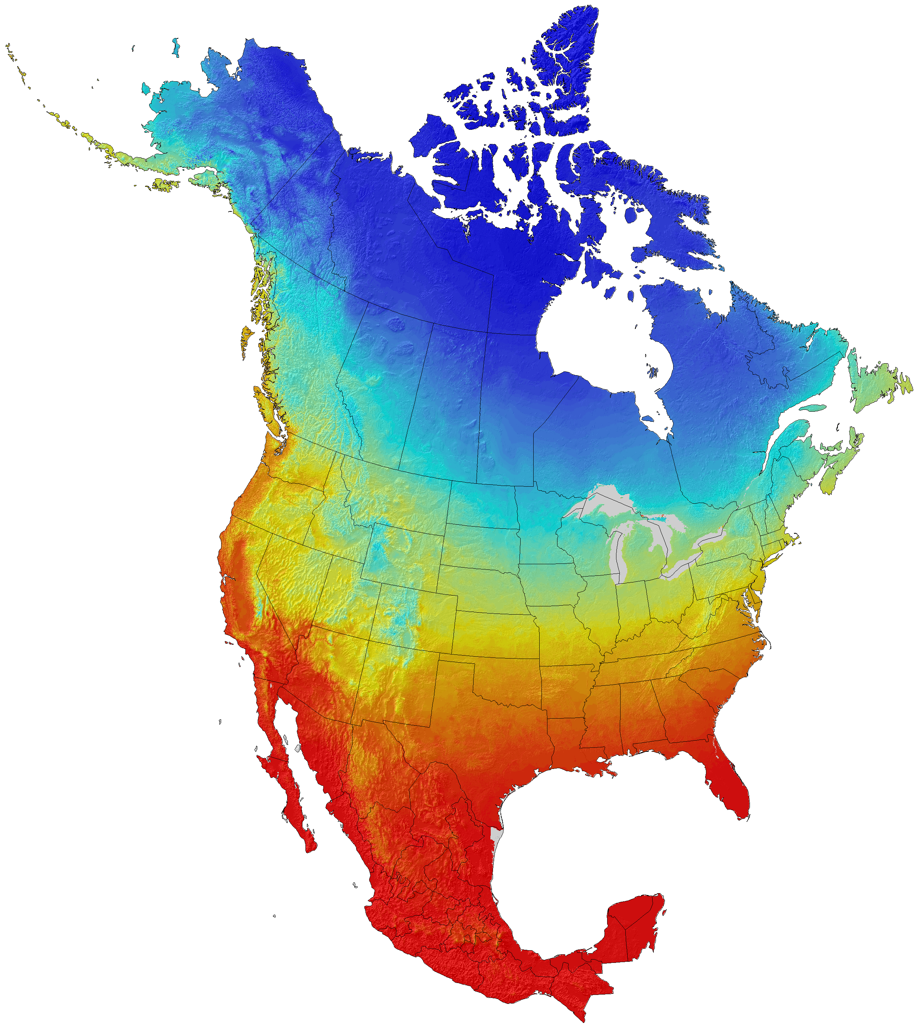
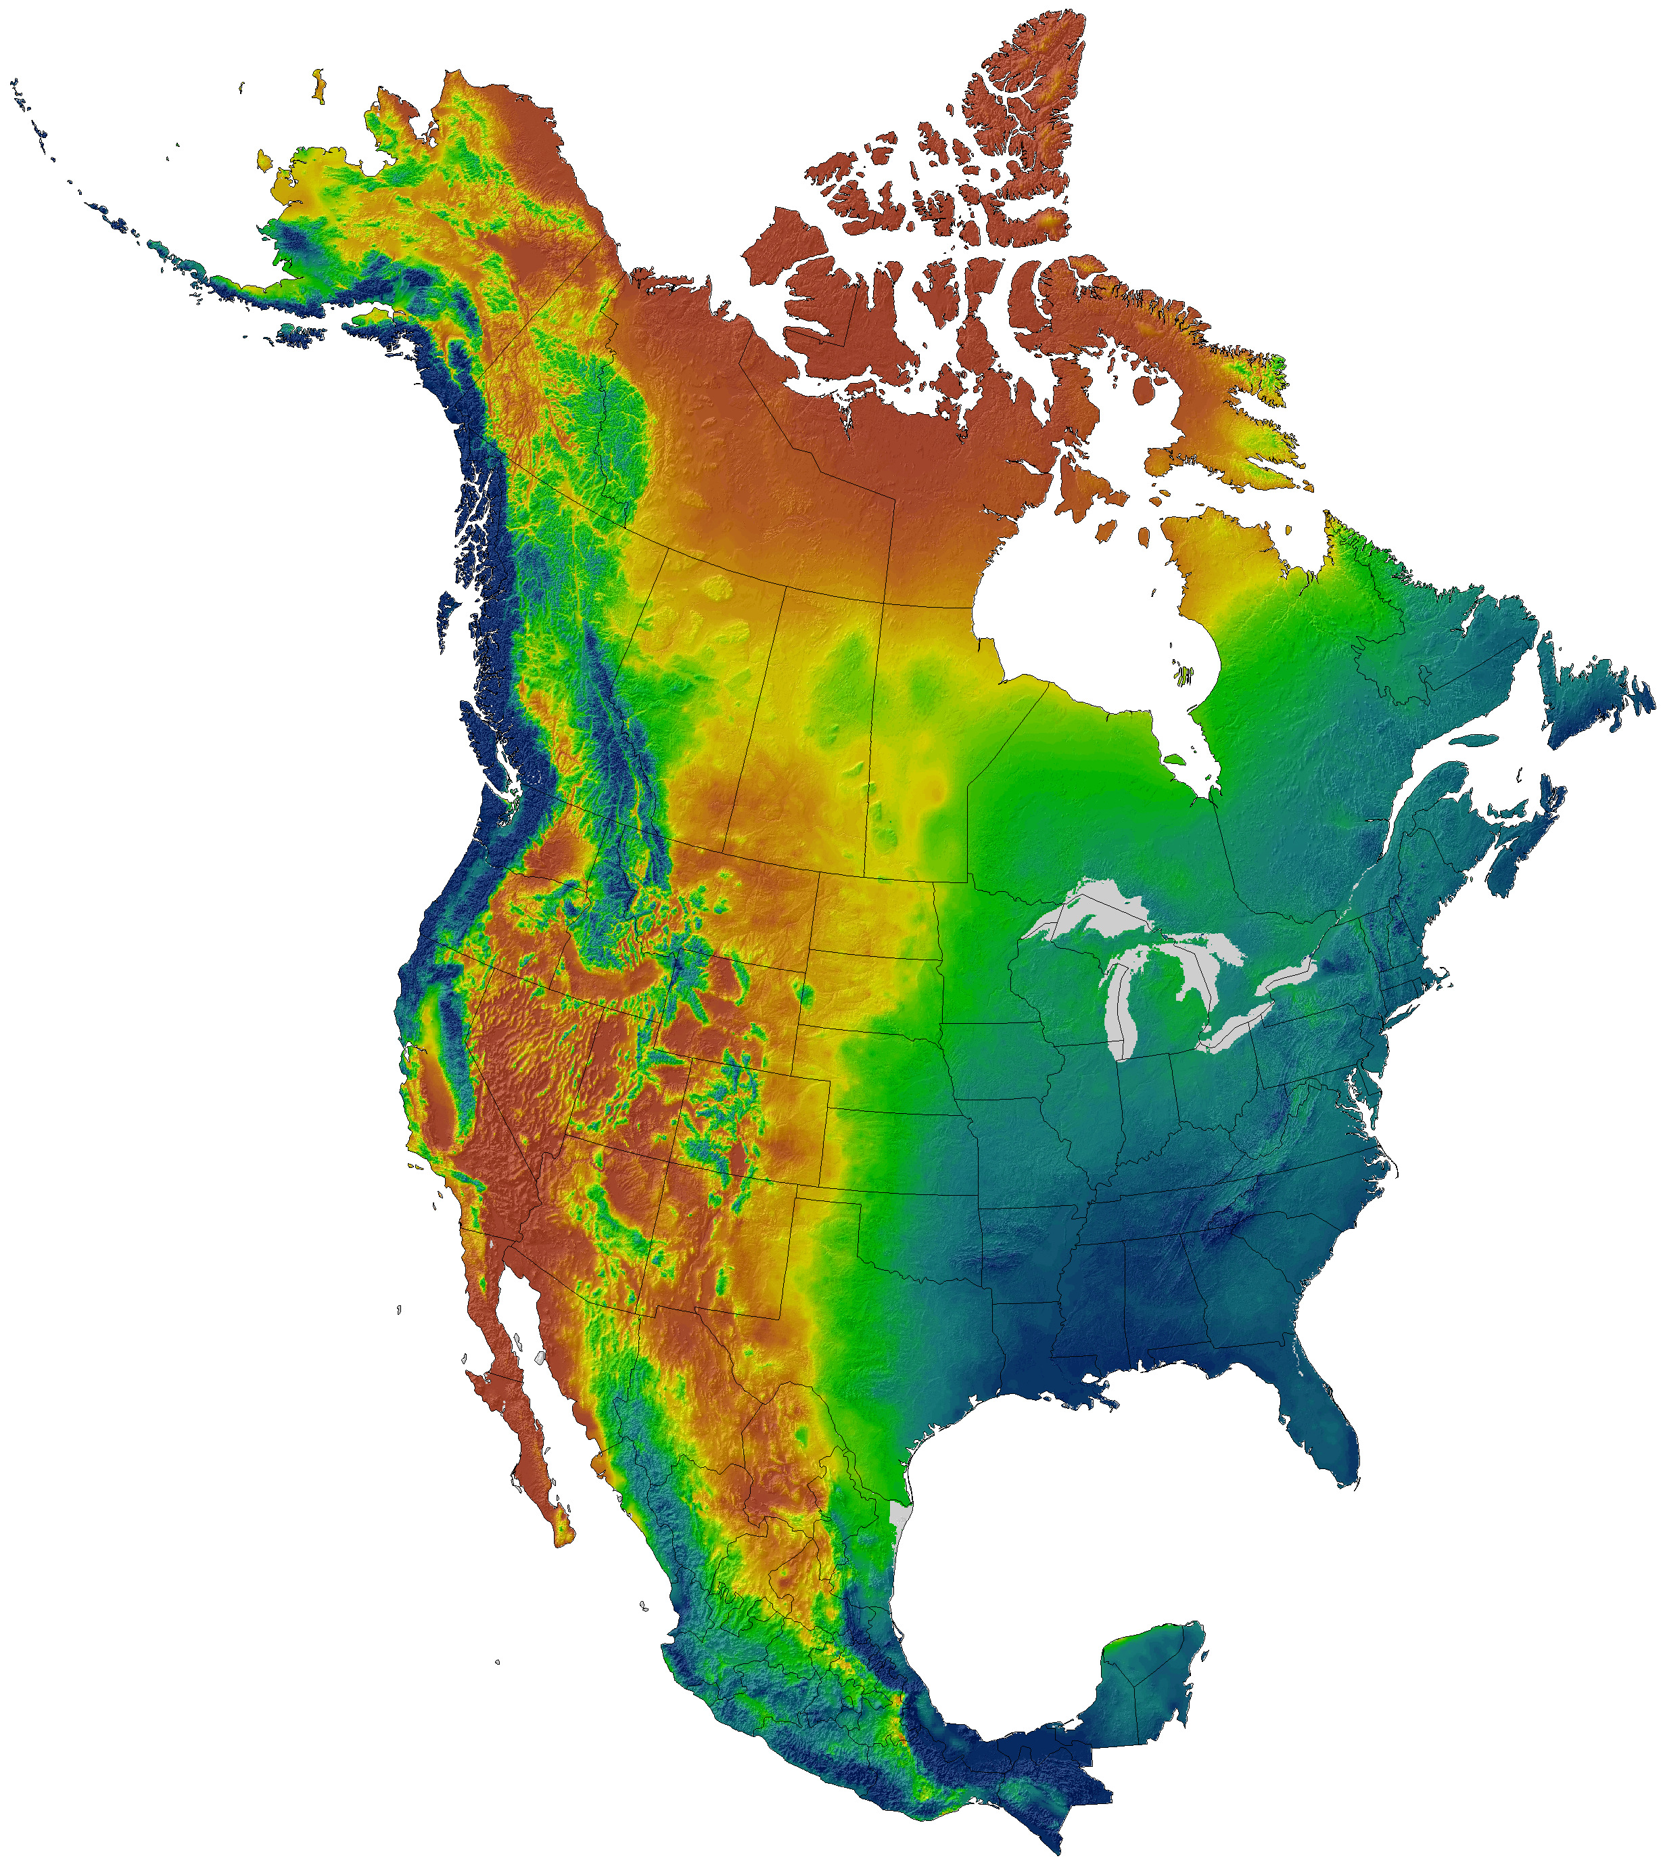
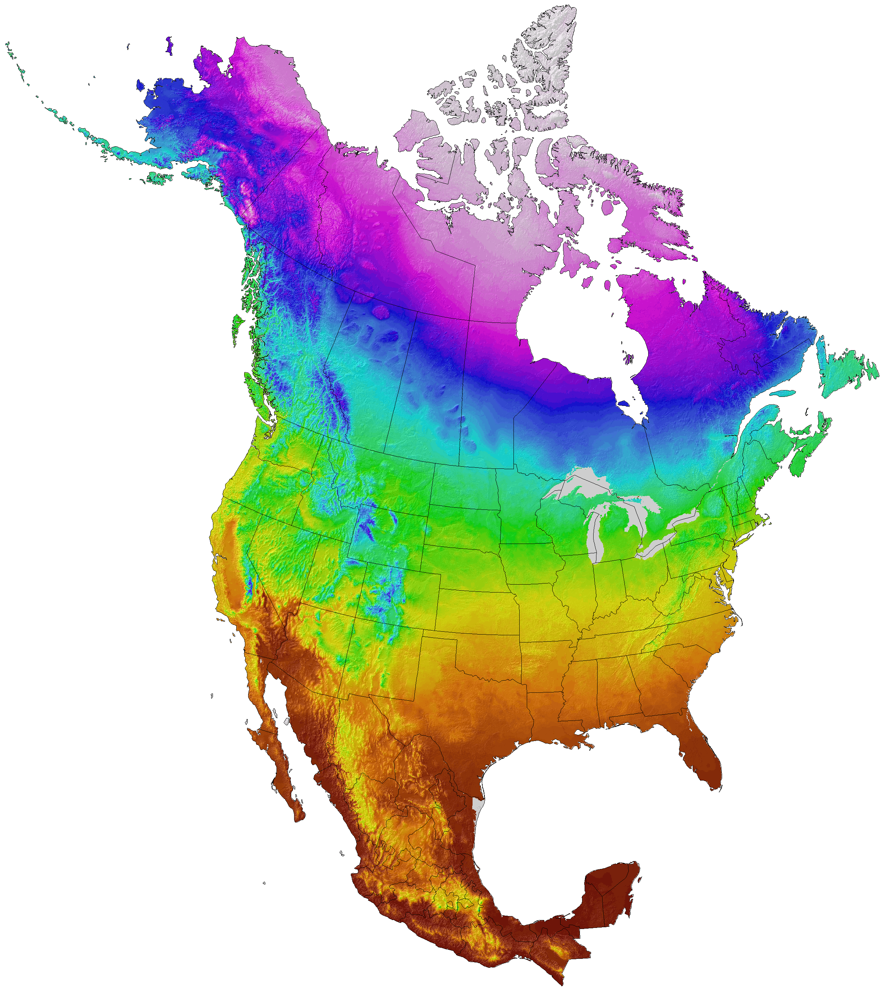
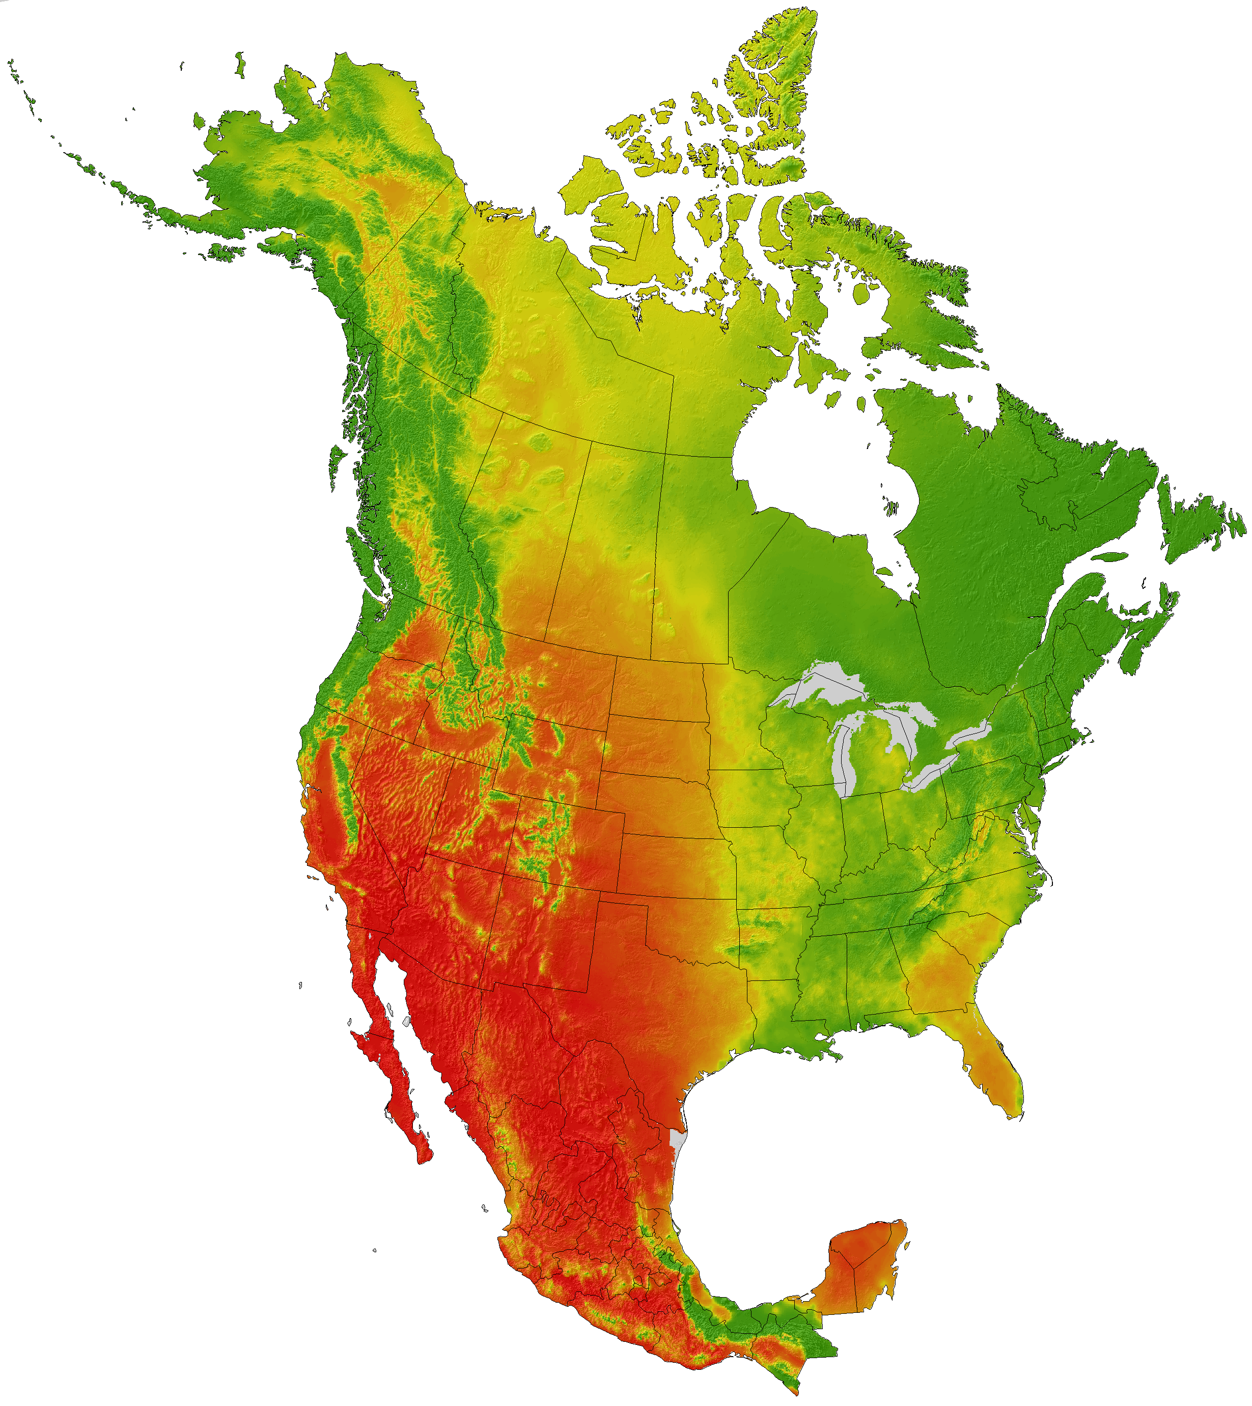
Climate Data
ClimateNA data covers 104 years (1901–2014) in monthly, annual, decadal and 30-year time steps. Our team utilized climate normals between 1981-2010.
ClimateNA data builds on PRISM and ANUSPLIN datasets through interpolation and elevation adjustments.
More than 50 variables are available such as Mean Annual Temperature (MAT), Mean Warmest Month Temperature (MWMT), Mean Annual Precipitation (MAP), Mean Annual Solar Radiation (MAR), and Extreme Minimum Temperature over 30 Years (EMT).
Notes:
Climate data was generated using ClimateNA software for both annual and seasonal climate normal for the study period. This software draws from 104 years of historical data and provides 30 year normal (average). The data is based on PRISM and ANUSPLIN for the historic data. It also provides the ability to project into the future using CMIP5 model emissions scenarios. From this data, we generated the predictor layers such as mean annual temperature, mean annual precipitation, number of frost-free days for both annual and seasonal periods during the study period at a 1km resolution

Slide 11
Habitat Suitability Modeling
Modeled using USGS Software for Assisted Habitat Modeling (SAHM) via VisTrails.
Modeling
approaches:
Random Forest (RF)
Boosted Regression Trees (BRT)
Maximum Entropy (MaxEnt)
Inputs:
Presence data
Environmental predictor variables (climate, topography, vegetation indices)
Notes:
What you see in this image is a snapshot of the SAHM Vistrails modeling workflow interface that allows for the user to run several models at once. In order to do so there are several inputs required, including presence points and environmental predictor layers, as well as a template layer for modeling scale and projections.
Because of the lack of true absence, we used randomized background pseudo absence points (10,000) option with in the SAHM MDS builder module.
The CoVariateCorrelationSelection tool was used to select the predictor layers with the most explanatory power and generate parsimonious models while removing highly correlated predictors. We utilized 3 modeling approaches and compared results between Boosted Regression Trees, Maximum Entropy (MaxEnt, and Random Forest (RF) models. SAHM produces prediction maps and a suite of statistical model evaluation metrics to assess the accuracy and strength of a given model.

Slide 12
Continental Scale Results: Reed Canarygrass
Random Forest
MaxEnt
Relative Probability of Reed Canarygrass Habitat
Very low
Low
Moderate
High
Eliminated due to extrapolation
AUC (Train/ CV):
0.962 / 0.961
% Correctly Classified (Train/CV): 89.3 / 93.4
AUC (Train/ CV):
0.94 / 0.929
% Correctly Classified (Train/CV): 85.9/ 85.4
1000
miles
Notes:
Random Forest and MaxEnt were the best performing models based on statistical model evaluation metrics, visual inspection, and considering feedback from project partners regarding the validity of model predictions. MaxEnt is most likely under-predicting suitable habitat for reed canarygrass, and in several of our model iterations, RandomForest predicted a higher range of values and may be somewhat overestimating. We primarily evaluated model performance based on the AUC value and the AUC difference between the training and and cross validation data.

Slide 13
Continental Scale Results: Reed Canarygrass
Random Forest
MaxEnt
Relative Probability of Reed Canarygrass Habitat
Very low
AUC (Train/ CV):
0.962 / 0.961
% Correctly Classified (Train/CV): 89.3 / 93.4
Low
AUC (Train/ CV):
0.94 / 0.929
% Correctly Classified (Train/CV): 85.9/ 85.4
Moderate
High
Eliminated due to extrapolation
500
miles
Notes:
The continental scale projections in Alaska highlight coast along the south, with almost no risk of suitable habitat in the interior.

Slide 14
Continental Scale Predictors: Reed Canarygrass
Random Forest
MaxEnt
Elevation
Average Winter Temperature
Solar Radiation
Terra MODIS Band 7
GLC Forest Cover
Mean Summer Precipitation
Average Temperature of Summer
Tasseled Cap Greenness
Terra MODIS Band 3
Tasseled Cap Wetness
Elevation
Average Winter Temperature
Terra MODIS Band 7
Average Summer Temperature
Solar Radiation
Mean Summer Precipitation
Tasseled Cap Greenness
GLC Forest Cover
Tasseled Cap Wetness
Terra MODIS Band 3
Notes:
In both models, elevation and average winter temperatures were the top two predictors.

Slide 15
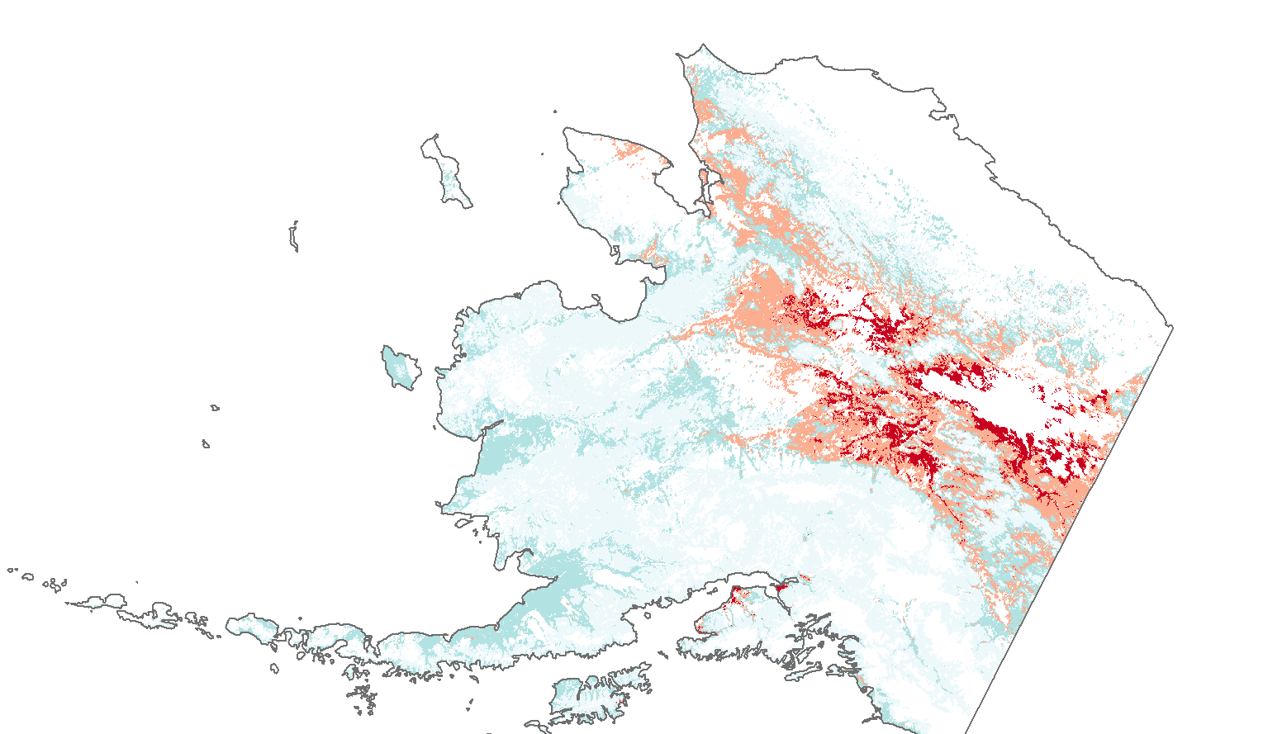
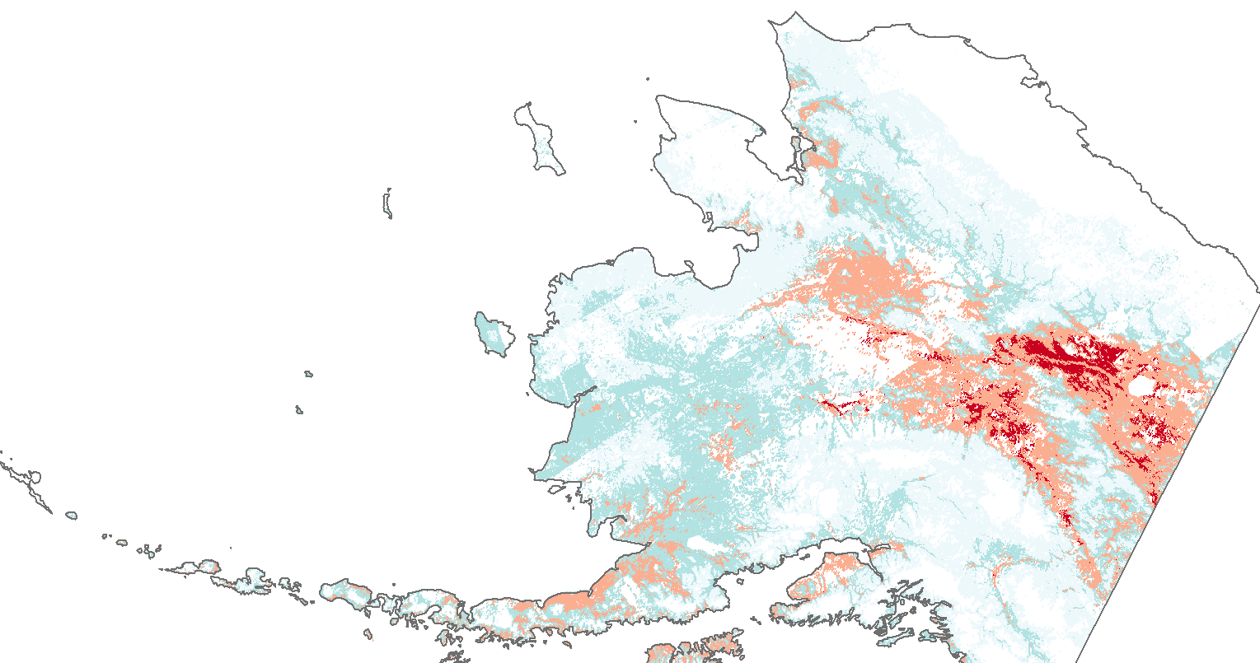
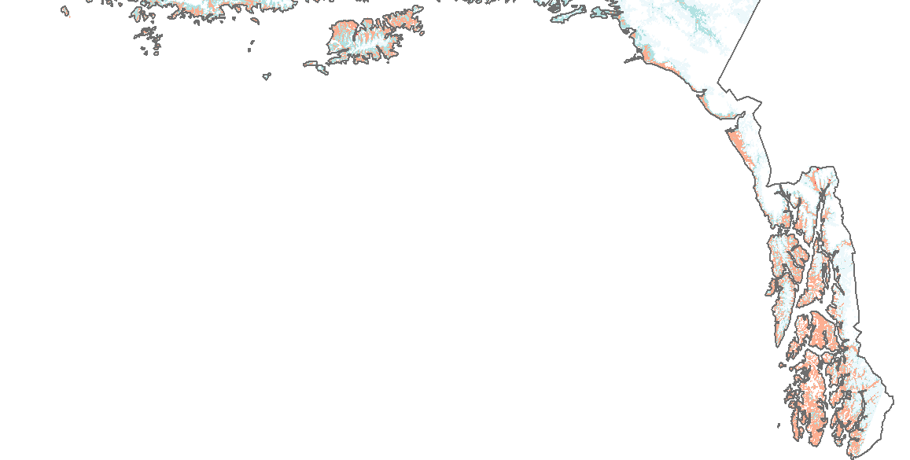
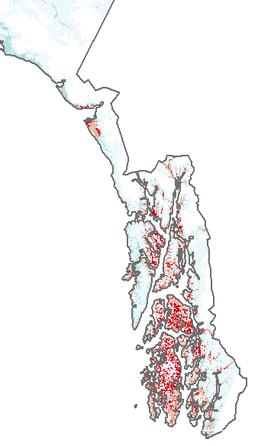
Alaska Scale Results: Reed Canarygrass
Random Forest
MaxEnt
Relative Probability of Reed Canarygrass Habitat
Very low
Low
Moderate
High
Eliminated due to extrapolation
AUC (Train/ CV):
0.941 / 0.941
% Correctly Classified (Train/CV): 87.9 / 88.7
AUC (Train / CV):
0.924 / 0.914
% Correctly Classified (Train/CV): 85.3/ 84.6
500
miles
Notes:
The continental projections contrast with the Alaska scale in that the coast is not predicted so extensively as suitable habitat, while the interior has a large area of high probability. This highlights the uniqueness of the Alaskan environment and the range of values in the covariates on the continental scale versus the Alaska scale. It is also a product of different predictors used based on the covariate correlation and deviance explained at the Alaska scale.

Slide 16
Alaska Scale Predictors: Reed Canarygrass
Random Forest
MaxEnt
Degree Days Above 5 in Spring
Aqua MODIS NDWI
Elevation
Mean Summer Precipitation
Precipitation as Snow in Winter
GLC Forest Cover
Terra MODIS Band 7
Solar Radiation
Terra MODIS Band 5
Slope
Aqua MODIS NDWI
Elevation
Degree Days Above 5 in Spring
Terra MODIS Band 7
Precipitation as Snow in Winter
Mean Summer Precipitation
Solar Radiation
GLC Forest Cover
Terra MODIS Band 5
Slope
Notes:
The strongest models for both random forests and maxent at the Alaska scale had degree days above 5 in spring, Aqua MODIS NDWI, and elevation as the strongest three predictors. This is in contrast to the continental scale that highlighted average temperature of winter as the strongest climatic variable.

Slide 17
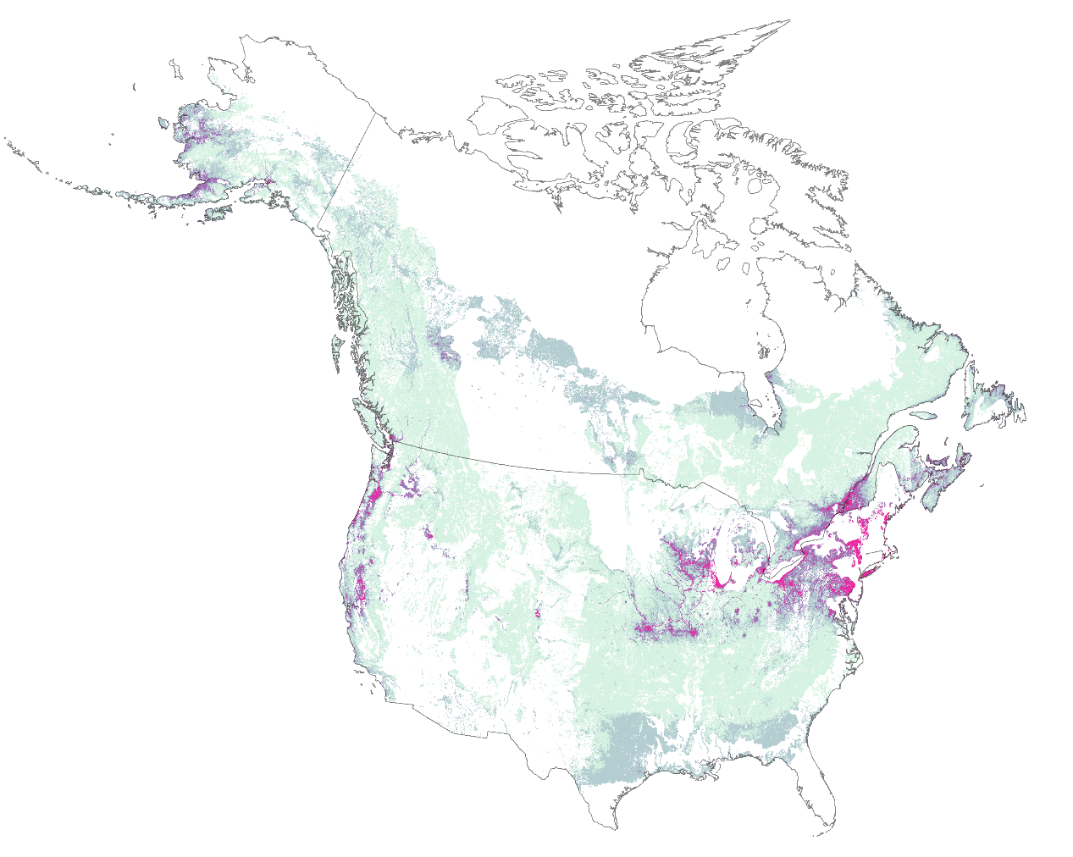
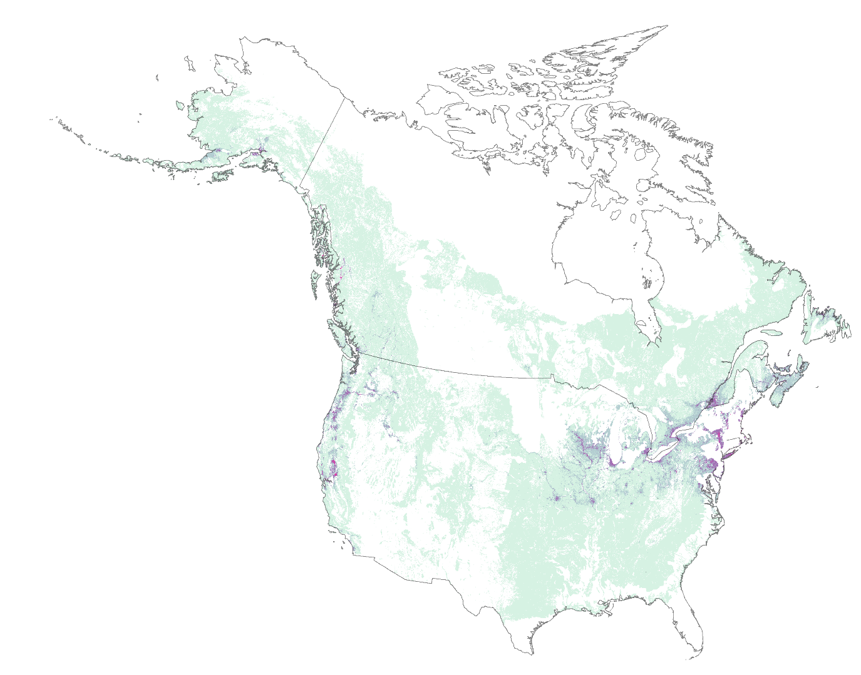
Continental Scale Results:
Purple Loosestrife
Random Forest
MaxEnt
Relative Probability of Purple Loosestrife Habitat
Very low
Low
Moderate
High
Eliminated due to extrapolation
AUC (Train/ CV):
0.950 / 0.941
% Correctly Classified (Train/CV): 88.4 / 93.0
AUC (Train / CV): 0.941 / 0.927
% Correctly Classified (Train/CV): 87.1 / 86.7
1000
miles
Notes:
These results show the habitat suitability of purple loosestrife. Maxent is, similar to reed canarygrass models, strongly underpredicting. The west coast of Alaska has a higher probability of suitable habitat for purple loosestrife as compared to the south coast in the reed canarygrass model.

Slide 18
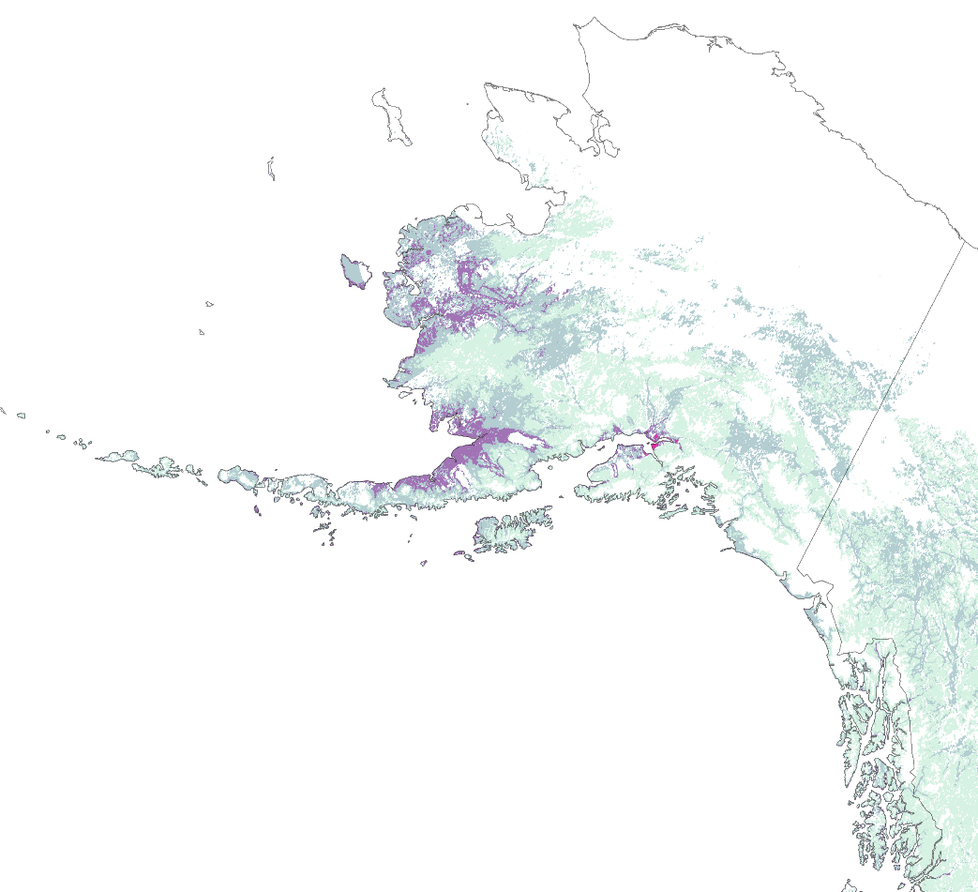
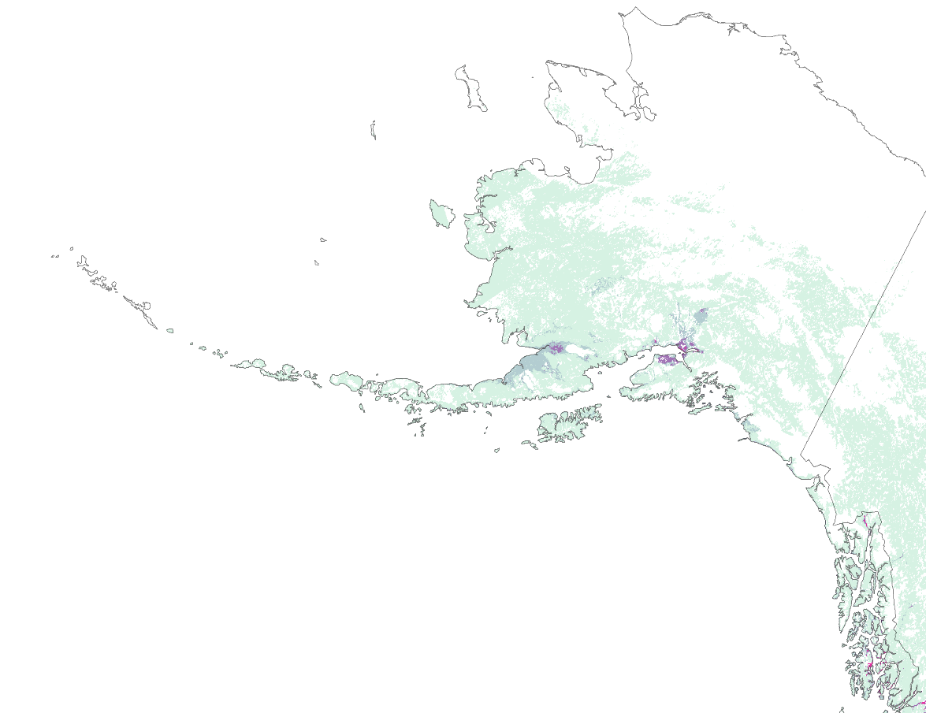
Continental Scale Results: Purple Loosestrife
Random Forest
MaxEnt
Relative Probability of Purple Loosestrife Habitat
Very low
Low
Moderate
High
Eliminated due to extrapolation
AUC (Train/ CV):
0.950 / 0.941
% Correctly Classified (Train/CV): 88.4 / 93.0
AUC (Train / CV):
0.941 / 0.927
% Correctly Classified (Train/CV): 87.1 / 86.7
500
miles
Notes:
Much more of the north is eliminated in the purple loosestrife Alaska projection than the reed canarygrass model. This zoomed in perspective highlighted the random forest west coast prediction, which matches partner feedback about reasonable areas of risk based on local knowledge. However, its interesting to note that the presence points in Alaska for this model only come from the southeast coast.

Slide 19
Continental Scale Predictors: Purple Loosestrife
Random Forest
MaxEnt
Elevation
Terra MODIS Band 6
Average Summer Temperature
Solar Radiation
GLC Forest Cover
Average Winter Temperature
Mean Summer Precipitation
Tasseled Cap Greenness
Terra MODIS Band 3
Roughness
Tasseled Cap Wetness
Elevation
Terra MODIS Band 6
Average Summer Temperature
Solar Radiation
Average Winter Temperature
Tasseled Cap Greenness
Tasseled Cap Wetness
Mean Summer Precipitation
Terra MODIS Band 3
GLC Forest Cover
Roughness
Notes:
For the random forests and maxent model, the top four predictors were the same: elevation, Terra MODIS band 6 surface reflectance, average summer temperature, and solar radiation.

Slide 20
Eurasian Watermilfoil and Hydrilla Results
Relative Probability of Eurasian Watermilfoil Habitat
Relative Probability of Hydrilla Habitat
Very low
Very low
Low
Low
Moderate
Moderate
High
Eliminated due to extrapolation
High
Eliminated due to extrapolation
Image Credit: US Fish and Wildlife Service
Notes:
Our models highlighted coastlines and waterways in Alaska as high relative probability of suitable habitat for both species. Across the model methods, random forest was the strongest model based on performance metrics, however, without the MESS map overlays, it consistently seemed to over-predict. MaxEnt is characteristically conservative in it’s predictions with these types of models– especially given the amount of novel environments in our models, this method seemed to be limited by the lack of coverage of environments by the presence point distribution.
Our efforts also underscore how critical it will be in the future to develop datasets that are more ecologically meaningful as predictors at a finer scale, such as water turbidity, salinity, and disturbance to improve model performance.
Image Credit : https://digitalmedia.fws.gov/cdm/singleitem/collection/natdiglib/id/14634/rec/85

Slide 21
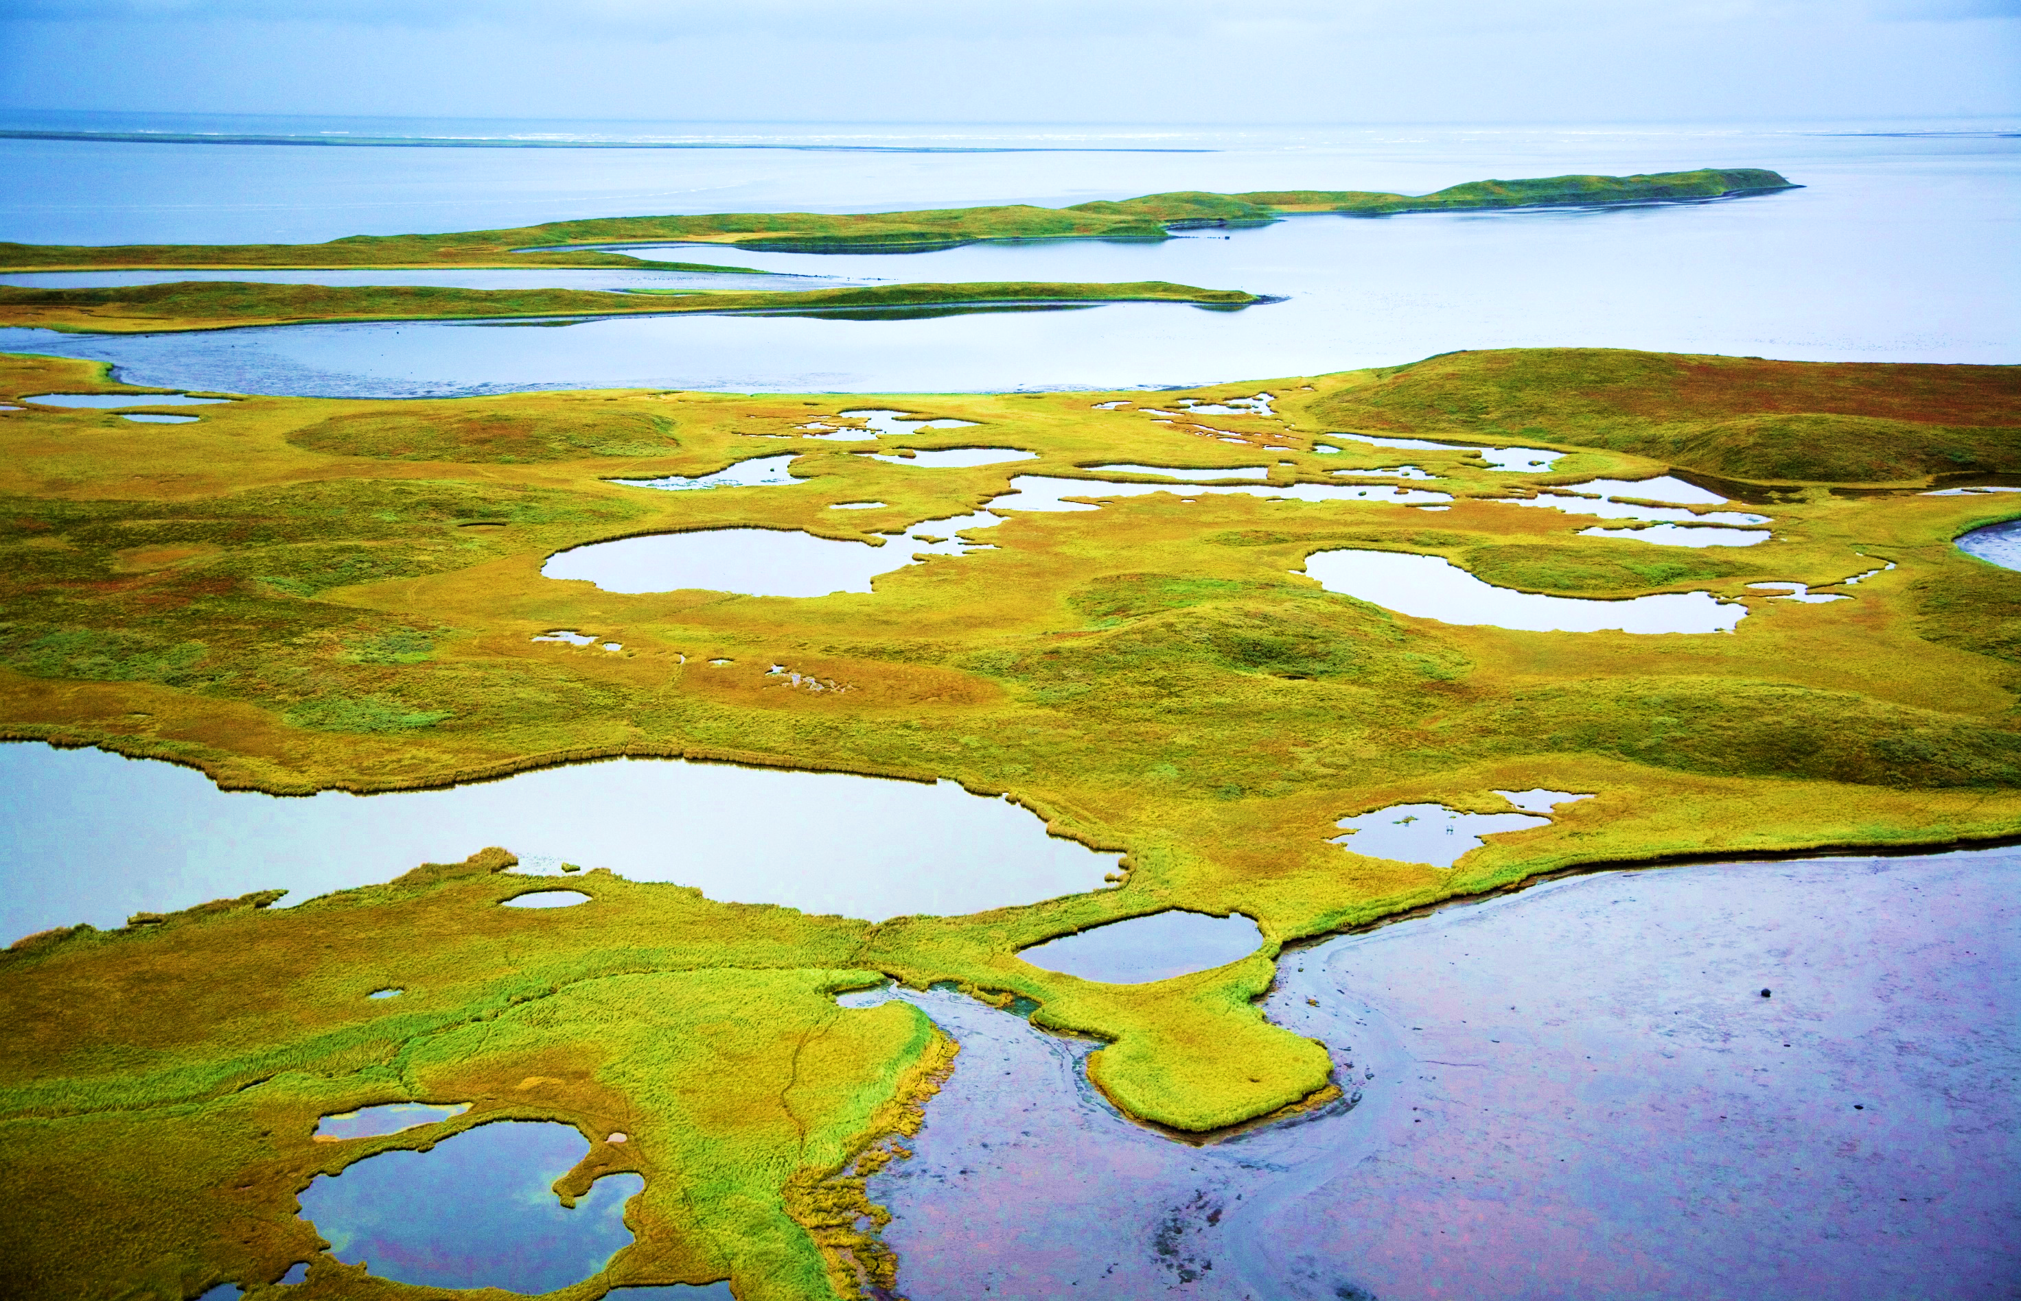
Limitations
Modeling generalist species
Extrapolating across space and time
Sampling bias
Field surveys
Image Credit: US Fish and Wildlife Service
Notes:
These results are limited by the sampling bias and point distribution. When distance to human infrastructure was included as a predictor to both represent disturbance and a vector of dispersal, this covariate had a disproportionate influence on the model outputs. This could be representative of collection bias that influences the point distribution. There were many environmental areas highlighted as novel in the MESS maps which demonstrate a need for data in these areas. There is also the issue, especially with the genetically diverse reed canarygrass, of hybridization. It is possible that some of the presence points represent reed canarygrass hybrids or variants with different environmental limits and thresholds.
Image Credit: https://digitalmedia.fws.gov/cdm/singleitem/collection/natdiglib/id/13576/rec/69

Slide 22
Conclusions
Areas of high suitability
Best model output
Methods to improve future models
Modeling efforts to underscore Alaskan novel environments
Image Credit: US Fish and Wildlife Service
Notes:
Our models highlighted coastlines and waterways in Alaska as high relative probability of suitable habitat for both species. Across the model methods, random forest was the strongest model based on performance metrics, however, without the MESS map overlays, it consistently seemed to over-predict. MaxEnt is characteristically conservative in it’s predictions with these types of models– especially given the amount of novel environments in our models, this method seemed to be limited by the lack of coverage of environments by the presence point distribution.
Our efforts also underscore how critical it will be in the future to develop datasets that are more ecologically meaningful as predictors at a finer scale, such as water turbidity, salinity, and disturbance to improve model performance.
Image Credit : https://digitalmedia.fws.gov/cdm/singleitem/collection/natdiglib/id/14634/rec/85

Slide 23
Acknowledgements
Dr. Paul Evangelista
(Colorado State University Natural Resource Ecology Laboratory) (Science Advisor)
Dr. Amanda West
(Colorado State University Natural Resource Ecology Laboratory)
(Mentor)
Brian Woodward
(Colorado State University Natural Resource Ecology Laboratory)
(Center Lead)
Dr. Catherine Jarnevich
(United States Geological Survey Fort Collins Science Center)
Aaron Martin
(US Fish and Wildlife Service, Alaska Region)
Image Credit: US Fish and Wildlife Service
Notes:
Dr. Paul Evangelista (Colorado State University Natural Resource Ecology Laboratory) (Science Advisor)
Dr. Amanda West (Colorado State University Natural Resource Ecology Laboratory) (Mentor)
Brian Woodward (Colorado State University Natural Resource Ecology Laboratory) (Center Lead)
Dr. Catherine Jarnevich (United States Geological Survey Fort Collins Science Center)
Aaron Martin (US Fish and Wildlife Service, Alaska Region)

