Slide 1
Lake Victoria Water Resources II
Downloading Sentinel-2 Tutorial
Jeanné le Roux (Project Lead)
Dwight Tigner
Daryl Ann Winstead
Christina Fischer
Sara Amirazodi

Slide 2
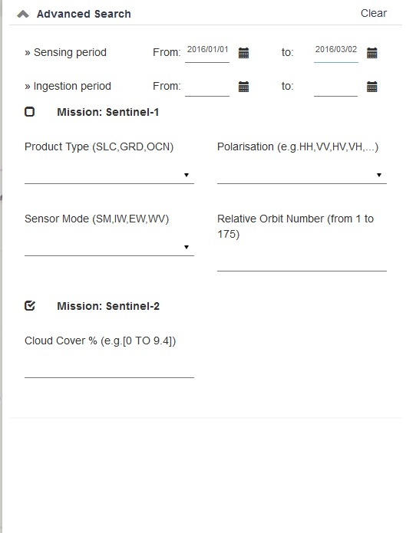
Go to ESA’s Scientific Data Hub: https://scihub.copernicus.eu/dhus/#/home
Zoom to area of interest
Draw Region of Interest
Search for Data Product

Slide 3
4. Select Data Product

Slide 4
5. Download Data Product

Slide 5
6. Unzip file

Slide 6
7. Band information will be found:
Directory>Unzipped File>GRANULE>_T36MXE_>IMG_DATA

Slide 7
Running SAVDT

Slide 8
Create Folder for Toolbox Outputs, this will be your User Workspace (Tip: Keep part of the original file name to track dates easily.)

Slide 9
2. Add SAVDT toolbox in ArcMap

Slide 10
3. Select Sentinel2 from Dropbox and add inputs
User Workspace: Output location
Sentinel Filename: User chosen name for file
Green Band: Band 3 JPG2000 File
SWIR Band: Band 11 JPG2000 File
Study Area: Shapefile of study area

Slide 11
4. Click “OK”

Slide 12
5. Outputs will be located in designated workspace

Slide 13
6. Add Files to ArcMap

Slide 14
7. With the MNDWIclip file selected, go to “Select by Attribute”

Slide 15
8. Select “Gridcode” “=“ “1” (from Get Unique Values button)
9. Click “OK”

Slide 16
10. Create a Layer from the selected feature

Slide 17
11. Save as a Layer File

