Slide 1
Texas Water Resources
Utilizing NASA Earth Observations to Monitor Drought Severity in Texas for Wildfire Mitigation Support
Megan Buzanowicz (Project Lead)
Jeff Close
Zacary Richards
Laura Lykens

Slide 2
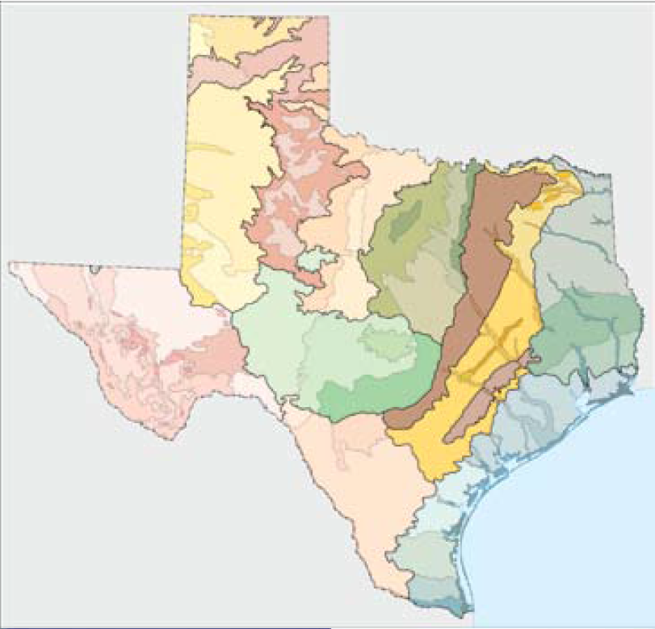

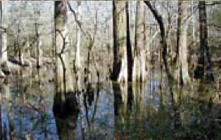
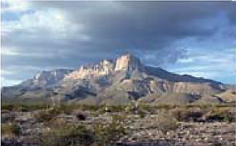
Study Area
The State of Texas
Encompasses 268,820 mi² in total sum
The factors contributing to drought will affect each of the 12 eco-regions of Texas differently
Credit: Environmental Protection Agency – Western Ecology Division
Notes:
Encompasses 268,820 mi² in total sum.
From the Chihuahuan Deserts in the west, to the Gulf Coastal Plains and Cross Timbers in the east, the factors contributing to drought will affect each of these regions differently.
Figure 2
Source: Environmental Protection Agency – Western Ecology Division
The 12 Eco-Regions of Texas have unique susceptibilities to drought conditions. Their differentiating environments should be taken into consideration when undertaking a study of this kind.
ftp://ftp.epa.gov/wed/ecoregions/tx/TXeco_Jan08_v8_Cmprsd.pdf

Slide 3
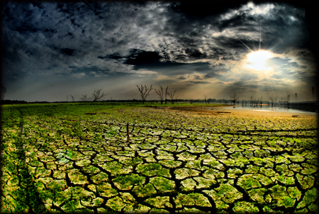
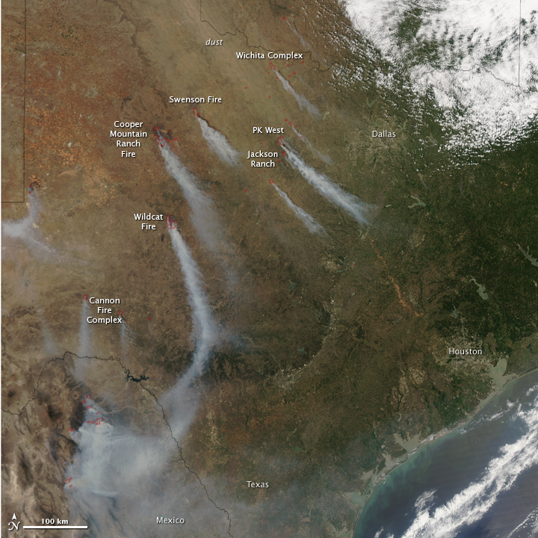

Study Period
Summer 2010 - Summer 2011
This period was selected because of the extreme drought conditions that brought about widespread wildfires.
Summer 2014 – Summer 2015
The latter years were included in this study as they offer the most current timeline.
Credit: Taken by Terry Shuck at Lake Ray Hubbard on September 01, 2006
Credit: NASA Earth Observatory Image was captured by Aqua MODIS on April 15, 2011
Notes:
This period was selected because of the extreme drought conditions that began in the state in 2010, and brought about widespread wildfires to various regions the following year as the vegetation became stressed and the fuel load increased dramatically.
The latter years were included in this study as they offer the most current timeline available for research.
Figure 3
Joe Wolf, Bastrop TX
Sept 05, 2011
https://www.flickr.com/photos/joebehr/6125109170/in/photostream/
Figure 4
Source: NASA Earth Observatory
Image was captured by Aqua MODIS on April 15, 2011.
http://earthobservatory.nasa.gov/IOTD/view.php?id=50168

Slide 4
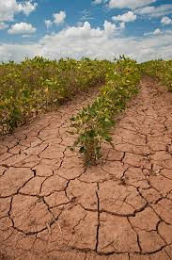

Community Concerns
Risk
Monitoring
Decision Making
Credit: United States Department of Agriculture
Soybean field in Navasota, TX
August 23, 2013
Notes:
Wildfires pose a constant risk for many regions across the state
The ability to accurately monitor drought conditions
Allow decision makers at TFS to better allocate water resources to mitigate the spread of wildfires
Figure 5:
https://pixabay.com/en/droplet-drop-fluid-liquid-water-161679/
Figure 6:
United States Department of Agriculture
Soybean field in Navasota, TX
August 23, 2013
https://www.flickr.com/photos/usdagov/9679053771
Pixabay 2013 https://pixabay.com/en/droplet-drop-fluid-liquid-water-161679/

Slide 5
Objectives
Expand
End Product
Design
Correlate
Notes:
Expand upon the Scaled Drought Condition Index (SDCI) created by Rhee et. al. (2010) by including a soil moisture component
Design a template for the Texas Forest Service to utilize in order to identify locations within the state most prone to wildfire disasters
Correlate the Drought Severity Index with the measurements of live fuel moisture content (FMC) obtained from the National Fuel Moisture Database in order to determine its accuracy.

Slide 6
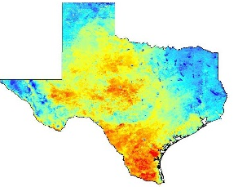
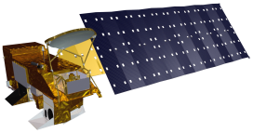
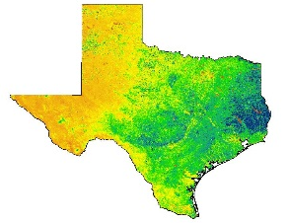

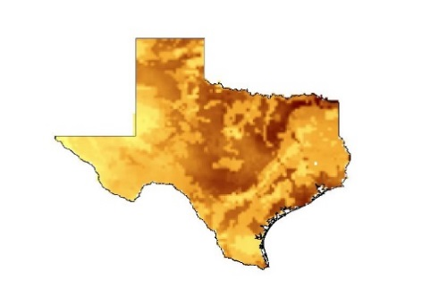
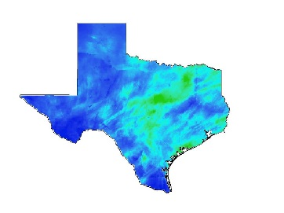

Methodology Flowchart
Data Processing
Data Acquisition
Aqua MODIS
Land Surface Temperature (LST)
Terra MODIS
Normalized Difference Vegetation Index (NDVI)
North American Land Data Assimilation System (NLDAS)
Noah-2.8 Model
Soil Moisture
Multi-sensor Precipitation Estimator (MPE)
Daily Observed Precipitation
Notes:
A sixteen-day Aqua MODIS Land Surface Temperature (LST) MYD11A2 with incorporated Terra MODIS Normalized Difference Vegetation Index (NDVI) MOD13Q1 was extracted from NASA’s Earth Observing System Data and Information System (EOSDIS) for the study period by a separate python script shared by the Texas Disasters Summer 2015 team at the John C. Stennis Space Center (SSC). MODIS was given preference by the team as it is capable of operating with 36 spectral bands that capture 250, 500 and 1000 meter resolutions. This is the highest number of spectral bands of any global coverage moderate resolution imager (Justice et al., 2002). With Terra descending by late morning and Aqua ascending in the early afternoon, the latter was selected to provide LST readings due to the greater impact of higher temperatures later in the day on vegetation and soil moisture.
To conduct soil moisture calculations, the Texas Water Resources team relied on the North American Land Data Assimilation System (NLDAS-2) as a model for securing soil moisture values. NLDAS-2 was chosen because of its frequent use by the Climate Prediction Center (CPC) for their seasonal drought outlooks and monthly briefings. Moreover, several authors of the US Drought Monitor (USDM) have referenced the NLDAS-2 soil moisture and total runoff percentiles in past analyses. The NLDAS-2 may incorporate one of four different land surface models (LSMs), whose purpose is to accurately reproduce observed water and energy fluxes (Xia, 2012). All four of these models include direct evaporation from bare soil, transpiration from vegetation, evaporation of interception, and snow sublimation. However, the processing of the models vary in vegetation phenology, canopy resistance parameters, and their root profiles. For the intentions of this project, the Noah 2.8 model was chosen as it offers four layers and the most layers of the four models, with a spatial thickness of 10cm in forested and non-forested regions that encompasses the root zone. Therefore, NLDAS-2 NOAH0125 Version 2 monthly archived files for the study period were downloaded from The Goddard Earth Sciences Data Information Services Center.
Multisensor Precipitation Estimator (MPE) data were collected from the National Oceanic and Atmospheric Administration (NOAA) National Weather Service (NWS) Advanced Hydrologic Prediction Service (AHPS). The MPE is an interactive software tool within the Advanced Weather Interactive Processing System that integrates rain gauge and satellite rainfall estimates with radar-only estimates and creates high-resolution gridded rainfall products at 4km² (Fulton, 2005).
The precipitation data was downloaded as point shapefiles and were converted to rasters through the “Point to Raster” tool in Arcmap and mosaicked to a full raster of Texas in ArcGIS using a code constructed in Model Builder. The eight-day Aqua MODIS Land Surface Temperature data (LST) MYD11A2 and 16-day Terra MODIS Normalized Difference Vegetation Index (NDVI) MOD13Q1were downloaded as multiple swath tiles for each day. Those tiles were mosaicked to form one raster with the Model Builder function in ArcMap and then followed by sub-setting the raster to our study area.
ArcGIS Model Builder and Raster Calculator were used to calculate a 30 day and 60 day sum for the precipitation datasets. Those summed outputs were compiled and normalized to adhere to the scales of both the MODIS NDVI data and Land Surface Temperature data. To obtain their correct values, MODIS MOD13Q1 NDVI data was multiplied by a factor of 0.0001 to obtain scaled NDVI values and MODIS MYD11A2 LST was multiplied by a factor of 0.02. Once the necessary variables were normalized, they were organized to adhere to the DSI equation.

Slide 7
Methodology Flowchart
Data Processing
Data Acquisition
Aqua MODIS
Land Surface Temperature (LST)
Terra MODIS
Normalized Difference Vegetation Index (NDVI)
North American Land Data Assimilation System (NLDAS)
Noah-2.8 Model
Soil Moisture
Multi-sensor Precipitation Estimator (MPE)
Daily Observed Precipitation
Notes:
A sixteen-day Aqua MODIS Land Surface Temperature (LST) MYD11A2 with incorporated Terra MODIS Normalized Difference Vegetation Index (NDVI) MOD13Q1 was extracted from NASA’s Earth Observing System Data and Information System (EOSDIS) for the study period by a separate python script shared by the Texas Disasters Summer 2015 team at the John C. Stennis Space Center (SSC). MODIS was given preference by the team as it is capable of operating with 36 spectral bands that capture 250, 500 and 1000 meter resolutions. This is the highest number of spectral bands of any global coverage moderate resolution imager (Justice et al., 2002). With Terra descending by late morning and Aqua ascending in the early afternoon, the latter was selected to provide LST readings due to the greater impact of higher temperatures later in the day on vegetation and soil moisture.
To conduct soil moisture calculations, the Texas Water Resources team relied on the North American Land Data Assimilation System (NLDAS-2) as a model for securing soil moisture values. NLDAS-2 was chosen because of its frequent use by the Climate Prediction Center (CPC) for their seasonal drought outlooks and monthly briefings. Moreover, several authors of the US Drought Monitor (USDM) have referenced the NLDAS-2 soil moisture and total runoff percentiles in past analyses. The NLDAS-2 may incorporate one of four different land surface models (LSMs), whose purpose is to accurately reproduce observed water and energy fluxes (Xia, 2012). All four of these models include direct evaporation from bare soil, transpiration from vegetation, evaporation of interception, and snow sublimation. However, the processing of the models vary in vegetation phenology, canopy resistance parameters, and their root profiles. For the intentions of this project, the Noah 2.8 model was chosen as it offers four layers and the most layers of the four models, with a spatial thickness of 10cm in forested and non-forested regions that encompasses the root zone. Therefore, NLDAS-2 NOAH0125 Version 2 monthly archived files for the study period were downloaded from The Goddard Earth Sciences Data Information Services Center.
Multisensor Precipitation Estimator (MPE) data were collected from the National Oceanic and Atmospheric Administration (NOAA) National Weather Service (NWS) Advanced Hydrologic Prediction Service (AHPS). The MPE is an interactive software tool within the Advanced Weather Interactive Processing System that integrates rain gauge and satellite rainfall estimates with radar-only estimates and creates high-resolution gridded rainfall products at 4km² (Fulton, 2005).
The precipitation data was downloaded as point shapefiles and were converted to rasters through the “Point to Raster” tool in Arcmap and mosaicked to a full raster of Texas in ArcGIS using a code constructed in Model Builder. The eight-day Aqua MODIS Land Surface Temperature data (LST) MYD11A2 and 16-day Terra MODIS Normalized Difference Vegetation Index (NDVI) MOD13Q1were downloaded as multiple swath tiles for each day. Those tiles were mosaicked to form one raster with the Model Builder function in ArcMap and then followed by sub-setting the raster to our study area.
ArcGIS Model Builder and Raster Calculator were used to calculate a 30 day and 60 day sum for the precipitation datasets. Those summed outputs were compiled and normalized to adhere to the scales of both the MODIS NDVI data and Land Surface Temperature data. To obtain their correct values, MODIS MOD13Q1 NDVI data was multiplied by a factor of 0.0001 to obtain scaled NDVI values and MODIS MYD11A2 LST was multiplied by a factor of 0.02. Once the necessary variables were normalized, they were organized to adhere to the DSI equation.

Slide 8
Methodology Flowchart
Data Processing
Data Analysis
ArcMap
10.3
(LST_{max} – LST)
(LST_{max} – LST_{min})
Python
2.7
(NDVI - NDVI_{min})
(NDVI_{max} – NDVI_{min})
Modified
Drought
Severity Index
scaled LST
+
scaled NDVI
+
scaled MPE
+
scaled NLDAS
(NLDAS – NLDAS_{min})
(NLDAS_{max} – NLDAS_{min})
(MPE – MPE_{min})
(MPE_{max} - MPE_{min})
Notes:
A sixteen-day Aqua MODIS Land Surface Temperature (LST) MYD11A2 with incorporated Terra MODIS Normalized Difference Vegetation Index (NDVI) MOD13Q1 was extracted from NASA’s Earth Observing System Data and Information System (EOSDIS) for the study period by a separate python script shared by the Texas Disasters Summer 2015 team at the John C. Stennis Space Center (SSC). MODIS was given preference by the team as it is capable of operating with 36 spectral bands that capture 250, 500 and 1000 meter resolutions. This is the highest number of spectral bands of any global coverage moderate resolution imager (Justice et al., 2002). With Terra descending by late morning and Aqua ascending in the early afternoon, the latter was selected to provide LST readings due to the greater impact of higher temperatures later in the day on vegetation and soil moisture.
To conduct soil moisture calculations, the Texas Water Resources team relied on the North American Land Data Assimilation System (NLDAS-2) as a model for securing soil moisture values. NLDAS-2 was chosen because of its frequent use by the Climate Prediction Center (CPC) for their seasonal drought outlooks and monthly briefings. Moreover, several authors of the US Drought Monitor (USDM) have referenced the NLDAS-2 soil moisture and total runoff percentiles in past analyses. The NLDAS-2 may incorporate one of four different land surface models (LSMs), whose purpose is to accurately reproduce observed water and energy fluxes (Xia, 2012). All four of these models include direct evaporation from bare soil, transpiration from vegetation, evaporation of interception, and snow sublimation. However, the processing of the models vary in vegetation phenology, canopy resistance parameters, and their root profiles. For the intentions of this project, the Noah 2.8 model was chosen as it offers four layers and the most layers of the four models, with a spatial thickness of 10cm in forested and non-forested regions that encompasses the root zone. Therefore, NLDAS-2 NOAH0125 Version 2 monthly archived files for the study period were downloaded from The Goddard Earth Sciences Data Information Services Center.
Multisensor Precipitation Estimator (MPE) data were collected from the National Oceanic and Atmospheric Administration (NOAA) National Weather Service (NWS) Advanced Hydrologic Prediction Service (AHPS). The MPE is an interactive software tool within the Advanced Weather Interactive Processing System that integrates rain gauge and satellite rainfall estimates with radar-only estimates and creates high-resolution gridded rainfall products at 4km² (Fulton, 2005).
The precipitation data was downloaded as point shapefiles and were converted to rasters through the “Point to Raster” tool in Arcmap and mosaicked to a full raster of Texas in ArcGIS using a code constructed in Model Builder. The eight-day Aqua MODIS Land Surface Temperature data (LST) MYD11A2 and 16-day Terra MODIS Normalized Difference Vegetation Index (NDVI) MOD13Q1were downloaded as multiple swath tiles for each day. Those tiles were mosaicked to form one raster with the Model Builder function in ArcMap and then followed by sub-setting the raster to our study area.
ArcGIS Model Builder and Raster Calculator were used to calculate a 30 day and 60 day sum for the precipitation datasets. Those summed outputs were compiled and normalized to adhere to the scales of both the MODIS NDVI data and Land Surface Temperature data. To obtain their correct values, MODIS MOD13Q1 NDVI data was multiplied by a factor of 0.0001 to obtain scaled NDVI values and MODIS MYD11A2 LST was multiplied by a factor of 0.02. Once the necessary variables were normalized, they were organized to adhere to the DSI equation.

Slide 9
Methodology Formulas
Scaled Drought Condition Index
(1/4) scaled LST + (1/2) scaled TRMM + (1/4) scaled VI
Equations used for Scaling
LST: (LST_{max} – LST)/(LST_{max} – LST_{min})
MPE: (MPE – MPE_{min})/(MPE_{max} - MPE_{min})
NDVI: (NDVI - NDVI_{min})/(NDVI_{max} – NDVI_{min})
NLDAS-2: (NLDAS – NLDAS_{min})/(NLDAS_{max} – NLDAS_{min})
Modified Drought Severity Index
scaled NDVI + scaled LST + scaled MPE + scaled NLDAS
Notes:
The Scaled Drought Condition Index (SDCI) model provides the foundation for the DSI. This particular model was chosen due its optimal performance as a remote sensing-based drought index for both arid and humid regions in the study undertaken by Rhee et al. (2010). The applicability of the model to our project encompasses both the semi-arid regions of Western Texas as well as the humid climate in the East. The SDCI is calculated using equation 1. This equation was modified to reflect the alternate satellites used to acquire similar data, but at much greater efficiency. For instance, the Vegetation Index (VI) listed in the equation above was replaced with the Normalized Difference Vegetation Index (NDVI) because of its higher correlation coefficients within arid regions as determined by Rhee et al., 2010. Due to its higher spatial resolution, MPE data were given preference over the Tropical Rainforest Monthly Mission (TRMM). MODIS MOD09A1 surface reflectance data in the Raster Calculator tool was used to calculate NDVI.
ArcGIS Model Builder and Raster Calculator were used to calculate a 30 day and 60 day rolling sum for both the precipitation and LST datasets. The rolling sum outputs were then applied to the Land Surface Temperature/NDVI calculated raster images.
A python script written by the Summer 2013 Great Plains Agriculture DEVELOP term, for the purpose of assessing drought in the Great Plains region, was implemented in order to scale land surface temperature, precipitation, and vegetation. The three inputs were scaled through the execution of the formulas above.
In addition to the calculations performed by the Great Plains Study, soil moisture data was included in the DSI equation as well. Therefore, the formula was once again modified to incorporate a NDVI, LST and MPE data batch with the NLDAS-2 model, each with a rough estimate in given percentage weight in accordance with the level of significance in drought contribution and the accuracy of the data.
In order to maintain consistency in the data, each of the attribute tables were selected values ranging from zero to one.

Slide 10
Methodology Formulas
Scaled Drought Condition Index
(1/4) scaled LST + (1/2) scaled TRMM + (1/4) scaled VI
Equations used for Scaling
LST: (LST_{max} – LST)/(LST_{max} – LST_{min})
MPE: (MPE – MPE_{min})/(MPE_{max} - MPE_{min})
NDVI: (NDVI - NDVI_{min})/(NDVI_{max} – NDVI_{min})
NLDAS-2: (NLDAS – NLDAS_{min})/(NLDAS_{max} – NLDAS_{min})
Modified Drought Severity Index
scaled NDVI + scaled LST + scaled MPE + scaled NLDAS
Notes:
The Scaled Drought Condition Index (SDCI) model provides the foundation for the DSI. This particular model was chosen due its optimal performance as a remote sensing-based drought index for both arid and humid regions in the study undertaken by Rhee et al. (2010). The applicability of the model to our project encompasses both the semi-arid regions of Western Texas as well as the humid climate in the East. The SDCI is calculated using equation 1. This equation was modified to reflect the alternate satellites used to acquire similar data, but at much greater efficiency. For instance, the Vegetation Index (VI) listed in the equation above was replaced with the Normalized Difference Vegetation Index (NDVI) because of its higher correlation coefficients within arid regions as determined by Rhee et al., 2010. Due to its higher spatial resolution, MPE data were given preference over the Tropical Rainforest Monthly Mission (TRMM). MODIS MOD09A1 surface reflectance data in the Raster Calculator tool was used to calculate NDVI.
ArcGIS Model Builder and Raster Calculator were used to calculate a 30 day and 60 day rolling sum for both the precipitation and LST datasets. The rolling sum outputs were then applied to the Land Surface Temperature/NDVI calculated raster images.
A python script written by the Summer 2013 Great Plains Agriculture DEVELOP term, for the purpose of assessing drought in the Great Plains region, was implemented in order to scale land surface temperature, precipitation, and vegetation. The three inputs were scaled through the execution of the formulas above.
In addition to the calculations performed by the Great Plains Study, soil moisture data was included in the DSI equation as well. Therefore, the formula was once again modified to incorporate a NDVI, LST and MPE data batch with the NLDAS-2 model, each with a rough estimate in given percentage weight in accordance with the level of significance in drought contribution and the accuracy of the data.
In order to maintain consistency in the data, each of the attribute tables were selected values ranging from zero to one.

Slide 11
Methodology Formulas
Modified Drought Severity Index
scaled NDVI + scaled LST + scaled MPE + scaled NLDAS
Weight 1
30% NDVI + 10% LST + 30% MPE + 30% NLDAS
Weight 2
25% NDVI + 25% LST + 25% MPE + 25% NLDAS
Weight 3
30% NDVI + 10% LST + 20% MPE + 40% NLDAS
Notes:
The Scaled Drought Condition Index (SDCI) model provides the foundation for the DSI. This particular model was chosen due its optimal performance as a remote sensing-based drought index for both arid and humid regions in the study undertaken by Rhee et al. (2010). The applicability of the model to our project encompasses both the semi-arid regions of Western Texas as well as the humid climate in the East. The SDCI is calculated using equation 1. This equation was modified to reflect the alternate satellites used to acquire similar data, but at much greater efficiency. For instance, the Vegetation Index (VI) listed in the equation above was replaced with the Normalized Difference Vegetation Index (NDVI) because of its higher correlation coefficients within arid regions as determined by Rhee et al., 2010. Due to its higher spatial resolution, MPE data were given preference over the Tropical Rainforest Monthly Mission (TRMM). MODIS MOD09A1 surface reflectance data in the Raster Calculator tool was used to calculate NDVI.
ArcGIS Model Builder and Raster Calculator were used to calculate a 30 day and 60 day rolling sum for both the precipitation and LST datasets. The rolling sum outputs were then applied to the Land Surface Temperature/NDVI calculated raster images.
A python script written by the Summer 2013 Great Plains Agriculture DEVELOP term, for the purpose of assessing drought in the Great Plains region, was implemented in order to scale land surface temperature, precipitation, and vegetation. The three inputs were scaled through the execution of the formulas above.
In addition to the calculations performed by the Great Plains Study, soil moisture data was included in the DSI equation as well. Therefore, the formula was once again modified to incorporate a NDVI, LST and MPE data batch with the NLDAS-2 model, each with a rough estimate in given percentage weight in accordance with the level of significance in drought contribution and the accuracy of the data.
In order to maintain consistency in the data, each of the attribute tables were selected values ranging from zero to one.

Slide 12
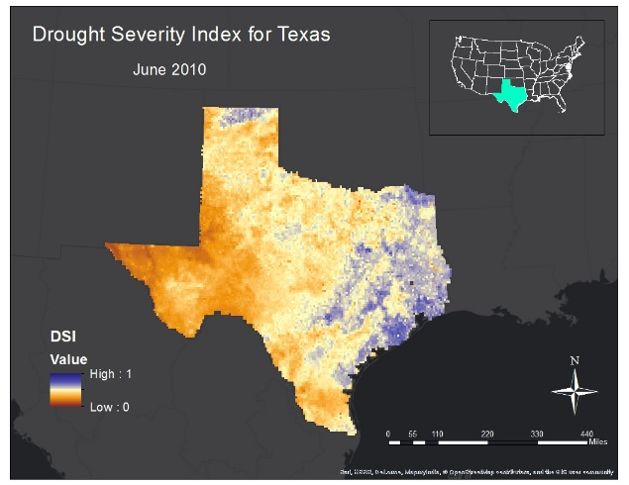
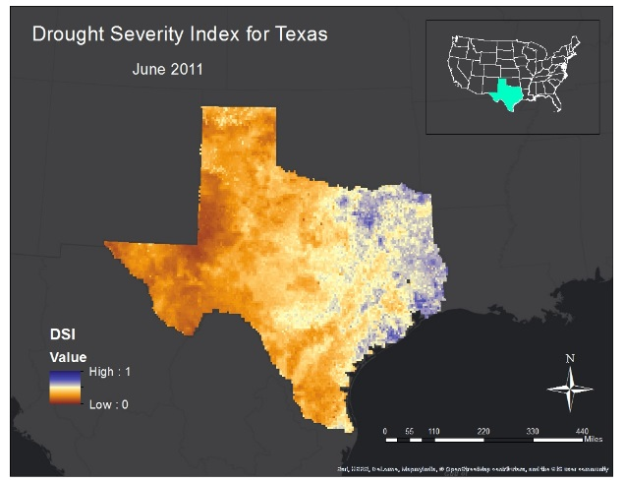
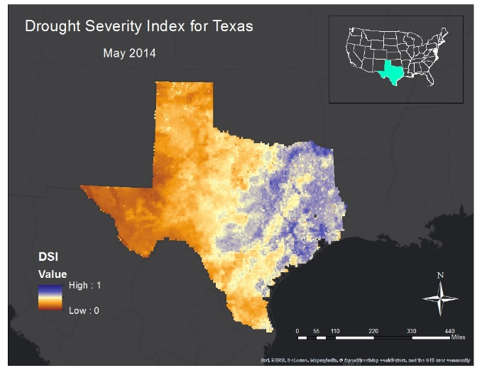
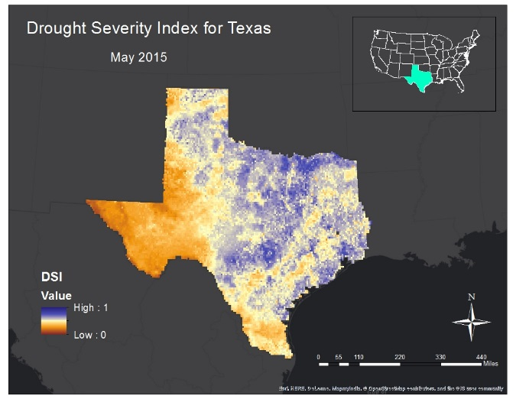
Results: Imagery
June 2010 – June 2011
May 2014 – May 2015
Weight 3 emphasis on soil moisture
Notes:
The summer months for each year in the study period reflect the change in the impact of drought conditions on various regions throughout the state (see Appendix). In the images above, the DSI reflects the increase in drought conditions within the state from June 2010 to June 2011. From May 2014 to May 2015 however, the western and northern regions were greatly alleviated of their dry spell after the rainstorms that occurred during May of 2015. In consideration of these results, it is clear that the DSI mirrors the environmental circumstances affecting Texas historically. The six classifications, ranging in numerical values from zero to one, identify areas low in value and dry, as well as areas high in value and wet. Blue areas reflect adequate to slightly lacking moisture levels while the pale yellow to brown colors indicate areas of concern and potential wildfire risk. This classification scheme was adopted from Rhee, et al (2010).

Slide 13
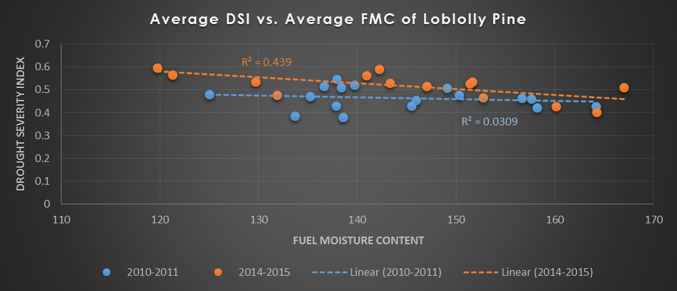
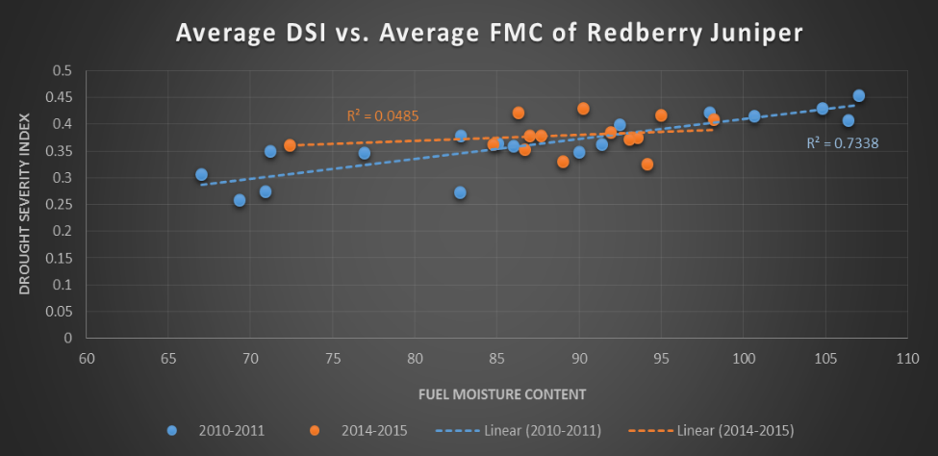
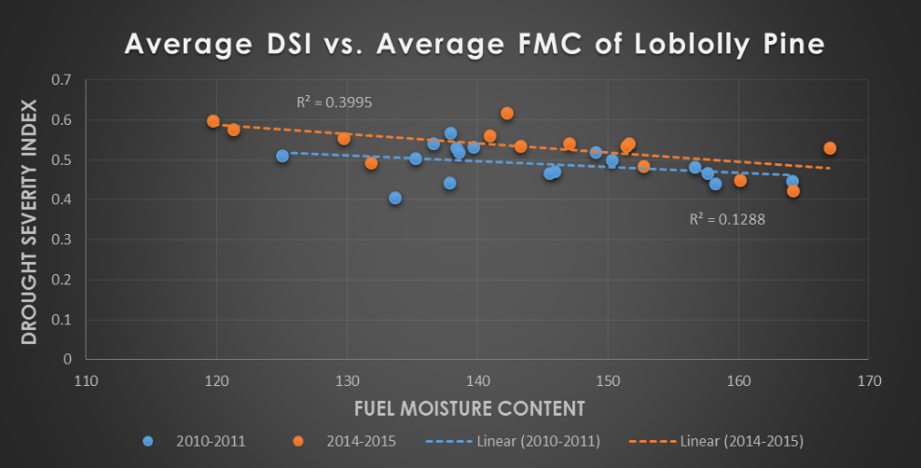
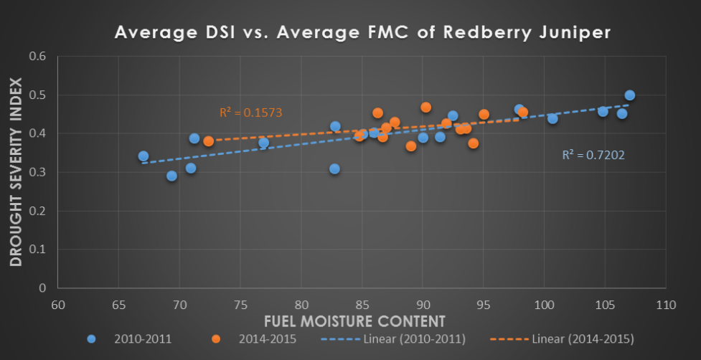
Results: Correlation with Fuel Moisture Content
Weight 1: less emphasis on temperature
Weight 3: more emphasis on soil moisture
Notes:
Scatter plots and correlation coefficient r figures were calculated with three different weight values applied to Redberry Juniper and Loblolly Pine FMC measurements. After applying Weight 1, the resulting r values from Redberry Juniper were quite high from 2010-2011 at 73%, however, the latter years of 2014-2015 were quite low at 0.04% due to what could be various reasons. The FMC stations in central and west Texas seem to indicate that they received wet conditions, although this is not portrayed in the DSI imagery until spring of 2015. Loblolly Pine on the other hand, also suffered inconsistent results within the study periods with values averaging 3% and 44%. Weight 3, however, produced results at slightly higher correlations. We believe the reason for this is due to the weight emphasis placed on vegetation and soil moisture.

Slide 14
Errors and Uncertainties
Spatial resolution discrepancies between MODIS and NLDAS
  250m² - 1km² vs. 13.75km²
Applicability of SDCI values to the many eco-regions that exist within Texas
Using strictly conifer fuel moisture content for correlation purposes
Notes:
This discrepancy may cause local scale accuracy errors in the final product.
These errors include large radar scans that result in average precipitation levels in a 16km² area, bright banding, low topped convection, and the accuracy of the reflectivity-rainfall algorithm.
SDCI values were developed for use within four separate states – two states for arid environments and two states for humid environments. Despite their close proximity to the area of study, Arizona, New Mexico, and the Carolinas, these environments may not accurately resonate with the coefficients that are needed for the unique regions in Texas.
Fuel moisture content measurements taken from Redberry Juniper and Loblolly Pine could alter drastically for grassland species such as Buffalo and Johnson grass which can stimulate fast-burning, “crawling” fires on the land surface. Including grasses in a study of this nature would be beneficial in determining the correlation between the FMC and the DSI. Additionally, the water requirements for vegetation during the cooler seasons could be significantly less than in the warmer seasons, particularly with Juniper species which tend to be drought-hardy (Sandoval). With this in mind, high soil moisture levels during temperate winter conditions may not directly reflect in the moisture absorbed by the tree.
The summer months in 2010 do not correlate particularly well in comparison to the summer months in 2011 due to the abundant amount of cloud cover in the former year. Estimations used to fill in the null values may have led to inaccuracies reflected in the scatter plot graphs.
Figure 8
David Goehring Nov. 26 2011
https://www.flickr.com/photos/carbonnyc/6415460111

Slide 15
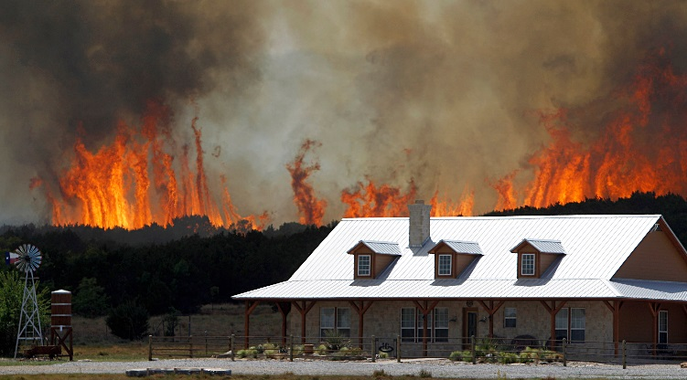
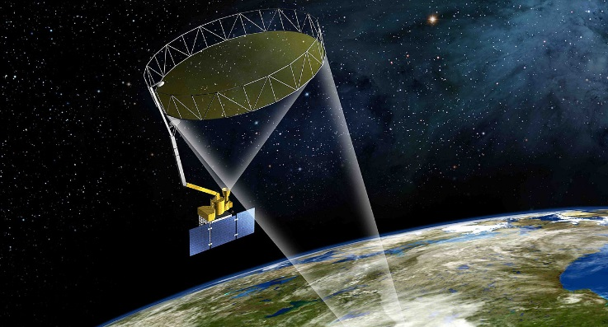
Future Work
Future studies should include the proximity of easily ignitable vegetation to residential and urban areas where populations are threatened should a wildfire occur.
The Soil Moisture Active Passive (SMAP) could very well replace the NLDAS component of the DSI.
A wildfire near Possum Kingdom taken by State Farm Insurance
April 19, 2011
SMAP satellite beam rendering from NASA’s Visualization Explorer
Notes:
Future studies should include the proximity of easily ignitable vegetation to residential and urban areas where populations are threatened should a wildfire occur.
Forthcoming DEVELOP teams who become responsible for the continuation of this project will have access to NASA’s first Earth-observing satellite designed to obtain soil moisture data. In light of this, the Soil Moisture Active Passive (SMAP) could very well replace the NLDAS component of the DSI.
According to the European Spread project, vulnerabilities to wildfire disasters are equally as important as the ignition potential when developing a fire risk map (Chuvieco et al., 2009).
Figure 10
A wildfire near Possum Kingdom taken by State Farm Insurance
April 19, 2011
https://www.flickr.com/photos/statefarm/12333738624
Figure 11
SMAP satellite beam rendering from NASA’s Visualization Explorer
Wikipedia Commons December 20, 2014
https://commons.wikimedia.org/wiki/File:SMAP_(Soil_Moisture_Active_Passive)_satellite.jpg

Slide 16

Conclusions
Results of the correlation graphs were inconsistent.
The flexibility of the DSI allows for multiple weight values that could be given for each of the four variables.
Higher correlation variability within the Spring months
The DSI should be tested against other indices and models in order to further its legitimacy.
Modified Drought Severity Index
scaled LST
+
scaled NDVI
+
scaled MPE
+
scaled NLDAS
Notes:
Despite inconsistencies in the correlation graphs between the DSI and the FMC, this study has laid the foundation for forthcoming work that involve a focus on the importance of soil moisture in dry conditions and how SMAP may play a role in determining prospective trends in wildfire risk.
There are multiple weight values that could be given for each of the four variables included in the DSI, and these values should continue to be experimented with in future work.
Figure 12
https://pixabay.com/en/question-problem-think-thinking-622164/

Slide 17
Advisors
Dr. Kenton Ross: NASA DEVELOP, National Science Advisor
Partners
Curt Stripling: Texas Forest Service, Geospatial System Coordinator
Tom Spencer: Texas Forest Service, Department Head of Predictive Services
Others
Emily Adams: DEVELOP Center Lead LaRC
Lance Watkins: NASA DEVELOP National Program, Geoinformatics/Center Lead
Grant Mercer: University of Nevada – Las Vegas
Rocky Garcia: City University of New York
Tiffani Miller: NASA DEVELOP, Project Coordinator Senior Fellow
Texas Disaster Team Summer 2015: John C. Stennis Space Center

