Slide 1
Coastal California
Water Resources
Assessing Estuarine Ecosystems in California for Improved Wetlands Monitoring and Management
Karina Alvarez, Molly Bruce, Roger Ly, Sarah Payne
California – JPL

Slide 2
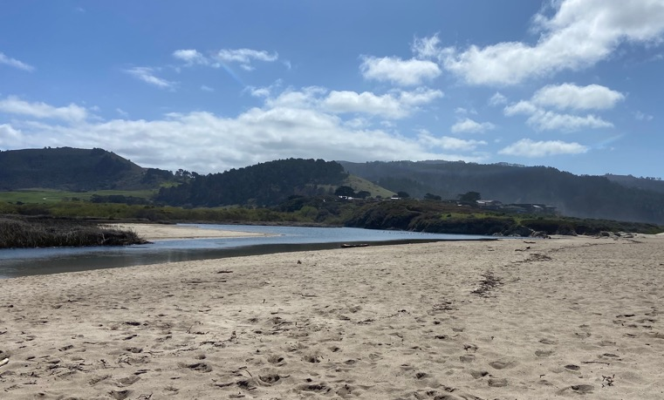
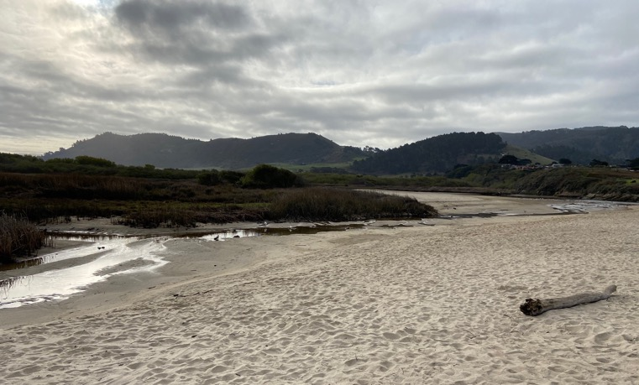
Estuarine Ecosystems
Partially-enclosed spaces where rivers and oceans/seas converge
Brackish
Extremely productive ecosystems
Extremely delicate ecosystems
Confront numerous anthropogenic stressors (development, pollution)
Image Credit: Kevin O’Connor, Central Coast Wetlands Group, Moss Landing Marine Labs
Notes:
Estuarine Ecosystems are…
Partially closed meaning they're partially protected from the open ocean and aren't subject to full-force wave dynamics, storms, etc.
They're brackish; they are a mix of freshwater from a river/water body feeding the system from inland and saltwater from the ocean/sea
Distinguish from wetlands (a more encompassing term...estuaries are always wetlands but wetlands aren't always estuaries)
Important breeding grounds/habitat, water filtration, storm buffering, flood prevention, carbon sequestration...TONS of ecosystem services
Degraded by pollution, coastal squeeze issues and development, rising sea levels, overfishing, etc.
Additionally, these systems are highly dynamic. Bar-built estuaries, which we focused on in this project, are particularly dynamic. In the images on the right of Carmel River Lagoon, you can see the drastic changes that an estuary experiences. These images are taken one day apart following a breach event. In this case, the lagoon lost 4 feet of water overnight.
------------------------------Image Information Below ------------------------------
Image Credit: Kevin O’Connor, Central Coast Wetlands Group, Moss Landing Marine Labs
Image Source: Provided by Kevin O’Connor (project partner) with permission

Slide 3
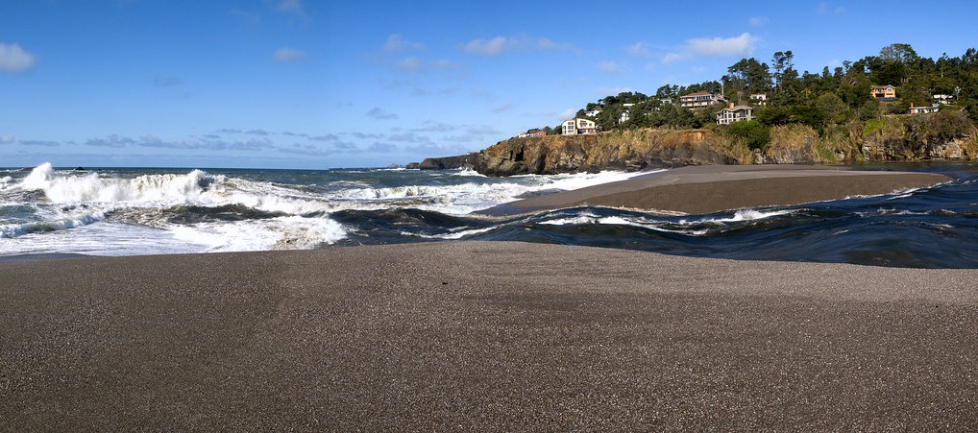
What is a Breach?
Ocean
Estuary Mouth
Estuary
Gualala Estuary. Image Credit: ianmacd
Notes:
A breach event occurs when…
When an estuary that was closed is connected to the ocean
Specifically, this is from erosion of the sand barrier at the estuary mouth
Either the water inside the estuary overflows and a channel is created through the barrier
And/or repeated waves create erode the barrier and a channel is formed
Natural breaches are difficult to predict, but important to monitor as they influence estuary water extent and quality
------------------------------Image Information Below ------------------------------
Image Credit: ianmacd
Image Source: https://search.creativecommons.org/photos/265bcf03-379a-4102-b3f4-0a9ca36904f1 (CC BY-NC-ND 2.0)

Slide 4
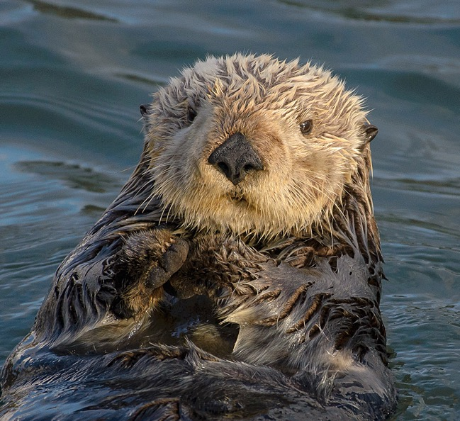
Community Concerns
Estuaries in California serve as essential habitat for endangered species such as salmon and sea otter
Breaching events result in changes to levels of salinity, inundation extent, water quality metrics
These factors affect health and productivity for estuarine and coastal ecosystems
Image Credit: Marshal Hedin
Notes:
The health of estuaries is important because they provide habitat to endangered species such as sea otters and salmon
Breach events significantly impact levels of salinity, inundation, chlorophyll-a, and turbidity which affects productivity in the estuarine ecosystem, but also ecosystems off the coast
Frequency or infrequency of estuary breaching can lead to events that can negatively impact estuarine systems permanently
Increasing data of estuary conditions is essential for detecting patterns of breaching and assessing the impacts of breaching to the ecosystem.
It also allows land conservation managers and decision makers to make well-informed policy regarding conservation
------------------------------Image Information Below ------------------------------
Image Credit: Marshal Hedin
Image Source: https://search.creativecommons.org/photos/8317b0a7-8382-4448-bd6f-26d64bd522d3 (CC BY-SA 2.0)

Slide 5
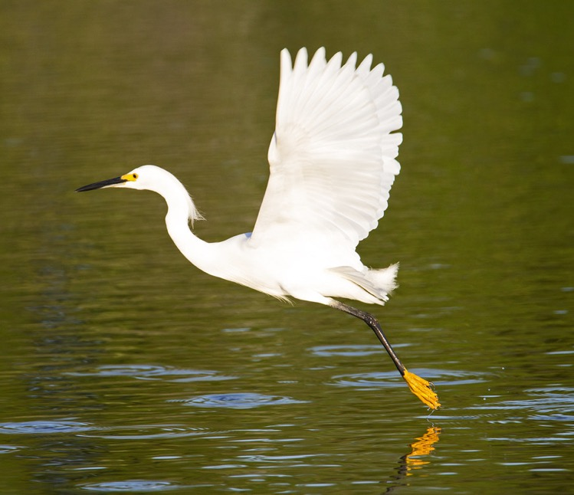
Partners
End User
  Ocean Protection Council
Collaborators
  Moss Landing Marine Laboratories, Central Coast Wetlands Group
  Southern California Coastal Water Resource Project
  University of California, Los Angeles
Image Credit: Ian Morton
Notes:
Our partner organizations are involved in the monitoring of California estuaries, especially those that are in Marine Protected Areas. These areas are known as EMPAs.
Our end user for our project deliverables is the Ocean Protection Council, which is one of the regulatory agencies tasked with collecting data on EMPAs and reporting to the government of the State of California.
Our collaborators include:
MLML CCWG, which is funded by the OPC
SCCWRP, whose governing board includes the OPC
And UCLA, whose expertise lies in coastal ecology and remote sensing
------------------------------Image Information Below ------------------------------
Image Credit: Dis da fi we (Ian Morton)
Image Source: https://search.creativecommons.org/photos/9656420c-87b3-4663-9f01-6f7589329ed8 (CC BY-NC-SA 2.0)

Slide 6
Objectives
1.
2.
Remote Sensing
Improve data collection of Estuary Marine Protected Areas (EMPA’s) throughout California by incorporating remote sensing
Tool
Create estuary assessment tools in Google Earth Engine (GEE) for California:
California Estuary Assessment (CEA) Tools
3.
4.
Mouth State
Identify mouth state and inundation extent of estuaries
Health Metrics
Assess water quality metrics such as turbidity, chlorophyll-a, and colored dissolved organic matter (CDOM)
Notes:
The primary aims of our project are to…
Incorporate RS to improve data collection of Estuary Marine Protected Areas (EMPAs) along the coast of California
Design and build tool in GEE that assesses estuaries
With this RS tool we hope to …
Identify if an estuary mouth is open (meaning it is connected to the ocean and subject to tidal influences) or closed (meaning it is separated from the ocean and not subject to tidal influences)
Then see how health metrics change in response to mouth state (how an open or closed estuary will affect turbidity, chlorophyll a, CDOM)
With these objectives in mind, we are now going to focus specifically on potential trends for objectives 3 and 4 (identifying mouth state, inundation, and health metrics)…

Slide 7
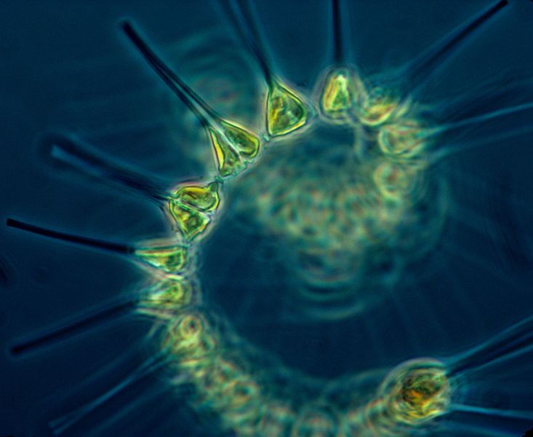
Background Information:
Water Quality Metrics
Primary indicators of phytoplankton availability
Turbidity: Amount of suspended matter in water, causes water to be hazy
  Higher turbidity: hazier water
Chlorophyll-a: Used for photosynthesis
  Higher chlorophyll-a: more phytoplankton
CDOM: Colored Dissolved Organic Matter
  Higher CDOM: limits photosynthesis
Phytoplankton under a microscope
Image Credit: NOAA
Notes:
Some important background on water quality metrics…
Phytoplankton are primary producers and live through photosynthesis.
They are one of the most important organisms in an aquatic ecosystem
They are at the bottom of the food web, and changes in phytoplankton concentration will result in rapid change in the rest of the food web
Not only are they a source of food, but also an important producer of oxygen which is needed for other species to survive
Researchers collect water samples to measure phytoplankton availability on a small scale
The tool aims to use satellite imagery produce metrics to use as a proxy in measuring phytoplankton on a much larger scale
Phytoplankton are affected by photosynthesis availability, which is why one of the metrics we are looking at is turbidity
Turbidity is the amount of suspended particle in water, high turbidity concentrations affect the passage of light through water limiting photosynthesis
Chlorophyll-a: used as a proxy for measuring phytoplankton
CDOM: Similar to turbidity
------------------------------Image Information Below ------------------------------
Image Credit: NOAA Mesa Project
Image Source: http://www.photolib.noaa.gov/bigs/fish1880.jpg (Public Domain)

Slide 8
Potential Trends
Mouth State > Inundation & Water Quality
 | Inundation | Chlorophyll-a (Open Water) | Turbidity | CDOM
Mouth-State Closed
Mouth-State Open
Notes:
With our GEE tool using remotely sensed data, here are some potential trends we hope to capture….
On the left we have estuary mouth-state as closed (not connected to the ocean) and mouth-state as open (connected to the ocean)
With the mouth state as closed we may have
Higher levels of inundation (as the water builds in the estuary)
Increased levels of chlorophyll-a (with water not being flushed out into the ocean)
Lower levels of turbidity (without the ocean’s influence)
Decreased levels of CDOM (with less water flow to spread sediments)
With mouth state as open, we may have
Lower levels of inundation (water leaving to ocean)
Lower levels of chlorophyll (washed out to ocean)
Higher levels of turbidity (waves influence, water flow)
Higher levels of CDOM (more water flowing moving sediment)
As we move forward with methods and out results, these are trends to keep in mind of how mouth-state might influence inundation and water quality

Slide 9
Study Area
A. Navarro
B. Russian River
C. Drake’s Estero
A.
B.
C.
0
1
2
0
2
4
0
3
6
Km
Km
Km
D.
D. Carmel
E. Ventura
F. Malibu
E.
F.
N
0
1
2
0
1
2
0
1
2
Km
Km
Km
ESRI World Imagery Base Source: Esri, Maxar, GeoEye, Earthstar Geographics, CNES/Airbus DS, USDA, USGS, AeroGRID, IGN, and the GIS User Community
Notes:
Our six study sites are spread across the coast of California and include: Navarro, Russian River, Drake’s Estero, Carmel, Ventura, and Malibu
When selecting our study sites we took into consideration:
Dynamic Estuary Mouths- some that opened and closed and some that were always open
Size- some on larger scale such as Drake’s Estero and a smaller scale such as Ventura
Spatial Resolution- ensure visible with satellite imagery
Location- we wanted sites in Northern, Central, and Southern California
In this presentation we will focus specifically on Navarro as a case study since we were provided by our partners recent in-situ water log data for verification
With our study sites selected, we then determined which satellites and sensors would properly capture estuary mouth opening and associated health metrics
ESRI World Imagery Base Source: Esri, Maxar, GeoEye, Earthstar Geographics, CNES/Airbus DS, USDA, USGS, AeroGRID, IGN, and the GIS User Community

Slide 10

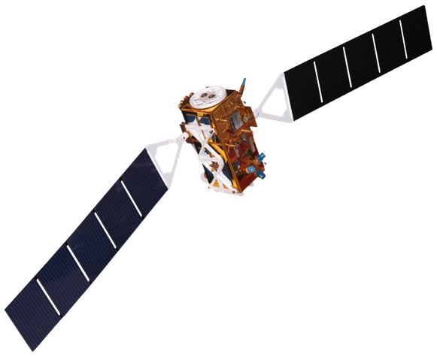
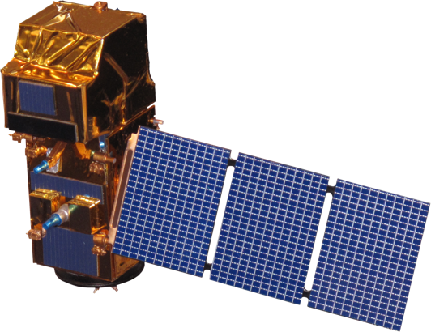
Satellites and Sensors
Landsat 8 Operational Land Imager
Level 2 Surface Reflectance Tier 1
Sentinel-2 Multispectral Instrument
Level 2A Surface Reflectance
Sentinel-1 C-Band Synthetic Aperture Radar
Level 1 Single Look Complex
16 days, 30 m, 2013 +
~5 days, 10-20m, 2018 +
12 days, 10 m, 2016 +
+
+
Image Credit: NASA (Landsat 8), ESA (Sentinel-2 & Sentinel-1)
Notes:
To best capture estuarine dynamics, we used 3 different satellites and their associated sensors
We used….
Landsat 8 OLI provided more flexibility in image selection and was an important component in turbidity analysis
Sentinel-2 MSI was essential in getting high resolution imagery for mouth state and health assessments
Sentinel-1 C-band was used to capture estuary inundation extent
With these satellites and data availability in mind, we set the study period to
2018 – Present
In this presentation, we focus on September 2019 to March 2020 in Navarro River Estuary,
We chose this study period because our partners were able to provide us with recent in-situ water logger data for verification
------------------------------Image Information Below ------------------------------
Image Credit: NASA, ESA
Image Source: https://www.devpedia.developexchange.com/dp/index.php?title=List_of_Satellite_Pictures

Slide 11

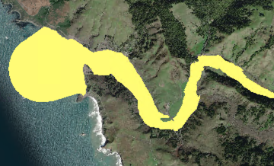
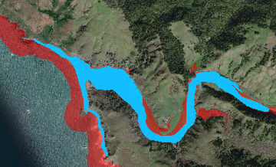

Methodology
Creation of Study Area Boundaries
Data Sources:
U.S. Fish and Wildlife National Wetland Inventory
1. Clip NWI to 6 Sites in ArcGIS
2. Expand NWI with USGS 3DEP 1m DEMs at a 5m threshold
3. Create buffer from shore that extends 2,000 m into ocean
4. Export to Google Earth Engine for data processing
U.S. Geological Survey 3D Elevation Project
Notes:
Defining the study are for our six study sites was crucial for a crisp analysis that excluded noise from the surrounding landscape
We utilized the USFS National Wetland Inventory (NWI) as a baseline designation of estuaries and the USGS 3D Elevation Project to include areas of potential inundation
We clipped the USFS NWI to our 6 study sites
Why = for ease of processing
Then expanded the NWI with the USGS 3DEP DEMs with a 1 m resolution at a threshold of 5 m
Why = this captured potentially inundated areas in a repeatable manner
A buffer extended 2,000 m into ocean
Why = to capture ocean interactions that are essential to estuary ecosystem functioning (ex. sediment plumes)
These shapefiles were then placed into GEE for further processing

Slide 12

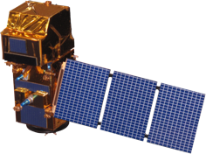
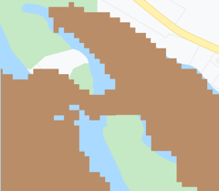
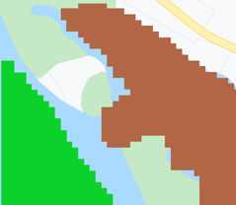

Methodology
Estuary Mouth State
Data Sources:
1. Cloud mask
2. Apply Normalized Difference Water Index (NDWI)
3. NDWI thresholds
4. Pixel Connectivity
Open or Closed Designation
Time Series
NDWI = $\frac{{\text{R}}_{\text{559}} \text{+ }{\text{R}}_{\text{833}}}{{\text{R}}_{\text{559}} \text{− }{\text{R}}_{\text{833}}}$
1
1
2
Open
Closed
Landsat 8 OLI and Sentinel-2 MSI
Visualization
Image Credit: NASA (Landsat 8), ESA (Sentinel-2)
Notes:
We assessed estuary mouth conditions using Landsat 8 and Sentinel 2 imagery processed in Google Earth Engine
Google Earth Engine was our platform of choice because we wanted to take advantage of it’s comprehensive database of free satellite imagery and cloud computing technology
GEE allowed us to create an accessible and free tool that could help automate the process of estuary monitoring
A Normalized difference water index was created and an NDWI threshold was created to identify water pixels
To determine whether an estuary mouth was opened or closed, we use a GEE function to determine if water from the estuary was connected to the open ocean
------------------------------Image Information Below ------------------------------
Image Credit: NASA, ESA
Image Source: https://www.devpedia.developexchange.com/dp/index.php?title=List_of_Satellite_Pictures

Slide 13
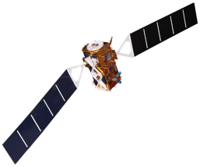
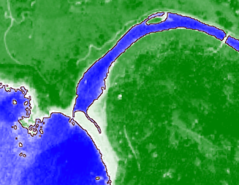
Methodology
Estuary Inundation Extent
Data Source:
Sentinel-2 MSI:
1. Cloud filter on AOI
2. NDWI threshold
3. Water/land binary
4. Water pixel count
Sentinel-1 C-SAR:
1. Examined VV, VH, VV/VH
2. Threshold
3. Water/land binary
4. Water pixel count
Inundation Layer
Spatial Analysis
Sentinel 1 C-SAR & Sentinel-2 MSI
Image Credit: ESA
Notes:
To determine estuary inundation extent we took 2 approaches using Sentinel 1 and 2.
We looked at both Sentinel 1 and 2 because we wanted to
Increase temporal resolution
Sentinel-2 code was already drafted in estuary mouth state detection
SAR approach for inundation widely used and respected
For Sentinel-2 …
Clouds were filter based on the percent of clouds within the estuary aoi,
For images that went through the cloud filter we then calculated NDWI and created a binary of water or non-water pixels at a threshold of 0.15
We then examined change in water pixels
For Sentinel-1 the process was similar…
No challenges with clouds
Using VV, VH, VV/VH we then created a threshold of water and non-water
We then examined change in water pixels
------------------------------Image Information Below ------------------------------
Image Credit: NASA, ESA
Image Source: https://www.devpedia.developexchange.com/dp/index.php?title=List_of_Satellite_Pictures

Slide 14
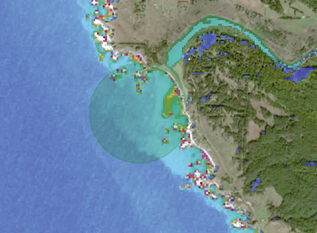

Methodology
Turbidity
Data Sources:
1. Apply turbidity algorithm in GEE
Turbidity Layer
Time Series
T = $\frac{\text{(}{\text{A}}_{\text{T}}\text{)(}{\text{P}}_{\text{W}}\text{)}}{\text{1 − (}{\text{P}}_{\text{W}}\text{/}\text{c}\text{)}}$
Calculations to Red-Band Surface Reflectance
Landsat 8 OLI and Sentinel-2 MSI
Spatial Analysis
Image Credit: NASA (Landsat 8), ESA (Sentinel-2)
Notes:
To get create our turbidity product, we utilized an algorithm take utilizes the red band on Landsat 8 and Sentinel-2 to create a turbidity layer in Google Earth Engine
This algorithm was developed during a previous effort from graduate students Sol Kim, Rafael Grillo Avila, and Xiaowei Wang from UC Berkeley under the guidance of our science advisor Christine Lee
It has been utilized effectively in previous DEVELOP projects that looked at monitoring water quality off the coasts of Belize and Honduras
The algorithm was further calibrated using in-situ data
------------------------------Image Information Below ------------------------------
Image Credit: NASA, ESA, Cogwheel: created in Power Point, Clipart
Image Source: https://www.devpedia.developexchange.com/dp/index.php?title=List_of_Satellite_Pictures, https://www.kissclipart.com/icon-clipart-computer-icons-market-research-8u9ax4/

Slide 15
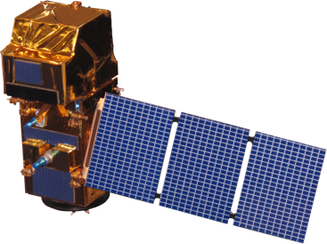
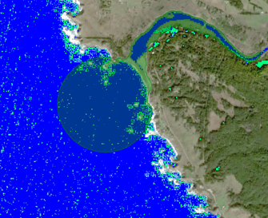


Methodology
Chlorophyll-a
Data Source:
1. Apply Normalized Difference Chlorophyll Index (NDCI)
Chlorophyll-a Layer
NDCI = $\frac{{\text{R}}_{\text{705}} \text{+ }{\text{R}}_{\text{665}}}{{\text{R}}_{\text{705}} \text{−} {\text{R}}_{\text{665}}}$
Time Series
2. Use NDCI layer to calculate Chlorophyll-a concentration
Sentinel-2 MSI
$$\text{Chl}\text{−}\text{a}\text{ = }{\text{a}}_{\text{0}}\text{+}\left({\text{a}}_{\text{1}}\text{∗}\text{NDCI}\right)$$
$$\text{+(}{\text{a}}_{\text{2}}\text{∗}{\text{NDCI}}^{\text{2}}\text{)}$$
Spatial Analysis
Image Credit: ESA
Notes:
For chlorophyll a we created a normalized difference chlorophyll index layer with Sentinel-2 imagery
We were limited to sentinel-2 imagery because NDCI requires the use of a sensor that captures values in the red edge range which Landsat 8 was lacking.
We then applied an algorithm that used NDCI values that takes in NDCI values as parameters and converts to chlorophyll concentration in mg per cubic meter.
------------------------------Image Information Below ------------------------------
Image Credit: NASA, ESA, Cogwheel: created in Power Point
Image Source: https://www.devpedia.developexchange.com/dp/index.php?title=List_of_Satellite_Pictures,

Slide 16
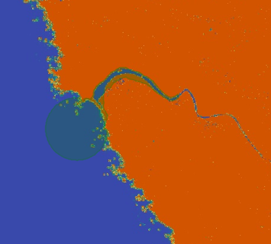

Methodology
Colored Dissolved Organic Matter (CDOM)
Data Source:
1. Apply CDOM algorithm (Chen et al. 2017)
CDOM Layer
$${\text{a}}_{\text{CDOM}}\text{(440) = 22.283}{\text{e}}^{\text{−}\text{1.724}\text{X}}\text{,}$$
$$\text{X}\text{ = }\frac{{\text{R}}_{\text{rs}}\text{(}\text{B}\text{3)}}{{\text{R}}_{\text{rs}}\text{(}\text{B}\text{5)}}$$
Time Series
Sentinel-2 MSI
Spatial Analysis
Image Credit: ESA
Notes:
Lastly for the water quality metrics we applied an algorithm to look at colored dissolved organic matter (CDOM) using bands 3 and 5 for Sentinel-2 imagery
------------------------------Image Information Below ------------------------------
Image Credit: NASA, ESA, Cogwheel: created in Power Point
Image Source: https://www.devpedia.developexchange.com/dp/index.php?title=List_of_Satellite_Pictures,

Slide 17
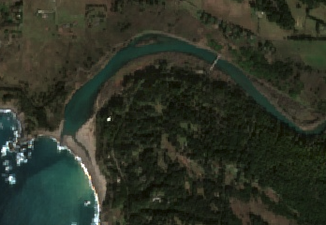
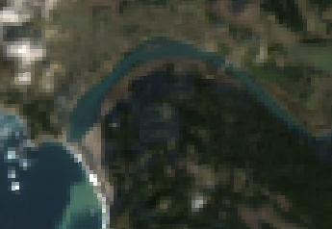

Results
Resolution
Sentinel-2
February 17th, 2020
Landsat 8
February 22nd , 2020
0
250
500 m
0
250
500 m
Notes:
Our following results are structured by image availability
Sentinel-2 spatial resolution (10 m) was well-suited to assess estuaries of all sizes
Landsat 8 spatial resolution (30 m) was too coarse for smaller estuaries
Sensor impacts temporal resolution and overall accuracy, important to capture mouth opening and closure and resulting changes in health metrics

Slide 18
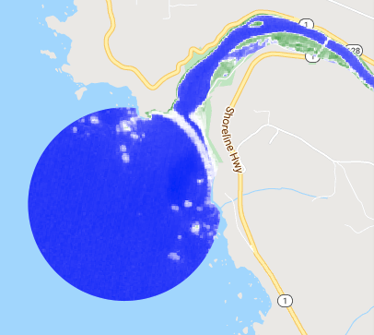
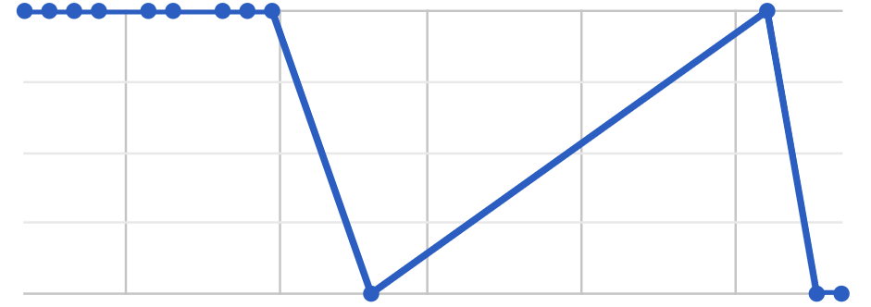
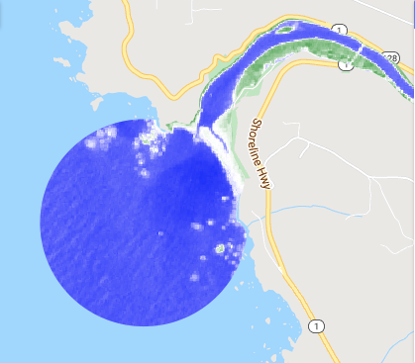

February 7th, 2020
Results
Mouth State
Image
Mouth
Closed
*
NDWI
-0.8
0.8
February 17th, 2020
Mouth
Open
Oct-19
Nov-19
Dec-19
Jan-20
Feb-20
*
In situ data suggests breach event on 2/11/2020
0 km
0.5
1.0
Notes:
Here is the chart we produce from our GEE code of Navarro River Estuary
To familiarize you to the chart…
On the X axis we have dates, which span from just before October 2019 to just after February 2020
On the Y axis we have mouth state if it is open or closed
Every dot is a single image that made it through our cloud filter
The light blue asterisks is a breach event as suggested by in-situ-data on Feburary 11th , 2020
On this chart we want to focus specifically on…
Image on February 7th code finds as closed
Image on February 17th code finds as open
This change from closed to open, a breach!, is supported from in-situ water log data
Base Map: Google Earth Engine Imagery Base Source:@2021, Maxar Technologies, USDA Farm Service Agency

Slide 19
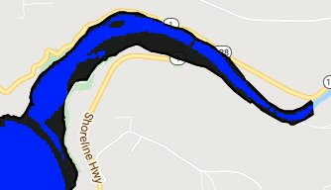
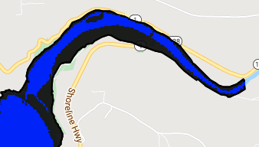
Results
Inundation
February 7th, 2020
Closed
February 17th, 2020
Open
NDWI threshold
Water
Non-water
0 m
250
500
More inland water pixels when estuary is closed
Fewer inland water pixels when estuary is open
% Water Pixels
Notes:
Following the dates of the 2 images from the previous slide (Feb 7th and 17th) we can also examined inundation extent...
In these images we are looking at a NDWI binary of blue being water and black being non-water
On Feb 7th when the estuary is closed, it seems to be more inundated than when the estuary is open on Feb 17th
Specifically in the orange and green circles there seems to be a change in inundation levels (closed = more water, open = less water)
This analysis is important because…
In the times closely preceding and closely following a breach event, we expected to see fairly dynamic water levels.
By visualizing these changes in water levels, identifying those pixels classified as water, and determining changes in water pixel coverage over time, inundation analysis can help us validate our breach tool and can provide the partners with another piece of information to compare to their in-situ data
Base Map: Google Earth Engine Imagery Base Source:@2021, Maxar Technologies, USDA Farm Service Agency

Slide 20
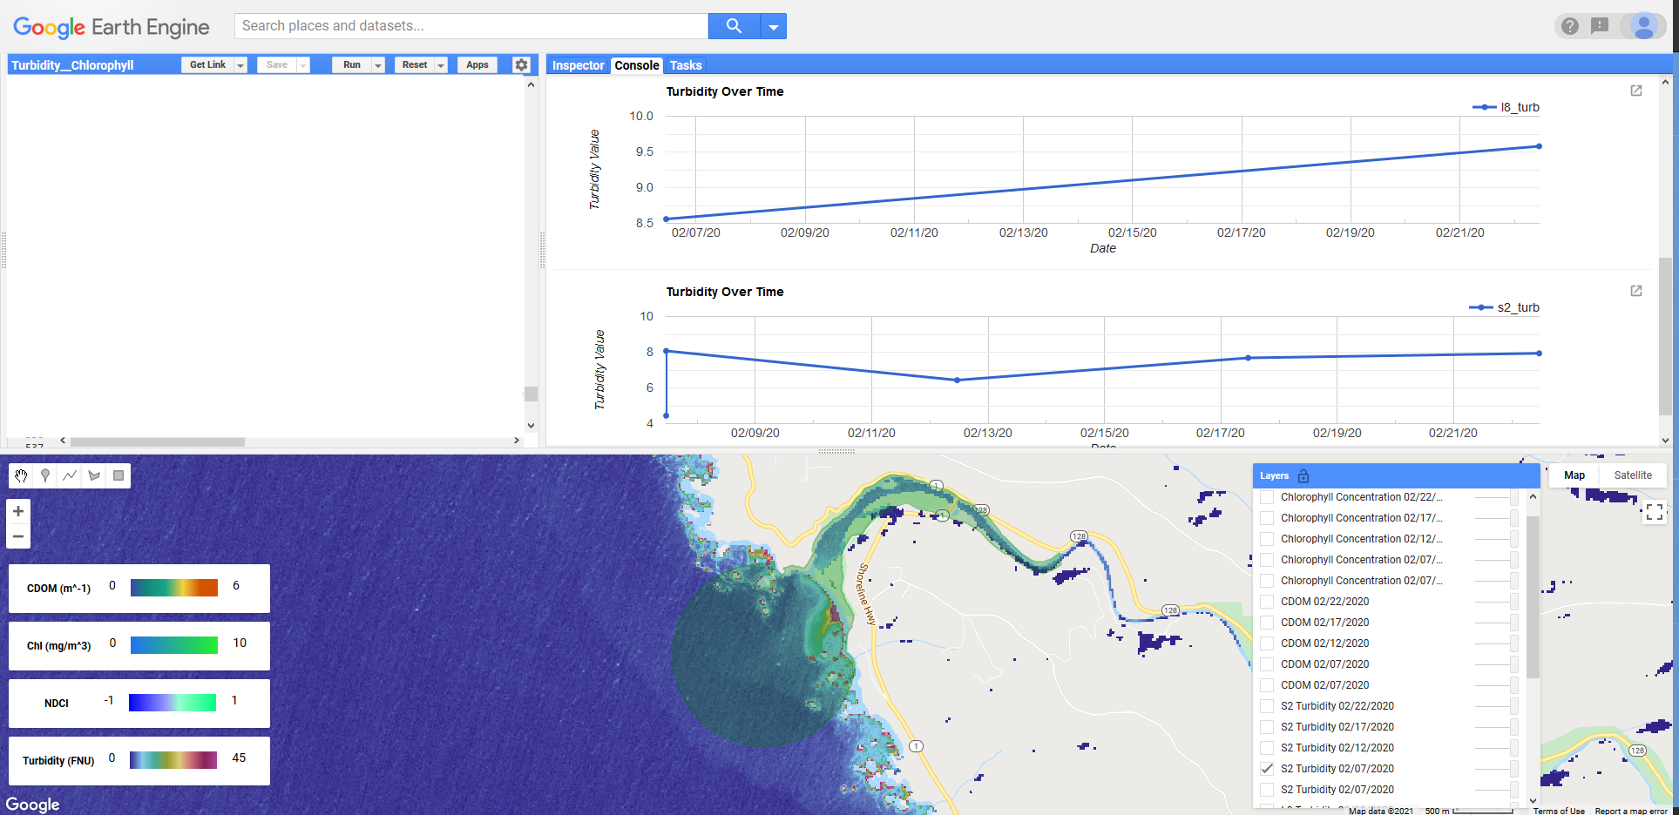
Results: Water Quality
Notes:
As part of the CEA tools, we created the water quality assessment tool to be used in conjunction with the breach detection tool so that partners can see the effects of estuary breaching on water quality
Partners can use this tool to easily pull up Sentinel-2 and Landsat-8 imagery stored on the Google Earth Engine cloud in a user specified date range
This tool also automatically applies algorithms that produces layers that can be used to assess chlorophyll, turbidity, and CDOM
It is loaded with six EMPA locations to switch between, shown here is Navarro river
The tools also creates a graph that averages the values of each metric in the estuary polygon over multiple image dates

Slide 21
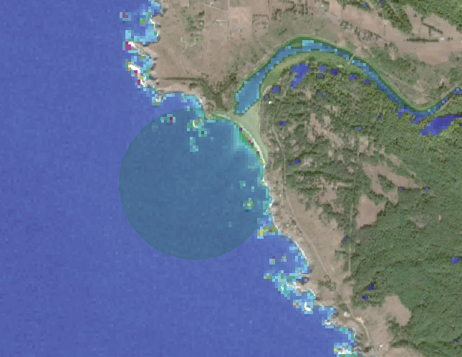
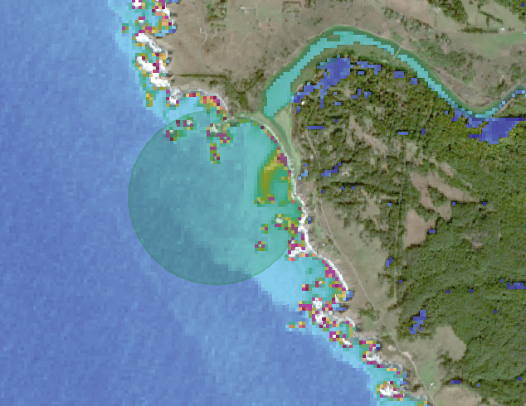
Results: Landsat-8 Turbidity
N
N
0
500
1000 m
45 FNU
0
45 FNU
0
0
500
1000 m
Turbidity derived from Landsat 8
Closed mouth, 10/30/2019
Turbidity derived from Landsat 8
Open mouth, 02/06/2020
Notes:
Both images show turbidity calculated over water, red areas indicate high levels of turbidity
On the left, shows Navarro river in October when the mouth of the estuary is closed
On the right, shows Navarro in February
We chose to look at this date because
In-situ data of water level implied that the breach date was 2/11 shown by a drop in water level
This was the closest date we had imagery over Navarro
A couple days before we can see the beginnings of the breach with a small plume highlighting area with high turbidity,
More sedimentation in and at the mouth of the estuary when it is about to breach

Slide 22

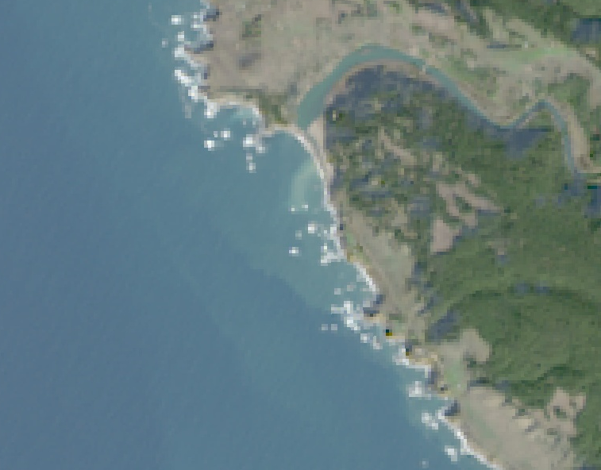
Results: Landsat-8 Turbidity
N
N
0
500
1000 m
45 FNU
0
0
500
1000 m
Turbidity derived from Landsat 8
Opening mouth, 02/06/2020
Surface Reflectance from Landsat 8
True Color (RGB) Opening mouth, 02/06/2020
Notes:
This is the same turbidity layer generated next to the true color image of Landsat 8
This imagery highlights location and direction of breach and plume that wouldn’t be seen with ground measurements
This tool has some potential to be useful for looking at the effects of breaching events on water quality, especially on turbidity, using Landsat 8.

Slide 23
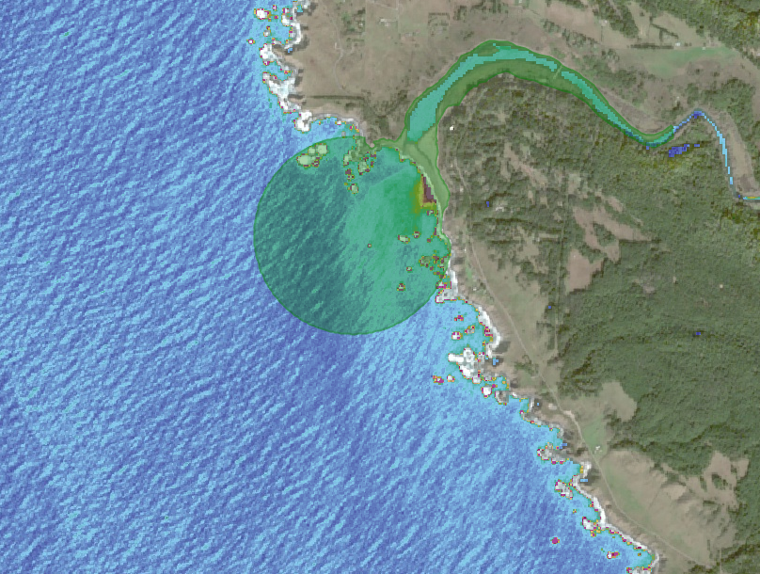
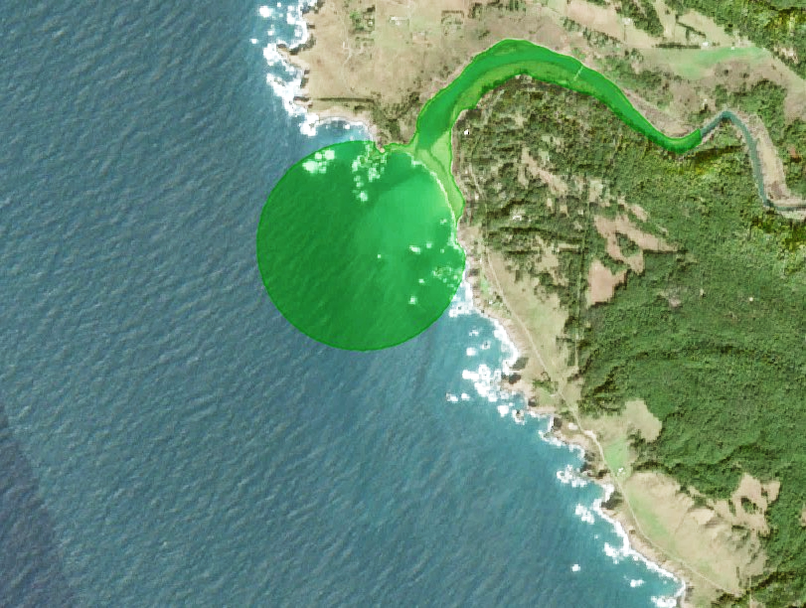
Errors and Uncertainties
Water Quality: Sentinel-2 Derived Products
N
N
500
1000 m
45 FNU
0
500
1000 m
0
0
Turbidity derived from Sentinel-2 02/17/2020
Sentinel-2 True Color 02/17/2020
Notes:
The work done in this term has shown that Sentinel-2 imagery did not work the best for measuring water quality metrics
After expanding the date range to look at the full year in 2020, we saw large gaps in usable imagery because of clouds, atmospheric interference, and wave interference
This is one example of Sentinel-2 imagery picking up wave action
Sentinel-2 imagery has higher resolution resulting in the image capture of water movement which alters the reflectance values
The waves are causing the algorithm to generate higher than normal levels of turbidity
When graphing average turbidity across the year, the values did not have any pattern to breaching
There were also artifacts that were observed in multiple Sentinel-2 imagery dates over the water that were part of sensor error
While chlorophyll-a and CDOM products generated were satisfactory for some images, most images had large variations in reflectance values over the same area that could not be explained by natural phenomena
This made looking for trends in the graph impossible, and layers produced from bad imagery were unusable
We decided that chlorophyll-a, CDOM products need further work or an alternative imagery source

Slide 24
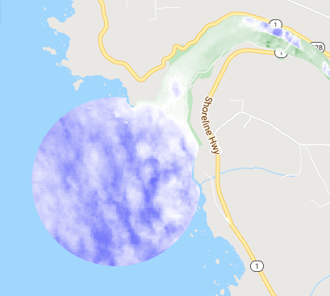
Errors and Uncertainties
Cloud Cover & Temporal Resolution
Image
Mouth
Closed
November 11th, 2019
*
Mouth
Open
NDWI
-0.8
0.8
Oct-19
Nov-19
Dec-19
Jan-20
Feb-20
0 km
0.5
1.0
*
In situ data suggests breach event on 12/7/2020
Notes:
While we do capture a proper breach in this Navarro case study, clouds have the potential to interfere with our analysis
Clouds sometimes pass through the clouds filter/ clouds masks that then are filtered and can potentially be analyzed as a false positive (breach event where none existed)
This is observed in this case study on November 11th, 2019, the image confused the pixel connectivity analysis
Furthermore, the cloud filter can also filter out a large period of time, potentially causing us to miss opening or closing events
In this case study, this is seen in the lack of images from December to February. Many of these are very cloudy days, but we may be able to refine the cloud filter to include images that are generally cloudy but clear over the AOI. This would provide more images for analysis.
Base Map: Google Earth Engine Imagery Base
Source: @2021, Maxar Technologies, USDA Farm Service Agency

Slide 25
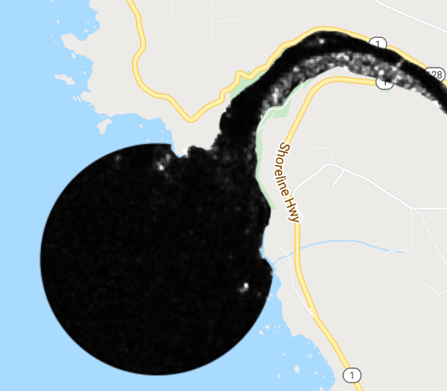
November 11th, 2019
Errors and Uncertainties
SAR Potential Solution?
Image
Mouth
Closed
NDWI
-0.8
0.8
*
December 10th, 2019
Mouth
Open
Oct-19
Nov-19
Dec-19
Jan-20
Feb-20
*
In situ data suggests breach event on 12/7/2020
SAR VV
0
0.3
0 km
0.5
1.0
Notes:
SAR could help fill in image gaps. As it is not affected by clouds, it could significantly increase temporal resolution and potentially capture more breach events.
While a potential solution to overcome challenges with the cloud mask and temporal resolution, SAR has challenges of detecting breach
Here we have a SAR VV image from Dec 10th right after the breach. Here, white indicates land and black indicates water.
As you can see it is difficult to determine the estuary mouth state of being open or closed
In terms of breach detection, SAR may need further refinement. If not for breach detection, then perhaps for other metrics, as will be further discussed shortly.
Base Map: Google Earth Engine Imagery Base Source:@2021, Maxar Technologies, USDA Farm Service Agency

Slide 26
Future Work
12
Refine
  Further verification with in-situ data
  Create a Graphical User Interface
Expand
  Assess vegetative health
  Explore more water quality metrics
  Explore C-SAR applications
  Further calibrate algorithms with in-situ data
  Incorporate other sites!
Notes:
As a two term project we hoped to provide a foundation for future work.
Here are some of the topics the next term may explore…
Refine
1. Verification of the tool, more in depth iterative process of adjusting things such as the cloud mask
2. Create a user friendly graphical interface, so the user does not have to go into the code for adjustments (potential for errors)
Expand
Assessment of vegetative health ex. Potentially through a more thorough classification methods
Explore other water quality metrics that may be of interest ex. Sea Surface Temperature
Further explore C-SAR applications
Validate tool output with in situ data
May want to incorporate other sites to compare opening and closing events and their resulting effects on health, there were 12 other sites we initially looked into and the tool has the potential to be expanded to some of those locations

Slide 27
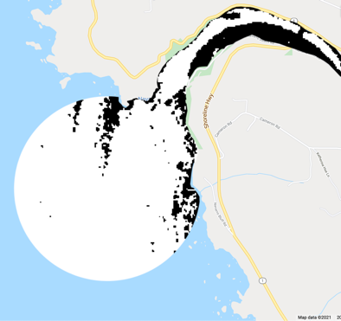
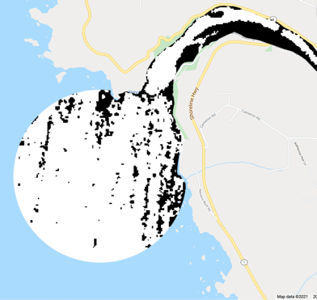
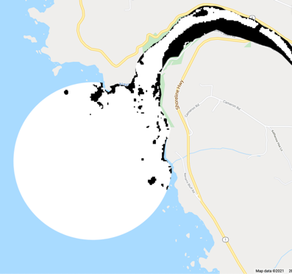
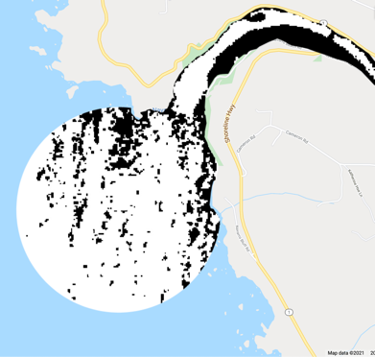
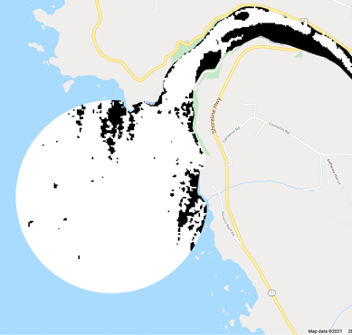
Potential Guideposts for Future Work
Ideas Not Fully Explored
*
November 16th, 2019
November 28th, 2019
December 10th, 2019
December 22nd, 2019
January 3rd, 2020
C-SAR exploration and changes in inundation over time
Random Forest Classifier & more detailed classification of study areas
Sea Surface Temperature changes in response to breach events
Edge-effect analysis
0 km
0.5
1.0
SAR threshold
Water
Non-water
Notes:
The team explored a lot more avenues for addressing the partner’s questions than are truly captured here today
For instance, we used C-SAR data to examine inundation extent
We examined annual averages of the VV and VH bands daily, and ratios of day to annual
The day to annual ratio did not convey much information
The day VV and VH seemed promising and we reduced speckle through 2VH + VV and a Lee filter
We then used a threshold to distinguish water from non-water pixels – however as you can see there are still some artifacts particularly over the ocean
Ultimately, we encourage the next term to tackle the use of SAR,
Major next steps would be finding a way to reduce artifacts or clip the analysis to just the inland portion of the estuary
Furthermore, Random Forest Classifiers in GEE are fairly sophisticated and complicated to wrangle.
We had limited training datasets and were therefore concerned about the quality of our outputs. Given the duration of the term and the breadth of questions the team sought to address, we decided to focus our energy elsewhere.
Fortunately, the breach detection code runs a fairly elementary classification of the scene that may be useful to the partners. (potential for future term if someone has expertise with this in GEE)
The team also contemplated whether breach events would correlate with SST changes.
However, this analysis required separate platforms the team hadn't previously been planning to engage.
Again, given the duration of the term and the three other methods we planned to employ to assess breach events (estuary mouth analysis with NDWI, water health metrics, and inundation), we decided to focus our energy elsewhere. (maybe potential for future term)
As part of the NDWI estuary mouth analysis, the team had originally considered an approach that involved edge effect analysis and connectivity across identified edges; however, the approach ultimately employed proved more straightforward.
Base Map: Google Earth Engine Imagery Base Source:@2021, Maxar Technologies, USDA Farm Service Agency

Slide 28
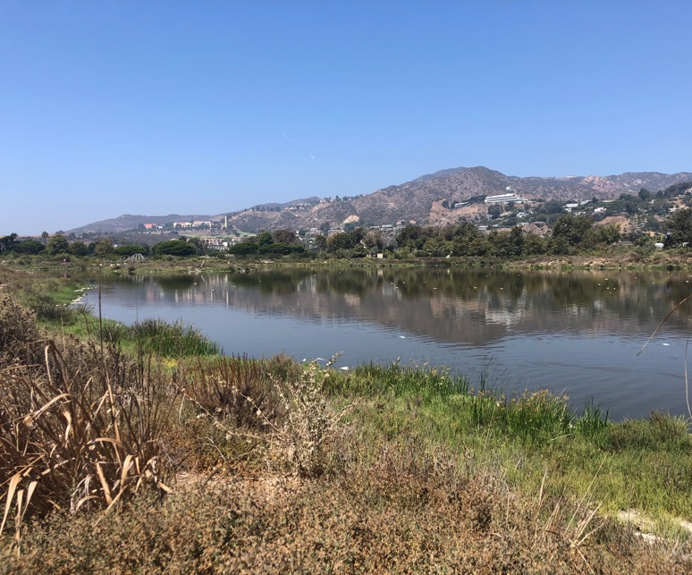
Conclusion
GEE tool will allow partners to monitor & understand estuarine dynamics & health
  Sentinel-2 derived NDWI determines estuary mouth state well
  Satellite imagery captures metrics influenced by mouth state:
    Inundation extent with NDWI
    Turbidity
2nd term
  User-friendly interface
  Further validation & analysis
Image Credit: Karina Alvarez
Notes:
Our preliminary CEA tool will allow partners to monitor and understand estuarine dynamics
At a finer temporal resolution than allowed by some in situ monitoring methods
At a wider spatial scale
And in the context of estuary state (e.g. quantify water quality changes before/after a breach)
We find that
Sentinel-2 derived NDWI is particularly useful, especially given the small size estuary mouths
Satellite data captures metrics influenced by mouth state, especially NDWI-derived inundation extent and Landsat-8 derived turbidity
The second term will work towards
A user-friendly interface
Further validation and analysis
------------------------------Image Information Below ------------------------------
Image Credit: Karina Alvarez
Image Source: Provided by Karina Alvarez

Slide 29
Science Advisors
Benjamin Holt (NASA Jet Propulsion Laboratory, California Institute of Technology)
Dr. Christine Lee (NASA Jet Propulsion Laboratory, California Institute of Technology)
Dr. Bruce Chapman (NASA Jet Propulsion Laboratory, California Institute of Technology)
Erica Carcelen (NASA DEVELOP, JPL Node Fellow)
Partners
Michael Esgro (Ocean Protection Council)
Dr. Eric Stein (Southern California Coastal Water Resource Project)
Dr. Kris Tanaguchi-Quan (Southern California Coastal Water Resource Project)
Ross Clark (Moss Landing Laboratories, Central Coast Wetlands Group)
Kevin O’Connor (Moss Landing Laboratories, Central Coast Wetlands Group)
Dr. Kyle Cavanaugh (University of California, Los Angeles)
This material contains modified Copernicus Sentinel data (2018-2021), processed by ESA.
Notes:
We wanted to send a big thank you to our amazing science advisors and partners!
We greatly appreciate your time, guidance, and support!
:D

