Slide 1
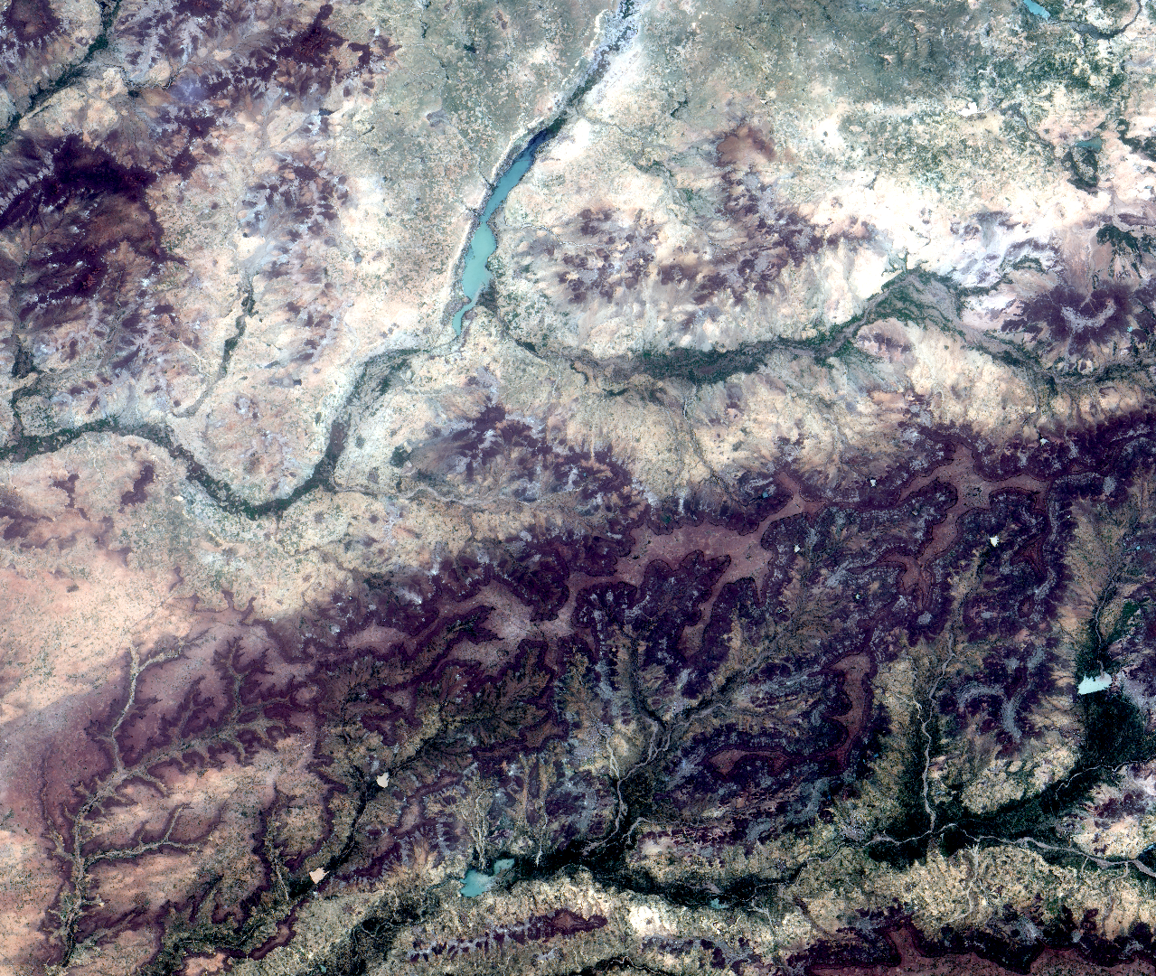
NIGER WATER RESOURCES
Implementing a Global Tool Based on Spatially Continuous Precipitation Analysis for Resiliency Monitoring and Measuring at the Community-Scale
Jared Tomlin
Sean McCartney
Raghda El-Behaedi
Alison Thieme
Ryan Lingo
NASA Goddard Space Flight Center
2017 Summer
Notes:
“Hi, we are the NASA DEVELOP Niger Water Resources team. I’m Jared, the team lead for this project. I’m currently pursuing my masters in Environmental Biology at Hood College.”
“Hi, my name is Didi. I’m pursuing my PhD in environmental anthropology and remote sensing at the University of Chicago.”
“Hi, my name is Alison. I am about to start a PhD in Geographical Sciences at the University of Maryland. Ryan, who could not join us today, is pursuing my masters in geography at Towson University.”

Slide 2
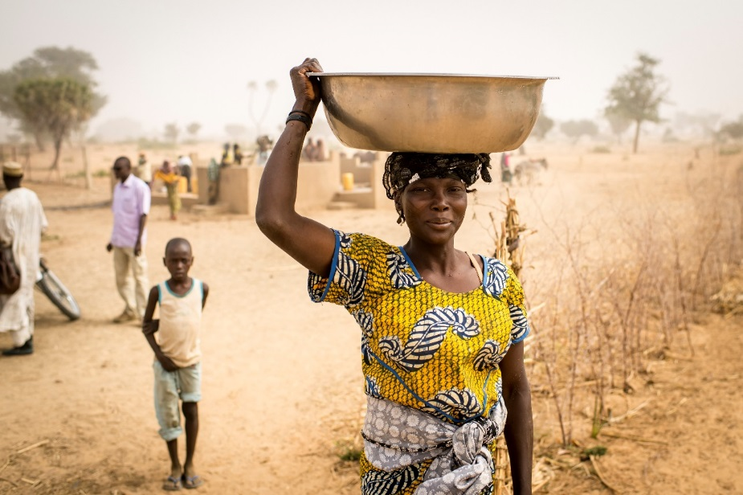
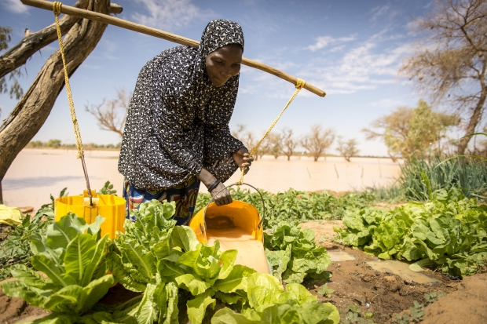
Mercy Corps
Global humanitarian aid agency
Operate on a global scale, partnering with over 40 countries
Assess and act on shocks and stressors
Connect people to resources
Image Credit: Mercy Corps
Notes:
This project grew out of the current NASA and Mercy Corps partnership which has been focused on integrating NASA Earth observations into Mercy Corps decision making process. Mercy Corps is a humanitarian aid agency founded in 1979 and currently operating in more than 40 countries. They evaluate communities through what is termed Strategic Resilience Assessment Process, or STRESS. By understanding a the shocks and stressors that a community faces, they are better able to connect people to necessary resources.
Images
Top: https://www.mercycorps.org/sites/default/files/niger-201402-ssheridan-1761_0.JPG
Bottom: https://www.mercycorps.org/sites/default/files/styles/slideshow/public/niger-201402-ssheridan-0890.JPG

Slide 3
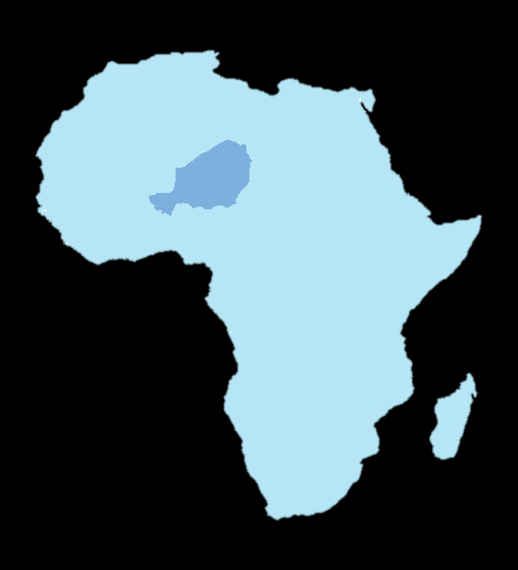
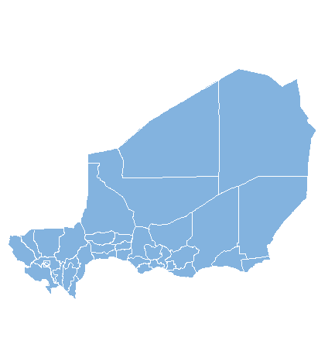
Study Area
Landlocked country in western Africa
Area: 1,267,000 km²
Population: ~20 million
A fifth of the country lies in the Sahel bioregion
Broken up into three main zones: agropastoral, pastoral, and desert
Niger
Africa
0
500
1,000
2,000
Study Period: 1981-2016
Kilometers
Notes:
As an example of how various Earth observations can be useful to the STRESS process, we focused on a large country, Niger. At roughly twice the size of Texas, Niger is made up of two major landscapes: the Sahara Desert and an arid climate called Sahel. Within the Sahel there are two agricultural zones: postoral and agropastoral. The predominant livelihoods are correspondingly herders and farmers.

Slide 4
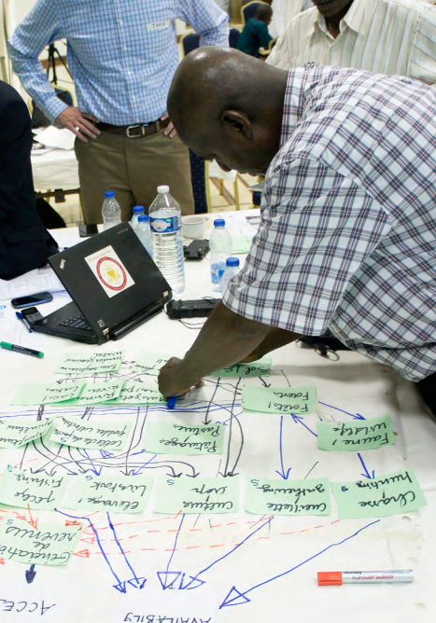
Community Concerns
STRESS Analysis Results:
Conflicts over natural resources
Grain / livestock price variability
Erratic, dispersed rainfall
Loss of pasture and viable land
Image credits: (L) Mercy Corps, (R) Sanjay Gurung 2016
Notes:
In this nation of extreme heat and limited natural resources the potential shocks and stressors on communities are numerous. A recent Mercy Corps STRESS analysis showed poverty, conflict, political instability, and drought are of highest concern. This particular project looks more closely at the community concern of drought.
Chart Left: Page 2 https://www.mercycorps.org/sites/default/files/Niger_STRESS_Capacities%20Summary%20Overview_August%202016.pdf
Image Right: Page 14 https://www.mercycorps.org/sites/default/files/Niger%20STRESS%20Report_English.pdf

Slide 5
Notes:
Considering that most people in Niger rely on rainfed agriculture, water, particularly precipitation, is exceedingly important for their livelihoods. When the rainy season arrives, farmers quickly sow their land. Most often they plant millet, sorghum, or cowpea. However, recently, the rainy season has become increasingly irregular, causing many agricultural issues. Herders that rely on grasses and shrubs face similar difficulties with inconsistent seasons.

Slide 6
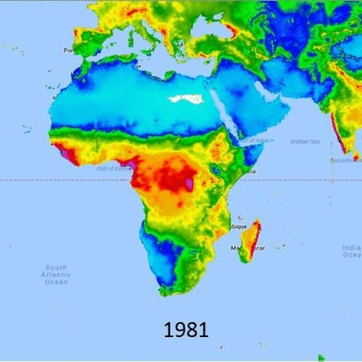
Objectives
CHIRPS Precipitation – 1981 to 2011
Enhance Mercy Corps’ ability to assess the role of precipitation as a shock or stressor in Niger
Address historical precipitation trends to identify the average start of the growing season and any significant deviations
Provide a common structure and interface for decision-making
Notes:
Our main objectives for this project were to enhance Mercy Corps’ ability to assess the role of precipitation as a shock or stressor. In order to accomplish this we sought to address historical precipitation trends and to provide an easy-to-use interface for decision-making.

Slide 7
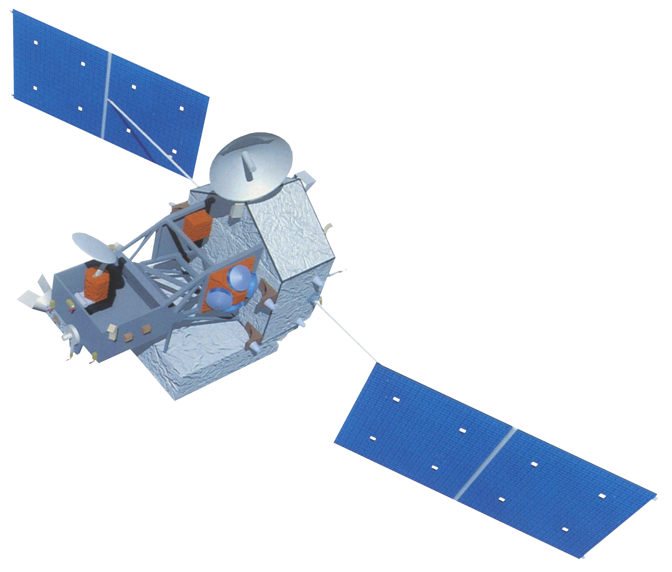
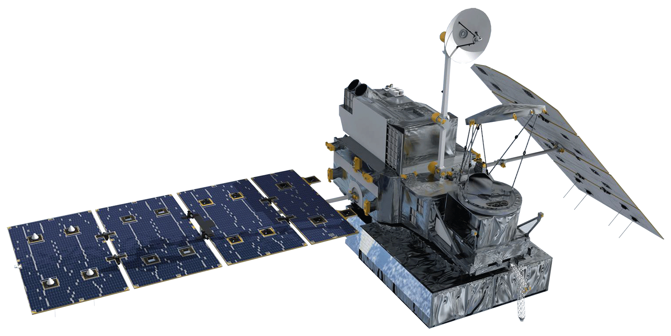
Earth observations
SRTM
TRMM
Terra
GPM
Notes:
We acquired data from four different NASA Earth observations. We utilized SRTM for elevation, TRMM and GPM for precipitation, and Terra MODIS for land surface temperature and vegetation indices.

Slide 8
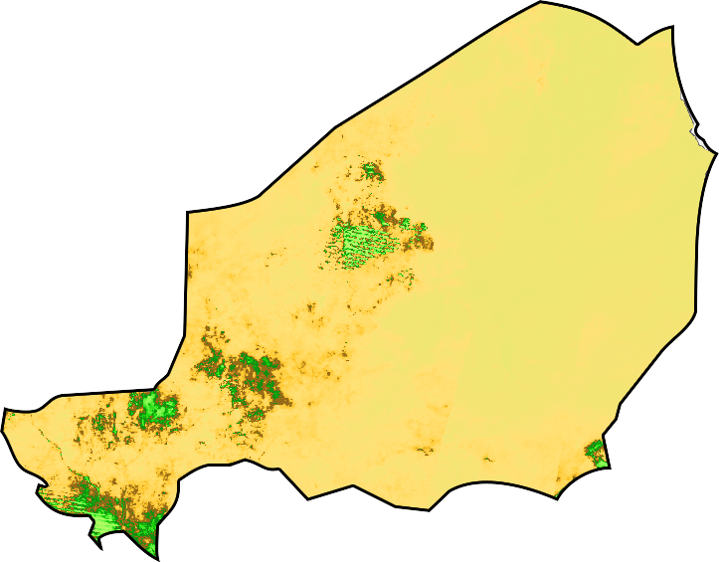
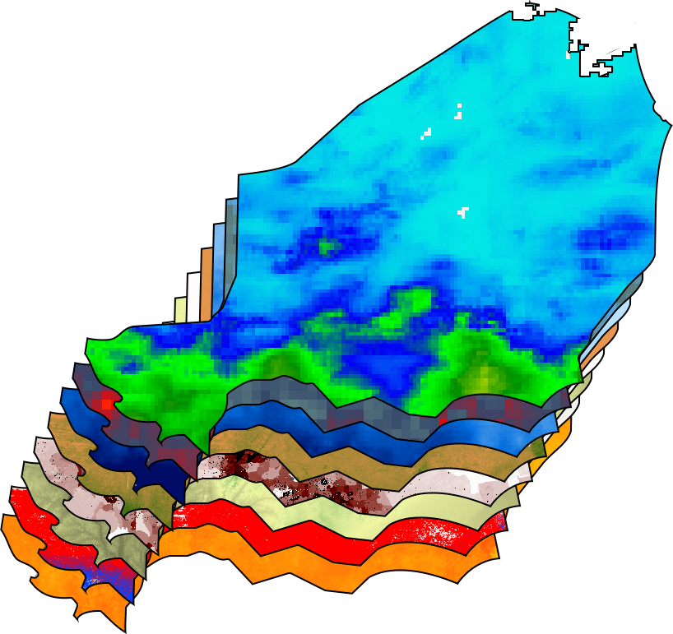
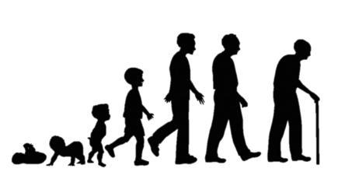
Methodology
Stress and Shock Indices
NASA Earth
Observations
Socioeconomic
Data
Notes:
In order to combine NASA Earth observations and socioeconomic data relevant to Mercy Corps into one easily available system, we selected Google Earth Engine to integrate these datasets. Working with the staff at Mercy Corps, we selected relevant datasets to both the communities and environment specific to Niger.

Slide 9
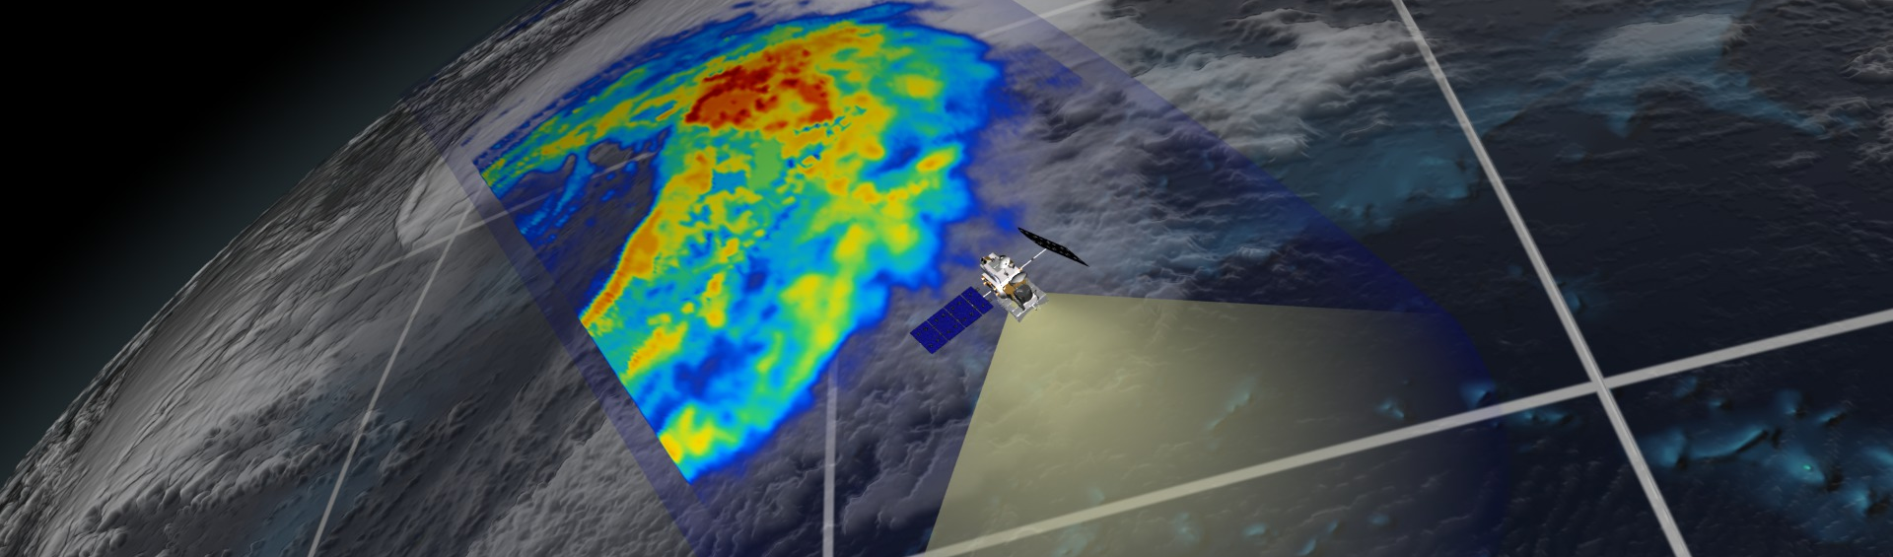
Results
Dynamic layers coded to pull weekly totals and averages
MODIS Normalized Difference Vegetation Index
MODIS Normalized Difference Drought Index
MODIS Land Surface Temperature
TRMM Precipitation
CHIRPS Precipitation
GPM Precipitation (visualized below)
Image credit: Alex Kekesi, NASA Scientific Visualization Studio
Notes:
Within Google Earth Engine we created an easy to use interface which calls on the repositories shown here. The user inputs a specific date and each dataset can be visualized almost instantaneously. For precipitation datasets, weekly totals are presented. For the other datasets and indices, weekly averages are presented.
Image Credit: https://svs.gsfc.nasa.gov/vis/a000000/a004100/a004153/Pac_storm_RRrider_no_dates.0783.jpg

Slide 10
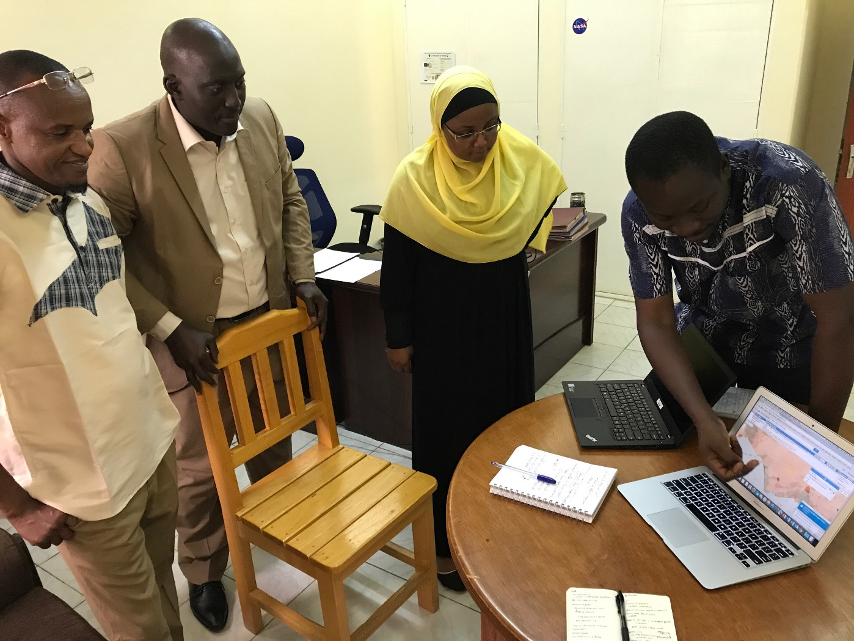
Results
Static layers coded to visualize social and economic data alongside remotely sensed data
DivaGIS Administrative Borders
FEWS NET Agricultural Zones
WorldPop Human Population Density
SEDAC Demographics
Oxford Malaria Infection Rates
ACLED Armed Conflict Events
Image credit: Jamie Favors, NASA
Notes:
While a variety of datasets are relevant to humanitarian aid, few are spatial and up to date. Here we incorporated administrative boundaries and human population density for reference. To give further insights into the regional dynamics, we included the agricultural zones, demographic information, malaria infection rates, and armed conflict events.
Image credit: Jamie Favors, NASA

Slide 11
Results
Seasonal Trend Analysis gives insights into changes in the start and intensity of the rainy season.
NDVI harmonic output and Precipitation 2000 - 2003
MODIS NDVI
CHIRPS Precipitation (mm)
2000
2001
2002
Notes:
As inconsistent seasons present major challenges to the dominant livelihoods in Niger, we decided to perform a seasonal trend analysis to better understand the changing phenology. We used Terra MODIS NDVI to perform a harmonic trend analysis in both TerrSet and Google Earth Engine to learn how season start dates, length, and intensity are changing since 2001. While some areas are experiencing little change, other areas are having shorter, more intense seasons.

Slide 12
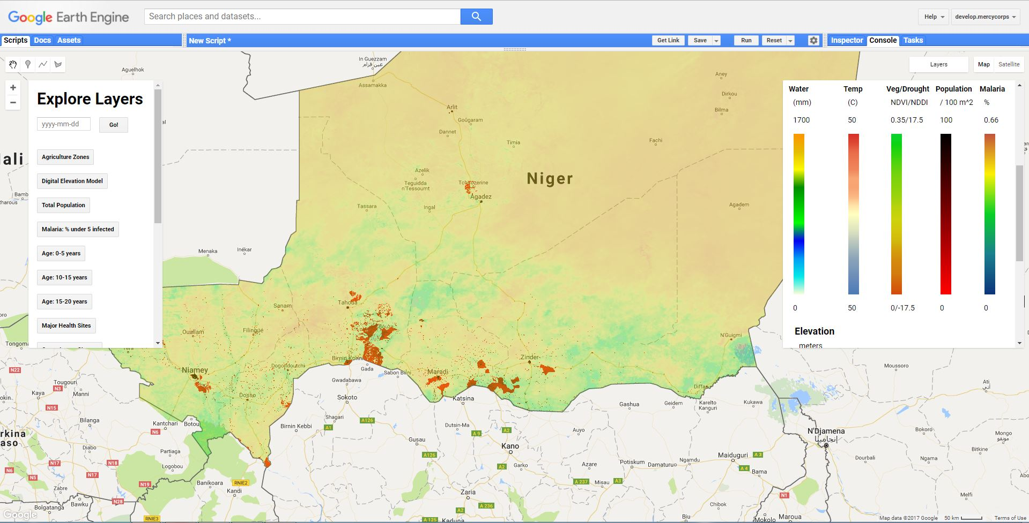
Results
Notes:
Here we are providing a first look at the tool. Notice that there are instructions to orient the user, a simple date selector for viewing dynamic variables, and easy to navigate layers and legends. We were intentionally trying to maximize the usability of the tool so that both scientists and aid workers can utilize all of the functions.
We have also included information on each of the data layers included such as source, resolution, and date.

Slide 13
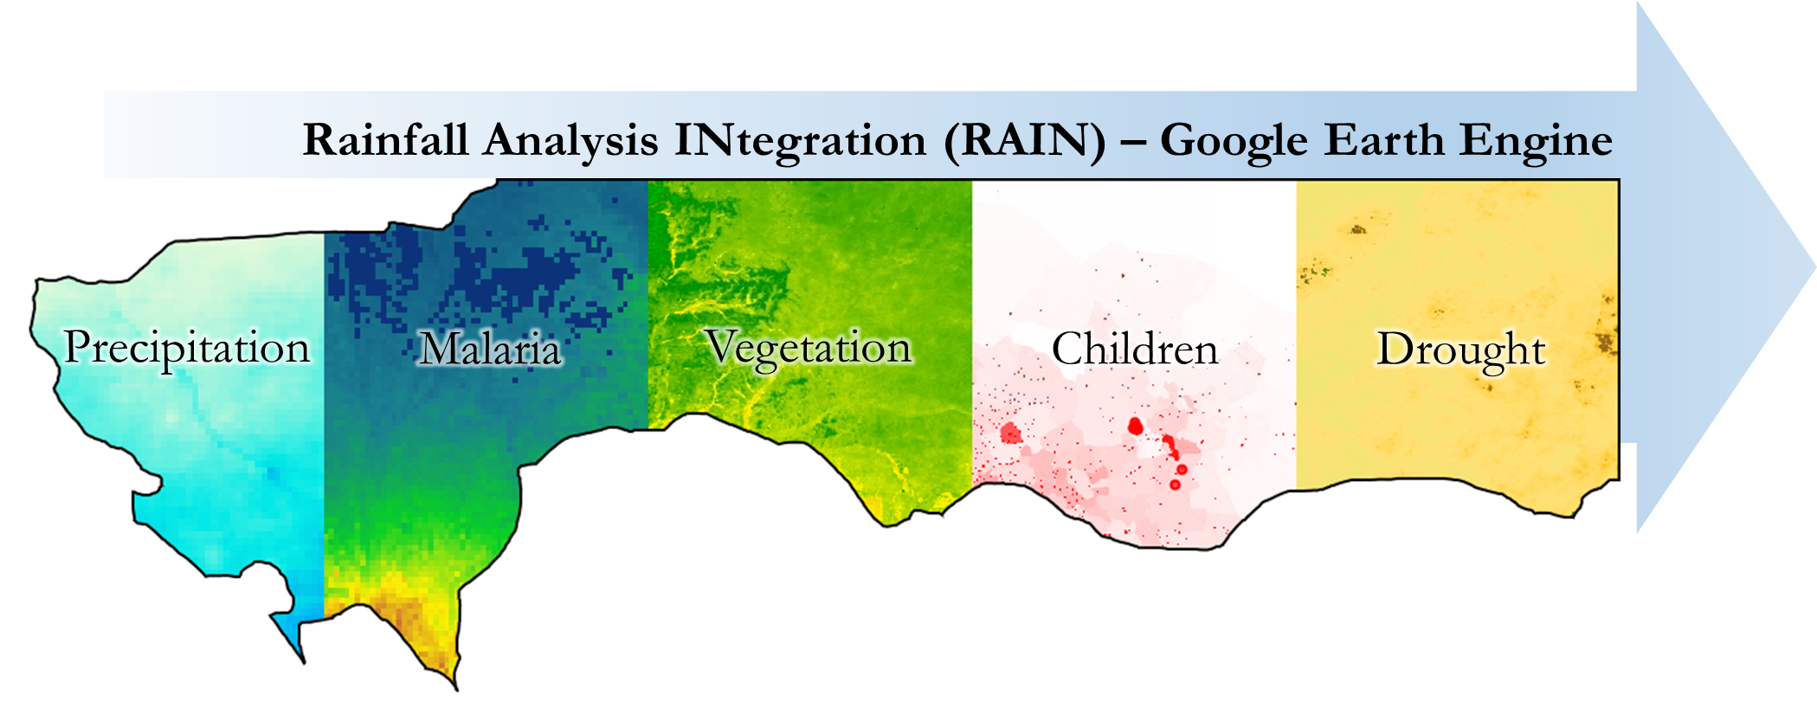
Conclusions
By creating a tool that displays a variety of data types, Mercy Corps is better able to understand the relationships between precipitation and socioeconomic variables.
Notes:
While no single analysis is able to identify the relationships between all these variables, we have created a tool to allow Mercy Corps to visualize multiple shocks and stressors within Niger. This will aid their planning efforts and enhance their understanding of the region.
Image created by Jared Tomlin

Slide 14
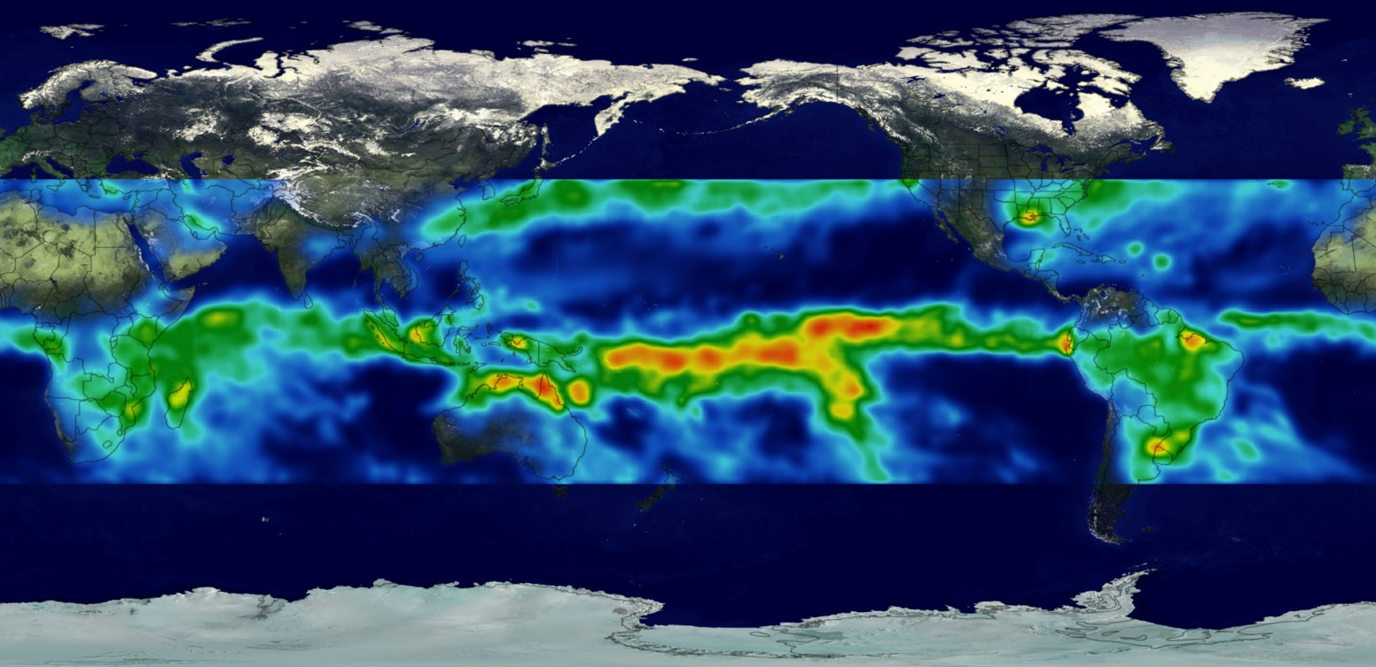
Errors and Uncertainties
TRMM and GPM are calibrated to tropical areas, where there is a lot of rainfall
Less accurate for areas with very little amount of rainfall, such as Niger
There is not much spatial data readily available for the country of Niger
Image credit: NASA GSFC
Notes:
Considering that TRMM and GPM are calibrated to tropical areas, where rainfall is most prevalent, precipitation data for a semi-arid place like Niger might be less accurate. Few datasets are calibrated to such extreme conditions as Niger has some of the hottest and driest inhabited areas in the world.
Image: https://eoimages.gsfc.nasa.gov/images/imagerecords/1000/1017/trmm_3year.jpg

Slide 15
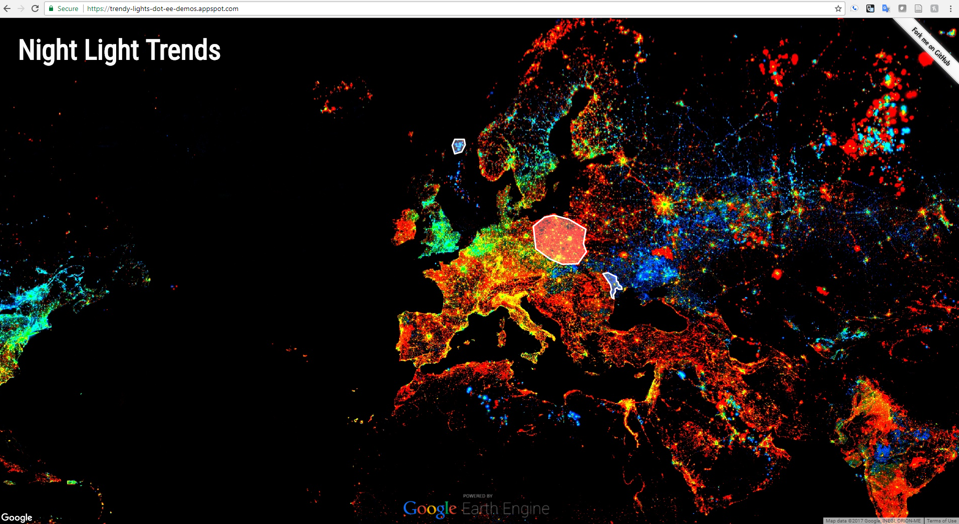
Future Work
Finalize Google App to create web interface
Integrate full groundwater and land cover datasets into the dashboard
Expanding our product to all countries that Mercy Corps has operations
Image Credit: Google App Engine
Notes:
While Google Earth Engine is capable of running complex analyses and hosting small amounts of user data, it is not designed as a stand alone user interface. We hope to create a Google App which would serve as a more user friendly dashboard that is accessible to the public and is tied to a geoserver that can host larger amounts of data such as GRACE groundwater models.
Image: https://trendy-lights-dot-ee-demos.appspot.com/

Slide 16
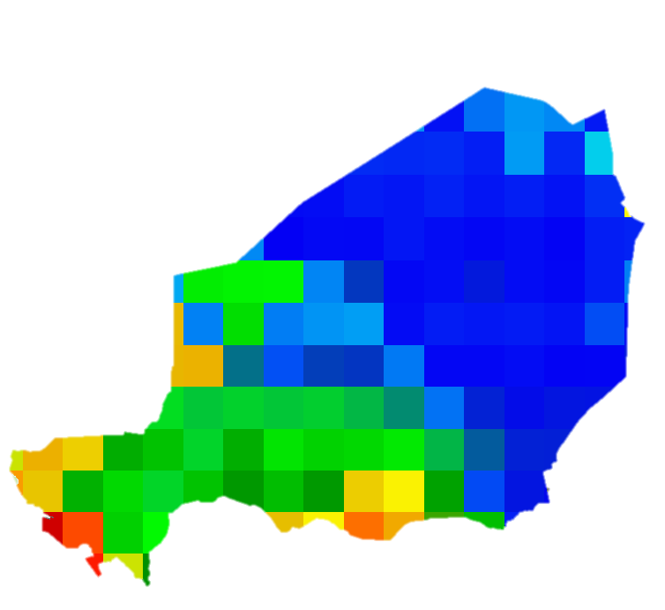
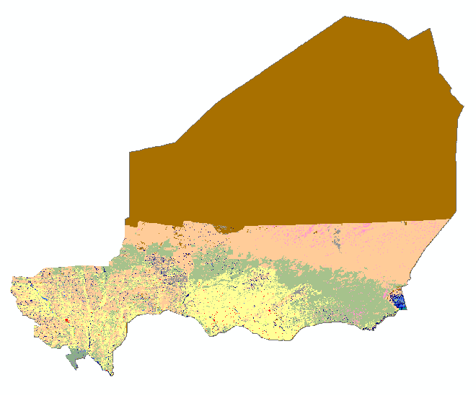
NASA | Mercy Corps Partnership
The NASA and Mercy Corps partnership is working to incorporate GRACE groundwater models and land cover types into the Mercy Corps decision making process.
Rather than establishing a separate tool, NASA scientists have provided sample data
to be incorporated into the NASA DEVELOP tool.
USGS
LCLU
GRACE
Notes:
As the NASA and Mercy Corps partnership continues, teams of scientists here at Goddard Space Flight Center are working to model GRACE groundwater and land cover change. The Google Earth Engine tool is currently designed to allow integration of these datasets as they become available.
These teams have focused initially on Niger and plan to expand the study area to cover all countries that Mercy Corps works currently works in.

Slide 17
Future Work
Creation of a Raspberry Pi based portable computing unit and geoserver
Enable field teams to access and analyze data while offline
Build capacity to deliver near real-time data and technology to individuals at the community level
Image Credit: Adafruit
Notes:
Another future endeavor is the creation of a Raspberry Pi based portable computing unit and geoserver. This technology would allow field teams the ability to both view and analyze data while disconnected from the internet.
Lastly, our main hope is that the type of information we produce and the technology we create is delivered directly to individuals on the community level.
Image: https://cdn-shop.adafruit.com/970x728/3055-08.jpg

Slide 18
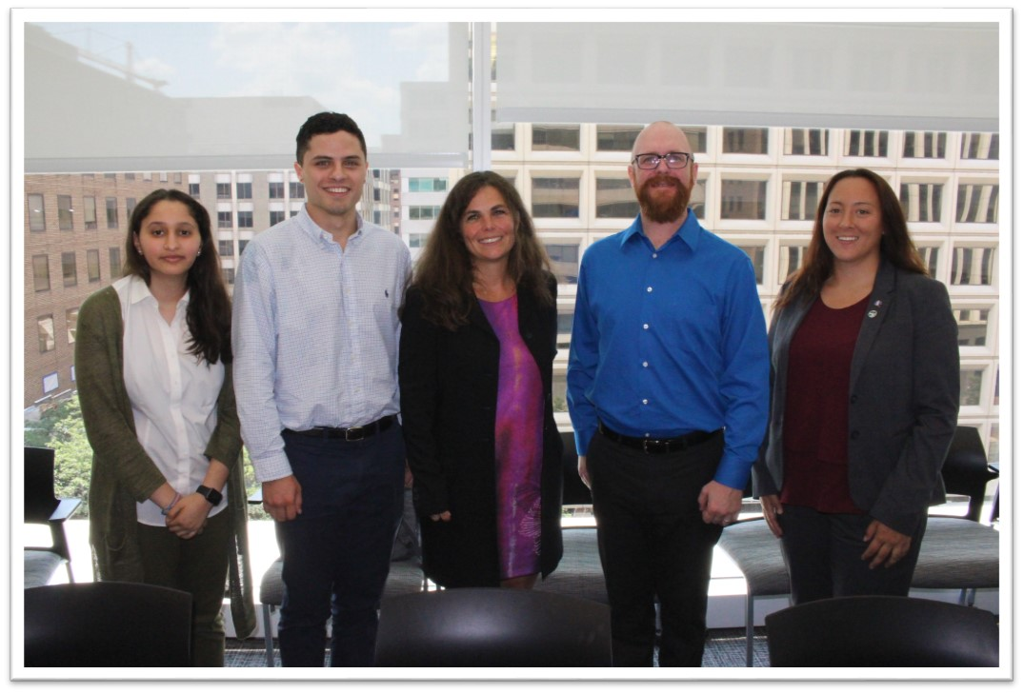
Acknowledgements
Thanks to Théodore Kabore,
Kate McMahon, David Nicholson, Sandrine Chetail and Eliot Levine at Mercy Corps for providing guidance in this effort.
Additional thanks to James Favors, Dr. Eric Brown de Colstoun,
Dr. John Bolten, Dr. Frederick Policelli, Dr. Kenton Ross, and Dr. David Green at NASA for their scientific advising throughout the project.
Image Credit: Sean McCartney
Notes:
We would like to thank Théo, Kate, Sandrine, David and Eliot from Mercy Corps for their outstanding support and guidance. We would also like to thank Jamie Favors, Dr. Bolten, Dr. Ross, Dr. Policelli, Dr. De Colstoun, and Dr. Green from NASA for their advising throughout the duration of this project.
Image credit: Sean McCartney, NASA DEVELOP

