Slide 1
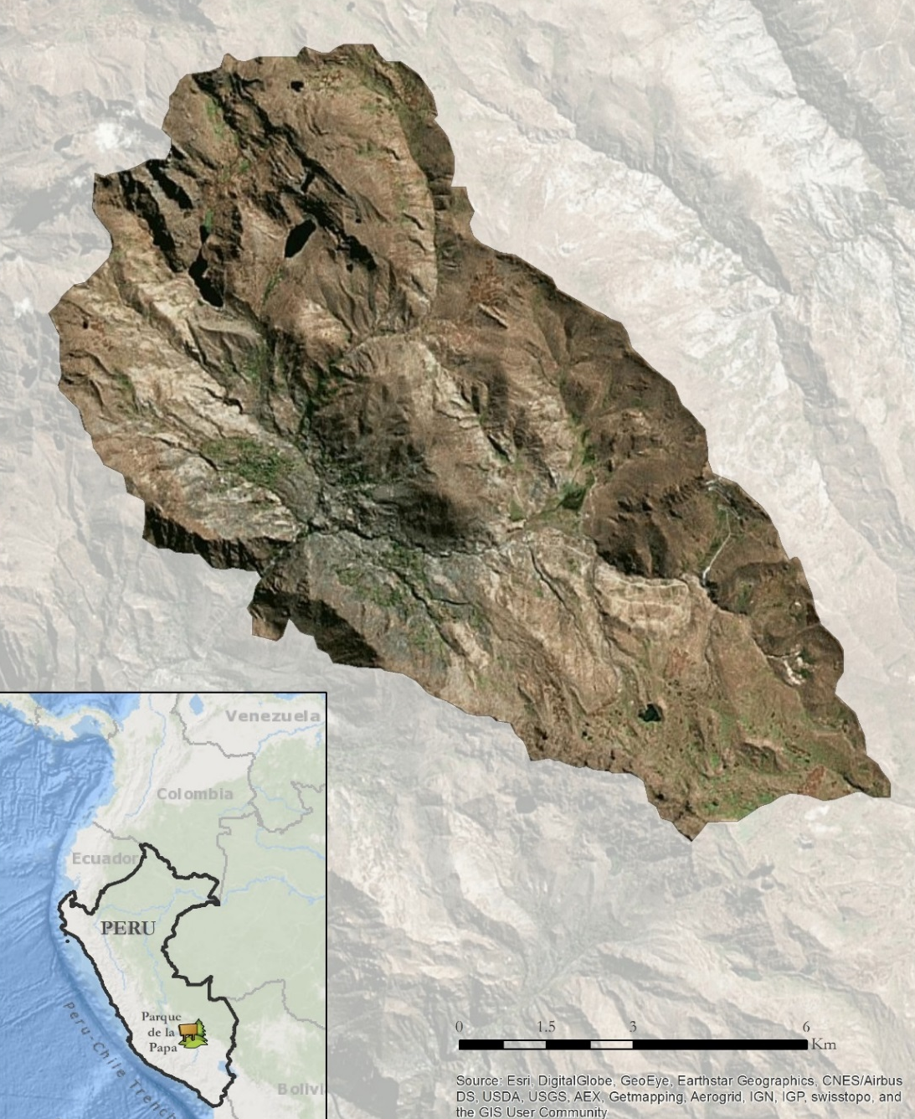
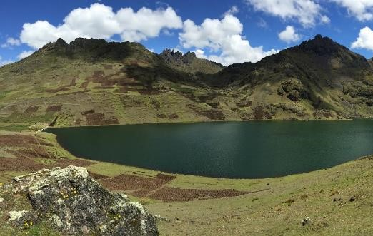
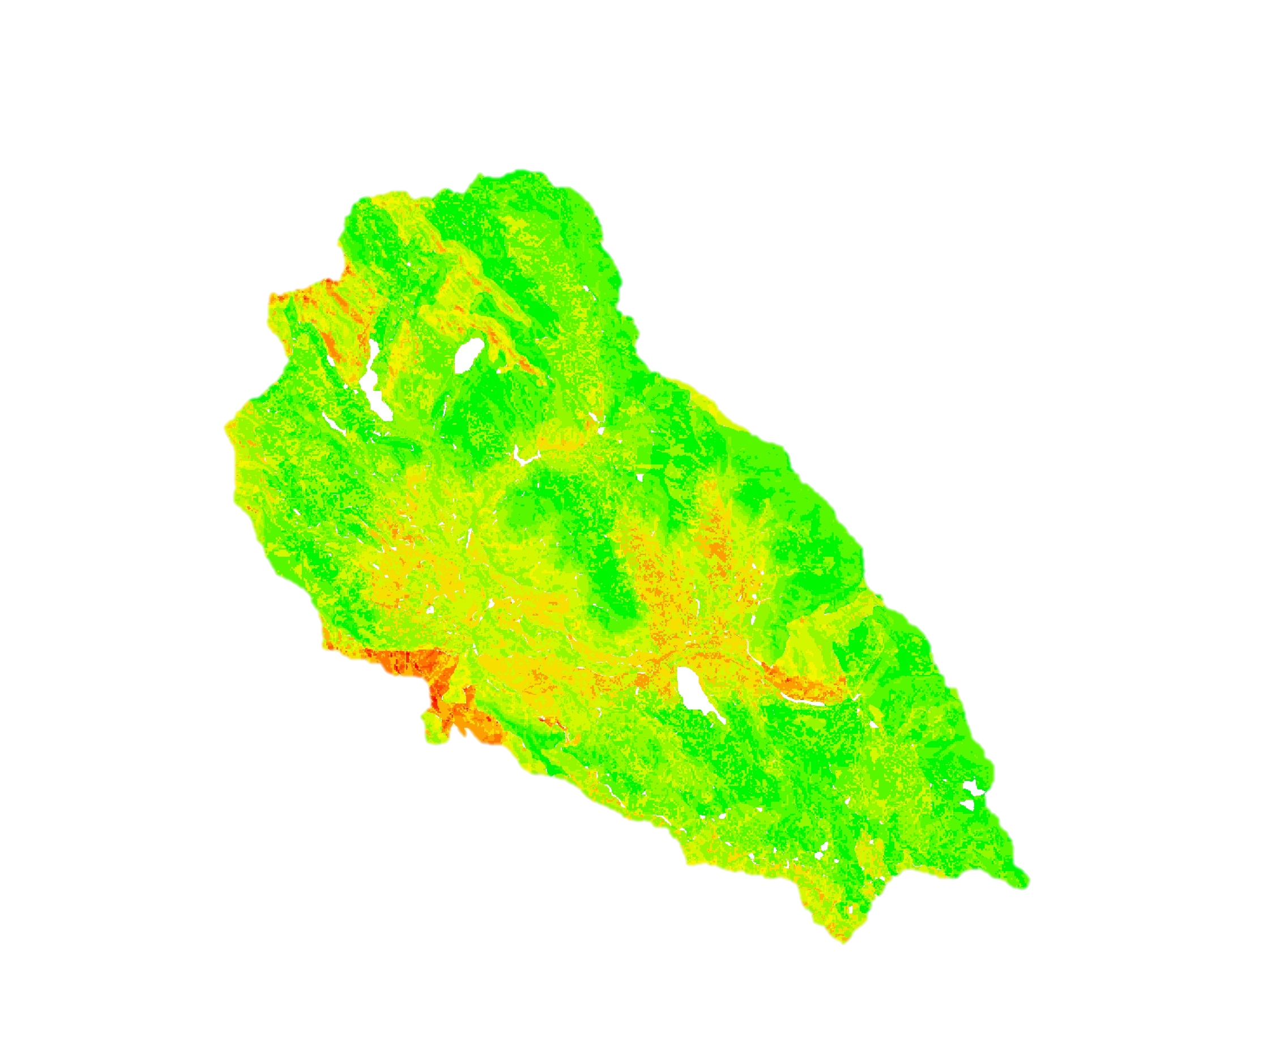
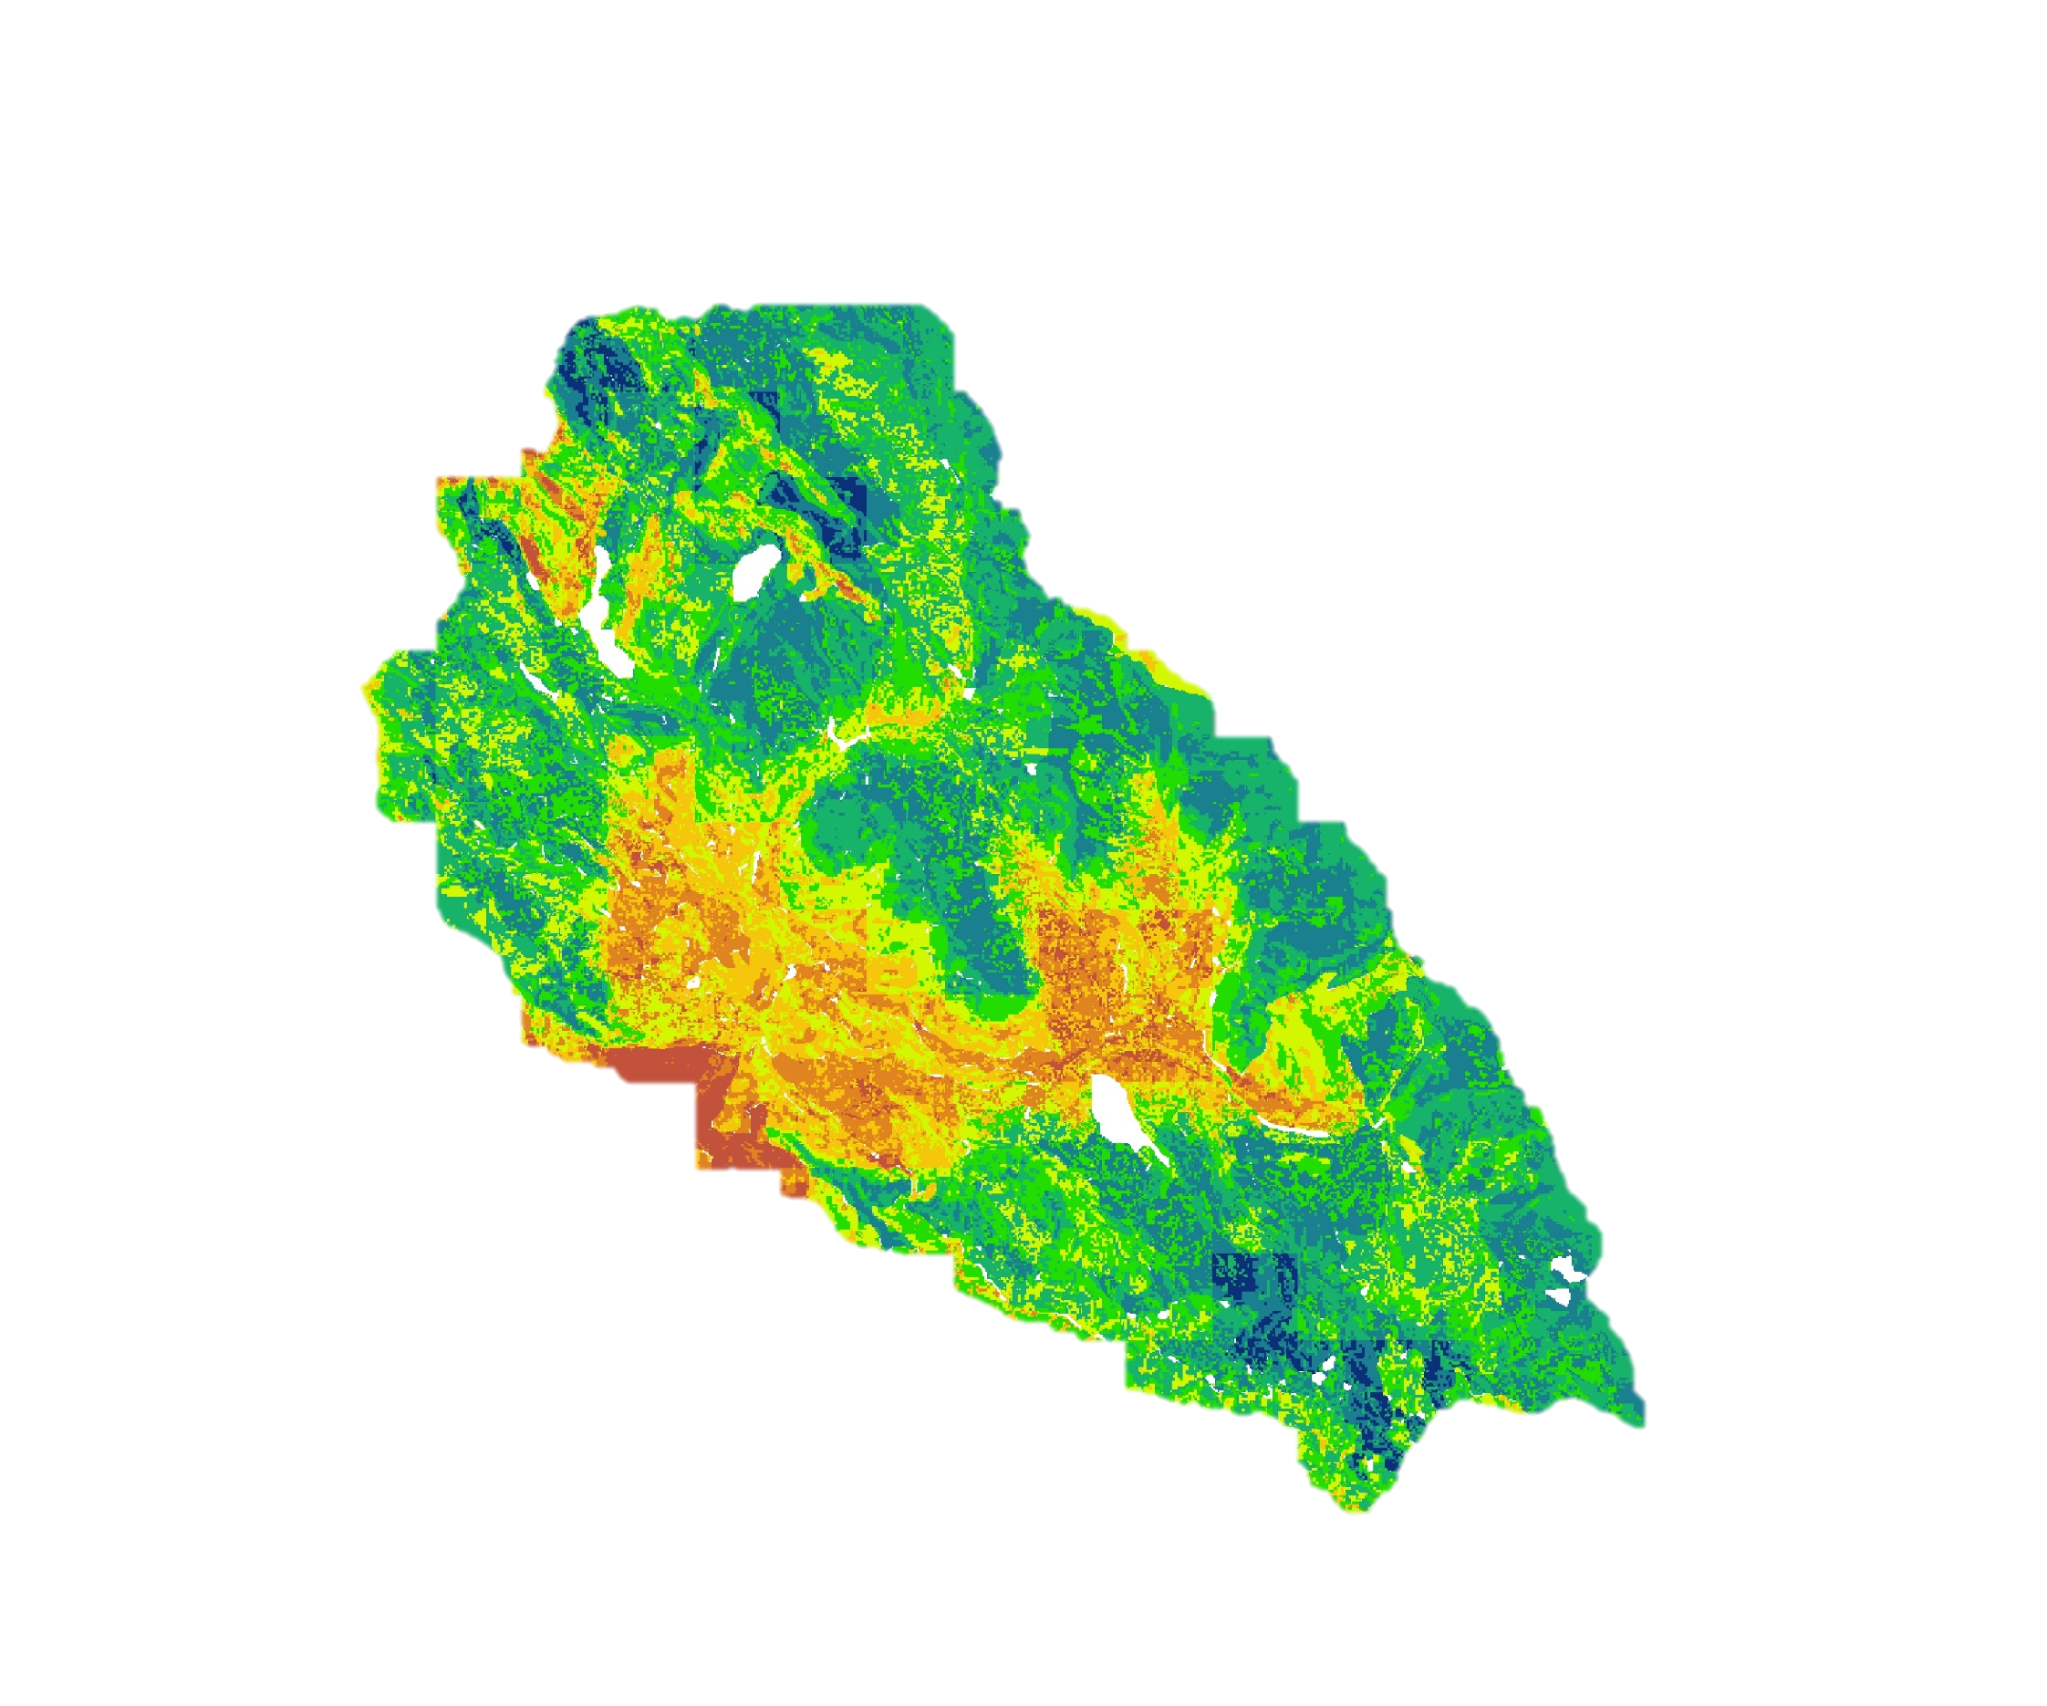
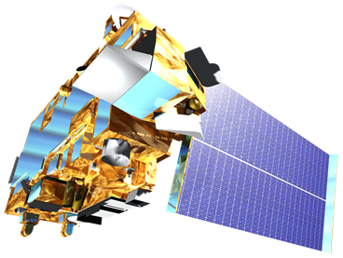
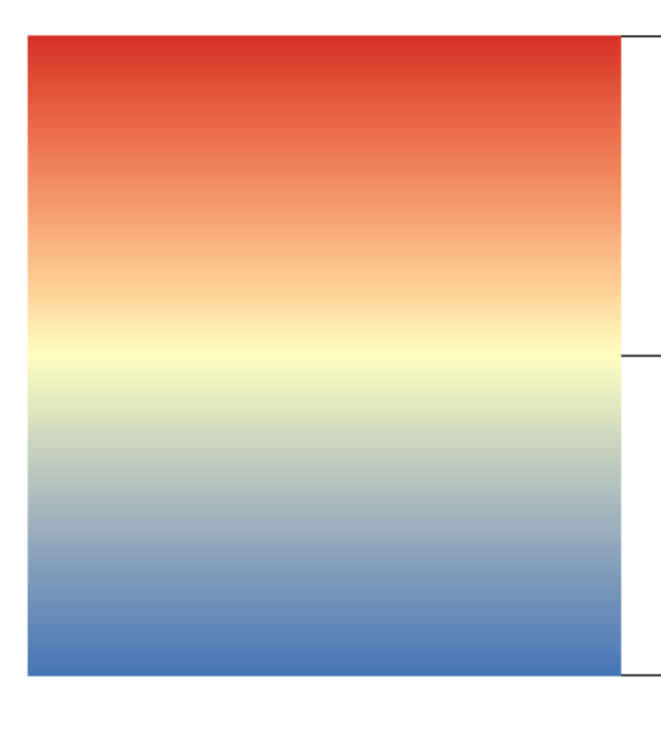
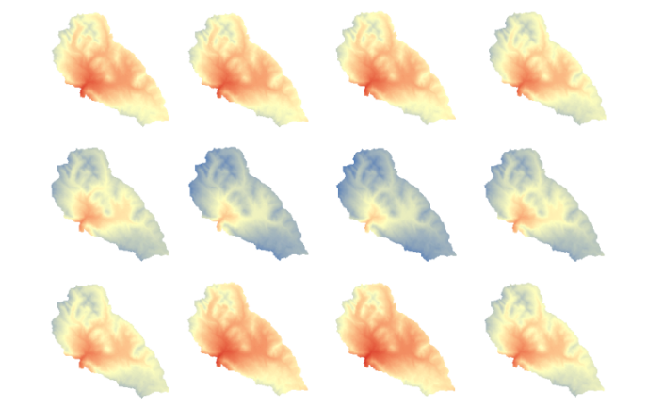
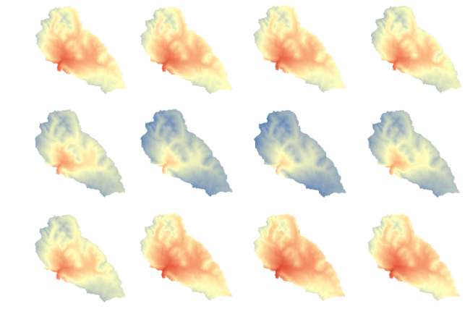
Monitoring and Forecasting Shifting Climate and Land Change Impacts in Perú’s Parque de la Papa for Enhanced Agricultural Management
Abstract
Objectives
Agricultural systems in tropical montane regions are particularly vulnerable to global climate change. Farmers at Parque de la Papa, located in the Peruvian Andes, have been forced to higher elevations seeking suitable growing conditions for the potato varieties they have cultivated for centuries. The primary threat to native potatoes is increased temperatures causing mortality from pests and diseases. In particular, rising temperatures have led to increases in the population and habitat range of the Andean potato weevil, Premnotrypes spp. A combination of traditional knowledge and remote sensing was used to create a suitability model that identified areas currently suitable for potato cultivation using traditional methods. Additionally, a risk assessment model was developed to forecast areas unsuitable for farming in the future. The results will be given to the International Center for Potatoes (CIP) and the Association for Nature and Sustainable Development (ANDES) to enhance agricultural management and decision-making for preserving traditional practices.
Create a suitability model to identify areas for optimal potato cultivation
Develop a risk assessment model to forecast unsuitable areas for potato cultivation in the future
Provide project partners with outreach materials
Enable indigenous communities to continue using traditional agricultural practices
Study Area
Parque de la Papa, Perú
Area: 8,661 ha
Elevation: 3,200-5,000 m
Indigenous Population: 7,000
Potato Varieties: 300
Methodology
Data Acquisition
Data Processing
Data Analysis
Landsat 8 OLI
Terra ASTER
Climate Data
Soil Capacity
Atmospheric Correction
Re-project DEM
Calculate Monthly Averages
Digitize Soil Data
Unsupervised Classification
Derive Slope & Elevation
Environmental Lapse Rate
Soil Classification
Model Input Data
Land Cover
Slope
Elevation
Temperature
Soil Capacity
End Products
Earth Observations
Potato Suitability Model
Risk Assessment Model
Results
Current Potato Suitability
Future Risk Assessment
High Suitability
Low Suitability
Low Risk
High Risk
Landsat 8 OLI
Terra ASTER
Conclusions
NASA satellite data were successfully used to model current and future suitability for potato cultivation within the Parque de la Papa.
The potato suitability model incorporated multiple datasets, including local knowledge, that identified areas of high and low suitability.
The future risk assessment model, based on 2050 climate projections, suggested an increase in at-risk areas.
NOAA climate data provided information about temperature trends of El Niño vs. non El Niño periods over the past 42 years.
The suitability and risk assessment models are flexible and can be adjusted by the user to inform current and future management plans that promote traditional agricultural practices.
Perú Climate III
Average temperature for El Niño years between 1973-2015
14.4°C
2.2°C
Average temperature for non-El Niño years between 1973-2015
January
February
March
April
January
February
March
April
Project Partners
International Potato Center (CIP)
Association for Nature and Sustainable Development (ANDES)
May
June
July
August
May
June
July
August
Acknowledgements
September
October
November
December
September
October
November
December
We would like to thank our science advisors: Dr. Sergio Bernardes and Dr. Marguerite Madden
Great thanks to the members of CIP and ANDES: Genesis Abreu, Noelle Barkley, David Ellis, and Rene Gomez
We would also like to acknowledge the previous work of the Perú Climate I and II teams: Dajon Begin, Brandon Hays, Kayla McDonald, Rebekke Muench, Benjamin Page, Richard Rose, Adam Salway, Michael Sclater, Sam Weber, Ryan Murphy, and Xuan Zhang
Any opinions, findings, and conclusions or recommendations expressed in this material are those of the author(s) and do not necessarily reflect the views of the National Aeronautics and Space Administration. This material is based upon work supported by NASA through contract NNL11AA00B and cooperative agreement NNX14AB60A.
Team Members
Caren Remillard
Project Lead
Shirin Esmaeili
Dorris Scott
Parul Singh
University of Georgia – Summer 2016
Notes:
1973 – 2015 period
Service Layer Credits: Source: Esri DigitalGlobe, GeoEye, Earthstar Geographics, SNES/Airbus DS, USDA, USGS, AEX, Getmapping, Aerogrid, IGN, IGP, Swisstopo, and the GIS User Community

