Slide 1
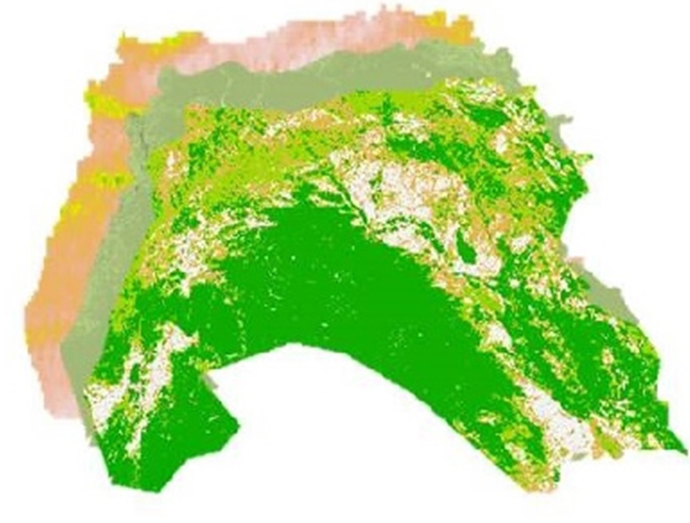
LEVANT & CENTRAL AMERICA CLIMATE II
Evan Henry (Project Lead)
Patrick Pierce
Lauren Cater
Enhancing Drought Monitoring and Prediction Capabilities of the US Air Force, 14th Weather Squadron in Levant and Central America
Notes:
Your project VPS Image should be placed behind the top aperture shape. An example shape has been placed in this position for your reference. Delete the example VPS image, insert your image, right click your image and select the “Send to Back” option. Position and adjust the size of your image so that it lines up with the provided margin rulers.

Slide 2
Study Area
Study Period:
July 2002 to October 2014
Image: Created by Team
Basemap: Mapbox, OpenStreetMap, Carto
Notes:
Basemap: Mapbox, OpenStreetMap, CARTO
Inset Map: Esri, USGS, NOAA, DeLorme, NPS
The study area for this project consists of 13 countries spread over 2 regions.
The Levant: consisting of Syria, Lebanon, Jordan, Israel, and Iraq is considered one of the most arid regions in the world
Central America: consisting of Guatemala, El Salvador, Hondoras, Nicaragua, Costa Rica, Panamá, as well as, Columbia and Venezuela and has a “Dry Corridor” experiencing a wide range of climatic differences
The study period for this project is from July 2002 to October 2014, the longest continuous time period that data sources were in operation.

Slide 3
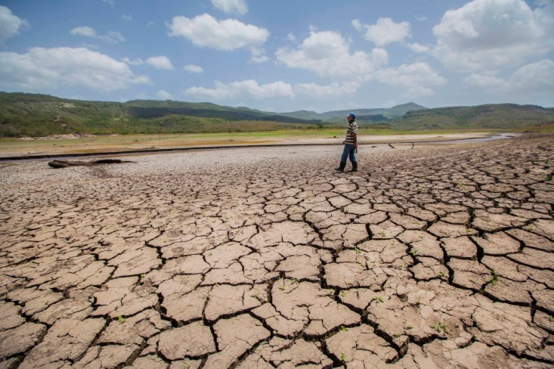
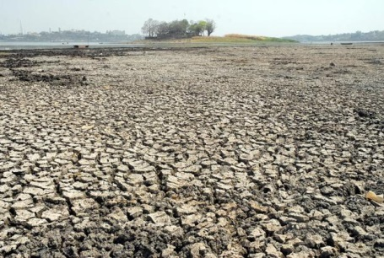
Community Concerns
Central America region Drought 2014
Drought
Precipitation variation
High temperature
High evapotranspiration
Implications
Agriculture
Water quality and quantity
Economic productivity
Socially and Politically
Conflict and civil unrest
Image Credit: Mint
Drought in Levant region of eastern Mediterranean 2016
Image Credit: Diana Ulloa
Notes:
Central America drought image - http://www.ticotimes.net/2014/08/07/drought-hits-central-americas-crops-cattle
Levant drought image - http://www.livemint.com/rf/Image-621x414/LiveMint/Period1/2016/03/03/Photos/drought.jpg
The primary concern in the Levant and Central America regions is extreme variations in precipitation, resulting in drought. The two regions have experienced an increase in extreme weather events in recent years. The implications of these events are varied, but include potential impacts on agriculture, water quantity and quality, economic productivity, and social and political systems. Without the proper amount of water, it is impossible to grow crops, which affects not only nutrition in the surrounding areas, but also impacts economic productivity. This leads to social and political chaos and eventually conflict and civil unrest because of agricultural failures. The conflict and civil unrest due to extreme weather is of particular concern to the US defense and intelligence communities.

Slide 4
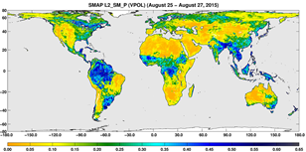
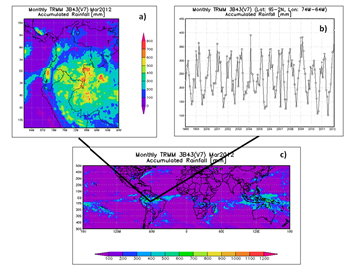
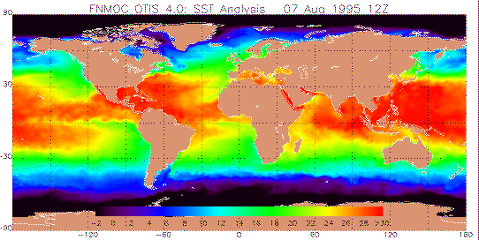
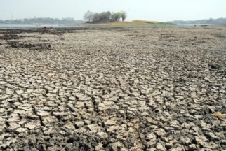
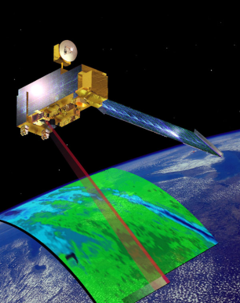
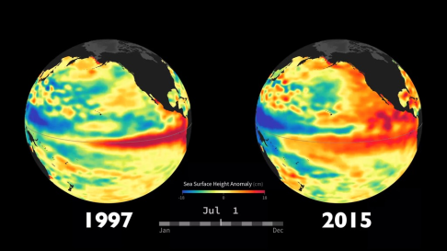
United States Air Force 14th Weather Squadron
Project Partners
Monitoring
Analysis
Prediction
End Users
Image Credit: Tico Times, Mint, and Defense
Notes:
SMAP image - http://www.nasa.gov/sites/default/files/thumbnails/image/pia19877_smap_l2smp_0825-0827_d.png
Terra image – https://www.nasa.gov/sites/default/files/images/738537main_mopitt-EOSAM1_2.jpg
NASA ESDIS image - http://disc.sci.gsfc.nasa.gov/gesNews/trmm_v7_multisat_precip/image_large
SST image - http://geosci.sfsu.edu/courses/geol102/graphics/kareng/world.temp_07895.gif
Anomalies image - http://en.people.cn/NMediaFile/2016/0321/FOREIGN201603210101000097050122938.jpg
Central America drought image - http://www.ticotimes.net/2014/08/07/drought-hits-central-americas-crops-cattle
Levant drought image – http://www.livemint.com/rf/Image-621x414/LiveMint/Period1/2016/03/03/Photos/drought.jpg
Defense image - http://media.defense.gov/2014/Oct/20/2000948836/-1/-1/0/141019-F-VT419-207.JPG
Our partners for this project are the United States Air Force 14th Weather Squadron, interested in the drought conditions and precipitation patterns of our study regions for increased response for military decision-making and crisis aid.
Monitoring regions that are vulnerable to water resource stress can help the Air Force better assist areas susceptible to conflict.
The 14th Weather Squadron is part of the 2nd Weather Group in the United States Air Force.
Mission statement: “Collect, protect and exploit authoritative climate data to optimize military and intelligence community operations and planning.”
Monitoring: Use remote sensing and in situ data for a variety of variables but focus heavily on precipitation.
Analysis: Analysis of weather and climate data is used to aid in military decision-making
Prediction: Using the analyzed data to predict based on patterns.
End Users: Most of their data is used to help the Department of Defense. The Squadron also provides environmental and climatic information to the United States Air Force, the Army, and the Intelligence Community.

Slide 5
Objectives
Enhance the 14th Weather Squadron’s capacity to monitor drought in the study regions
DEVELOP a robust drought model using a machine learning approach
Compare performance of model within and across both study regions
Image Credit: Theo Beentjes
Notes:
Image: http://www.juniortouchchamps.org/files/armadillo/media/ppc.png
The objectives for this project include:
Enhance the 14th Weather Squadron’s capacity to predict and monitor drought in the study regions
Create a robust drought model utilizing a machine learning approach
Compare the performance of the model created within and between the two study regions using both TRMM precipitation data and CMORPH precipitation datasets for confidence

Slide 6
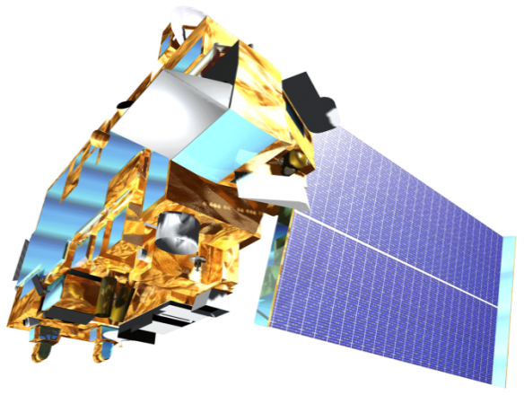
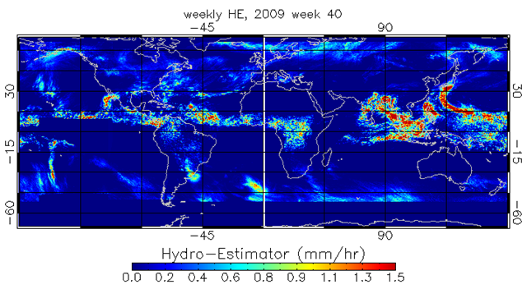
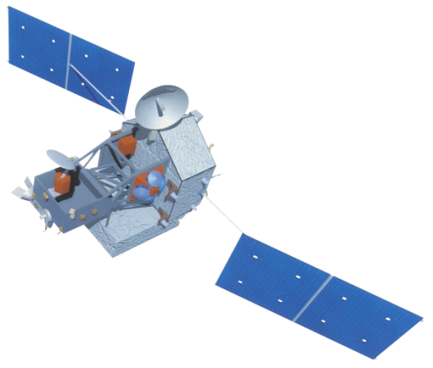
Earth Observations
Terra & Aqua – MODIS sensor (NASA)
Land Surface Temperature (LST)
Monthly, 1 km
Evapotranspiration (ET)
Monthly, 1 km
Normalized Difference Vegetation Index (NDVI)
Monthly, 250 m
CPC CMORPH – (NOAA)
Precipitation
Daily, 8 km
Tropical Rainfall Measuring Mission(TRMM) - NASA/JAXA
Precipitation
Monthly, .25°
Image Credit: DigitalGlobe, Inc.
Notes:
Satellite images from DEVELOPedia at http://www.devpedia.developexchange.com/dp/index.php?title=List_of_Satellite_Pictures
CMORPH image from http://www.star.nesdis.noaa.gov/smcd/emb/vci/images/CMORPH/cmorph.daily.20160101.png
The Earth Observations used consist of:
The Terra – MODIS sensor from NASA to acquire Land Surface Temperature (LST), Evapotranspiration (ET), and Normalized Difference Vegetation Index (NDVI), each at monthly temporal resolution. Spatial resolution is 1 km for LST and ET while NDVI is at 250 m spatial resolution.
Also using Tropical Rainfall Measuring Mission, or TRMM, for precipitation at monthly temporal resolution and .25 degree spatial resolution.

Slide 7
Data Acquisition
Drought Related Parameters
Terra – MODIS Sensor
NDVI
LST
ET
Satellite Precipitation
Tropical Rainfall Measuring Mission (TRMM)
CPC CMORPH
Drought Index (in situ)
Global Precipitation Climatology Centre (GPCC)
1- 3- 9- and 24- month moving average indicies
Notes:
Data was downloaded and processed from their original data formats into GeoTIFF, cropped to the boundaries of the two study regions, and scaled temporally to 1 month and spatially to 1 degree using R statistical programming language
- NDVI and LST were downloaded through USGS’s EarthExplorer as GeoTIFFs
- ET was downloaded from NASA/ The University of Montana Numerical Terradynamic Simulation Group (NTSG)
- TRMM was downloaded from NASA’s Goddard Earth Sciences Data and Information Services Center (GES DISC) server
- CMORPH was downloaded as binary from NOAA-NCEI’s server
- GPCC was downloaded directly from the GPCC site as NetCDF

Slide 8
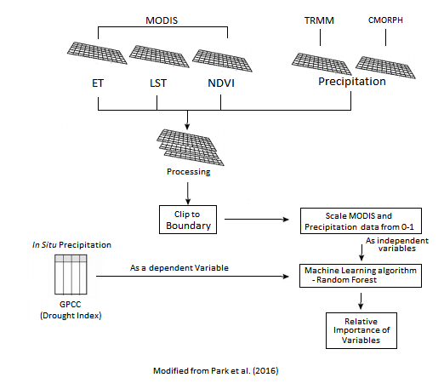
Methodology
Data Processing
Scale data:
1 month temporal resolution
1° spatial resolution
0 – 1 data normalization scaling for independent variables
Random Forest Modelling: 16 Models
1 model per study region (2), precipitation dataset (2), and drought indices (4)
1001 trees
Split data 80% training dataset
20% validation dataset
Image Credit: Digitalhead
Notes:
Image: https://d3njjcbhbojbot.cloudfront.net/api/utilities/v1/imageproxy/https://coursera.s3.amazonaws.com/topics/ml/large-icon.png
The methodology of this project will closely follow the methodology from Park et al. (2016) where a machine learning approach was taken for an arid and a humid location in the United States and were modified accordingly to better suit this project’s study region.
Data will be analyzed and model a relationship through the machine learning algorithm between each of the drought factors and the drought condition from GPCC DI, the dependent variable in the equation.
The machine learning algorithm used is Random Forest and was chosen for its ability to avoid overfitting and sensitivity problems in two ways: out-of-bag randomization for the training dataset and at the node selection at each tree (Park et al. 2016). Both data sets were modeled using each of the 1-, 3-, 9-, and 24-month drought index dependent variables

Slide 9
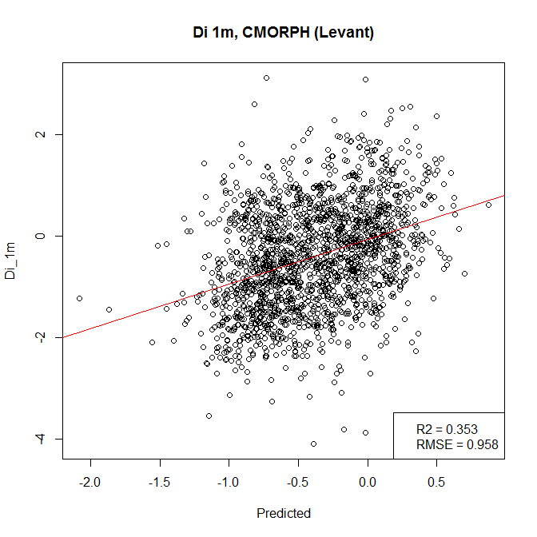
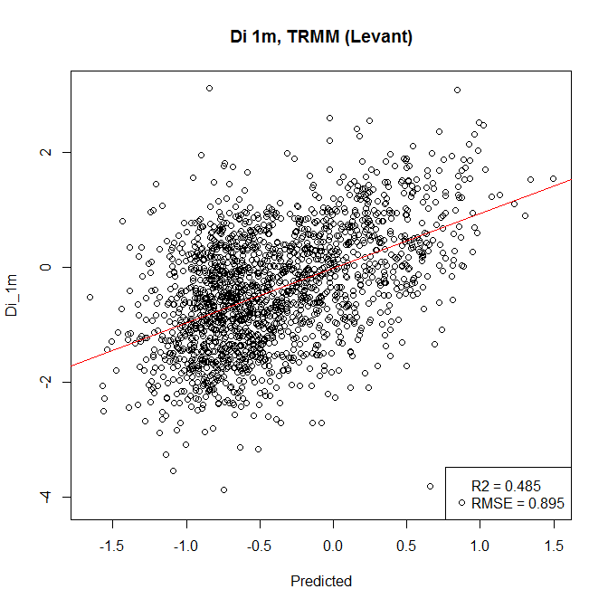
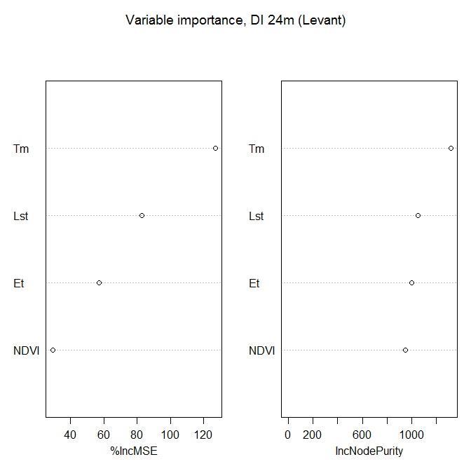
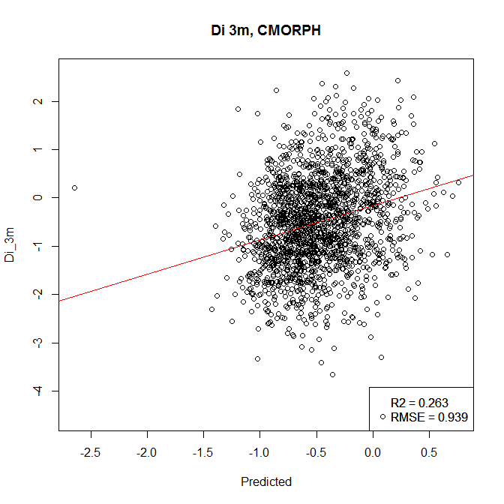
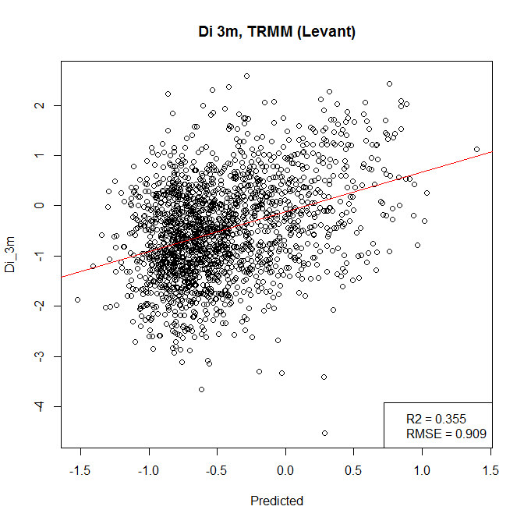
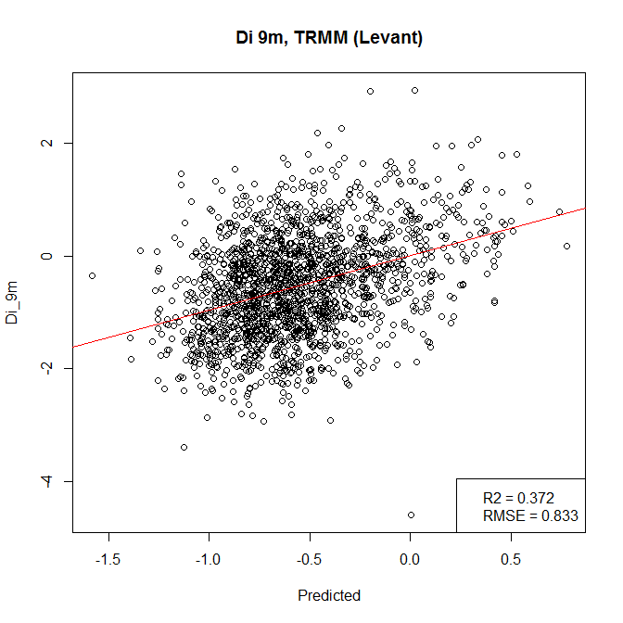
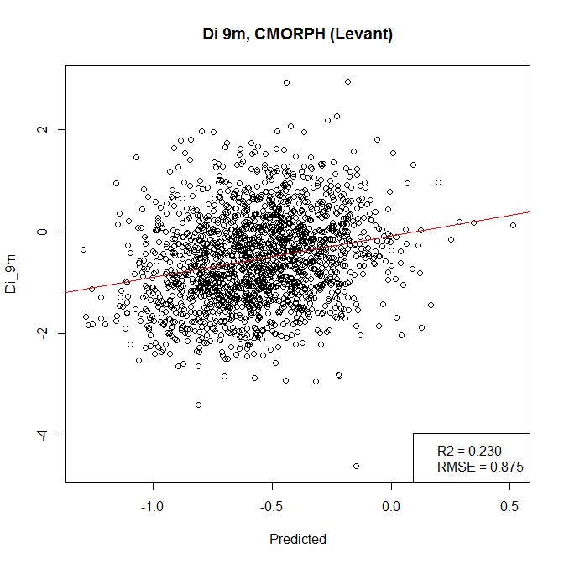
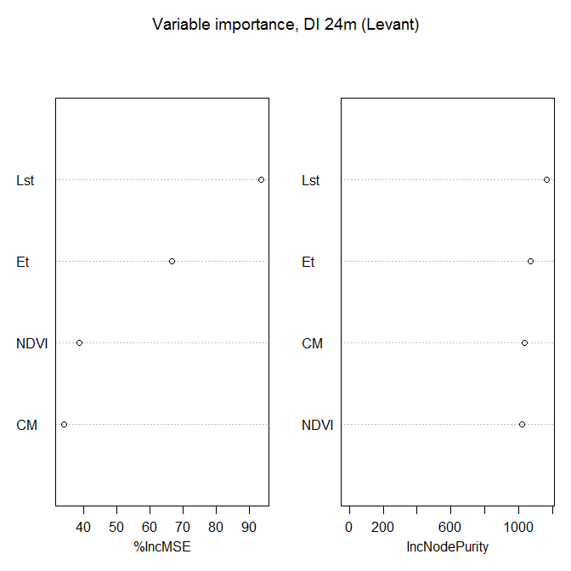
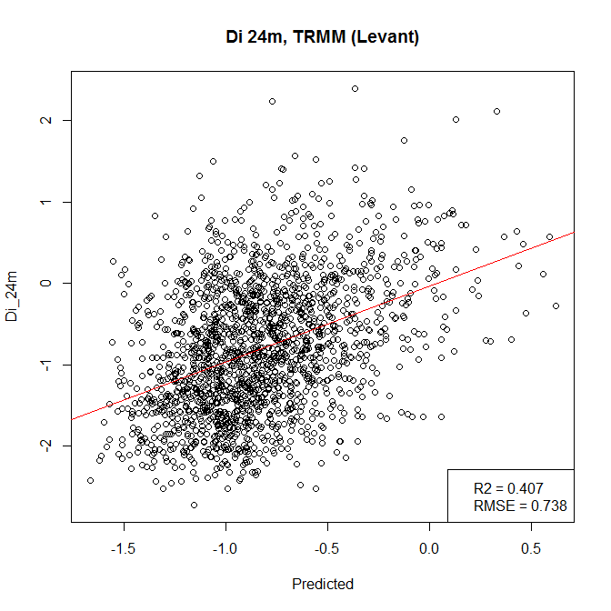
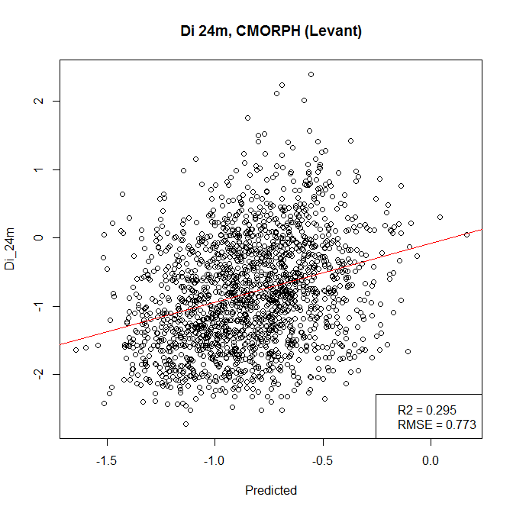
Data Analysis
Model Performance:
Variable importance
%Inc MSE: Larger value ~ predictor importance
Drought Prediction Analysis
Pearson’s Correlation Coefficient (r²)
Between actual drought index values from test dataset and predicted
RMSE
Notes:
The final processes would be using the Pearson’s Correlation Coefficient, or R-squared, and RMSE to compare the performance results and identify relative importance of remotely sensed drought factors.
%IncMSE - It is computed from permuting test data: For each tree, the prediction error on test is recorded (Mean Squared Error - MSE ). Then the same is done after permuting each predictor variable. The difference between the two are then averaged over all trees, and normalized by the standard deviation of the differences. If the standard deviation of the differences is equal to 0 for a variable, the division is not done (but the average is almost always equal to 0 in that case). Higher the difference is, more important the variable. MSE = mean((actual_y - predicted_y)^2)

Slide 10
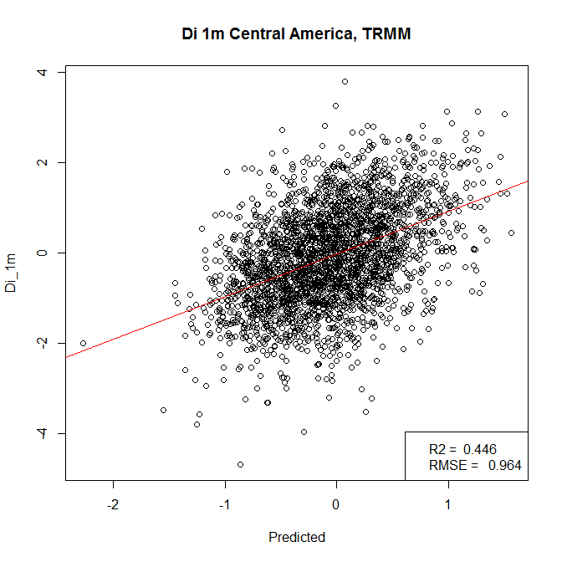
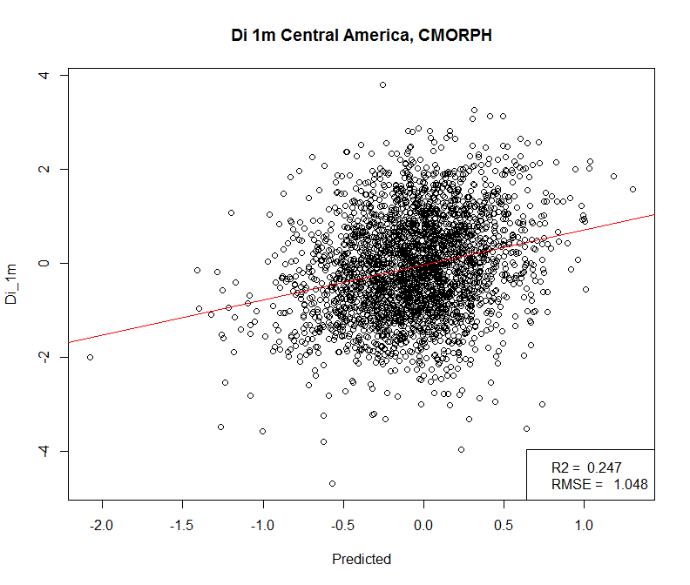
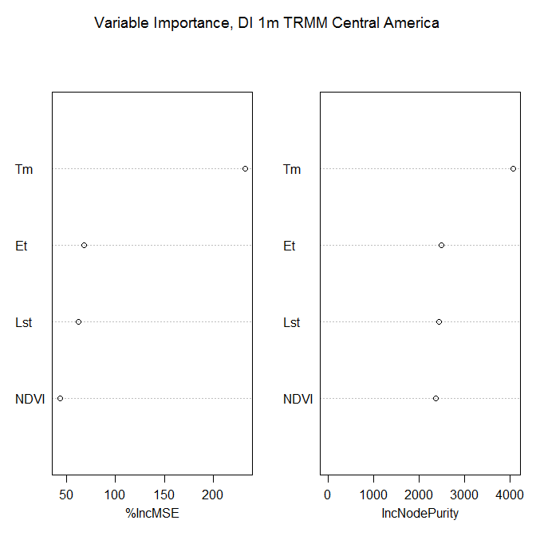
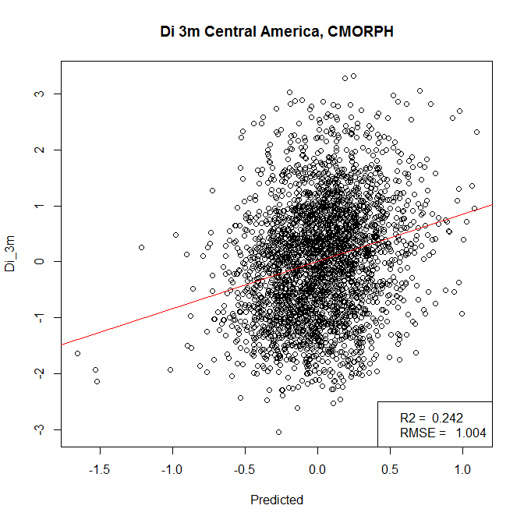
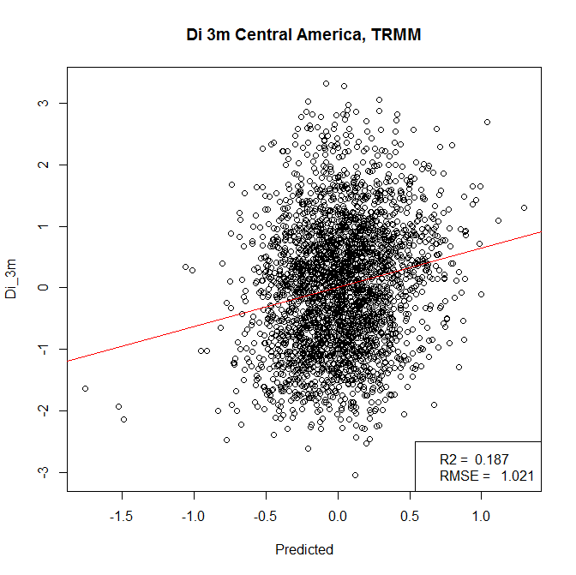
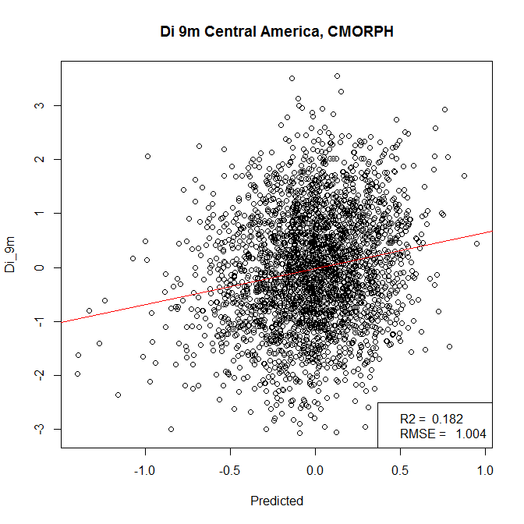
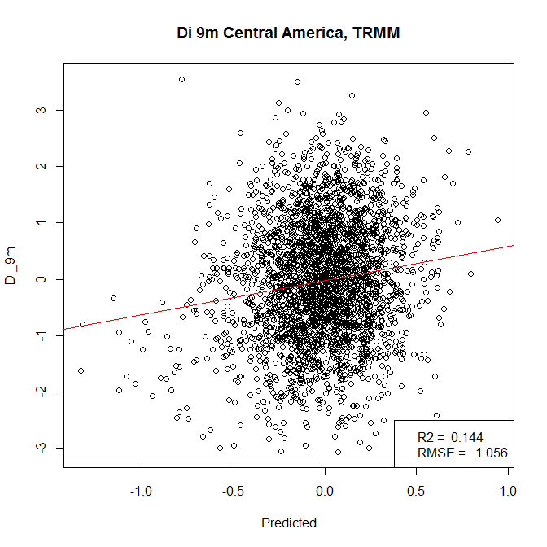
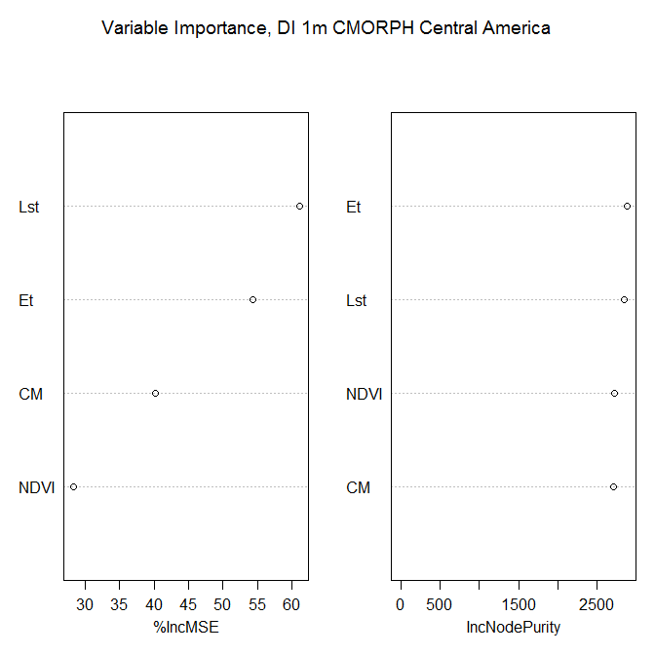
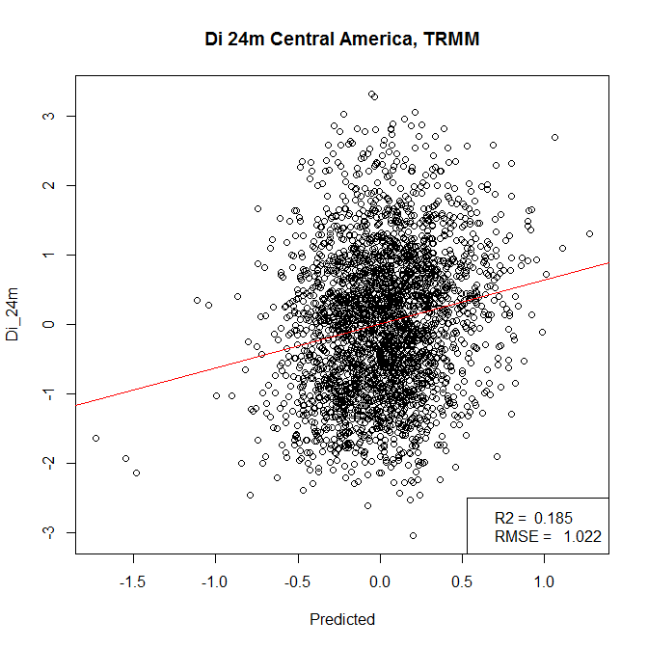
Results
For every drought index:
TRMM models outperformed models using CMORPH data
TRMM always placed as the top predictor
Levant region predictions outperformed Central America
LST always was a more important predictor than ET in Levant
Shorter Drought Index period models outperformed longer drought index time periods
Notes:
Explanation of expected figures and images from data analysis will be placed here

Slide 11
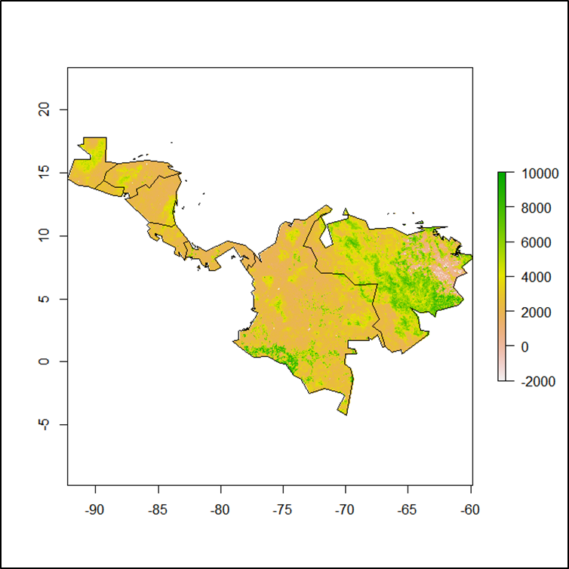
Conclusion
In this study, drought was modelled via satellite derived precipitation, vegetation variables, and 1-, 3-, 9-, and 24- month GPCC Drought Indices in Central America and the Levant.
Drought models were more accurate in the Levant region than Central America for both TRMM and CMORPH datasets
In all cases, TRMM outperformed COMPRH.
The tools are fully operational for future use by our project partners.
Central America
NDVI

Slide 12
Future Work
Use alternate drought index datasets
SPI
SPEI
Agricultural drought
Comparing RF models to SDCI models
Drought indicators for social conflict
Image Credit: Buck
Notes:
Image: https://www.flickr.com/photos/buckaroobay/3721809183
Future work for a potential third term consist of including Agricultural drought (as crop yield was unavailable), comparing Random Forest models to SDCI models, and determining drought indictors for social conflict

Slide 13
Advisor
Dr. L. DeWayne Cecil, Global Science & Technology, Inc.
Partners
Major Jason Scalzitti, US Air Force, 14th Weather Squadron
Raymond Kiess, US Air Force, 14th Weather Squadron
Ryan Smith, US Air Force, 14th Weather Squadron
Previous Contributors
Christine Stevens
Hayley Hajic
Others
Alec Courtright, Center Lead
Kelly Meehan, Assistant Center Lead
Michael Kruk
Michael Brewer
Rob Blevins

