Slide 1
DEVELOP National Program
COLORADO Water Resources
DEVELOP Langley
Spring 2015
Final Imagery

Slide 2
Checklist for Each Image:
Image is derived from NASA sensor data
  Not from an outside source
  Not a photograph of the team/issue
Preferably, At least one image provided is derived from recent data (2014-2015)
  This is mandatory for inclusion in any highlight to NASA HQ
Some kind of processing has taken place
  Not a raw image or a photograph
The team actually created the image
  Not from some other source/world wide web/etc.
High-resolution (over 300 dpi)
Saved as a JPEG or TIFF
Also:
While there are three slides, you can have more imagery. Minimum of one, max of ten.
The “best” image should have a SVG version, saved as a separate file, that will be used on the DEVELOP website and brochures

Slide 3
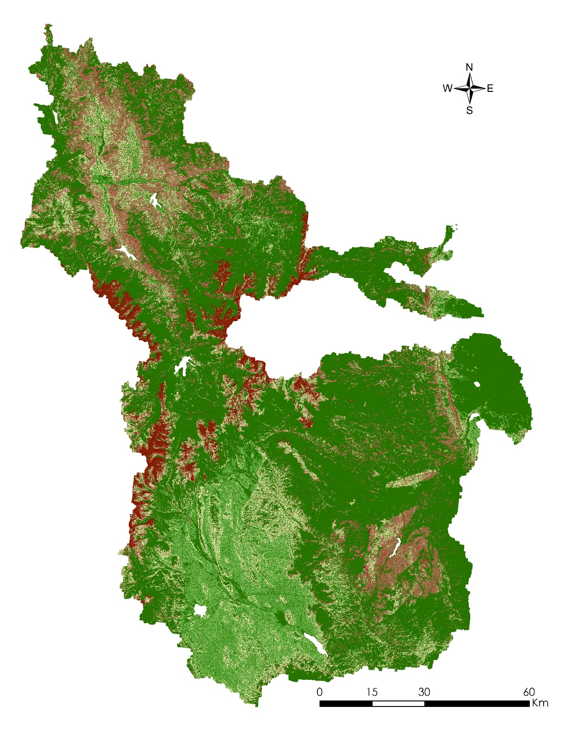
NASA Langley
Research Center
Colorado Water Resources
Estimated soil erosion map for Denver watershed’s area. This map was created by using the Revised Universal Soil Loss Equation (RUSLE). NASA Earth observations data from Terra- Advanced Spaceborne Thermal Emission and Reflection Radiometer (ASTER) were used to obtain the Digital Elevation Model. In addition, land cover data were extracted using the National Land Cover Database (2011) and Cropland Data Layer (2011), which is comprised of images taken from Landsat 7 Enhanced Thematic Mapper Plus (ETM+). This Erosion Susceptibility map allows the user to understand how soil moves in terms of erosion.

Slide 4
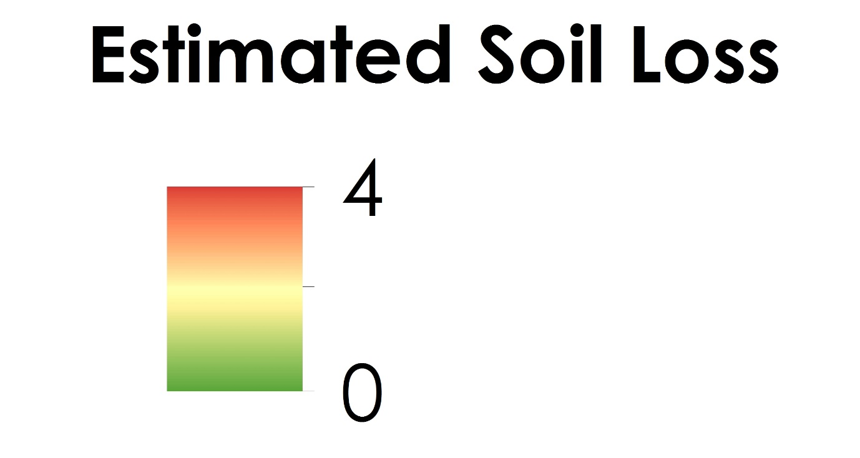

Slide 5
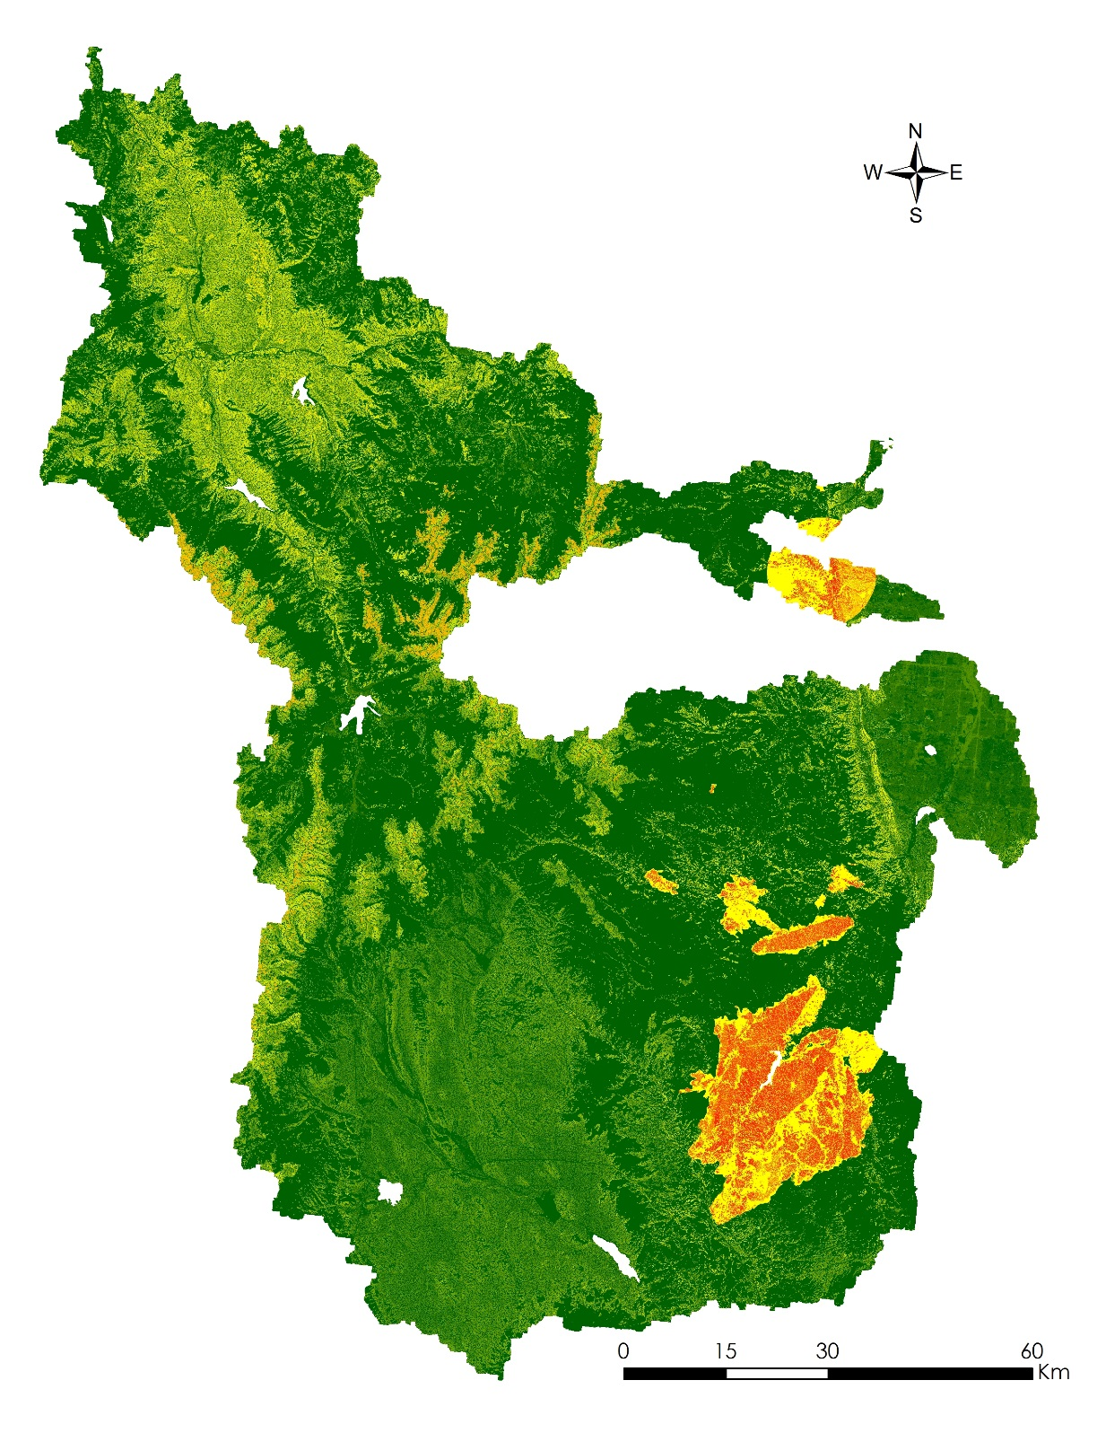
NASA Langley
Research Center
Colorado Water Resources
The Pollution Risk Assessment map for Denver watershed’s area was created by combining the Soil Loss map (RUSLE map), weighted land cover data, wildfires data and the location of an uranium mine. The land cover data were extracted from the National Land Cover Database (2011) and Cropland Data Layer (2011), which used NASA Earth observations taken from the sensor Enhanced Thematic Mapper Plus (ETM+)on board Landsat 7. This analysis resulted in the creation of a water sampling site suitability map, which identified optimal locations for water quality sampling sites.

Slide 6
