Slide 1
Alto Orinoco Health & Air Quality
Utilizing NASA Earth Observations to Locate Remote Yanomami Villages in the Alto Orinoco Municipality for Targeted Eradication of River Blindness Disease
Amanda Rumsey
Rajkishan Rajappan
Kyle Sowder
Annabel White
Timothy Larson
Zachary Tate

Slide 2
General Guidelines I
Things that are typically included in a presentation:
The slides provided in the template are just a starting point for teams. Feel free to expand upon these topics, alter the headings, and change the order of the slides to fit your needs.
Study area
Study period
Objectives
Community concerns
NASA satellites/sensors used
Methodology
Results
Conclusions
Errors & uncertainties
Future work
Acknowledgements
Backup slides
Required Statement

Slide 3
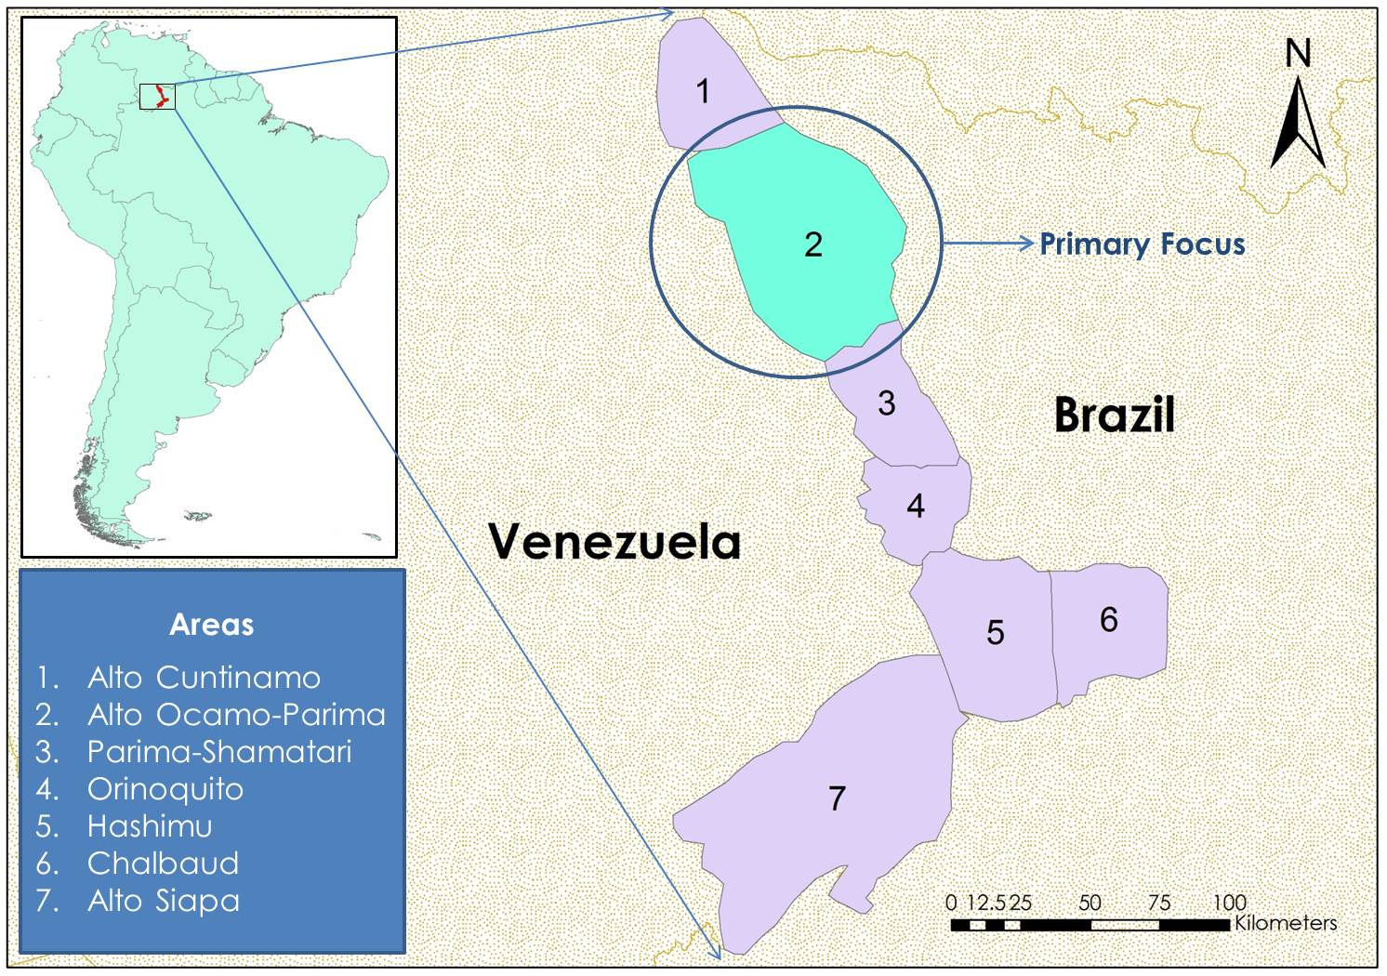
Notes:
Location:
7 sub regions of the Alto Orinoco Municipality in Venezuela
Area Size:
Population:

Slide 4
Community Concerns
What is Onchocerciasis (River Blindness Disease)?
Caused by Onchocera volvulus
Transmitted through blackfly bite
Symptoms include rash, skin discoloration, visual impairment and blindness
Who is at Risk in the Region?
122,282 people are at risk
20,500 people currently need treatment
Creative Commons Image of River Blindness Disease
Why Is Eradication Important?
Disease reinforces poverty cycle by impacting quality of life, ability to work, and ability to visually learn survival skills and cultural practices
Notes:
Onchocerciasis, commonly known as river blindness, is a treatable disease caused by the vector-borne parasite Onchocerca volvulus. This parasite is transmitted through bites of infected blackflies from the genus Simulium (Pan American Health Organization, 2014). Once inside the human host, O. volvulus migrates to the skin, various organs, and eyes. As the larvae migrate to the skin and die, they cause debilitating itching, rashes, and skin discoloration (World Health Organization [WHO], 2015). This intense itching has been known to drive people to injure themselves to obtain relief and in some cases even commit suicide (Landau, 2013). Onchocerciasis also has other ill effects, such as elephantiasis type disfigurement, glandular inflammation, “hanging groin”, visual impairment, and eventually complete blindness (Centers for Disease Control and Prevention, 2013). The majority of symptoms diminishes a person's quality of life and reinforces the cycle of poverty in already poverty stricken communities.

Slide 5
Community Concerns
Notes:
Image from Carter Center…. Citation to be added later

Slide 6
Objectives
Long Term Objectives
Support the Carter Center in their efforts to eliminate River Blindness Disease
Use NASA Earth Observations and Digital Globe data to locate remote Yanomami villages in densely forested areas
Convey locations and physical characteristics of villages to the Carter Center so that they can provide medical treatment
Short Term Objectives
Develop Cloud-Free Landsat 8 Composite for the Study Area
Perform Unsupervised Classification on Landsat 8 Composite
Analyze High Resolution Digital Globe Imagery to Identify Yanomami Villages
Create geospatial database detailing locational and physical characteristics of villages

Slide 7
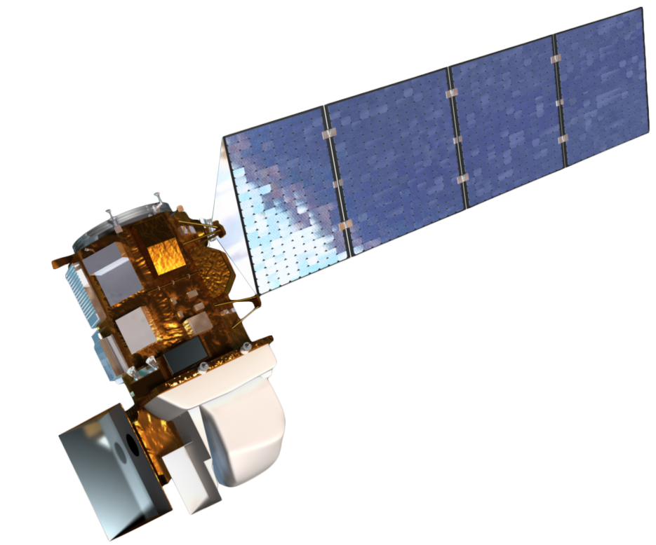
Sensors Used:
NASA Earth Satellites
LANDSAT 8, OLI and TIRS
Digital Globe Satellites
Worldview 1,2,3
IKONOS
GeoEye 1,2
QuickBird

Slide 8
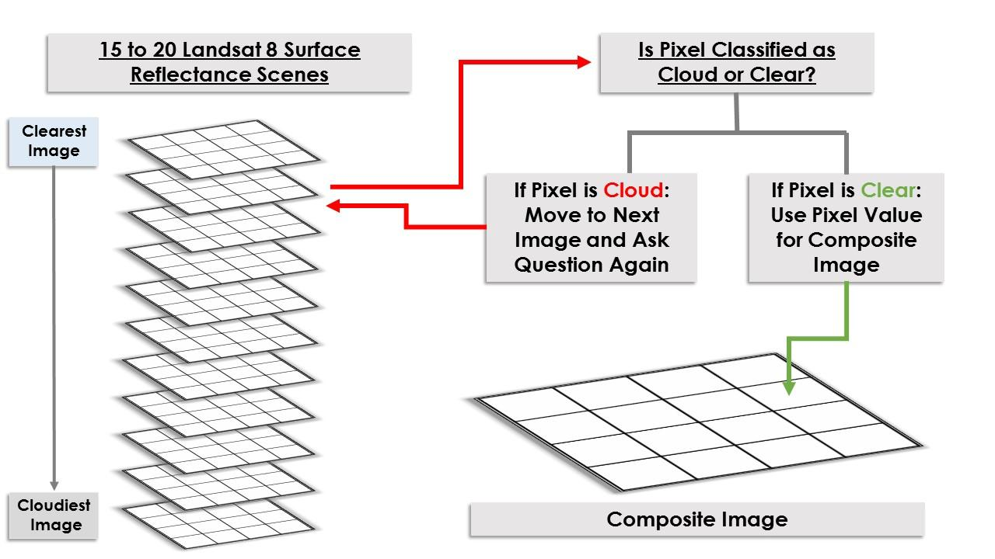
Methodology
Cloud free composite created from Landsat 8 tiles
Notes:
Will include summary of methodology in paper when corrections come back

Slide 9
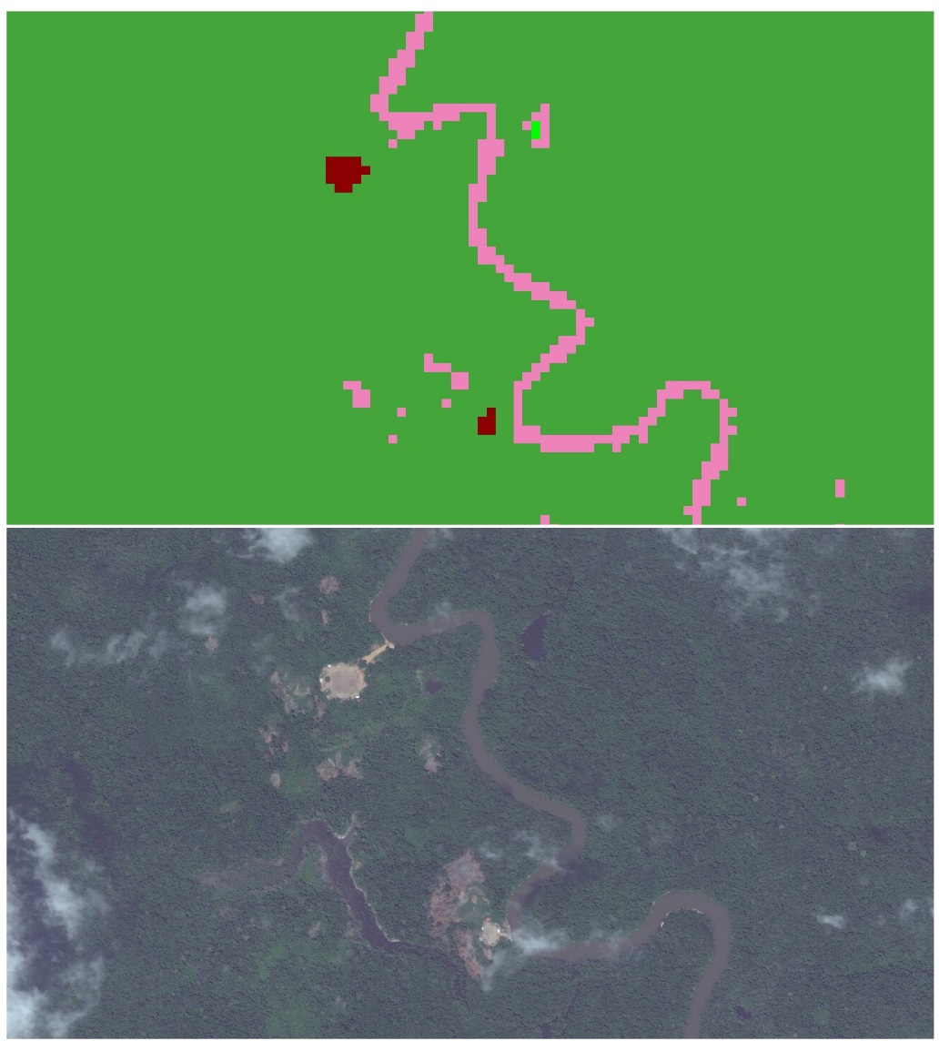
Methodology
Land cover Classification: Unsupervised K-means algorithm
Classify land as forest, bare soil, rangeland, and open water.
Groupings of Soil pixels were then compared to high-res World View 3 Panchromatic imagery
Notes:
Image Source: http://commons.wikimedia.org/wiki/File:Claude_Monet_-_The_Magpie_-_Google_Art_Project.jpg
Insert Amanda’s images of how the cloud free composite was created

Slide 10
Data Analysis:
None yet
Image Credit: Monet
Notes:
Image Source: http://commons.wikimedia.org/wiki/File:Claude_Monet_-_The_Magpie_-_Google_Art_Project.jpg

Slide 11
Results
Put them here!
Image Credit: Monet
Notes:
Image Source: http://commons.wikimedia.org/wiki/File:Claude_Monet_-_The_Magpie_-_Google_Art_Project.jpg

Slide 12
General Guidelines II
Header text point size should be between 40 and 60 on most slides.
Body text point size should be at least 20.
Use Century Gothic.
Keep text to a minimum.
Try to use a consistent font size between slides.
Image Credit: Monet
Notes:
Image Source: http://commons.wikimedia.org/wiki/File:Claude_Monet_-_The_Magpie_-_Google_Art_Project.jpg

Slide 13
Image Credit: Monet
General Guidelines III
Include speaker notes for each slide (see below).
Include a visual on each slide, if possible.
Arrange content to minimize white space.
Notes:
These notes should be thorough enough for someone not familiar with the project to clearly present the material.
Image Source: http://commons.wikimedia.org/wiki/File:Claude_Monet_-_The_Magpie_-_Google_Art_Project.jpg

Slide 14
Maps & Logos
Maps
Import the legend separately.
Make sure all text is legible and editable.
Cite base layer source in speaker notes.
Logos
US Federal logos only.
No state, NGO, local and or international government logos, or software logos.

Slide 15
Photos & Figures I
You may only use images taken by your team, provided by your partners (as long as you have permission from them), from a Federal Agency, from the new DEVELOP stock imagery collection on DEVELOP’s Flickr page, or Creative Commons images.
Obtain a media release form from all people in photos that your team has taken — no children!
All image sources should be cited using a consistent format and should be visible on the slide.

Slide 16
Photos & Figures II
Please do not include the image URL in the source text box but rather place it in the notes section below.
If you use a border for your images include it on all photographs to keep your presentation consistent.
Keep all images and text boxes editable, including individual elements of flowcharts.
Background images are discouraged. If you use one, make sure that your text remains clear and legible.

Slide 17
Acknowledgements
List advisors, partners, and others who have contributed in any way to the project.
If your project is a multi-term one, acknowledge past contributors.
Choose one of the two following slides as an acknowledgements page. Feel free to modify them as needed to fit your content.
Image Credit: Monet
Notes:
Image Source: http://commons.wikimedia.org/wiki/File:Claude_Monet_-_The_Magpie_-_Google_Art_Project.jpg

Slide 18
Advisors
Dr. Jim Tucker, GSFC
Dr. John Bolten, GSFC
Partners
Dr. Frank Richards, The Carter Center
Lindsay Rakers, The Carter Center
Others
Katie Melocik, GSFC

