Slide 1
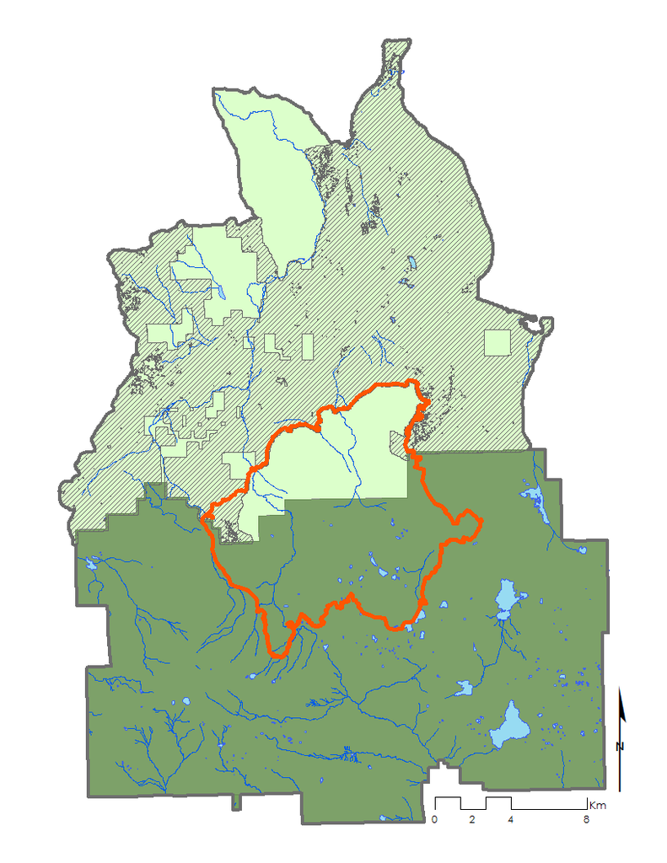
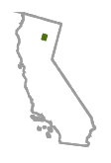
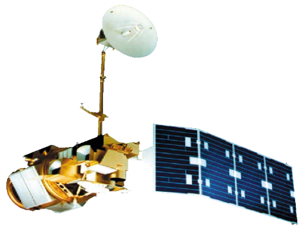
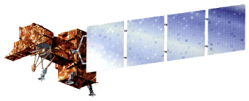
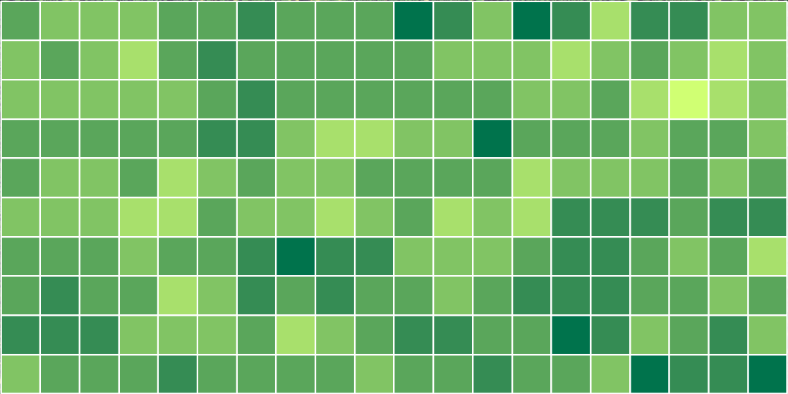
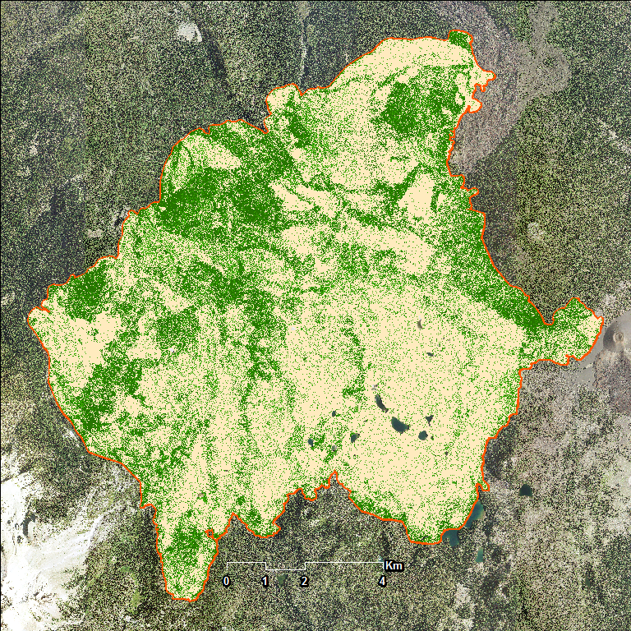
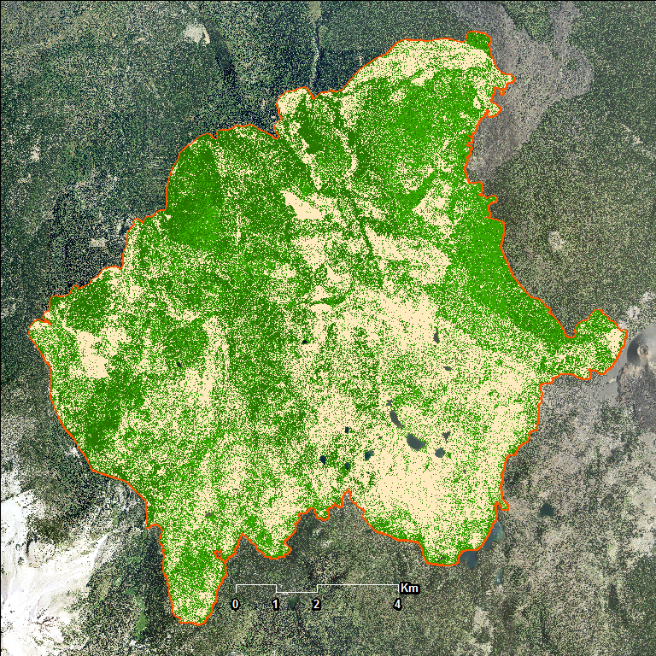
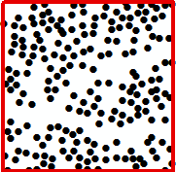
Evaluating Fuel Loading at a Landscape Scale in High Elevation Alpine Forests of Lassen Volcanic National Park
Abstract
Objectives
Study Area
The disruption of natural fire regimes caused by fire suppression policies, coupled with drought and changing climate conditions, allow fuel loads to grow in the absence of naturally occurring, low intensity surface fires. Within the mixed conifer forests of the Cascades, catastrophic wildfires challenge forest resilience in Lassen Volcanic National Park (LVNP) and Lassen National Forest (LNF). Land managers within these forested areas can benefit from integrating landscape-scale fuel load density and ecosystem recovery assessments derived from high-resolution, remotely sensed data into their wildfire mitigation and management projects. To provide a landscape-scale assessment, we calculated density estimates of stems per acre and canopy understory fuel loads for the Badger Planning Area with LiDAR, studied ecosystem recovery from the 2012 Reading Fire by calculating pre- and post-fire land cover using high spatial resolution imagery from the USDA National Agriculture Imagery Program (NAIP), and provided land managers an integrated web tool for spatiotemporal analysis of historical tree mortality and regional fire history using multispectral data from the Landsat series accessed in Google Earth Engine API. Examining fuels with this methodology for historic mortality trends, present conditions, and future planning, will improve wildfire management strategies across administrative boundaries in the Lassen area.
Identify continuous fuel structures using LiDAR in the Badger Planning Area by producing per acre stem density and high-risk canopy data
Analyze how land cover has changed within the 2012 Reading Fire perimeter and assess the state of restoration interventions using NAIP imagery and planting data from LNF
Expand the capabilities of the Simple Analysis of Vegetative Trends in Earth Engine (SAVeTrEE) tool to map historic tree mortality
Project Partners
National Park Service,
Lassen Volcanic National Park
USDA, US Forest Service
Lassen National Forest
Earth Observations
Landsat 5 TM
Landsat 7 ETM+
Landsat 8 OLI
LiDAR and
USDA NAIP
Methodology
Lassen Volcanic National Park
2012 Reading Fire Boundary
Lassen National Forest
LiDAR, Badger Planning Area
Badger Planning Area LiDAR Case Study
Reading Fire Recovery Map
Waterbodies
Total Study Area
SAVeTrEE 2.0
Acquire
Segment
Density
Acquire
Classify
Change Analysis
Acquire
Google Earth Engine
USFS 2015 Badger LiDAR
Thiessen polygons to segment individual canopies
Stems per acre
NAIP 2012-2016
LNF planting points
Supervised classification: bare earth, tree, grass
State of ecosystem recovery post-Reading Fire
LNF and Badger Planning Area boundaries
CA fire history data
Fuels treatment data
Enable user uploaded area of interest
Drape documented fuel treatments and wildfires over mortality classification
Process
Process in ArcMap
Canopy Base Height (CBH) for all trees
Process in ArcMap
Mean NDVI
Change Analysis
Canopy Height Model (CHM)
Canopy Cover (CC)
Mosaic quadrangles Calculate NDVI
At planting points in LNF
At random points in LVNP
Compare recovery across boundary
Peak green
Max health
Lassen Volcanic National Park Disasters II
Results
Land Cover Classification
0
Peak moisture
Density of Stems/Acre for 200 Acres
2 years post-fire
4 years post-fire
Bare Earth
Grass
Tree
+ β₁
# Stems
225
200
175
150
125
100
Acre
Stem
Figure 3. In 2014, the Reading Fire area was 63% bare earth and 37% vegetation. In 2016, that has changed to 45% bare earth and 55% vegetation.
β₁≈0
203
Stems
̶ β₁
Figure 6. Time series map of vegetation health trend calculated with a linear regression over a user-specified spectral index, interval, area. Inner map is a bivariate plot of moisture and greenness for one year. Historic fire perimeters are overlaid over entire area.
Figure 1. In this planted area of Lassen National Forest, the stem locations of dominant and co-dominant pine trees were determined using a tree segmentation algorithm. This algorithm uses Thiessen Polygons to interpolate the natural boundary between relative maximum heights.
Distribution of vegetation health within the Reading Fire
Height (m)
26-30
21-25
16-20
11-15
6-10
1-5
Canopy Structure Height
Canopy Base Height
HEALTHY VEGETATION RANGE
LASSEN VOLCANIC NATIONAL PARK,
Samples
Figure 5: Before the fire, vegetation was evenly distributed within the healthy NDVI range from 0.2 to 0.8. However, the post-fire health varies due to different management practices at the U.S. Forest Service and National Park Service. In 2016, less than 10% of vegetation was healthy, whereas 75% and 50% were healthy in the Forest and Park. Four years after the fire, the distribution of vegetation health increased by approximately 0.2 towards the healthy range.
Canopy
Height (m)
4+
2-4
0-2
27,939
Acres Burned
from the
Reading Fire
Figure 2. In this square acre, the canopy structure heights and boundaries for 203 stems show the density of dominant and co-dominant trees. Canopies with low base heights along the interface of forest and grass patches present a concern for continuous surface fuels that can lead to canopy fires.
Figure 4. 2,460 acres (9%) grew from bare earth to grass or tree.
LASSEN NATIONAL FOREST,
Planting Activity
Conclusions
Team Members
The mean density of stems in the Badger Planning Area is 157 stems per acre.
Canopies with low base heights along the forest-grassland interface are high-priority locations for fuel treatments.
Within the Reading Fire perimeter: 9% of the vegetation has returned to near pre-fire state, 3% is in transition to its pre-fire state, and 25% show no signs of post-fire recovery.
According to spectral data from NAIP imagery, planting restorations have not significantly accelerated vegetation recovery.
SAVeTrEE tool now includes historical fire perimeters.
Acknowledgements
Anna McGarrigle
Team Lead
Andrea Ferrer
Heather Myers
Peter Norton
Jenna Williams
Ames Center Lead
DEVELOP National Program
Dr. Juan Torres-Perez
Bay Area Environmental Research Institute
John Dilger
Ames Assitant Center Lead
DEVELOP National Program
Joshua Verkerke
Previous Contributor, Summer 2017
Steve Buckley
National Park Service
Elizabeth Hale
National Park Service
Amber Wittner
National Forest Service
Janine Book
National Forest Service
California – Ames
Fall 2017

