Slide 1
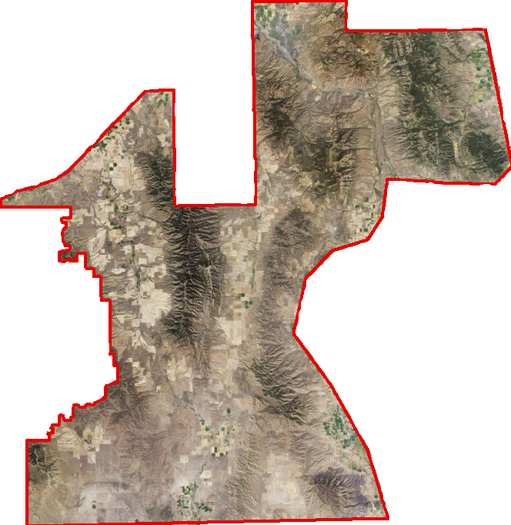
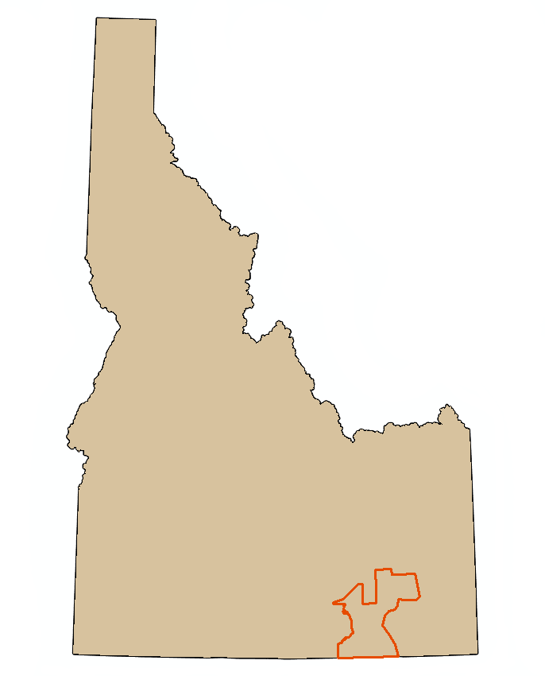
Southeast Idaho Disasters ll
Using NASA Earth observations to characterize juniper invasion and assess changes in soil moisture within cheatgrass dominated sites relative to wildfire susceptibility in southeast Idaho.
Jenna Williams(Project Lead), Cody O’Dale, Kshitiz Shrestha
DEVELOP National Program at BLM at Idaho State University GIS TReC
Abstract
Objectives
Characterize juniper encroachment by analyzing 30 meter Landsat imagery from 1985 to 2015.
Assess temporal changes in soil moisture in cheat grass dominated sites and compare that to sagebrush dominated sites over the 2015 growing season; April 1st through September 30th.
Study Area
Southeast Idaho
Landsat WRS-2 Path 39 Row 30
Landsat WRS-2 Path 39 Row 31
Study area requested by BLM
Methodology
Vegetation Based soil moisture
SMAP: Soil moisture resampled to 10km
Classified Vegetation Layer
Pocatello/ Chubbuck
GPM: Root Zone 10 Km
Seasonal Soil moisture Comparison
Daily Evapotranspiration
and
Precipitation
Vegetation Based Soil Map
Juniper Encroachment 1985 to 2015
Earth Observations
NAIP 2009
Landsat 8
NAIP 2011
Classification Points
CTA Classification
Land Change Modeler
Juniper Encroachment Map
NAIP 2013
Landsat 5
Soil Moisture Active Passive (SMAP)
Landsat 8 Operational Land Imager (OLI)
Landsat 5 Thematic Mapper (TM)
Results
Conclusions
Placeholders until we get a great picture
Team Members
Project Partners
Bureau of Land Management
Idaho Fish and Game
Caribou-Targhee National Forest
NASA RECOVER
Acknowledgements
Ryan Howerton (ISU), Keith Weber (ISU), Sara Ramos (DEVELOP), Zachary Simpson (DEVELOP), Mike Kuyper (BLM), Brian Holmes (BLM), Shelli Mavors (BLM), Scott Bergen (IDFG), Airk Jorgensen (FS)

