Slide 1
North Carolina Ecological Forecasting
Examining shoreline extent and overall wetland health
Zand Bakhtiari (Team Lead)
Brad Gregory
Stephen Zimmerman
Kayla Patel

Slide 2
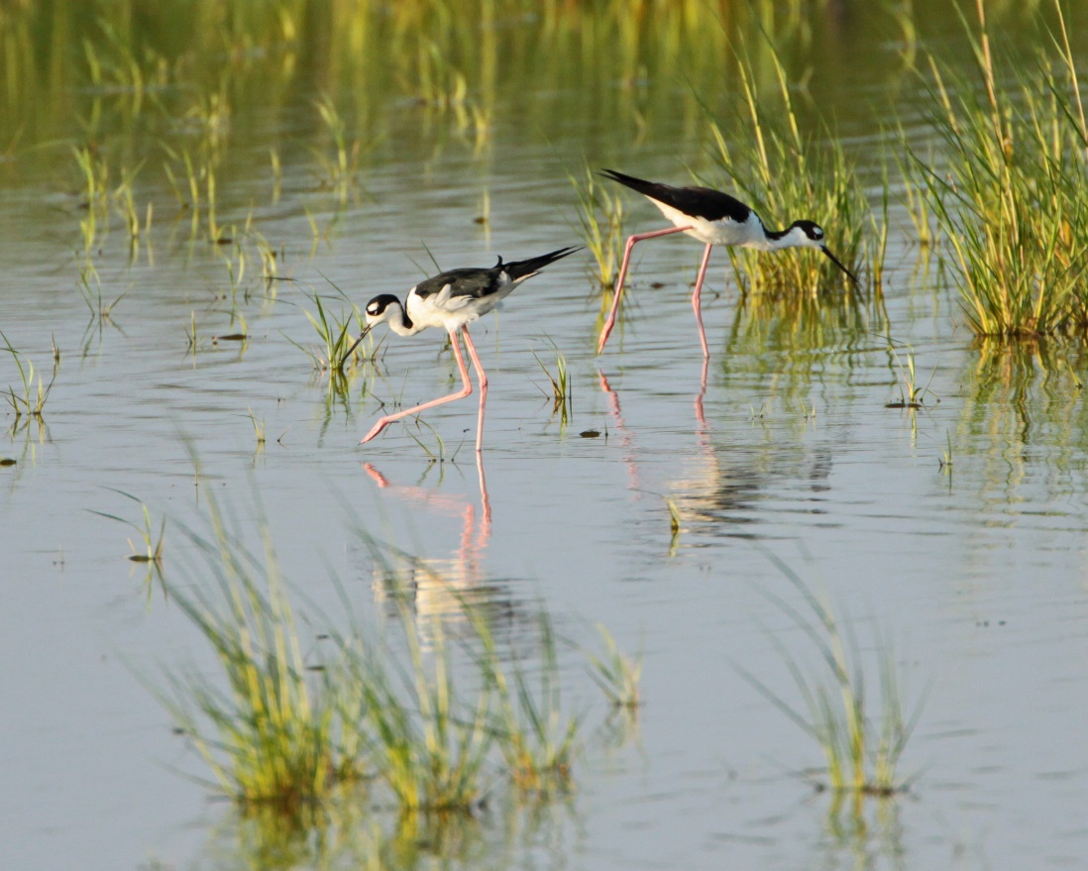
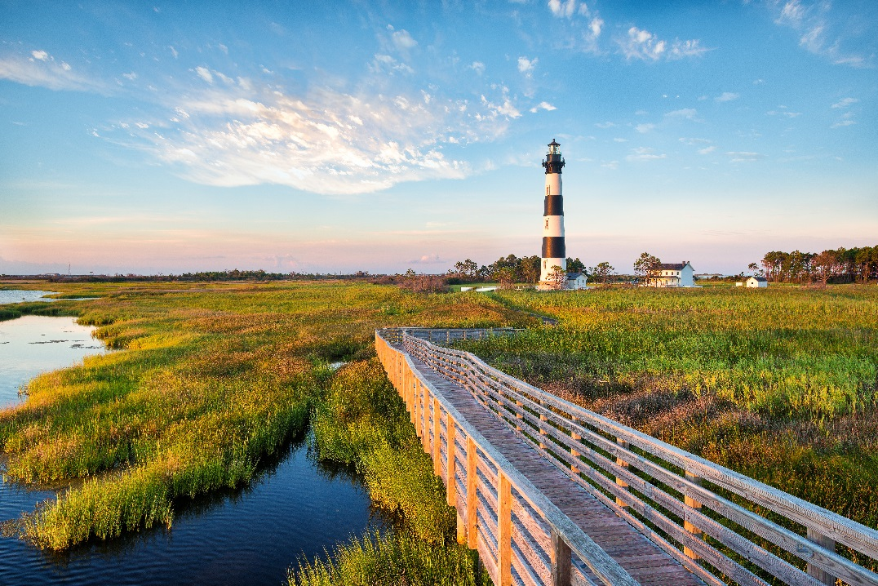
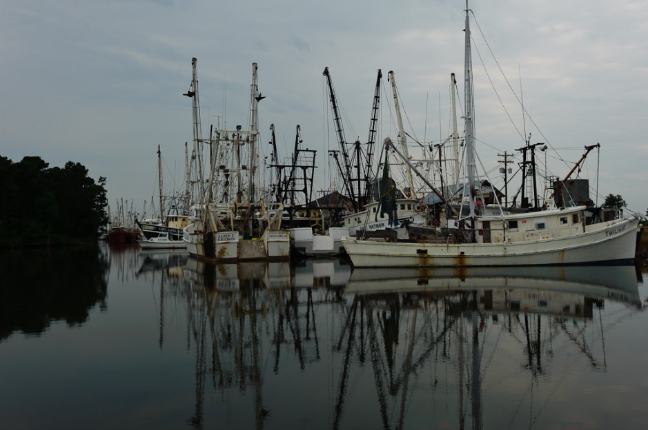
Background
Credit: Matt Tillett, creative commons
Credit: Alistair Nicol, creative commons
Vital terrestrial/aquatic buffers
Support diverse wildlife
Recreational activities
Credit: John Bule, creative commons
Notes:
Wetlands are an important buffer between terrestrial and aquatic ecosystems, they are simply regions of land that are frequently inundated with water (much like Norfolk, VA). Wetlands can filter toxic heavy metals introduced by certain industries and also high concentrations of excess nutrients introduced by agriculture from runoff. High primary productivity in wetlands removes excess nutrients by absorption for growth; toxic heavy metals are filtered from the water by a process called phytoremediation, where the plant uptakes the metal and stores it throughout the biomass of the plant (depending on the plant will decide where the metal will be stored within the plant). Dense vegetation root structures allows for trapping of sediment and consequently mitigates shoreline erosion. Vegetation also dampens tidal/wave energy from the tides, storms, hurricanes.
Wetlands provide nursery for many juvenile fish species by providing shelter among the aquatic/subaquatic vegetation from larger predatory fish. Having these areas of refuge increases the chance of survival to adulthood and is major part in sustaining healthy populations of adult fish species. Healthy fish populations is crucial for commercial fisherman which is a large part of the economy and culture in the Albemarle-Pamlico sounds.
These ecosystems also offer recreation for humans, things like kayaking/canoeing, recreational fishing, nature photography, and conservation enthusiasts.
Top right image: Ken Lund, creative commons: some rights reserved
https://www.flickr.com/photos/mattyfioner/4828726481/in/photolist-8mGu9R-eQRRnf-ePLwAq-eND3Wu-6FNB17-agJxAZ-34v34Q-8mGJjT-34qq1z-34uW1b-34uXMu-34qmtF-34uWTN-5BaeS7-8mKEmA-34qv7i-8mGxAe-5kazLt-8mGyzD-eR3tnZ-eRADMo-8mGPLt-8mGNNT-8mKGZC-8mGRCp-8mKCAE-8mGEaP-8mKHtA-8mGLAa-8mGKNg-8mKC9J-8mKAYC-8mGHMZ-8mGD8P-8mKKFh-8mKM1o-8mGtfB-8mKJxE-8mKN49-8mKDr3-8mGFQF-8mKUEf-8mGsBn-8mKPL3-8mKxJE-8mGrPa-6Gt4q4-6Gt4Jt-eRAxkf-eZ7Y1g
Bottom right image: John Bule, creative commons: some rights reserved
https://www.flickr.com/photos/bumeister/5818228939/in/photolist-8ujAyU-o2k2d6-VZmtz-o1Krb4-8uguTF-9SbR9A-9S8Wgn-PwqRu-9SbRuQ-9SbRy5-9S8WL4-9S8WcT-6u8Lpn-4MCNfE-oFUBRC-nJNWh3-nJfZzE-o217m6-o1Kq18-eCkyDK
Left image: Alistair Nicol , creative commons: some rights reserved
https://www.flickr.com/photos/27870539@N07/10473954306/in/photolist-gXxKH5-edv9hr-dgfeLV-anzdPf-9ucyhB-ekEhyQ-jtu68s-eaet7v-jXbNMs-dMMyMo-aFQRXT-8bM1HG-bBoUrH-d6V9ah-jMMUPZ-ecwRzw-eMpNvS-4ZVe5T-ekEWXz-dCHXc5-ekyt7Z-ekESJH-ekyDrx-ekzxr6-4ZZyHW-4ZZyeW-4ZVqtF-dQNGNu-ekzuxB-ekFjz7-9ucvie-9ucy3F-PwAqG-qSYni-7MYBwW-4ZZtY7-4ZVaMt-6nbpCy-4ZZtw3-4ZVftF-4ZVpyH-4ZZBFL-4ZZCyd-9ucyok-8desQJ-4ZVoEX-4ZVmsH-9ucyap-afAZD7-dQNGWy

Slide 3
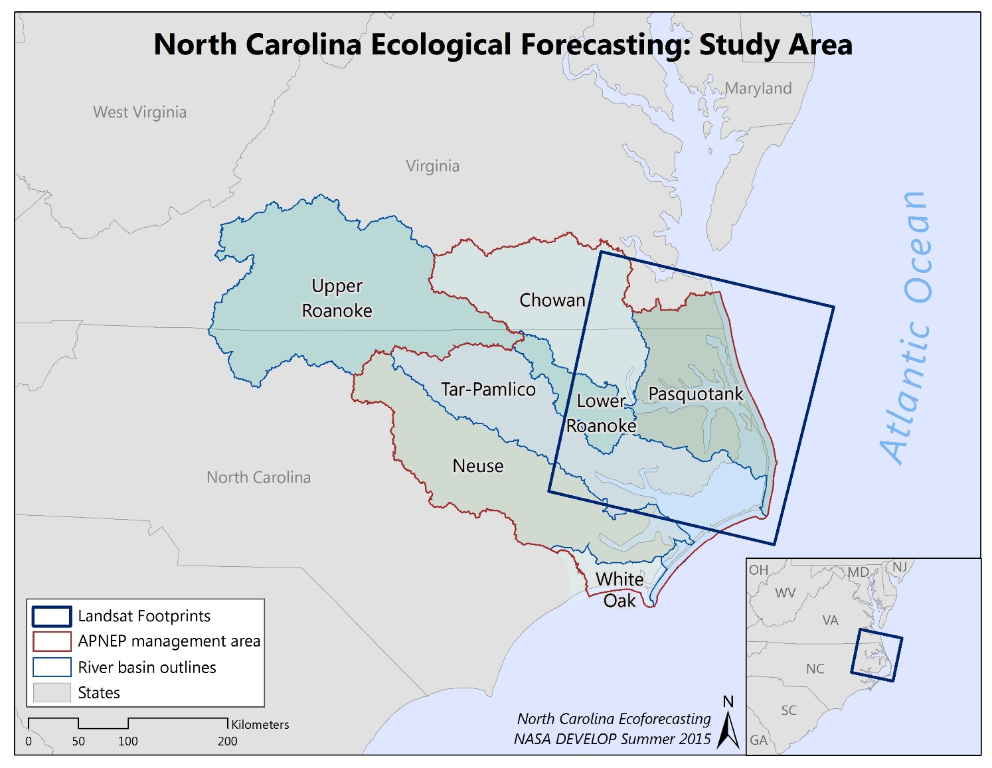
Study Area – Study Period
Albemarle-Pamlico watershed
National Estuary Program (NEP)
2000-2015
Notes:
Albemarle-Pamlico Watershed:
Second largest estuary system in the United States
Water from 43 North Carolina and 38 Virginia counties drains into the A-P watershed
There are 6 major river basins that drain water from these counties into the A-P watershed → Chowan, Roanoke, Tar-Pamlico, Neuse, Pasquotank, and White Oak
Drainage from the NC/VA counties and the major river basins all end up in one of the 8 major sounds in this region → Albemarle, Pamlico, Back, Bogue, Core, Croatan, Currituck, and Roanoke
National Estuary Program (NEP):
Deemed an “estuary of national significance” in 1987 among the first 28 National Estuary Programs (NEP) established by the U.S. Environmental Protection Agency (EPA) through amendments of the federal Clean Water Act (CWA).
Study Period:
2000-2015 → We decided on this period simply because of time constraint.

Slide 4
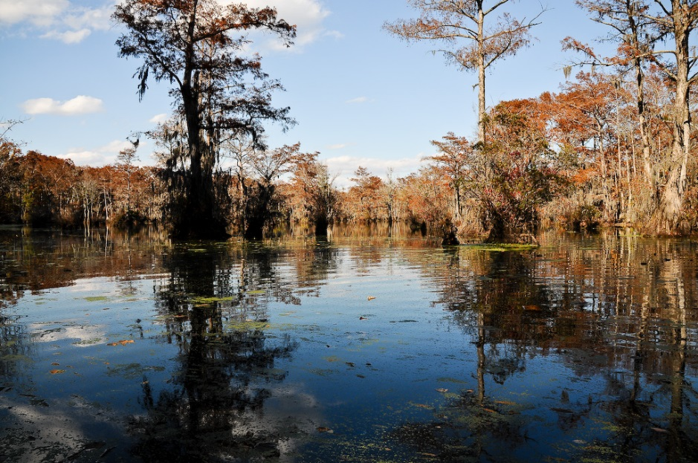
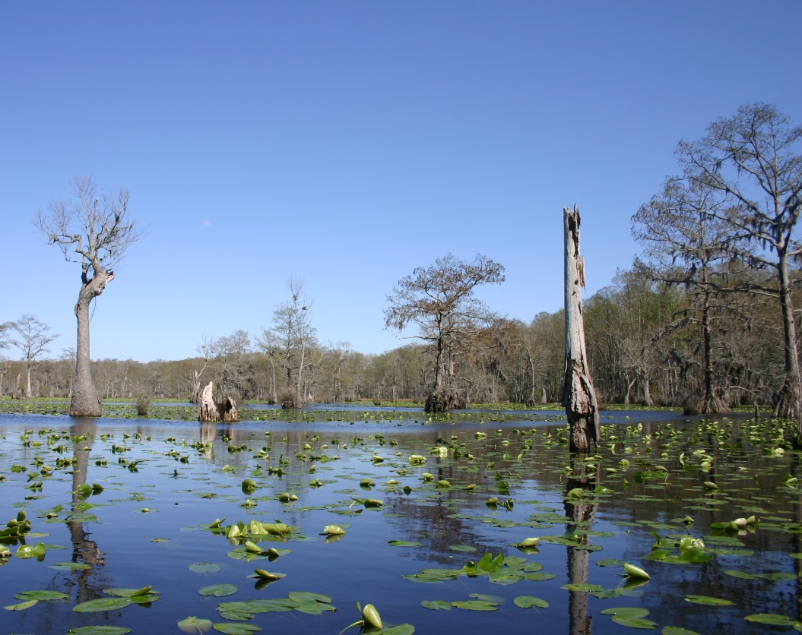
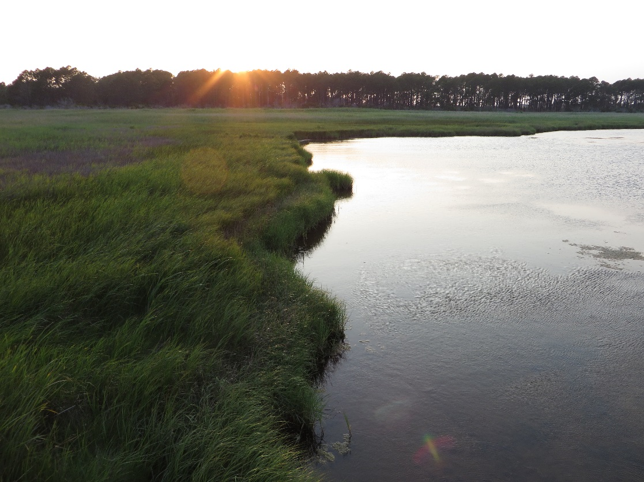
Nature Inspiration
Credit: John Bule, Creative Commons
Credit: Ryan Somma, Creative Commons
Credit: Ken Lund, Creative Commons
Notes:
Top right and bottom left photos were taken at Merchant’s Millpond State Park in North Carolina, just southwest of the Great Dismal Swamp.
Bottom right photo is a marsh, vegetation seen is Spartina alterniflora (cordgrass).
Bottom left image: Ryan Somma, creative commons: some rights reserved
https://www.flickr.com/photos/ideonexus/3414205007/in/photolist-6cGGcz-6cMxFf-6cLiUA-6cLivh-6cGMBt-6cGSNk-6cHpGz-6cMALL-6cMcVs-6cGCXc-6cLzno-6cGhwa-6cHmvc-6cLYUj-6cH2Fg-6cLyTu-6cM9ty-6cLkUq-6cMbgh-6cGMe8-6cMDdd-6cHnD4-6cGjmr-6cMdLA-6cLRDU-6cGdFa-6cLT5G-6cHuKr-6cGS9B-6cHeUV-6cHrzV-6cH13t-6cLYc7-6cGLqx-6cGWFT-6cLPp7-6cG9Jt-6cGYbM-6cG2t6-6cGChB-6cG37r-6cGFfr-6cLd3q-6cMrZw-6cH7Za-6cGi8T-6cLApQ-6cGAbz-6cGXAp-6cLCi1
Top right image: John Bule, creative commons: some rights reserved
https://www.flickr.com/photos/bumeister/3104655319/in/photolist-5JmaRZ-6xBVMx-oEy6Ga-7cDUZB-5JmbgH-oX3bok-31eKZk-6CErBu-8o1q4P-7cEpGa-ptBs9L-ftn3jw-5eHqBs-8o1qP8-8o4zF
b-6CzWXz-6CE9qU-qSa1rU-6CzXSe-5Jma1P-4tWd9Q-5Jm9Cz-4tT4bB-5JmamH-5Jmb5V-8o4zns-ftn3y7-6CA4Aa-6CA48g-m3JRpt-a2EoMZ-fs1urG-5JmbFT-66MWcm-a2Hixm-qzNS6X-ptyQrZ-6RM82B-vegoqy-52CcZH-ptC2kK-fs1uXC-ftn3oo-pHXU7m-6CA2XD-m3Jzsv-fvobXT-4tSb7i-4tLCh5-4tGCFM
Bottom right image: Ken Lund, creative commons: some rights reserved
https://www.flickr.com/photos/kenlund/14444951701/in/photolist-o1s9Tp-PwJfr-PwJfk-o1KpHV-5NLvxd-5NLzQN-8mGJjT-8mKEmA-9sUuUM-8mGxAe-a1BdQc-5JnbvA-5NLz1L-5NGj1H-5NK85o-a1zXV6-a1E6Fh-5kazLt-8dzbTP-8mGyzD-5NLnzN-8dPM3o-8dNfMR-8dPMeJ-a1zXsV-8mGPLt-8mGRCp-6c1ik6-nfk5oM-ogHEKa-4MCNfE-8ULWeF-b62KSz-g4gc8s-8dPMgN-8mKYeA-a1zX2z-8dRvnf-8mGNNT-6C6LhC-6C6LjJ-8mGrPa-8mKPL3-8mKxJE-8mGD8P-8mKGZC-8mGEaP-8mKKFh-8mKCAE-8mGFQF

Slide 5
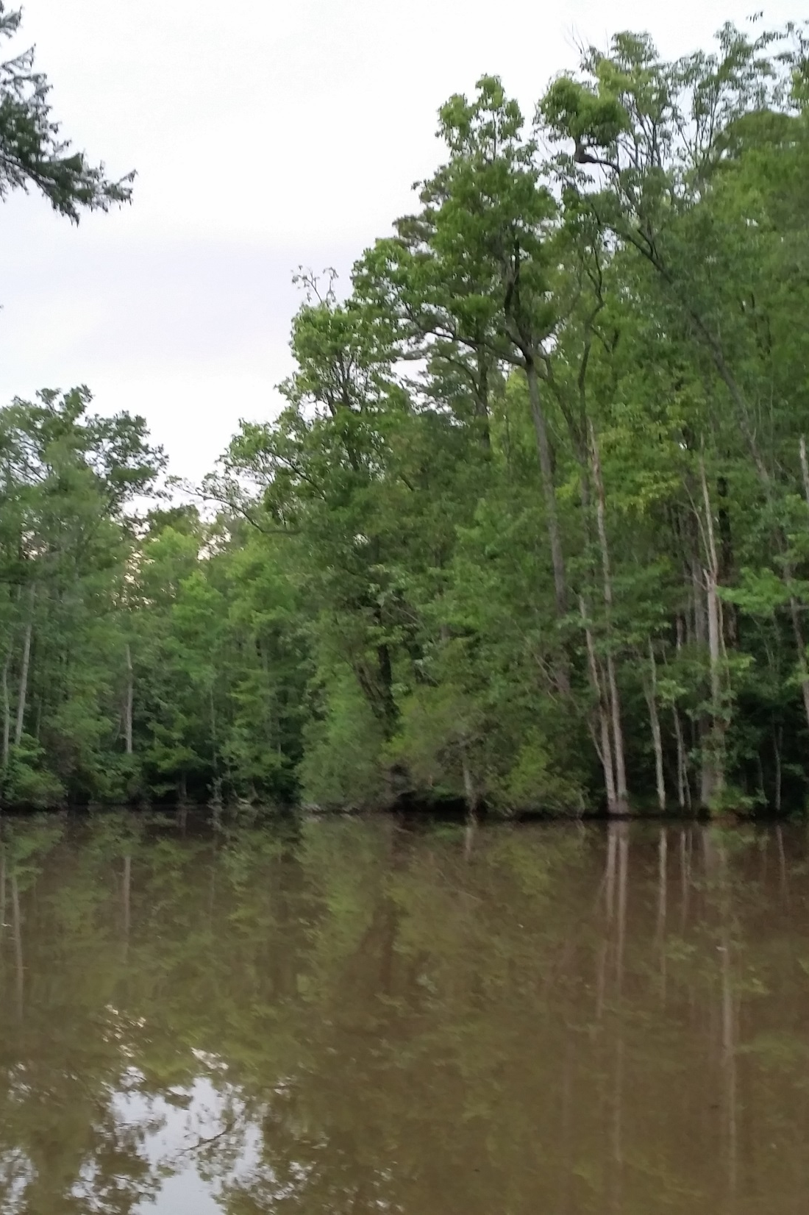
Community Concerns
Impacts of wetland degradation:
  Local ecosystems
  Local and regional economies
Credit: Stephen Zimmerman
Notes:
Wetland degradation is a major concern because of all the services these ecosystems provide not only for the general health of the wetland ecosystem itself but other surrounding ecosystems, and also for the economic services provided for humans.
Local ecosystems:
Wetlands are good at filtering excess nutrient and toxic heavy metals
Wetlands provide nursery for many juvenile fish species
Wetlands have high primary productivity and effectively sequester CO₂ in the form of plant biomass
Local and regional economies:
Because many juvenile fish species rely on wetlands for nursery the local fishing industry success is dependent on healthy wetlands to nurse juvenile fish species and sustain adult fish populations
Eco-tourism and recreation is a major economic opportunity in this region and would likely diminish with loss of healthy wetlands

Slide 6
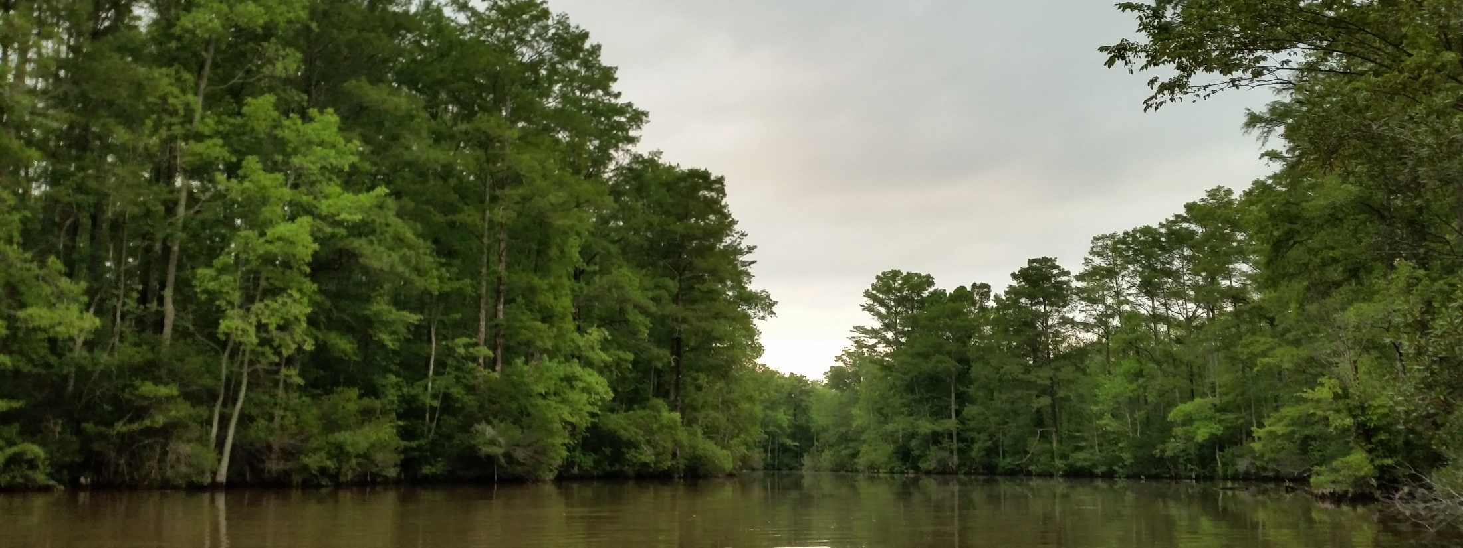
Credit: Stephen Zimmerman
Objectives
Determine shoreline extent
Assess relative wetland health
Case studies
Notes:
We determined the extent of the shoreline by applying a Normalized Difference Water Index (NDWI) that tracks the changes in water extent over the years of our study period.
We also assessed the relative health of wetlands by applying a [specific wetland health index TBD] that determines the carotenoid/chlorophyll-a ratio, a good indicator of healthy vegetation.
As a means to validate our indices we conducted case studies at specific sites of interest that represent where either wetland health has degraded due to natural disturbances (ie. Sea level rise), or from anthropogenic causes such as intentional wetland draining for urban development or conversion to agriculture.
****Something about C-CAP****

Slide 7


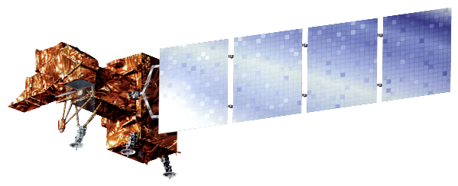
NASA Satellites/Sensors
Landsat 5 Thematic Mapper (TM)
Landsat 7 Enhanced Thematic Mapper Plus (ETM+)
Landsat 8 Operational Land Imager (OLI)

Slide 8
Methodology
Data Acquisition
Data Pre-processing
Data Analysis
Automated file unzipping, images separated by year
NDWI, wetland health index, NDPI calculated
Landsat 5 TM, 7 ETM+, and 8 OLI
Summer, winter, spring, fall image for each year
Top-of-atmosphere reflectance calculated for each scene
Threshold applied to NDWI images, years summed
Notes:
A python script was built that unzips the images and separates them by year
important that in the original image file the year is specified correctly – for example we used an image from December 28th, 2002 as the winter 2003 image and we needed to change the initial tar.gz file path to have a 2003 in it so the image would not be thrown in with the 2002 images.
Top-of-atmosphere reflectance was calculated for each image using the dnppy module

Slide 9
Methodology
Data Acquisition
Data Pre-processing
Data Analysis
Automated file unzipping, images separated by year
NDWI, wetland health index, NDPI calculated
Landsat 5 TM, 7 ETM+, and 8 OLI
Summer, winter, spring, fall image for each year
Top-of-atmosphere reflectance calculated for each scene
Threshold applied to NDWI images, years summed
Notes:
A python script was built that unzips the images and separates them by year
important that in the original image file the year is specified correctly – for example we used an image from December 28th, 2002 as the winter 2003 image and we needed to change the initial tar.gz file path to have a 2003 in it so the image would not be thrown in with the 2002 images.
Top-of-atmosphere reflectance was calculated for each image using the dnppy module

Slide 10
Methodology
Data Acquisition
Data Pre-processing
Data Analysis
Automated file unzipping, images separated by year
NDWI, wetland health index, NDPI calculated
Landsat 5 TM, 7 ETM+, and 8 OLI
Summer, winter, spring, fall image for each year
Top-of-atmosphere reflectance calculated for each scene
Threshold applied to NDWI images, years summed
Notes:
A python script was built that unzips the images and separates them by year
important that in the original image file the year is specified correctly – for example we used an image from December 28th, 2002 as the winter 2003 image and we needed to change the initial tar.gz file path to have a 2003 in it so the image would not be thrown in with the 2002 images.
Top-of-atmosphere reflectance was calculated for each image using the dnppy module

Slide 11
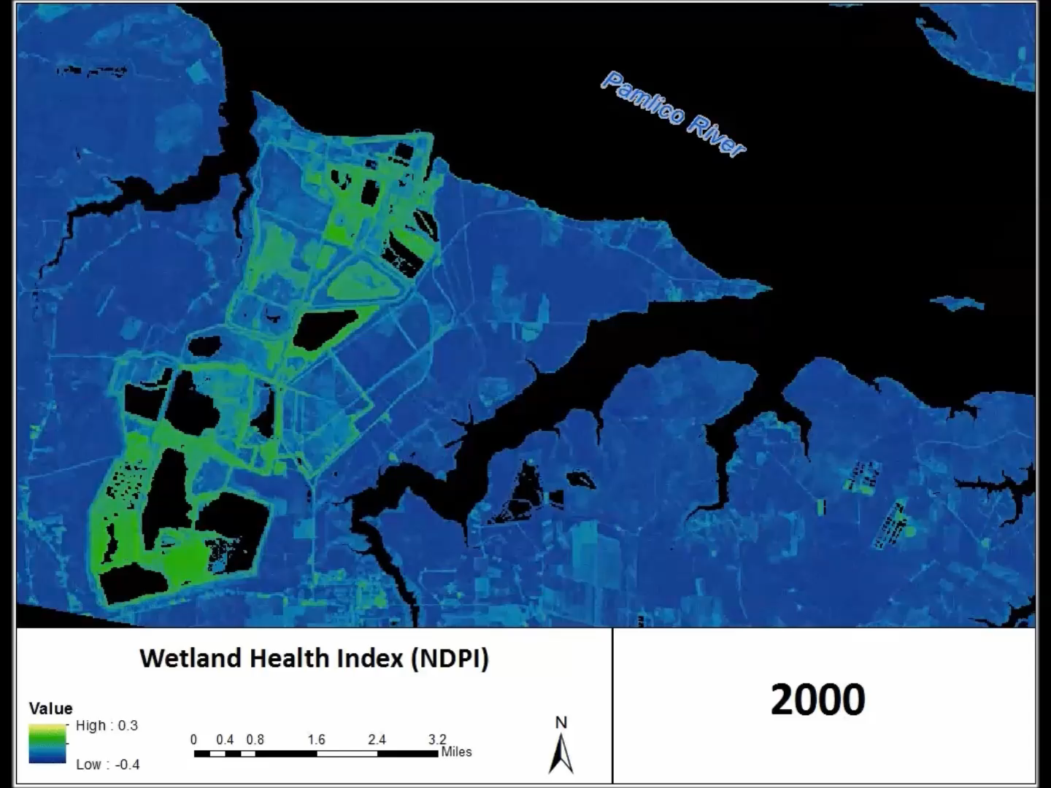
Results
Notes:
For our results we chose three specific sites to conduct case studies which represent changes in wetland land cover and overall wetland health.
This first case study is located along the Pamlico River, we chose this area because it represents the most stark change in wetland land cover found in our Landsat scene. We compared NOAA C-CAP data sets for the years 2001, 2006, and 2010 and saw a significant part of the shore that was wetland in 2001 had been destroyed by the year 2010; it represents an anthropogenic (human) cause for wetland loss. The green pixels generally represent unhealthy vegetation, but it has also picked up this phosphate mining plant that had expanded from 2000 to 2010 and that’s what we’re seeing here.
We used the Normalized Difference Pigment Index to create images for each year from 2000 to 2010 and put them into a GIF to easily represent the year-by-year changes in wetland land cover and health.

Slide 12
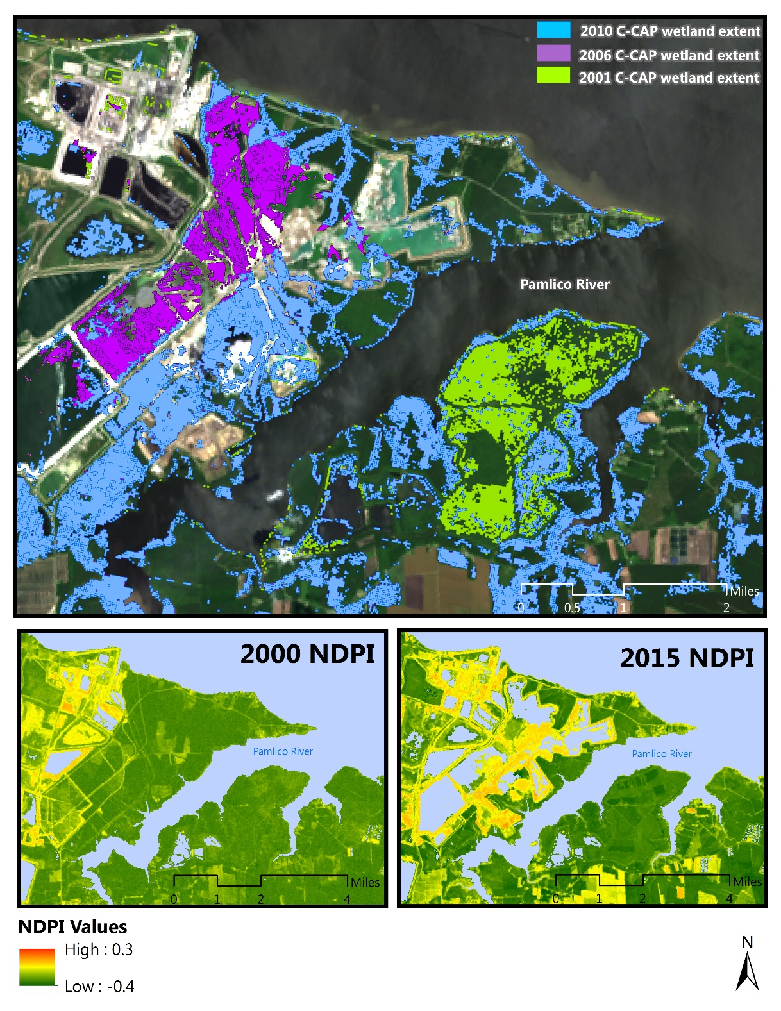
Notes:
This is just a still image of the GIF in the previous slide, the top image shows changes in NOAA C-CAP data. Lime green pixels are wetlands that had been lost from 2001 to 2006. Purple pixels are wetlands that had been lost from 2006 to 2010.
The bottom two are images from the Landsat scenes for 2000 (left) and 2015 (right) after the NDPI had been calculated. We can clearly see the expansion of the phosphate mine across the time series, the colors are different from those in the GIF but they represent the same thing. In this case the red/yellow values are unhealthy vegetation and the green values are healthy vegetation. The values are mostly yellow, and have moved into the green values adjacent to it (these are the expansions of the mine).

Slide 13
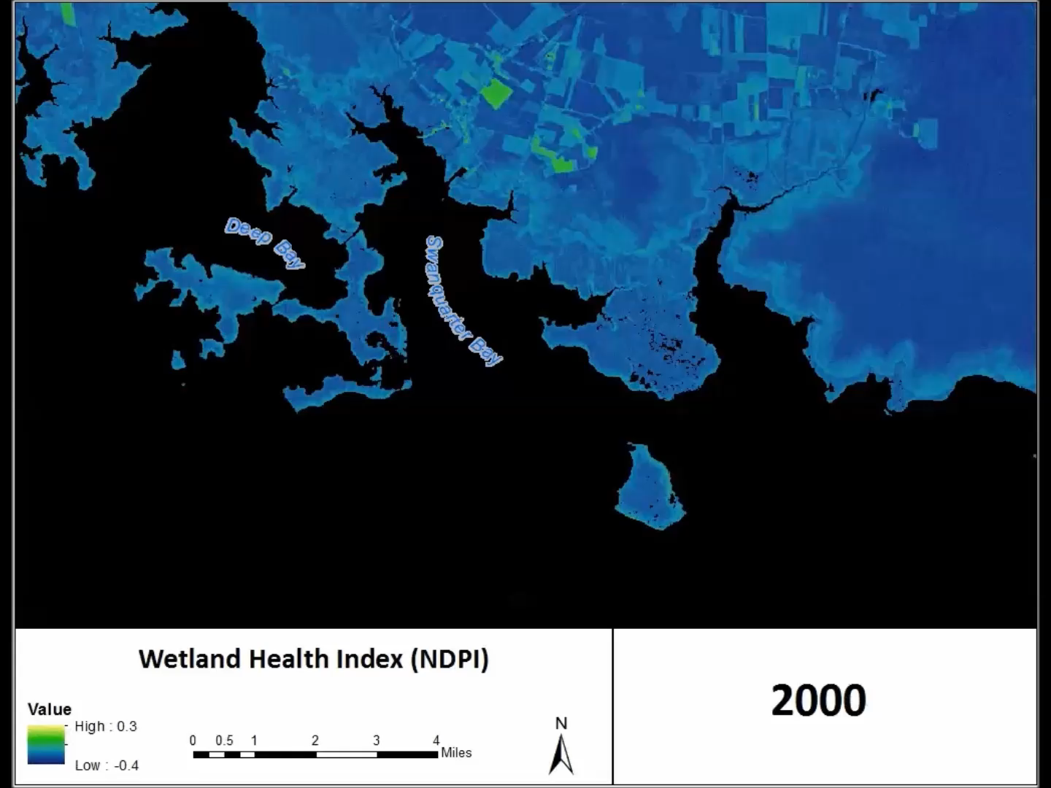
Results
Notes:
This is another one of our three case studies slightly downstream on the Pamlico River from the phosphate mining site. We chose this site because it represents a shoreline with wetlands that have not exhibited notable land cover change over the 15 years of Landsat scenes. However, our NDPI picks up a notable decrease in wetland health. Again, the higher green/yellow color represents unhealthy vegetation while darker blue represents healthy vegetation.

Slide 14
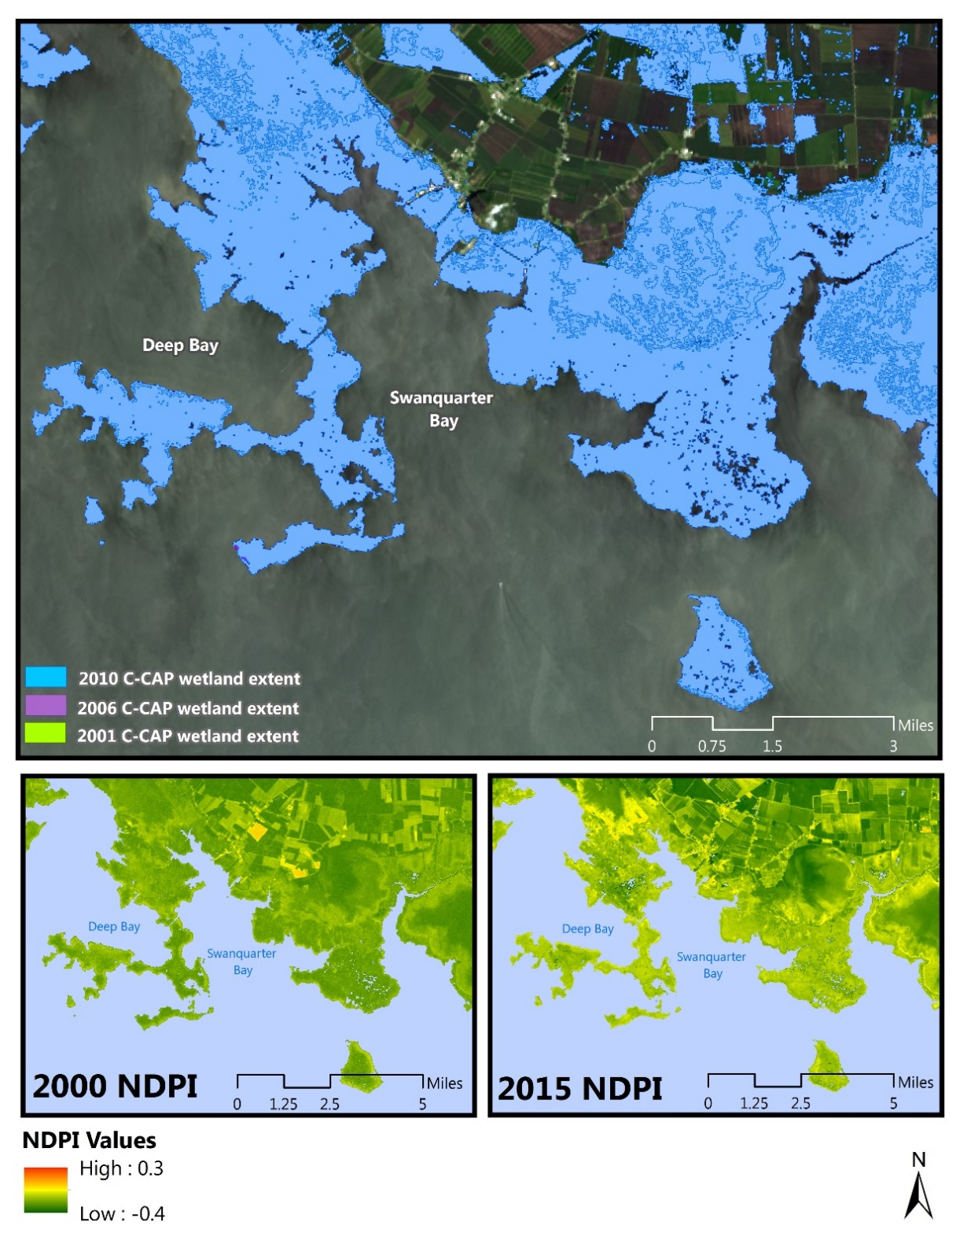
Notes:
This still image represents the previous GIF. Like before in the top image, green pixels represent wetland loss from 2001 to 2006, purple pixels represent wetland loss from 2006 to 2010 and blue pixels represent wetlands in 2010. In this image there are no green or purple pixels so we can ascertain there has been no to minimal wetland loss, but our NDPI images on the bottom reveal that despite the persistence of the wetlands their health has decreased over the years 2000 to 2015. The causes for this are still undetermined, that is something we recommend for the Fall term project to address.

Slide 15
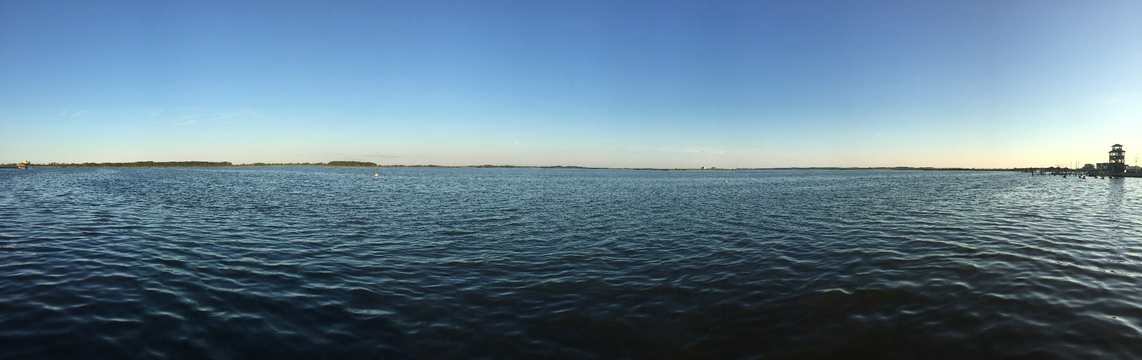
Conclusions
Credit: Zand Bakhtiari
From 2000 – 2010 there was minimal change in wetland extent (approximately 30 mi²)
Noticeable decrease in the overall wetland health detected from health index (NDPI)
According to C-CAP for 2000-2010 wetland area will remain relatively consistent in future years, our assessment predicts wetland health will continue to decrease

Slide 16
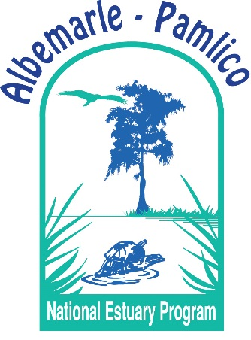
Advisors
Dr. Kenton Ross – NASA DEVELOP National Science Advisor
Partners
Albemarle-Pamlico National Estuary Program (APNEP)
Others
Jeff Ely – NASA DEVELOP Geoinformatics Fellow
Emily Adams – NASA DEVELOP Langley Center Lead
Dan Wozniak – NASA DEVELOP Langley Assistant Center Lead

