Slide 1
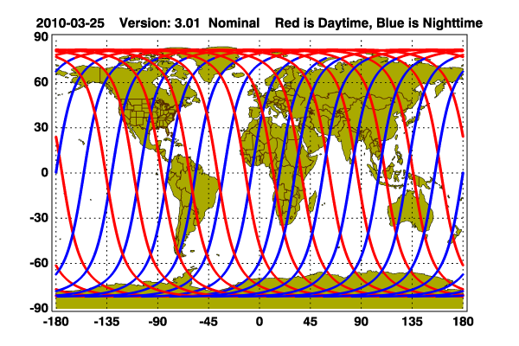
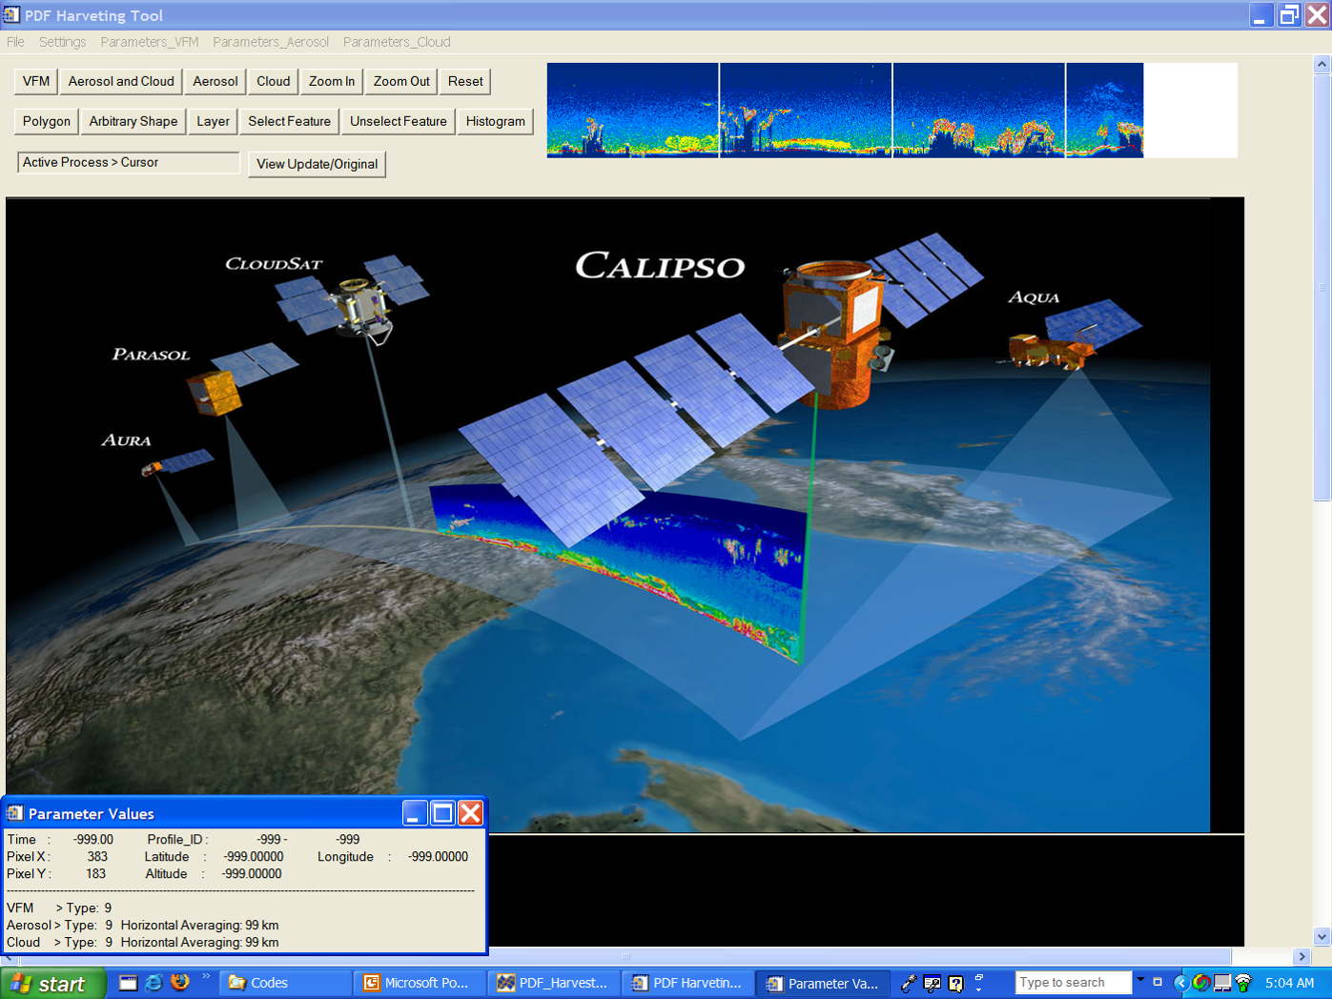
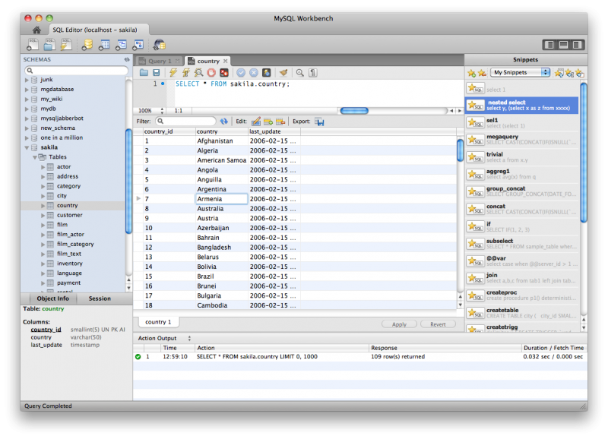
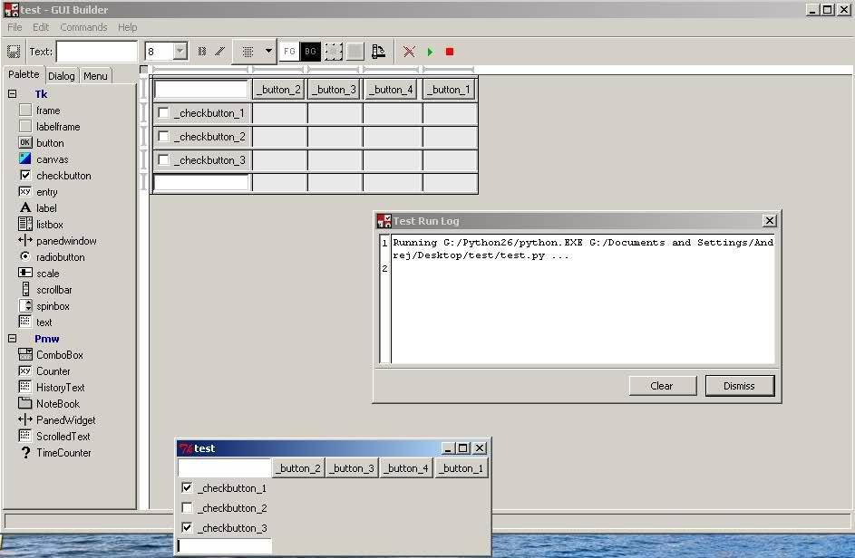
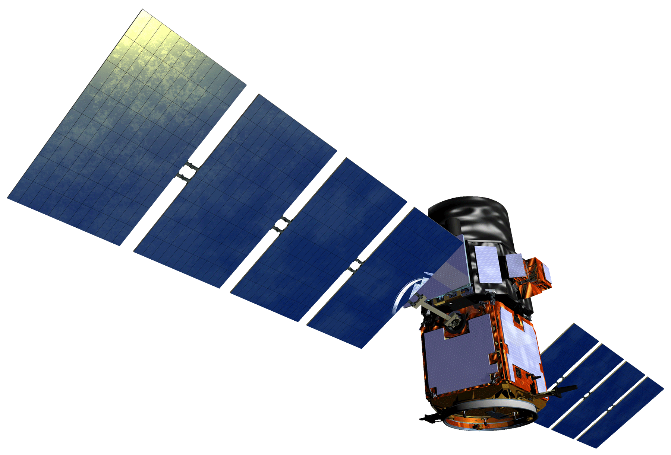
CALIPSO Health & Air Quality
Creating tool to help identify Smoke Plumes Observed with CALIPSO to Improve Future Research and Decision-making
Jordan Vaa (George Mason University), Ashna Aggarwal (College of William and Mary),
Courtney Duquette (Christopher Newport University)
NASA Langley Research Center
*** Placeholder Abstract ***
Create a tool for the visualization and selection of objects within CALIPSO data files
Groom data for storage in a database in order to facilitate searching based on data characteristics
The user uploads a CALIPSO data file, which is plotted on a grid of time versus altitude
An object of interest is selected by freehand and catalouged into a database
The database is web-accesible and open to a large user platform
CALIPSO
Jordan Vaa
Ashna Aggarwal
Courtney Duquette
Dr. Charles Trepte
Dr. Amber Soja
Brian Magill
Dr. Kenton Ross
DEVELOP National Science Advisor

