Slide 1
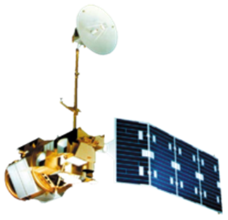
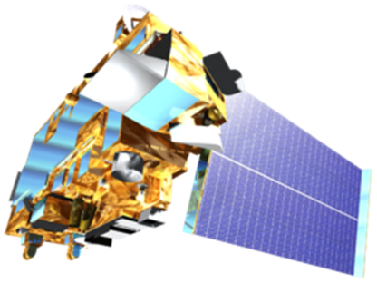
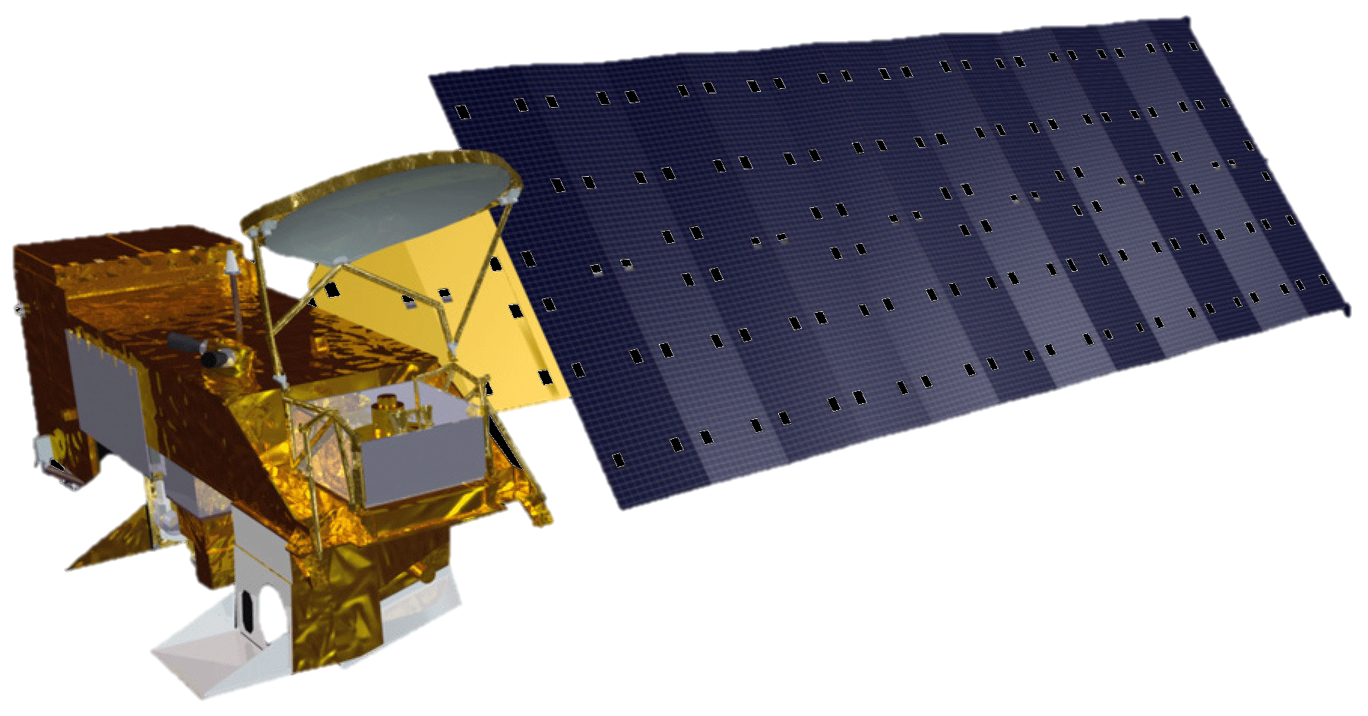
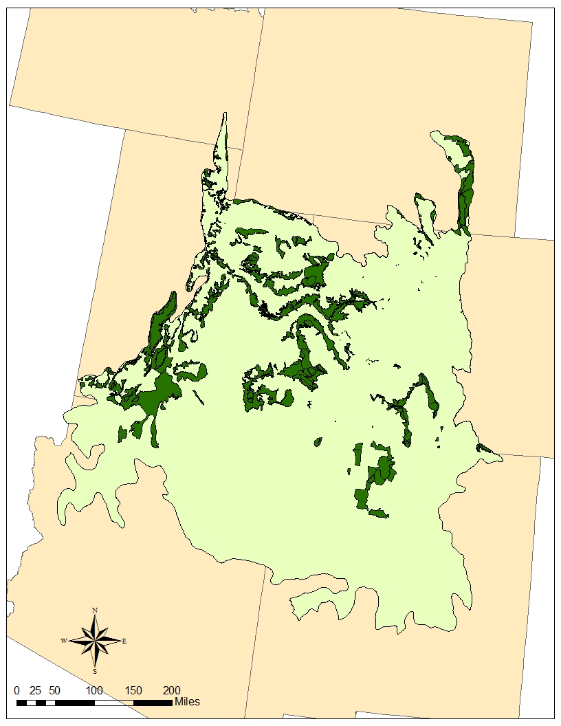
Southern Rockies Eco Forecasting
Using NASA Earth Observations to Identify and Predict Suitable Mule Deer Habitats
Ross Reahard (Project Lead), Teresa Fenn, Jeri Wisman
NASA DEVELOP National Program at John C. Stennis Space Center
Abstract
Objectives
Earth Observations
Keep this blank for now.
Body text point size should be at least 24.
Caption text point size should be at least 16.
Feel free to rename, move, and resize sections as needed.
Characterize components that comprise high quality habitats for mule deer in the Southern Rockies LCC (SRLCC)
Describe the effects of wildfires on vegetation changes in the SRLCC
Develop a habitat suitability model for the mule deer’s winter range
Predict potential winter range areas for wildlife management teams to prioritize conservation and restoration
Landsat 8
Landsat 5
Aqua
Terra
Study Area
Idaho
Wyoming
Methodology
Landcover
Utah
Elevation
Clip
to
Study
Area
Vegetation/ Phenology Changes After Fire Disturbances
Habitat Parameters Weighted
Overlaid
All
Layers
Final
Image
Colorado
Mule Deer Habitat
Fire Perimeters
Arizona
New Mexico
Mule deer
winter range
SRLCC
boundary
Results
Conclusions
Use images.
Make sure that it has some sort of flow, that it makes sense. Show your results in a logical order.
No bullets.
Use bullets.
Use complete sentences with periods.
Team Members
Project Partners
Acknowledgements
Ross Reahard (Project Lead)
Teresa Fenn
Jeri Wisman
Southern Rockies Landscape
Conservation Cooperative
Western Association of Fish and Wildlife Agencies Mule Deer Working Group
Joseph Spruce – Senior Scientist and Lead Science Advisor at NASA SSC
James “Doc” Smoot – Senior Scientist and Assistant Science Advisor at NASA SSC
Ross Reahard – SSC DEVELOP Center Lead
NASA DEVELOP National Program Office
John Rice – Southern Rockies LCC – Science Coordinator
Jim Heffelfinger – WAFWA Mule Deer Working Group – Chair
RS/GIS Laboratory – College of Natural Resources – Utah State University
NASA John C. Stennis Space Center

