Slide 1
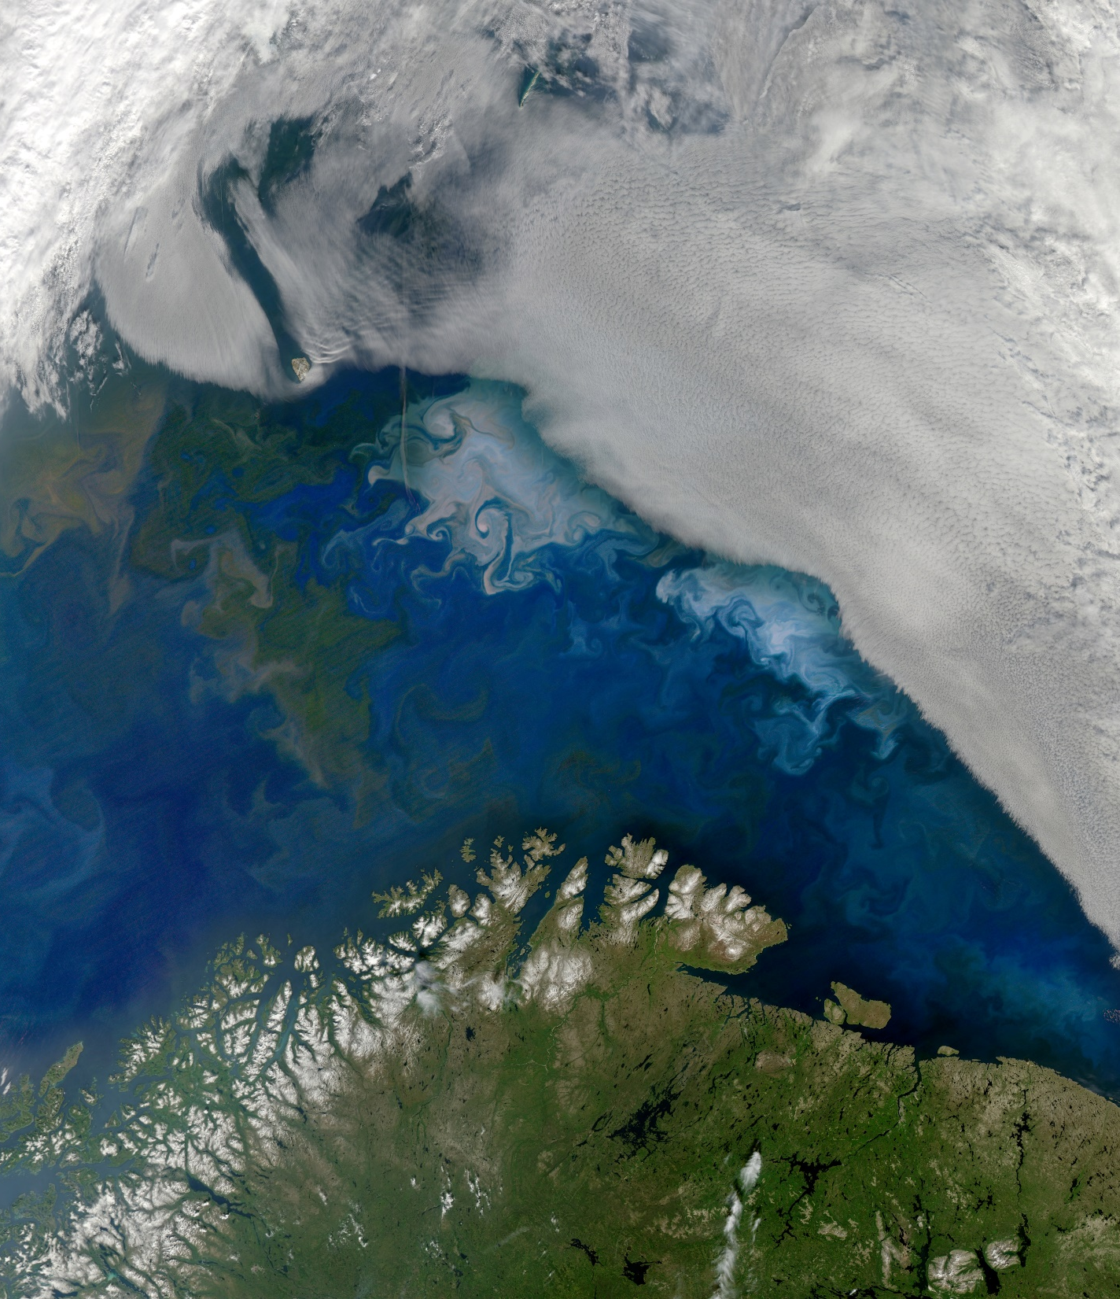
DEVELOP National Orientation (2022)
Module 3. Participants

Slide 2
Getting Started

Slide 3


PARTICIPANTS
First Week Overview
Week 1 is focused on orientation, getting to know each other, and beginning literature review.
Orientations this week fall into two categories:
  Space Systems Orientation – Space Systems is your contracting employer and this orientation covers logistics and company-specific systems, tasks, requirements, etc.
  DEVELOP Orientation – this introduces you to NASA DEVELOP, provides information about the people you will interact with, resources available to you, federal regulations and requirements, and insight into what you will be doing.
Your Fellow is your one-stop-shop when you have questions. If they can’t answer a question, they will point you to the right person to reach out to!
By The Way
It’s typical that during the orientation overload, you will forget things. A best practice is to take notes and refer back to the materials throughout the term!

Slide 4
PARTICIPANTS
Weeks 3 & 4: Coding Workshops
DEVELOP offers multiple coding workshops that participants are encouraged to attend if they would like to improve their programming skills!
At this point, you should have signed up for a subset of the following workshops:
  Google Earth Engine – teaches the basics of GEE and how to do various processes such as random forest modeling and GUI construction. Good for participants at any skill level.
  Unix – teaches the basics of the Unix shell and basic command line functionality. Good for participants just starting out with coding.
  Git – Part 1: teaches the basics of Git using the command line. Part 1 is required for any new participants and any returners that have not done the workshop before. Part 2: how to collaborate using GitLab (used for Geo deliverable submissions). 1-2 people per team should participate in Part 2.
  Python – covers the basics of Python programming and introduces geospatial Python topics. Good for participants who have never programmed or never used Python before. Cannot enroll in R if enrolled in Python.
  R – covers the basics of R programming and introduces geospatial R topics. Good for participants who have never programmed or never used R before. Cannot enroll in Python if enrolled in R.

Slide 5
PARTICIPANTS
Weeks 3 & 4: Coding Workshops
Times and dates for all workshops available on the Fall 2022 Events calendar.
Tune into the Introduction to Geoinformatics webinar at 2pm ET on Thursday, September 15th to learn more!
By The Way
(Almost) all of these workshops are totally optional! If you decide that you would rather focus on your project at the start of the term, you are more than welcome to.

Slide 6
PARTICIPANTS
Tips for Success
Be flexible
Have an open mind
Stay organized
Teamwork is key
Learn from those around you
Go above and beyond
Help and encourage others
Be mindful and respectful
Demonstrate integrity
Follow the rules
Have fun
Build your résumé
Be on time
Maintain a positive attitude
Promote harmony
Be ready to present any moment
Accept that things change
Expect the unexpected
Keep track of deadlines
Nomenclature matters
File management is key
Be innovative
Never plagiarize
Explore opportunities
Try new things
Network! Network! Network!

Slide 7
Professionalism &
Best Practices

Slide 8
PARTICIPANTS
Professionalism
Professionalism is “the conduct, aims, or qualities that characterize or mark a profession or a professional person.”
DEVELOP is an opportunity for all participants to improve in their professionalism.
Characteristics of professionalism:
Reliable
Competent
Ethical
Poised
Organized
Mindful
Polite
Orderly Appearance
Calm Demeanor
Good Written & Oral Correspondence
Accountable
By The Way
Why? DEVELOP’s signature is that of professionalism and respect. We respect ourselves, our partners, and NASA. We go above and beyond. We stand out from our peers. We strive for excellence in all things we do.

Slide 9
PARTICIPANTS
Dress Code
Whether you’re working from home or in-person at a node, the way you dress can influence the way you work!
Pay special attention to dress when your team has in-person or video call meetings with partners, science advisors, and NPO! Make sure you are presenting yourself professionally.
Dress for success when working from home or in the office!!
Daily Dress Code = Business Casual
Dresses: Avoid spaghetti straps
Shirts: Collared shirts, polo shirts, blouses, sweaters
Professional Presentations = Business Professional
Wear blazers or jackets for hand-off and closeout presentations
Follow the instructions and advice given by your DEVELOP Lead/Fellow when in doubt.

Slide 10
PARTICIPANTS
By The Way
These points also apply to in-person work!
Remote Work Best Practices
While many are working remotely, please make sure communication lines are open
Be responsive to virtual communications: Teams, email, texts, etc.
Ensure that all virtual interactions are positive, thoughtful, and respectful
Technical difficulties will happen! Just troubleshoot as best you can
Use your camera during video calls to help with non-verbal communication
#1 check – are you muted when you should be?
Camera best practices: position your camera at/around eye level, minimize background distractions, make sure what’s behind you is professional (not unmade beds or dirty laundry piles), assess lighting – being front-lit is best
Aim to arrive right on time for virtual meetings (taking into consideration connecting can take a minute or two)
Remember you are representing NASA, CBP, DEVELOP, your team, and yourself in all interactions
Make sure to “disconnect” at the end of the day!

Slide 11
PARTICIPANTS
Remote Work Best Practices (cont.)
When in doubt about anything, ask!
Prepare for each day as you would if you were working on site at a DEVELOP node
Take breaks – stand, stretch, go for a walk, eat your lunch away from your computer!
Attend all required meetings
Check your calendar often
Maintain consistent communication with your team, Lead/Fellow and science advisor(s)
Keep to your scheduled work hours
Do what works for you! Your personal and project success are important
By The Way
Struggling with working from home? It’s ok! Reach out to your Fellow or NPO – We’ve had over a year of practice!

Slide 12
PARTICIPANTS
Use of Government Equipment*
US Government computers are for authorized users only.
It is NASA's policy to permit limited personal use of Government office equipment, including information technology (IT).
The limited personal use of Government office equipment by NASA employees and contractors shall not interfere with official business, violate existing laws, and should involve only minimal additional expense to the Government.
Unauthorized use of the computer accounts and computer resources to which you are granted access is a violation of Federal Law; constitutes theft; and is punishable by law.
Misuse of assigned accounts and accessing others' accounts without authorization is strictly forbidden.
Failure to abide by these provisions may constitute grounds for termination of access privileges, administrative action, as well as civil or criminal prosecution.
*All information for government policy and equipment is also true for SSAI
NASA 2540.1G & NPR 2810.1A: http://insidenasa.nasa.gov/ocio/policy/policy_direct/index.html

Slide 13
PARTICIPANTS
By The Way
If you log into a personal Gmail while on a government computer, they can see your entire browsing history! Do you want them to see it? Think twice before you log in to personal accounts!
Virtual Machine Usage
Online Policies:
Virtual machines should be used for DEVELOP purposes only, meaning absolutely no games, commercial radio, or music/video downloads (unless it’s for the project).
No Facebook, Twitter, etc. unless it’s for DEVELOP purposes!
Limited personal emails are acceptable as long as they DO NOT interfere with your project work.
Be mindful of the websites you visit and links you click on.
Be diligent against phishing attempts.
Software:
Installation of legally licensed software is permitted if the software is necessary to complete your project – but you must have approval from your Fellow.
Do not make copies of proprietary software.
If you have questions regarding permissibility of software, please contact your Fellow.

Slide 14
PARTICIPANTS
Privacy
Expect NO privacy when using a government/SSAI computer OR when emailing a government/SSAI email address. This also applies to the SSAI instance of Microsoft Teams and Office365.
Strict computer use policy in effect – every keystroke is stored, every NASA email is public domain.
NASA Policy:
NASA employees and contractors do not have a right to expect privacy while using Government office equipment at any time, including accessing the Internet and using email.
The Government maintains call details and network access records to monitor telephone activity and internet access.
The Government also employs monitoring tools to track system performance and improper usage.
This applies to those emailing a NASA email as well.
NASA 2540.1G & NPR 2810.1A: http://insidenasa.nasa.gov/ocio/policy/policy_direct/index.html

Slide 15
Surveys, Taxes, and More

Slide 16
PARTICIPANTS
Participant Reporting
Personal Growth Assessments: Two online assessments that collect information relating to participant skill levels and expectations, provide valuable feedback to nodes and the program.
  Entrance Assessment - week 2
  Exit Assessment - week 10
Exit Survey: An online survey which serves as DEVELOP’s performance review and allows for a national perspective on the program, leadership, and advisors. It helps DEVELOP evolve and improve, and we value your input greatly!
  Link emailed - week 10
Performance Reviews: DEVELOP’s main objective is to assist participants in developing both professionally and personally. Part of this process is giving feedback in performance reviews at the middle and end of the term. Please consider this process constructive and take any feedback as goals for improvement.
  Midterm Review - typically weeks 5 or 6
  End of Term Review - typically weeks 9 or 10
Alumni Survey: In recent years, a survey has been shared with alumni to assess the impact of DEVELOP, enhance the network of alumni engaged with the program, and assess the career fields that participants progress into. We look forward to surveying you in the near future! Before you leave this term, please make sure that DEVELOP has the best email address to reach you.

Slide 17
PARTICIPANTS
Payment & Taxes
Pay Scales
All participants are part-time, temporary employees of Space Systems
Participants are paid on a step scale based on applicant classification and education level.
Your classification and education level was self-identified in your application to the program.
  Classification = student, recent graduate, early/transitioning career professional
  Education level = degree held for non-students or current grade level for students
Some remote work locations have locality adjustments – these are set by the federal government based on cost of living in specific geographic areas.
To qualify for the next step pay rate, the participant must be currently taking classes or graduated at that grade level.
Ex. a participant who finishes their sophomore year in May is only eligible to move to the next pay step in the fall once they begin taking junior level classes.
Taxes & Insurance
All necessary taxes will be withheld from your paycheck based on your tax enrollment forms
Foreign nationals who are from countries that do not have a tax treaty with the United States will see an automatic 30% of their payment withheld by their funding organization and sent to the IRS. To see which countries have tax treaties with the US visit this website.
It is your responsibility to have the appropriate health and medical coverage. SSAI does not provide insurance coverage for temporary employees.

Slide 18
PARTICIPANTS
By The Way
The Spring 2022 application window opened on August 29th and closes on October 7th. Despite it being early in the term, if you are even potentially interested, get your application in to keep options open!
Reapplication & Eligibility
DEVELOP Terms: 10 weeks
Classifications:
Currently Enrolled Student
Recent Graduate (within 2 years of graduation)
Early or Transitioning Career Professional (2+ years after graduation from last degree)
Eligibility Requirements:
18+
Minimum 3.0 GPA (for paid positions)
Strong interest in Earth science and remote sensing
Able to provide personal transportation to and from DEVELOP location
DEVELOP does not provide transportation to nodes nor can DEVELOP provide a badge to a participant’s driver to gain access to NASA Centers
U.S. citizenship is required to apply to: ARC, JPL, LaRC, MSFC, GSFC, NCEI
Reapplication:
Required if you would like to continue with DEVELOP in a future term
The returning application is shorter and does not require letters of recommendation

Slide 19
PARTICIPANTS
Quiz Time
What should participants wear if giving a formal presentation?
Is it ok to use your teammate’s account log-in when you can’t get access?
Can you expect privacy when using a government computer OR when emailing a government email address?
Should you email personnel problems to NPO?
What are the 4 reporting mechanisms for participants?
Does Space Systems provide insurance coverage for temporary employees?
Do you need to reapply if you want to come back in a future term?

Slide 20

Thank You.
“Respect for ourselves guides our morals, respect for others guides our manners.”
-- Lawrence Sterne --

