Slide 1
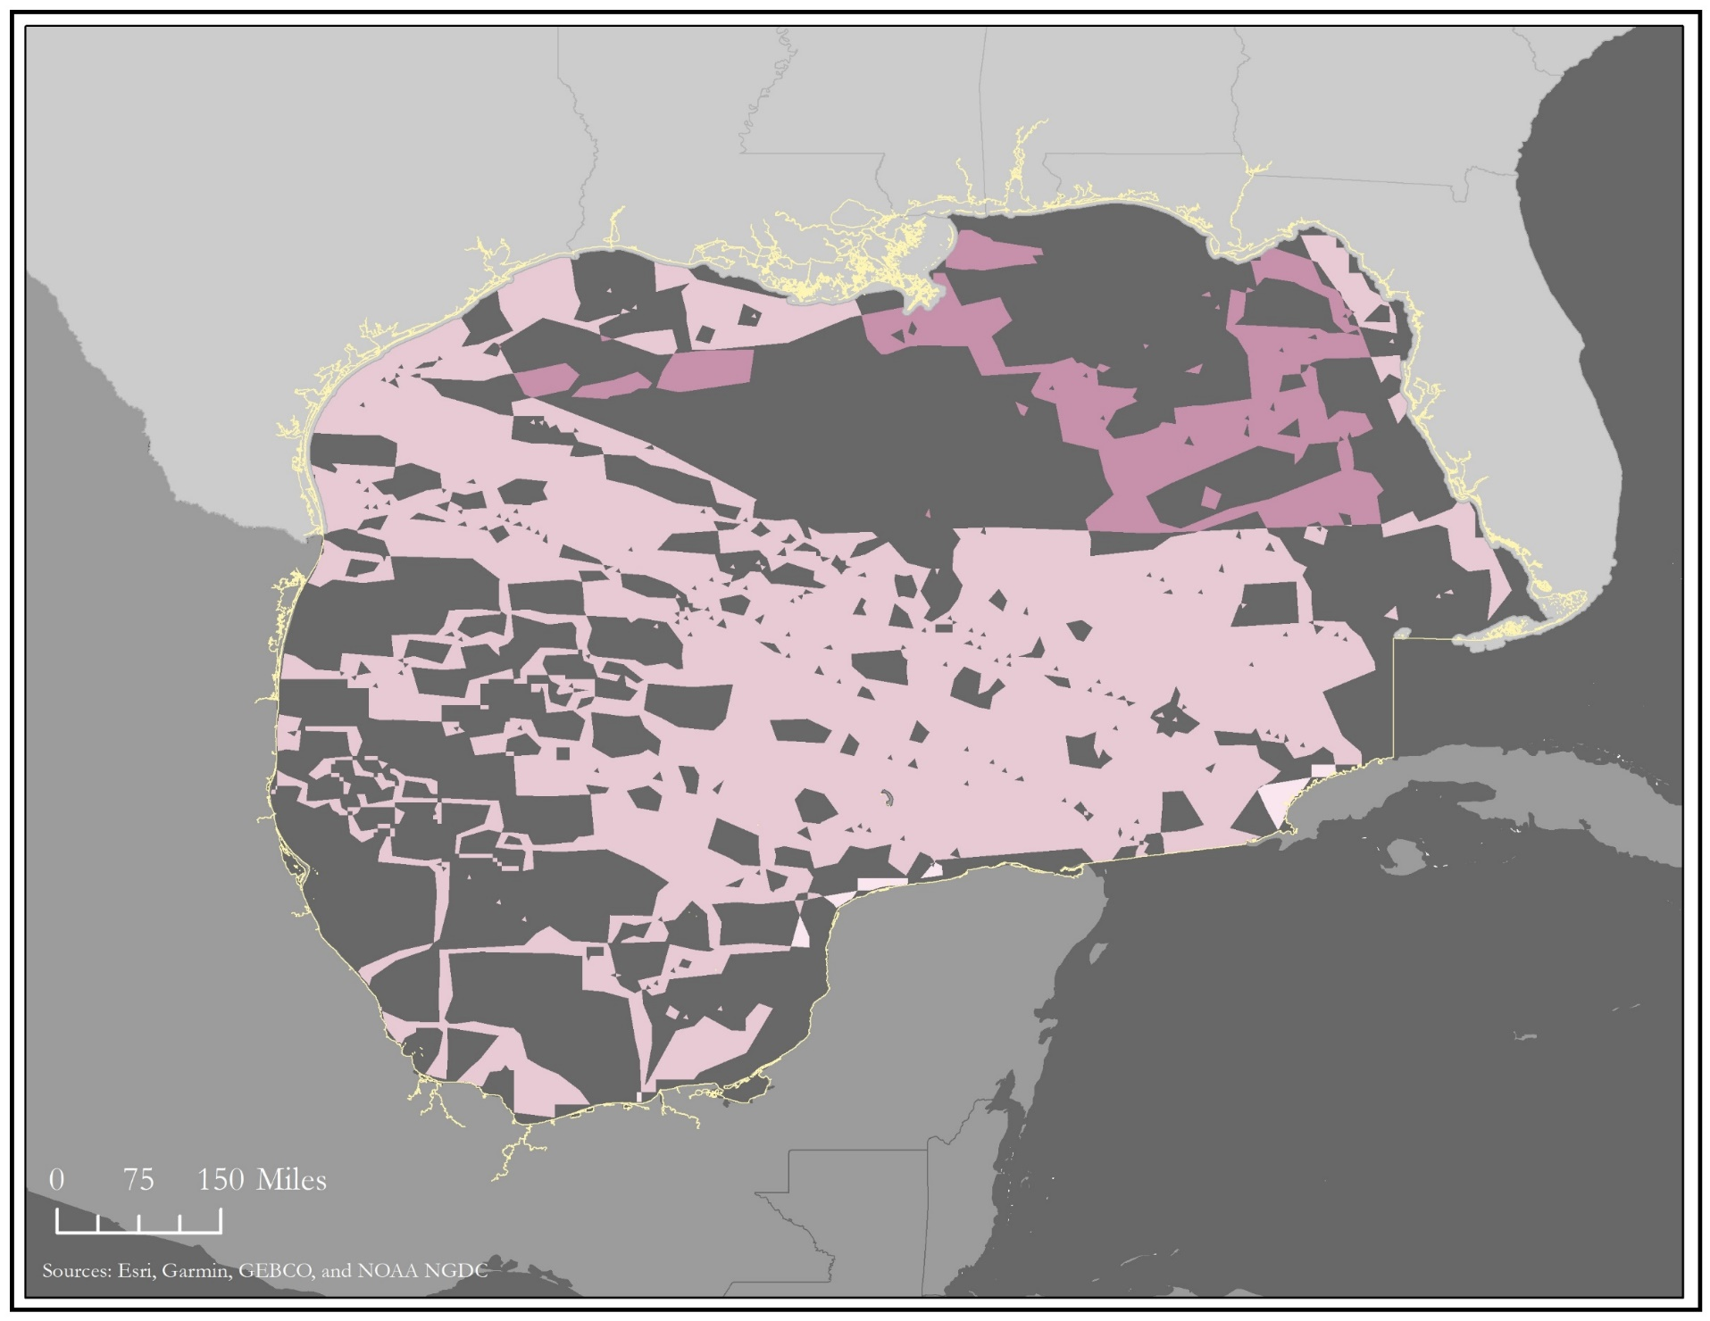
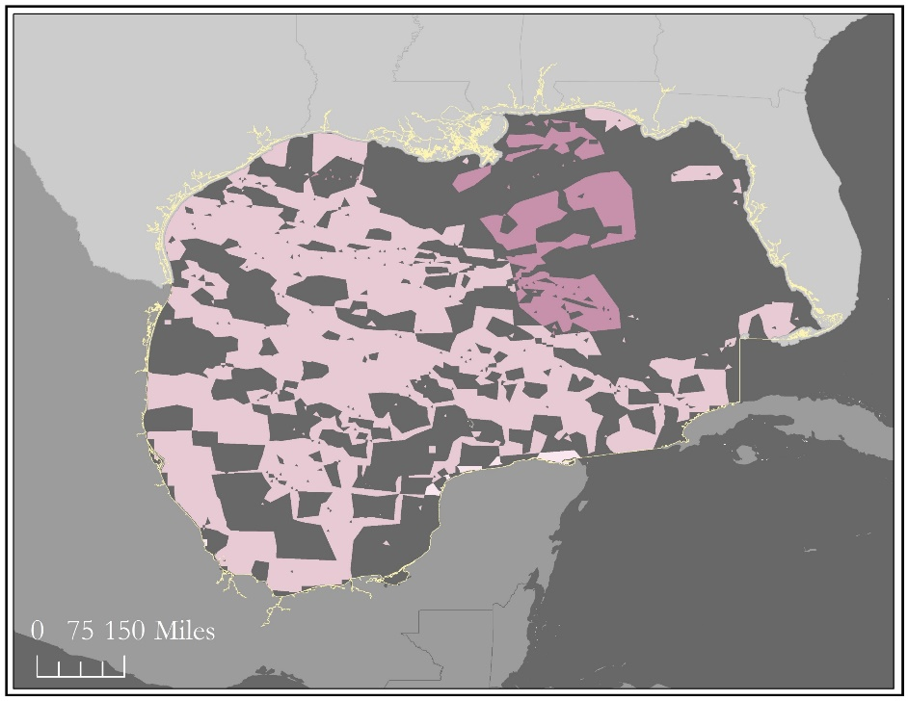
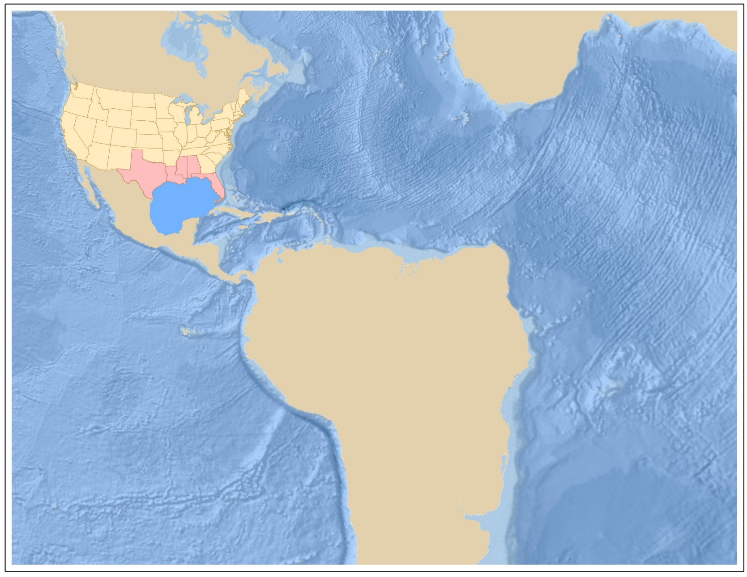
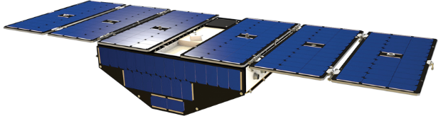
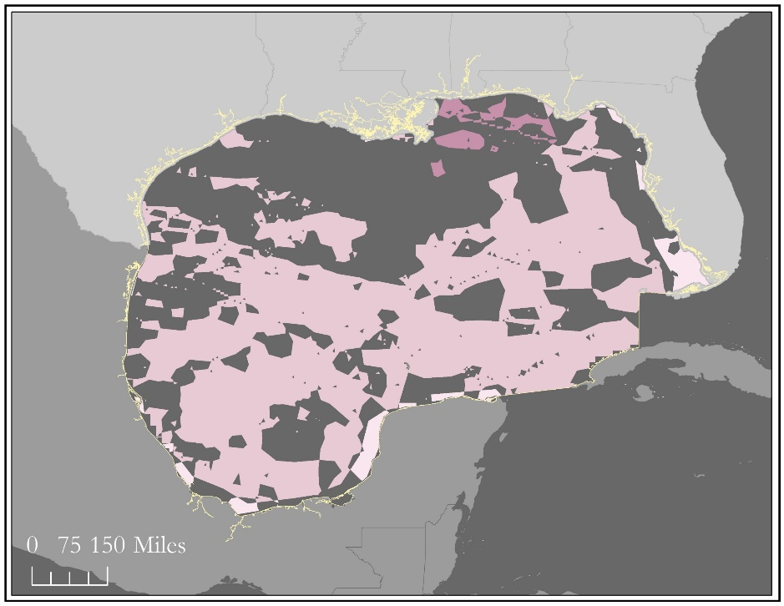
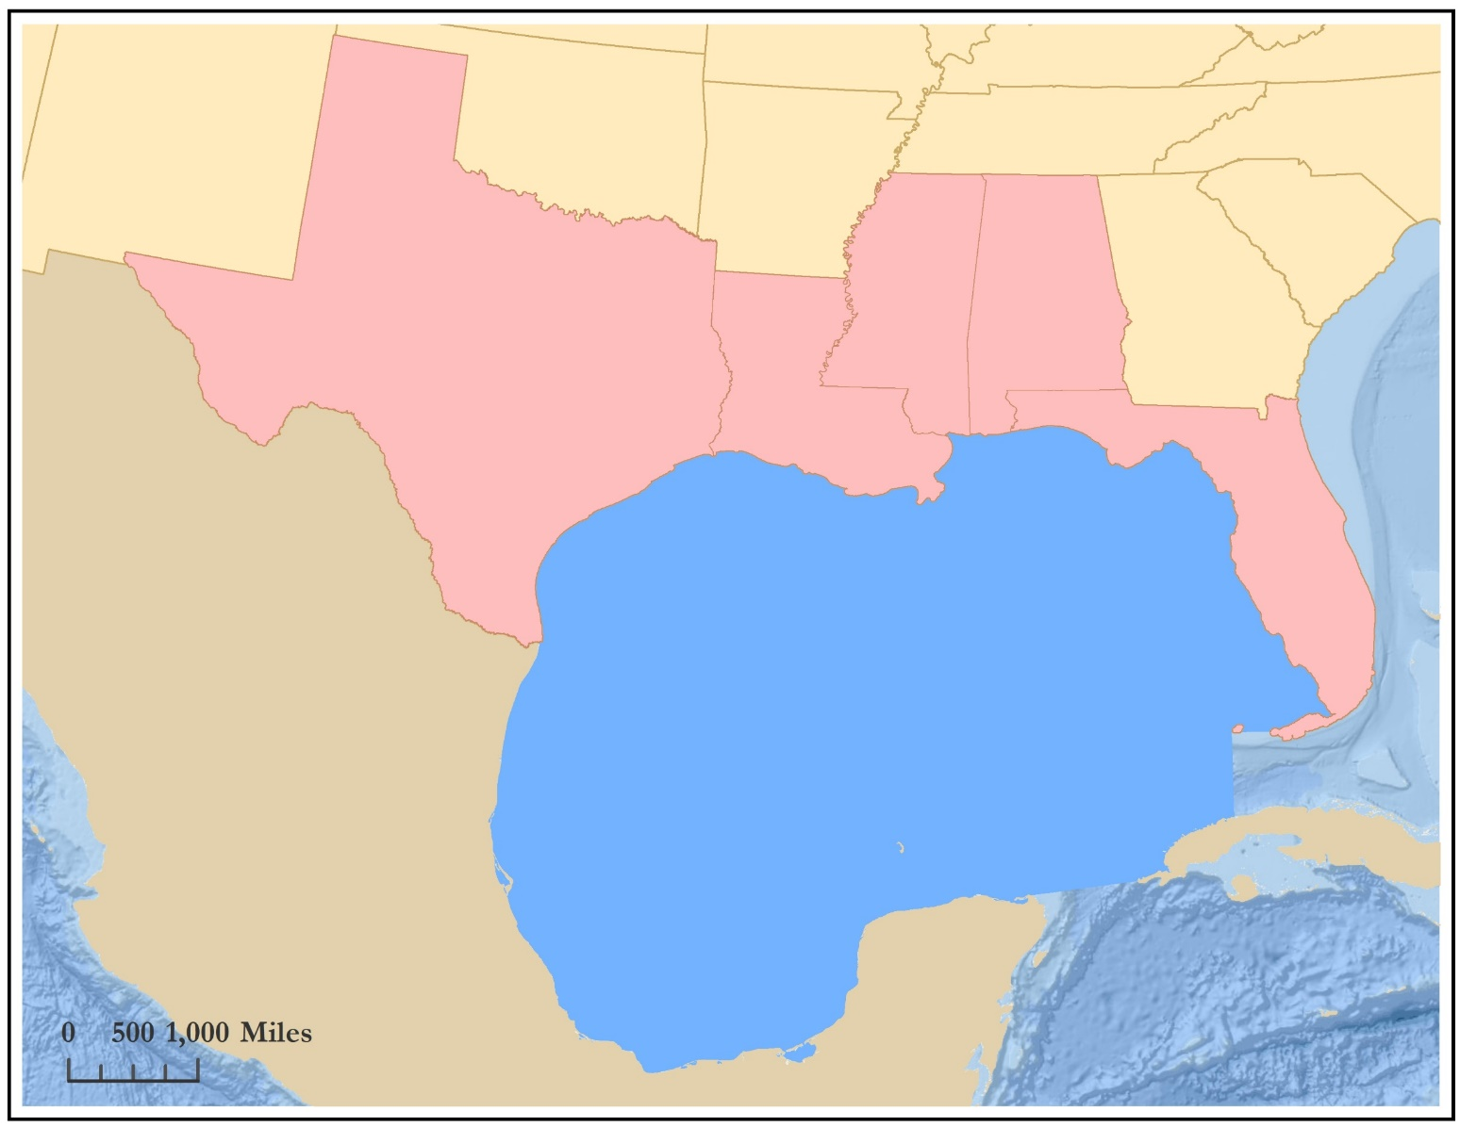
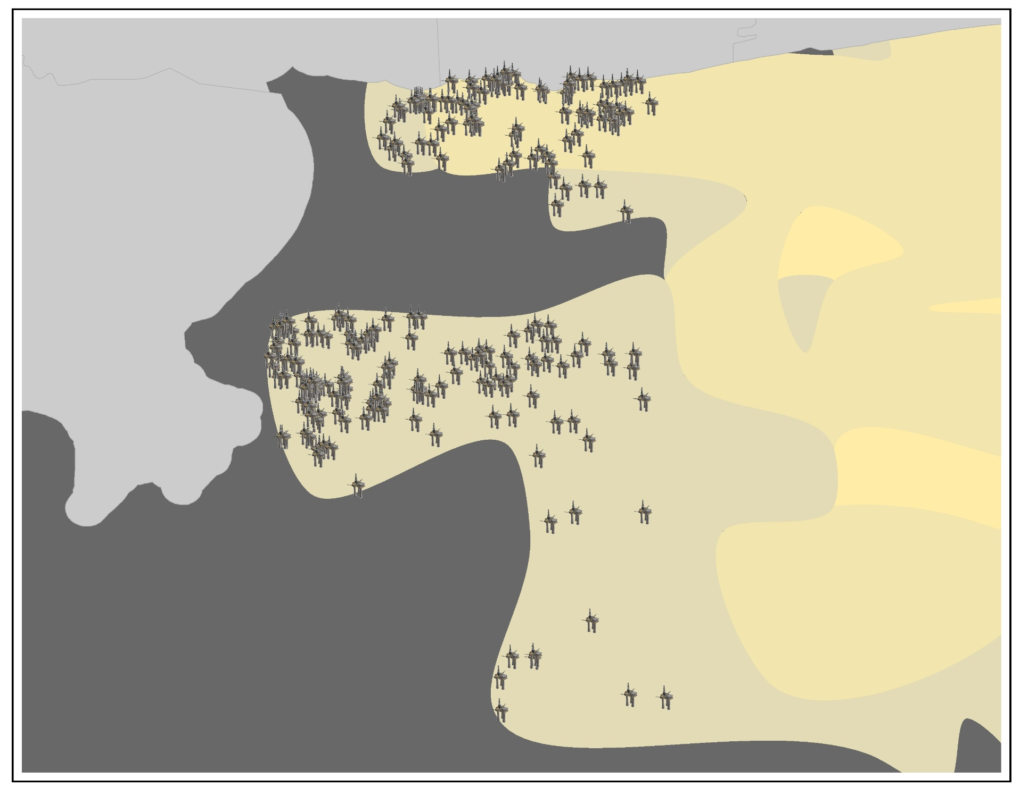
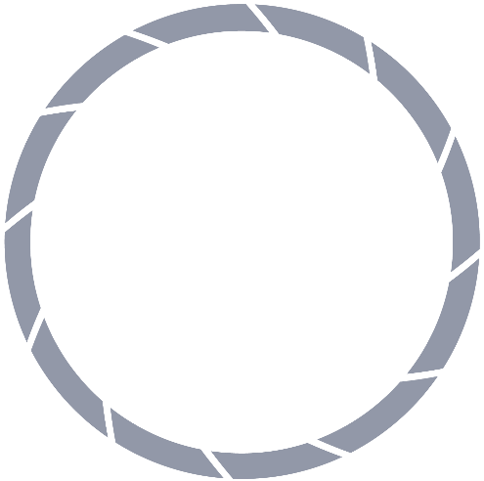
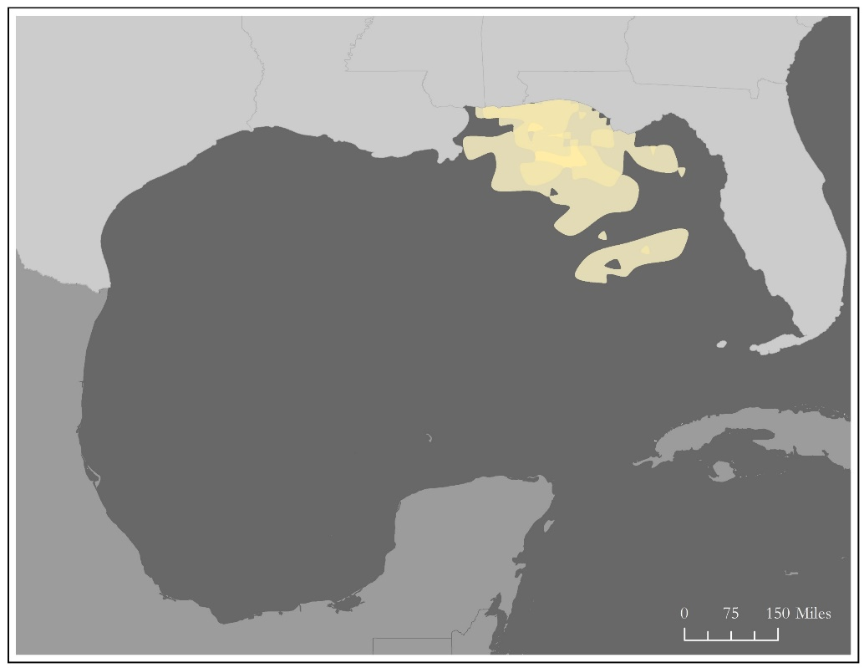


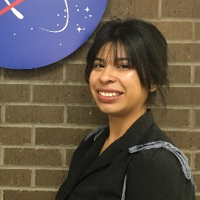

Evaluating the Potential of CYGNSS Wind Data to Assess Tropical Storm Impacts on Energy Infrastructure in the Gulf of México
Abstract
Methodology
In recent years, the Gulf of México (GoM) has gained national attention for its significant contributions to the country’s overall oil supply – the area today accounts for 17% of all US oil production. The production and availability of such oil resources is threatened when tropical storm systems enter the GoM. Oil and natural gas rigs, transportation pipelines, processing plants, and other energy infrastructure in the expected path of a tropical storm are often shut down, effectively halting production. In an effort to assess and mitigate the impact of tropical storms on such infrastructure, the fall 2018 NASA DEVELOP Gulf of México Transportation and Infrastructure team partnered with the Bureau of Ocean Energy Management (BOEM) to analyze the dynamics of wind and wave-intensity during tropical storm events. The team created maps of wind and wave conditions using data collected by the Cyclone Global Navigation Satellite System (CYGNSS) constellation and the National Oceanic and Atmospheric Administration’s (NOAA) WaveWatch III (WW3). The project compared and validated CYGNSS measurements using Modern-Era Retrospective Analysis for Research and Applications, Version 2 (MERRA-2) and NOAA’s National Data Buoy Center (NDBC) wind data. The team found that CYGNSS wind speeds have an average error of 2.3247ms-1 for randomized days of March through August 2018 when compared to buoy data. This information can assist BOEM in identifying possible impacts to energy infrastructure during tropical storm events and provide guidance for future infrastructure placement sites.
NDBC Buoys
MERRA-2
CYGNSS
NOAA Wave Watch
BOEM Infrastructure
Daily Average
Wind Speed from UV Components
IDW Interpolation
Daily Average
Root Mean Square Error
Combine Wind Speed & Wave Height
Wind Speed Comparison
Storm Intensity Map
Infrastructure Overlay
Potential Infrastructure Map
Project Partner
Objectives
Bureau of Ocean Energy Management, Gulf of Mexico Outer Continental Shelf Region, Office of Environment
Assess the wind and wave environment in the Gulf of México during tropical storm systems
Predict trends in wave height and wind speed through a potential storm intensity analysis
Calculate the correlation between wind speed and wave height
Compare the wind measurements from CYGNSS, MERRA-2, and the NOAA buoy network to assess the accuracy of CYGNSS wind data
Assess the risk posed to energy infrastructure in the Gulf of México by wind and waves
Results
Tropical Storm Gordon Overlay Analysis: Areas with Correlated Sea State
September 4, 2018
September 3, 2018
Study Area
Earth Observation
September 5, 2018
CYGNSS
Sea State
Calm
Smooth
Slight
Moderate
MS
AL
Platforms in Areas with Elevated Wind Speed and Wave Height
TX
LA
September 4, 2018
United States
México
FL
States of Interest
Gulf of México
Gulf of México
Team Members
Platform
Wind and Wave Intensity
Strong
Strongest
Shelby Ingram
Project Lead
Jada Blankenship
Michelle De Luna
Essence Raphael
Acknowledgements
Conclusions
Dr. Jeffrey Luvall, NASA Marshall Space Flight Center
Dr. Robert Griffin, University Alabama in Huntsville
Dr. John Mecikalski, University of Alabama in Huntsville
Dr. Xuanli Li, University of Alabama in Huntsville
Dr. Brent Roberts, NASA Marshall Space Flight Center
Dr. Timothy Lang, NASA Marshall Space Flight Center
Maggi Klug, University of Alabama in Huntsville
Leigh Sinclair, University of Alabama in Huntsville/Information Technology and Systems Center
Greg Kozlowski, BOEM, Office of Environment, Gulf of Mexico OCS Region
Jack Irion, BOEM Office of Environment, Gulf of Mexico OCS Region
Helen Baldwin, NASA DEVELOP
Kathrene Garcia, NASA DEVELOP
CYGNSS wind measurements register higher than those for MERRA-2. During our randomized days, difference ranged from 15.23% to 38.71%.
During Tropical Storm Gordon, areas of increased wind speed have a strong correlation with areas of increased wave height with an R value of 0.73.
CYGNSS wind measurements can be used to identify risk in areas frequently exposed to tropical cyclone activity.
Gulf of México Transportation & Infrastructure
Alabama – Marshall | Fall 2018

