Slide 1
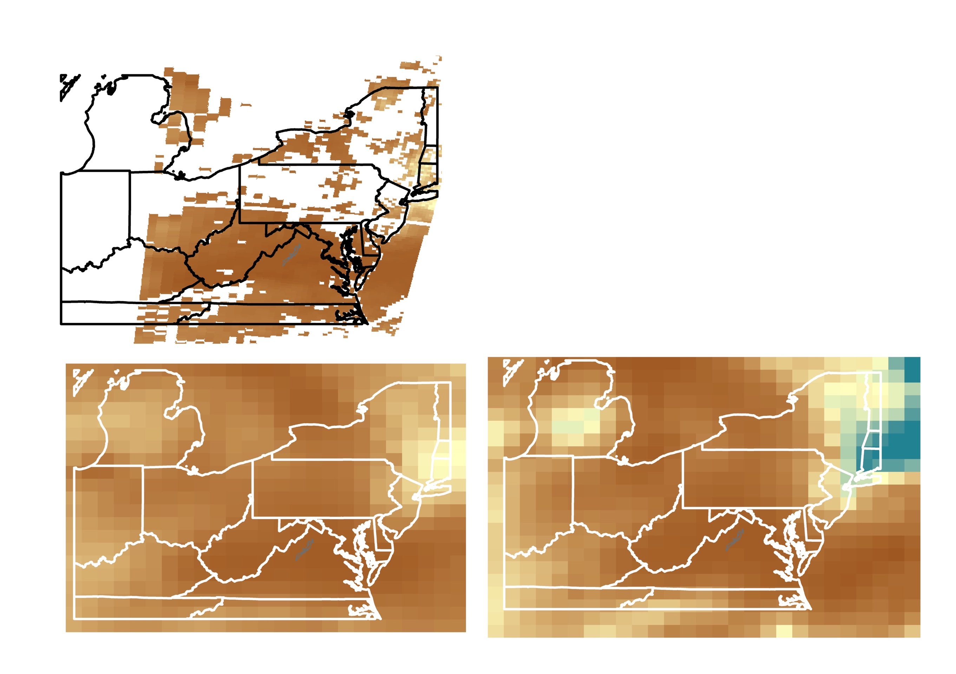



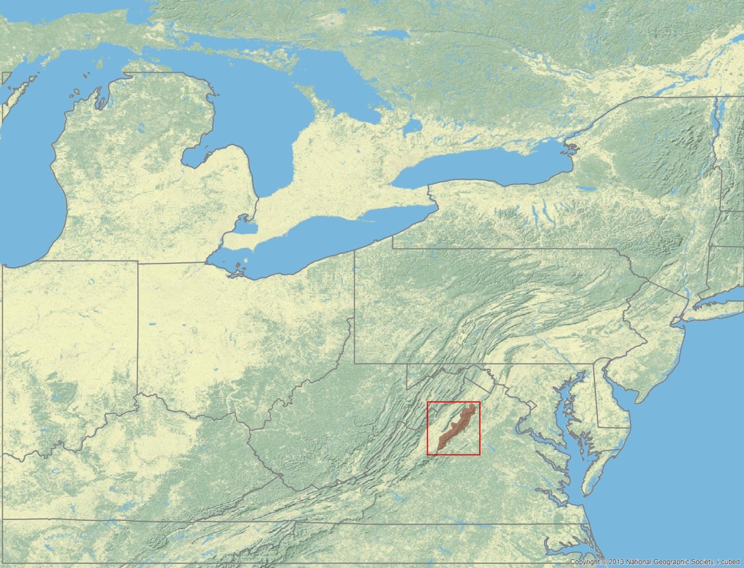
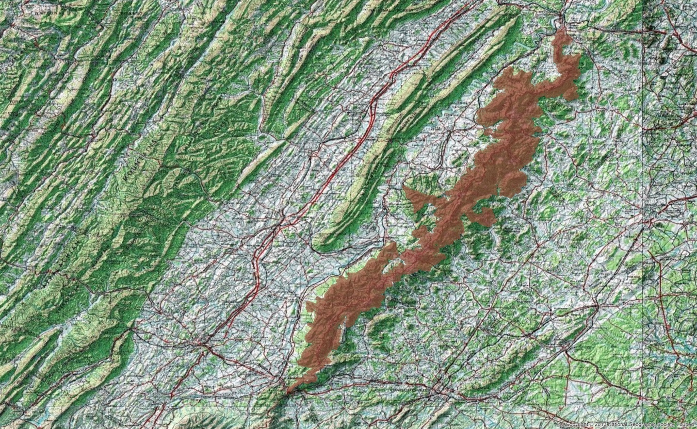








Monitoring Air Quality in Shenandoah National Park to Address
National Park Service Initiatives
Using Earth Observations
Abstract
Results
Air quality is considered one of Shenandoah National Park’s most fundamental resources. The park’s ecological health and visitor attendance are dependent on maintaining high air quality standards. This project utilized the NASA’s Aerosol Optical Depth (AOD), aerosol extinction profile, and Tropospheric Ozone Residual (TOR) datasets to create a long-term analysis of air quality in the park from May 2007 to August 2017. This analysis was used to identify trends in visibility and tropospheric, or ground-level, ozone throughout the park. In situ station data from Big Meadows monitoring station and 29 Automated Surface Observing System (ASOS) stations located within a 200 km radius from Shenandoah National Park were used to validate the NASA Earth observations. A tutorial on how to download, subset, and analyze TOR and AOD datasets was created to help park staff incorporate remote sensing data into their management practices related to air quality concerns. This project provided statistical and quantitative support for incorporating satellite data into Shenandoah National Park’s current air quality monitoring efforts and will aid in future decisions related to visitor education and ecological management.
Visibility: June 10, 2015 Case Study
Good
Visibility
150 km
R = 0.514
MODIS AOD
Poor
Visibility
0 km
Objectives
Continue to introduce applications for NASA’s Earth observations to Shenandoah National Park to supplement current air quality monitoring efforts
Assess the effectiveness of current NASA satellites to measure surface visibility and ground-level ozone
Create a tutorial for park officials to help incorporate NASA Earth observations into their management decisions related to park health and air quality concerns
Display trend maps showing historic visibility and ozone levels in Shenandoah National Park
MERRA-2 AOD
MERRA-2 Extinction Profile
Ozone: June 2007 and 2016
Study Area
Shenandoah Airshed
Shenandoah National Park Boundary
TOR in ppbv
2007
TOR in ppbv
2016
Shenandoah Health & Air Quality II
High O₃
75 ppbv
Low O₃
60 ppbv
Correlation between in situ and satellite measurements:
R = 0.526
Earth Observations
Conclusions
Terra MODIS
Visibility calculated from AOD provides a more accurate measurement of surface visibility than visibility calculated from MERRA-2 extinction profiles.
Shenandoah National Park experiences ground-level O₃ highs in late spring.
NASA Earth observations can indicate where in the atmosphere O₃ originates.
NASA Earth observations can provide the park with big-picture, long-term data to foresee trends in air pollutants that affect the park; however, higher resolution imagery will provide more accurate results.
Aqua MODIS
Project Partners
Acknowledgements
National Park Service, Shenandoah National Park
National Park Service, Air Resources Division, Research & Monitoring Branch
Subject Matter Advisors:
Dr. Hongyu Liu, NASA Langley Research Center
Dr. Jerry R. Ziemke, NASA Goddard Space Flight Center
Science Advisors:
Dr. Bruce Doddridge, NASA Langley Research Center
Dr. Rich Ferrare, NASA Langley Research Center
Dr. Kenton Ross, NASA Langley Research Center
Partners:
Jalyn Cummings, National Park Service, Shenandoah National Park
Dr. Barkley Sive, National Park Service, Air Resources Division, Research & Monitoring Branch
Previous DEVELOP team:
Ellen Bubak, Amanda Clayton, Doug Gardiner, Nicholas Lenfant, Julie Terhune
Methodology
CASTNET (ozone measurements); Tropospheric Ozone Residuals (TOR); IMPROVE and ASOS (in situ visibility measurements); Aqua & Terra MODIS AOD; MERRA-2 extinction profiles
Convert TOR, MODIS, MERRA-2 into GIS-ready formats; extract 1pm timeframe for ASOS; Convert TOR Dobson units to ppbv
Compare Earth observations and model-based estimations of visibility with ASOS reference data; create time series and trend maps
Data Acquisition
Data Processing
Team Members
Data Analysis
Emily S. Doerner
Project Lead
Andrew A. Bonifas
James Ficklin
Nick Gulston
Roger Johnson
Sarah K. Philips
Virginia – Langley
Fall 2017

