Slide 1
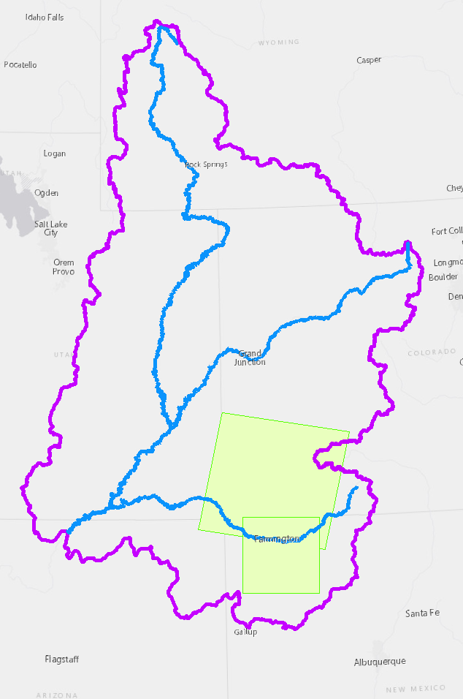
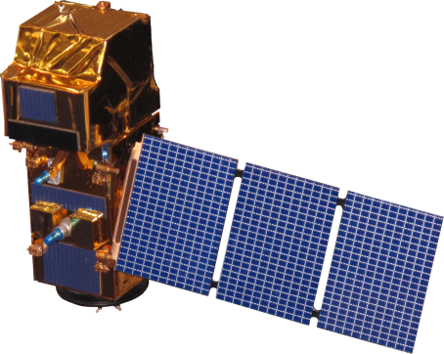


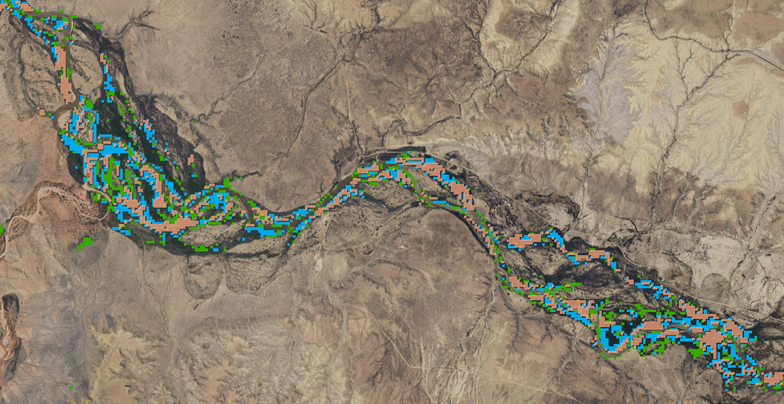
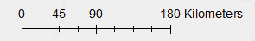
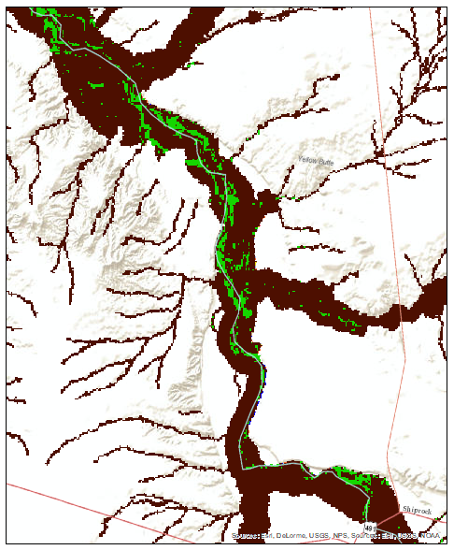
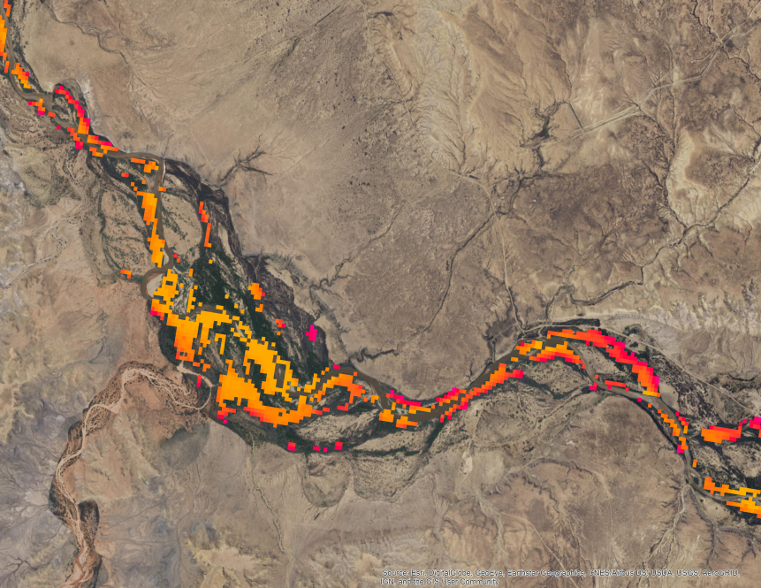
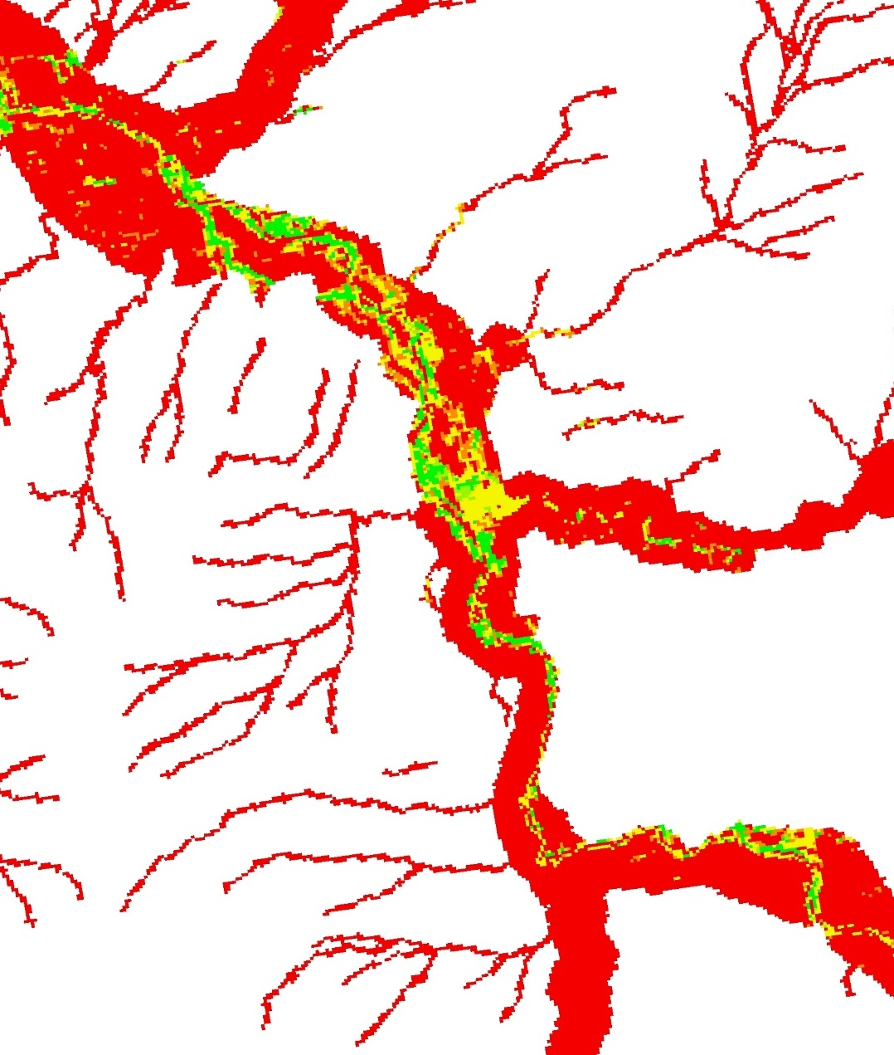

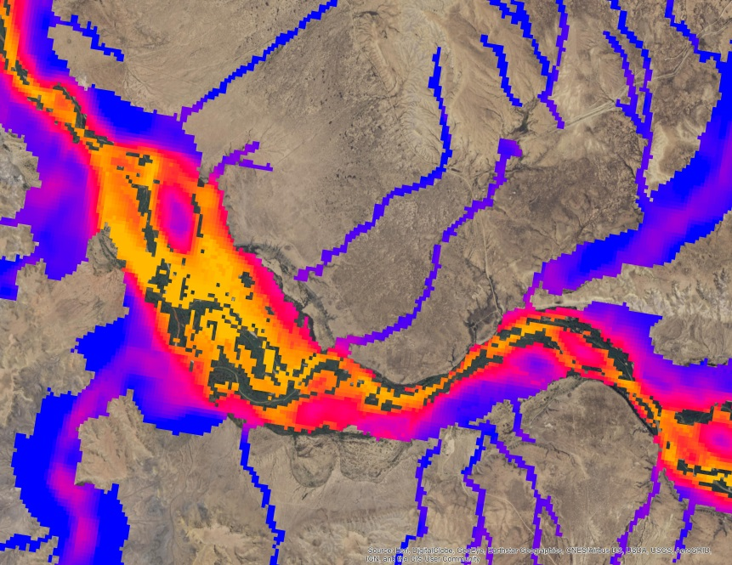




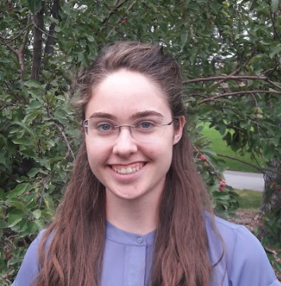
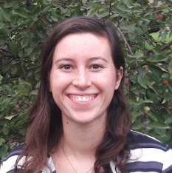
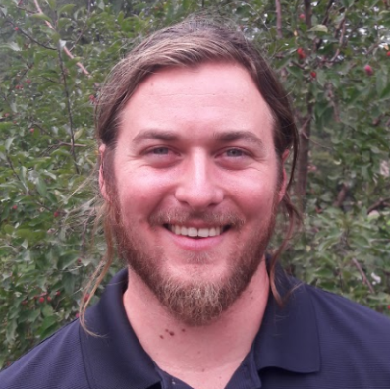
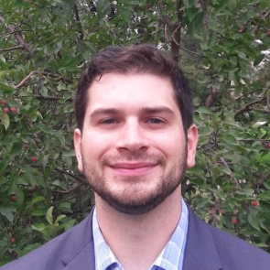
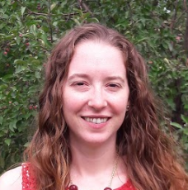

Utilizing NASA Earth Observations to Evaluate the Distribution of Russian Olive and its Impact on Evapotranspiration in the Upper Colorado River Basin
Abstract
Objectives
Riparian plant communities are vital to water quality, erosion control, biodiversity, and functionality of river ecosystems. The invasion of nonnative Russian olive (Elaeagnus angustifolia L.) poses a risk to these fragile ecosystems, as it outcompetes native riparian species such as cottonwoods (Populus spp.) and willows (Salix spp.) in semiarid environments throughout the western United States. Russian olive is well-established in the Colorado River Basin, which supplies water to 40 million people. Studies show that Russian olive alters riparian evapotranspiration rates, streamflow, and sediment regimes. Quantifying the effect of this species on the Colorado River Basin is vital for managing water quality and quantity. In this study, the team 1) mapped the distribution of Russian olive in the San Juan River (a tributary of the Colorado River) using Landsat 5 Thematic Mapper (TM),, Landsat 8 Operational Land Imager (OLI), and Sentinel-2 MultiSpectral Instrument (MSI) imagery, 2) compared the accuracy of Landsat 5 and 8 presence maps to those of Sentinel-2, and 3) determined relative evapotranspiration (ET) rates for Russian olive. We identified predictor variables and utilized Software for Assisted Habitat Modeling (SAHM) to generate multiple classification algorithms, including Boosted Regression Trees (BRT), General Linear Model (GLM), Multivariate Adaptive Regression Splines (MARS), and Random Forest (RF). These algorithms were used to produce presence maps and evaluate modeling approaches. The Walton Family Foundation will use our products to assess previous restoration efforts of Russian olive and to prioritize future management plans and restoration efforts.
Create a digital sampling methodology to collect Russian olive presence data using high resolution orthoimagery (NAIP)
Predict Russian olive distribution along the Upper Colorado River Basin (UCRB) in 2006 and 2016 using Landsat 5, Landsat 8 and Sentinel-2 imagery and the U.S. Geological Survey’s Software for Assisted Habitat Modelling (SAHM)
Compare Russian olive distribution between 2006 and 2016, and between Landsat 8 and Sentinel-2 imagery
Create a methodology and a map of predicted evapotranspiration for riparian zones in the study area
Assess how the predicted evapotranspiration in areas of high Russian olive cover compares to areas of no observed Russian olive presence
Study Area
Earth
Observations
Methodology
Major rivers
Upper Colorado River Basin
Landsat P35-R34
Sentinel-2 MSI
Satellite Imagery
Convert Band 10 to Surface Temperature
Apply ET model
Product: ET Maps
Sentinel-2 Tile 12SYF
Derive Indices
Landsat 5 TM
NAIP Sample Data
Extract Values to Points
Distribution
Model in SAHM
Product: SAHM Binary Map
Field Data
Variable Selection VSURF
Landsat 8 OLI
Colorado River Basin Water Resources II
Results
LS8 Field and Digital Presence Detection
Area Calculations
Data Set | Percentage of VBET Predicted as RO
 | Digital | Field
LS5 | 3.30 | 63.75
LS8 | 1.06 | 1.46
LS8_subset | 1.42
Sentinel | 1.26
Both Agree
Conclusions
LS8 Field presence
LS8 Digital presence
Models weere fit using datasets generated from digitally sampled NAIP imagery and previously sampled field data points in order to compare models produced with each sampling method.
Russian olive is well-suited for mapping with remotely sensed imagery due to its unique spectral signature.
Models fit with digital points had higher performance metrics than did models fit with field points, but field data is imperative for validation.
Evapotranspiration rates were higher in areas mapped as Russian olive presence than areas mapped as Russian olive absence within the VBET delineation.
Our evapotranspiration methodology can be applied to other invasive species and across time series.
Our presence maps can aid land managers in restoration and monitoring efforts.
ET calculations can inform restoration decision making and prioritization.
LS8 Model Ensemble
LS8 Digital Presence
LS8 Digital June ET
Presence
9.25 mm/day
0 mm/day
Models Mapping Presence
Absence
Acknowledgements
Binary Presence/ Absence Model
Amanda West (Natural Resource Ecology Laboratory, Colorado State University)
Anthony Vorster (Natural Resource Ecology Laboratory, Colorado State University)
Dr. Paul Evangelista (Natural Resource Ecology Laboratory, Colorado State University)
Timothy Mayer (SSAI, NASA DEVELOP)
Gabriel Senay (USGS, North Central Climate Science Center)
Catherine Jarnevich (USGS, Fort Collins Science Center)
This material contains modified Copernicus Sentinel data (2017), processed by ESA
Absence
Presence
Team Members
Project Partners
Katie Walker
Project Lead
Caroline Martin
Dan Carver
Kevin Gallagher
Kristin Davis
Walton Family Foundation
USGS
Fort Collins Science Center
USGS
North Central Climate Center
Colorado – Fort Collins
Fall 2017

