Slide 1
Texas Water Resources
Utilizing NASA Earth Observations to Monitor Drought Severity in Texas for Wildfire Mitigation Support
Megan Buzanowicz
Jeff Close
Zacary Richards
Laura Lykens

Slide 2
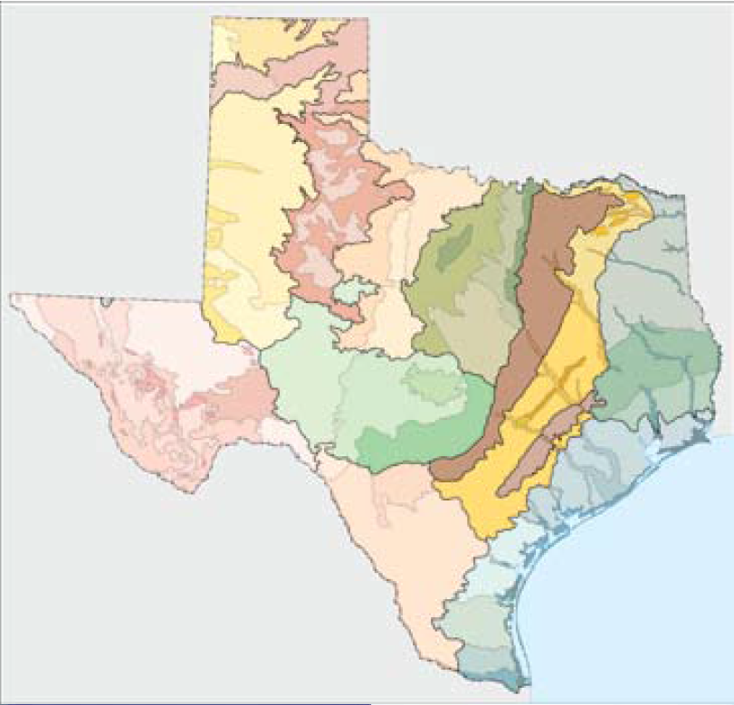
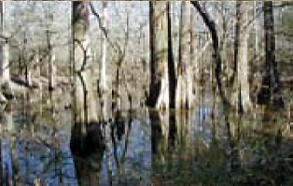

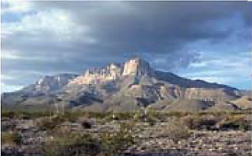
Study Area
The State of Texas
Encompasses 268,820 square miles in total sum.
From the Chihuahuan Deserts in the west, to the Gulf Coastal Plains and Cross Timbers in the east, the factors contributing to drought will affect each of these regions differently.
Source: Environmental Protection Agency – Western Ecology Division
Notes:
Figure 1
Source: Environmental Protection Agency – Western Ecology Division
The 12 Eco-Regions of Texas have unique susceptibilities to drought conditions. Their differentiating environments should be taken into consideration when undertaking a study of this kind.
ftp://ftp.epa.gov/wed/ecoregions/tx/TXeco_Jan08_v8_Cmprsd.pdf

Slide 3
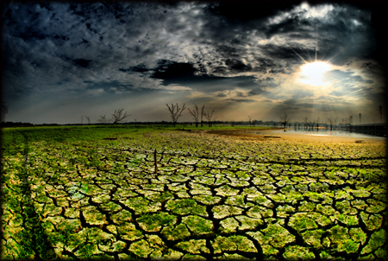
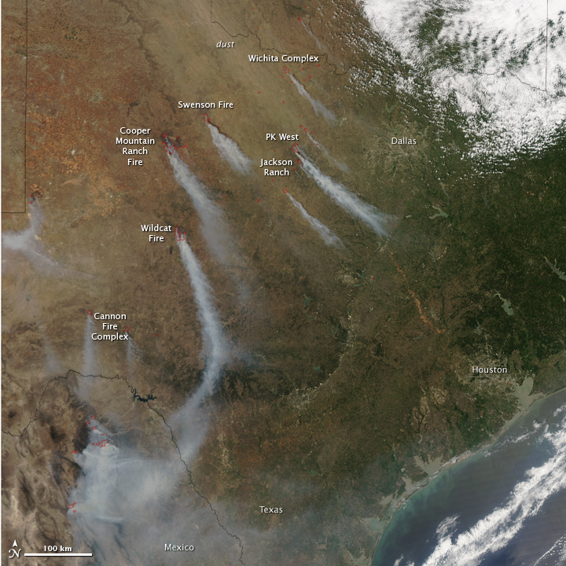

Study Period
Summer 2010 - Summer 2011
Summer 2014 – Summer 2015
This period was selected because of the extreme drought conditions that began in the state in 2010, and brought about widespread wildfires to various regions the following year as the vegetation became stressed and the fuel load increased dramatically.
The latter years were included in this study as they offer the most current timeline available for research.
Source: Taken by Terry Shuck at Lake Ray Hubbard on September 01, 2006
Source: NASA Earth Observatory Image was captured by Aqua MODIS on April 15, 2011
Notes:
Figure 2
Joe Wolf, Bastrop TX
Sept 05, 2011
https://www.flickr.com/photos/joebehr/6125109170/in/photostream/
Figure 3
Source: NASA Earth Observatory
Image was captured by Aqua MODIS on April 15, 2011.
http://earthobservatory.nasa.gov/IOTD/view.php?id=50168

Slide 4
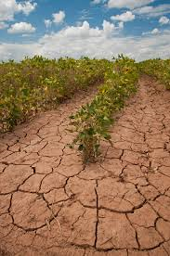

Objectives
Community Concerns
Wildfires pose a constant risk for many regions across the state
The ability to accurately monitor drought conditions
More information about the spatial coverage of drought conditions will allow decision makers at TFS to better allocate water resources to mitigate the spread of wildfires
Expand upon the Scaled Drought Condition Index (SDCI) created by Rhee et. al. (2010) by including a soil moisture component
Design a template for the Texas Forest Service to utilize in order to identify locations within the state most prone to wildfire disasters
Compare and contrast the accuracy of the DSI with other drought indices
United States Department of Agriculture
Soybean field in Navasota, TX
August 23, 2013
Notes:
United States Department of Agriculture
Soybean field in Navasota, TX
August 23, 2013
https://www.flickr.com/photos/usdagov/9679053771

Slide 5
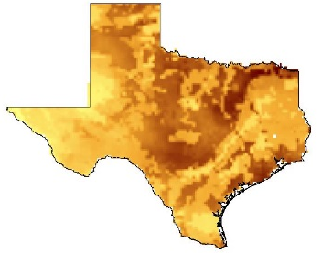


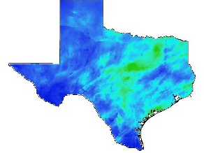

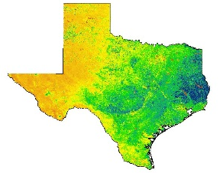

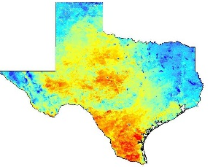

Satellites, Sensors and Flowchart
Data Acquisition
Data Processing
Data Analysis
Land Data Assimilation System (NLDAS)
Noah-2.8 Model
Soil Moisture
ArcMap
10.3
Daily Observed Precipitation
Multi-sensor Precipitation Data (MPE)
Normalized Difference Vegetation Index (NDVI)
Python
2.7
Modified
Drought Severity Index
scaled LST
+ scaled NDVI
+ scaled MPE
+ scaled NLDAS
Aqua/Terra MODIS
Land Surface Temperature (LST)
Notes:
Multisensor Precipitation Estimator (MPE) data were collected from the National Oceanic and Atmospheric Administration (NOAA) National Weather Service (NWS) Advanced Hydrologic Prediction Service (AHPS). The MPE is an interactive software tool within the Advanced Weather Interactive Processing System that integrates rain gauge and satellite rainfall estimates with radar-only estimates and creates high-resolution gridded rainfall products at 4km² (Fulton, 2005). Each day for the study periods were extracted in a batch using wget, a free utility tool for non-interactive downloading from the Web, through a script written in Python 2.7. These shapefiles were renamed and clipped within the boundaries of Texas in ArcGIS using a code constructed in Model Builder.

Slide 6
Methodology
Scaled Drought Condition Index
(1/4) scaled LST + (1/2) scaled TRMM + (1/4) scaled VI
Modified Drought Severity Index
scaled NDVI + scaled LST + scaled MPE + scaled NLDAS
Equations used for Scaling
LST: (LST_{max} – LST)/(LST_{max} – LST_{min})
MPE: (MPE – MPE_{min})/(MPE_{max} - MPE_{min})
NDVI: (NDVI - NDVI_{min})/(NDVI_{max} – NDVI_{min})
NLDAS-2: (NLDAS – NLDAS_{min})/(NLDAS_{max} – NLDAS_{min})
Notes:
This equation was modified to reflect the alternate satellites used to acquire similar data, but at much greater efficiency. For instance, the Vegetation Index (VI) listed in the equation above was replaced with the Normalized Difference Vegetation Index (NDVI) because of its higher correlation coefficients within arid regions as determined by Rhee et al., 2010. Due to its higher spatial resolution, MPE data were given preference over the Tropical Rainforest Monthly Mission (TRMM). MODIS MOD09A1 surface reflectance data in the Raster Calculator tool was used to calculate NDVI
Before scaling the data, Model Builder and Raster Calculator were used to calculate a 30 day and 60 day rolling sum for both the precipitation and LST datasets. The rolling sum outputs were then applied to the Land Surface Temperature/NDVI calculated raster images.
In addition to the calculations performed by the Great Plains Study, soil moisture data was included in this equation as well. However, the Texas Disasters team at the John C. Stennis Space Center had completed the NDVI and LST portions of the equation earlier in the summer term. Therefore, the DSI equation was once again modified to incorporate a combined NDVI/LST data batch with MPE and Soil Moisture data, each with a rough estimate in given percentage weight in accordance with the level of significance in drought contribution and the accuracy of the data

Slide 7
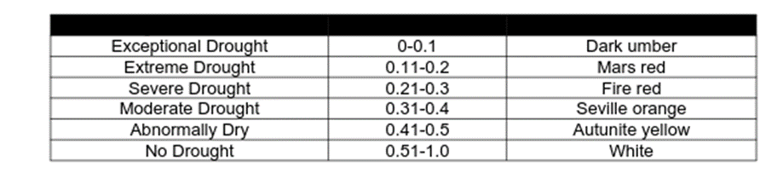
Results
Expand

Slide 8
Conclusions
Expand

Slide 9
Errors and Uncertainties
Spatial resolution discrepancies between MODIS and MPE
  250m - 1km² vs. 4km²
NEXRAD data are susceptible to typical errors associated with weather radar
The MPE is notorious for underestimating precipitation values
Applicability of SDCI values to the many eco-regions that exist within Texas
Notes:
This discrepancy may cause local scale accuracy errors in the final product.
These errors include large radar scans that result in average precipitation levels in a 16km² area, bright banding, low topped convection, and the accuracy of the reflectivity-rainfall algorithm.
C12 values were developed for use within four separate states – two states for arid environments and two states for humid environments. Despite their close proximity to the area of study, Arizona, New Mexico, and the Carolinas, these environments may not accurately resonate with the coefficients that are needed for the unique regions in Texas.

Slide 10
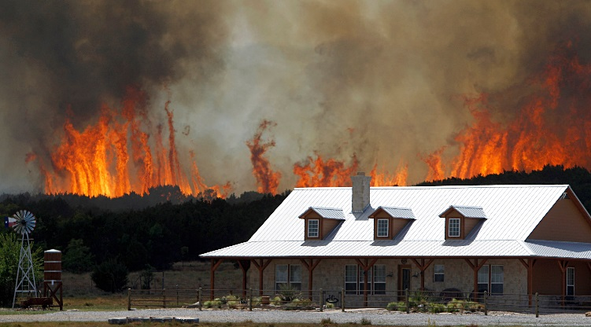
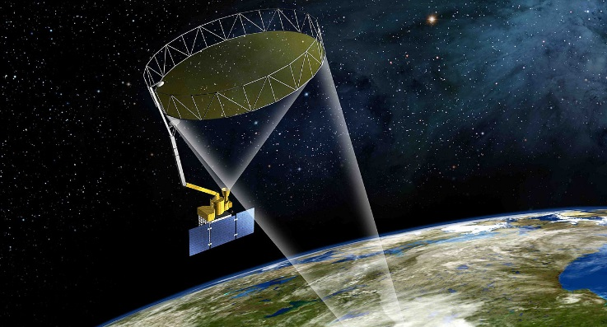
Future Work
Future studies should include the proximity of easily ignitable vegetation to residential and urban areas where populations are threatened should a wildfire occur.
Forthcoming DEVELOP teams who become responsible for the continuation of this project will have access to NASA’s first Earth-observing satellite designed to obtain soil moisture data. In light of this, the Soil Moisture Active Passive (SMAP) could very well replace the NLDAS component of the DSI.
A wildfire near Possum Kingdom taken by State Farm Insurance
April 19, 2011
SMAP satellite beam rendering from NASA’s Visualization Explorer
Notes:
According to the European Spread project, vulnerabilities to wildfire disasters are equally as important as the ignition potential when developing a fire risk map (Chuvieco et al., 2009).

Slide 11
Advisors
Dr. Kenton Ross: NASA DEVELOP, National Science Advisor
Partners
Curt Stripling: Texas Forest Service, Geospatial System Coordinator
Tom Spencer: Texas Forest Service, Department Head of Predictive Services
Others
Lance Watkins: NASA DEVELOP National Program, Geoinformatics/Center Lead
Grant Mercer: University of Nevada – Las Vegas
Rocky Garcia: City University of New York
Tiffani Miller: NASA DEVELOP, Project Coordinator Senior Fellow

