Slide 1
CALIPSO Health & Air Quality
Creating tool to help identify Smoke Plumes Observed with CALIPSO to Improve Future Research and Decision Making
Jordan Vaa (Project Lead)
Ashna Aggarwal
Courtney Duquette
Notes:
Jordan: Hi, I’m Jordan Vaa. I graduated from ECPI University with a Database programming degree and I am the Team Lead.
Ashna: Hi, I’m Ashna Aggarwal. I attend the College of William and Mary and I’m a Physics major.
Courtney: Hi, I’m Courtney Duquette. I attend Christopher Newport University and I’m a Computer Science major.
Jordan: And our project was CALIPSO Health and Air Quality.

Slide 2
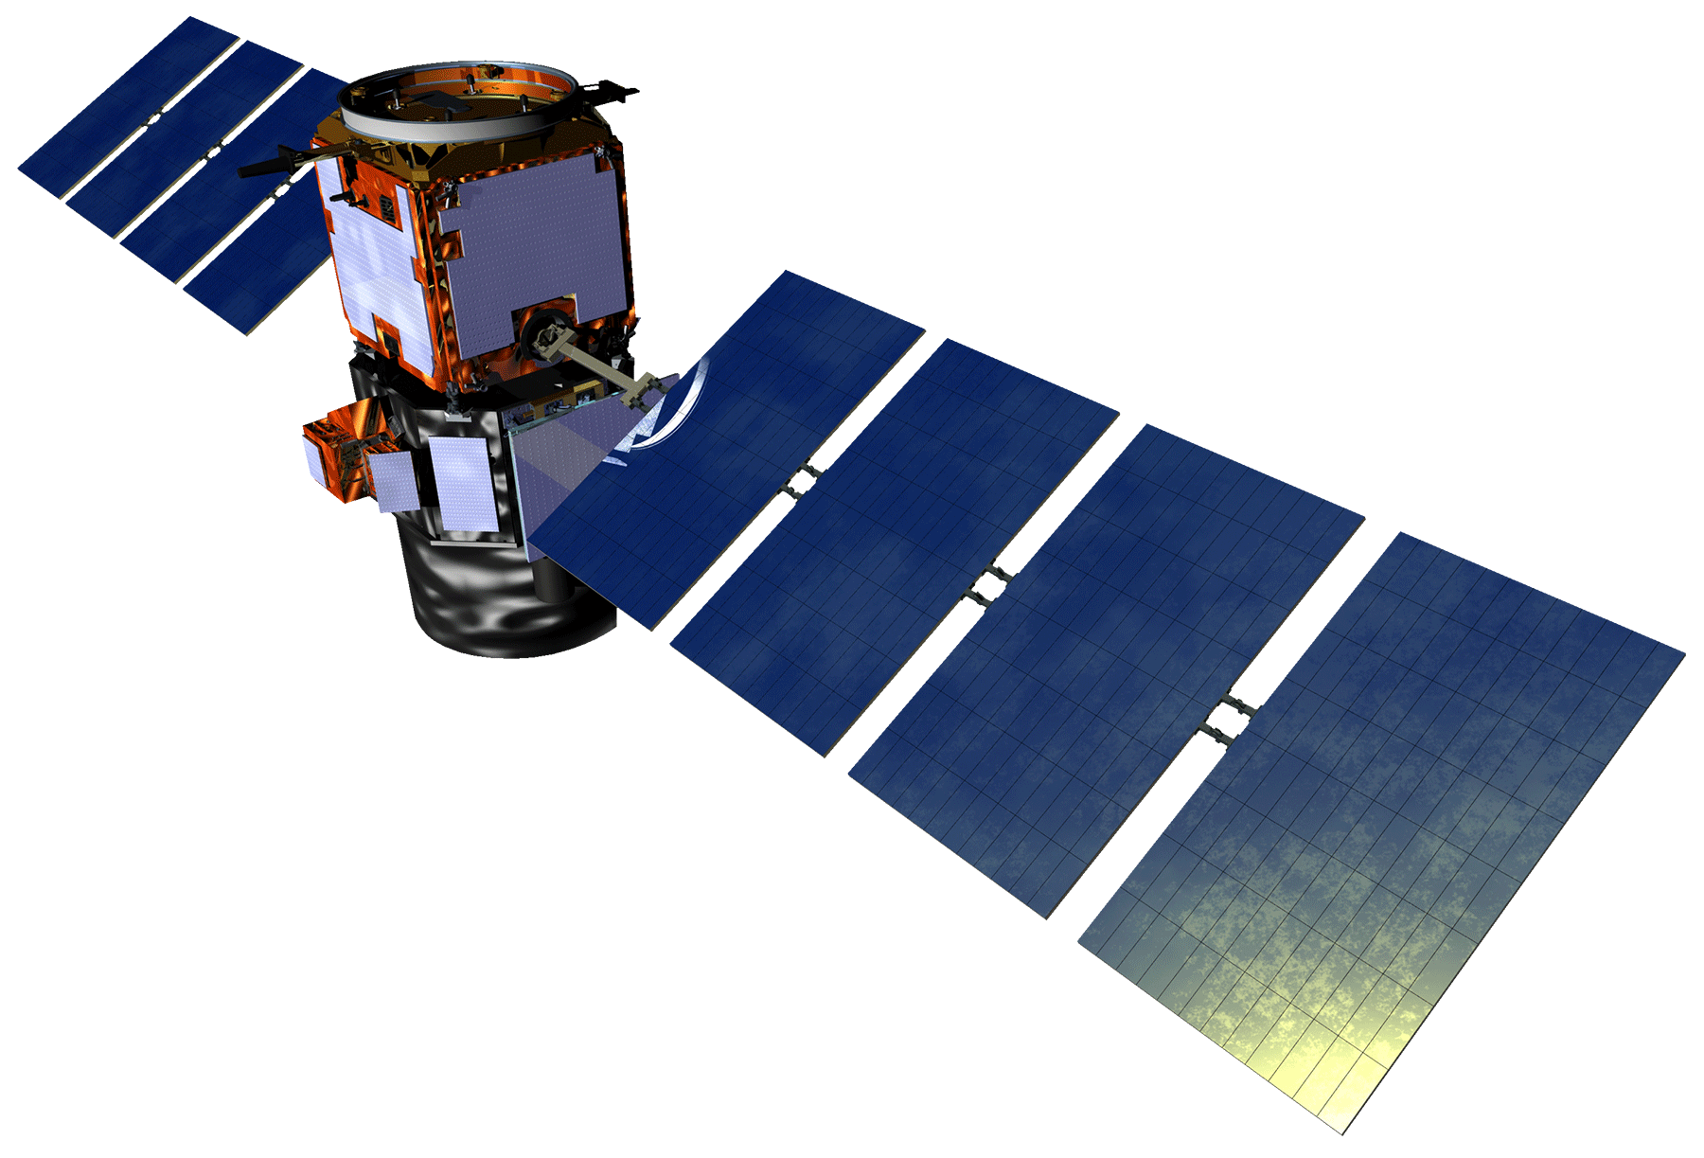
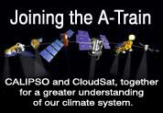
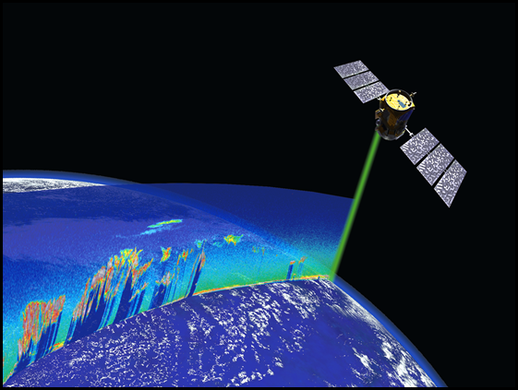
Background Information
CALIPSO
Imaging Infrared Radiometer (IIR)
Wide-Field Camera (WFC)
Cloud-Aerosol Lidar with Orthogonal Polarization (CALIOP)
Notes:
The CALIPSO satellite, which stands for “Cloud Aerosol Lidar and Infrared Pathfinder Satellite Observations” was launched in early 2006 along with the CloudSat as a member of the “A-Train”, a group of Earth observing satellites. The instruments aboard CALIPSO are the Imaging Infrared Radiometer, Wide Field Camera (WFC), and the main instrument, the Cloud Aerosol Lidar with Orthogonal Polarization. The CALIOP sensor makes CALIPSO unique, as it is one of the only existing lidar satellites, the other one being the CATS (Cloud-Aerosol Transport System) system onboard the ISS (International Space Station). CALIOP uses its Lidar to take a vertical profile of atmospheric composition.

Slide 3
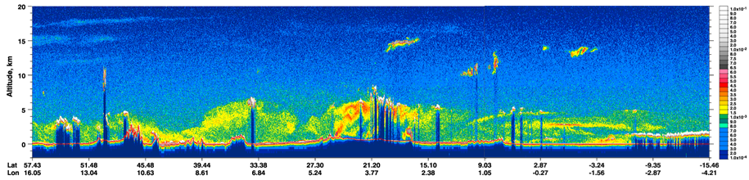
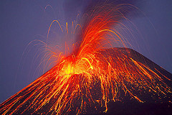
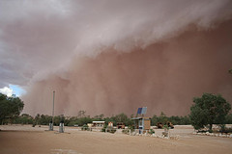
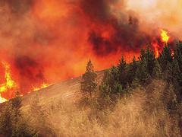
Community Concerns
Tracking aerosols as they move through the environment is a difficult process
Notes:
Then, CALIOP using sensing techniques to analyze the reflected light. By viewing this backscatter, we can visualize various structures in the atmosphere, such as clouds, smoke, or plumes of dust in plot format, such as the one shown on the screen.
CALIPSO has the ability to track aerosol objects of interest, such as dust and smoke plumes. Smoke plumes are of particular interest to us since their composition changes over time --- making them very difficult to track. By understanding how smoke moves through the environment, researchers hope to improve the Health and Air Quality of certain regions.
Volcano: Walter Lim; The Day the Volcano Erupted - A Halloween Horror Story, Posted via email from Coolest Insights, is licensed under CC BY 2.0
Dust: Sydney Oats; Dust Storm Heading For Mungerannie Hotel Jan 31 2010, With kind Permission from Pam and Phill Proprietors Mungerannie Hotel, is licensed under CC BY 2.0
Fire/ Smoke: Oregon Department of Forestry; Douglas Complex fires 2013: Rabbit Mountain. Photo courtesy of Marvin Vetter, 2013, is licensed under CC BY 2.0

Slide 4
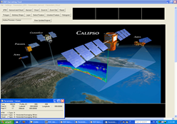
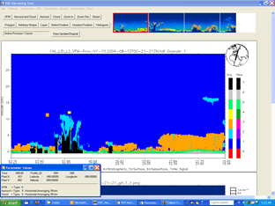
Objectives
Translate tool that allows researchers working with CALIPSO to view and classify clouds and aerosols
Add ability to select and export objects of interest into a database
Notes:
The goal of this project has been to update the PDF_Harvesting tool. This tool, coded in the proprietary language IDL (Interactive Data Language), allowed the team to view CALIPSO data products as vertical composition plots (as you can see). By updating the program from IDL into Python, the tool will be more adaptable and easily accessible to users. Researchers will be able to view CALIPSO data and select and classify aerosol objects of interest to track for further study. These selected objects will be stored in a database which would allow users to track objects based on various criteria (such as location and composition).
By utilizing this database quality, scientists will be able to better address community and global concerns about the atmosphere.

Slide 5
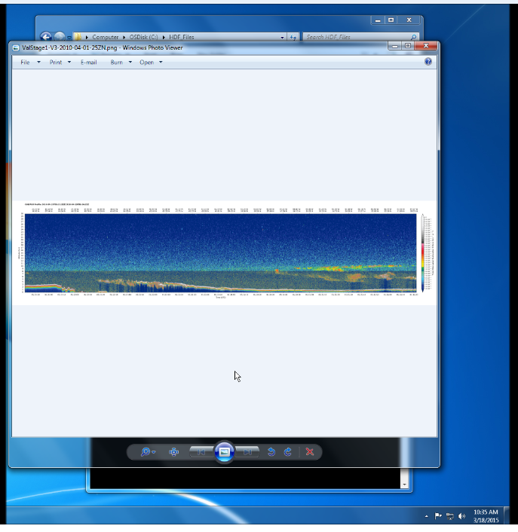
Project Methodology
Python 2.7 through PyDev Eclipse
  Using Tkinker and PIL to build and work with the GUI and Images
  Producing Plots with CCPLOT and MatPlotLib
Notes:
For this project, we wanted to use the most up-to-date version of Python that is still widely supported; thus choosing version 2.7. Also to make the development process easier, we used the IDE PyDev through Eclipse so running the tool throughout development was streamlined and simplistic. We used Tkinter as the primary module to build the physical Graphical User Interface or GUI. Using Tkinter allowed us to add different views and buttons. We also used PIL, which is a module that allows us to turn the images into something the python script can understand and also allows us to manipulate the image to fit our needs. To produce the different plots within the GUI we used code previously written by the CALIPSO Science team to view the plots. These scripts used a combination of CCPLOT, which is specifically designed for CALIPSO data and MatPlotLib which makes displaying the data easy to read.

Slide 6
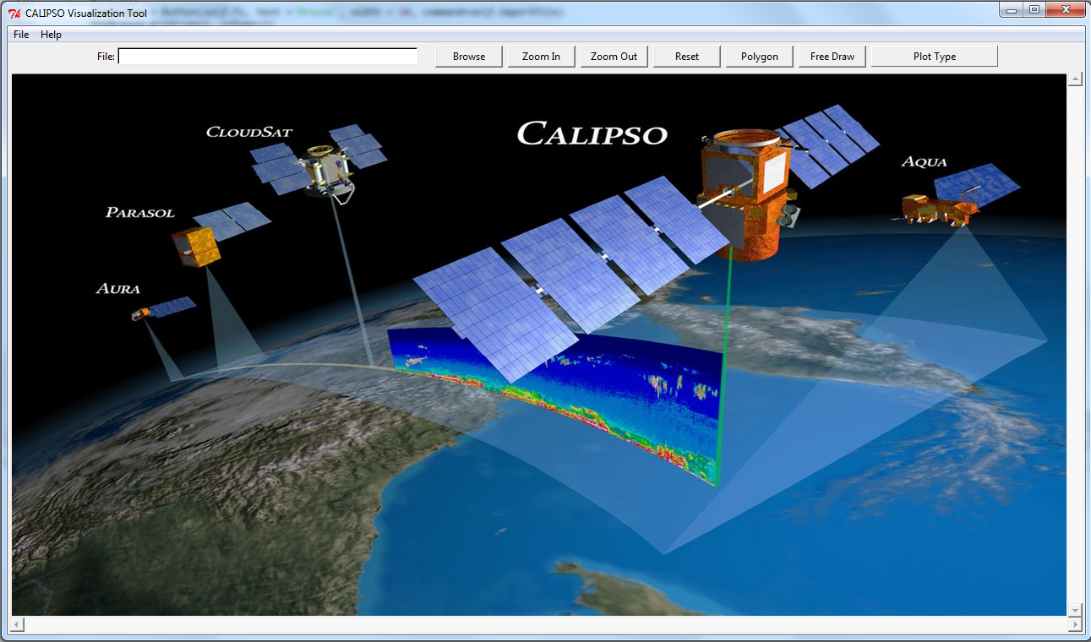
Results
CALIPSO Visualization Tool
Notes:
When the package is run, this is the home screen the user will get. As you can see, this tool does look similar to the PDF_Harvesting Tool that is currently in use. Instead of having the buttons to one side, this new tool has them spread out across the top. This makes it easy for the users to load and display different versions at will.

Slide 7
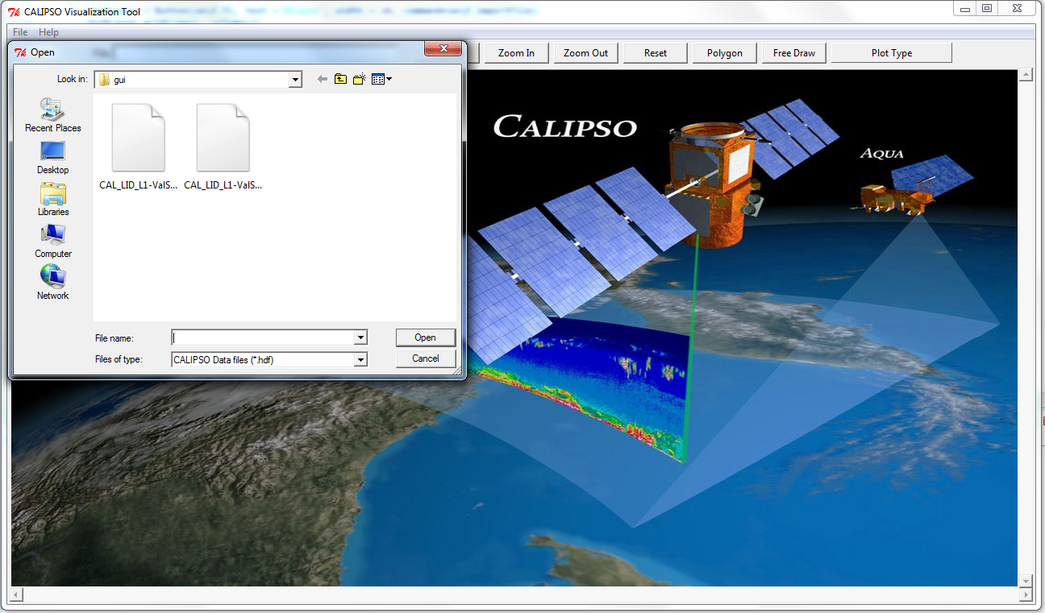
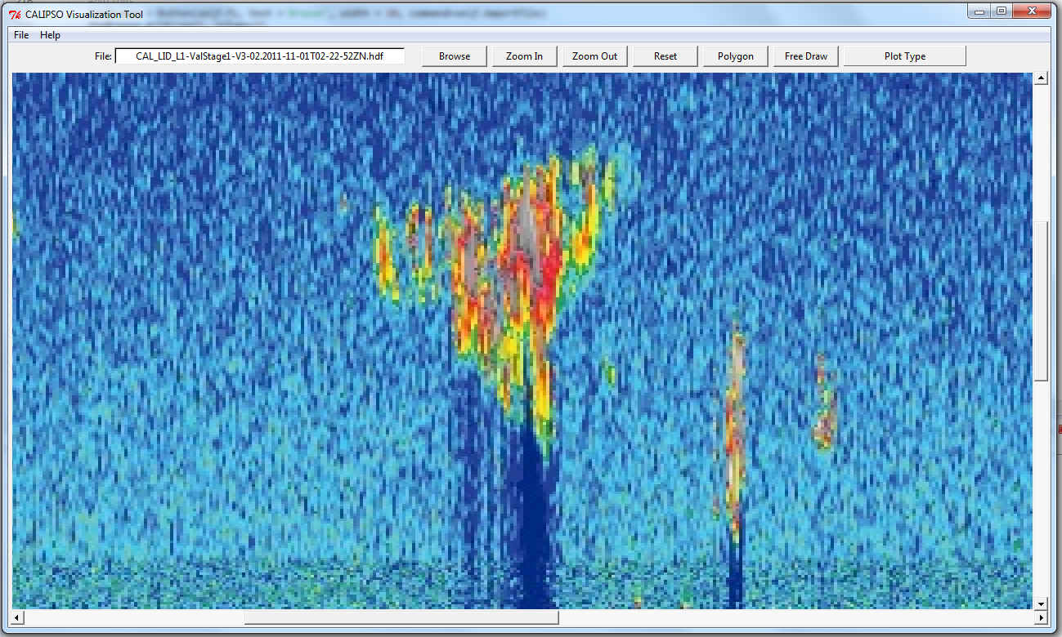
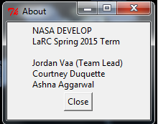
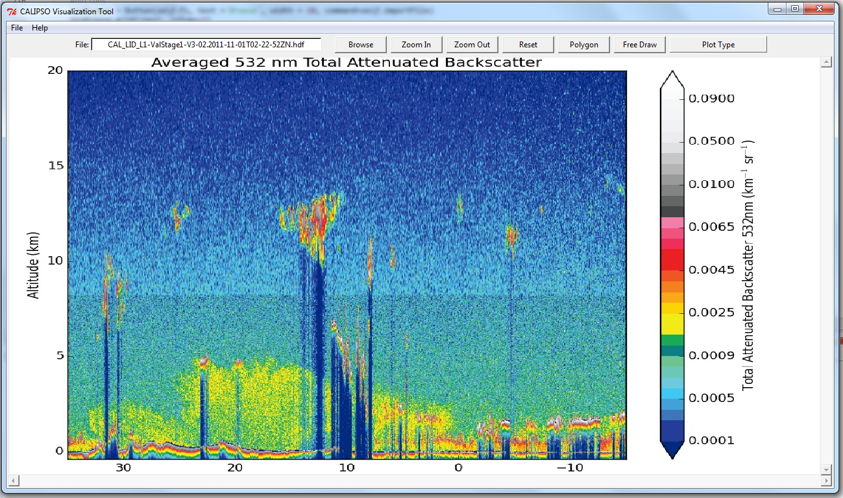
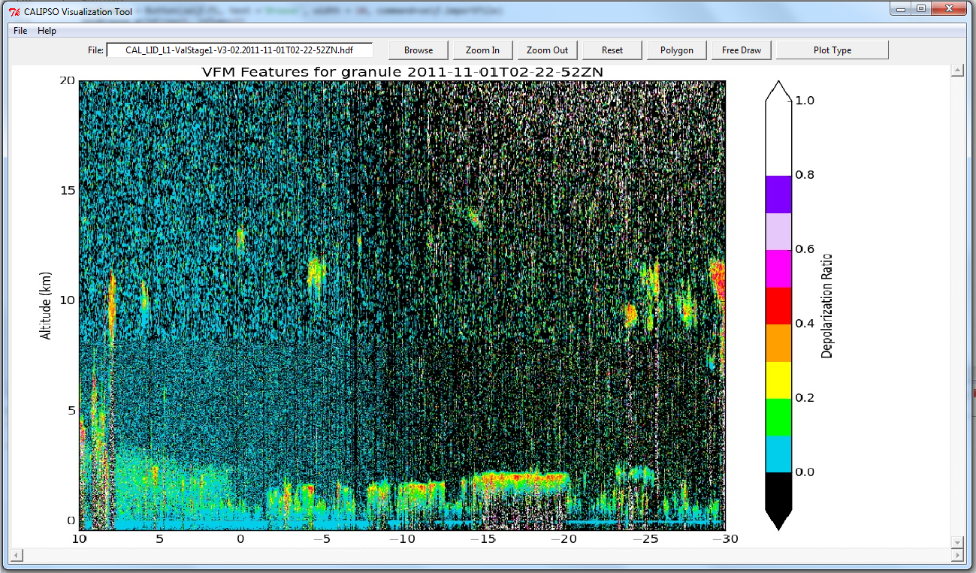
Features
Import CALIPSO Files
Zoom In/Zoom Out
About
Backscatter Plot
Depolarization Plot
Notes:
We have several features implemented on our tool. Within our tool there are two different ways to import the CALIPSO data; you can either use the Import File in the Menu Bar or the browse button across the top. The program requires a .hdf file type, which is the standard file type that all CALIPSO data is in. This plot currently has two different plots implemented, the Backscatter Plot and the Depolarization Plot. Each of these plots are helpful in analysing different aspects of the data. We also have a Zoom In/Zoom out function that allows the user to focus in on specific parts of the plot for better analysis. Finally, we have implemented an About menu that gives basic information and a Reset button that allows the user to clear any work they have done to start analysing a new set of data.

Slide 8
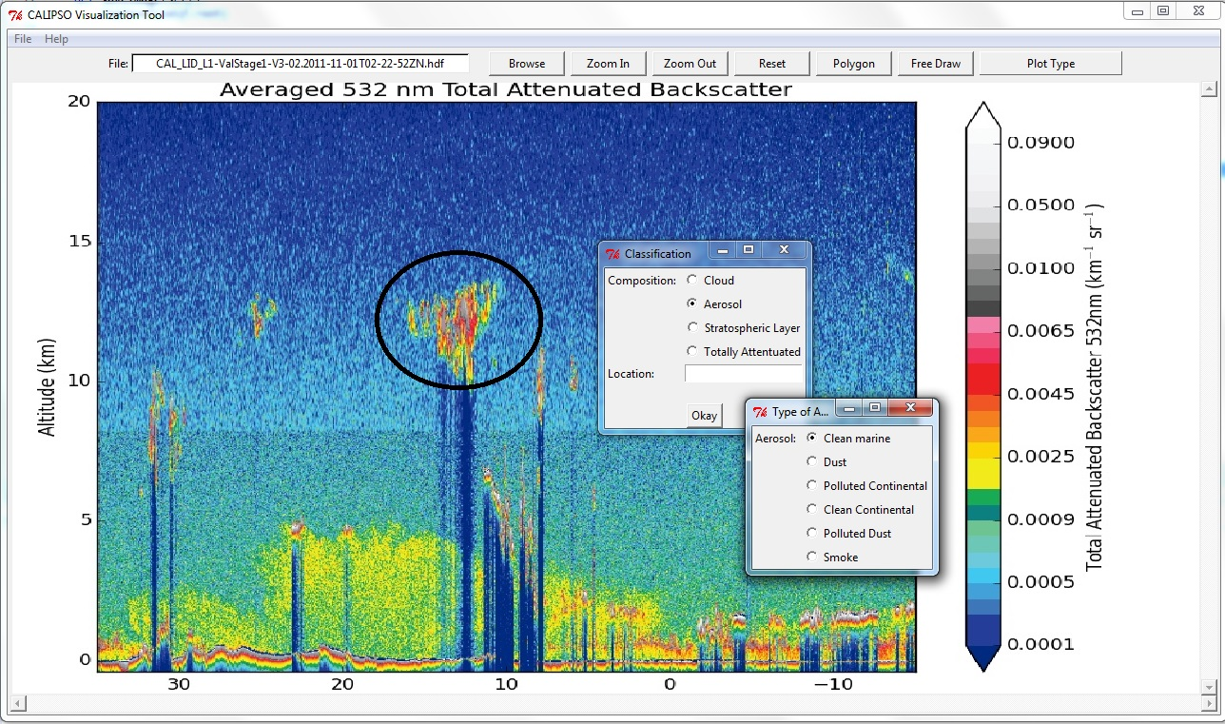
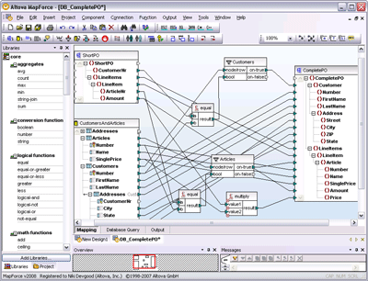
Future Work
Additional Functionality for Selecting Objects of Interest
Creation of a database of Aerosol Objects
More Plot Types, as well as Functionality for Adding Plot Types
Notes:
There are several unimplemented features in our tool at this time. The most prominent of which are the Polygon and Free-Draw buttons. The Polygon button should allow the user to choose a shape and place that shape over an object of interest. The Free-Draw button would be essentially the same, except that the user would not select a shape, but instead draw around the object of interest. Once selected either with a polygon or freely drawn image, the user would be able to classify the object based on what it is and where it is. From there they would use another unimplemented feature, export object, which is located in the file menu. This would take that selected object and send it to a database of similarly selected objects. The creation of this database is one of the major end goals for the DEVELOP CALIPSO teams. It would allow researchers to collate and share various aerosol objects in once place. This would allow them to track various objects of interest through the atmosphere as well as find objects with similar compositions around the globe.
There are also Save and Save as buttons in the file menu that are currently unimplemented, but it is our intention to for them to allow the user to save their current plots as images, allowing them to utilize that image for whatever purpose they have.
We also wanted to include a user manual to help users better utilize the tool in the form of a tutorial option under help. this should provide useful documents and videos to help new users.
Finally, we would like to include functionality for a greater number of plots, since there are several important CALIPSO plots that are not yet supported

Slide 9
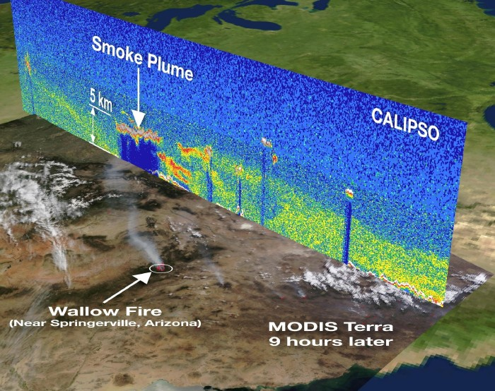
Benefits of Research
Translation of the tool over from IDL into Python allows greater adaptability and flexibility
Organization of data based on identifiable characteristics of smoke and aerosol objects
Simplification of collaboration with a centralized data repository
Notes:
The two biggest benefits of this project is the simplification of the tool and the ease of collaboration it will enable. By translating the tool from IDL into Python, it will be much easier for users to come along and be able to interact with the tool on a coding level. This will allow them to use and update the tool as fits their needs very easily.

Slide 10

Acknowledgements
Advisors
  Dr. Kenton Ross (NASA DEVELOP National Program)
Partners
  NASA CALIPSO Science Team; Partner POC: Dr. Charles Trepte
  National Institute of Aerospace: Dr. Amber Soja
Others
  Brian Magill (NASA CALIPSO Science Team)
  Nathan Owen (Langley DEVELOP Center Lead)
  Chad Smith (Langley DEVELOP Assistant Center Lead)
This material is based upon work supported by NASA through contract NNL11AA00B and cooperative agreement NNX14AB60A.

Slide 11
Pictures From
Volcano: Walter Lim; The Day the Volcano Erupted - A Halloween Horror Story, Posted via email from Coolest Insights
Dust: Sydney Oats; Dust Storm Heading For Mungerannie Hotel Jan 31 2010, With kind Permission from Pam and Phill Proprietors Mungerannie Hotel.
Fire/ Smoke: Oregon Department of Forestry; Douglas Complex fires 2013: Rabbit Mountain. Photo courtesy of Marvin Vetter, 2013.
Database Image: 2000-2015; Directory of Shareware; http://images.directoryofshareware.com/full/altova_mapforce_professional_edition_business_database_management-615763.gif

