Slide 1
WET Water Resources
A Google Earth Engine Python API Tool to Automate Wetland Extent Mapping Using Radar Satellite Sensors for Wetland Management and Monitoring
Lori Berberian (Project Lead) • Kaely Harris • Mitch Porter • Emma Waugh
California – JPL| Spring 2023
Notes:
Speaker Notes:
This project is A Google Earth Engine Python API Tool to Automate Wetland Extent Mapping Using Radar Satellite Sensors for Wetland Management and Monitoring
Introduce team members: Lori, Kaely, Mitch, Emma
Introduce science advisors: Bruce Chapman and Benjamin Holt

Slide 2
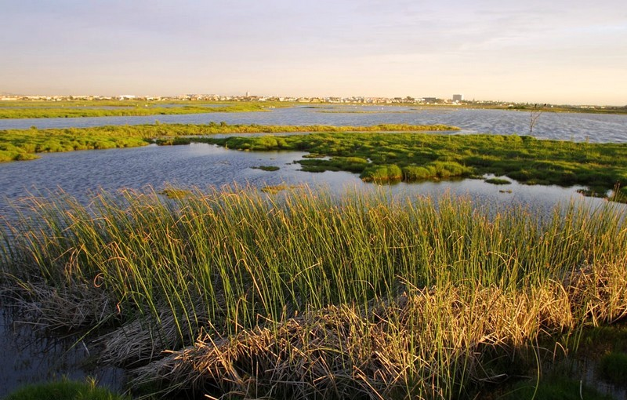
Wetland Ecosystems
Year-round or seasonally wet transition zones between land and water
Ecosystem Functions
Water filtration
Flood mitigation
Biodiversity
Carbon sequestration
Image Credits: Abu Shawka
Notes:
Speaker Notes:
Wetlands are year-round or seasonally wet transition zones between. land and water.
They perform vital ecosystem functions, such as water filtration, floodwater storage, hosting wildlife, and sequestering carbon.
------------------------------Image Information Below ------------------------------
Image Credit: Wikipedia Commons
Image Source: https://commons.wikimedia.org/wiki/File:Rietvlei_wetland_reserve_-_Cape_Town_2.jpg, Licensed under Creative Commons CC 1.0 Universal Public Domain Dedication

Slide 3

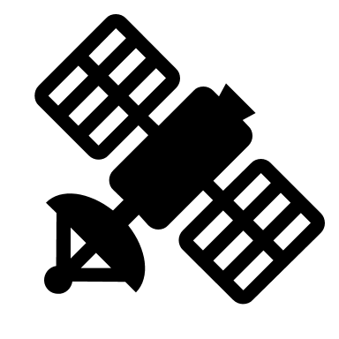


Research Opportunities
Wetland extent indicates seasonal wetland change and interannual trends
Provide inexpensive, automated wetland monitoring to support management decisions
Include processing steps for upcoming NISAR mission – functional tool for new, high-resolution imagery upon launch
Image Credit: Mimihimi Glyph
Notes:
Speaker Notes:
Wetland extent is a valuable parameter to measure seasonal and interannual change in wetland areas
Remote sensing applications can provide inexpensive, automated wetland monitoring to support management decisions
Including processing steps for upcoming
The upcoming NASA-ISRO NISAR mission with hi-res L-band SAR, to be launched in January 2024, provides us with the opportunity to include NISAR processing in our tool so analysis is ready to go as soon as data is available.
------------------------------Image Information Below ------------------------------
Image Credit: Mimihimi Glyph, NASA
Image Source:https://www.flaticon.com/free-icons/wetland (flaticon license), Satellite icon provided by Powerpoint

Slide 4


Research Opportunities: Synthetic Aperture Radar
different surface types give off unique backscatter signals
not limited by cloud cover and vegetation, unlike optical imagery
Calibrating SAR-based classification to optical products can fill in the gaps to create a dense time series of inundation products
Notes:
Speaker Notes:
Synthetic aperture radar (SAR) is a type of satellite remote sensing that transmits radar waves and records the reflected energy, called backscatter.
When hit by radar signals, different surface types and moisture levels reflect the waves in distinct ways, giving unique backscatter signals.
Because of the longer wavelengths, SAR can penetrate cloud cover and vegetation, unlike optical imagery.
We utilize SAR imagery in this project because it allows for high resolution imagery regardless of local cloud cover, which is especially helpful during rainy seasons.
Calibrating SAR-based wetland classification to optical products can fill in the gaps to create a dense time series of inundation products.
------------------------------Image Information Below ------------------------------
Image Credit:
Image Source: Icons provided by Powerpoint

Slide 5


Project Objectives
Develop tool to quantify wetland extent on regional scales anywhere on Earth
Create user-friendly interface for visualizing and analyzing wetland extent
Improve remote sensing applications for water resources using SAR sensors
Notes:
Speaker Notes:
The goals of this project are to develop a tool to quantify wetland extent on regional scales anywhere the planet. Previous versions of this tool were geographically restricted. This tool will allow for the user to choose any region on an interactive map to run their analysis
We also wanted to create a user friendly interface for visualizing and analyzing wetland extent for users from any background.
And lastly, the tool will improve remote sensing applications for water resources using SAR sensors. Combined with optical products, we hope this tool will help stakeholders and researchers create a dense time series of inundation products to support water resource management.
------------------------------Image Information Below ------------------------------
Image Credit:
Image Source: Icons provided by Powerpoint

Slide 6
Why use Python API vs JavaScript Interface?
Python API enables the best of both worlds in a user-friendly interface
  Python modules and software management
  GEE functions for data access and cloud computing
  Jupyter Notebook offers accessible to any users and promotes continuation of code development
Notes:
Speaker Notes:
The tool was built in a jupyter notebook utilizing Google Earth Engine though a Python API
Jupyter notebooks are user-friendly and allowed us to use valuable Python data processing modules and software management
While still accessing Google Earth Engine’s data catalog and cloud computing without having to download data
The python script allows for the user to makes adjustments to the script once downloaded, which promotes continuation of code development

Slide 7



Intended Users
Future DEVELOP projects & partners
NASA science network
Public access to the script via GitHub
Image Credits: NASA
Notes:
Speaker Notes:
We hope our tool can contribute to environmental management, conservation and research initiatives surrounding wetland areas.
This tool is meant to be used by future DEVELOP wetlands projects and the NASA science network
Pending JPL software release, we hope that the algorithms are eventually publicly available via GitHub for continued use and development.
------------------------------Image Information Below ------------------------------
Image Credit: NASA DEVELOP, NASA
Image Source: https://develop.larc.nasa.gov/about.php. People icon provided by Powerpoint.

Slide 8
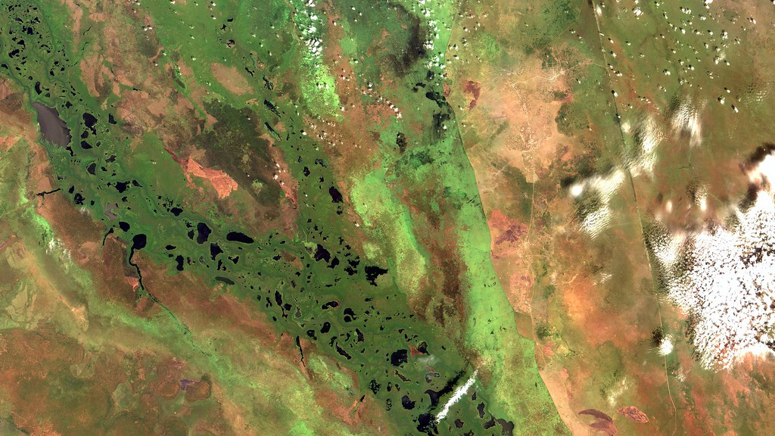
Case Study: Sudd wetland, South Sudan
Test the precision and accuracy of our tool
Regionally important freshwater environment threatened by development
Unobscured by tree canopy
2021flood season
White Nile River
South Sudan
Sudd Wetland
Satellite image of the Sudd in October 2018
0
100
200 km
Image Credits: INPE
Notes:
Speaker Notes:
We used a case study region in the Sudd wetland in South Sudan to validate and calibrate the sensitivity of our tool
We chose this study site in part because it’s a large, regionally important freshwater ecosystem that supports wildlife and pastured livestock and provides critical floodwater storage. A proposed dam in the While Nile River threatens the Sudd’s primary water source.
Also, there is limited tree cover in the Sudd, making it a perfect test case for Sentinel-1’s C-band SAR that is unable to penetrate dense canopy.
------------------------------Image Information Below ------------------------------
Image Credit: Terra/INPE (Brazil National Institute for Space Research)
Image Source: "Pantanal Sudd, Sudão do Sul" by Coordenação-Geral de Observação da Terra/INPE https://www.flickr.com/photos/153282474@N02/45666872191, licensed under CC BY-SA 2.0.
South Sudan Map shapefiles sourced from Humanitarian Data Exchange
Subnational Administrative Boundaries, ssd_admbnda_imwg_nbs_20221219_SHP, https://data.humdata.org/dataset/cod-ab-ssd
Water Bodies, ssd_Lakes_and_marshland_fao_500k https://data.humdata.org/dataset/south-sudan-water-bodies

Slide 9
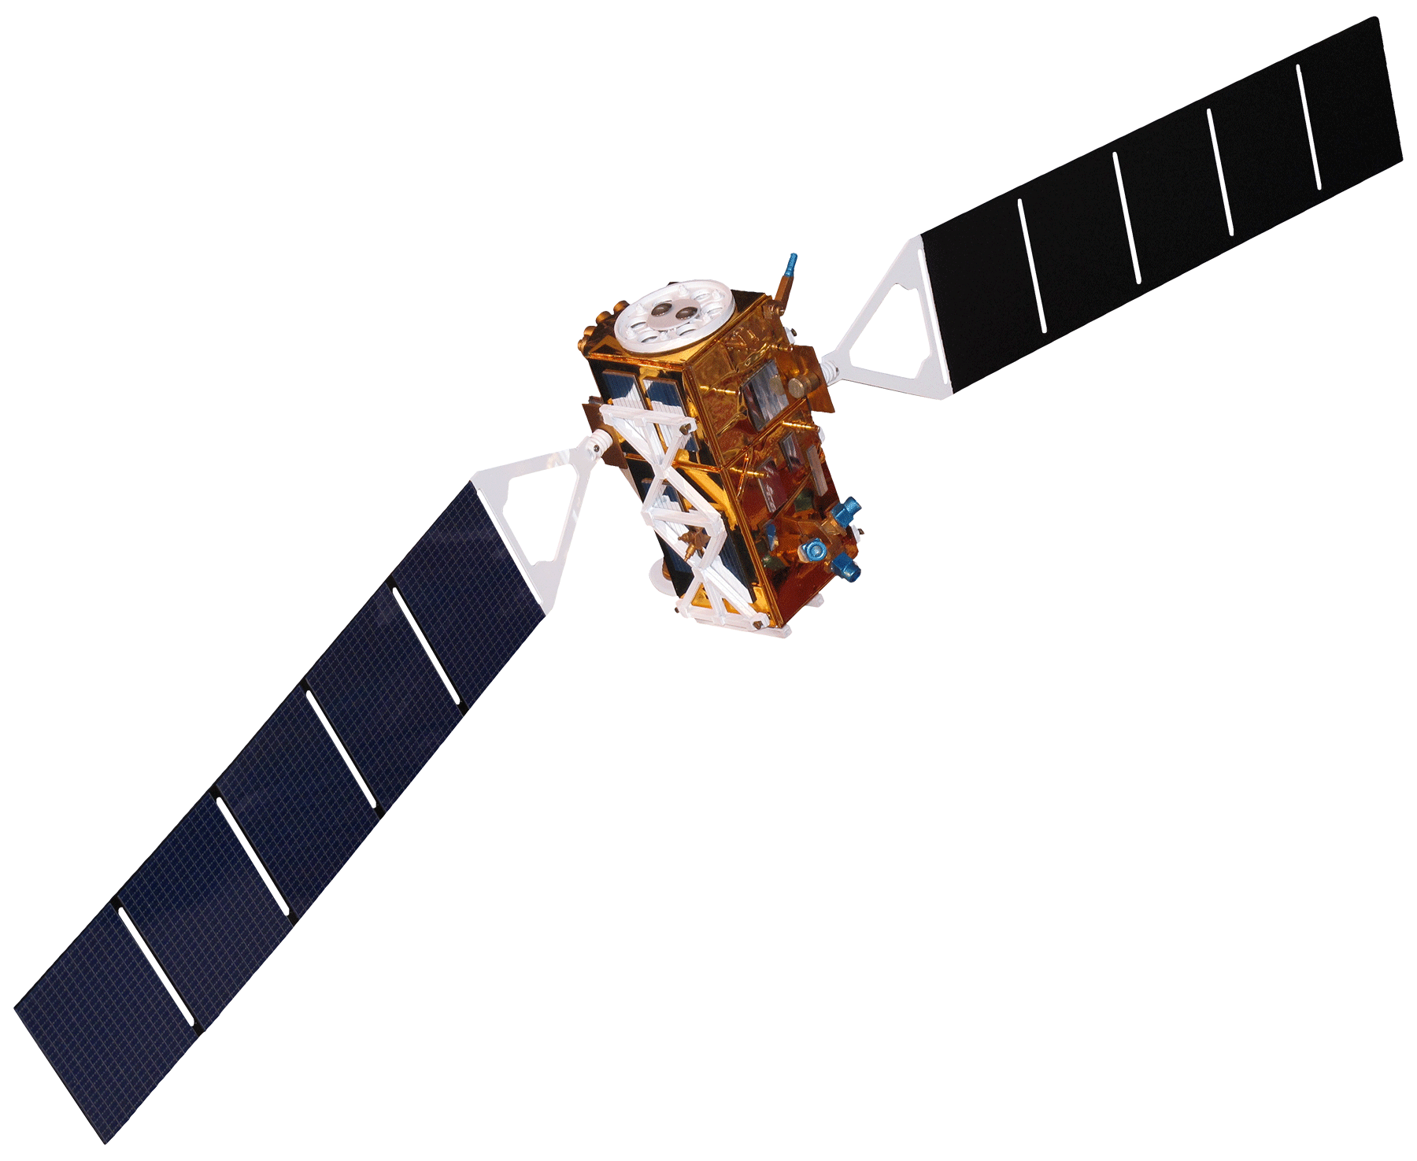
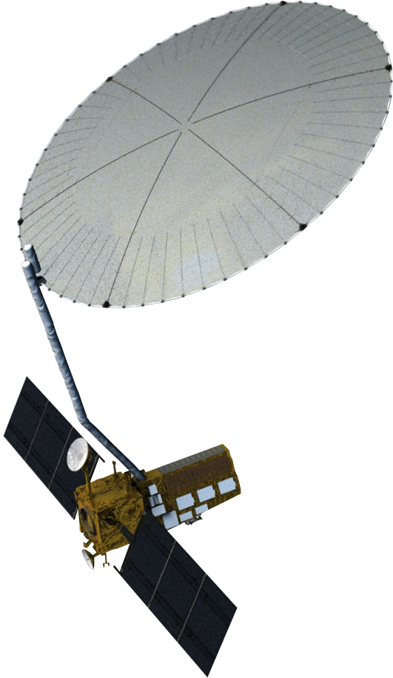
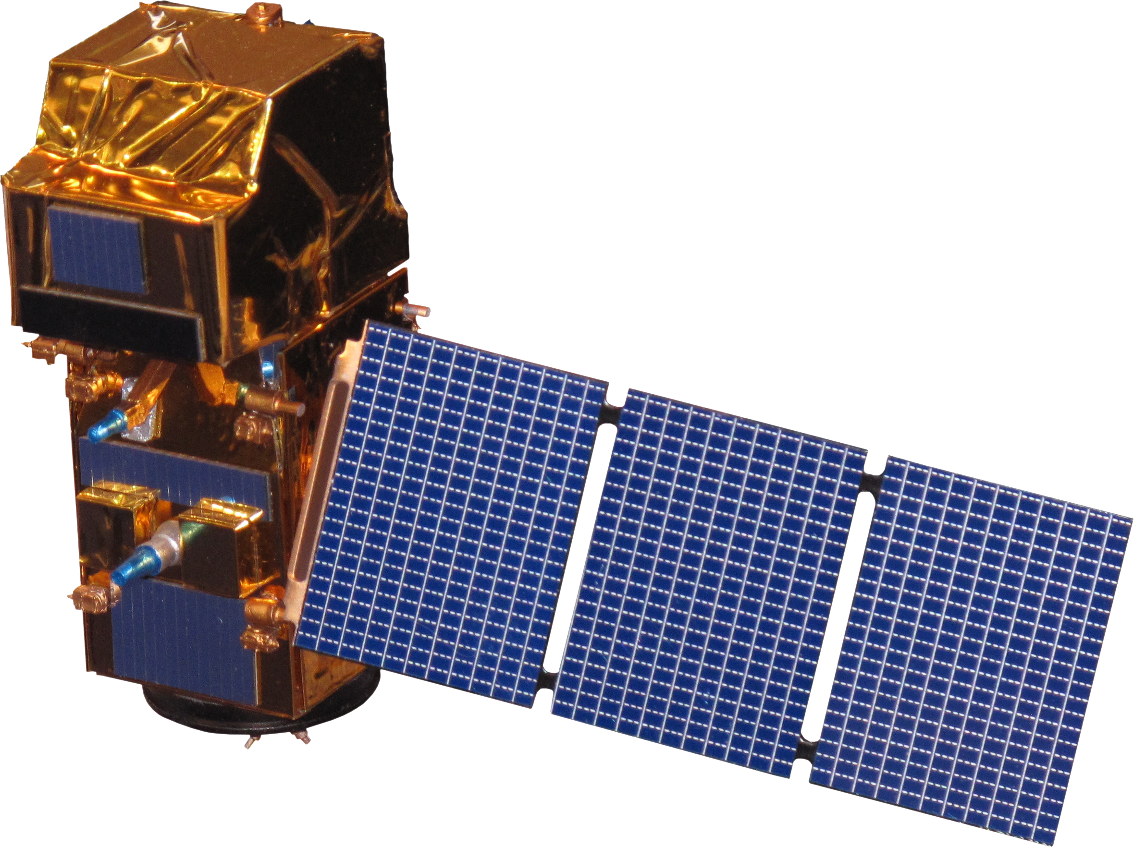

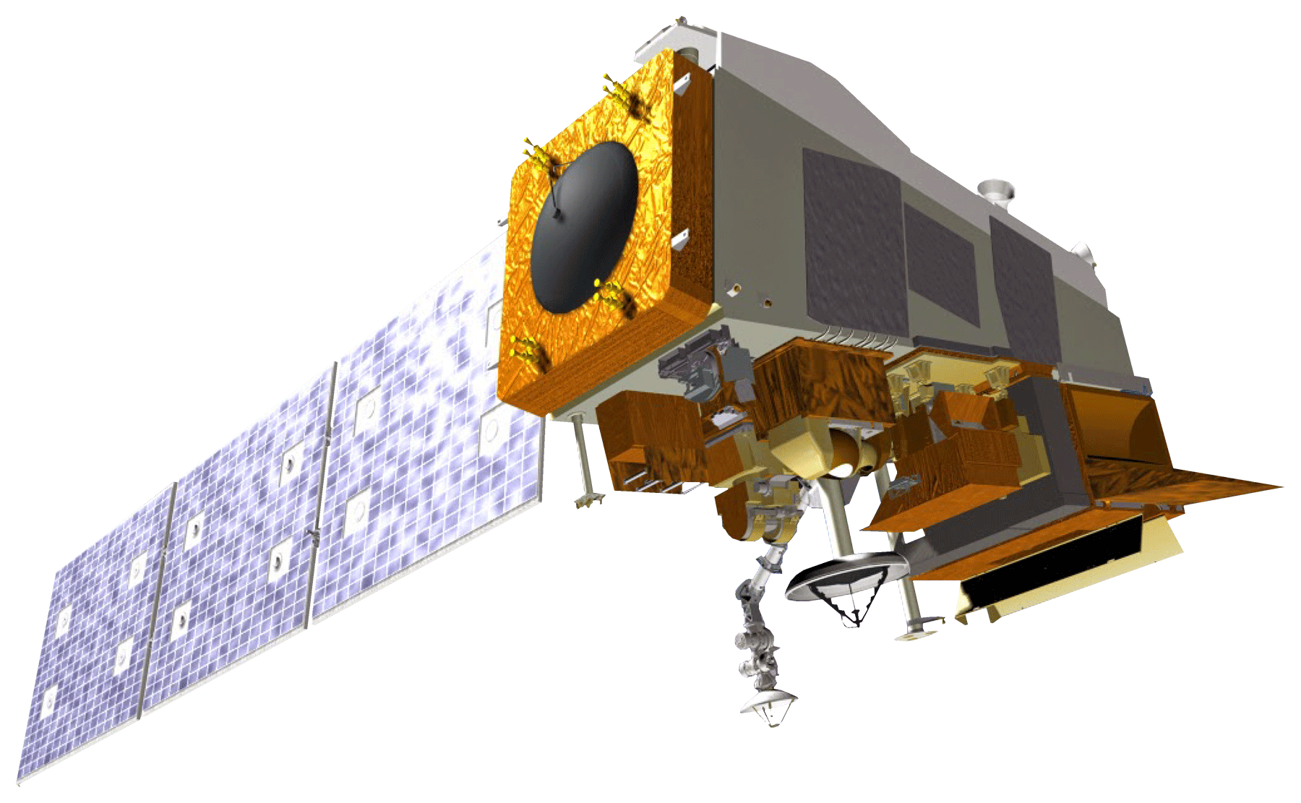
Satellites: NASA Earth Observations
Sentinel-2 MSI
Sentinel-1 C-SAR​
NISAR (set to launch in 2024)
Terra MODIS
Suomi-NPP VIIRS
Image Credits: NASA, ESA, NOAA​
Notes:
Speaker Notes:
We utilize data from five Earth Observing satellites:
The European Space administration’s Sentinel-1 C-band SAR as well as Sentinel-2’s Multispectral Instrument,
NASA’s Terra Moderate Resolution Imaging Spectroradiometer (MODIS)
NASA and the Indian Space Research Organization’s NISAR (Set to launch 2024)
And we used a validation product from NOAA Suomi-NPP Visible Infrared Imaging Radiometer Suite (VIIRS)
------------------------------Image Information Below ------------------------------
Image Credit: NASA, DEVELOP, ESA, NOAA
Image Sources: https://www.devpedia.developexchange.com/dp/images/8/81/23_Sentinel1.png, https://smd-prod.s3.amazonaws.com/science-pink/s3fs-public/thumbnails/image/NI-SAR_0.png, https://www.devpedia.developexchange.com/dp/images/9/91/05_Terra.png, https://www.devpedia.developexchange.com/dp/images/d/dd/24_Sentinel2.png, public domain.

Slide 10
Methodology: Thresholds for classification
INPUT
SELECT IMAGES
SELECT
CLASSIFY
Sentinel-2 Dynamic World
determine inundation thresholds
filter by ROI
draw polygons
REFERENCE IMAGES
cloud free
GeoTIFF
plot histograms
Sentinel-1 C-SAR
match date
SAR DATA
NISAR*
Notes:
Speaker Notes:
This is the methodology for determining the thresholds we used for our inundation classification.
We used the Dynamic World product as well as SAR imagery as a reference, where we found images with few clouds in our region of interest. We made sure the dates were matched to a SAR image from the same area.
Then we drew polygons for each of our chosen land cover classes, which were open water, inundated vegetation, and land/no water.
We plotted histograms of the pixel values to determine the thresholds between each class.

Slide 11
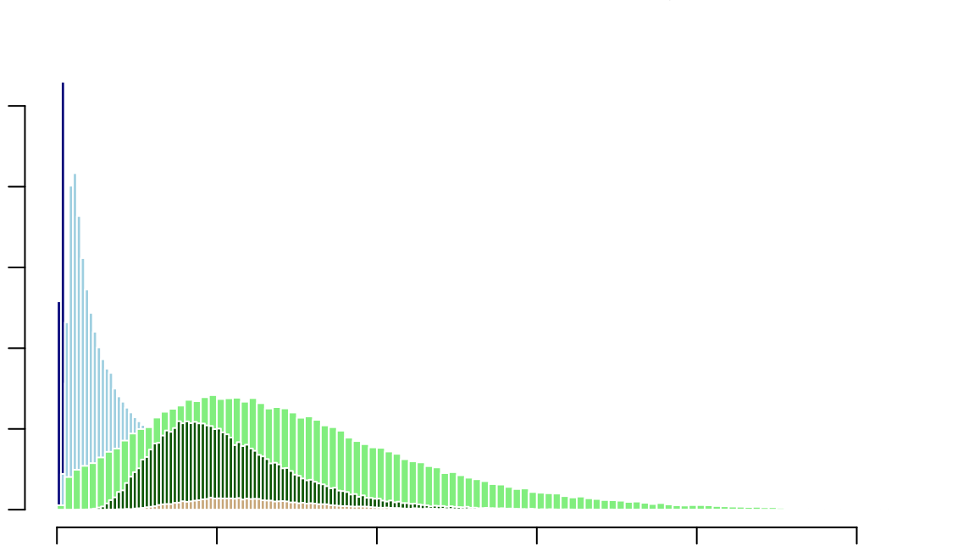
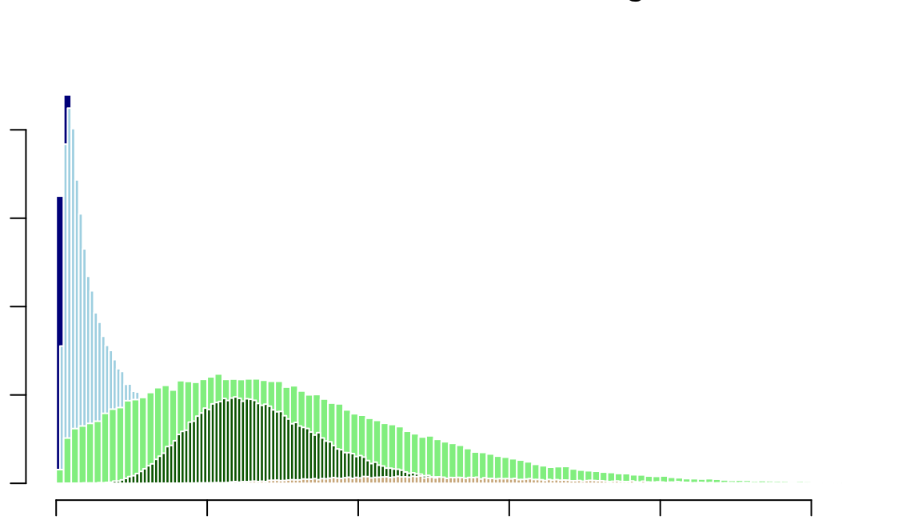
Methodology: Thresholding
VV Pixel Values
VH Pixel Values
open water
inundated vegetation
0 2000 6000 10000
grass
trees
0 2000 4000 6000 8000
shrub & scrub
0 0.2 0.4 0.6 0.8 1.0
0 0.02 0.04 0.06 0.08 0.10
Notes:
Speaker Notes:
These are histograms showing the distributions of pixel values within each class from both vertically transmitted-vertically received and vertically transmitted-horizontally received data from an area in the Sudd wetland in October 2021.
We combined the grass, trees, and shrub and scrub classes to “no water” because of their overlap.
We selected threshold values between each of the three classes.

Slide 12
Methodology: WET 3.0 workflow
INPUT
PROCESSING
ANALYSIS
CLASSIFICATION
OUTPUT
Sentinel-1 C-SAR
filter by date and ROI
calculate mean pixel values
change from the mean
inundation thresholds
NISAR*
snow mask
Terra MODIS
classify study area
de-speckle
calculate VV/VH ratio
accuracy assessment
final classification
VIIRS data from Downs et al. 2023
Notes:
Speaker Notes:
This is the overall workflow for the WET 3.0 tool
We input SAR data, filter by a desired date range and region of interest, then display a range of snow-free dates from a Terra MODIS snow mask
We also despeckle the images using spatial and temporal rolling averages, and calculate a VV to VH ratio
We calculate mean pixel values across the date range to calculate a relative change from the mean for each image in the range
And we apply the inundation thresholds determined with our histograms to create a classified image from each SAR image
We used a VIIRS floodwater fraction dataset from Downs et al (2023) to assess the accuracy of our classified products

Slide 13
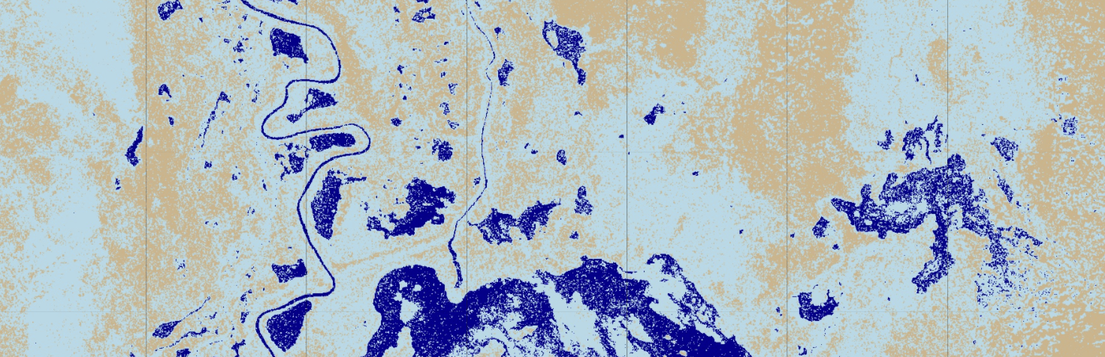
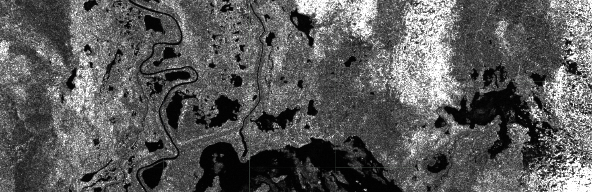
Results
October 16, 2021
Classified Image
open water
inundated vegetation
no water
Sentinel-1 C-SAR VV Image
Backscatter
0
0.5
Notes:
Speaker Notes:
Here is an example classified image from the Sudd from October 16, 2021, during the flood season, along with the VV backscatter image from the same date.
For the thresholds, we used 0 to 0.01 for open water, 0.01 to 0.11 for inundated vegetation, and about 0.11 for no water. There are different values for the VH image, not pictured here.
VV threshold values are: open water < 0.01 < inundated vegetation < 0.11 < no water.
VH threshold values are: open water < 0.0015 < inundated vegetation < 0.011 < no water.

Slide 14
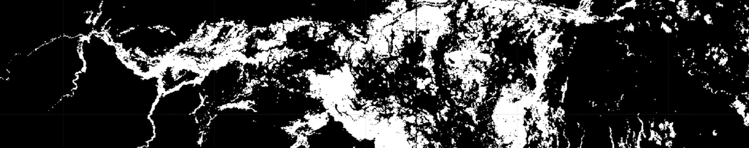
Accuracy Assessment
We compared our land classification tool to a VIIRS floodwater fraction dataset from the same month.
Actual
 | Positive | Negative
Positive | True positive | False positive
Negative | False negative | True Negative
Floodwater Fraction product from Downs, et al. 2023
  % accuracy of classifier
  Overall accuracy
  User's accuracy
  Producer's accuracy
  Kappa coefficient
Predicted
Notes:
Speaker Notes:
We compared our land classification product from the Sudd from mid-October 2021 to a VIIRS floodwater fraction dataset from the same month, and produced a confusion matrix
A confusion matrix is a table that is used to define the performance of a classification algorithm, and visualizes and summarizes the performance in a table like the one on the right, and includes various measurements of accuracy
% accuracy measures the number of correct predictions made divided by the total number of predictions made
Overall accuracy is the probability that an individual will be correctly classified by a test; that is, the sum of the true positives plus true negatives divided by the total number of individuals tested
User’s accuracy, or reliability, is the accuracy from the point of view of a map user, not the map maker. The User's accuracy essentially tells us how often the class on the map will actually be present on the ground
Producer’s accuracy is the map’s accuracy from the point of view of the map maker (the producer). This is how often real features on the ground are correctly shown on the classified map or the probability that a certain land cover of an area on the ground is classified as such
The Kappa coefficient is generated from a statistical test to evaluate how well the classification performed as compared to just randomly assigning values, i.e. did the classification do better than random. The kappa coefficient can range from -1 to 1, where 0 indicates that the classification is no better than a random classification, a negative number indicates the classification is significantly worse than random, and a value close to 1 indicates that the classification is significantly better than random.

Slide 15
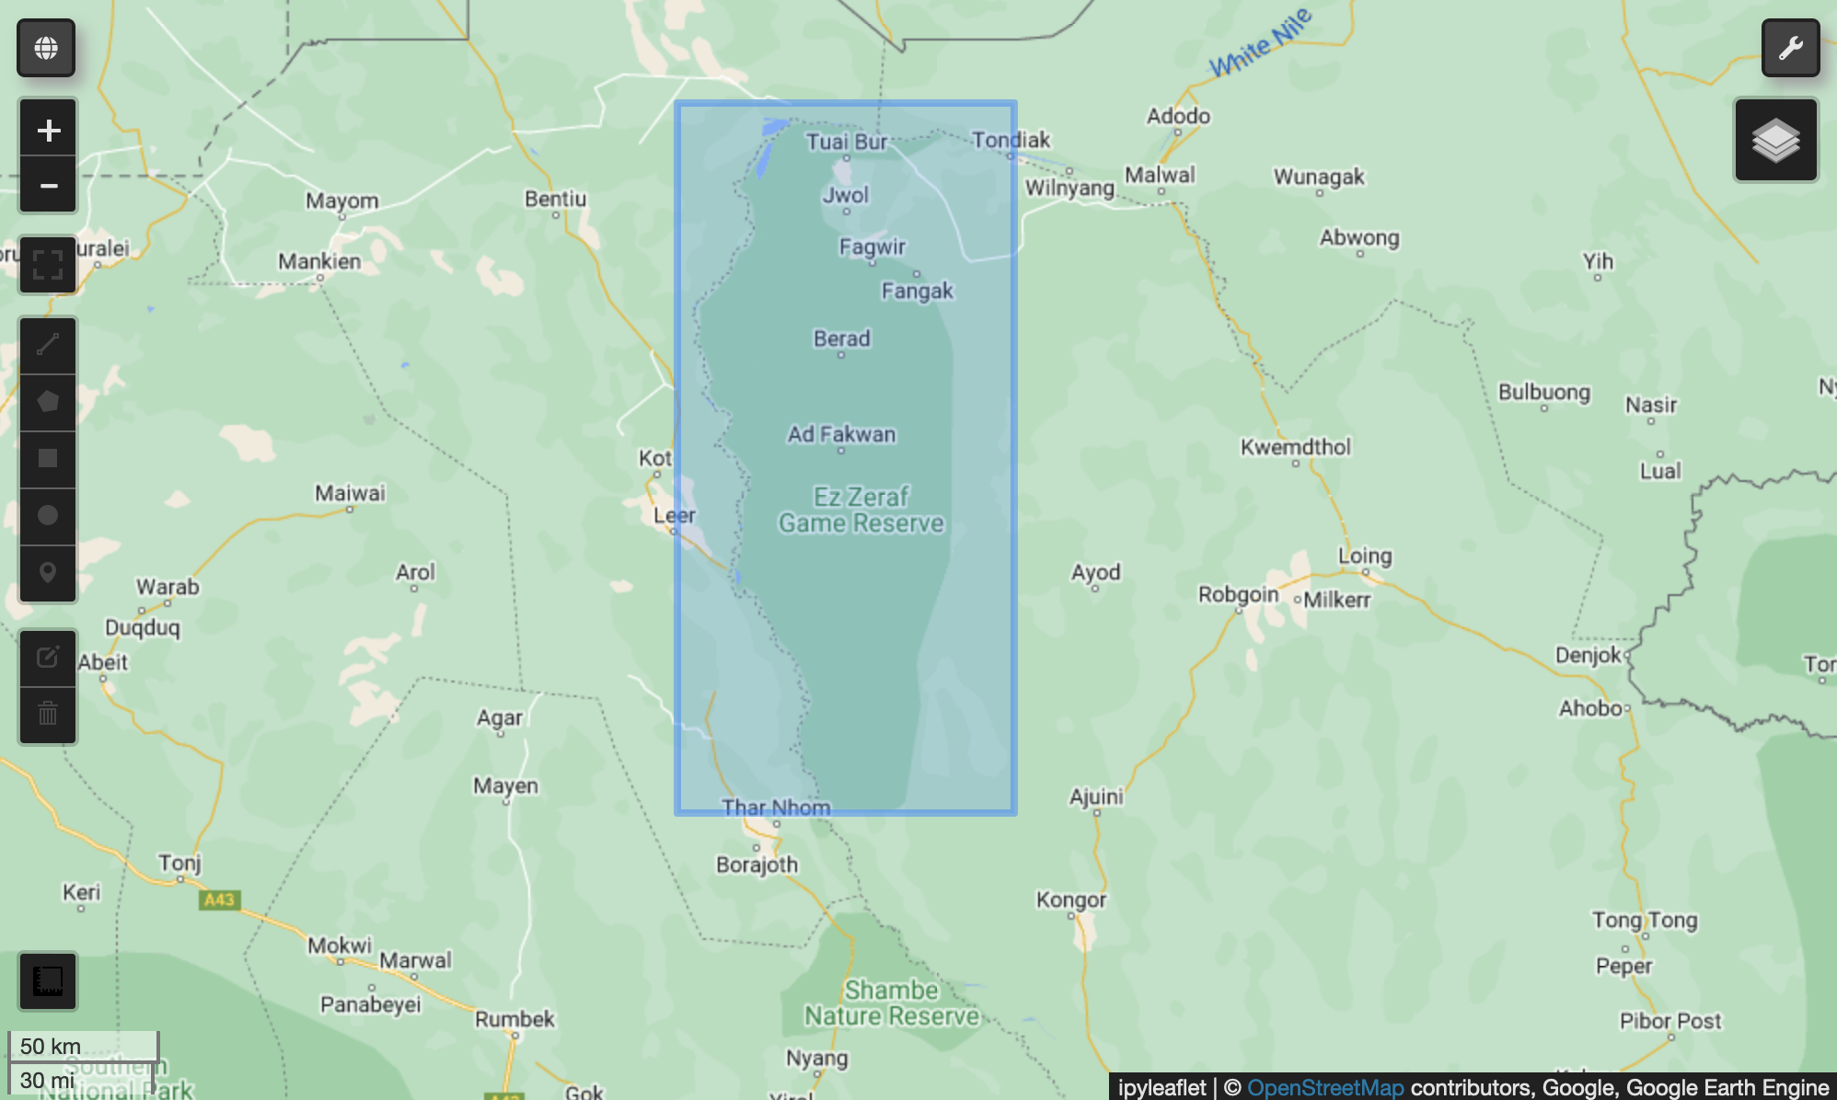
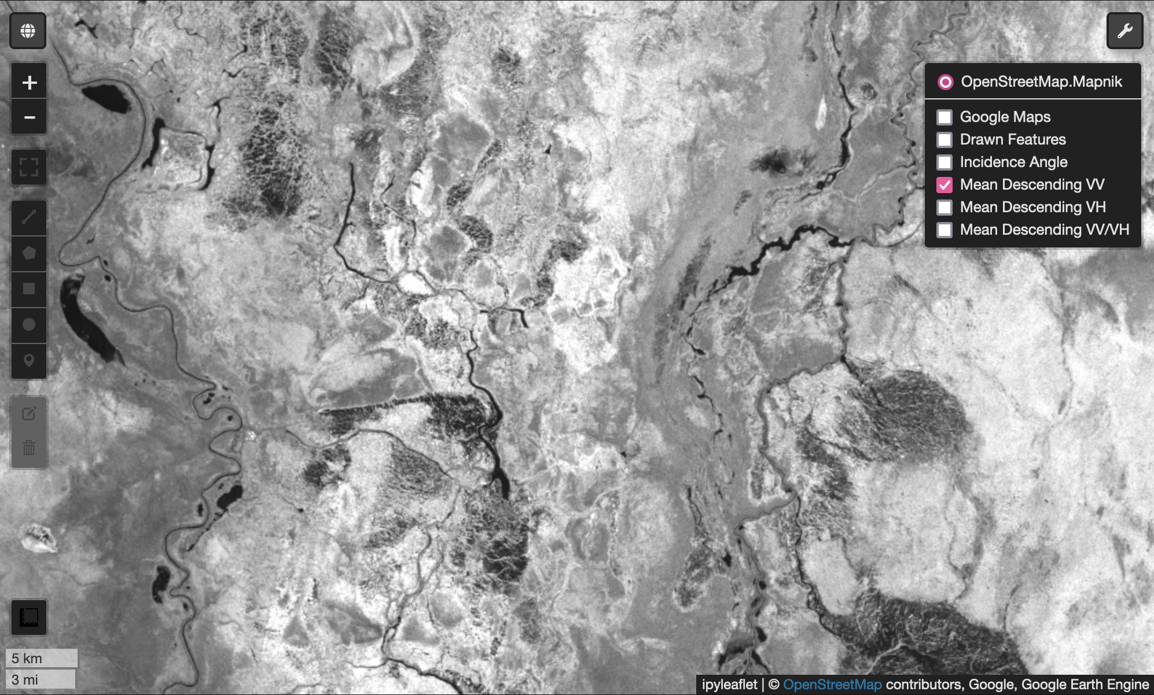
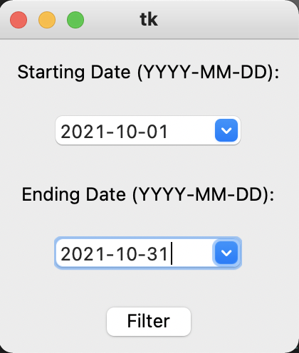
Interactive Script
Users can select region of interest and date range
Utilizes embedded Folium map to display and inspect imagery
Notes:
Speaker Notes:
Here’s an overview of some interactive pieces of the script that we included to make it more accessible.
First, users select a region of interest with the draw geometry tool, similar to in the GEE Javascript code editor, and then use the calendar widget to select a beginning and end date.
Users can also customize other parts of the script to adjust dates to the local snow-free period, select ascending or descending orbits depending on the data that’s available in the region of interest, and more.
The script also includes an embedded Folium map that displays imagery and allows users to inspect each layer.

Slide 16
Addressing Uncertainties
Sentinel-1 C-SAR is less effective in the presence of tree canopy
Overlapping ranges for different classes
Limited accuracy of inundated vegetation class in Dynamic World
GEE is a proprietary software and may not remain free
Notes:
Speaker Notes:
C-band SAR is less effective than other wavelengths, like L-band, in penetrating tree canopy. This tool is better suited for wetland areas without tree canopy for now, while it utilizes Sentinel-1.
In our classification, the inundated vegetation class and the no water class have pretty significant overlap, meaning those areas could be misclassified.
The Dynamic World inundated vegetation class is not always accurate, which we used as one of the reference images for drawing our training polygons. This contributes to some of the uncertainty of the classification, but was mitigated somewhat by also referring to SAR images.
Current data management and remote sensing platforms are slowly trending towards subscription based models. If Google begins charging for Earth Engine processing the data catalog and data structure utilized in this tool would become inaccessible to some users.

Slide 17
Future Work
Integrate with NISAR imagery on GEE
Automated thresholding from histograms
Continued development and use by DEVELOP projects
Notes:
Speaker Notes:
Currently, the tool works with Sentinel-1 C-SAR data, but our team has made preparations in the script for the integration of NISAR data as well when it becomes available.
We’d also like to include an algorithm for automated thresholding that integrates both VV and VH data.
And lastly, we’re hoping this tool will continue to be developed and improved upon as needed by future data and projects!

Slide 18
Conclusions
Developed user-friendly tool for regional wetland inundation assessment
Contributed to a dense time series used for detecting wetlands, a particularly important application during rainy seasons
Promoted the use of Python API which increases accessibility and data analysis capacity
Created an open-source tool for potential Sentinel-1 and NISAR data fusion
Notes:
Speaker Notes:
We developed a user-friendly tool that can be used for regional wetland monitoring anywhere on Earth, and allows users to visualize and analyze satellite data within the script.
This tool will improve remote sensing applications for water resource management using SAR, and contributes to a denser timeseries of wetland inundation products.
The tool is ready for NISAR integration once it’s launched.
It also promotes the use of Google Earth Engine’s Python API, which increases accessibility to more users and capitalizes on python data analysis and software management.
We’re hoping the tool is released soon, to be used for wetland research and management in all spheres.

Slide 19
Science Advisors Dr. Bruce Chapman (NASA Jet Propulsion Laboratory)
Benjamin Holt (NASA Jet Propulsion Laboratory)
Node Fellow Michael Pazmino
Past Contributors WET 2.0 DEVELOP team
Additional Thanks Brandi Downs et al. (2023)
This material contains modified Copernicus Sentinel data (2016-2019), processed by ESA.
Notes:
Speaker Notes:
We’d like to thank our science advisors, Bruce Chapman and Benjamin Holt of JPL, and our DEVELOP Fellow from JPL, Michael Pazmino.
This work is based on the work of the WET 2.0 DEVELOP project.
We’d also like to acknowledge Brandi Downs and the other authors on their 2023 paper, for the use of their VIIRS floodwater data we used for our validation in the Sudd case study.

