Slide 1
Portland Urban Development
Quantifying and Visualizing Urban Heat with Compounding
Vulnerabilities to Support Community Depaving Initiatives
Keegan Kessler • Hadwynne Gross • Jordan Larson • Adam Nayak
Virtual Environmental Justice – VEJ | Summer 2023
Notes:
Hello, we are NASA DEVELOP's Portland Urban Development team.
Next slide.

Slide 2




OUR TEAM
Keegan Kessler
Hadwynne Gross
Jordan Larson
Adam Nayak
Notes:
My name is ____, and I am joined by my teammates: [unmute and say names]. Over the past ten weeks, our team has worked toward quantifying and visualizing urban heat island and compounding vulnerabilities in Portland, Oregon to understand and support community depaving initiatives.
Next slide.
--
Image credits: Portland Urban team

Slide 3
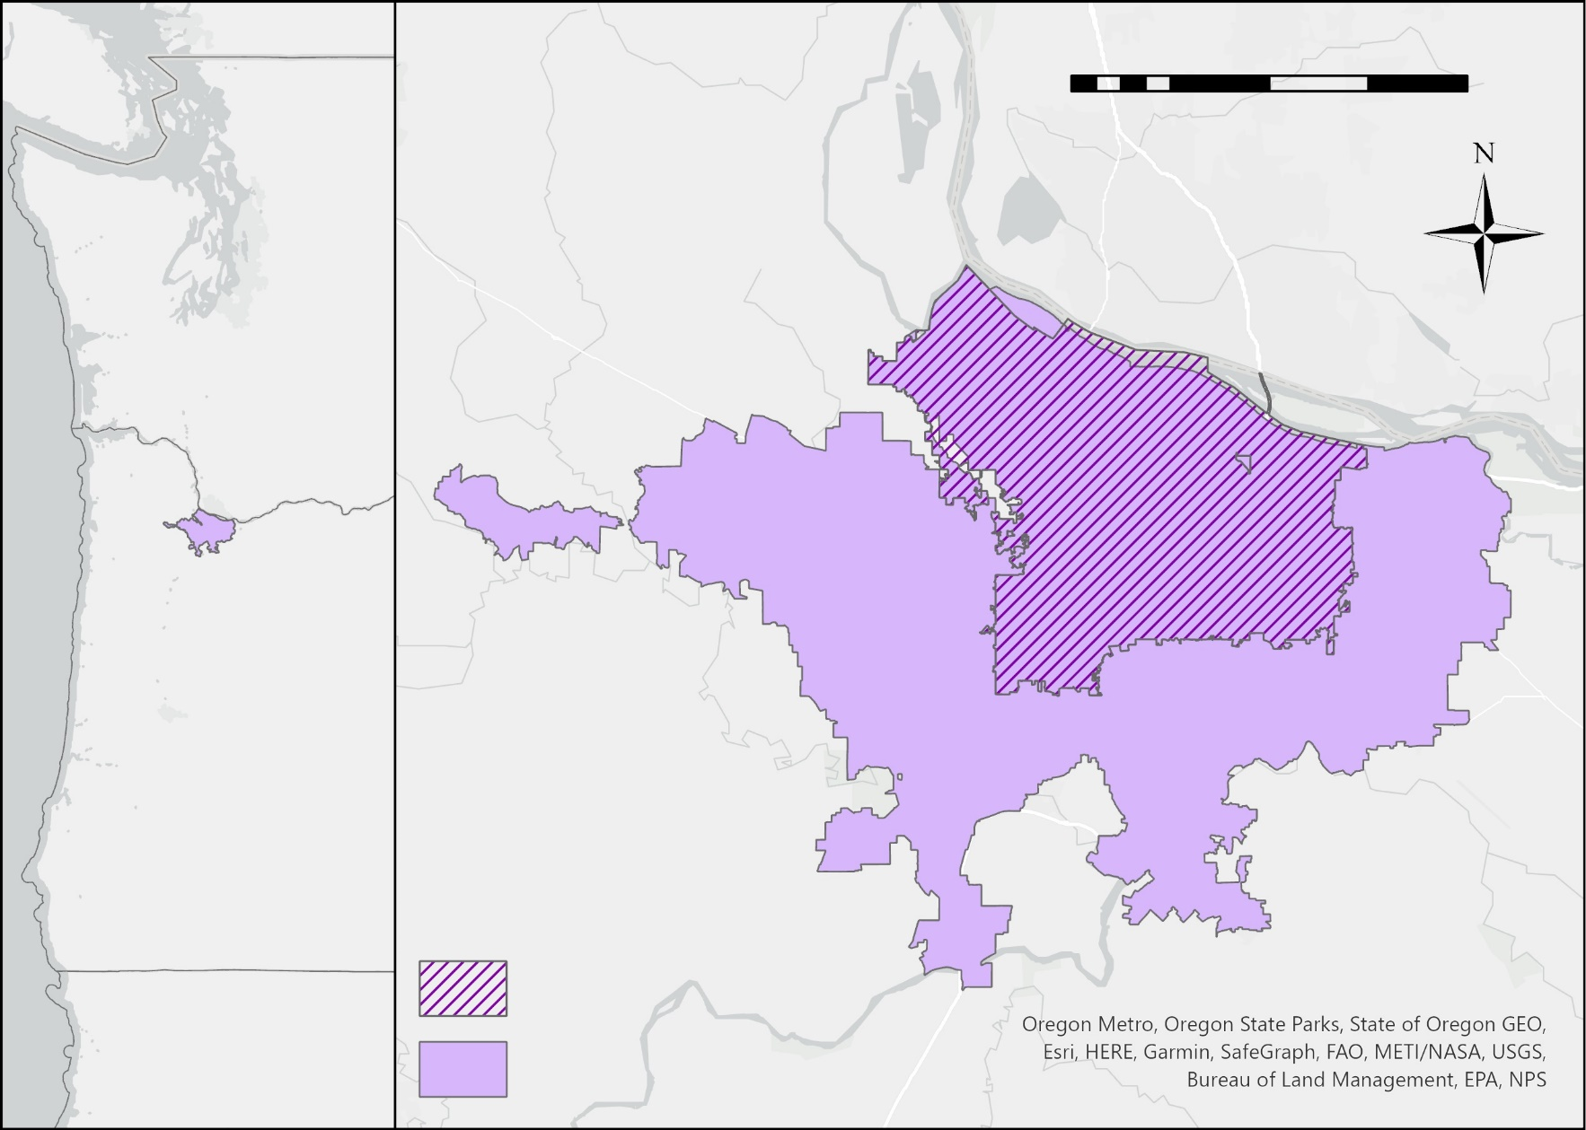
PROJECT OVERVIEW
0
10
20
Study Area
  Portland, Oregon
  Located in Pacific Northwest
  Urban Growth Boundary
Study Period
  2013 to 2023
  Focus on hot months (June-Aug)
Miles
Washington
Oregon
City of Portland
California
Urban Growth Boundary
km
2
5
Notes:
Our study area is Portland, Oregon, a city located in the Pacific Northwest region. Our study period encompassed 2013-2023, and within those years, we focused on June through August to capture Portland's hottest months.
Next slide.
--
Basemap credits: Oregon Metro, Oregon State Parks, State of Oregon GEO, Esri, HERE, Garmin, SafeGraph, FAO, METI/NASA, USGS, Bureau of Land Management, EPA, NPS

Slide 4

ENVIRONMENTAL JUSTICE (EJ)CONCERNS
Environmental injustices are the disproportionate impact of environmental hazards on marginalized communities, driven by systemic barriers, historic disenfranchisement, and colonial legacies
Current EJ Issues in Portland
Historic Injustice
  Urban Growth Boundary Policy
    Rapid gentrification
    Rising housing costs
    Displacement of minority populations in urban core
  Inequitable access to public resources
    Green space and transportation
    Healthcare coverage
1844
1930s
1960s
Oregon Black
Exclusion Laws
Urban Renewal Projects
Housing Discrimination and Redlining
Notes:
Our project is centered around environmental justice. Portland’s legacies of racial exclusion are connected to contemporary environmental justice issues. For example, Portland faces rapid gentrification and high population density due to the city’s urban growth boundary planning policy, which raises property values and displaces residents in the urban core. Influenced by historic disenfranchisement, low-income and communities of color in Portland are disproportionately exposed to the effects of climate change, as they are more likely to live in areas with less tree canopy cover, more pavement, and have less access to air conditioning or community shelters.
Next slide.
--
Lightbulb Icon credit: Microsoft Powerpoint

Slide 5
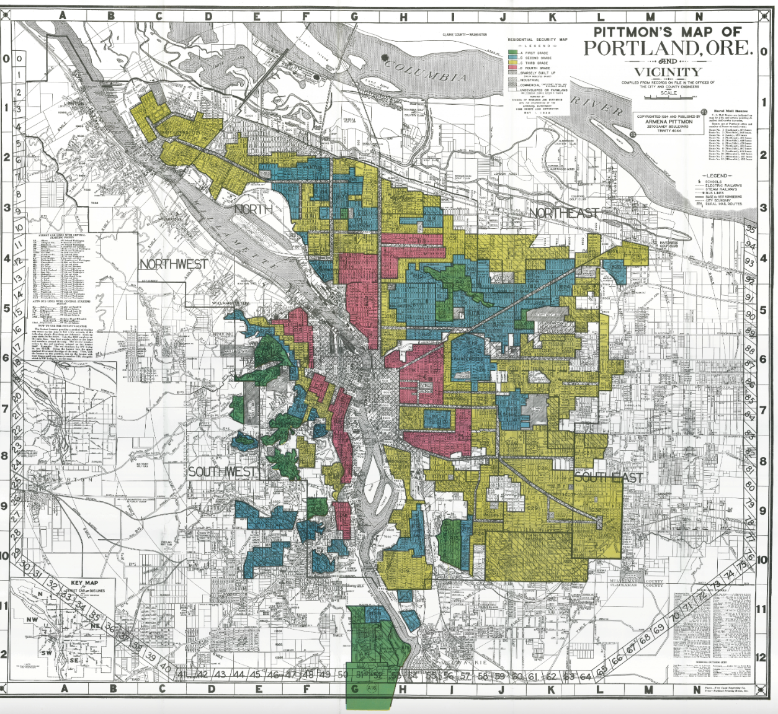
REDLINING IN PORTLAND ONCERNS
In the 1930s, the Home Owners’ Loan Corporation (HOLC) assessed neighborhood “desirability” by assigning color grades to areas. Redlining reinforced racial segregation by restricting federal and private lending.
A – Green: ethnically homogeneous (white), developing
B – Blue: ethnically homogeneous (white), developed
C – Yellow: bordering diverse neighborhoods (non-white), declining
D – Red: diverse neighborhoods (non-white) and low-income, declined
1938 HOLC Residential Security Map
Image Credit: Mapping Inequality
Notes:
Redlining practices have had lasting effects on the city today. In the 1930s, housing discrimination in the form of redlining engendered systematic racial segregation, as the zones were decided based on racial and ethnic makeup. The Portland zoning map shown on the left shows green areas indicating ‘highest quality’ neighborhoods and restricted them to single-family homes. Simultaneously, redlining allowed private developers to deny the sale of properties to minorities, namely Black, Japanese, or Chinese residents. As a result, minority homeownership was geographically restricted, and today, marginalized groups are disproportionately prone to environmental hazards.
Next slide.
--
Image Credit: Mapping Inequality
Image source: https://dsl.richmond.edu/panorama/redlining/#loc=11/45.513/-122.833&city=portland-or (CC Attribution-NonCommercial-ShareAlike 4.0 International License)

Slide 6

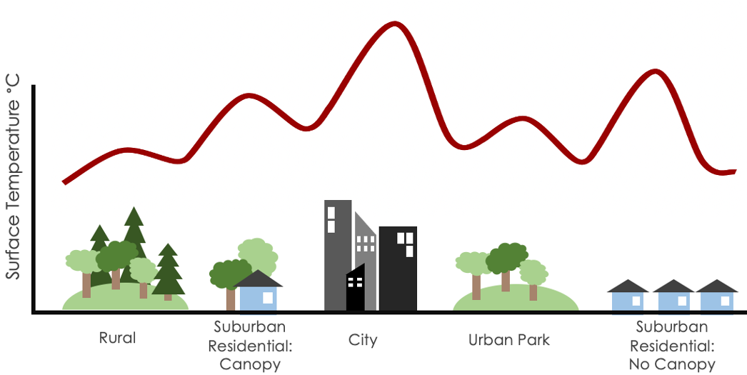
URBAN HEAT ISLAND (UHI)
Due to the Urban Heat Island (UHI) effect, cities experience hotter temperatures than surrounding rural areas
Surface Temperature
Rural
Suburban Residential: Tree Canopy
City
Urban Park
Suburban Residential:
No Tree Canopy
Image Credit: Caleigh McLaren (NASA DEVELOP Milwaukee Urban Development II)
Notes:
One of the largest environmental hazards facing cities across the country is extreme heat. Urban heat islands occur when cities are experiencing warmer temperatures than surrounding rural areas. Urban areas have higher concentrations of impervious surfaces like roofs, sidewalks, roads, buildings, and parking lots – which have less shade and absorb heat, contributing to higher temperatures. On the other hand, rural areas have trees, vegetation, and water bodies that provide cooling.
Next slide.
--
Lightbulb Icon credit: Microsoft Powerpoint
UHI Image credit: Caleigh McLaren from NASA DEVELOP Milwaukee Urban Development II VEJ Fall 2022
UHI image source: NASA DEVELOP Milwaukee Urban Development II VEJ Fall 2022 Poster https://www.devpedia.developexchange.com/dp/index.php?title=Milwaukee_Urban_Development_II_VEJ_Fall_2022

Slide 7
URBAN HEAT ISLAND (UHI)
Due to the urban heat island (UHI) effect, cities experience hotter temperatures than surrounding rural areas
Within the city, heat is experienced unequally.
Frontline communities are more vulnerable to extreme heat due to historic disenfranchisement and already face the negative effects of climate change.
Surface Temperature
Rural
Suburban Residential: Tree Canopy
City
Urban Park
Suburban Residential:
No Tree Canopy
Image Credit: Caleigh McLaren (NASA DEVELOP Milwaukee Urban Development II)
Notes:
Risks associated with extreme heat are experienced unequally. Certain populations have different access to resources that affect their ability to respond to extreme heat events. For instance, low-income residents may have limited access to air conditioning or cooling centers in the case of extreme heat waves. Frontline communities, who tend to be predominantly low-income and BIPOC, experience the brunt of climate change and are disproportionately affected by extreme heat and related health disparities, such as high rates of asthma and COPD, due to historic disenfranchisement and systemic barriers.
Next slide.
--
Lightbulb Icon credit: Microsoft Powerpoint
UHI Image credit: Caleigh McLaren from NASA DEVELOP Milwaukee Urban Development II VEJ Fall 2022
UHI image source: NASA DEVELOP Milwaukee Urban Development II VEJ Fall 2022 Poster https://www.devpedia.developexchange.com/dp/index.php?title=Milwaukee_Urban_Development_II_VEJ_Fall_2022

Slide 8
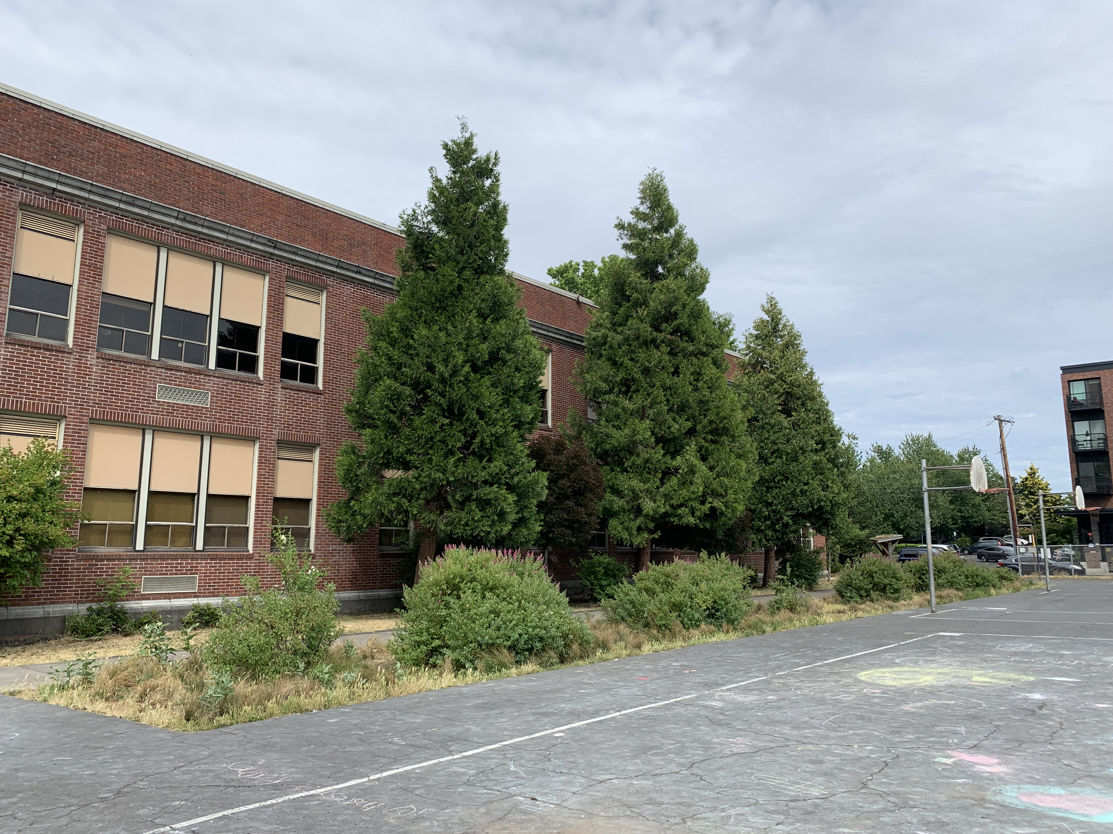
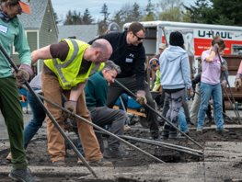
PROJECT PARTNER
Mission: “Depave empowers disenfranchised communities to overcome social and environmental injustices and adapt to climate change through urban re-greening. Depave transforms over-paved places, creates resilient community greenspaces, promotes workforce development and education, and advocates for policy change to undo manifestations of systemic racism.”
Depave
Portland, Oregon
Image Credits: Elle James (L), Julianne Liu (R)
Notes:
Our team partnered with Depave, a non-profit based in Portland. This organization works to “depave” surfaces across the city, empowering disenfranchised communities to adapt to climate change through urban re-greening. Depave works to turn over-paved areas like parking lots into vibrant greenspaces for the community to enjoy.
Next slide.
--
Greenspace Image credit: Julianne Liu
Image Source: Julianne Liu (given permission to use photos)
Depaving Image credit: Elle James
Image source: Elle James (given permission to use photos)

Slide 9







COMMUNITY CONCERNS
Excess heat and public health
Increased vulnerability
Environmental justice
Access to green space
Need for quantitative data
Urban overdevelopment
Image Credit: Eucalyp
Notes:
In working with Depave, we sought to address community concerns regarding public health, increased vulnerability, environmental justice, open green space, urban overdevelopment, and particularly quantitative data that supports their work.
Next slide.
--
Buildings image credit: Eucalyp from www.flaticon.com
Buildings image source: https://www.flaticon.com/free-icon/cityscape_2451728?term=buildings+city&page=1&position=6&origin=search&related_id=2451728 (CC Attribution-NonCommercial)
Icons credit: Microsoft Powerpoint

Slide 10



PROJECT OBJECTIVES
Develop a Land Surface Temperature (LST) urban heat map using NASA Earth observations
Aggregate socio-environmental implications of urban heat through social vulnerability mapping
Analyze specific case studies of past Depave projects to understand lived experiences and impacts of their work
km
2
5
Notes:
To address these concerns, our three main project objectives were to develop a land surface temperature urban heat map using NASA Earth observations, aggregate socio-environmental implications of urban heat by mapping social vulnerability to indicate Portland's frontline communities most affected by extreme heat, and to analyze specific case studies of past Depave projects to underscore the impacts of their work.
Next slide.
--
Icons credit: Microsoft Powerpoint

Slide 11
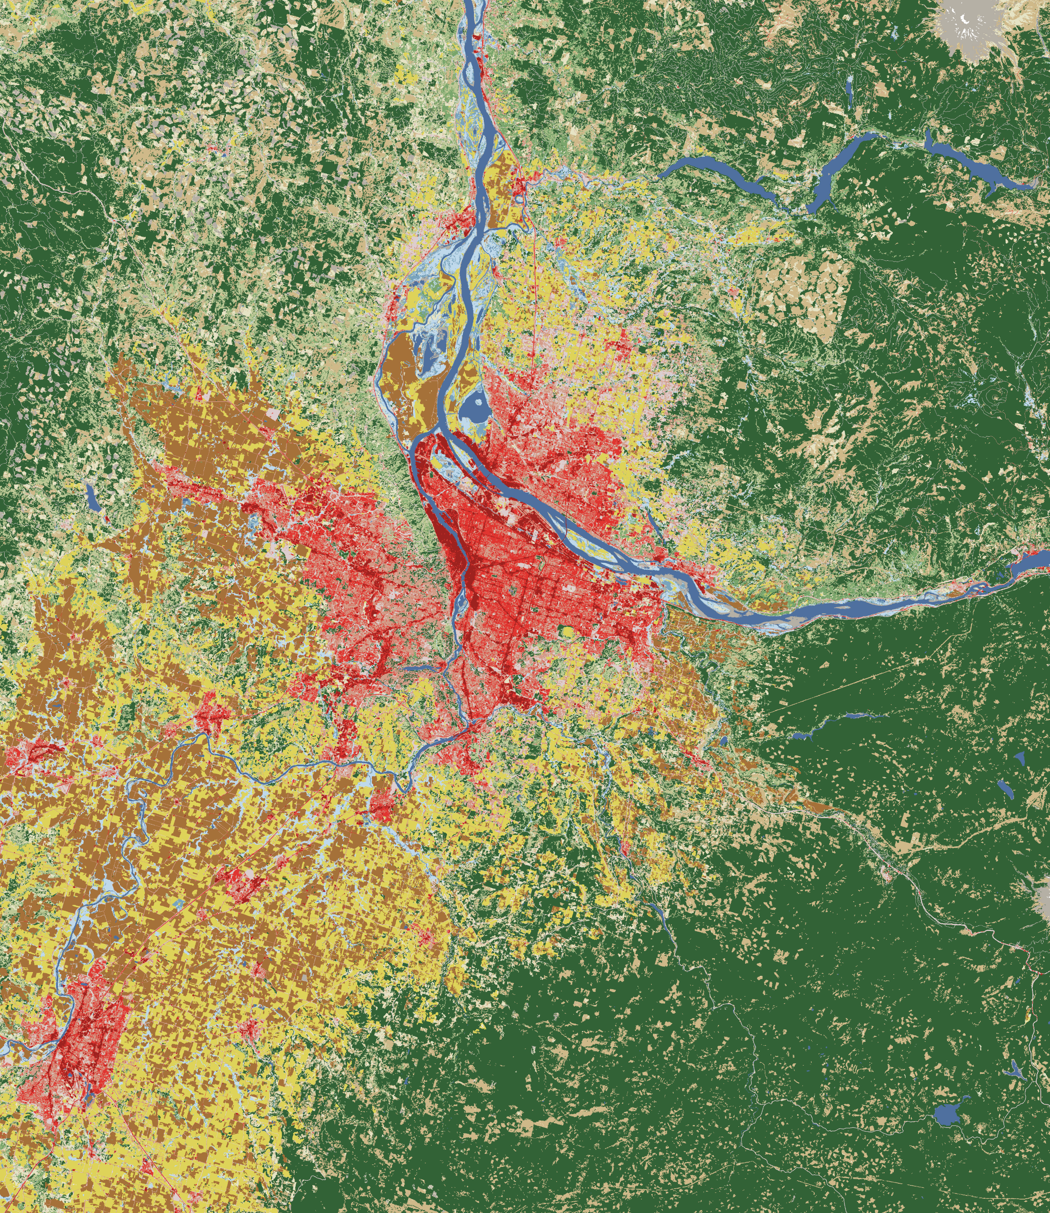
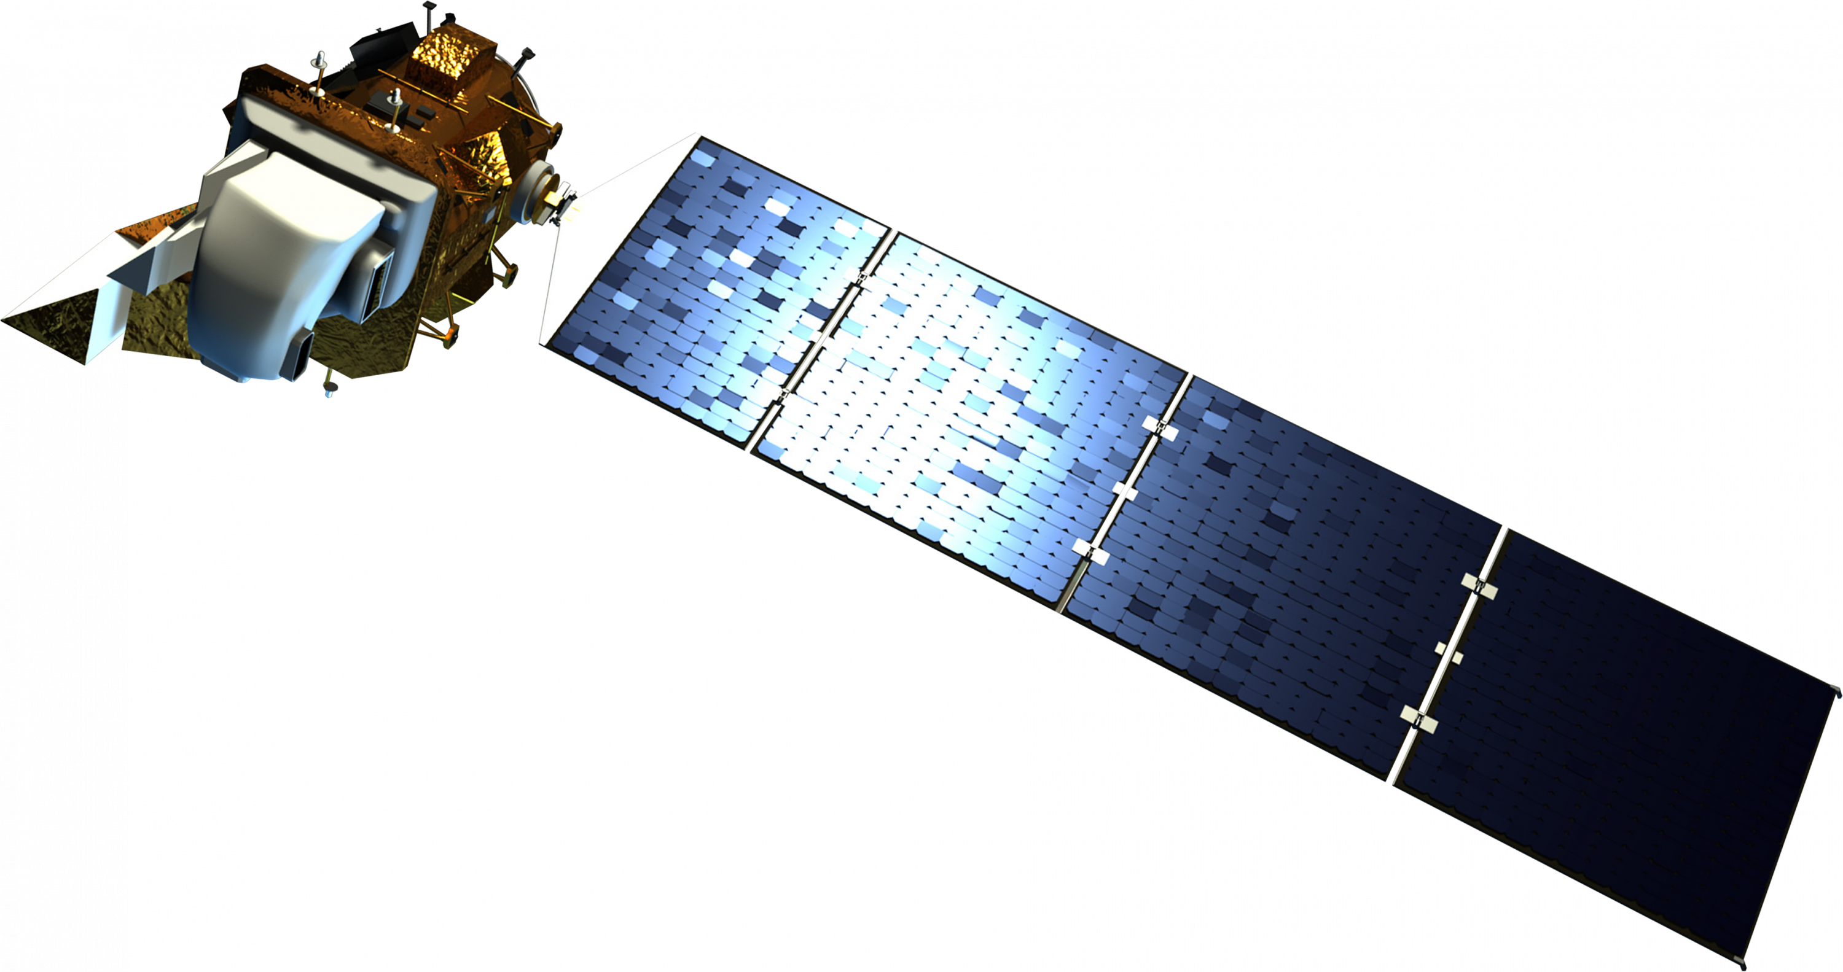
EARTH OBSERVATIONS
Landsat 8
Thermal Infrared Sensor (TIRS)
Launched February 11, 2013
Image Credits: NASA
Notes:
The team used Landsat 8 observations with the Thermal Infrared Sensor, or “TIRS”, to quantify and visualize UHI.
Next slide.
--
Satellite Image source: https://science.nasa.gov/get-involved/toolkits/spacecraft-icons (CC BY-SA 2.0 FR)
Raster Image Credit: NASA's National Land Cover Database 2001 (NLCD 2001)
Raster Image Source: https://earthobservatory.nasa.gov/images/78732/landsat-shows-land-use-around-portland (Public Domain)

Slide 12



METHODOLOGY
Land Surface Temperature (LST) Urban Heat Map
Landsat 8 Thermal Infrared Sensor (TIRS)
Tier 1, Collection 2, Level 2
Selected Band 10 and calculated median pixel value
5-Year Median Land Surface Temperature
Calculated mean pixel value for each census tract
Filtered collection (June – August, 2018 – 2022)
Masked cloud cover and cloud shadow
Average LST Per Census Tract
Clipped to Urban Growth Boundary
Notes:
There are three main components to our analysis. First, we calculated Portland’s land surface temperature. Land surface temperature measures how hot the ground is rather than the air temperature. So, we calculated the land surface temperature over a 5-year period and used this to calculate the average temperature of each census tract in Portland’s urban growth boundary.
Next slide.
--
Icons credit: Microsoft Powerpoint

Slide 13
METHODOLOGY
Land Surface Temperature (LST) Urban Heat Map
Frontline Analysis
Selected social, economic, health, and heat-related variables
Generated Sub-Components
Added sub-components to calculate final vulnerability index score
Racial Demographics
Socioeconomic Profiles
Housing Characteristics
Frontline Analysis
Principal Component Analysis (PCA)
in R Studio
Aging and Health Disparities
Notes:
Then, we conducted a Frontline Analysis by creating our own social vulnerability index specific to urban heat in Portland. We selected relevant social variables, then performed a Principal Component Analysis in R studio to generate a vulnerability score that we used to identify Portland’s frontline communities that have the highest potential vulnerability to extreme heat.
Next slide.
--
Icons credit: Microsoft Powerpoint

Slide 14
METHODOLOGY
Land Surface Temperature (LST) Urban Heat Map
Frontline Analysis
Case Studies of Depave Sites
Temperature Change after Depave Intervention
Calculated LST Pre- and Post- Depave intervention at site locations
Selected sites for analysis based on size and age of site
Created 0.25-mile buffers around site locations
Notes:
Finally, we analyzed case studies to quantify the impact of Depave’s projects on local heat. After selecting 6 sites based on their size and when they were completed, we performed a temporal analysis in Google Earth Engine. Comparing the land surface temperature before and after these Depave sites were completed, we assessed the temperature change impact of depaving intervention. These case studies use Landsat 8 LST LST data to capture before and after changes on specific sites, which widens our data window to 2013 to 2022.
Next slide.
--
Icons credit: Microsoft Powerpoint

Slide 15
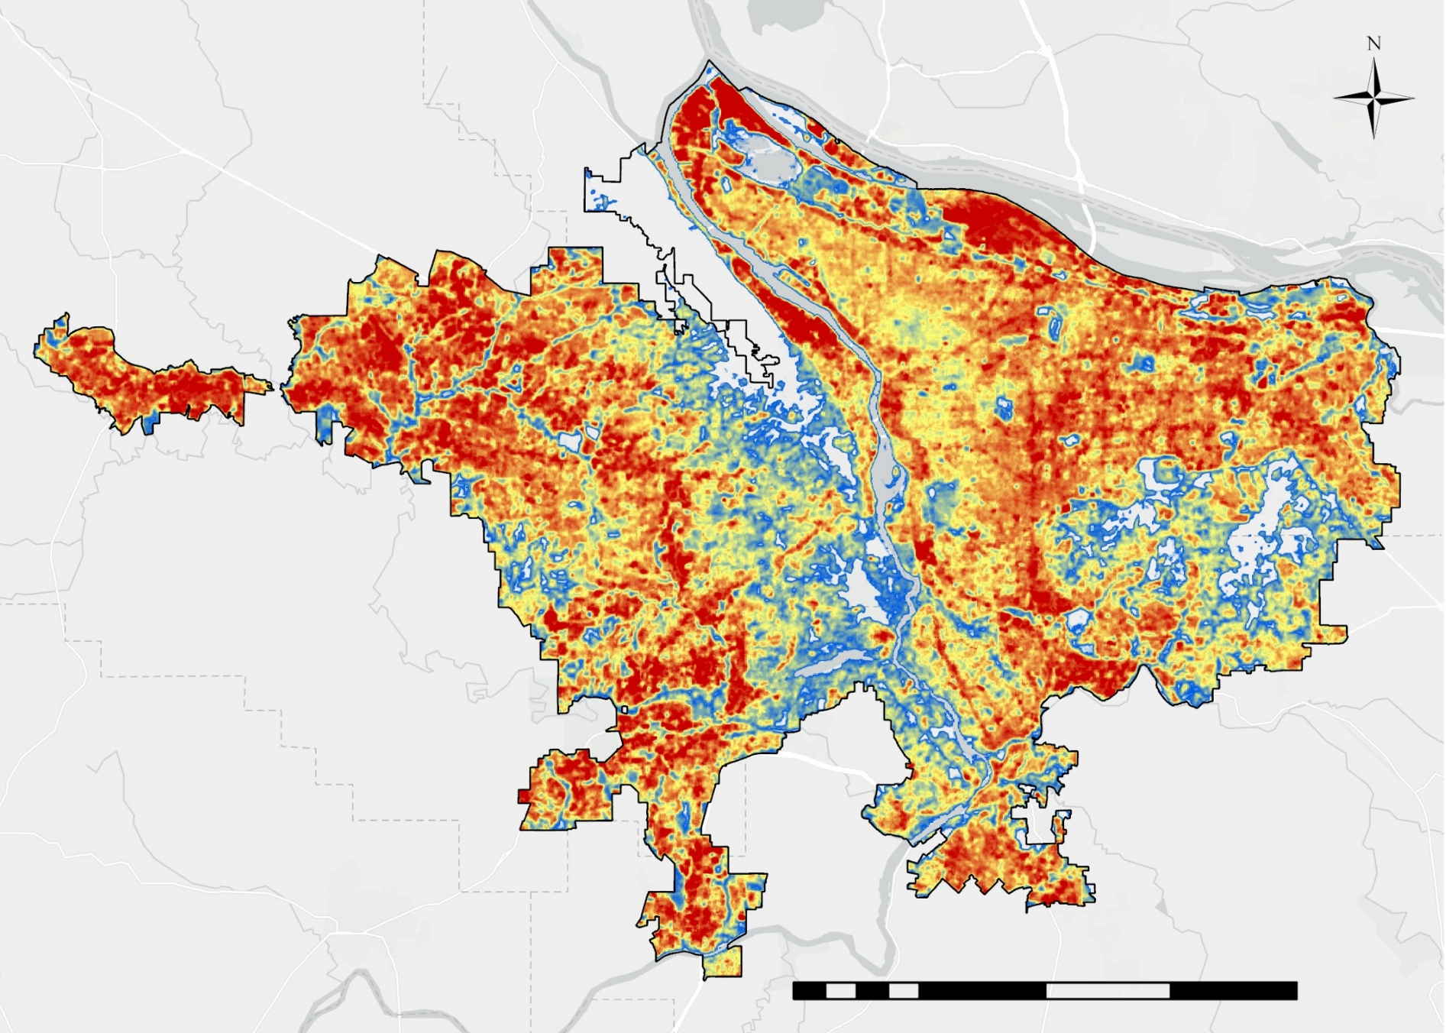
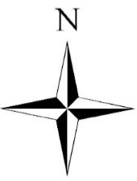

LAND SURFACE TEMPERATURE (LST)
5-Year (‘18–'22)
Median LST (ºF)
110
80
0
10
20
miles
Basemap credit: Oregon Metro, Oregon State Parks, State of Oregon GEO, Esri, HERE, Garmin, SafeGraph, FAO, METI/NASA, USGS, Bureau of Land Management, EPA, NPS
Notes:
This is the result of our LST from 2018 to 2022. The hottest areas are indicated in red, while cooler areas are in blue and white. The hottest areas appear to be around the urban core, and particularly in the north and far west of the urban growth boundary. The large patch of white in the center of the study area is a protected forest, and therefore experiences much cooler land surface temperature.
Next slide.
--
Basemap Credits: Oregon Metro, Oregon State Parks, State of Oregon GEO, Esri, HERE, Garmin, SafeGraph, FAO, METI/NASA, USGS, Bureau of Land Management, EPA, NPS

Slide 16
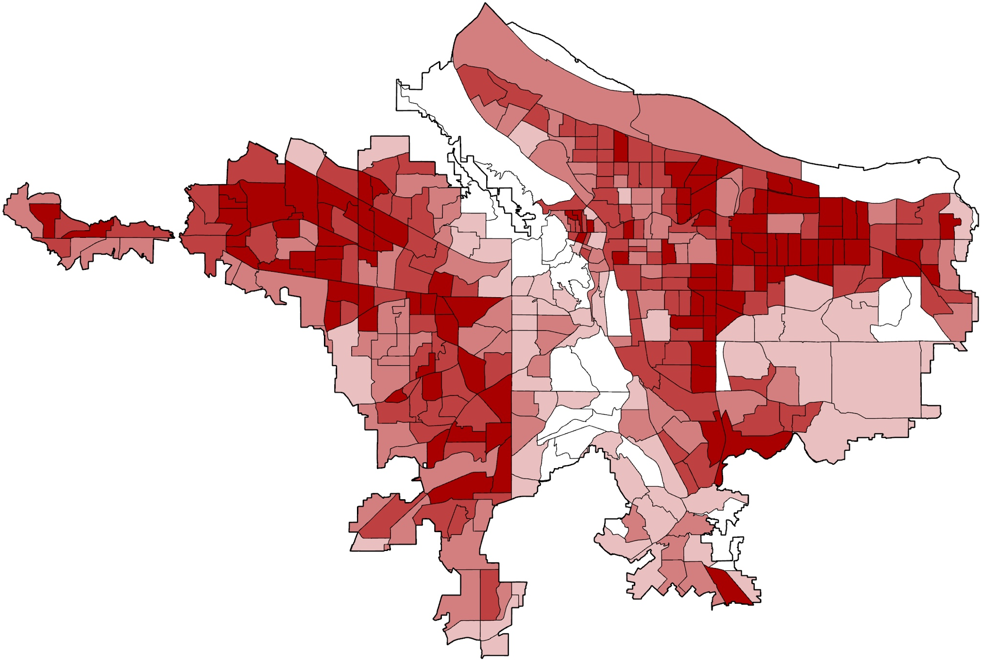

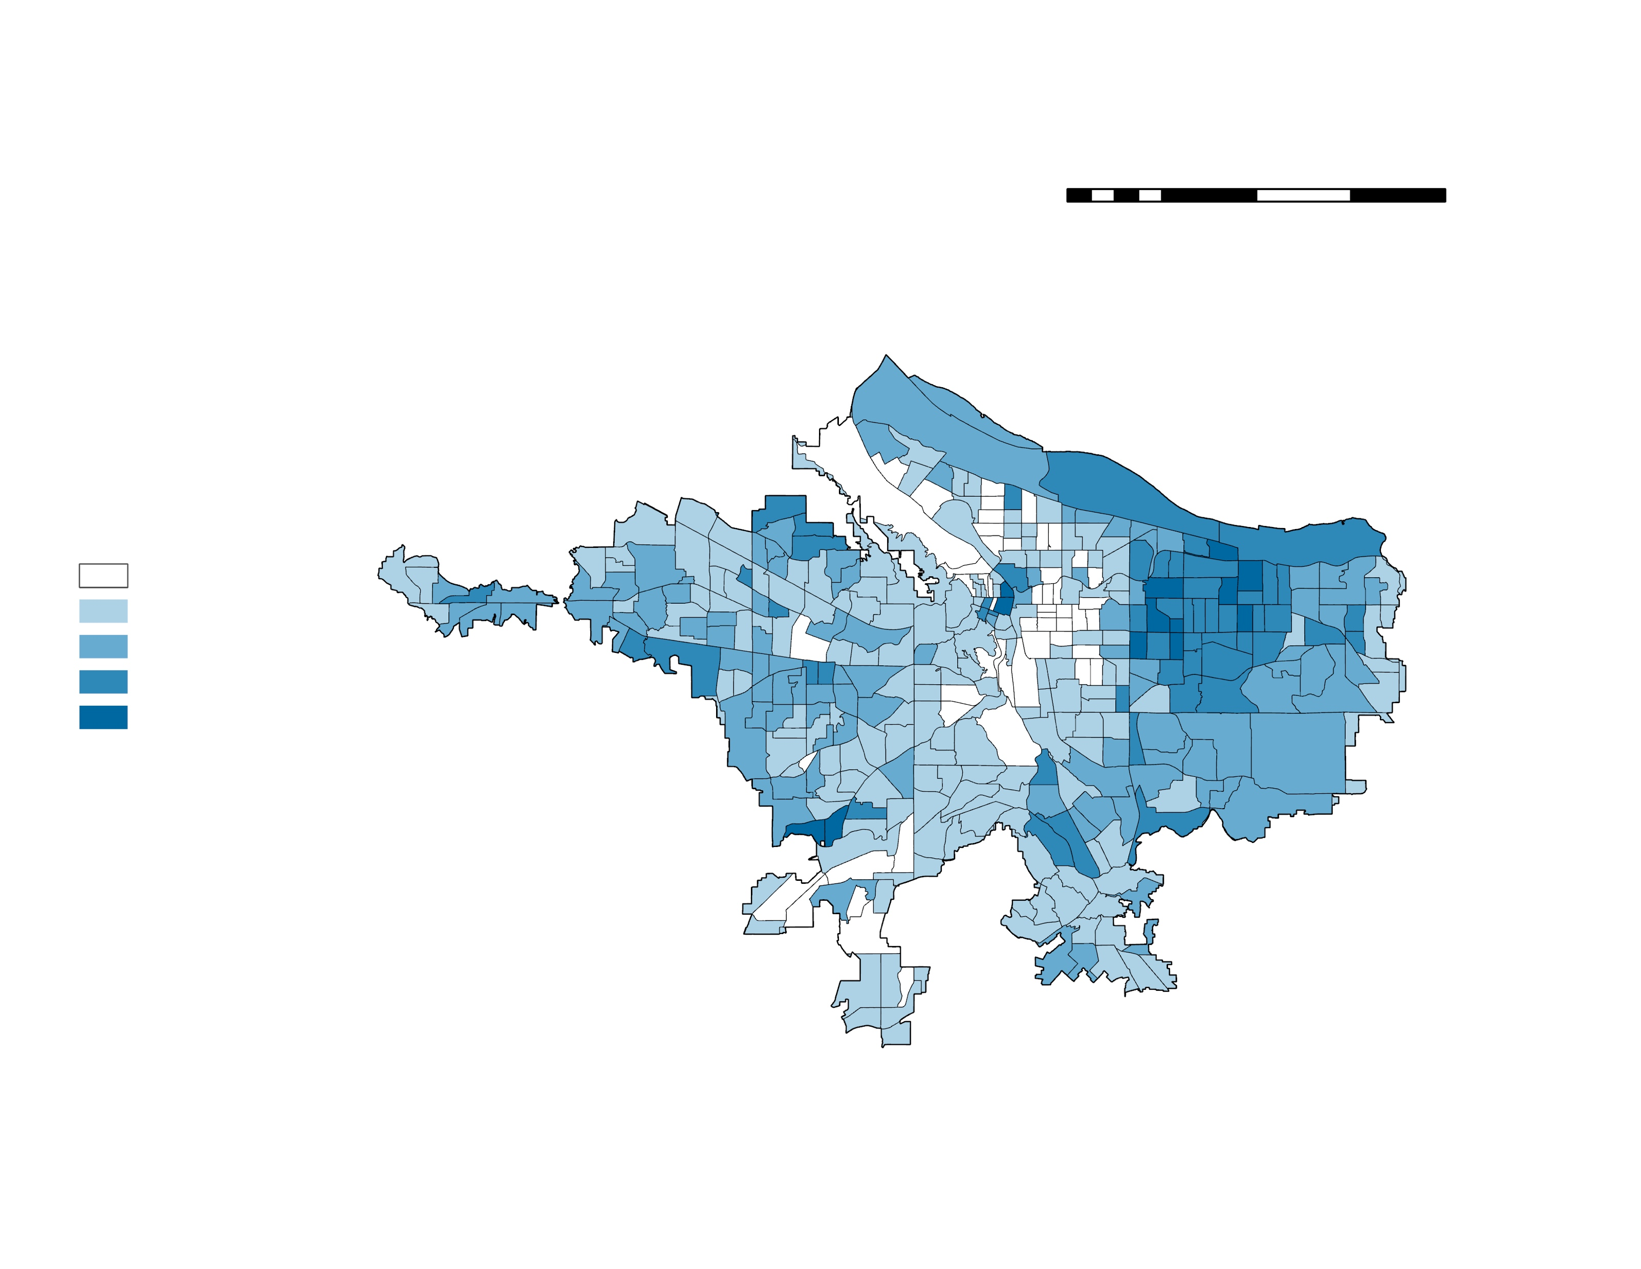
LAND SURFACE TEMPERATURE (LST)
Average LST per
Tract (ºF)
Above 102
99 to 102
95 to 99
89 to 95
Below 89
0
10
20
miles
Notes:
This map further breaks down the results of our LST by taking the average land surface temperature of all pixels within each census tract, identifying which neighborhoods are particularly subject to extreme heat.
Next slide.

Slide 17

Vulnerability
Resilience
Adaptability
Intentionality
Intersectionality
FRONTLINE ANALYSIS
Conducting meaningful conversations with communities about representation and experiences
Being intentional with our language
Frontline Communities
Notes:
In conversation with our project partners, we decided to refer to the social vulnerability index that our team created as a frontline analysis. As a research project working alongside Depave, it was critical for us to be intentional with the language we used to represent these communities. The term vulnerability can have a negative and victimizing connotation when placed upon communities at the forefront of environmental justice, so Depave identified the term "frontline communities" to appropriately describe the areas with the highest potential vulnerability to extreme heat. With this, we hope to acknowledge the intersectionality of vulnerability and climate change experiences, as well as highlight the resiliency of these frontline communities. Our decision to use this language not only demonstrates the importance of having meaningful conversations with the communities that we work with, but also, we hope that this will encourage more thought to be put into contexts that may be associated with words that have become normalized within scientific literature, recognizing the historic underrepresentation of diverse voices in science.
Next slide.
--
Icon credit: Microsoft Powerpoint

Slide 18
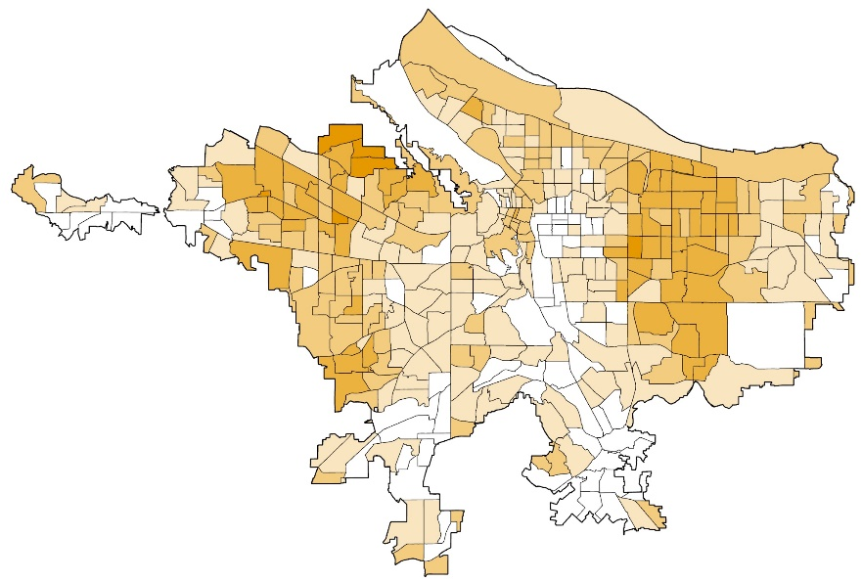
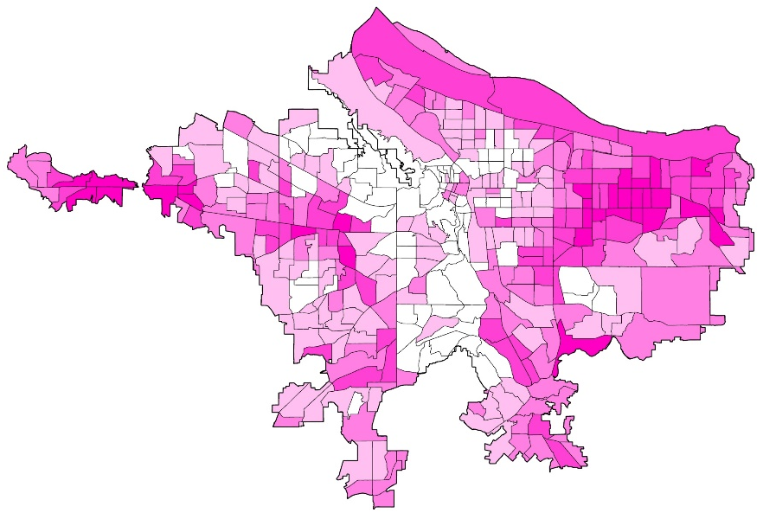
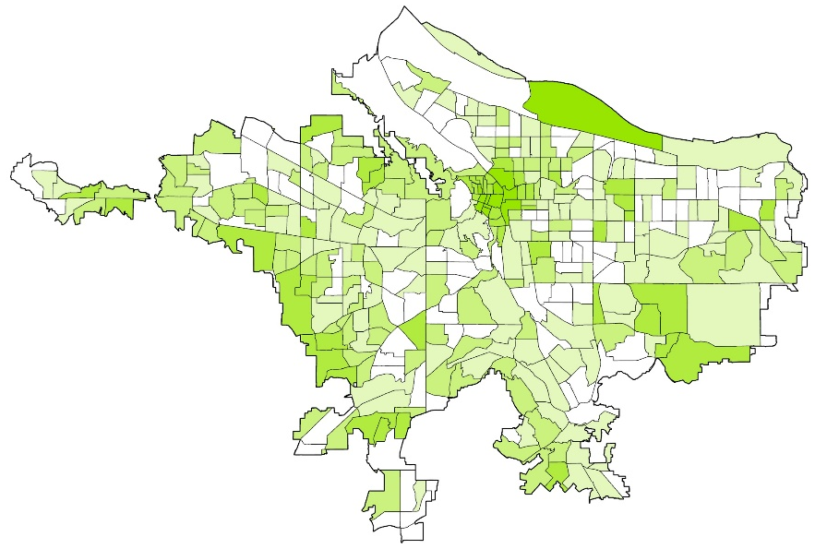
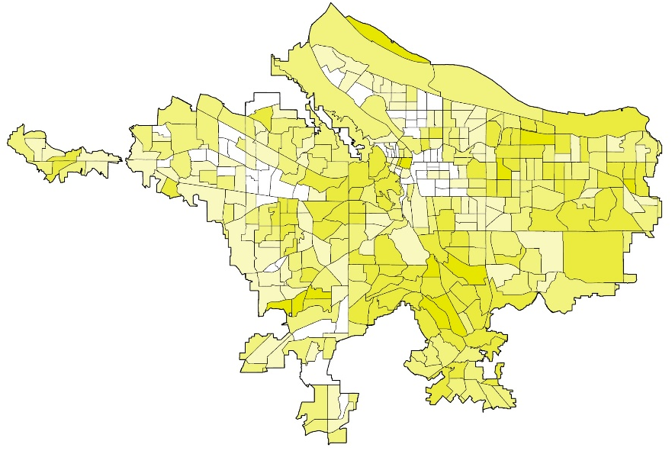

FRONTLINE ANALYSIS
Our Principal Component Analysis (PCA) generated four sub-components:
Racial Demographics
Socioeconomic Profiles
More Vulnerable
More Vulnerable
Less Vulnerable
Less Vulnerable
Housing Characteristics
Aging and Health Disparities
More Vulnerable
More Vulnerable
Less Vulnerable
Less Vulnerable
Notes:
For this frontline analysis, our Principal Component Analysis generated 4 subcomponents: racial demographics, socioeconomic profiles, housing characteristics, and aging and health factors. These four components were then summed to calculate the final composite social vulnerability score.
Next slide.

Slide 19

FRONTLINE ANALYSIS
Vulnerability Index Score
Over 4.44
2.18 to 4.44
0.54 to 2.18
-0.96 to 0.54
Less than -0.96
0
10
20
miles
Notes:
This map shows the vulnerability score for each census tract based on the sum of the previous 4 subcomponents. With this, we identified the areas in eastern Portland as having a higher potential vulnerability to extreme heat events.
Next slide.

Slide 20
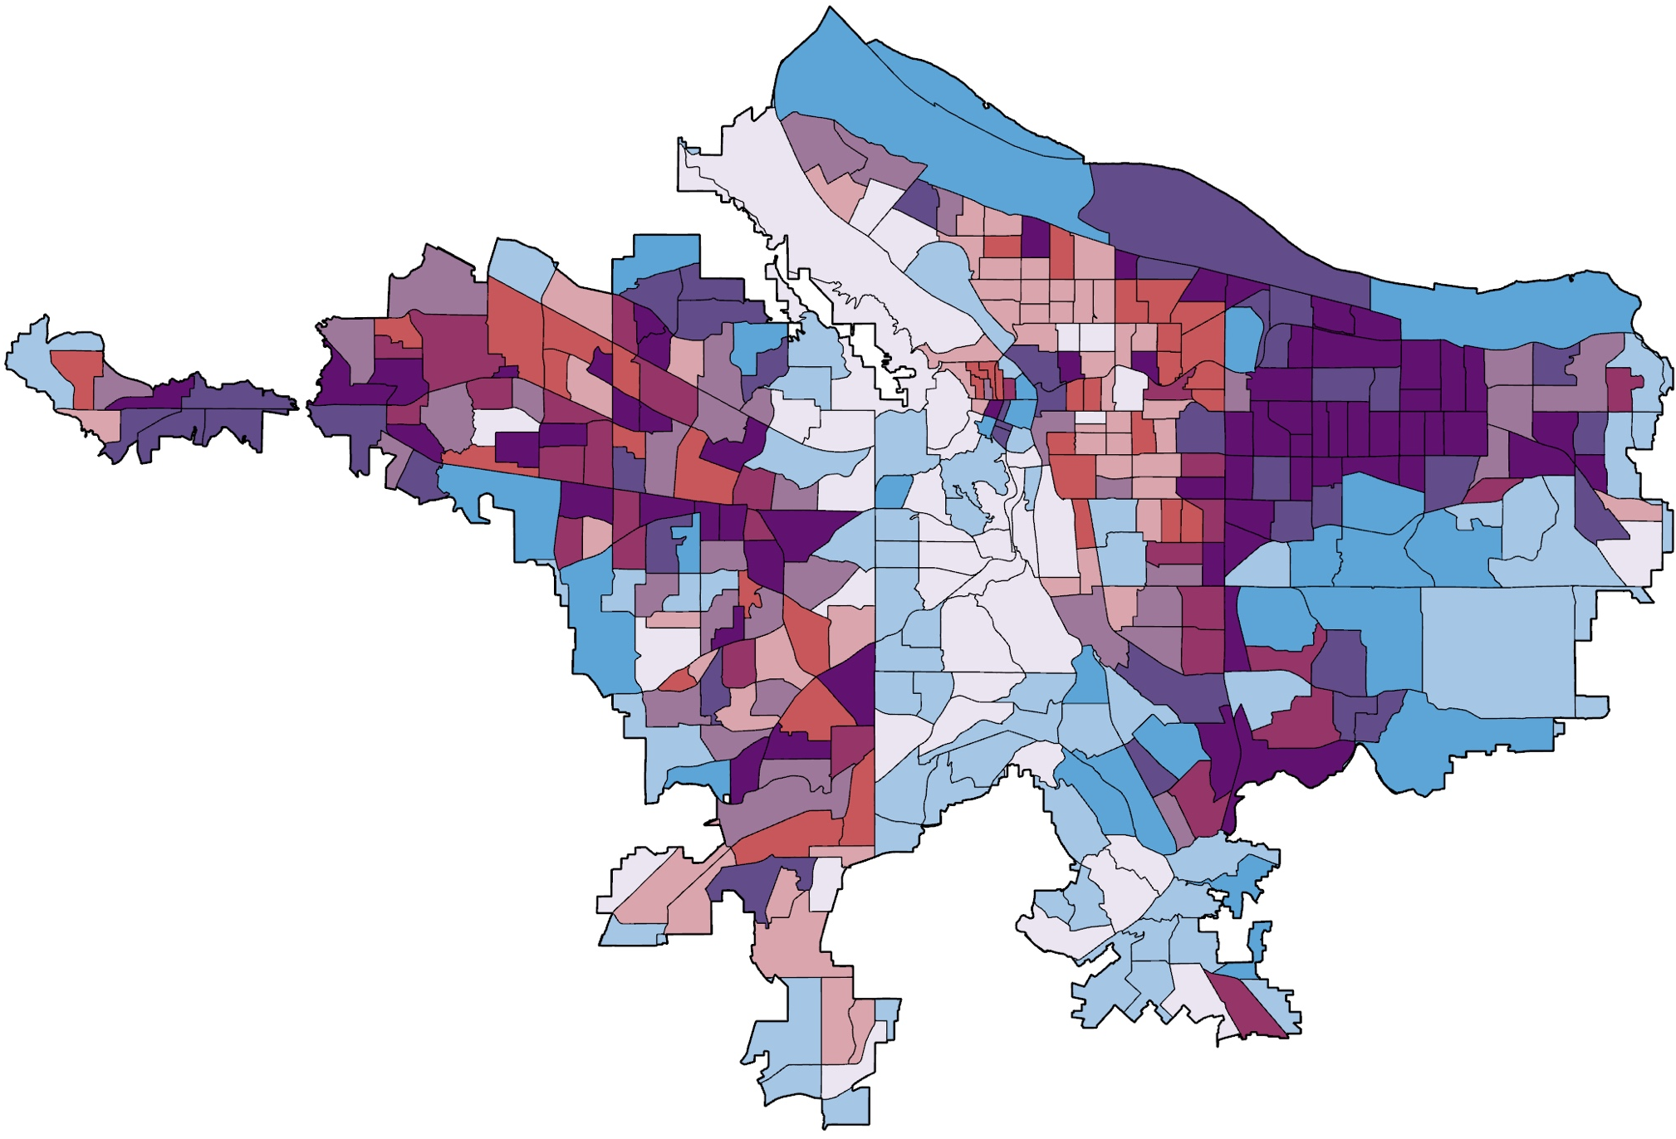
MAPPING FRONTLINE COMMUNITIES
Land Surface Temperature
Vulnerability
High
Low
Low
High
0
10
20
miles
Notes:
We then combined our land surface temperature and Frontline Analysis to identify Portland’s frontline communities that are at the intersection of experiencing high social vulnerability and extreme heat. The vertical axis is our vulnerability score from the frontline analysis, with white to blue indicating low to high vulnerability. The horizontal axis is our heat variable, showing white to red as low to high land surface temperature.
Next slide.

Slide 21
MAPPING FRONTLINE COMMUNITIES
Land Surface Temperature
Vulnerability
Less presence of vulnerability and lower surface temperatures
High
Low
Low
High
0
10
20
miles
Notes:
The lighter region in the center of the city indicates less presence of social vulnerability and lower surface temperatures.
Next slide.

Slide 22
MAPPING FRONTLINE COMMUNITIES
Land Surface Temperature
Vulnerability
More presence of vulnerability and higher surface temperatures
High
Low
Low
High
0
10
20
miles
Notes:
The dark purple indicates Portland’s frontline communities, feeling the brunt of climate change impacts and adapting to extreme heat. These areas experience both high vulnerability and high land surface temperatures, underscored and influenced by historic disenfranchisement and contemporary environmental justice issues.
Next slide.

Slide 23
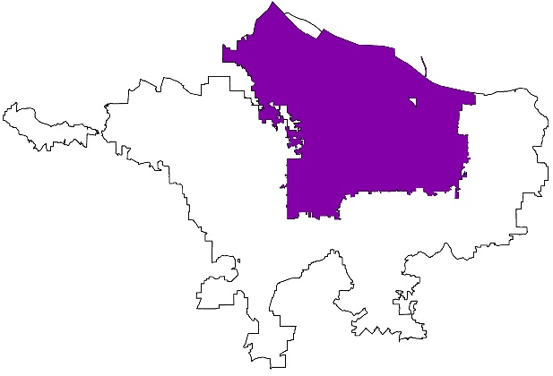
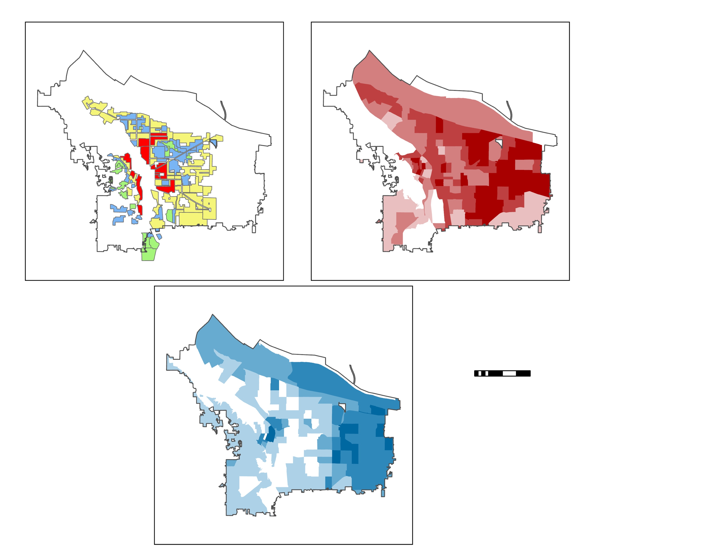
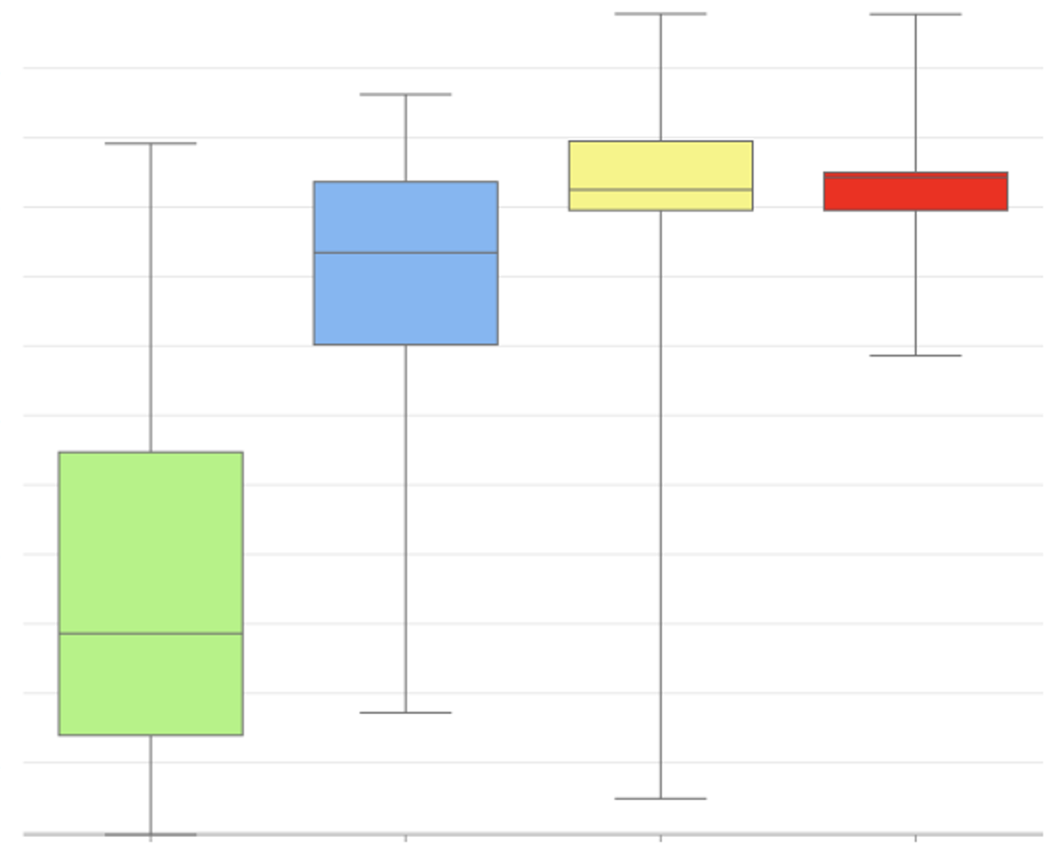

REDLINING AND URBAN HEAT
Neighborhoods rated “green” in the 1938 HOLC maps experience less heat than historically redlined areas
104
102
100
98
96
94
Mean LST (degrees F)
92
90
88
A - Green
86
B - Blue
84
C - Yellow
82
D - Red
0
3
6
A
B
C
D
miles
Notes:
Further, to investigate the relationship between contemporary urban heat and historic redlining practices, we found that neighborhoods rated as “green” in the 1938 HOLC policy experience substantially less heat than historically redlined areas.
Next slide.

Slide 24
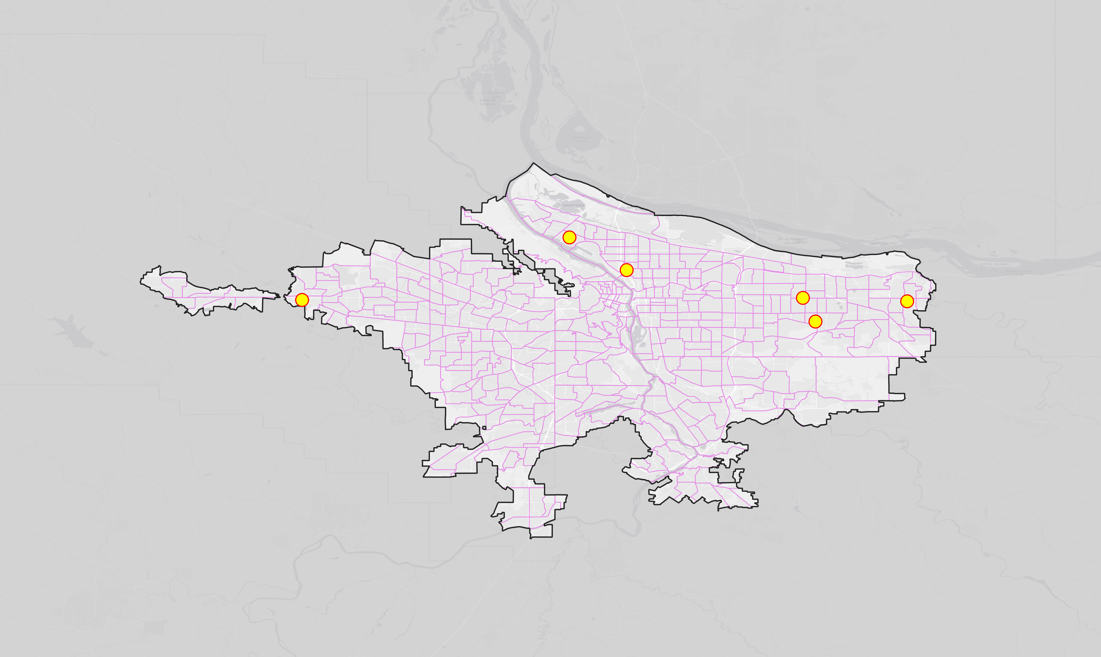


CASE STUDIES
Urban Growth Boundary
Census Tracts
Case Study
Depave Sites
0
10
20
miles
Basemap credits: Oregon Metro, Oregon State Parks, State of Oregon GEO, Esri, HERE, Garmin, SafeGraph, FAO, METI/NASA, USGS, Bureau of Land Management, EPA, NPS
Notes:
For our final analysis, these are the six sites we chose for our case study temporal analysis. For the sake of time, we will be highlighting one case study site in this presentation.
Next slide.
--
Basemap Credits: Oregon Metro, Oregon State Parks, State of Oregon GEO, Esri, HERE, Garmin, SafeGraph, FAO, METI/NASA, USGS, Bureau of Land Management, EPA, NPS
Icon credit: Microsoft Powerpoint

Slide 25



LIMITATIONS AND UNCERTAINTIES
Heat Analysis
Frontline Analysis
Case Studies
  Temporal resolution of Landsat 8 TIRS limiting the number of images per year
  Lack of in-situ measurements to assess accuracy of satellite-derived LST values
  Implementation year of Landsat 8 TIRS reducing ability to analyze change over time
  Census tract data cannot explain neighborhood level experiences
  Lack of heat-related data (i.e., air conditioning, cooling centers) to add to index
  Need to use qualitative data for understanding community stories
  Temporal and spatial resolution of Landsat 8 TIRS data limited fine scale results
  Some sites are not fully grown, and as canopy cover grows, it may affect surface temperature more
  Unusual hot and cold days affecting results
Notes:
Overall, one of the largest limitations of our study was the spatial and temporal resolution of the Landsat 8 TIRS data. The Landsat 8 thermal band has a spatial resolution of 100m pixels, and most Depave sites make up only a portion of a pixel. This resolution poses a large limitation to accurately capturing site impacts to LST. Additionally, since a number of sites were implemented before 2008, Landsat 8 with its launch in 2013 cannot capture the before and after impacts all past projects. Further, limitations to our social vulnerability index included access to data. Our project was only 10 weeks, and that limited our ability to interact with communities on the ground and understand neighborhood level experiences. Furthermore, we were limited by a lack of data regarding factors like access to air conditioning or cooling centers, which would be pertinent to our heat-related analysis. Overall, our study lacked a more mixed-methods approach that would have considered the community-level impact that urban heat has on neighborhoods across Portland.
Next slide.
--
Icon Credit: Microsoft Powerpoint

Slide 26
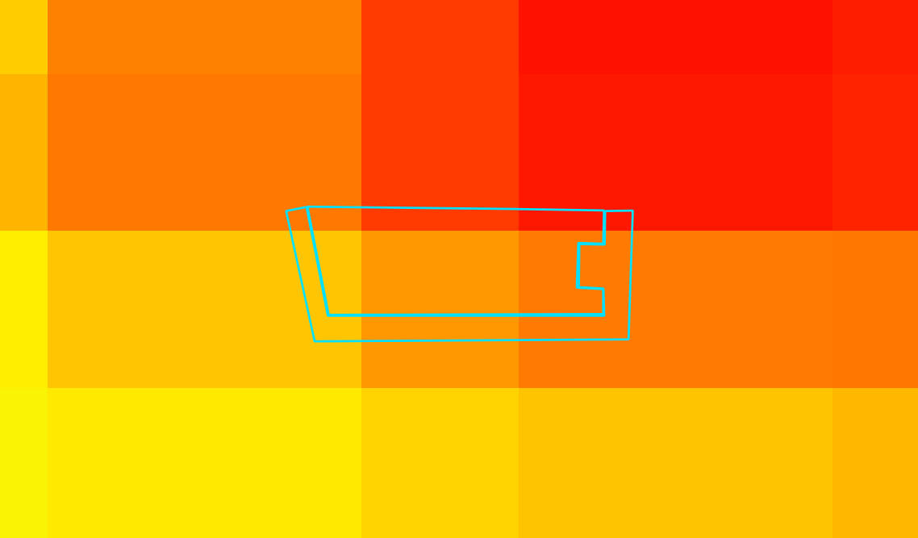
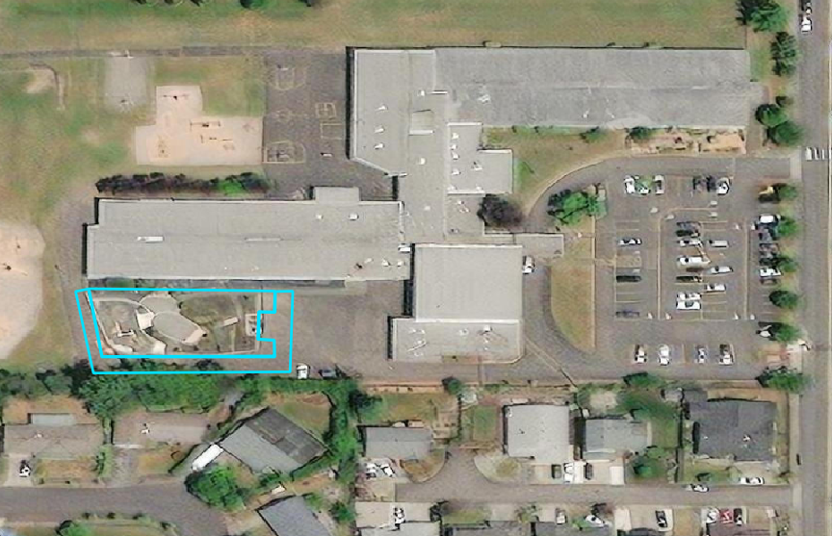
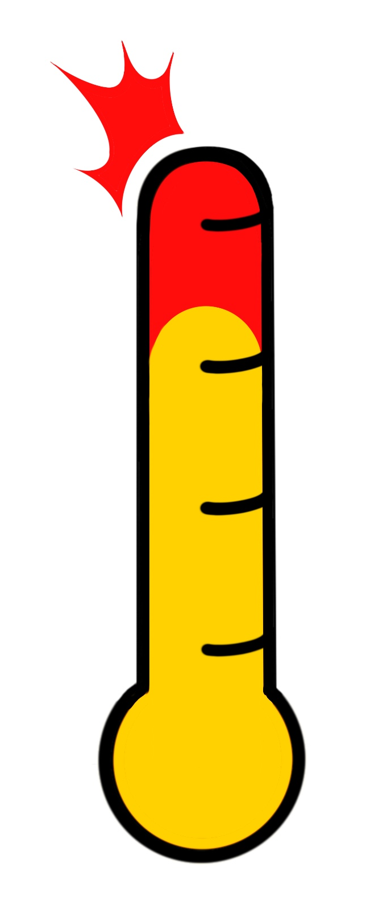


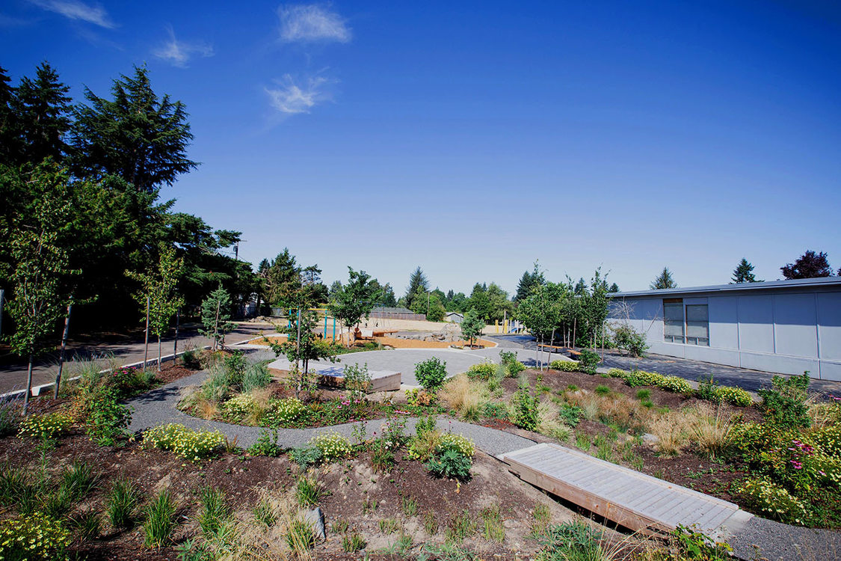
Powell Butte Elementary School (2019)
CASE STUDIES
Before: 2016–2018
Before
108ºF
After
106ºF
After: 2020–2022
Image Credits: ESRI, Depave
Notes:
Powell Butte elementary school is located in eastern Portland. In 2019, Depave uprooted 7400 sqft of pavement. In our before and after analysis of the site, we found that Powell Butte experienced the largest change in mean land surface temperature, with a 2º temperature decrease, and a 5º change after normalization with the average land surface temperature of the entire city of Portland.
In our case study analysis, most sites exhibited decreases in average land surface temperature after depaving. Also, it demonstrated that small-scale urban heat interventions can be identified using Earth observing technology.
Next slide.
--
Aerial image credit: ESRI Satellite Basemap
Site image credit: Depave (permission to use)
Thermometer image credit: NASA DEVELOP VEJ Portland Urban Team

Slide 27

CONCLUSIONS
Specific areas are both socially and environmentally susceptible to extreme heat risk
Local-scale urban heat interventions can be observed and quantified with remote sensing data
Case studies demonstrate impact of Depave on reducing local heat and building community
Community involvement is crucial for understanding and addressing urban heat issues
Notes:
Using remotely sensed imagery from Landsat 8 and US Census data, this project illustrates the city-wide importance of community depaving and the integration of greenspace to mitigate urban heat island. Through evaluation of land surface temperature from 2013 to 2022 before and after community depavement, we show that Depave’s community-driven efforts in concrete removal and greenspace integration can decrease urban heat. Specifically, we show clear decreases in LST at case studies before and after project implementation for Depave’s work on sites at Powell Butte Elementary, M&M Market, Our Just Future, and Boise-Eliot Elementary. Through the assessment of social vulnerability and bivariate heat and socio-demographic analysis, we illustrate the importance of considering compounding social and environmental impacts when considering the implications of urban heat in communities. Using publicly available data including remotely sensed imagery is a strong method to uplift Depave’s community work and provide quantifiable backing for their important community work.
Next slide.
--
Icon Credit: Microsoft Powerpoint

Slide 28

FUTURE WORK
Depave Project
Mixed Methods
Intentionality
In-situ data
Image Credits: Freepik
Notes:
Given the limitations of this project, next steps could include the integration of fine-scale and on-the-ground temperature data paired with remote-sensing data to further assess the impact of local depaving initiatives on neighborhood-level climates. With this, integrating a more mixed methods approach to urban heat is crucial for understanding lived experiences. Remote sensing and satellite data offer an exciting opportunity to focus on multi-scalar research that highlights how individual experiences are connected to and shaped by world processes. As we continue to incorporate communities into the conversation, it is necessary for us to do so with meaningfulness and intention. It is important to reflect upon the language that we use, even if it means breaking from the norm, to appropriately represent the communities that have so graciously agreed to work alongside us. Lastly, a future DEVELOP project could put these considerations into practice with a second term Urban heat project or a project focused on Depave’s stormwater runoff and watershed work. These are just some of the exciting and intriguing next steps to fostering a more inclusive and understanding scientific community, and we believe DEVELOPers have the capacity to continue these critical conversations.
Next slide.
--
Road Image credit: Freepik from Flaticon (www.flaticon.com)
Road Image source: https://www.flaticon.com/free-icon/road_2554952?term=road&page=1&position=2&origin=search&related_id=2554952 (CC Attribution-NonCommercial)

Slide 29
Fellow: Julianne Liu
Advisors: Lance Watkins, Dr. David Hondula (Arizona State University), Joe Gordon (Oregon Metro, Portland Community College), Joshua Applegate (Oregon State University), Dr. Vivek Shandas (Portland State University), Dr. Kent Ross (NASA Langley), Lauren Childs-Gleason (NASA Langley)
Partners: Katya Reyna, Katherine Rose, Ted Labbe, Shawn Perez (Depave)
Notes:
We would like to acknowledge and thank our mentors, partners, and collaborators in their support of this project. In particular, we would like to thank our node lead, Julianne Liu, for her leadership and project support. We would also like to thank Depave, particularly Katya Reyna and Katherine Rose, for their continued partnership and the important work they do throughout the City of Portland. Last but not least, we would like to thank our science advisors Dr. David Hondula, Lance Watkins, Joe Gordon, Joshua Applegate, Lauren Childs-Gleason, Dr. Kenton Ross, and Dr. Vivek Shandas for their continued support and guidance throughout our project.

Slide 30
BACK UP SLIDES
Notes:
We would like to acknowledge and thank our mentors, partners, and collaborators in their support of this project. In particular, we would like to thank our node lead, Julianne Liu, for her leadership and project support. We would also like to thank Depave, particularly Katya Reyna and Katherine Rose, for their continued partnership and the important work they do throughout the City of Portland. Last but not least, we would like to thank our science advisors Dr. David Hondula, Lance Watkins, Joe Gordon, Joshua Applegate, Lauren Childs-Gleason, Dr. Kenton Ross, and Dr. Vivek Shandas for their continued support and guidance throughout our project.

Slide 31
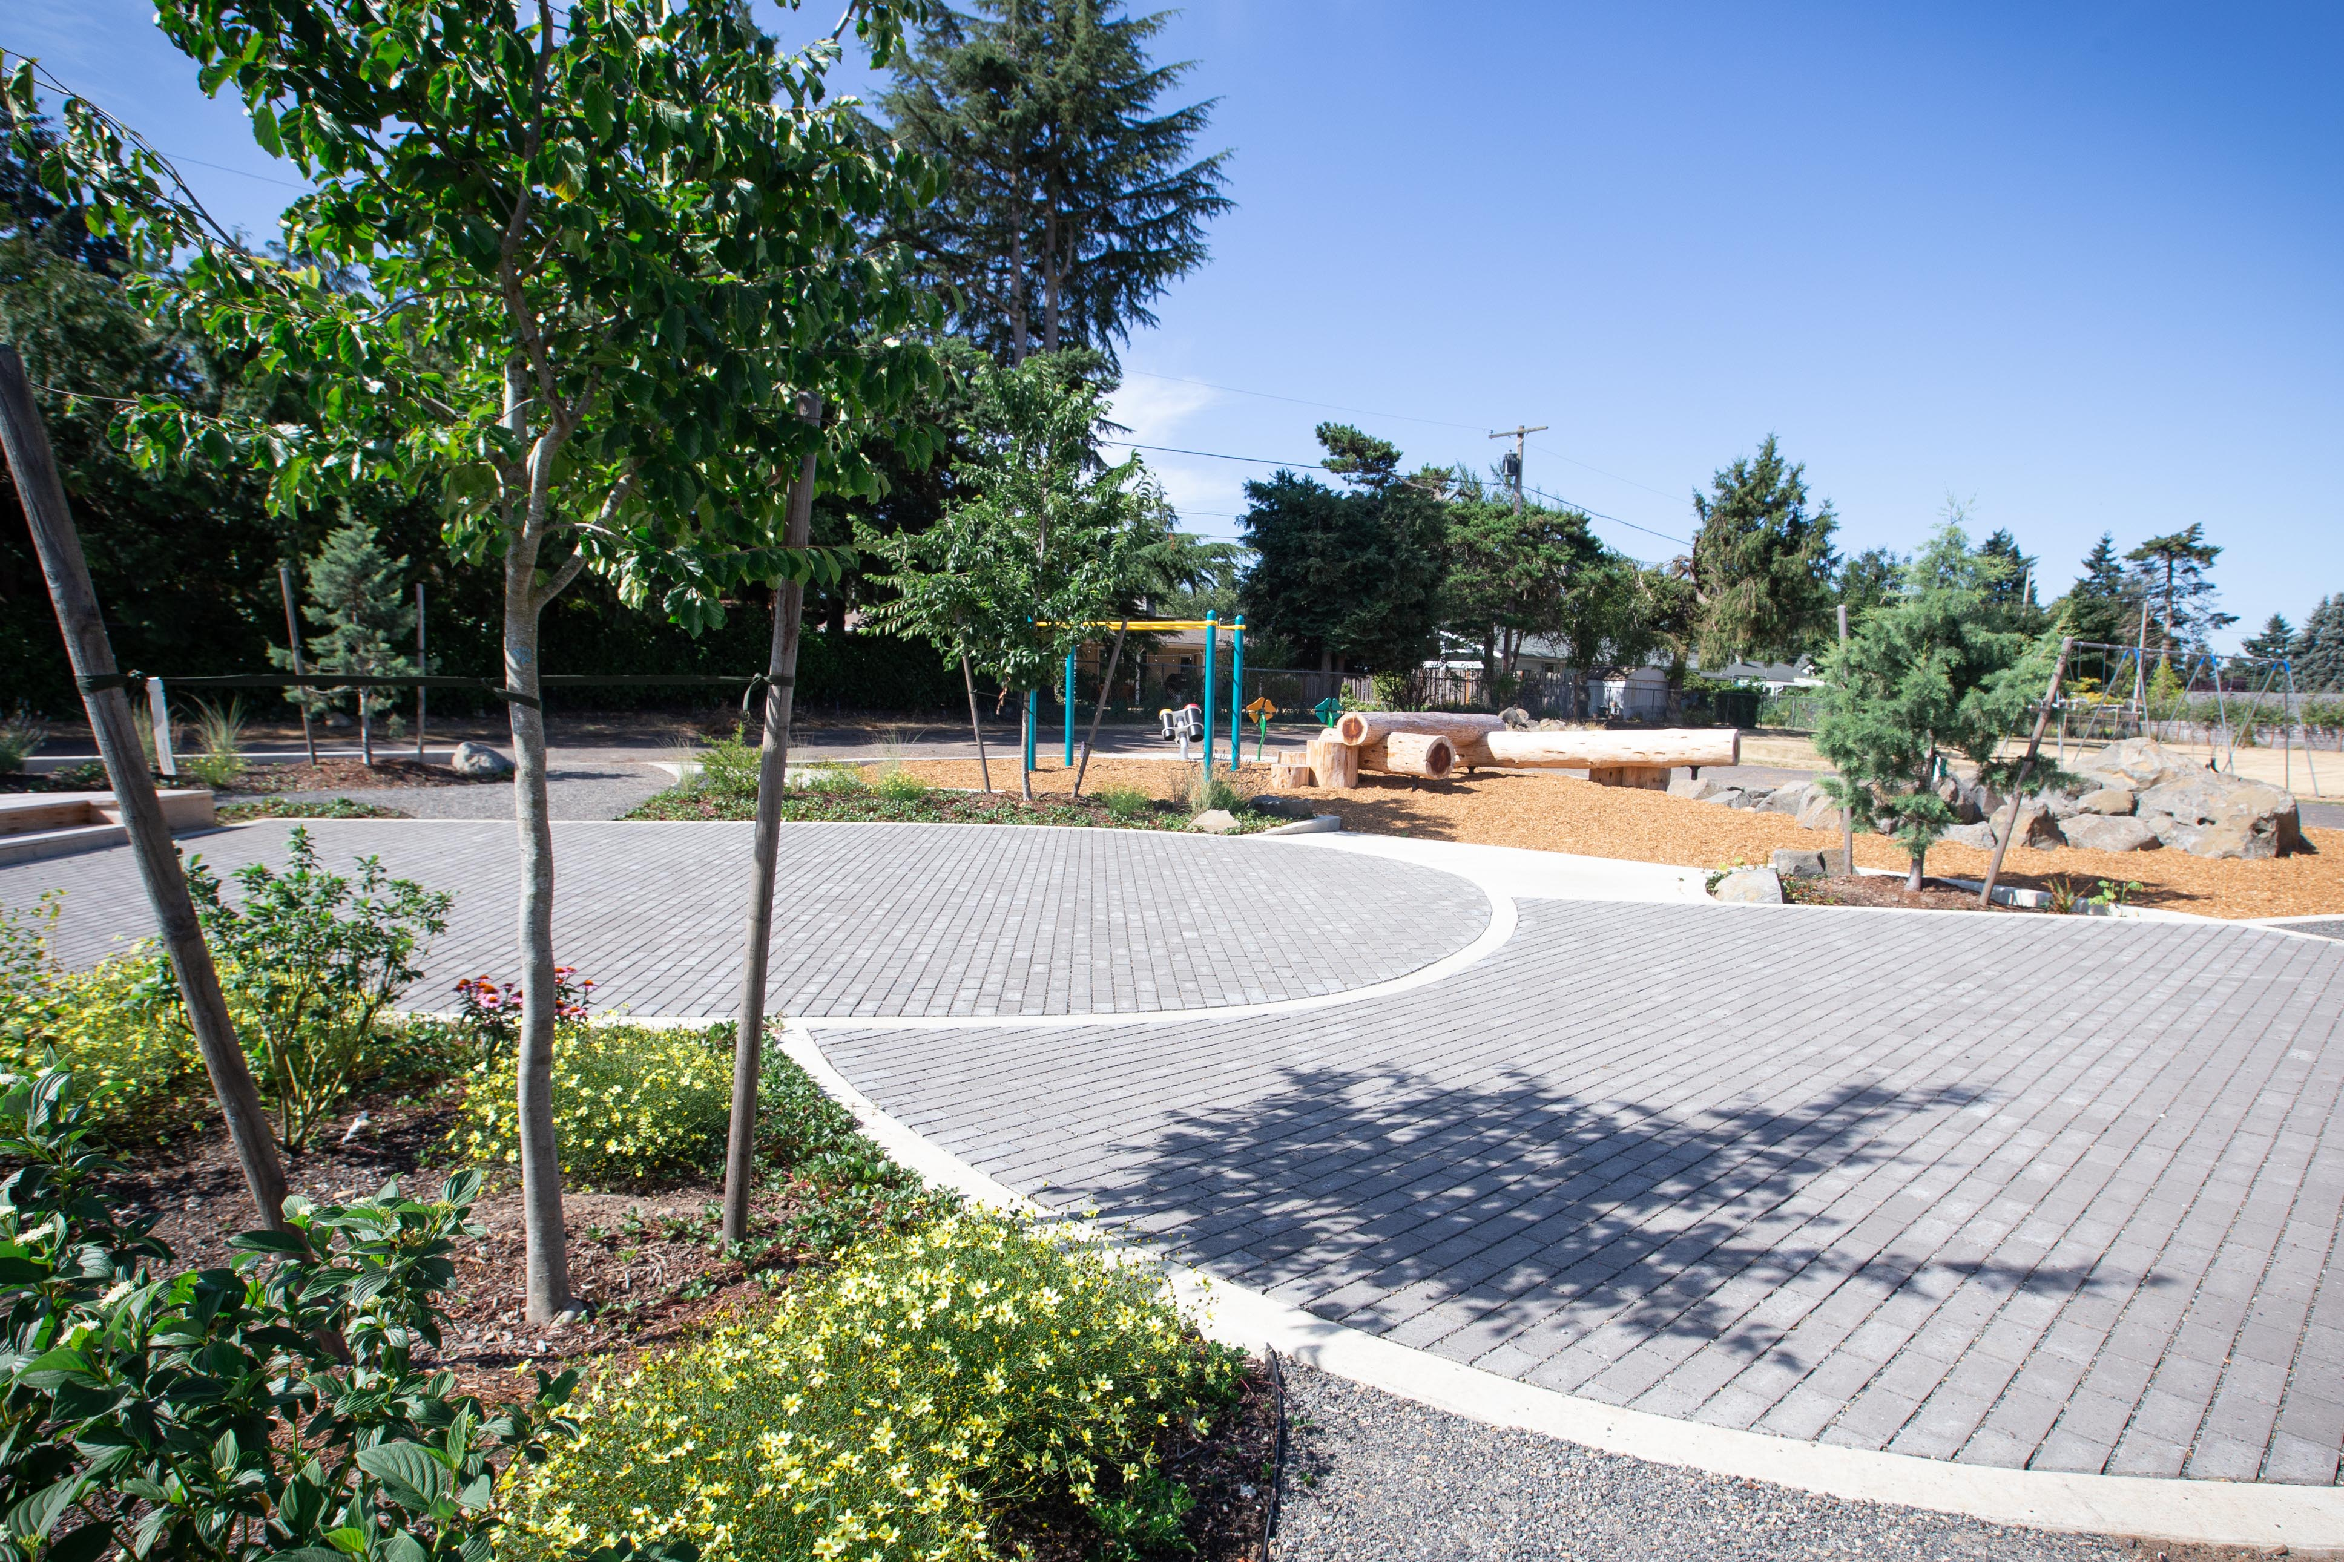
CASE STUDIES
Powell Butte Elementary School (2019)
Image Credits: ESRI, Depave
Notes:
Here we can see images of the case study location with both aerial imagery and site photos. The Powell Butte project had a total site footprint of 7400 square feet of pavement removal.
--
Aerial image credit: ESRI Satellite Basemap
Site images credit: Depave (permission to use)

Slide 32
CASE STUDIES
Before: 2016-2018
Powell Butte Elementary
Before
108ºF
Year
2019
Size
7400 ft²
Change
-2ºF
After
106ºF
Difference
-4.8ºF
After: 2020-2022
Notes:
Powell Buttee actually had the largest change in mean LST, with a decrease in average LST of nearly 5 °F after normalization with the average LST of the entire City of Portland.
--
Image Credit: Portland Urban Team

Slide 33
CASE STUDIES
Site Name | Year | Footprint (sq ft) | Mean LST Before (F) | Mean LST After (F) | Change (F) | Years Before | Years After | Duration (yr)
Astor Elementary | 2016 | 16000 | 6.6 | 10.8 | 4.2 | 2013-2015 | 2017-2019 | 3
Our Just Future | 2016 | 6000 | 13.2 | 9.5 | -3.7 | 2013-2015 | 2017-2019 | 3
Boise-Eliot Elementary | 2018 | 8830 | 7.9 | 5.7 | -2.3 | 2014-2017 | 2019-2022 | 4
Mt. Hood Community College | 2018 | 10150 | 4.2 | 5.9 | 1.7 | 2014-2017 | 2019-2022 | 4
Powell Butte | 2019 | 7400 | 12.7 | 8.0 | -4.8 | 2016-2018 | 2020-2022 | 3
M&M Market | 2017 | 5000 | 15.3 | 14.1 | -1.2 | 2013-2016 | 2018-2021 | 4
Notes:
Our case study temporal analysis showed that most sites exhibited decreases in mean LST after depaving. Out of six sites examined between 2016 and 2019, four showed a decrease in LST of over 1 °F.

