Slide 1
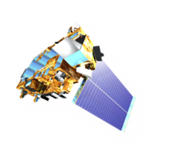
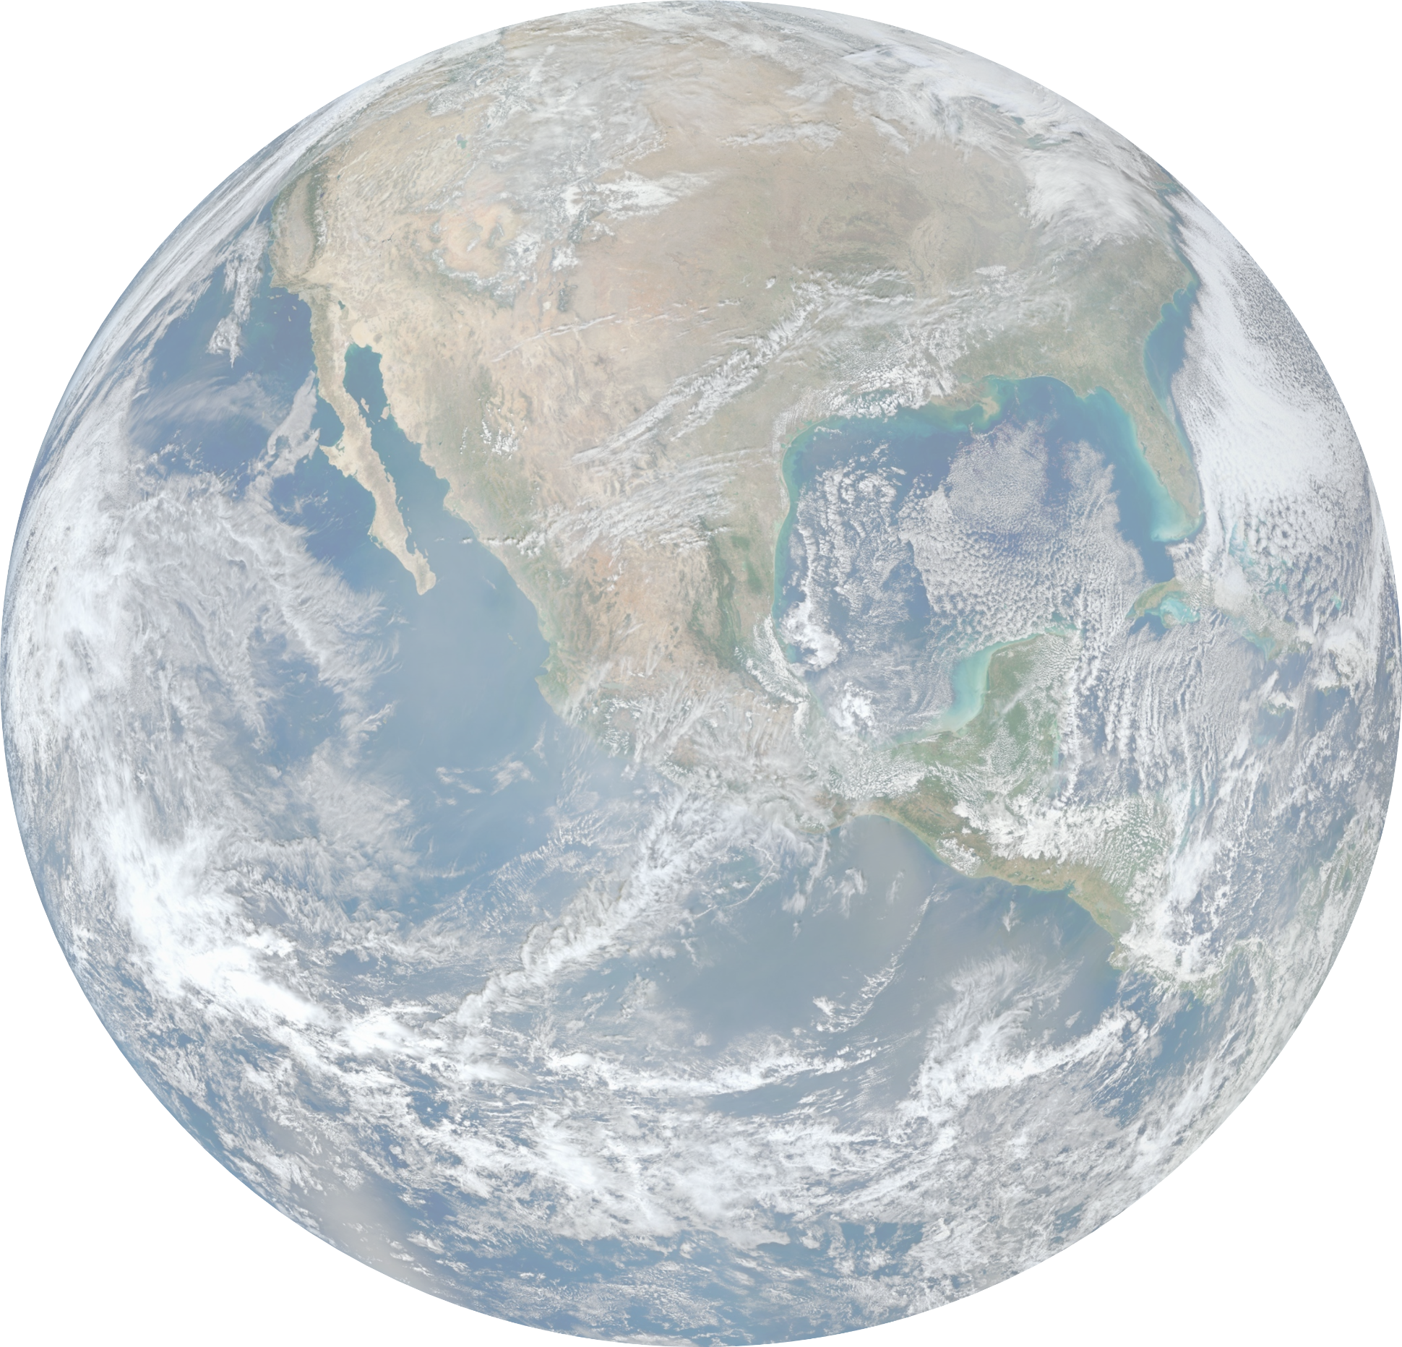
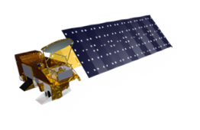
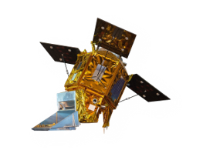
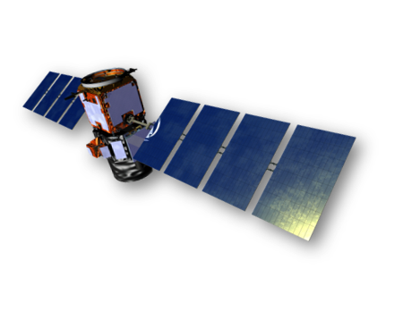
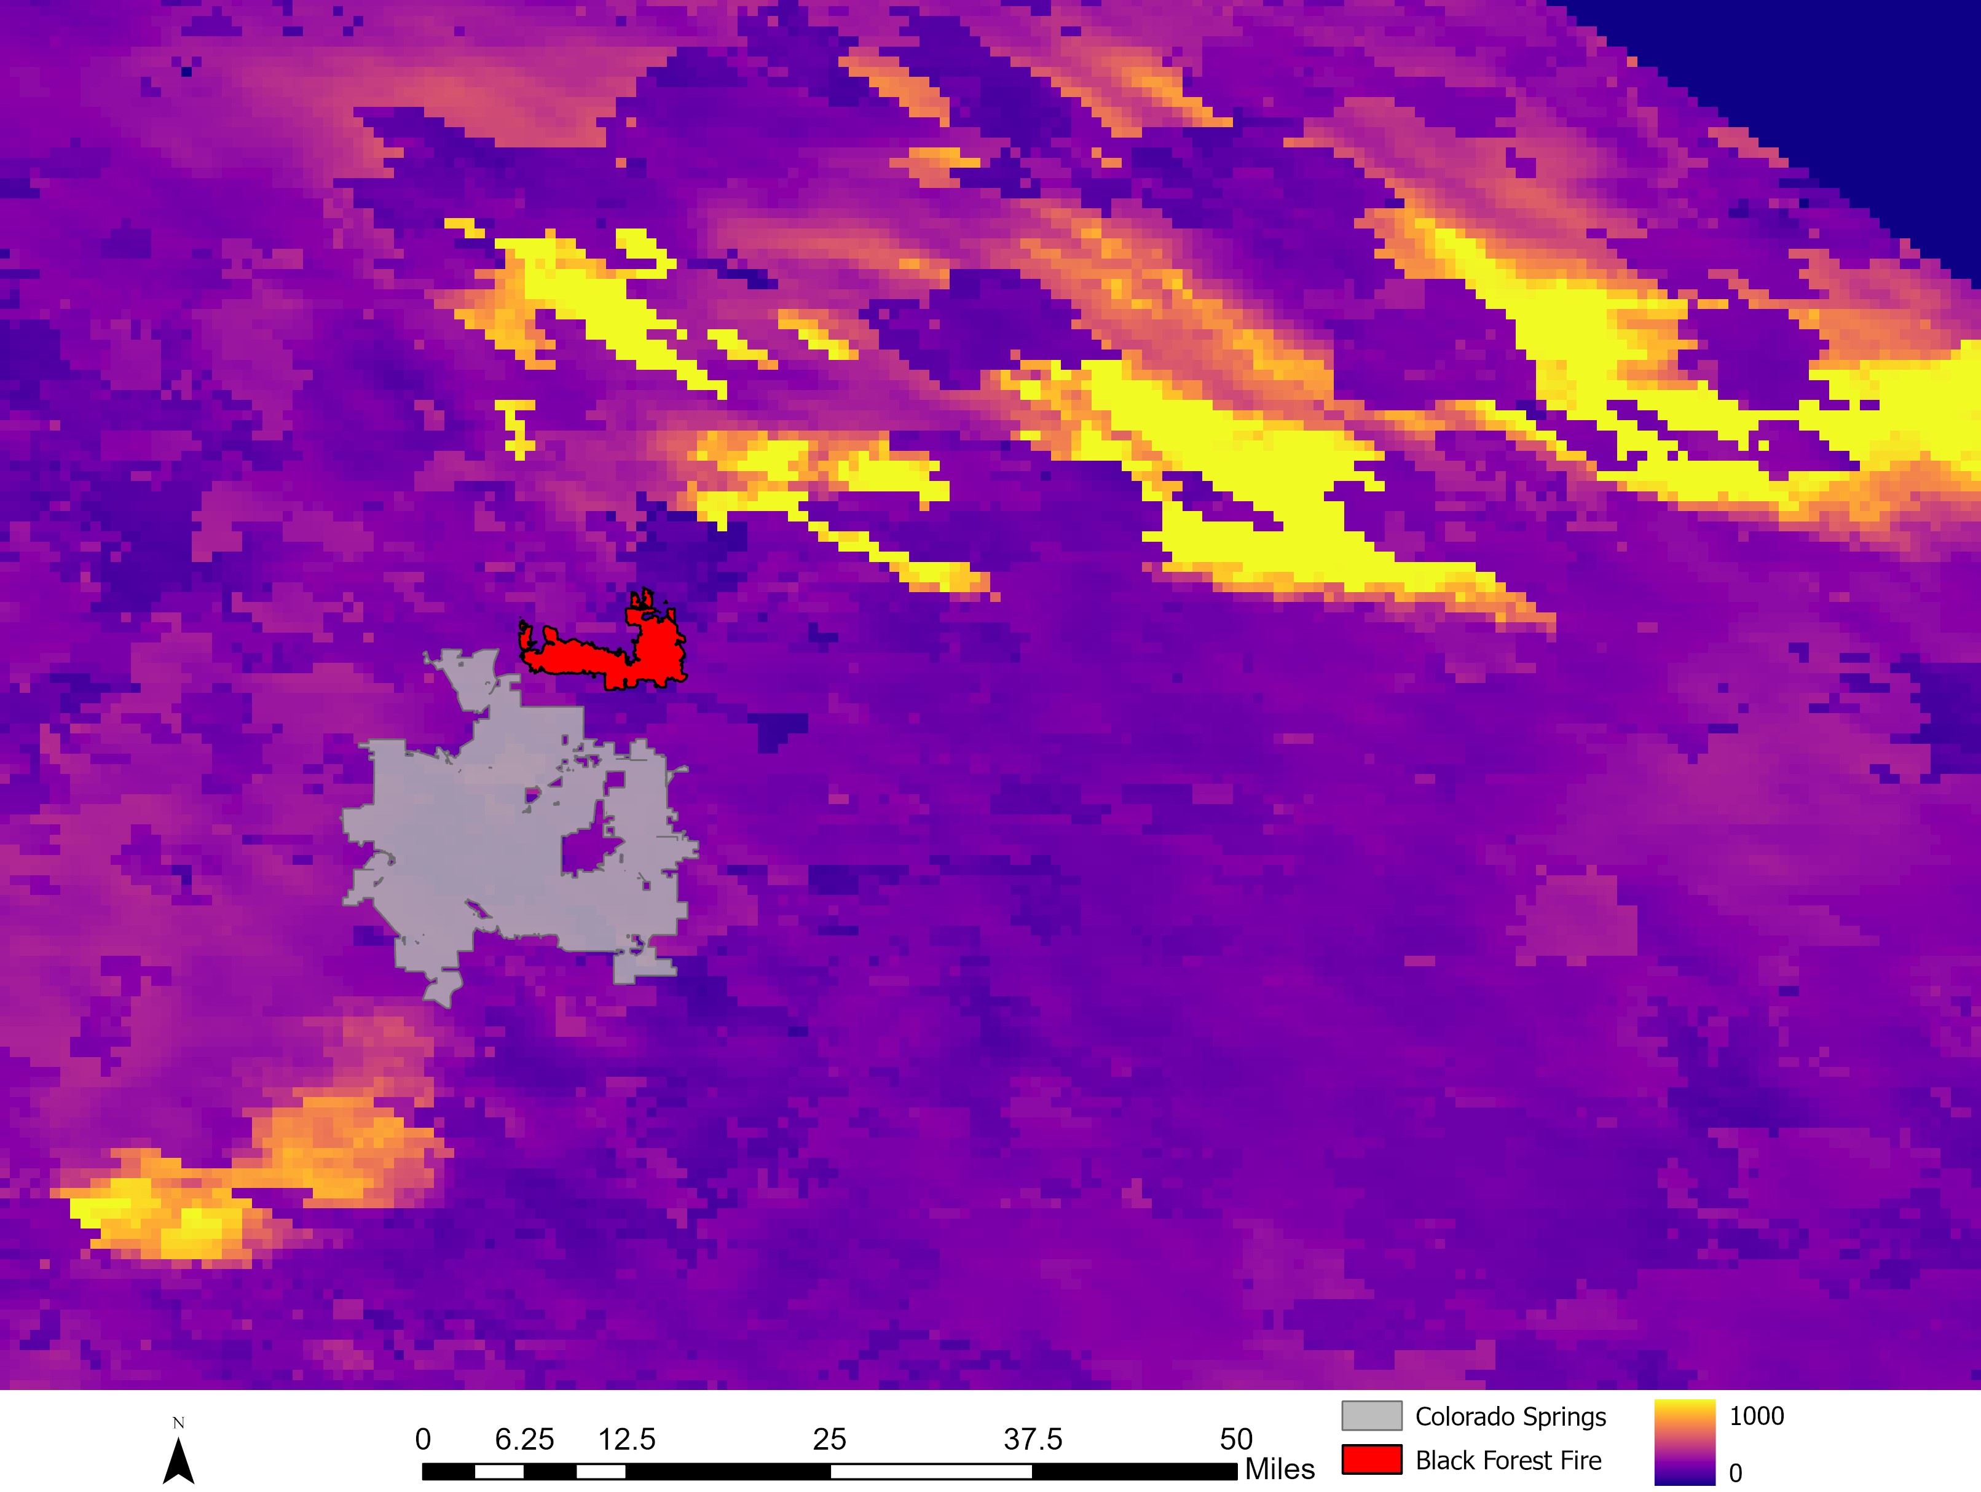
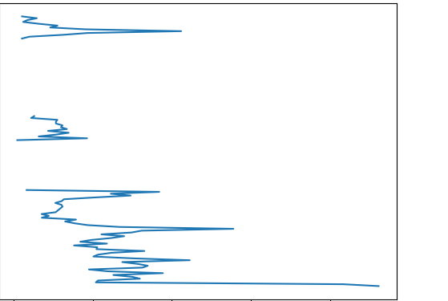
Colorado Springs Health & Air Quality
Using Earth Observations to Monitor Wildfire Smoke and Air Pollution for Enhanced Air Quality Management in Colorado Springs, Colorado
Terra MODIS – Aerosol Optical Depth
Community Concerns
Aqua MODIS –
Aerosol Optical Depth
Adherence to Clean Air Act quality standards
Adverse health risks to communities breathing polluted air
Intensifying wildfire regimes in the region, fueled by climate change
CALIPSO CALIOP –
Aerosol profiles and aerosol subtype
Sentinel-5P
TROPOMI – Nitrogen dioxide
The City of Colorado Springs, situated in Colorado’s Front Range corridor, is grappling with poor air quality exacerbated by intensifying wildfire regimes, a major concern for its rapidly growing population.
TROPOMI
Through the application of Earth observations, this project developed products to monitor wildfire events and their impacts on air quality, including particulate matter and NO₂ .
TROPOMI can assess long-term trends in nitrogen dioxide (NO₂ ), a precursor for ground-level ozone. Spikes in NO₂ concentration are seen during the summer and after wildfire events, such as the peak in October following the Sweetwater Fire.
MODIS
0.30
2022 Yearly NO₂ Concentration
Sweetwater Fire
N
0.28
0.26
Concentration
(mol/m²)
0.24
0.22
0.20
0.18
0.16
0.14
7
8
9
10
11
12
1
2
3
4
5
6
Month
CALIOP
Colorado Springs
CALIOP data can potentially validate in situ ground monitor data using the extinction coefficient, or how much light is attenuated due to hitting aerosol particles, and by vertical profiles of aerosol subtypes. Shown below: aerosol subtypes and presence following the Waldo Canyon Fire (2012).
Black Forest Fire
High AOD
Low AOD
Mean 532 nm Extinction Coefficient by Altitude
(Colorado Springs, July 7, 2012)
CALIOP Aerosol Subtypes Vertical Profile
(Colorado Springs, July 7, 2012)
0
6.25
12.5
25
37.5
50
Miles
10
8
No Signal
MODIS aerosol optical depth (AOD) measurements can be used as a proxy to monitor spatiotemporal trends in fine particulate matter (PM_{2.5}), a primary pollutant emitted by wildfires. High AOD concentrations can indicate smoke plumes, such as those from the 2013 Black Forest Fire, pictured above.
7
Terrain
8
6
Elevated Smoke
Altitude (AMSL) (km)
5
Polluted Dust
6
4
Team Members
Altitude (AMSL) (km)
Clean Continental
4
3
Polluted Continental/
Smoke
2
2
Dust
0
0.05
0.10
0.15
0.20
1
Not Aerosol
EXAMPLE
Mean 532 nm Extinction Coefficient (km⁻¹)
0
38.4
38.5
38.6
38.7
38.8
Takeaways
Latitude
Olivia Etherton
Jeanette Moritz
Joshua Stokes
Ephrata Yohannes
Earth and atmospheric observations can elucidate spatiotemporal trends in air quality, bolstering the City of Colorado’s capacity to mitigate air quality impacts on its citizens.
MODIS, CALIOP, and TROPOMI data show spikes in indicators of poor air quality following fire events (PM2.5, aerosols, NO₂).
Acknowledgements
Colorado Springs Partners: Carlos Tamayo, Innovation Manager; Samantha Bailey, Sustainability Coordinator; Megan White, Senior Program Manager; Deborah Newman, Office of Innovation Analyst
NASA Langley Research Center Science Advisors: Dr. Kenton Ross; DEVELOP Program Manager, Dr. Travis Toth; Physical Scientist, Lauren Childs-Gleason, DEVELOP Science Manager
Fellows: Olivia Landry, LaRC Fellow; Cecil Byles, Senior PC Fellow; Laramie Plott, PC Fellow
Virginia – Langley

