Slide 1
Black Hills
Wildfires
Mapping Post-fire Conifer Regeneration
using Snow-on Imagery
Casey Menick
Haley Stuckmeyer
Heidi Rogers
Yeshey Seldon
Colorado – Fort Collins | Summer 2022
Notes:
Hi everyone, we are the Black Hills Wildfires team from the Colorado Node. In this project, we used Earth observations to map post- Jasper fire tree regeneration to understand forest recovery patterns.

Slide 2
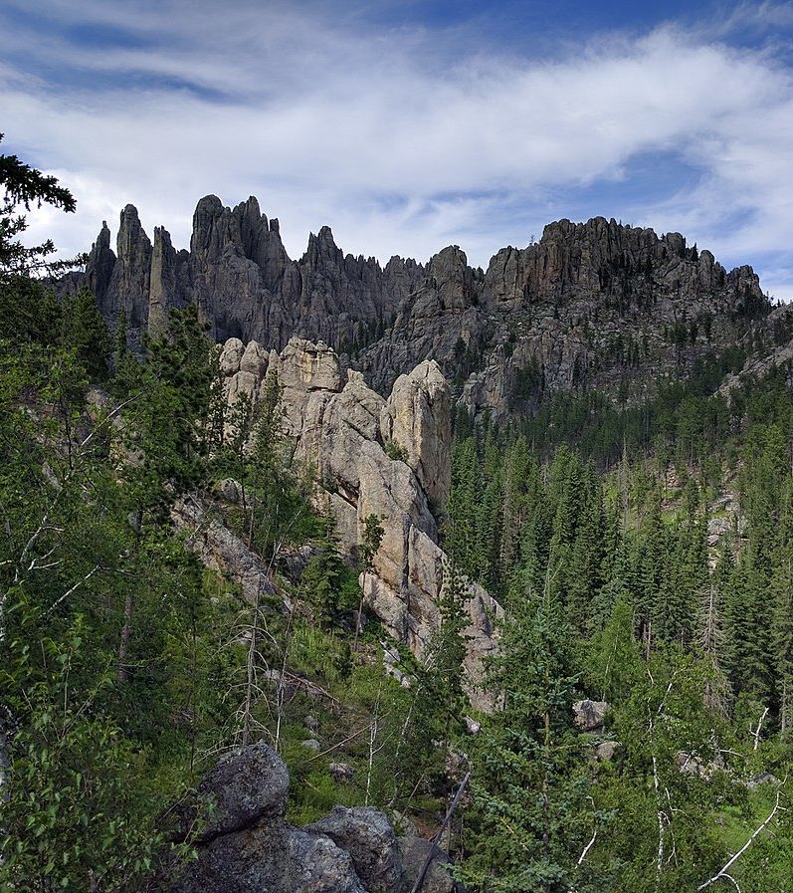
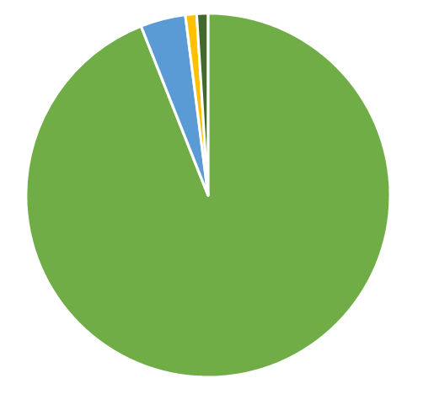
BACKGROUND| Black Hills
1.2-million-acre national forest
High timber output
History of fire suppression
Ponderosa pine dominated ecosystem
Tree Species in the Black Hills by Biomass
Ponderosa Pine (94%)
White Spruce (4%)
Quaking Aspen (1%)
All Other Species (1%)
Image Credit: Runner1928
Notes:
The Black Hills National Forest is a 1.2 million-acre forest in Western South Dakota and northeastern Wyoming. The forest is dominated by Ponderosa pine and is one of the highest timber-producing national forests in the country.
------------------------------Image Information Below ------------------------------
Credit: Runner1928
Source: https://commons.wikimedia.org/wiki/File:Needles_Highway_05.jpg
License: CC BY-SA 4.0

Slide 3
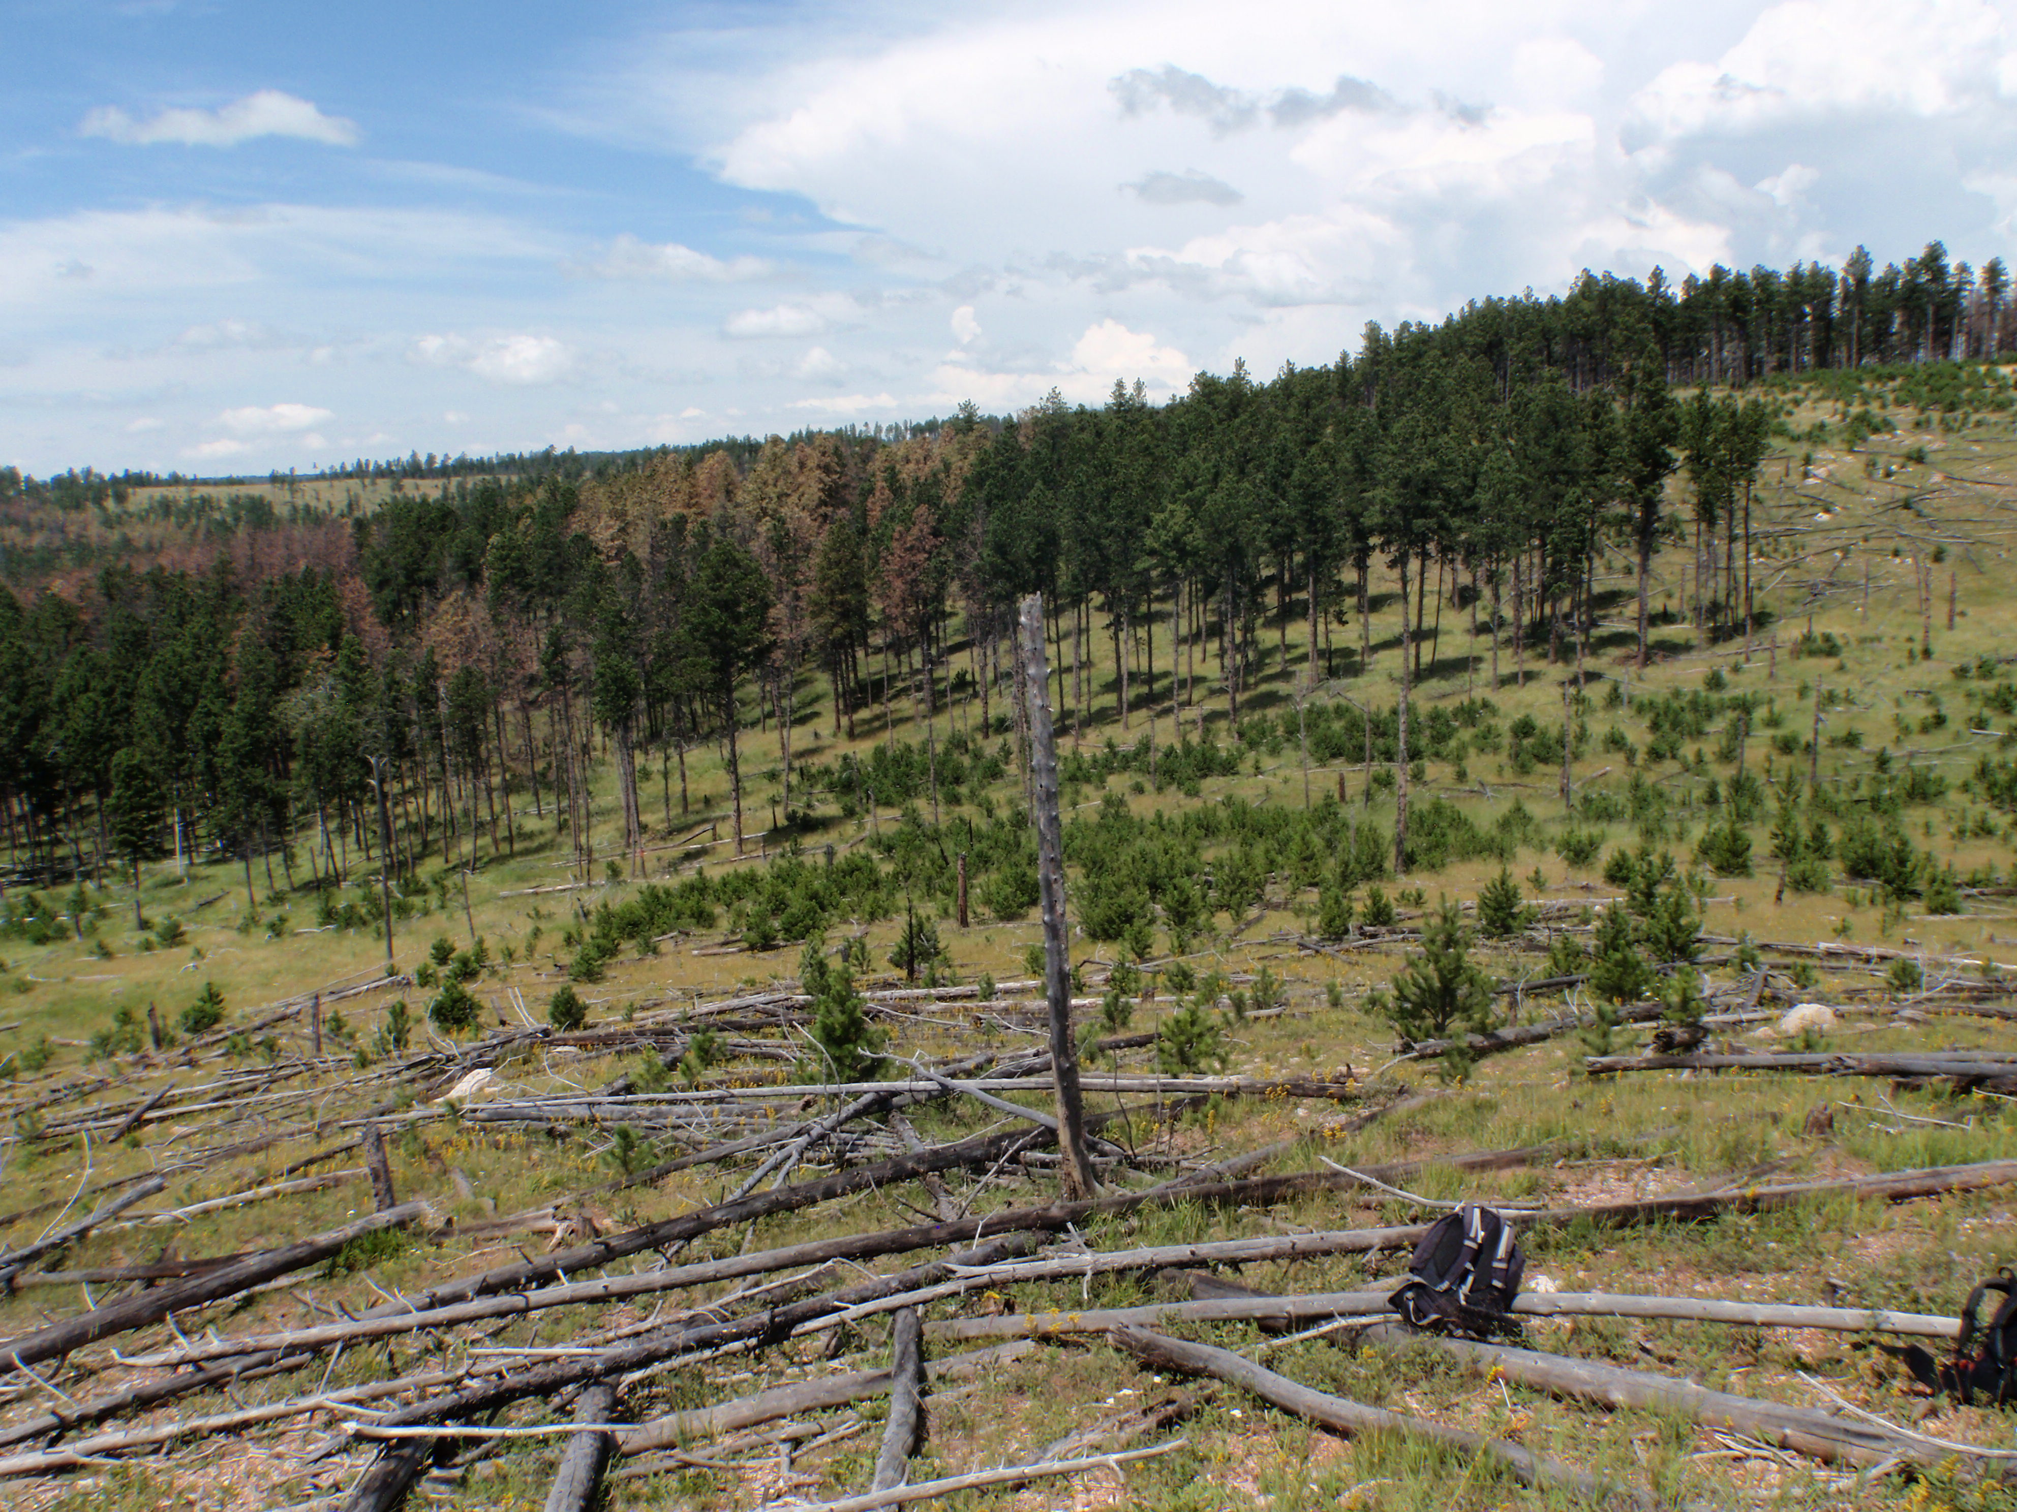
Image Credit: Paula Fornwalt
BACKGROUND| Ponderosa Pine
Ecologically and economically important species
Adapted to low-severity fire
Seed dispersal limited by distance from surviving trees
Notes:
Ponderosa pine is an important species to the Black Hills for timber production and ecology. It is adapted to low-severity fire and has a limited seed dispersal distance because of relatively heavy seeds. As a result, ponderosa pine recolonization within high-severity burn patches is slow, or limited.
------------------------------Image Information Below ------------------------------
Credit: Paula Fornwalt
Source: written permission to use

Slide 4
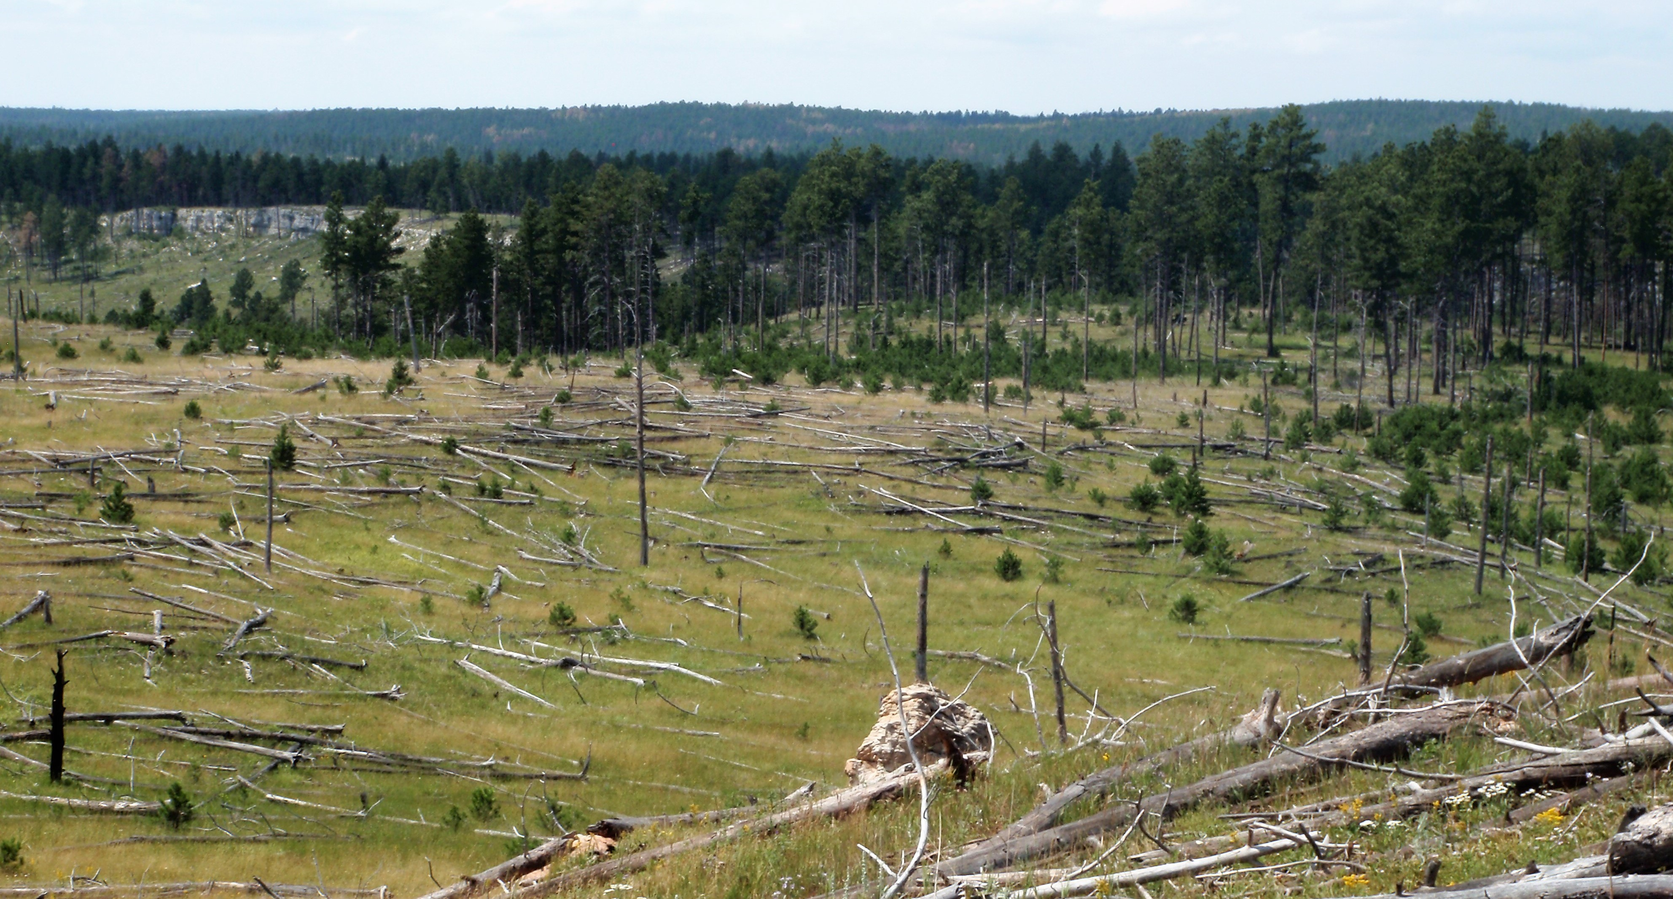
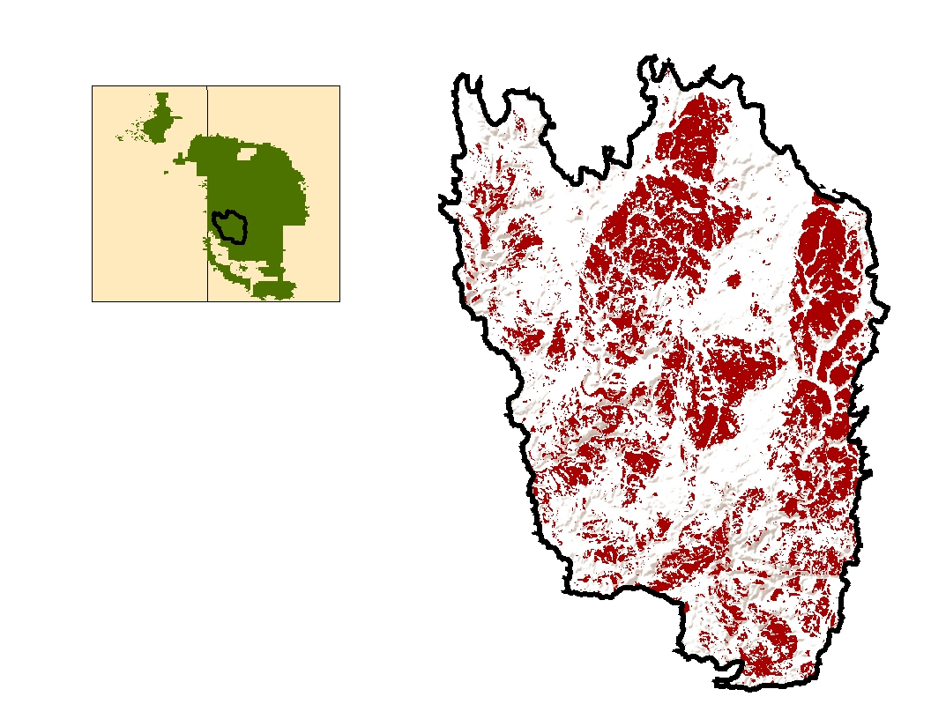
Image Credit: Paula Fornwalt
BACKGROUND| Jasper Fire
South
Dakota
Burned from Aug 24 to Sept 9, 2000
Impacted 83,508 acres
27% burned at high-severity
High-severity patches as large as 2,200 acres
Wyoming
States of Interest
Black Hills National Forest
Jasper Fire Boundary
High Severity Burn
N
5 10 miles
Jasper Fire occurred in 2000 within Black Hills National Forest
27% of this 83,508-acre fire burned at high-severity
South
Dakota
Wyoming
Black Hills National Forest
Jasper Fire Boundary
High Severity Burn
N
5 10 miles
Notes:
The study area of our project is the Black Hills National Forest in South Dakota that has been affected by Jasper Fire. The fire occurred in 2000 from August 24 to September 9
and is one the one of largest fires in Black Hills history, impacting 83,503 acres of land. 27% of this burn was categorized as a high-severity burn.
We will be focusing on high severity burn areas for 2001-2021 post-fire years.
------------------------------Image Information Below ------------------------------
Team generated high severity burn map using ArcMap 10.8.1 and a hillshade basemap from ESRI, USGS, NOAA
Background Image Credit: Paula Fornwalt
Source: written permission to use

Slide 5
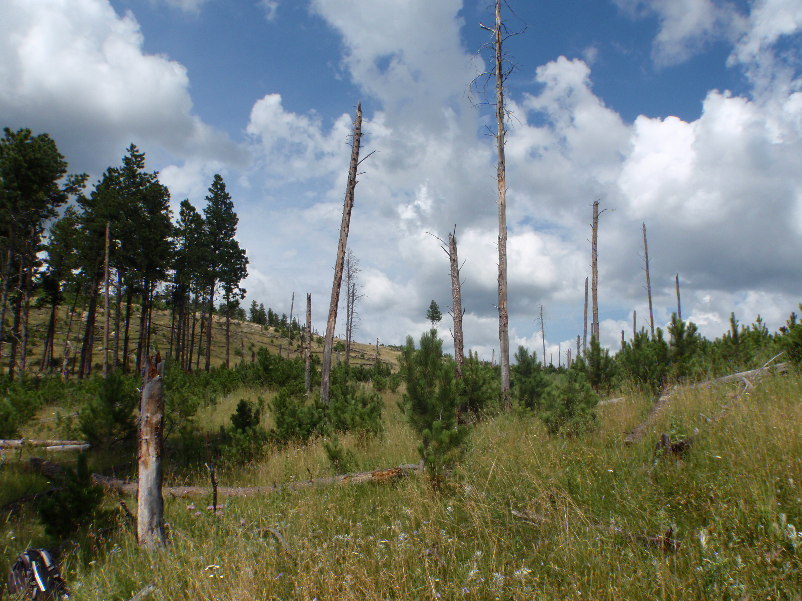
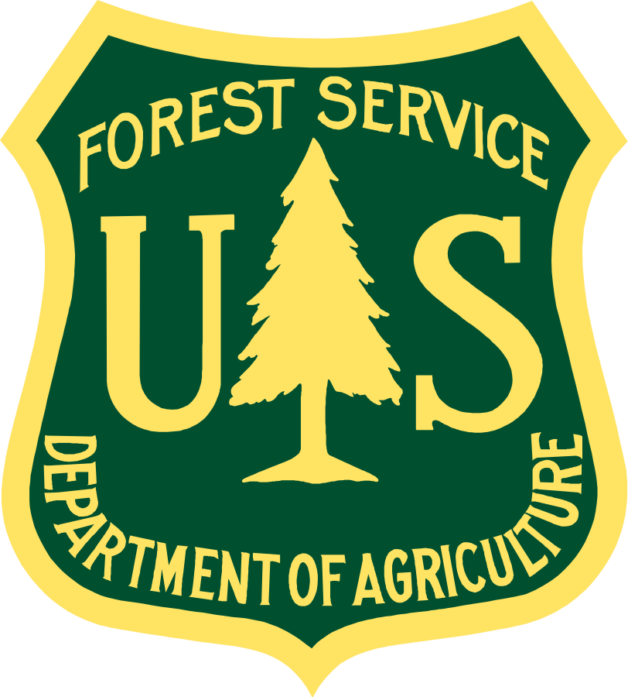
Image Credit: Paula Fornwalt
BACKGROUND| Partners
Black Hills Experimental Forest
Mike Battaglia, Director
Rocky Mountain Research Station
Paula Fornwalt,
Research Ecologist
Geosciences and Environmental Change Science Center
Melanie Vanderhoof,
Research Scientist
Notes:
Our partners are Melanie Vanderhoof of the USGS and Mike Battaglia and Paula Fornwalt of the US Forest Service.
------------------------------Image Information Below ------------------------------
Background Image Credit: Paula Fornwalt
Source: written permission to use
Logo: USFS
License: Public Domain
https://commons.wikimedia.org/wiki/File:Logo_of_the_United_States_Forest_Service.svg
Logo: USGS
License: Public Domain
https://commons.wikimedia.org/wiki/File:USGS_logo.png

Slide 6
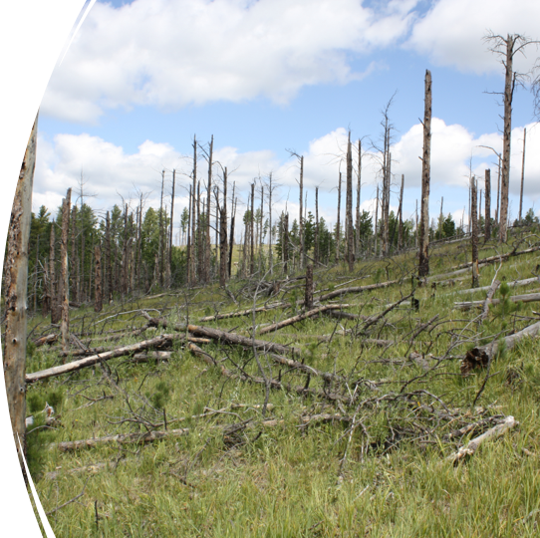
BACKGROUND| Community Concerns
Reforestation efforts
MANAGE
Increasing high-severity wildfire
Ponderosa pine recovery
MONITOR
PRIORITIZE
Image Credit: Mike Battaglia
Notes:
With many areas of 100% tree mortality, a return to a ponderosa pine dominated forest is an important measure of forest recovery in the Black Hills.
The observed fire impacted timber production and economic growth in the region. The community is working together to prioritize restoration efforts that help monitor ever-green ponderosa pine regeneration and manage growing high-severity wildfires.
------------------------------Image Information Below ------------------------------
Credit: Mike Battaglia
Source: written permission to use

Slide 7
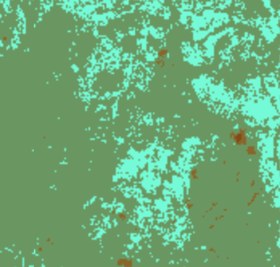
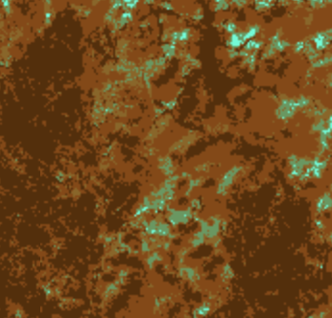
BACKGROUND| Seasonal Remote Sensing
Leaf-on
Snow-on
NDVI
-1.0 - 0.0
0.0 - 0.05
0.05 - 0.1
0.1 - 0.2
0.2 - 1.0
N
N
5 10 miles
Growing season NDVI is influenced by deciduous trees, grasses and shrubs
Snow-cover NDVI provides opportunities to isolate conifer regrowth
Notes:
Typically, a return to pre-fire NDVI is used to determine the return of forest greenness after a fire, and it is usually measured when forests are greenest during the growing season. However, NDVI cannot distinguish quickly between tree species. Snow cover NDVI may better measure a return to forest structure instead of simply a return to forest greenness. Snow on imagery allows us to tamp down the spectral signal given by deciduous trees and understory shrubs. This is because deciduous trees will have no leaves and understory evergreen vegetation would ideally be covered by snow. Therefore, snow-on NDVI should show recovery of the coniferous trees in the area.
On the left, we have an image of the Black Hills during spring green-up. Green and aqua colors indicate high vegetation as indicated by NDVI.
On the right, we have the same image featuring the NDVI band during the snow-on season. Dark brown locations indicate negative NDVI where high snow cover exists.
---------
Team generated images using Google Earth Engine

Slide 8
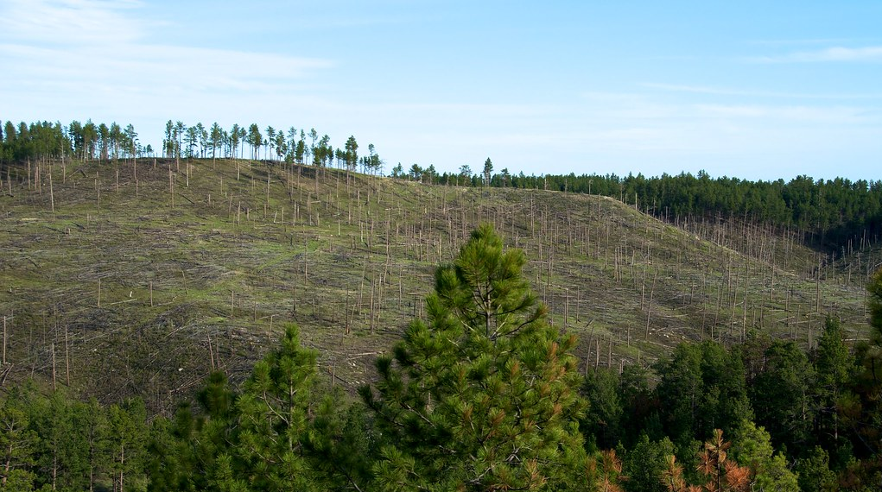
Image Credit: Steve Borsch
OBJECTIVES
Validate application of snow-on imagery to detect conifer regeneration
Quantify density of conifer regeneration in high-severity burn areas
Generate maps to inform reforestation priorities
Notes:
Our objectives are 3 fold:
First, we aim to test the application of snow-on imagery to detect the signal from conifer specific vegetation and validate the method with field collected data (herein referred to as "stem data").
Second, we aim to classify high-severity burn, conifer regeneration into low, medium and high trees per acre in the Black Hills.
Third, we will use this classification to produce a map for our partners that identifies accessible areas of low regeneration for planting.
------------------------------Image Information Below ------------------------------
Icons: PowerPoint
Background Image Credit: Steve Borsch
Source: https://search.openverse.engineering/image/53523431-86e7-4441-b901-9a0c0116dc1b
License: CC BY-NC 2.0

Slide 9
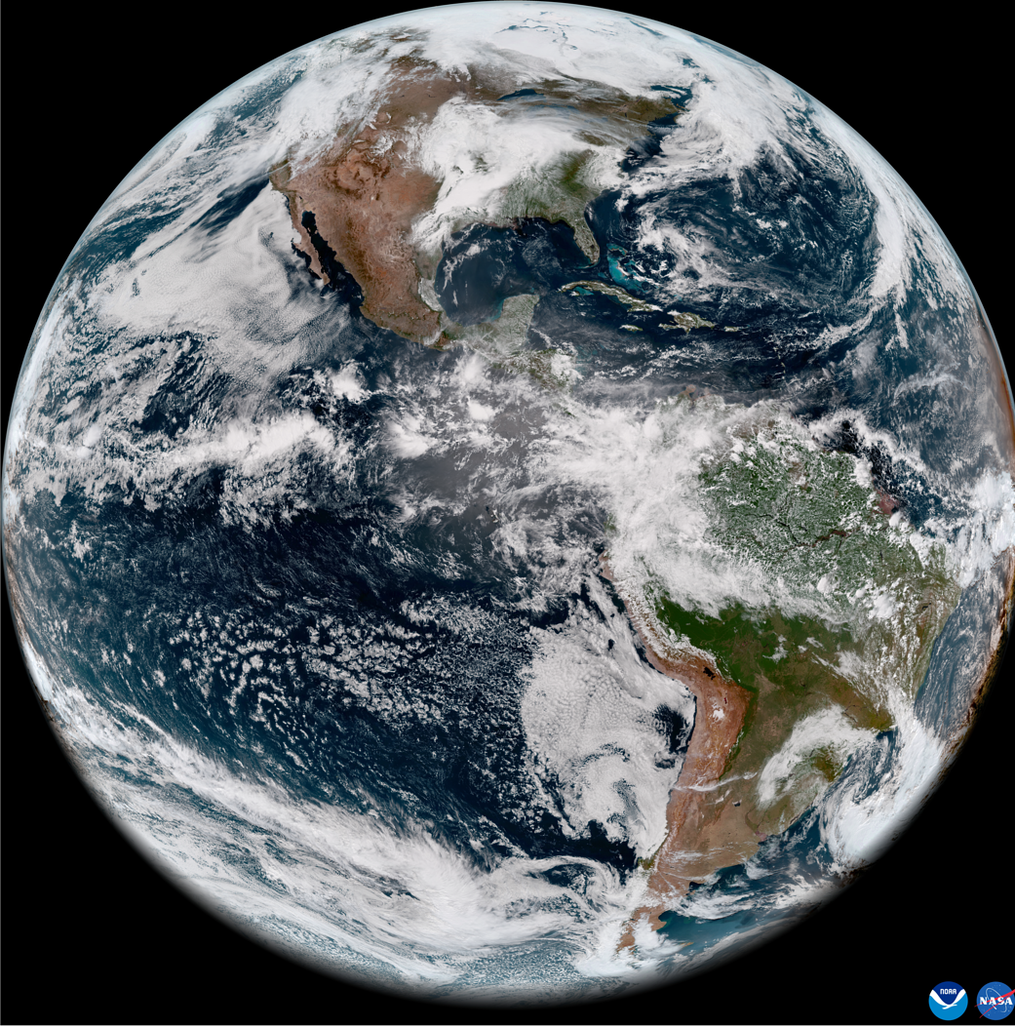
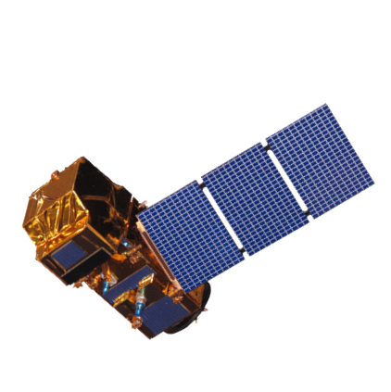
SATELLITES
Data
Process
Model
Classify
Landsat 8 Operational Land Imager (OLI)
Sentinel-2 MultiSpectral Instrument (MSI)
Image Credits: NASA, ESA
Notes:
In service of project objectives, our team used Earth observations from NASA's Landsat 8 OLI and ESA's Sentinel-2 MSI. These sensors are ideal, as they are open source and easily scalable.
------------------------------Image Information Below ------------------------------
Earth
Credit: NASA
Source: https://www.nasa.gov/topics/earth/images/index.html Earth from Orbit: NOAA Debuts First Imagery from GOES-18
License: Public Domain
Landsat 8 OLI
Credit: NASA
Source: http://www.devpedia.developexchange.com/dp/index.php?title=File:03_Landsat8.png
License: Public Domain
Sentinel-2 MSI
Credit: European Space Agency (ESA)
Image Source: https://www.devpedia.developexchange.com/dp/index.php?title=File:24_Sentinel2.png
License: Public Domain

Slide 10
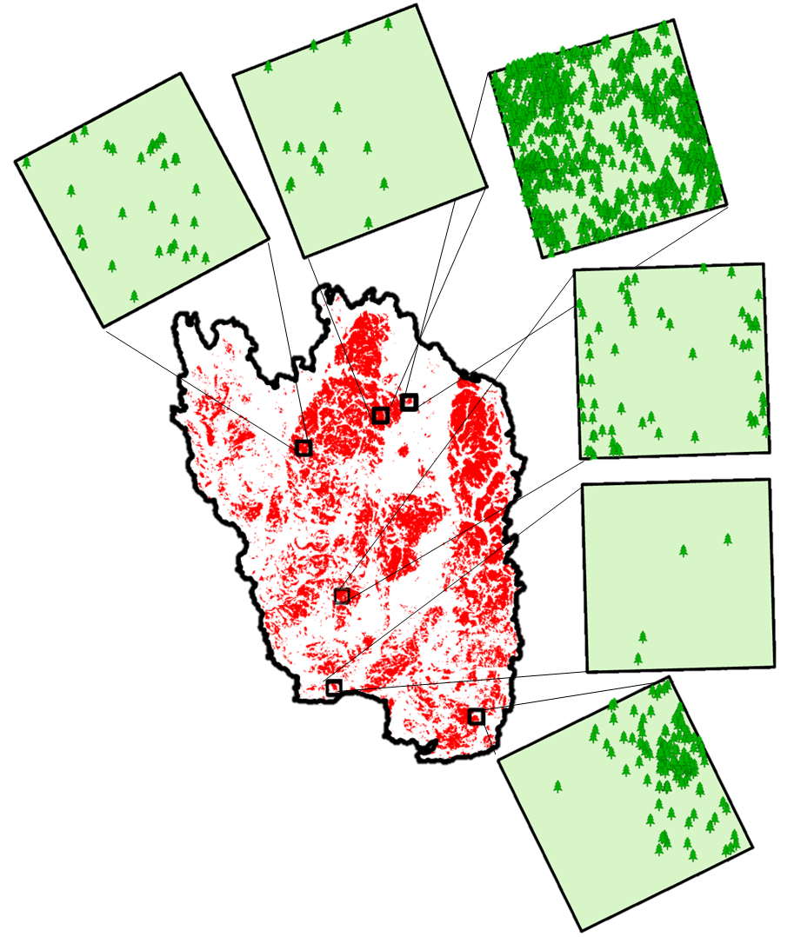
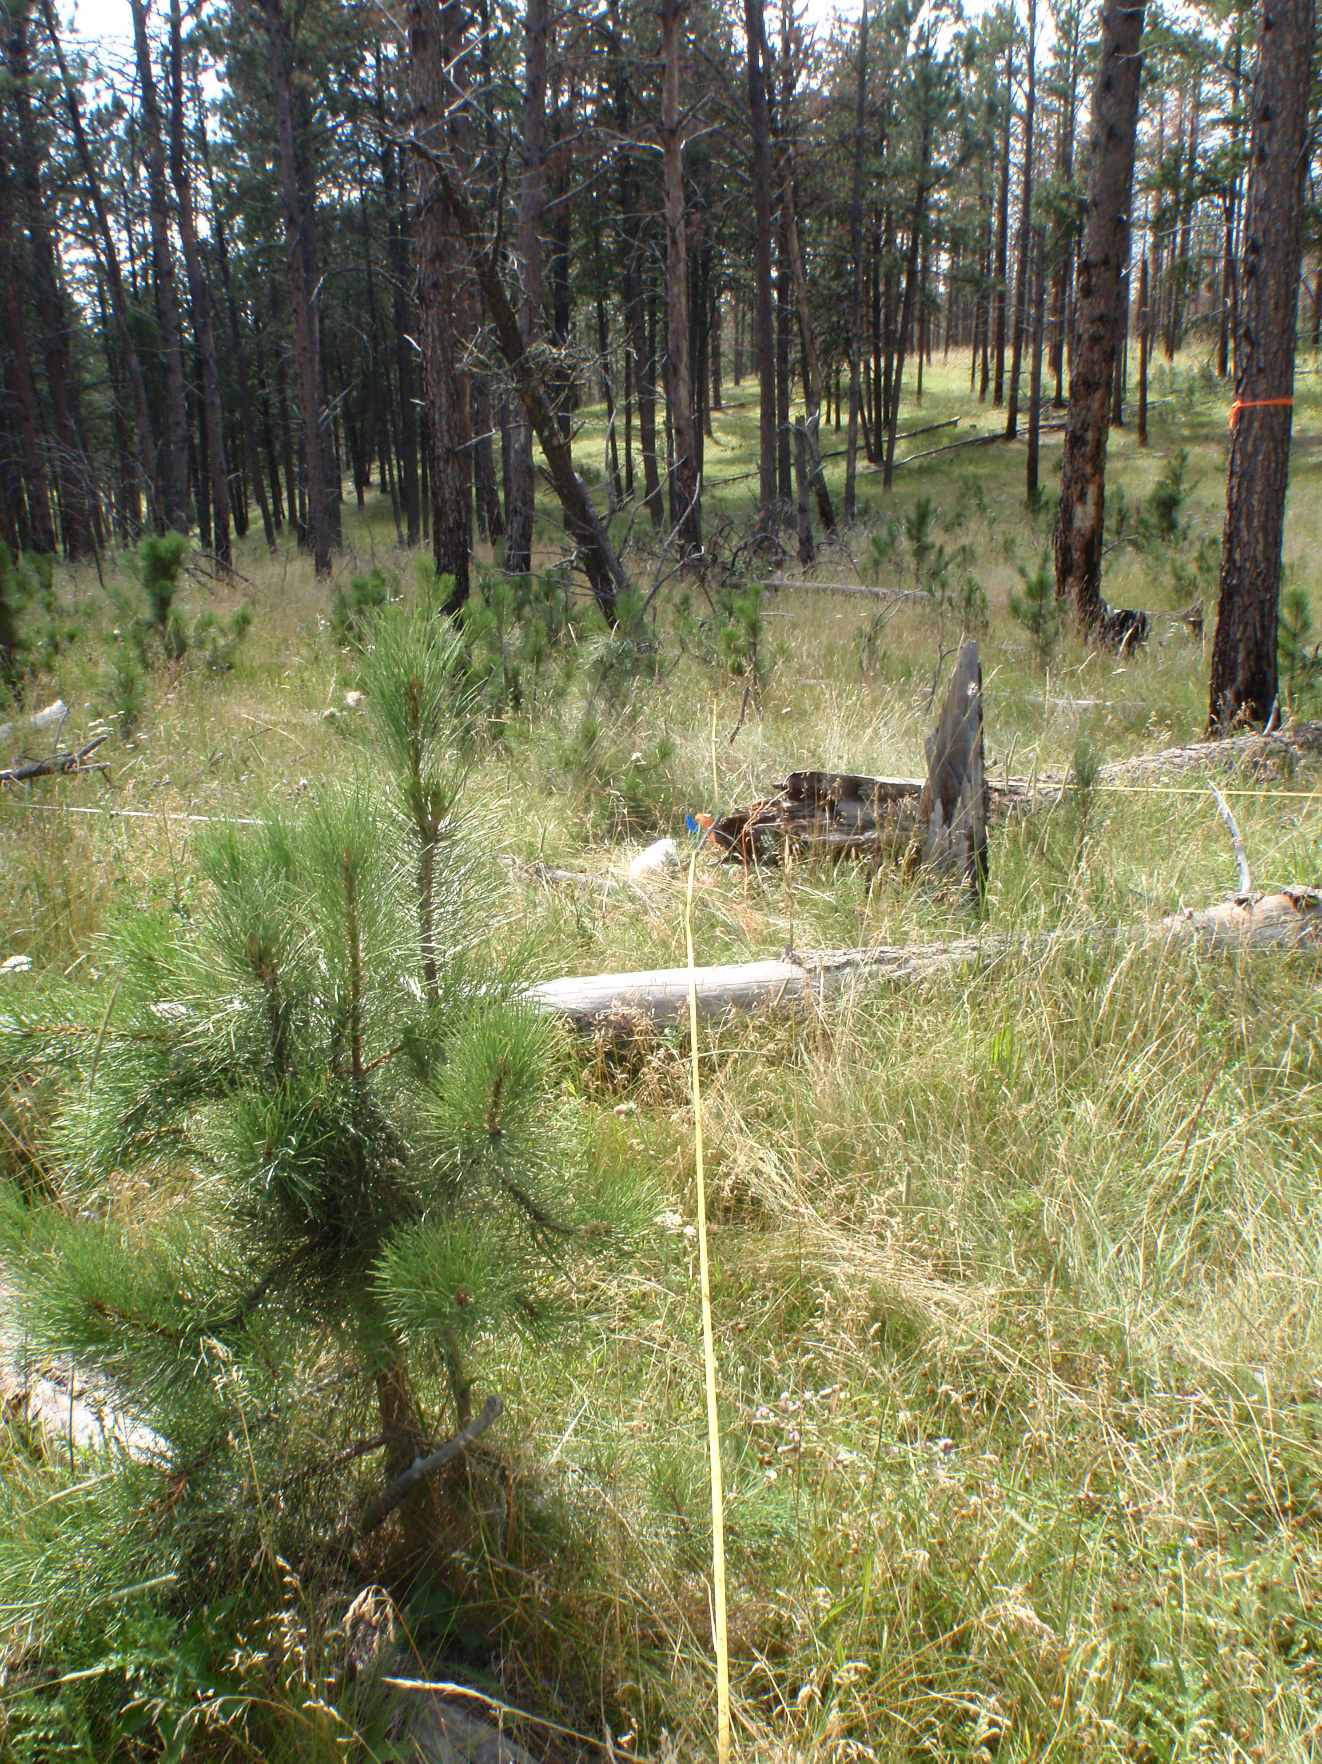
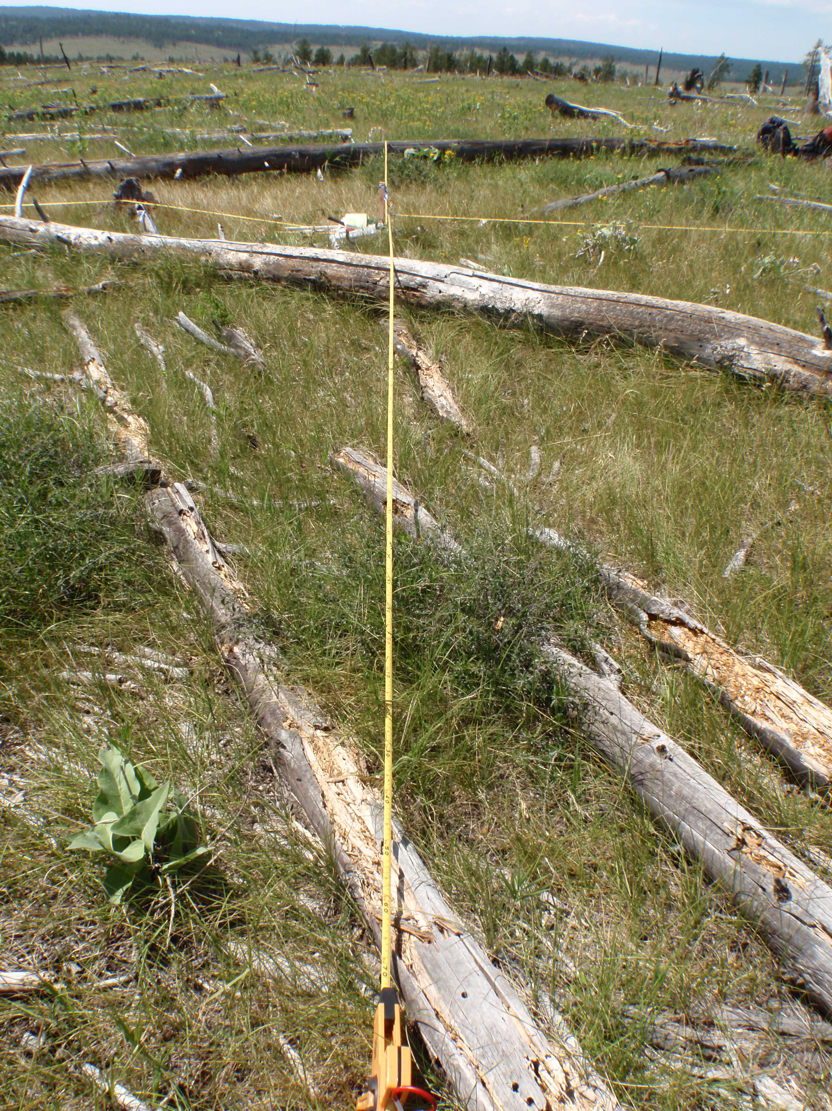
Data
Process
Model
Classify
METHODOLOGY
Six 4-ha stem maps collected by partners in 2015
N
Image Credit: Paula Fornwalt
5 10 miles
Notes:
Here, we begin to present to you our data.
On the left is an image of field data collection. Note the severity of the burn has left what was once a forest, to be more of a grassland with small tree regrowth.
On the right is a top-down representation of the points collected in the field. Six, four-hectare stem maps were collected by Paula Fornwalt and our partners at the Rocky Mountain Research Station in the high severity burn area.
------------------------------Image Information Below ------------------------------
Team generated map using Esri ArcGIS Pro
Fieldwork Images
Credit: Paula Fornwalt
Source: written permission to use

Slide 11
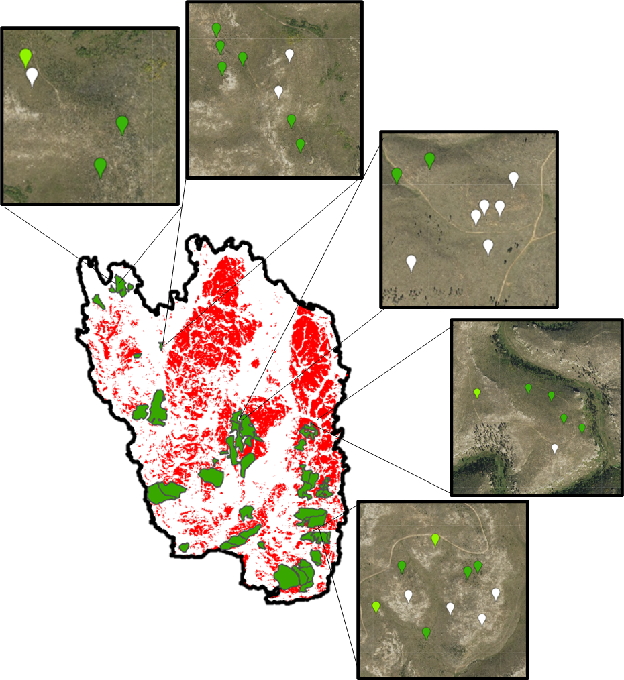
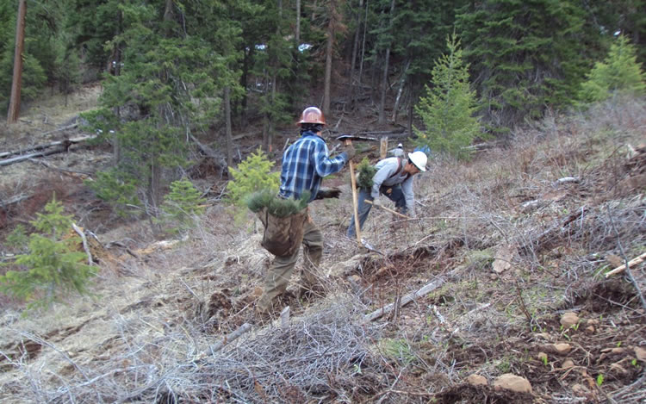
Data
Process
Model
Classify
METHODOLOGY
USFS FACTS database of known reforestation areas (2000–2013), digitized with NAIP imagery
N
Image Credit: Lisa Lam
5 10 miles
Notes:
Our team used the forest service FACTS database to gather information about plantings done in the area since the Jasper fire. Ocular sampling was used to include more training points in our model from these planted areas for moderate and high regeneration classes.
------------------------------Image Information Below ------------------------------
Team generated map using ArcGIS Pro
2021 Jasper Fire area tree planting
Credit: Lisa Lam, USDA Forest Service, Black Hills National Forest
Source: https://www.facebook.com/blackhillsnf/posts/over-the-course-of-two-and-a-half-weeks-the-black-hills-national-forest-will-ove/2795975803996338/

Slide 12
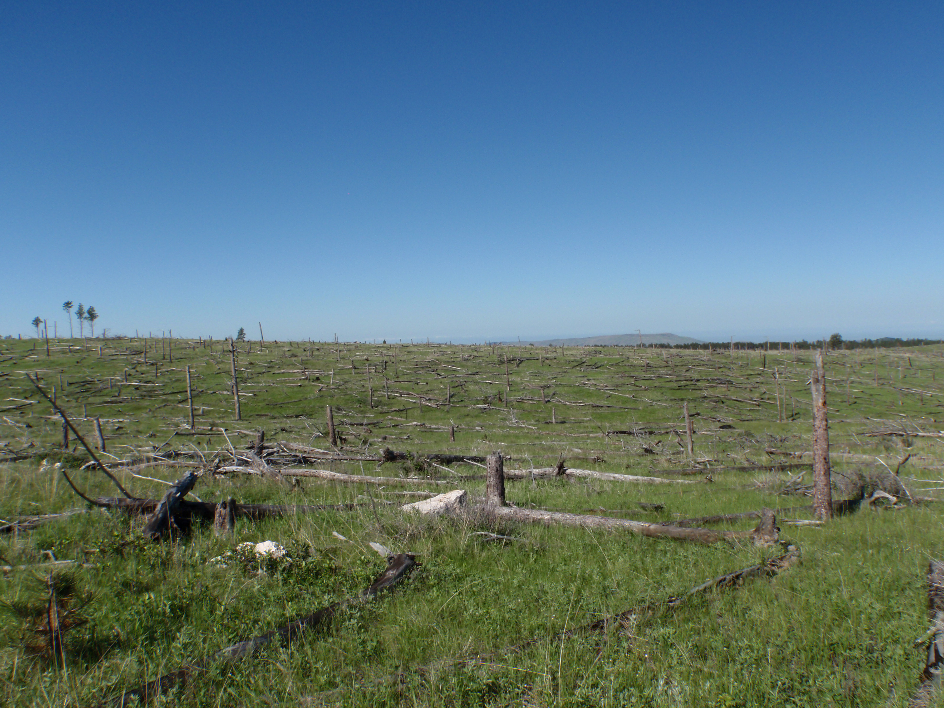
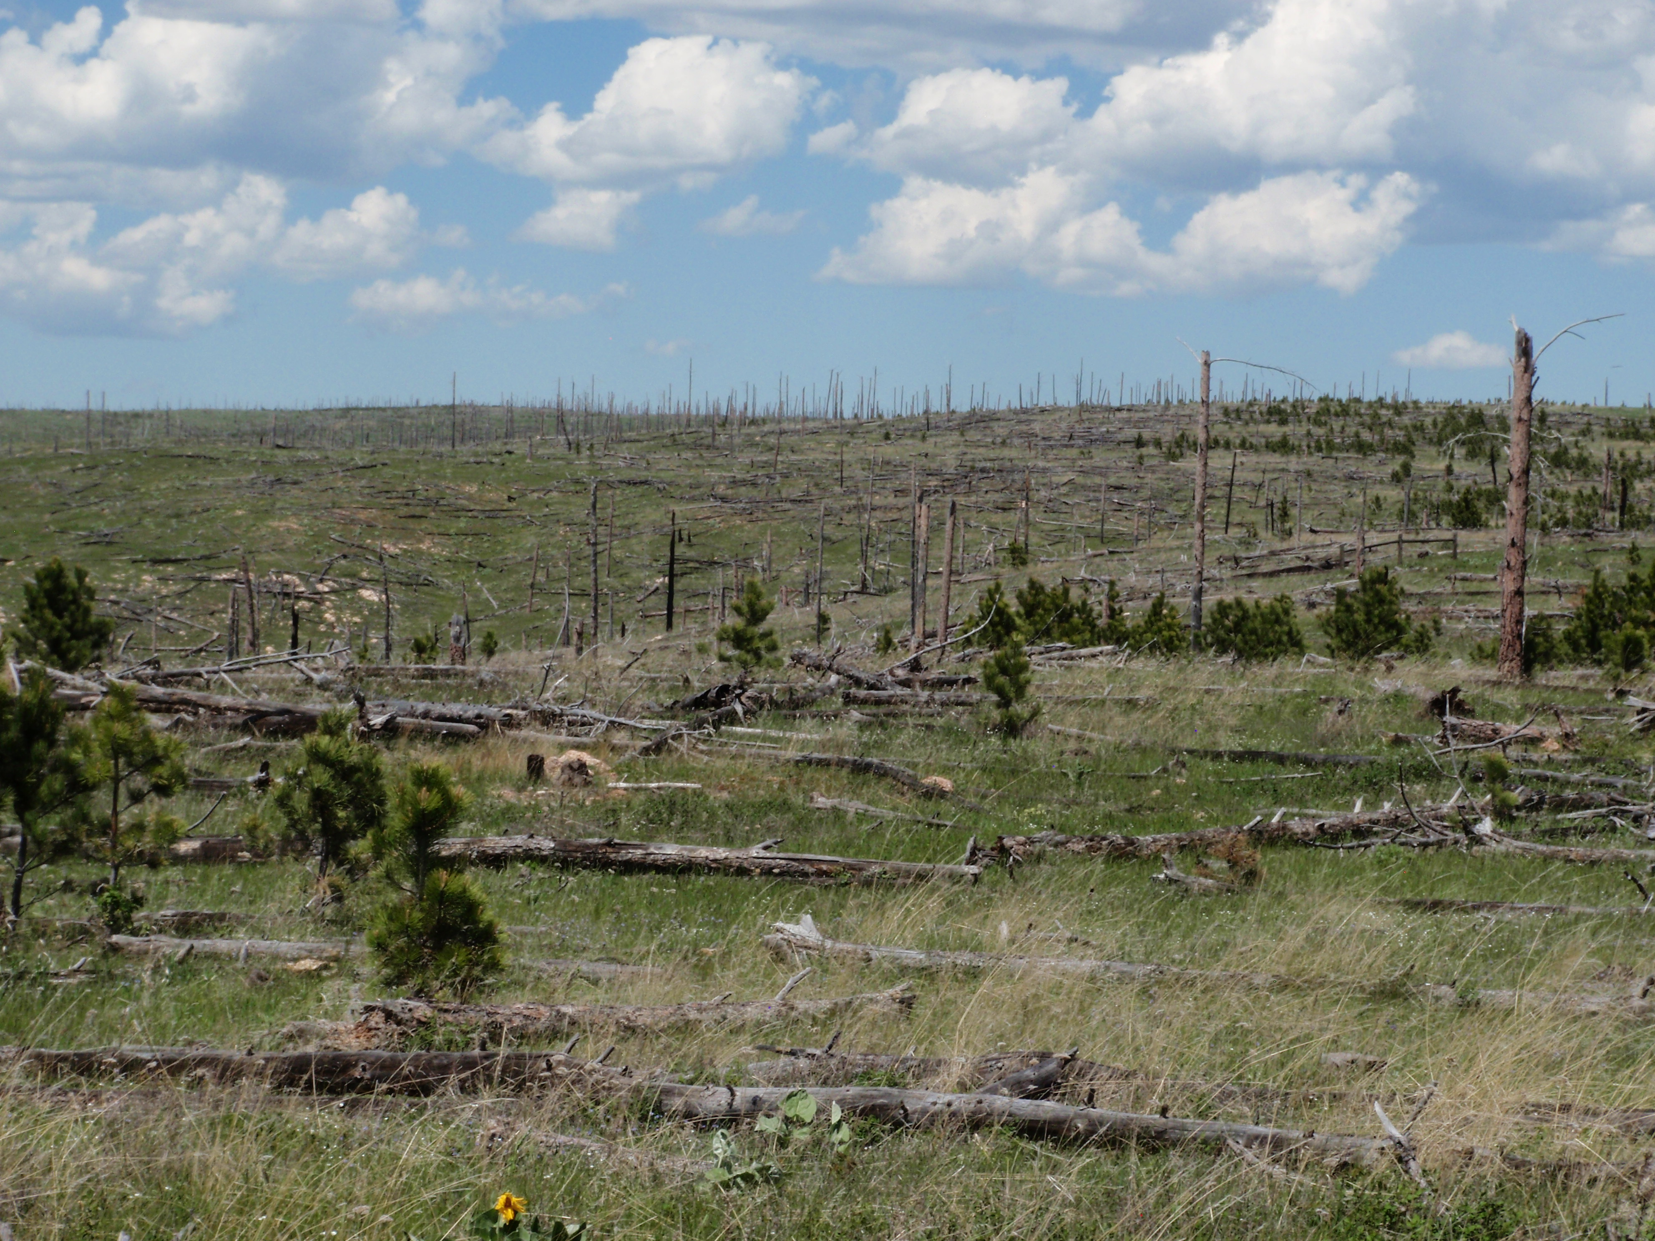
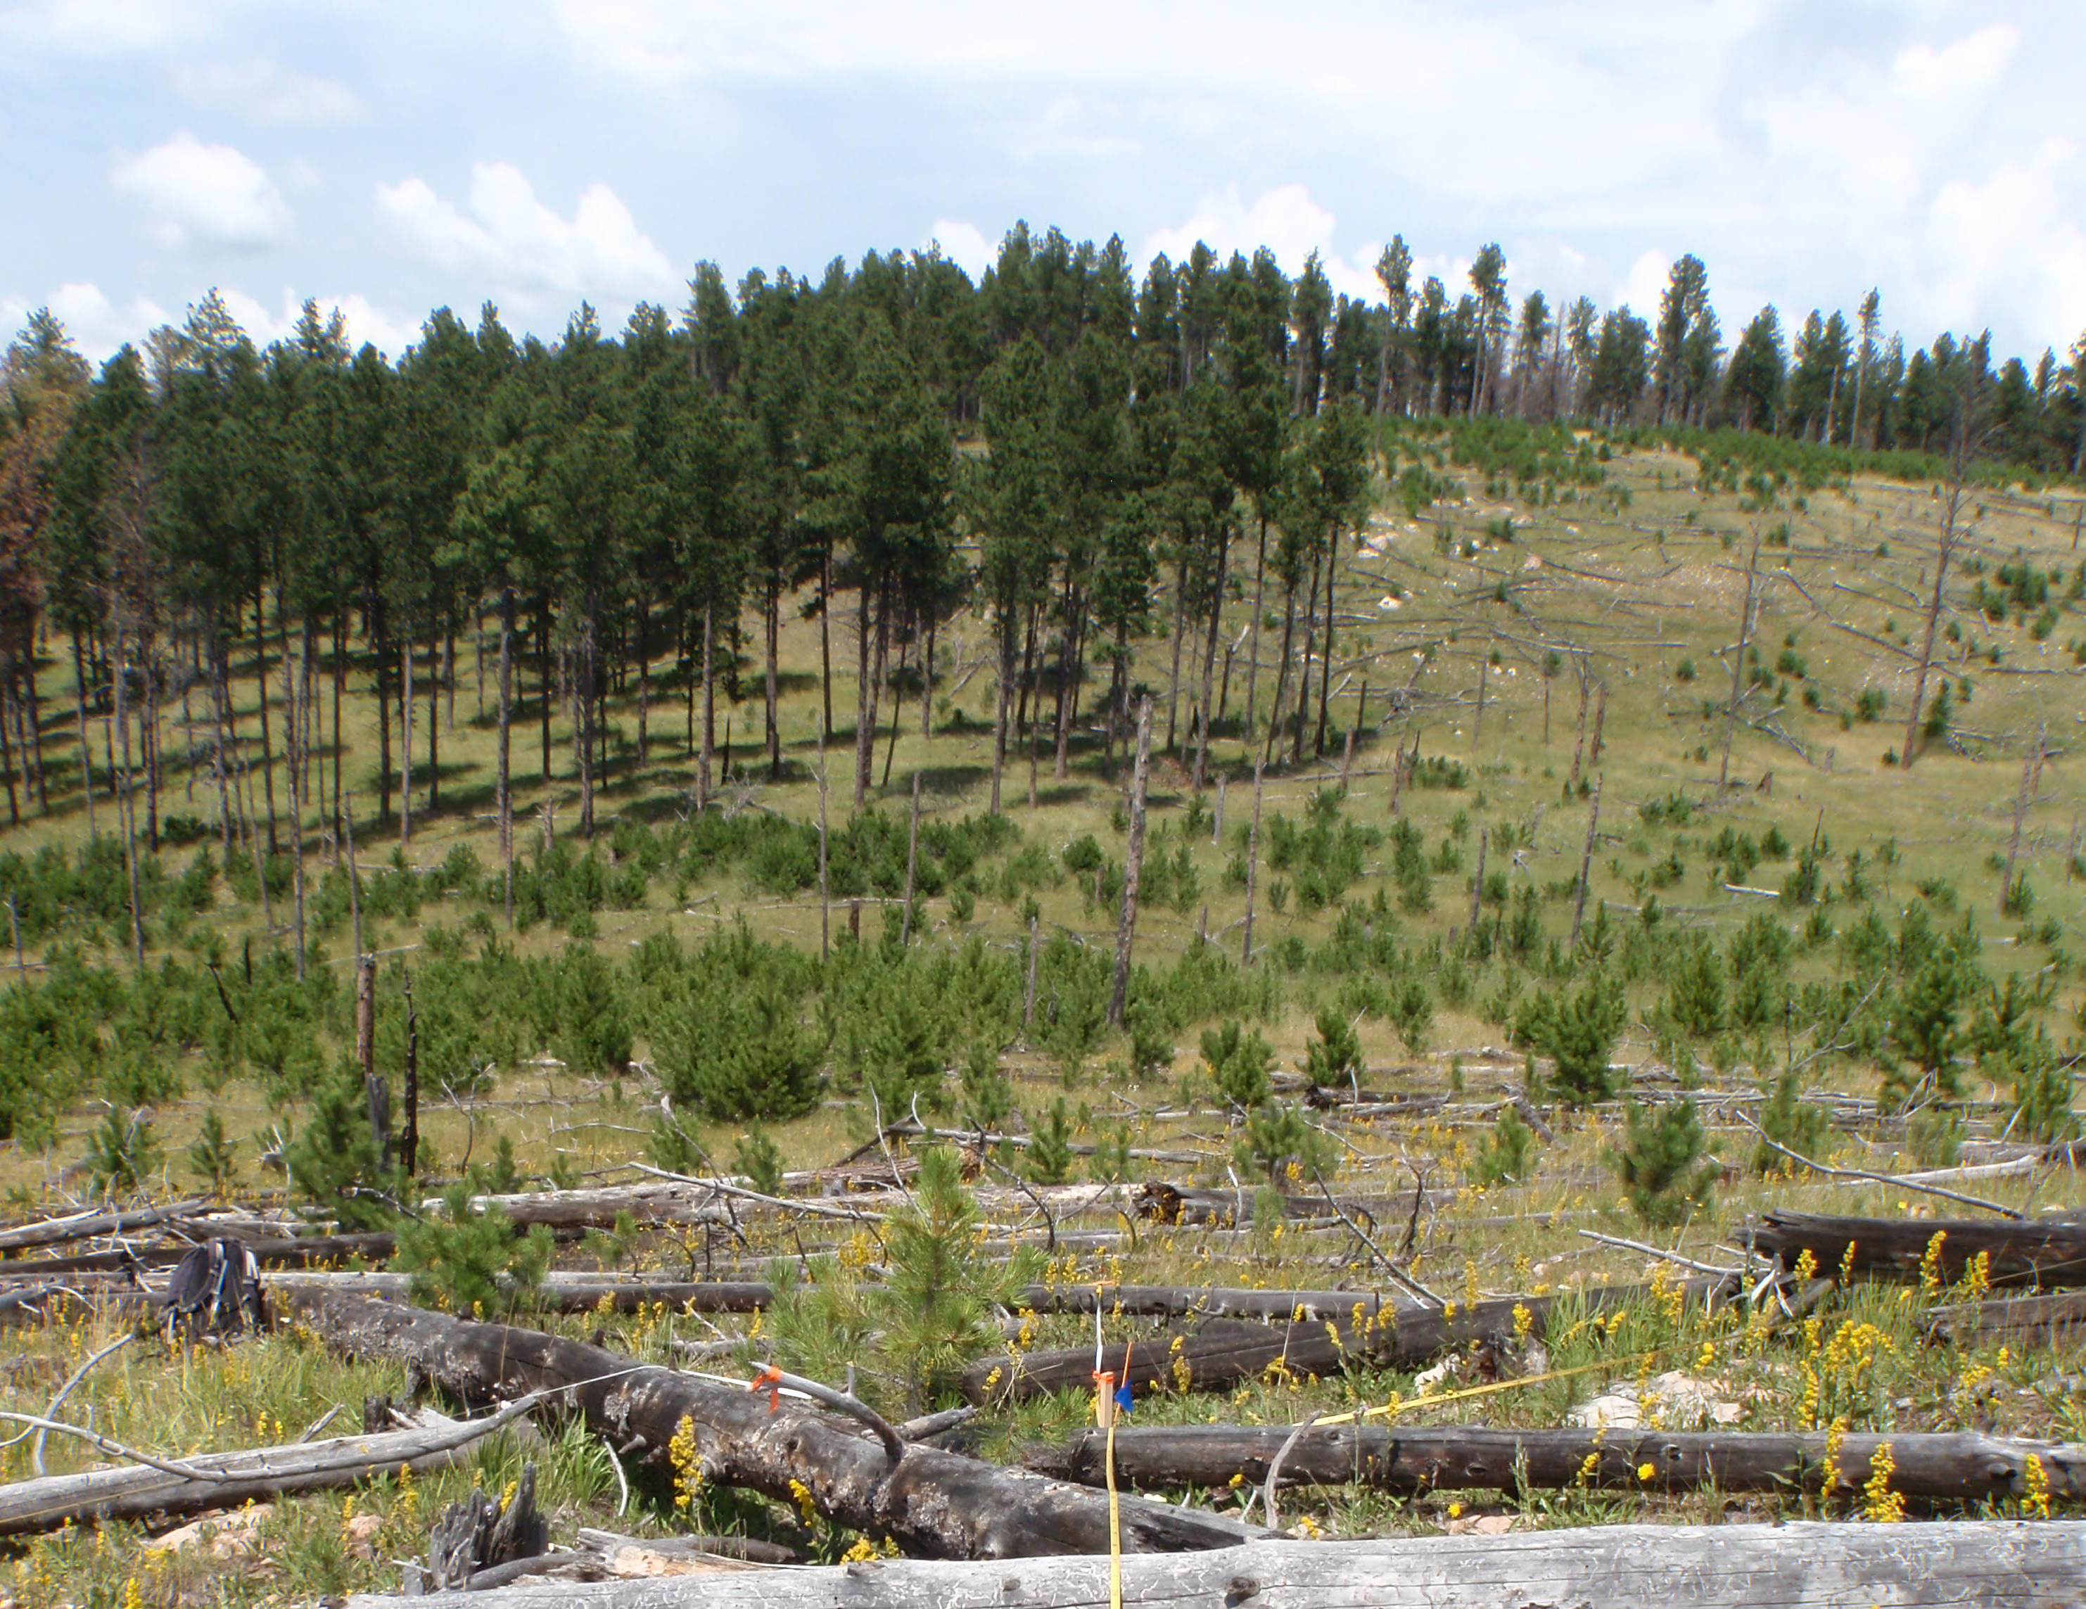
Data
Process
Model
Classify
METHODOLOGY
 | Low Regeneration​ (0-40 Trees per acre) | Medium Regeneration​ (40-150 Trees per acre) | High Regeneration (150+ Trees per acre) ​
Reforestation Priority | High | Moderate | Low
No. of stem samples | 521 | 45 | 17
No. of ocular samples | 0 | 181 | 155
Photos of field plots
Image Credits: Paula Fornwalt
Notes:
Based on the available field-validated training data we had, we created classes of regeneration based on what was spectrally separable in 2015 when the field data was collected. Forest managers of the Black hills were interested in areas of high priority for planting, so we created low thresholds of 0-40 trees per acre, 40-150 trees per acre, and above 150 trees. Fully stocked forests, however, are considered 300-400 TPA. Most of the stem map field collected data was in the low regeneration class.
------------------------------Image Information Below ------------------------------
Credit: Paula Fornwalt
Source: written permission to use

Slide 13
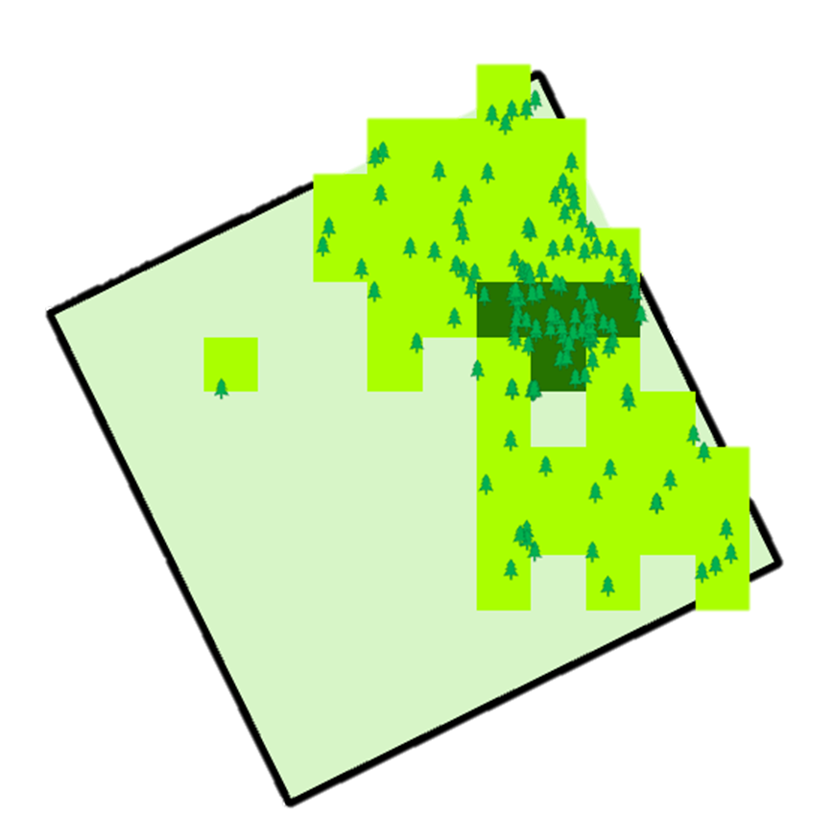
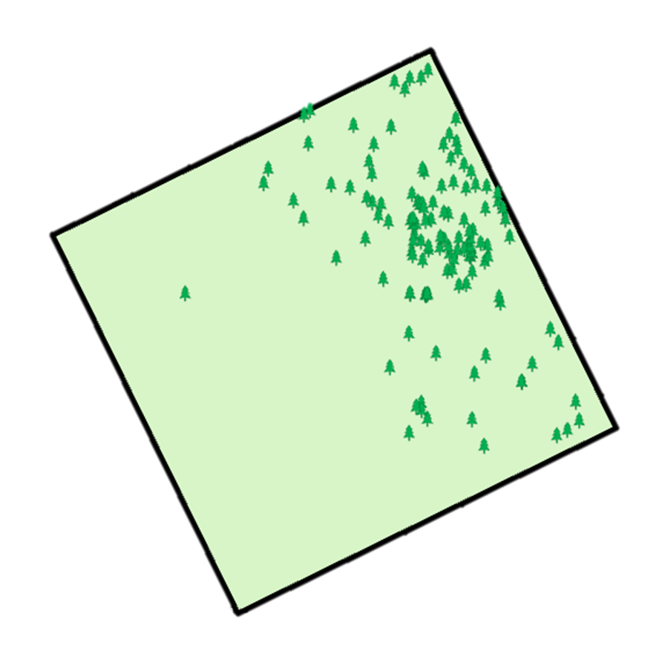
Data
Process
Model
Classify
METHODOLOGY
Classify stem maps and planting data by tree density thresholds
Low: 0-40 TPA
Medium: 40-150 TPA
High: 150+ TPA, "stocked"
Create raster dataset for model training and validation
Medium
High
Low
Notes:
Based on these thresholds, we classified our stem maps by seedling density. Then, we created a 20x20 raster dataset from the stem maps of high, medium, and low regeneration to match the scale of our sentinel-2 images. On the right is an example of how we classified stem points to train and validate our model
------------------------------Image Information Below ------------------------------
Team generated map using ArcGIS Pro

Slide 14
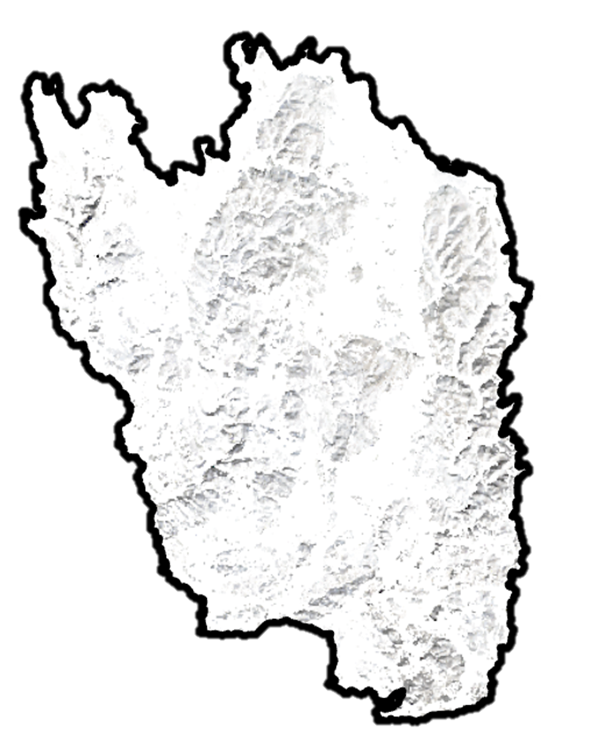
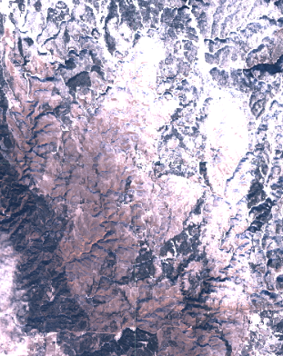
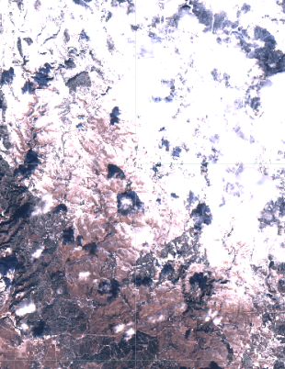
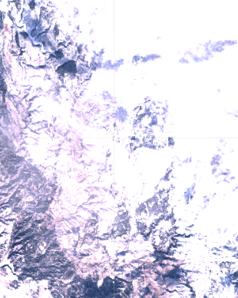
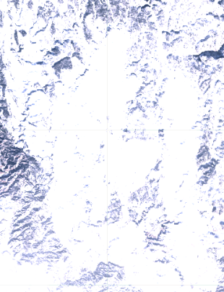
Data
Process
Model
Classify
METHODOLOGY
Indices used for snowy pixels
Index | Description | Threshold
NDSI | Normalize Difference Snow Index | 0.4 - 0.8
NDFSI | Normalize Difference Forest Snow Index | 0.4 - 0.8
Dates used for snowy pixels
Year Range | Day Range
2019–2022 | December 11th – April 10th
+
+
+
=
Individual images reveal variable snow coverage across the study area, but masking provides a full snow cover composite.
Notes:
A fundamental premise we assume is that, under snow-cover conditions, only conifer presence contributes to NDVI. Therefore, in order to detect conifer in snow conditions, we had to filter patchy snow image collections across our study range. Given the possibility of uneven snow packs for one year, we also used imagery for the year prior and year after the year of interest. Then, we filtered satellite imagery using a standard date range to select images with the highest probability of snow cover over winter (see table on the right). Then we masked our images with a NDSI and NDFSI thresholds as described in the table on the left, which after taking the median of the collection provided us with a single snowy image composite. You can see an example on the bottom screen showing a range of snow cover over different winter dates, and how those images look when masked and composited to a full-snow image. This composite strategy minimizes the signal from non-coniferous vegetation greenness from influencing our model algorithm for each pixel.
------------------------------Image Information Below ------------------------------
Team generated map using ArcGIS Pro

Slide 15
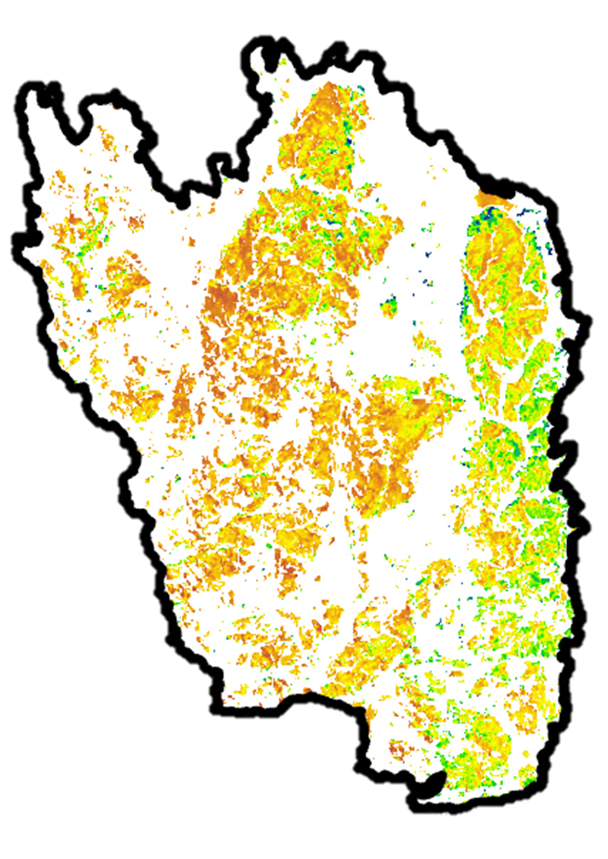
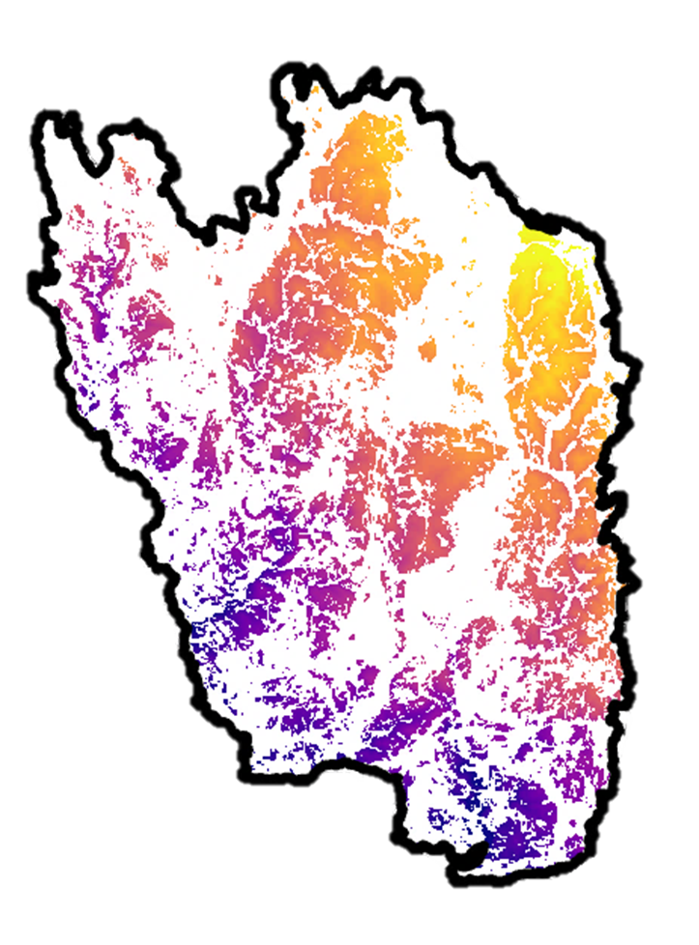
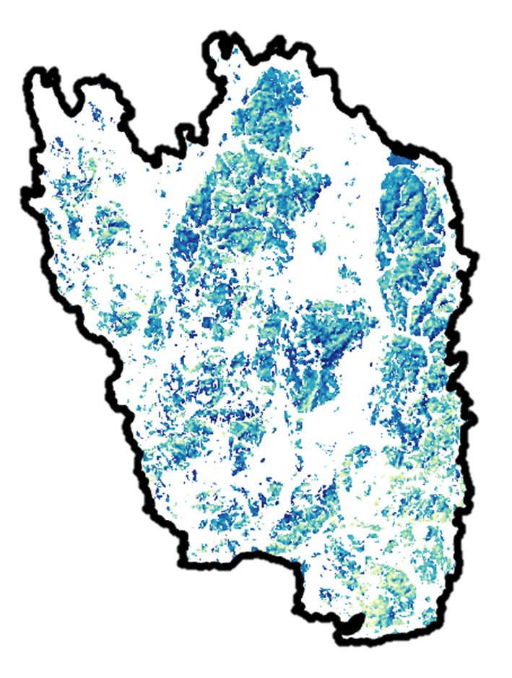
Data
Process
Model
Classify
METHODOLOGY
Variable Selection
Type | Variable | Use
Spectral Index | NDVI | Measures vegetation greenness
 | NDSI | Measures snow presence
Topography | Elevation | Controls for differences across large study area
NDVI
NDSI
Elevation
Notes:
We started our analysis with many spectral indices that were common in our literature review. We condensed our spectral indices by examining collinearity and contribution to the model to avoid overfitting the model. Our resulting model used the normalized difference vegetation index, a measure of vegetation greenness.
As can be seen on the most left map, NDVI is lower in the middle of the burned area in orange, and higher around the edges in green.
As can be seen in our middle map, we used the normalized difference snow index as a measure of snow cover. In this map, you can see variable snow cover across the study map area. We attempted to homogenize snow cover across the range using snow selection dates and snow masking.
Lastly, for the map on the right, we used elevation to account for large differences across our study area. You can see higher elevation in the north of the map in yellow and lower elevation in the south.
NDVI in yellow,
NDSI in blue,
Elevation last

Slide 16
Data
Process
Model
Classify
METHODOLOGY
Field Data
Stem Maps
Ocular Sampling
Satellite Data
NDVI
NDSI
Elevation
Random Forest Classification
Google Earth Engine
Categorical classification
80% training | 20% validation
340 decision trees
Classified Image
Notes:
We used a Random Forest model in Google Earth Engine to classify conifer regeneration. A random forest model is essentially a collection of decision trees using random subsets of variables. The random forest algorithm attempts to split the decision trees in a way that resulting groups are as different from each other as possible while maintaining the members of the subgroup are as similar to each other as possible. In our case, the variables used in the model include spectral indices and topography. After training the modeling using our field collected stem data and ocular samples combined with the spectral indices and topography, the trained model used our variables to classify new image pixel information as low, med, or high regeneration.
We specified our random forest classifier with a 80%/20% training/validation split and 340 decision trees.

Slide 17
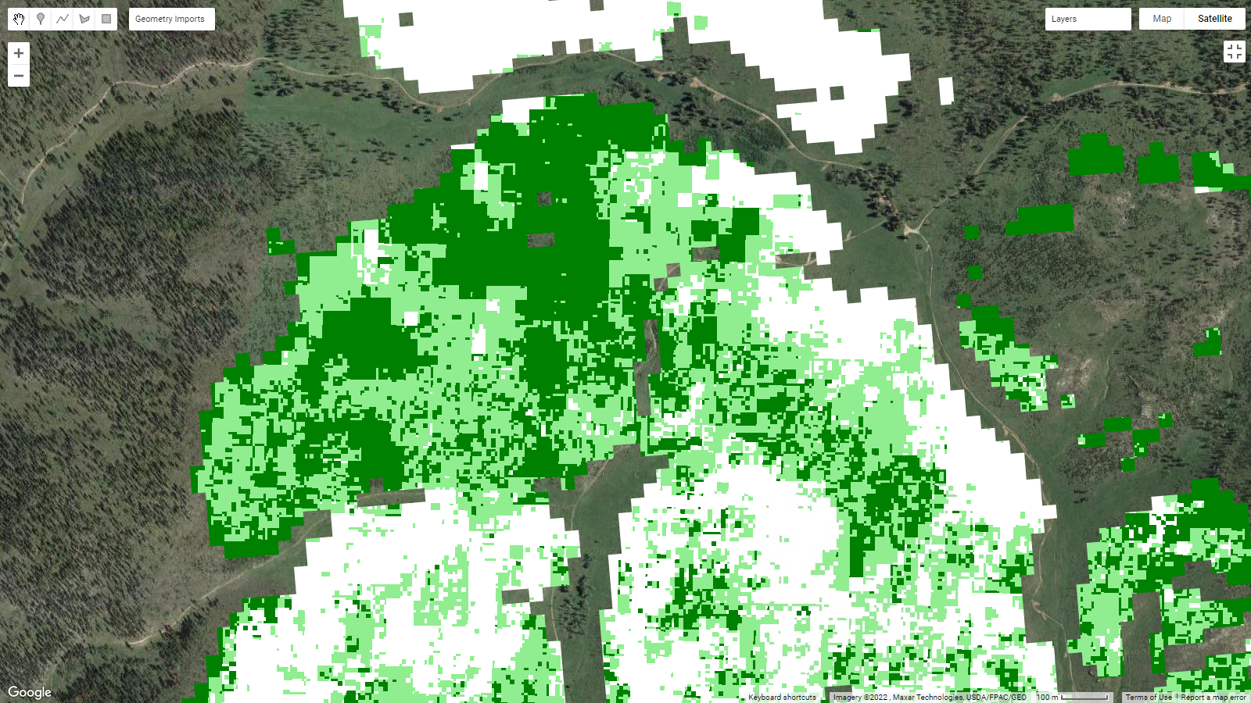
Data
Process
Model
Classify
METHODOLOGY
Low Regeneration
Medium Regeneration
High Regeneration
0.25 0.5 miles
Apply model across high-severity burn area
N
Notes:
After training our model, we classified all of the high severity burned areas with our random forest model.

Slide 18
RESULTS| Model Success
Accuracy Assessment
81.4% overall accuracy
Best performance in the low regeneration class
More confusion between the higher density classes
 | Low | Medium | High | Accuracy
Low | 97 | 4 | 1 | 95.1%
Medium | 7 | 26 | 4 | 70.3%
High | 3 | 14 | 21 | 55.3%
Image Credit: Paula Fornwalt
Notes:
The validation results of our random forest model showed most success classifying the low regeneration class. This is as expected since most of our training field data was of the low regeneration class.
------------------------------Image Information Below ------------------------------
Credit: Paula Fornwalt
Source: written permission to use

Slide 19
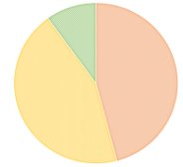
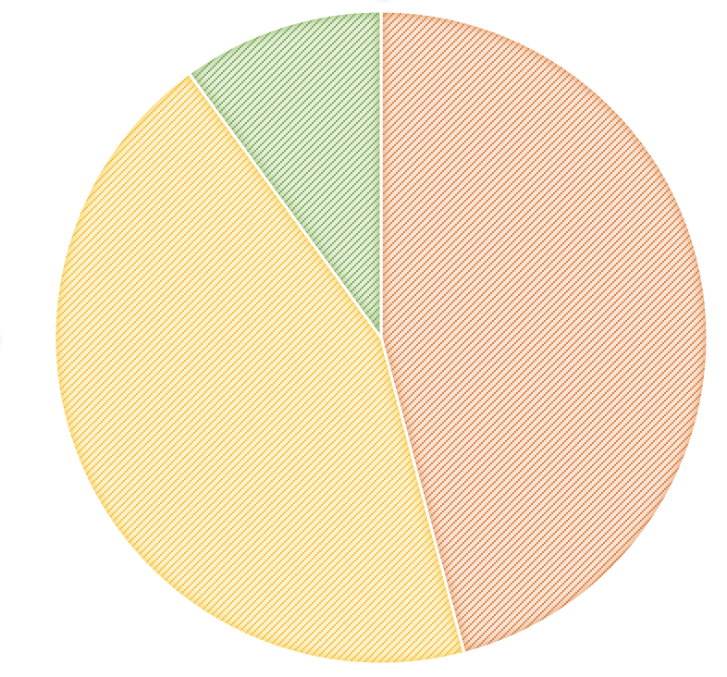
RESULTS| Classification
Classified regeneration within high severity burn
 | Low Regeneration​ (0-40 TPA) | Medium Regeneration​ (40-150 TPA) | High Regeneration (150+ TPA) ​
Reforestation Priority | High | Medium | Low
% of High Severity Area | 45.9% | 44.1% | 10.0%
Number of Acres | 10,349 | 9,943 | 2,254
Low Regeneration
Medium Regeneration
High Regeneration
Classified regeneration within high severity burn
Classified regeneration within high severity burn
10.0%
High
10.0%
High
Classified regeneration within high severity burn
Classified regeneration within high severity burn
10.0%
High
10.0%
High
10.0%
High
10.0%
High
10.0%
High
45.9%
Low
45.9%
Low
45.9%
Low
45.9%
Low
45.9%
Low
44.1%
Medium
44.1%
Medium
44.1%
Medium
44.1%
Medium
44.1%
Medium
Notes:
Our model classified almost 46% of the high severity burned area as low regeneration, 40 or less trees, in 2021. 44% of the high severity burned area was classified as medium regeneration, and only 10% was classified as high regeneration. This means more than 20,000 acres of the high severity burn have less than 150 trees per acre according to our model.
------------------------------Image Information Below ------------------------------
Background Image: Paula Fornwalt
License: Written Permission to use

Slide 20
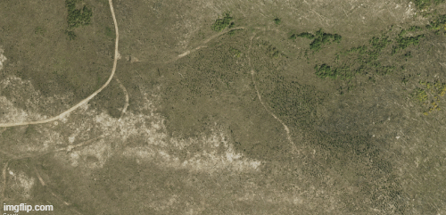
Notes:
Here is an animated example of our classification results. In this image you can see how the tree dense areas become dark green for high regeneration, and areas without many trees are white for low regeneration.
------------------------------Image Information Below ------------------------------
Created using imgflip.com

Slide 21
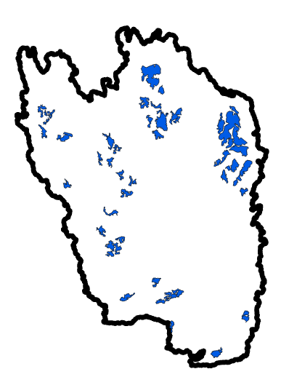
RESULTS| Partner Outputs
4,079 acres identified as greatest need for reforestation
Criteria
Low regeneration category
<1500 ft from road
Patch size >50 acres
Not previously planted
Notes:
After identifying areas of low regeneration, we identified areas within that class that were feasible for replanting. Our partners provided the criteria that feasible areas would be close to roads, in larger areas for efficiency, and we did not want to double efforts where previous plantings had taken place. Filtering for all these criteria, we found 4,079 acres as highest priority for reforestation. These areas are identified in blue on the map to the right.

Slide 22
Image Credit: Paula Fornwalt
CONCLUSIONS
Snow-on imagery is a viable technique to identify conifer regeneration.
Areas of low regeneration were clustered near lower elevations.
4,079 acres were identified as high priority and feasible for planting.
Notes:
This project showed that using snow-on imagery is a viable option to identify conifer regeneration post-fire. Areas found to be low regeneration in 2021 were mostly clustered in the south with low elevations, with some low regeneration areas in the northernmost of the burned area. 4,709 acres were found to be low regeneration, near roads, larger patch sizes, and not previously planted. These areas will be marked as high priority and given to our project partners.
Ideas:
Amount of area that is low regen- unlikely to regenerate naturally due to less seed sources, and hasn't regenerated yet.
These types areas (south, low elevation, aspect, etc) showing lo regen
These types of areas showing high regen
------------------------------Image Information Below ------------------------------
Credit: Paula Fornwalt
Source: written permission to use

Slide 23
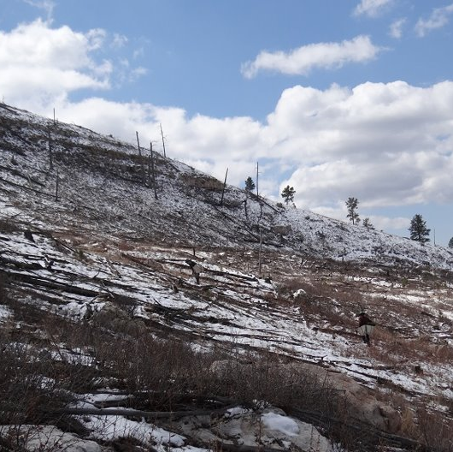
LIMITATIONS
Image Credit: Lisa Lam
Snow cover introduces uncertainty
Requires large field-collected training dataset
Difficulty separating tree densities
Analysis must be completed several years post-fire
Changing tree size limits multitemporal analysis
Notes:
This project relies on the assumption that snow cover NDVI in this area and these years of interest measured primarily the coniferous tree vegetation, but differences in snow depth and cover introduce uncertainty about that assumption. Our project also relied on a field-collected dataset to train our random forest model, and this field dataset had to be collected several years post-fire to ensure the seedlings counted were well established. The lack of fully "stocked" areas of 300-400 TPA did not exist in our field data, so our model thresholds had to be lowered to spectrally feasible levels. Lastly, NDVI changes throughout years could be measuring not only the establishment of new trees, but the growth of existing trees as well so interpretation of this model applied throughout time is limited without more data.
------------------------------Image Information Below ------------------------------
2021 Jasper fire area tree planting
Credit: Lisa Lam, USDA Forest Service, Black Hills National Forest
Source: https://www.facebook.com/blackhillsnf/posts/over-the-course-of-two-and-a-half-weeks-the-black-hills-national-forest-will-ove/2795975803996338/

Slide 24
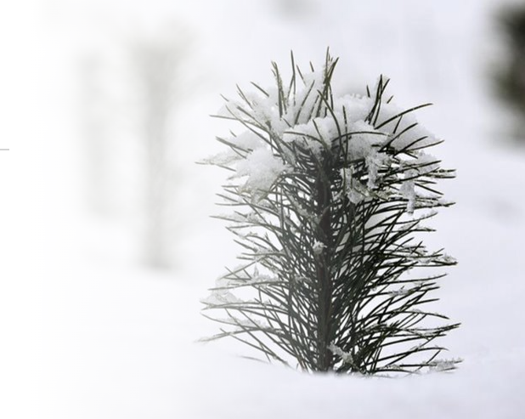
FUTURE WORK
Improvements:
Compare snow-on pre-fire NDVI to snow-on post-fire NDVI
Correct for shrub cover contributions to NDVI
Validate model accuracy in recent years with new field data
Expansion:
Continue monitoring conifer growth and planting survival in the Black Hills
Apply techniques to other fires to further test usage of snow-on imagery
Image Credit: Artur Pawlak
Notes:
Potential additions or continuations of this project could include determining a return to pre-fire conditions with pre-fire and post-fire NDVI differences. Also, coniferous tree species may be better isolated by correcting for shrub cover, potentially by using NDVI directly after the fire to isolate the NDVI contributions of these faster-growing understory species. Validating the model accuracy with field data collected nearer to our 2021 final results would give more insight to our model. Adding more planting data as training data to the model, especially in areas of high planting survival and diverse elevation, slope, and aspect, should increase the model's accuracy in determining areas of high regeneration.
Lastly, this project could be continued by applying these techniques to continue monitoring growth and planting in our study area, as well as applying these techniques to other areas with adequate snow cover.
------------------------------Image Information Below ------------------------------
Credit: Artur Pawlak
Source: https://pixabay.com/photos/tree-pine-needles-snow-frost-5958665/
Pixabay License: free for commercial use, no attribution required

Slide 25
Science Advisors:
Dr. Wade Tinkham, Colorado State University
Lauren Lad, Colorado State University
Partners:
Dr. Mike Battaglia, Director, United States Forest Service
Paula Fornwalt, Research Ecologist, United States Forest Service
Dr. Melanie Vanderhoof, Research Scientist, United States Geological Survey
Node Leadership:
Sarah Hettema, NASA DEVELOP Colorado – Fort Collins
Others:
Black Hills National Forest Silviculturists
This material contains modified Copernicus Sentinel data (2022), processed by ESA.
Maps throughout this work were created using ArcGIS® software by Esri. ArcGIS® and ArcMap™ are the intellectual property of Esri and are used herein under license. All rights reserved.

