Slide 1
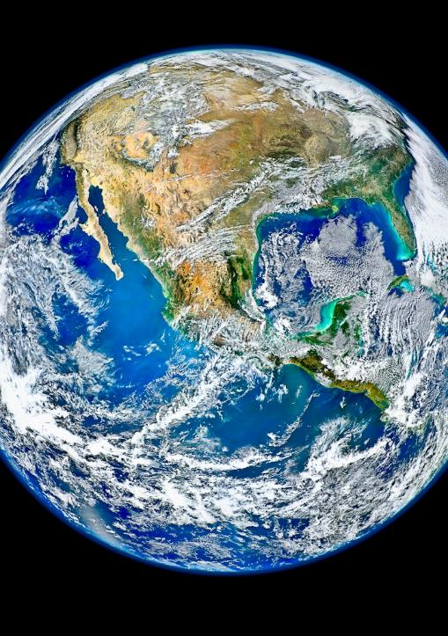


2020 Summer
NATIONAL
ORIENTATION
MODULE 9. Personalities

Slide 2

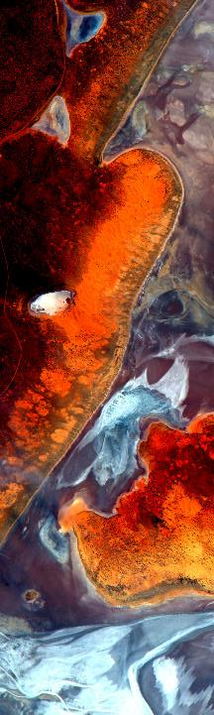
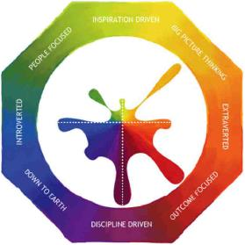
Personality Typing? Why?
DEVELOP teams must storm – form – norm – perform in only 10 weeks! Working together is critical to that success, and part of working together is understanding each other and ourselves.
Personality typing provides an opportunity for:
  Introspection: to understand your tendencies and motivations, strengths and weaknesses, and innate preferences
  Interpersonal skill development: recognize these traits in others
  Common language: provides terminology for identifying inherent nature
  Freedom: assesses what’s “normal”, identifies inherent needs, and helps alleviate pressure, all so you can be accepted for just being you
Benefits:
  Amplified strengths, minimized weaknesses
  Improved interaction and communication
  Enriched team dynamic and relationships
  Increased understanding and patience
  Enhanced leadership capabilities
  Increased team performance and efficiency
  Broadened viewpoints and awareness
  Enhanced job selection and satisfaction
  Balanced and diverse teams

Slide 3
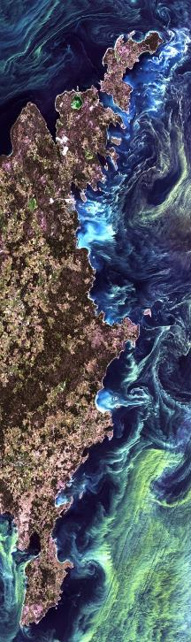

Two Approaches
Myers Briggs Indicator Type
Based on Carl Jung’s work, developed by Katharine Cook Briggs and Isabel Briggs Myers, categorizes personalities into 16 types
Created to put psychological theory to practical use - assisting women entering the WWII workforce with job selection
NASA’s 4D System
Foundation of MBTI, developed by Charles Pellerin, refines personalities to four types
Applicable to individuals and organizations
Created to help science/engineering teams (like those at NASA) boost performance and avoid mistakes

Slide 4
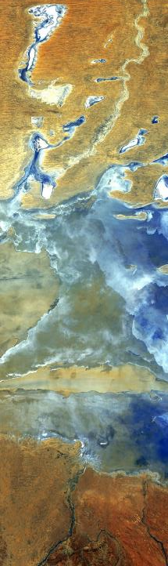
Myers Briggs Type Indicator
Sixteen Personality Types Based on Four Dimensions of Personality
Four dichotomies
Attitude
Where do we get our energy?
Extroversion
(E)
Introversion
(I)
Information Gathering
How do we take in our information?
Intuiting
(N)
Sensing
(S)
Decision-Making
How do we make our decisions?
Thinking
(T)
Feeling
(F)
Lifestyle
How do we organize our world?
Judging
(J)
Perceiving
(P)

Slide 5
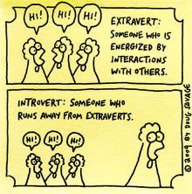
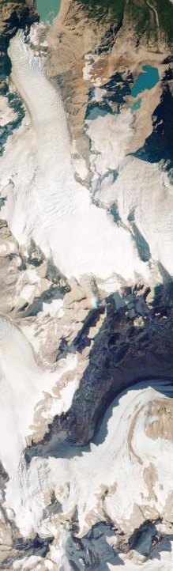
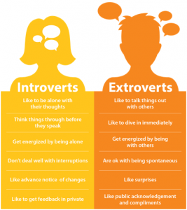
Extroversion vs. Introversion
Attitude… Where do you get your energy?
Extroversion (E): Outward-turning
  Flow is directed outward toward people and objects
  Action-oriented
  Seek breadth of knowledge and influence
  Prefer more frequent interaction with others
  Recharge and get energy from spending time with people (need break from time spent in reflection)
  Act, then think
Introversion (I): Inward-turning
  Flow is directed inward toward concepts and ideas
  Thought-oriented
  Seek depth of knowledge and influence
  Prefer more substantial interaction with others
  Recharge and get energy from spending time alone (away from activity)
  Think, then act

Slide 6
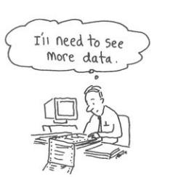
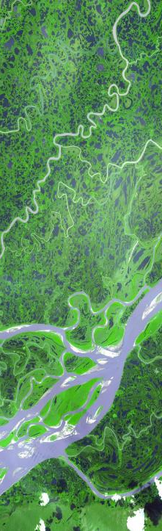
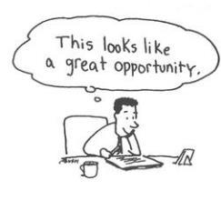
Sensing vs. Intuition
Information Gathering… How do you take in information?
Sensing (S): Experiences
  Trust information that is present, tangible, concrete, and interpreted (collected by the five senses)
  Distrust hunches
  Prefer to look for details and facts
  Admire practical solutions
  Work at a steady pace
  Meaning is in the data
Intuition (N): Concepts
  Trust information that is more abstract and theoretical, and can be associated with other information (memories/patterns)
  More interested in future possibilities & big picture
  Admire creative ideas
  Work in bursts of energy
  Meaning is in the underlying theory and principles manifested in the data

Slide 7

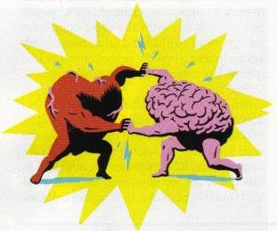
Thinking vs. Feeling
Decision-Making… How do you make your decisions?
Thinking (T): By the Rules
  Make decisions objectively - measure by what is reasonable, logical, causal, consistent, and matching a given set of rules
  Value truth, fairness and honesty
  Tend to give very honest and direct feedback to others
  Good at seeing flaws, debating
  Motivated by achievement
Feeling (F): Empathizing
  Make decisions based on feelings - measure from the inside, associate or empathize with the situation
  Value people, harmony and compassion
  Tend to be diplomatic and tactful with feedback
  Weighs the situation to achieve the greatest harmony, consensus of the people involved
  Motivated by appreciation

Slide 8
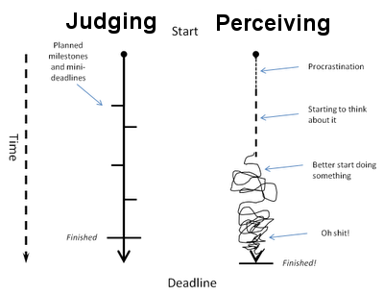
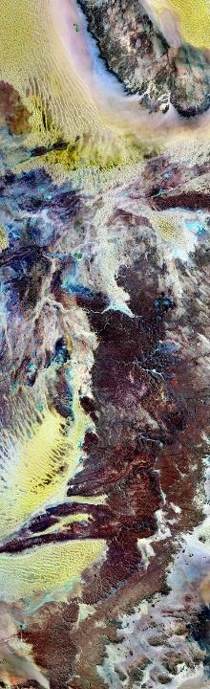
Perceiving vs. Judging
Lifestyle… How do you organize your world?
Perceiving (P): Spontaneous
  Like to keep options open
  Are playful and casual
  Less aware of time, may run late
  Play first, work later
  Question the need for many rules
  Find comfort in flexibility and freedom
Judging (J): Organized
  Like to have things settled
  Take responsibility seriously
  Pay attention to time, usually prompt
  Work first, play later
  Like to make, stick with plans
  Find comfort in schedules and organization

Slide 9
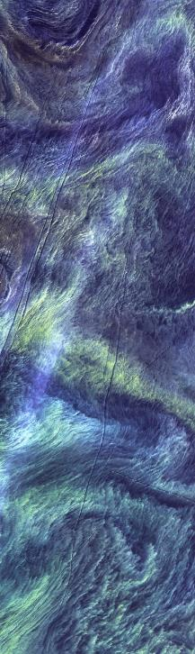
16 Types
ENFJ
Teacher
2-5%
ENFP
Champion
6-8%
ENTP
Inventor
2-5%
ENTJ
Field Marshall
2-5%
INFJ
Counselor
1-3%
INFP
Healer
4-5%
INTP
Architect
3-5%
INTJ
Mastermind
2-4%
ISFJ
Protector
9-14%
ISFP
Composer
5-9%
ISTP
Operator
4-6%
ISTJ
Inspector
11-14%
ESFJ
Provider
9-13%
ESFP
Performer
4-9%
ESTP
Promoter
4-5%
ESTJ
Supervisor
8-12%
What Myers Briggs types are represented in the room?
Do you have any opposites on your team? (ex. E vs. I or J vs. P)
Review those types (slides at the end of this presentation)

Slide 10
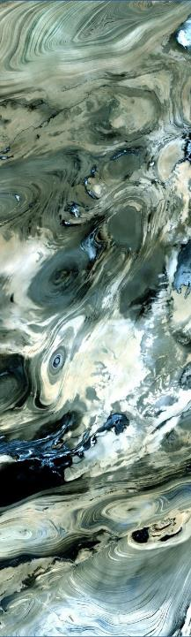
NASA’s 4D System
Created to help scientific teams to collaborate and work together more effectively
Four quadrants / types named by color
Intuited
Feeling & Imagining
Appreciate and care for others
Share interests for a better world
Thinking & Imagining
Constantly innovate and create
Need to be the best/smartest
Cultivating
Visioning
Emotional
Logical
Including
Directing
Feeling & Sensing
Include and motivate others
Bring integrity and build teams
Thinking & Sensing
Take organized action
Direct others towards results
Sensed

Slide 11
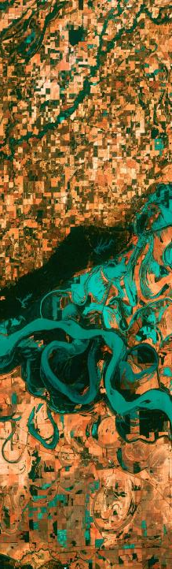
4D Innate Deciding Preference
EMOTIONAL
LOGICAL
Harmony is intrinsically valuable?
OR
Harmony is a means to an end?
Prefer to act on “what feels right”?
OR
Prefer to act on “what’s logical”?
Consider the people first?
OR
Consider the task first?
Prefer harmonious relationships?
OR
Prefer being right?
Decide through consensus?
OR
Decide with my own thinking?
First, trust my heart?
OR
First, trust my head?
Intolerant of conflict?
OR
OK with conflict?

Slide 12
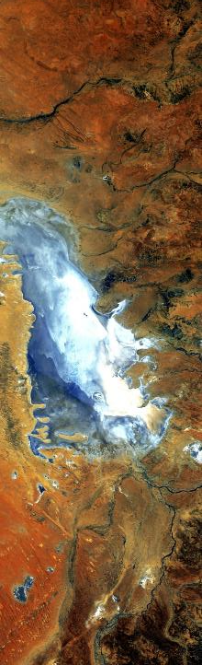
4D Information Preference
INTUITED
SENSED
Rely on my inner knowing?
OR
Rely on my observations?
Think more about “what could be”?
OR
Think more about “what is”?
Prefer creativity?
OR
Prefer common sense?
Act on flashes of insight?
OR
Act on careful analysis?
Prefer wrestling with concepts?
OR
Prefer wrestling with facts and data?
Prefer holistic perspectives?
OR
Prefer details?
Love big ideas?
OR
Love established reality?

Slide 13
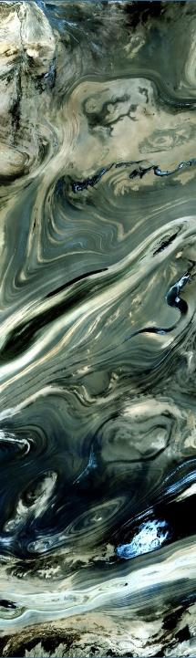
Review & Discussion
What 4D colors are represented in the room?
Do you have any opposites on your team? (ex. Blue vs. Yellow or Green vs. Orange)
Review types (next four slides)
Intuited
Feeling & Imagining
Appreciate and care for others
Share interests for a better world
Thinking & Imagining
Constantly innovate and create
Need to be the best/smartest
Cultivating
Visioning
Emotional
Logical
Including
Directing
Feeling & Sensing
Include and motivate others
Bring integrity and build teams
Thinking & Sensing
Take organized action
Direct others towards results
Sensed

Slide 14
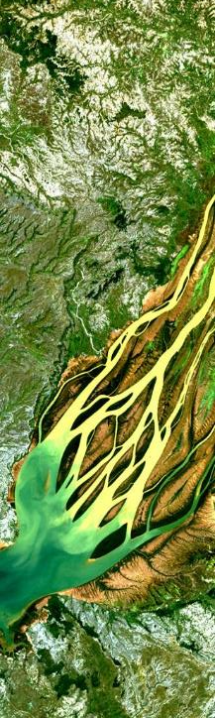
Green: “Cultivating” People Builders
Signature Personality DNA: Primary motivation is to avoid conflict by keeping peace and unity within the team.
Strengths: Compassionate, idealistic, warm-hearted, good coach, easy going, well balanced, conscious of others’ needs/feelings, steady, good under pressure, mediates problems, calm and collected
Weaknesses: Disorganized, indecisive, unrealistic, lacks self-motivation, worrisome, unenthusiastic, hypersensitive, overly emotional, judgmental, often needs goals and decisions to be made by others
Major Challenge: Sufficiently organize themselves to lead
Inherent Desire: To feel worth and that they are needed and respected
“It’s hard to get your thing together if your thing is paradise on Earth.”
- Jerry Garcia
Innate AMBR
Attention: Greens naturally attend to people’s needs and universal values
Mindset: Greens are stewards – for others, family, and religious/spiritual values
Behavior: Supporting others in being happy and successful
Results: Success without damaging others

Slide 15
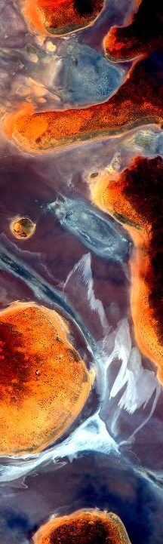
Yellow: “Including” Team Builders
Signature Personality DNA: Primary motivation is to have fun and enjoy their team members. Yellows are the team motivators and encouragers.
Strengths: Caring, loyal, friendly, cooperative, appreciative of others, enthusiastic, expressive, volunteers for jobs, inspires others to join in, appealing personality, lives in the present, good on stage, has natural optimism, team builder
Weaknesses: Forgets obligations, undisciplined, decides by feelings, easily distracted, compulsive talker, complains, gets angry easily, egotistical, conflict averse, too compliant, needs approval, lacks opinions of their own
Major Challenge: Acting on difficult personnel problems and tolerating conflict
Inherent Desire: To know that their team members trust them
“Some of my friends are for it. Some of my friends are against it. I am for my friends.”
- Dwight D. Eisenhower
Innate AMBR
Attention: Yellows naturally attend to teamwork and relationships
Mindset: We are here to work together
Behavior: Facilitating teamwork and collaboration
Results: Success through harmony

Slide 16
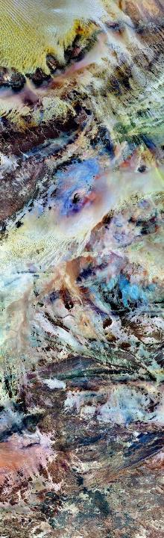
Orange: “Directing” System Builders
Signature Personality DNA: Primary motivation is to get the job done. Oranges stay on track until it’s done, achievement is huge. They are the directors and organizers of the team.
Strengths: Takes responsibility, organized, goal oriented, seeks practical solutions, stimulates activity, moves quickly to action, decisive, exudes confidence, excels in emergencies, reliable, task focused, logical
Weaknesses: Inflexible, intolerant of mistakes, blames others, judgmental, controlling, close-minded, insensitive, decides for others, impatient, tactless
Major Challenge: Seeing people as people, with legitimate personal needs
Inherent Desire: To know that the team in on board, to be validated
“A team effort is a lot of people doing what I say.”
- Michael Winner
Innate AMBR
Attention: Oranges naturally attend to task, process, and certainty
Mindset: Plan the work–work the plan
Behavior: Execute with discipline and rigor
Results: Success through processes and consistency

Slide 17
Blue: “Visioning” Idea-Builders
Signature Personality DNA: Primary motivation is to plan and be the best at whatever they set out to do. Blues are the team thinkers and visionaries.
Strengths: Visionary, innovative, inquisitive, analytical, bright, independent, schedule oriented, detail conscious, persistent, thorough, finds creative solutions, finishes what they start, orderly, organized, can solve others’ problems
Weaknesses: Standards often too high, argumentative, critical, depressed over imperfections, remembers the negatives, self-centered, hard to please, anti-authority, values ideas more than people
Major Challenge: Joining teams as collaborators
Inherent Desire: Team approval and attention
“The difference between a dreamer and a visionary is that a dreamer has his eyes closed and a visionary has his eyes open.”
- Martin Luther King, Jr.
Innate AMBR
Attention: Blues naturally tend to ideas, concepts, and being the “best”
Mindset: Big, novel ideas are ideal
Behavior: Blues generate, and then promulgate their ideas
(often faster than anyone can respond to them)
Results: Success through excellence and innovation

Slide 18
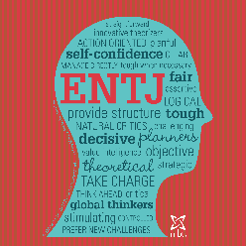
ENTJ: The Field Marshall
EXTROVERTED
Dominant, Outgoing, Energetic, Communicative
INTUITING
Innovative, Forward-Thinking, Visionary, Bold
THINKING
Analytical, Objective, Rational, Blunt
JUDGING
Ambitious, Determined, Organized, Decisive
Strategic leaders, motivated to organize change, enjoy bringing order to the world around them, good at conceptualizing new solutions, quick to see inefficiency and flaws, decisive, enjoy developing long-range plans, organizes people and processes, excel in discovering and implementing solutions, enjoy logical reasoning, articulate, quick-witted, analytical, objective, assertive, enjoys taking charge, very motivated by success, enjoys hard work, ambitious, interested in gaining power and influence, decision-making is a vocation, blunt, driven to get things done, critical, friendly, outgoing, love working with others toward a common goal, focused on results and want to be productive, competent, and influential
Famous ENTJs: Bill Gates, Carl Sagan, Margaret Thatcher, Napoleon Bonaparte, Al Gore, Madeleine Albright, Douglas MacArthur, Alexander Hamilton, Nancy Pelosi

Slide 19
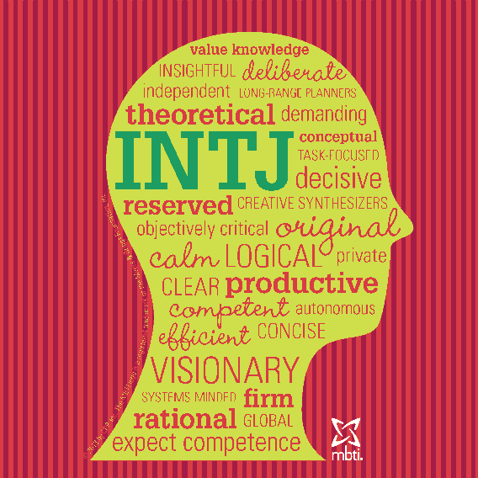
INTJ: The Mastermind
INTROVERTED
Thoughtful, Reserved, Independent, Focused
INTUITING
Innovative, Forward-Thinking, Imaginary, Theoretical
THINKING
Analytical, Objective, Rational, Tough-Minded
JUDGING
Organized, Determined, Dedicated, Decisive
Analytical problem-solvers, eager to improve systems and processes with innovative ideas, perceptive about systems and strategy, enjoy logical reasoning and complex problem-solving, intellectual, able to foresee logical outcomes, enjoy applying themselves to a project or idea in depth, approach life by analyzing the theory behind what they see, uncomfortable with unpredictable nature of other people and their emotions, drawn to logical systems, focused inward, hunger for knowledge, strive to constantly increase their competence, often perfectionists with extremely high standards, lifelong learners, keen interest in self-improvement, selective, independent, always looking to add to their base of information and awareness
Famous INTJs: Elon Musk, Isaac Newton, Ayn Rand, Karl Marx, Nicola Tesla, Steven Hawking, James Cameron, Isaac Asimov, Mark Zuckerberg, Jane Austen, John Adams

Slide 20
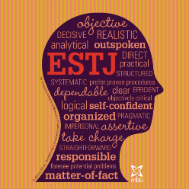
ESTJ: The Supervisor
EXTROVERTED
Dominant, Outgoing, Straightforward, Forceful
SENSING
Practical, Hands-on, Conventional, Detailed
THINKING
Logical, Objective, Pragmatic, Rational
JUDGING
Organized, Structured, Decisive, Persistent
Hardworking traditionalists, eager to take charge in organizing projects and people, excel at setting goals, making decisions, organizing resources to accomplish a task, orderly, rule-abiding, conscientious, like to get things done, systematic, methodical, consummate organizers, bring structure to their surroundings, value predictability, prefer things to proceed in a logical order, take initiative to establish processes and guidelines when organization is lacking, conventional, factual, grounded in reality, value evidence over conjecture, trust their personal experience, look for rules to follow and standards to meet, help other people meet expectations and goals, want to achieve efficient productivity
Famous ISTJs: Henry Ford, Hillary Clinton, Condoleezza Rice, Martha Stewart, Dr. Phil, Michelle Obama, Bill O’Reilly, Tom Clancy, Judge Judy, Nancy Grace

Slide 21
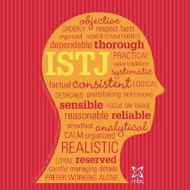
ISTJ: The Inspector
INTROVERTED
Reserved, Controlled, Self-Motivated, Deliberate
SENSING
Realistic, Practical, Detail-Oriented, Traditional
THINKING
Logical, Objective, Pragmatic, Levelheaded
JUDGING
Orderly, Responsible, Methodical, Hardworking
Responsible organizers, driven to create and enforce order within systems and institutions, neat and orderly, tend to have a procedure for everything, reliable, dutiful, uphold tradition, follow regulations, steady, productive, contributor, maintains social order, ensure standards are met, need to know the rules of the game, value predictability more than imagination, most comfortable in familiar surroundings, trust the proven method, hardworking, will persist until a task is done, logical, methodical, enjoy tasks that require them to use step-by-step reasoning to solve a problem, meticulous in attention to details, examine things closely to be sure they are correct, work systematically to bring order to their own small parts of the world
Famous ISTJs: George Washington, Jeff Bezos, Queen Elizabeth II, Harry Truman, Dwight D. Eisenhower, JD Rockefeller, Sigmund Freud, Warren Buffett, Sean Connery

Slide 22
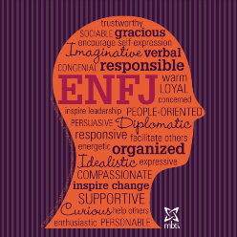
ENFJ: The Teacher
EXTROVERTED
Outgoing, Energetic, Communicative, Warm
INTUITING
Idealistic, Imaginative, Forward-Thinking, Visionary
FEELING
Compassionate, Sympathetic, Ethical, Humanitarian
JUDGING
Dedicated, Ambitious, Organized, Authoritative
Idealist organizers, driven to implement their vision of what is best for humanity, often act as catalysts for human growth, able to see potential in other people, charismatic, focused on values and vision, passionate about the possibilities for people, typically energetic and driven, often have a lot on their plates, tuned into the needs of others, acutely aware of human suffering, tend to be optimistic and forward-thinking, intuitively seeing opportunity for improvement, ambitious, not self-serving, driven by a deep sense of altruism and empathy for other people, believe that cooperation is the best way to get things done, feel personally responsible for making the world a better place
Famous ENFJs: Martin Luther King Jr., Neil deGrasse Tyson, Nelson Mandela, Ronald Reagan, Oprah Winfrey, Tony Blair, James Lipton, Bono, Morgan Freeman

Slide 23
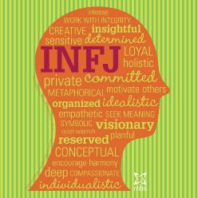
INFJ: The Counselor
INTROVERTED
Composed, Reserved, Independent, Focused
INTUITING
Idealistic, Perceptive, Imaginative, Complex
FEELING
Ethical, Compassionate, Sensitive, Empathetic
JUDGING
Dedicated, Conscientious, Loyal, Steady
Creative nurturers, strong sense of personal integrity, drive to help others realize their potential, creative and dedicated, talented in helping others with original solutions to their personal challenges, able to intuit others' emotions and motivations, trust their insights about others, strong faith in their ability to read people, sensitive, reserved, private, guided by a deeply considered set of personal values, intensely idealistic, can be discouraged by the harsh realities, want a meaningful life and deep connections with others people, typically motivated and persistent in taking positive action, profoundly value authentic connections with people they trust, feel an intrinsic drive to do what they can to make the world a better place
Famous INFJs: Mahatma Gandhi, Thomas Jefferson, Eleanor Roosevelt, Carl Jung, Jimmy Carter, Florence Nightingale, Woodrow Wilson, Ron Paul, George Harrison

Slide 24
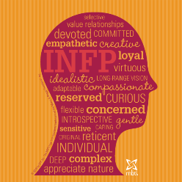
INFP: The Healer
INTROVERTED
Composed, Self-Reliant, Reserved, Thoughtful
INTUITING
Creative, Imaginative, Idealistic, Innovative
FEELING
Empathetic, Sensitive, Ethical, Authentic
PERCEIVING
Flexible, Accepting, Tolerant, Open-Minded
Imaginative idealists, guided by core values and beliefs, possibilities and potential are paramount, pursue truth and meaning with their own individual flair, sensitive, caring, compassionate, deeply concerned with the personal growth of themselves and others, individualistic, nonjudgmental, creative, often artistic, value authenticity, want to be original and individual in what they do, decide for themselves what seems right, often offbeat and unconventional, feel no desire to conform, accepting, flexible, nonjudgmental, accommodating, support others, may react strongly if they feel their values are violated, dislike the idea of one right way to do things, want an open and supportive exchange of ideas
Famous INFPs: John Lennon, JRR Tolkien, Princess Diana, Helen Keller, Jim Morrison, William Shakespeare, Edgar Allen Poe, Vincent van Gogh, Andy Warhol

Slide 25
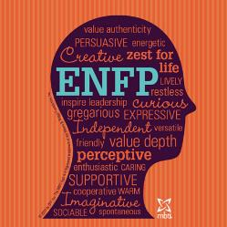
ENFP: The Champion
EXTROVERTED
Enthusiastic, Gregarious, Sociable, Expressive
INTUITING
Imaginative, Unconventional, Forward-Thinking
FEELING
Open-Minded, Spontaneous, Adaptable, Whimsical
PERCEIVING
Orderly, Responsible, Methodical, Hardworking
People-centered creators, focus on possibilities, contagious enthusiasm, energetic, warm, passionate, love to help other people explore their creative potential, agile and expressive communicators, o create engaging stories, imaginative and original, strong artistic side, drawn to art, curious about others, preoccupied with discovering the deeper meaning in people and ideas, want authentic experiences, often seek emotional intensity, easily bored by details and repetition, seek out situations that offer an escape from the mundane, prize individuality, place great importance on personal freedom and self-expression, and want to be able to go wherever inspiration leads
Famous ENFPs: Oscar Wilde, Mark Twain, Hunter S. Thompson, Ralph Nader, Walt Disney, Anne Frank, Kurt Vonnegut, Joseph Campbell, Katie Couric, Jerry Seinfeld

Slide 26
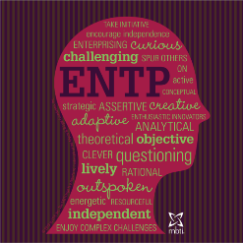
ENTP: The Inventor
EXTROVERTED
Lively, Energetic, Quick-Witted, Clever
INTUITING
Inventive, Imaginative, Entrepreneurial, Futuristic
THINKING
Analytical, Logical, Objective, Unsentimental
PERCEIVING
Open-Minded, Adaptable, Spontaneous, Changeable
Inspired innovators, find new solutions to intellectually challenging problems, curious and clever, seek to comprehend the people, systems, and principles that surround them, open-minded, unconventional, want to analyze, understand, and influence other people, enjoy playing with ideas and like to banter, use their quick wit and command of language to keep the upper hand with other people, often cheerfully poking fun at their habits and eccentricities. enjoys challenging others, but in the end they are usually happy to live and let live, rarely judgmental, re-invent the wheel, question norms, prefer to try a new method, jump into new situations and trust themselves to adapt as they go
Famous ENTPs: Leonardo da Vinci, Benjamin Franklin, Steve Wozniak, Barack Obama, Henry Kissinger, Newt Gingrich, Catherine the Great, Voltaire

Slide 27
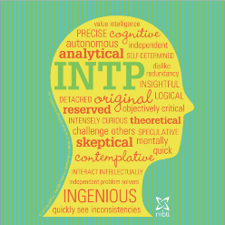
INTP: The Architect
INTROVERTED
Independent, Cool, Thoughtful, Self-Reliant
INTUITING
Innovative, Unconventional, Theoretical, Complex
THINKING
Analytical, Objective, Rational, Unsentimental
PERCEIVING
Tolerant, Open-Minded, Changeable, Unstructured
Philosophical innovators, fascinated by logical analysis, systems and design, focus on theory, seek to understand unifying themes, detached, analytical observers, focus internally: exploring concepts, making connections and seeking understanding, inquisitive, cool exterior, privately passionate about reason, analysis, and innovation, seek to create complex systems of understanding to unify the principles they've observed in their environments, independent problem solvers, active mind, more interested in theory than reality, non-traditional, suspicious of assumptions and conventions, eager to break apart ideas that others take for granted, thoroughly analyze concepts and beliefs
Famous INTPs: Albert Einstein, Charles Darwin, Abraham Lincoln, Marie Curie, Paul Allen, Jane Austen, James Madison, Jimmy Wales, Larry Page, Alan Greenspan

Slide 28
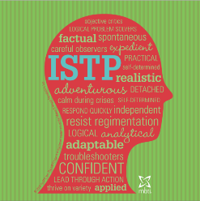
ISTP: The Operator
INTROVERTED
Independent, Self-Reliant, Reserved, Cool
SENSING
Realistic, Hands-On, Grounded, Mechanical
THINKING
Logical, Objective, Unbiased, Pragmatic
PERCEIVING
Responsive, Spontaneous, Flexible, Active
Observant artisans, understand mechanics, interested in troubleshooting, flexible logic approach, looking for practical solutions to the problems at hand, optimistic, generous, confident in abilities, independent, adaptable, self-directed, spontaneous, attentive to details, responsive to demands, astute sense of their environment, quickly respond to emergencies, reserved but not withdrawn, enjoy taking action, appreciates physical and sensory experiences, curious about how things work, detached, independent, treasure personal space, spontaneous, follow their own lead, seek practical understanding, appreciate freedom to do their own thing, prefer technical knowledge to theory
Famous ISTPs: Steve Jobs, Stanley Kubrick, Jack Dorsey, Donald Rumsfeld, Erwin Rommel, Michael Jordan, Amelia Earhart, Frank Zappa, Jack Bauer

Slide 29
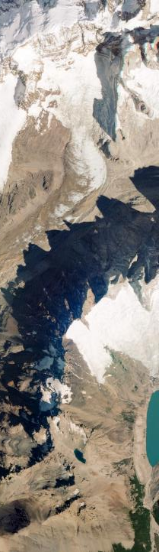
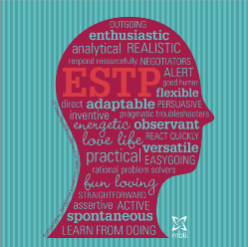
ESTP: The Promoter
EXTROVERTED
Outgoing, Friendly, Engaging, Energetic
SENSING
Hands-On, Practical, Observant, Physical
THINKING
Logical, Objective, Pragmatic, Outspoken
PERCEIVING
Responsive, Spontaneous, Adaptable, Adventurous
Energetic thrill-seekers, dynamic, energetic, assess situations quickly, move adeptly to respond to immediate problems with practical solutions, active, playful, life of the party, at their best when putting out fires (literal or metaphorical), risk takers, good sense of humor, observers, adapt quickly, social but rarely sensitive, fast-paced, natural athletes, highly coordinated, engaged with environment, excellent in emergencies, place a high value on integrity, rational, logical, flexible, tolerant, pragmatic, focus on immediate results, spontaneous, learn through doing, straight-forward, intuitive
Famous ESTPs: Winston Churchill, Theodore Roosevelt, Malcom X, Franklin D. Roosevelt, Alexander the Great, George S. Patton, Bruce Willis, MacGyver

Slide 30
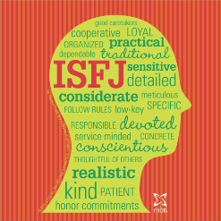
ISFJ: The Protector
INTROVERTED
Reserved, Unassuming, Thoughtful, Calm
SENSING
Practical, Traditional, Observant, Factual
FEELING
Devoted, Caring, Kind, Principled
JUDGING
Organized, Methodical, Dedicated, Persistent
Industrious caretakers, loyal, practical, compassionate, caring, motivated to provide for and protect others, conventional, grounded, steady and committed workers, deep sense of responsibility to others, focus on fulfilling their duties, particularly when they are taking care of the needs of other people, reliable, trustworthy, conscientious, methodical, persist until the job is done, driven by personal values, conscientious in their behavior, want to work hard, get along with others, meet responsibilities and expectations, highly value relationships, cooperative, seek stability and longevity in their relationships, appreciate tradition and established methods and values
Famous ISFJs: Mother Teresa, George Marshall, Rosa Parks, Robert E. Lee, Clara Barton, George H.W. Bush, King George IV, Dr. Watson

Slide 31
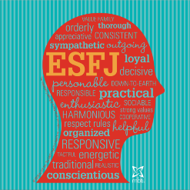
ESFJ: The Provider
EXTROVERTED
Friendly, Outgoing, Expressive, Communicative
SENSING
Grounded, Hands-On, Traditional, Practical
FEELING
Caring, Generous, Sensitive, Nurturing
JUDGING
Loyal, Organized, Conscientious, Disciplined
Conscientious helpers, sensitive to the needs of others, energetic, dedicated, attuned to emotional environment, considerate and attentive to the feelings and perceptions of others, take commitments seriously, high value on safety and security, strong team players, stable, loyal, value loyalty and tradition, generous with their time, effort, and emotions, understand and try to address the needs of others, organized, strict moral code, seek harmony and cooperation, strong sense of personal responsibility, enjoy routine, serious, devoted, practical, productive, warmhearted, altruistic, sociable, perceptive
Famous ESFJs: Andrew Carnegie, Harry S. Truman, Pope Francis, Gerald Ford, Sam Walton, Colin Powell, Barbara Walters, Dave Thomas

Slide 32
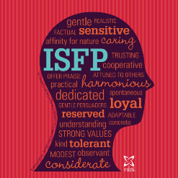
ISFP: The Composer
INTROVERTED
Quiet, Modest, Calm, Gentle
SENSING
Practical, Observant, Hands-On, Grounded
FEELING
Attentive, Kind, Sensitive, Accepting
PERCEIVING
Flexible, Spontaneous, Easygoing, Responsive
Gentle caretakers, cheerful, spontaneous, go with the flow, quiet, unassuming, enjoy the present moment, strong aesthetic sense, seek out beauty in their surroundings, attuned to sensory experience, often have a natural talent for the arts, tolerant, nonjudgmental, deeply loyal to the people and causes that matter to them, accept and support others, ultimately guided by their own core values, accommodating, modest, may underestimate themselves, avoid the spotlight, prefer supporting roles, sensitive, responsive, step in to do what needs to be done and are satisfied by their personal sense of being helpful to others
Famous ISFPs: Jacqueline Kennedy Onassis, Princess Diana, Jonathan Ive, Sofia Coppola, Bob Dylan, Steven Spielberg, Wolfgang

Slide 33
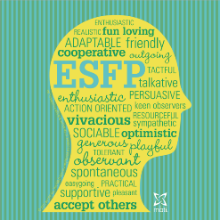
ESFP: The Performer
EXTROVERTED
Enthusiastic, Friendly, Lively, Vivacious
SENSING
Down-to-Earth, Practical, Observant, Sensual
FEELING
Warm, Caring, Expressive, Personable
PERCEIVING
Playful, Spontaneous, Responsive, Casual
Vivacious entertainers, charming, engaging, spontaneous, energetic, people-oriented, fun-loving, warm, talkative, contagious enthusiasm for life, outgoing, friendly, accepting, flexible, like to be in the middle of the action and the center of attention, have a playful, open sense of humor, like to keep busy, can become overextended, practical, down-to-Earth, grounded in reality, strong aesthetic sense, keenly aware of the facts and details in their environment, especially as they pertain to people, observant, responsive in offering assistance, adapt readily to new people and environments, enjoy helping other people, especially in practical, tangible ways
Famous ESFPs: Bill Clinton, John F. Kennedy, Ronald Reagan, Richard Branson, Larry Ellison, Magic Johnson, Marilyn Monroe, Paul McCartney

Slide 34
References
Myers Briggs
www.typefinder.com/view/types
www.myersbriggs.org/
http://kindredgrace.com/mbti/
www.celebritytypes.com/
4D System
http://www.4-dsystems.com/
http://faculty.winthrop.edu/olsena/CSCI475/How%20Nasa%20Builds%20Teams%20%204D%20system.pdf

Slide 35
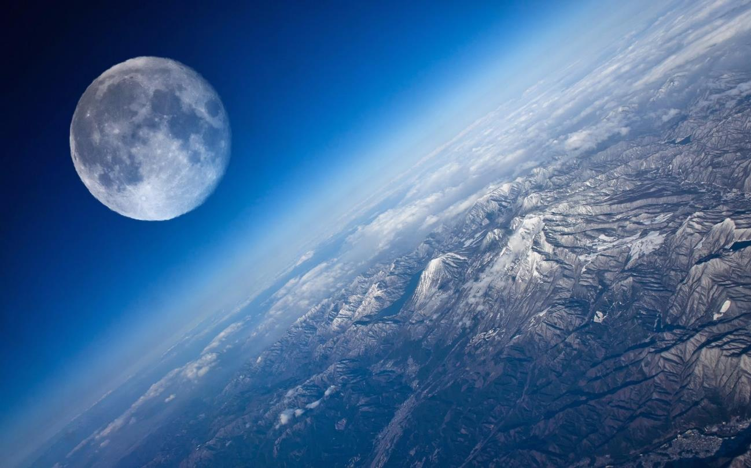
THANK YOU!
Teamwork makes dream work!
Notes:
Your project Website Image should be placed behind the hexagon grid. An example image has been placed in this position for your reference. Delete the example image, insert your image, right click your image and select the “Send to Back” option. Position and adjust the size of your image so that it lines up with the provided margin rulers.

