Slide 1
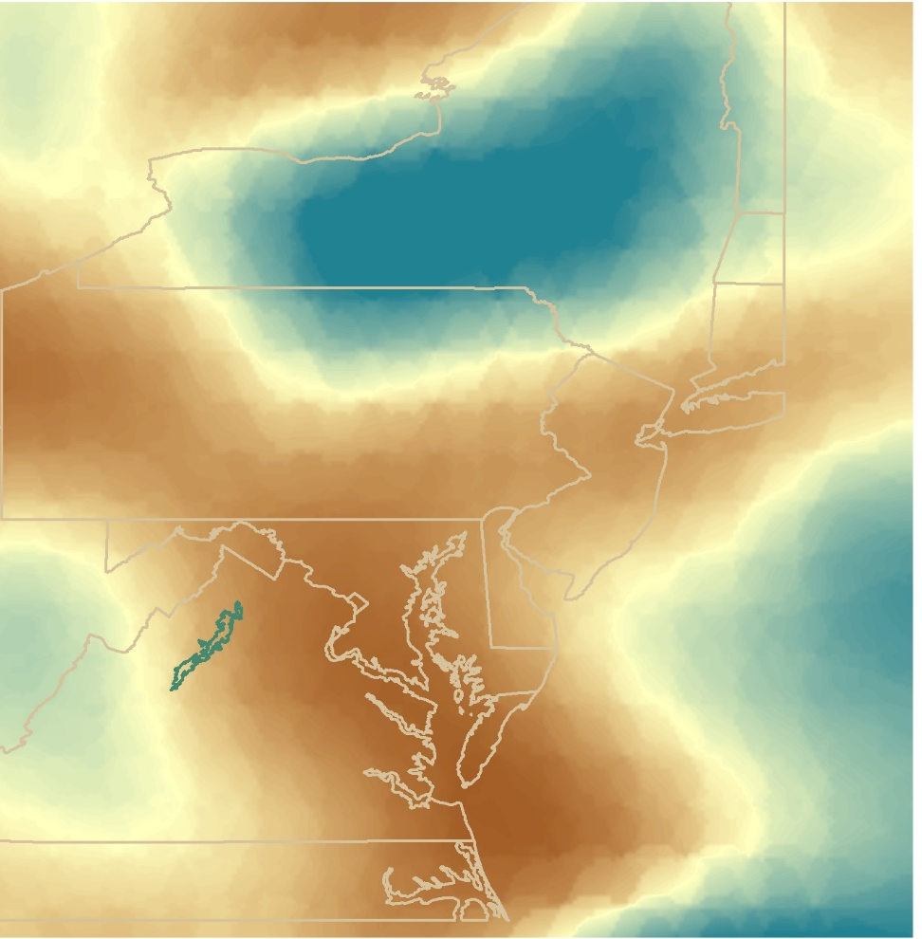


SHENANDOAH HEALTH &
AIR QUALITY II
Monitoring Air Quality in Shenandoah National Park to Address National Park Service Initiatives Using NASA Earth Observations
Emily S. Doerner
Nick Gulston
Andrew Bonifas
Roger Johnson
James Ficklin
Sarah K. Phillips
Virginia – Langley
Fall 2017
Notes:
Thank you all for coming today. This morning my team and I are going to be explaining how to use NASA’s Earth observations to Monitor Air Quality in Shenandoah National Park.

Slide 2
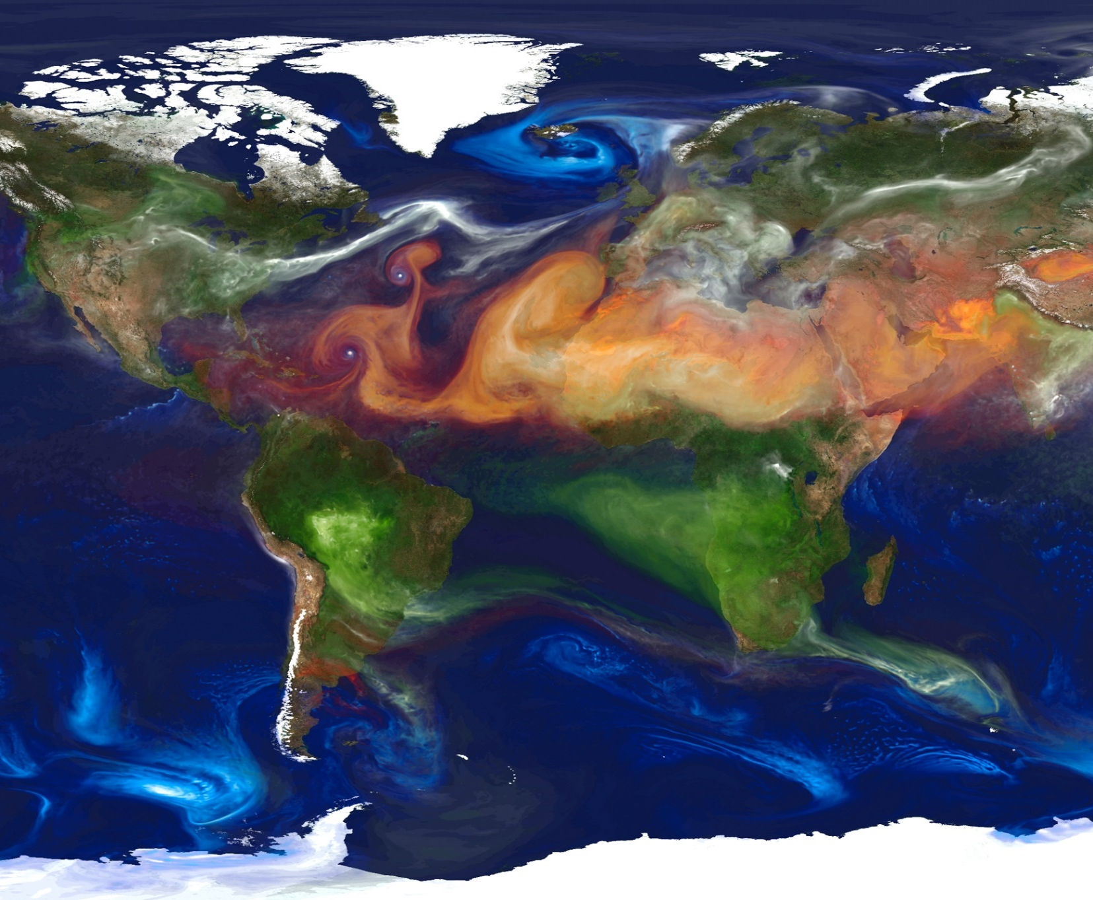
Outline
Scope
Objectives
Partners & concerns
NASA Earth observations
Methodology
Results
Conclusions
Errors & uncertainties
Future work
Image Source: NASA's Scientific Visualization Studio / NASA Center for Climate Simulation
Notes:
Image Credit: https://www.nasa.gov/sites/default/files/images/706644main_705852main_GEOS5_full_full.jpeg

Slide 3
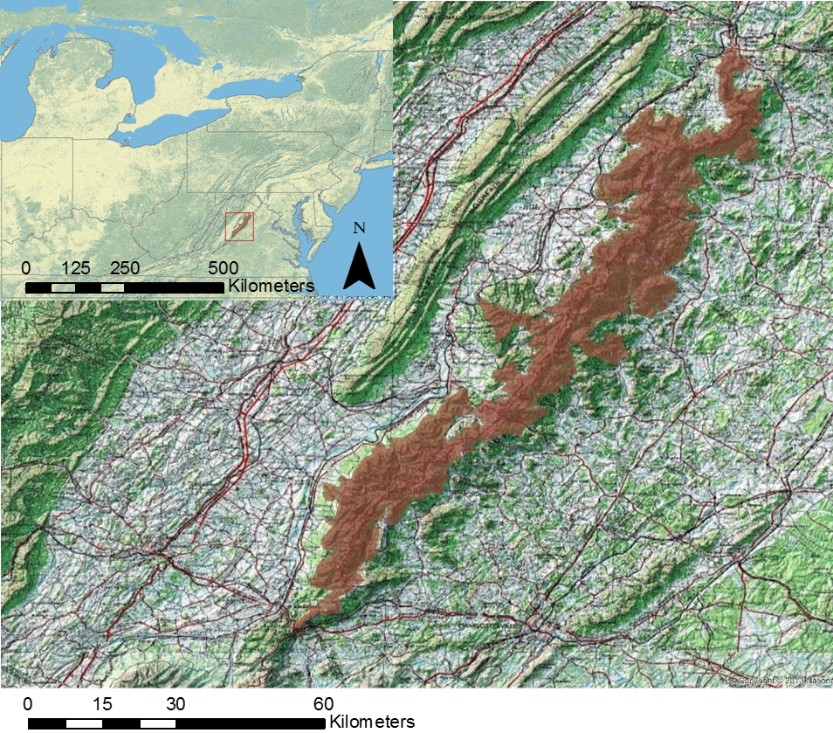
Scope of Project
Shenandoah National Park, Virginia
Coordinates: 38.2928° N, 78.6796° W
Total Area: 500.8 km²
Spans: 8 counties; 197,438 total acres
Topography: 60+ peaks over 915 m
  Highest peak: Hawksbill at 1,234 m
  Lowest elevation: 170 m near north end
Facilities: 830 km of hiking trails
  4 campgrounds
  75 overlooks along Skyline Drive
Visitors: 1+ million people visit the park each year
Notes:
Andrew: Before we dive into the applications for NASA Earth observations, lets look at our study area, Shenandoah National Park. Located in western Virginia Shenandoah National Park spans over 500km2 across 8 counties. The topography of the park varies greatly, the highest peak is over 1200 meters and the lowest elevation is 170 meters. The Park sees roughly 1 million visitors each year who enjoy camping, hiking, and Shenandoah’s famous Skyline Drive.
Image Source: Shenandoah Health & Air Quality II

Slide 4
Objectives
Continue to introduce applications of NASA Earth observations to Shenandoah National Park (SNP) to supplement current air quality monitoring efforts
Assess the feasibility and effectiveness of current NASA Earth observations to measure surface visibility and ground-level ozone (O₃)
Create a tutorial to help park officials incorporate NASA Earth observations into their management decisions related to park health and air quality concerns
Display trend maps showing the surface visibility and ground-level O₃
Notes:
Andrew: Our objective for this project was to continue the work of past DEVELOP projects to use NASA Earth observations to monitor air quality in Shenandoah National Park, to Assess the feasibility and effectiveness of current NASA Earth Observations to monitor surface visibility and ground levels ozone in the Park, to create a tutorial for National Park officials to incorporate NASA Earth Observations into their management decisions related to park health, and to display trends in surface visibility and ground level ozone.

Slide 5
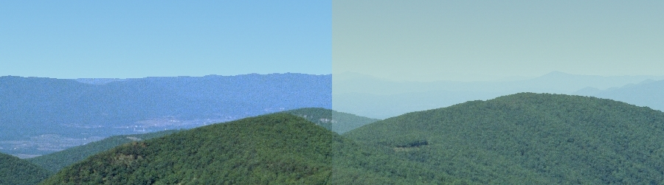

Objectives
SHEN: Rocky Mount, 2007 Image Credit: WinHaze
Our Partners & Their Community Concerns
A decrease in visibility of scenic views due to atmospheric pollutants adversely affects the park’s attendance.
Ground-level O₃ is a pollutant that poses significant health risks to plants, wildlife, and humans.
Shenandoah has special protections under the Clean Air Act, yet they still have some of the highest levels of air pollution than any other national park.
Notes:
Andrew: Through this project we hope to address concerns that Shenandoah National Park, and the larger community, have about access to scenic views, plant, animal, and human health, and acting in compliance with National air quality regulations.
Image Source: WinHaze, http://vista.cira.colostate.edu/Improve/winhaze/

Slide 6
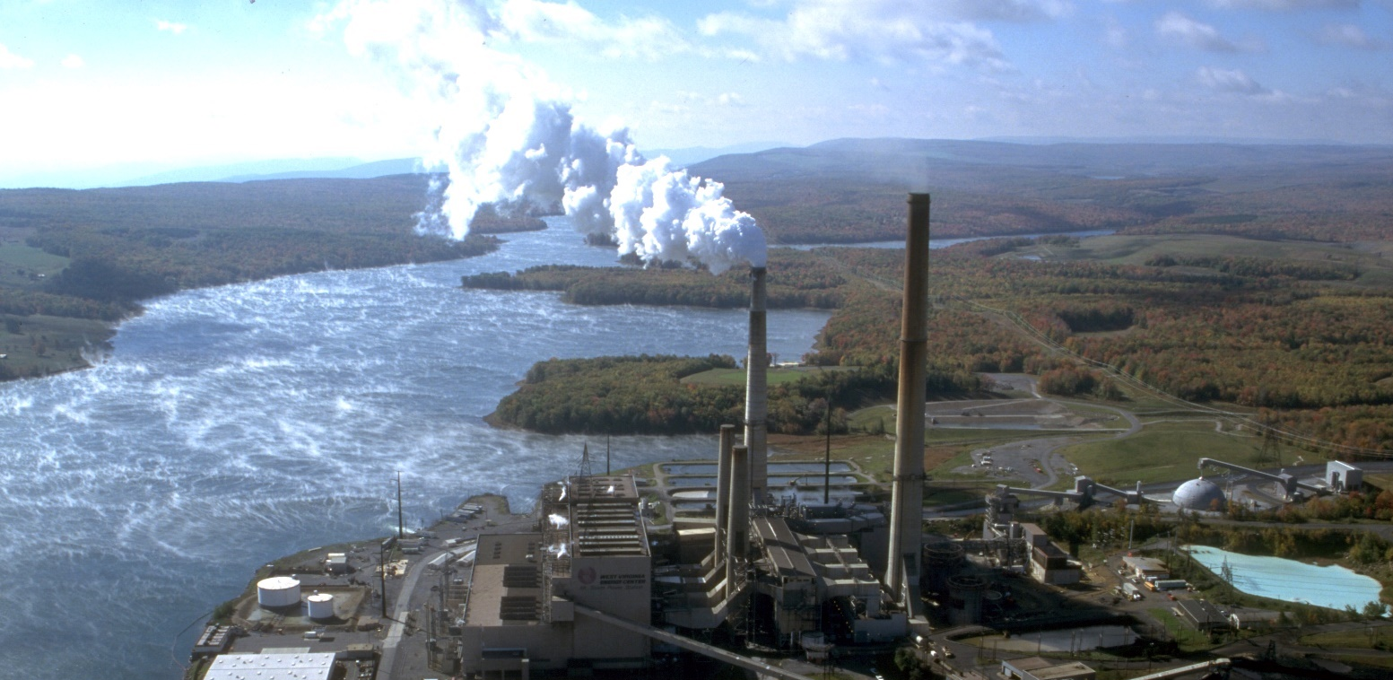
Air Quality in Shenandoah National Park
Categories of air pollution
  Airborne nitrogen dioxide (NO₂) & sulfur dioxide (SO₂)
  Ground-level ozone (O₃)
  Haze
Mount Storm Power Plant, West Virginia
Image Credit: Wikimedia Commonss
Ground-level O₃ is formed by the photo-oxidation of nitrogen oxides (NO_{X}) and volatile organic compounds (VOCs)
Smoke, dust, humidity, and air pollution from the area surrounding the park create haze
Notes:
Andrew: Previous NASA DEVELOP teams conducted an air quality study of Shenandoah National Park looking at Nitrogen dioxide and sulfur dioxide. This project address the remaining two of three major air quality concerns in Shenandoah National Park, ground-level ozone and haze.
Ground level ozone is formed by the photo-oxidation of nitrogen oxides (NOx) and volatile organic compounds (VOCs). Here was can see VOC’s entering the atmosphere from a factory in Shenandoah Valley.
Smoke, dust, humidity and air pollution from the area surrounding SNP, the Ohio River Valley, West Virginia, and Kentucky carried by air sheds to SNP, create haze. According to Shenandoah National Park, on average, haze reduces visibility in the park by 80%.
Image Credit: https://commons.wikimedia.org/wiki/File:Mount_Storm_Power_Plant,_Aerial.jpg

Slide 7
Monitoring Air Quality in the Park
IMPROVE (Interagency Monitoring of Protected Visual Environments) to monitor visibility begins operating in the park
NASA Earth observations were used this summer to monitor visibility, O₃, NO₂, and SO₂ throughout the park
CASTNET (Clean Air Standards and Trends Network) was created with cooperation from NOAA, and begins operating in park
Monitoring instruments were first installed at Big Meadows to measure particulate matter
1981
1987
1990
2017
Notes:
Sarah: Shenandoah National Park has been monitoring air quality since the 1980s. Improvements in technology have given Shenandoah National Park access to faster, more accurate air quality data. NASA DEVELOP partnered with Shenandoah National Park and the National Parks service to use NASA’s earth observations as another mode for assessing air quality in the park.

Slide 8


NASA Earth Observations
Aqua MODIS
Terra MODIS
Notes:
James: We used aerosol optical depth (AOD) from MODIS on board the Aqua and Terra satellites, in addition too…
Images Source: http://www.devpedia.developexchange.com/dp/index.php?title=List_of_Satellite_Pictures

Slide 9
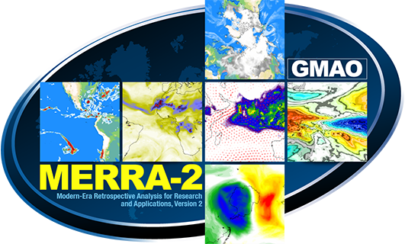
Data Products Used
Visibility (MODIS & MERRA-2)
Aerosol Optical Depth (AOD)
Aerosol Extinction Profiles
Ozone (derived from Aura OMI-MLS)
Surface Tropopause Pressure
Tropospheric Ozone Residuals (TOR)
Modern-Era Retrospective Analysis for Research and Applications, Version 2 (MERRA-2)
Image Credit: NASA Goddard, Global Modeling and Assimilation Office
Notes:
Jame: aerosol optical depth (AOD), aerosol extinction profiles, and tropopause pressure from NASA’s MERRA-2 model and Tropospheric Ozone Residual (TOR)’s from NASA Goddard’s Homepage for tropospheric ozone
Image Credit: NASA Goddard, Global Modeling and Assimilation Office

Slide 10
In situ Monitoring
CASTNET (Clean Air Standards and Trends Network) located at Big Meadows in SNP
IMPROVE (Interagency Monitoring of Protected Visual Environments) located at Big Meadows in SNP
ASOS (Automated Surface Observing System) from 30 select stations located within a 200km radius of SNP
Ozone
Visibility
Visibility
Credit: Shenandoah National Park
Notes:
Sarah: To give confidence and validate our results we used CASTNET and IMPROVE ground station data from the Big Meadows monitoring station in Shenandoah National Park. We also used visibility estimates from 30 select ASOS stations located within a 120km radius of Shenandoah National Park with varying elevations.

Slide 11
Methodology
CASTNET (ozone measurements); Tropospheric Ozone Residuals (TOR); IMPROVE and ASOS (in situ visibility measurements); Aqua & Terra MODIS AOD; MERRA-2 extinction profiles
Convert data into GIS-ready formats and same units of measure; extract 10am and 1pm timeframe for ASOS; apply Koschmieder’s Law to calculate visibility
Compare Earth observations and model-based estimations of visibility with ASOS reference data; create time series and trend maps; calculate statistics
Data Acquisition
Data Processing
Data
Analysis
CASTNET (ozone measurements); Tropospheric Ozone Residuals (TOR); IMPROVE and ASOS (in situ visibility measurements); MODIS Aqua & Terra AOD; MERRA-2 extinction profiles
Convert TOR, MODIS, MERRA-2 into GIS-ready formats; extract 1pm timeframe for ASOS
Compare Earth observations and model-based estimations of visibility with ASOS reference data; create time series and trend maps
Data Acquisition
Data Processing
Data Analysis
Notes:
James: Once we downloaded all our data from the GES DAAC and from NASA Goddard’s Homepage for tropospheric ozone we wrote code to convert this data into GIS-ready formats. We then applied Koschmieder’s Law to calculate visibility based on the MERRA-2 aerosol extinction profiles, and converted the tropospheric ozone residuals from Dobson units to parts per billion volume. We then created trend maps of our data and compared our data to the ground monitoring stations.

Slide 12
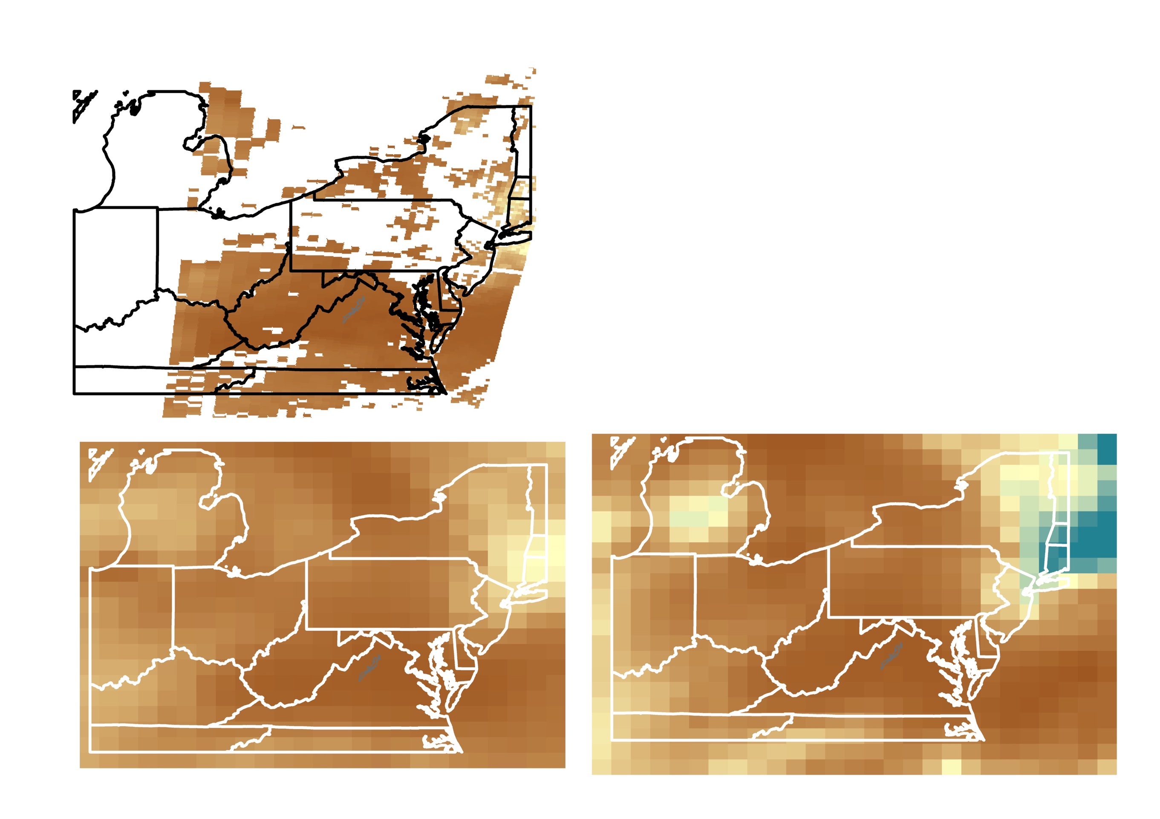
Results of Case Study #1: Visibility
June 10, 2015
Comparison between
MODIS AOD, MERRA-2 AOD, and
MERRA-2 Extinction Profiles
MODIS AOD
Good
Visibility
150 km
Poor
Visibility
0 km
MERRA-2 AOD
MERRA-2 Extinction Profile
Notes:
Emily: Visibility estimates derived from MODIS AOD, MERRA-2 AOD, and MERRA-2 extinction profiles all vary greatly. MODIS provides finer resolution, but rarely covers the entire study area, we did not have enough cloud free days to calculate a reliable correlation coefficient. MERRA -2 extinction had the highest coorlation to ground station standard visual range, but it requires a lot of post processing to make it user friendly and usefully to our partners at the National Park., MERRA-2 AOD had the second best correlation and was easy to calculate, but it has poor spatial resolution.
The three visibility predictors give us different values, but each shows the same pattern. We can see for example, that June 10th, 2015 is a particularly poor visibility day.

Slide 13
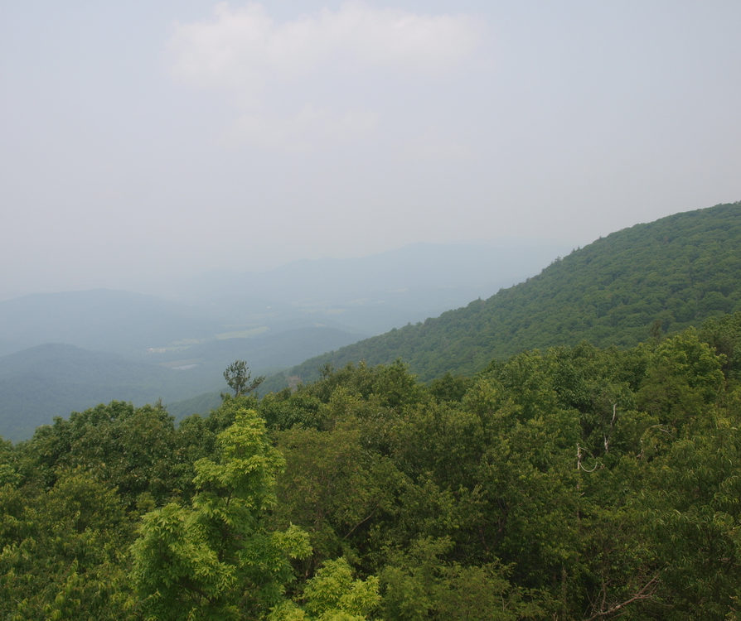
Results: Visibility
June 10, 2015 at 2:00pm EST
Air Web Cam Photo: View from Pinnacles, Skyline Drive, Shenandoah National Park
R = 0.514
Photo Credit: Air Web Cam (SNP)
Notes:
Emily: When we compare our findings to what is taking place on the ground, we see that we are fairly accurate. According the Shenandoah National Park’s Air Web Cam, June 10, 2015 is a poor visibility day. When we run a correlation analysis with visibility data from MERRA-2 and MODIS we find that the models are fairly good at predicting visibility below 150 km, above that they are not very accurate at all.

Slide 14
Results of Case Study #2: Ozone
June 2007 and 2016
TOR in ppbv
TOR in ppbv
2007
2016
High O₃
75 ppbv
Low O₃
60 ppbv
Notes:
James: In these two maps we can see a comparison of June average ozone over Shenandoah National Park in 2007 and 2016. Both of these maps show relatively high ozone levels.
O₃ concentrations tend to increase with elevation
Forested areas have higher concentrations of O₃ than the industrial areas where most of the pollutant sources are located

Slide 15
Further Ozone Results
R = 0.526
Notes:
Emily: We used MERRA-2 surface and tropopause pressure to convert the Tropospheric Ozone residuals from Dopson units to parts per billion volume. We can see from the top graph that the tropopause fluctuates significantly throughout the year. As predicted higher, ozone levels correlate with lower tropopause pressure.
Studies have indicated that “Pristine” wilderness areas have monthly averages between 25 to 50ppbv, based on the graph we can see that Shenandoah is well above this range, and therefore requires ozone monitoring.
We calculated correlation coefficients with Tropospheric Ozone Residuals and Big Meadows CASTNET data at 0.526. This is not a terribly strong correlation but it is in line with other studies that have used NASA Earth observations to quantify ground-level ozone.
When we plot out ozone residuals against the ground station data we can see that ozone peaks in the spring, the difference in the peaks could indicate there is some significant stratospheric-tropospheric exchange going on.

Slide 16
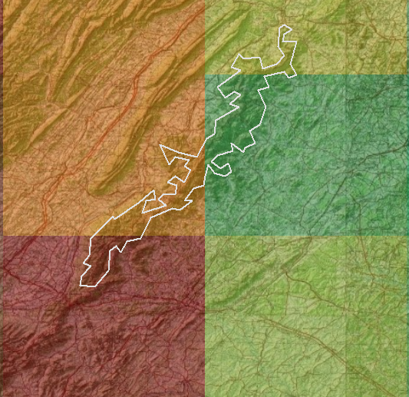
Errors & Uncertainties
Extinction Profiles
Coarse Resolution
MERRA-2 extinction profile are only accessible with calculator from a NCCS computer, thus they are difficult to calculate and obtain
TOR data has a coarse spatial and temporal resolution
MERRA-2 extinction profiles are modelled globally and, therefore, have coarse resolution
For example, the Park covers just FOUR pixels →
1
2
3
4
Notes:
James: The greatest uncertainty associated with our research is the coarse spatial and temporal resolution of the Tropospheric Ozone Residuals and MERRA -2 model. Finer resolution would provide more accurate measurements of ground-level ozone in Shenandoah National Park. Another uncertainty of this project is its ability to be replicated by our partners because of the use of MERRA-2 aerosol extinction at 532 nm because these profiles were calculated using NASA Goddard's NCCS computer. These profiles they are difficult to calculate and obtain.
Image Source: Shenandoah Health & Air Quality II

Slide 17
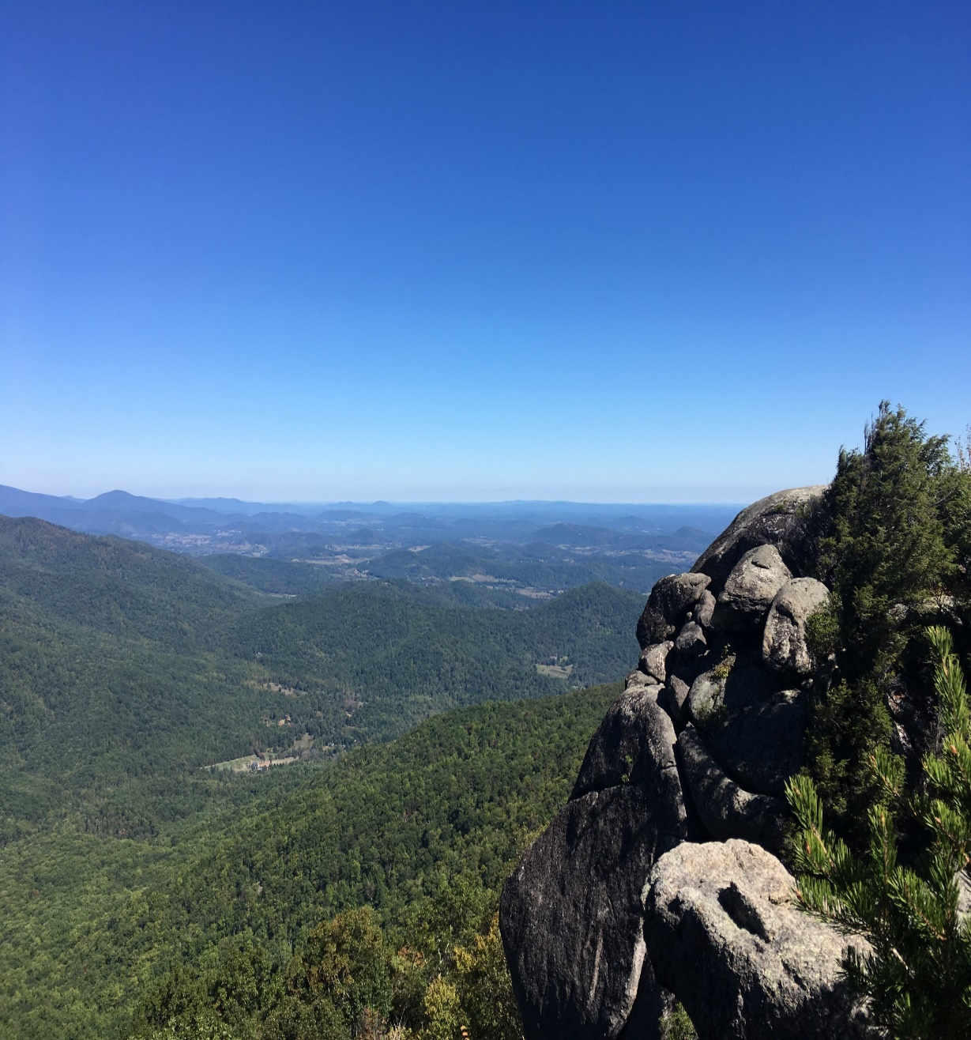
Future Work
Visibility Predictor Tool
Look-up table
AOD Comparison between MERRA-2 and MODIS
Sentinel-5P and TEMPO
  More accurate air pollution measurements
  Finer temporal modeling techniques
Photo Credit: Emily Doerner
Notes:
Emily: In the future we would like to create a tool for the National Parks to predict visibility possible using GOES-5, which can provide us with a ten day forecast. We would also like to provide a look up table, you download the MERRA or MODIS AOD level for the park and based on the table you can estimate the visibility in km. This would provide the park with faster visibility estimates for the entire park. Improvements in Earth observing systems would improve the accuracy and potential predictive ability of our data. Sentinel-5P satellite will be a step forward in pollution monitoring although the data is unlikely to be available until next summer. The TEMPO (Tropospheric Emissions: Monitoring Pollution) mission, set to launch in 2019, will be the first space-based instrument to monitor major air pollutants across the North American continent every daylight hour at high spatial resolution.
I look forward to being able to play with their data.

Slide 18
Acknowledgements
Subject Research Contributors:
Dr. Hongyu Liu, NASA Langley Research Center
Dr. Jerry R. Ziemke, NASA Goddard Space Flight Center
Science Advisors:
Dr. Bruce Doddridge, NASA Langley Research Center
Dr. Rich Ferrare, NASA Langley Research Center
Dr. Kenton Ross, NASA Langley Research Center
Partners:
Jalyn Cummings, National Park Service, Shenandoah National Park
Dr. Barkley Sive, National Park Service, Air Resources Division, Research & Monitoring Branch
Previous DEVELOP team:
Ellen Bubak, Amanda Clayton, Doug Gardiner, Nicholas Lenfant, Julie Terhune
Notes:
James: We would like the thank all our contributors and advisor for their support and our partners, Jalyn Cummings and Dr. Barkley Sive, at the National Park service for their help. This project would not have been possible without Dr. Hongyu Liu, Dr. Bruce Doddridge, and Dr. Kenton Ross.

