Slide 1
Louisiana Ecological Forecasting II
Using UAVSAR, AVIRIS, and AirSWOT to Model Coupled Water Flow and Sediment Transport for Delta Building within the Wax Lake Delta, Louisiana to Inform Coastal Restoration Efforts
Erika Higa (Project Lead)
Emily Beck
Mark Barker
Notes:
We are the Louisiana Ecological Forecasting team II. This spring we participated in a project using UAVSAR, AVIRIS, and AirSWOT data to model coupled water flow and sediment transport in the Wax Lake Delta.

Slide 2
Introduction
Wetlands reduce the impacts from storm damage and flooding.
Filter harmful pollutants and store large amounts of carbon
Louisiana loses about 75 km² of wetlands per year.
Interestingly, the Wax Lake Delta has been steadily aggregating.
Image Credit: Dr. Alex Kolker
Notes:
Wetlands play a key role in the global environment and are linked to major issues such as climate change, water quality, and the carbon cycle. They act as a buffer zone during severe storms by absorbing water and dissipating wave energy. Additionally, they help in filtering harmful chemicals, and storing large amounts of carbon caused by air pollution.
This makes healthy wetlands crucial to maintaining a balanced hydrological system. Unfortunately, Louisiana’s 3 million acres of its coastal wetlands are currently being lost at a rate of about 75 square kilometers annually.
Image provided by Dr. Alex Kolker

Slide 3
Community Concerns
Potential loss of up to 1/3 of Louisiana's coastal wetlands by 2050
80 miles of LA coastline are only 1 ft. above sea level
Negative impacts to critical habitat and economy
60-70% of population within 50 miles of the coast
Image Credit: Dr. Alex Kolker
Notes:
Louisiana’s coastal wetlands are being lost at a rate equivalent to a football field of wetlands an hour.
So what does that mean for Louisiana in the long term?
Well with current USGS predictions, Louisiana is likely to lose up to one-third of its coastal wetlands by 2050 due to erosion, land subsidence, and sea level rise. These losses will result the destruction of critical habit for a large variety of unique flora and fauna along Louisiana’s coast as well as a having significant economic impacts to the well-established 1 billion dollar fishing and shrimping industry.
It is also important to keep in mind that between 60 and 70% of the state’s population lives within 50 miles of the coast. Without any adequate coastal restoration and protection, 2 million people are left vulnerable to life-threatening storms and hurricanes.
Image provided by Dr. Alex Kolker

Slide 4
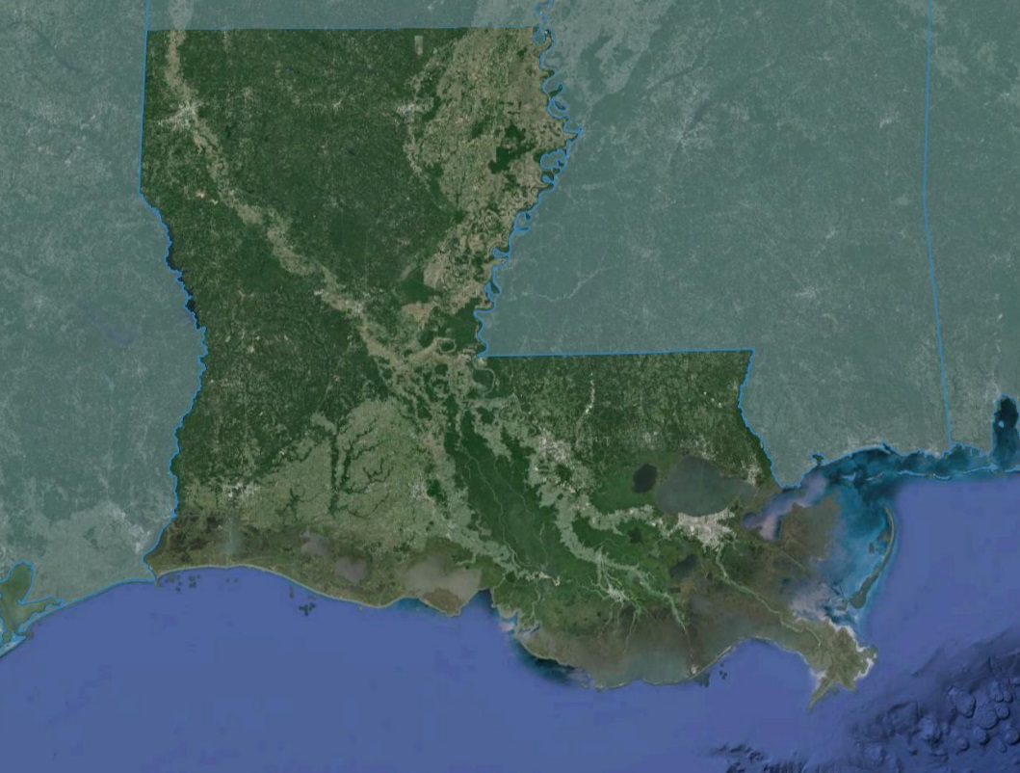
Study Area
Wax Lake Delta, Louisiana
Study Period: April 2015 – May 2015
Notes:
The study area for this project is the Wax Lake Delta, located on the southern coast of Louisiana.

Slide 5
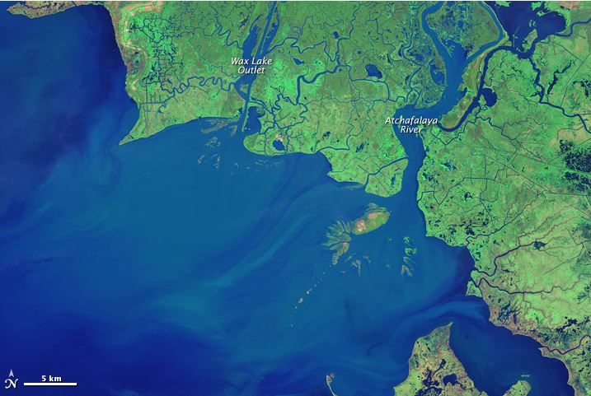
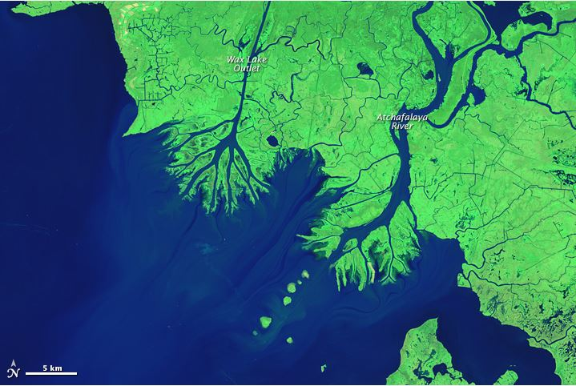
Wax Lake Delta
Delta is built by sediment carried by the Atchafalaya River
The delta grows 1.2 km² (0.46 m²) per year
Rate of growth varies with the timing of floods and hurricanes
1984
2014
Image Credit: NASA
Notes:
The Wax Lake Delta in Louisiana is a well-studied area due to it being one of only two deltas in the state that is currently building land.
The delta was created over time by deposition of sediment which occurred after the creation of a manmade canal through Wax Lake in 1942. The U. S. Army Corps of Engineers created this artificial channel in the outlet to reduce the amount of flooding in Morgan City, this diverted about 30 percent of the flow from the Atchafalaya River.
The deltas currently grows at a rate of 1.2 square kilometers per year, but that rate can vary with time and the severity of floods and hurricanes in the area.
Image Credit: http://earthobservatory.nasa.gov/Features/WorldOfChange/wax_lake.php

Slide 6
Objectives
Extrapolate delta vegetation elevations using UAVSAR
Model water flow and sediment transport using Deltares Delft3D
Calibrate resulting model with AirSWOT
Examine delta formation processes to gain a better understanding of why the Wax Lake Delta is aggregating
Notes:
The first objective of this project is to derive vegetation elevation in the delta using UAVSAR imagery with a combination of estuarine bathymetry data to create a full coverage bathymetry image to be used in Delft3D.
The second objective is to then model water flow and sediment transport using this layer within Delft3D.
The third objective is to calibrate the results from Delft3D with readings from AirSWOT.
Lastly, our fourth objective is to examine the delta formation processes within the model to hopefully gain a more detailed understanding of the deltas aggregation process.

Slide 7
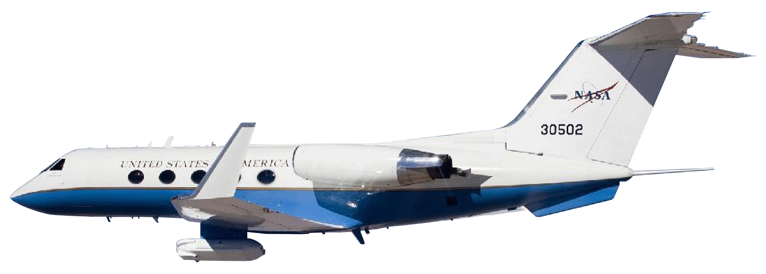
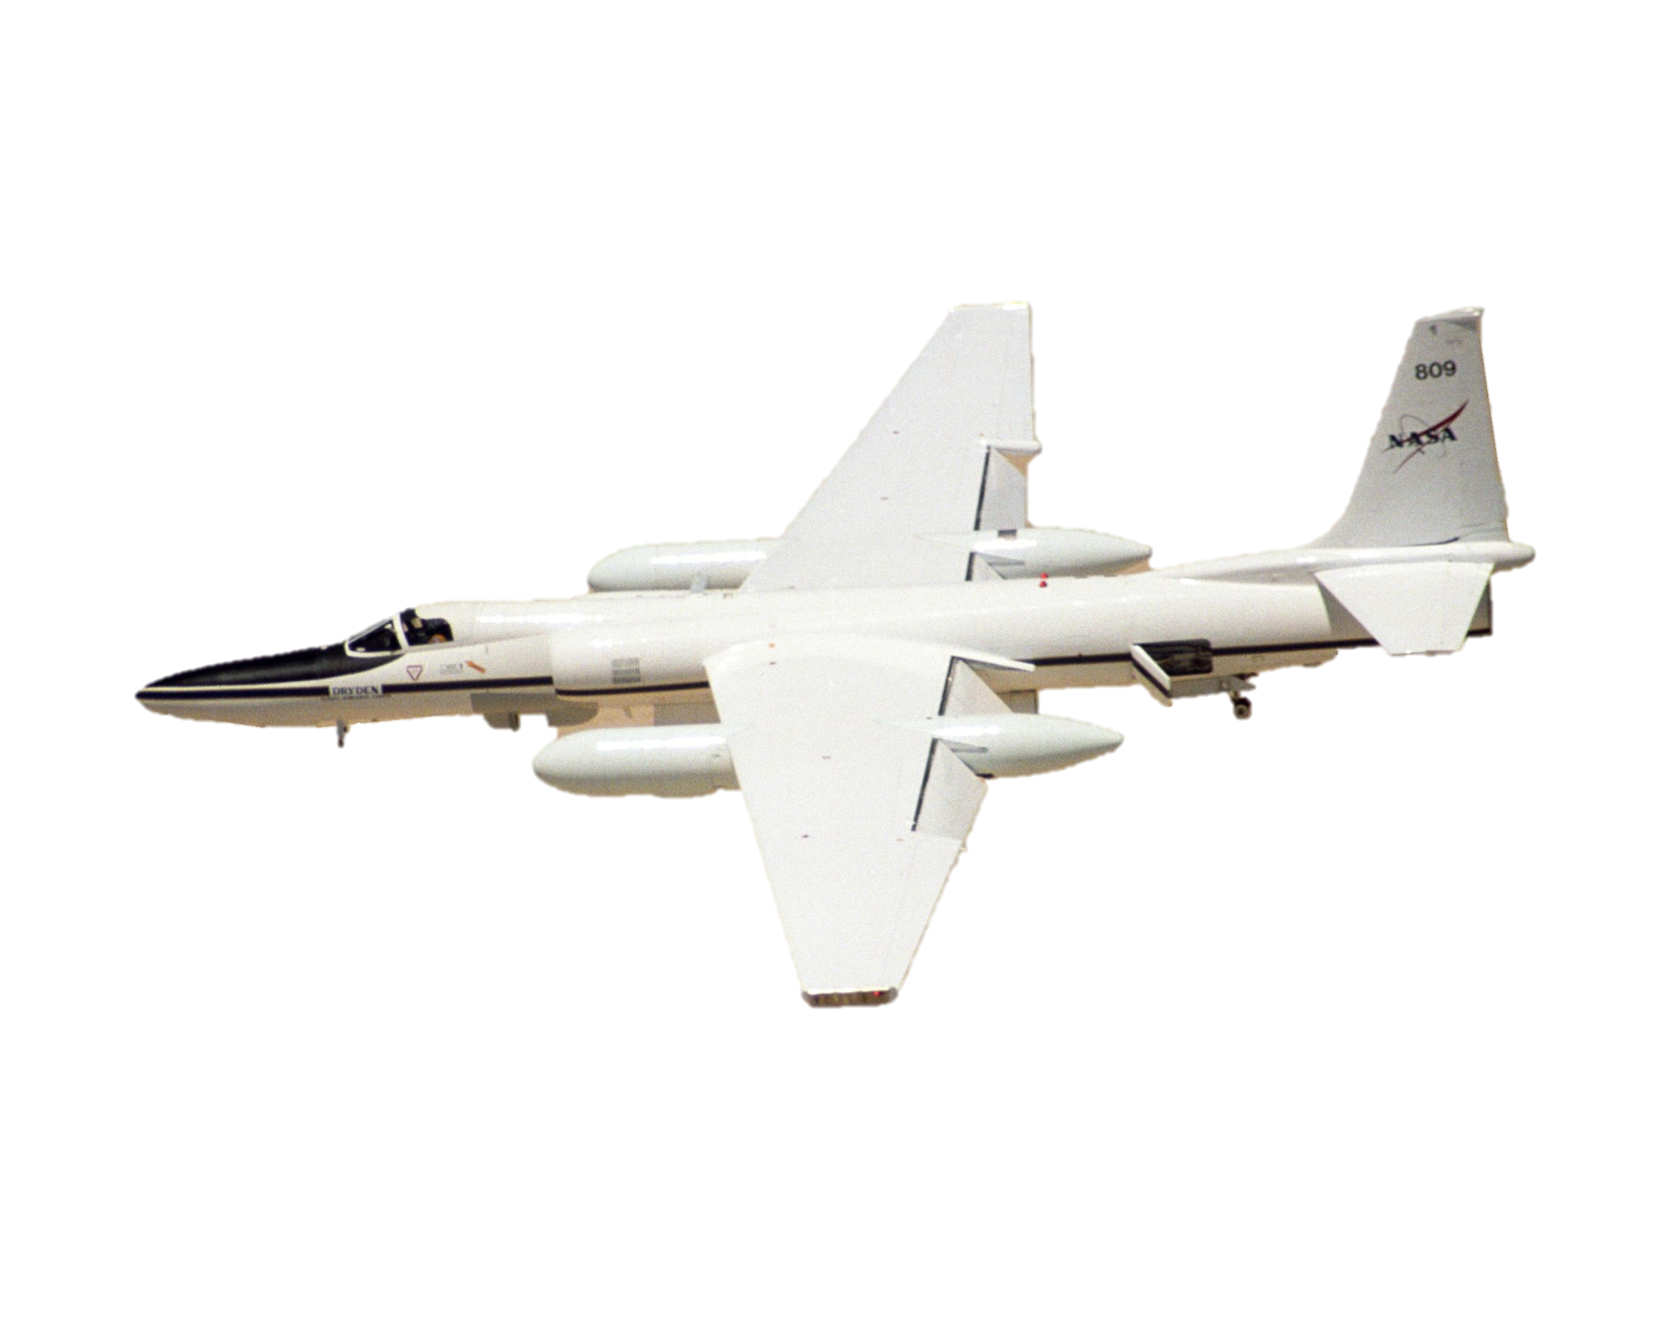
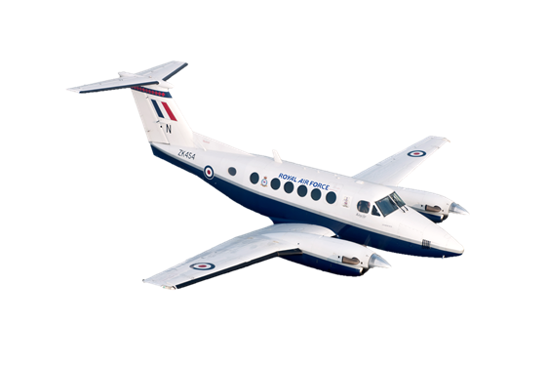
NASA Earth Observation Systems
UAVSAR
L- band Radar
High spatial resolution (6m)
HVHV
AVIRIS-NG
Hyperspectral Sensor
High spatial resolution (4m)
AirSWOT
Centimeter-level water surface detection
Landsat 8 OLI
Space borne, 16 days
Lower spatial resolution (30m)
Image Credit: NASA JPL
Notes:
Four NASA Earth Observations were used in this project, UAVSAR, AVIRIS-NG, AirSWOT, and Landsat 8 OLI.
The Uninhabited Aerial Vehicle Synthetic Aperture Radar (UAVSAR) is an airborne sensor on a Gulfstream III aircraft and uses an L-band radar which penetrates smoke and clouds. UAVSAR data has a high spatial resolution of 6 meters and is available in multiple forms of polarization. In our study, we focused on the HVHV polarization which shows the most radar backscatter interaction with the vegetation. This data was used to create the vegetation elevation layer in our bathymetry image.
The Airborne Visible Infrared Imaging Spectrometer Next Generation (AVIRIS-NG) is a hyperspectral sensor aboard an ER-2 Jet. It has a high spatial resolution of 4 meters and is used to identify vegetation types around the delta.
The Air Surface Water Ocean Topography (AirSWOT) is a new airborne sensor, onboard a KingAir B200, that can detect water surfaces and flood plains at a centimeter-level. AirSWOT data is used to calibrate our modeled results produced from Delft3D.
Landsat 8 Operational Land Imager (OLI) was used to map the land cover in and around the Wax Lake Delta.

Slide 8
Methodology
Raster Datasets of Bathymetry
(ESRI ArcGIS)
Vegetation Elevation Mask from UAVSAR
(Python)
Modeled Sediment Transport
Calibrate Model using AirSWOT Data
Delft3D Hydrological Model
Vegetation Species Classification from AVIRIS
(Exelis ENVI)
Modeled Water Flow
In Situ Data: Vegetation Species, Water Level, Flow Rate
Notes:
The inputs into the Delft3D Hydrological model include the delta and coastal bathymetry layers which are combined with the Vegetation elevation mask from UAVSAR. Vegetation classification from AVIRIS along with multiple in situ sensors and readings to provide water level and flow rate are then incorporated.
The outputs from the Delft3D model are then calibrated using water surface height measurements from the AirSWOT sensor. The end products include modeled sediment transport and modeled water flow.

Slide 9
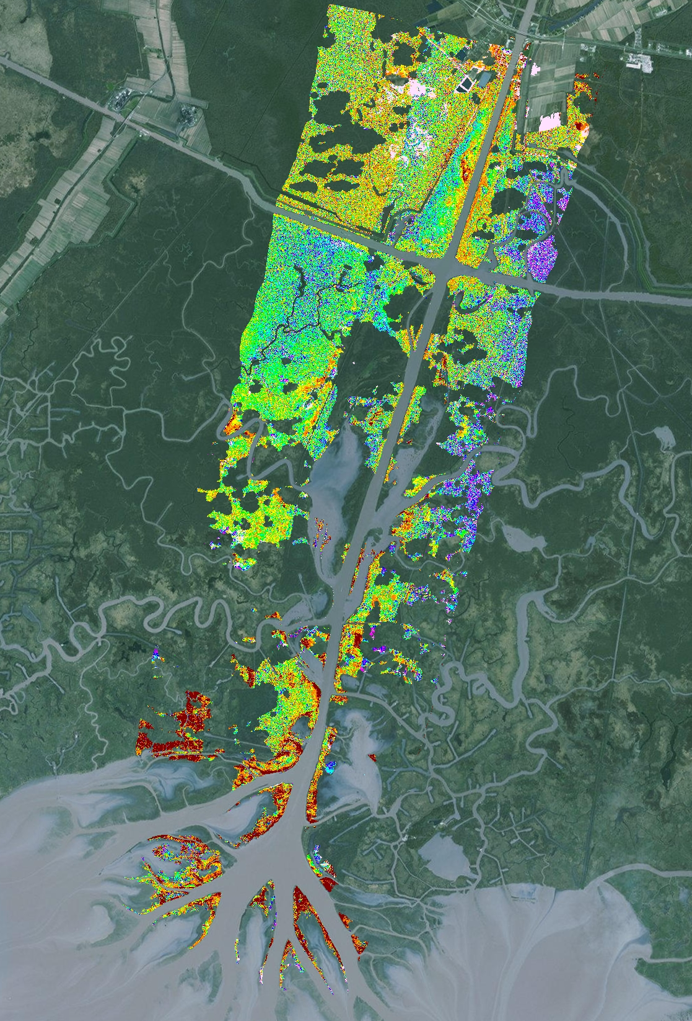
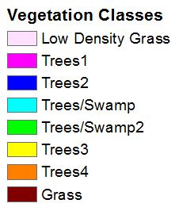
AVIRIS-NG
Vegetation Classification
Clouds, Shadows, and Water masked out
ISODATA Unsupervised Classification on 11 bands
Result: 8 generalized classes
Notes:
The AVIRIS-NG data was collected in May 2015. Multiple swaths were collected over the study area, but only three calibrated and mosaiced swaths were available for use in this project. Clouds, shadows, and water were masked out since these areas would interfere greatly with the classification process.
AVIRIS-NG has 432 spectral bands and 11 bands that were sensitive to vegetation conditions were chosen to do an ISODATA Unsupervised classification. The end result of the classification process was 8 generalized land cover classes.
Since there were holes in the AVIRIS-NG image, a land cover map from Landsat 8 OLI data was created to compare the land cover results.

Slide 10
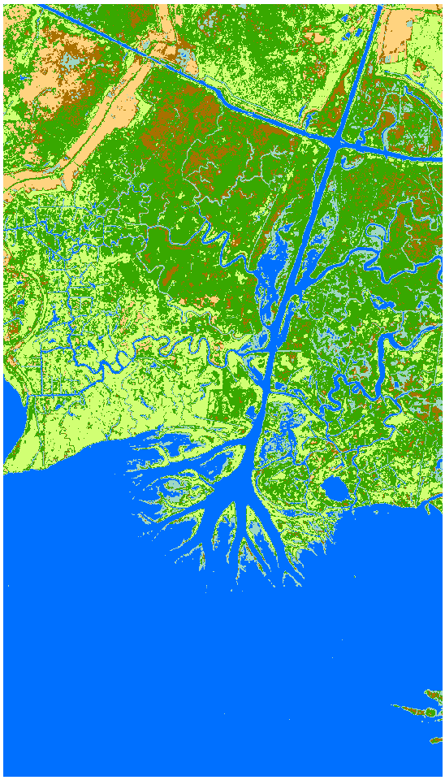
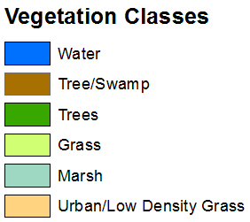
Landsat 8 OLI
Vegetation Classification
Cloud free image from April 19th, 2015
ISODATA Unsupervised Classification on 3 bands
Result: 6 generalized classes
Notes:
A cloud free Landsat 8 OLI data from April 19th, 2015 was used to do an ISODATA Unsupervised classification on three bands: 3 (Green), 5 (NIR), and 6 (SWIR). Since these 3 bands are the least correlated out of all the Landsat 8 bands, it was optimal to use for classification.
The result was 6 generalized land cover classes.

Slide 11
Vegetation Classes
Landsat 8 OLI
AVIRIS-NG
Notes:
There are clear differences between the Landsat 8 and AVIRIS-NG vegetation classes. Landsat 8 is useful for a broad classification of vegetation, while AVIRIS-NG is able to detect and map vegetation on a species level. However, there was no training data and a condensed field data of species type in the study area to identify species and test the accuracy of the vegetation map. Looking at the two maps, AVIRIS-NG shows promise in classifying vegetation on a species level which will be useful in incorporating vegetation roughness based on the species in the Delft3D model.

Slide 12
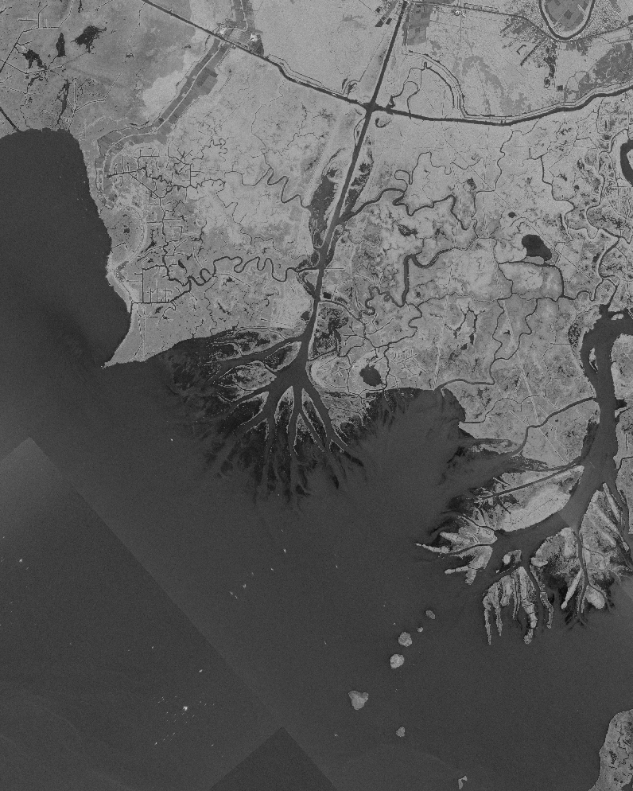
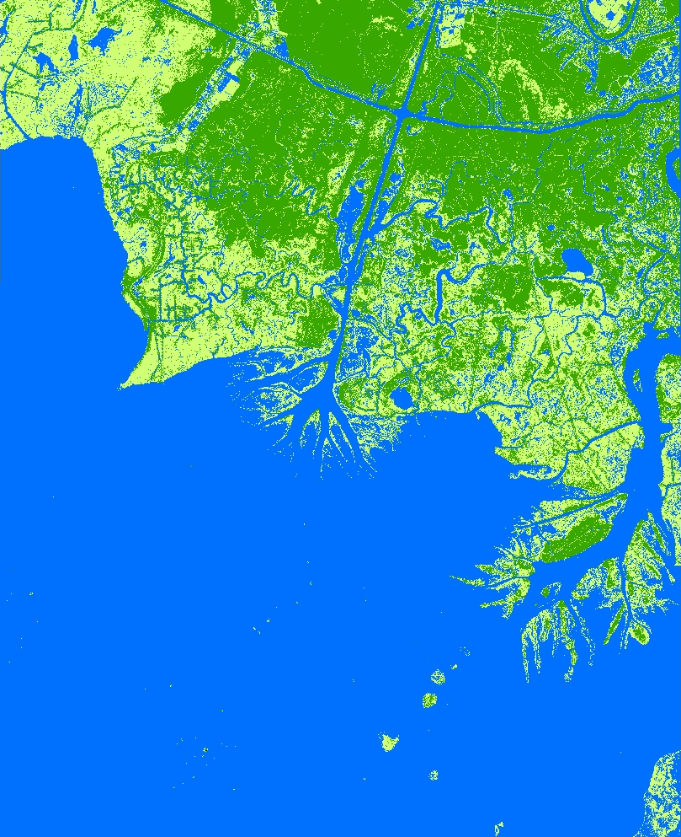
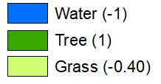
UAVSAR Classification
Decibel values reclassifed into 3 Vegetation-Elevation Classes
Decibel ranges | Vegetation classification | Elevation (m)
< -24 | Water | -1
< -17 | Grass | -0.40
< -2 | Tree | 1
Notes:
We received a processed mosaicked UAVSAR image from Dr. Marc Simard that was collected on May 2015. The image was reclassified into three vegetation classes based on the backscatter values. Water was classified in areas that had a decibel value below -24. Grass was classified in areas that had a value below -17, and trees was classified in areas that had a decibel value below -2.
The data was given preliminary elevation values according to the vegetation type— -1 meters for water, -0.40 meters for grass, and 1 meter for trees. These elevation values will be changed later as discussed in the next slides.
Note: The UAVSAR data reclassification process was processed through a python script using tools from GDAL with Python. The decibel ranges were chosen by creating Region of Interests (ROIs) on the image for each vegetation class and observing the mean and standard deviation ranges of the decibel value per class.

Slide 13
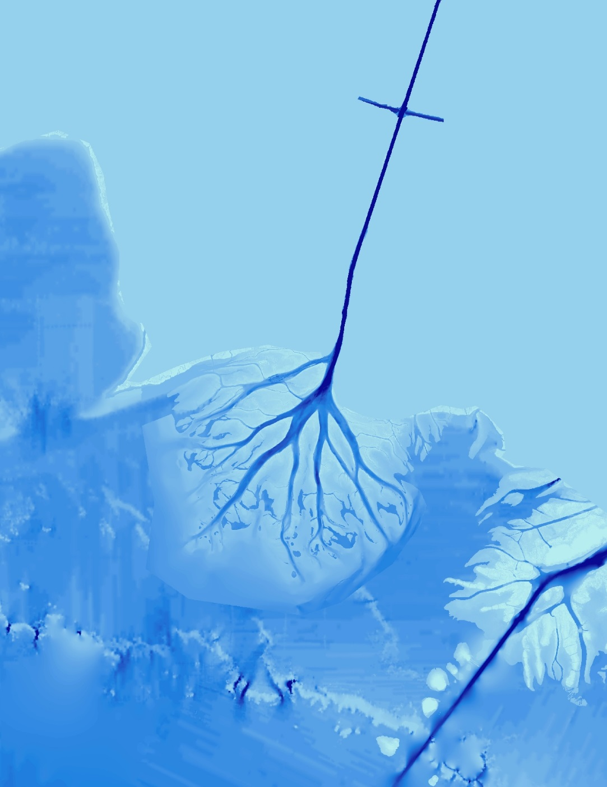
Bathymetry
Interpolated channel derived from USACE transects
Delta layer from Dr. John Shaw (Univ. of Arkansas)
CoNED TBDEM
Notes:
We created the bathymetry layer by combining three different datasets. We used a Wax Lake Outlet channel bathymetry that was interpolated from the US Army Corps of Engineers (USACE) transect points 1998 Atchafalaya River Hydrographic Survey. Dr. John Shaw from the University of Arkansas created and provided the bathymetry for the Wax Lake Delta. For the offshore bathymetry and middle channel, we used the Coastal National Elevation Database (CoNED) Topobathymetric Digital Elevation Model (TBDEM) dataset.

Slide 14
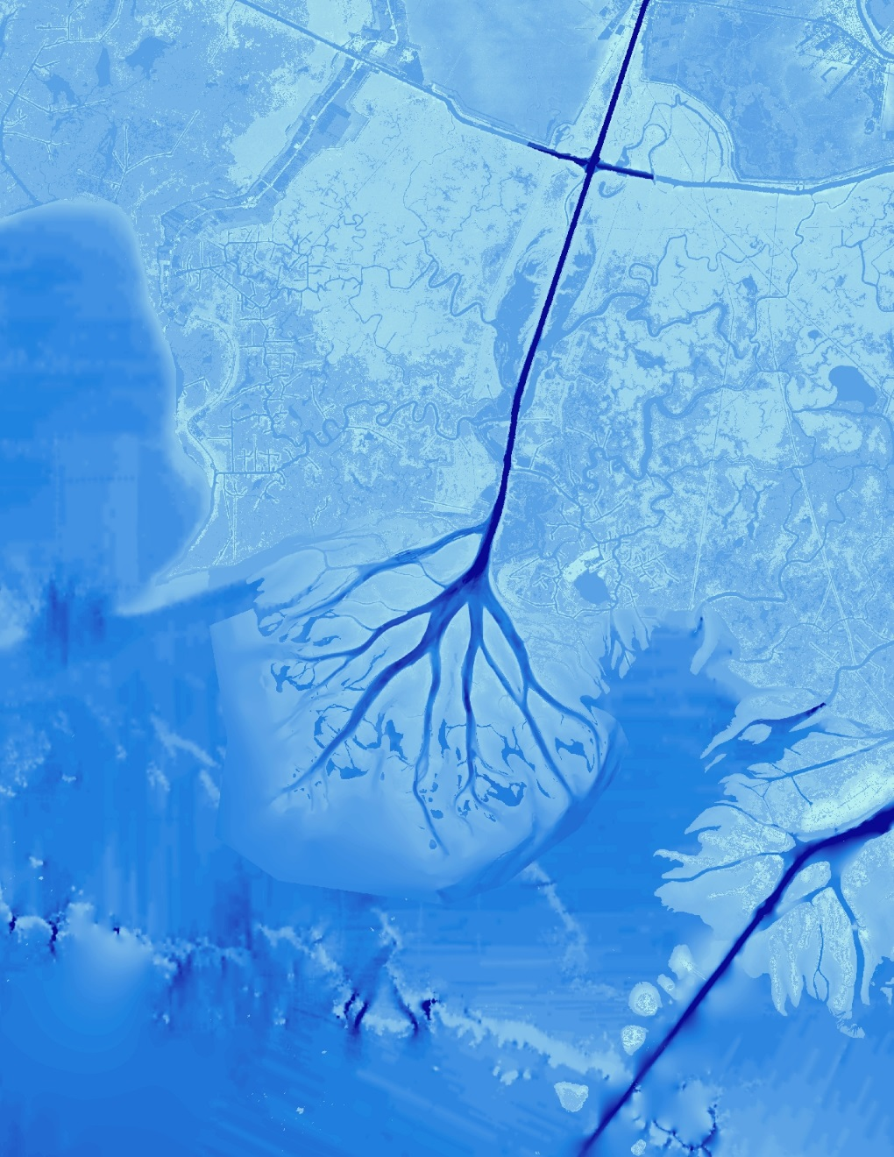
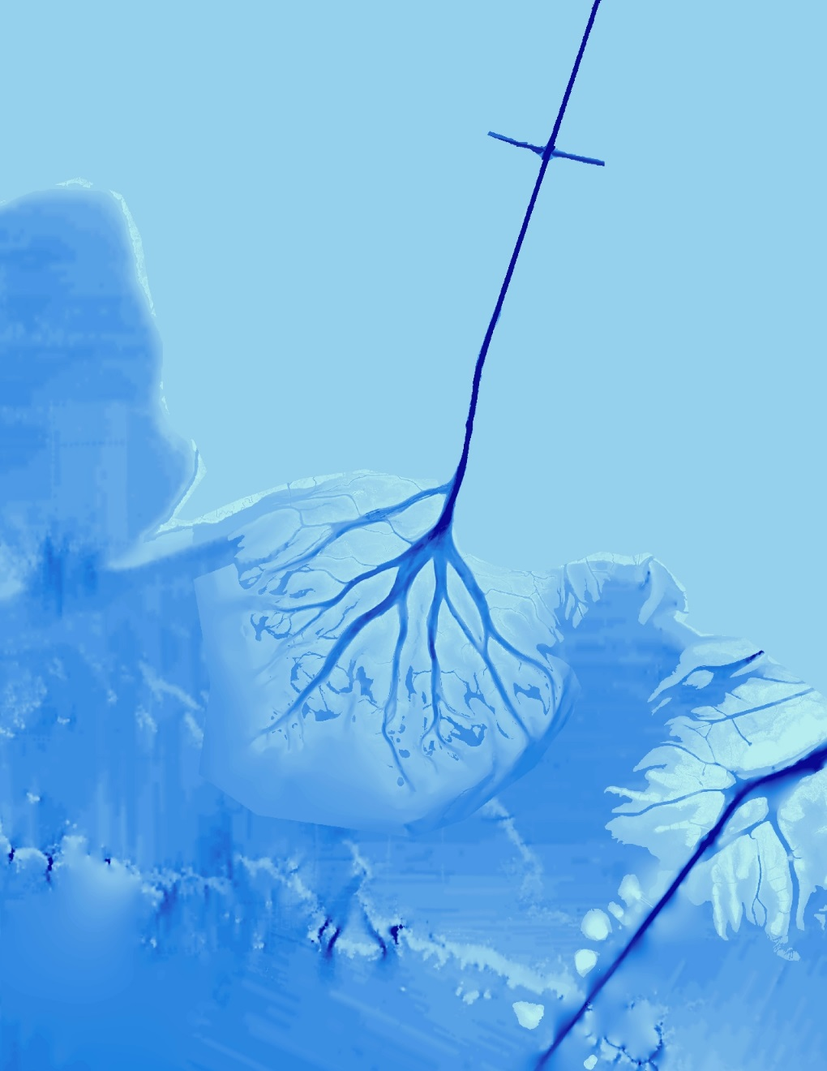
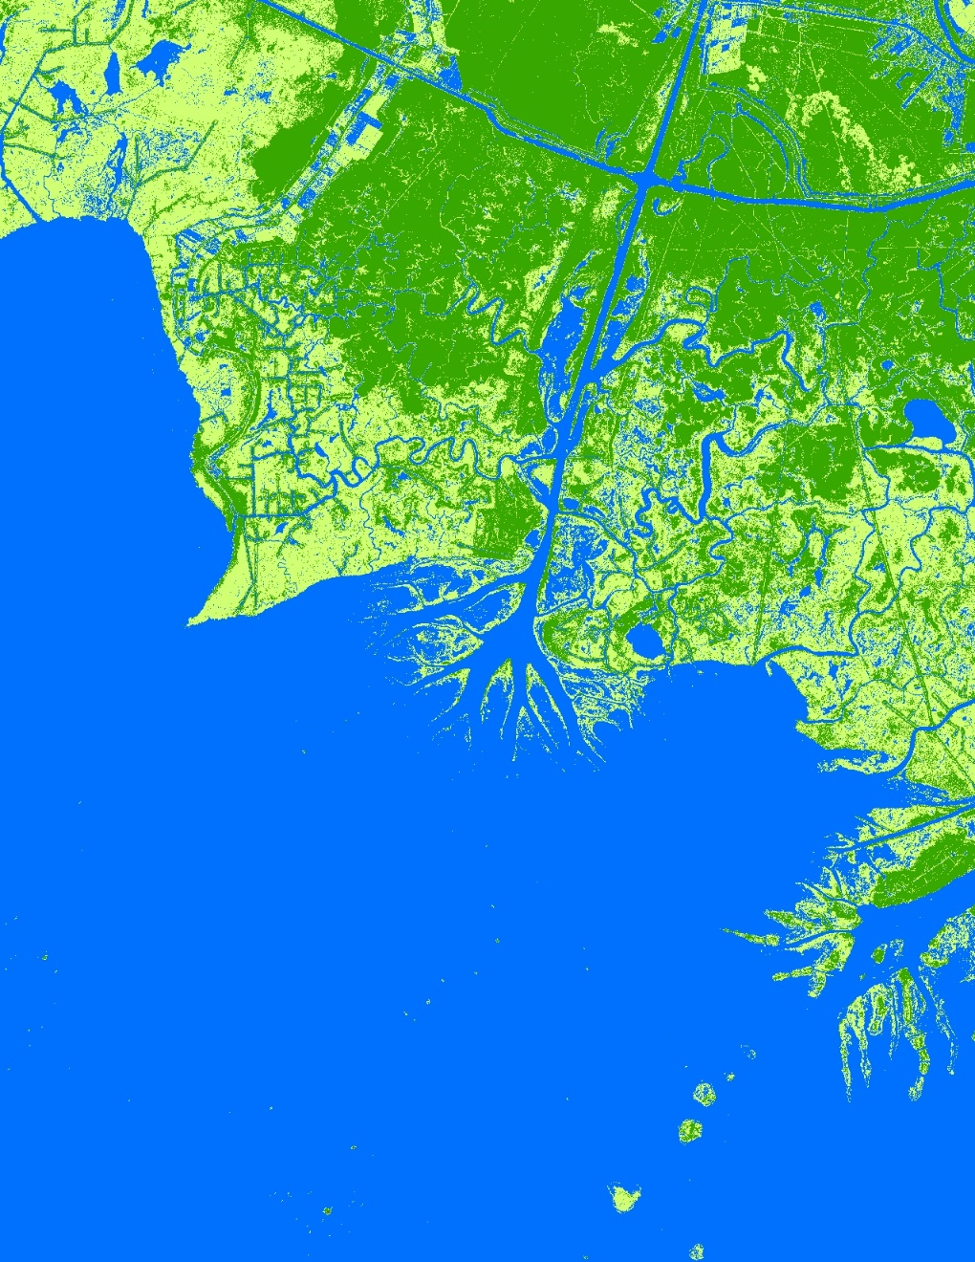
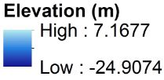
Bathymetry and Vegetation Elevation
Merged the classified UAVSAR image with the Bathymetry layer
Areas classified as trees in the UAVSAR image were replaced with bare earth elevation values
Notes:
We created this bathymetry and vegetation elevation raster by combining the bathymetry and classified UAVSAR data. The areas that were classified as water but were not covered in the bathymetry layer were given an arbitrary value of -1 meter. This value was mainly given to streams and other water bodies located outside of the channel.
The areas that were classified as trees (and given an arbitrary elevation value of 1 meter) in the UAVSAR image were replaced with bare earth elevation values from the USGS National Elevation Dataset (NED).
The elevation value of -0.40 meters remained for areas that were classified as grass.

Slide 15
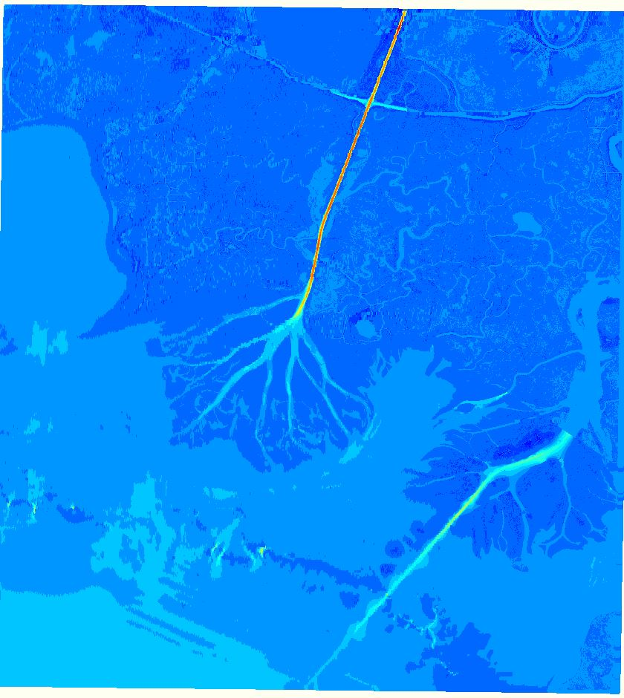
Delft3D
A 2D/3D modeling suite for fluvial, estuarine and coastal environments
FLOW: a hydrodynamic simulation program that calculates transport
Capable of modeling flow, transport and morphological changes
Notes:
We created a hydrological model using Deltares Delft3D. Delft 3D is a 2D/3D modeling suite to investigate hydrodynamics, sediment transport and morphology and water quality for fluvial, estuarine and coastal environments. The software has a 30 year track record and is frequently used in published scientific research since it is capable of modeling flow, transport, and morphological changes.

Slide 16
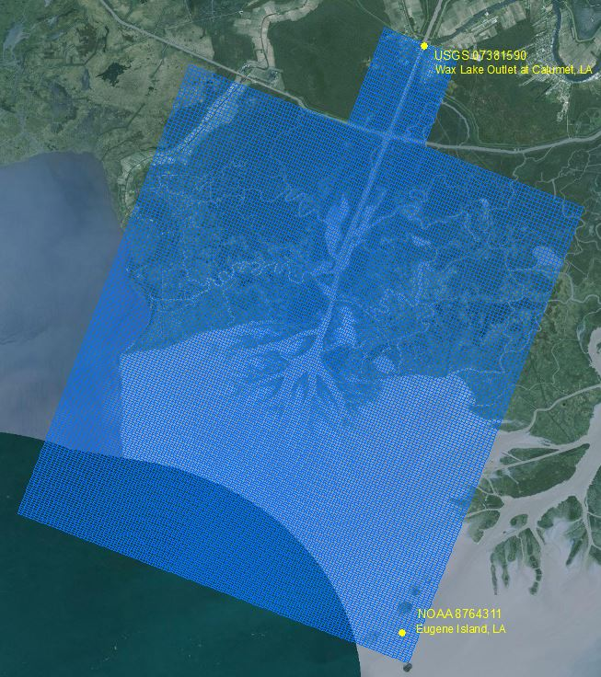
Model Setup
Model domain was built using bathymetry data and a rectangular model grid.
Boundary conditions set using time series data from USGS and NOAA gage stations.
Parameters populated based on in situ data.
Notes:
The model domain was built using created bathymetry and a rectangular model grid that encompassed the study area. The model has two open boundary conditions : an upstream discharge boundary based on discharge time series data from the USGS Wax Lake Outlet gage at Calumet, Louisiana and an ocean water level boundary based on data from the NOAA Eugene Island gage. Initial conditions and physical parameters were populated using in situ data.

Slide 17
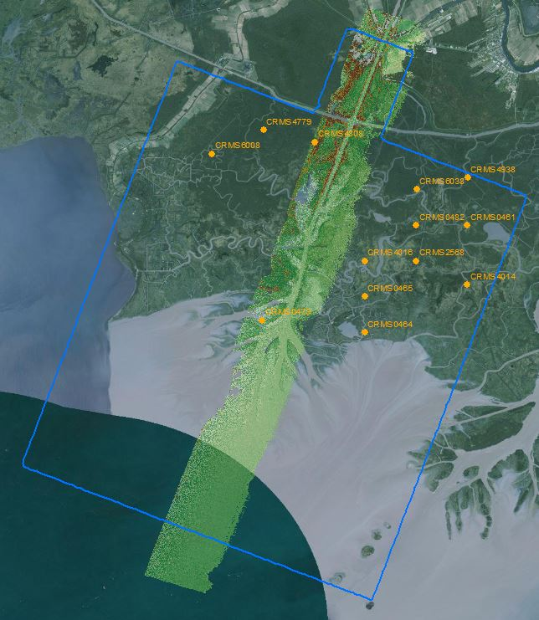
Calibration
Calibration efforts involved comparing modeled outputs to measured data
Calibration datasets:
LA CRMS water level data
AirSWOT
Further work is needed to finalize calibration
Notes:
Modeled water level was compared to measured water level using observation points in the model domain. Water level at the observation points was compared to water level at corresponding gage stations in the state of Louisiana’s Coastwide Reference Monitoring System (CRMS), and water surface height from AirSWOT sensor data.

Slide 18
Preliminary Model Output
Notes:
This is a video of the model output time series.

Slide 19
Future Work
Finalize model calibration using in situ data and water surface height from the AirSWOT sensor.
Assess the impact of vegetation on water flow using a simulated plant layer in Delft3D.
Use the model to forecast land building and examine potential impacts of sea level rise due to climate change.
Image Credit: Dr. Alex Kolker
Notes:
For future work, the model needs to be calibrated further with in situ data and measured water surface height from the AirSWOT sensor. The calibration process will help with making the model run better since the flow rates will be similar to the real-world flow rates occurring in the delta. Vegetation roughness will need to be incorporated from AVIRIS-NG data and in situ data in order to simulate the impact of vegetation on water and sediment flow by adding a simulated vegetation plant layer in Delft3D. It is by creating a simulated plant layer in Delft 3D and calibrating the model, the model can further be used to forecast land building and examine potential impacts of sea level rise due to climate change.

Slide 20
Conclusions
Created an extensive bathymetry layer
Constructed a detailed hydrological model in Delft3D
Identified 8 generalized land cover types from AVIRIS-NG data
A more robust model that will include vegetation biomass from NASA AVIRIS-NG still needs to be conducted
Image Credit: Dr. Alex Kolker
Notes:
This spring term, we were able to construct a detailed hydrological model of the Wax Lake Delta in Delft3D which included a more extensive bathymetry layer created from UAVSAR and multiple topo-bathymetric datasets.
Eight generalized land cover types were derived from AVIRIS-NG data and more work needs to be done to include vegetation biomass in Delft3D.
The Delft3D model can be used to model sediment transport and water flow with a combination of earth observation data and in situ data.
Image provided by Dr. Alex Kolker

Slide 21
Partners
Alex Kolker
Louisiana Universities Marine Consortium
Working on 2017 Louisiana coastal Master Plan
Richard Crout
United States Naval Research Laboratory, Stennis Space Center
Image Credit: Dr. Alex Kolker
Notes:
Our project partners in this project includes Dr. Alex Kolker of the Louisiana Universities Marine Consortium and Dr. Richard Crout of the United States Naval Research Laboratory.
Dr. Kolker is an academic liaison to the 2017 Louisiana’s Comprehensive Master Plan for a Sustainable Coast. The products from this project will provide Dr. Kolker a broad-scale picture of the accretion process to inform the development of an improved sediment distribution algorithm that will help these managers understand how to direct land restoration efforts along the Louisiana coast.
Dr. Crout is currently investigating buoyancy plume modulation of coastal processes in the area impacted by the Mississippi and Atchafalaya River discharge. Dr. Crout is working on a project that utilizes an ocean circulation model that requires water level and discharge rates from the Atchafalaya Bay. The products from this project will be useful as an input in his model.
Image provided by Dr. Alex Kolker

Slide 22
Advisors
Dr. Cathleen Jones, NASA Jet Propulsion Laboratory
Dr. Marc Simard, NASA Jet Propulsion Laboratory
Partners
Richard Crout, US Naval Research Laboratory (NRL)
Dr. Alexander Kolker, Louisiana Universities Marine Consortium
Others
Gwen Miller, DEVELOP at NASA Jet Propulsion Laboratory
Doug Edmonds, Delft3D
John Barras, USGS
Dr. John Shaw, University of Arkansas
Brittany Zajic and Raul Garcia, past DEVELOP team members
Ben Holt, DEVELOP mentor at NASA Jet Propulsion Laboratory
Nick Rousseau, DEVELOP Center Lead at NASA Jet Propulsion Laboratory
Notes:
We would like to thank our advisors, Dr. Marc Simard and Dr. Cathleen Jones for their support and guidance throughout this term. We would also like to thank our project partners, Dr. Richard Crout and Dr. Alex Kolker for answering our questions and sharing their knowledge on the Wax Lake Delta and wetlands in general.
Overall, we would like to thank the many others that made our project possible.

Slide 23
Questions?
Image Credit: Cindy Gumucio
Notes:
Thank you and we would now like to open the floor to any questions you may have.
Image source: Cindy Gumucio

