Slide 1
New Mexico Water Resources
Delivering Automated Evapotranspiration Data to the New Mexico Office of the State Engineer for Enhanced Water Resource Decision Making in New Mexico
Sol Kim (Team Lead)
Agustin Muniz
Trevor Mcdonald

Slide 2
Study Area & Study Period
New Mexico- Focus on eastern portion
2000 – Current
Benefits for:
  Water Resource & Land Managers
  Ranching/Agriculture
  Fire Management & Emergency Response
  Drought Assessment
Notes:
Study Area: New Mexico with more focus on the eastern portion of New Mexico. This area has suffered the brunt of the state’s drought and has rangeland, agriculture, and oil/gas industries
Study Period: Limited by the availability of certain data products

Slide 3
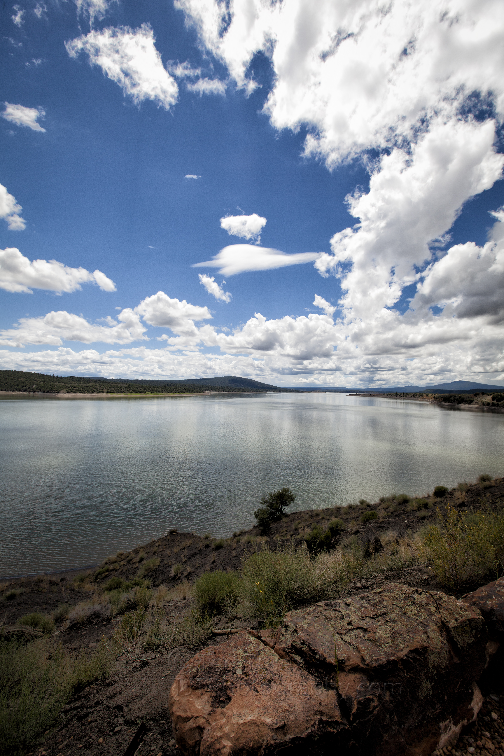
Community Concerns
New Mexico has suffered consistent drought conditions throughout the last decade
Decision makers need tools that facilitate accurate and timely rangeland condition assessments
Need for easily accessible, remotely-sensed evapotranspiration data

Slide 4


Objectives
Automate MODIS and NCEP data acquisition
Streamline evapotranspiration product generation
Disseminate product to New Mexico decision makers
NASA Satellites/Sensors
Satellites: Terra & Aqua
Sensor: Moderate Resolution Imaging Spectroradiometer (MODIS)
Notes:
Terra's orbit around the Earth is timed so that it passes from north to south across the equator in the morning, while Aqua passes south to north over the equator in the afternoon. Terra MODIS and Aqua MODIS are viewing the entire Earth's surface every 1 to 2 days, acquiring data in 36 spectral bands.

Slide 5
Methodology
Data Retrieval
Pre-Processed Data
Data Conversion
ET Inputs
Internet
ET Algorithm
ET Outputs
Web Server
Databases
Notes:
The data pipeline architecture

Slide 6
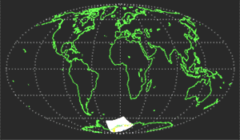
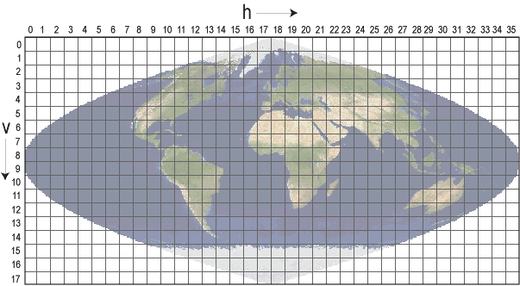
Methodology
From Swath Granules to Sinusoidal Tiles
Retrieve atmospheric MODIS data in swath granules
Grid each granule file onto a sinusoidal projection
For each sinusoidal tile, stitch together every granule that has overlap
Subset out the tile’s domain
Notes:
Top image: Shows atmospheric MODIS swath granules. Level-2 MODIS atmospheric products are produced at a spatial resolution of either a 1 by 1 kilometer or a 5 by 5 kilometer (at nadir) pixel array. Each MOD06_L2 product file covers a five-minute time interval (based on the start time of each MODIS Level-1B granule). This means that for 5km resolution parameters, the output grid is 270 pixels in width by 406 pixels in length for nine consecutive granules.
Bottom image: There are 460 non-fill tiles, tiles are 10 degrees by 10 degrees at the equator.
The tile coordinate system starts at (0,0) (horizontal tile number, vertical tile number) in the upper left corner and proceeds right (horizontal) and downward (vertical). The tile in the bottom right corner is (35,17).
Bottom image: Shows sinusoidal tiles used by MODIS land products.
Image Credits: http://modis-atmos.gsfc.nasa.gov/MOD06_L2/grids.html (top)

Slide 7
Advisors
Josh Fisher, NASA JPL
Greg Moore, NASA JPL
Manish Verma, CalTech
Partner
John Longworth, New Mexico Office of the State Engineer
Others
Gwen Miller, DEVELOP Center Lead
Daniel Jensen, DEVELOP Assistant Center Lead
Christine Rains, DEVELOP Assistant Center Lead

