Slide 1
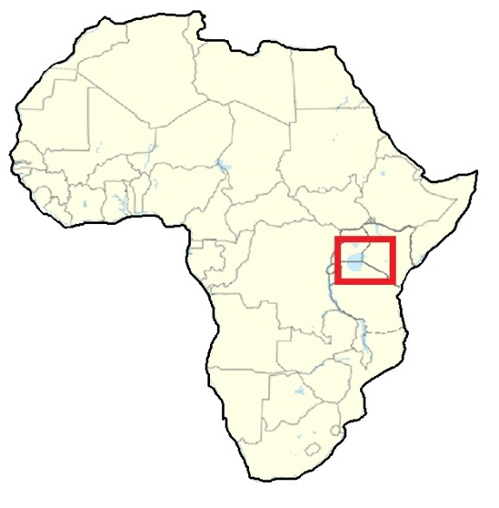
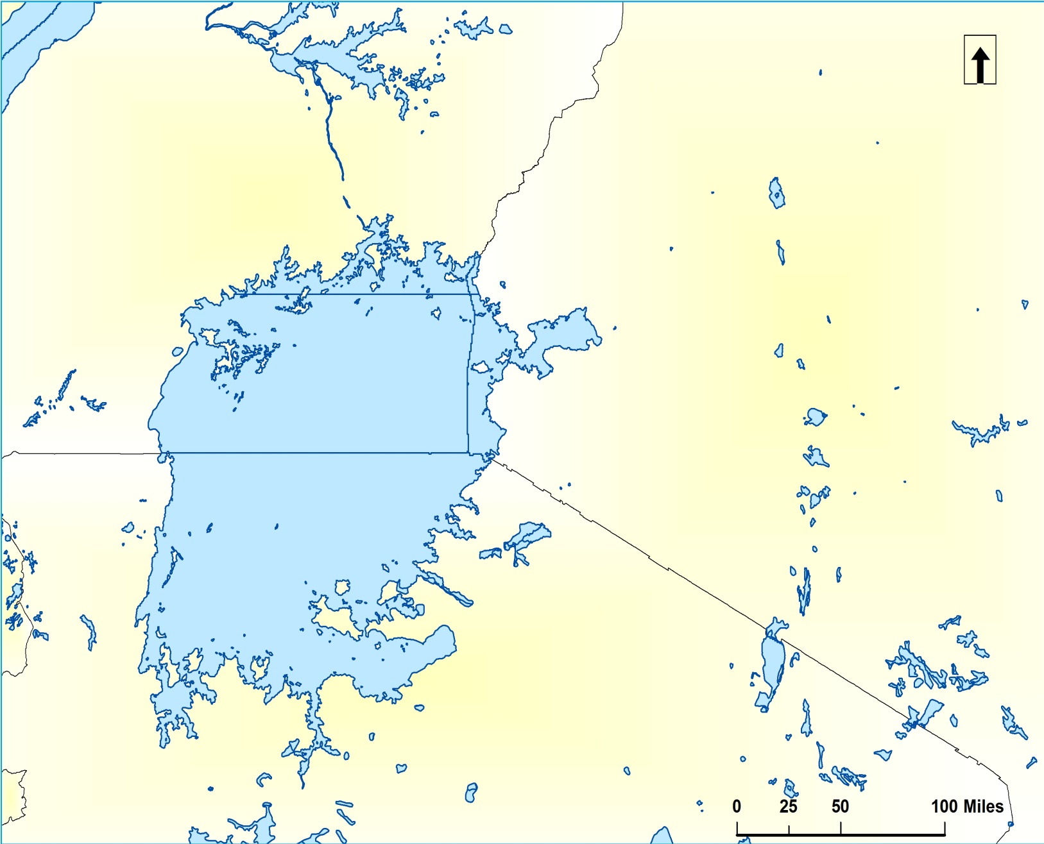
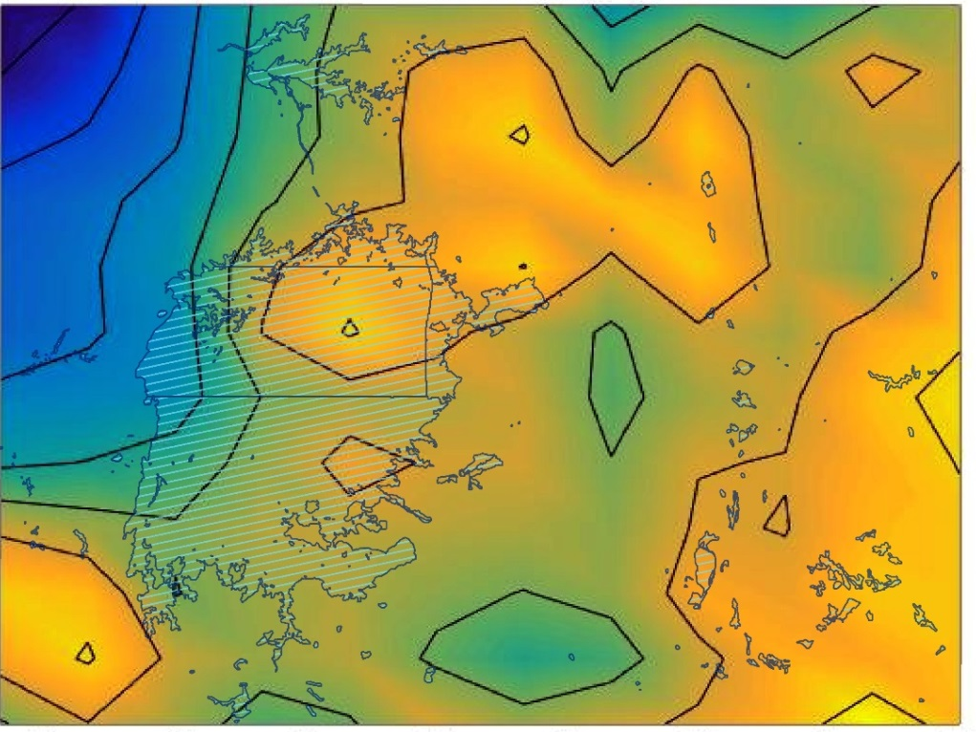
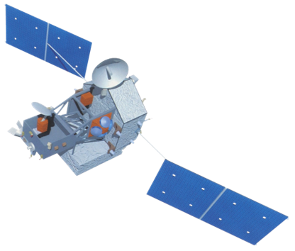
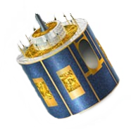
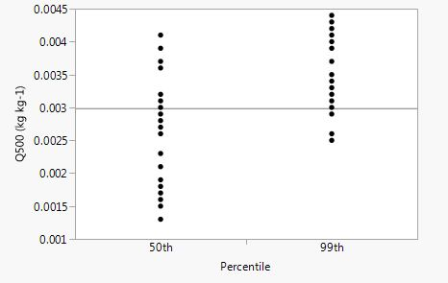
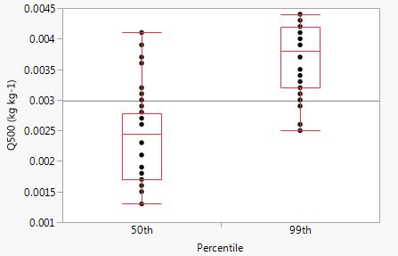
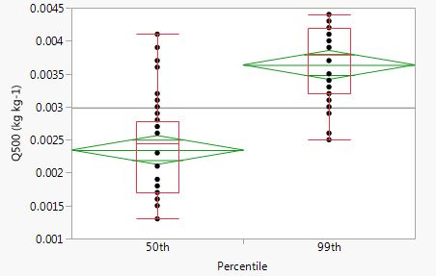
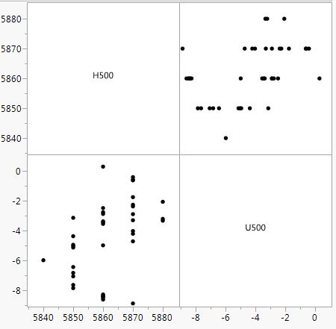
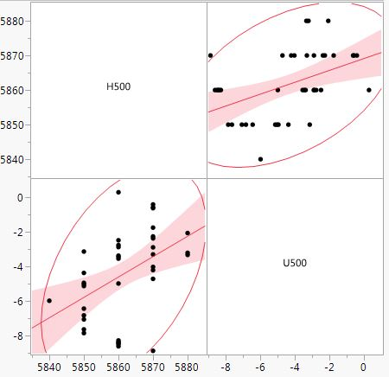
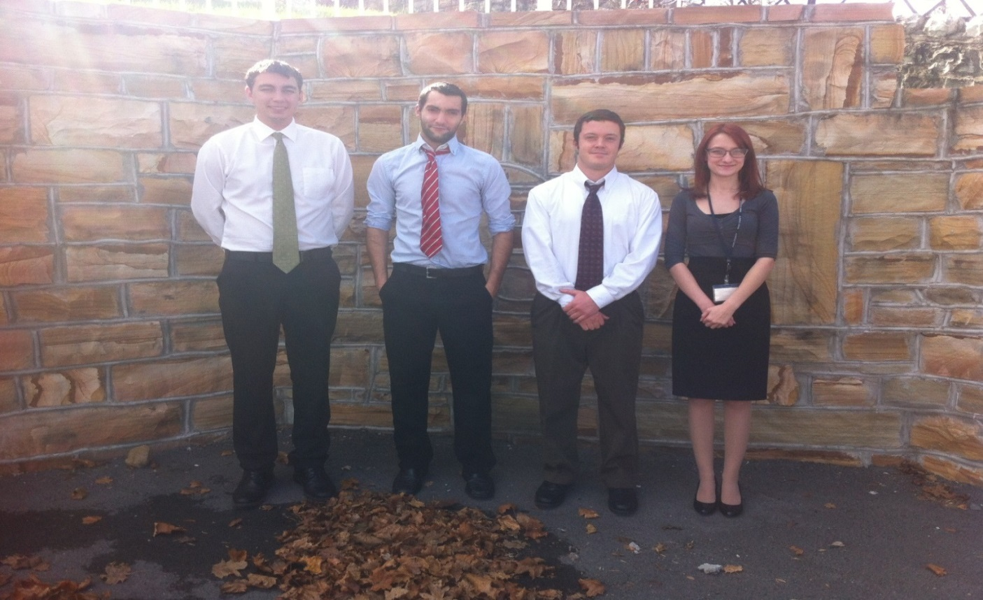
African Great Lakes Weather
Utilizing NASA Earth Observations to Identify Indicators to Help Predict Deadly Storms over the African Great Lakes
Will Wilson (Project Lead), Anabelle White, Grant Bloomer, Juan Antonio Chacon Castro
NASA DEVELOP National Program at Wise County Clerk of Court’s Office
Abstract
Objectives
The African Great Lakes lie along the East African rift valleys and play an important role in the economy and culture of the millions of people in the region. The regional governance of the lakes’ climate and weather, while less understood, is just as profound. Intense storms occur around the lakes with little warning and can create life-threatening hazards to unsuspecting fisherman. Finding correlations between climatic indicators that precede the onset of these storm events will aid the Kenya Meteorological Department in their ability to improve the forecasting efforts of local and regional authorities. Utilizing the overshooting top (OT) detections within the Hazardous Storm Event Database (derived from the SEVIRI sensor on the METEOSAT satellite), certain times of heightened detection were used as temporal study areas around which an assortment of meteorological data was compiled. MERRA products and TRMM LIS data were used in this term project as mediums of analysis for which intensity levels of OT frequency were compared statistically and spatially.
Figure out temporal domain of further study by reducing the Hazardous Storm Events Database to summary sets of data. Extract sample dates at the 50th and 99th percentiles.
Determine what Earth observations and other data products will be useful for analysis.
Statistics will be run through the data compiled at these respective dates. This will serve to highlight contributing environmental aspects and their posture over high intensity storm days.
Methodology
Study Area
Hazardous Storm Event Database
50th
Study Date [x20]
Summarize
OT detections / day
Intensity Percentiles
Uganda
99th
Study Date
[x20]
Lake
Victoria
Kenya
Contours of Avg. Daily Temp
[x20]
Contour of Average Daily Temperature (K) at 500mb on 3/8/2006
MERRA
MAT1NXSLV
2
268.5
Tanzania
1
268
0
267.5
Earth Observations
Longitude (Degrees)
Geopotential Height, Eastward Wind,
Northward Wind, Temperature, Humidity, Vertical Pressure Velocity, Surface Skin Temperature
-1
267
-2
Temperature (K)
-3
266.5
-3.5
31 32 33 34 35 36 37 38
266
Results
Latitude (Degrees)
265.5
TRMM
Eumetsat - SEVIRI
One-way Response Plot
Quantiles & Summary Stats
Analysis of Variance
Conclusions
OT tops on average days centered around interior of lake.
OT tops on high impact days most frequent around outer rim on Kenyan side of lake.
No immediate visual consistency with MERRA contour maps – may need to both be more specific and/or more broad to capture the ‘environment’ of the lake. Narrowing the time-steps to portions of the day and summarize or zoom out and look at grand mean across study dates. May to incorporate more study dates from interval for this type of analysis.
Also MERRA variables should be looked at other pressure levels besides 500mb. Lower atmosphere pressure levels at 700mb and 850mb.
Correlations show strong positive correlations between V500 and U500 at IL50 that diminishes at IL99 conditions. Same between variables H500 and T500.
Strong negative correlation between temperature and eastward wind at IL50 has evaporated at IL99.
Reasonably strong negative correlation between atmospheric moisture content and eastward winds (at 500mb) at IL50 has become a very strong positive correlation at IL99. This same pattern, although not as strong a positive also shows between H500 and U500.
Scatterplot
Correlation Report
Team Members
Project Partners
Acknowledgements
Dr. Kenton Ross, Science Advisor (NASA DEVELOP)
Kristopher Bedka, NASA Climate Science Branch
Dr. DeWayne Cecil, Science Advisor (Global Science and Technology Inc. )
Robert VanGundy (UVA –Wise)
Ms. Melanie Salyer, NASA DEVELOP Mentor
From left to right: Grant Bloomer, Juan Antonio
Chacon Castro, Annabel White, Will Wilson
Kenya Meteorological Department
Wise County Clerk of Court’s Office

