Slide 1
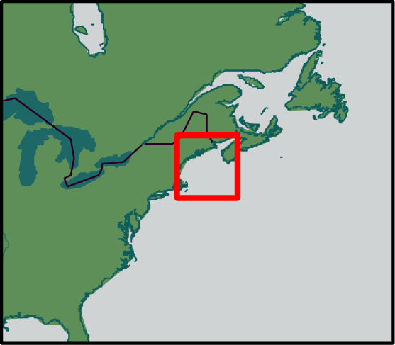
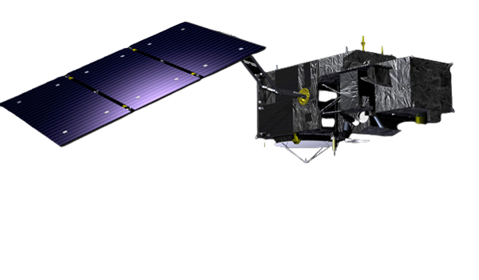
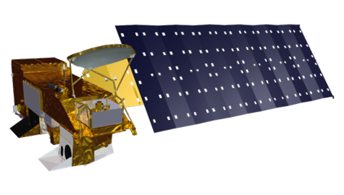
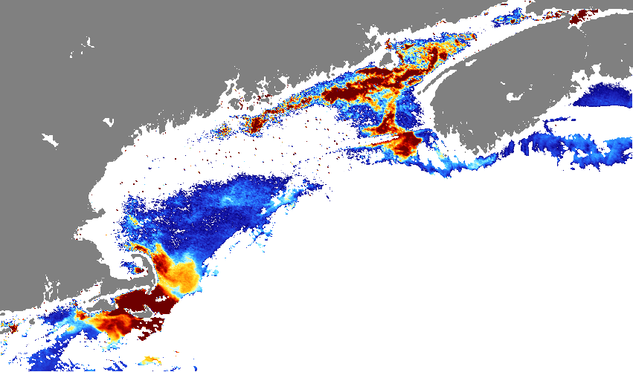
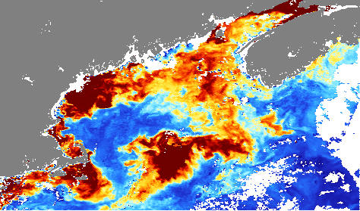
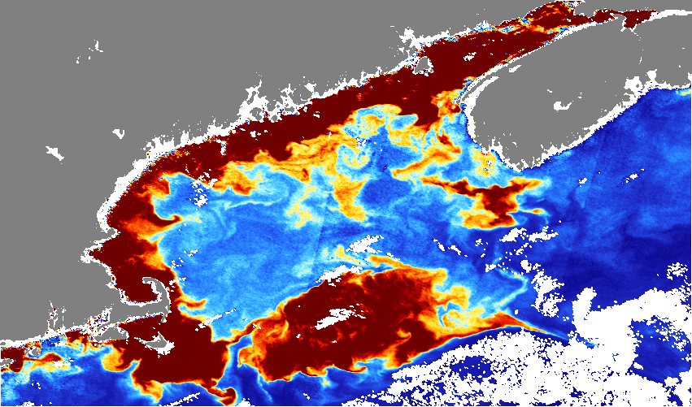
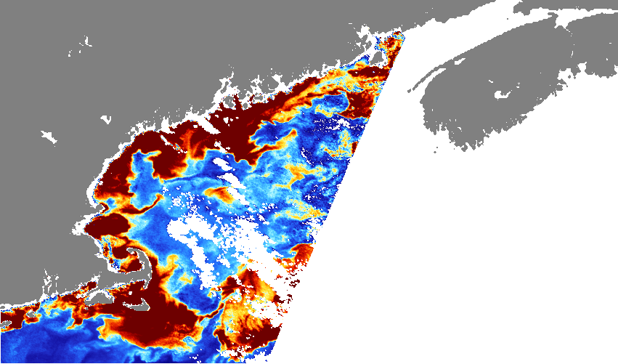
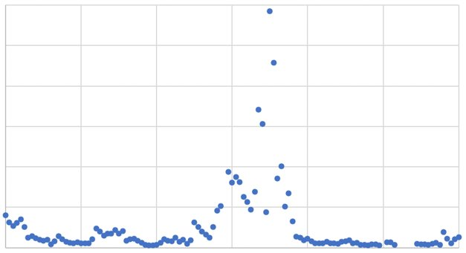
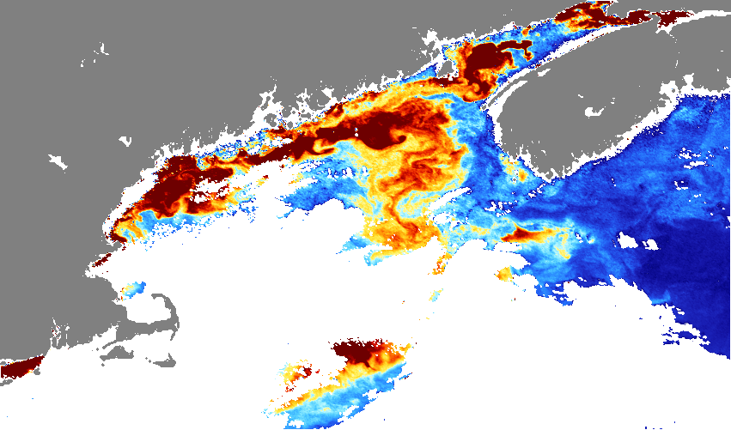
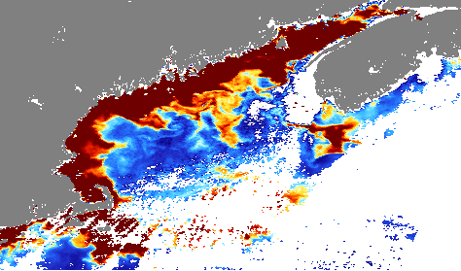
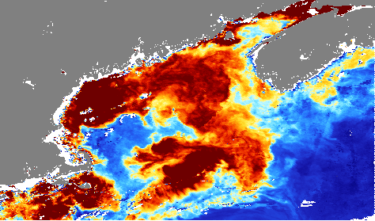
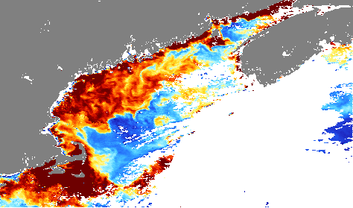
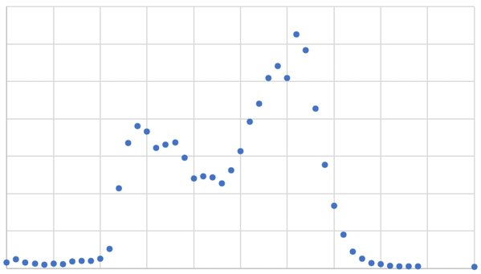
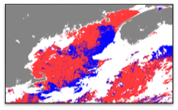
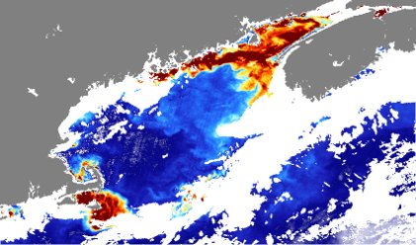
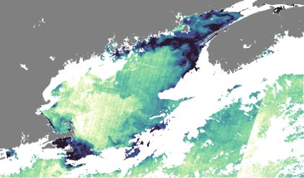
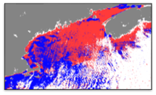
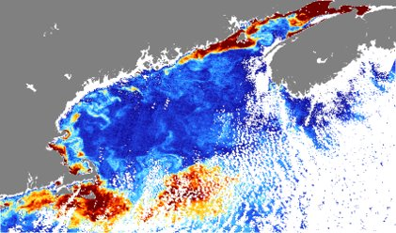
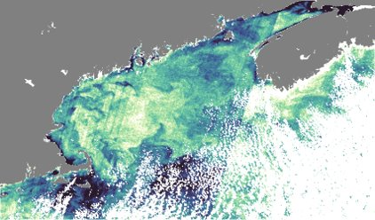
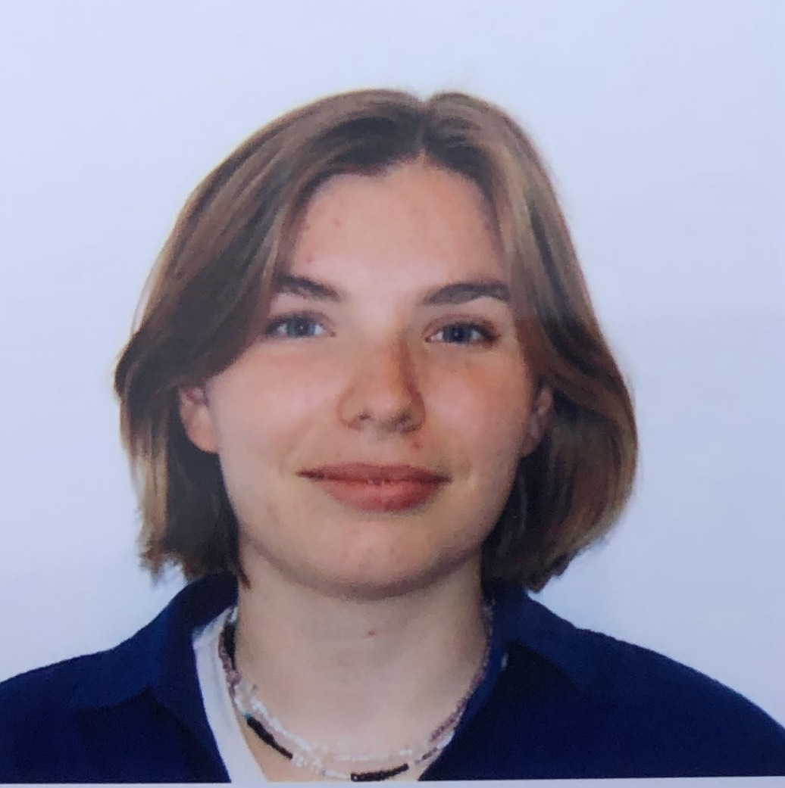
Assessing the Use of NASA Earth Observations for Identifying Harmful Algal Blooms of Pseudo-nitzschia in the Gulf of Maine
Abstract
Study Area
The Gulf of Maine has a history of harmful algal blooms (HABs) that have been increasing in frequency and intensity in recent years, raising concerns in the community. Specifically, the Pseudo-nitzschia genus possesses harmful toxins that can induce food-borne illnesses and infect humans through ambient water. We observed in-situ data from known 2016 and 2020 Pseudo-nitzschia blooms as case studies to test the feasibility of using satellite data to track bloom events. We worked in partnership with the Woods Hole Oceanographic Institution (WHOI), Battelle Environmental Division, and the National Oceanic and Atmospheric Administration (NOAA) Stellwagen Bank National Marine Sanctuary. To map the frequency and distribution of Pseudo-nitzschia bloom events, we acquired satellite data from Aqua Moderate Resolution Imaging Spectroradiometer (MODIS) and Sentinel-3 Ocean and Land Color Instrument (OLCI). We utilized satellite data to calculate normalized fluorescence line height (nFLH) and visualize absorption due to phytoplankton (aph443), which we compared with in-situ observations to analyze ocean and algal color variations. The end products included daily, weekly, and monthly time-series maps for the 2016 and 2020 blooms; in-situ data and satellite imagery statistical analyses; and visualizations of the in-situ data.
Gulf of Maine Water Resources
Study Area:
Gulf of Maine, Buzzard's
Bay, Nantucket Sound
Study Period:
August to December,
2016 and 2020
Objectives
Earth Observations
N
Identify and track two known Pseudo-nitzchia blooms
Validate remotely sensed bloom data with in-situ data
Determine if reflectance in a given pixel is caused by a diatom
Aqua Moderate Resolution Imaging Spectroradiometer (MODIS) NASA
Methodology
Process WHOI IFCB in situ 2016 & 2020 bloom data
Process MODIS and Sentinel-3 imagery for nFLH and aph443 products
Cross-reference in-situ data with remote sensing products & calculate diatom distinction using imagery
Sentinel-3 Ocean and Land Color Instrument (OLCI) European Space Agency
Results
Week 1
Week 2
Week 3
Week 4
aph443
2016 Pseudo-nitzschia Concentration Martha's Vineyard, MA
September
0 (Low)
120
100
Weekly aph443 Composite Sentinel-3 Images 2016
80
Week 1
Week 2
Week 3
Week 4
Concentration (images/mL)
60
40
October
20
0.1 (High)
0
Sept
Oct
Nov
Dec
Jan
Cloud Coverage or No Data
70
2020 Pseudo-nitzchia Concentration Harpswell, ME
Diatom Distinction
aph443
nFLH
60
50
August 19th
Concentration (images/mL)
40
30
20
Day Diatom Distinctions vs. aph443 and nFLH 2016
10
0
Nov
Dec
Oct
October 31st
Cloud Coverage or No Data
0 (No diatoms)
(Diatoms) 1
0 (Low)
0.1 (High)
0 (Low)
0.1 (High)
Conclusions
Project Partners
The satellite imagery aligns with the in-situ data, indicating that Earth observations can be utilized to track Pseudo-nitzschia events in the Gulf of Maine.
Diatoms can be distinguished in satellite imagery from other types of algal species present in a bloom.
Acquired Earth observations can help partners monitor and track Pseudo-nitzschia blooms in near real-time.
Battelle's Environmental Division
Woods Hole Oceanographic Institution (WHOI)
NOAA's Stellwagen Bank Marine Sanctuary
Acknowledgements
Team Members
A special thank you to our Science Advisors, Fellow, and Partners for their dedication and support:
Dr. Cédric Fichot, Science Advisor (Boston University Earth & Environment Department)
Tyler Pantle, NASA DEVELOP Fellow
Dr. Michael Brosnahan, Science Advisor & Partner (WHOI)
Dr. Dave Ralston, Science Advisor & Partner (WHOI)
Dr. Scott Libby, Partner (Battelle's Environmental Division)
Ben Haskell, Partner (NOAA Stellwagen Bank National Marine Sanctuary)
Liam Waters, Partner (NOAA Stellwagen Bank National Marine Sanctuary)
This material contains modified Copernicus Sentinel-3 data (2016, 2020), processed by ESA.
Suhani Dalal
Project Lead
Lily Gray
Phyllis Yixuan Li
Jane Zugarek
Massachusetts – Boston
Notes:
Image Credit: Esri, HERE, Garmin, FAO, NOAA, USGS, OpenStreetMap contributors, and the GIS User Community

