Slide 1
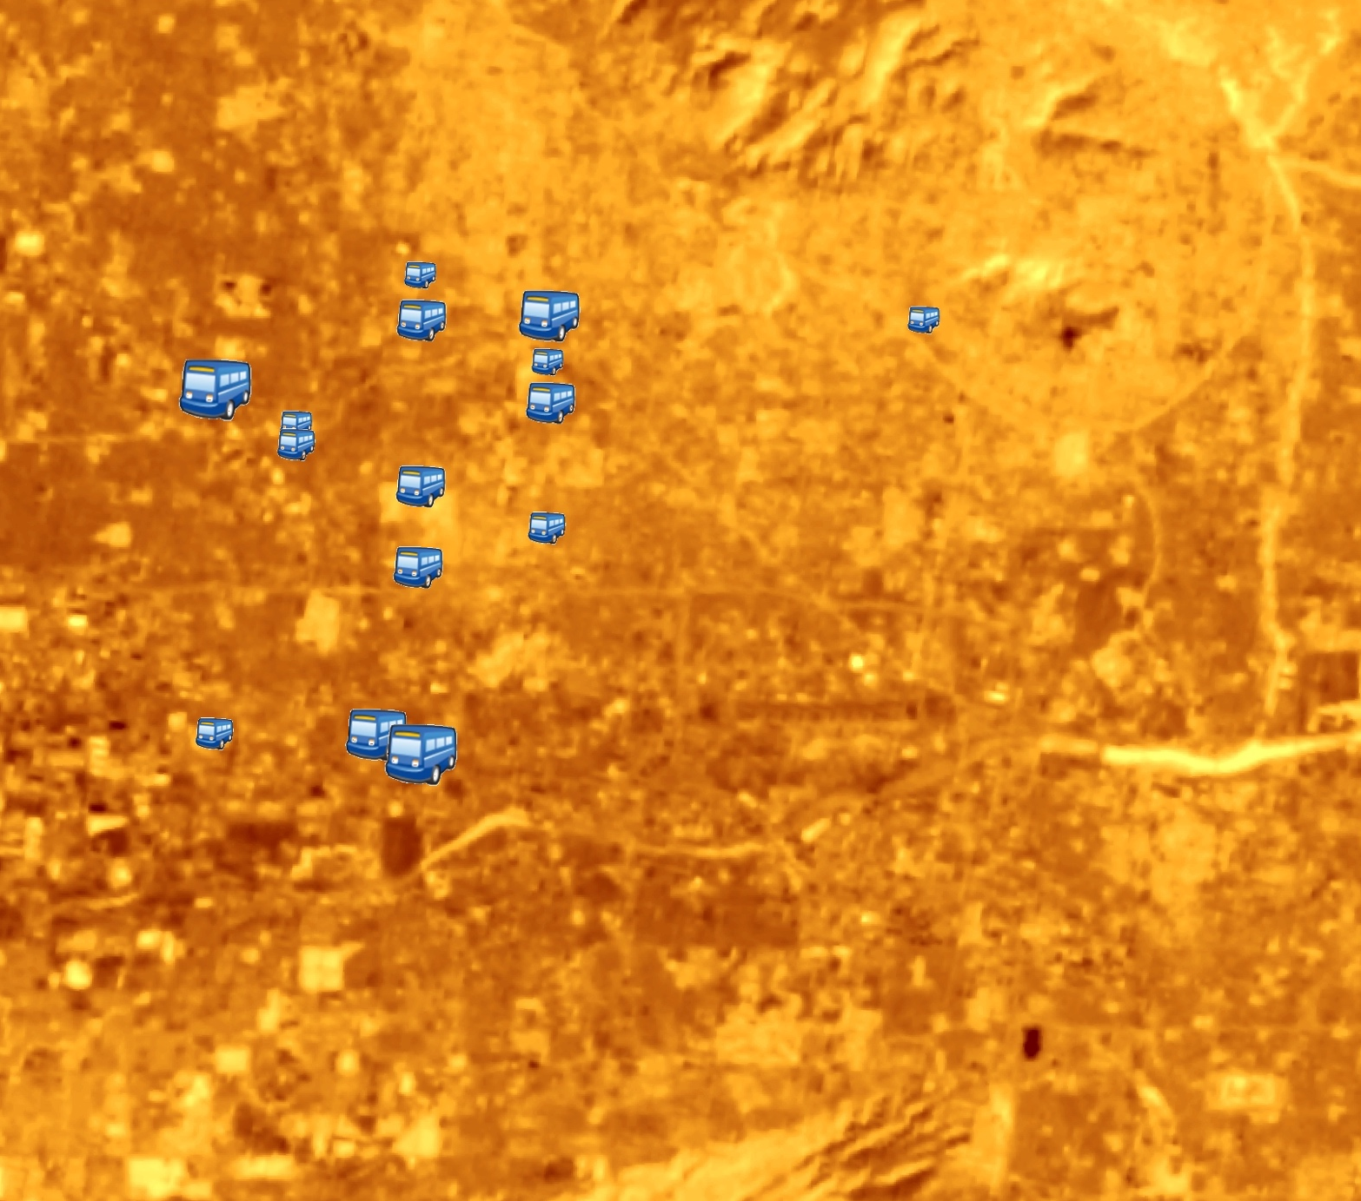


Phoenix Health & Air Quality II
Utilizing NASA Earth Observations and Ground Measurements to Reduce Extreme Heat Experienced by Transit Riders in Phoenix, Arizona
Lance Watkins
Yalin Qu
Elizabeth Dyer
Mario Chavez
Dean Blumenfield
Arizona - Tempe
Fall 2017

Slide 2
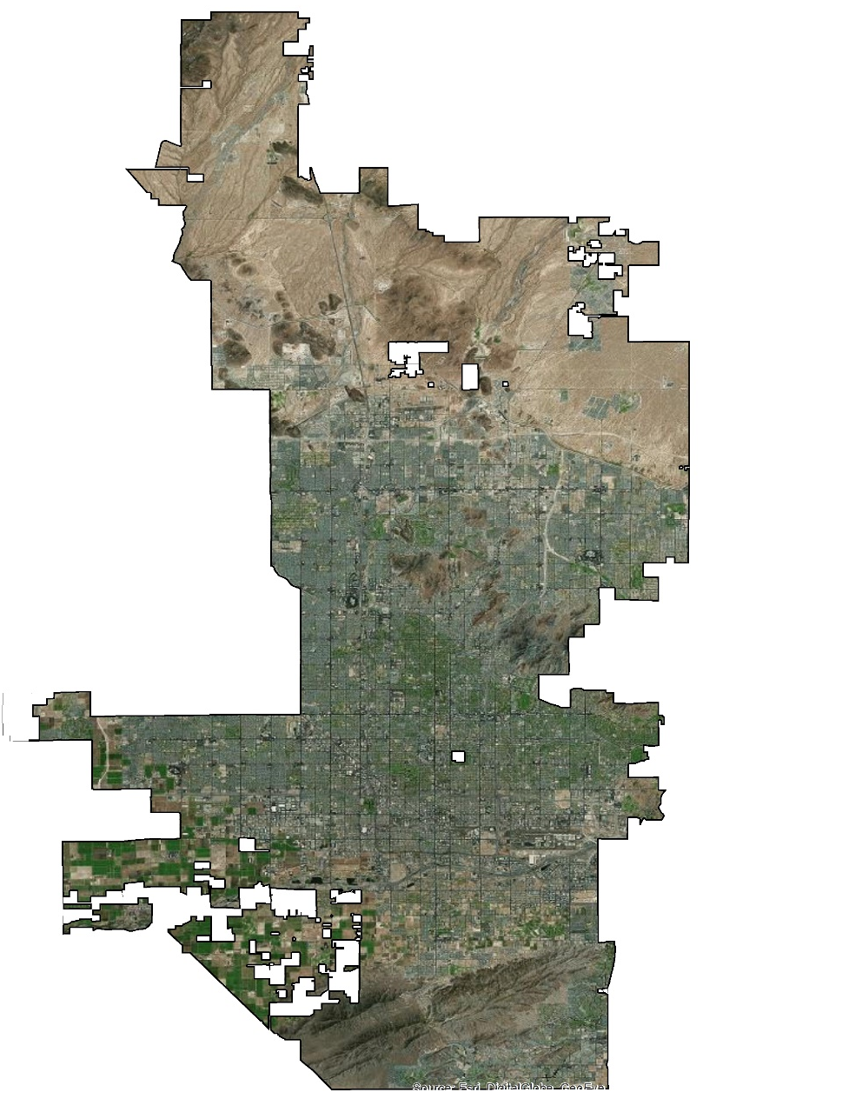
Study Area & Period
Phoenix, Arizona
Semi-arid climate
517 mi²
1.5 million (U.S. Census Bureau)
Summer Temperature
  Average High: 106 °F
  Average Low: 80 °F
  Record High: 122 °F
Yearly Bus Ridership: > 49 million
Study Period: Sept. – Nov. 2017
PHOENIX,
AZ
Notes:
Phoenix, Arizona has a semi-arid climate with a population of 1.5 million spread across 517 square miles.
The city frequently experiences temperatures north of 100°F and can reach north of 110°F from months May through October. Thermal discomfort is therefore a major public health concern.
The yearly transit ridership is north of 49 million.
The DEVELOP team performed this study between September through November 2017.

Slide 3
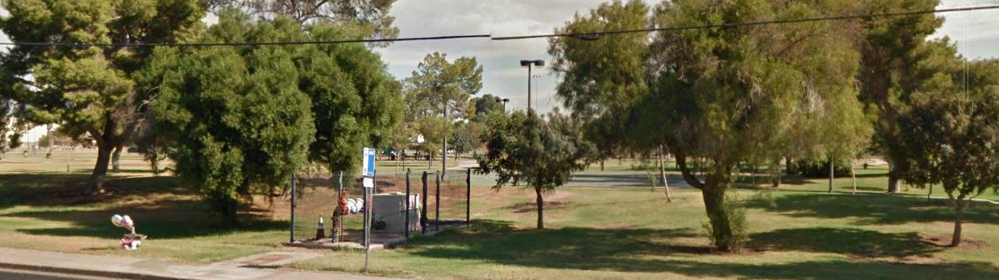
Background
Extreme heat in Phoenix
T2050: City of Phoenix Transit Department Shade Structure Program;
Current prioritization criteria: Ridership only
Notes:
More than 1.5 million residents are prone to thermal discomfort during the extreme heat of the summer months, especially a portion of the population that relies regularly on public transportation.
The City of Phoenix Public Transit Department is heavily invested in addressing this concern through infrastructure development of shade structures aimed at reducing riders’ heat exposure at transit stops.
The Department’s previous method of determining priority for improvements such as shade structures, was based solely upon ridership.

Slide 4
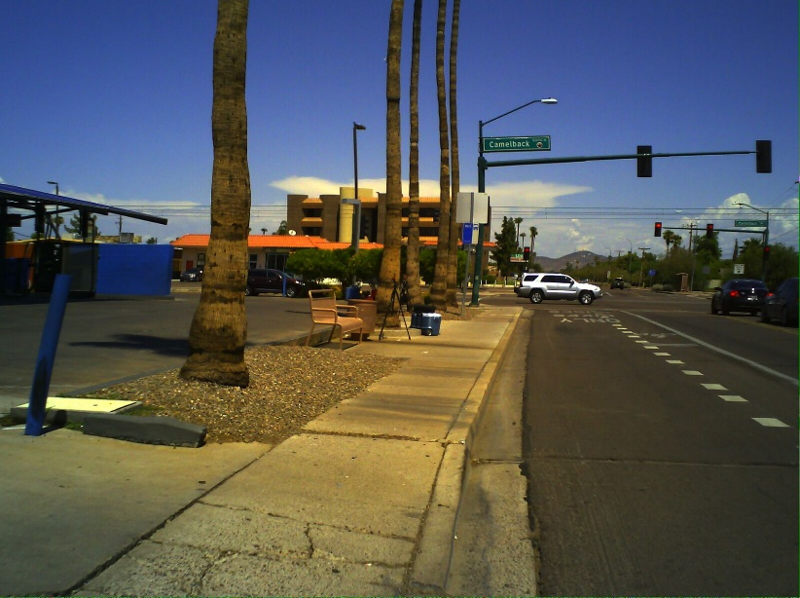
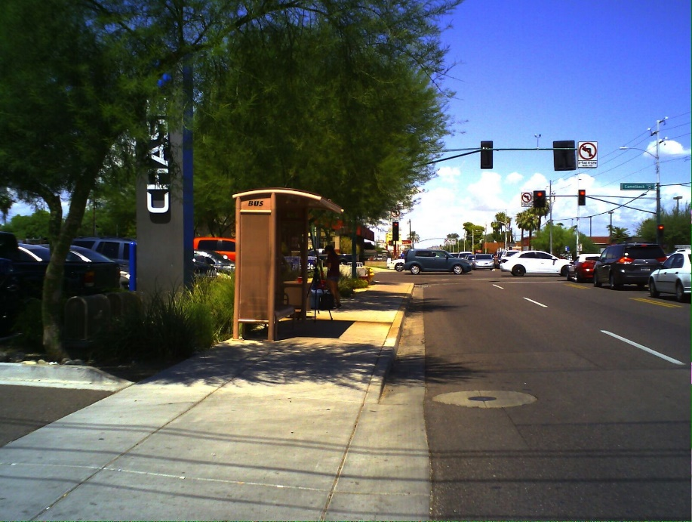
Community Concerns
Lack of shade at transit stops
Thermal discomfort
Increased heat vulnerability
Efficient and effective use of public transit investment
Photos taken by DEVELOP team member
Notes:
Numerous transit stops across the city remain lacking shade structures.
Transit riders waiting at these unshaded stops are more prone to thermal discomfort and health risks.
Portions of the population with certain demographic or socioeconomic characteristics, are often more vulnerable to extreme heat or at greater risk of experiencing extreme heat.
The City of Phoenix Transit Department aims for efficient and effective use of investment funds into the public transit system.

Slide 5






Project Objectives
Provide partners with information on thermal environment at bus stops
Validate satellite-based land surface temperature (LST) estimates by conducting site visits
Assess heat vulnerability of residents using Census data
Estimate secondary shade at and around transit stops
Notes:
The DEVELOP team’s main objective was to provide the City of Phoenix Transit Department with information they may utilize in determining prioritization of locations for shade structure infrastructure investment.
Site visits were conducted to try to validate the NASA Landsat 8 LST by taking LST measurements in situ. Air temperature data was also collected during these visits.
Census data was also utilized in creating a Heat Vulnerability Index assessment of residents across the city.
Secondary shading potential was extracted from LiDAR earth observation imagery at and around transit stops.

Slide 6

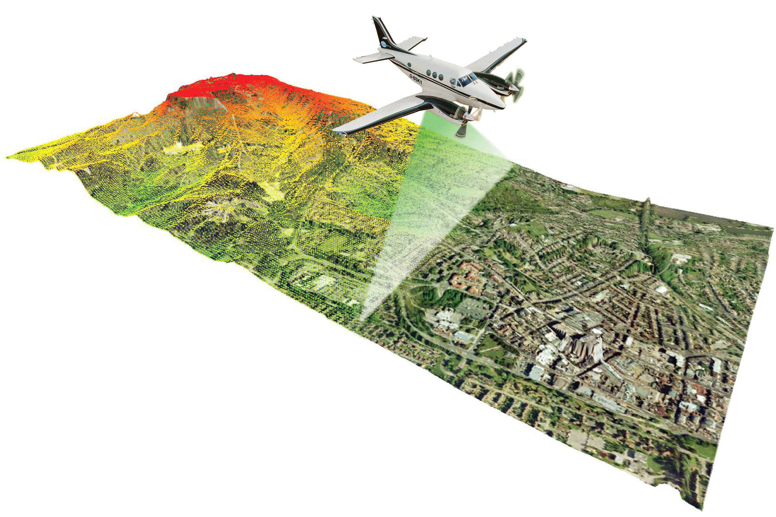
Earth Observations
Landsat 8
LiDAR
Image from NASA
Image from LiDAR America
Notes:
NASA Landsat 8 earth observation satellite imagery was utilized in this project to look at Land Surface Temperature, which indicates the temperature of the ground for a particular area. This was done for 12 sample unshaded transit stops within the City of Phoenix. Cells coinciding with these unshaded stops, were extracted to gain a better understanding of the thermal environment of each selected sample stop.
Using LiDAR earth observation imagery, the team was able to create a three-dimensional analysis of potential secondary shading over the sample transit stops and their surrounding area. Shading prevalence is an important variable when considering the thermal environment of transit stops as stops with more secondary shading tend to be cooler and therefore may be lower on the prioritization scale and unshaded stops with little to no secondary shading may need to be higher in prioritization of shade-structure implementation.
Landsat 8 Picture Source: http://www.devpedia.developexchange.com/dp/index.php?title=List_of_Satellite_Pictures
LiDAR Picture Source: LIDAR-America.com

Slide 7
Methodology
DATA
PROCESSING
ANALYSIS
Landsat 8 satellite imagery
Ground in situ Measurement Data
Landsat 8 Based LST
Ground Measurement Based LST
Ground Measurement Based Air Temperature
LST Validation
LiDAR
NAIP Aerial Imagery
LiDAR Building and Walkway Layers
NAIP Vegetation Prevalence Layer
Secondary Shade Analysis
CENSUS ACS
Census Social Vulnerability Layers
Heat Vulnerability Analysis
Notes:
NASA Landsat 8 satellite imagery was collected for it’s overpass of Phoenix (path 37/row 37)on October 3rd, at 11:05AM. This image was then processed into LST values.
Ground LST measurements were conducted in situ during the same time as the Landsat 8 satellite image was being taken from space.
These in situ LST measurements were compared to the Landsat 8 LST values in an analysis to determine how well the satellite LST can determine the thermal environment at transit stops; which are only a portion of the 30x30 meter grid scale at which Landsat 8 takes.
Air temperature measurements were also collected during in situ site visits to further deepen understanding of the thermal environment of transit stops.
LiDAR data corresponding with the project’s sample unshaded transit stop locations was extracted and used to create a 3D layer of buildings. This visualization allowed for an analysis of secondary shading potential at and around each respective stop.
NAIP aerial imagery is able to go the whole way down to a 1x1 square meter scale. Processing NAIP grid cells that coincide with the sample transit stops, the team performed object-based classification to the entire 30x30 square meter grid square taken from Landsat 8 satellite imagery to determine land cover classification.
Specific demographic and socioeconomic characteristics relating to the team’s research, were pulled from the United States Census American Community Survey (ACS). Combining the chosen characteristics together and creating a rating of each census tract in the City of Phoenix, provided a Heat Vulnerability Index (HVI) showing which parts of the City are more vulnerable to thermal discomfort and health risks during times of extreme heat.

Slide 8
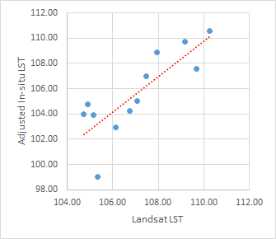
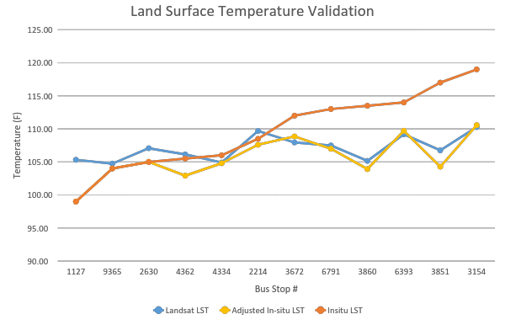
LST Validation
Regression Result
R=0.821
R Square=0.675
Significance=0.001
Regression Equation:
In situ LST=0.48*Landsat LST+56
Notes:
After adjusting the ground measurement based LST, which result is adjusted In-situ LST here on the graph, the Landsat LST was then compared with it. From the graph on the left, we can generally see that the Landsat LST can really reflect the adjusted In-situLST, which is assumed as the real ground temperature. When taking regression analysis on this group of data, the result tells us that the Landsat LST can explain 67.5% of the real ground temperature at the 99% confidence level. Here we also provide a regression equation to estimate the ground temperature, which is shown as In-situ LST from landsat based LST. However, larger sample groups should be utilized in order to improve the accuracy.

Slide 9
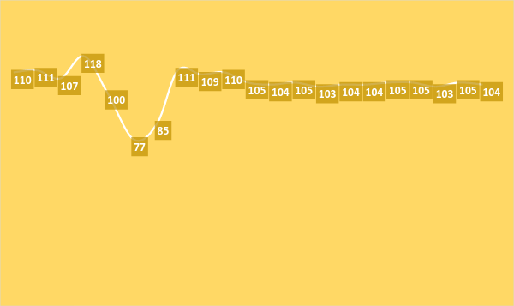
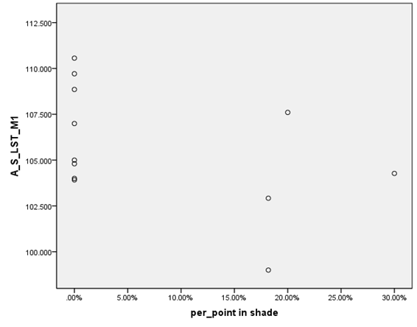



LST Validation
Ground Temperature at Stop 2630
On 2017/10/3 11:05 am
118-77=41 °F
What different can shade make?
Notes:
When looking at the ground measurement based LST in a micro environment, we can see that the difference between highest and lowest temperature within the same pixel can be as high as 41°F. In other pixels, the difference is around 30°F. Therefore, we explored the relationship between the real ground temperature with the percentage of the measurement spots in shade within each pixel. The result shows that all the low in-situ temperature pixels have high shaded spot percentage.
picture credit: https://pixabay.com/zh/%E9%93%81%E8%B7%AF-%E6%80%9D%E8%80%83%E7%9A%84%E7%BB%93%E6%9E%9C-%E6%95%99-%E7%81%AB%E8%BD%A6-%E7%94%9C%E8%8F%9C-%E8%A1%8C%E4%BD%BF-%E5%8F%B8%E6%9C%BA-%E9%A9%B1%E5%8A%A8%E7%A8%8B%E5%BA%8F-%E6%8E%A7%E5%88%B6-1825699/

Slide 10
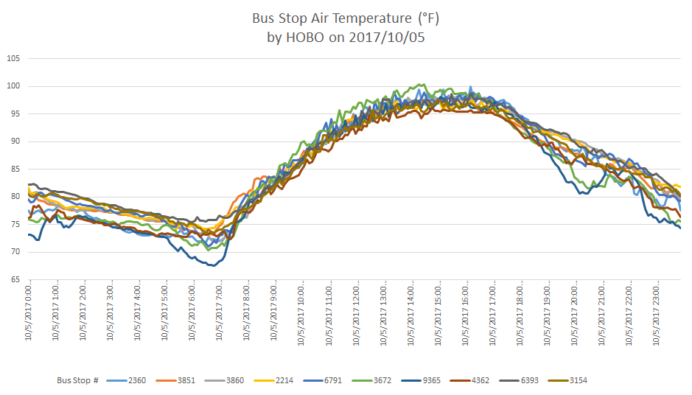
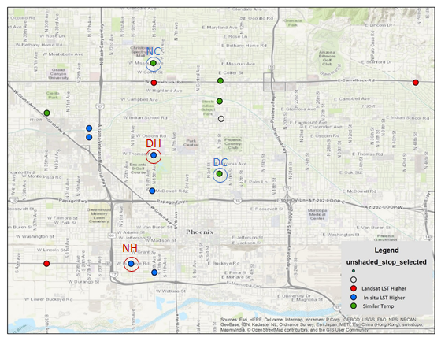
Air Temperature Assessment
Stop 3672:
Hottest stop at day
Stop 6393:
Hottest stop at night
Stop 4362:
Coolest stop at day
Stop 9365:
Coolest stop at night
Notes:
When it comes to the thermal environment, the air temperature is another variable that should be considered. In addition to the manually measured ground temperature, the air temperature is also collected in visiting the sample stops. This graph shows how it changes within 24 hours a day. According to previous study, it is easy to understand that air temperature changes more softly than ground temperature.
However, there still exists difference among different stops. The map shows where the hottest and coolest stops in both daytime and nighttime are located.

Slide 11
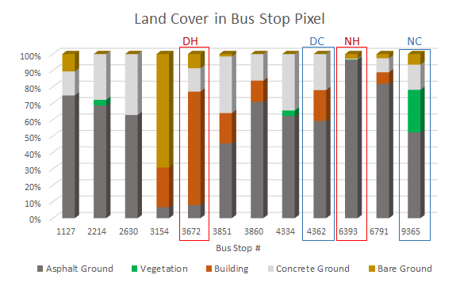
Land Cover Classification
How can land cover explain the air temperature difference?
Notes:
Then we conducted land cover classification with one meter by one meter satellite image, in order to see how the land cover can explain the air temperature differences. When utilizing the import methods to conduct regression analysis, the result here shows the vegetation and building land cover have separately strong positive and negative effect on the air temperature.
picture credit: https://pixabay.com/zh/%E9%93%81%E8%B7%AF-%E6%80%9D%E8%80%83%E7%9A%84%E7%BB%93%E6%9E%9C-%E6%95%99-%E7%81%AB%E8%BD%A6-%E7%94%9C%E8%8F%9C-%E8%A1%8C%E4%BD%BF-%E5%8F%B8%E6%9C%BA-%E9%A9%B1%E5%8A%A8%E7%A8%8B%E5%BA%8F-%E6%8E%A7%E5%88%B6-1825699/

Slide 12
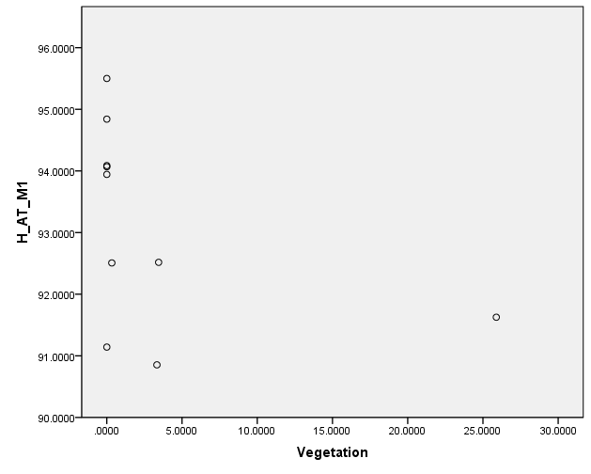
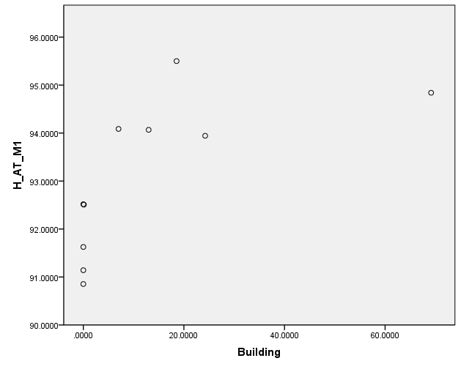
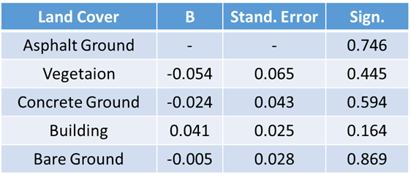
Vegetation and Air Temperature
In the daytime
  More vegetation, lower air temperature
  More building roof, higher air temperature
Notes:
During the daytime it was found that more vegetation causes lower air temperatures at transit stops, while a Landsat 8 satellite image grid (which is a 30x30 meter square) with more building roof land cover, causes higher air temperatures.

Slide 13
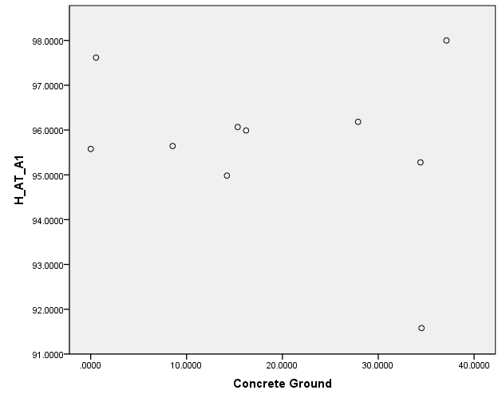
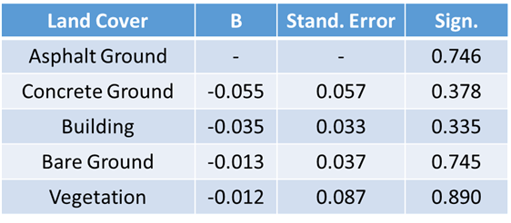
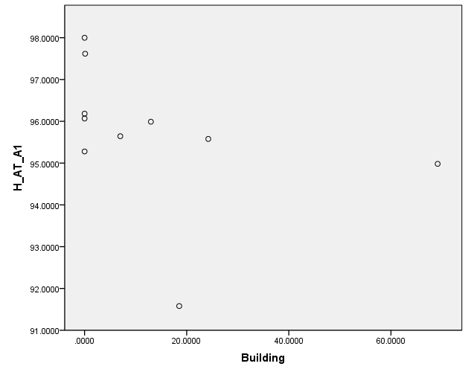
Building and Air Temperature
In the nighttime:
  More concrete ground, higher air temperature
  More building roof, lower air temperature.
Notes:
During the nighttime though, concrete ground created a higher air temperature at transit stops, and satellite grid-squares with more building roof coverage now actually lowered air temperature.

Slide 14
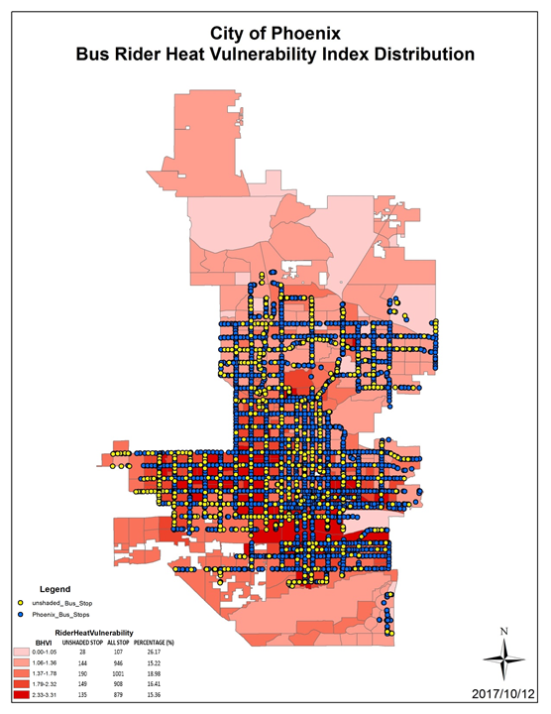
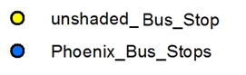
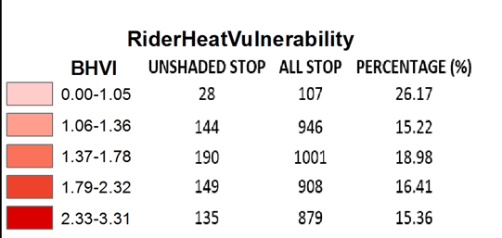
Heat Vulnerability Assessment
Notes:
As you can see from this map, areas that are more vulnerable to experiencing extreme heat and experiencing thermal discomfort and heat-related health risks (those in red), contain the majority of transit stops. This shows the City of Phoenix’s Transit Department’s focus on Social Justice in caring for it’s residents.

Slide 15
Conclusions
Landsat 8 Land Surface Temperature closely matches in situ LST of transit stops
Normalized Difference Vegetation Index (NDVI) shows more vegetation equates to a lower LST
LiDAR preliminary results show secondary shading also lowers LST values, this topic should be explored more in future work

Slide 16
Acknowledgements
David Hondula
Joe Bowar
Herb Munoz
Jorie Bresnahan
Ariana Middel
David Sailor
Matthew Toro
Tamara Dunbarr
McKenzie Murphree
Mary Wright
Hana Putnam

