Slide 1
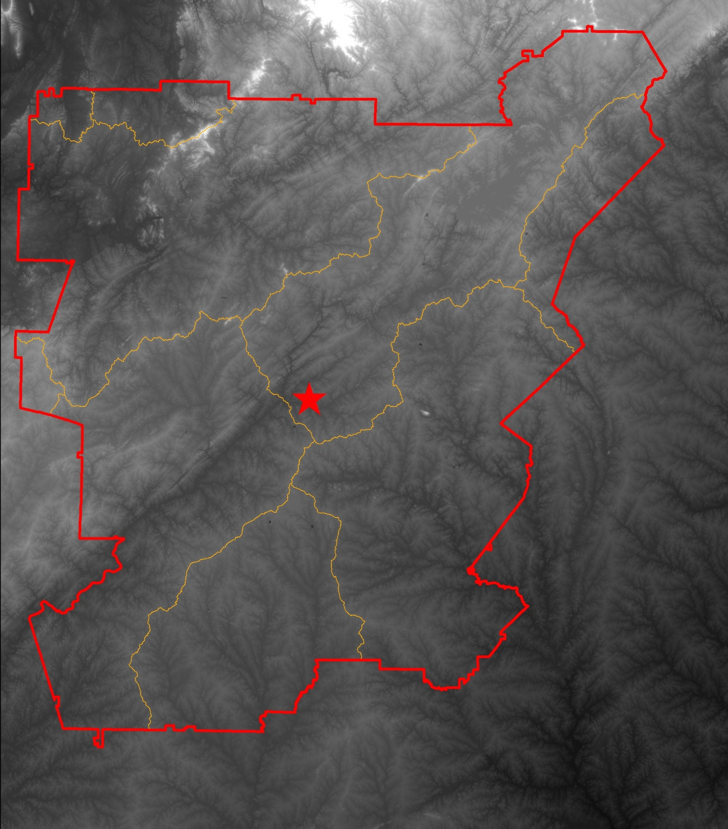
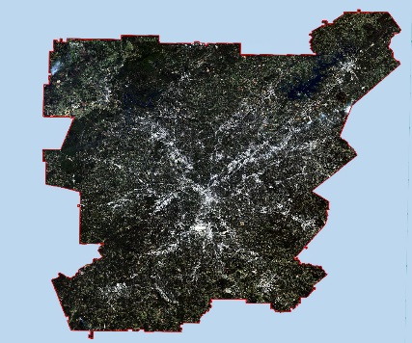
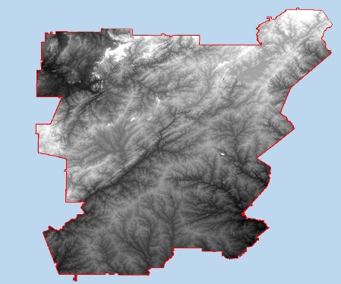
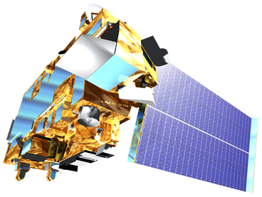
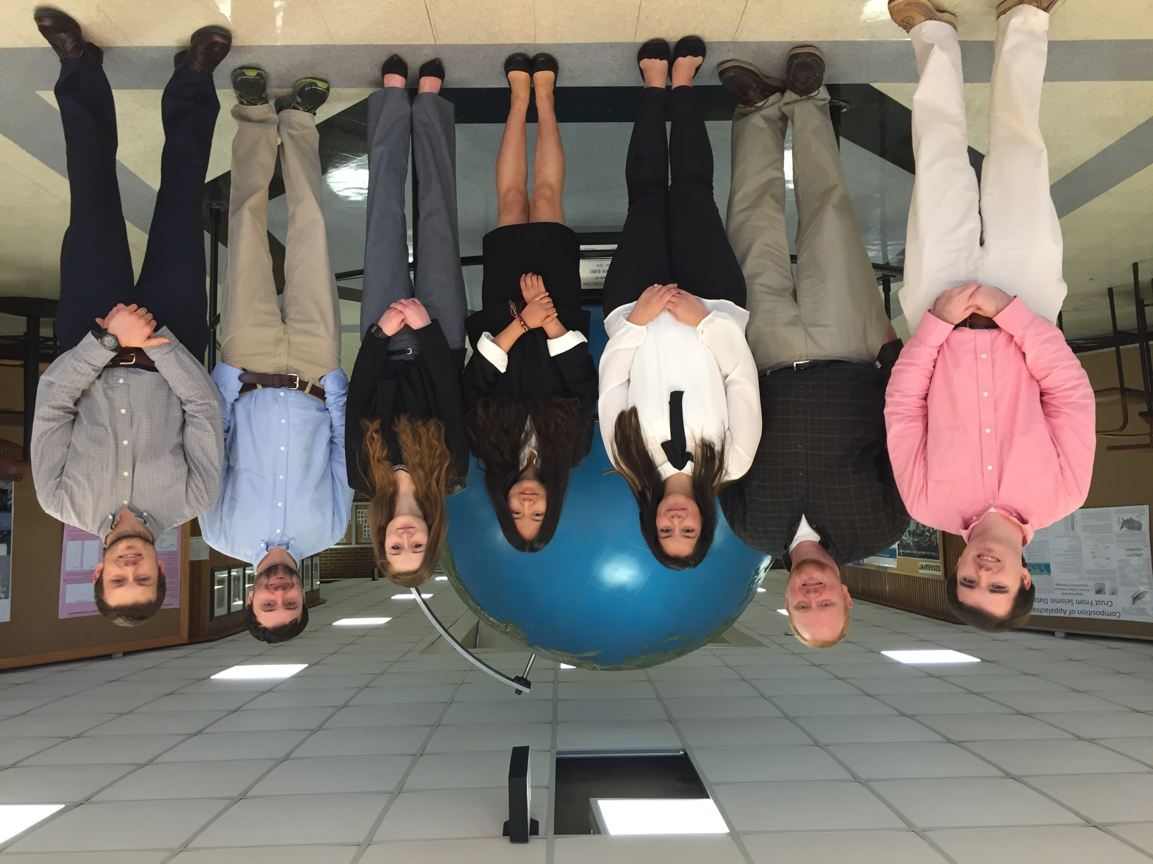
Atlanta Water Resources
Identifying key urban areas to reduce stormwater runoff and maximize conservation efforts in metropolitan Atlanta
Christopher Cameron (Project Lead), Beatriz Avila, Veronica Fay, Jason Reynolds, Alex Smith, Jacob Spaulding, Wenjing Xu
DEVELOP National Program at The University of Georgia
Abstract
Objectives
Assess the effects of recent land cover change on currently forested watersheds
Identify sites with a high potential to impact local water quality using SWAT
Locate areas within the Atlanta region for targeted reforestation and conservation efforts using LUCIS
Study Area
Methodology
Atlanta
Data Acquisition
Processing and Analysis
End Products
Landsat 8 Images
Atmospheric Correction
Supervised Land Cover Classification
Land Cover Classification
ASTER DEMs
SWAT
LUCIS
Hydrologic Processes Model
Earth Observations
Ancillary Datasets
LUCIS Suitability Maps
Results
Landsat 8, OLI
Terra, ASTER
Conclusions
Use images.
Make sure that it has some sort of flow, that it makes sense. Show your results in a logical order.
No bullets.
Use bullets.
Use complete sentences with periods.
Team Members
Project Partners
Acknowledgements
The Nature Conservancy
We would like to thank our science advisors, Dr. Rosanna Rivero and Dr. Marguerite Madden, for their advice and guidance on this project.
We also would like to thank our partners at The Nature Conservancy, Sara Gottlieb and Myriam Dormer, for their support and involvement throughout the project.
From left to right: Christopher Cameron, Alex Smith, Beatriz Avila, Wenjing Xu, Veronica Fay, Jason Reynolds, Jacob Spaulding
The University of Georgia

