Slide 1

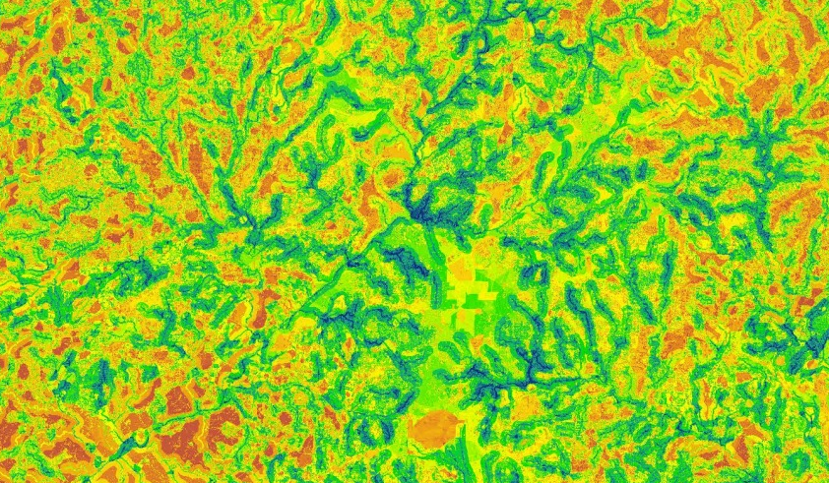
Identifying Key Urban Areas to Reduce Stormwater Runoff and Maximize Conservation Efforts in Metropolitan Atlanta
Christopher Cameron (Project Lead)
Amanda Aragon
Ike Sari Astuti
Natalia Bhattacharjee
Alys Hannum
Doori Oh
Kamalakanta Sahoo
Atlanta Water Resources
Notes:
This project began in the spring term of 2016 at the UGA node. It was a project partners with The Nature Conservancy’s GA chapter.

Slide 2
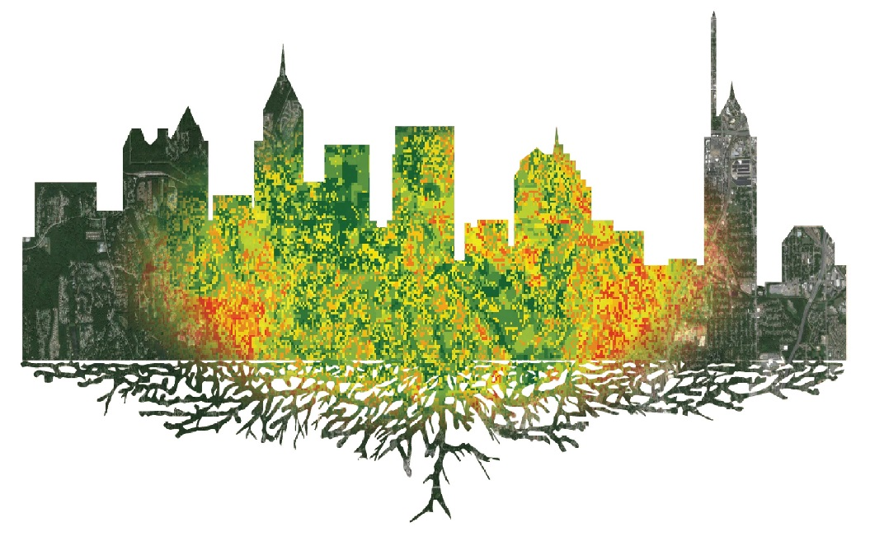


Project Overview
Identify reforestation targets to help reduce harmful stormwater runoff
Integrate NASA Earth Observation data into a multi-input spatial analysis
Analyze watershed processes using the Soil Water Assessment Tool (SWAT)
Model multiple land allocation scenarios for reforestation purposes using the Land Use Conflict Identification Strategy (LUCIS)
Image credit: NASA
Notes:
The goal of this project was to provide project partners at The Nature Conservancy with end-products that would allow them to help promote conservation and science-based decision making strategies in the Atlanta region.
The objectives of this project were to assist The Nature Conservancy with their on-going work in the Atlanta region and to provide a spatial analysis for their proposed reforestation efforts. We accomplished our objectives by identifying prime reforestation targets to help reduce harmful stormwater runoff and by modeling multiple land allocation scenarios for reforestation purposes using the Land Use Conflict Identification Strategy, or LUCIS model.
We simulated the hydrological processes of the MNGWPD watershed and identify at-risk or vulnerable areas within our study area with a Soil and Water Assessment Tool, or SWAT model.
Credit: NASA

Slide 3
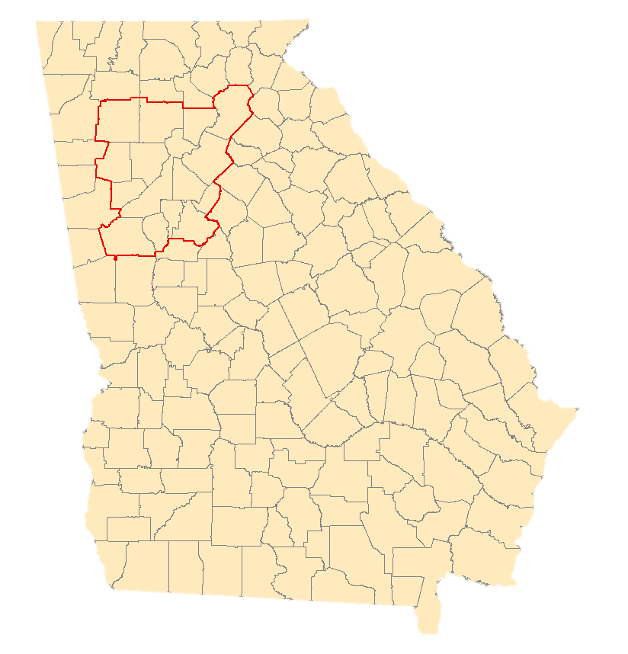
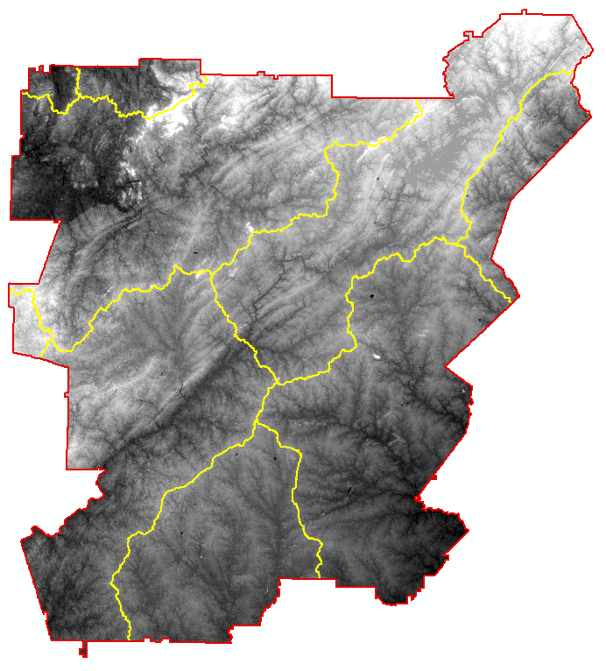
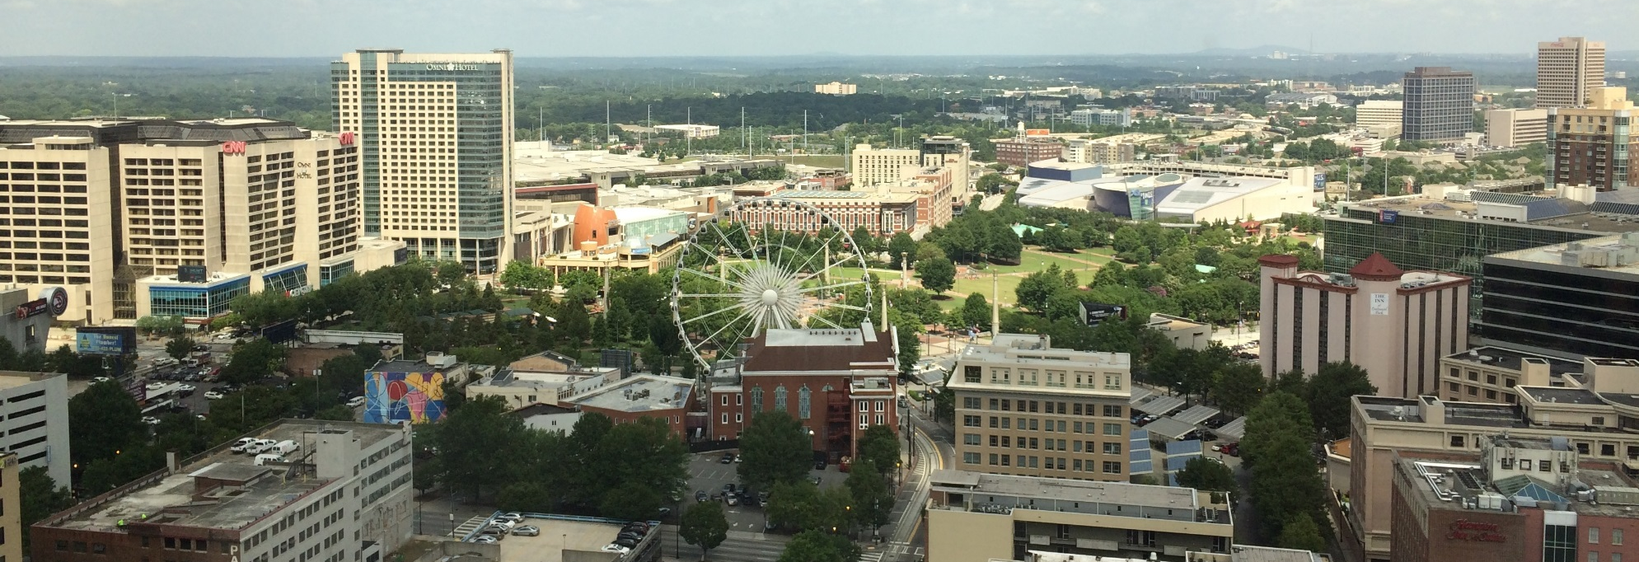
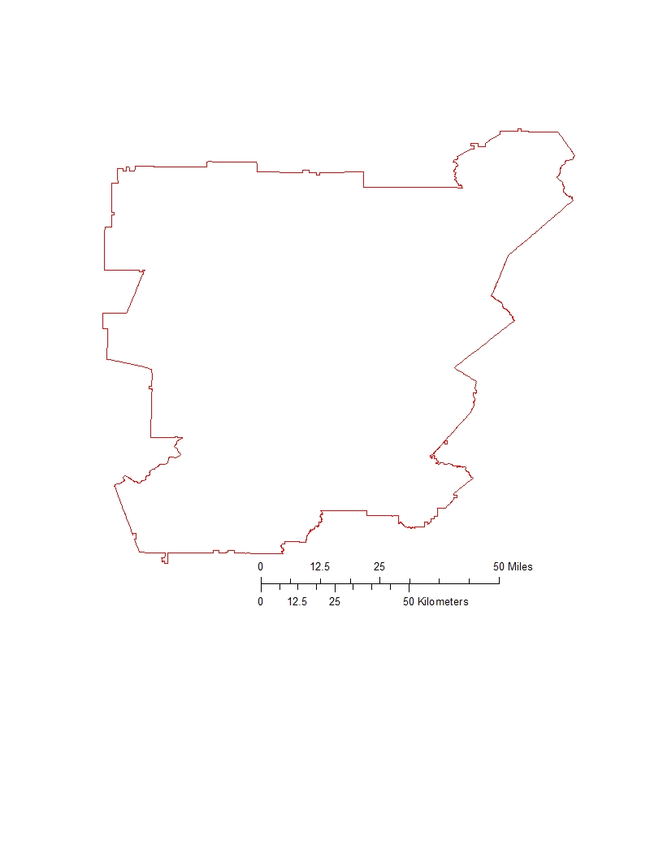
Study Area & Period
Metropolitan North Georgia Water Planning District (MNGWPD)
  15 counties
  9 major watersheds
Contains the greater Atlanta area
  Population of approximately 5.2 million (U.S. Census, 2010)
Atlanta
Etowah
Upper Chattahoochee
Ocmulgee
Middle
Chattahoochee
Flint
Notes:
The study area focused on the Metropolitan North Georgia Water Planning District (MNGWPD) (approx. 12k km²), which was composed of the following 15 counties in GA: Bartow, Cherokee, Clayton, Cobb, Coweta, DeKalb, Douglas, Fayette, Forsyth, Fulton, Gwinnett, Hall, Henry, Paulding, and Rockdale. Nine major watersheds that cross/are contained in the MNGWPD are: Upper Chattahoochee, Middle, Chattahoochee, Upper Ocmulgee, Flint, Upper Tallapoosa, Etowah, Upper Oconee, Coosawattee, and Oostanaula.
It should be mentioned that our study area also contained the city of Atlanta, as it is one of the largest and most populated cities in the USA.
Our study period spans from 2001- 2015 . This timeframe allowed us a sufficient data collection period, and it also documented the pattern in Atlanta’s growth around and after the time of the 2008 national recession.
Credit: NASA

Slide 4
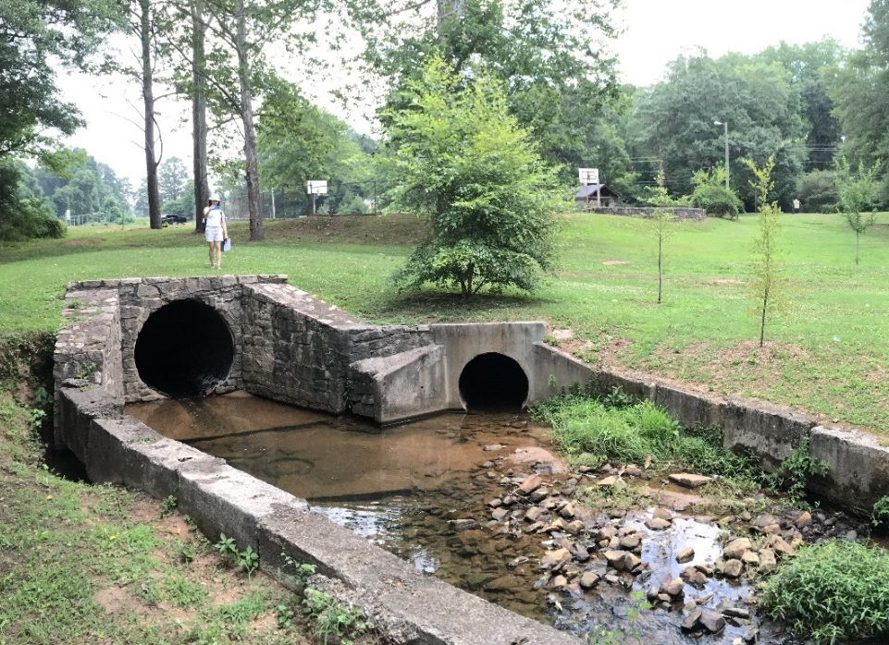
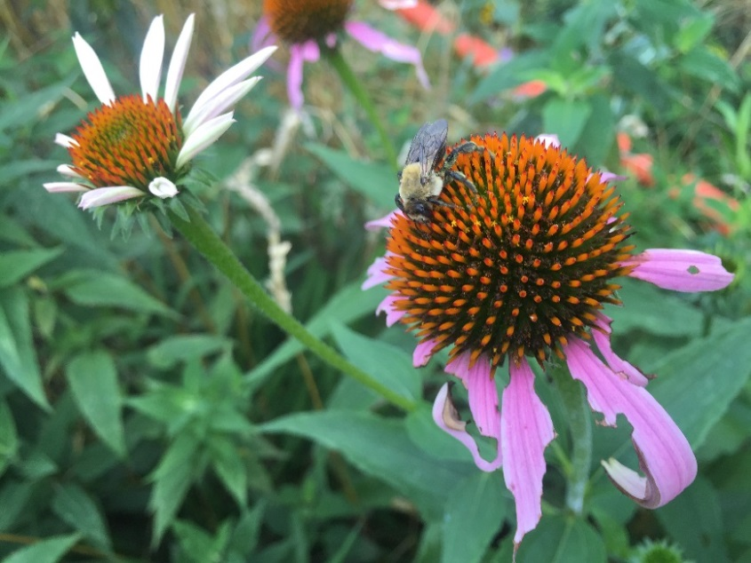
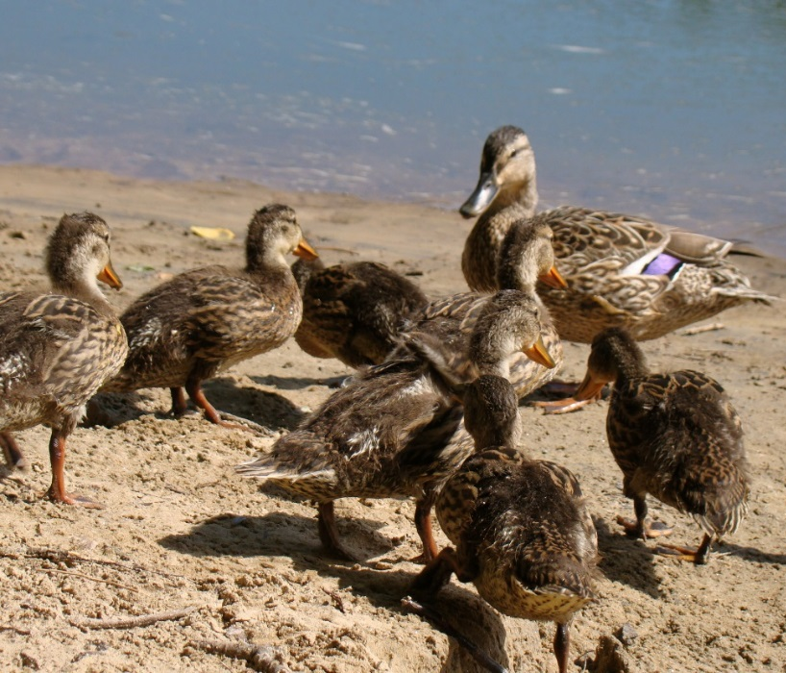
Community Concerns
Image credit: David Cotten
Rising cost of municipal water management in metro Atlanta
Growth of Atlanta exacerbates stormwater management problems
Increased impervious surface cover could mean more pollution entering waterways
Notes:
Atlanta is one of the fastest growing cities in the nation, and it is considered a key player when it comes to Georgia’s regional water resource use discussions for two reasons: (1) Atlanta is Georgia’s largest city (2) The Chattahoochee river, which supplies this region and neighboring areas with most of its water, flows through the heart of the city. As of late, the costs of municipal water management in the metropolitan Atlanta area have risen due to an increased demand of infrastructure required to handle stormwater runoff. This predicament is expected to worsen as rapid, continued development in the city of Atlanta and its suburbs will expand areas of impervious surface cover, exacerbating stormwater management problems. In an attempt to relieve the extensive stormwater volumes that tax existing infrastructure, the Nature Conservancy suggested implementing green infrastructure in Atlanta and its surrounding areas.
Credit: Atlanta Water Resources Team

Slide 5
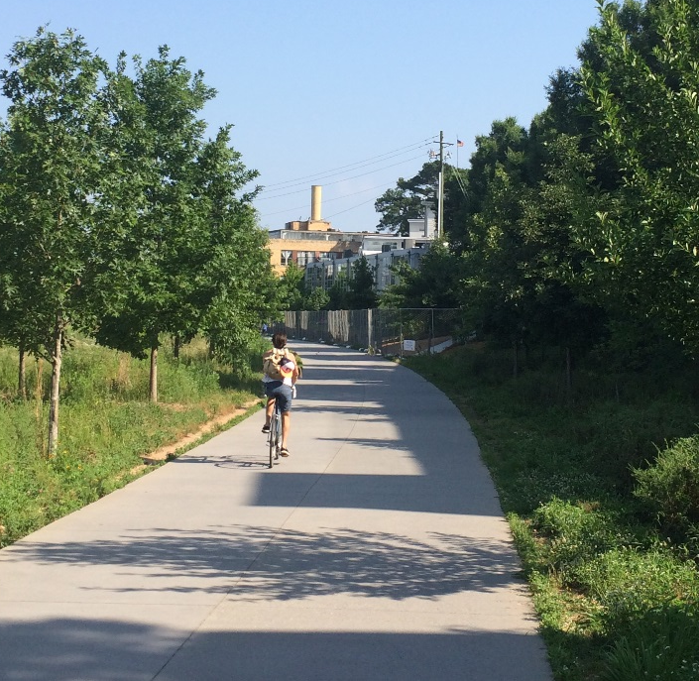
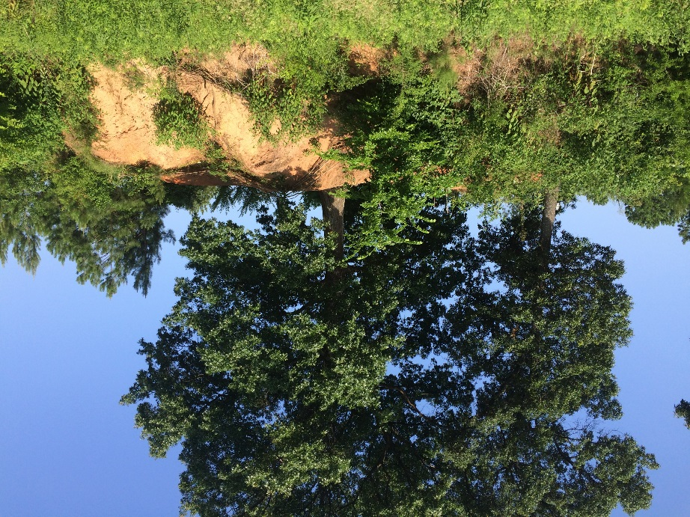
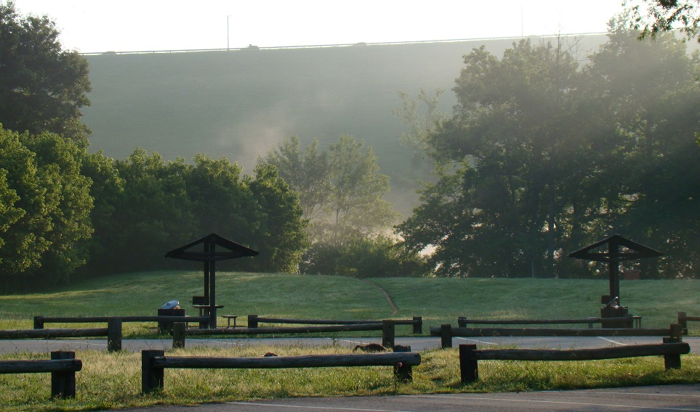
Green Infrastructure & Reforestation
Green infrastructure refers to a network of forests, wildlife habitats, parks, and natural areas within urban landscapes (McMahon, 2000)
Acts as a natural remediator and is a cost-effective tool for managing water quality in cities (Livesly et. al., 2011)
Provides recreational services, improves air quality, and enhances biodiversity
Image credit: David Cotten
Notes:
Green infrastructure has many direct and indirect benefits for local communities. For example, green spaces can enrich the quality of life for local residents by providing areas for recreational use and by enhancing the biodiversity and aesthetic beauty of an area (McMahon, 2000) . From an environmental standpoint, green infrastructure acts as natural remediator by… (summarize the two bullets on the slide). Because green infrastructure offers these ecofriendly benefits, there has been a push from Atlanta’s policy makers to construct and reforest more “green areas” to create an Atlanta Greenway.
Credit: Atlanta Water Resources Team

Slide 6
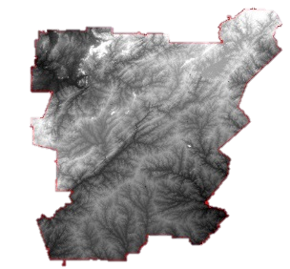
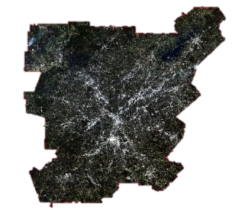
NASA Earth Observing Systems
Landsat 8, OLI
Terra, ASTER
Landsat 8 and Terra satellites were utilized in this project to produce land cover and topographic datasets
Image credit: NASA
Notes:
To address the needs of the Nature Conservancy, we decided to implement a Land Use Conflict Identification Strategy or (LUCIS) model and a Soil and Water Assessment Tool or (SWAT) model. For these models’ input datasets, we obtained cloud-free Landsat 8 OLI images from October, 2015. Images were obtained for 2 Landsat scenes corresponding to the coverage of the MNGWPD by path-row. We also downloaded 30m ASTER DEMs for elevation data.
Both datasets were acquired through the USGS EarthExplorer website.
Credit: NASA

Slide 7
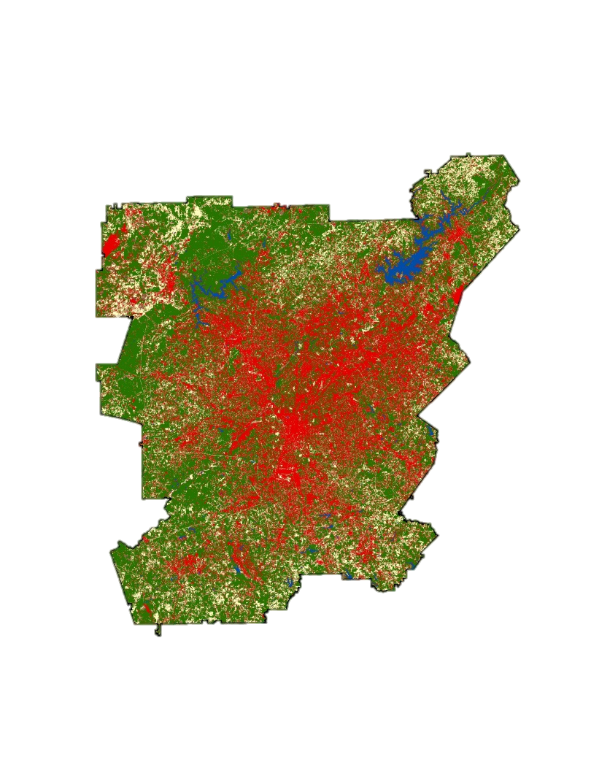

2015 Land Cover Classification
Processing
Mosaic
Atmospheric Correction
Classification
Training Sets
Maximum Likelihood Classification
Validation
Accuracy Assessment
Confusion Matrix
Urban
Agriculture
End-Product
Water
Forest
Supervised 2015 Land Cover Classification
Bare
0
40
Km
Notes:
The supervised land cover classification was performed in ENVI on our Landsat 8 images. This classification scheme is meant to reflect the major land use allocations in LUCIS. The accuracy assessment was done by generating 150 random points and interpreting them using NAIP imagery.

Slide 8
2015 Land Cover Classification
 | Urban | Agriculture | Water | Vegetation | Bare Land | User Accuracy
Urban | 25 | 2 | 0 | 6 | 0 | 76%
Agriculture | 6 | 31 | 0 | 4 | 7 | 65%
Water | 0 | 0 | 6 | 0 | 0 | 100%
Vegetation | 2 | 1 | 0 | 57 | 1 | 93%
Bare Land | 0 | 1 | 0 | 0 | 2 | 67%
Producer Accuracy | 78% | 89% | 100% | 85% | 20% | 81%
Kappa |  |  |  |  | Kappa | 0.75
From 2001 to 2015, approximately one-third of this area (4,000 km²) experienced a change in land cover
Almost half of all land cover change was deforestation
Notes:
This is the confusion matrix for our 2015 Landsat-based classification
Kappa measures the strength of classification on a 0 to 1 scale- a 0.75 value is considered substantially accurate.
The majority of misclassification came from the bare land class. This is likely due to the low number of accuracy assessment points (total of 3) compared to the other classes.
Comparing the 2001 NLCD to our 2015 classification showed some trends: 32% of the study area changed its land cover type. Of this change, 47% of it is loss of forested land.

Slide 9
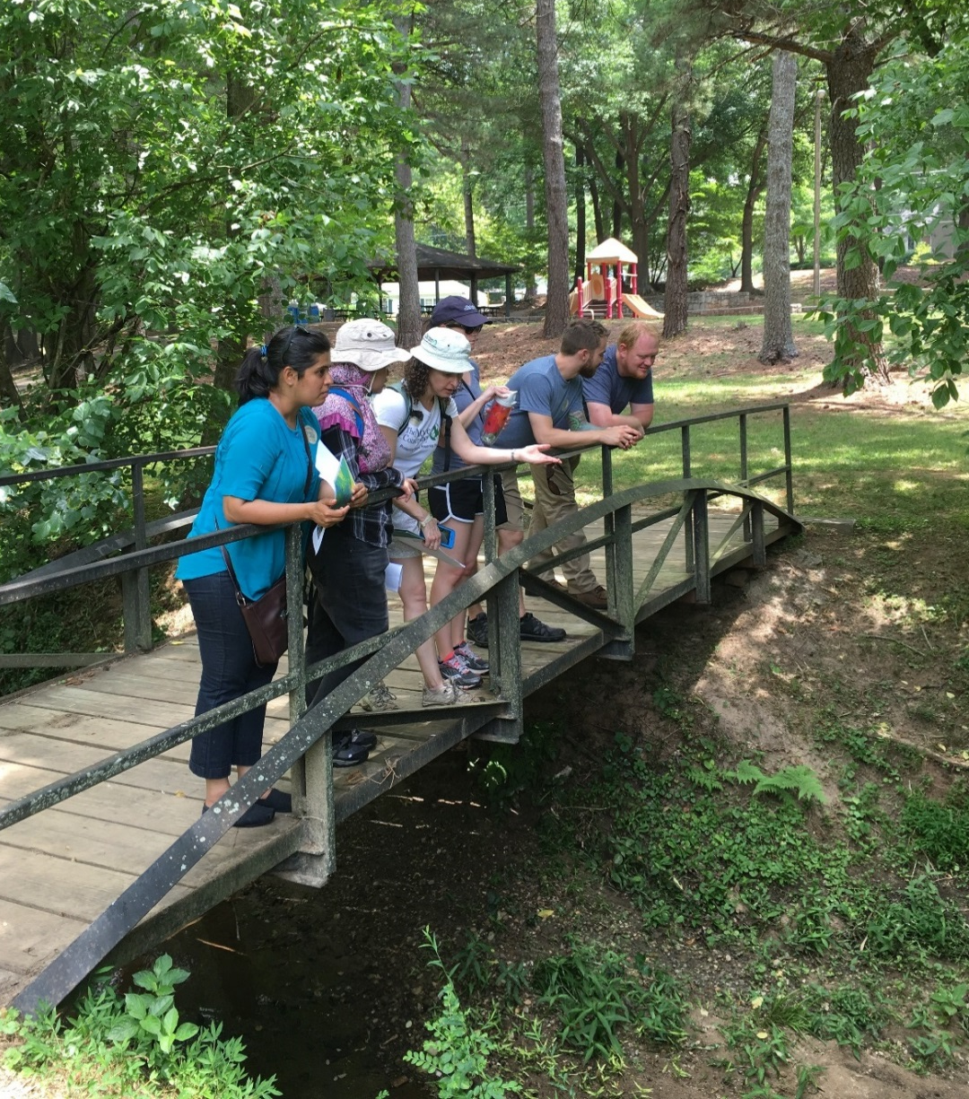
Data-Driven Suitability Analysis
SWAT combines weather, surface runoff, evapotranspiration, and water storage data to characterize hydrologic processes
LUCIS integrates a broad range of input datasets to create suitability data layers based on defined goals and objectives for primary land use allocations
Both of these models can be adapted to incorporate a range of spatial data inputs
Notes:
Both of the models used in this project emphasize the effects of land use management and allocations on local hydrologic processes. In particular, the SWAT and LUCIS models can incorporate a wide range of datasets to help map the impacts of land use decisions and changes on local watersheds.

Slide 10
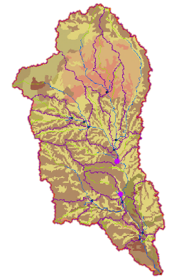
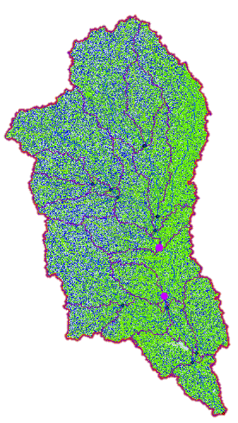
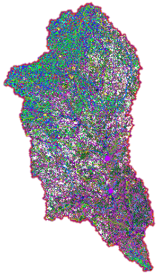
The SWAT Model
Soil
Water
Assessment
Tool (SWAT)
SWAT output
Delineates watersheds and their sub-basin from chosen location utilizing a DEM
Incorporates soil data to best model the interaction between soil properties and precipitation
Produces hydrological model of water-related processes in watersheds
Quantifies the effect of land use and management on ecosystems to inform best management practices
Notes:
Soil Water Analysis Tool (SWAT) ArcGIS 10.2 was developed at the Texas A&M University. SWAT has been widely applied for modeling water-related processes in watersheds and quantifying the effect of land management on ecosystems to inform best management practices and policies. The SWAT model was used to assess the impact of different land management practices, pollutions sources, and contaminants on local watersheds.

Slide 11
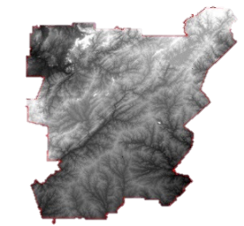
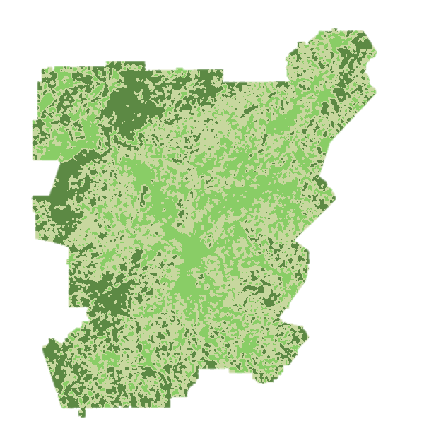
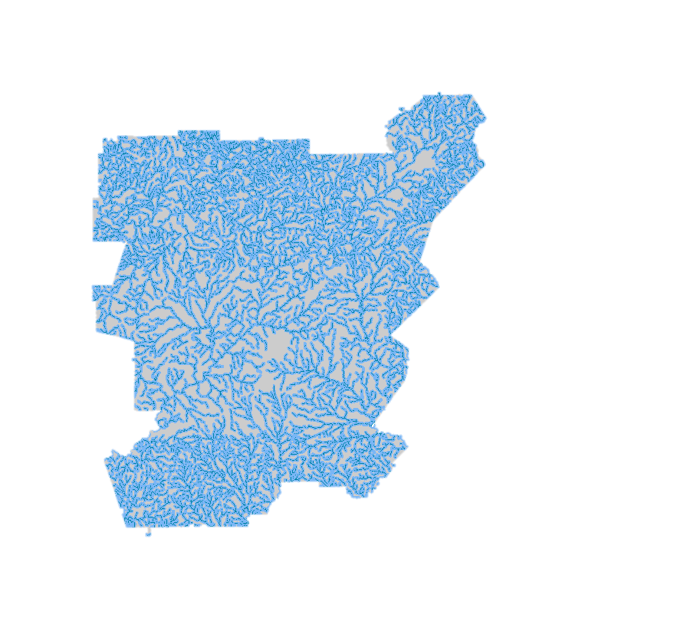
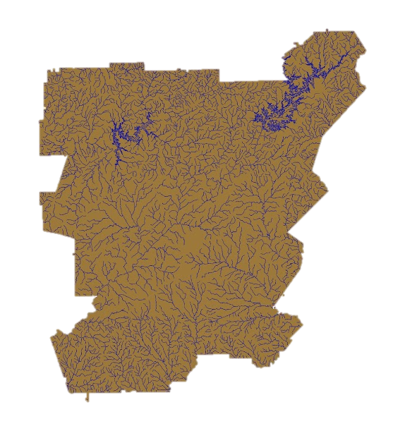
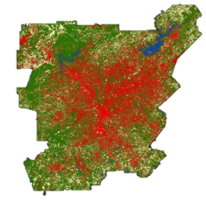
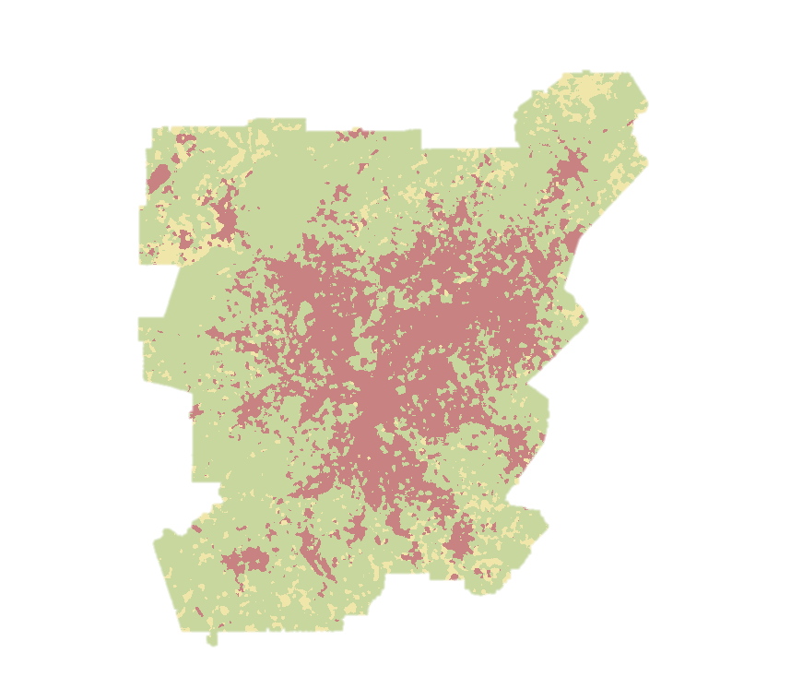
The LUCIS Model
Land
Use
Conflict
Identification
Strategy (LUCIS)
Suitability Analysis
Integrates input datasets to create suitability data layers based on defined goals and objectives
Locates areas of potential land use conflict based on suitability prioritization and ranking
Produces flexible land use allocation scenarios based on goals and objectives that can be easily adapted
Notes:
LUCIS was developed by Carr and Zwick at the University of Florida. It was previously used in the UGA DEVELOP Miami Ecological Forecasting project (2014). LUCIS is a flexible model that can account for variations in stakeholder and local interest groups as it relates to land use allocation.
LUCIS Integrates a broad range of input datasets to create suitability data layers based on defined goals and objectives for primary land use categories (urban, agriculture, and conservation)
LUCIS Produces flexible land use allocation scenarios based on goals and objectives that can be adapted to a range of stakeholder and community preferences

Slide 12
A Data-Driven Approach To Suitability Analysis
Landsat 8 OLI imagery
US Census
ASTER DEM
Soil & Watershed Assessment Tool (SWAT)
Soils & Geology
Topography
National Hydrography Dataset
Global Weather Data
USGS Streamflow & Water Quality
gSSURGO
Land Cover & Land Use
Climate
Input Data
National Land Cover Dataset
Stormwater Infrastructure
Proximity to Waterways
Green Spaces
Community Impact
Soil Permeability
Proximity to Forests
Canopy Cover
Pollution Sources
Open Spaces
Proximity to Waterways
Associated Land Cover
Proximity to Waterways
Surface Flow
Slope
Minimize Untreated Stormwater Flow from Impervious Surface
Protect Existing Green Infrastructure and Identify Opportunities for Conservation
Identify Lands with a High Potential to Impact Water Quality
Suitability Analysis
Land Use Prioritization
Land Use Conflict Identification Strategy (LUCIS)
Notes:
This graph represents flow chart of our analysis. We used LUCIS and SWAT for identifying important sites for water quality and conservation purposes. All ancillary and project-generated datasets were utilized based on goals and objectives (marked in green) corresponding to three primary land use types (urban, agriculture and conservation). These objectives were used to perform suitability and perform land use prioritization. We integrated the SWAT and LUCIS models, and produced in-depth land use prioritization and allocation scenarios with the help of project partners.

Slide 13
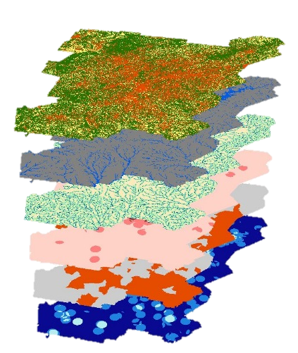
Minimize Untreated Flow from Impervious Surfaces
Objectives:
Identify locations that contribute pollutants by point source
Identify superfund sites, abandoned, and open bare land
Identify areas of high impervious surface not currently served by green infrastructure
Identify regions in close proximity to waterways
Identify areas of greater preference or suitability for development
2015 Land Cover
Floodplain Zoning
Distance to Waterways
Superfund Sites
Neighborhood Age
NPDES Sites
Notes:
Overlay image layers (from top to bottom): Urban land cover, floodplain zoning, distance to waterways, superfund sites, neighborhood age, NPDES site.
Goal:
Minimize untreated stormwater flow into the Chattahoochee from impervious surfaces
Objective reasoning:
Higher compliance per watershed is preferred for retention ponds. Residential and commercial property owners can reduce impact fees by as much as 50% by demonstrating compliance. Easements granted to the city for future sanitary outfalls shall be executed by the landowner (less outfalls equals more access to city sewer for developers and less cost)
The City of Atlanta has managed several programs and initiatives aimed at identifying, assessing and remediating brownfield sites throughout the city. Brownfields is a real property whose expansion, redevelopment, or reuse may be complicated by the presences of potential hazardous substance, pollutant, or contaminant. Abandoned subdivision land is one large contiguous piece of property which make it more suitable than older neighborhoods to construct new development. Developers would prefer such property because of reduced purchasing cost and construction cost. Newer neighborhoods are preferred over older neighborhoods because the property is more “elastic”. Elastic meaning that it lacks the same repetitive patterns of older neighborhoods, which are more “static”.
The City Areas with lower property values can be of higher interest for development, as well as conservation. The reduced property value serves as an incentive for purchasing certain areas for development, but this is not always the case with a number of factors contributing to buyer preference. These lands are also of value for conservation and reforestation. Areas of lower property values and limited vegetation provides a unique opportunity for creating an equitable environment for people and to utilize under value land. Floodplain protection. The commissioner shall not authorize the approval of any permit authorizing the placement of fill or stored materials, or the construction of any building or other structure within the floodplain.

Slide 14
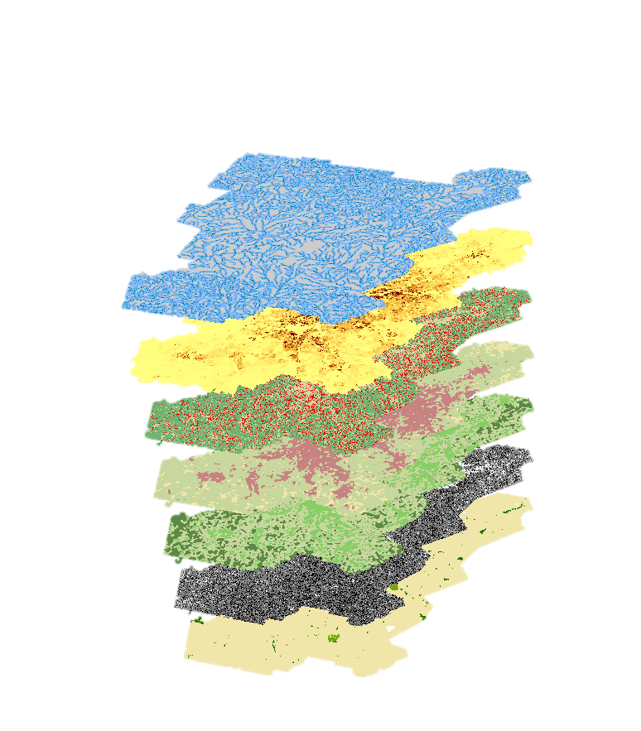
Protect Green Spaces & Identify Conservation Areas
Objectives:
Identify existing protected areas/green spaces
Analyze existing proportions of local vegetation and forests
Identify associated land cover types for potential reforestation areas
Identify regions in close proximity to waterways
Prioritize reforestation targets
Distance to Waterways
Population Density
Land Cover Change
Associated Land Cover
Percent Forest Cover
Slope
Protection Status
Notes:
Overlay image layers (from top to bottom): distance to waterways, 2010 population density, land cover change, associated land cover for forested areas, percent forest cover, slope, protection status
Goal: Protect existing green infrastructure and identify opportunities to increase or expand green spaces
Objective Reasoning:
Locating areas near existing protected lands or green spaces could facilitate expansion of conservation management locally and provide existing conditions for reforestation plots.
Composition of existing vegetation communities could affect decisions related to reforestation – such as what types of trees to plant
Significant changes in adjacent land cover could affect the suitability (particularly soils and pollution) for forestation
Self explanatory

Slide 15
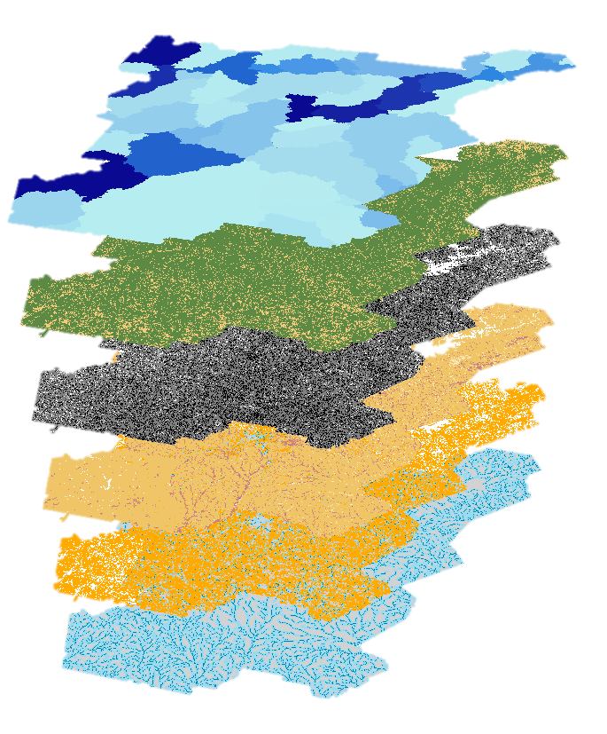
Identify Lands with Potential to Impact Water Quality
Objectives:
Identify regions in close proximity to waterways
Identify regions with high topographic gradients
Identify regions with highly permeable soils
Identify agricultural land in close proximity to forest cover
Surface Flow
& Runoff
Agricultural Lands
Slope
Soil Permeability
Proximity to Forests
Waterways
Notes:
Overlay image layers (from top to bottom): surface flow and runoff, agricultural lands, slope, soil permeability, agricultural land near forested areas, distance to waterways
Goal: Identify agricultural lands with a high potential to impact local water quality and stormwater runoff
Reasoning for Objectives:
Agricultural lands that are in a close proximity to streams and other water bodies have a higher risk of introducing organic nutrients, pesticides, and eroded sediment to these waterways during precipitation events.
Agricultural lands that have a higher slope will increase the amount of surficial runoff during a precipitation event. It is a hydrologic principle that water will always travel from a higher elevation to a lower elevation.
Low permeability soils, such as soils with high clay content, have low infiltration rates during precipitation events. Low infiltration rates increase surficial ponding and surficial runoff. Agricultural lands that have these types of soil have a higher risk of introducing higher volumes of surficial runoff and agricultural related nutrients to surrounding waterways.

Slide 16
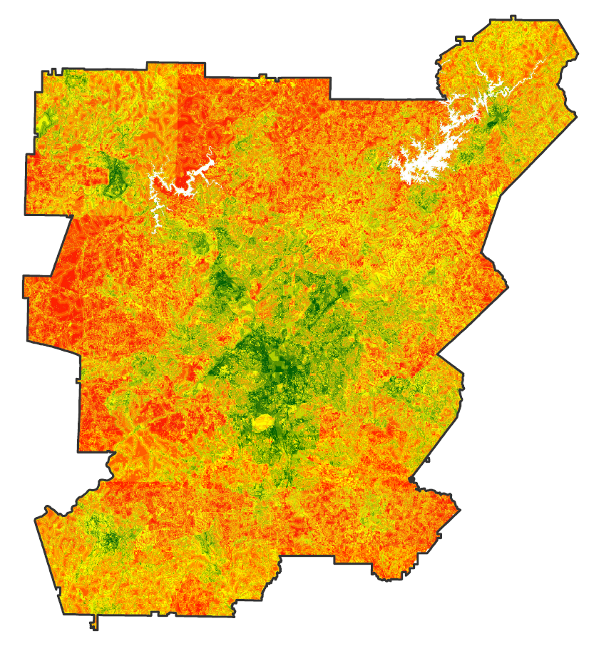

Results: LUCIS Goals
Minimizing Untreated Stormwater Flow From Impervious Surfaces
Atlanta and its suburbs are major sources of impervious surface and stormwater runoff
These regions also represent areas with the highest potential to minimize stormwater flow through development of green infrastructure
Highest Potential
Lowest Potential
0
40
Km
Notes:
There is a high probability that further land use allocation in this area will rely primarily on the stakeholder interests in Atlanta.
This could be modeled or accounted for in the next phase of the LUCIS analysis, where we place to assess community land use preferences (with The Nature Conservancy’s help)

Slide 17
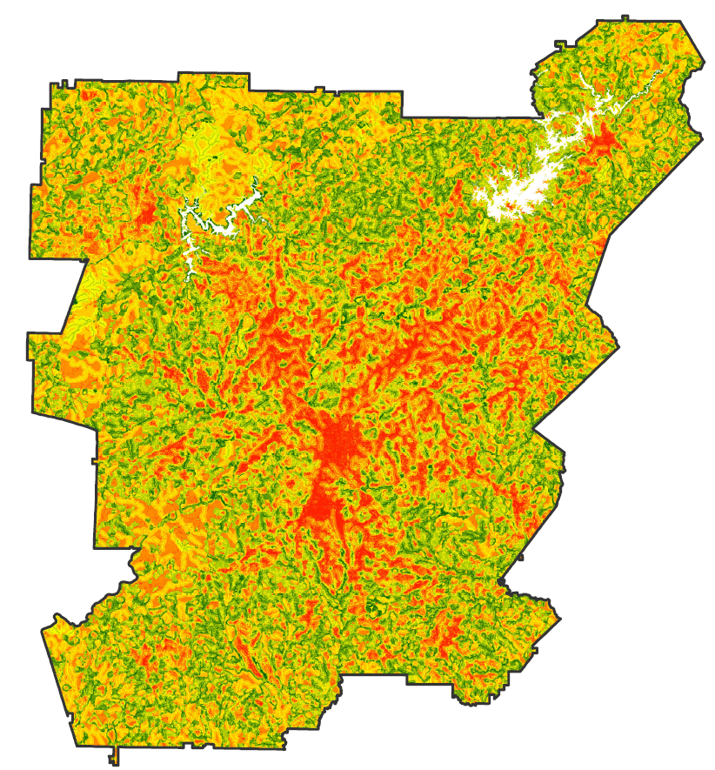
Results: LUCIS Goals
Protecting Existing Green Infrastructure and Identify Reforestation Opportunities
Reforestation and green space development opportunities exist along several waterways adjacent to Atlanta
Existing protected areas or forests can be expanded to help promote this strategy as an alternative to municipal infrastructure
Highest Potential
Lowest Potential
0
40
Km
Notes:
The main locations for reforestation and green space potential are along major waterways that cross sections of Atlanta and its suburbs.
Existing protected areas (parks, forests, etc.) can serve as reference points upon which further infrastructure can be expanded.

Slide 18
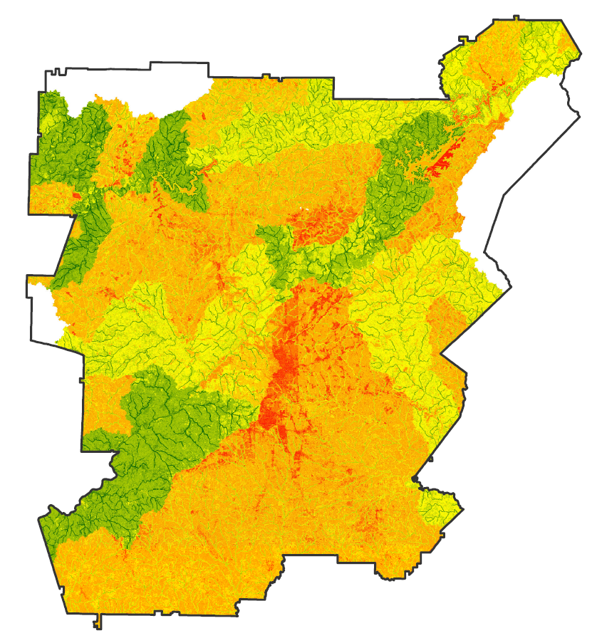
Results: LUCIS Goals
Identifying Managed Lands with a High Potential to Impact Local Water Quality
The majority of open land (agriculture) with the highest potential to affect water quality occurs north of Atlanta
Downstream effects of land management practices at these locations could be significant
Highest Potential
Lowest Potential
0
40
Km
Notes:
The significance of Fulton county as the lowest potential area in this image is likely the result of NoData values for soil permeability attained from the USDA.
The pending SWAT analysis will help to better understand downstream affects and the significance of open land management practices in this area

Slide 19
SWAT Results: Water Quality & Runoff
Etowah
Upper Chattahoochee
Surface Flow
Phosphorus
Sediment
Nitrogen
Ocmulgee
kg/ha
tons/ha
Middle
Chattahoochee
m³/s
kg/ha
Low
Low
Low
Low
Flint
High
High
High
High
Notes:
These results are preliminary for the Upper Chattahoochee watershed. Flow here has been calibrated using historic USGS data.

Slide 20
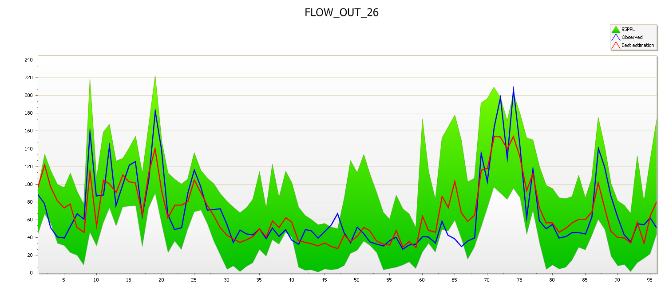
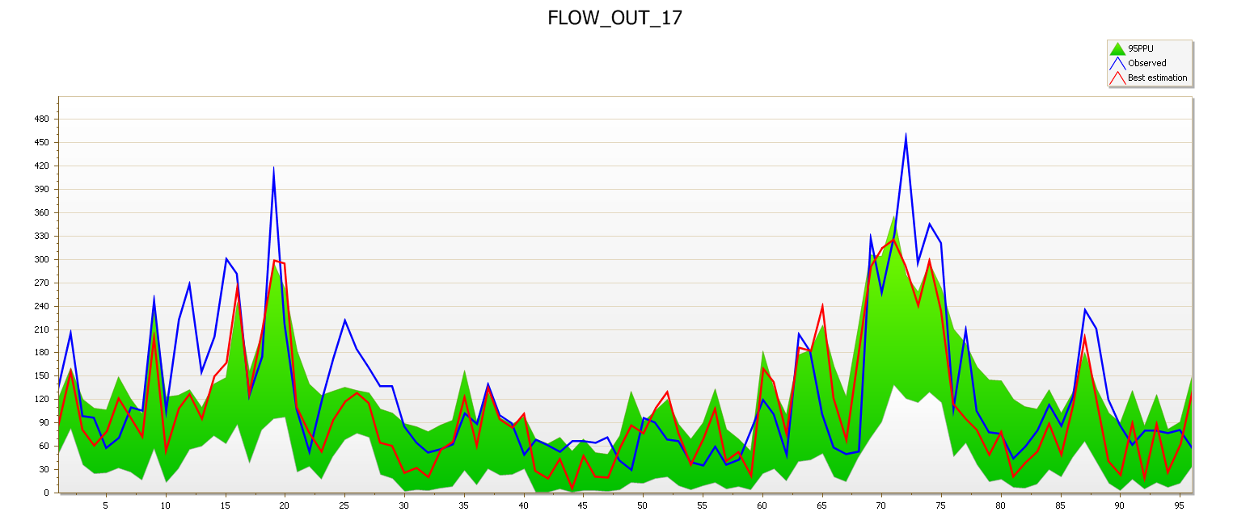
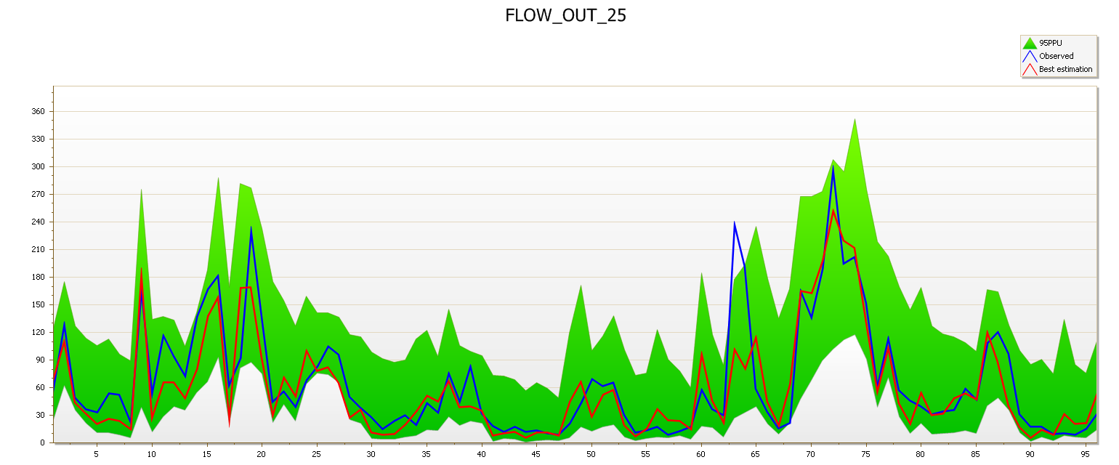
SWAT Results: Flow Calibration
Upper Chattahoochee
Upper Ocmulgee
Cubic Meters per Second
Months
Months
Middle Chattahoochee
Etowah
Cubic Meters per Second
Months
Months
Notes:
Here are the comparative hydrographs showing observed and simulated values for each of the watersheds we have completed. Here, the blue line shows the observed (USGS data) while the red line shows the simulated values (SWAT). The green band represents the 95% confidence interval associated with these hydrographs.

Slide 21
SWAT Results: Accuracy & Statistics
 | R² | NSE
Upper Chattahoochee | 0.65 | 0.65
Middle Chattahoochee | 0.63 | 0.55
Upper Ocmulgee | 0.77 | 0.77
Etowah | 0.68 | 0.67
Upper Flint | 0.71 | 0.71
Etowah
Upper Chattahoochee
Ocmulgee
Middle
Chattahoochee
Flint
Notes:
The R² value represents a statistical measurement of how close the data are to the fitted regression line (a.k.a. our models observed flow rate calculations).
The Nash-Sutcliffe efficiency (NSE) coefficient is sued to assess predictive power of hydrologic models. In general, model simulation can be judged as satisfactory if NSE > 0.50.
Our results for surface water flow rate in the Upper Chattahoochee, Middle Chattahoochee, Upper Ocmulgee, and Etowah watersheds have proven to be scientifically satisfactory with R² and NSE values above 0.50.
(The range of the p-factor and the r-factor vary from 0-1. A p-factor value close to 1 indicates a very high model performance and efficiency. The r-factor refers to the thickness of the PPU envelope. The p- and r-factors are closely related to each other, which indicates that a large p-factor can be achieved only at the expense of a higher r-factor.)
Credit: NASA

Slide 22
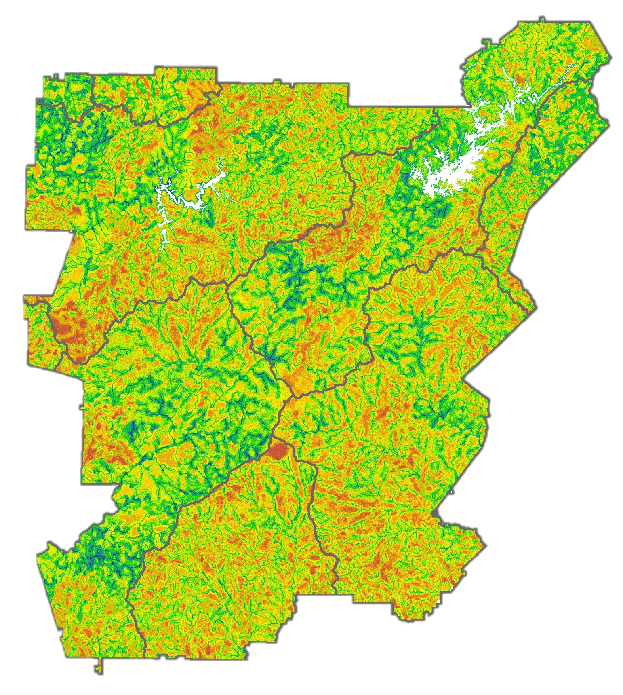
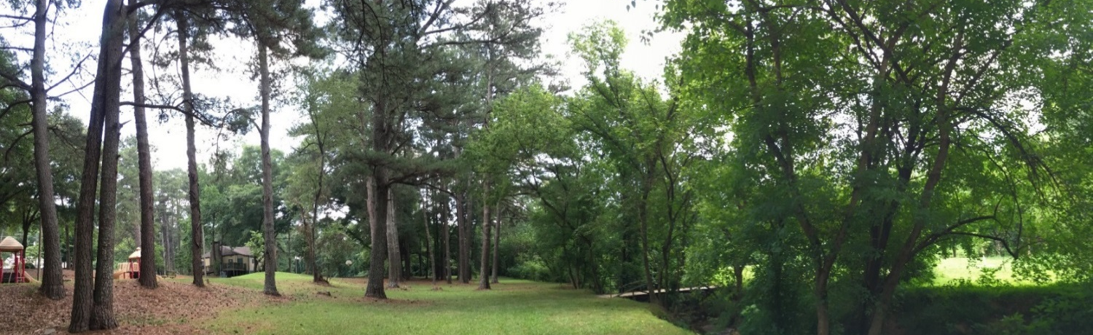
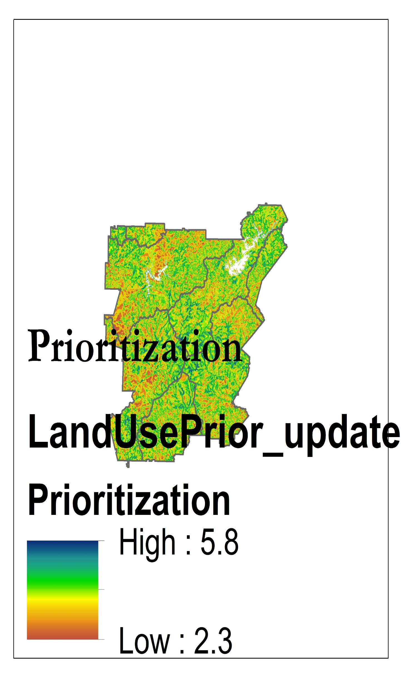
Land Use Prioritization
Spatially analyzes the metropolitan region of Atlanta to designate prioritization values based on a locations suitability for conservation efforts
Can be used to inform stakeholders on land acquisition and management strategies
High Priority
0
40
Km
Low Priority
Notes:
By combining the 3 LUCIS goal layers, the team was able to produce a land use prioritization that could be used by TNC to identify locations that maximize all 3 water resource management goals. This layer was used by TNC to inform a socio-economic baseline survey of communities in the Atlanta region about greenspaces (conducted by the Green infrastructure Center) and also to inform a regional biodiversity assessment.
The red star location shows one of the places that the team visited in the summer with TNC to validate locations selected in our model.
Credit: Atlanta Water Resources Team

Slide 23
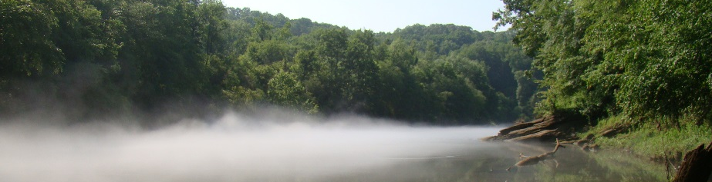
Errors & Uncertainties
Some datasets are incomplete
Land cover misclassification
SWAT model accuracy and calibration
Do LUCIS criteria weights accurately reflect community preferences?
Image credit: David Cotten
Notes:
NoData values in existing datasets (such as soil permeability) can have a huge effect on model outputs.
Misclassification of land cover in the 2015 Landsat 8 imagery occurred primarily in the bare land class.
LUCIS weights will be refined/determined through communicating with The Nature Conservancy.

Slide 24
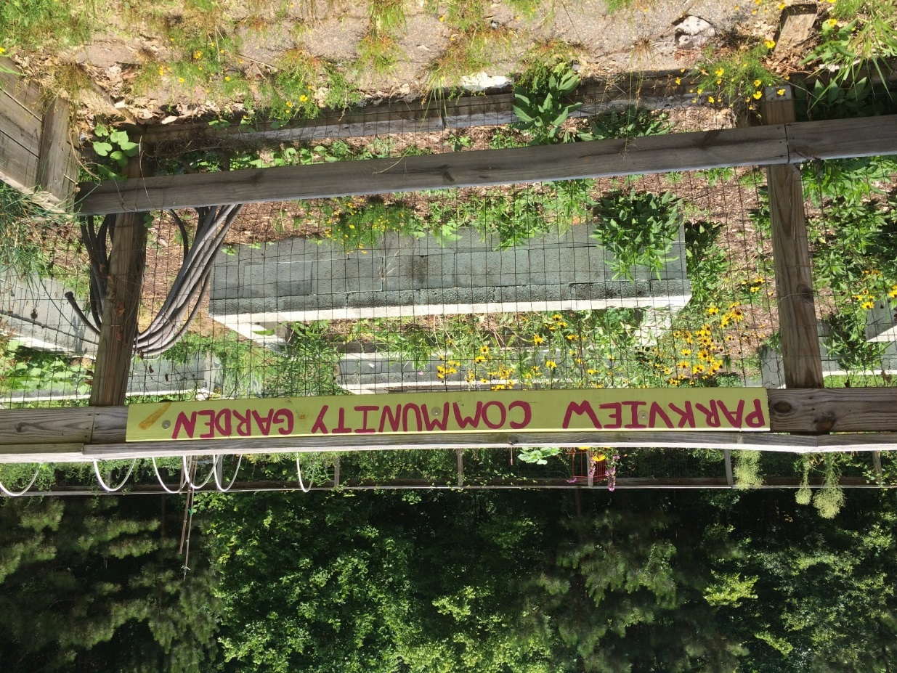
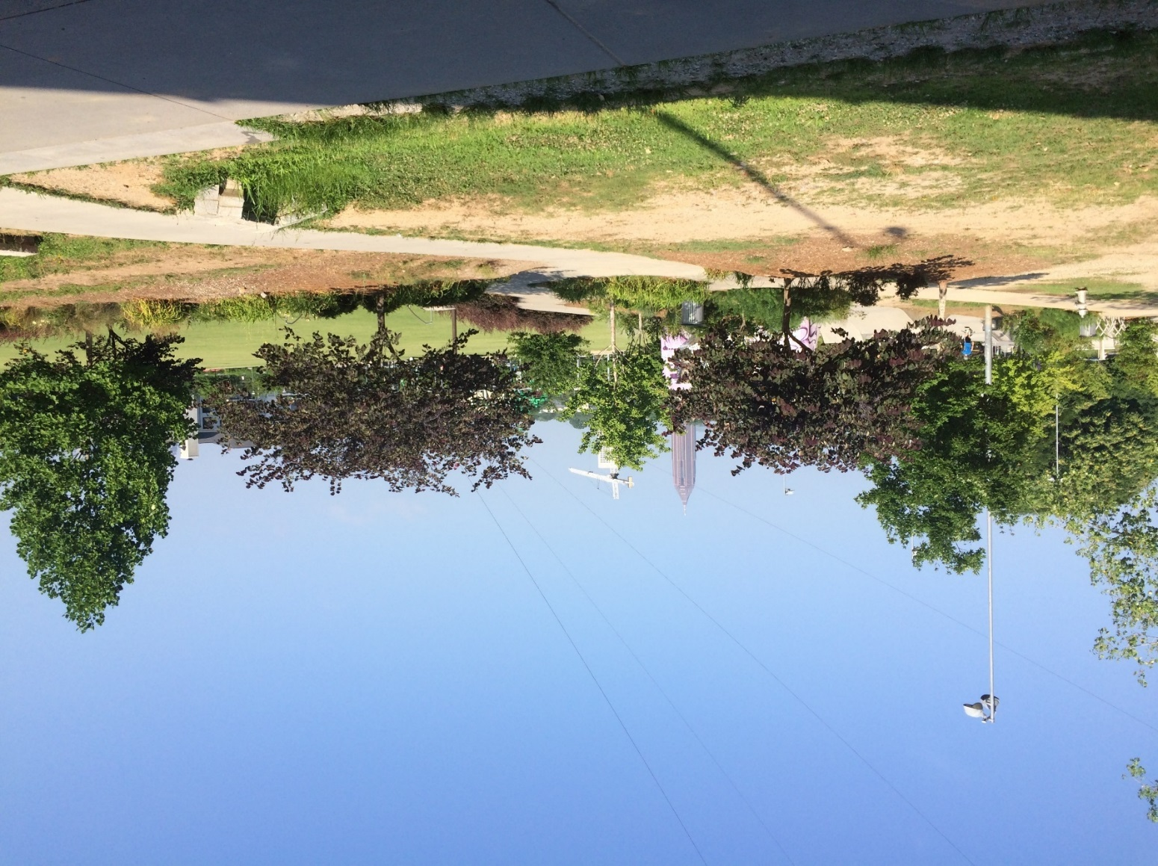
Conclusions
NASA datasets were successfully utilized to address three water resource management goals
Expansion of green spaces will be able to assist stormwater management around Atlanta
Existing urban infrastructure and associated land cover will have an important effect on water resource management
Notes:
The results of the LUCIS model analysis will provide project partners with an understanding of potential land use conflicts from a spatial and stakeholder perspective.
These results will allow The Nature Conservancy to identify lands for future conservation efforts relating to reforestation.
Credit: Atlanta Water Resources Team

Slide 25
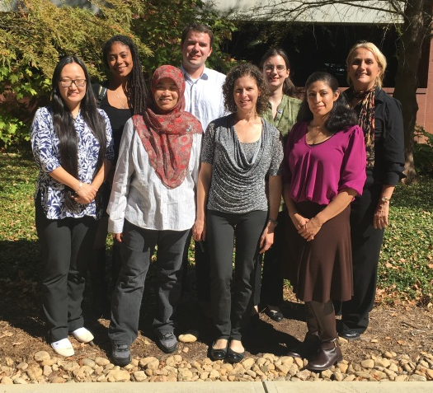
Advisors
Dr. Marguerite Madden, UGA Center for Geospatial Research
Dr. Rosanna Rivero, UGA College of Environment and Design
Dr. Adam Milewski, UGA Geology Department
Partners
Sara Gottlieb, The Nature Conservancy
Whitney Palanci, The Nature Conservancy
Myriam Dormer, The Nature Conservancy
Others
Caren Remillard, NASA DEVELOP UGA Center Lead
Past Contributors
Beatriz Avila Mark Beatty Veronica Fay Manasi Parkhi
Jason Reynolds Alex Smith Jacob Spaulding Wenjing Xu
Notes:
We would like to take the time to thank our Science Advisors Dr. Marguerite Madden and Dr. Rosanna Rivero for their guidance and continued support.
We would also like to thank our project partners Sara Gottlieb, Whitney Palanci and Myriam Dormer of The Nature Conservancy, who are here with us today. They have had a very interactive role with this project, whether it be providing helpful ancillary datasets for the model or providing insightful feedback, which will help shape the project in the second term.
Lastly, we would like to acknowledge Dr. Adam Milewski for his expertise on the SWAT model and UGA Center Lead Caren Remillard for her support.

